Slide 1
Development of Multi-Messenger Observation Database & Viewer
Yuta Kawakubo
Aoyama Gakuin University
The second annual conference, Nov. 18-20, 2024
Notes:
Hello, everyone. I'm Yuta Kawakubo at Aoyama Gakuin University. Today, I will talk about the Multi-messenger observation Database and Viewer.

Slide 2
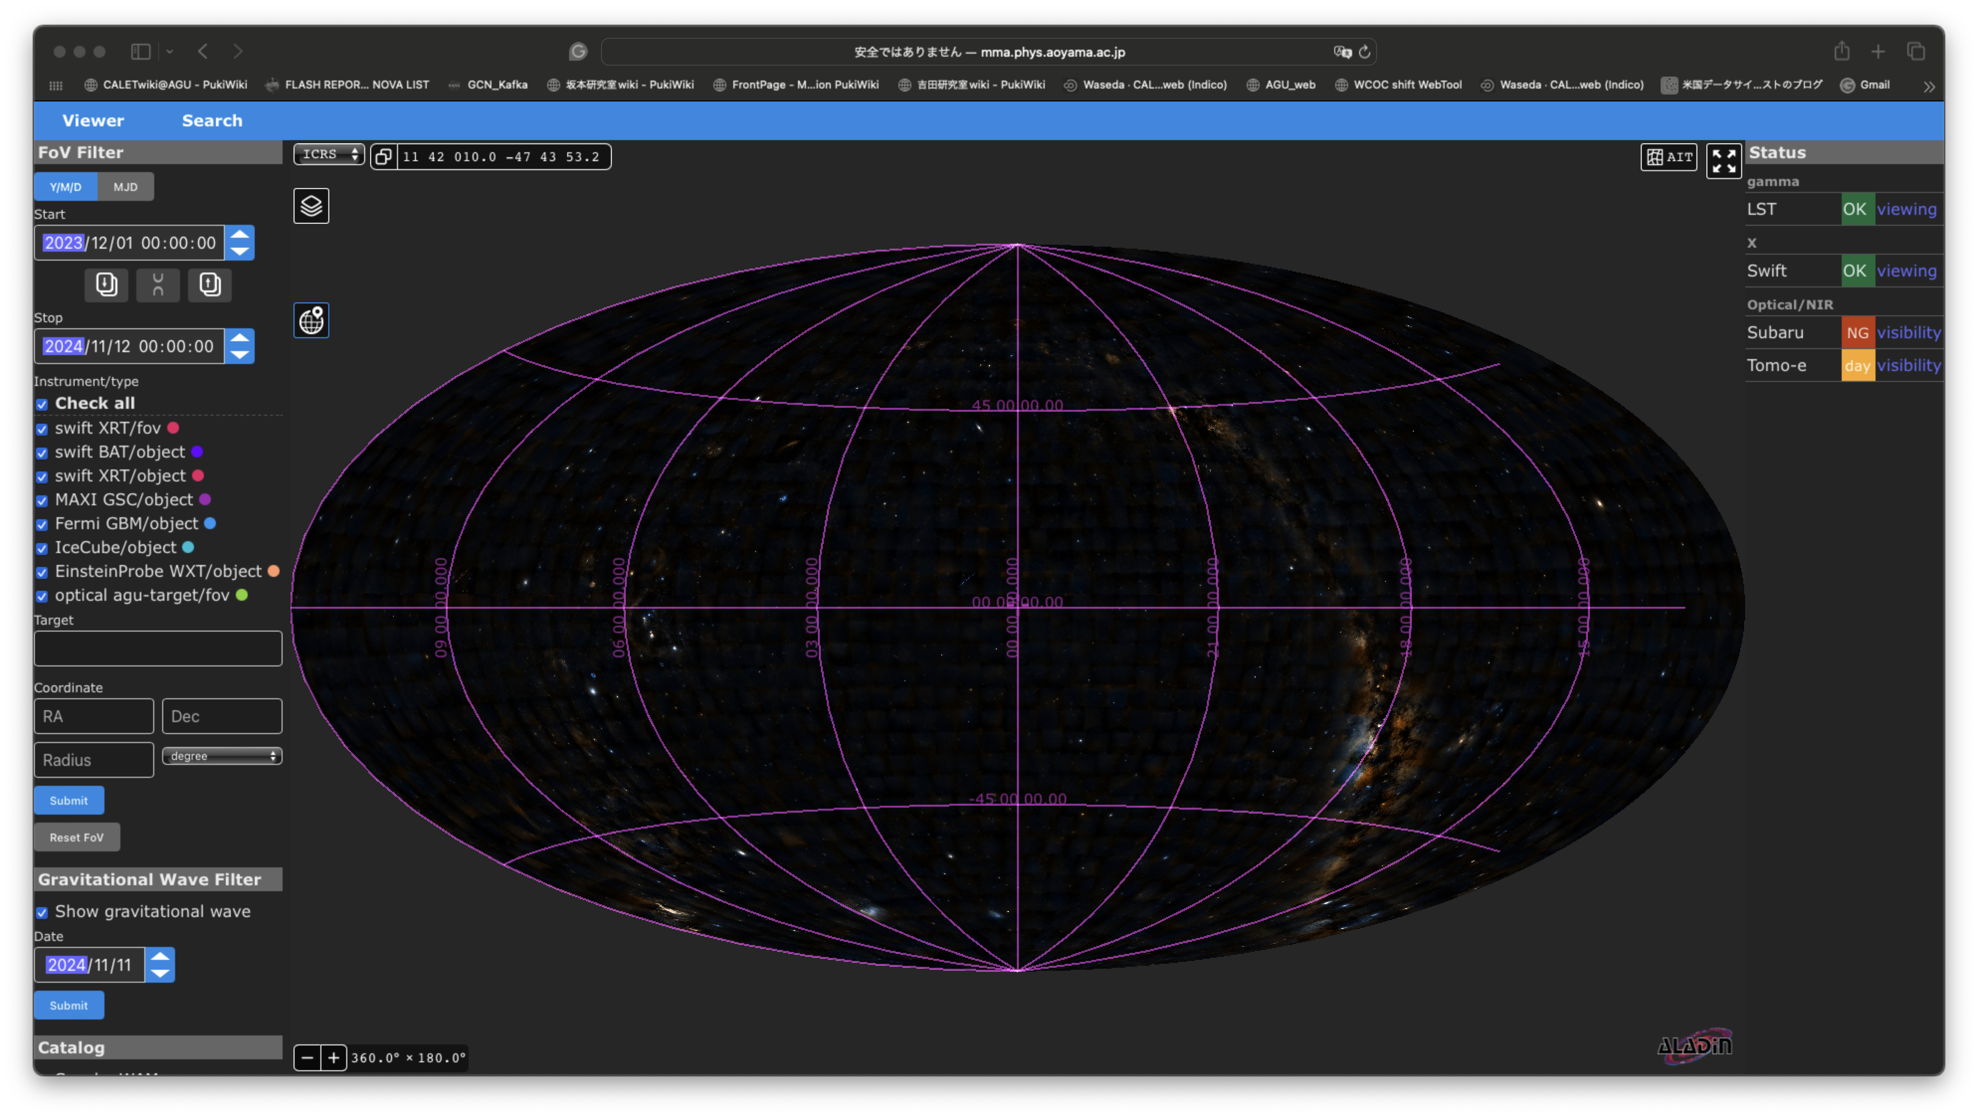
Multi-messenger observation Database & Viewer
http://mma.phys.aoyama.ac.jp
Notes:
This is the top page of the Viewer. You can access the Viewer from this URL. Please play with the Viewer and give us your feedback for further development.

Slide 3
Aims of Database and Viewer
The multi-messenger observation Database collects and archives data from various observatories and telescopes.
Viewer visualizes the observational data, providing helpful information for devising strategies for future observations and analyses.
The Viewer may inspire us to potential targets for multi-messenger astronomy by overlaying observational data.
Notes:
First, I want to talk about the aims of the Database and Viewer.
The Database collects and archives multi-messenger data from various observatories and telescopes.
The Viewer visualizes the observational data in the Database, providing information for devising strategies for future observations and analysis.
The Viewer may inspire us to potential targets for multi-messenger astronomy by overlaying various observational data.
These are the aims of the Database and Viewer, and we are developing them with these aims in mind.

Slide 4
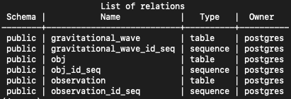
Development of Database and Viewer
The development of the main system was outsourced to AstroArts.
https://www.astroarts.co.jp/official/corporate/index-j.shtml
We manage the servers and develop the data collection system for the Database at Aoyama Gakuin University.
Database
Ubunts 22.04 LTS
PostgreSQL
Viewer (+ Object Search)
Ubunts 22.04 LTS
HTTP server: nginx
Aladin Lite (https://aladin.cds.unistra.fr)
© Centre de Données astronomiques de Strasbourg.
Notes:
I will talk about the development status of the Database and Viewer.
We outsourced the development of the main system to AstroArts.
You know, AstroArts is the company that publishes the webpage and magazines about astronomy. They also develop software for astronomy.
The main system has already been developed by AstroArts.
At Aoyama Gakuin University, we manage the servers for the Database and Viewer and we develop the data collection system for the Database.
We established an Ubuntu server for the Database. We use PostgreSQL and this is the actual tables of the Database. We are adding various data to these tables.
We also established another Ubuntu server for the Viewer. The Viewer is based on Aladin lite, which enables the Viewer to display observational data hierarchically.

Slide 5
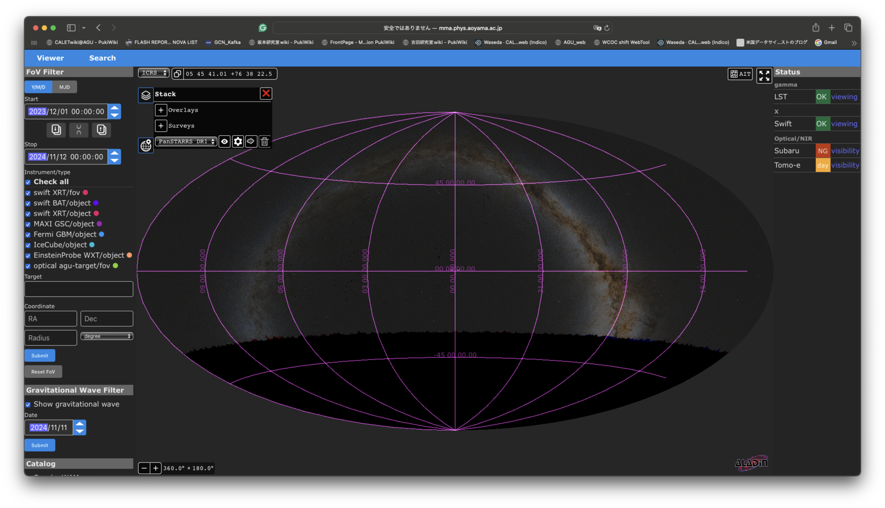
Viewer: Survey
The background survey image can be changed.
Detailed instructions are in the backup slides.
PanSTARRS
Notes:
Next, I will overview the contents of the Viewer. Since time is limited, I will introduce them very briefly. Please see the user's manual in the backup slides for detailed instructions. Also, I plan to demonstrate how to use the Viewer in this conference. Of course, you can ask me about Viewer anytime.
First, I will show you the function of displaying survey images.
The Viewer can display the survey image as a background image thanks to the Aladin-lite feature. I showed the PanSTARRS survey image as an example. We can see where the survey covers the sky region.
There are many survey images available.
Please check the survey list on the Viewer.

Slide 6
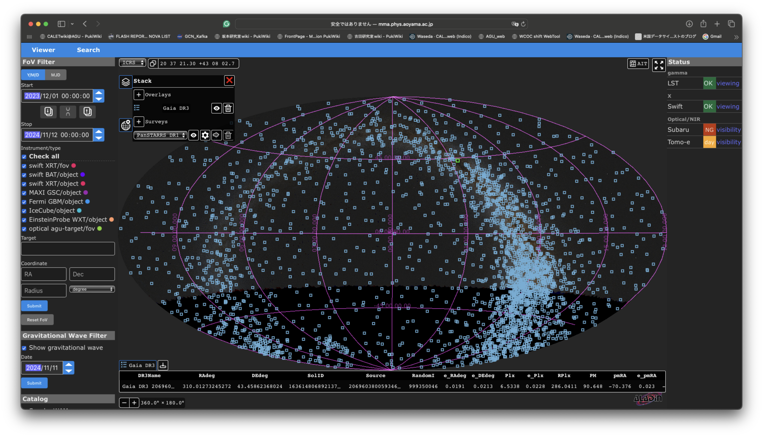
Viewer: Catalog
Catalogs can be overlaid on the survey image.
Detailed instructions are in the backup slides.
Gaia
Notes:
Next, I will talk about the function to display catalogs.
The Viewer can display catalogs overlaid on the survey image.
You can load publicly available catalogs you want, like this example.
In this example, I showed the Gaia catalog.
We can see where objects in the catalog are distributed in the sky, like this.
Since there are many choices of survey images and catalogs, we need to know which one is essential for each messenger and group. If you find out which catalogs or surveys are helpful for us, please share them with us.
If you want to add unpublic or manually created catalogs, we can add them to the "Catalog" section.

Slide 7
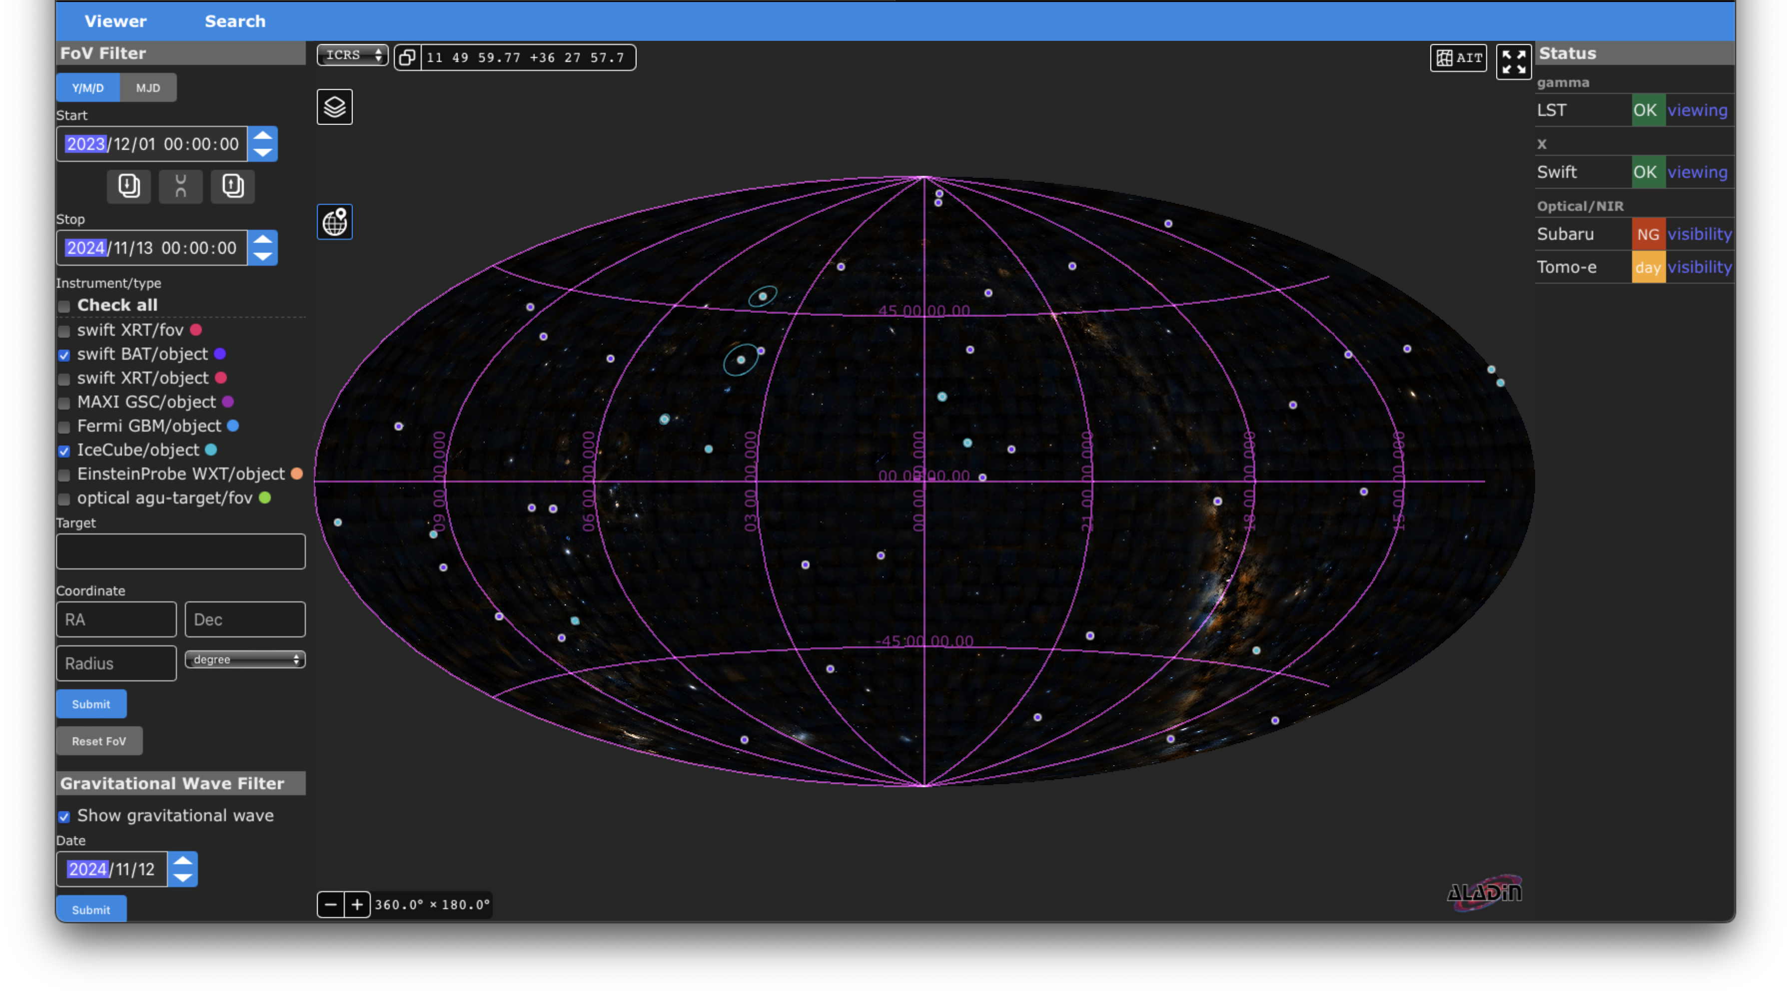
Viewer: FoV Filter
Objects/FoV can be turned on/off by checkboxes.
Filters by time, target name, and position are available.
Swift/BAT
IceCube
Swift/BAT, Fermi/GBM, IceCube, and Einstein Probe events are automatically added from GCN/Notices.
Notes:
Next, I will talk about the FoV Filter.
Once a new object or FoV is registered to the Database, the record can be displayed by the FoV filter. Therefore, the FoV filter provides object or FoV information more flexibly and quickly than catalogs. So far, alerts from Swift-BAT, Fermi-GBM, IceCube, and Einstein Probe have been automatically added to Database from GCN/Notice.
In this example, I showed IceCube events and Swift-BAT events. We can see where events are distributed in the sky.

Slide 8
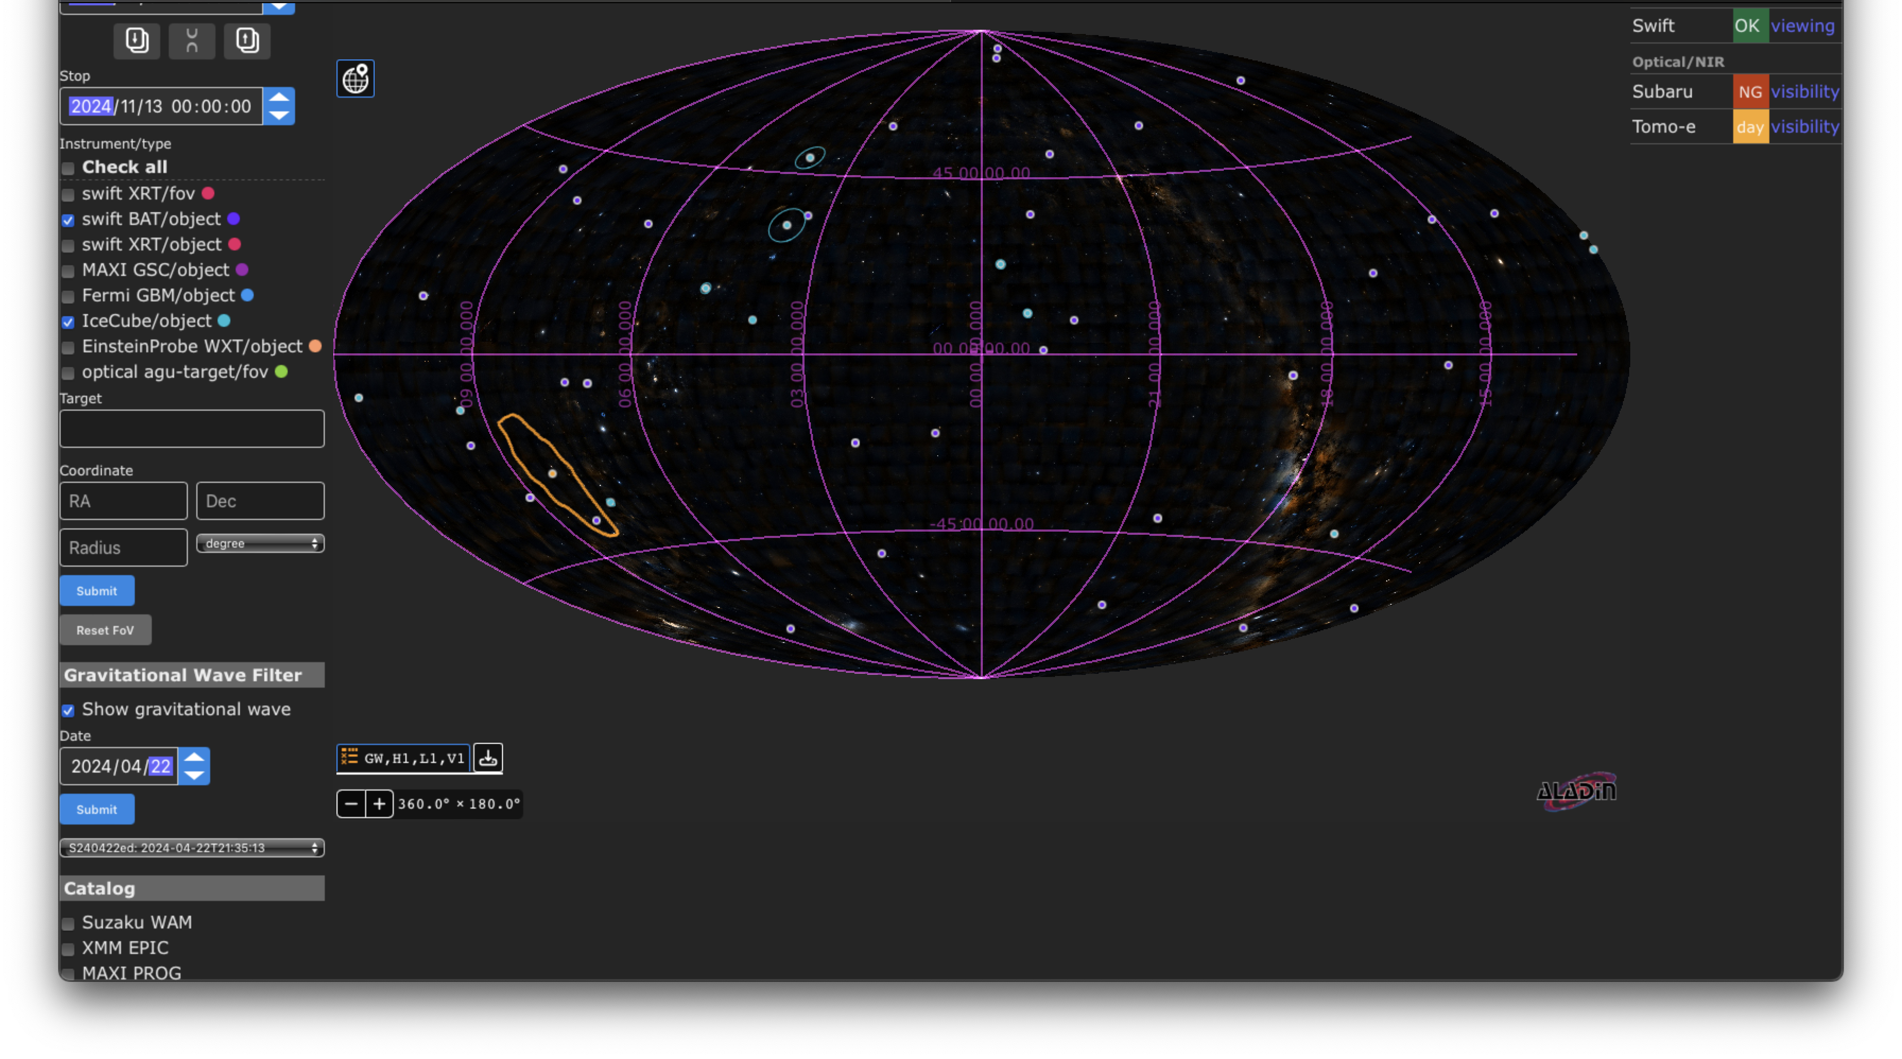
Viewer: Gravitational Wave Filter
S240422ed
The LIGO/Virgo/KAGRA 90% localization region can be overlaid.
Gravitational wave events (FAR < 6.34e-7) are automatically added from GCN/Notices.
Notes:
Gravitational wave events are also automatically registered in the Database. Once the server receives the GCN/Notice, the gravitational wave filter can display the LIGO/Virgo/KAGRA 90 % localization region like this.
In this example, I showed the 90 % localization region of S 240422ed. We can compare the localization region with other objects and events.

Slide 9
Object Search
Click.
Notes:
The web interface has an "Object search" tab.
If you click the "Search" button, you can switch to the "Object search" tab.

Slide 10
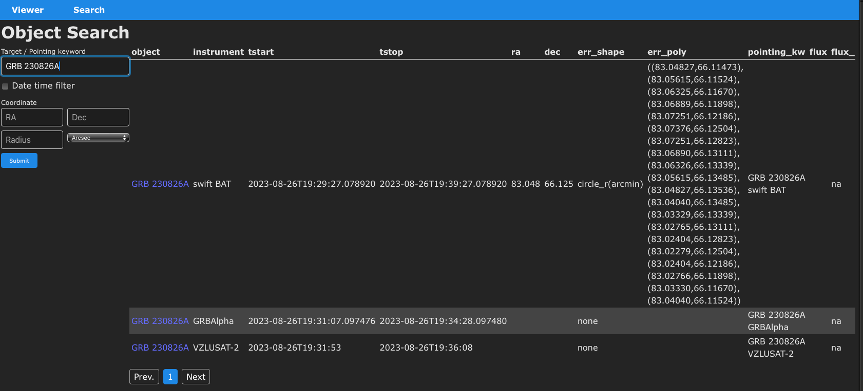
Object Search
Search with Object name or Pointing keyword (e.g., “GRB 230826A”).
Results can be filtered by time and coordinate.
Notes:
On the object search, we can search for objects recorded in the Database. with the object name or pointing keyword.
If we search for GRB 230826A, the records for this GRB are listed, like this.
The object information page will open if we click the link in the object column.

Slide 11
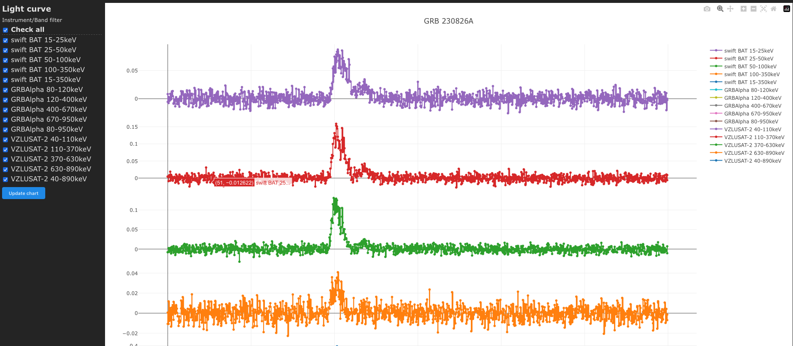
Object Search: GRB 230826A
Light curve (Count)
Implemented:
GRBALpha
VZLUSAT-2
In Progress:
Swift/BAT
MAXI/GSC
Fermi/GBM
CALET/GBM
Light curve (Flux)
Pending:
Swift/XRT
MAXI/GSC
Optical
BAT light curves
Notes:
Object information includes all records, flux, and count light curves of the object. We are increasing object information now.
In particular, we are adding light curves for GRBs. Since I'm interested in GRB prompt emission, I prioritize adding light curves. At least we plan to add light curves listed here.

Slide 12
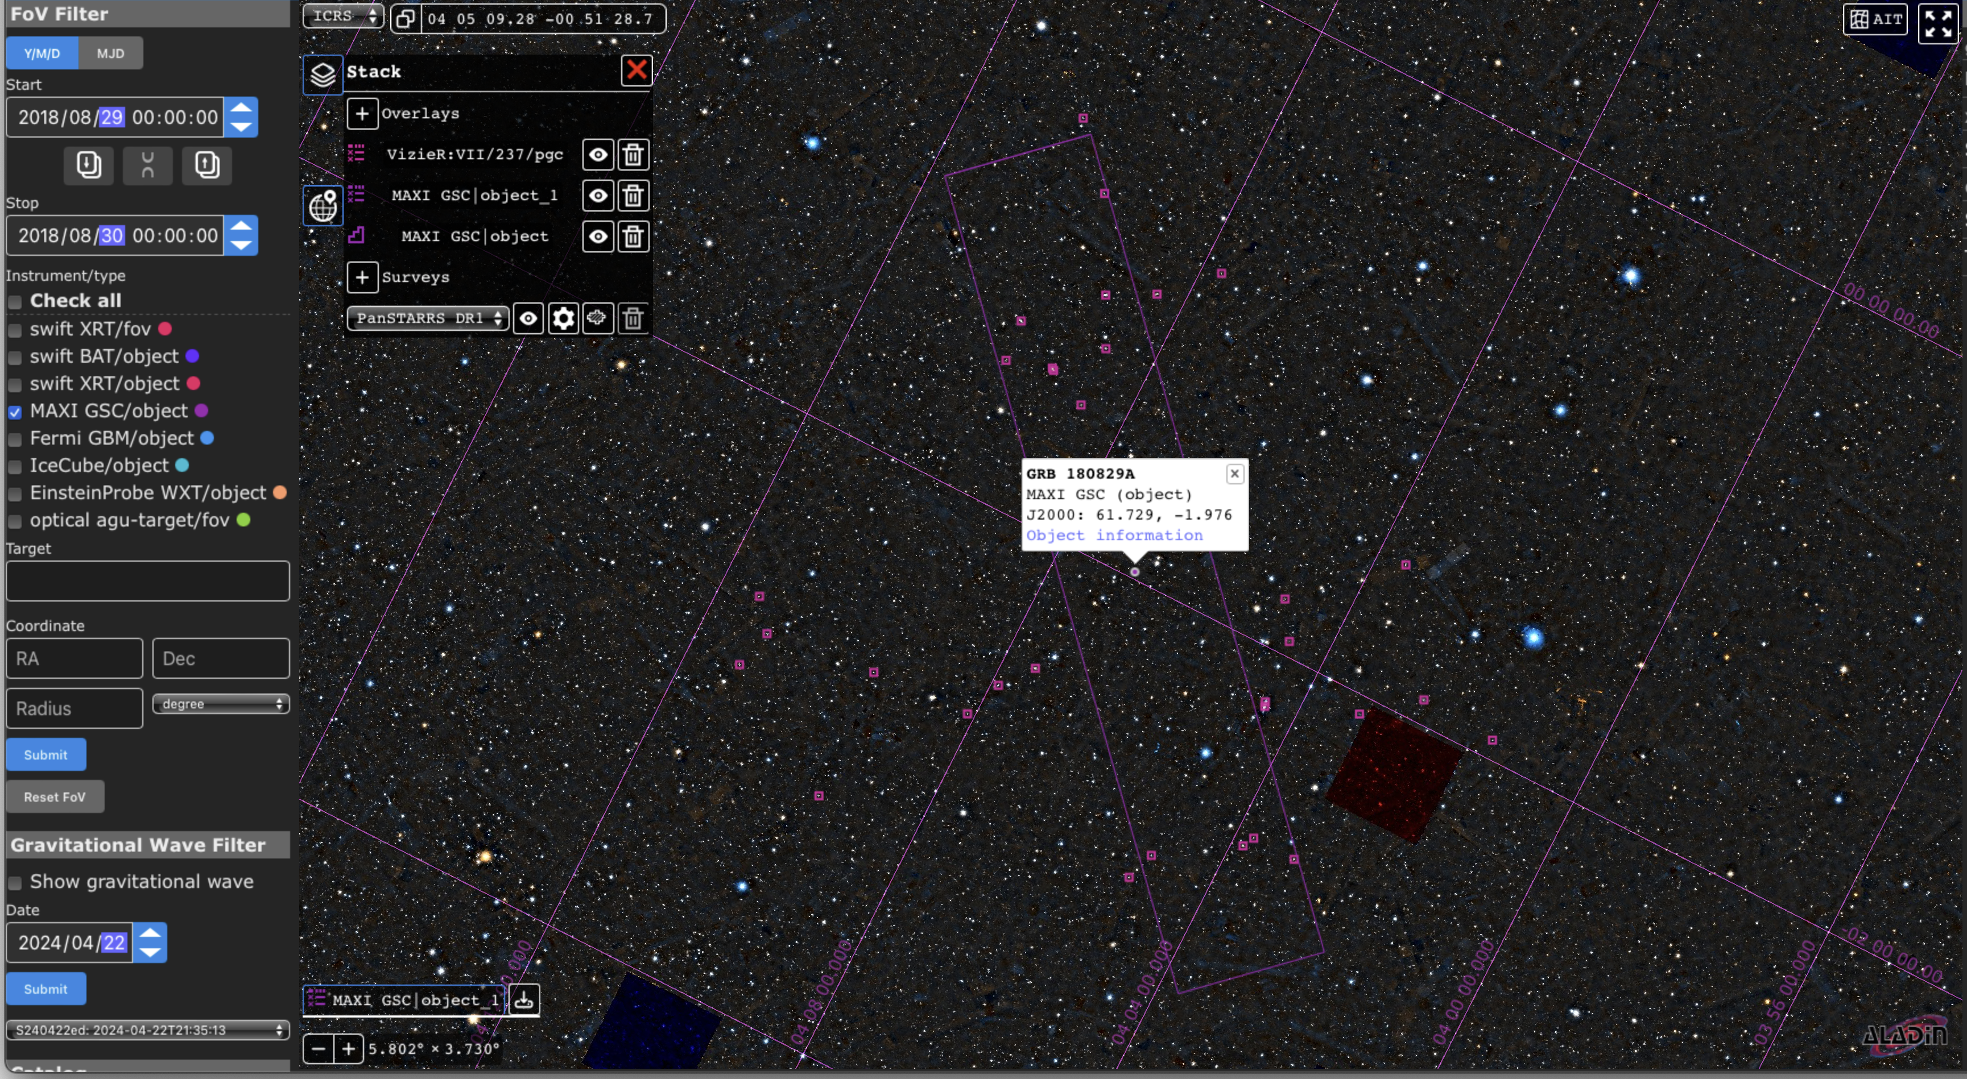
Use example: GRB180829A
Are there any galaxies in the MAXI’s error box for GRB 180829A?
Survey image
PanSTARSS DR1
Catalog
HYPERLEDA
Paturel+ 2003
FOV Filter
MAXI GSC/object
2018/08/29
GRB 180829A
Notes:
OK, I have introduced each function of the Viewer very briefly.
Here, I will show you the use case of the Viewer for GRB 180829A as an example.
We wanted to know whether there were galaxies in MAXI's error box to schedule follow-up observations.
In this case, We can display them using the FoV filter and the catalog function. The purple box shows the MAXI's error box and the magenta points show the galaxies in the HYPERLEDA catalog. We can see galaxies in the MAXI's error box.
I think you have better examples than me. If you have good usage of the Viewer, please share it with us. It is essential to tune the Viewer for actual use.

Slide 13
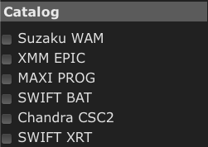
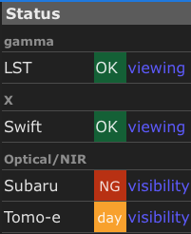
Ongoing and future tasks
Enrichment of existing contents
Catalogs
Status
Light curves
Reported events (FoV Filter )
Outsourcing to AstroArts
Improvement of UI
More convenient search
Link from the trigger ID to the object/event name
Major revision (if needed, the next fiscal year)
Sub-threshold events
Promoting more collaborative observations
MAXI sub-threshold
Swift-BAT sub-threshold
API to access data in the Database
Anticipating future automatic analysis
The “Catalog” section can have non-public catalogs.
What catalog should be listed here?
Ongoing
Pending
Under Review
The ”Status” section was prepared to share observation status of each mission.
What information can/should be shared here?
Notes:
Here, I will talk about ongoing and future tasks.
We are working on enriching the existing content, particularly to register GRB light curves. We also plan to add events reported in the transient name server as the FoV filter. However, we have not yet worked on the Catalog and Status section.
The "Catalog" section can include non-public or manually created catalogs. We need to determine which catalogs should be listed here.
The "Status section" was prepared to share each mission's observation status. However, this is just a shell for now. We need to discuss which information should be shared in this section.
We have asked AstroArts to improve the UI in this fiscal year. If we need to apply a significant revision, we must order it in the next fiscal year. So, we want to decide what we order AstroArts by the end of this fiscal year.
Also, we have some ideas for improving the Database and Viewer. But they are not well-considered yet.
One is the sharing the subthreshold events to promote more collaborative observations.
The other one is preparing API to access the Database for future automatic analysis and observations in mind.
There are our development plans. But we can change this plan depending on your demands.
Therefore, we need your feedback on the actual use.

Slide 14
Summary
The multi-messenger observation Database and Viewer are under development.
The beta version is available on the web. http://mma.phys.aoyama.ac.jp
We are working on the enrichment of existing content.
Light curves
Reported events (FOV Filter)
We need inputs to proceed with the development below:
Catalog
Status
Major revision (if needed, the next fiscal year)
The user’s manual is available in backup slides.
Notes:
I will summarize my talk.
The multi-messenger observation database and Viewer are under development.
The beta version is available on the web.
We are working on enriching the existing content.
We need your input to proceed with the development of the catalog section and the status section.
If we need a major revision, we should ask AstroArts in the next fiscal year.
I prepared the user's manual in backup slides. Please play with the Viewer with manual.
And, give us your feedback for further development.
That's all. Thank you for your attention.

Slide 15
Backup

Slide 16
Implementation Items
Implemented
Implementing
Pending
Under Review
Temporal
FOV Filter
MAXI GSC/object
Swift XRT/fov
Swift BAT/object
Fermi GBM/object
IceCube/object
EinsteinProbe WXT/object
MAXI/GSC sub-threshold
Swift/BAT sub-threshold
GCN Circular events
Transient Name Server
Swift XRT/object
optical agu-target/fov
others
Status
LST
Swift
Subaru
Tomo-e
others
Catalog
Suzaku WAM
XMM EPIC
MAXI PROG
Swift BAT
Chandra CSC2
Swift XRT
Gravitational Wave Filter
LVK GCN Notice
Light curve (flux)
MAXI/GSC
Swift/XRT
others
Light curve (count rate)
GRBAlpha
VZLUSAT-2
Swift/BAT
Fermi/GBM
MAXI/GSC
CALET/GBM
others

Slide 17
Multi-messenger Observation Database & Viewer User’s manual ver. 241117
Yuta Kawakubo (Aoyama Gakuin University)

Slide 18
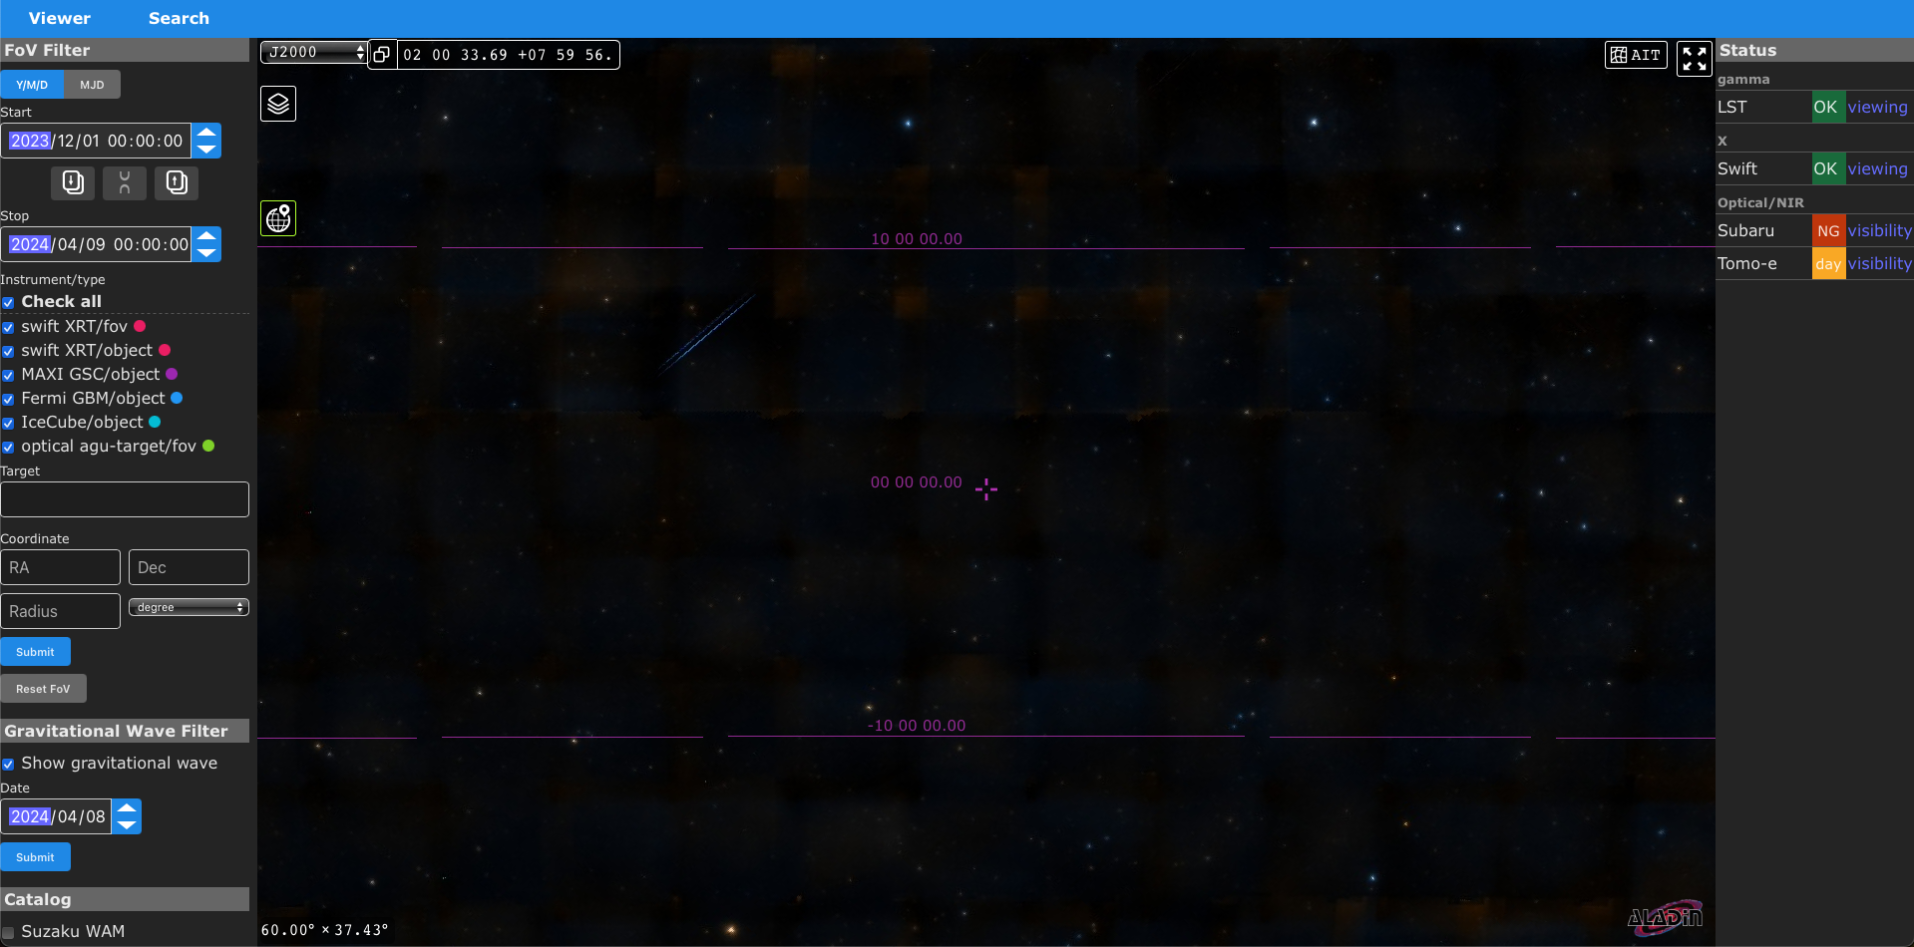
Top page (Viewer): http://mma.phys.aoyama.ac.jp

Slide 19
Button Usage
Switching between
Viewer & Object Search
Switching coordinates
Switching Projection
Setting the central position of Viewer
Copy coordinates to your clipboard
Full screen
Layer control (Change or Add surveys and catalogs)
Turn on / off grid
Zoom in / out by scrolling

Slide 20
Viewer: Survey
The background survey image can be changed.

Slide 21
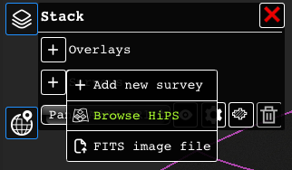
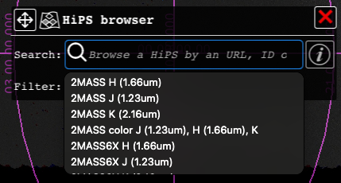
Display survey image
More selections:
https://aladin.cds.unistra.fr/hips/list

Slide 22
Viewer: Catalog
Catalogs can be overlaid on the survey image.
Information for clicked event/object are shown.

Slide 23
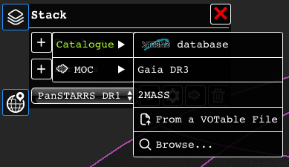
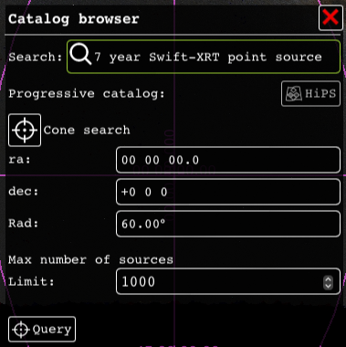
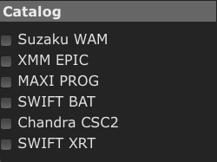
Display catalogs
Search & select catalog
“Cone search” can set the filter with GUI.
Unavailable catalogs can be added to the “Catalog” section.
The current catalogs listed are temporal for testing.
Set the filter & Push “Query”.

Slide 24
Viewer: FoV Filter
Objects/FoV can be filtered by time. “Y/M/D” and “MJD” can be switched by the button.
Upward (downward) arrow copy Stop (Start) time to Start (Stop) time.
Start and Stop times increase/decrease independently.
Start and Stop times increase/decrease synchronized.
Checkboxes can turn each item on/off.
Events/objects can be filtered by the name.
If you input central position (equatorial coordinates) and radius (degrees, arcmin, arcsec), Objects/FoV can be filtered by the circle.
“Submit” applies the settings above.

Slide 25
Viewer: FoV Filter
Objects/FoV can be turned on/off by checkboxes.
Filters by time, target name, and position are available.
Swift/BAT, Fermi-GBM, IceCube, and Einstein Probe events are automatically added from GCN/Notices.

Slide 26
Viewer: Gravitational Wave Filter
S240422ed
The LIGO/Virgo/KAGRA 90% localization region can be overlaid.
Gravitational wave events (FAR < 6.34e-7) are automatically added from GCN/Notices.

Slide 27
Use example: GRB180829A
Are there any galaxies in the MAXI’s error box for GRB 180829A?
Survey image
PanSTARSS DR1
Catalog
HYPERLEDA
Paturel+ 2003
FOV Filter
MAXI GSC/object
2018/08/29
GRB 180829A

Slide 28
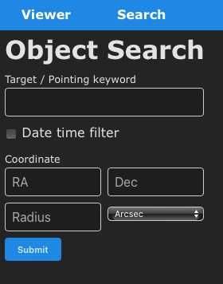
Object Search
Click “Search” to switch to object search.
Search with Target (Object) / Pointing keyword.
The exact match is only available (a partial match will be available in the future).
The filters by time and coordinate are also available in the same way as the Viewer.

Slide 29
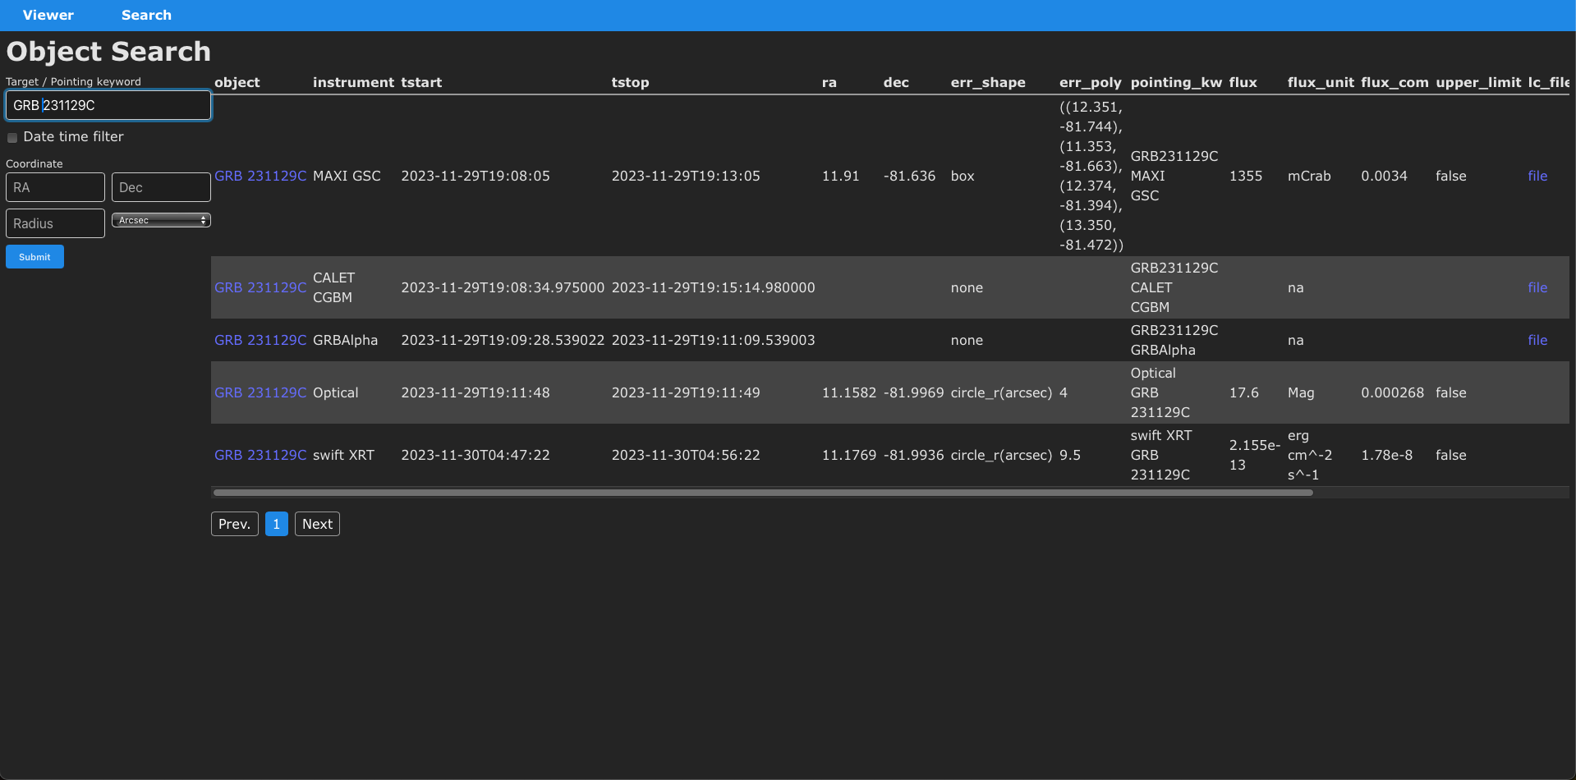
Object Search (GRB 231129C)
If we search with “GRB 231129C”, observations are listed.
If we click “GRB 231129C” in “object” column, a new tab for object information will open (see next page).
Keywords in “object” and “pointing_kw” can be used for the search.

Slide 30
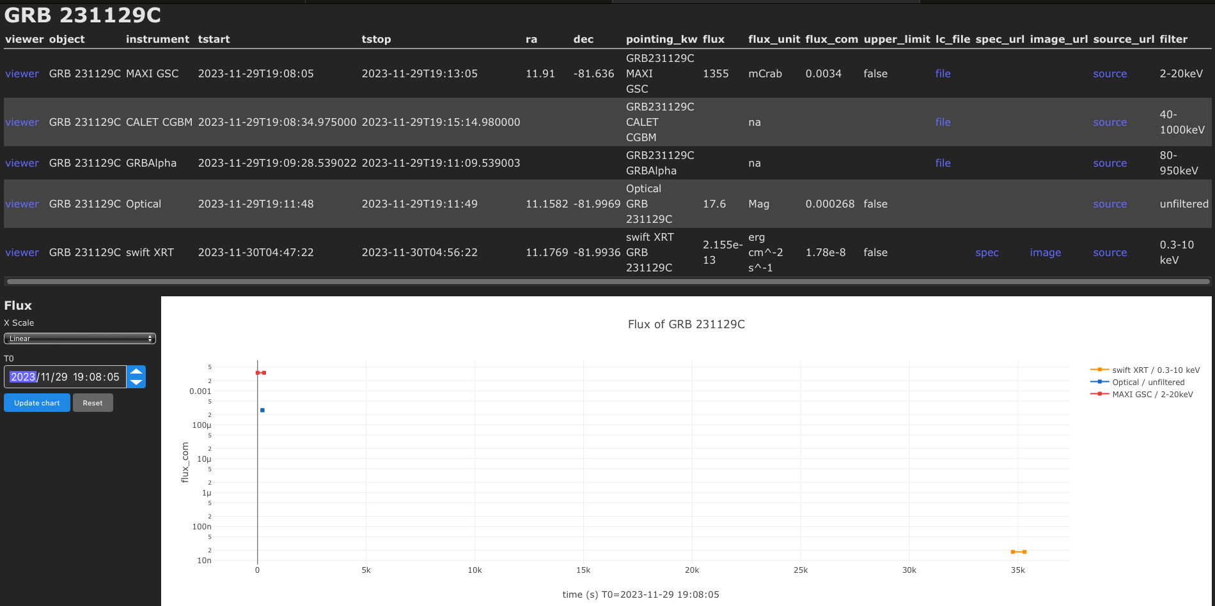
Object Search (GRB 231129C)
Switch the x-axis scale (Linear/Log)
If the cursor is on the plot, function buttons appear.
The label appears if the cursor is on each button.
“Download plot as a png” saves plots as png file.
Pushing “Zoom” and dragging on the plot zoom in the plot.
Pushing “Pan” and dragging on the plot shifts the plot.
“Zoom in/out” can zoom in/out.
“Reset axes” (“Auto Scale”) reset the plot.
Change offset time (T0)
”update chart” apply settings changed.

Slide 31
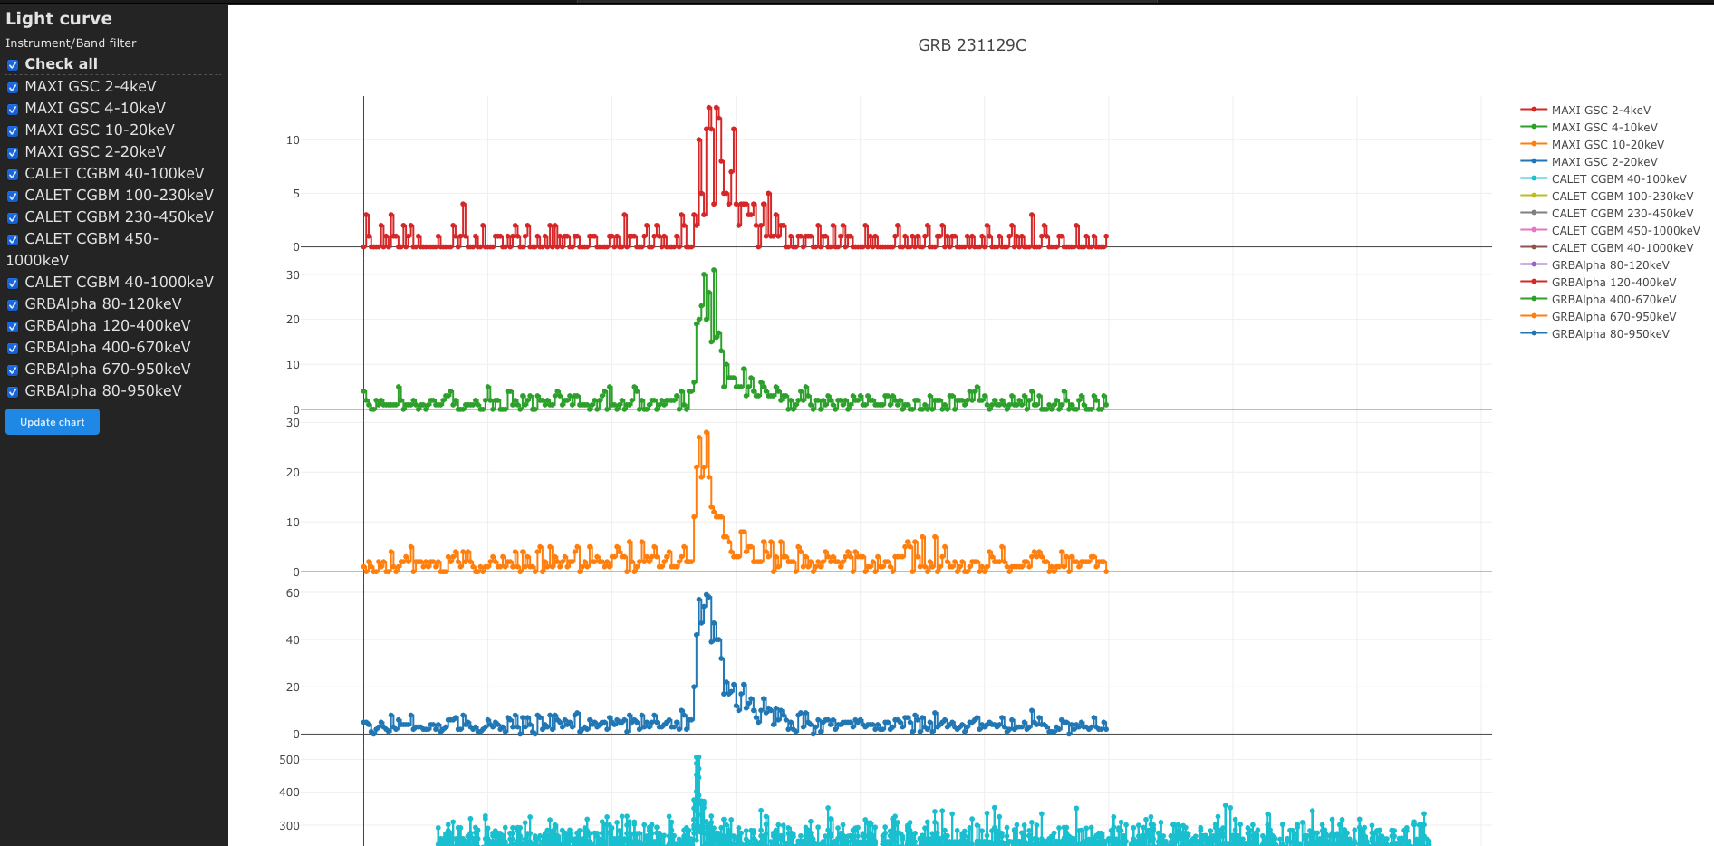
Object Search (GRB 231129C)
Each lightcurve can be turned on/off by the checkboxes.
The same function buttons are available as the flux light curves.

Slide 32
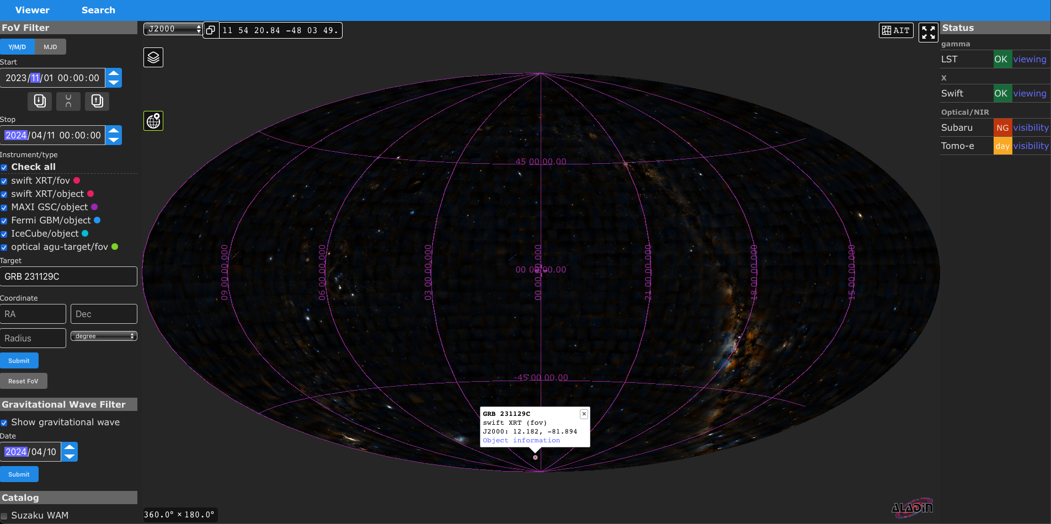
Link from Viewer to Object information
The popup appears if we click object/FoV.
“Object information” in the popup is a direct link to the object information.

Slide 33
Registered data (2024/11/14)
Swift XRT/fov
observation history (once / day)
Swift BAT/object
every GCN/Notice (near real-time)
MAX GSC/object
MAXI GRBs (manual)
Fermi-GBM/object
every GCN/Notice (near real-time)
IceCube/object
ICECAT-1 (Gold & Bronze, 2011-2023) https://dataverse.harvard.edu/dataset.xhtml?persistentId=doi:10.7910/DVN/SCRUCD
every GCN/Notice (near real-time)
optical agu-target/fov (temporary)
S230927ba (for testing)
Gravitational wave filter
GW150914
GW170817
O4b (FAR < 6.34e-7 )
every GCN/Notice (near real-time)
Light curves (count)
GRB 241129C (for testing)
MAXI/GSC
CALET/GBM
GRBAlpha
GRBAlpha GRBs
VZLUSAT-2 GRBs
Swift/BAT GRBs (~ 2023)
Light curves (flux)
GRB 241129C (for testing)
MAXI/GSC
Swift/XRT
Optical

