Slide 1
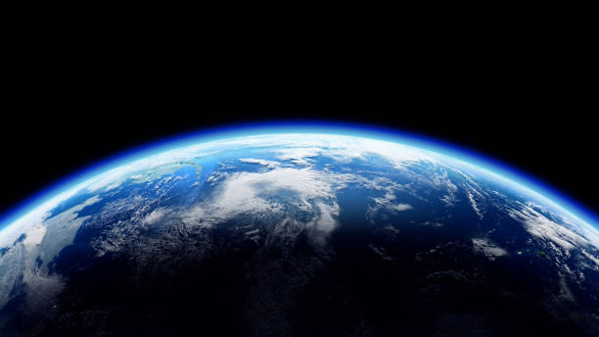
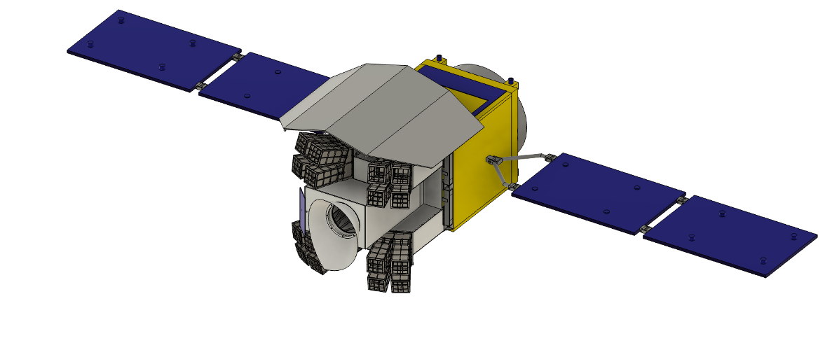
Thermal analysis of the near-infrared telescope
on board the HiZ-GUNDAM satellite
Rinon Kageyama
Kohji Tsumura¹, Hideo Matsuhara², Akihiro Doi², Daisuke Yonetoku³ and HiZ-GUNDAM collaboration
¹Tokyo City University, ²ISAS, ³Kanazawa University
Notes:
I’m Rinon Kageyama
This is HiZ-GUNDAM satellite.
Several people before me were talking about this satellite.
In particular, I’m going to talk about thermal analysis of the near-infrared telescope on bord the HiZ-GUNDAM satellite.
This part is the near-infrared telescope.
Here are the collaborators.

Slide 2
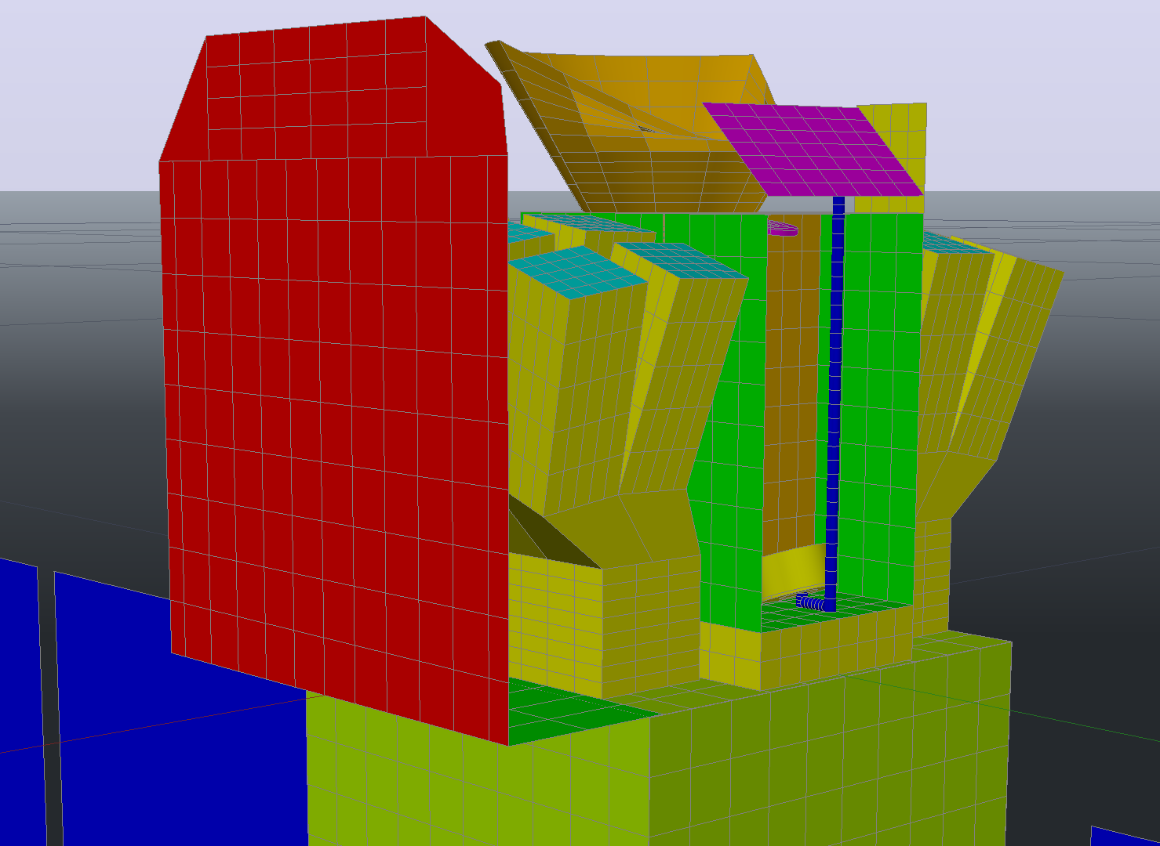
One of the problems of HiZ-GUNDAM
The telescope must be cooled
to achieve high sensitivity.
Radiative cooling (no mechanical cooler)
⚠️
The telescope body
: below 200 K
The IR detector
: below 120 K
Notes:
First, I would like to talk about one of the problems of this satellite, the thermal challenge.
The telescope must be cooled to the required temperature only by radiative cooling without a cooler to obtain high sensitivity.
The temperatures are below 200K for the telescope body installed here and below 120K for the near-infrared detector installed here.

Slide 3
One of the problems of HiZ-GUNDAM
A previous study has succeeded in temperature requirements.
The telescope body
requirement:200 K
result:165 K
The IR detector
requirement:120 K
result:105 K
Notes:
A previous study has succeeded in temperature requirements.
In this model, the temperature of telescope body was below 165K and the detector was below 105K.

Slide 4
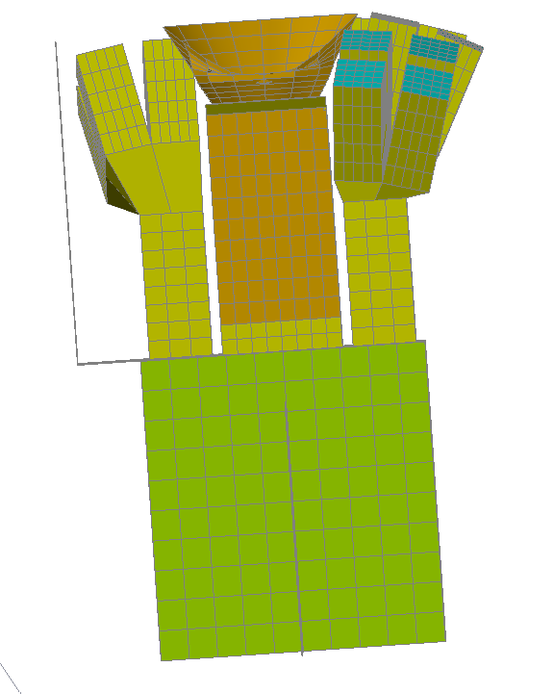
One of the problems of HiZ-GUNDAM
When the satellite finds GRBs
30°
Attitude change
60°
Notes:
I will explain the new problem with this model.
The satellite changes its attitude after finding a GRB.
After the attitude change, the heat input from the Earth is greater than before the attitude change.

Slide 5
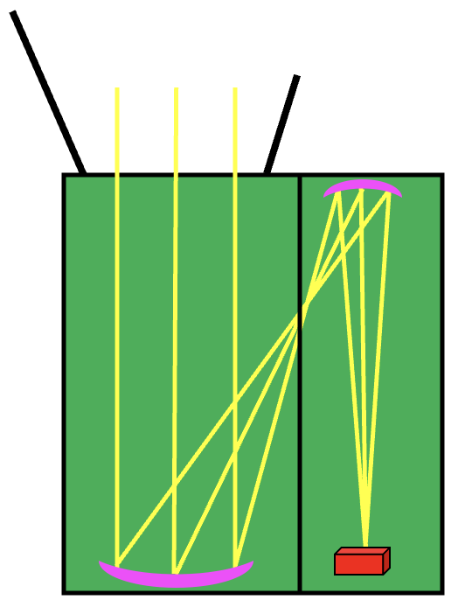
One of the problems of HiZ-GUNDAM
Previous model’s telescope body
Temperature increase
IR detector
Image is in focus
Notes:
This is an image of the telescope body for that model.
Before changing the attitude, an image is formed on the detector and in focus.

Slide 6
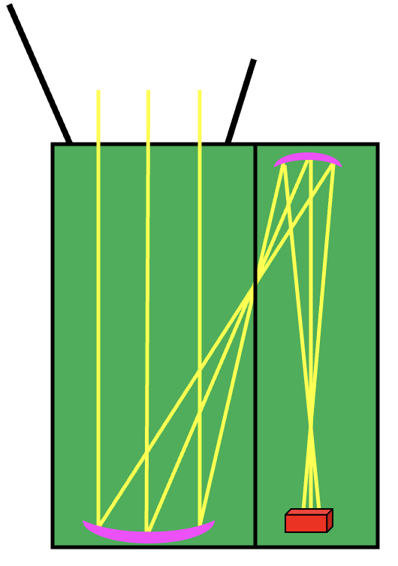
One of the problems of HiZ-GUNDAM
Previous model’s telescope body
Temperature increase
IR detector
Image is in focus
Image is out of focus
⚠️ The telescope body expands with heat.
Notes:
But the satellite changes the attitude and heats up、the telescope body expands with heat
And the distance between the primary and secondary mirrors increases.
At that time, an image is created here and out of focus.

Slide 7
One of the problems of HiZ-GUNDAM
Previous model’s telescope body
 | Previous study
Allowable expansion | 18 μm
Actual expansion | 34.0 μm
⚠️ Actual value exceeded the maximum value.
Image is out of focus
Purpose of this study
Verify thermal feasibility in new optical designs.
Notes:
The allowable expansion of telescope body in previous study was 18μm, whereas the actual expansion was 34.0μm.
Actual expansion exceeded the allowable expansion.
That’s why, purpose of this study is verifying thermal feasibility in new optical designs.

Slide 8
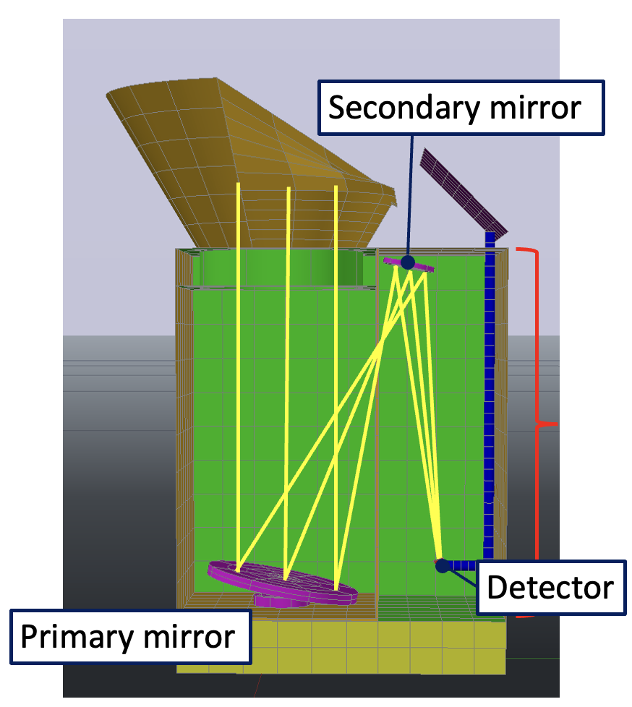
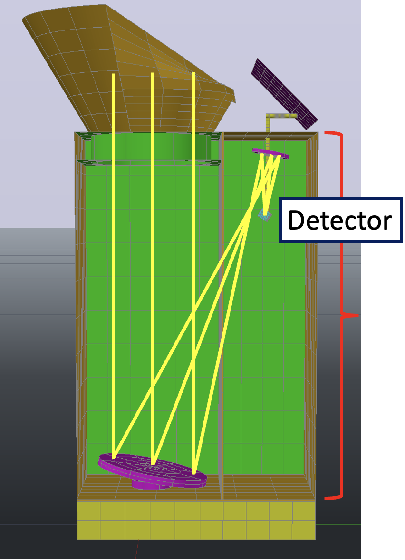
Thermal model change
Previous model
New model
70 cm
95 cm
Satellite bus (300 K)
Benefits
① Longer focal lengths allow for greater displacement tolerance.
② The detector to be cooled has been moved from the satellite bus.
Notes:
Seconds, I’m going talk about thermal model change.
The first model change is the telescope body extended vertically to extend the focal length of primary mirror.
The second model change is the focal point is moved to the top, so the detector is placed at the top.
That’s why longer focal lengths allow for greater displacement tolerance.
This yellow line shows the light path.
And the detector to be cooled has been moved from the satellite bus to the position closer to the radiator.

Slide 9
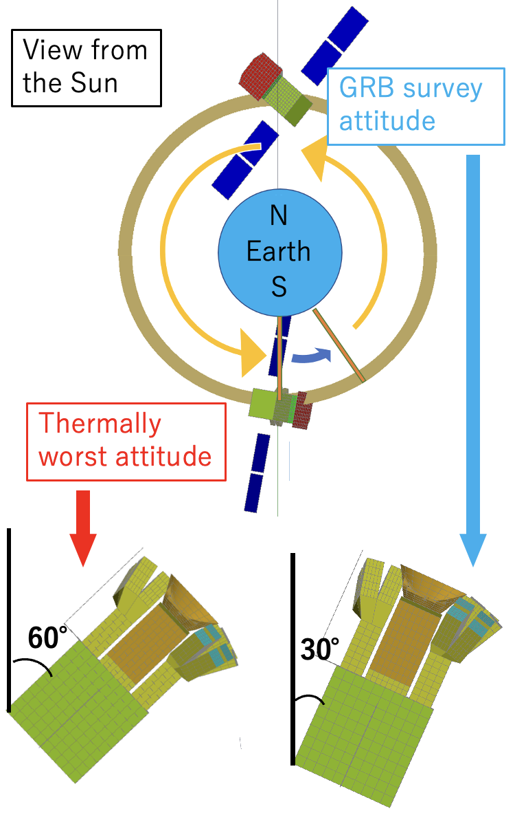
Methods of thermal analysis
Orbit
A sun-synchronous polar orbit on the day-night boundary
(Dawn-Dusk orbit)
Attitude
・During GRB exploration → GRB survey attitude
・After discovering a GRB → GRB tracking attitude
Heat input is larger
＜Worst-case conditions with high heat input from the sun＞
Analysis in tracking attitude
at the South Pole during the winter solstice.
Notes:
Thirds, I would like to talk about methods of thermal analysis.
This is the condition under which the thermal analysis was performed.
This is a diagram of the orbit and attitude of the HiZ-GUNDAM satellite as seen from the sun.
An orbit of HiZ-GUNDAM is a sun-synchronous polar orbit on the day-night boundary.
During GRB search, the satellite is in a GRB survey attitude tilted 30 degrees away from the sun.
After a GRB is found, the satellite is in a GRB tracking attitude that can tilt up to 60 degrees away from the sun.
The thermal analysis was carried out under the condition that the satellite would be in a GRB tracking position at the South Pole on the winter solstice.
This is the worst case, assuming a large amount of heat input.

Slide 10
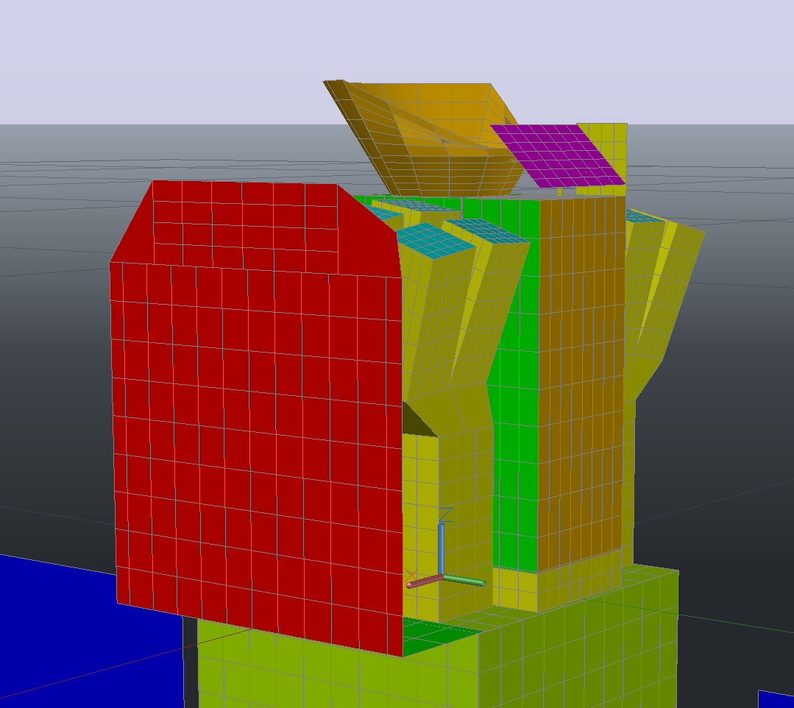
Methods of thermal analysis
Earth infrared radiation
Radiator
for detector
Albedo
Radiator
for telescope
Sunlight
irradiation
Sun shield
Instrument heat
・The finite element method is used for thermal analysis.
Notes:
The conditions for heat input and output to the satellite model used in the analysis are as follows:
Heat inputs are Earth infrared radiation, Albedo, sunlight irradiation and instrument heat.
Heat outputs are radiator for detector, radiator for telescope and sun shield.
Thermal analysis was performed using the finite element method with the Thermal Desktop.

Slide 11
Results
 | Allowable expansion | Actual expansion
Previous model | 18 $μm$ | 34.0 $μm$
New model | 40 $μm$ | 27.0 $μm$
Expansion!
Reduction!
・Tolerances have been relaxed to meet the requirements.
・Actual expansion is within the allowable expansion.
Notes:
Finally, I would discuss the results.
As can be seen from this table, the allowable expansion has increased from 18 μm in the previous model to 40 μm in the new model.
In addition, the actual expansion of new model has also been reduced from 34μm to 27.0μm compared to the previous model.
So, actual expansion is within the allowable expansion.

Slide 12
Results
 | Telescope | Detector
Requirement | 200 K | 120 K
Previous model | 164.5 K | 104.1 K
New model | 164.5 K | 96.9 K
lowering!
・Telescope and detector temperatures also remained below the required values.
Future
The results of the manufacturer's conceptual study are also incorporated.
Notes:
And also, the temperature conditions.
The telescope body and detector temperatures were kept below the requirement.
Furthermore, the new model’s temperature of the detector was lower than in previous studies.
As for future prospects, the results of the manufacturer’s conceptual study are also incorporated.

