Slide 1
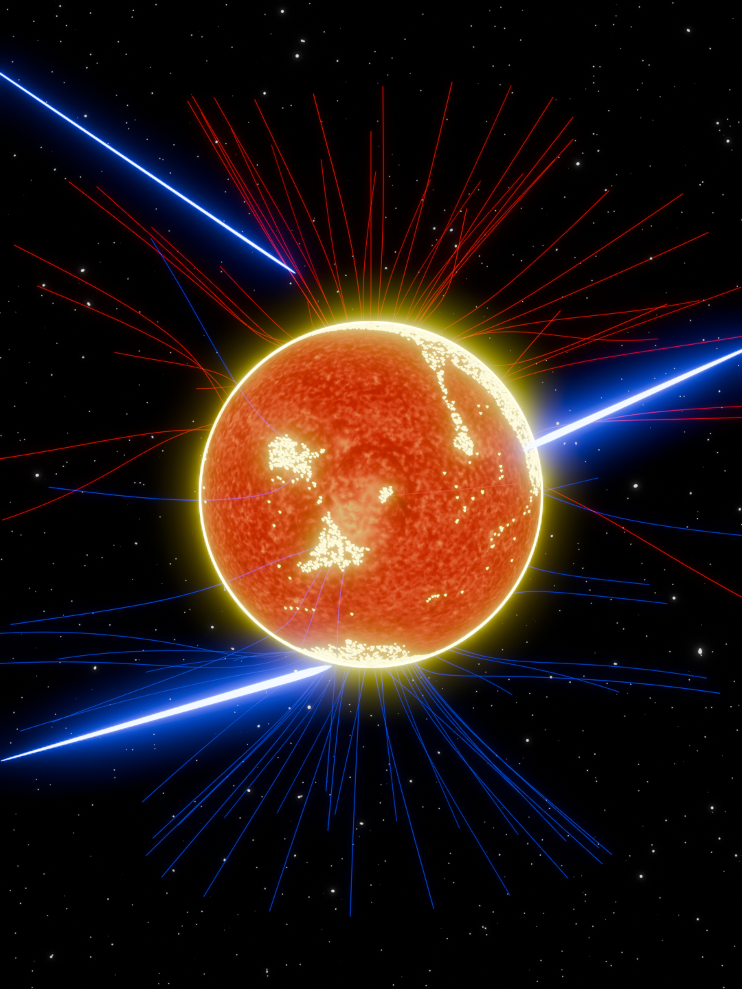
Coronal Magnetic Field
Modulates GeV Solar Disk Gamma Ray
Chingam Fong (房智岩)¹ , Zhe Li ², Kenny C. Y. Ng¹
1. Department of Physics, The Chinese University of Hong Kong, Shatin, Hong Kong, China
2. Institute of High Energy Physics, Chinese Academy of Sciences, Beijing 100049, China
NOT AI generated
NOT AI generated

Slide 2


Cosmic Ray to Solar Gamma Ray
Galactic Cosmic Ray
Gamma Ray
Photosphere
Inter-planetary Space
Field in the Sun
Coronal Field
Primary consideration
NOT AI generated

Slide 3
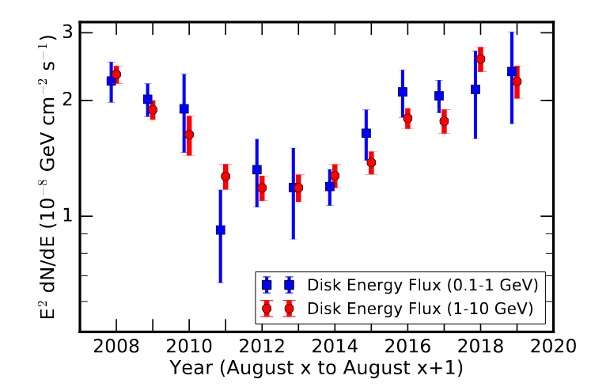
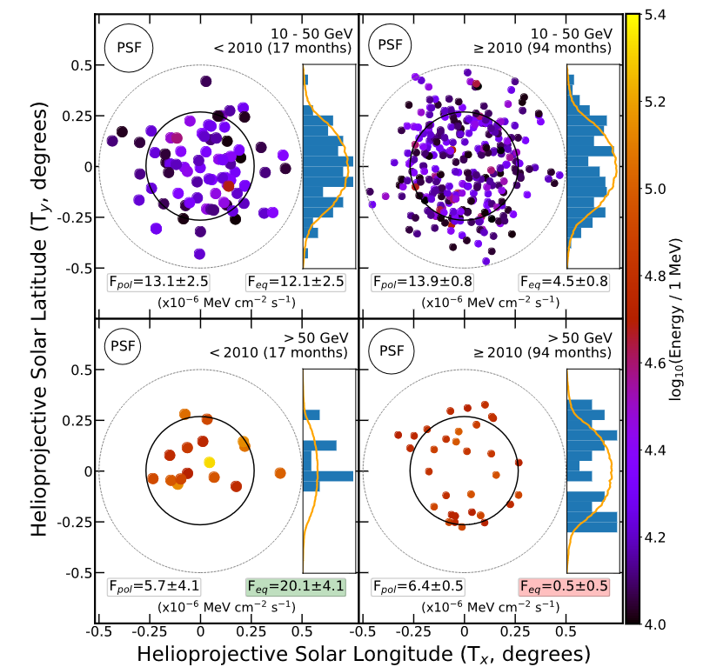
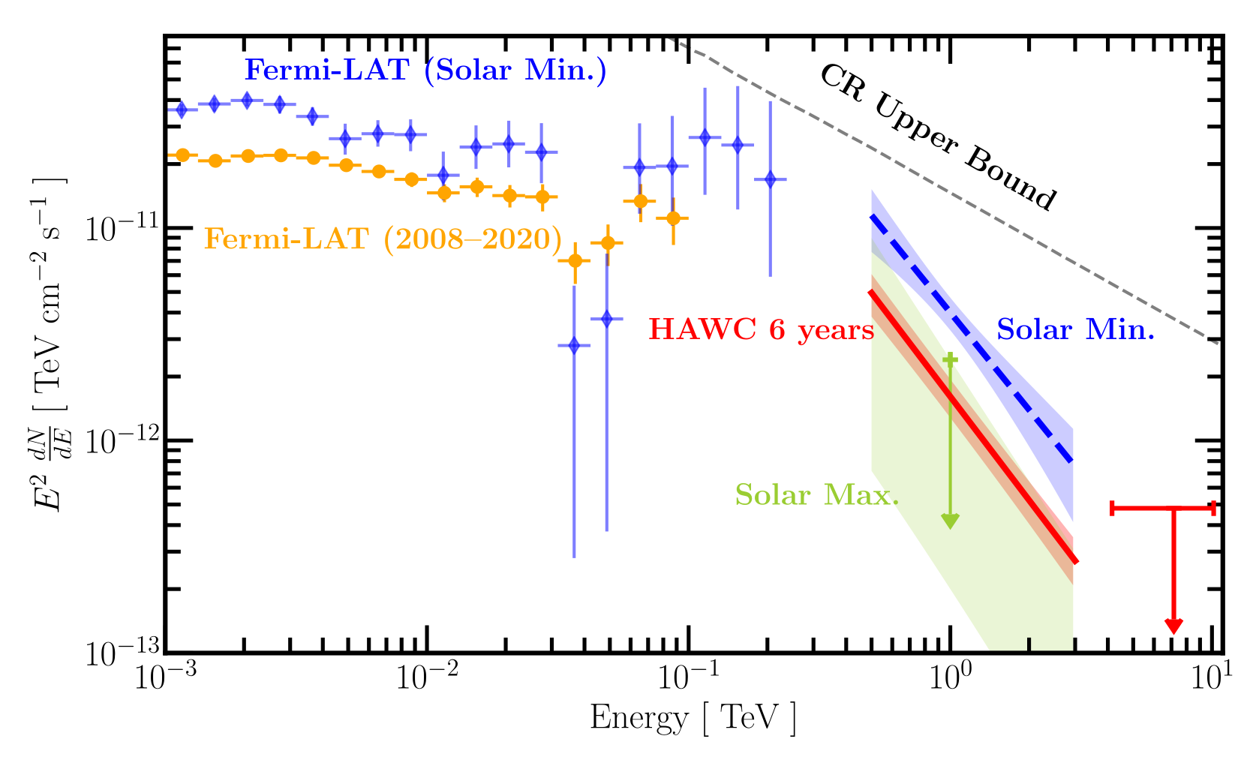
Observation Puzzles
High flux, flat spectral index
Anti-correlation with solar activity cycle
Energy and time dependent Morphology
Linden et, al 2020
arxiv:2012.04654
Quiet
Active
HAWC Collaboration, 2022
arxiv:2212.00815
Linden et, al 2018
arxiv:1803.05436
Full overview in K. C. Y. Ng’s talk on Monday

Slide 4
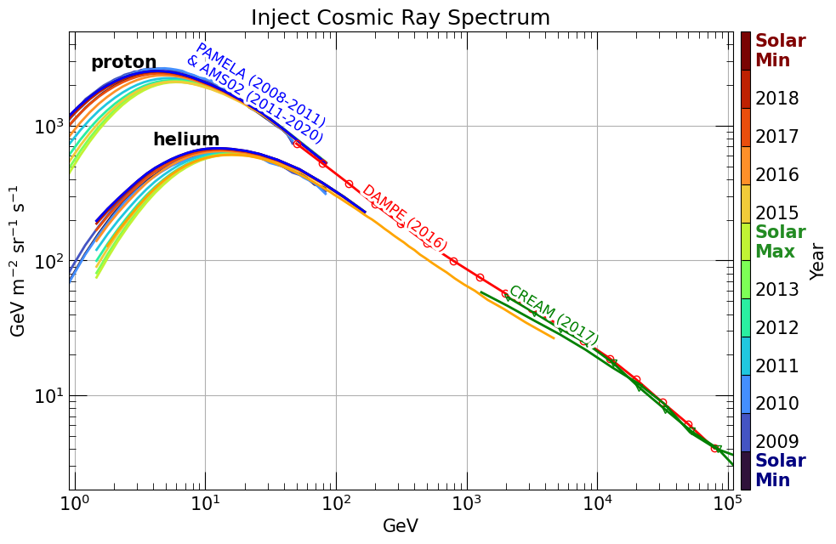
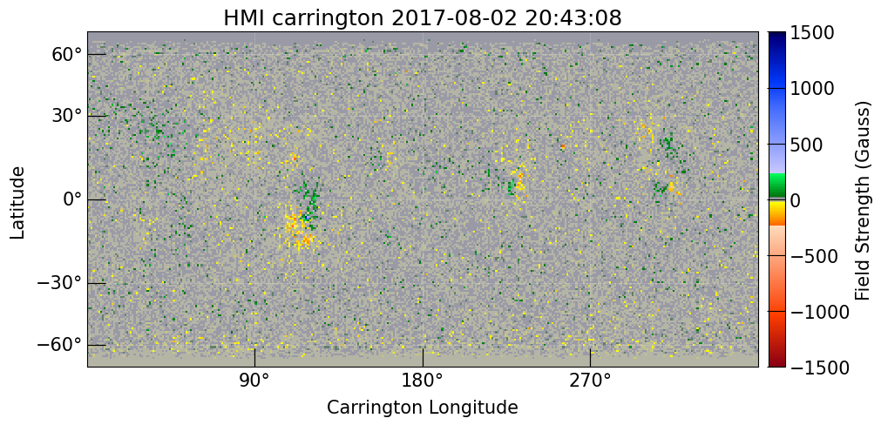
Simulation Toolkit G4SOLAR
Written in Geant4, developed by Zhe Li (2009.03888)
Isotropic inject Cosmic Ray (p & He)
36 MHD field models, entire solar cycle
  Previous works: only a few PFSS field (Mazziotta et al 2020, Dörner et al 2026)
Assume: field inside the Sun same as the surface
tools.ssdc.asi.it/CosmicRays/
Surface Magnetogram
Solar Dynamics Observatory
http://jsoc.stanford.edu/ajax/lookdata.html?ds=hmi.pfss_synop

Slide 5
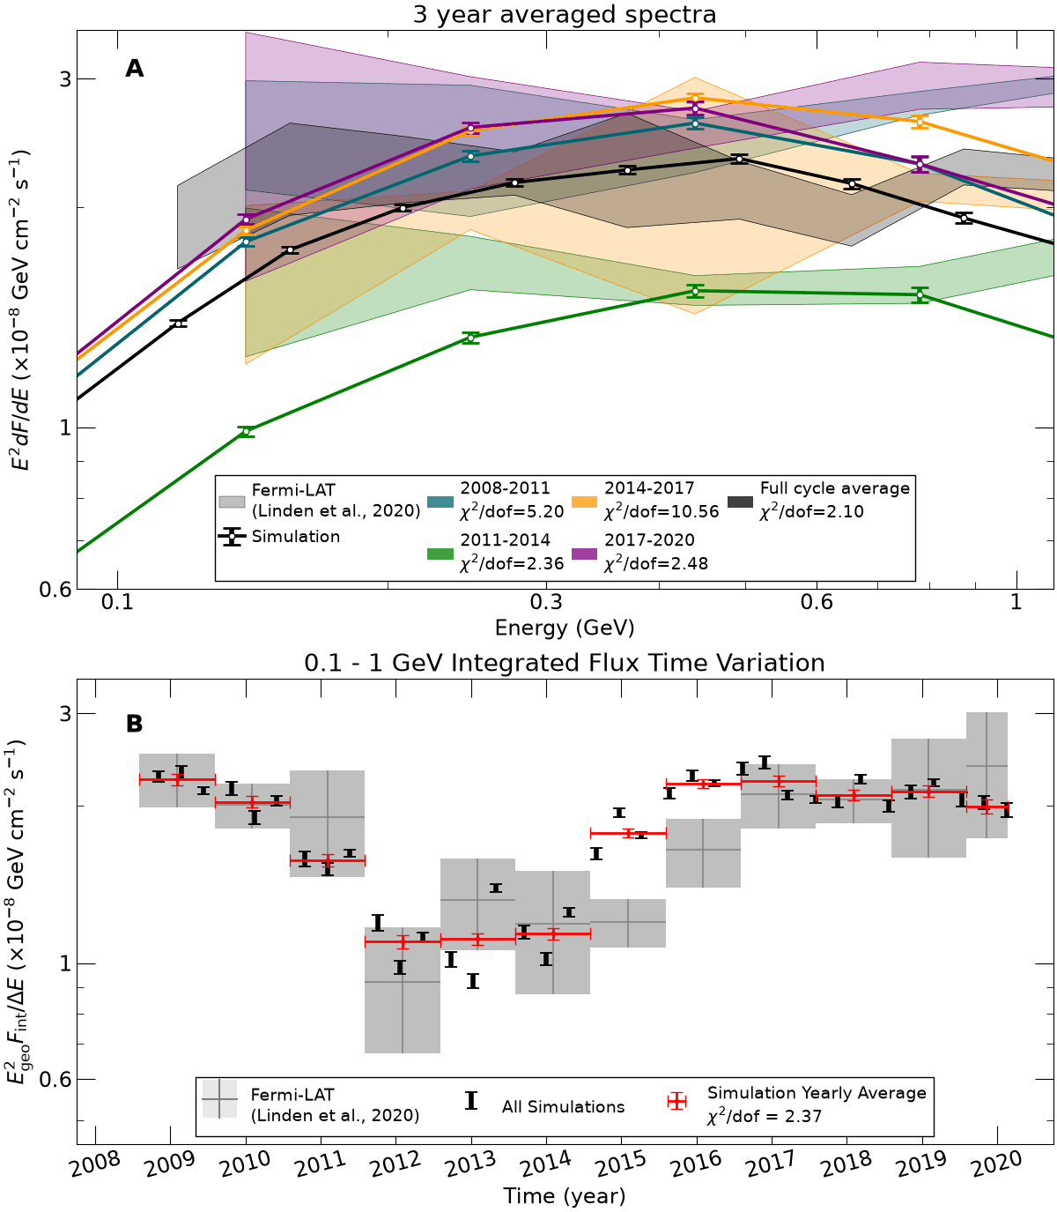
Time Varying 0.1 – 1 GeV Flux
From simulation we calculate spectral flux at Earth
Between 0.1 - 1 GeV, simulation matches observation, in flux, spectral shape, and time varying behavior
First study pointing out corona field as a cause of solar time variation!

Slide 6
Critical Role of Open Corona Field
We trace cosmic ray (CR) propagation and interaction, as well as magnetic field lines
CR < 10 GeV (yellow) must follow open field lines (red and blue)
Area of open field regions directly decides GeV gamma ray flux

Slide 7
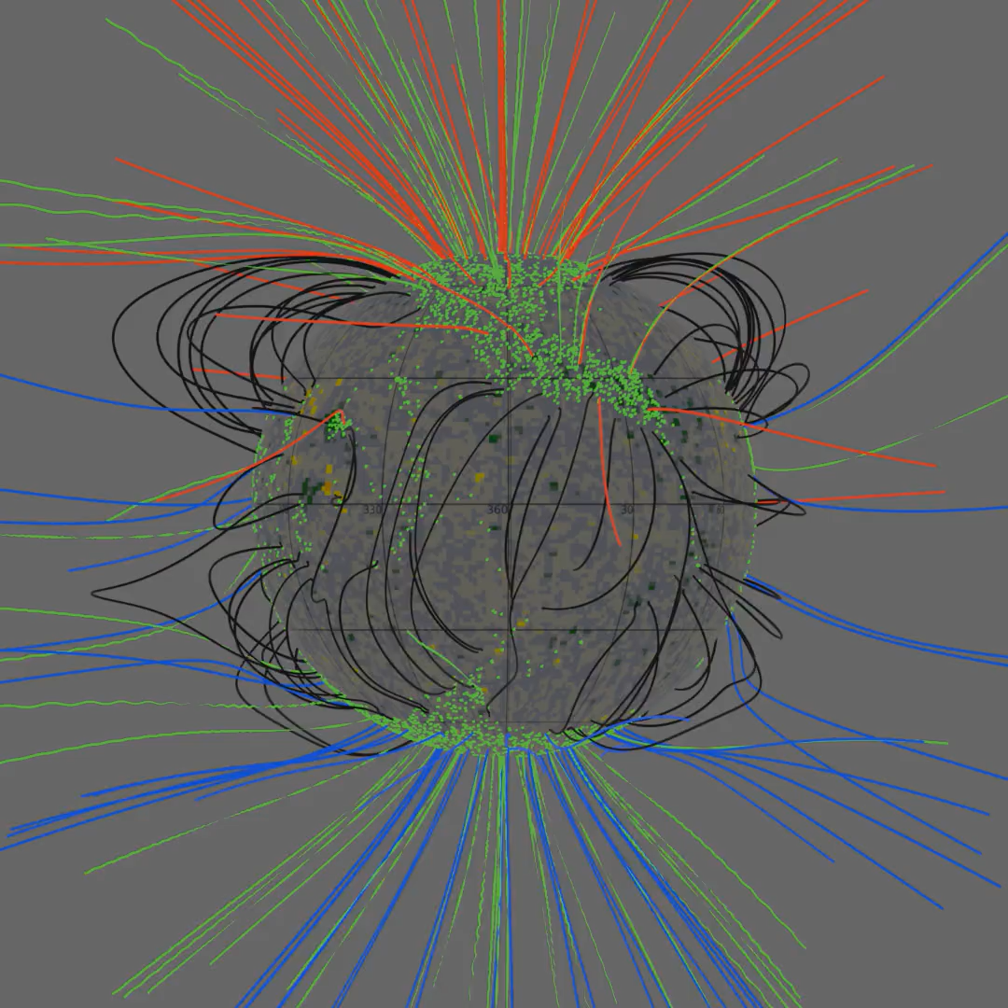
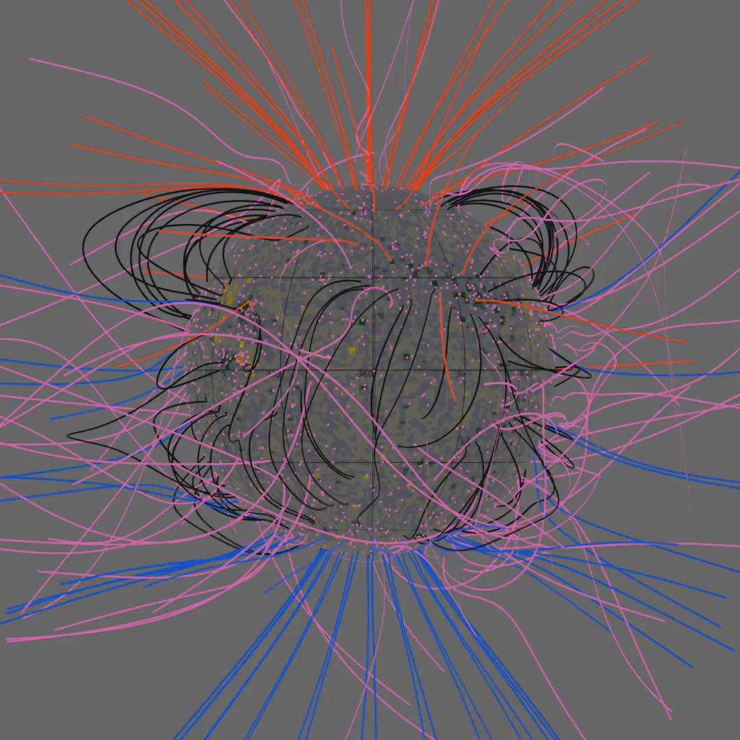
Low Energy Trajectories vs High Energy
10 GeV proton
1 TeV proton

Slide 8
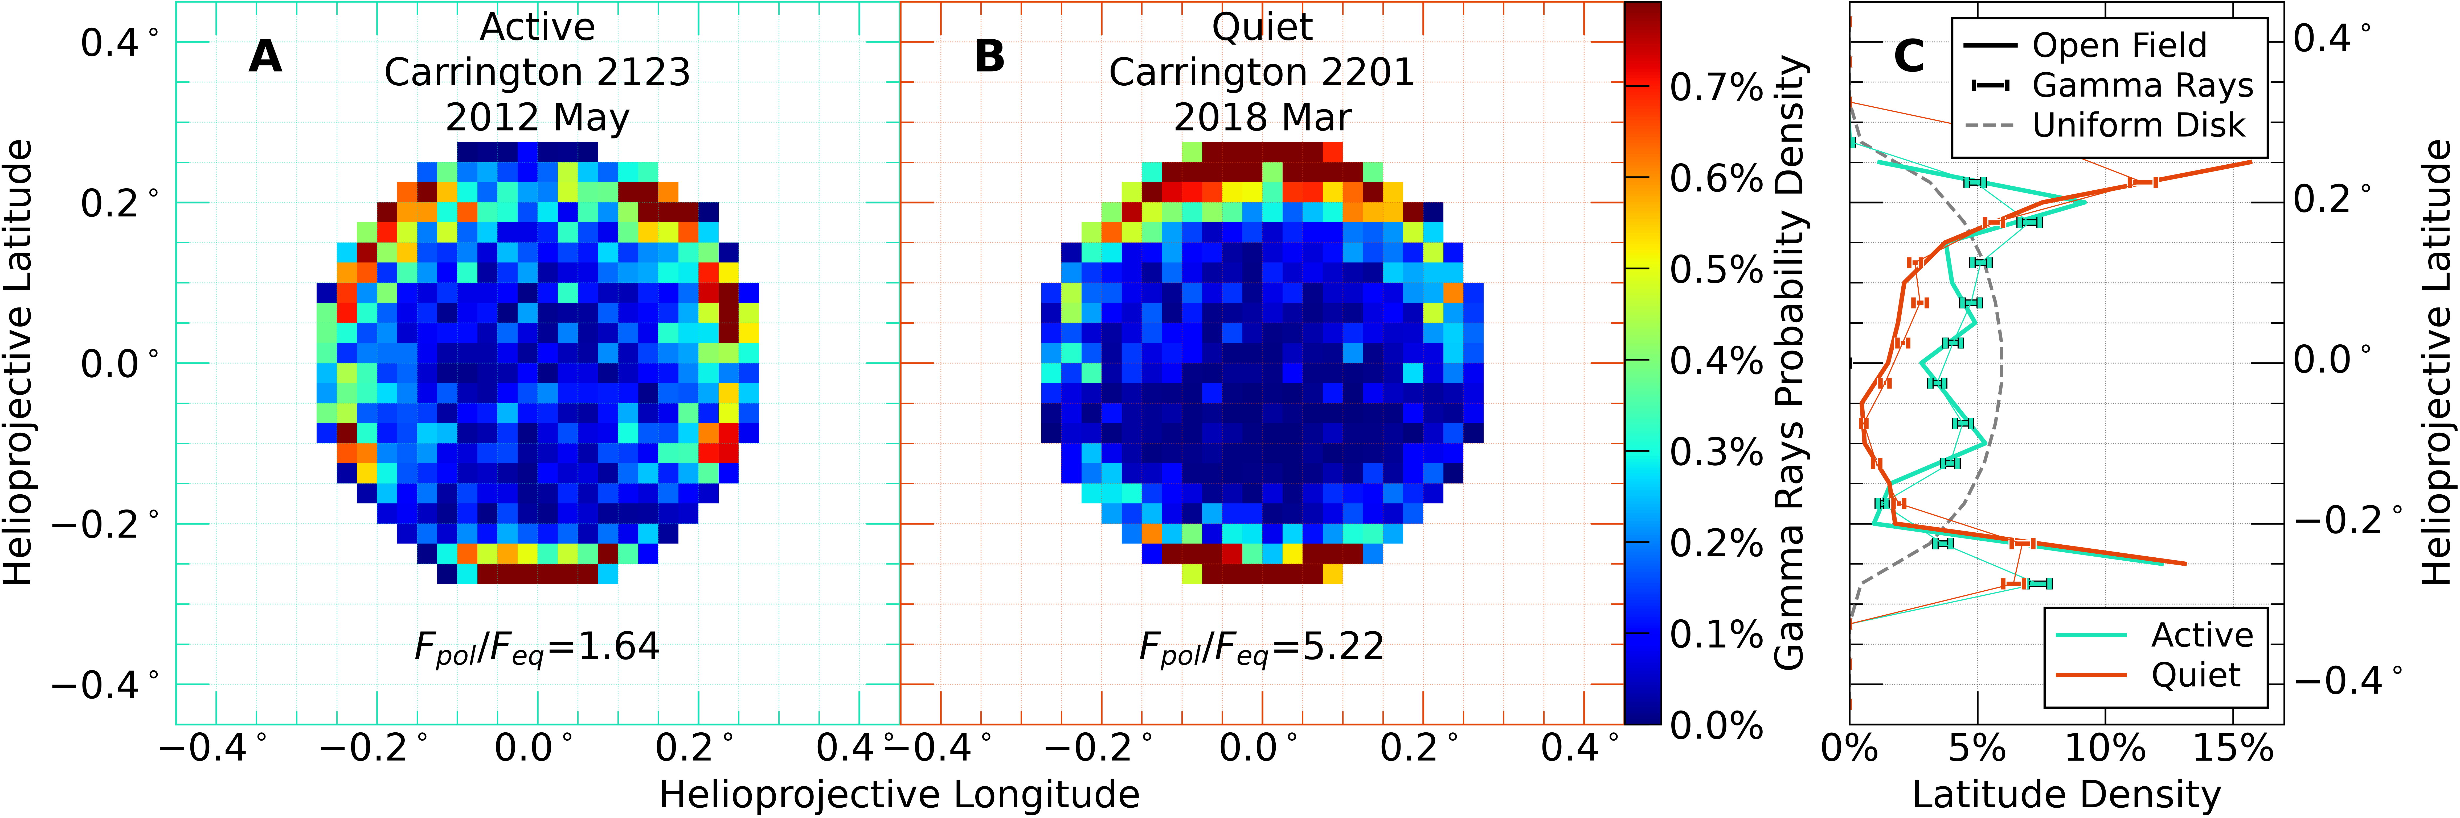
Implication for Observed Morphology
We make predictions of 1 GeV gamma ray morphology
The coronal field – flux connection is very pronounced.
Gamma ray morphology is a powerful tool to probe coronal field

Slide 9
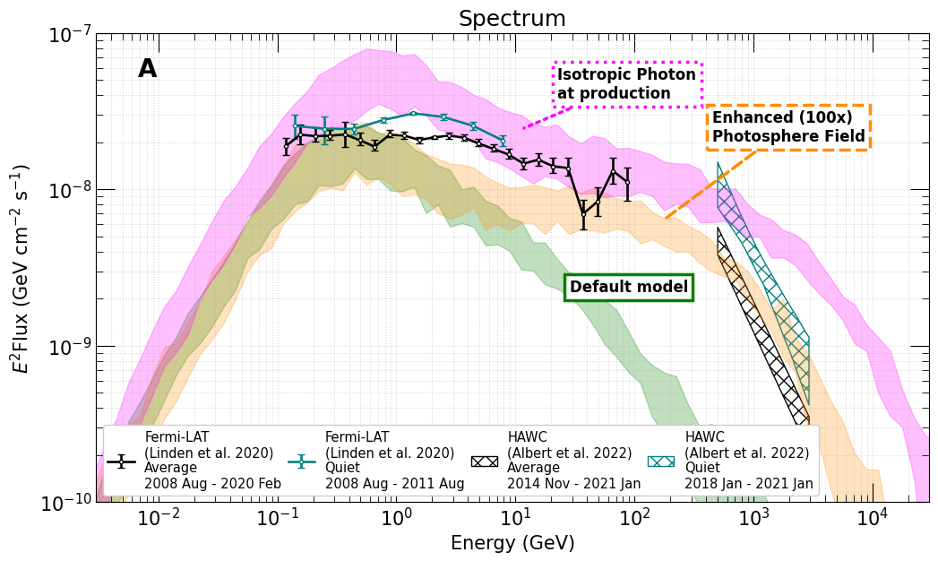
Testing Photosphere Field Effect
We test 2 different "toy models" photosphere field: 1. 100x field strength, 2. isotropic photon production
Almost no effect on low energy flux, enhances high energy flux
High energy gamma-ray caused by different magnetic field component!

Slide 10
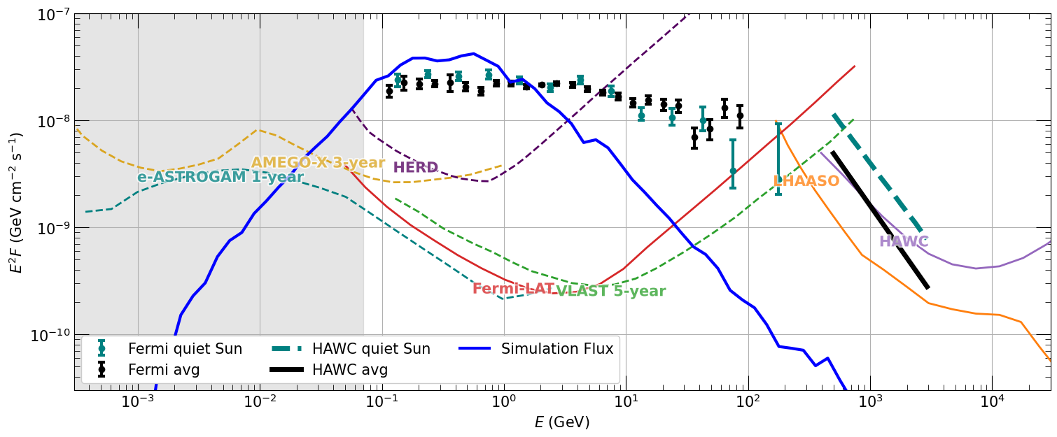
The Future of Solar Gamma is Bright
Many planned future gamma ray missions can observe > MeV solar gamma
  Better angular resolution and sensitivity
  eASTROGAM, AMEGO-X, HERD, VLAST …
COSI

Slide 11
Conclusions
Corona field has significant effect on low energy cosmic ray propagation near the Sun and solar gamma ray
  Simulation result matches observed flux and time variation < 1 GeV
Our full Sun simulation allows us to study morphology of gamma ray, which can verify corona models
Exercise in photosphere field shows high energy gamma are influenced by field inside the Sun
Acknowledgement
C. F. and K. C. Y. N. are supported by Croucher foundation, RGC grants (24302721,14305822, 14308023), NSFC/RGC joint research scheme (N CUHK456/22), and NSFC grant 12322517.
Z. L. is supported by NSFC-RGC No.1226116036.

Slide 12
Questions?

Slide 13
Backup slides

Slide 14
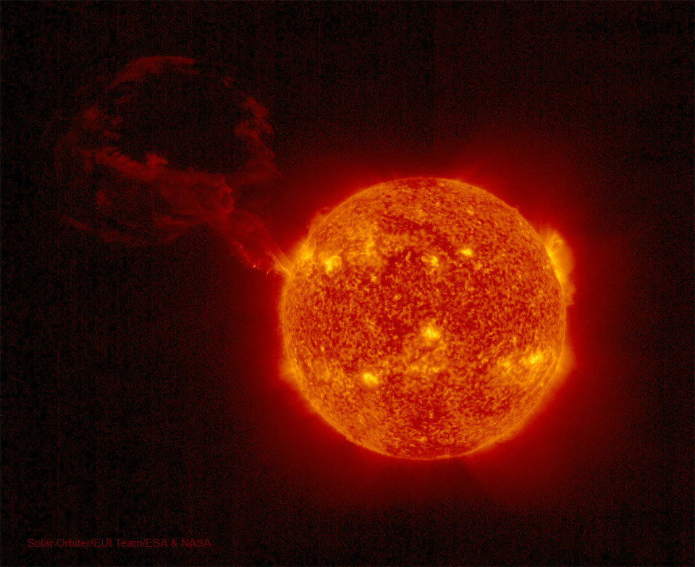
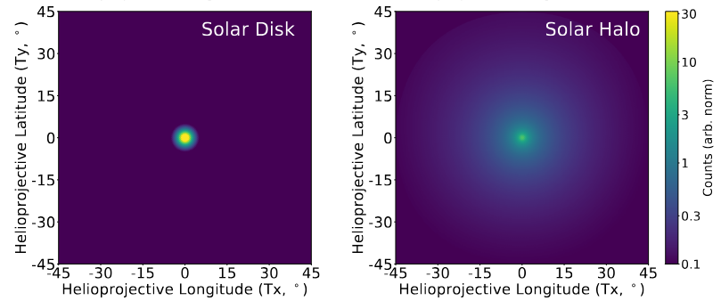





Sun as a Gamma Ray Source
Cosmic ray proton + solar atmosphere -> “Solar disk”
T. Linden et al., 2025
arxiv: 2505.04625
$$p^{+}$$
$$γ$$
$$γ$$
Solar flare
$$γ_{low}$$
$$γ$$
Cosmic ray electron ICS with photon -> “Solar halo”
$$e^{−}$$
Easily distinguishable from one another
We focus on solar disk gamma ray here

Slide 15
Surface Emission Map
Tracing field lines to surface, open field regions correlate with gamma emission

Slide 16
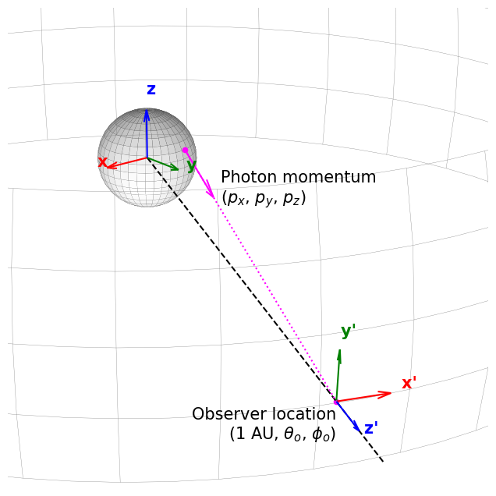
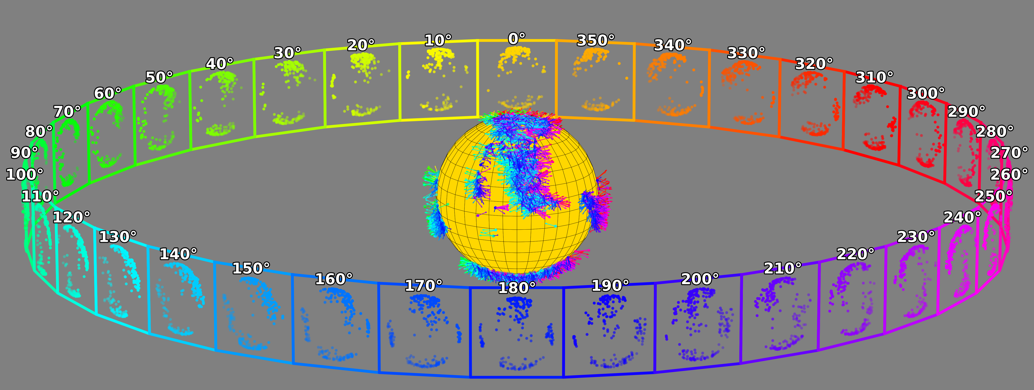
More Detail about Morphology Calculation
We project gamma ray onto Earth perspective, based on emission location and direction, thus getting collected gamma ray morphology at specific points in time
Integrated over entire orbit -> time averaged gamma ray morphology

Slide 17
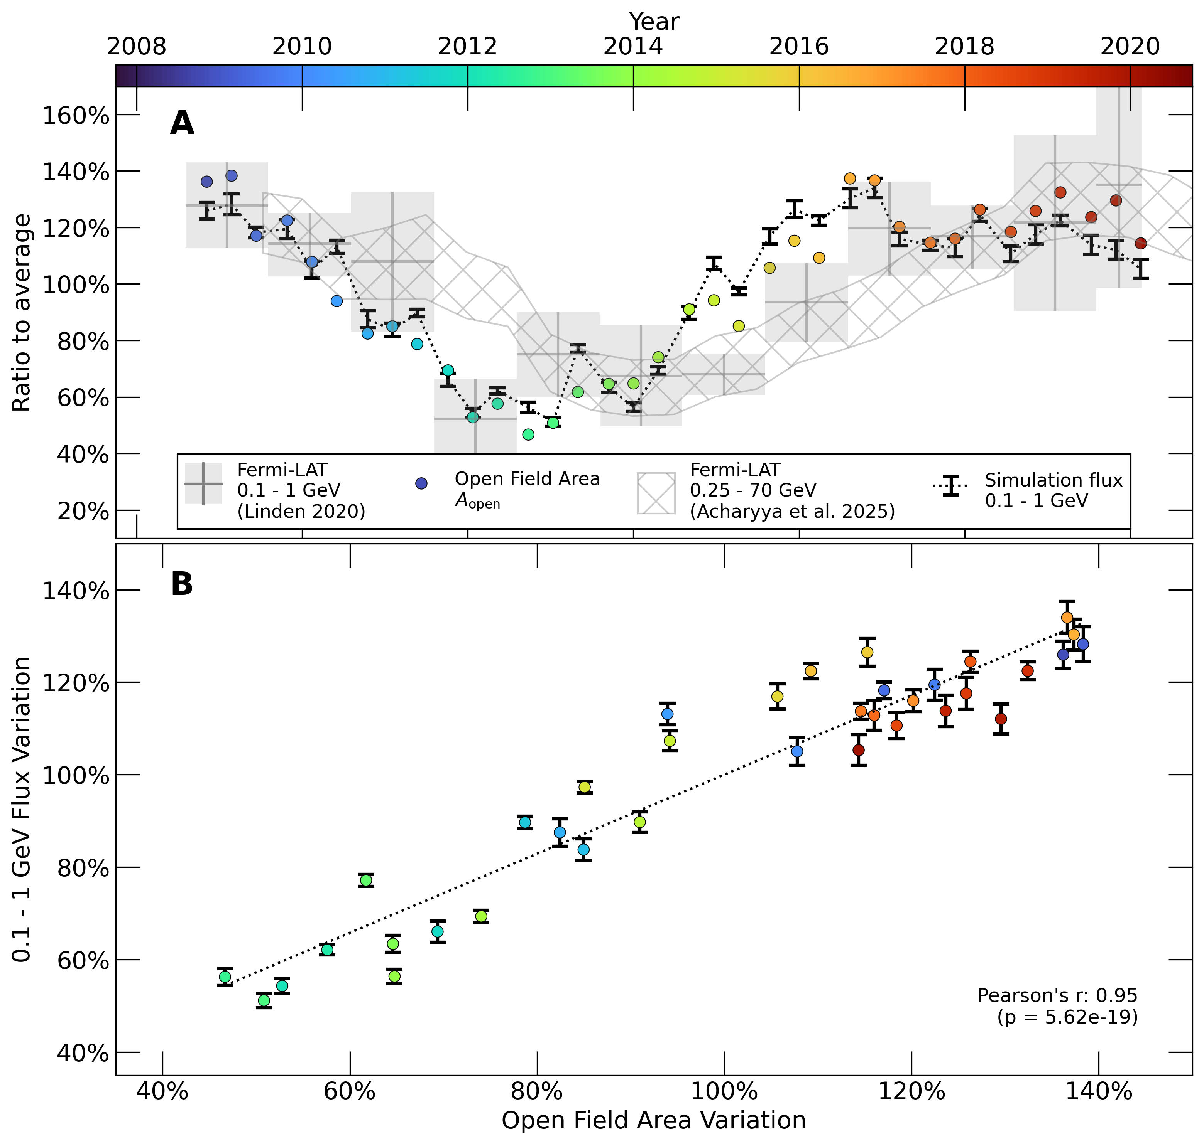
Open Field Modulates Solar Gamma Rays
Throughout solar cycle, the open field area on the Sun changes by factor of 2, causing gamma ray variation
  Strong correlation in long-term trend

Slide 18
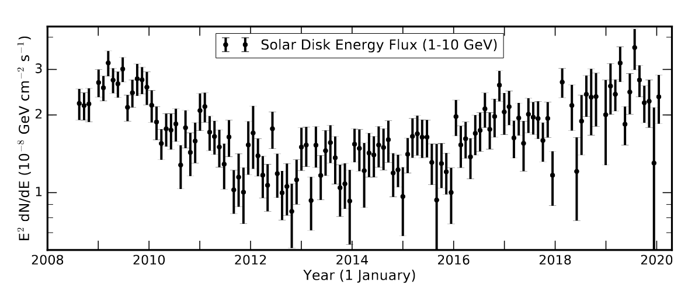
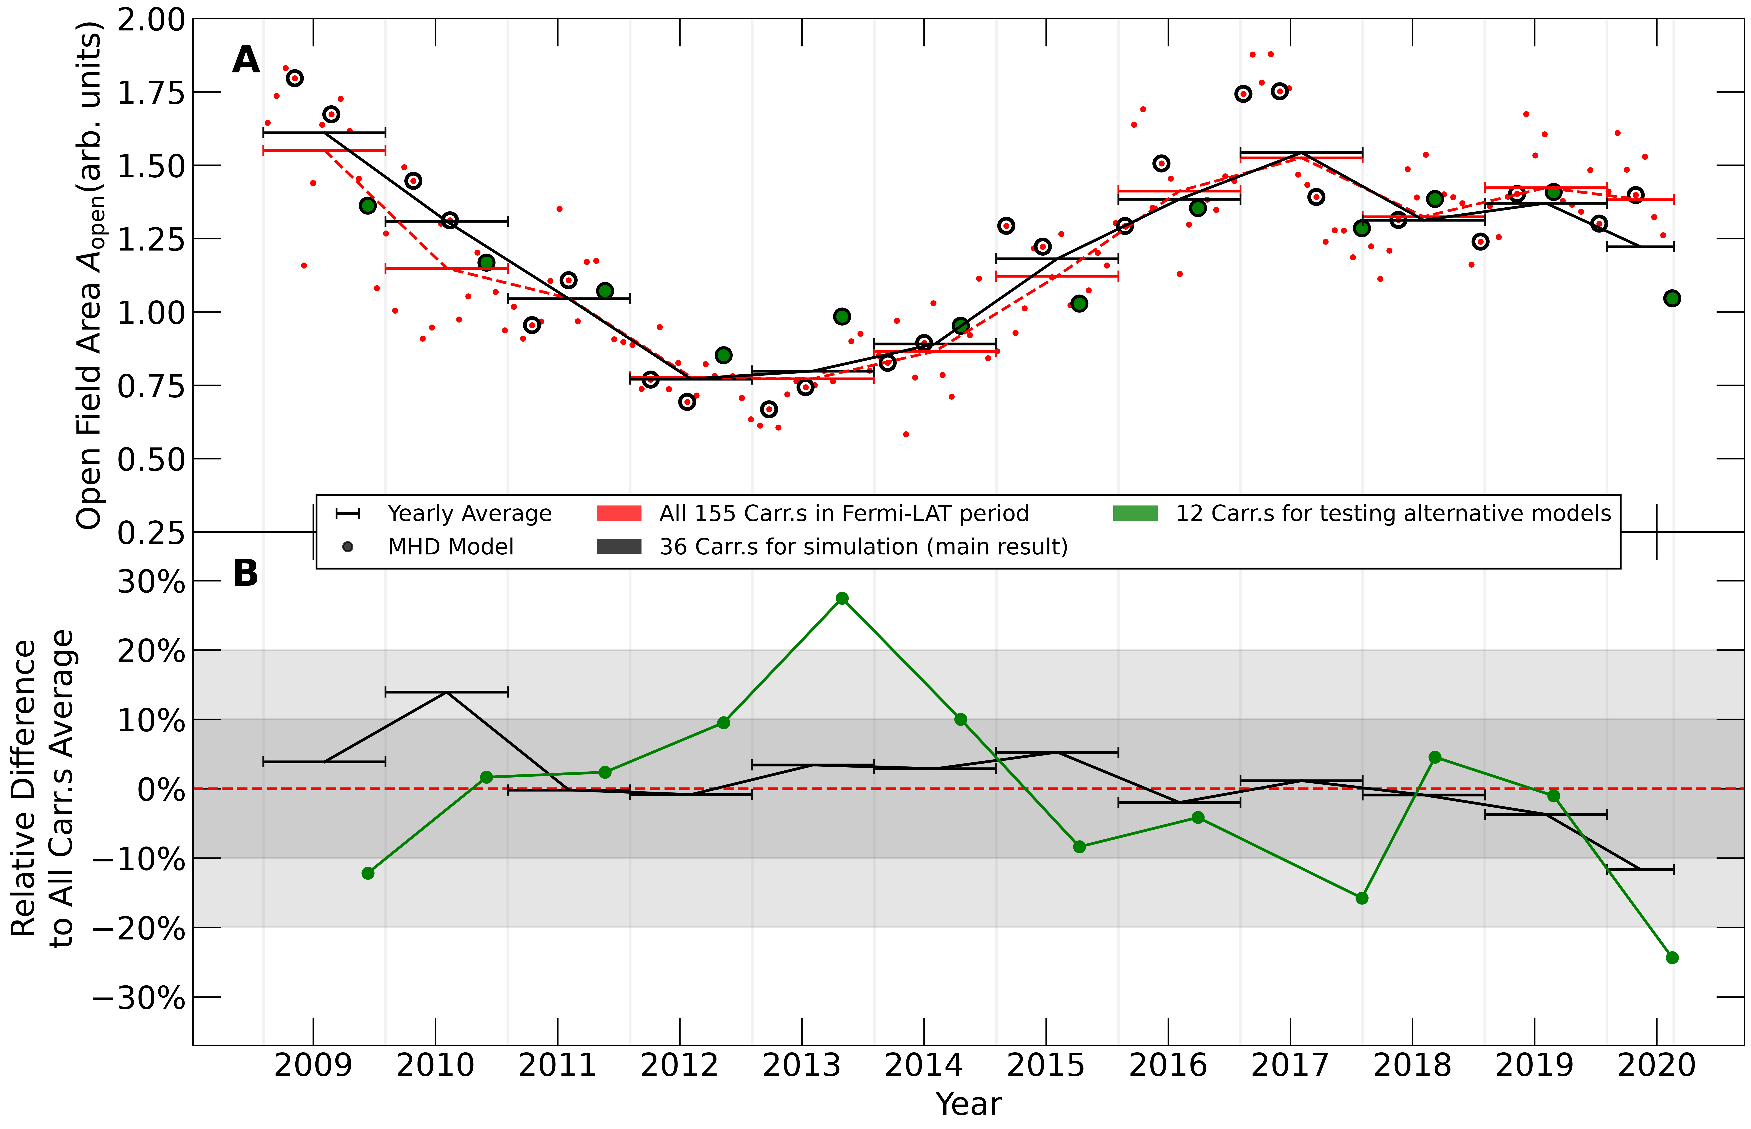
Higher order periodicity
All cycle, open field area predicted by coronal field follow the same trend
Linden et, al 2020​
arxiv:2012.04654​

Slide 19
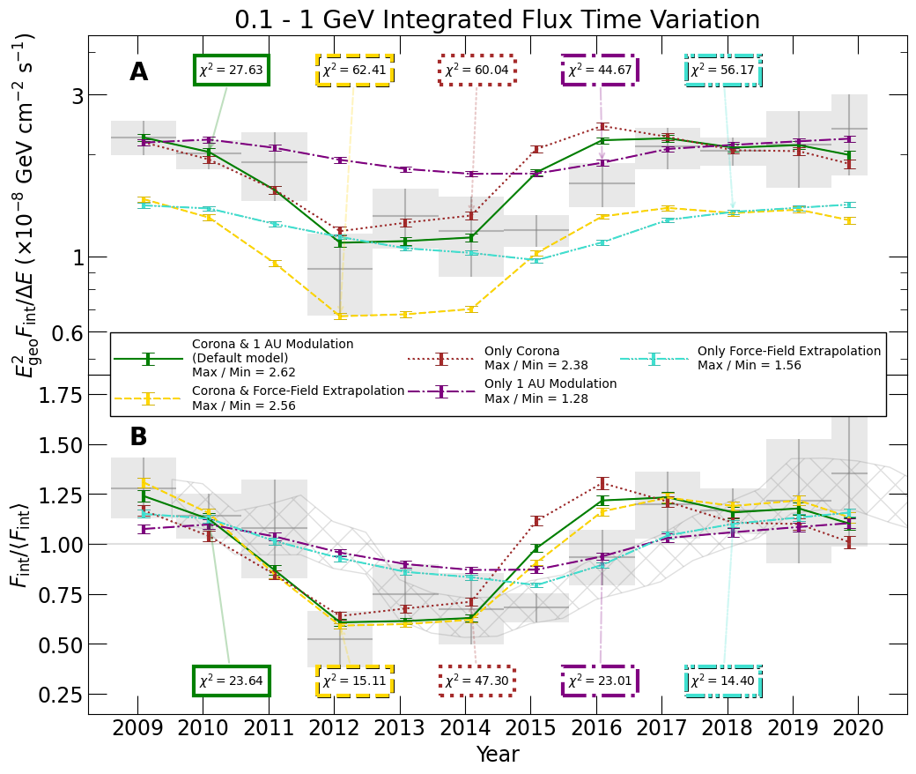
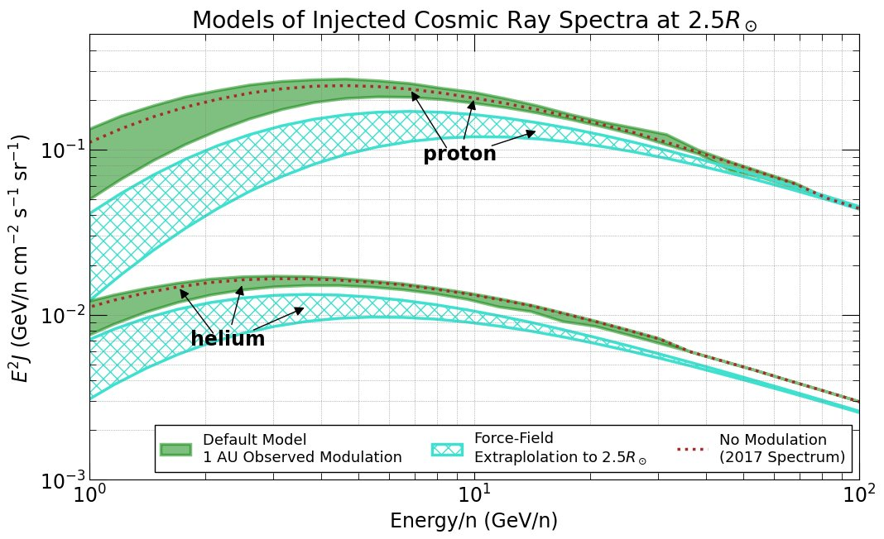
Alternative CR
Flux Models
Main analysis: 1 AU flux = corona flux
To compare IMF effect, force field approximation
Corona field effect dominates over force field approximation

Slide 20
Morphology Under Enhanced Field
More turbulence -> concentrated center emission

