Slide 1



Search for Sub-Solar Mass Binary Black Holes by Gravitational Waves
TeVPA 2026, Takinoyu, August 31, 2026
Credit: Maggie Chiang
Yasuhiro Murakami ー The University of Tokyo / ICRR
Collaborators: Tathagata Ghosh (ICRR), Soichiro Morisaki (ICRR)

Slide 2
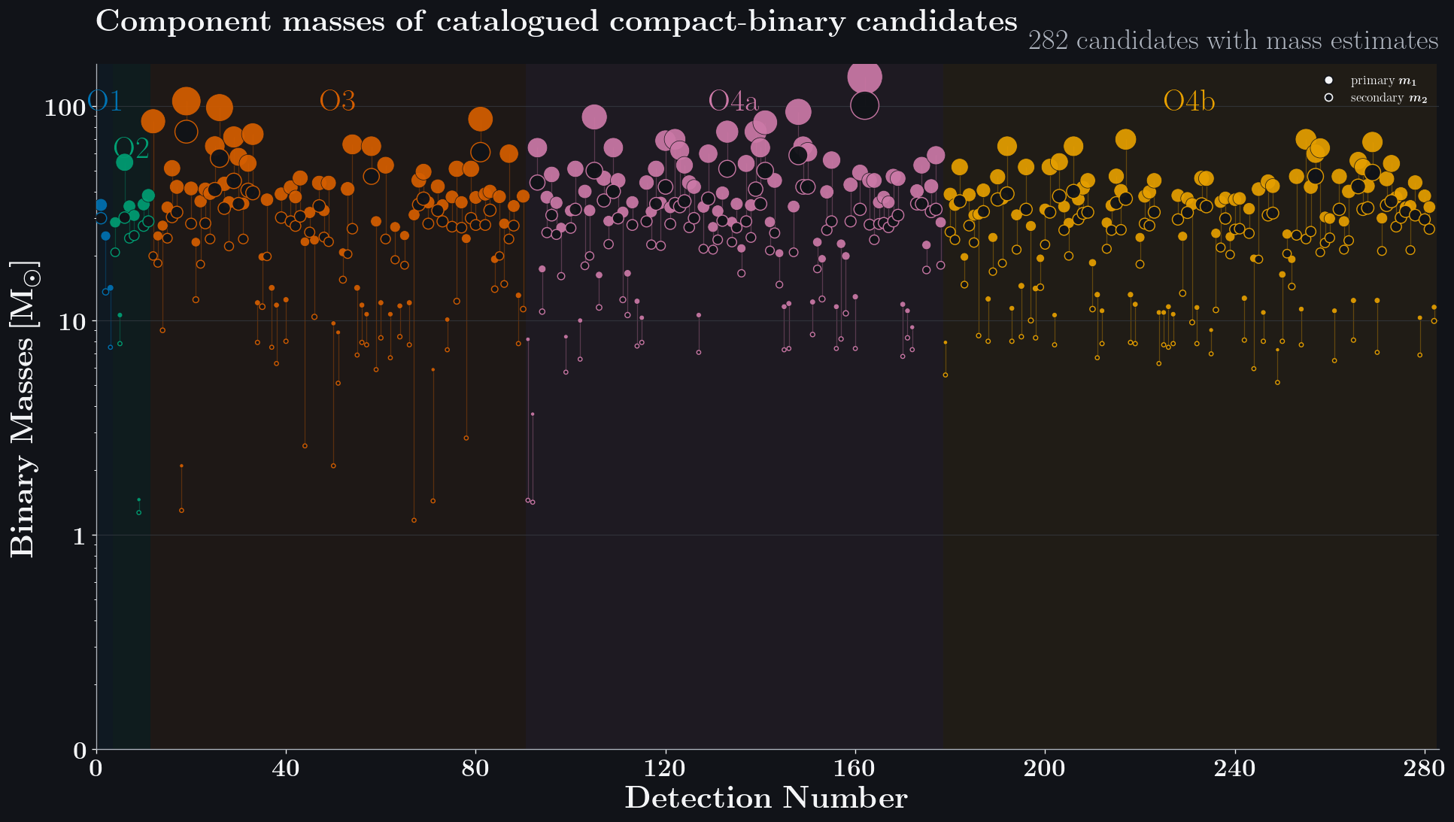
Notes:
After the first detection, LIGO-Virgo-KAGRA collaboration has already 4 long-term observation run.
This figure shows the compact binary events with each component mass up to O4b.
The vertical axis is binary mass, and the horizontal axis is the order of detection.
So far, LVK has reported about 300 gravitational-wave events.

Slide 3
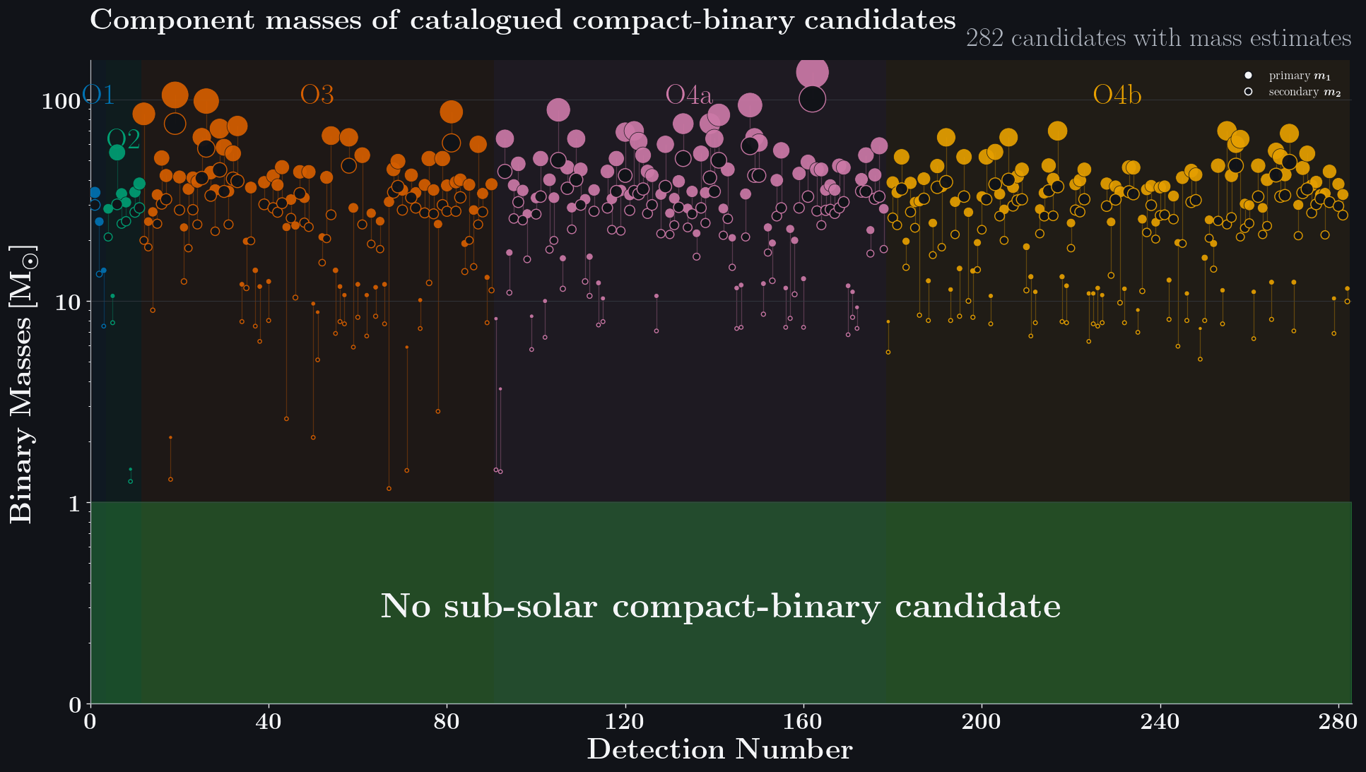
Notes:
However, they have not reported sub-solar compact-binary events so far, even thought 300 events are found.

Slide 4
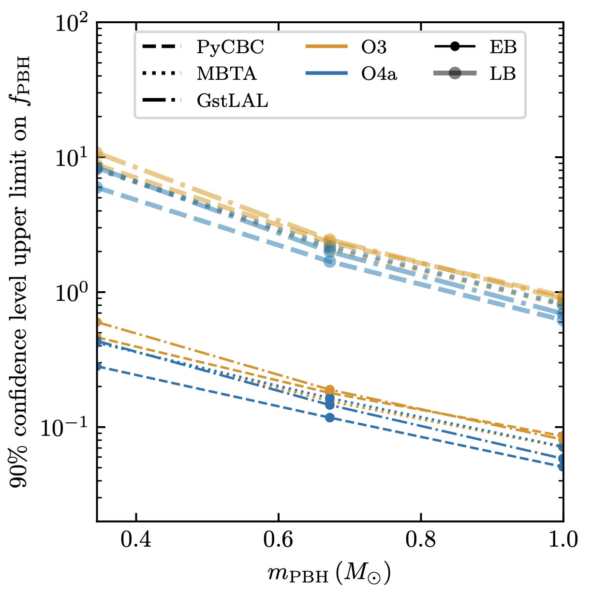
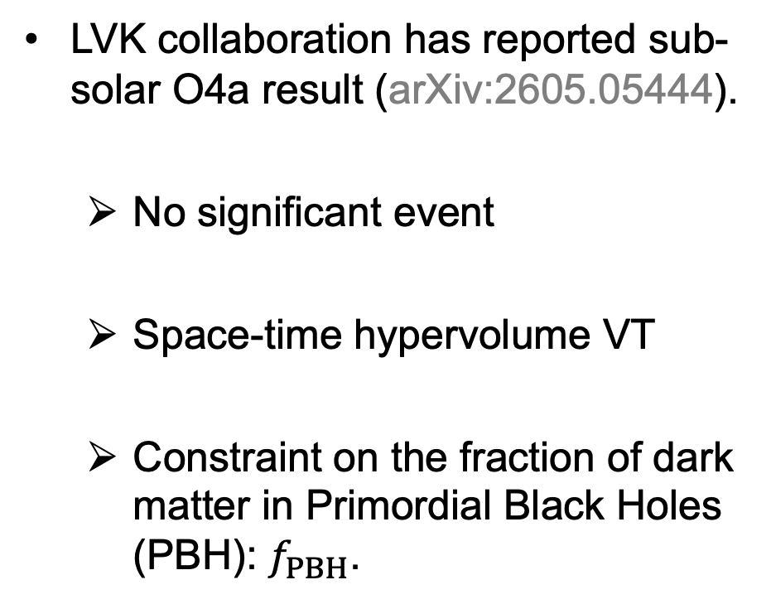
LVK sub-solar search for O4a
LVK collaboration has reported sub-solar O4a result (arXiv:2605.05444).
  No significant event
  Space-time hypervolume VT
  Constraint on the fraction of dark matter in Primordial Black Holes (PBH): $f_{PBH}$.
Credit: LVK collaboration (2026)
Notes:
The LVK has already performed dedicated sub-solar searches, including a recent analysis of O4a data.
Based on the fact that no signal has been detected at the current sensitivities,
LVK estimates the space-time volume, which is written as VT.
This gives an upper limit on the merger rate.
Then, by assuming the primordial black hole binary-formation model, the merger rate limit is converted to the fraction of dark matter in primordial black hole.

Slide 5
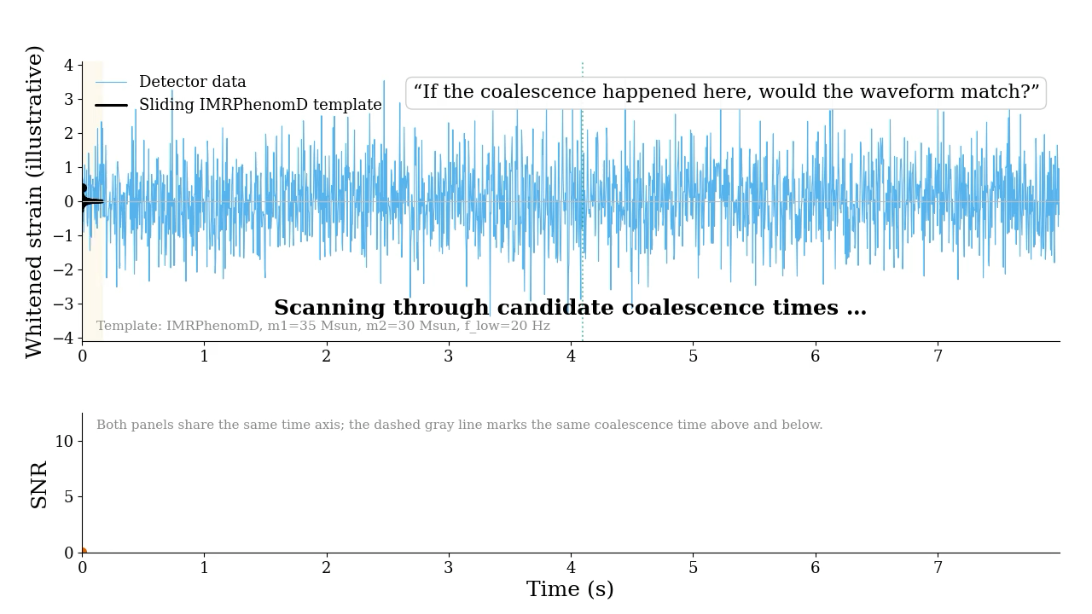
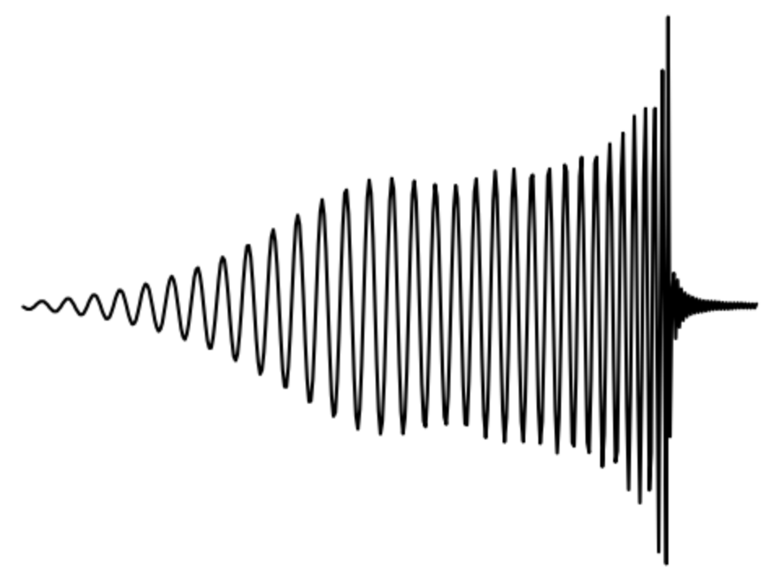
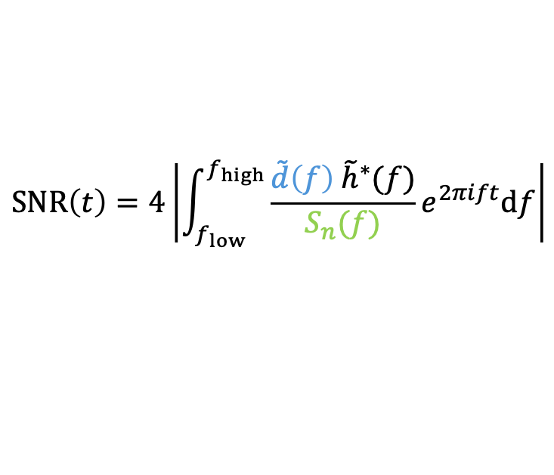
Matched filtering to find Gravitational Waves
$$SNR\left(t\right)=4\left|\int_{f_{low}}^{f_{high}}{\frac{\tilde{d}\left(f\right){ \tilde{h}}^{∗}(f)}{S_{n}(f)}}e^{2πift}df\right|$$
Noise Power Spectral Density (PSD)
Notes:
Gravitational-wave signal is very weak, so we have to extract it from the observational data.
To identify the signal, we use a technique called matched filtering.
The basic idea is to compare theoretical waveforms predicted by general relativity with the observational data.
The output is signal-to-noise ratio, which is called SNR.
If the data contains a signal, matched filtering can visualize it as a peak at a particular time in the SNR.

Slide 6
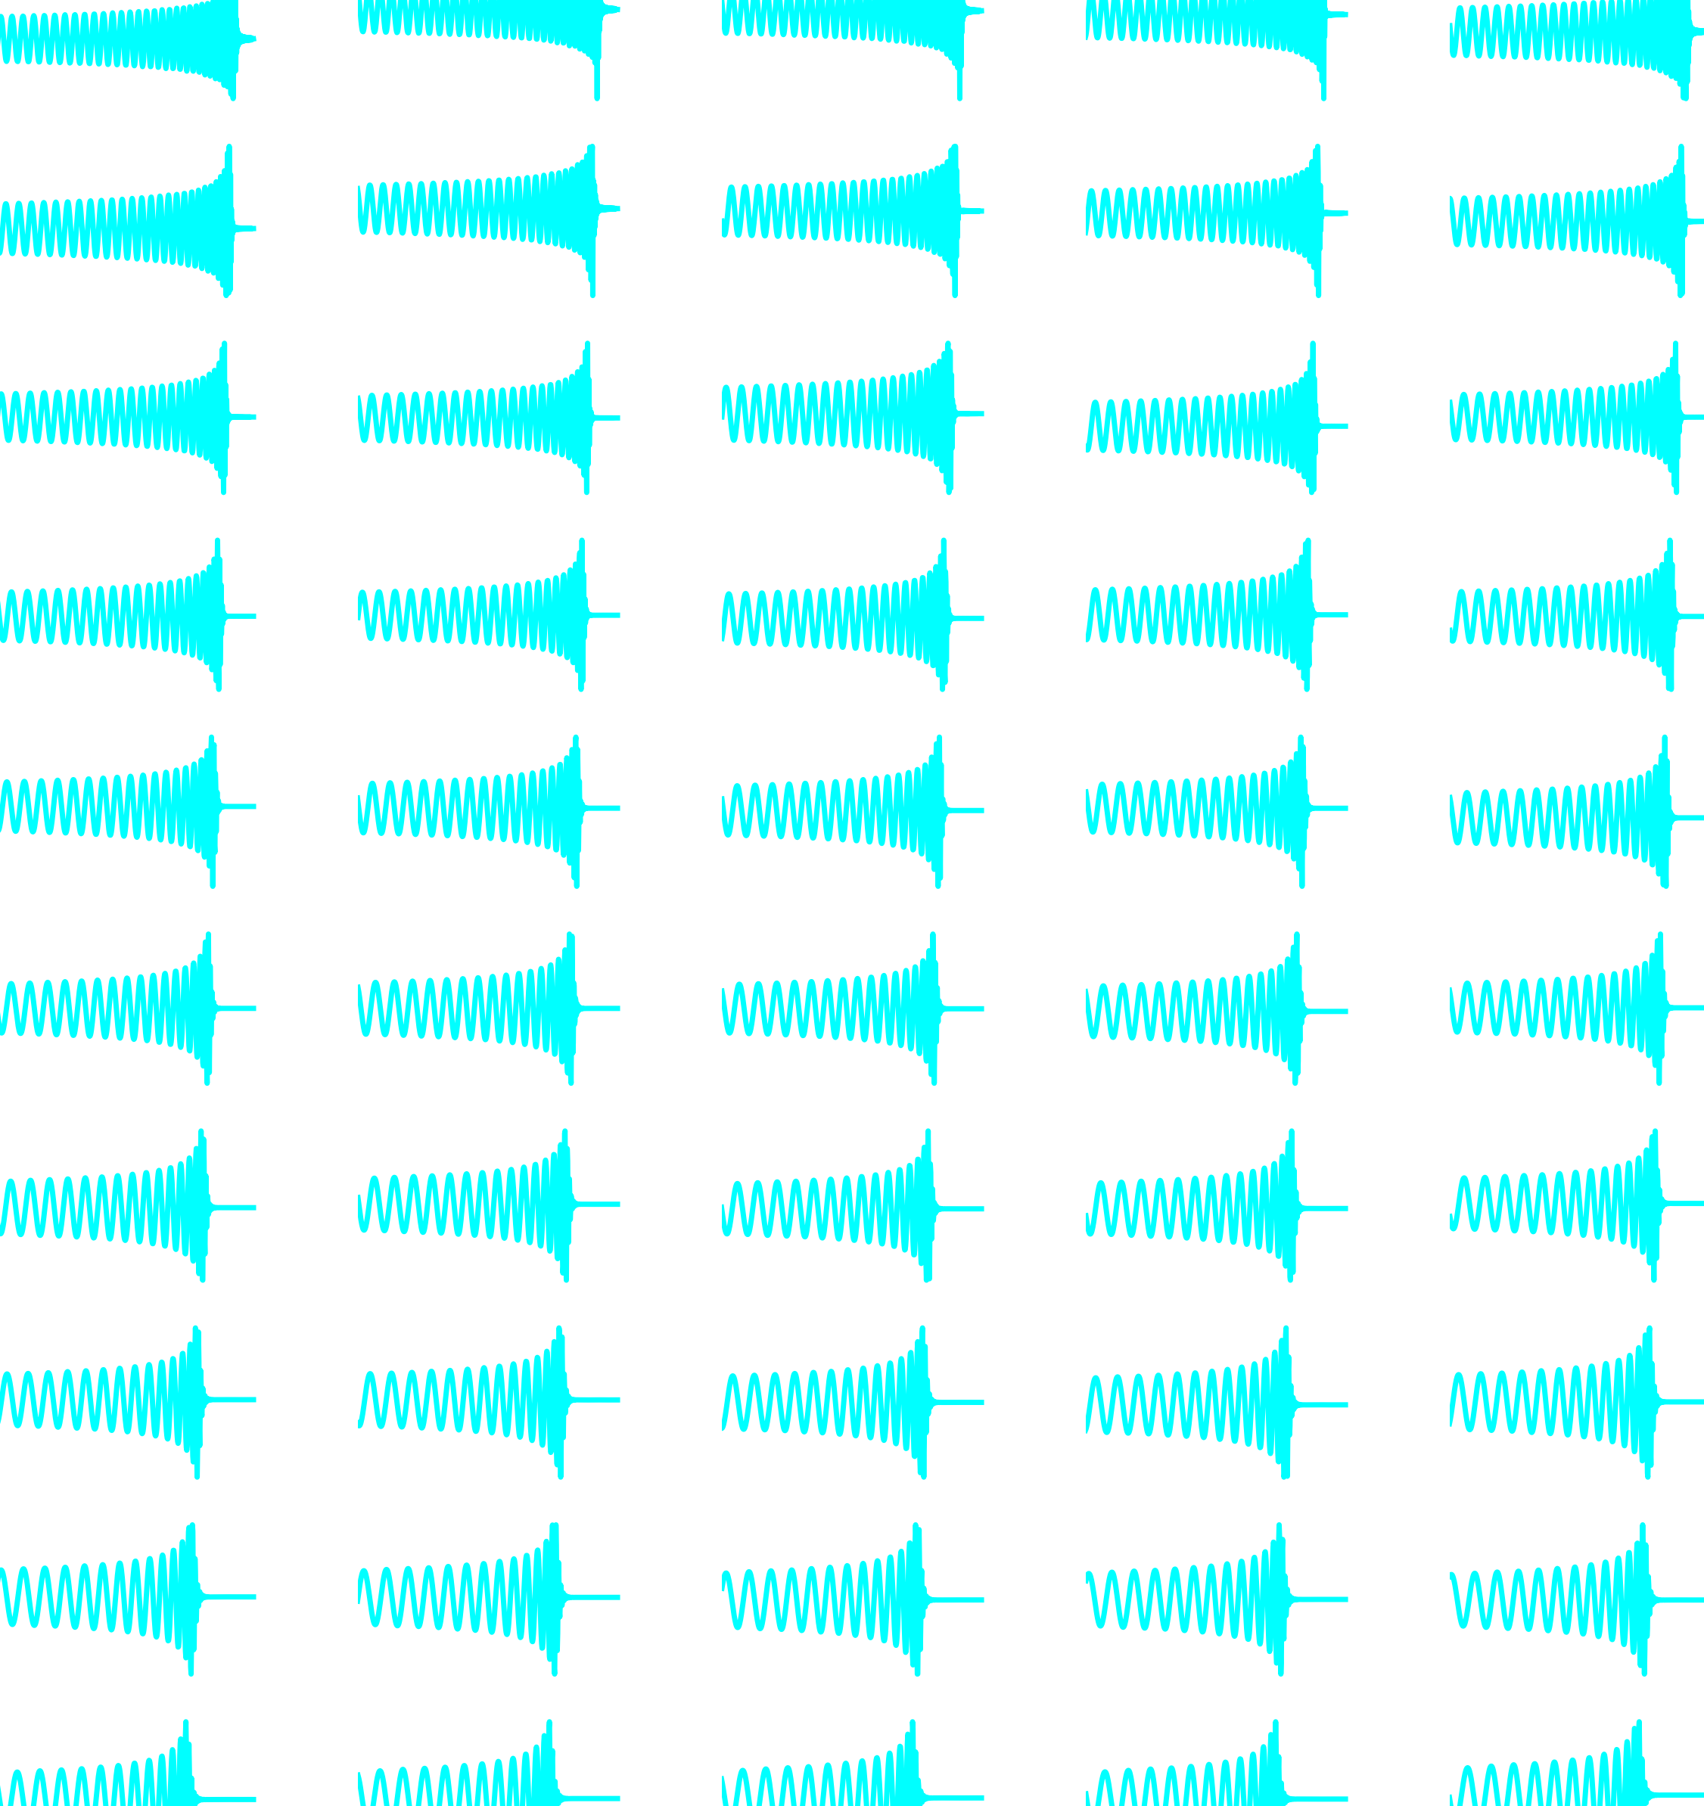
Matched filtering to find Gravitational Waves
Template bank
Repeat for
all templates
$$SNR\left(t\right)=4\left|\int_{f_{low}}^{f_{high}}{\frac{\tilde{d}\left(f\right){ \tilde{h}}^{∗}(f)}{S_{n}(f)}}e^{2πift}df\right|$$
Noise Power Spectral Density (PSD)
Notes:
However, the source mass and spin are not known in advance.
So, we prepare a large template bank and repeat the calculation for every template.

Slide 7
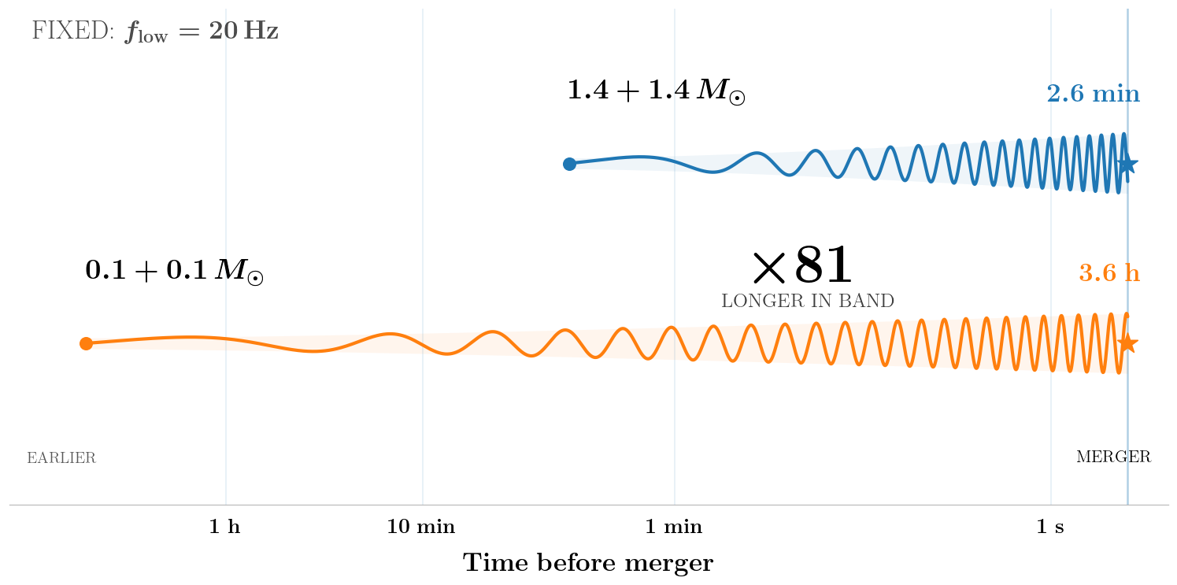
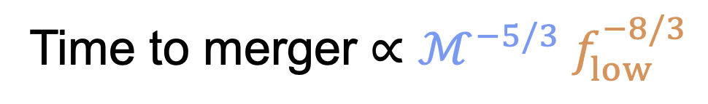
Challenge of sub-solar search
Time to merger $∝ℳ^{−5/3} f_{low}^{−8/3}$
Longer waveform More memory / larger FFT / larger template bank
Notes:
Matched filtering is a powerful search method, but it becomes increasingly difficult as the waveform duration gets longer.
Especially, sub-solar mass waveform is very long.
Basically, the waveform duration is scaled as the chirp mass, which is combination of each mass, and low-frequency cutoff.
For example, at a fixed start 20Hz, 1.4 + 1.4 binary is 2.6 minutes, but 0.1 + 0.1 binary becomes 3.6 hours, approximately 81 times longer.

Slide 8
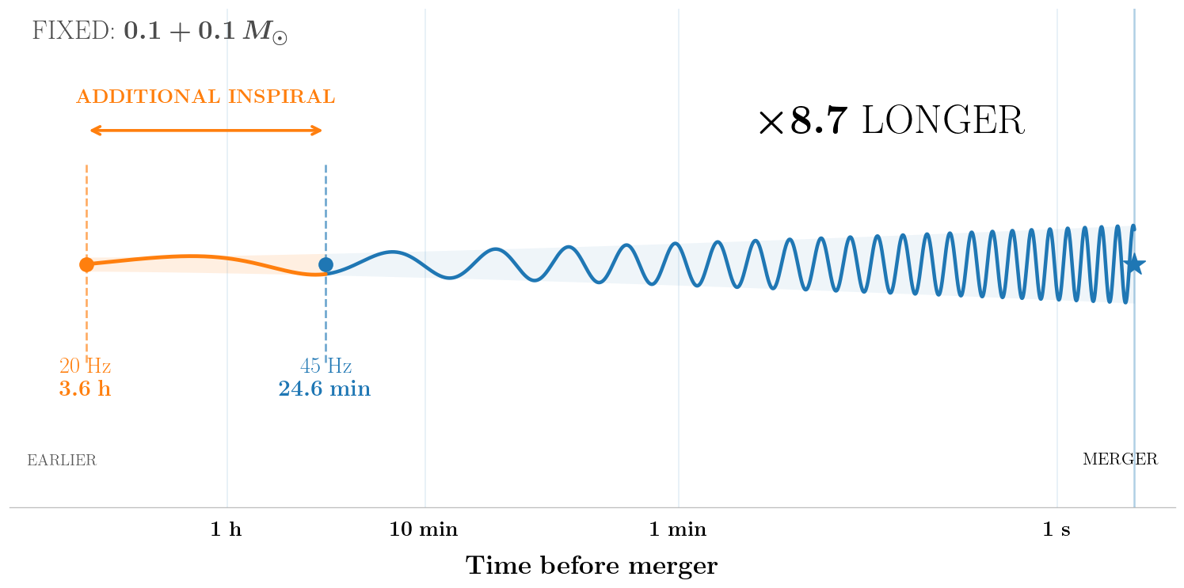
Current searches limit the low-frequency cutoff
Time to merger $∝ℳ^{−5/3} f_{low}^{−8/3}$
Longer $f_{low}$ shorter waveform This leads to a loss of sensitivity.
Notes:
To deal with issues, one practical way to reduce the cost is to increase the low-frequency cutoff.
This is a reasonable to reduce the computational cost, but the removed low-frequency signal contains snr, so this leads to a loss of sensitivity.

Slide 9
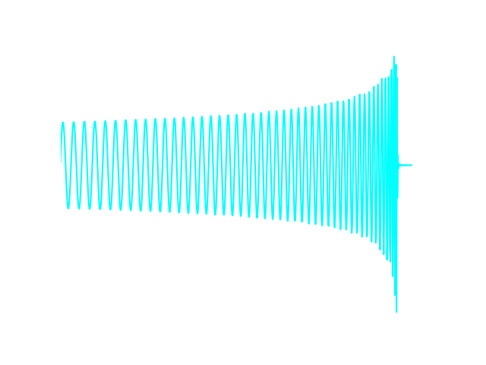
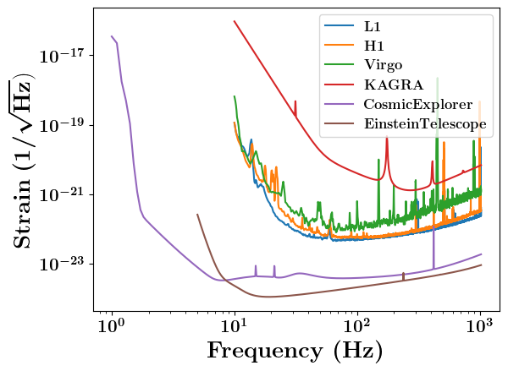
Future detectors will extend their sensitivity to lower frequency
1 Hz
20 Hz
Longer waveforms are inevitable
in future detectors.
Notes:
Furthermore, future detectors will extend their sensitivity toward lower frequency.
In the current search, we can search from 20 Hz, but Cosmic explorer and Einstein Telescope can reach a few Hz.
This makes long waveforms inevitable in future analyses.
However, if you were to rely on the same strategy which increases low-frequency cutoff, you could inevitably loss the low-frequency information that future detectors cover.

Slide 10
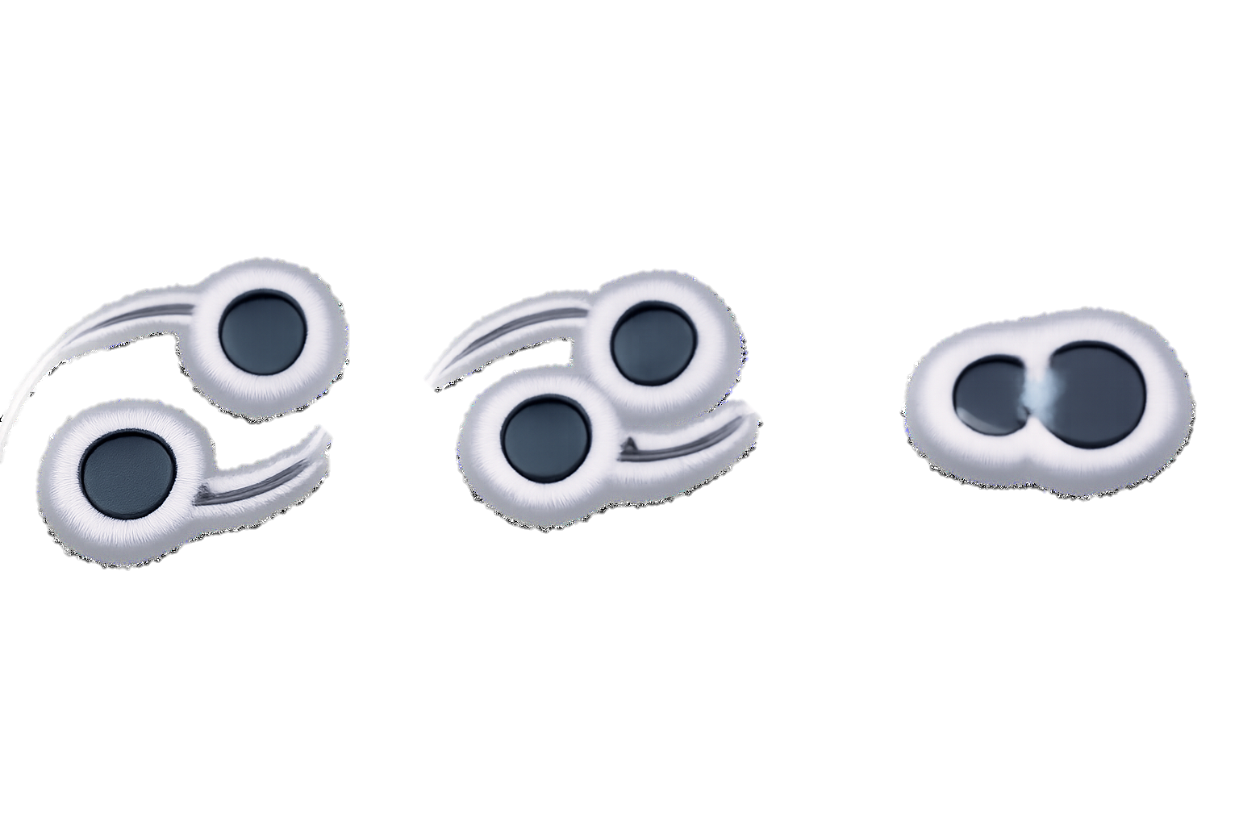

OUR APPROACH: RATIO FILTER
(PRD:113, 064006 (2026))
SCAN ME
Notes:
So far, I’ve discussed why long waveforms are unavoidable and why existing approaches are insufficient.
Now, let me introduce our approach, which we call the ratio filter.
I’ll explain the basic concept and its performance in the following slides, and the full details can be found in the paper linked here.

Slide 11
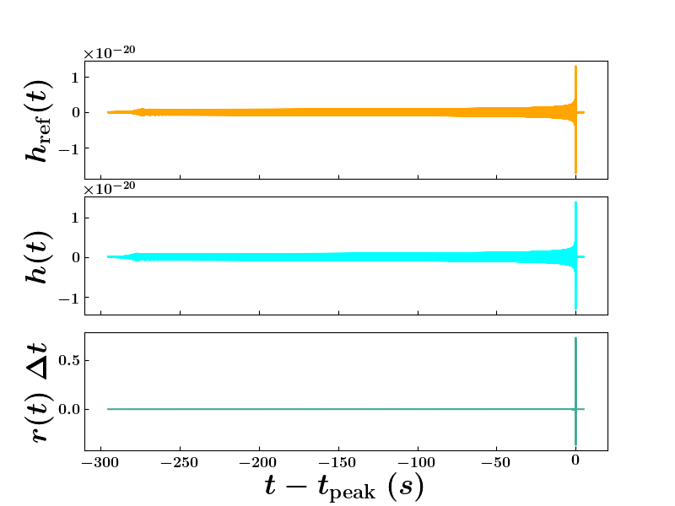
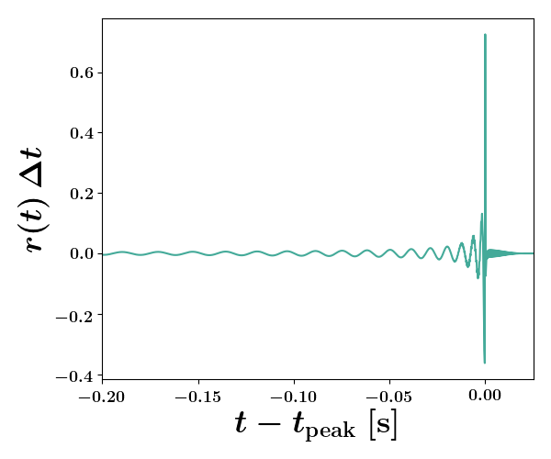
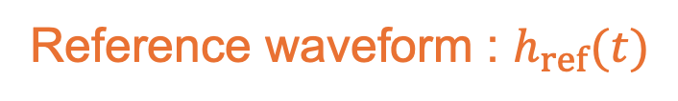
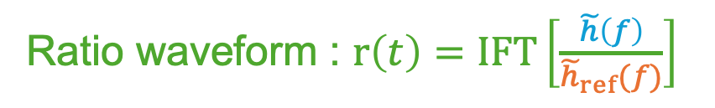
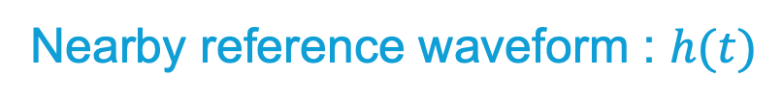
The ratio waveform is as long as the duration difference
Reference waveform : $h_{ref}(t)$
Nearby reference waveform : $h(t)$
Ratio waveform : $r\left(t\right)=IFT\left[\frac{\tilde{h}\left(f\right)}{{\tilde{h}}_{ref}(f)}\right]$
Heterodyning / relative binning
[Cornish 2010; Zackay+ 2018]

Slide 12
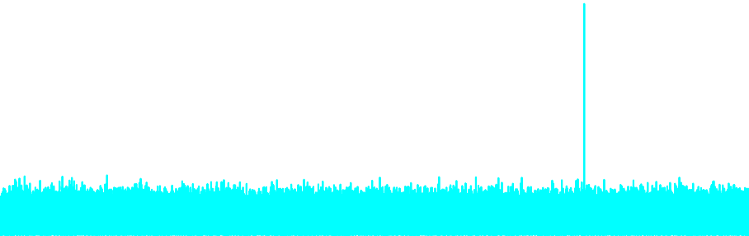
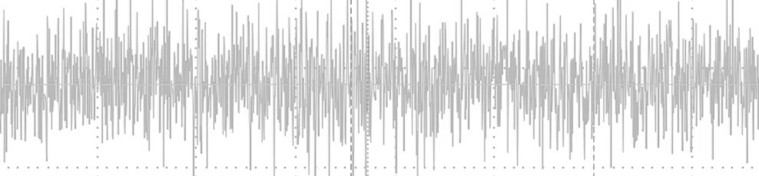

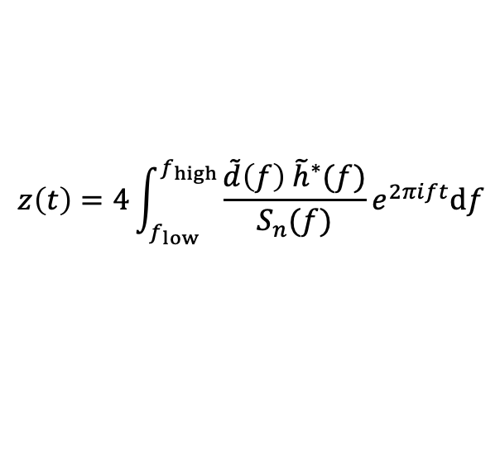


Conventional matched filtering
Detector data
Waveform
Matched-filter SNR
$$d\left(t\right)$$
$$h(t)$$
$$z\left(t\right)$$
×
Time
Time
$$z\left(t\right)=4\int_{f_{low}}^{f_{high}}{\frac{\tilde{d}\left(f\right){ \tilde{h}}^{∗}(f)}{S_{n}(f)}}e^{2πift}df$$
Full matched filtering for all waveforms
all waveforms
Notes:
For this reference waveform, we perform the full matched filtering calculation.
Then, for the nearby waveforms, we do not repeat the full matched filtering.
Instead, we can reconstruct the new SNRs for nearby waveforms utilizing the precomputed reference SNR.
In other words, we significantly reduce the number of times we need to compute and handle the full waveform.
Full matched filtering is required only for the reference waveforms.

Slide 13

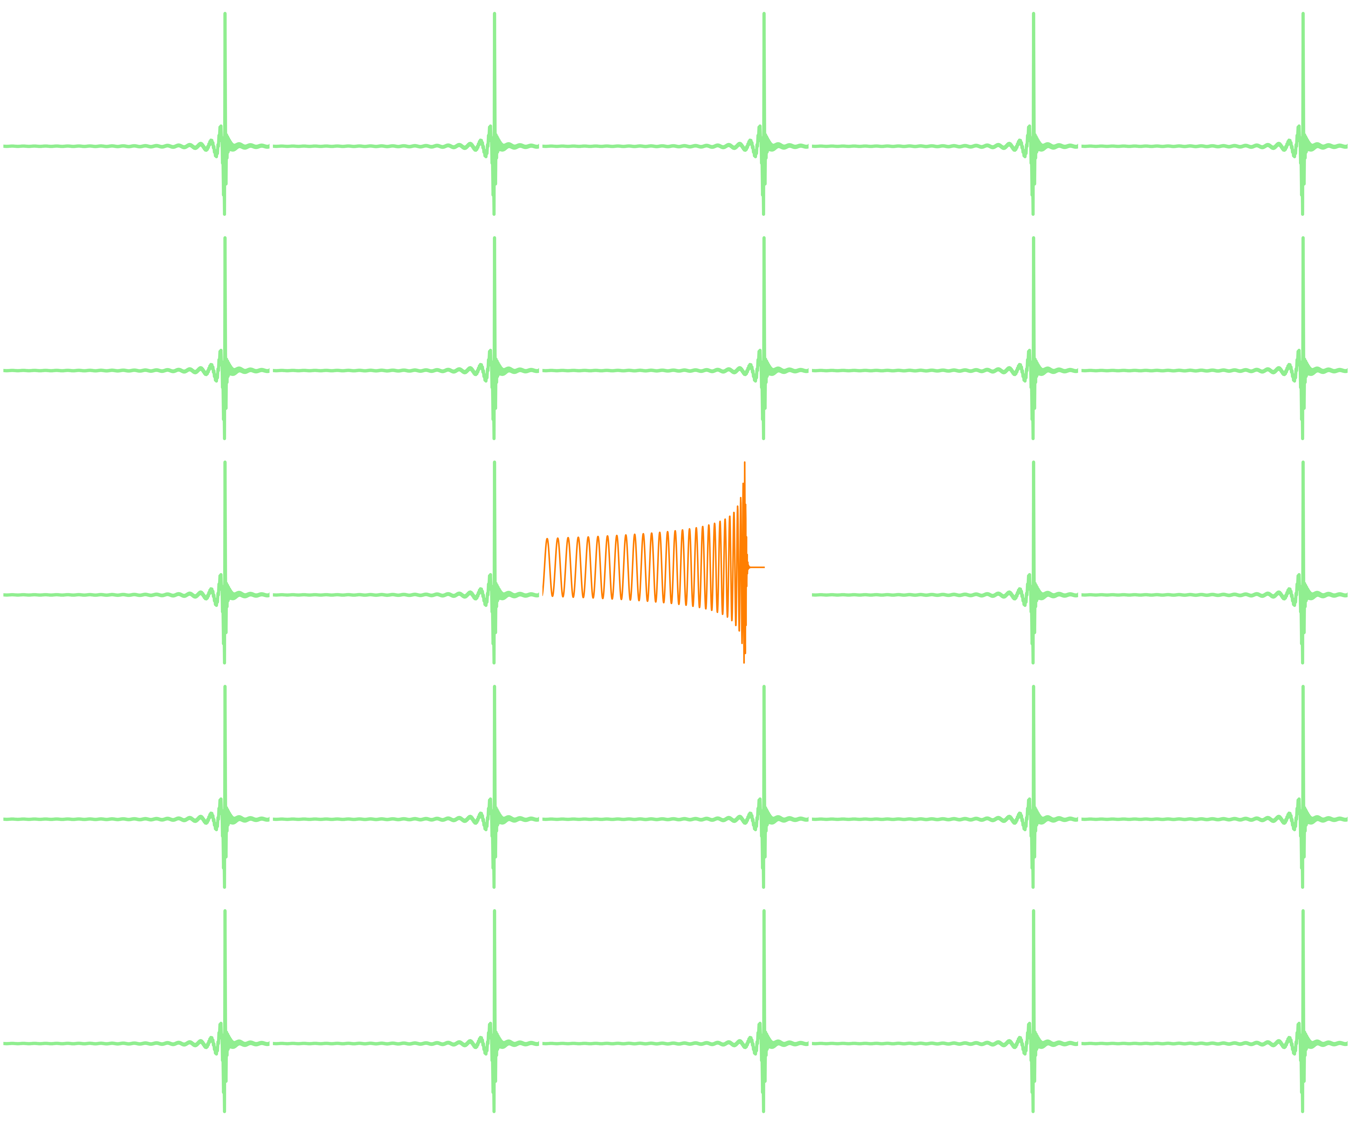
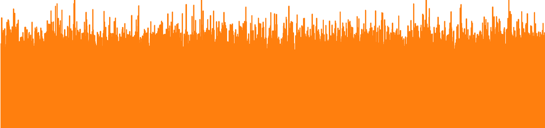

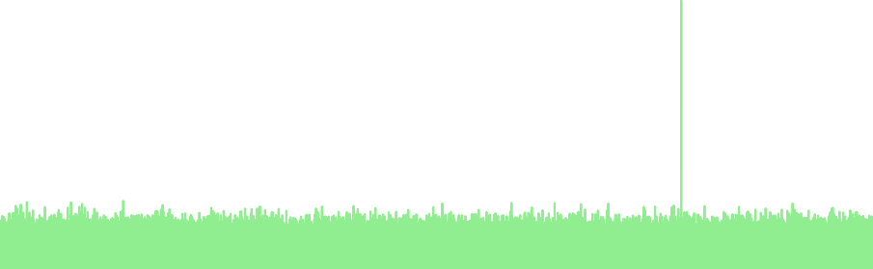
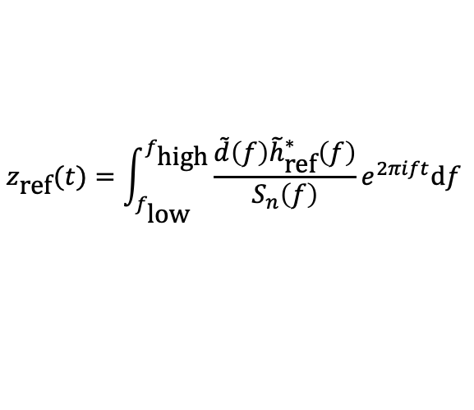



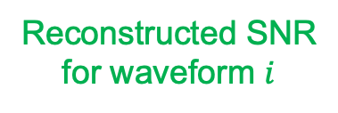


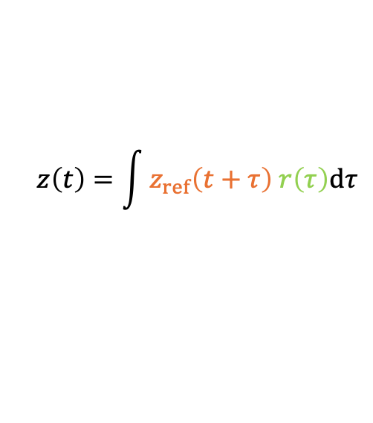

Reusing one reference SNR for nearby waveform
Detector data
Reference waveform
Reference matched-filter SNR
$$d\left(t\right)$$
$$h_{ref}(t)$$
$$z_{ref}\left(t\right)$$
×
Time
Time
$$z_{\text{ref}}(t)=\int_{f_{\text{l}\text{ow}}}^{f_{\text{high}}}{\frac{\tilde{d}\left(f\right){\tilde{h}}_{\text{ref}}^{∗}\left(f\right)}{S_{n}\left(f\right)}e^{2πift}\text{d}f}$$
reference waveform
Ratio waveform for waveform $i$
Reconstructed SNR for waveform $i$
$$r_{i}\left(t\right)$$
short in time
$$z_{i}\left(t\right)$$
nearby waveforms
Time
$$z\left(t\right)=\int{z_{ref}\left(t+τ\right) r\left(τ\right)dτ}$$
One full matched filtering, many short reconstructions
Time
Notes:
For this reference waveform, we perform the full matched filtering calculation.
Then, for the nearby waveforms, we do not repeat the full matched filtering.
Instead, we can reconstruct the new SNRs for nearby waveforms utilizing the precomputed reference SNR.
In other words, we significantly reduce the number of times we need to compute and handle the full waveform.
Full matched filtering is required only for the reference waveforms.

Slide 14
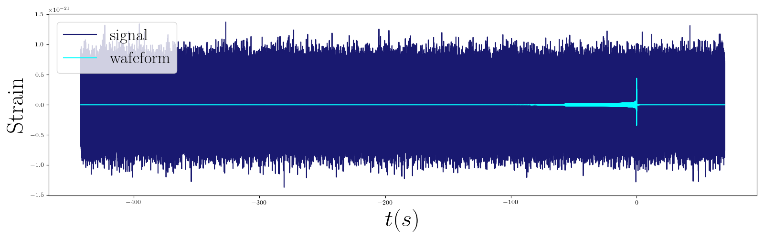
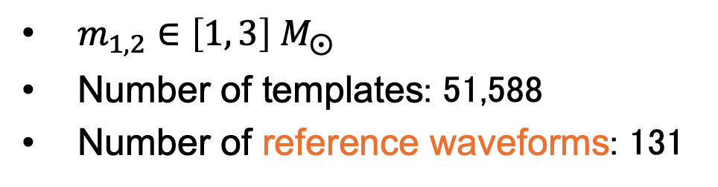
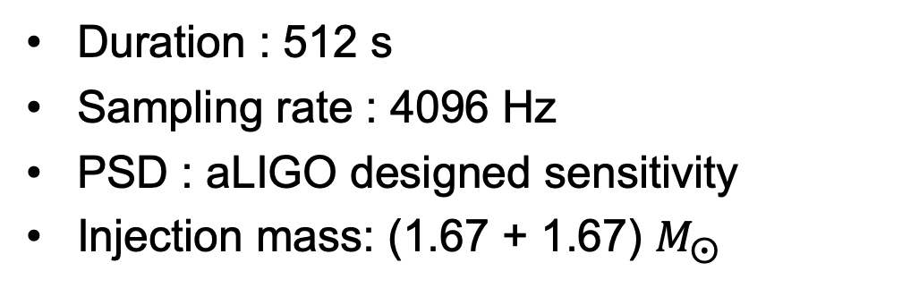


Ratio filter on simulated data
Non-spinning template bank
Subset 1
Subset 2
$m_{1,2}∈\left[1, 3\right] M_{⨀}$
Number of templates: 51,588
Number of reference waveforms: 131
$$h_{ref,1}(t)$$
$$h_{ref,2}(t)$$
…
…
Simulation data
Duration : 512 s
Sampling rate : 4096 Hz
PSD : aLIGO designed sensitivity
Injection mass: (1.67 + 1.67) $M_{⨀}$

Slide 15
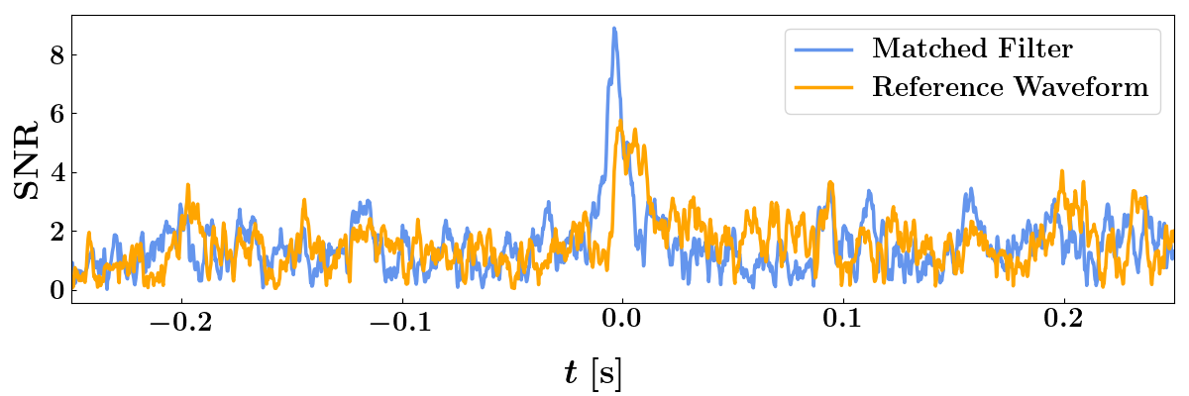
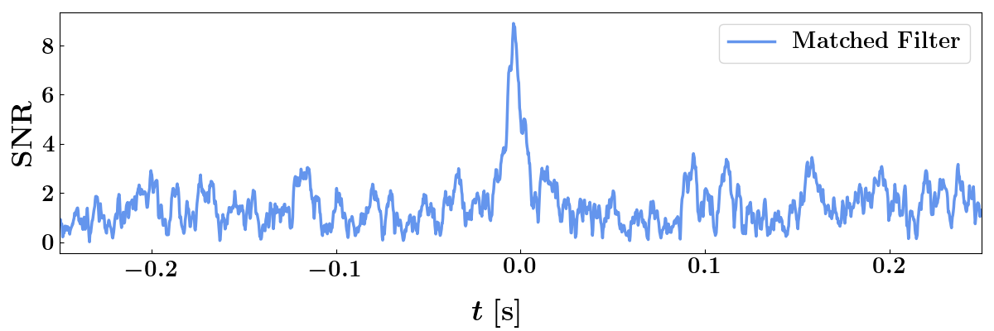
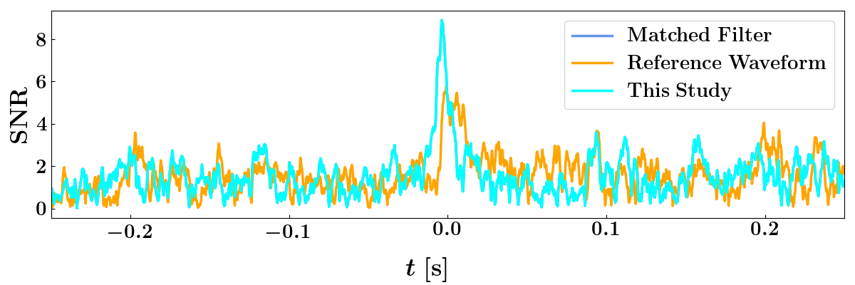
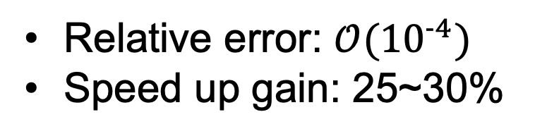
SNR time series for the loudest template
Relative error: $𝒪({10}^{−4})$
Speed up gain: 25~30%
Notes:
Here are the results of our mock data test.
This line is standard matched filtering for the loudest template.
The orange one is SNR for reference waveform.
This reference waveform corresponds to the group that contains the loudest template among its nearby templates.
Using ratio filter, we get the cyan line.
As you can see, the cyan line completely overlaps the standard one.
At least, there is no visible difference between them.
This means that our ratio filter reproduces the SNR time series with excellent accuracy.

Slide 16
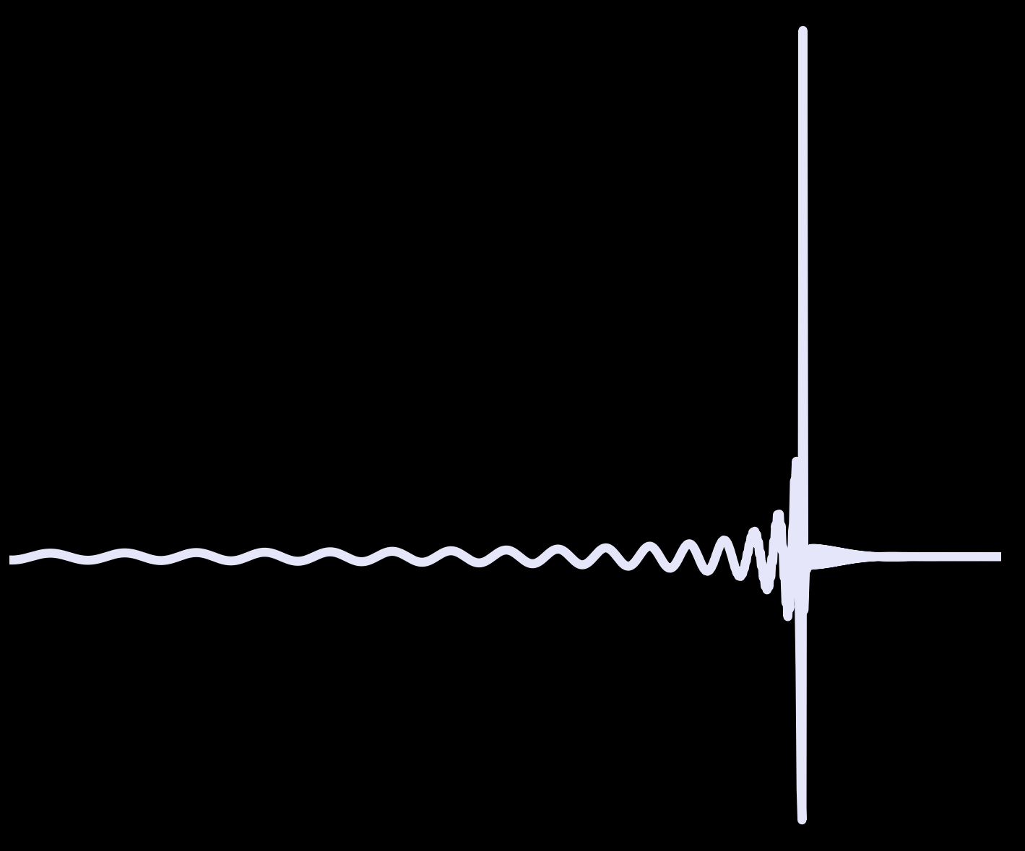
REAL DATA TEST
Notes:
So far, I’ve introduced the method,
From this slide, let me demonstrate how it works in practice.

Slide 17
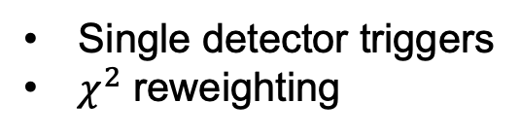
Where the ratio filter enters the pipeline
Data preparing
Conventional search
Input strain
Conditioning & PSD
Full matched filtering for all templates
Ratio filter search
Reference filter
Ratio construction
Check the consistency of the true trigger
Trigger selection
Single detector triggers
$χ^{2}$ reweighting
Multi-detector search
H1-L1 coincidence
Time-slide background

Slide 18
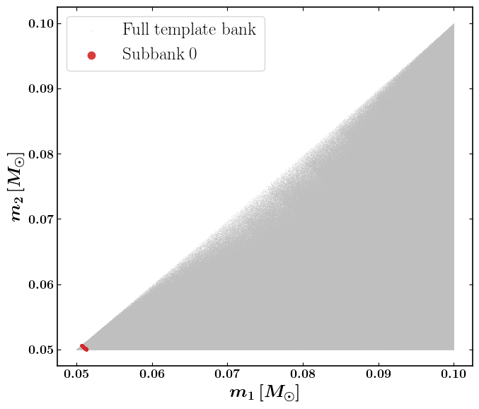
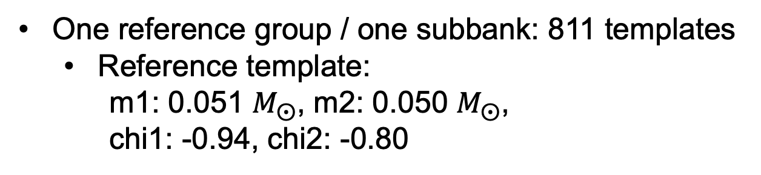
First real-data demonstration: one subbank
One reference group / one subbank: 811 templates
  Reference template:
    m1: 0.051 $M_{⨀}$, m2: 0.050 $M_{⨀}$,
    chi1: -0.94, chi2: -0.80
LIGO Livingston and Hanford during O1
  H1: 2015-09-12 05:51:43 ～ 2015-11-10 16:38:07 (live time: 34.3 days)
  L1: 2015-09-12 04:43:27 ～ 2015-11-24 03:45:51 (live time: 36.8 days)
No candidate

Slide 19
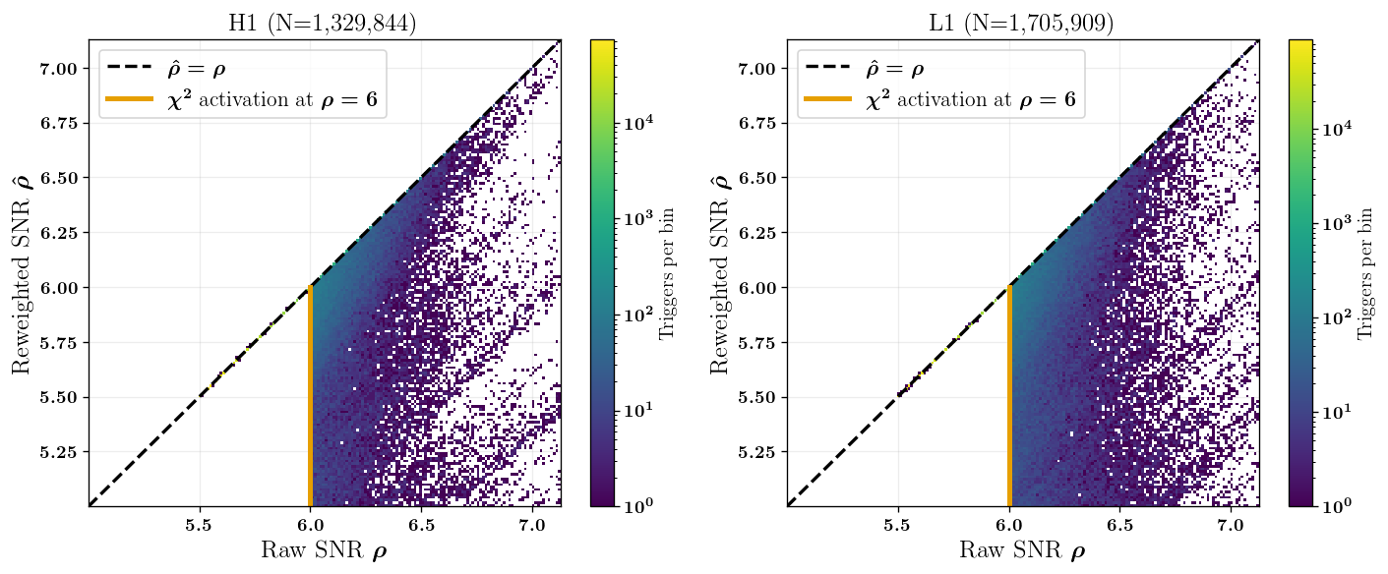

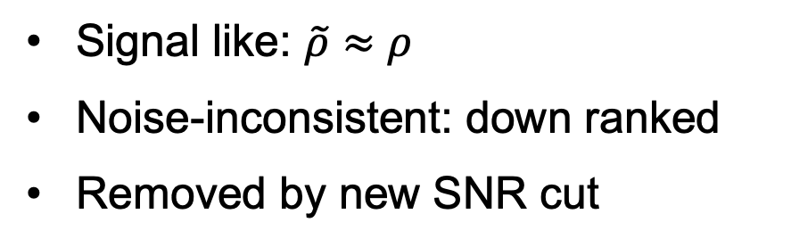
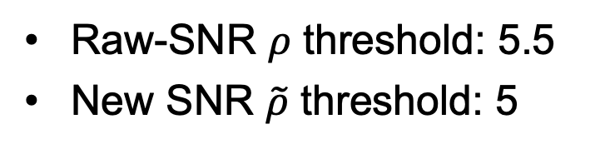
$χ^{2}$ down-ranks inconsistent triggers
$p=$ the degree of freedom
Signal like: $\tilde{ρ}≈ρ$
Noise-inconsistent: down ranked
Removed by new SNR cut
Raw-SNR $ρ$ threshold: 5.5
New SNR $\tilde{ρ}$ threshold: 5

Slide 20
Conclusions
The problem
Sub-solar and future-detector signals are very long
The method
One reference matched filter + short ratio convolutions (ratio filter)
The result
Accurate SNR reconstruction + first real-data subbank analysis
Future work
Complete the search for sub-solar mass region and find sub-solar mass candidates or constraint on the existence of PBH

Slide 22
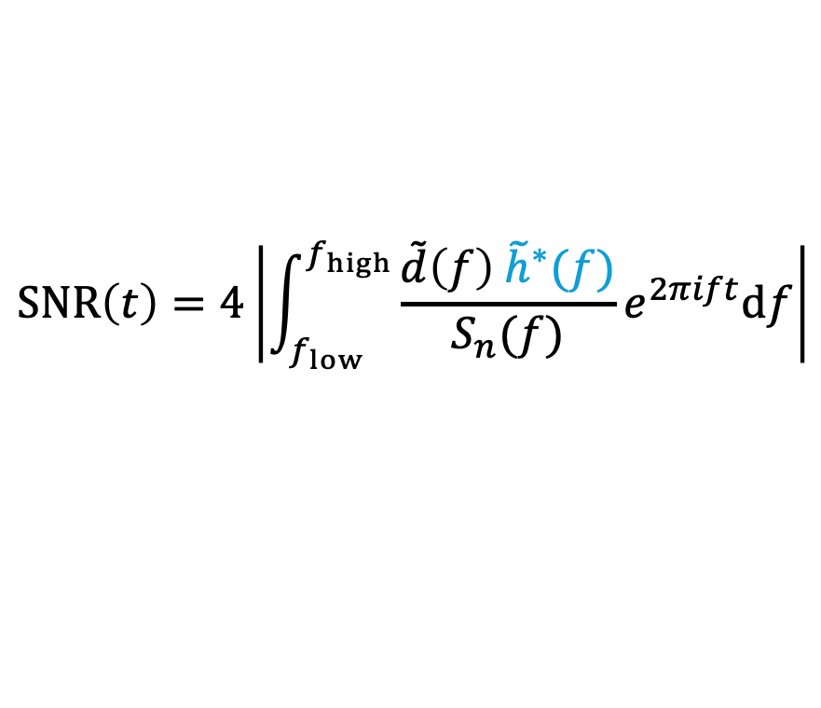
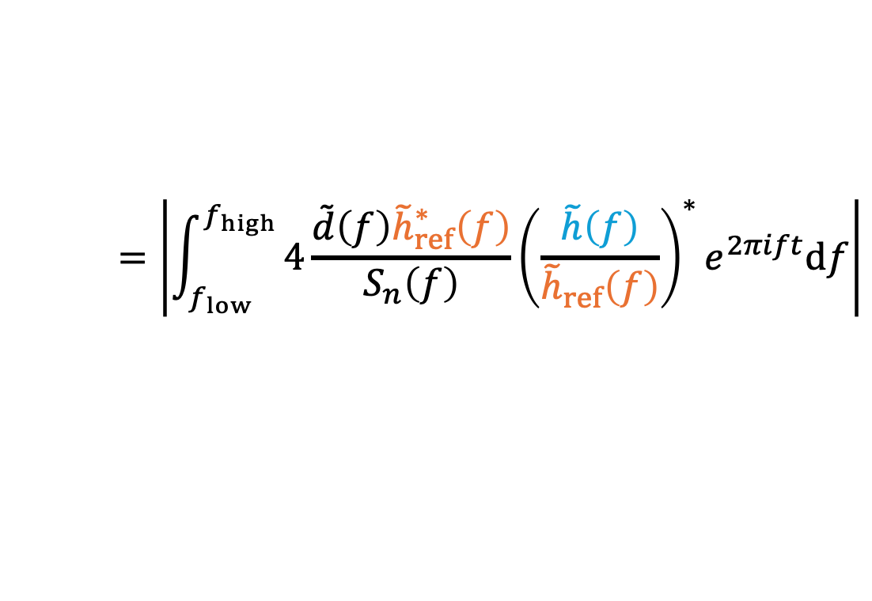
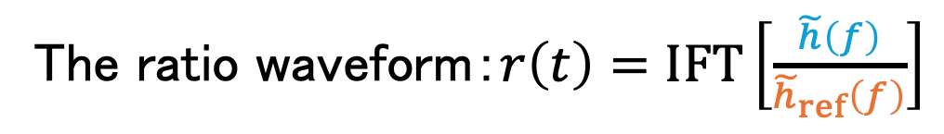
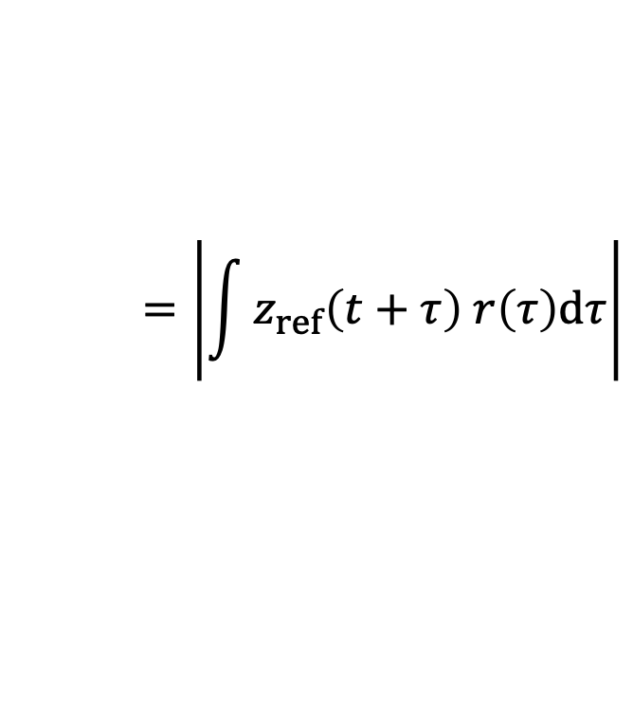
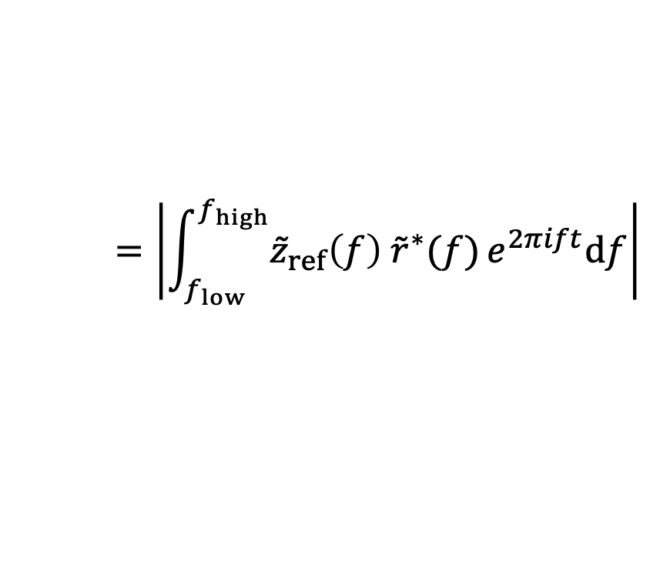
Ratio filter: reconstructs the new SNR via convolving with the reference SNR
$$SNR\left(t\right)=4\left|\int_{f_{low}}^{f_{high}}{\frac{\tilde{d}\left(f\right){ \tilde{h}}^{∗}(f)}{S_{n}(f)}}e^{2πift}df\right|$$
SNR for nearby waveform
$$=\left|\int_{f_{low}}^{f_{high}}{4\frac{\tilde{d}\left(f\right){\tilde{h}}_{ref}^{∗}\left(f\right)}{S_{n}\left(f\right)}{\left(\frac{\tilde{h}\left(f\right)}{{\tilde{h}}_{ref}\left(f\right)}\right)}^{∗}e^{2πift}df}\right|$$
$$=\left|\int_{f_{low}}^{f_{high}}{{\tilde{z}}_{ref}\left(f\right) {\tilde{r}}^{∗}(f)}e^{2πift}df\right|$$
The ratio waveform：$r\left(t\right)=\text{IFT}\left[\frac{\tilde{h}\left(f\right)}{{\tilde{h}}_{ref}\left(f\right)}\right]$
$$=\left|\int{z_{ref}\left(t+τ\right) r\left(τ\right)dτ}\right|$$
SNR for the reference waveform
Notes:
So, using the ratio waveform I introduced earlier, we can compute the SNR for nearby waveforms by using the SNR of the reference waveform.
This involves only a simple algebraic rearrangement.
We start from the standard matched filtering, which gives the SNR for the nearby template.
In the next line, we insert the reference waveform.
By adding h_ref in this way, the integral can be rewritten as the product of two terms, one that represents the SNR in frequency domain on the reference waveform, and another that corresponds to the ratio waveform.
Since the product in frequency domain corresponds to convolution, this can also be rewritten as the final line.
Using the relation, we fully analyze only the reference waveforms.
And we can obtain the SNR time series for all neighboring templates instead of performing full matched filtering on every template.

Slide 23
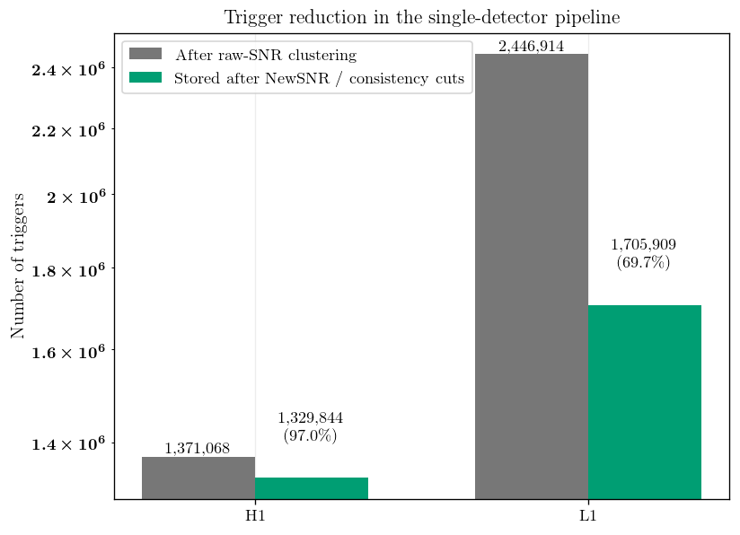
The number of triggers

