Slide 1




First Light with the Protoype Schwarzschild-Couder Telescope’s Upgraded Camera
Zachary Curtis-Ginsberg, UW-Madison
On behalf of the CTAO-SCT Collaboration and the CTAO Consortium
TeVPA 2026, Tendo, Japan
September 2nd, 2026

Slide 2

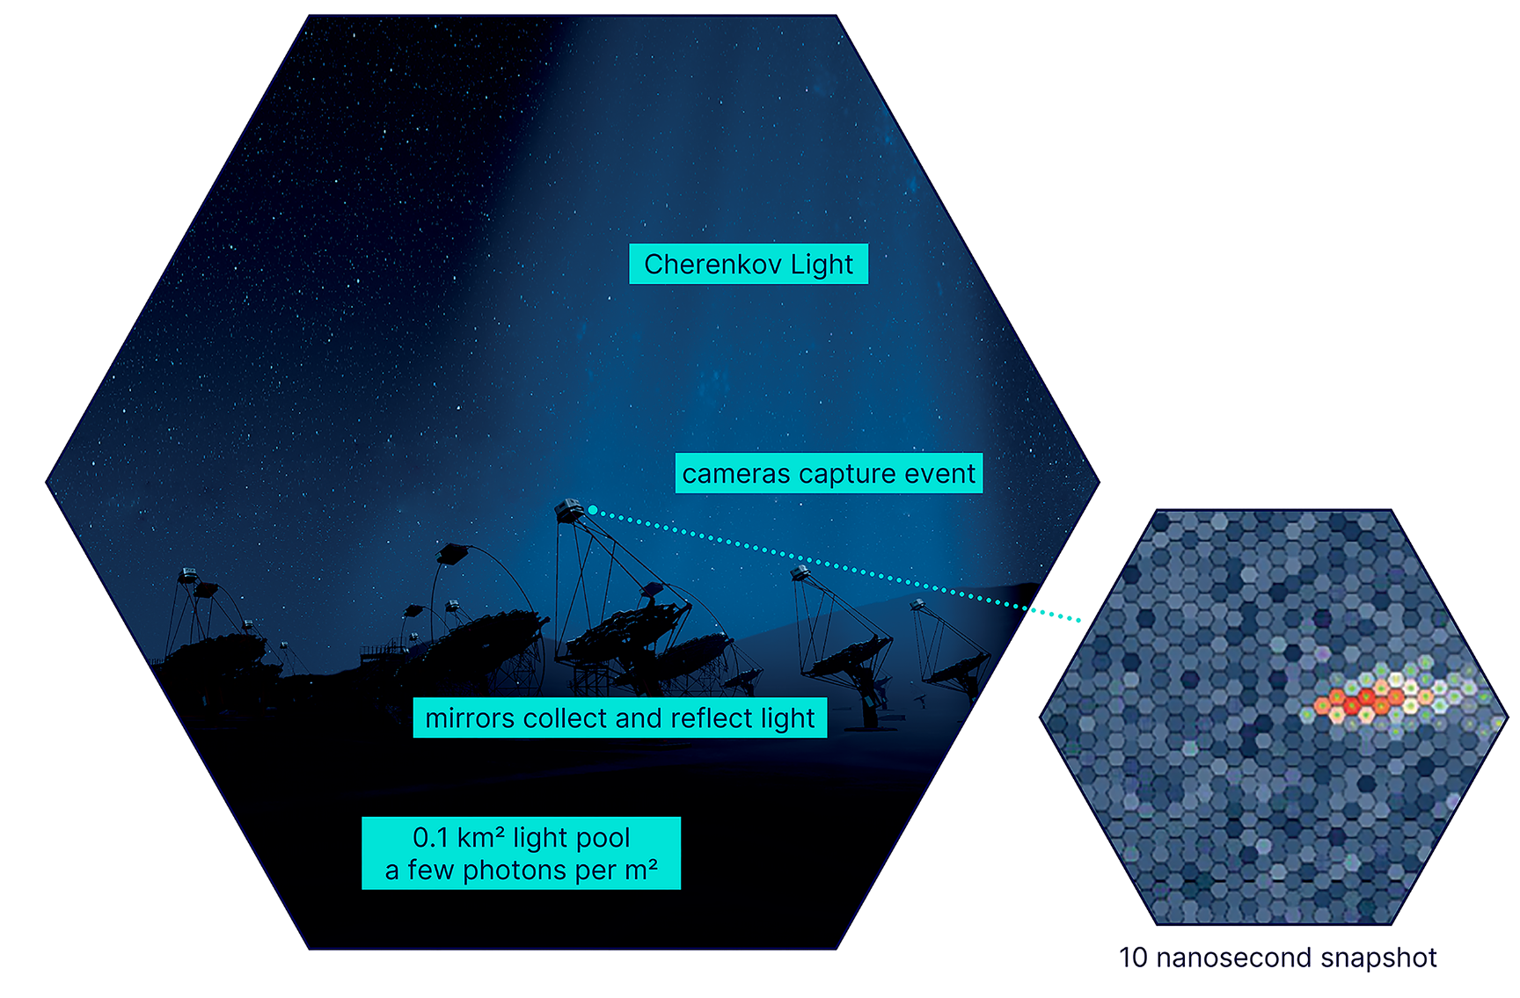
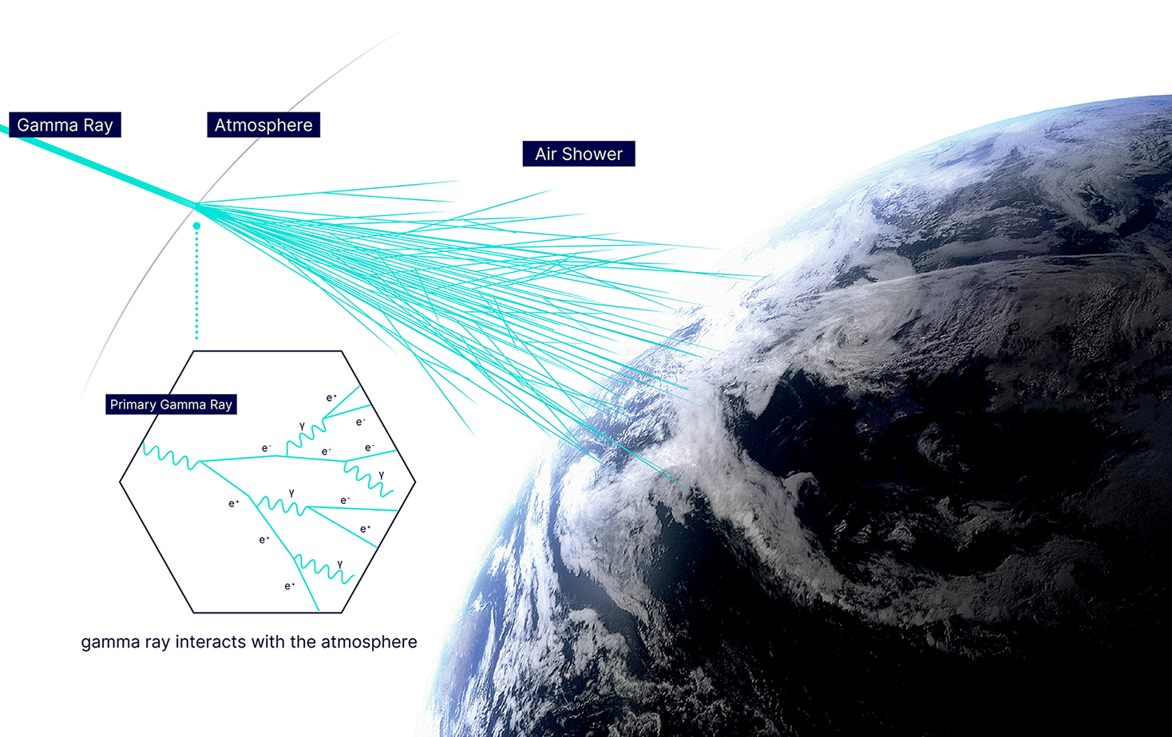
Imaging Atmospheric
Cherenkov Telescopes
Zach Curtis-Ginsberg, pSCT First Light, 9/2/26
Imaging atmospheric Cherenkov telescopes (IACTs) detect Cherenkov light from extensive air showers
Those images are used to reconstruct the incident gamma rays (and cosmic rays)

Slide 3
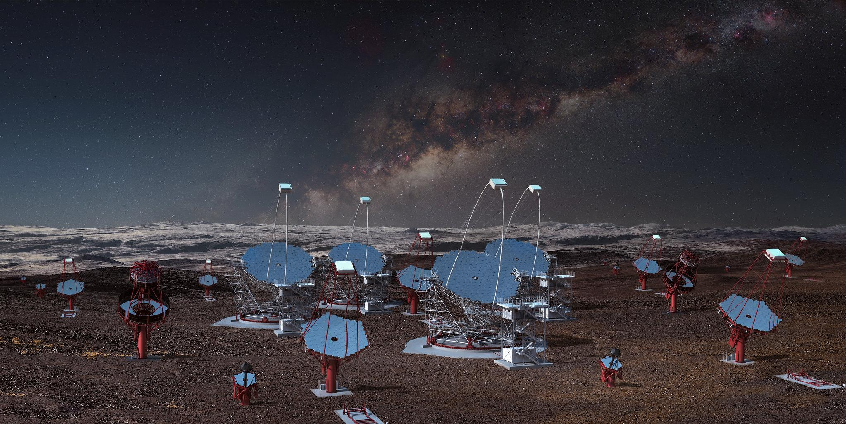
CTAO
Zach Curtis-Ginsberg, pSCT First Light, 9/2/26
Cherenkov Telescope Array Observatory
  Next generation gamma-ray observatory
Full sky coverage
  Two IACT arrays: La Palma, Spain & Paranal, Chile
20 GeV to 300 TeV energy range
  Large-Sized Telescope (LST): 20 GeV to 3 TeV
  Medium-Sized Telescope (MST): 80 GeV to 50 TeV
  Small-Sized Telescope (SST): 2 TeV to 300 TeV
Both arrays under construction

Slide 4
SCT
Zach Curtis-Ginsberg, pSCT First Light, 9/2/26
Schwarzschild-Couder Telescope (SCT)
Medium-sized dual mirror telescope
Dual-mirror design improves point spread function across the entire field of view, enabling better angular resolution

Slide 5
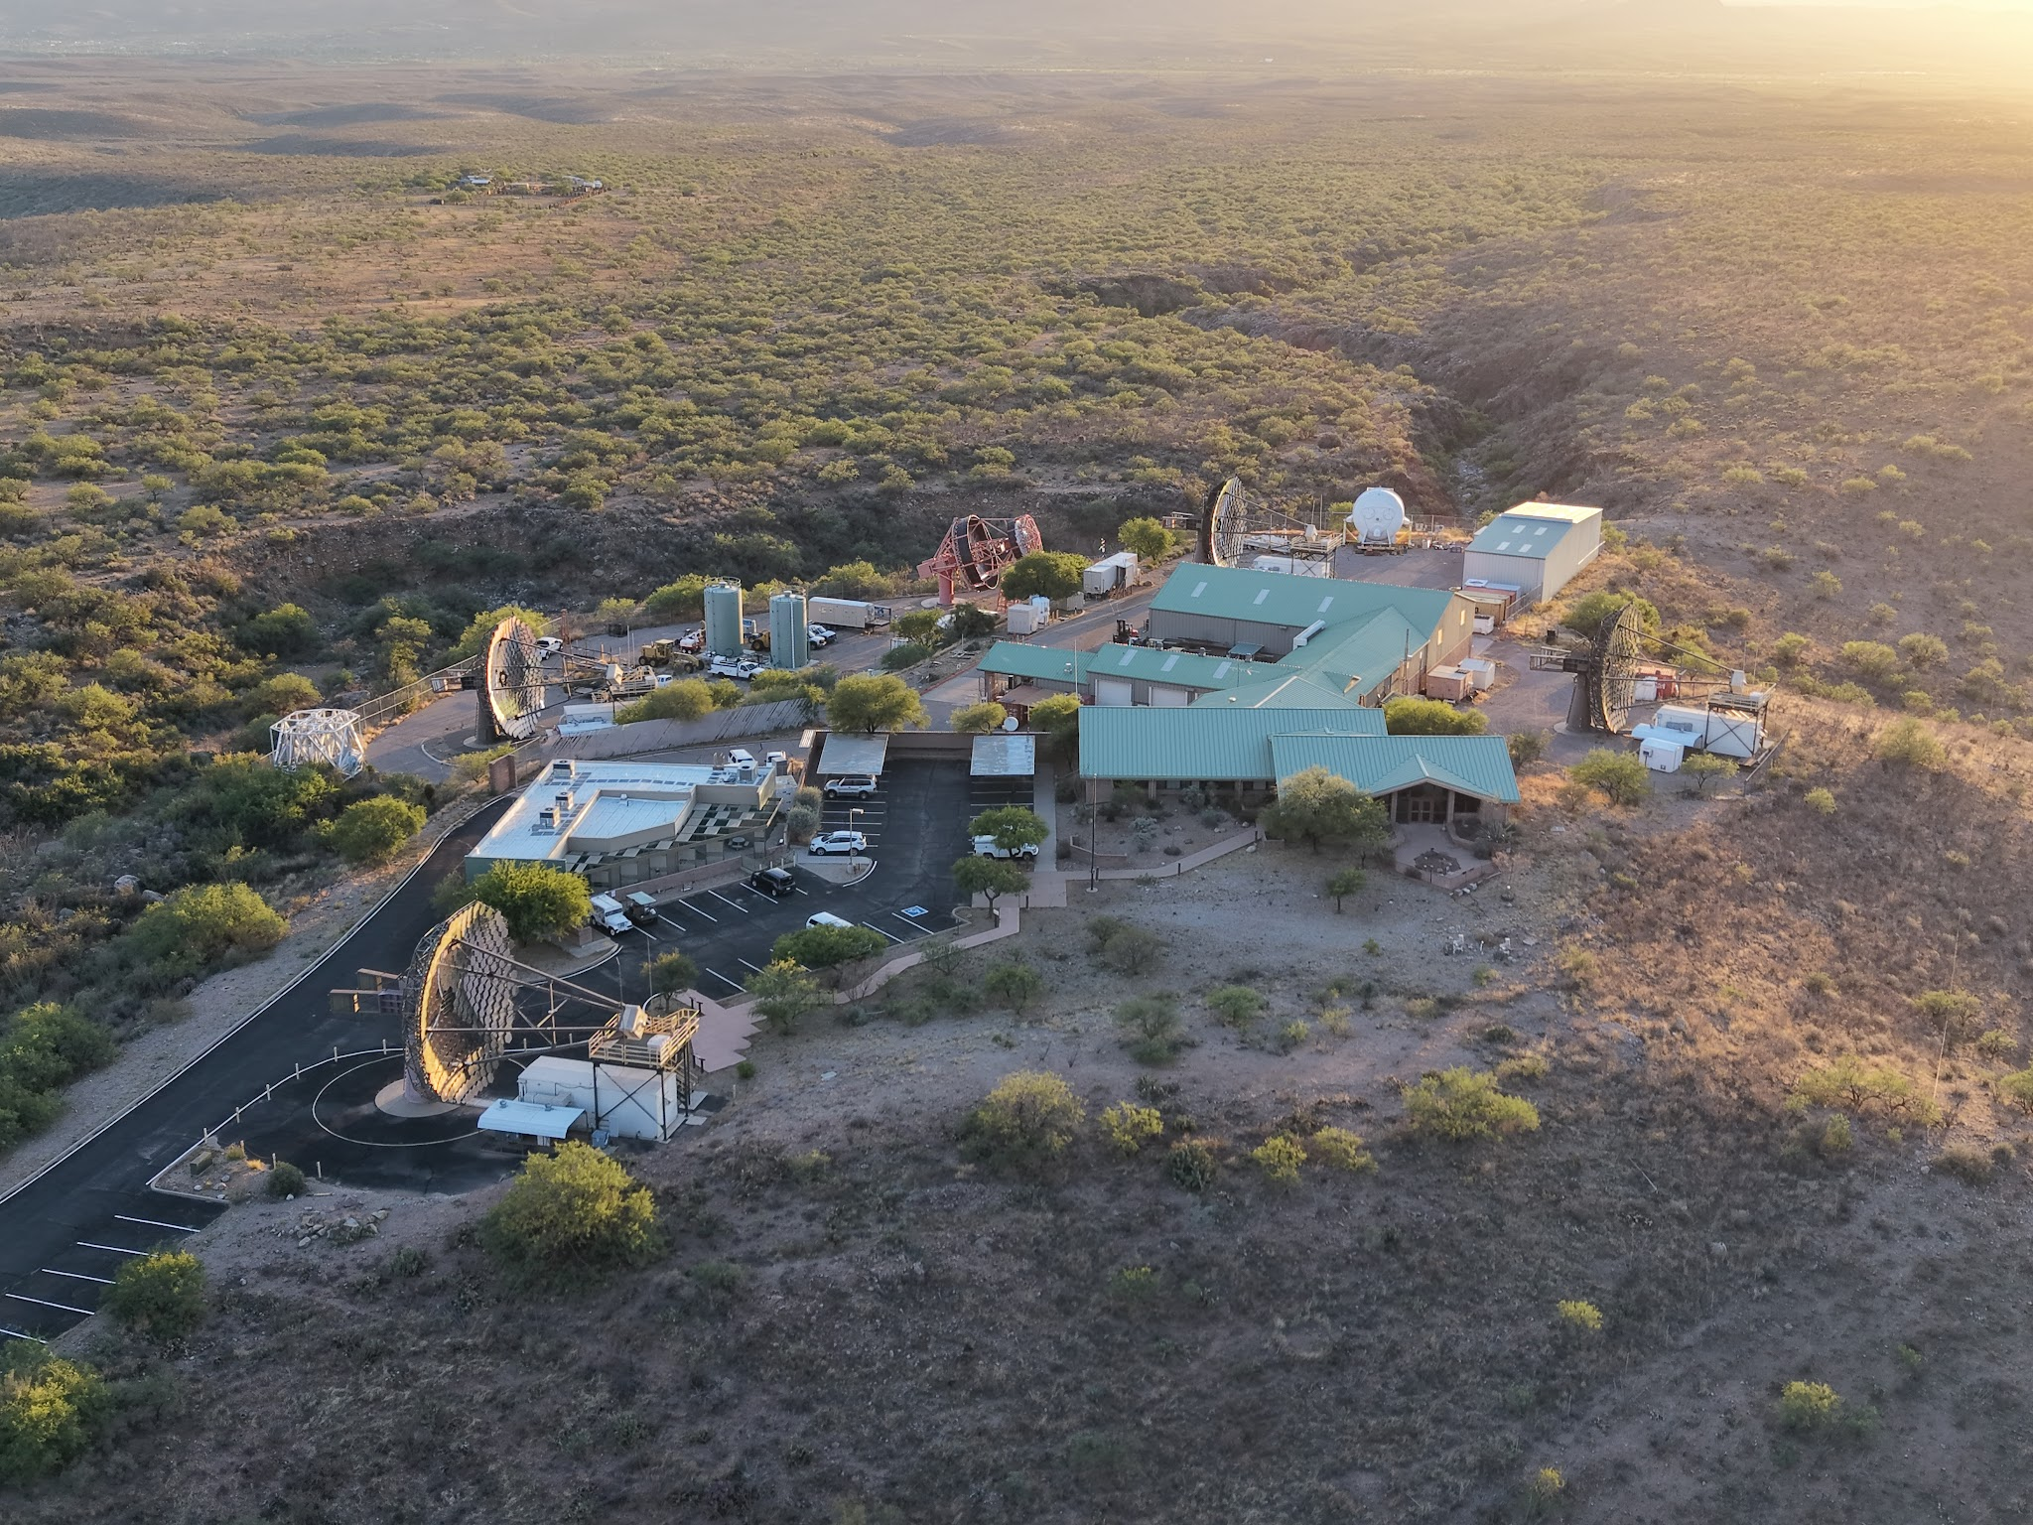
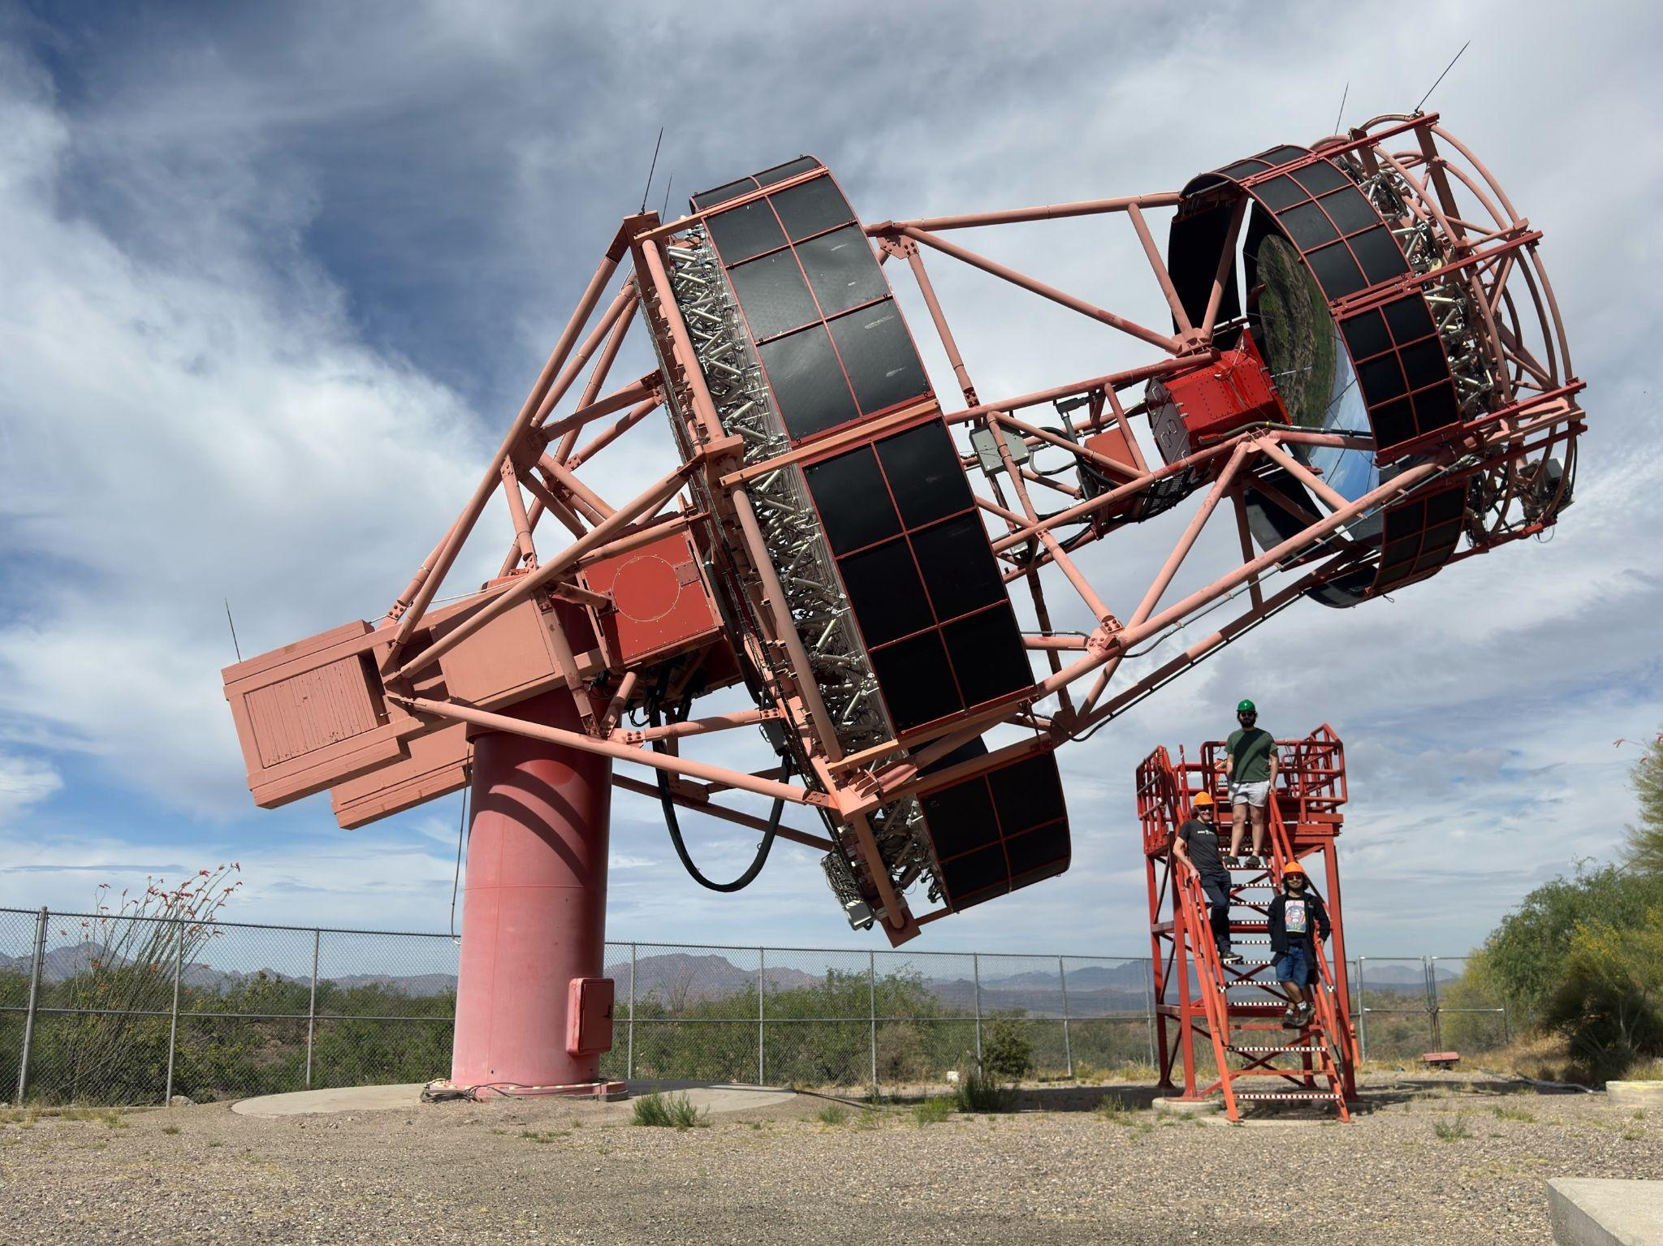
Prototype SCT (pSCT)
Zach Curtis-Ginsberg, pSCT First Light, 9/2/26
Located at the Fred Lawrence Whipple Observatory in Arizona, USA
  Co-located with VERITAS
Dual-mirror optical system
  Good optical resolution across the entire field of view
  Fine pixel resolution to match the optical resolution
8° field of view with almost constant point spread function (PSF)
Notes:
Small plate scale: 1.625 mm per arcminute with an 80 cm focal plane
PSF 0.05-0.07°

Slide 6
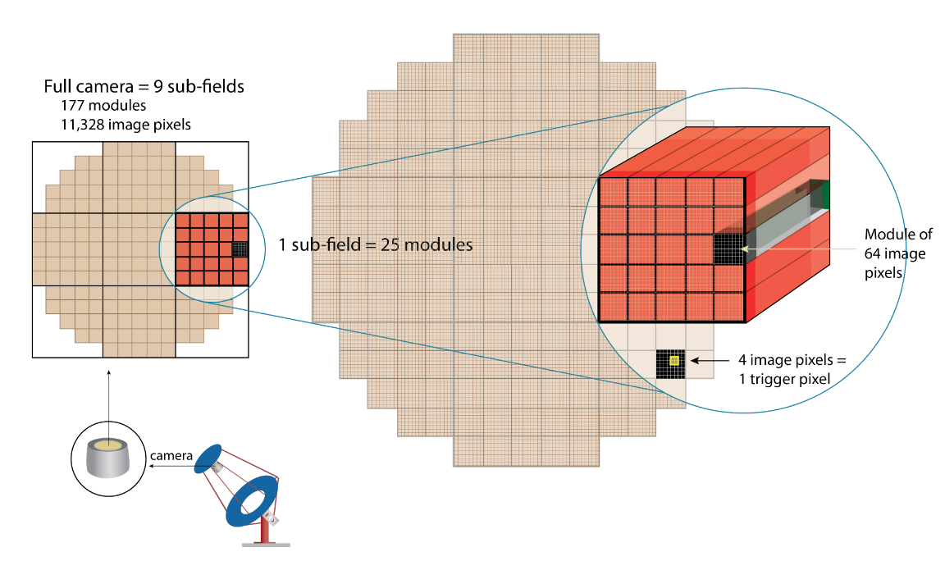
pSCT Camera
Zach Curtis-Ginsberg, pSCT First Light, 9/2/26
Modular camera with 9 sectors
177x 64-pixel camera modules
11,328x 6x6 mm silicon photomultiplier pixels
  0.067° per side
Original camera detected the Crab Nebula in 2020 with only the central
sector

Slide 7

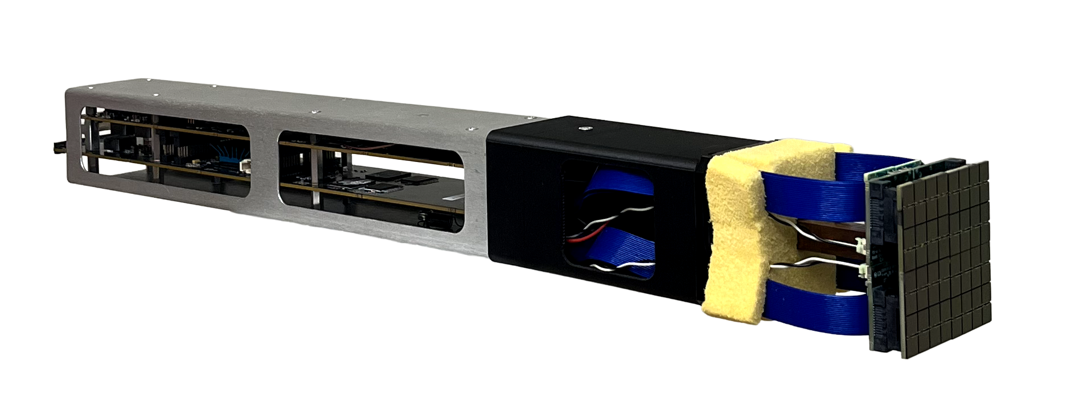
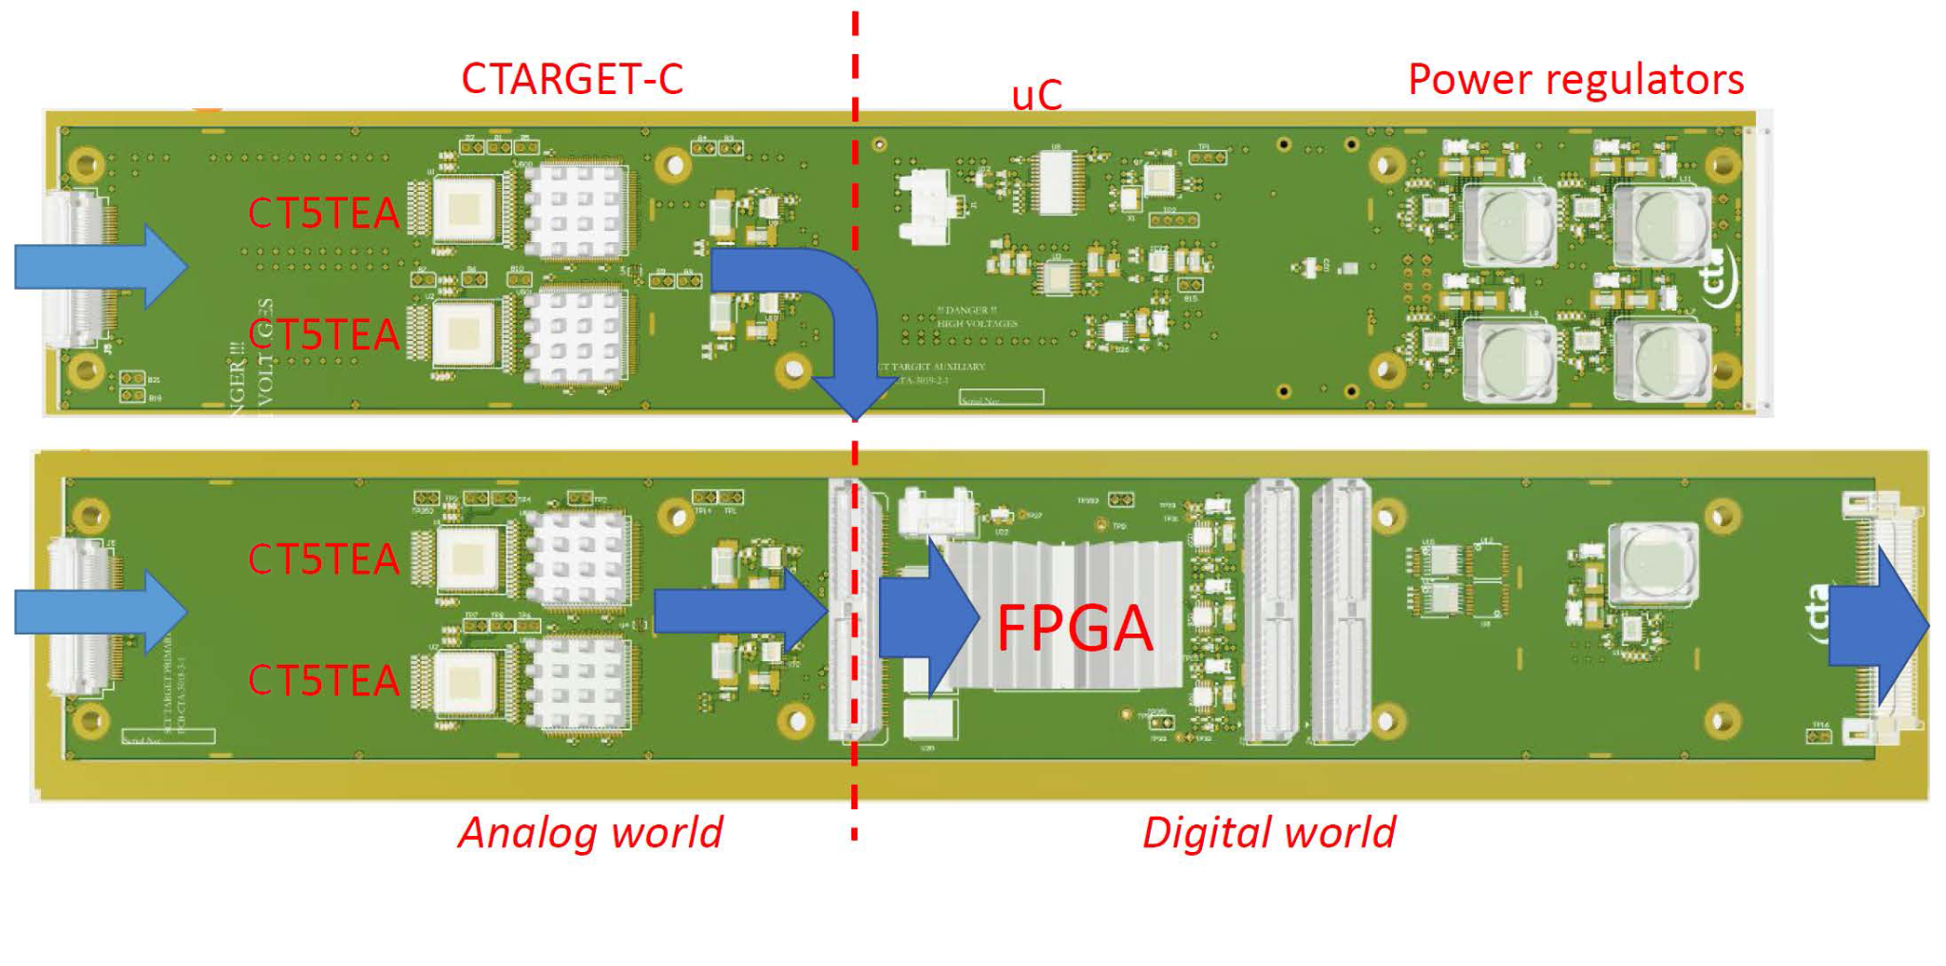
pSCT Camera Upgrade
Zach Curtis-Ginsberg, pSCT First Light, 9/2/26
JATIS Volume 12 Issue 3 Article 034001 (2026)
Ongoing upgrade to improve camera electronics and mechanics
Will fully populate the camera
Updated electronics with reduced crosstalk and trigger noise
Notes:
Cherenkov TARGET C
Chrenkov TARGET 5 Trigger Extension ASIC
SiPM multichannel ASIC for high Resolution Cherenkov Telescopes
TeV Array Readout Electronics with GSa/s sampling and Event Trigger

Slide 8
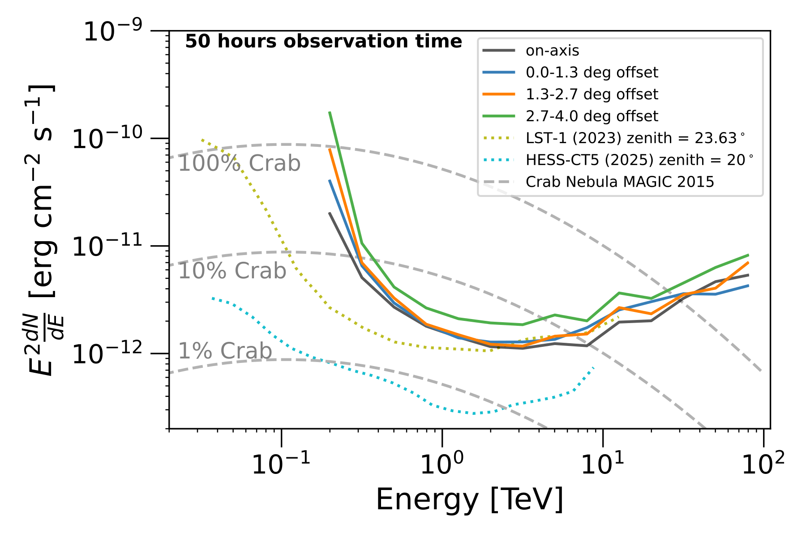
Mono-pSCT Simulations
Zach Curtis-Ginsberg, pSCT First Light, 9/2/26
Point source sensitivity of the mono-pSCT full camera
Comparable in its core energy range with other mono telescopes
Very little loss in sensitivity for off-axis observations

Slide 9
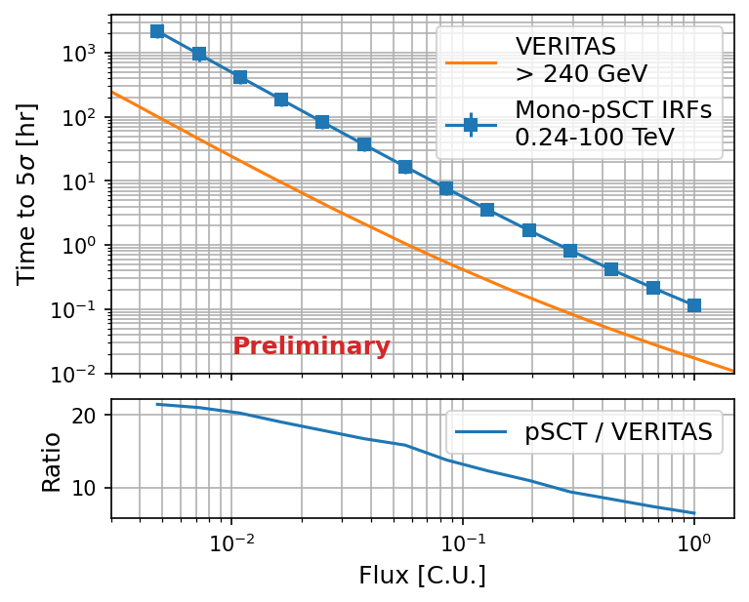
Mono-pSCT Simulations
Zach Curtis-Ginsberg, pSCT First Light, 9/2/26
Observation duration to detect a point source across a broad range of fluxes
10% Crab source takes ~5 hours of observations for a 5σ detection
~1 order of magnitude less sensitive than VERITAS
  Under Crab spectrum assumptions

Slide 10
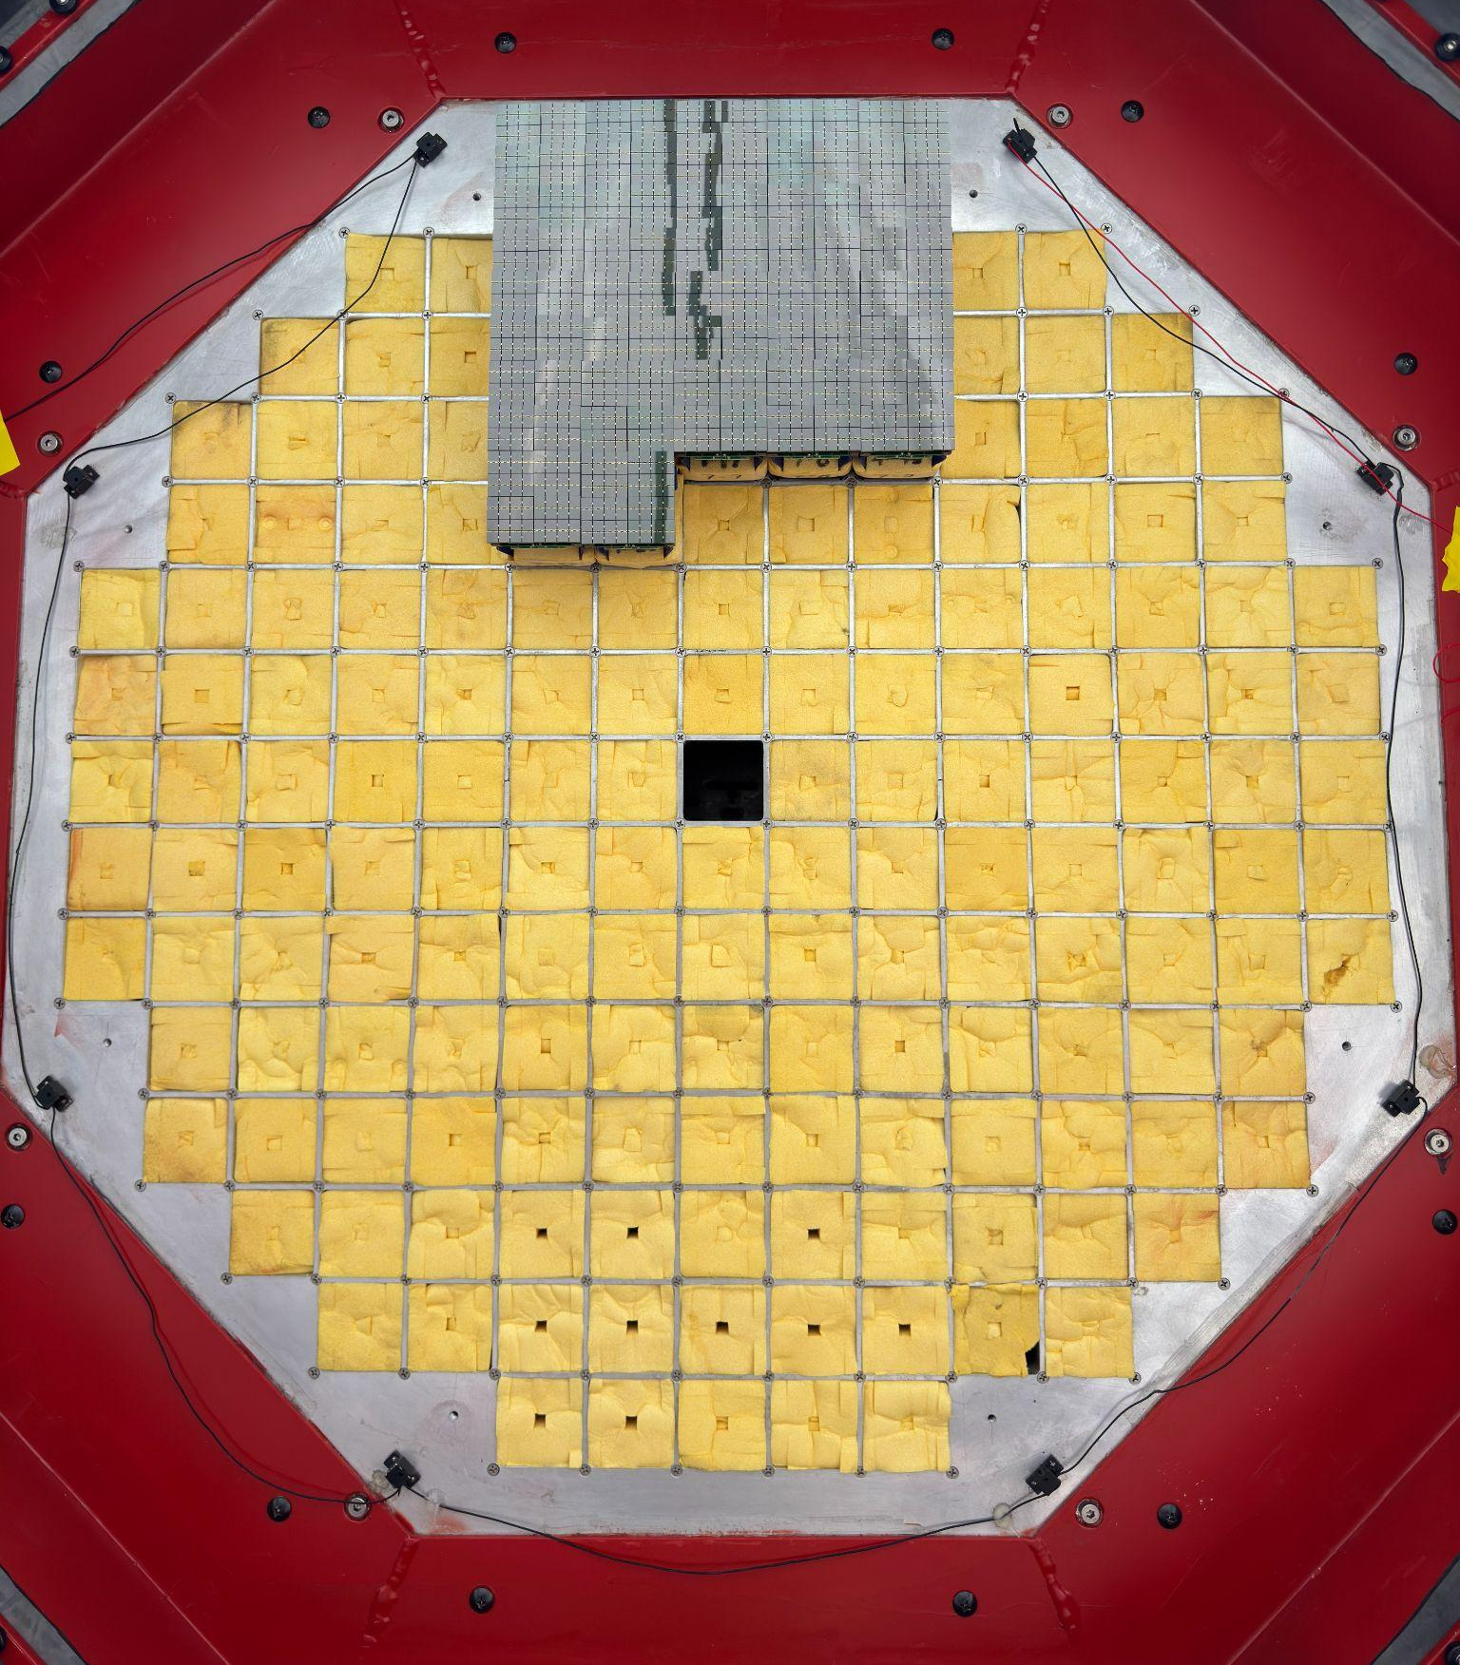
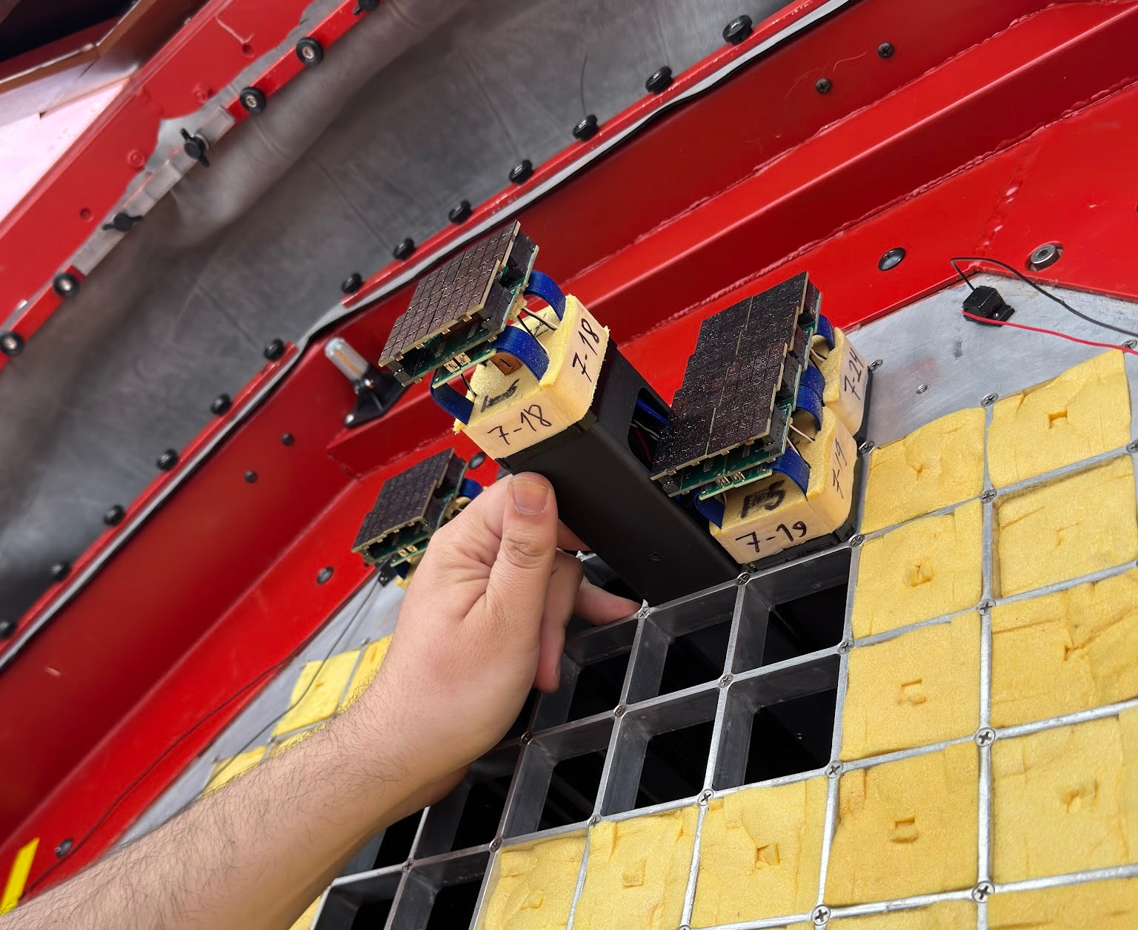
First Sector Installation
Zach Curtis-Ginsberg, pSCT First Light, 9/2/26
22 modules installed April 1st 2026

Slide 11
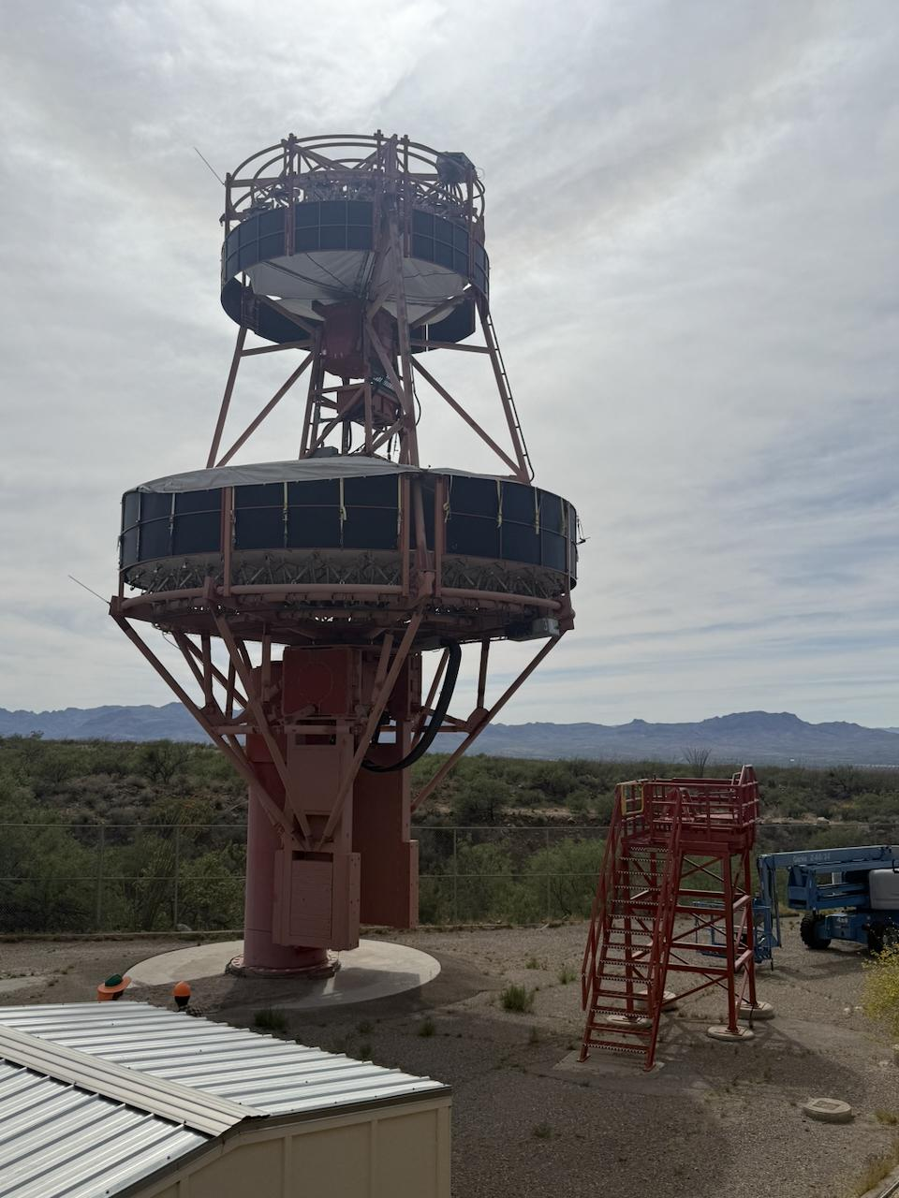
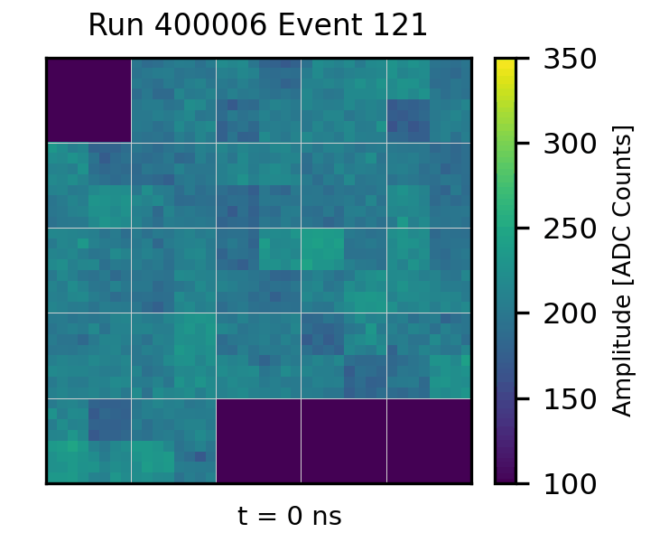
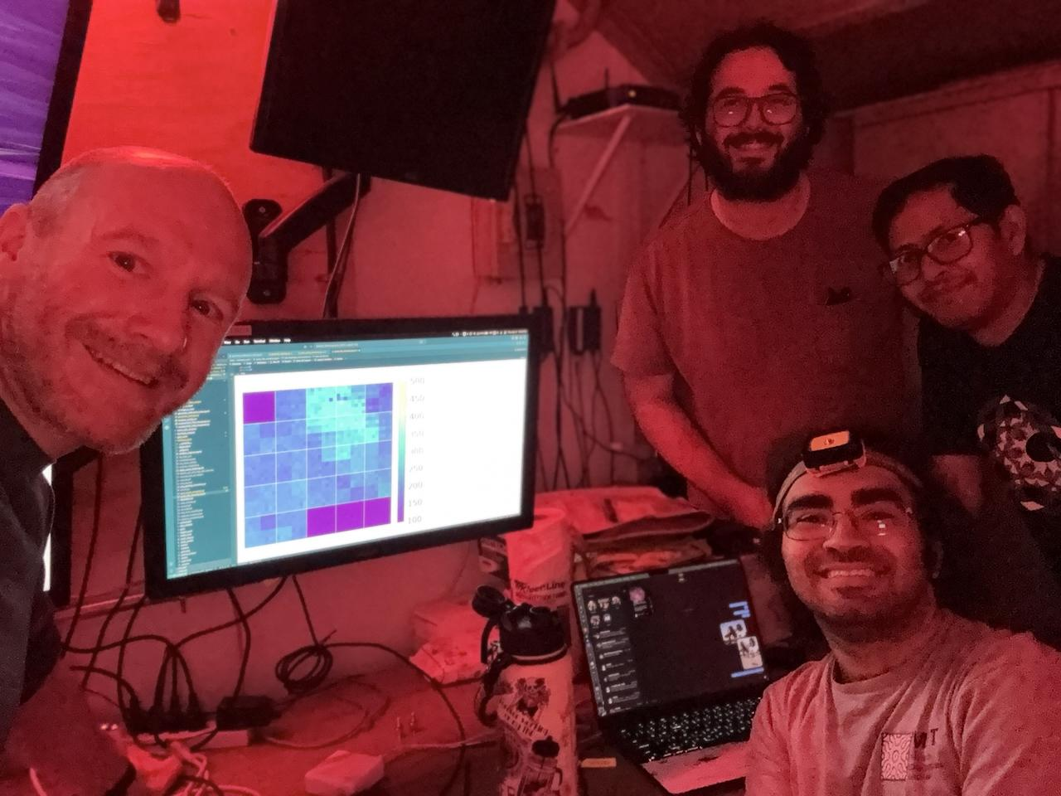
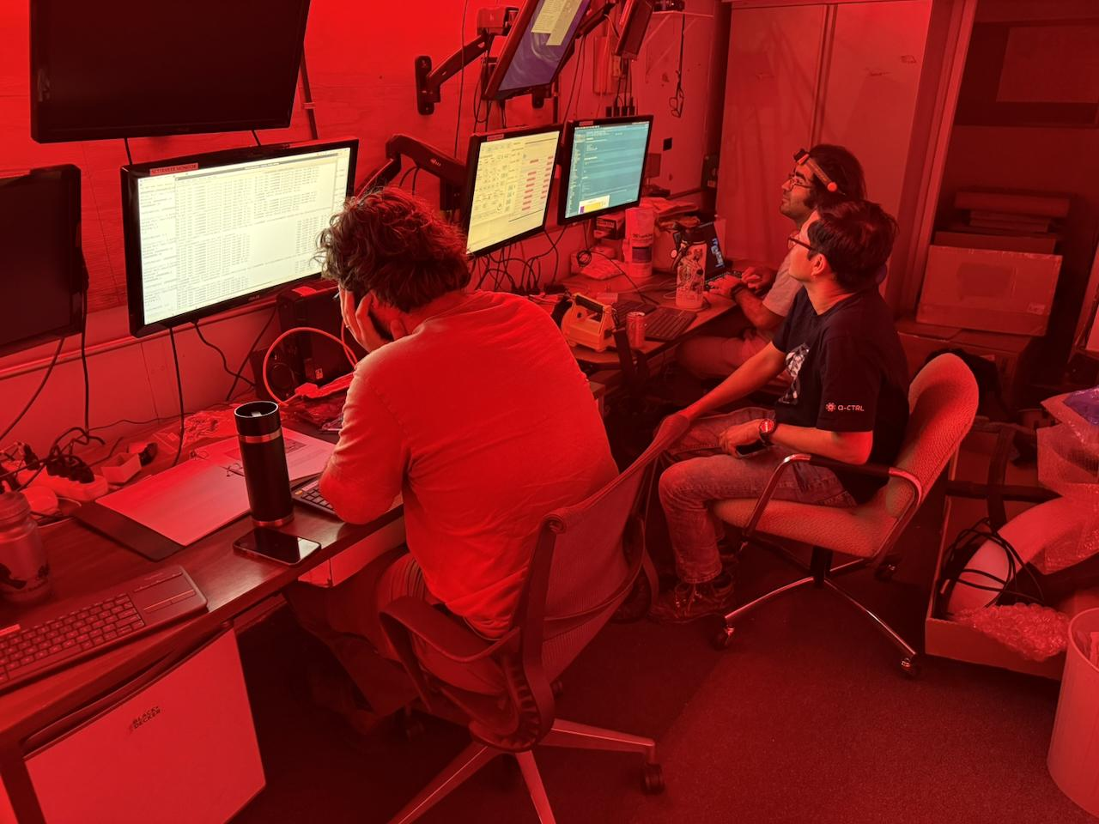
First Light April 2nd ‘26
Zach Curtis-Ginsberg, pSCT First Light, 9/2/26
First light was achieved with…
  Camera out of focus
  Mirrors dirty
  98% moonlight
    Demonstrates the increased robustness and observing time of SiPM cameras
  No module calibrations applied

Slide 12
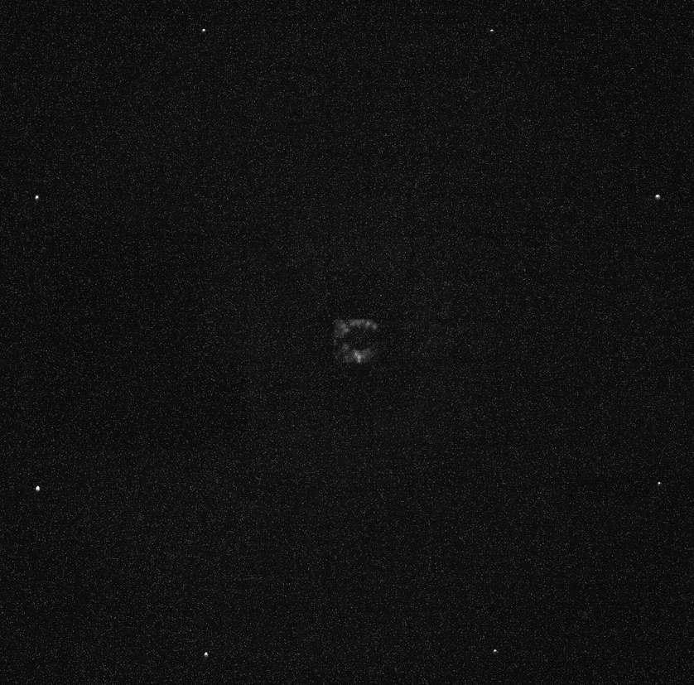
PSF Optimization
Zach Curtis-Ginsberg, pSCT First Light, 9/2/26
Camera has 3D motion control
Pointing at the bright star Arcturus and moving the camera to/from the focal point to optimize the point spread function
Further optimization of the optical alignment is planned
Notes:
Current PSF measured to be ~3.7’

Slide 13
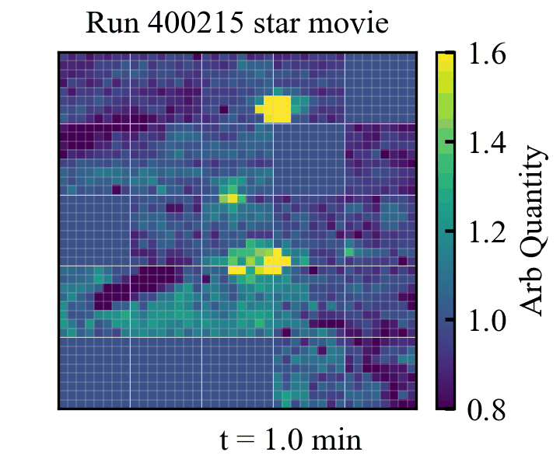
Star Tracking
Zach Curtis-Ginsberg, pSCT First Light, 9/2/26
Using waveform baseline variance from night sky background events
Stacking thousands of events to increase signal-to-noise
Saturated peaks come from colorbar limit

Slide 14
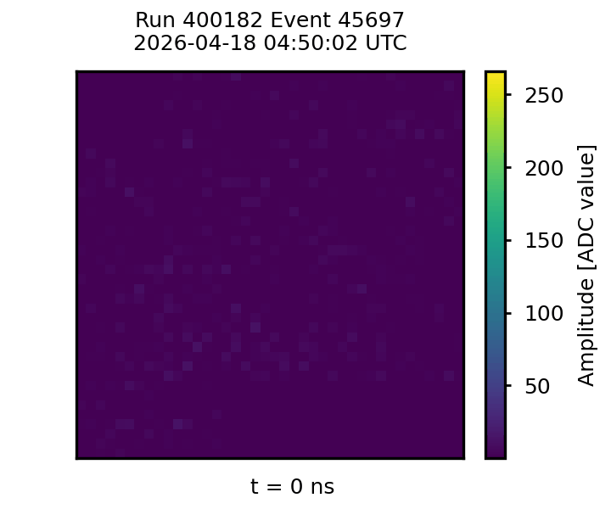
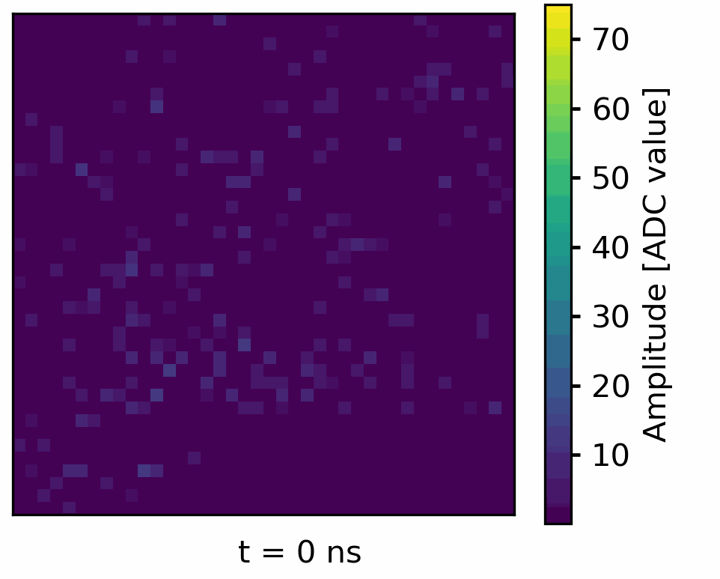
Commissioning Example
Zach Curtis-Ginsberg, pSCT First Light, 9/2/26
Cherenkov ring from a muon followed ~8ns later by a cosmic-ray shower
Demonstrates the concept of imaging atmospheric Cherenkov telescopes
-> muon reaches the ground before the Cherenkov light

Slide 15
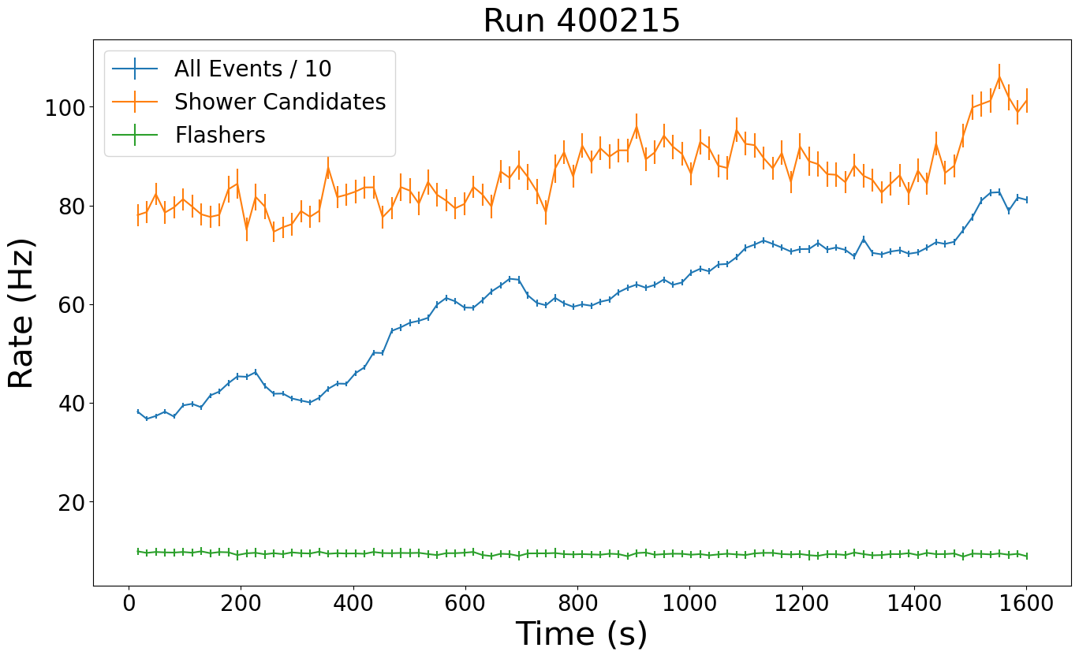
Markarian 421 Observations
Zach Curtis-Ginsberg, pSCT First Light, 9/2/26
Example run
Shower candidate rate is constant at ~80 Hz
  Events surviving basic cleaning and filtering
  True shower rate is lower
Night sky background changes increase all event rate
Preliminary

Slide 16
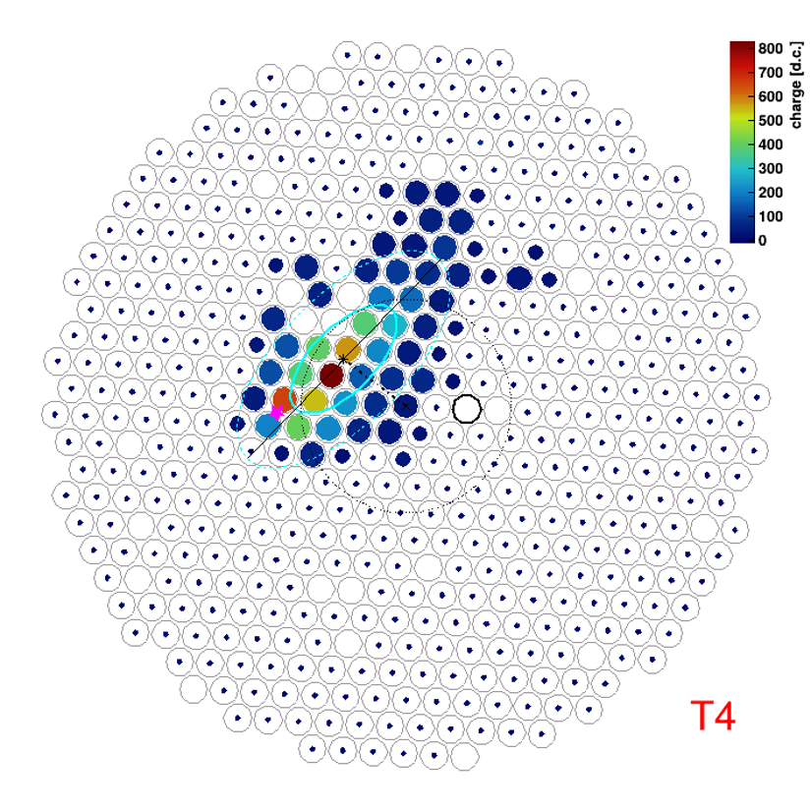
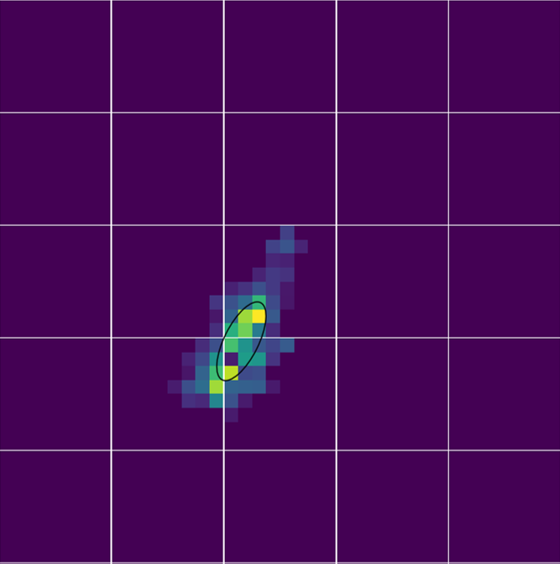
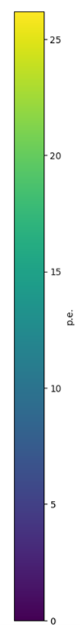
Markarian 421 Observations
Zach Curtis-Ginsberg, pSCT First Light, 9/2/26
The pSCT is ~35 meters from VERITAS T4
Matched cosmic ray
25
20
15
p.e.
10
Central circles are 0.5° radius
5
0
Notes:
Likely a few TeV
~10 m impact position for pSCT

Slide 17
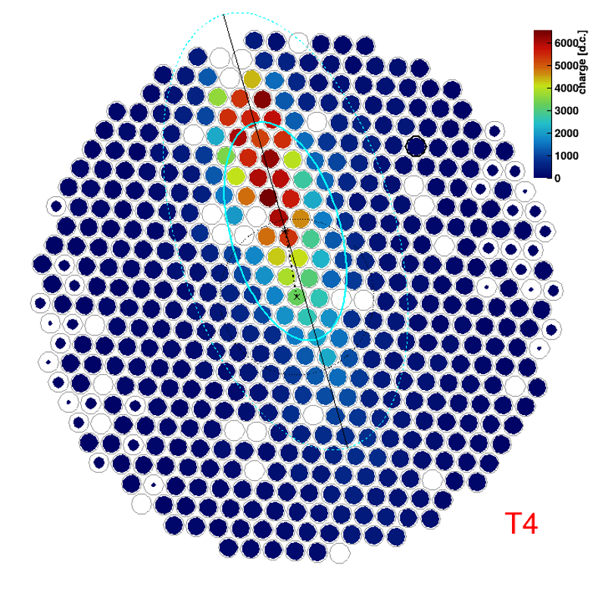
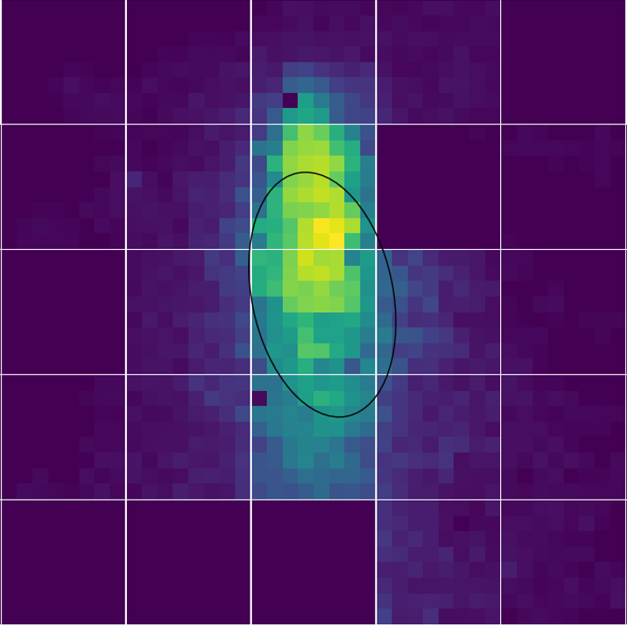
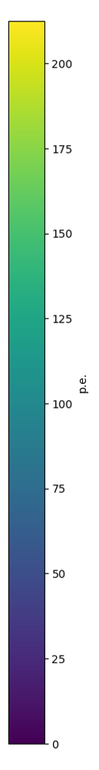
Markarian 421 Observations
Zach Curtis-Ginsberg, pSCT First Light, 9/2/26
Matched bright cosmic ray
200
175
150
125
p.e.
100
75
50
Central circles are 0.5° radius
25
0
Notes:
Medium impact (~50-100 m)

Slide 18
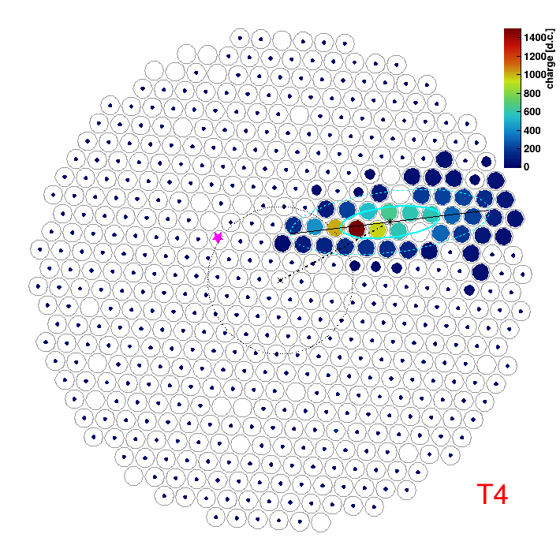
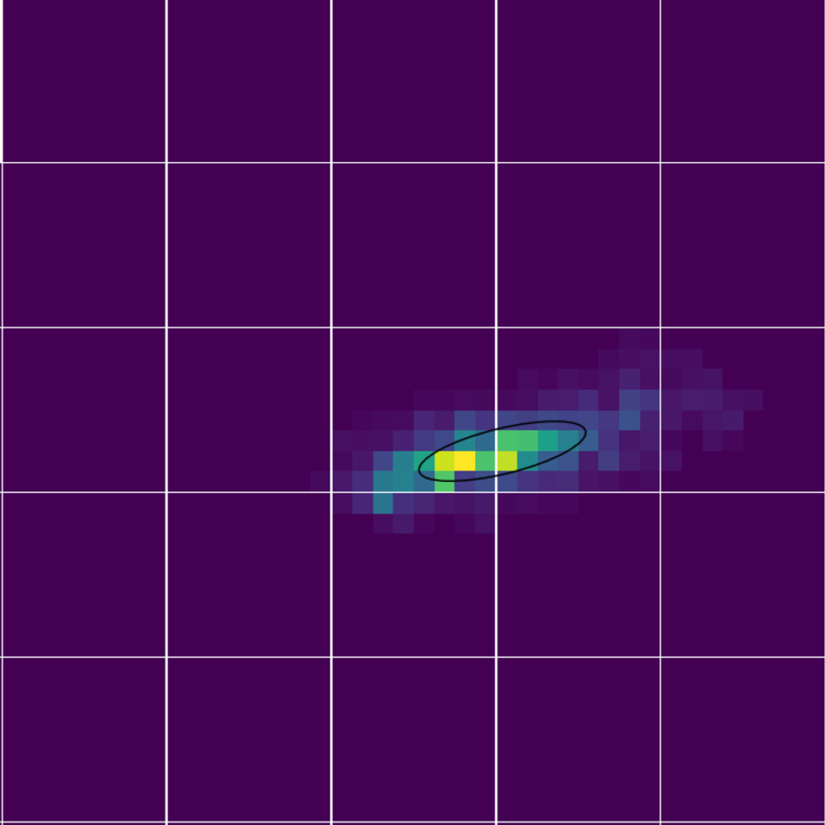
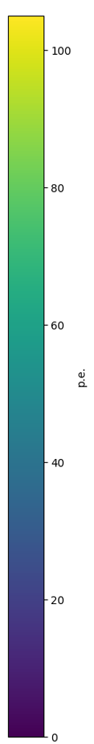
Markarian 421 Observations
Zach Curtis-Ginsberg, pSCT First Light, 9/2/26
Matched 3.4 TeV gamma ray
100
80
60
p.e.
40
Central circles are 0.5° radius
20
0
Notes:
Impact ~125-150 m from pSCT (162 m from T4)

Slide 19
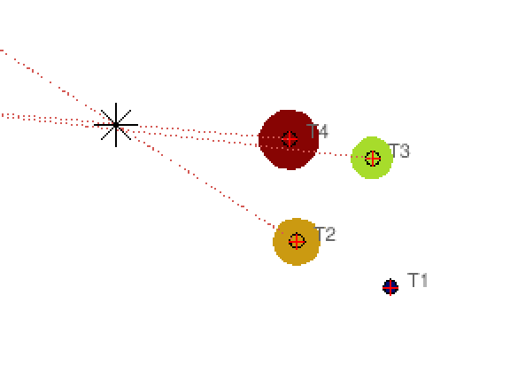
Markarian 421 Observations
Zach Curtis-Ginsberg, pSCT First Light, 9/2/26
Matched 3.4 TeV gamma ray (162 m from T4)
Offline matching of cosmic rays and gamma rays is robust
  ~15 Hz rate of matched showers
An important step towards possible integration of the pSCT as part of an IACT array
100
80
pSCT
60
p.e.
40
20
0
Notes:
Impact ~125-150 m from pSCT (162 m from T4)

Slide 20
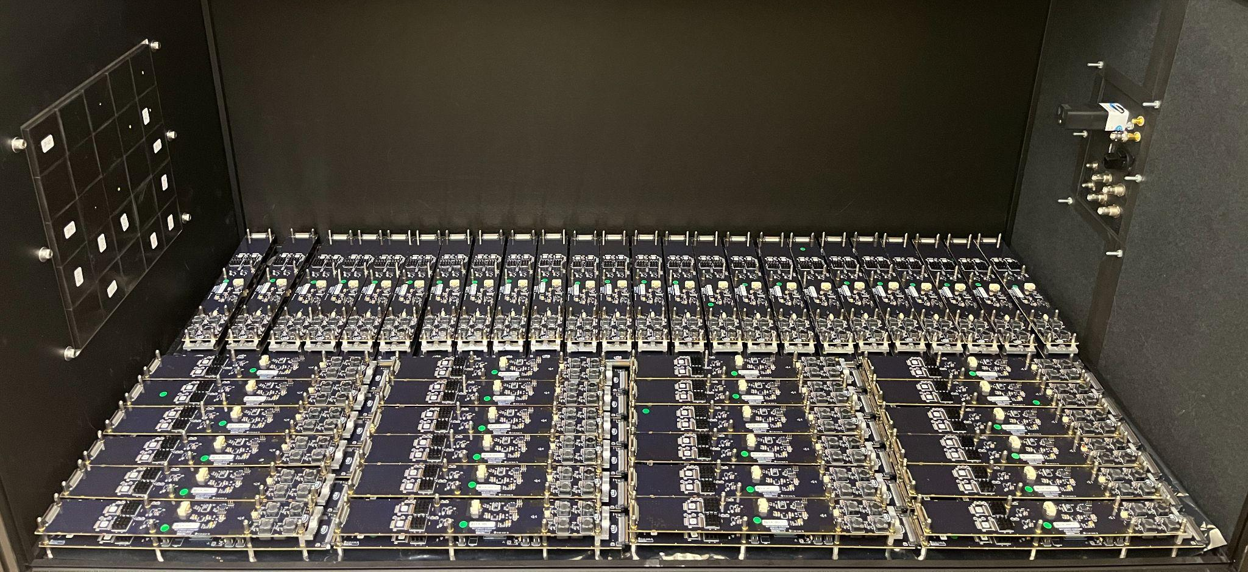
Next Steps
Zach Curtis-Ginsberg, pSCT First Light, 9/2/26
52 more camera modules are in Wisconsin for optimization, calibration, assembly, and testing
They will be installed this fall
The final 103 modules will follow after that
Simulations of the mono-pSCT are in development, with further work to improve SCT array simulations

Slide 21
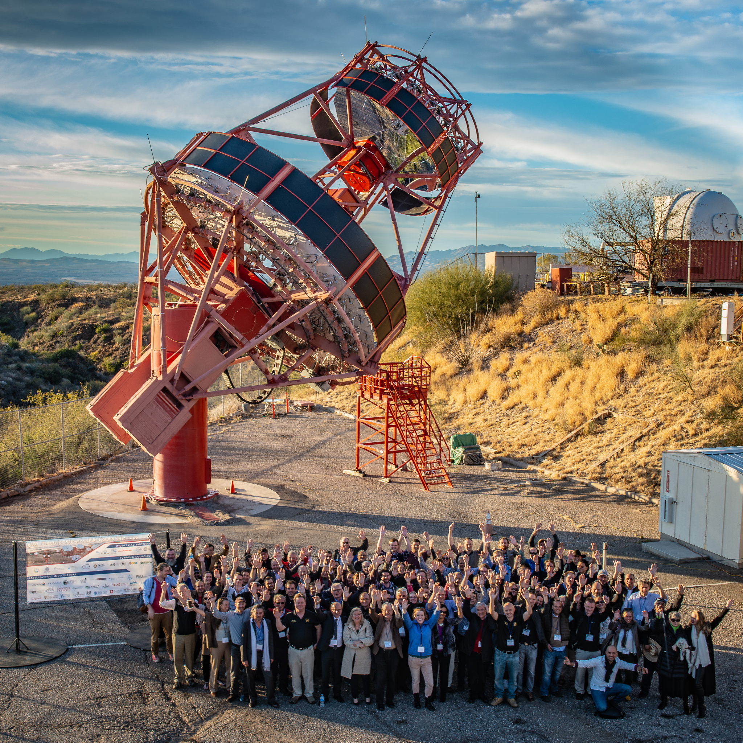
Summary
Zach Curtis-Ginsberg, pSCT First Light, 9/2/26
The pSCT camera upgrade is underway
Installation and first light of 22 camera modules
Gamma-ray coincidence matching with VERITAS during initial Markarian 421 observations
52 more modules are expected to be installed this fall
The last 103 modules are expected to be installed in 2027

Slide 22
Thank you! curtisginsbe@wisc.eud
Zach Curtis-Ginsberg, pSCT First Light, 9/2/26

Slide 23
Backup
Zach Curtis-Ginsberg, pSCT First Light, 9/2/26

Slide 24
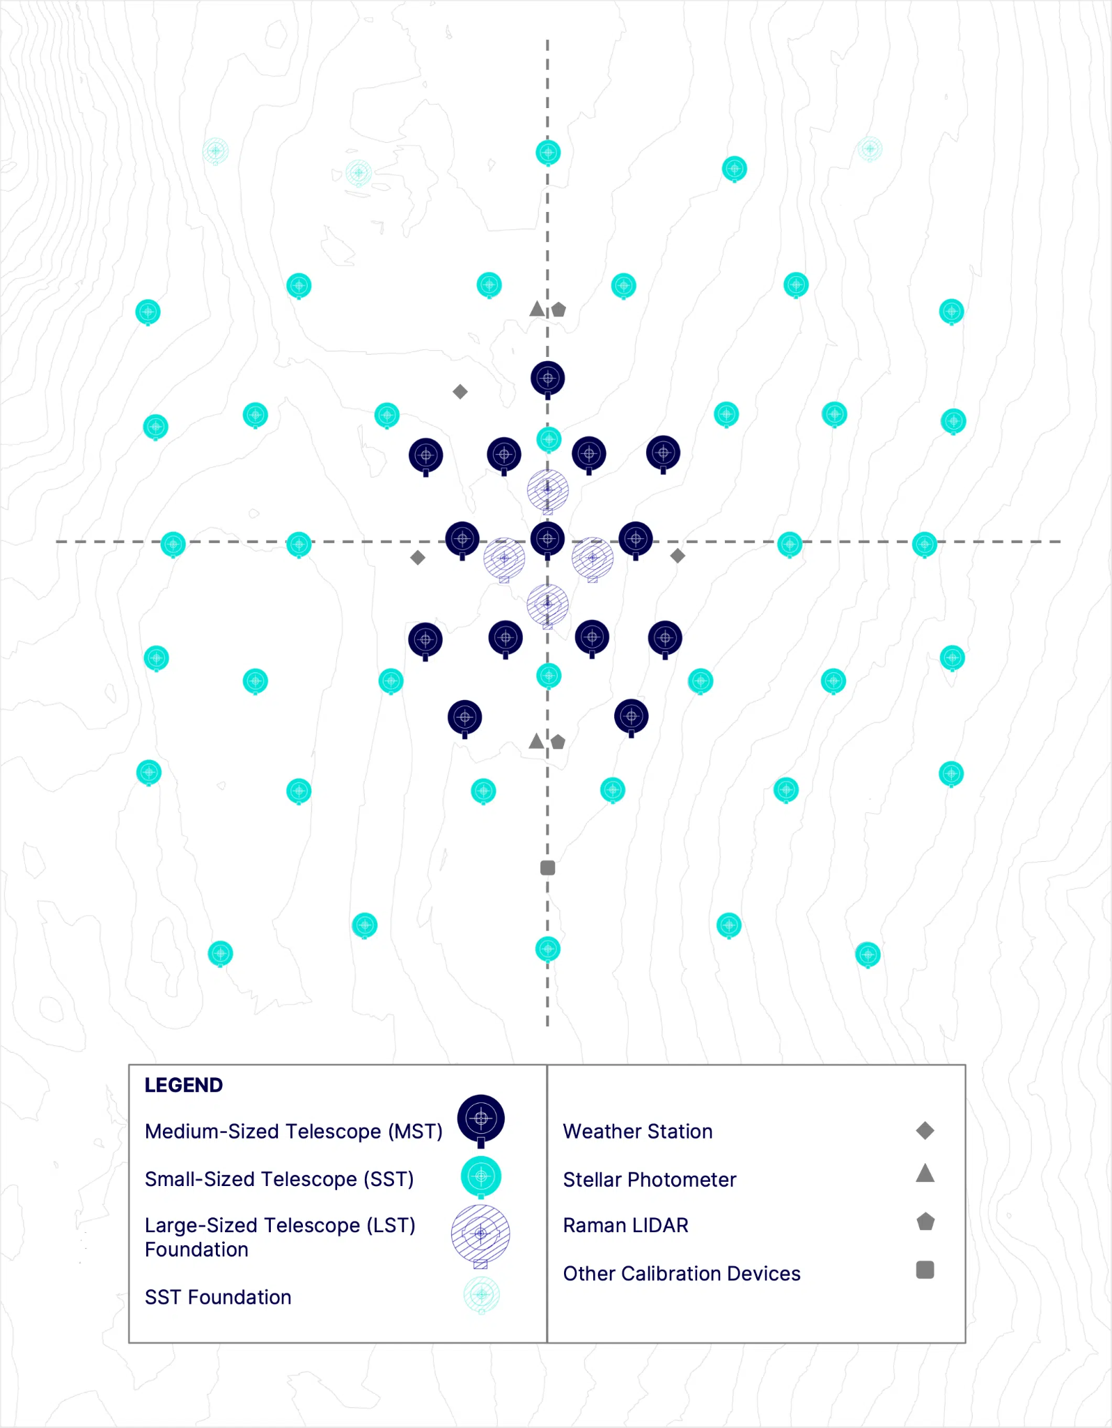
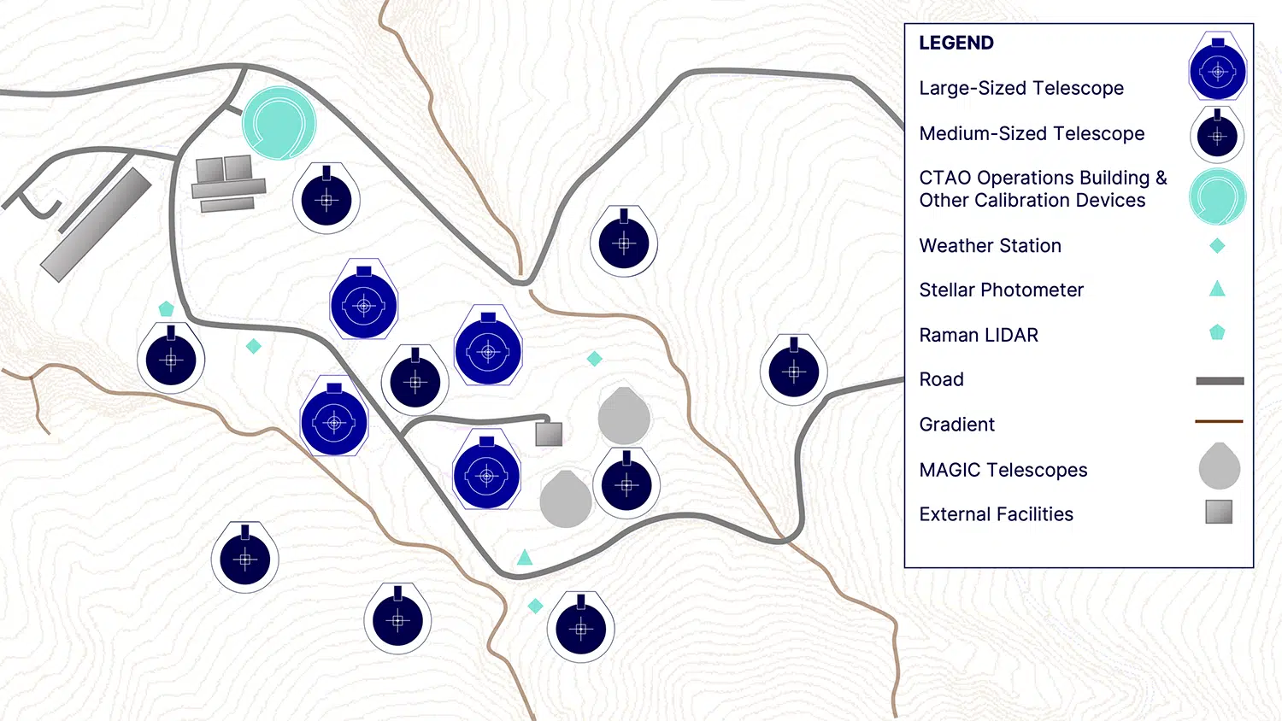
CTAO Alpha Configuration
Zach Curtis-Ginsberg, pSCT First Light, 9/2/26
Southern Array: 150 GeV - 300 TeV, 14 MST, 37 SST
Northern Array: 20 GeV - 5 TeV, 4 LST, 9 MST
Source: CTAO
Notes:
There has been funding for 2 LSTs and 5? more SSTs in the south now

Slide 25
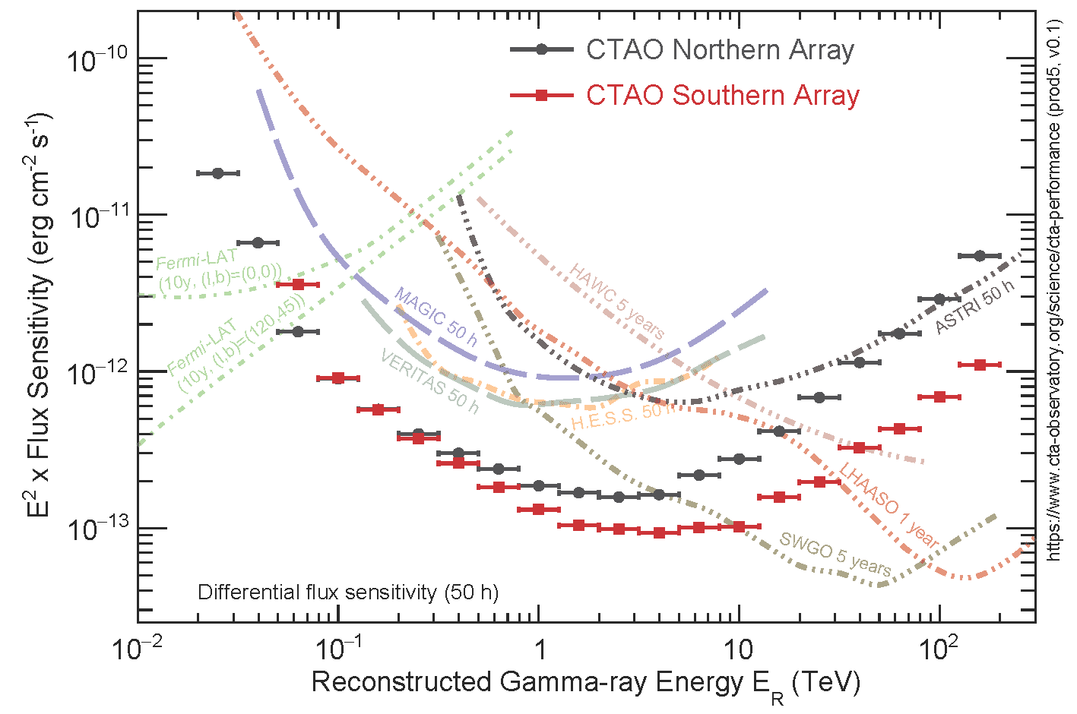
CTAO Sensitivity
Zach Curtis-Ginsberg, pSCT First Light, 9/2/26
Minimum flux needed for 5σ detection of a point source with 50 hours of exposure (or instrument equivalent)
  For the alpha configuration
Comparing CTAO to other current and upcoming instruments
Source: CTAO

Slide 26
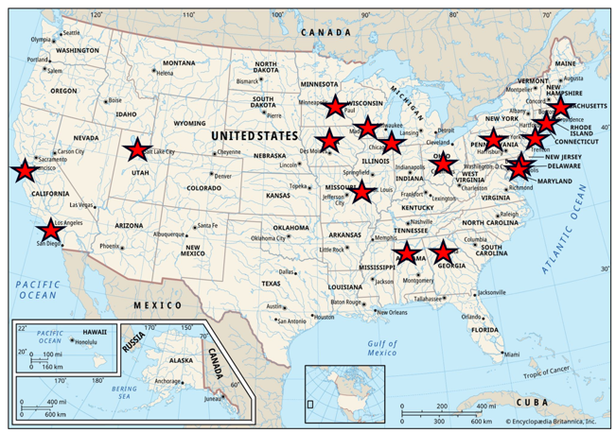
CTAO-US
Zach Curtis-Ginsberg, pSCT First Light, 9/2/26
17 US institutions, 50+ current members
Development of the pSCT/SCT instrument
CTAO leadership contributions
  Co-spokesperson
  Science Coordinator
  Science working group leads
  SAPO leadership/members
  Science and technology development
  White papers leadership

Slide 27
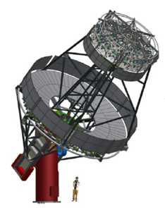
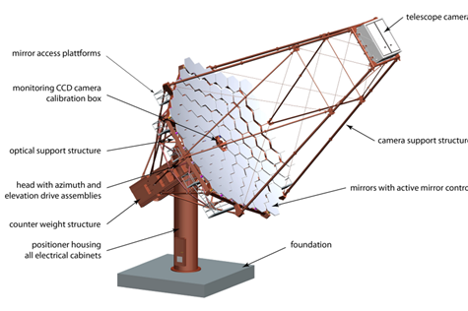
SC Vs. DC Medium Sized Telescope
Zach Curtis-Ginsberg, pSCT First Light, 9/2/26
Source: D. Nieto et al. “Construction of a medium-sized Schwarzschild-Couder telescope as a candidate for the Cherenkov Telescope Array: development of the optical alignment system”, J-F. Glicenstein. “Status of the Davies-Cotton and Schwarzschild-Couder Medium-Sized Telescopes for the Cherenkov Telescope Array”

Slide 28
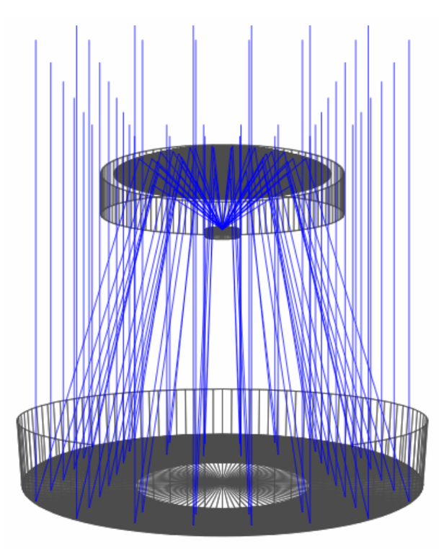
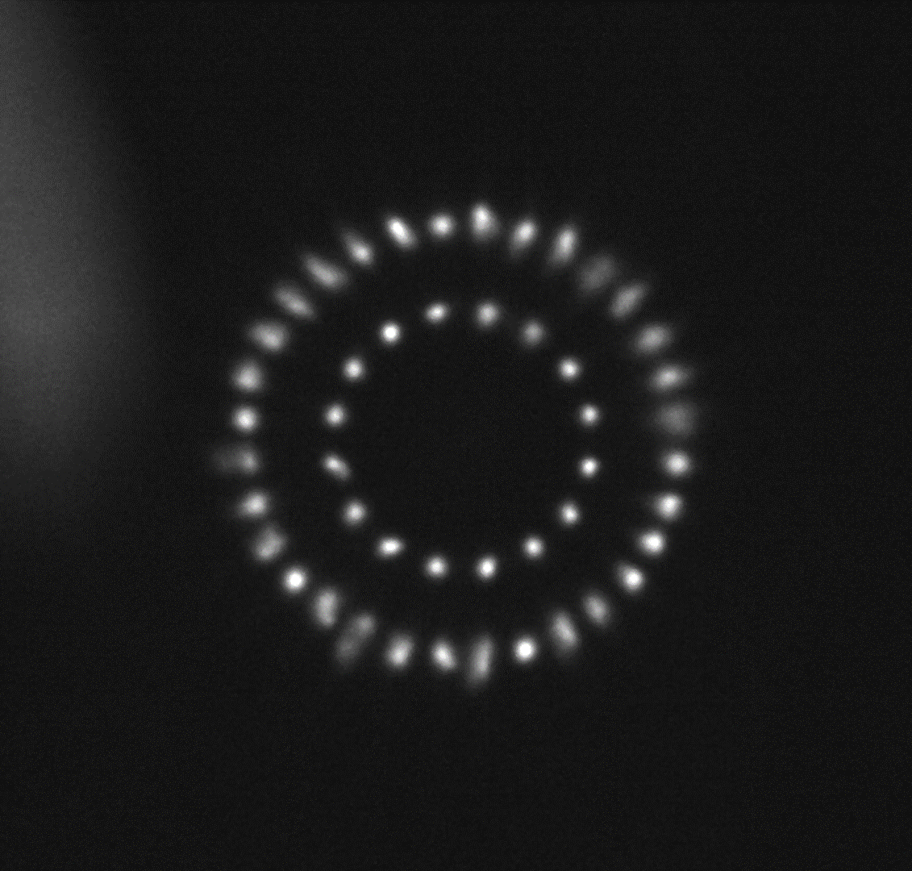
SC Optics
Zach Curtis-Ginsberg, pSCT First Light, 9/2/26
Focal length 5.586m
Aperture 9.66m
Source: J. Rousselle et al. “Construction of a Schwarzschild-Couder telescope as a candidate for the Cherenkov Telescope Array: status of the optical system”
Notes:
Schwarzschild-Couder design is isochronous, no spherical or comatic aberrations
2nd mirror is defocusing, located ~halfway along the focal length of 1st mirror
This defocusing gives the higher image resolution and smaller focal plate scale
Focal plan is curved

Slide 29
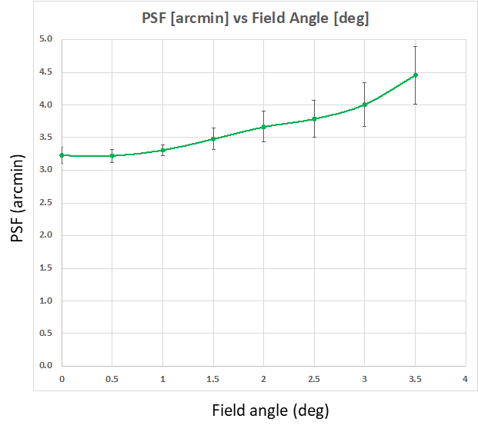
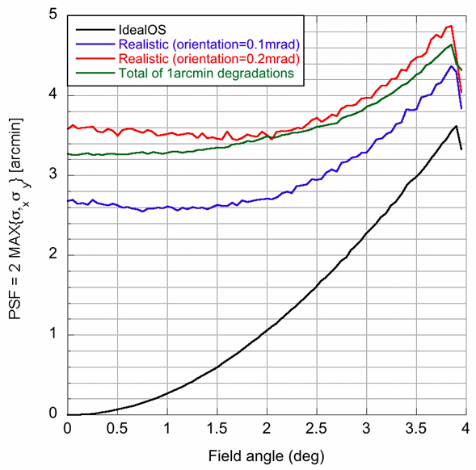
SC Optics
Zach Curtis-Ginsberg, pSCT First Light, 9/2/26
9.7m primary, 5.4m secondary
48 segments on primary, 24 segments on secondary
On-axis PSF ~3.2’
Measurement
Simulation

Slide 30
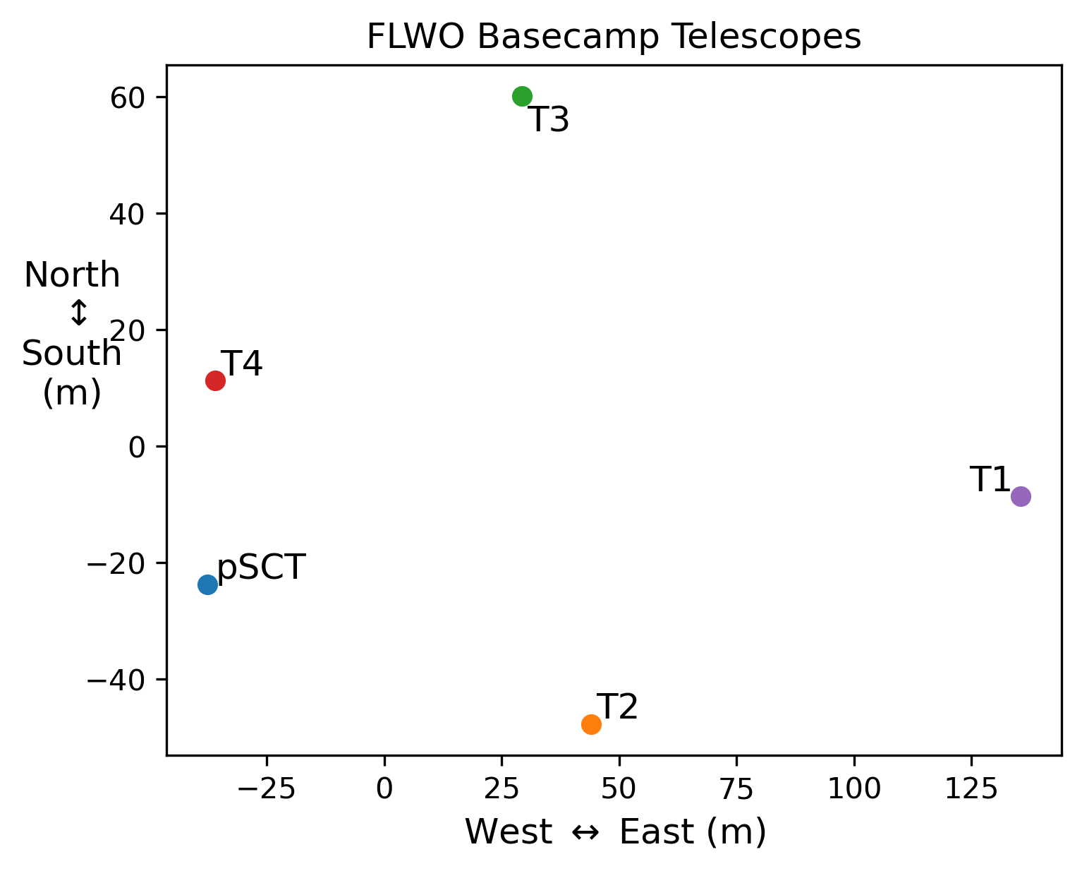
pSCT & VERITAS Locations
Zach Curtis-Ginsberg, pSCT First Light, 9/2/26

Slide 31
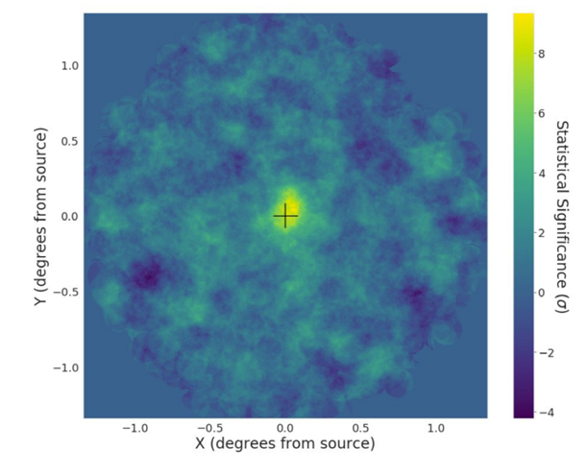
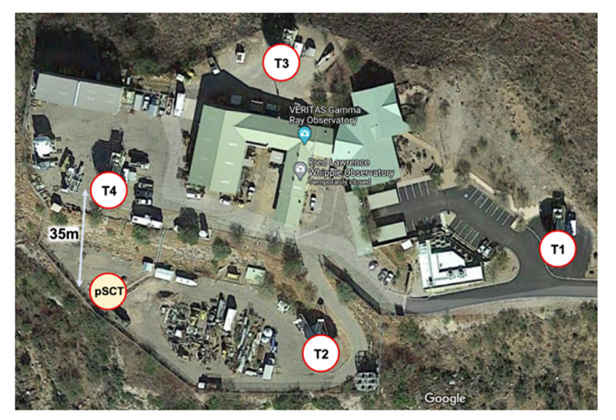
pSCT Crab Detection
Zach Curtis-Ginsberg, pSCT First Light, 9/2/26
Observation campaign of the Crab Nebula in 2020
17.6 hours of data
8.6σ detection
Source: C. Adams et al. “Detection of the Crab Nebula with the 9.7 m Prototype Schwarzschild-Couder Telescope”
Notes:
VERITAS generally sees ~1 Hz of gammas from the Crab and ~400 Hz of cosmic rays (cuts preserve ~85% of gammas and ~1% of hadrons)
pSCT with this data saw ~0.005 Hz of gammas from the Crab and ~1.5 Hz hadrons (pre-cuts)

Slide 32
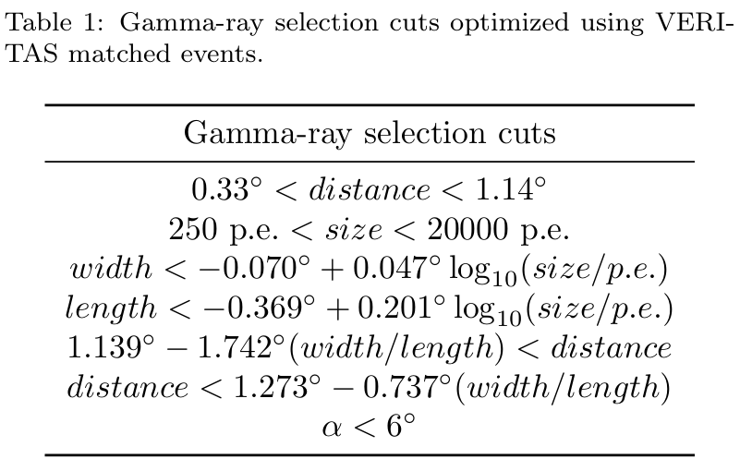
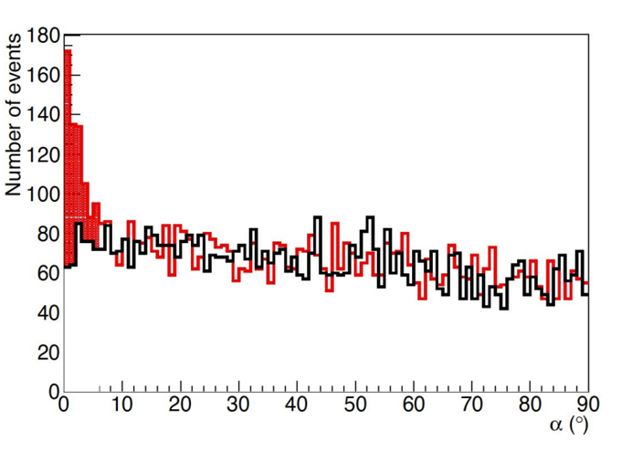
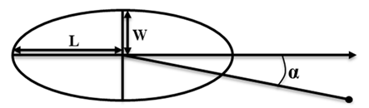
pSCT Crab Detection
Zach Curtis-Ginsberg, pSCT First Light, 9/2/26
Source: C. Adams et al. “Detection of the Crab Nebula with the 9.7 m Prototype Schwarzschild-Couder Telescope”
Notes:
Cuts were helped by looking at the Crab with VERITAS and using its gammaness as truth
Distance is length of ray angle alpha below perpendicular
Black is events off source, red is events on source
Alpha is angle from Crab

Slide 33
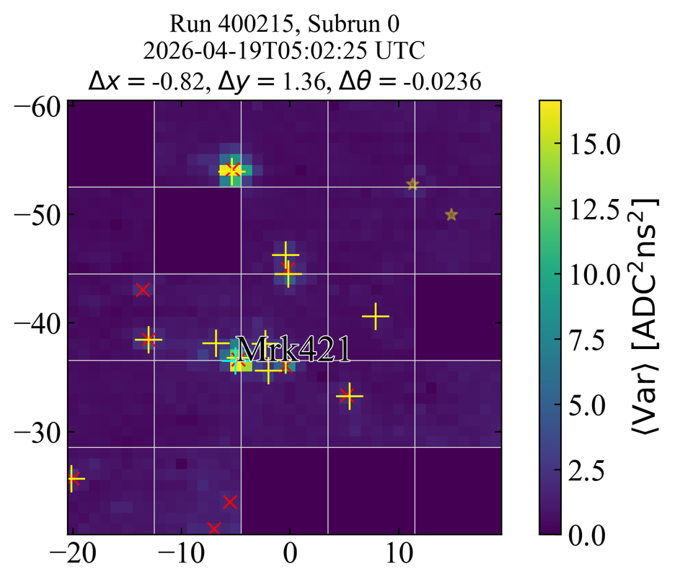
Star Tracking
Zach Curtis-Ginsberg, pSCT First Light, 9/2/26
Red X are peaks in the stacked variance image
Yellow + are stars expected in the field
Using solved star field to calculate source position (Markarian 421)

Slide 34

Markarian 421 Observations
Zach Curtis-Ginsberg, pSCT First Light, 9/2/26
Matched cosmic ray
25
20
pSCT
15
p.e.
10
5
0
Notes:
Likely a few TeV
~10 m impact position for pSCT

Slide 35

Markarian 421 Observations
Zach Curtis-Ginsberg, pSCT First Light, 9/2/26
Matched bright cosmic ray
200
175
150
pSCT
125
100
p.e.
75
50
25
0
Notes:
Medium impact (~50-100 m)

Slide 36



Markarian 421 Observations
Zach Curtis-Ginsberg, pSCT First Light, 9/2/26
Matched 1.5 TeV gamma ray
30
25
20
15
p.e.
10
Central circles are 0.5° radius
5
0
Notes:
Impact ~200-250 m from pSCT (221 m from T4)

Slide 37

Markarian 421 Observations
Zach Curtis-Ginsberg, pSCT First Light, 9/2/26
Matched 1.5 TeV gamma ray (221 m from T4)
30
pSCT
25
20
15
p.e.
10
5
0
Notes:
Impact ~200-250 m from pSCT (221 m from T4)

Slide 38



Markarian 421 Observations
Zach Curtis-Ginsberg, pSCT First Light, 9/2/26
Matched 1 TeV gamma ray (falls almost on top of pSCT)
30
25
20
p.e.
15
10
Central circles are 0.5° radius
5
0
Notes:
Low impact (< 20 m)

Slide 39

Markarian 421 Observations
Zach Curtis-Ginsberg, pSCT First Light, 9/2/26
Matched 1 TeV gamma ray (falls almost on top of pSCT)
30
25
pSCT
20
p.e.
15
10
5
0
Notes:
Low impact (< 20 m)

Slide 40

Markarian 421 Observations
Zach Curtis-Ginsberg, pSCT First Light, 9/2/26
Spatial location of Hillas centroid for all shower candidates
29 minute run
Preliminary

Slide 41


SCT Array
Zach Curtis-Ginsberg, pSCT First Light, 9/2/26
1
Adding 11 SCTs improves performance more than 11 DC-MSTs
The off-axis improvement is even larger
Updated simulations are in development
1

