Slide 1
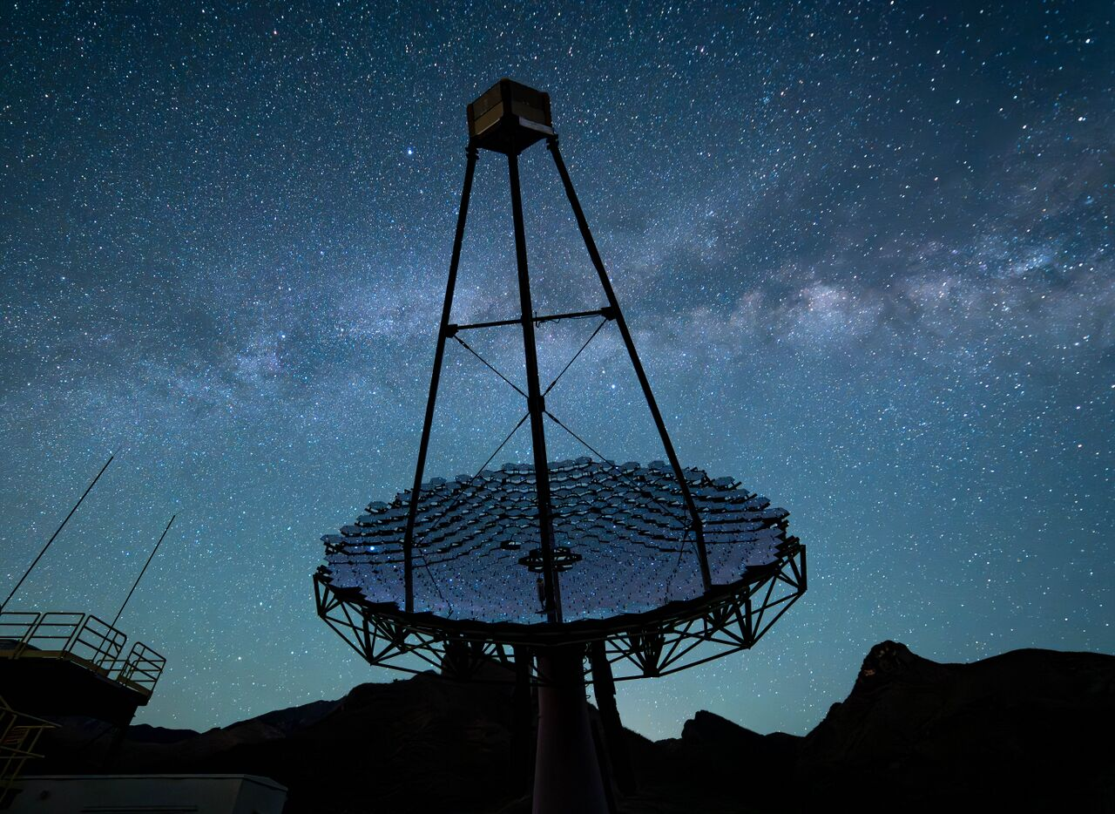
Explorations of PeVatrons with VERITAS
Understanding galactic cosmic rays through the investigation of new mysterious TeV Sources.
Event Level Searches for New Physics with IACTs: Ultrashort gamma-ray bursts
Matthew Lundy,
Ngan H. Nguyen, Erwin Tanin, Xuheng Luo, Rachel Freeman, Qi Feng, Sophie Mertzel
on behalf of the VERITAS Collaboration
Columbia University
TeVPA 2026
Matthew Lundy
mwl2145@columbia.edu
matthew.lundy@mail.mcgill.ca

Slide 2
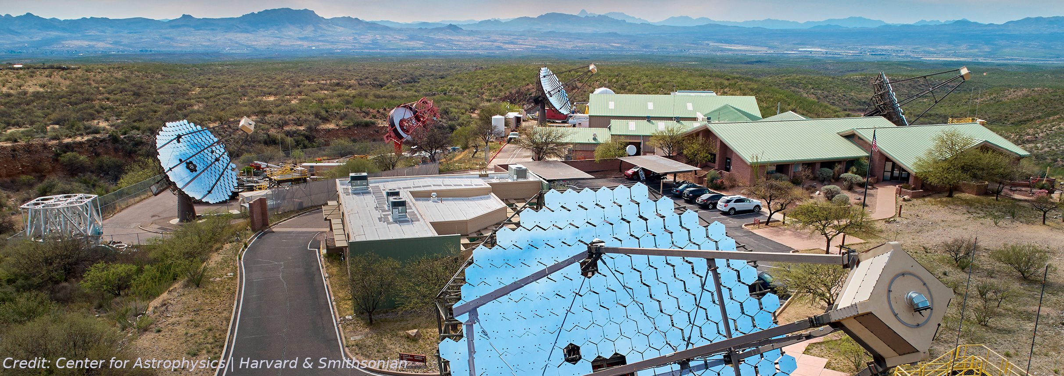
Very Energetic Radiation Imaging Telescope Array System
Pointed Instrument (3.5 ˚ diameter)
Good angular resolution (0.08 ˚ at 1 TeV)
85 GeV to >30 TeV Energy range
~905 h of “dark time” a year
~175 h in “moon time” (illum. >30%) a year
Operating from 2007-2026 with continued operations planned through 2027, at least
Fundamental Physics with VERITAS | 2026 | Matthew Lundy

Slide 3
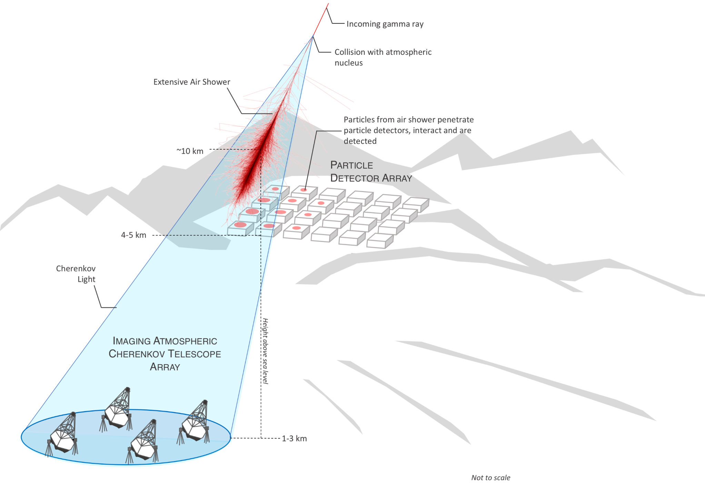
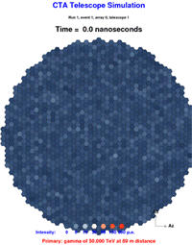
Cherenkov Telescopes
Particle detectors detect the direct interactions of particles from the air shower in their volume.
Credit: Barnacka
IACTs operate using an array of telescopes to stereoscopically image the approximately nanosecond flash of Cherenkov light from relativistic particles produced in an extensive air shower initialized by very high energy photons.
Typically showers occur ~10 km above sea level with a ~250 m light pool on the ground.
Fundamental Physics with VERITAS | 2026 | Matthew Lundy
Credit: Richard White

Slide 4
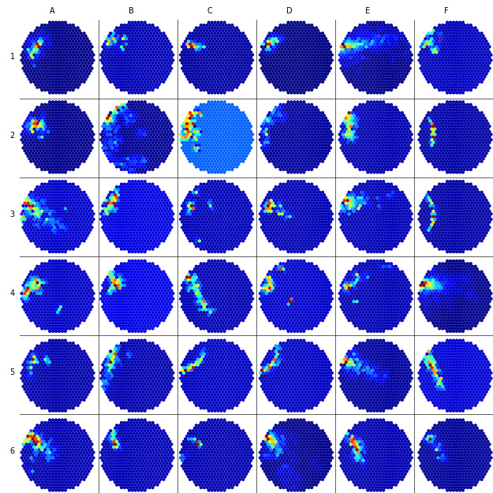
The VERITAS Event Archive
Credit: Muon Hunter 2.0
Trigger Rate:
~300 Hz
Yearly Observations:
~1000 Hours
Years of Observations:
~20 years
Total Event Archive:
> 20 billion events!
The vast majority of these events (>90%) are rejected for not appearing as gamma-ray like events and never investigated further.
Is there a hidden subset of these events that are rejected automatically but encode rare astrophysical phenomena or new fundamental physics?
Fundamental Physics with VERITAS | 2026 | Matthew Lundy

Slide 5
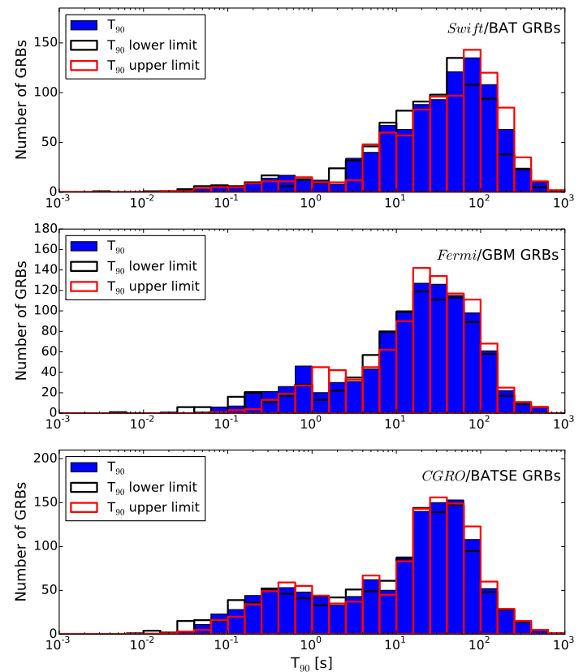
(Lien+, 2016)
Gamma-ray Bursts
?
Gamma-ray bursts are typically detected by space based keV-GeV detectors, and clear distinct populations are separated by duration (~0.01-5 seconds and ~1-1000s).
An obvious question to ask is if there exists additional populations outside of the search window that traditional detectors are sensitive to (LLGRBs for example).
If the event is narrow enough in time, deadtime constraints may lead to a non-detection of even extremely luminous events.
?
?
Fundamental Physics with VERITAS | 2026 | Matthew Lundy

Slide 6
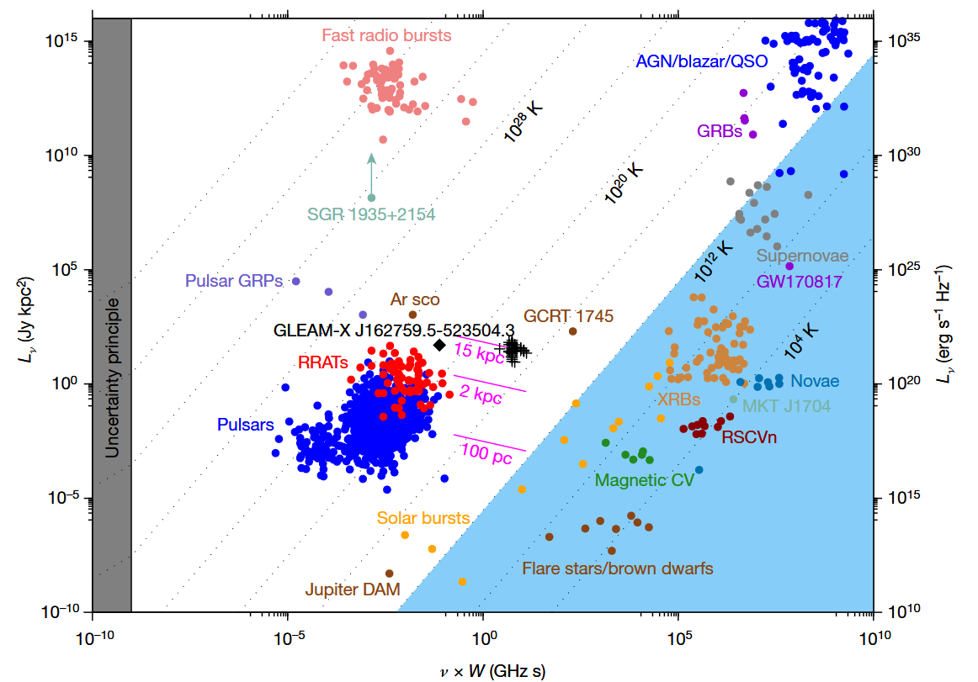
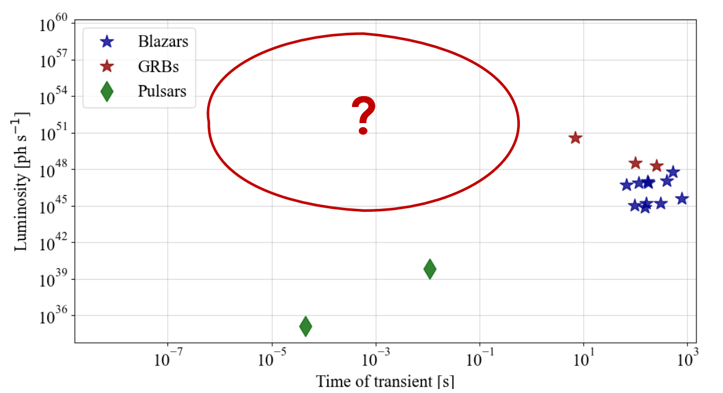
Radio
Gamma-ray
Preliminary
Preliminary
Preliminary
Preliminary
Preliminary
Preliminary
Preliminary
Preliminary
Transients that had orders of magnitude higher luminosity went undiscovered for decades in the radio simply because analysis had not been correctly targeted for high dispersion measure narrow pulses.
Fundamental Physics with VERITAS | 2026 | Matthew Lundy

Slide 7
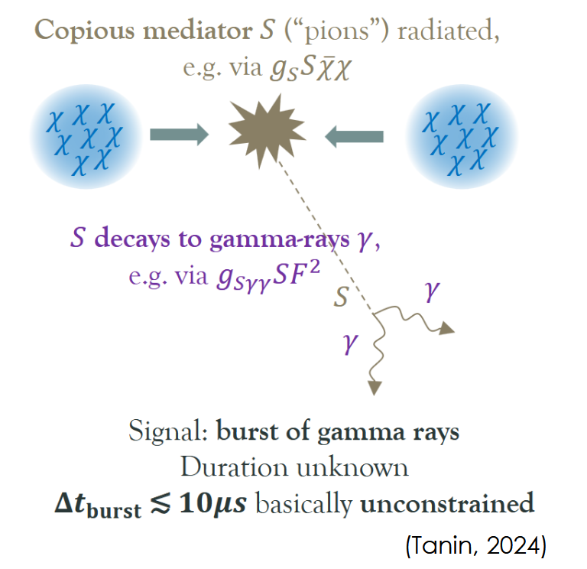
Dark Matter Potential Model
Most conventional IACT dark matter searches assume the signal from dark matter is constant in time, but perhaps bright local signatures may be transient.
One scenario could involve systems of strong self-interactions and ultraheavy composites with new particles mediating DM self-interactions. Potential DM self-interaction scenarios include;
Collapse of cosmic perturbations
Savastano et al. (2019), Chang et al. (2019), Flores et al. (2021), Domenech et al. (2023), Bramante et al. (2024)
First-order phase transitions
Witten (1984), Bai et al. (2019), Hong et al. (2020), Gross et al.(2021), Asadi et al. (2021)
And many more….
Fundamental Physics with VERITAS | 2026 | Matthew Lundy

Slide 8
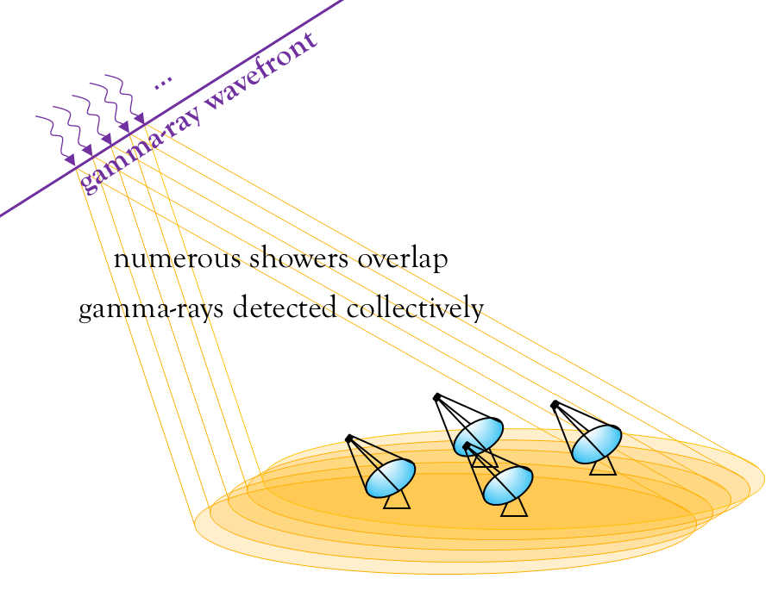
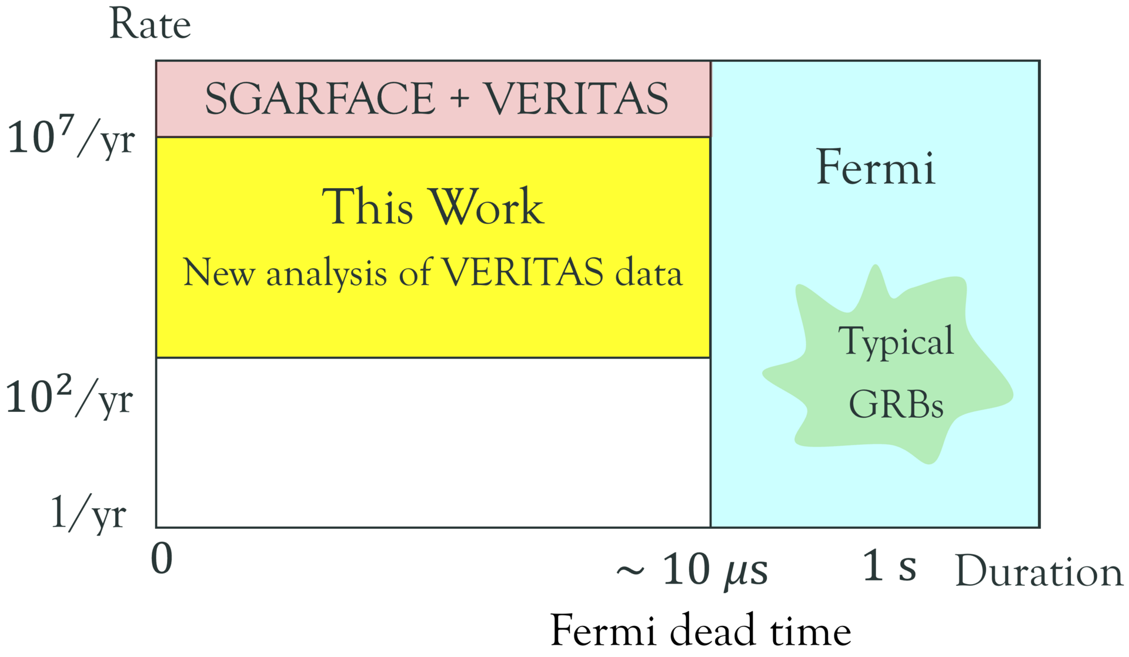
USGRBs in IACTs
The region of parameter space for ultra-short gamma-ray bursts (USGRBs) remains effectively unprobed since conventional analyses reject such signals.
Fundamental Physics with VERITAS | 2026 | Matthew Lundy

Slide 9
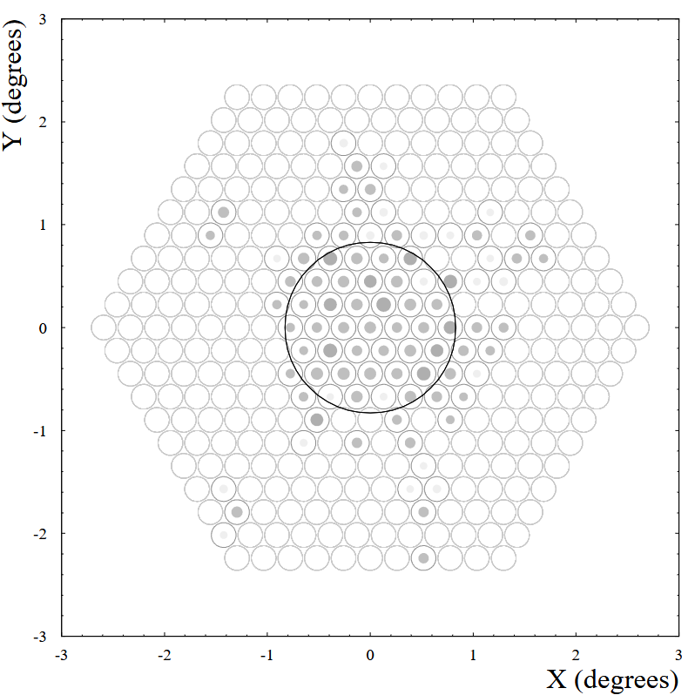
Ways of Identifying a Wavefront Event
(Krennrich+, 1999)
Previous searches with Whipple + VERITAS relied on several key difference between traditional air-showers and wavefronts.
Size of light pool
Separating telescopes beyond the typical light pool radius of single showers and searching for coincidences (Porter+, 1979)
Shape of Image
Due to the unique symmetric profile of the images compared to traditional ellipses the radius and eccentricity can be used to discriminate between traditional events and wavefronts (Krennrich+, 1999)
Duration of Events
The typical event duration is >100 ns compared to the ~10 ns duration of a single shower (LeBohec+ 2005).
Previous searches were limited in duration and/or had higher backgrounds due to the telescope(s) configuration.
Fundamental Physics with VERITAS | 2026 | Matthew Lundy

Slide 10
Basic Analysis Chain
Simulations
Threshold Determination
Characterization
Search and Candidate Validation
Traditional gamma-ray showers are simulated with CORSIKA (1, 10, 100 GeV gamma rays)
Fluence levels can be simulated from stacking random subsets of Cherenkov photon distributions
Photons are then passed through optics and camera simulations (GrOptics + CARE)
Effective fluence sensitivity is then determined for various camera offsets (~5 degree) and photon energies.
Triggered events are then parameterized with a standard moment analysis (“Hillas Parameters”)
Self-similarity of parameters (“parallax”) are then used as an initial discriminant for wavefront identification.
Initial parallax based cuts are applied to the VERITAS processed archive to select candidate subsets.
Candidates can be further reduced with trace level verification of the time decomposed event images.
Fundamental Physics with VERITAS | 2026 | Matthew Lundy

Slide 11
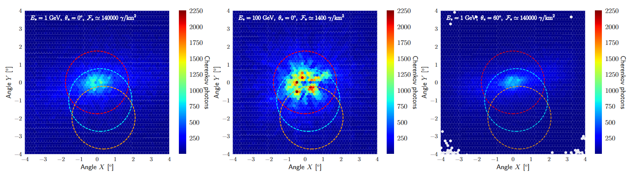
Basic Analysis Chain
Simulations
Threshold Determination
Characterization
Search and Candidate Validation
Preliminary
Preliminary
Preliminary
Traditional gamma-ray showers are simulated with CORSIKA (1, 10, 100 GeV gamma rays)
Fluence levels can be simulated from stacking random subsets of Cherenkov photon distributions
Photons are then passed through optics and camera simulations (GrOptics + CARE)
Effective fluence sensitivity is then determined for various camera offsets (~5 degree) and photon energies.
Triggered events are then parameterized with a standard moment analysis (“Hillas Parameters”)
Self-similarity of parameters (“parallax”) are then used as an initial discriminant for wavefront identification.
Initial parallax based cuts are applied to the VERITAS processed archive to select candidate subsets.
Candidates can be further reduced with trace level verification of the time decomposed event images.
Fundamental Physics with VERITAS | 2026 | Matthew Lundy

Slide 12
Basic Analysis Chain
Simulations
Threshold Determination
Characterization
Search and Candidate Validation
Traditional gamma-ray showers are simulated with CORSIKA (1, 10, 100 GeV gamma rays)
Fluence levels can be simulated from stacking random subsets of Cherenkov photon distributions
Photons are then passed through optics and camera simulations (GrOptics + CARE)
Effective fluence sensitivity is then determined for various camera offsets (~5 degree) and photon energies.
Triggered events are then parameterized with a standard moment analysis (“Hillas Parameters”)
Self-similarity of parameters (“parallax”) are then used as an initial discriminant for wavefront identification.
Initial parallax based cuts are applied to the VERITAS processed archive to select candidate subsets.
Candidates can be further reduced with trace level verification of the time decomposed event images.
Fundamental Physics with VERITAS | 2026 | Matthew Lundy

Slide 13
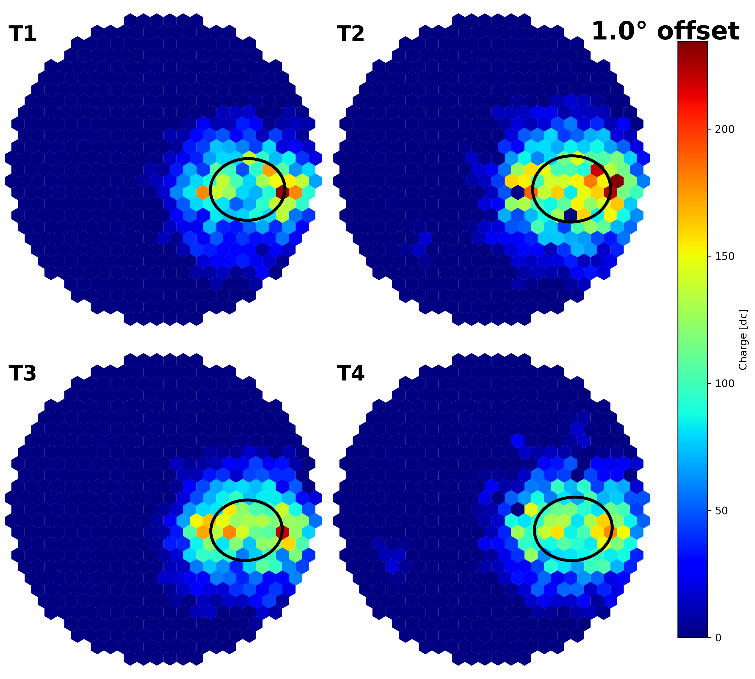
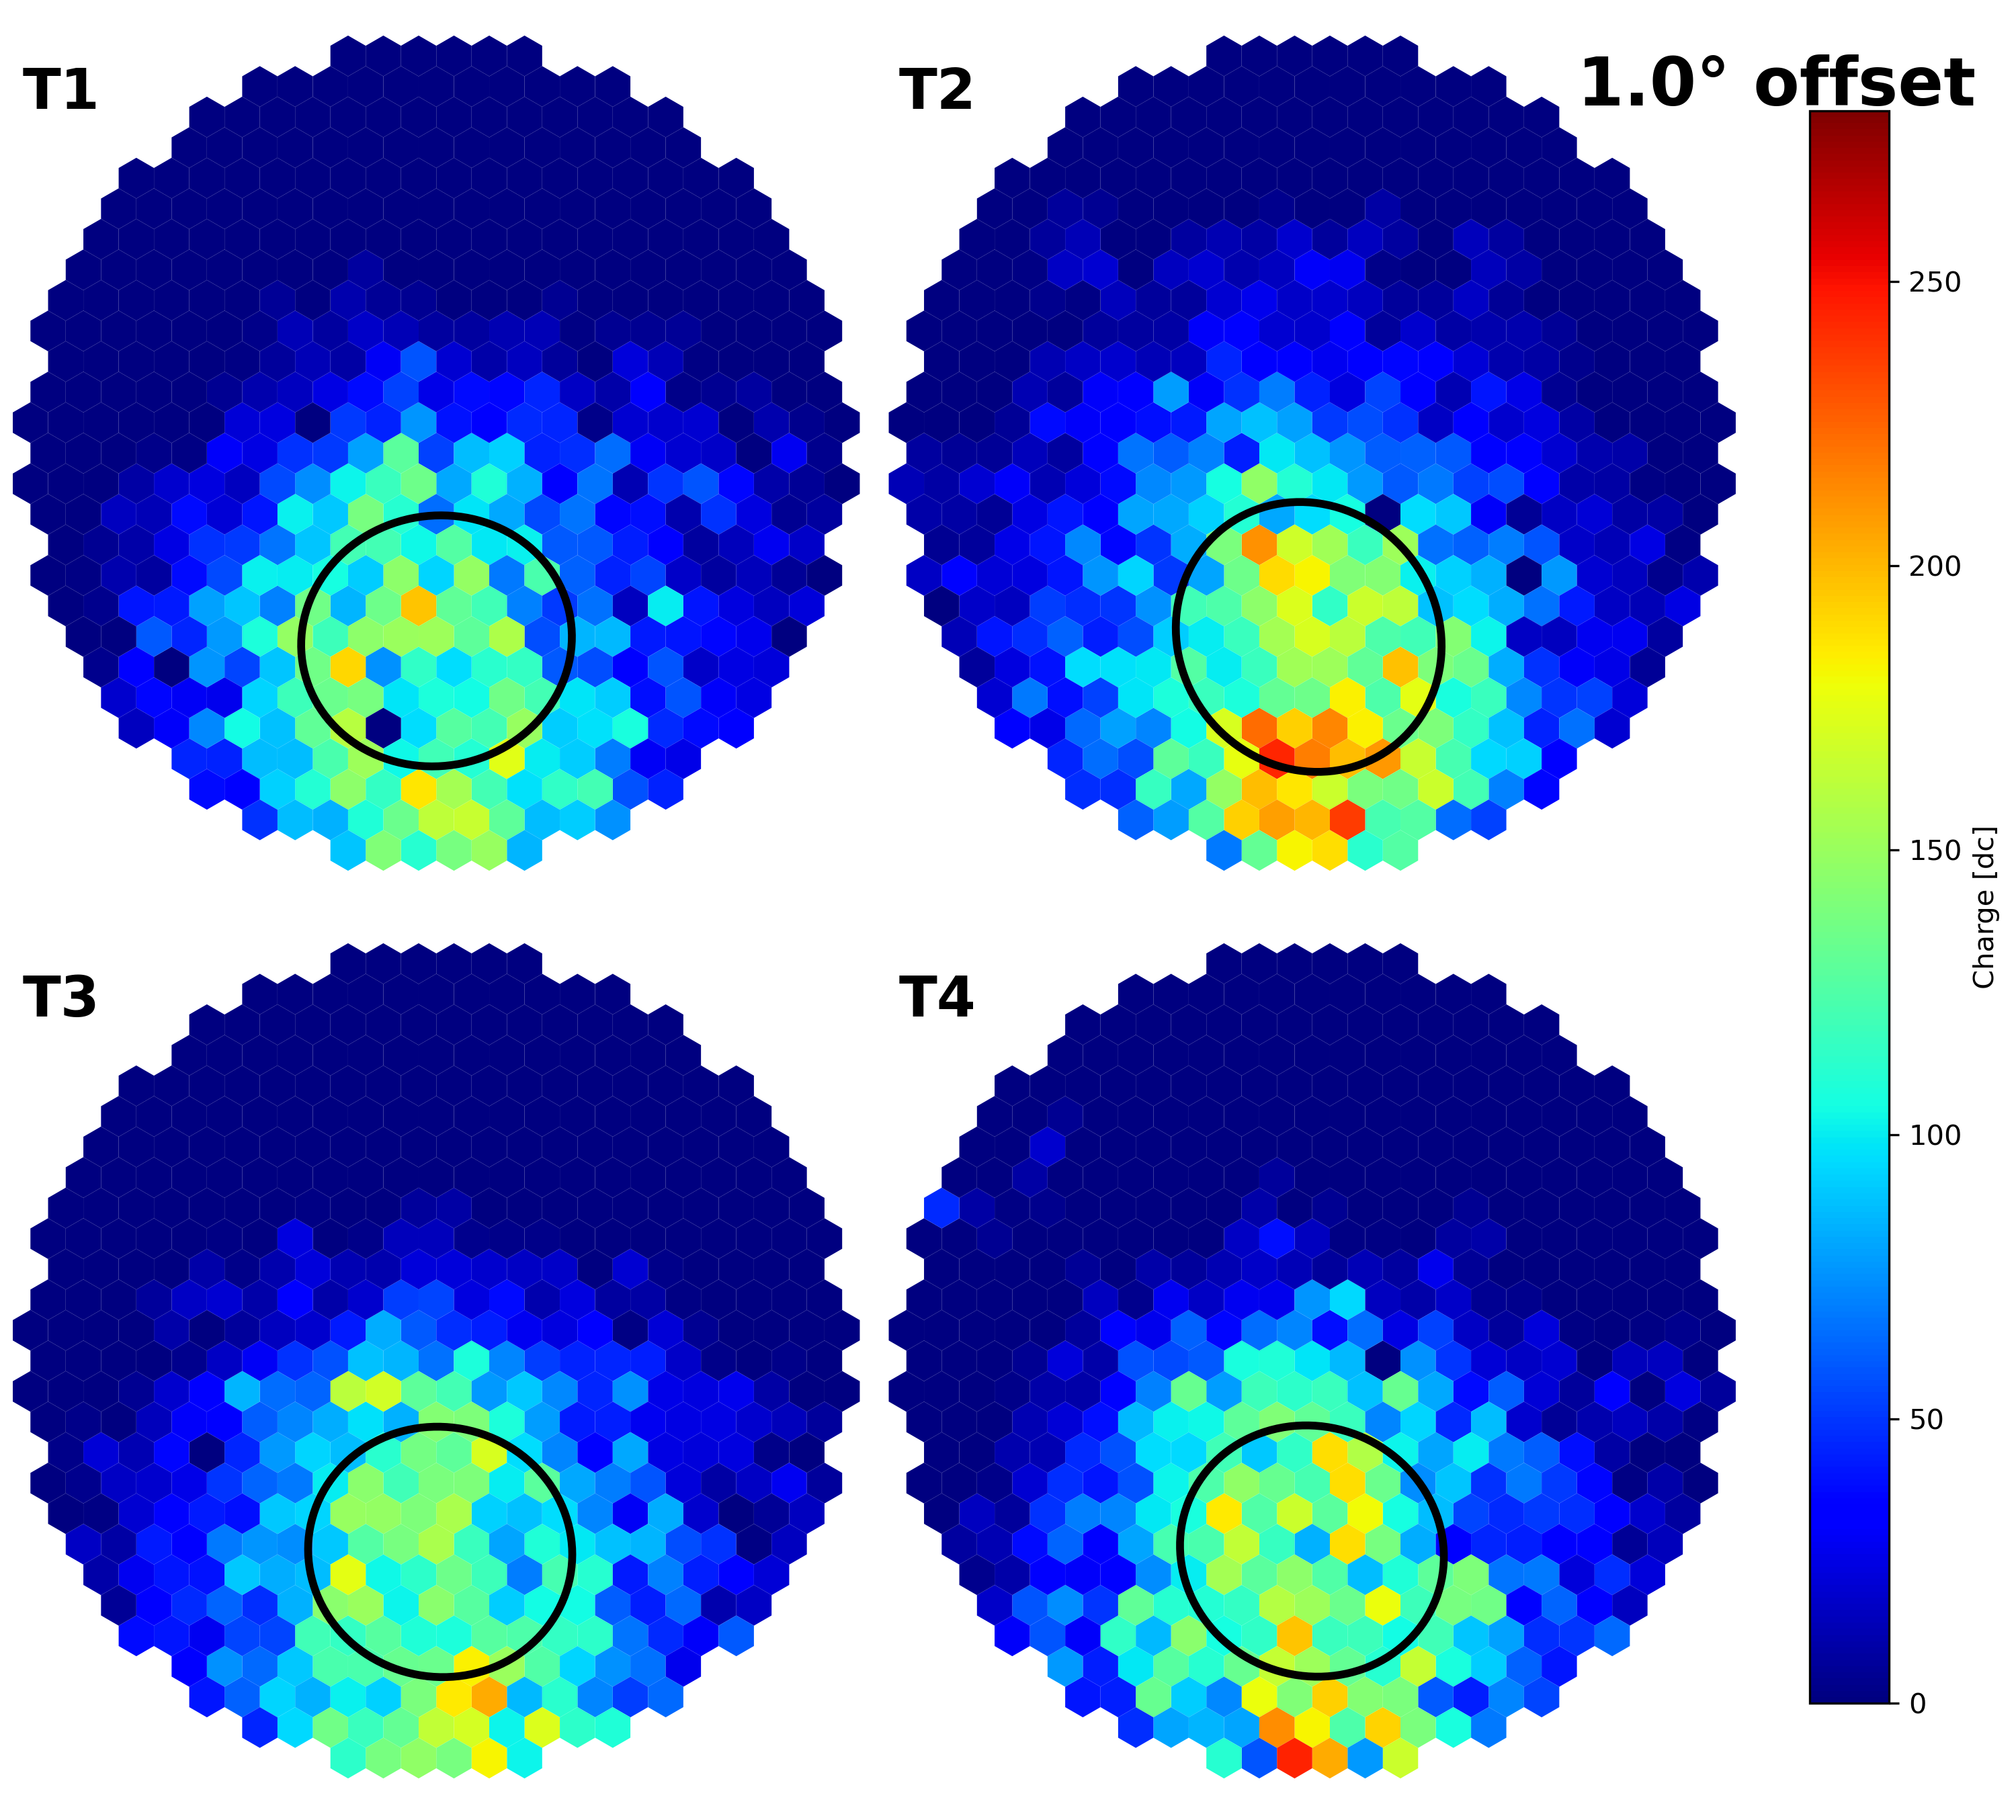
Rare Event Searches – Realistic Simulations
VERITAS Collaboration, in prep.
Preliminary
Preliminary
Preliminary
Preliminary
Preliminary
Preliminary
Preliminary
Preliminary
First modern shower simulations for wavefront events have been performed to realistically simulate USGRBs in VERITAS. Rates and acceptances have been calculated for all typical array configurations.
Search ongoing through ~20 years of events with search optimization based on simulations.
Fundamental Physics with VERITAS | 2026 | Matthew Lundy

Slide 14
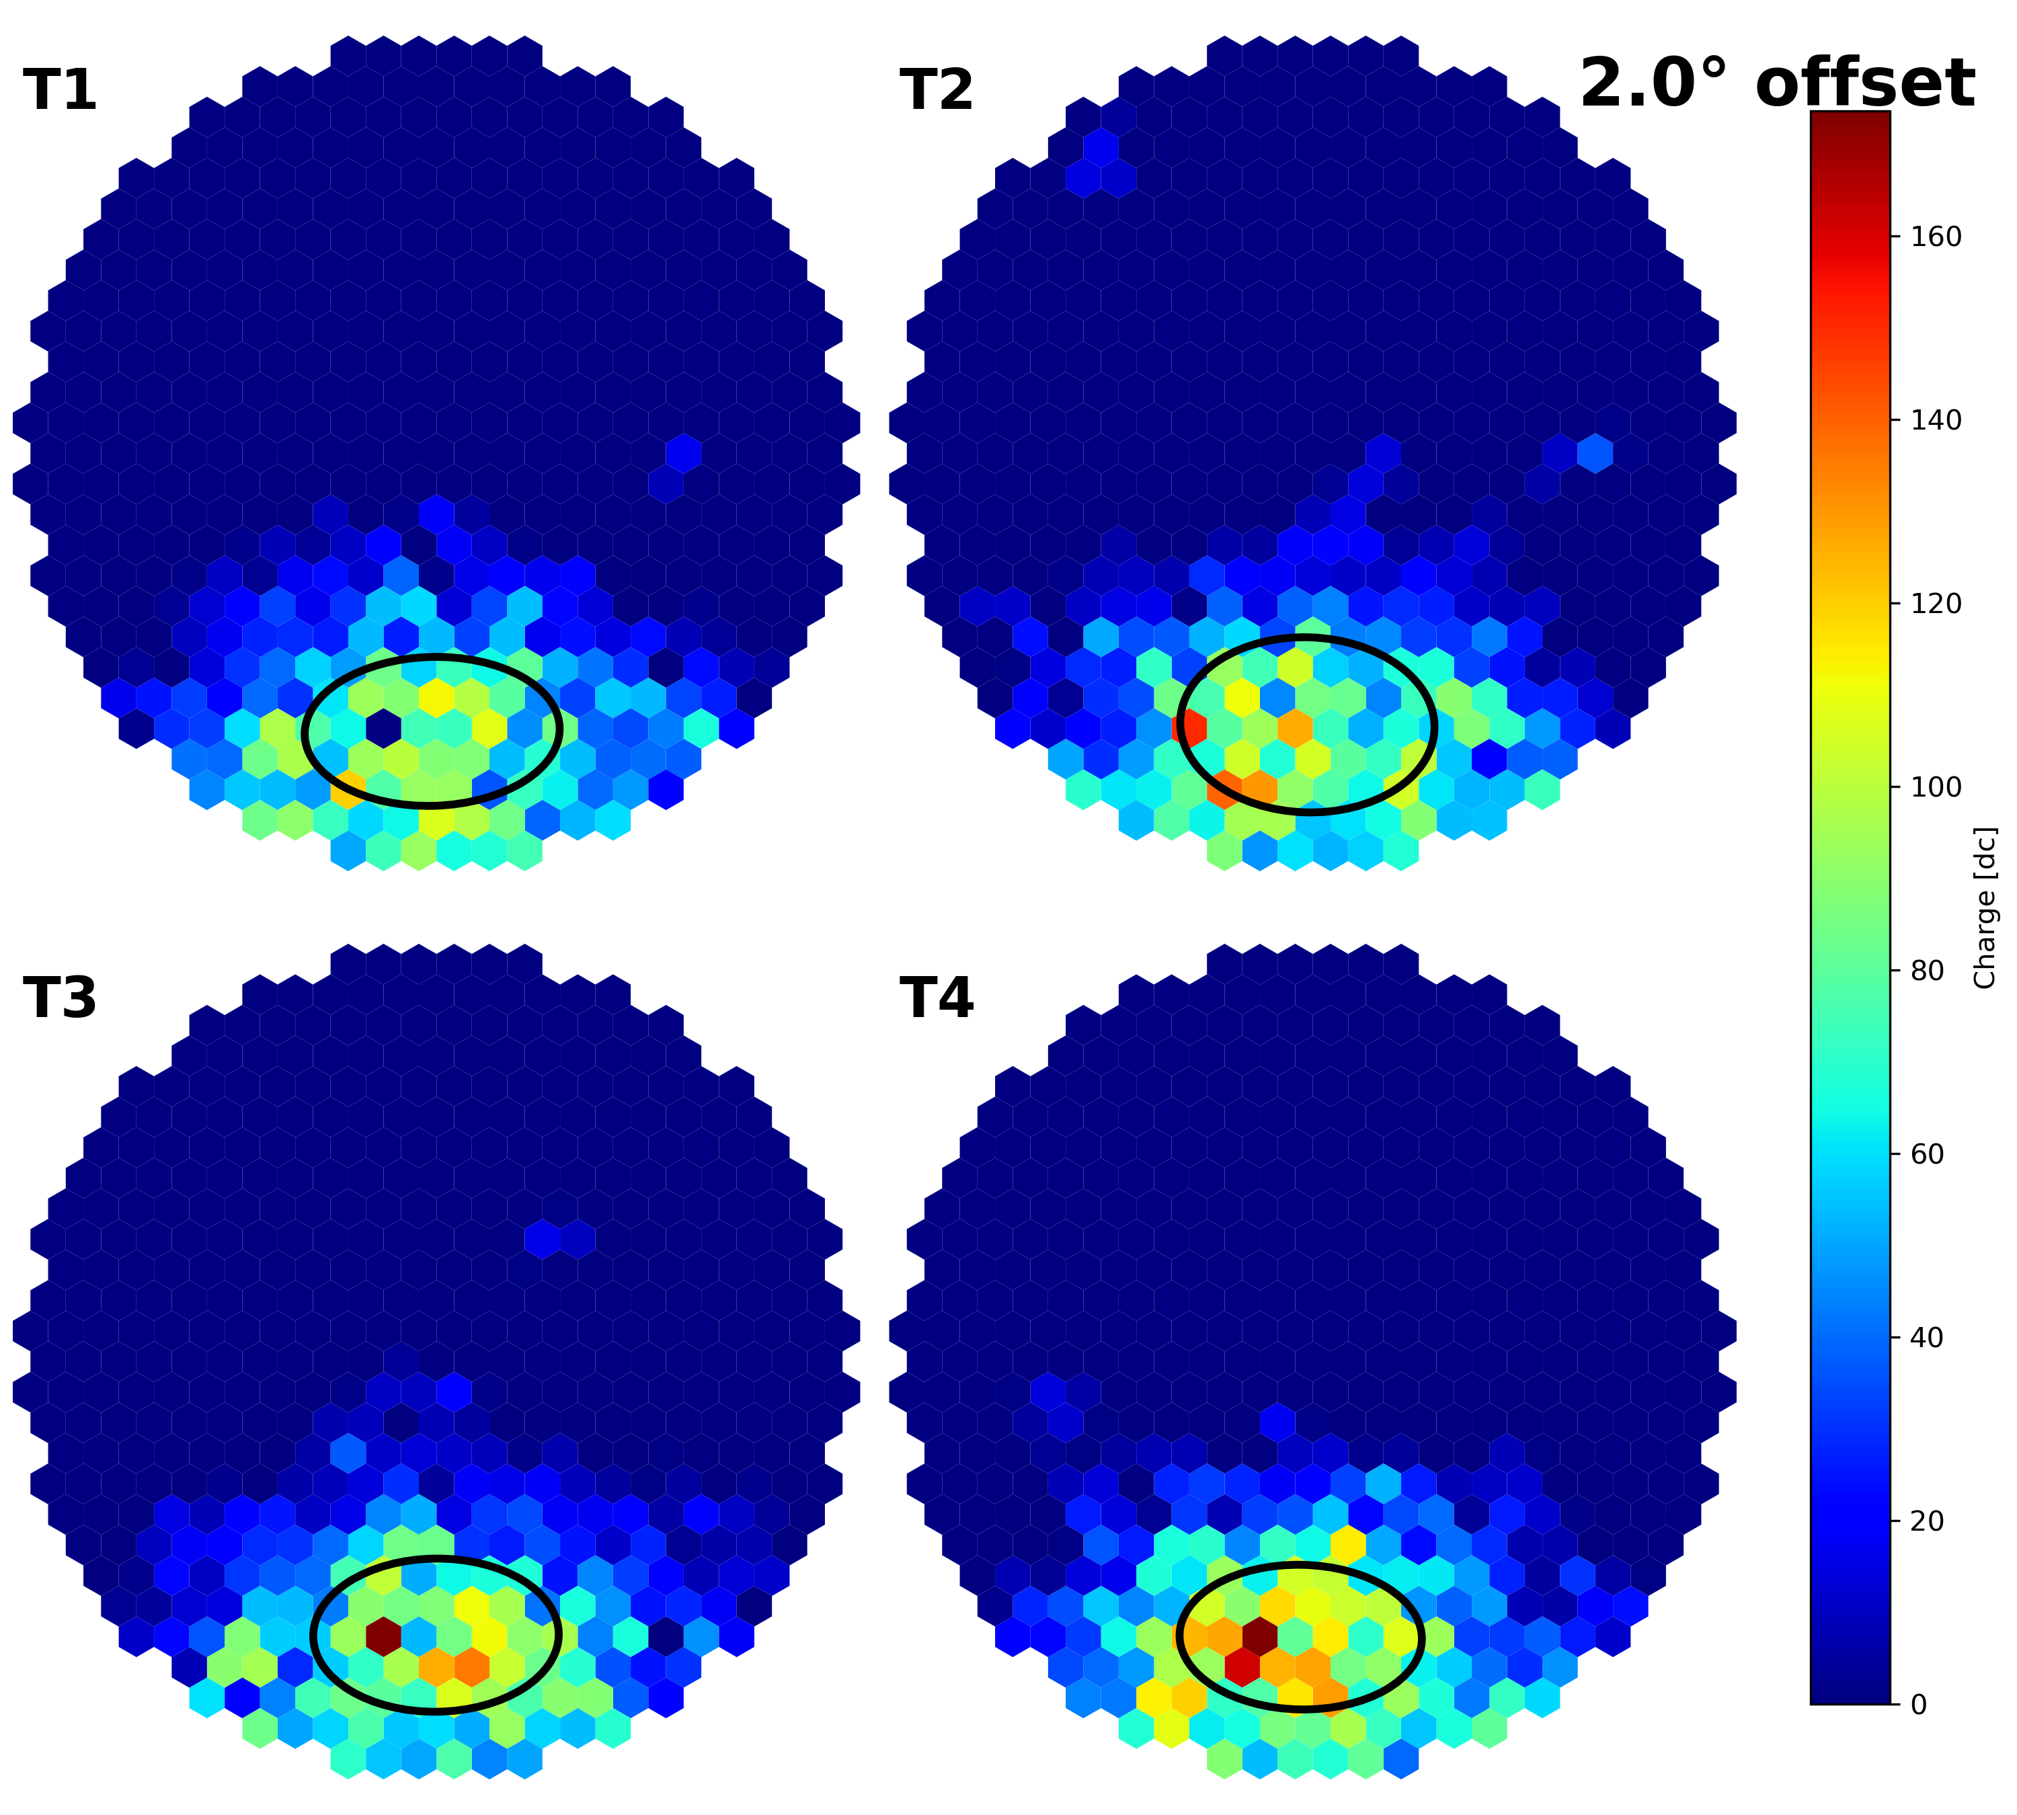
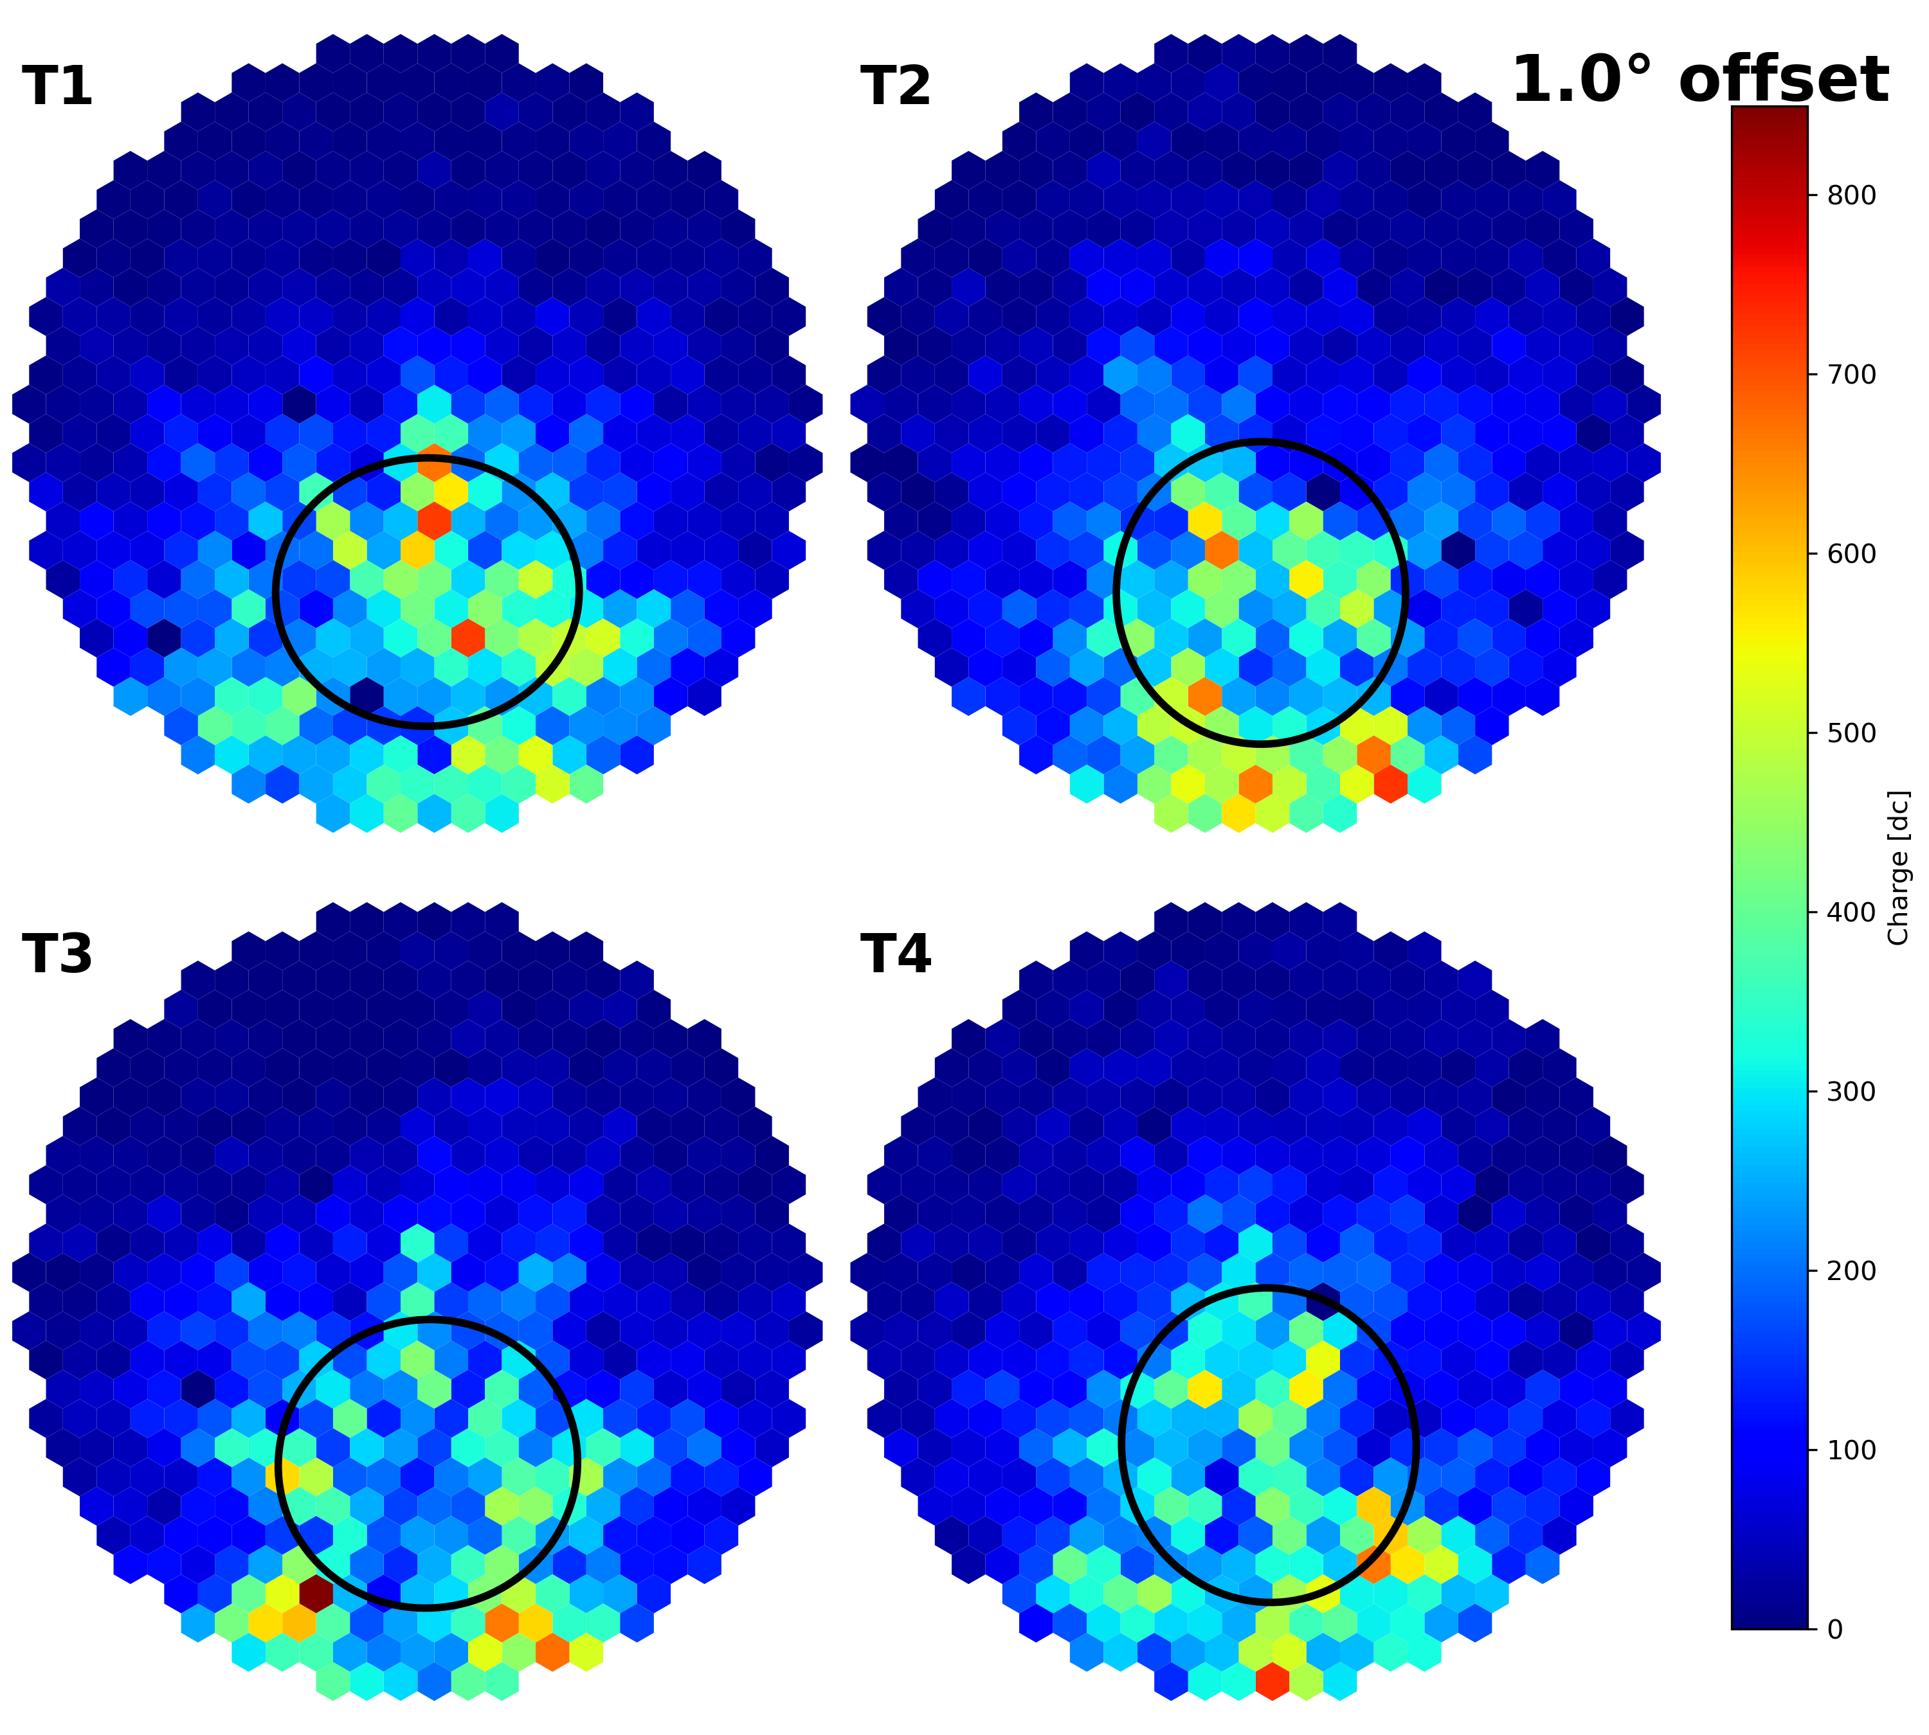
Rare Event Searches – Realistic Simulations
VERITAS Collaboration, in prep.
Preliminary
Preliminary
Preliminary
Preliminary
Preliminary
Preliminary
Preliminary
Preliminary
First modern shower simulations for wavefront events have been performed to realistically simulate USGRBs in VERITAS. Rates and acceptances have been calculated for all typical array configurations.
Search ongoing through ~20 years of events with search optimization based on simulations.
Fundamental Physics with VERITAS | 2026 | Matthew Lundy

Slide 15
Projected Sensitivity
VERITAS Collaboration, in prep.
Preliminary
Preliminary
Preliminary
Preliminary
Preliminary
Preliminary
Preliminary
Preliminary
Preliminary
Preliminary
Simulation are processed through a standard VERITAS gamma-ray trigger procedure to estimate the reach and sensitivity of VERITAS to various configurations of shower parameters and estimate the burst rate sensitivity.
Fundamental Physics with VERITAS | 2026 | Matthew Lundy

Slide 16
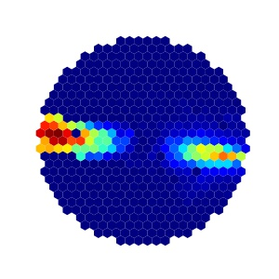
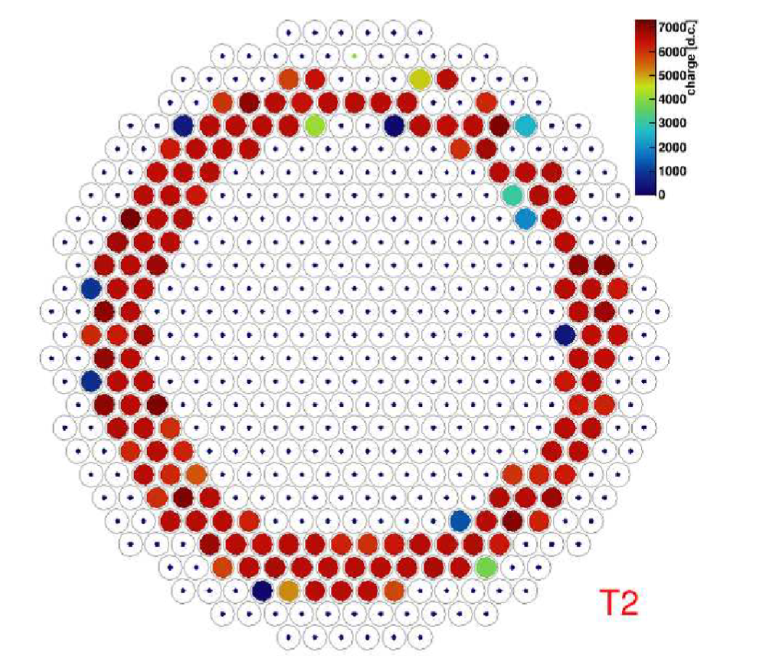
Future of Rare Event Searches With VERITAS
Magnetic Monopoles
Double Events
Quark Nuggets
(Rizk, 2025)
Simulation
Data
Sketch
Bright “muon ring” like signals.
Air showers with double event
Strip like showers
Fundamental Physics with VERITAS | 2026 | Matthew Lundy

Slide 17
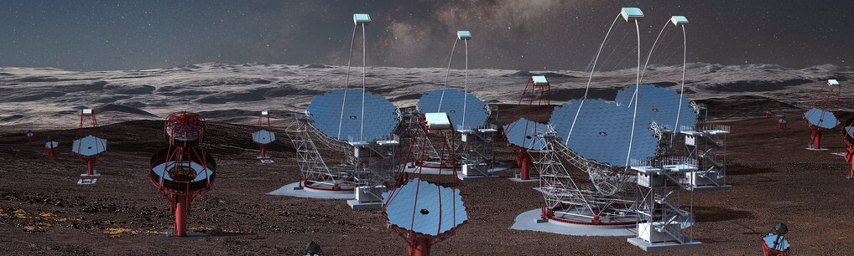
Prospects for Future IACTs
Next generation IACTs are currently under construction with larger effective areas and number of instruments.
CTAO, LACT, ASTRI, and PANOSETI are all expected to be partially or fully operational by ~2026-2028.
But they do not have the archive of the current generation -> critical for rare events!
Fundamental Physics with VERITAS | 2026 | Matthew Lundy
Image Credit: CTAO

Slide 18
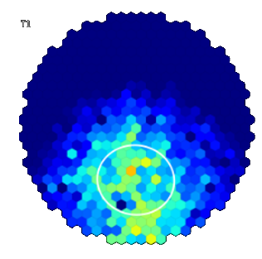
VERITAS USGRBs – Summary
IACTs are sensitive to a new potential class of transients called Ultra-Short Gamma-ray Bursts
Realistic shower simulations from CORISKA processed through a VERITAS pipeline have allowed for accurate estimations of the VERITAS sensitivity to events from 1 GeV – 100 GeV
VERITAS’s default gamma-ray trigger will record USGRB showers down to fluences of 10⁻³ GeV/m²
Current search through the VERITAS archival data for these candidates is ongoing.
Preliminary
Fundamental Physics with VERITAS | 2026 | Matthew Lundy

Slide 19
Questions?
Contact:
mwl2145@columbia.edu
Fundamental Physics with VERITAS | 2026 | Matthew Lundy

