Slide 1

Optical Counterpart search for a Month-timescale
IceCube Neutrino Multiplet Event
Seiji TOSHIKAGE in collaboration with
Masaomi Tanaka, Shigeo S. Kimura (Tohoku U.),
Nobuhiro Shimizu, Wataru B. Iwakiri, Shigeru Yoshida (Chiba U.),
Tomoki Morokuma (Chiba Tech), and IceCube follow-up team

Slide 2
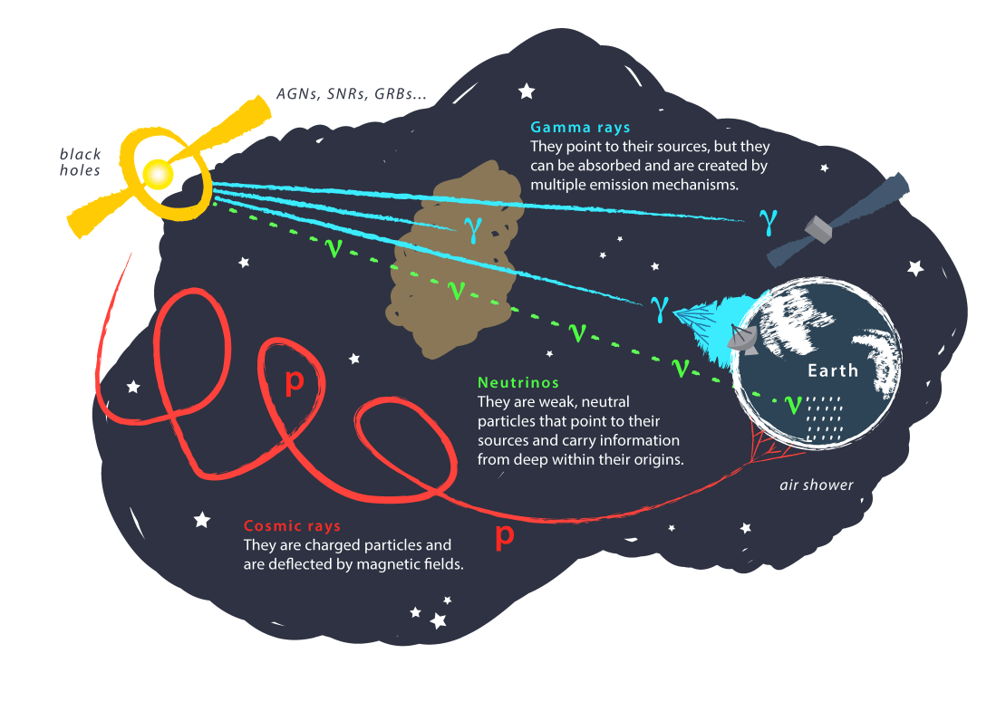
Origin of high-energy particles
Credit: Juan Antonio Aguilar and Jamie Yang. IceCube/WIPAC
Neutrino as a probe of high-energy particle origins

Slide 3
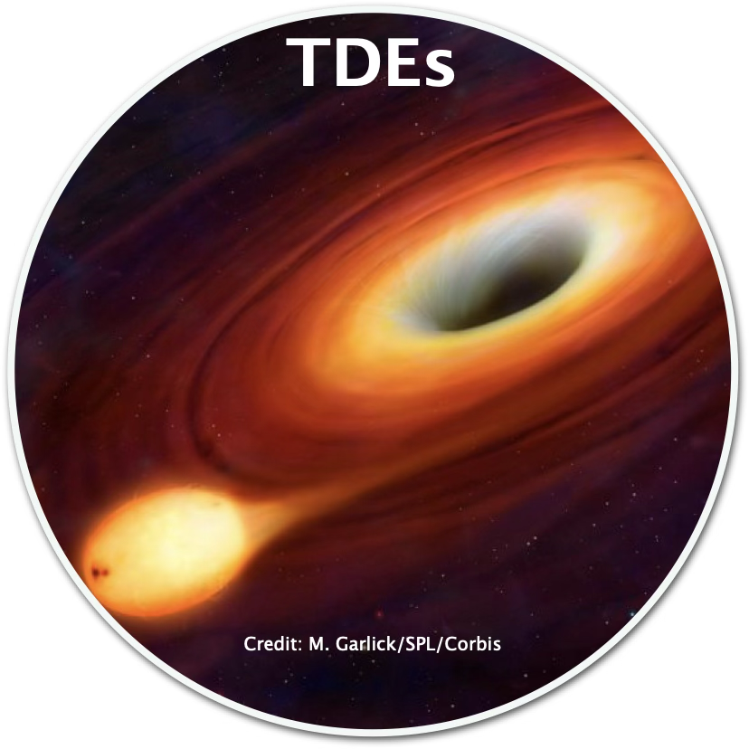
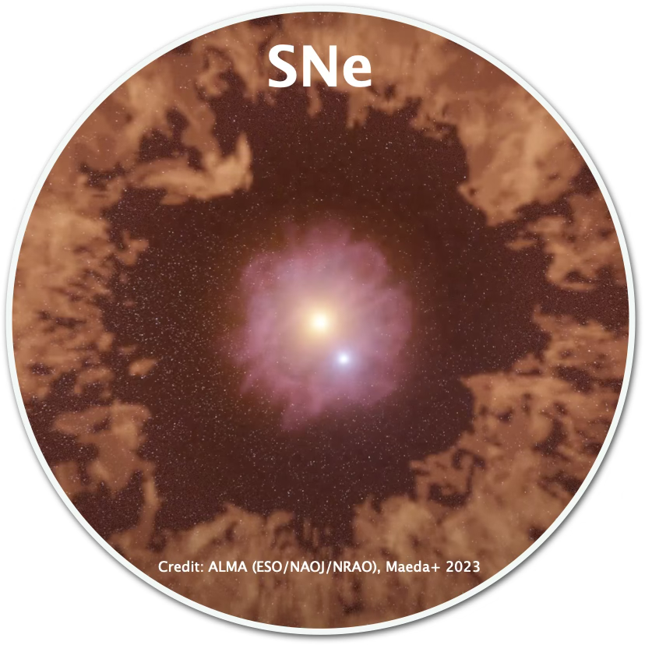
Optical transient as neutrino sources
Theoretical predictions
Choked jets/CSM interaction
Jetted TDEs/Corona
e.g., Razzaque+ 2004, Murase+ 2011
e.g., Wang+ 2011
Possible Associations ??
Type Ibn: Stein+ 2025
Type IIn: Lu+ 2025, Garrappa+ 2025
Stein+ 2021, Reusch+ 2022, Jiang+ 2023,
van Velzen+ 2024, Yuan+ 2024, Li+ 2024, …
Talk by Mainak (SLSNe, yesterday), Yosuke (Ibn, tomorrow)

Slide 4
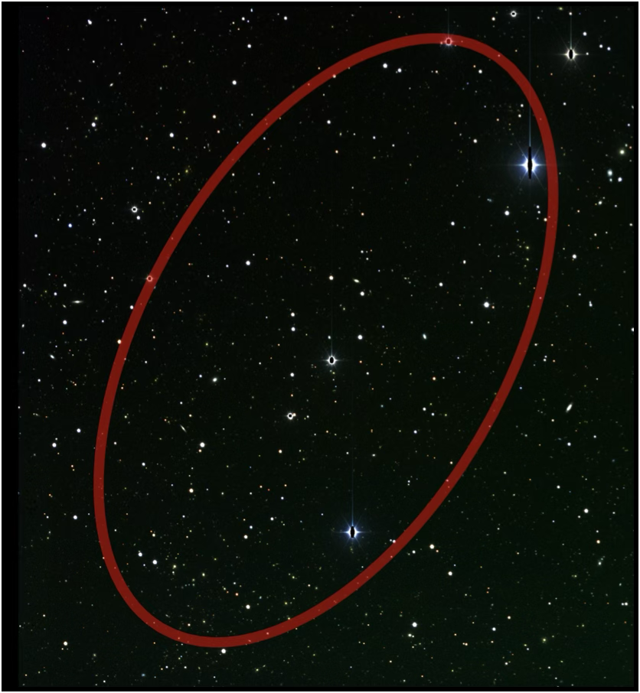
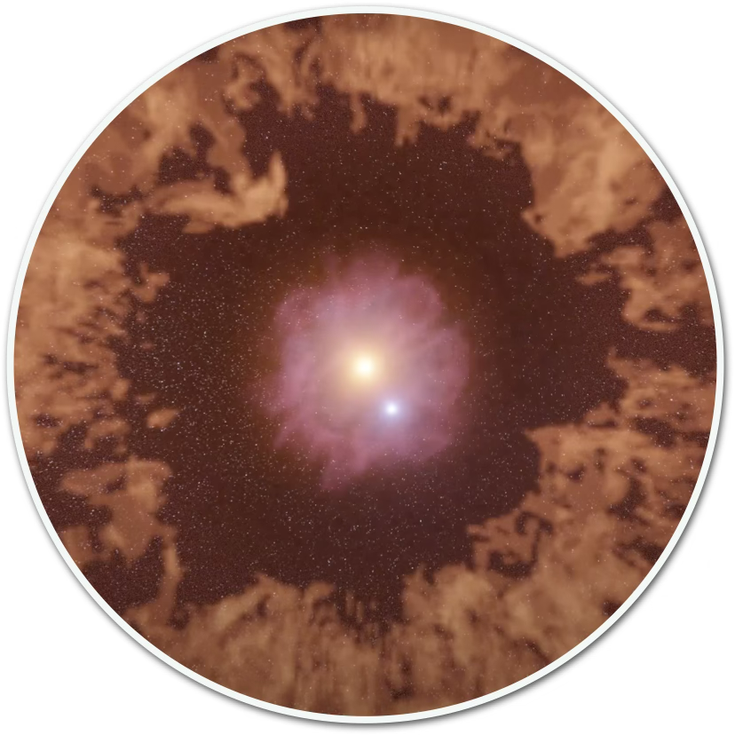
Optical follow-up observations
To put it very simply,
Find a candidate!
No transient…
Identify neutrino source!
Constrain transient scenario

Slide 5
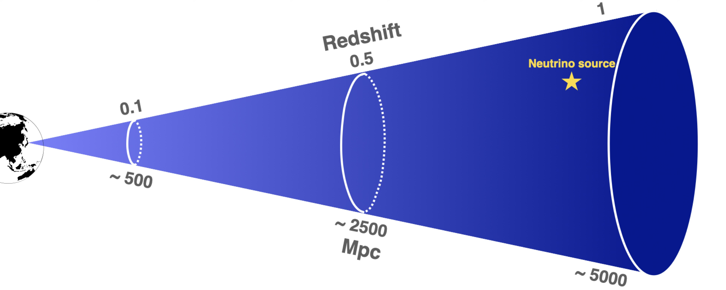
Issue: Difference of sensitivity
IceCube is sensitive to neutrino sources up to redshift ~ 1-2

Slide 6
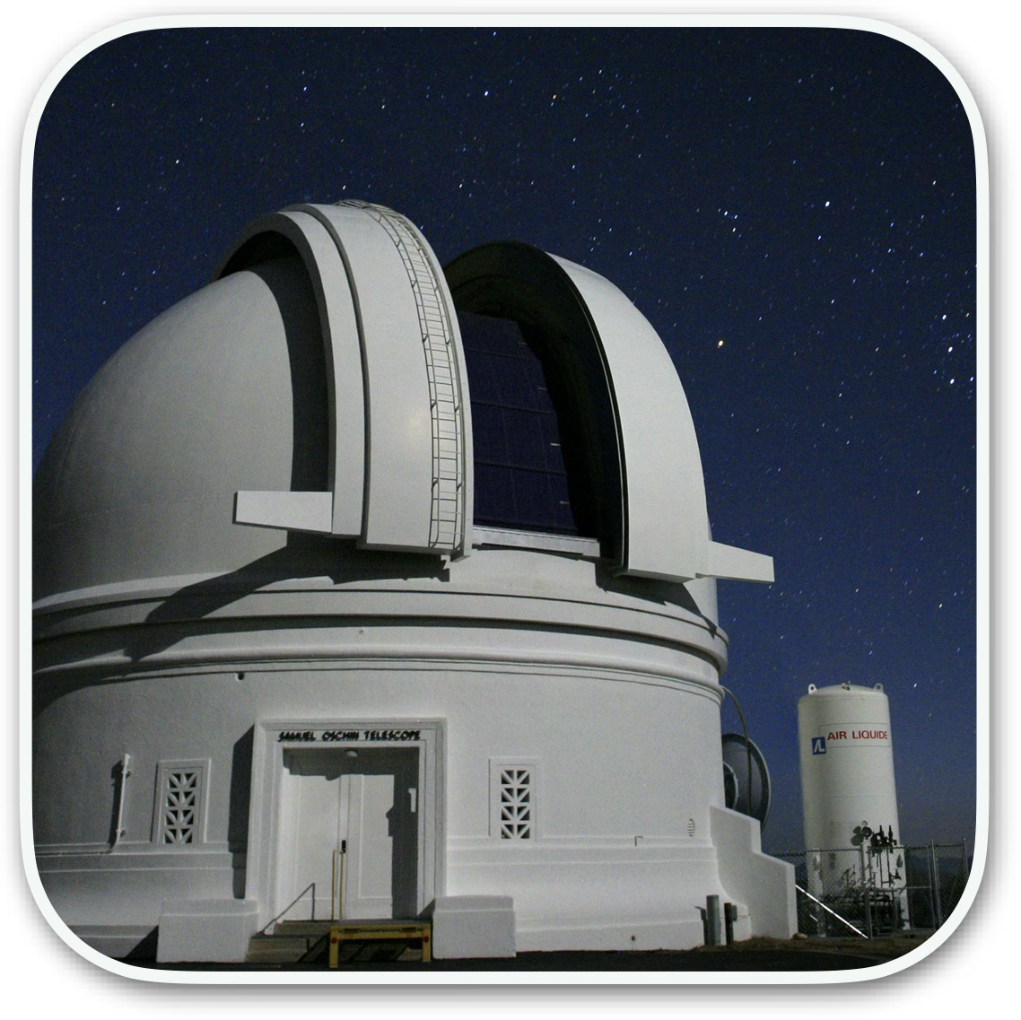
Issue: Difference of sensitivity
1m
Optical counterparts are easily missed by small telescope
High “recovery rate” is needed

Slide 7

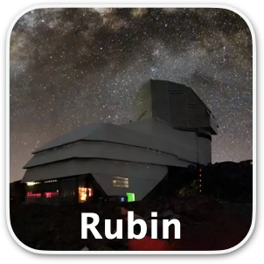
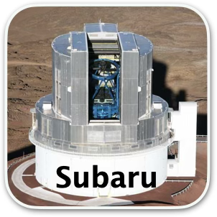
Solution 1: Use large telescope
1m
High recovery rate can be achieved
BUT, high background (unrelated SNe/TDEs) …

Slide 8
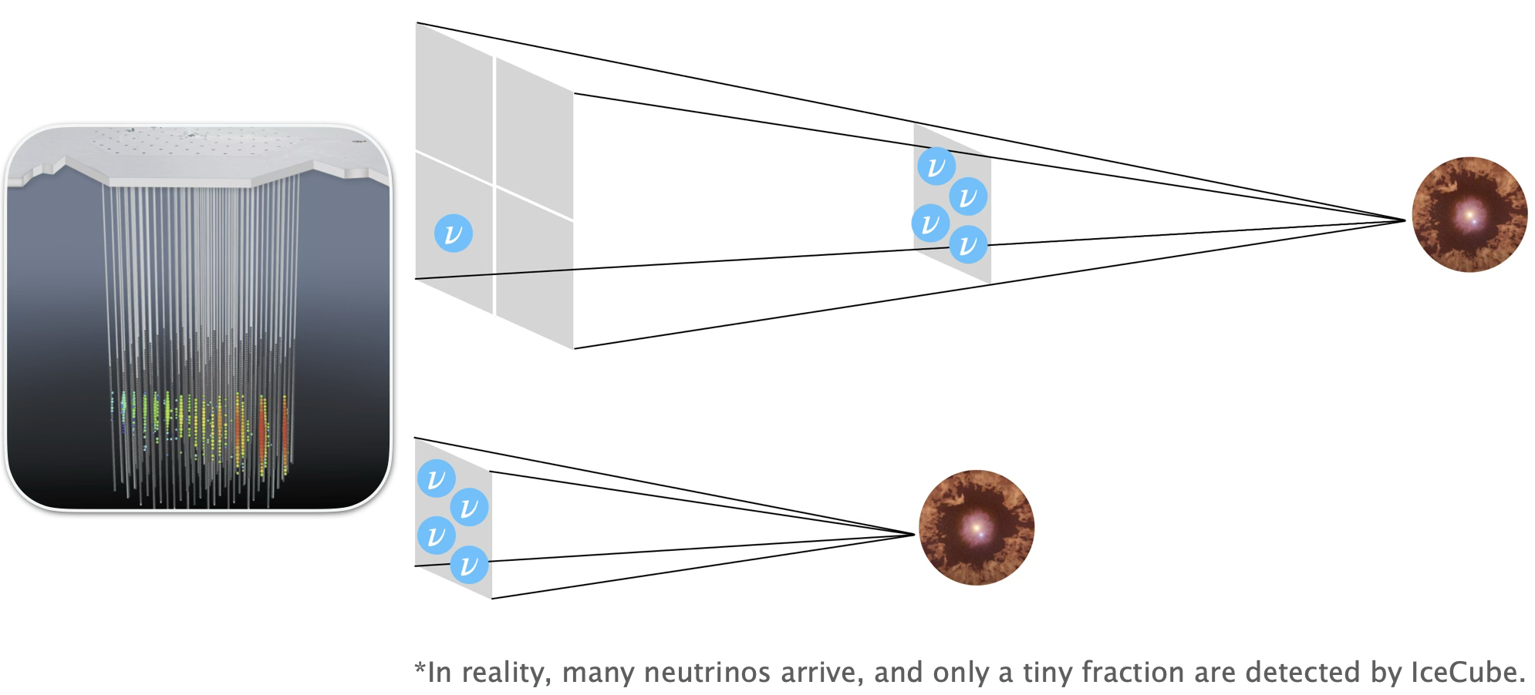
Solution 2: Neutrino “multiplet”
“Multiplet”: multiple neutrino detections coincident in both space and time
Yoshida+ 2022, IceCube collaboration 2025

Slide 9
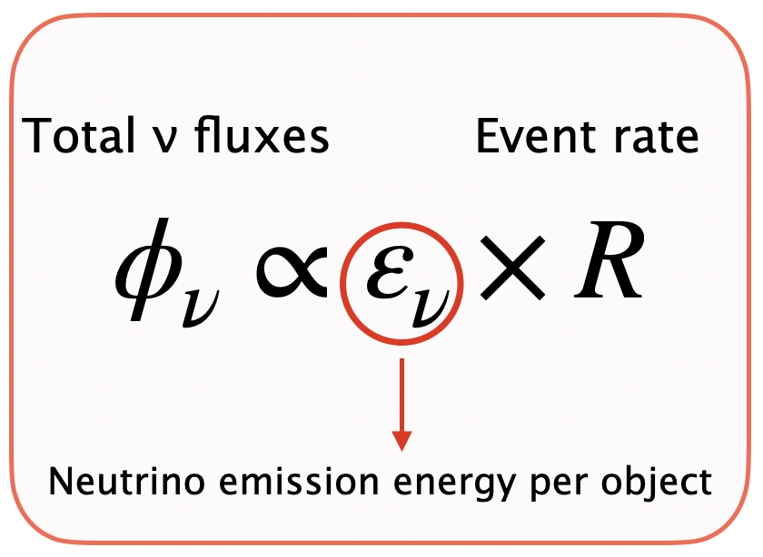
Solution 2: Neutrino “multiplet”
e.g., Assume SLSNe are the dominant high-energy neutrino sources
We can focus on nearby events

Slide 10
Solution 2: Neutrino “multiplet”
1m
High recovery rate
AND Low-background rate can be achieved!

Slide 11
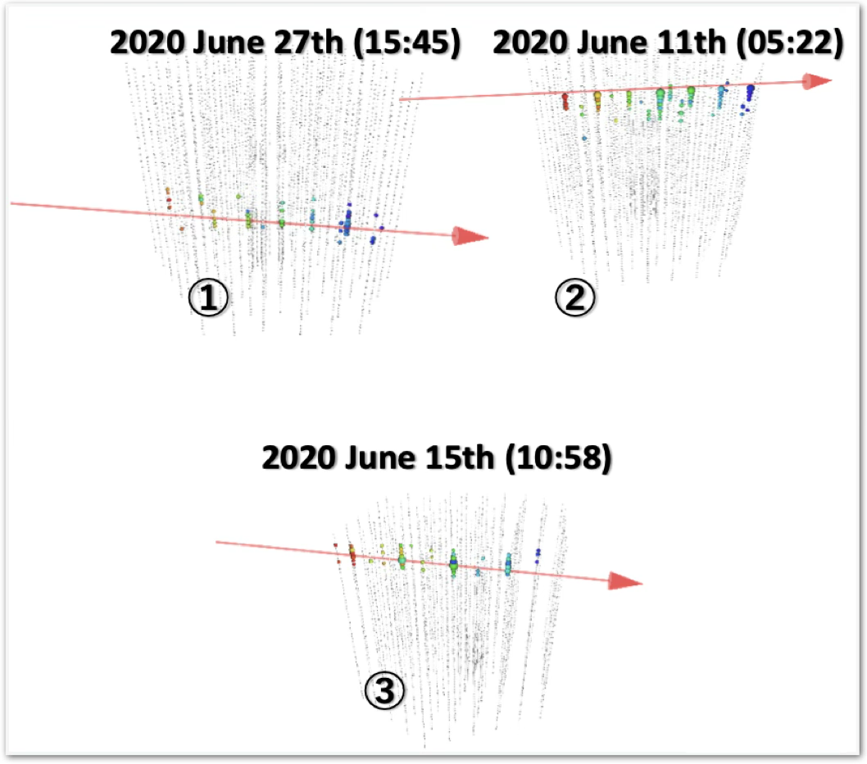
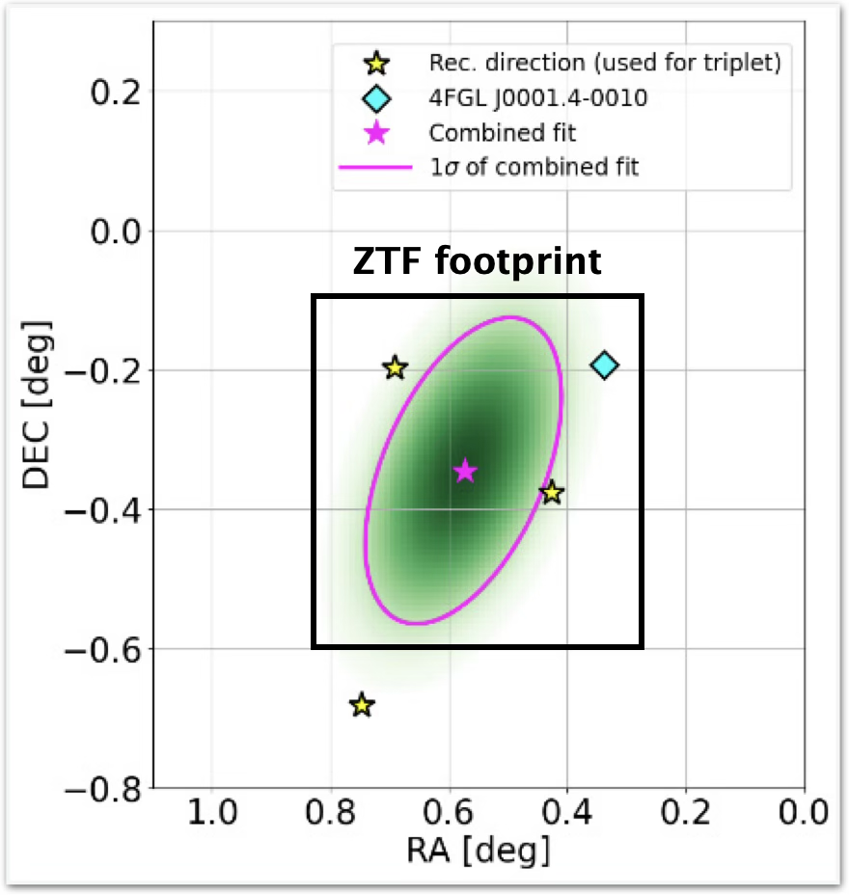
A neutrino triplet event in June 2020
IceCube collaboration 2025
Month-timescale neutrino triplet!
Serendipitous ZTF observations!
From Nobu Shimizu’s slide
First opportunity to search for an optical counterpart to a neutrino multiplet!

Slide 12






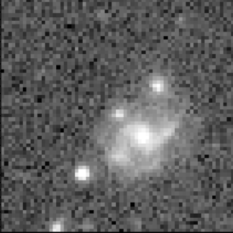
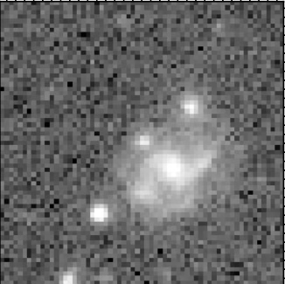
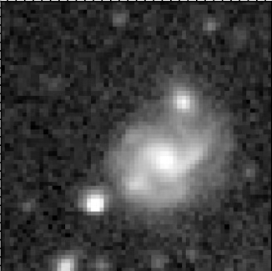
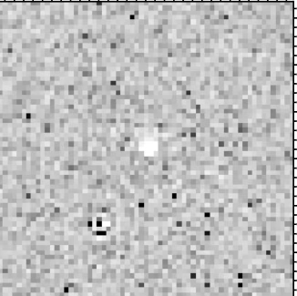
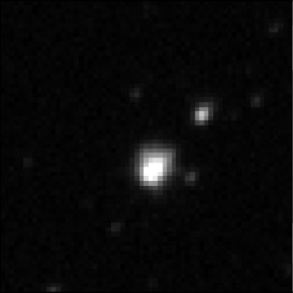
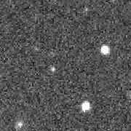
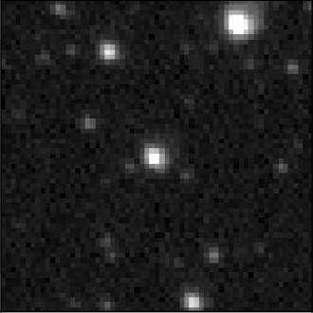
Data analysis: ZTF general filtering procedure
Image quality
Multiple detections
No galactic star
All detections
Transient
New
Diff
-
Old
=
Artifacts
Moving objects
Variables

Slide 13
Data analysis: ZTF general filtering procedure
Image quality
Multiple detections
No galactic star
All detections
Recovery rate
has not been measured
Room to
reduce background
~ 0.1
per sq. deg
Artifacts
Moving objects
Variables
Optimize for month-timescale optical counterpart search

Slide 14
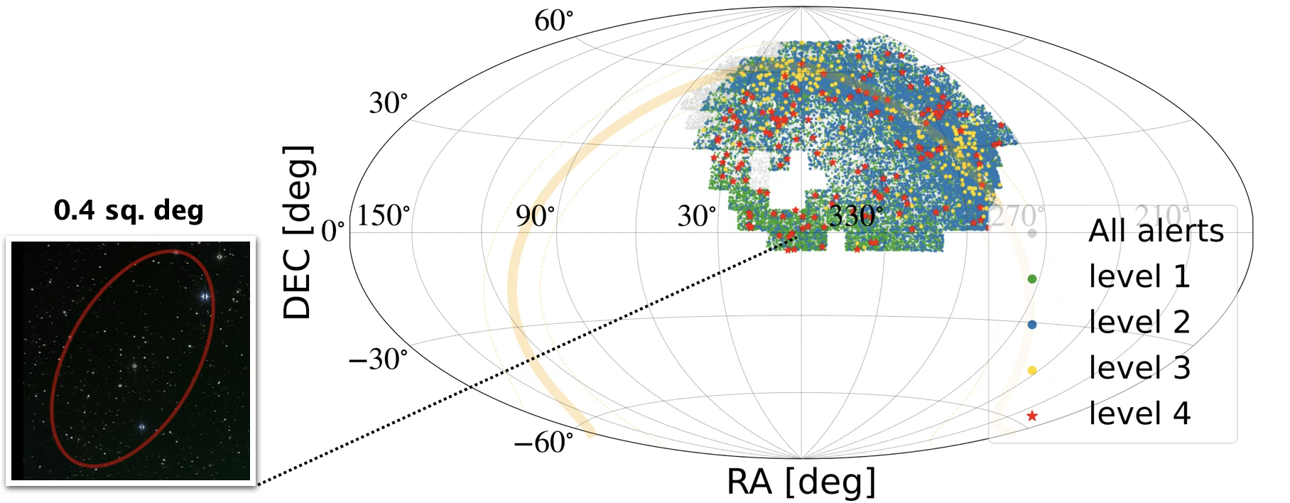
Background estimation
Using background area ~ 16,000 times larger than target area

Slide 15


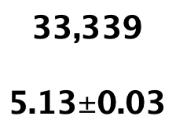
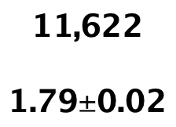
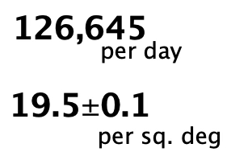
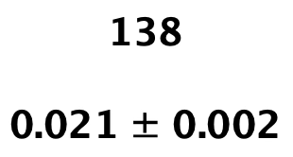

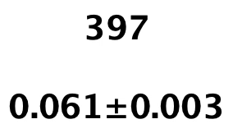
Data analysis: Optimized for ν counterpart
Image quality
Multiple detections
No galactic star
No persistent source
All detections
Predefined criteria optimized through data-driven measurements

Slide 16
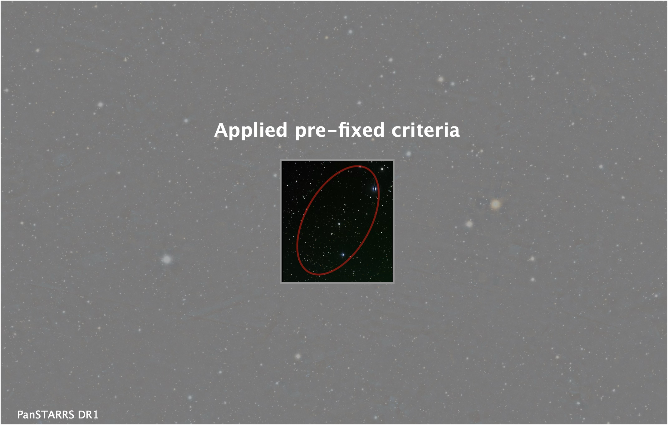
Finally, unblind the data!
No candidate was found in the multiplet direction

Slide 17
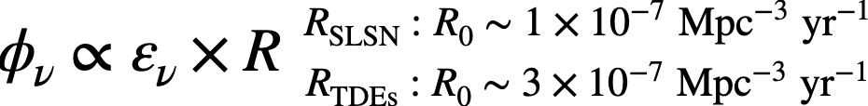
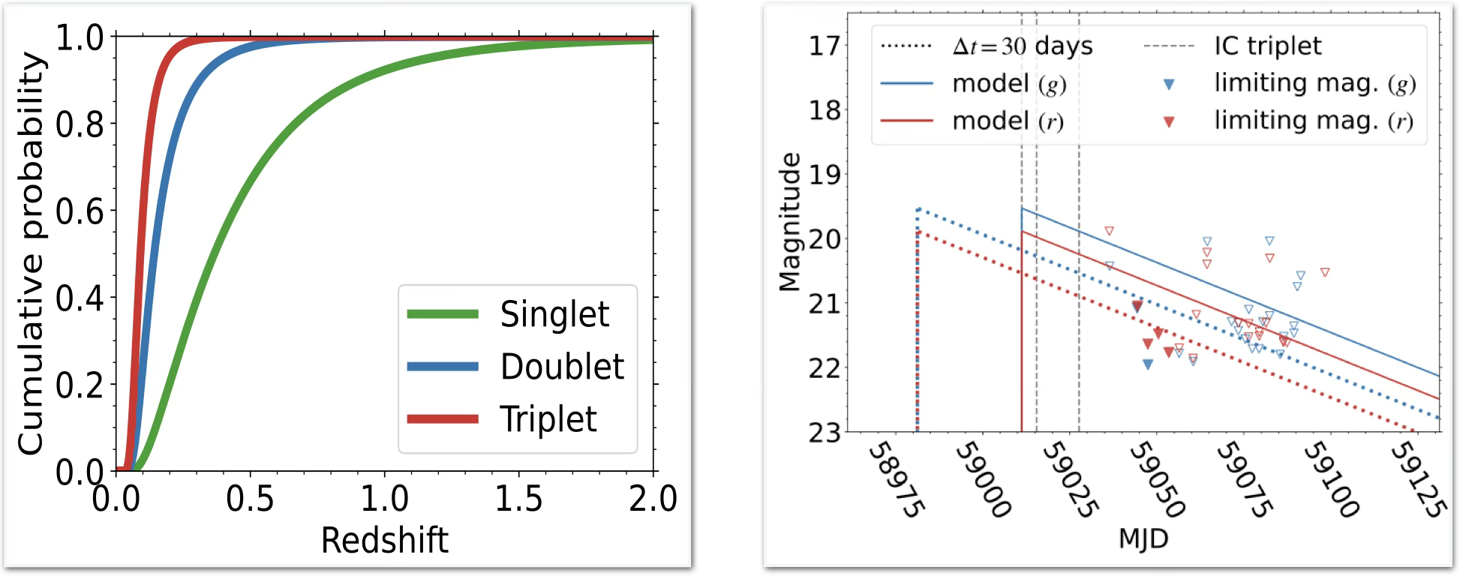
Constraints on source properties
Distance Distribution Inferred from Neutrinos
Simple optical light curve model
High detectability → Strong constraints

Slide 18
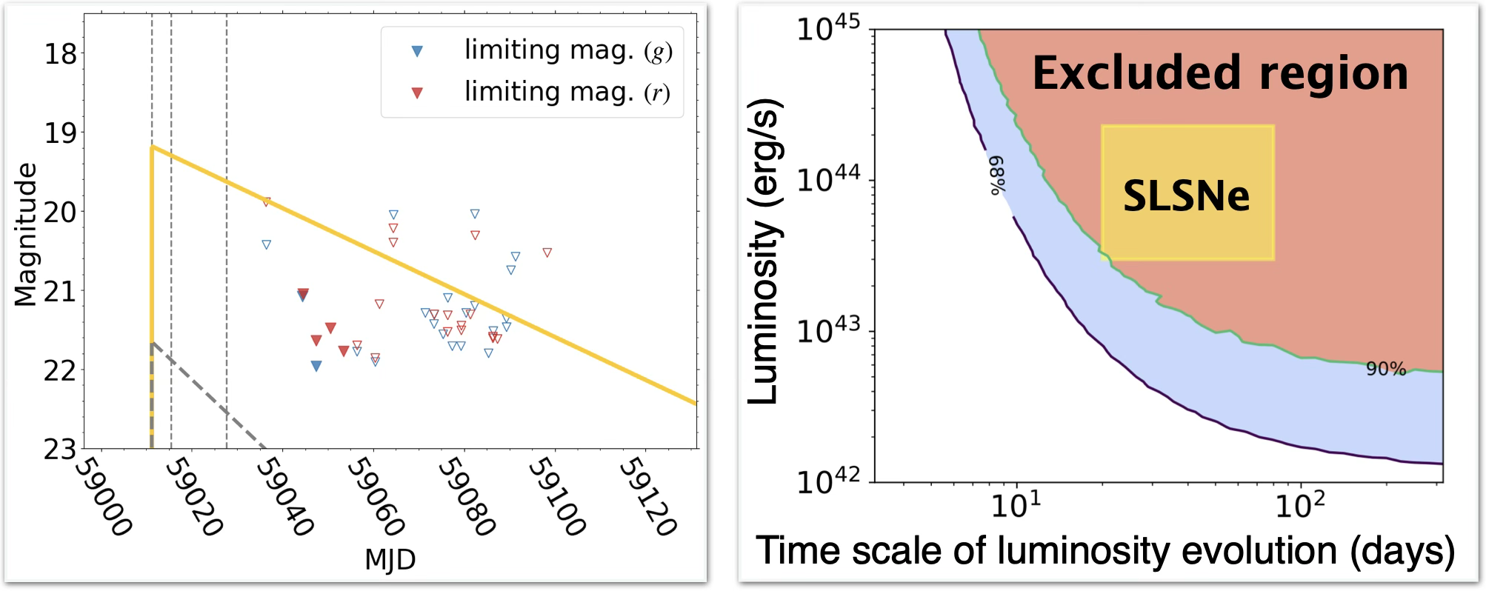
Constraints on source properties
Confirmation of low-background&high-recovery rate a priori
One multiplet search can put meaningful constraints on source properties

Slide 19
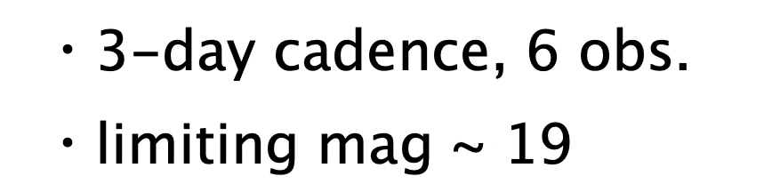
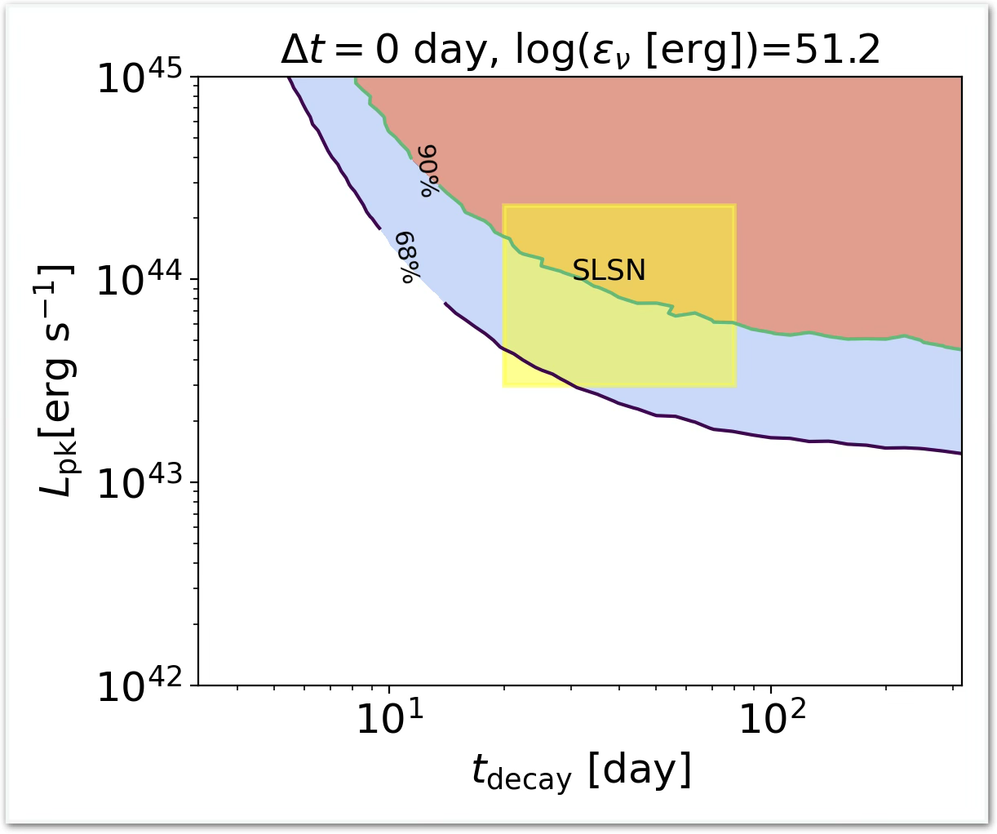
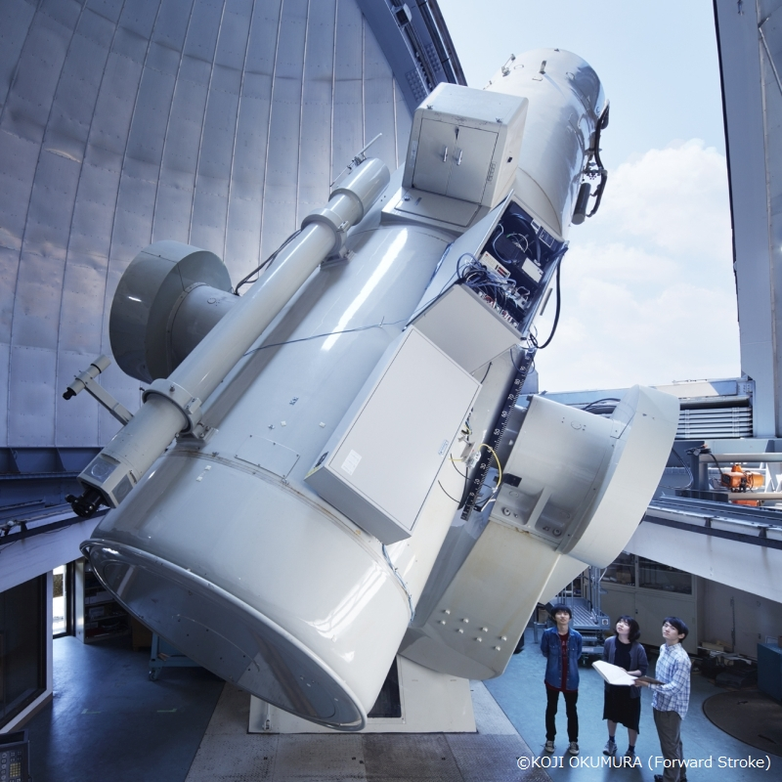
For future real time follow-up 1
Real time alerts for IceCube “multiplet” will come
Kiso/Tomo-e
Real time follow-up using Kiso/Tomo-e

Slide 20
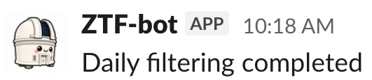
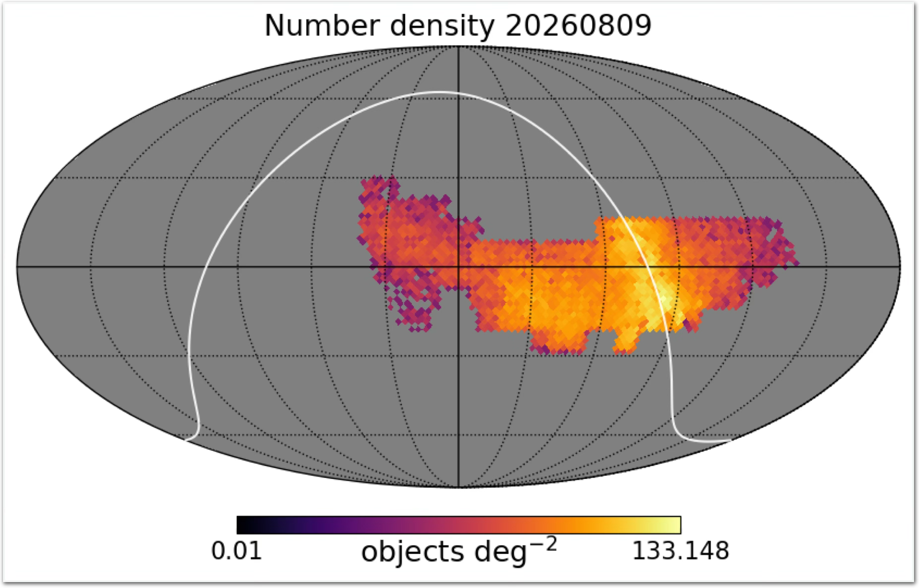
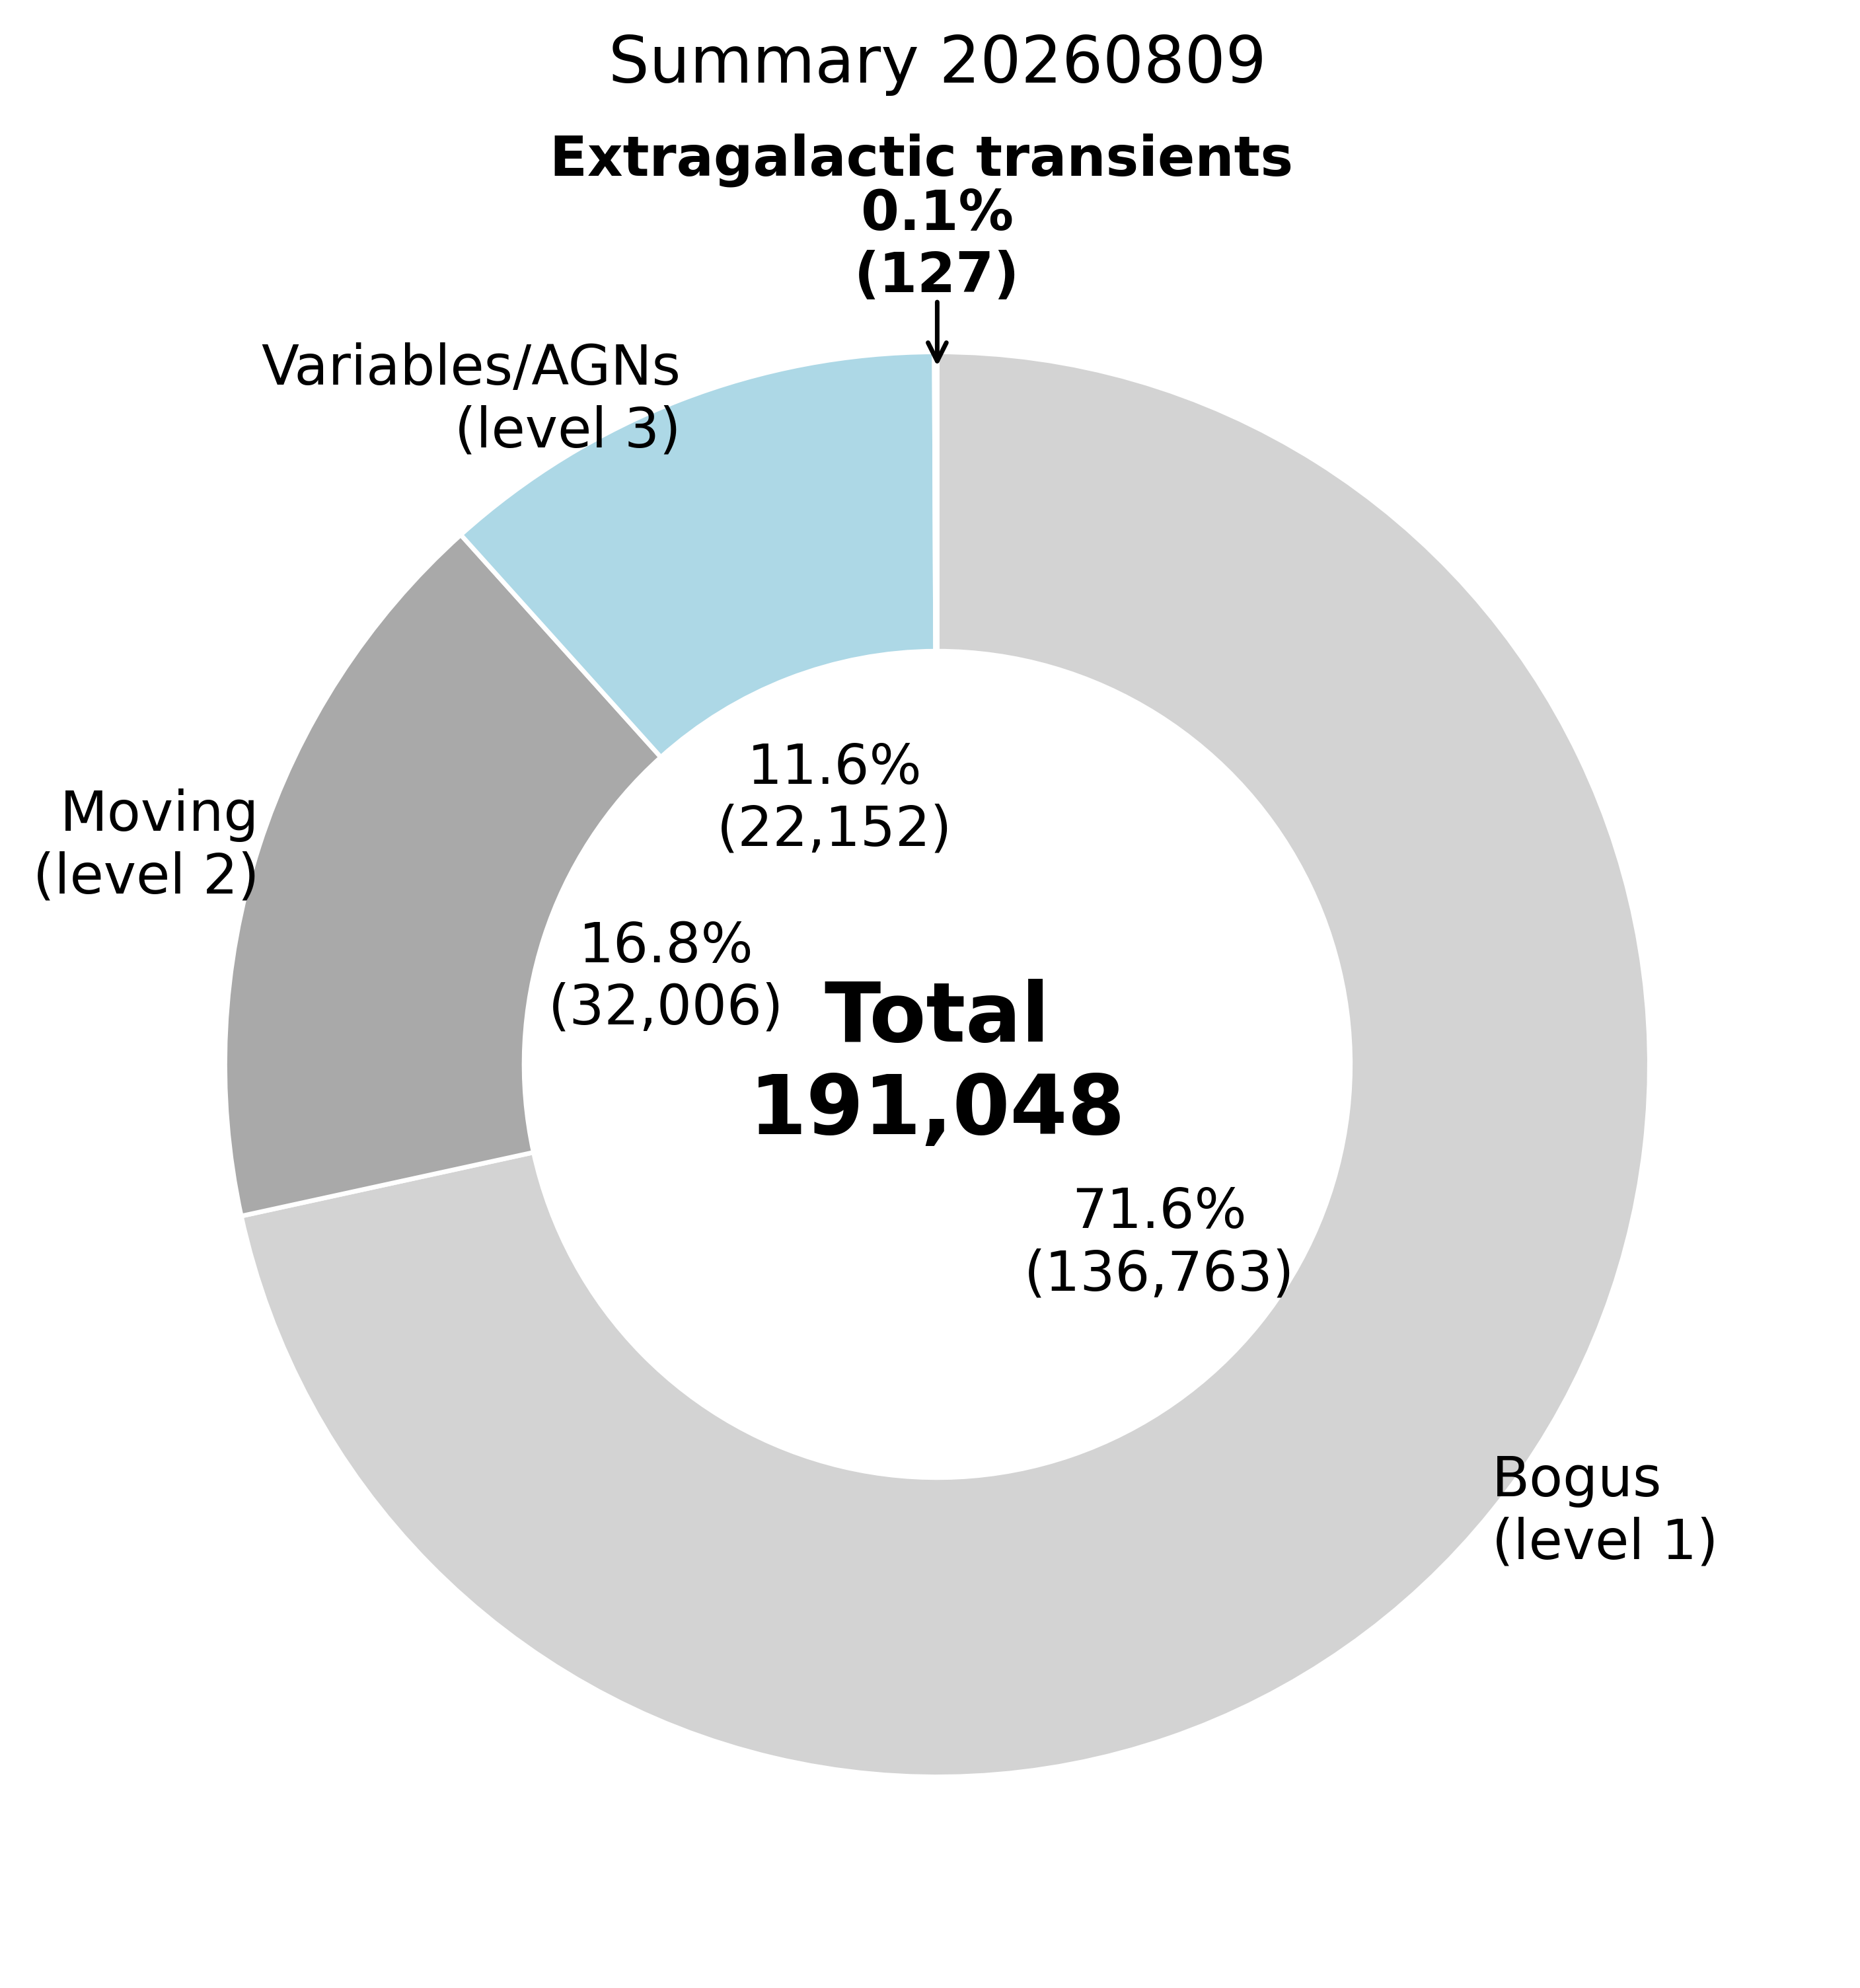
For future real time follow-up 2
Background estimation for daily ZTF public data
Daily ZTF data analysis to estimate the background
and build up statistics for rapid response

Slide 21
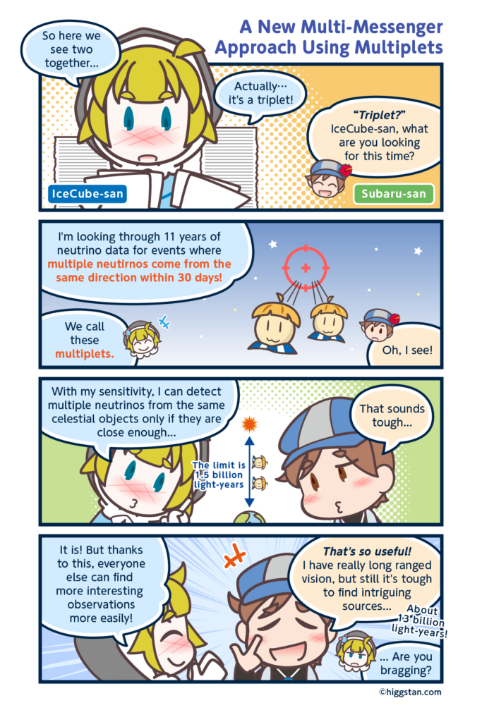
Summary
Optical counterpart search for multiplet
  Focus on nearby neutrino sources
  Data-driven background modeling
    High recovery rate + Low background rate
  Non-detection puts meaningful constraints
Future follow—up
  Kiso/ZTF candidate search + Gemini follow-up
  ZTF background estimate for real-time unblind

Slide 22
Appendix

Slide 23
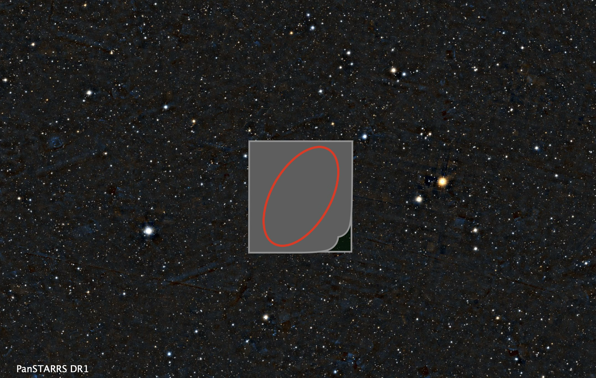
Data driven approach through blind analysis

Slide 24
In real data …
Background in optical transient counterpart search
Astrophysical transient
Astrophysical
poorly-modeled background
Non-astrophysical
background
SNe, TDEs
moving objects
variable stars
artifacts
Difficult to simulate (poorly modeled/depend on data quality, instrument,…)
→ Data driven approach !

Slide 25
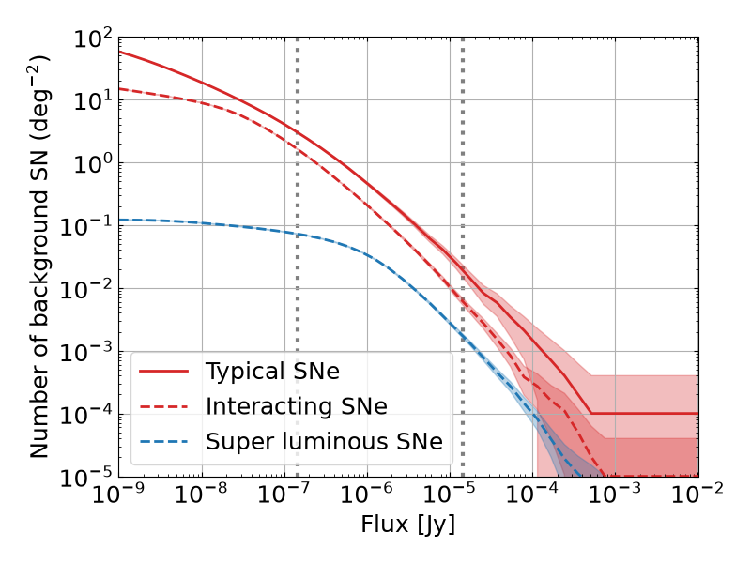
Astrophysical transient background
Subaru/Rubin
ZTF
Low astrophysical transient background for multiplet

Slide 26
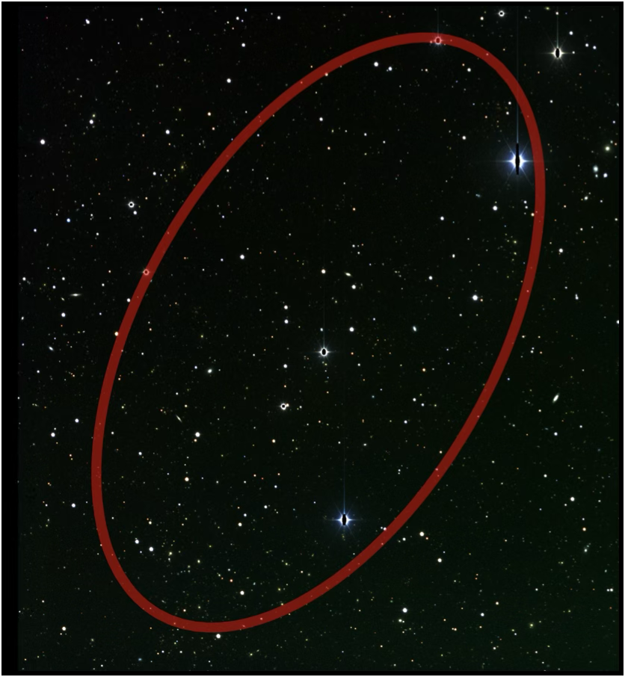
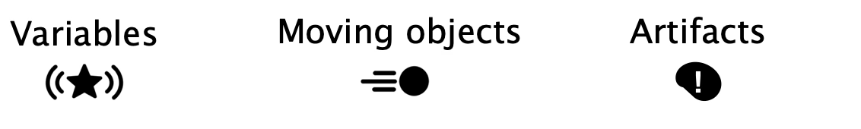
Optical counterpart search
Background characterization is essential before arrival-direction analysis
1. Astrophysical transient
    → Simulation-driven estimate
2. Non-transient objects & artifacts
    → Data-driven measurement
Explosive transient (SNe, TDEs)

Slide 27
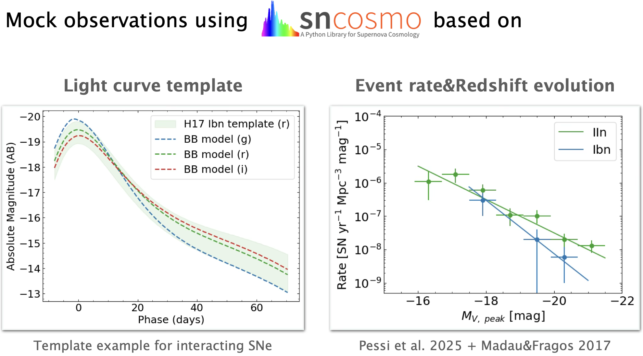
Simulation-driven estimate 1

Slide 28
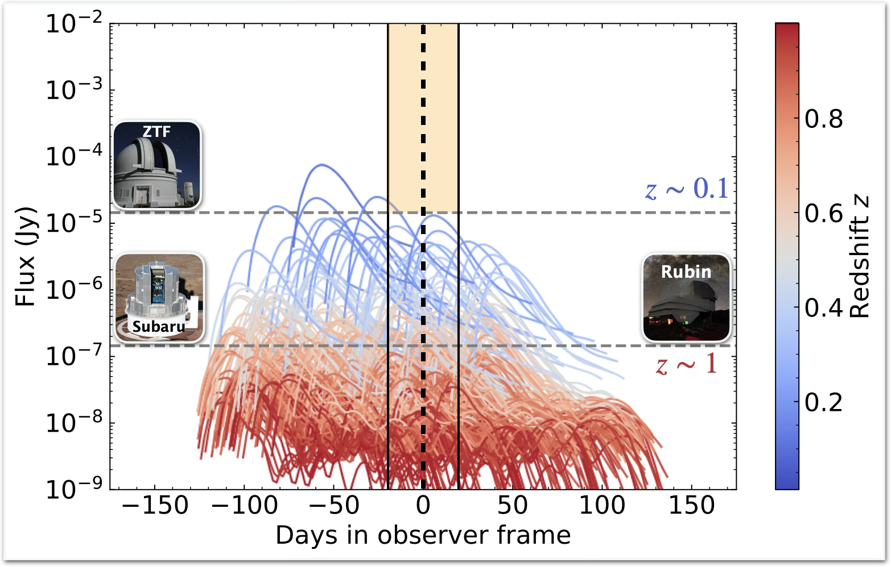
Simulation-driven estimate 2

Slide 29
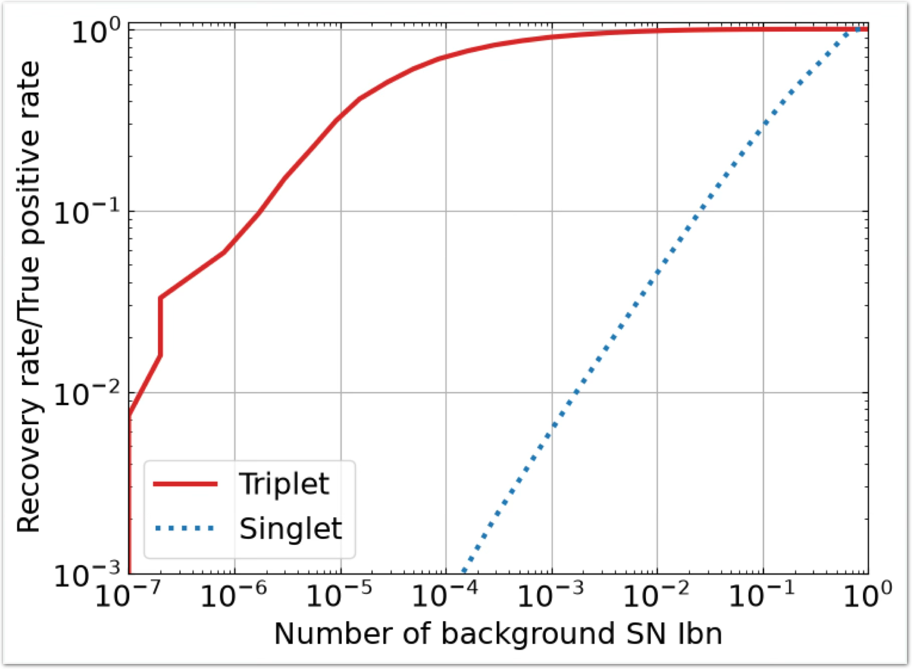
Recovery rate vs Background rate

Slide 30
Data analysis: optimized for counterpart
No galactic star
No galactic star criterion
Transient-like
Variable-like
Classification score
Pass
Cut
ZTF
New
Low background rate!
BUT, low recovery rate …
High recovery rate!
BUT, high background rate …

Slide 31
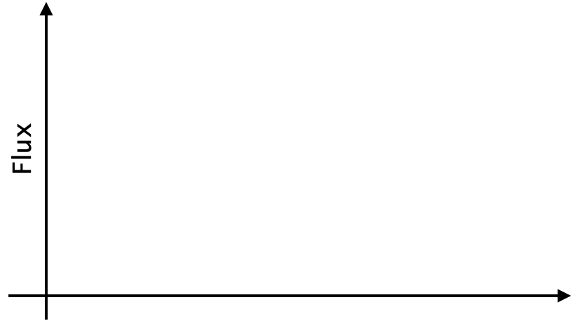
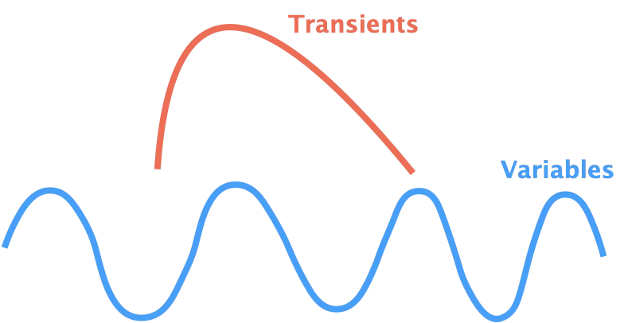
Data analysis: optimized for counterpart
No galactic star
No persistent source
No persistent source
High recovery rate!
AND, low background rate !
High recovery rate!
BUT, high background rate …

Slide 32
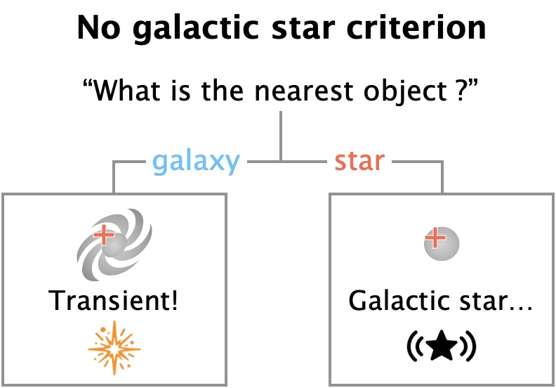
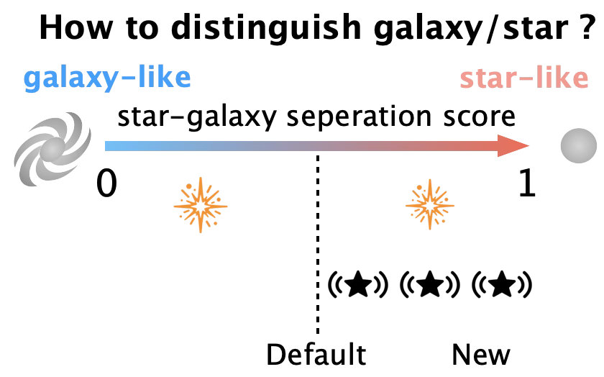
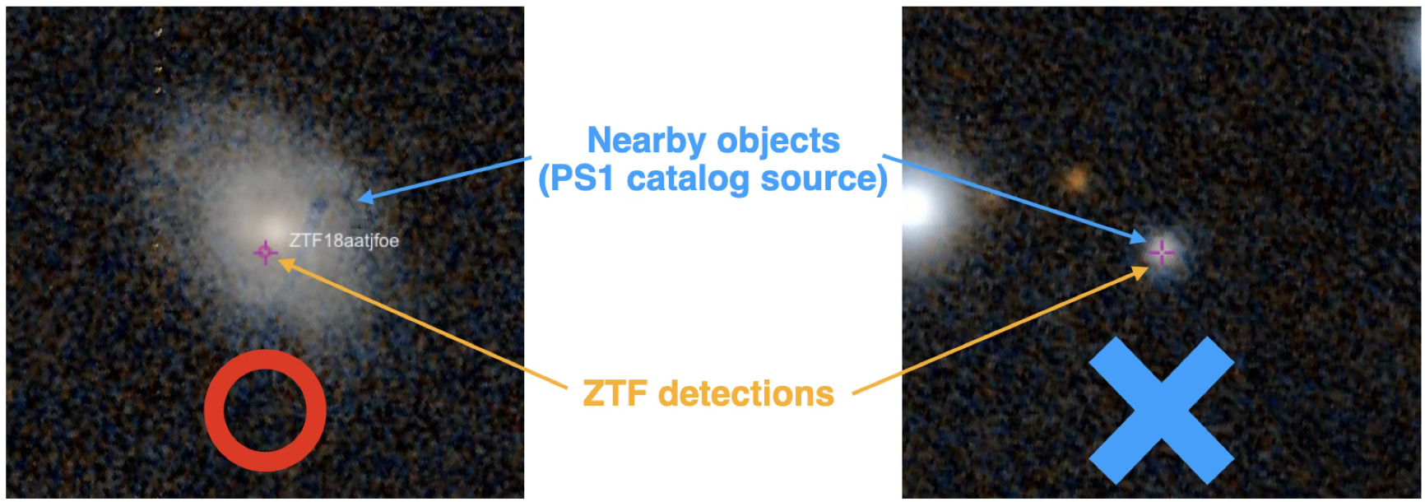
No galactic star criterion

Slide 33
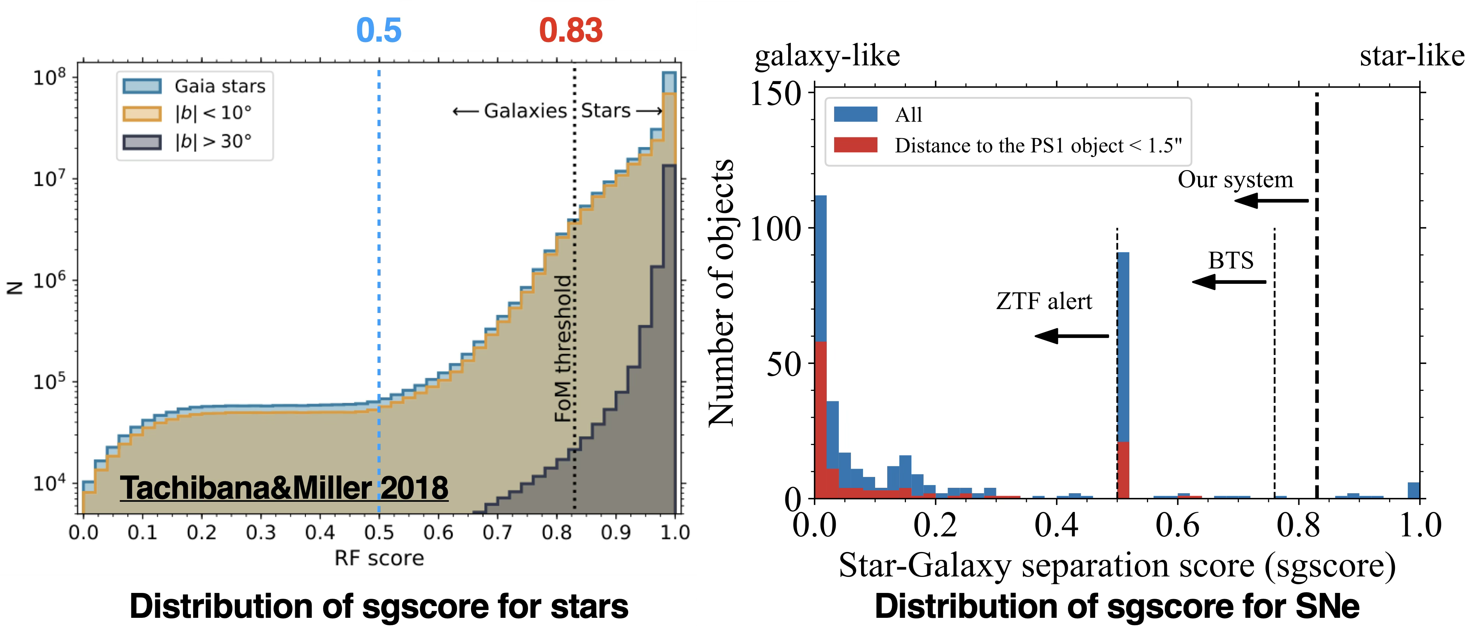
Star-galaxy separation score

Slide 34


Light curve cut

Slide 35

Flux dependence of recovery rate

Slide 36

Recovery rate vs Background rate

Slide 37

Recovery rate vs background rate

