Slide 1
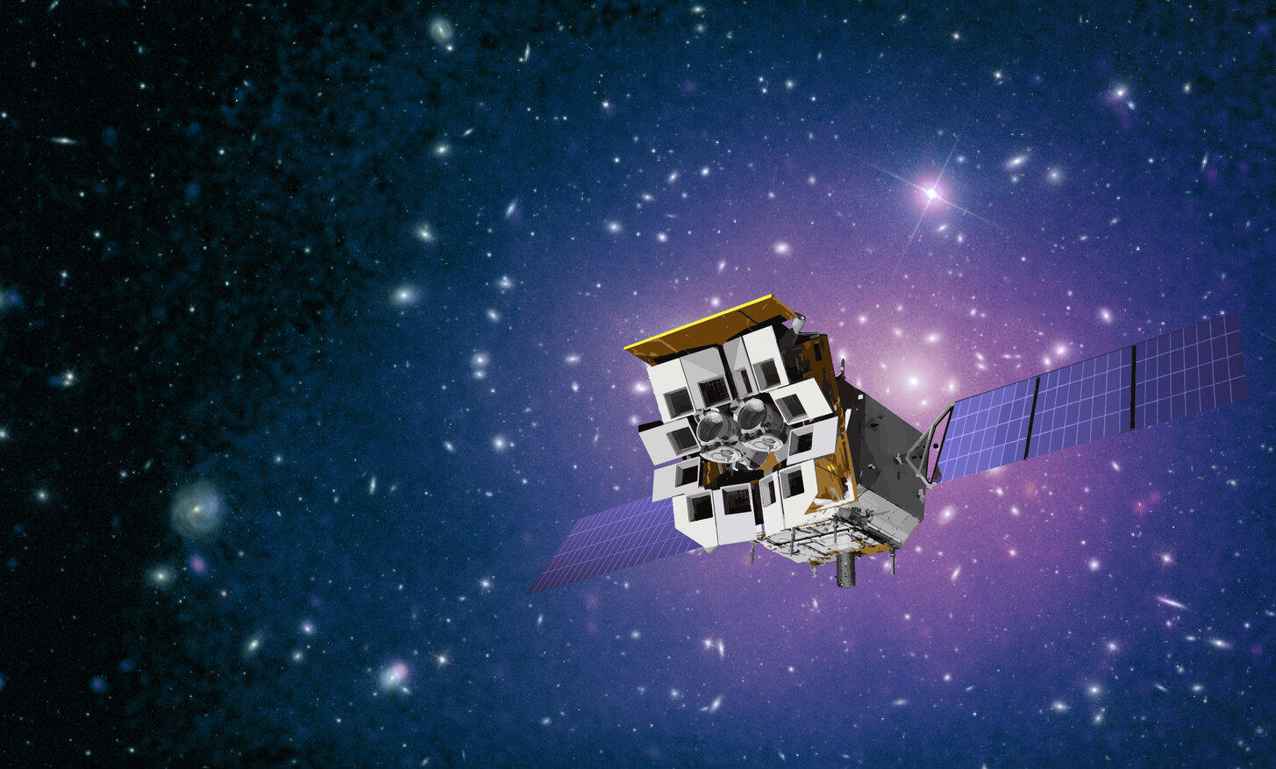



Einstein Probe and its role in multi-messenger astronomy
Yuan Liu
National Astro. Obs.，CAS
on behalf of the EP consortium
1
Image credit CAS/ESA
TeV Particle Astrophysics 2026
Notes:
EP is a space mission to monitor and explore the X-ray sky.
It is led by CAS, in collaboration with ESA, MPE and CNES.
The satellite is complicated as there are 14 telescopes onboard,
12 X-ray monitors (WXT) to make a large FoV, and 2 telescopes for deep observations.
EP was launched in January 2024, and started science operations from July the same year.

Slide 2

Outline
Scientific & technical background
Einstein Probe (EP) & science capabilities
Selected discoveries of transients by EP
Its role in multi-messenger astronomy

Slide 3
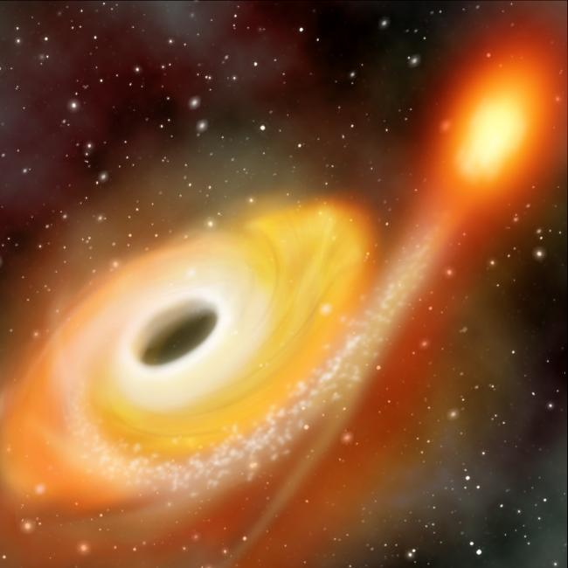
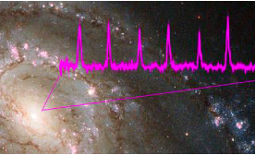
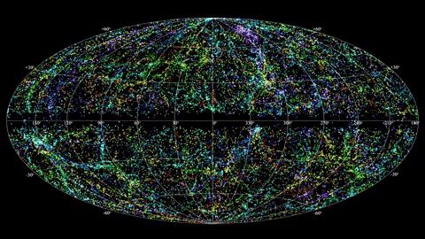
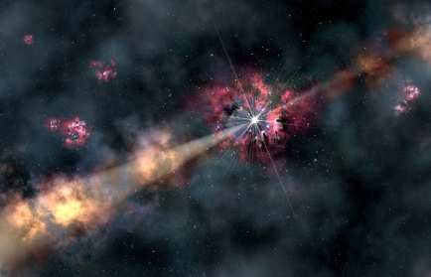
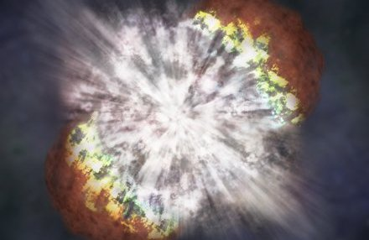
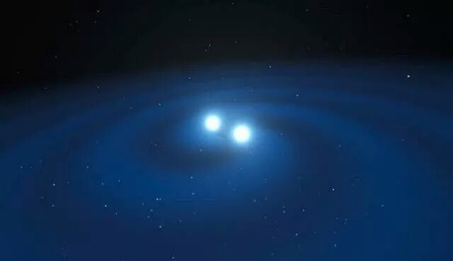
New high-energy transients & science questions
BH tidal disruption event
Quasi-periodic eruption
EMRI as GW sources?
Demography of Black holes
How matter falls onto BH?
How jets form?
  High-redshift GRB
Next generation X-ray monitors needed to see
deeper/further
High cadence
EM counterpart of neutrino events
When first stars
formed?
metal enrichment in early universe
How particles
Accelerated?
Supernova
shock breakout
EM counterpart of gravitational waves
Supernova physics
& progenitors
What are EM counterparts?
How compact objects merge?
Notes:
In recent years, some new high-E transients have been discovered, of high scientific values.

Slide 4
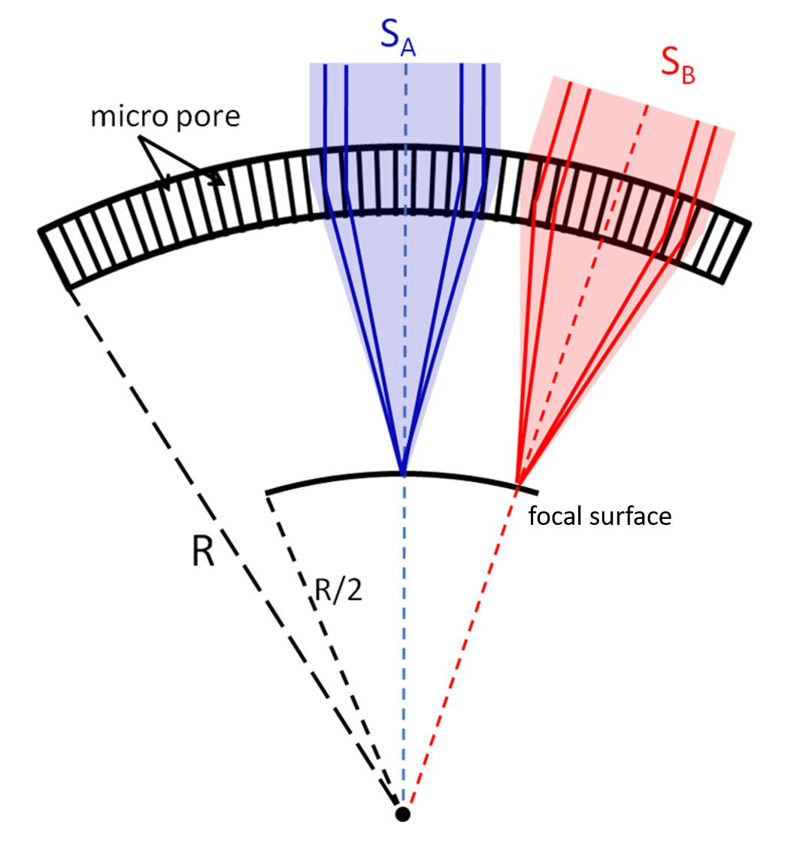
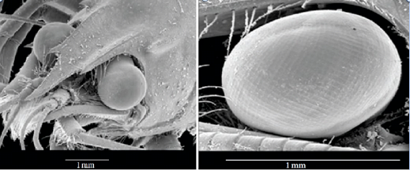
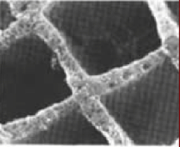
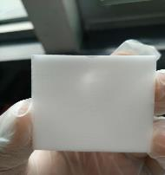
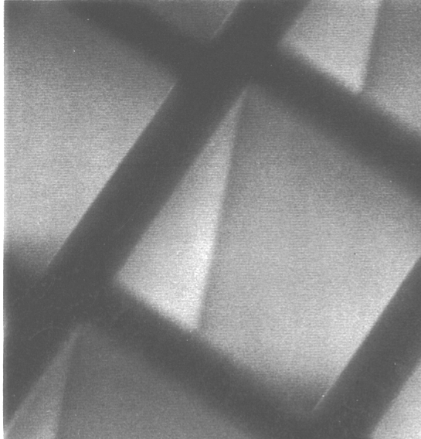

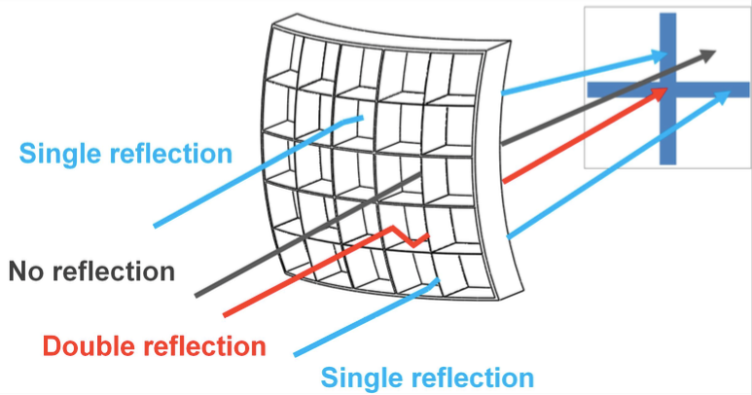
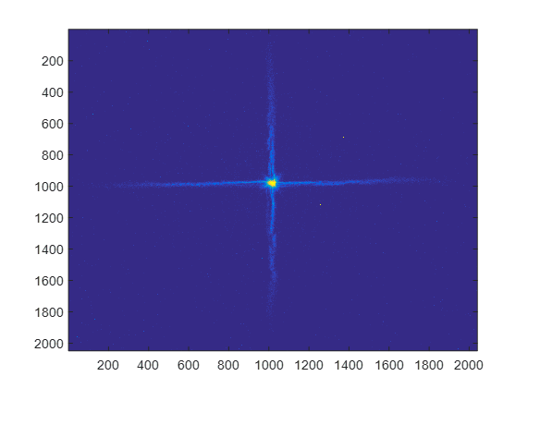

Lobster-eye optics for X-ray focusing imaging
grazing incidence reflection by Lobster-eye Micro-Pore Optics (MPO)
MPO plates
40μ
image credit: http://www.as.utexas.edu/lectures/great_lecture_twenty.html
Wide FoV (no vignetting)
True focusing imaging
Dr. Roger Angel
PSF: core + cruciform arms
curvature
center
Focal image for point-like source
measured X-ray
PSF mage
@XIL/NAO/CAS
PSF core = 5 arcmin (fwhm)
Since 2010, Lobster-eye R&D @ XIL/NAO/CAS (est. by S.-N. Zhang)

Slide 5
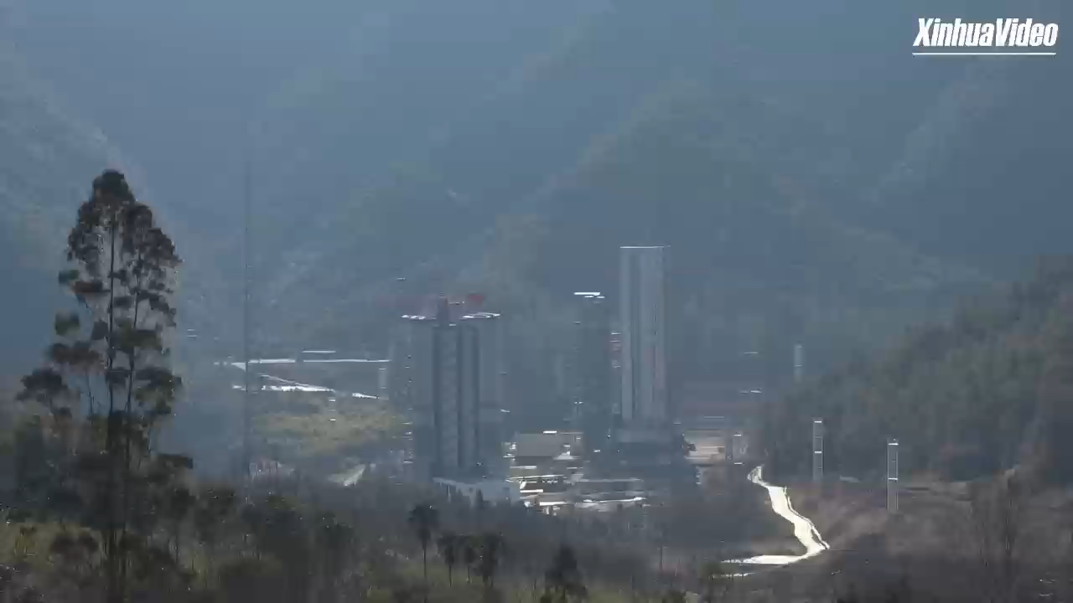

Einstein Probe (EP) - Tianguan (天关) mission
Goals space X-ray observatory for time-domain astro.
Discover soft X-ray transients & monitor source variability at unprecedented sensitivity
Characterise transients/variables by quick X-ray follow-up onboard
Disseminate transient alerts to astro. community in time, quick response ToO
Milestones
2011 Lobster-eye R&D @ XIL/NAO & X-ray ASM on CSS
2012 Mission concept
2017/12 Funded by the 2nd phase of the Space Science Programme (CAS)
2018 Joined by ESA & MPE; 2022 CNES
2022/07 Pathfinder LEIA launched
2024 Jan. 9 launch
2024/01-07 commissioning & calibration
2024/07- nominal mission (lifetime: 3 yr, goal 5 yr)

Slide 6

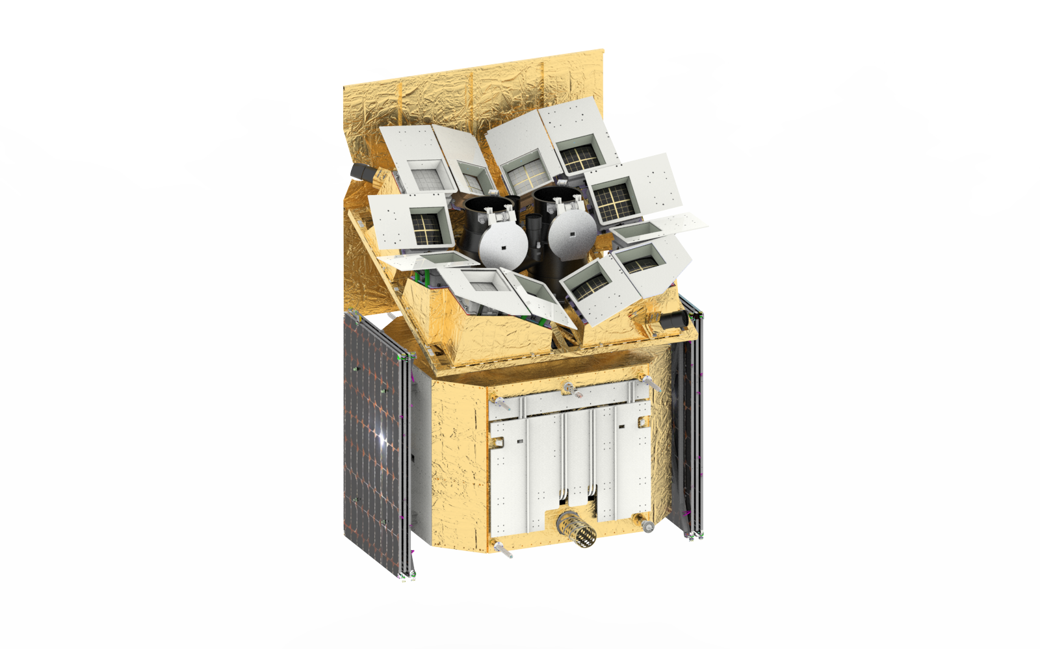

Instruments & spacecraft
Wide-field X-ray Telescope
WXT (12 modules)
Lobster-eye MPO + CMOS
FoV: 3,850 sq deg
Band: 0.5 – 4 keV
Effe. area: ~3 cm² @1keV
Resolution: ~ 5’ (FWHM)
Spacecraft
On-board data processing
Quick slew & autonomous follow-up
Follow-up X-ray Telescope
FXT (2 units)
Telemetry
Wolter-1 + pn-CCD (eROSITA)
FoV: 1 deg x 1 deg
Band: 0.3 – 10 keV
Effe. area: ~300 cm² @1 keV (x 2 units)
Resolution: 24” (HPD, on-axis)
X/S-band (several hours)
BD (down/up-link; minutes)
VHF (down-link; minutes)
Yuan, et al. 2022 Handbook of X-ray and Gamma-ray Astrophysics

Slide 7
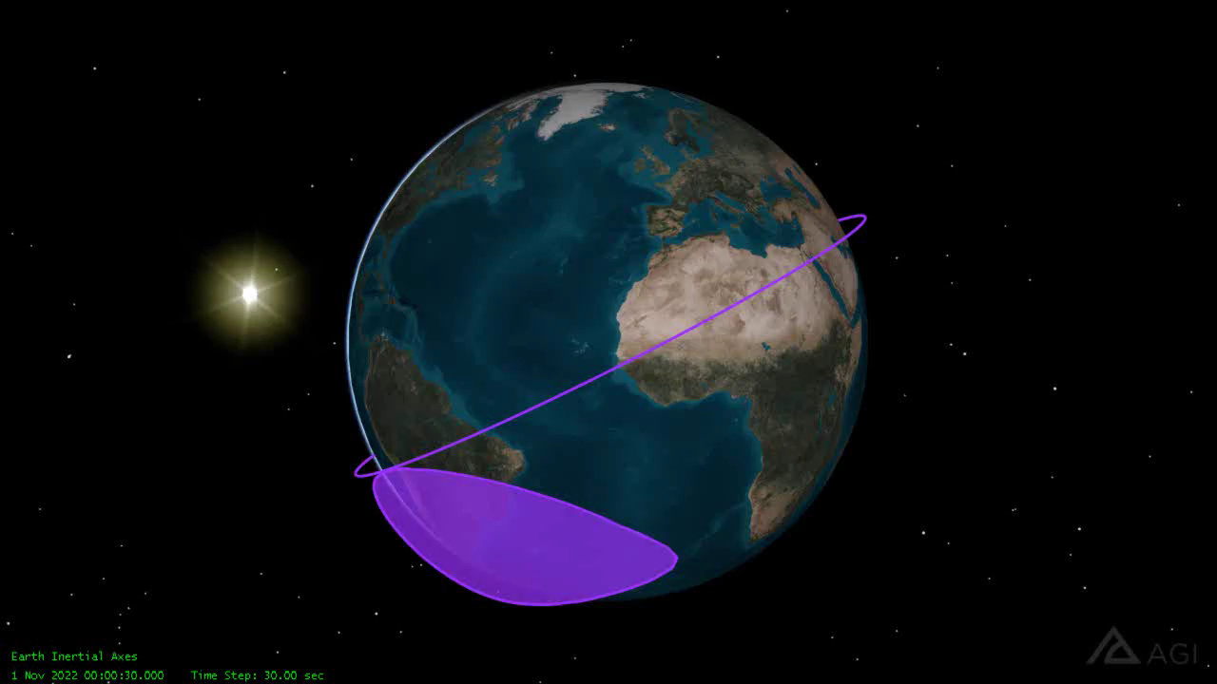
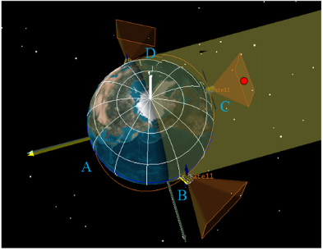
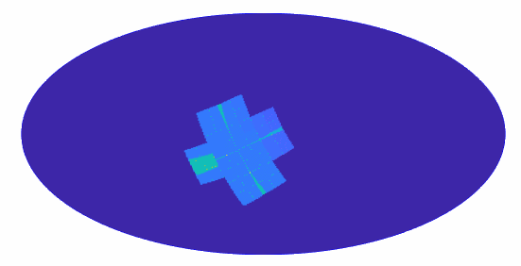
Mission profile
Orbit: 590 km (P ~97min), i = 29 deg
Observation modes
  Survey: 3 snapshots per orbit in the night-sky, each ~20 min exposure
  cover most of night sky in 3 orbits
  Cover whole sky in half a year
  Autonomous follow-up: FXT (3-5 min)
  ToO
On-board data processing & transient search
Alert data rapid downlink & triggering (Beidou & VHF)
Fast ToO uplink (Beidou)
night sky
Sun
Survey mode:3 pointings per orbit

Slide 8
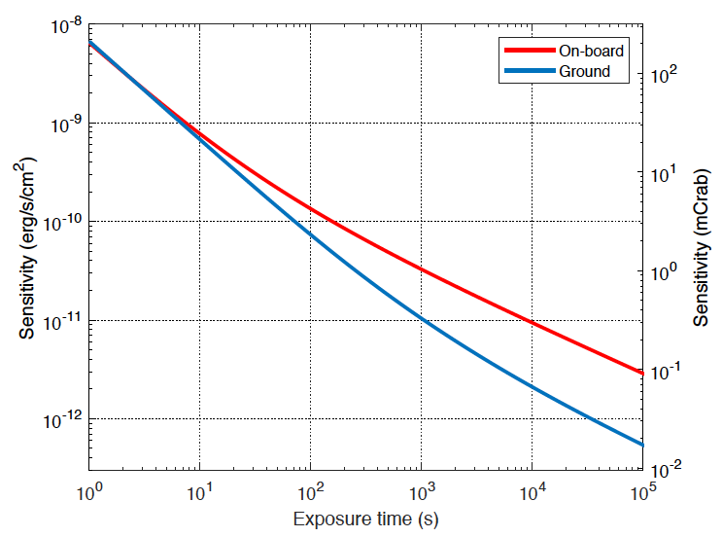
Simulated EP WXT sensitivity
central spot used only
> 1 order of magnitude better than current X-ray ASM (MAXI, Swift)
photon limited
regime
0.3mCrab
5-sigma c.l.
power-law 𝛤=-2,N_{H}=3.e20cm⁻²
background limited
backgrounds : particles, diffuse background, with shielding
~ 1 survey snapshot
background 3.3 counts @ central spot
Zhao D. et al. 2017
Notes:
Assuming a power law shape of photon index 2 and 3, respectively. Absorption column density 3X10^20

Slide 9
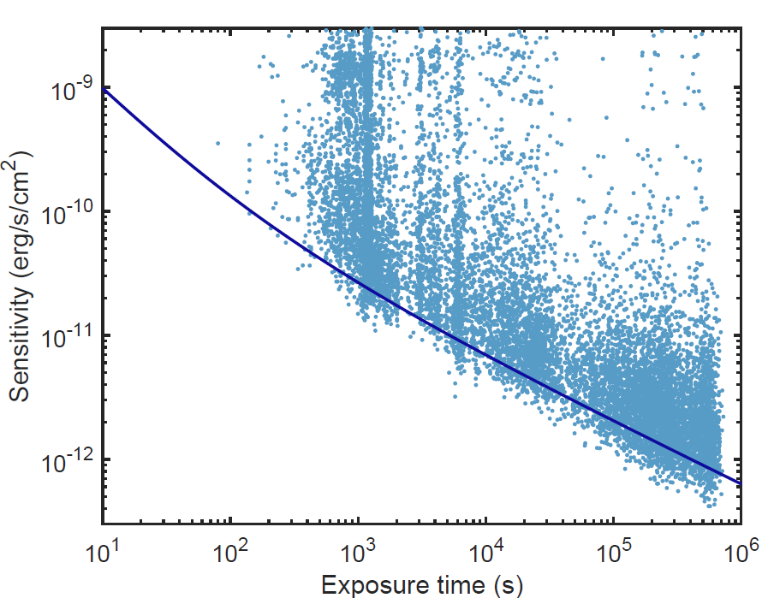
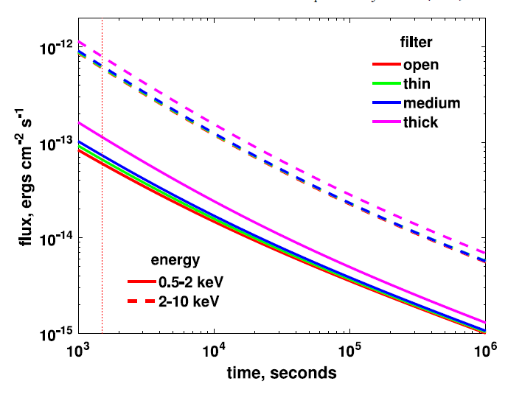
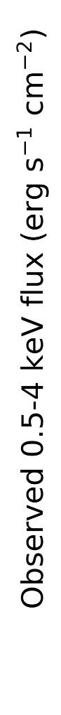
Sensitivity
WXT
FXT (1 unit)
snapshot
survey
mode

Slide 10
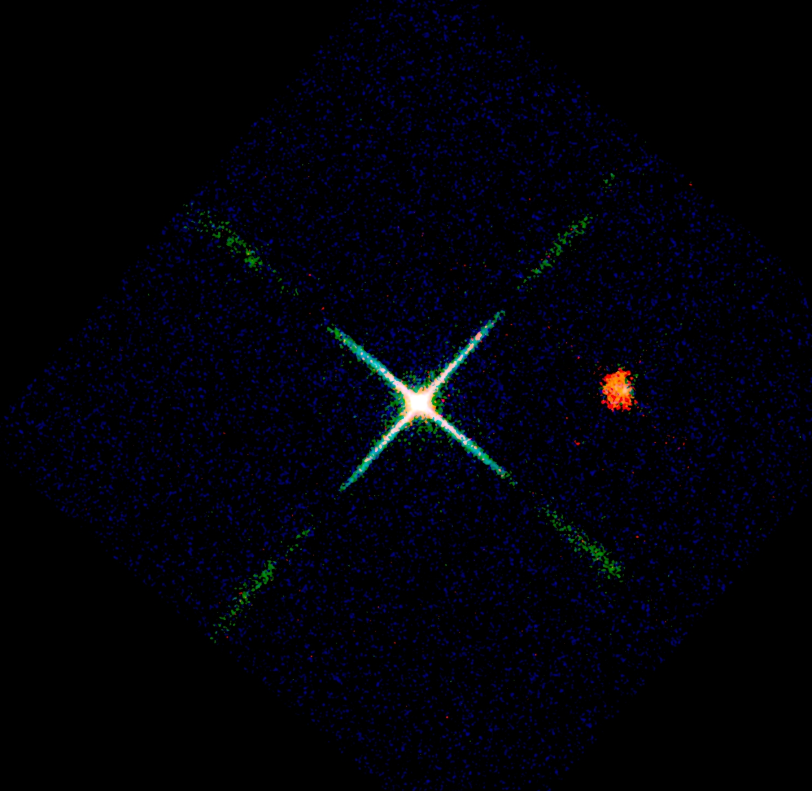
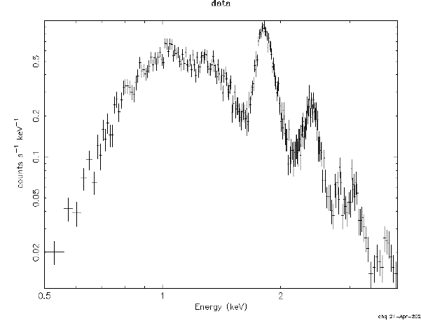

X-ray First light 2024 Feb. 19
Cassiopeia A supernova remnant (nebula)
X-ray spectrum obtained at the same time
Si He 1.83
S He 2.41
Counts/sec/keV
$Δ$E ~ 122eV @1.25keV
Energy (keV)
Red: 450 to 1000 eV
Green: 1000 to 2000 eV
Blue: 2000 to 5000 eV
Image size 9.3° X 9.3 °
exposure 22 kilo-seconds
X-ray data credit: EPSC, image credit: Chen Zhang, Huaqing Cheng.

Slide 11
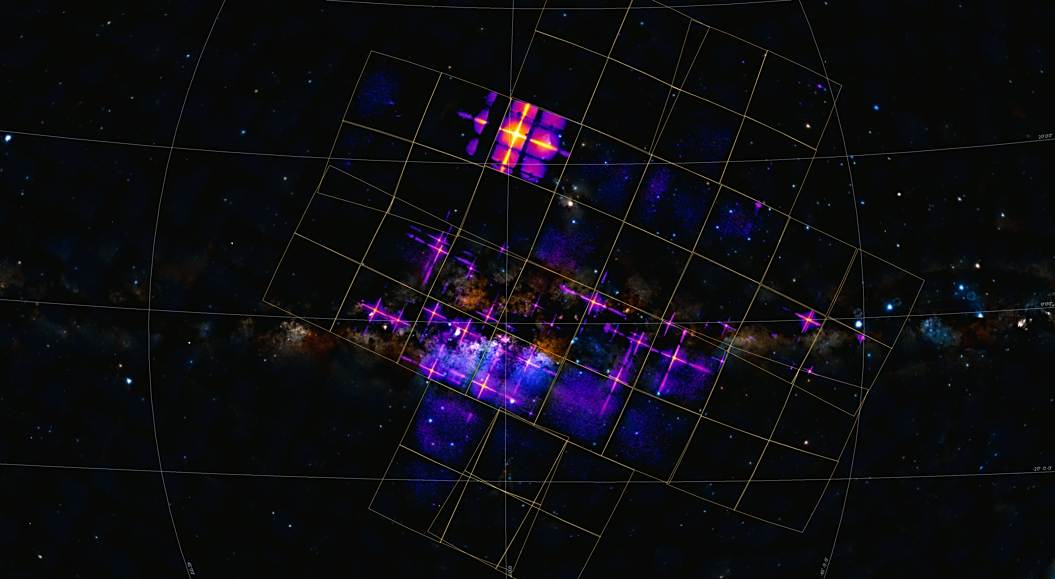
Central region of our Galaxy (purple, red, yellow)
9.3°
WXT FoV 3850 sq. deg.
2
exposure 40 kilo-seconds
9
3
6
4
1: Cir x-1 and Swift J151857.0-572147
2: Sco X-1
3: V2216 Oph
4: V1101 Sco
5: V821 Ara
6: NP Ser
7: V4134 Sgr
8: Sgr X-4
9: Lupus SN
10: SNR RCW 86
1
10
7
5
8
X-ray data credit: EPSC, image credit: Chen Zhang, Huaqing Cheng.

Slide 12
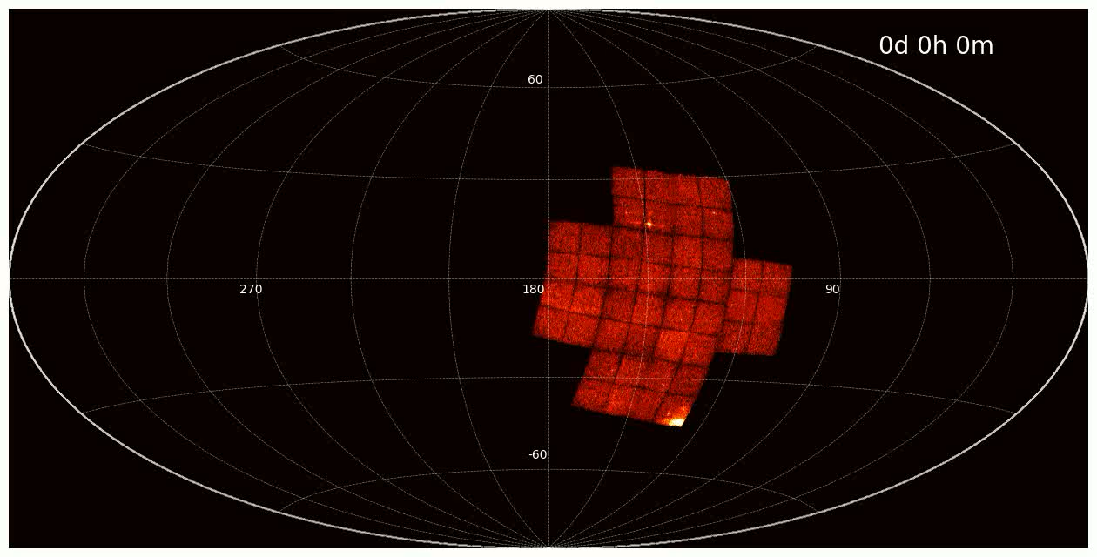
EP-WXT 1 day sky coverage

Slide 13
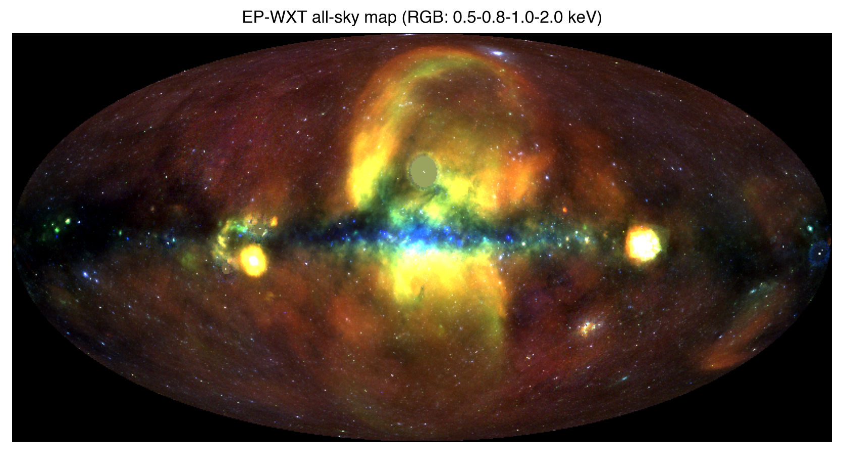
X-ray All-sky image obtained with WXT
credit: EPSC (Pan et al. in prep.)

Slide 14
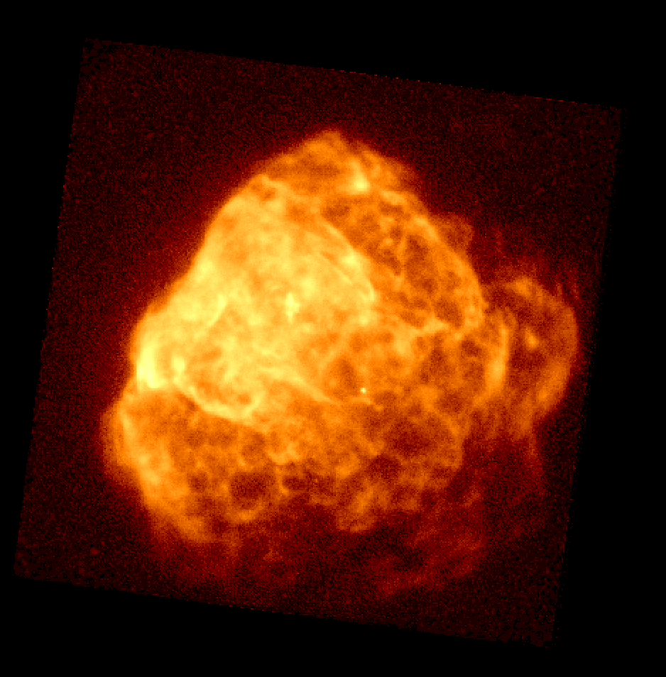
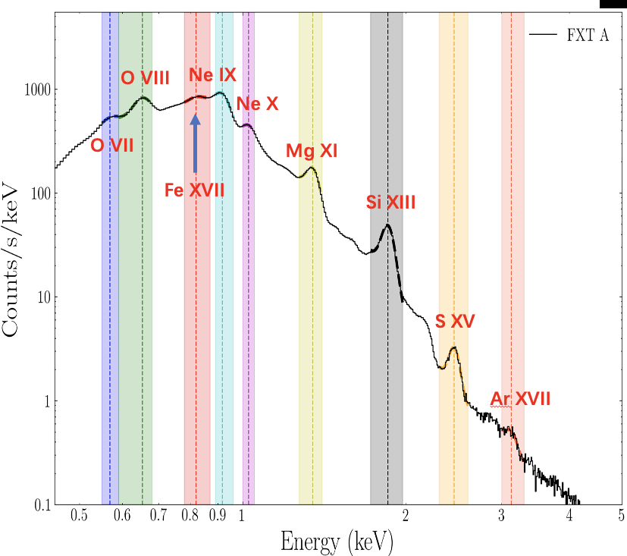
FXT X-ray First light (0.3-10 keV)
Puppis A supernova remnant (nebula)
FoV 1 deg
FXT X-ray spectrum obtained at the same time

Slide 15

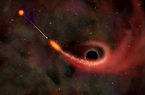
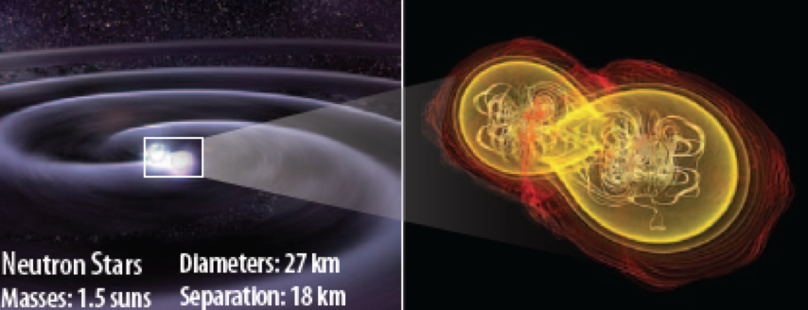
Main science goals
Carry out systematic survey of soft X-ray transients and variability of X-ray sources at unprecedented sensitivity and high cadence
Discover otherwise quiescent Black holes at almost all astrophysical mass scales and other compact objects by capturing their transient flares
Detect and localize the electromagnetic-wave sources of gravitational-wave events by synergy with gravitational-wave detectors
defined in proposal of 2013 Jan

Slide 16
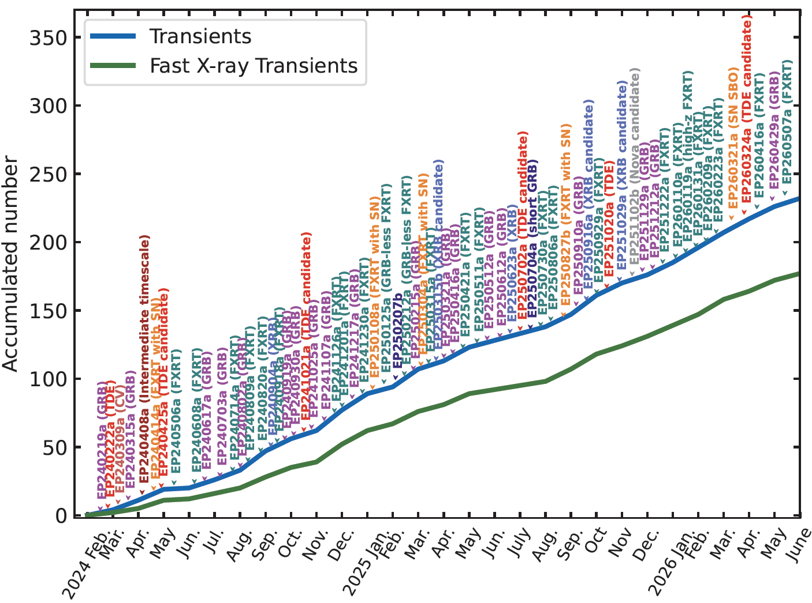
EP transients in 1st two years
X-ray transients: 232
  > 400 GCN/ATel
  follow-ups by multi-W telescopes worldwide
  102 optical counterparts, 55 redshifts
  ~100 /year (highest rate)
FXT 177
the rest: 55
  FXRTs with long afterglow
  TDEs
  compact object flares
  unknown classies

Slide 17
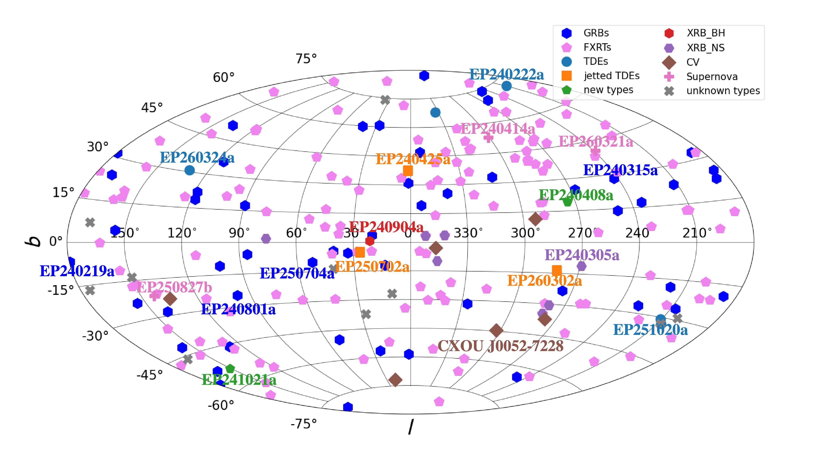
EP transients in 1st two years
Transients: 232
EP detection rate ~ 100/year
(Gal. coordinates)

Slide 18
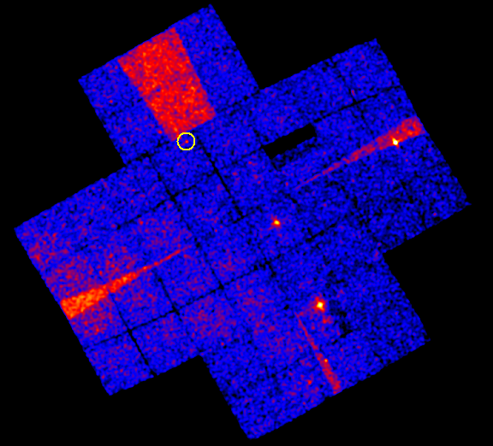
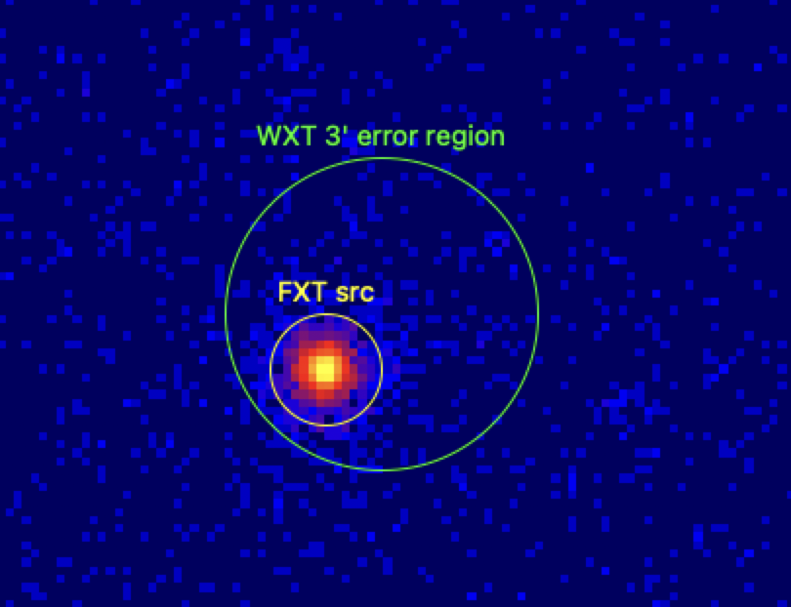
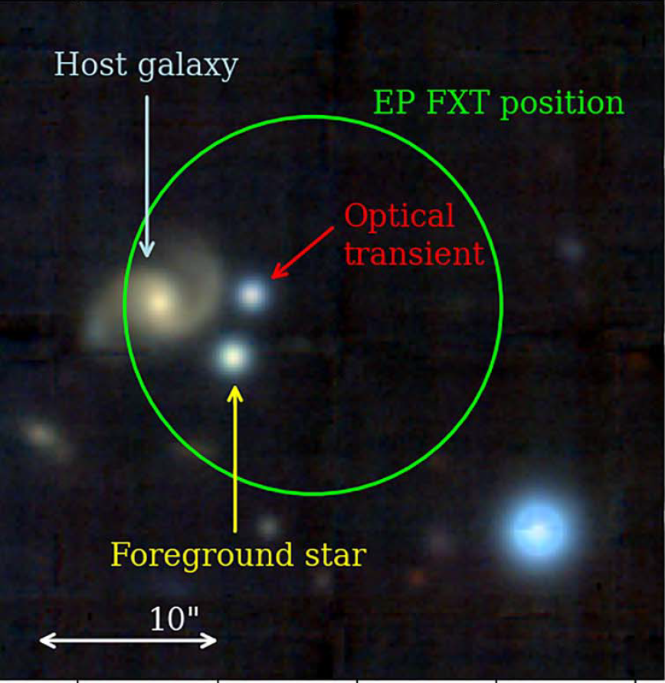
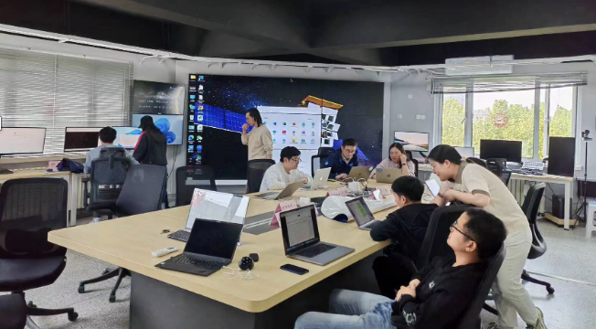
WXT monitoring survey + FXT automated follow-up
WXT obs. and onboard search
FXT automated follow-up
multi-waveband follow-ups
WXT X-ray image. 3600 sqr. deg.
FXT X-ray image
identification of optical/IR counterpart
expo 3.6 ks
WXT position error 2’-3’
FXT error radius: 5-8 arcsec
several minutes
van Dalen et al. 2025
EPSC @ NAOC/CAS
transient alert downlinked to EPSC and
automatically disseminated via GCN/notices
in minutes

Slide 19
EP transients in 1st two years
Catastrophic processes
  Fast X-ray transients (FXT): stellar core collapse, compact object mergers
  TDEs (IMBH)
Non-catastrophic processes
  16 new X-ray binaries (3 BH candidates, 4 NS, 6 WD, 3 unclassified)
Main advancements
  enlarging samples of rare types:
  e.g. X-ray flashes, FXT with SN associations
  new insight into well-studied transients, e.g. GRBs
  theoretical predicted but hitherto no clear evidence
    e.g. dirty fireballs, X-rays from binary NS mergers, thermal SN-SBO
  new phenomena or types of transients

Slide 20
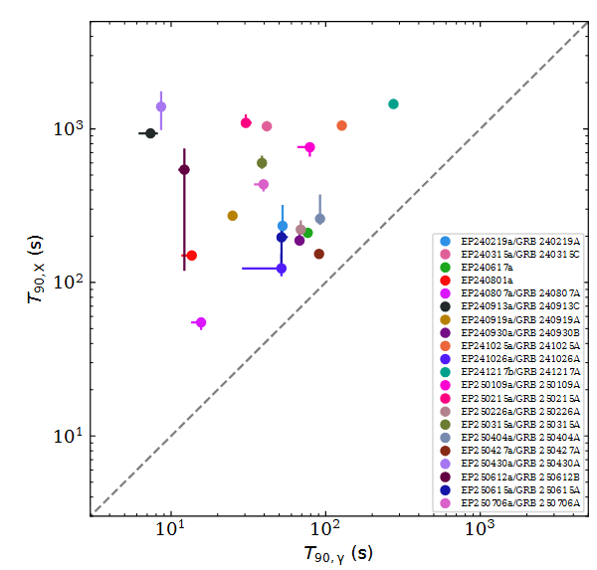
Extragalactic Fast X-ray Transients (EFXT)
Fast X-ray transient mysteries
  bursts lasting seconds - hours, since 1970s
177 FXT
  ~1/3 X-ray flashes: several tens before EP
  ~1/3 GRBs in soft X-ray: a new window
  9 SN associations: 3 before EP
Starting to
  find previously predicted or unknown phenomena
  revealing diversity of collapsars & compact binary mergers
GRB: distinct prompt emission in soft X-ray and gamma-ray
X-ray durations are much longer
Wu et al. in prep.

Slide 21
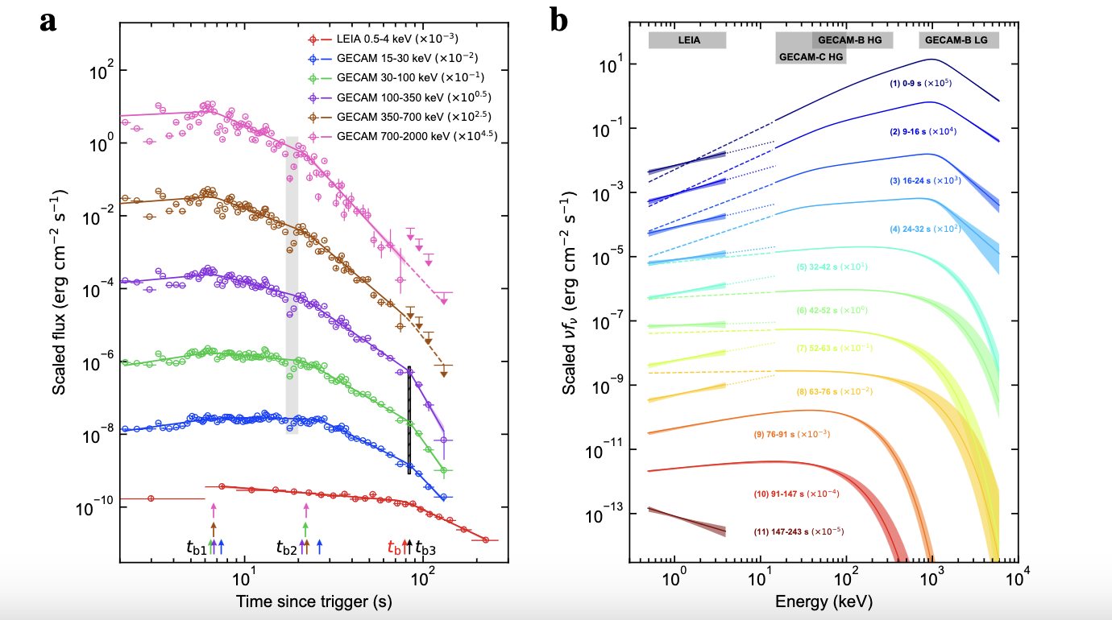
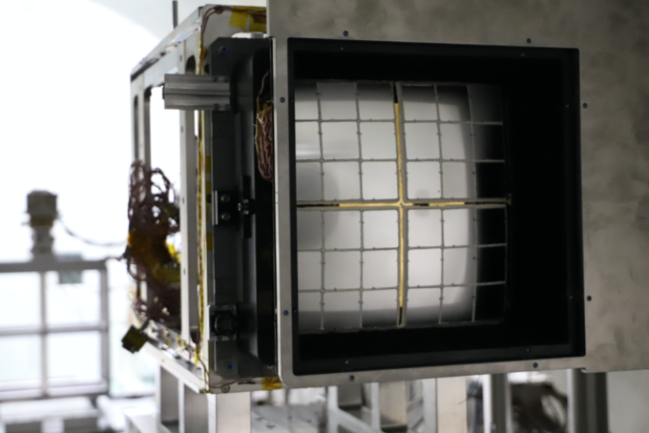
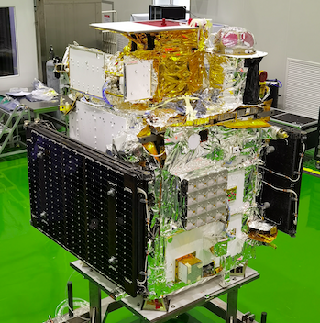
LXT 230307A: X-ray transient likely powered by BNS merger
GRB-jet
LEIA: EP-pathfinder
2022/07 – 2024/02
LEIA 0.5 – 4 keV
GRB-jet
magnetar-powered
Sun H. et al. 2025
National Science Review
magnetar-powered
credit: CAS
Soft X-ray likely powered by a magnetar, emerging from burst onset
Consistent with the association of kilonova signature found by JWST
other FXTs of possible merger origin: LXT 240402a, EP250207b, EP250704a
Becerra et al. 2026, Jonker P. et al. 2025, Li A. et al. arXiv/2601.14137
CAS’s SATech-01 experiment satellite

Slide 22
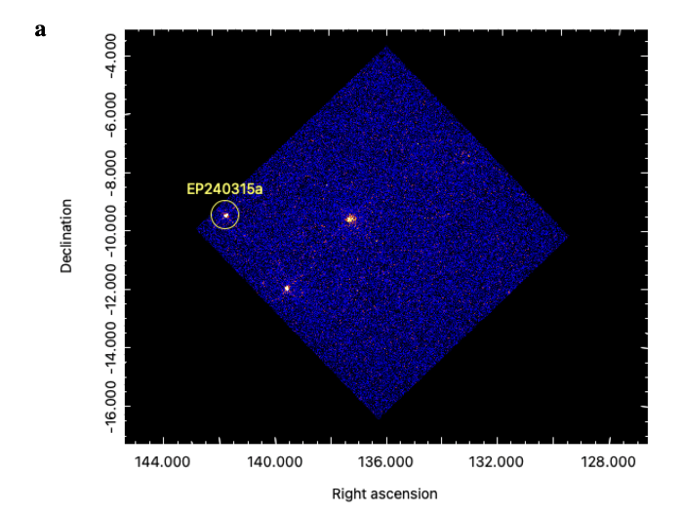
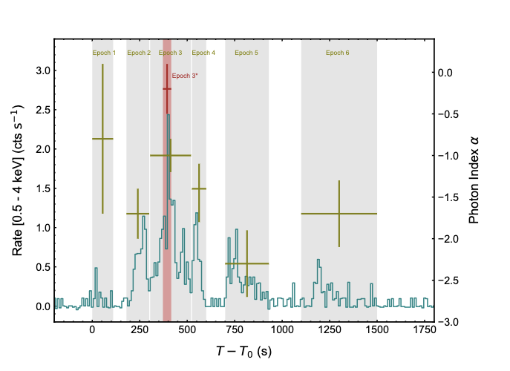
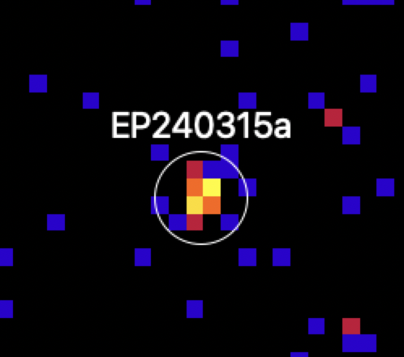
EP240315a: GRB @redshift 4.859
WXT image
Gamma-ray T90：41 s
by Swift/BAT & Konus-Wind
Soft X-ray T90: 1034 s
FXT detection of X-ray afterglow
Marked difference in soft X-ray and hard X/γ rays
Liu Y., et al. 2025 Nature Astronomy, 9, 564
Levan A., et al. 2025 Nature Astronomy, 9, 1375
Gillanders J.H., et al. 2024 ApJ
Redshift 4.859 by VLT (Levan et al. 2025)
Fast X-ray transient & GRB
Central engine activity before detection

Slide 23
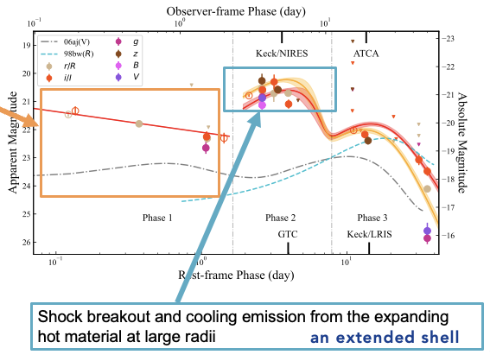
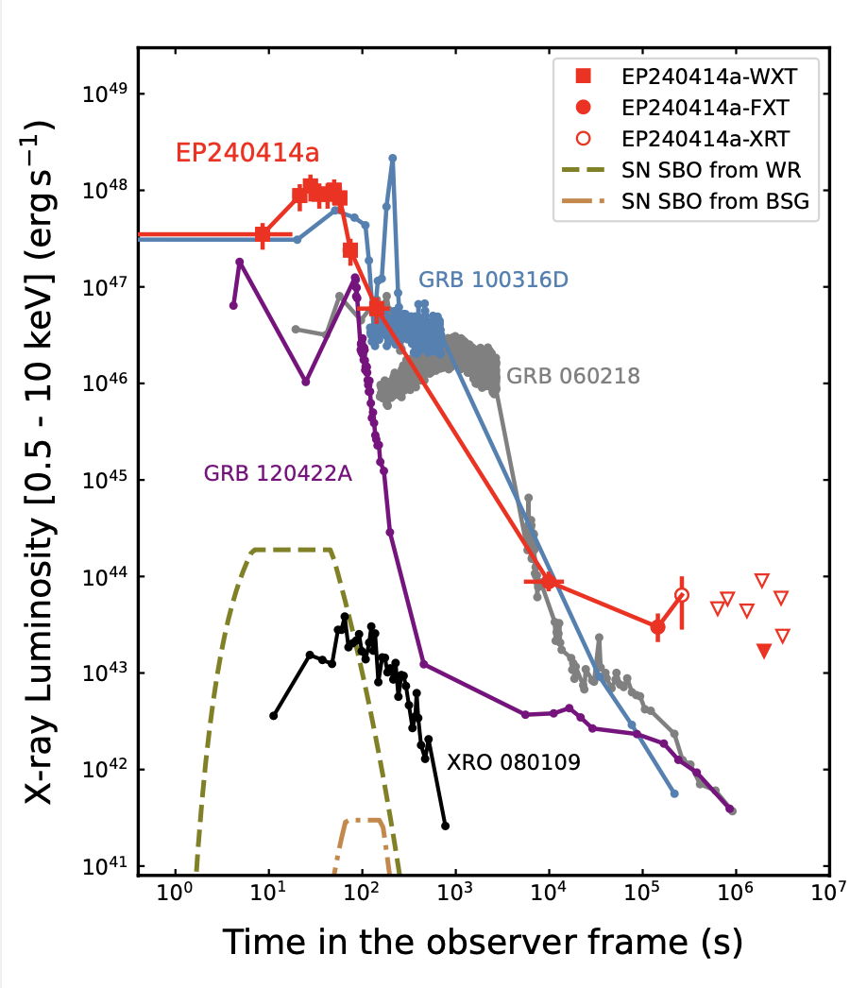
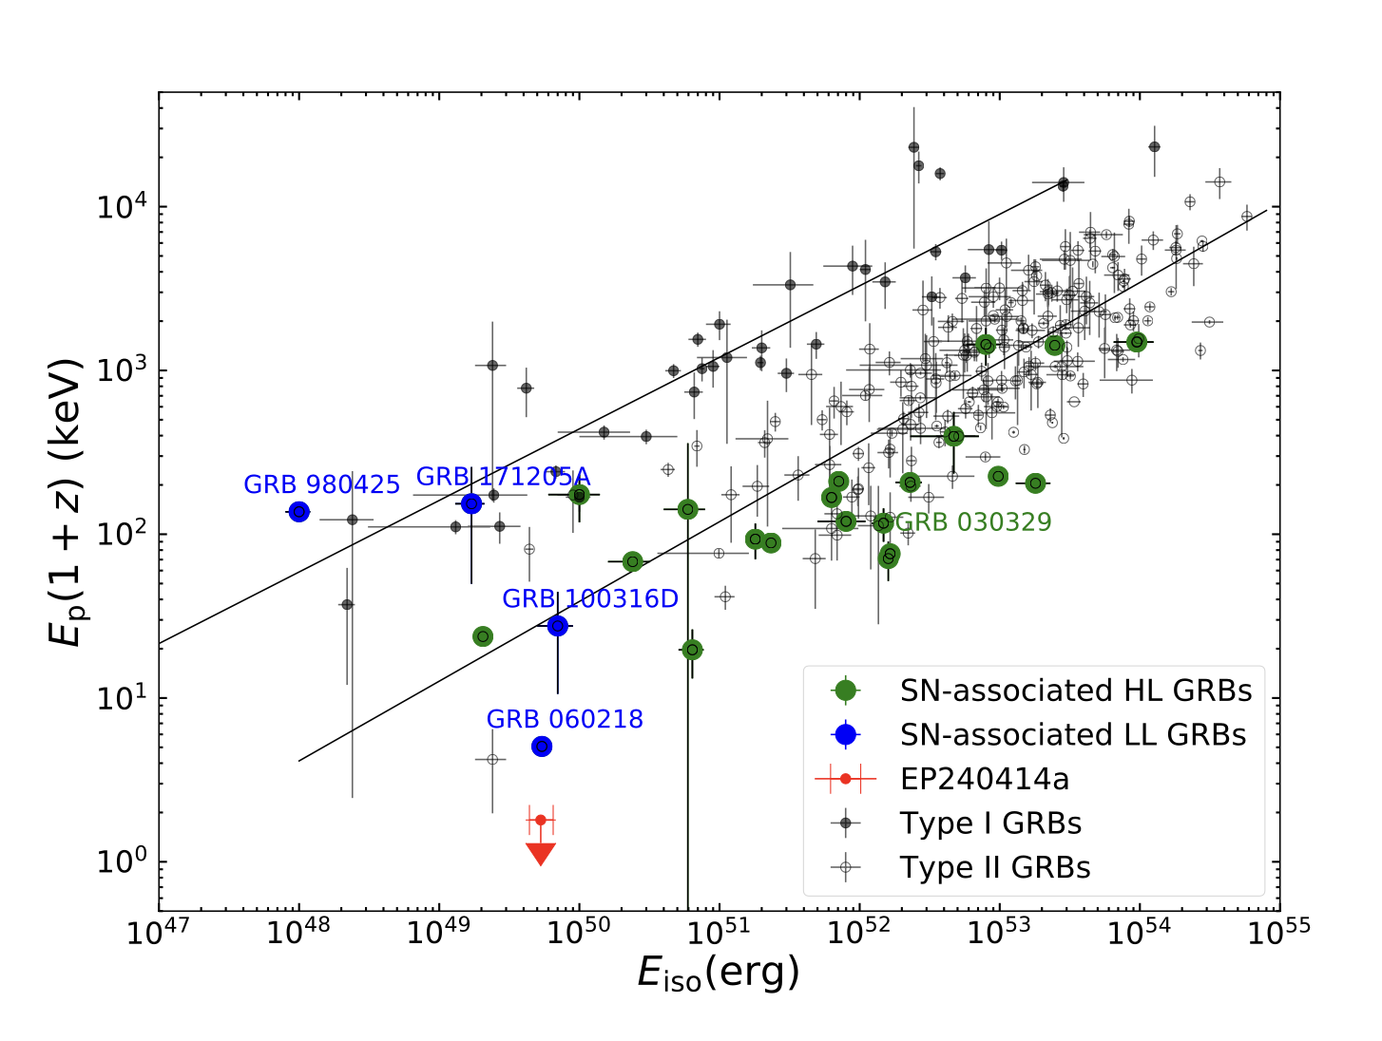
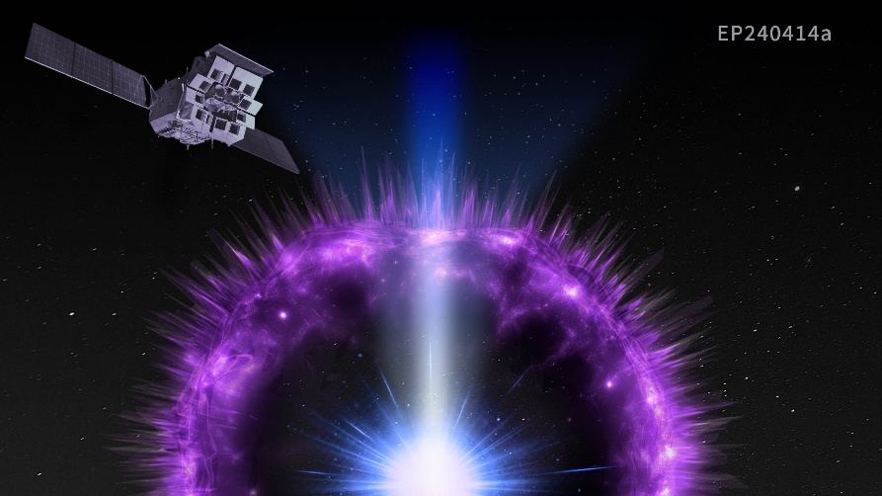
EP240414a: possibly new type of fast X-ray transients with SN
No GRB, very soft spectrum
Associated with Ic-BL supernova 2024gsa z=0.4
No similar previous events
A weak relativistic jet that interacts with an extended shell surrounding the progenitor star
X-ray light curve
Sun H. et al. 2025 Nature Astronomy 9, 1073
Notes:
associated with the Type Ic supernova SN 2024gsa at a redshift of 0.401. The X-ray emission evolution is characterised by a very soft energy spectrum peaking at < 1.3 keV, which makes it distinct from known LGRBs, X-ray flashes, or low-luminosity GRBs. Follow-up observations at optical and radio bands revealed the existence of a weak relativistic jet that interacts with an extended shell surrounding the progenitor star

Slide 24
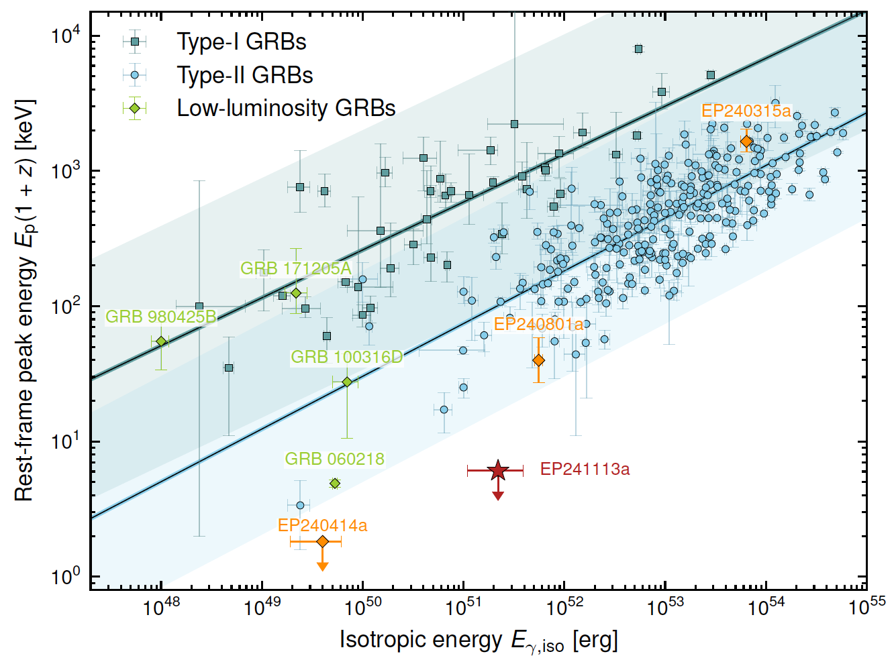

EP241113a: an energetic dirty fireball in X-ray
dirty fireball
No GRB, very soft spectrum
Lorentz factor ~ 20, viewed on axis
Long-predicted dirty fireball: relativistic jet contaminated by baryons
Dai C., et al. arXiv/2603.26213, Science, under review

Slide 25





EP240222a: TDE by Intermediate-mass black hole
EP240222a
X-ray light curve
optical light curve
EP-WXT detection
35 kpc projected distance from the center of a massive galaxy (z=0.033)
host stellar mass: ~10⁷ Msun
Jin et al. arXiv/2501.09580
Science under review
kT: ~ 200 eV
BH mass 10⁴⁻⁵ Msun

Slide 26











EP250702a: possible TDE of a white dwarf by IMBH ?
outburst SED: X-ray to gamma
extreme relat. jet
EP250702a
HST
outburst last 1 day, undetectable after 10 days
Unprecedented light curve & spectra
extreme relativistic jets + thermal/disc
TDE of a white dwarf by an IMBH
JWST
Fermi/GBM
VLT
MeerKAT
Hubble
Li D. et al. 2026 Science Bulletin

Slide 27



A new transient class?
EP240408a
A 12s-long extremely bright X-ray burst
Spectral and temporal properties inconsistent with any known transient types
Zhang W., et al. 2025 Science China
O'Connor B., et al. 2025 ApJL
Notes:
unusual transient, previously unknown type

Slide 28


EP follow-up observation of GW event
Credit: Yunfei Xu
Figure: Jingwei Hu

Slide 29

ToO-MM automated uplink
Equatorial coordinates
Figure: Mo Zhang Software: Yunfei Xu, Mo Zhang
Notes:
EP Gravitational Wave Follow-up Process
The EP GW follow-up involves two main components: event notification and observation scheduling, both supported by the EPSC infrastructure hosted on Alibaba Cloud.
For Notification Pipeline showing in red arrows: Gravitational wave alerts are received via the GCN Kafka service. Only NSBH/BNS events are retained. Upon detection, the TA/DS is immediately notified via phone call and Feishu notifications.
For Observation Scheduling showing in blue arrows: A tiling algorithm at TDIC generates the tiling table. This is sent via the messaging queue to the toomm tool, which formats it into a formal observation request. The request is submitted to the Mission Center and uplinked to the satellite via the Beidou link. The entire process is designed to complete within a few minutes.

Slide 30



S250206dm
S250206dm: T0=2025-02-06 21:25:30.439 UTC; NSBH (55%), BNS (37%); 373 +/- 104 Mpc; 90% area=547 $\deg^{2}$
EP follow-up observations:
$1^{st}$ round: 2$×$2400s WXT coverage + 100$×$300 s FXT targeting galaxies (2025-02-07T02:55:12Z ~ Feb. 8th)
$2^{nd}$ round: 59$×$2000s FXT tiling (from Feb. 11th to 18th)
Search for transient or variable candidates in the FXT data (apparently associated with the galaxies):
found ~20 uncatalogued sources, two of which exhibit significant flux decay.
Detailed information: GCN Circular 39545; https://ep.bao.ac.cn/ep/cms/article/view?id=185
$1^{st}$: WXT covered 302 $\deg^{2}$ within (55% of) the 90% GW area
WXT 0.5-4 keV flux limits: $1×{10}^{−11}$ ${erg s}^{−1}cm^{−2}$
FXT 0.5-10 keV flux limits: $3×{10}^{−13}$ ${erg s}^{−1}cm^{−2}$
$2^{nd}$: FXT covered 34 $\deg^{2}$ within (89% of) the 50% GW area
FXT 0.5-10 keV flux limits: $5×{10}^{−14}$ ${erg s}^{−1}cm^{−2}$

Slide 31


The origin of high-energy astrophysical neutrinos
Diffuse neutrino background
Possible sources:
  Blazar
  Seyfert
  Supernova?
  Low-luminosity GRB ?
  TDE ?
The IceCube Collaboration(2022)
γ~ 1 keV (WXT band!)
Expect association between X-ray transients and neutrinos

Slide 32


EP observing strategy
Prompt FXT follow-up
  IceCube Gold event
  Automated uploading
  Latency ~ 40 min
  Seek evidence counterpart
FXT monitoring (weekly)
  Blazar candidates
  Long-term correlation
WXT/FXT and neutrino event correlation
  WXT+ gold/bronze events (collaborate with Chiba University)
  FXT + low significant events
  Constrain cosmic-ray loading factor
FXT (1 deg x 1 deg) IceCube-250706A
(T0+40 min)
Error circle radius ~ 0.5 deg

Slide 33







EP-FXT follow-up of IceCube-250706A
IceCube Gold alert: ~210 TeV and signalness ~65%
Rapid FXT follow-up: T0+43 min, five epochs, and ~96% localization coverage (90% C.L.)
54 X-ray sources: no convincing counterpart
Flux upper limits + LLGRB afterglow model
z>0.44 (ISM-like) or z>2.38 (Wind-like)
Tight constraint with more events
Solid: ISM z=0.44 Γ=10
Dashed: Wind z=2.38 Γ=10
FXT
XMM-Newton
Dotted: ISM z=0.08 Γ=5
Legacy Surveys
Slide credit: Guojiong Yang
ALLWISE
Notes:
associated with the Type Ic supernova SN 2024gsa at a redshift of 0.401. The X-ray emission evolution is characterised by a very soft energy spectrum peaking at < 1.3 keV, which makes it distinct from known LGRBs, X-ray flashes, or low-luminosity GRBs. Follow-up observations at optical and radio bands revealed the existence of a weak relativistic jet that interacts with an extended shell surrounding the progenitor star

Slide 34







Follow-up analysis of IceCube neutrino alerts by the WXT
X-ray is a natural target of cosmic rays to produce O(100) TeV $ν$ via p+γ interaction
Theoretical prediction: $φ_{ν}∝L_{X}^{3/2}ρ ξ_{CR}$
($ξ_{CR}$ is a scaling factor connecting $L_{CR}=ξ_{CR}L_{X}$)
Only long time window match ($±{10}^{4.5}$ s)
Long + short time window match ($±{10}^{3}$ s)
PRD 110, 043045 (2024)
Short time scale
transients ($±10^{3}$ s)
Performed follow-up analyses on ~2 years of IceCube alerts
with EP/WXT to search for X-ray transient counterparts:
14 alerts : long time window $±{10}^{4.5}$ s
5 alerts : short time window $±{10}^{3}$
No X-ray counterpart was observed.
Assuming IceCube $ν$ are from X-ray transients, we could provide a very strong limit on the X-ray sources: X-ray luminosity, $L_{X},$ and rate density $ρ$.
=> LLGRBs and TDEs as origins of high energy neutrinos are very much
disfavored by this analysis
Experimentally
Excluded
LLGRB?
preliminary
Slide credit: Nobu Shimizu

Slide 35



Release of 1st batch of EP science data
National Astronomical Data Centre (NADC)
https://ep.bao.ac.cn/ep/next/data-release
National Space Science Data Centre (NSSDC)
https://ep.nssdc.ac.cn
ESA's Einstein Probe Science Archive (EPSA)
https://www.cosmos.esa.int/web/einstein-probe/data
35
Notes:
1yr Proprietary period

Slide 36
Summary
Einstein Probe has been operating remarkably well in the past 2 years
Public availability & data release
  FXT data after 1-year proprietary period already made public
  WXT data
Some core science objectives have been partly fulfilled
  Dramatically enlarged samples, e.g. fast X-ray transients (XRF, SN, …), stellar flares
  Rare or long-predicted transients/objects (IMBH-TDE, WD-TDE, dirty fireball, ..)
  Unexpected: jet-SN connection, other new types of transients
EP will continue to advance our understanding of high-energy transients ..
  larger samples, new types, multi-messenger transients, ……
  http://ep.bao.ac.cn
  https://www.esa.int/Science_Exploration/Space_Science/Einstein_Probe_factsheet

