Slide 1


The Payload for Ultrahigh Energy Observations (PUEO)
2025-2026 Flight and Experiment Overview
Lucas Beaufore
The Ohio State University

Slide 2
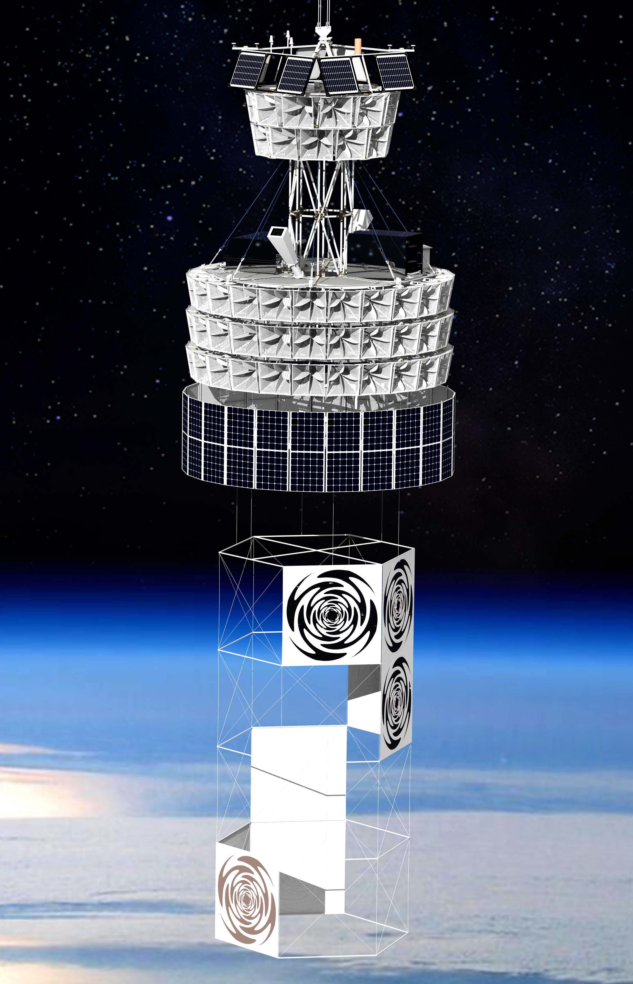
PUEO: A Brief Introduction
Payload for Ultrahigh Energy Observations
Science goal of detecting ultrahigh energy (UHE) >1 EeV neutrino interactions in Antarctic ice using radio detection techniques.
NASA Long-Duration Balloon payload, achieved a ~23 day flight in the 2025-2026 Antarctic Summer
Successor to the ANITA I-IV (2006-2016) balloon missions.
CSBF

Slide 3
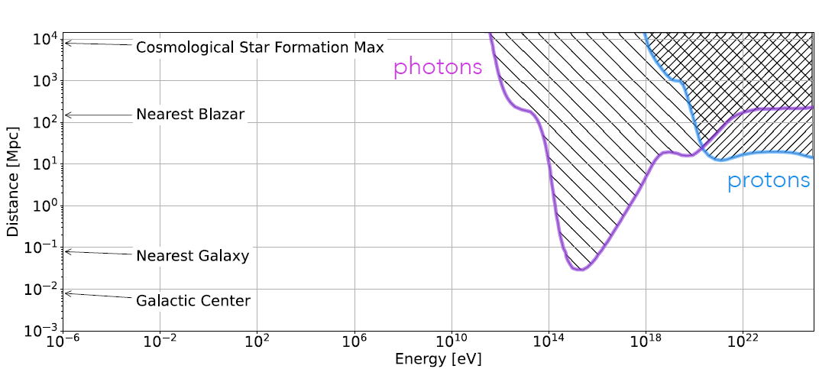
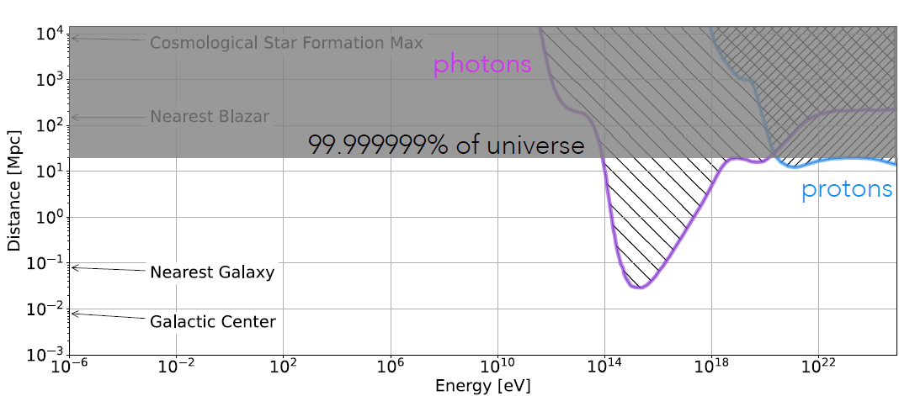
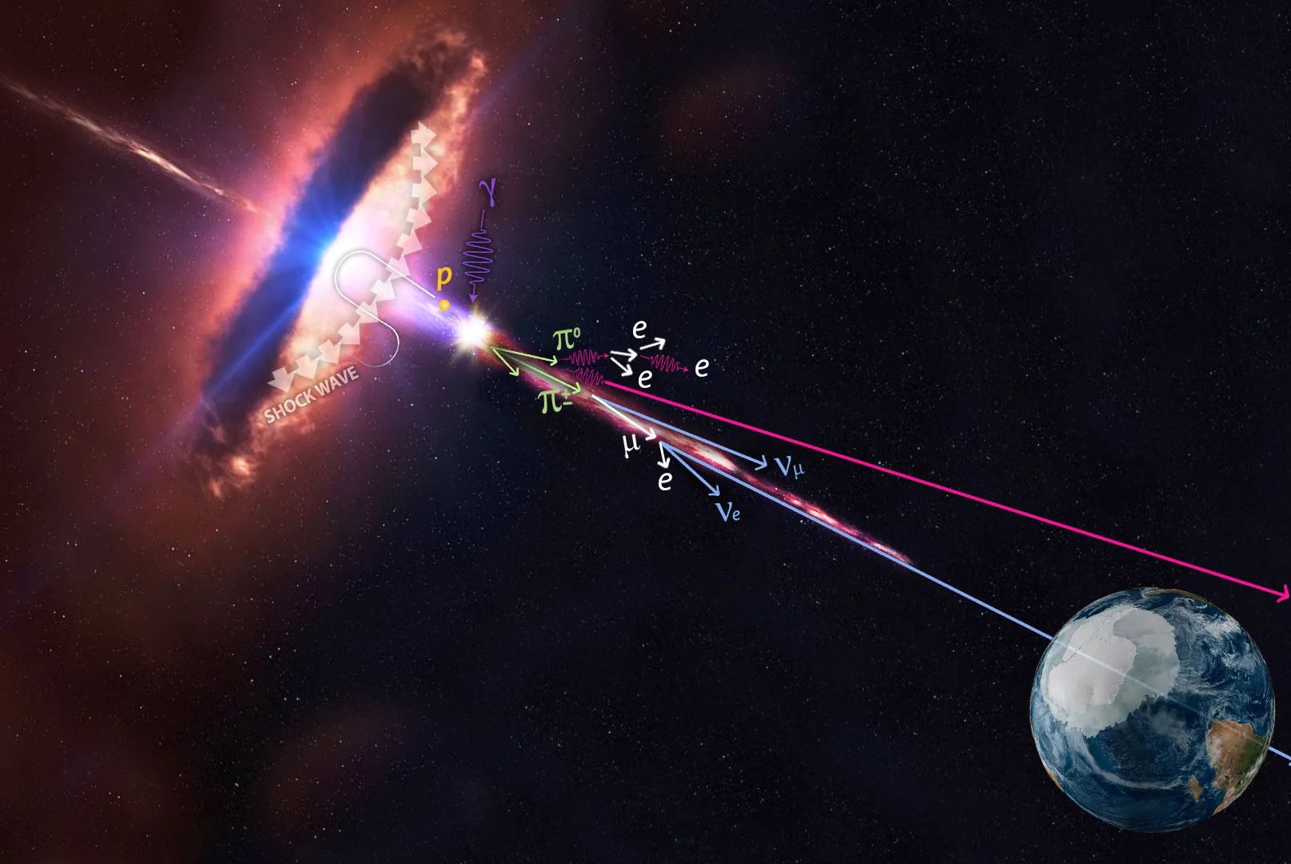
What is PUEO looking for?
We want to study the distribution and nature of the sources of the highest energy particles in the universe!
Neutrinos are uniquely well-suited messengers for this purpose.
IceCube
Source: K. Hughes

Slide 4
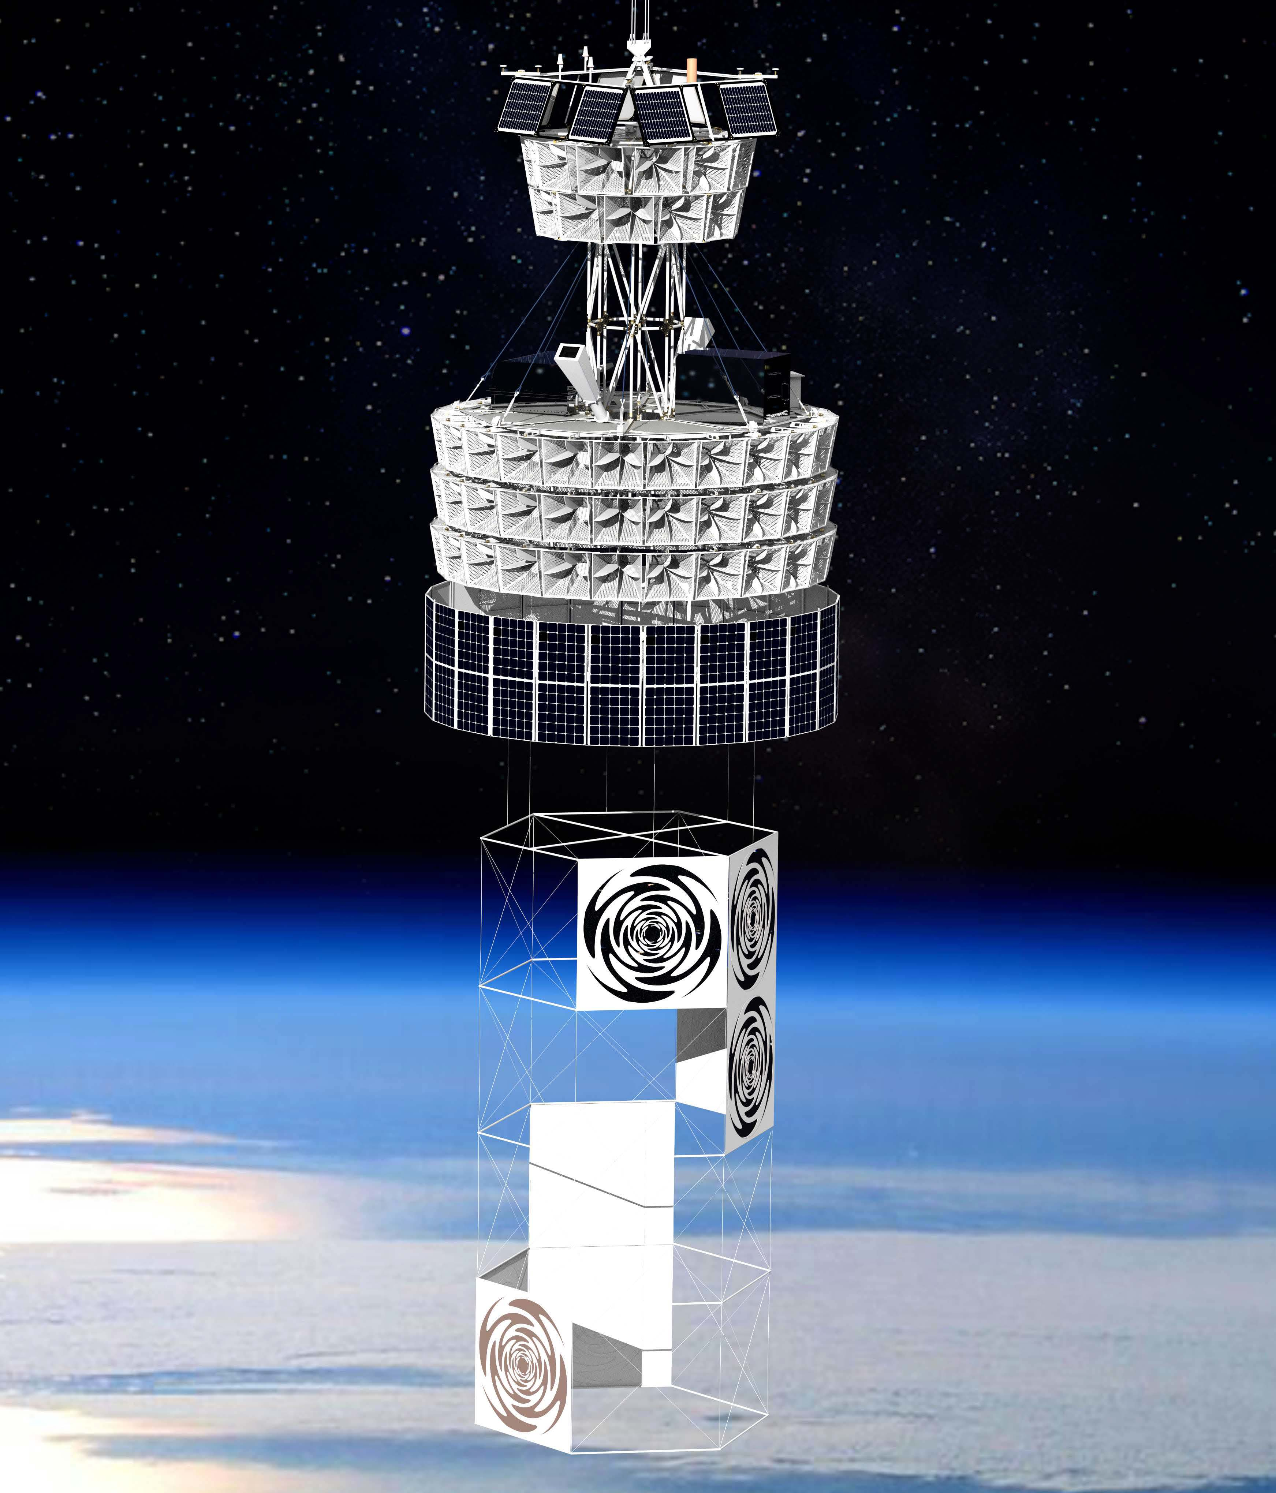
Design of PUEO
Main instrument antennas
  96 Quad-ridged horns
  Dual polarized
  Arranged into 4 rings
  2π (full) azimuthal coverage
  300-1200 MHz band
Low frequency instrument
  8 Sinuous antennas
  Dual polarized
  50-500 MHz band
  Made of conductive fabric
Top Antenna Ring
Main Instrument Enclosure
Lower Antenna Ring
PV Arrays (power)
LF Instrument

Slide 5
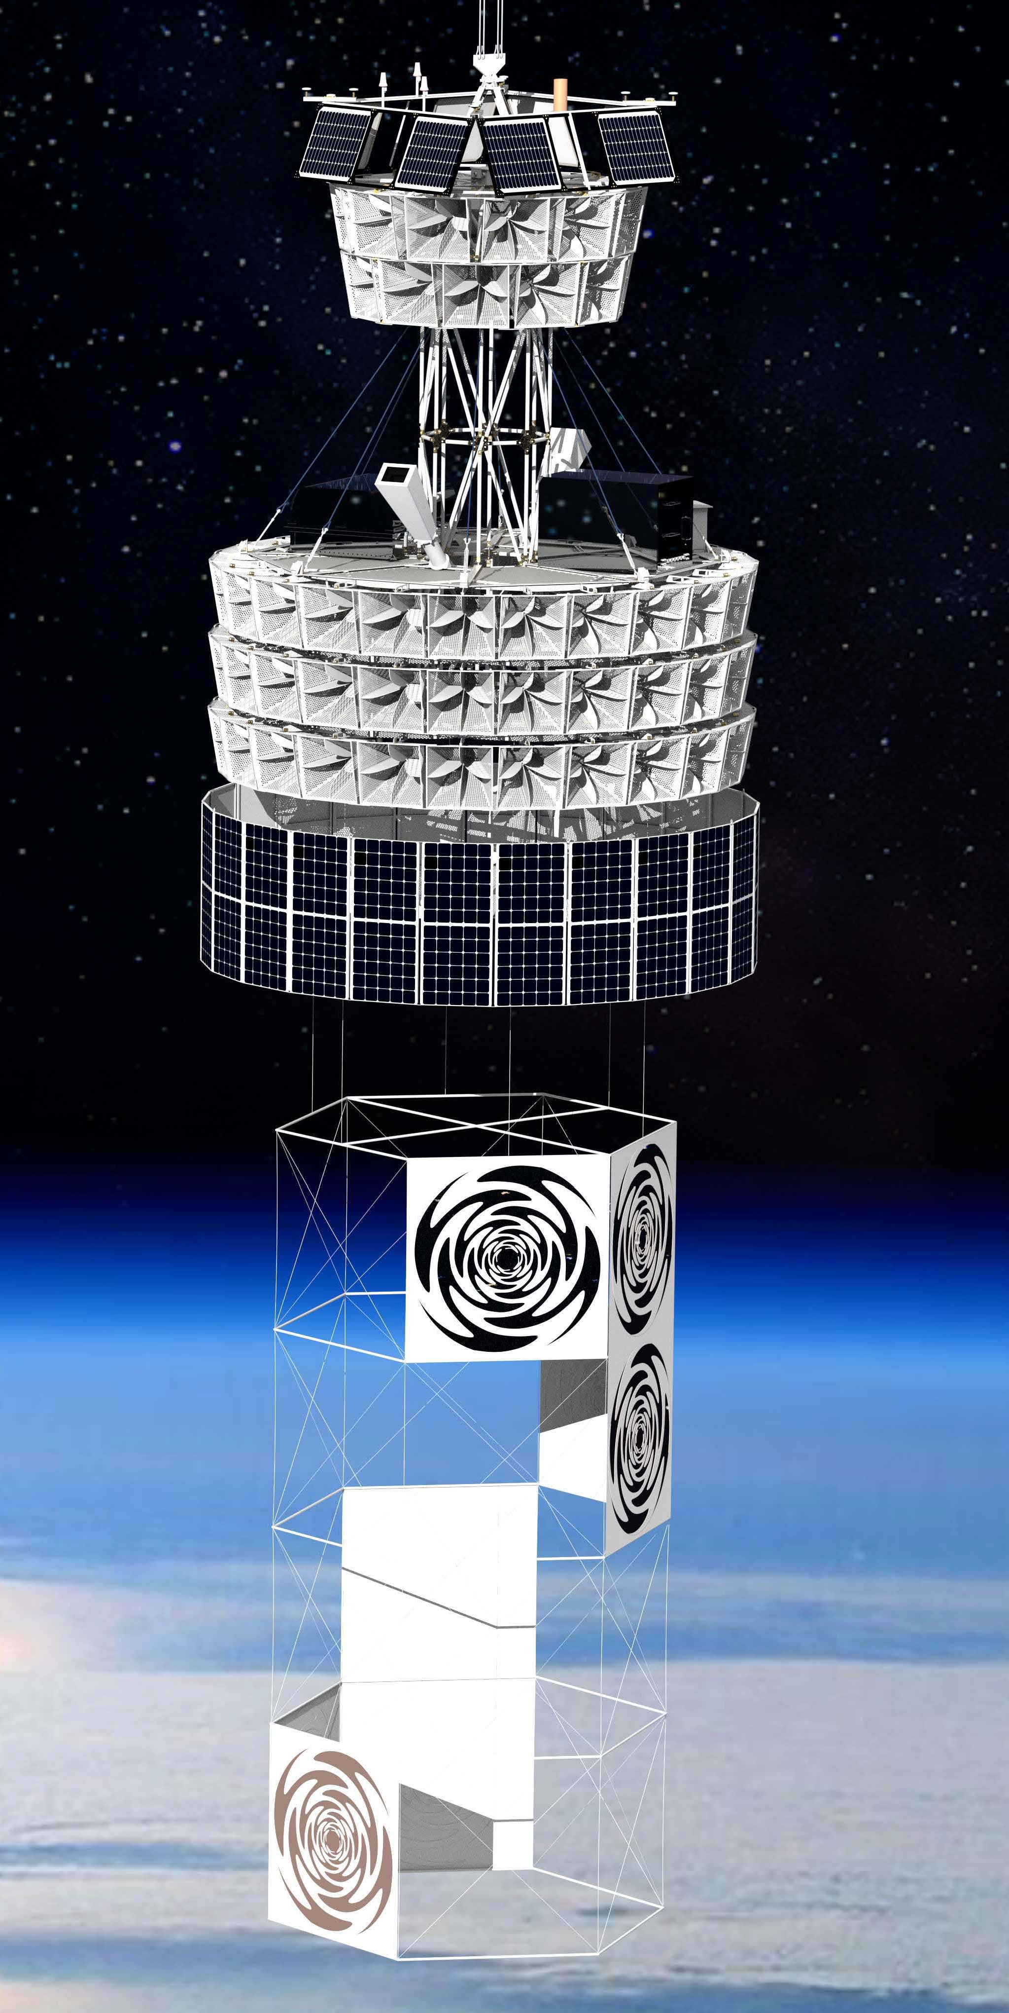
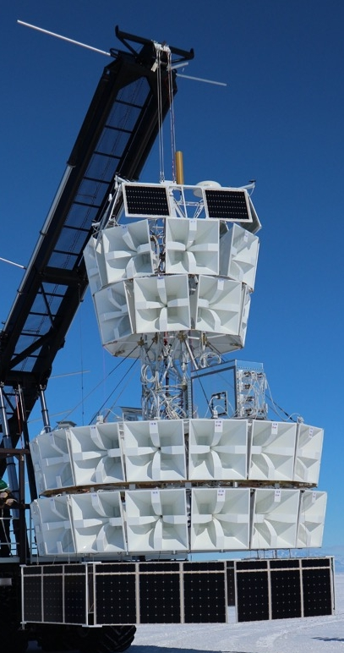
Improvements over ANITA
300 MHz high-pass antennas vs 200 MHz
  Anthropogenic noise below 300 MHz
  Smaller antennas → more collecting area
Longer baselines between antennas
  Improved pointing and background rejection
Improved DAQ and trigger system
  Phased array trigger → higher effective SNR
  Enabled by use of RFSoCs (8 channels @ 3 GHz)
LF instrument
  Better sensitivity to air showers from CRs or taus
Improved navigation/orientation suite

Slide 6
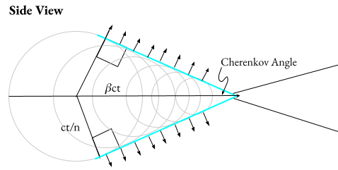
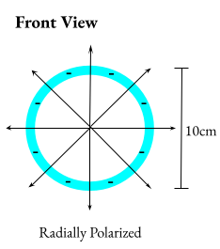
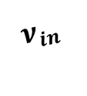
How does PUEO see these particles?
Method 1: Askaryan emission in ice
When a UHE neutrino interacts in the ice, the resulting shower emits Askaryan radiation at the Cherenkov angle.
This radiation will add coherently in radio (with power ~ E²) if the width of the shower is less than radio wavelength.
The radio emission is radially polarized, which is useful for reconstructing the direction of the shower.
Ice
$$ν_{in}$$
Askaryan
Interaction
Credit: Rachel Scrandis

Slide 7

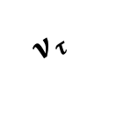

How does PUEO see these particles?
Method 2: Geomagnetic emission in air showers
PUEO can also detect the radio that is produced by geomagnetic emission in air showers.
Tau neutrinos interacting in the Earth produce tau particles, which then decay and produce an Extensive Air Shower (EAS).
EASs can also be produced by UHE cosmic rays.
UHECR
(Above Horizon)
UHECR
EAS
EAS
EAS
$$τ$$
Reflected Radio
Ice
$$ν_{τ}$$

Slide 8
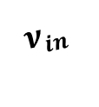
How does PUEO see these particles?
Differentiation Between Radio Sources
In-ice Askaryan
  Below horizon
  Vertically polarized
Tau-neutrino
induced EAS
  Below horizon
  Horizontally polarized
UHECR induced EAS
  Above horizon
  Horizontally polarized
UHECR induced EAS (reflected)
  Below Horizon
  Horizontally polarized
  Polarity flip relative to other EAS showers
UHECR
(Above Horizon)
UHECR
EAS
EAS
EAS
$$τ$$
Reflected Radio
Ice
$$ν_{τ}$$
Askaryan
$$ν_{in}$$
Interaction

Slide 9
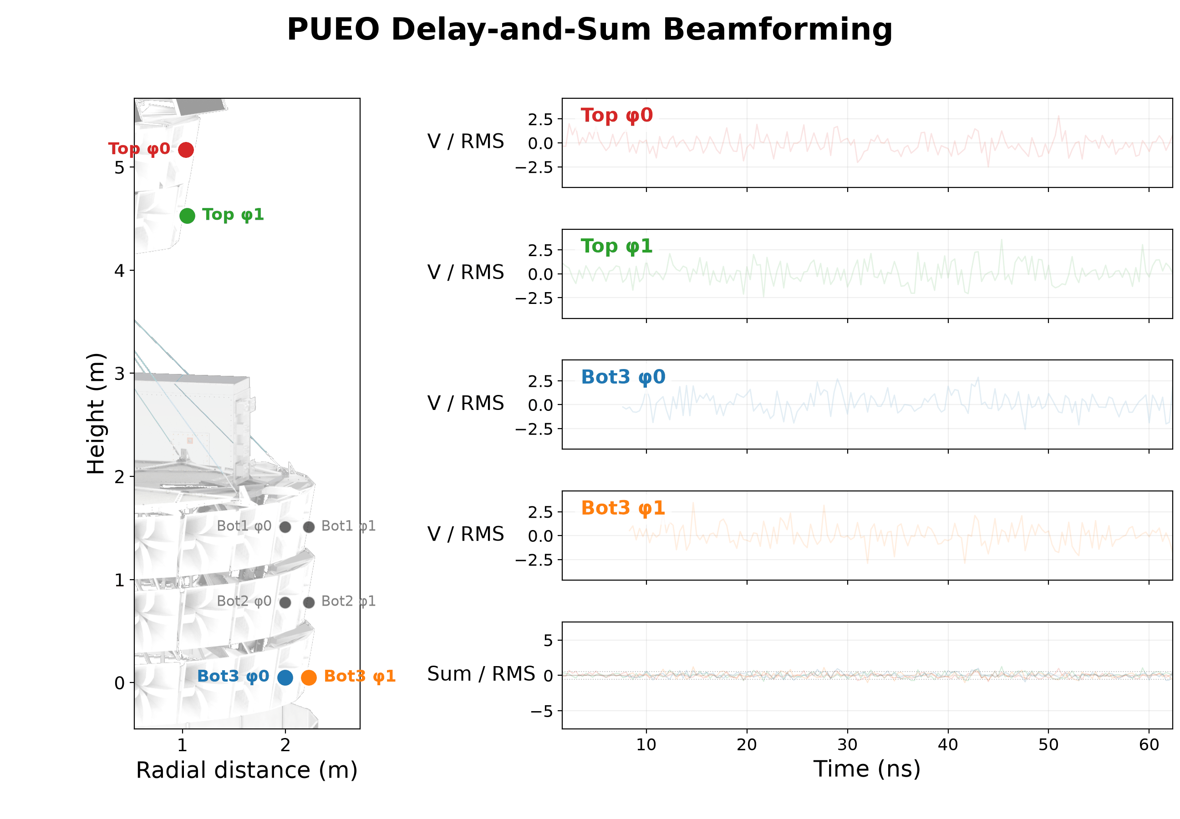
Beamforming: Delay and Sum
With multiple antennas, you can use interferometry to greatly lower your trigger thresholds.
1152 precomputed “beams” of antenna delays are used in PUEOs trigger to search different arrival directions.

Slide 10
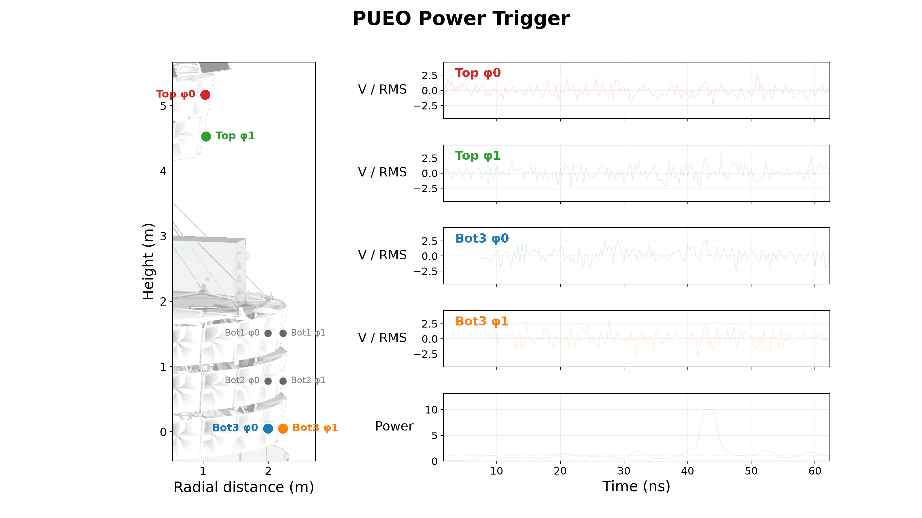
Beamforming: Power Trigger
With multiple antennas, you can use interferometry to greatly lower your trigger thresholds.
1152 precomputed “beams” of antenna delays are used in PUEOs trigger to search different arrival directions.

Slide 11
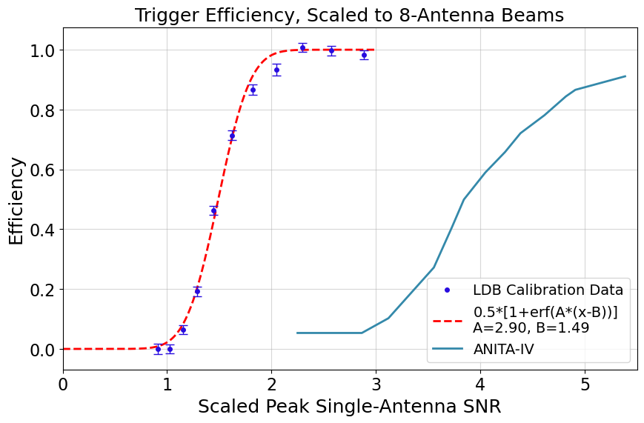
DAQ and Phased Array Trigger
RFSoCs digitize signals from the antennas to 12 bits
Real-time digital processing
  Low-pass filter at ~750 MHz
  Tunable dual-biquad notch filters (unused in flight)
  Matched filter for RF chain
  Automatic gain control
  12-to-5 bits, then beamform
Trigger thresholds adjust to maintain a constant event rate

Slide 12
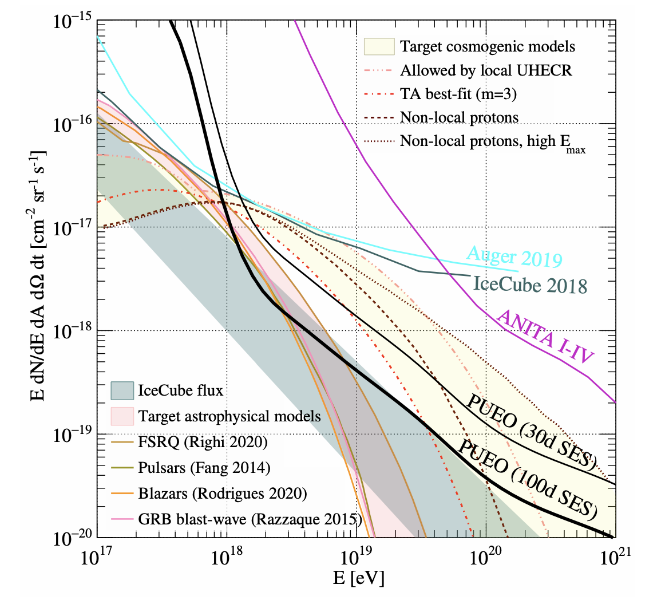
PUEO’s Sensitivity Improvements

Slide 13
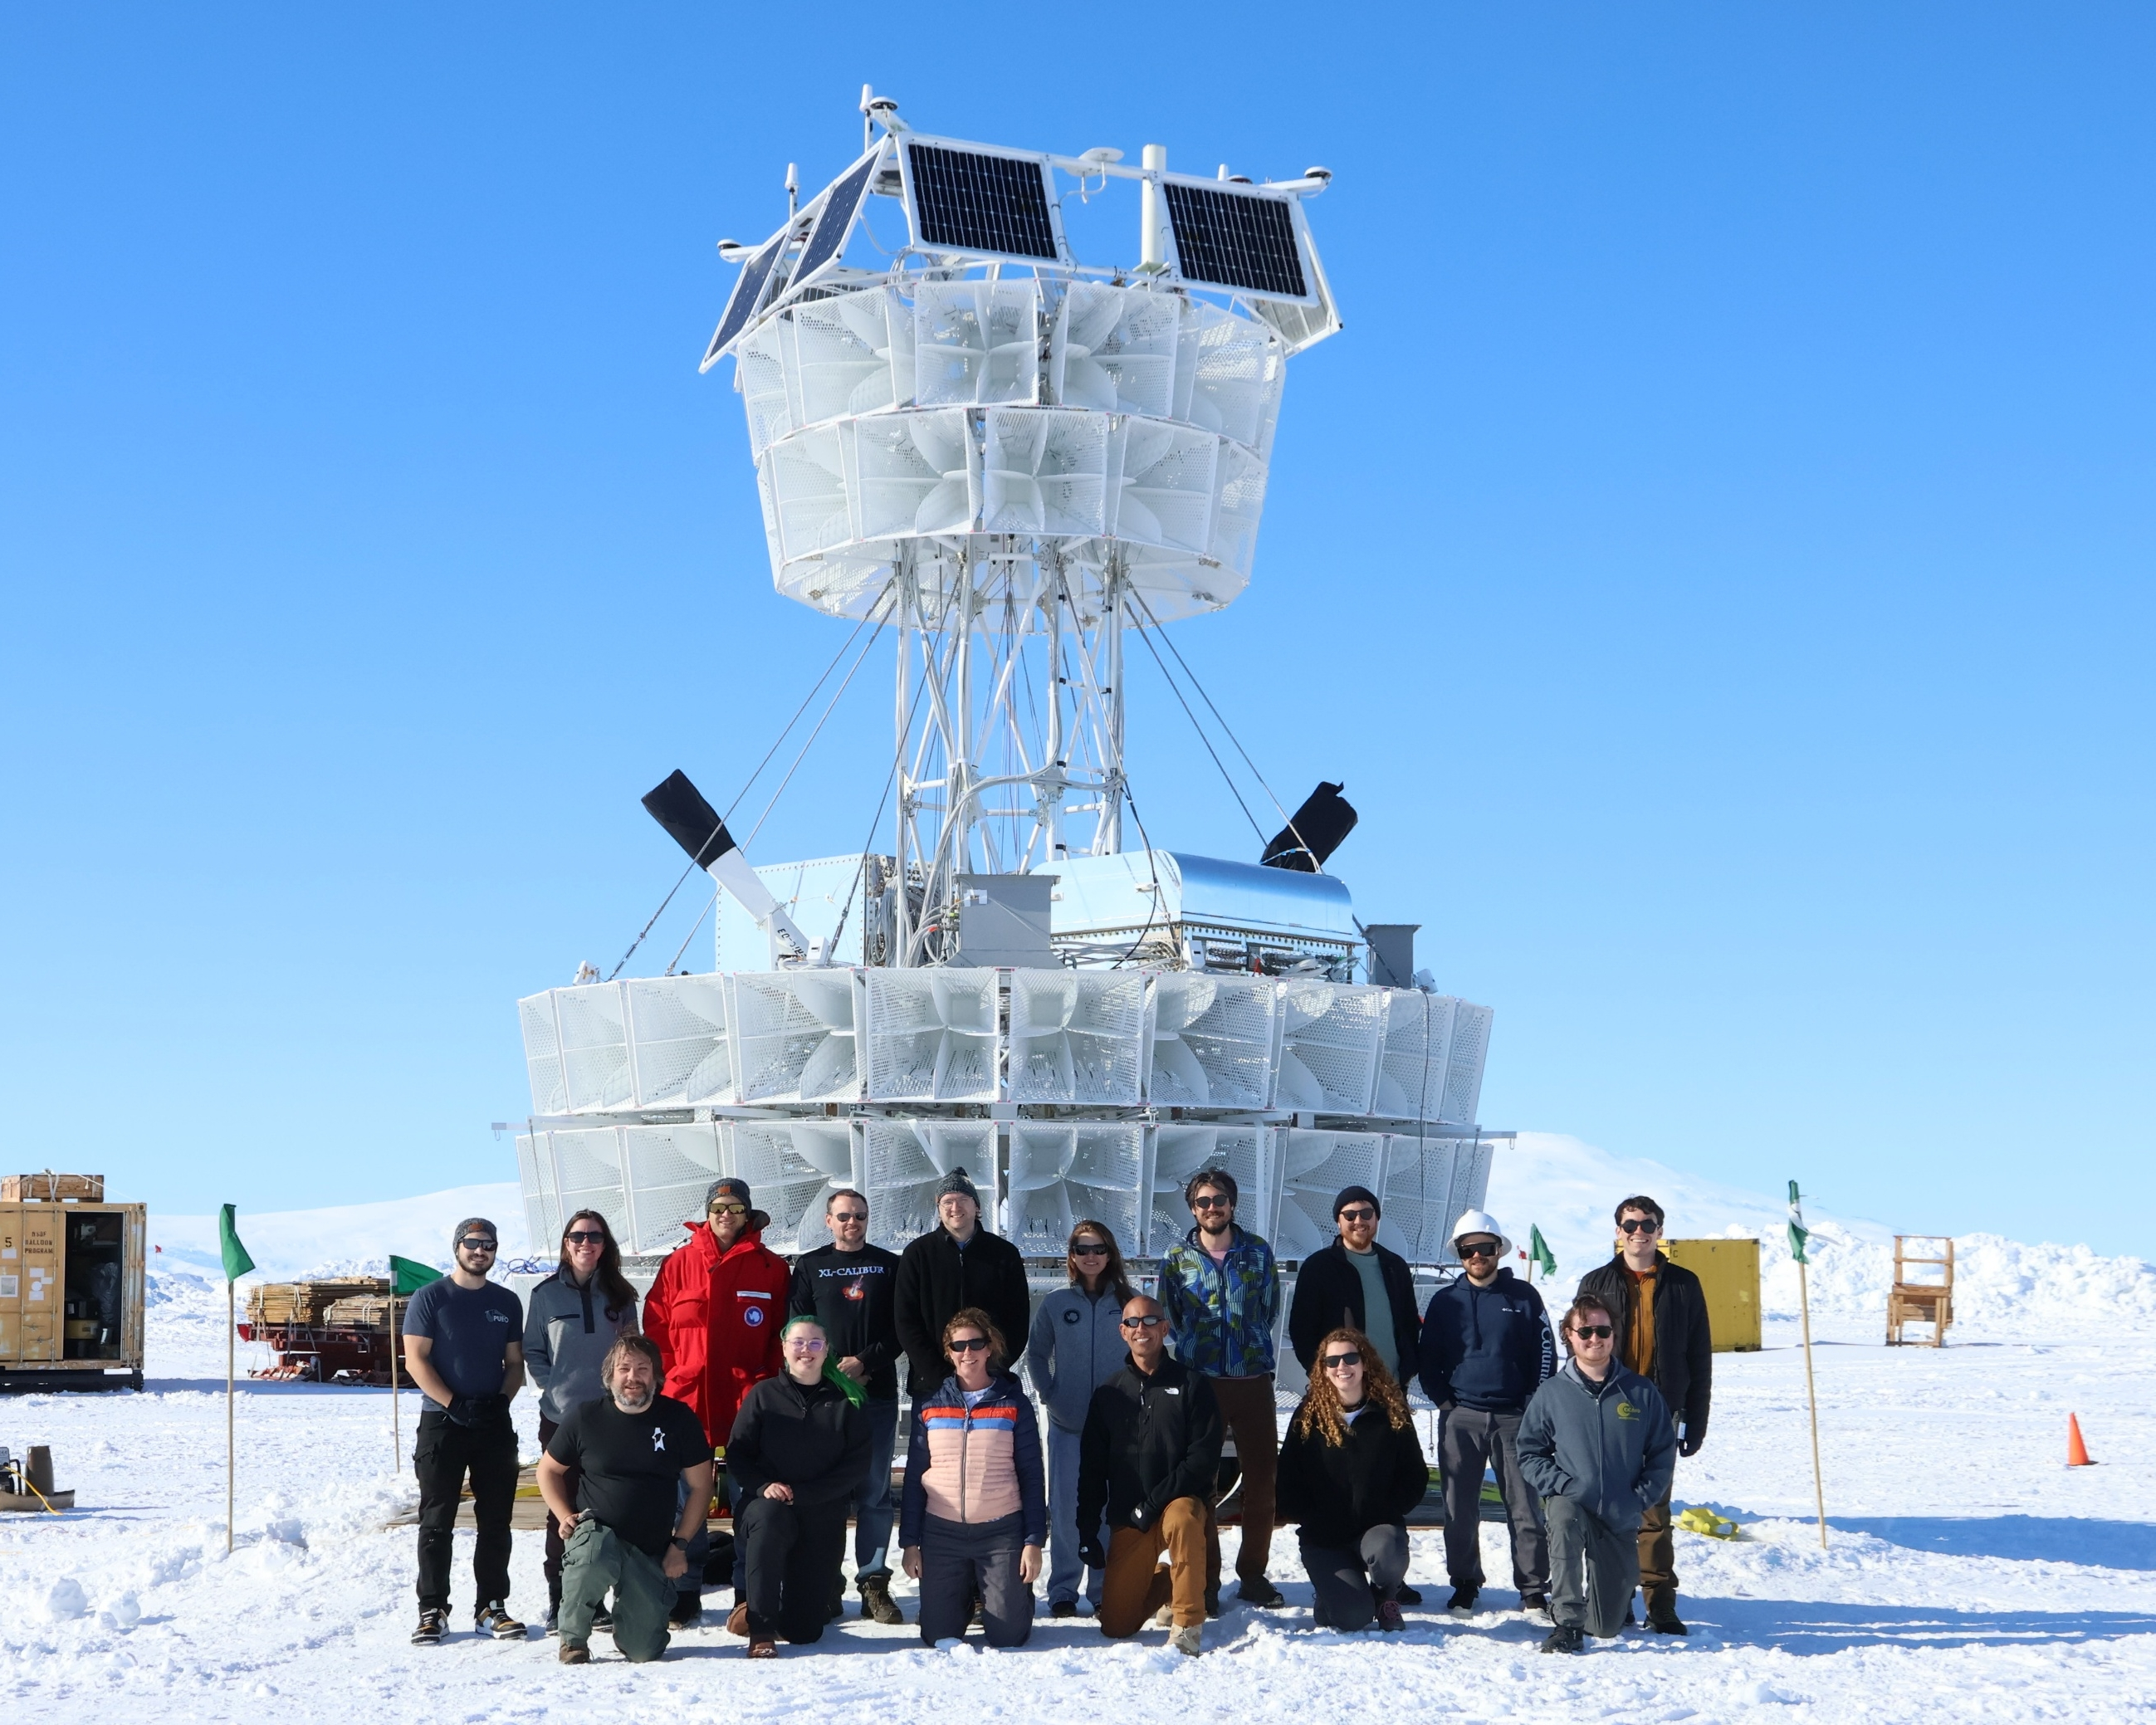
Antarctic Deployment: Ice Team

Slide 14
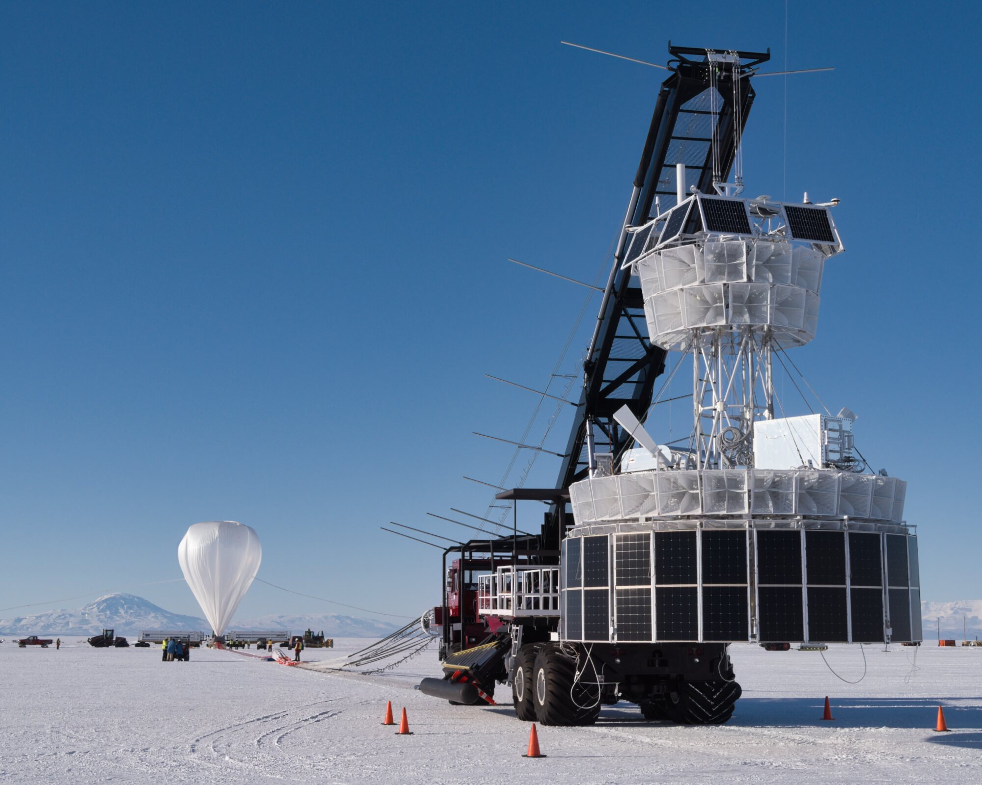
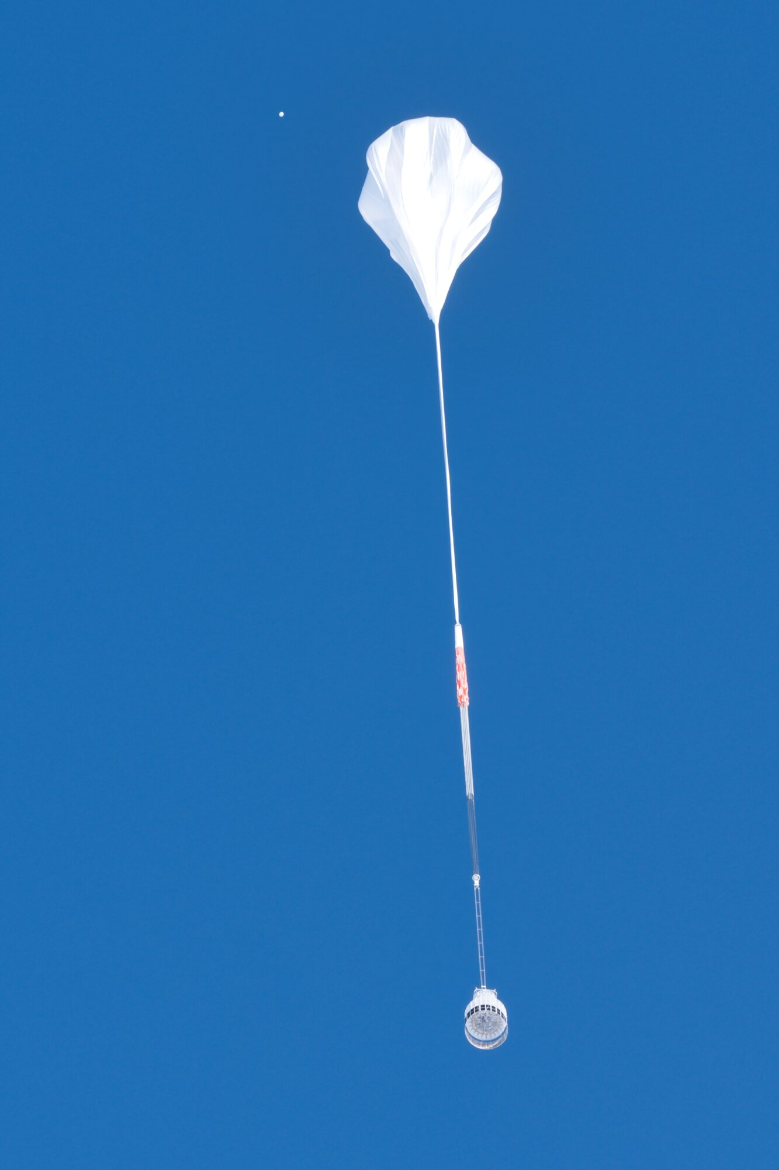
Antarctic Deployment: Launch Day

Slide 15
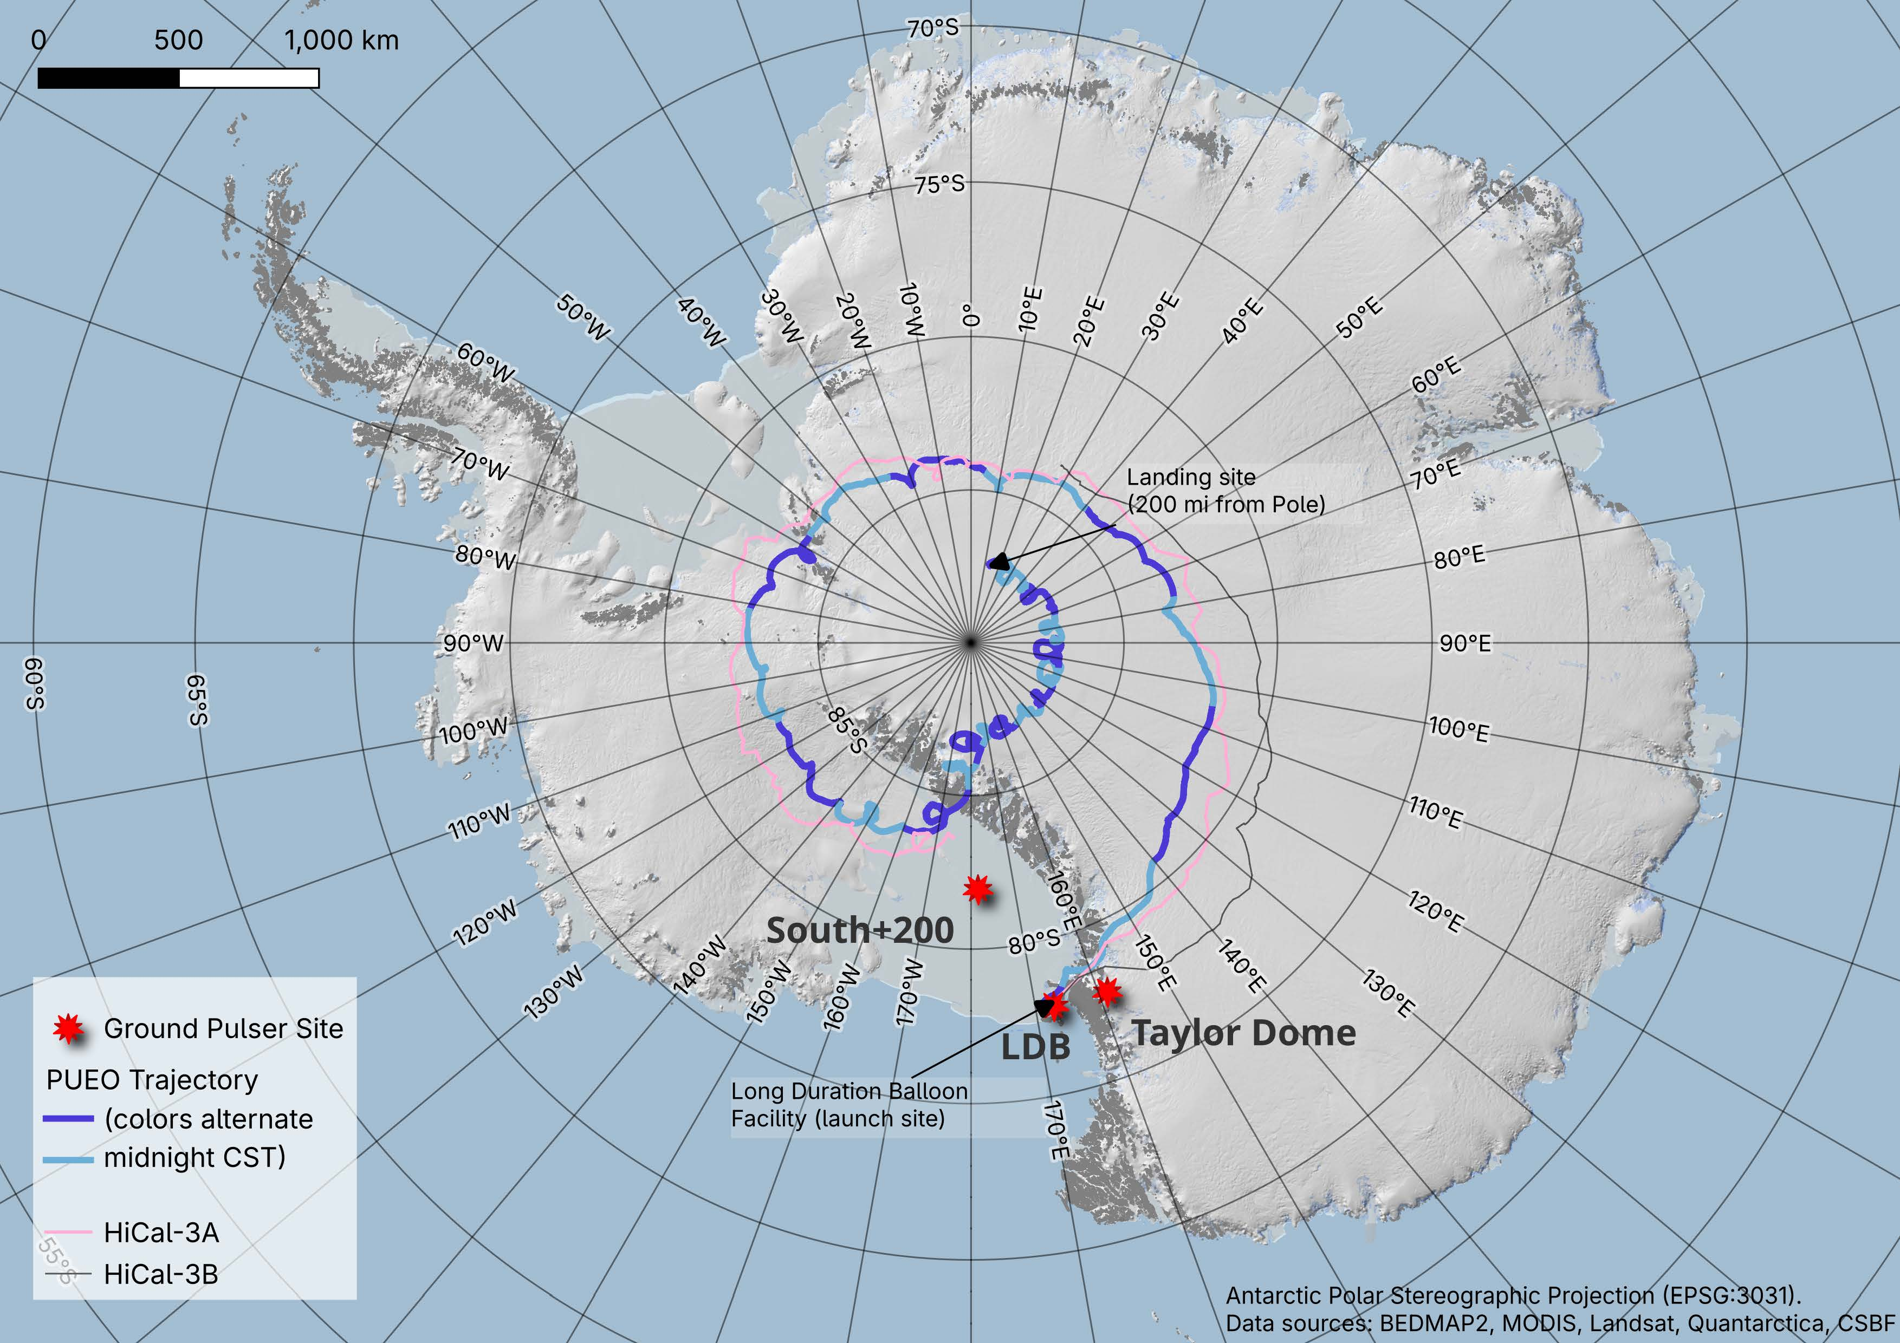
PUEO Flight
Dec 20, 2025 - Jan 12, 2026.
~ 53% data taking livetime. This was due to running in a duty cycle for thermal management.
Terminated within range of Arctic Truck recovery dispatched from Pole.
Cosmin Deaconu

Slide 16
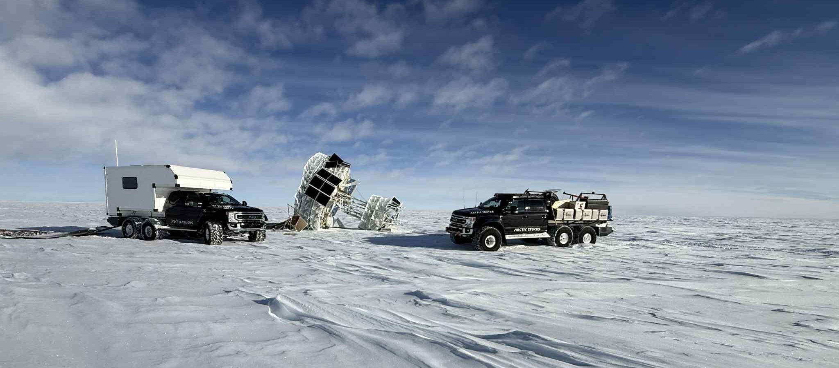
Antarctic Recovery

Slide 17
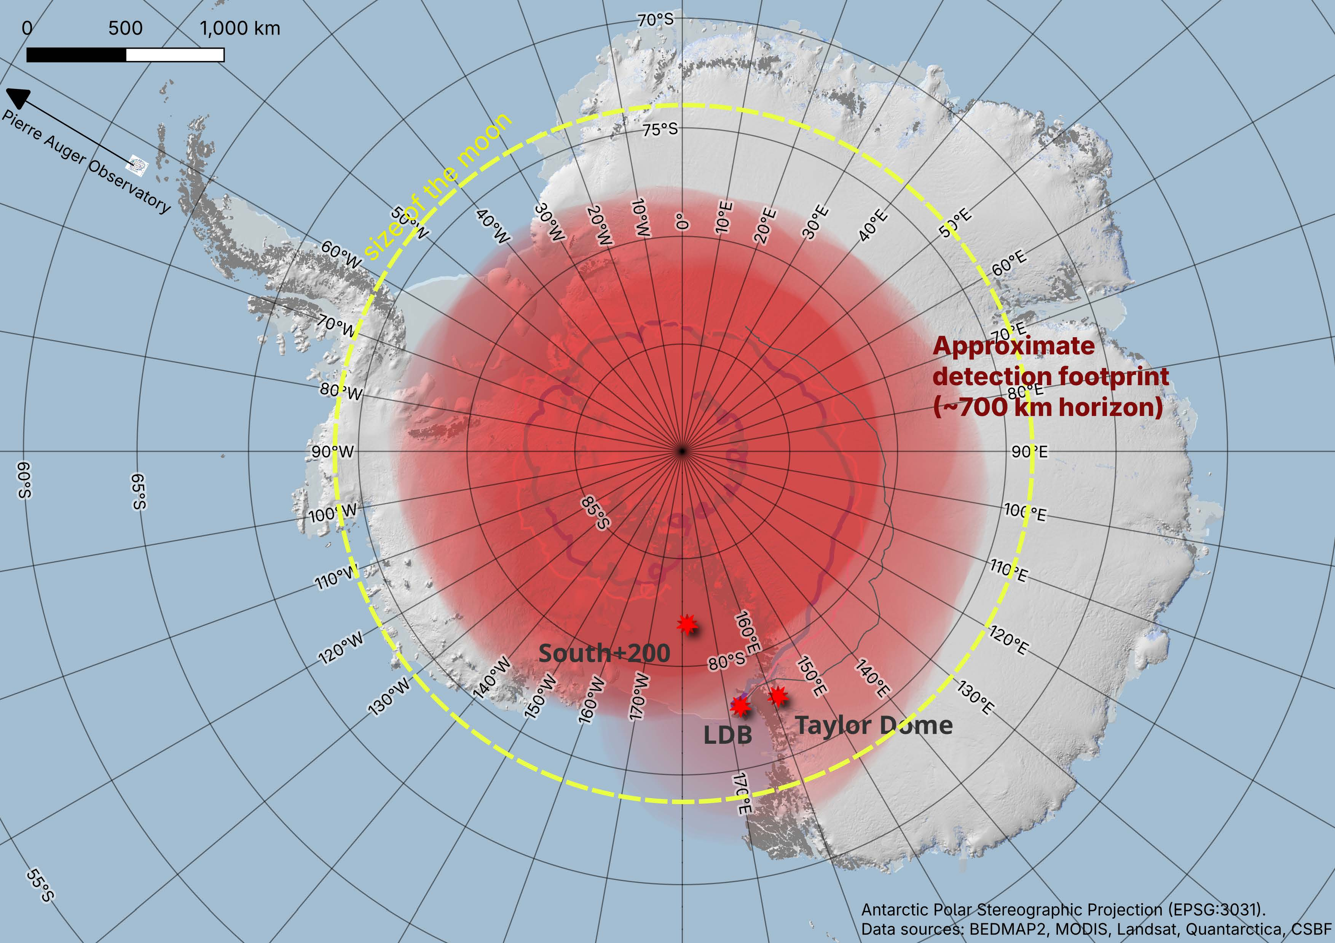
Where PUEO Looked
Cosmin Deaconu

Slide 18












Conclusion
PUEO had a successful 23-day flight!
All data was successfully recovered.
Calibration and analysis is underway and going well!
PUEO is grateful to be selected as a NASA Pioneers mission funded by NASA grants #80NSSC20K0775 and #80NSSC20K0925. We would like to particularly thank the staff at the Columbia Scientific Balloon Facility, the National Science Foundation, and the Antarctic Support Contractor, whose talented and tireless efforts made PUEO possible.

Slide 19
Backup

Slide 20
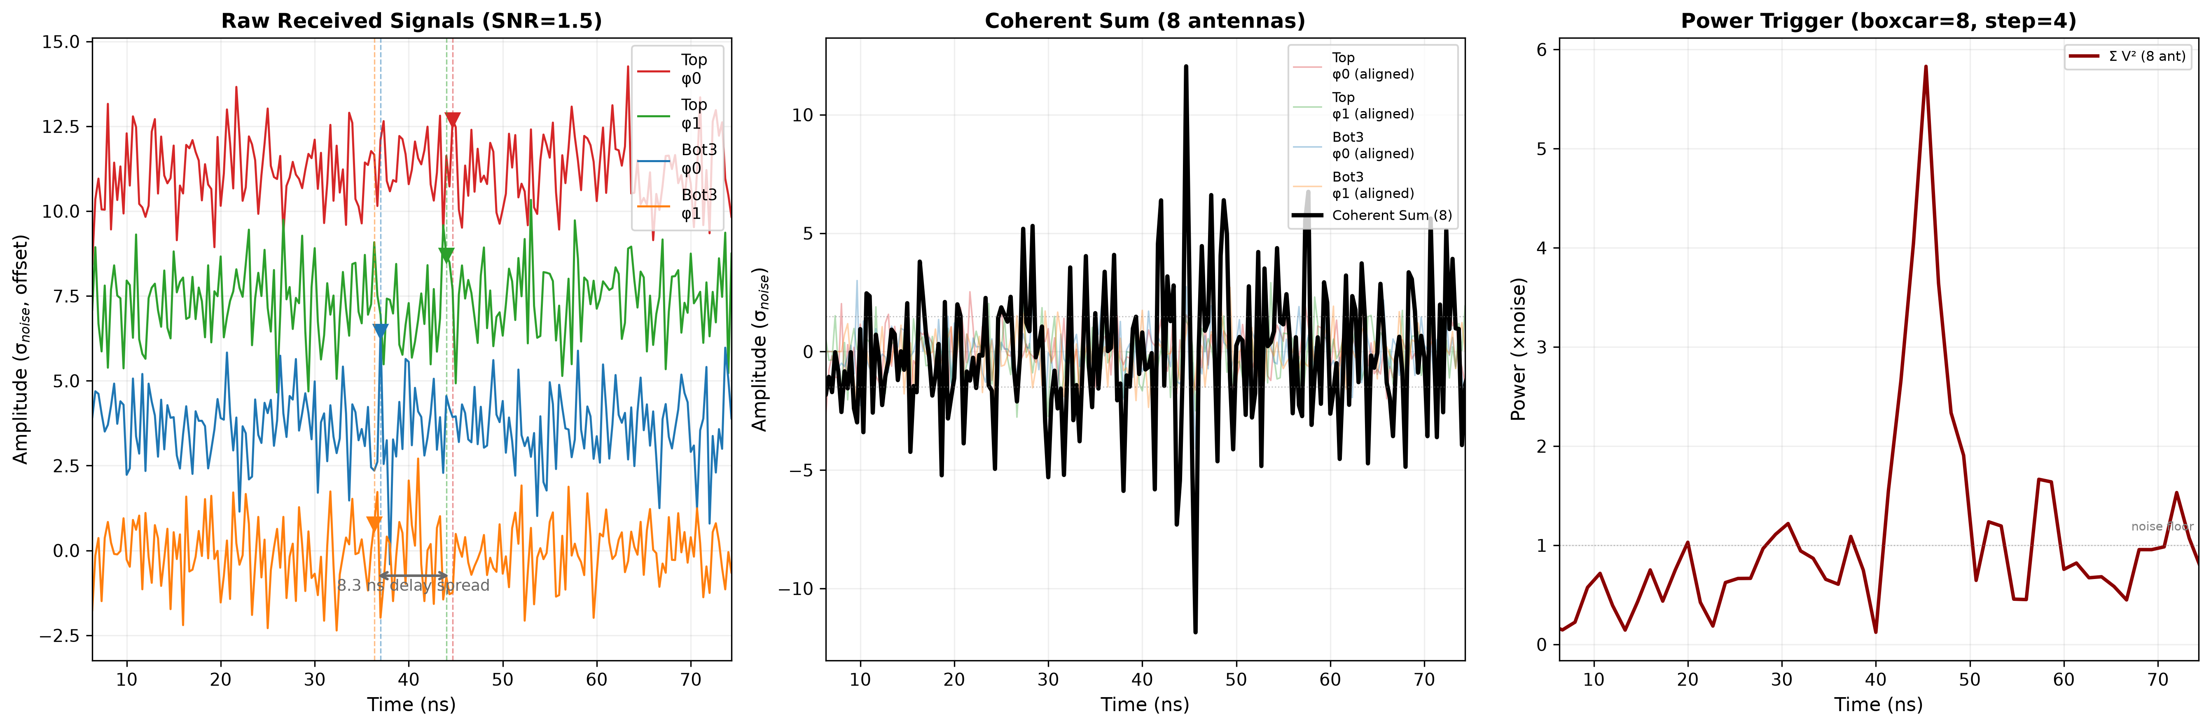
Beamforming Basics
*not PUEO, for illustration only
Source: Dan Southall

Slide 21
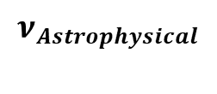
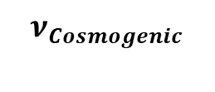

Types of UHE neutrinos PUEO looks for
Astrophysical
Cosmogenic
UHE neutrinos produced directly by their astrophysical sources.
UHECR with energies above ~50 EeV interact with the CMB, producing neutrinos.
GZK Horizon
(~50 Mpc)
$$γ_{CMB}$$
$$ν_{Cosmogenic}$$
p
Antarctica
Earth
$$ν_{Astrophysical}$$
Source
Columbus

Slide 22
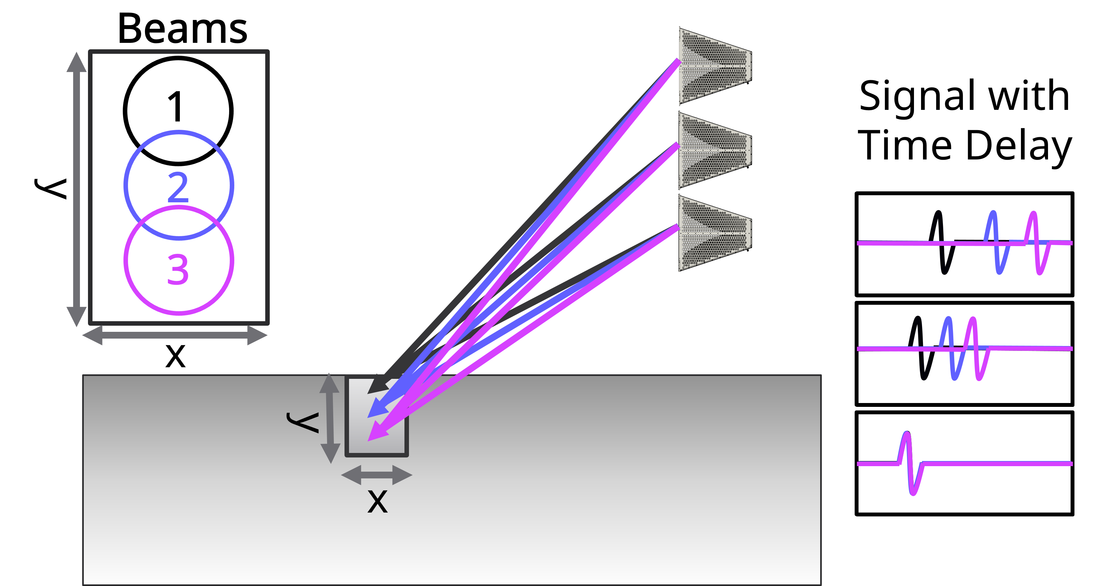
Beamforming Basics
Source: Taylor Coakley

Slide 23
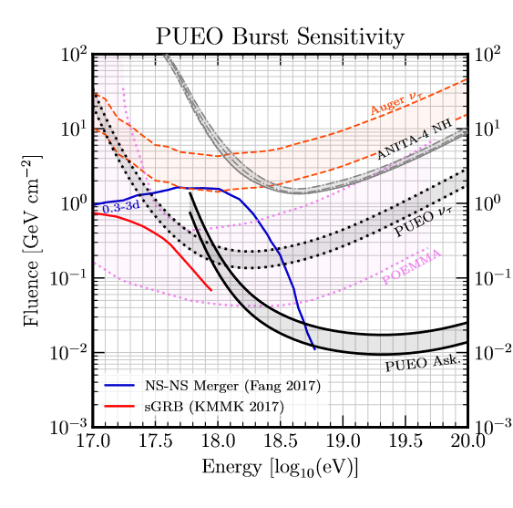
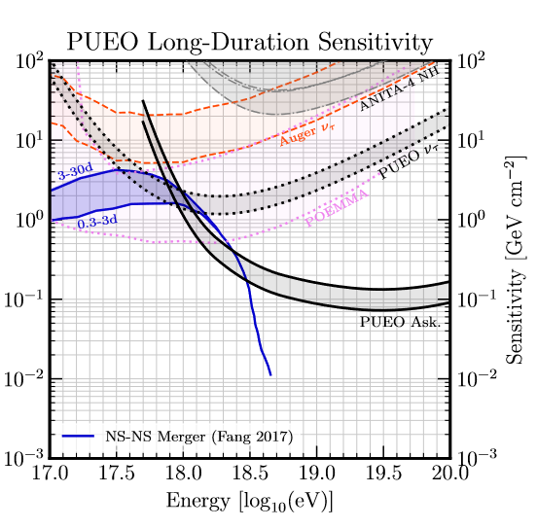
PUEO Transient Sensitivity
Pueo Whitepaper
PUEO’s large instantaneous aperture makes it ideal for transient searches within its field-of view!
Burst sensitivity is for transients lasting a few hours.
Long duration sensitivity is for transients lasting around the same length as the flight, so effective area is averaged over the full flight.

Slide 24
L1 Trigger Chain
750 MHz FIR Lowpass Filter
Dual Biquad Movable IIR Notch Filters
Automatic Gain Control
Delay and Sum Beamforming
Boxcar Sum and Trigger Decision
Band limiting
CW Noise (satellites)
Balance SNR
Add signals constructively
Lowpass filter and trigger threshold

Slide 25
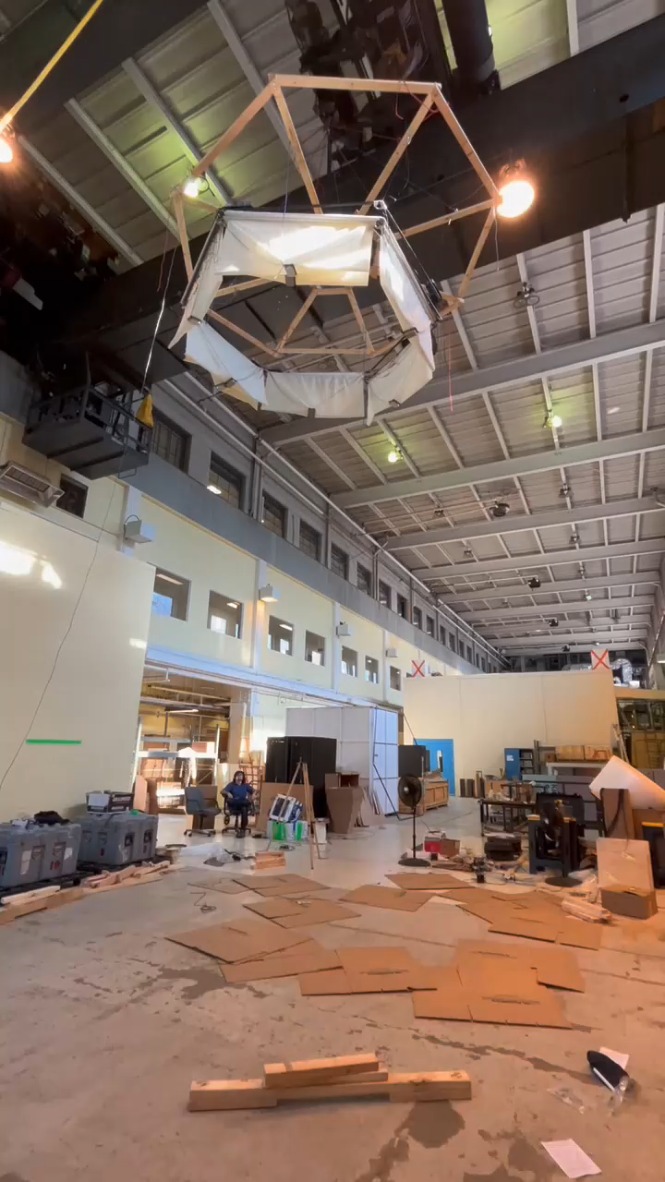
Low Frequency Instrument
Sensitive to the lower frequency (50-500 MHz) components present in air showers
  Overlaps frequency range with main instrument, providing independent measurement
Enhanced measurement of tau-neutrino induced EASs
Measurements of cosmic ray induced EASs
  Understanding neutrino signal background
  Opportunity to better characterize events like the ANITA “mystery events”

