Slide 1
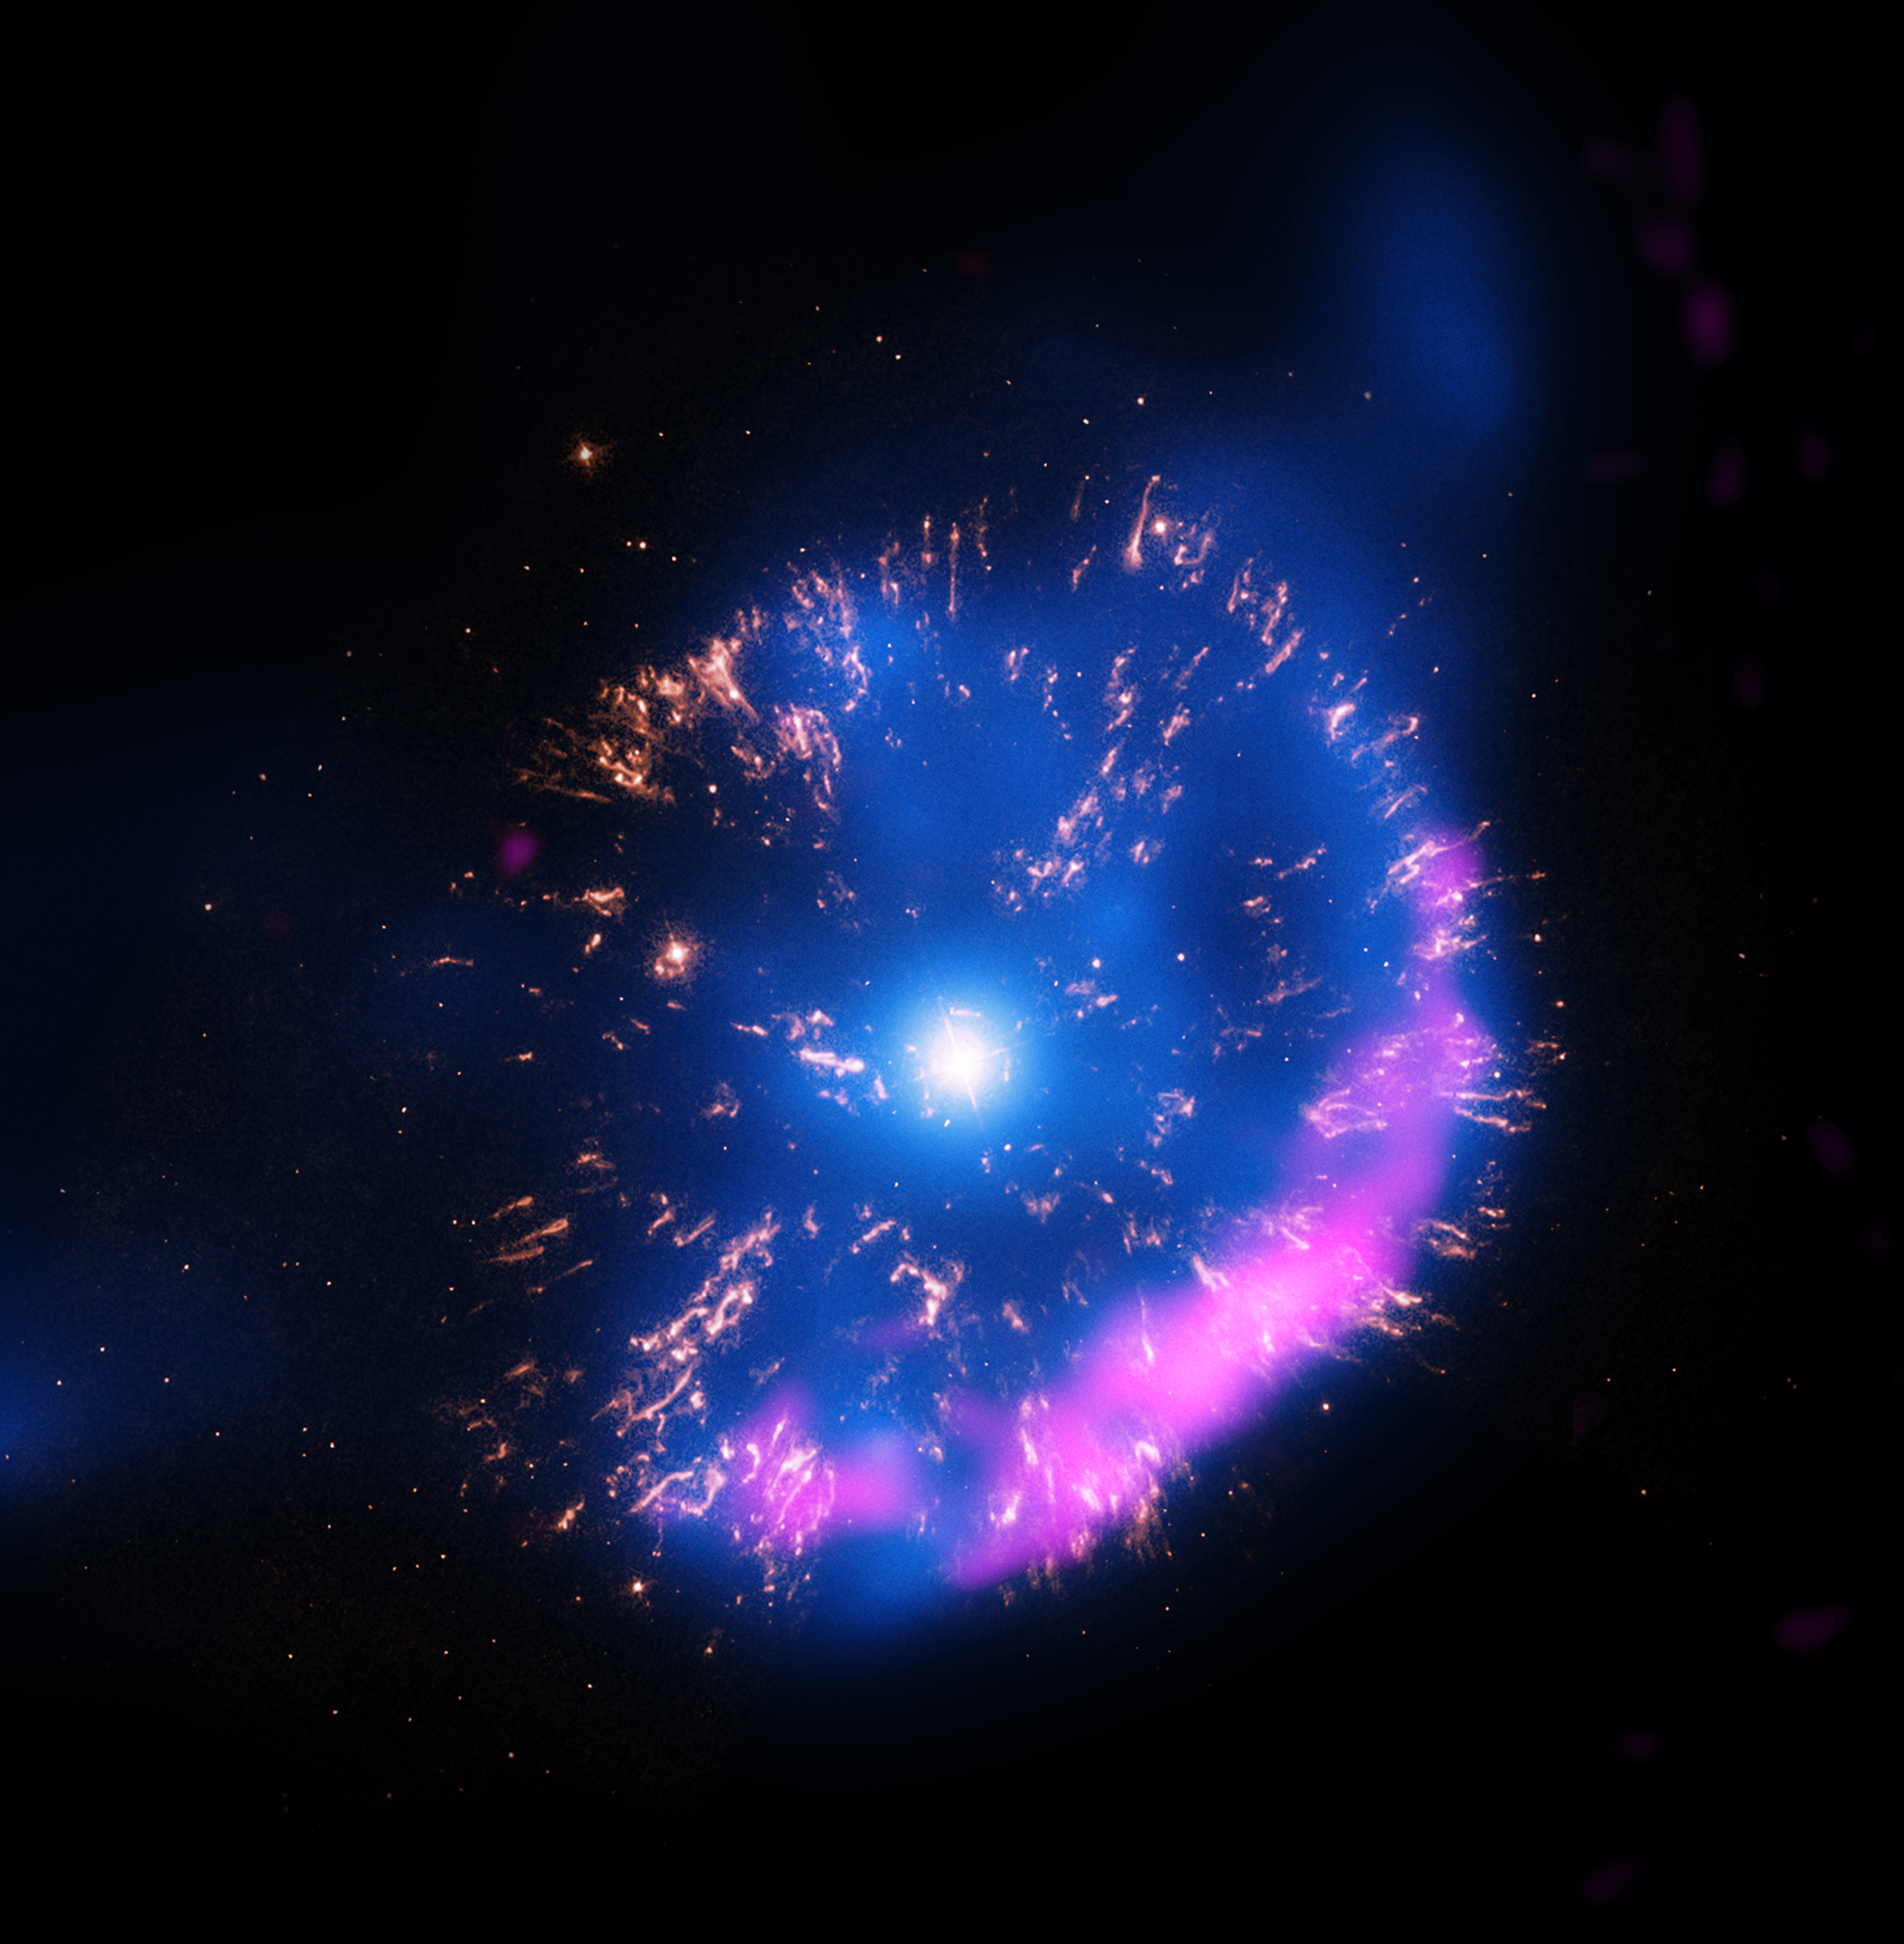

Delayed TeV Emission from Classical Novae
Rebecca Diesing & BRIAN Metzger
TeVPA | September 2, 2026
Image: GK Persei; Credit: Chandra, Hubble, VLA

Slide 2
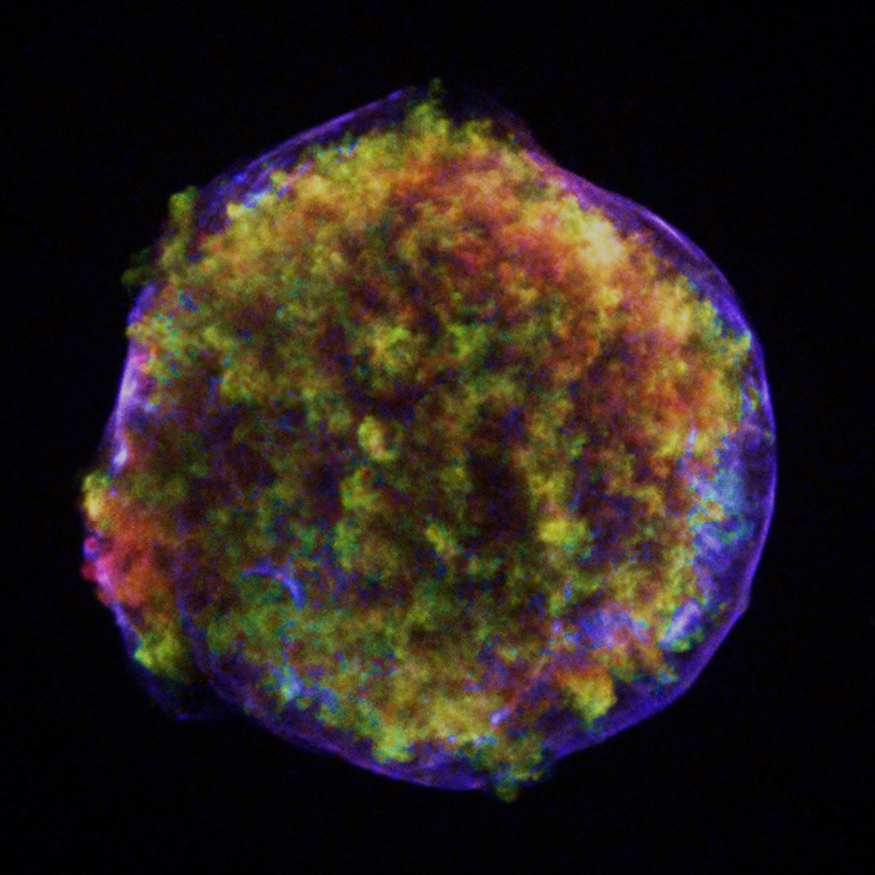
Shock physics: the standard paradigm
Strong shocks accelerate protons and electrons via diffusive shock acceleration (DSA). This is the primary mechanism by which supernova remnants accelerate Galactic cosmic rays.*
u₂
u₁
Downstream (ρ₂)
Upstream (ρ₁)
Image: Tycho’s SNR
Credit: Chandra
*Fermi54, Krymskii77, Axford+77, Bell78, Blandford+78

Slide 3

The maximum energy
LIMIT #1: AGE
The acceleration time must be shorter than the age of the system.
Drury83

Slide 4

The maximum energy
LIMIT #2: CONFINEMENT
The diffusion length must be smaller than the size of the system.
Hillas84

Slide 5

The problem with the supernova remnant paradigm
LIMIT #2: CONFINEMENT
Assuming Bohm diffusion (optimistic),
This is inconsistent with TeV observations of SNRs!

Slide 6
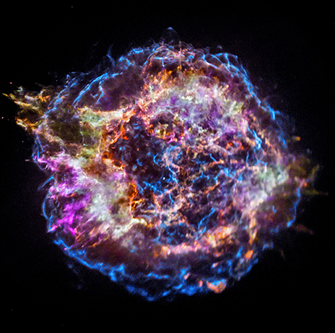
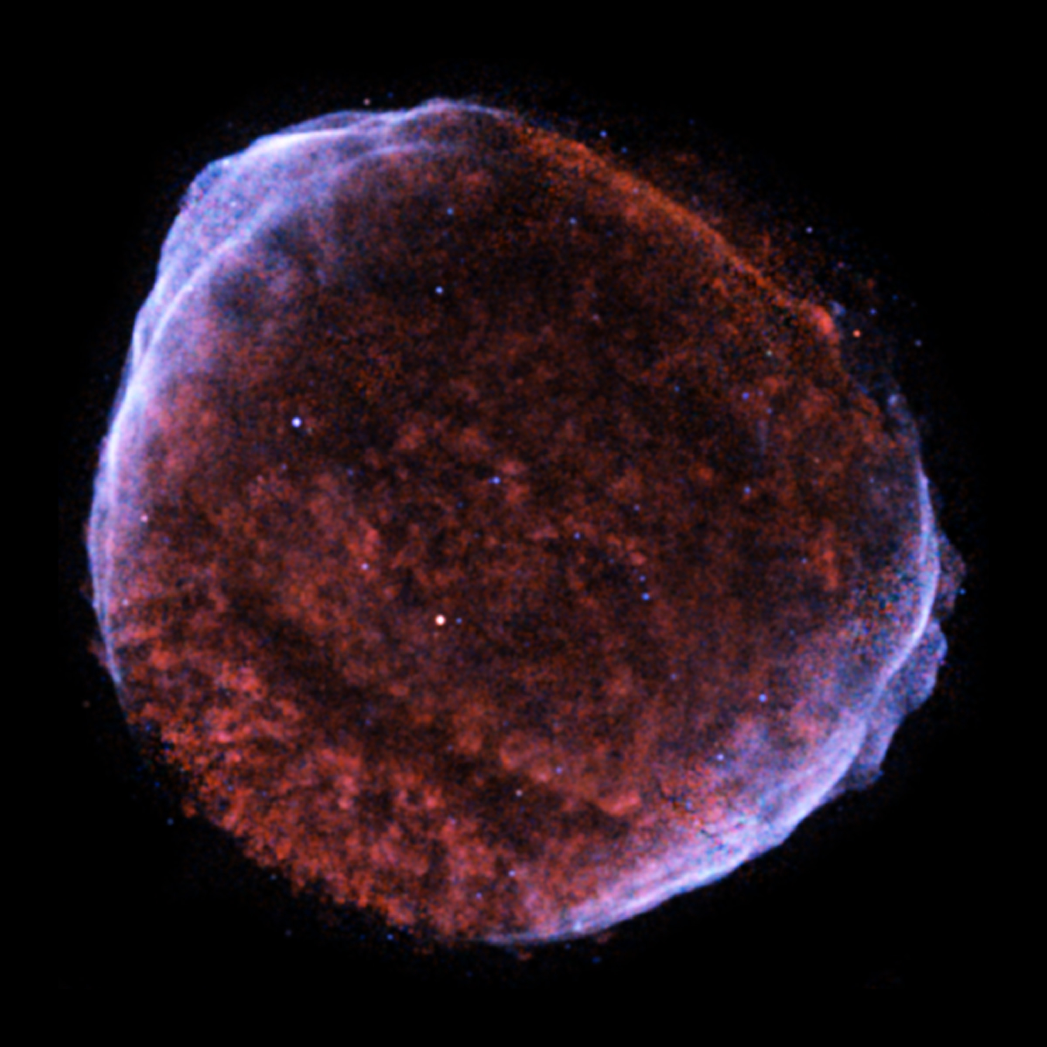
A note about magnetic fields
Thin synchrotron-emitting rims indicate that supernova remnants have enhanced magnetic fields (~ 100 μG compared to ~ 30 μG in the interstellar medium).*
*e.g., Bamba+05, Parizot+06, Morlino+10, Ressler+14
How does magnetic field amplification work?

Slide 7
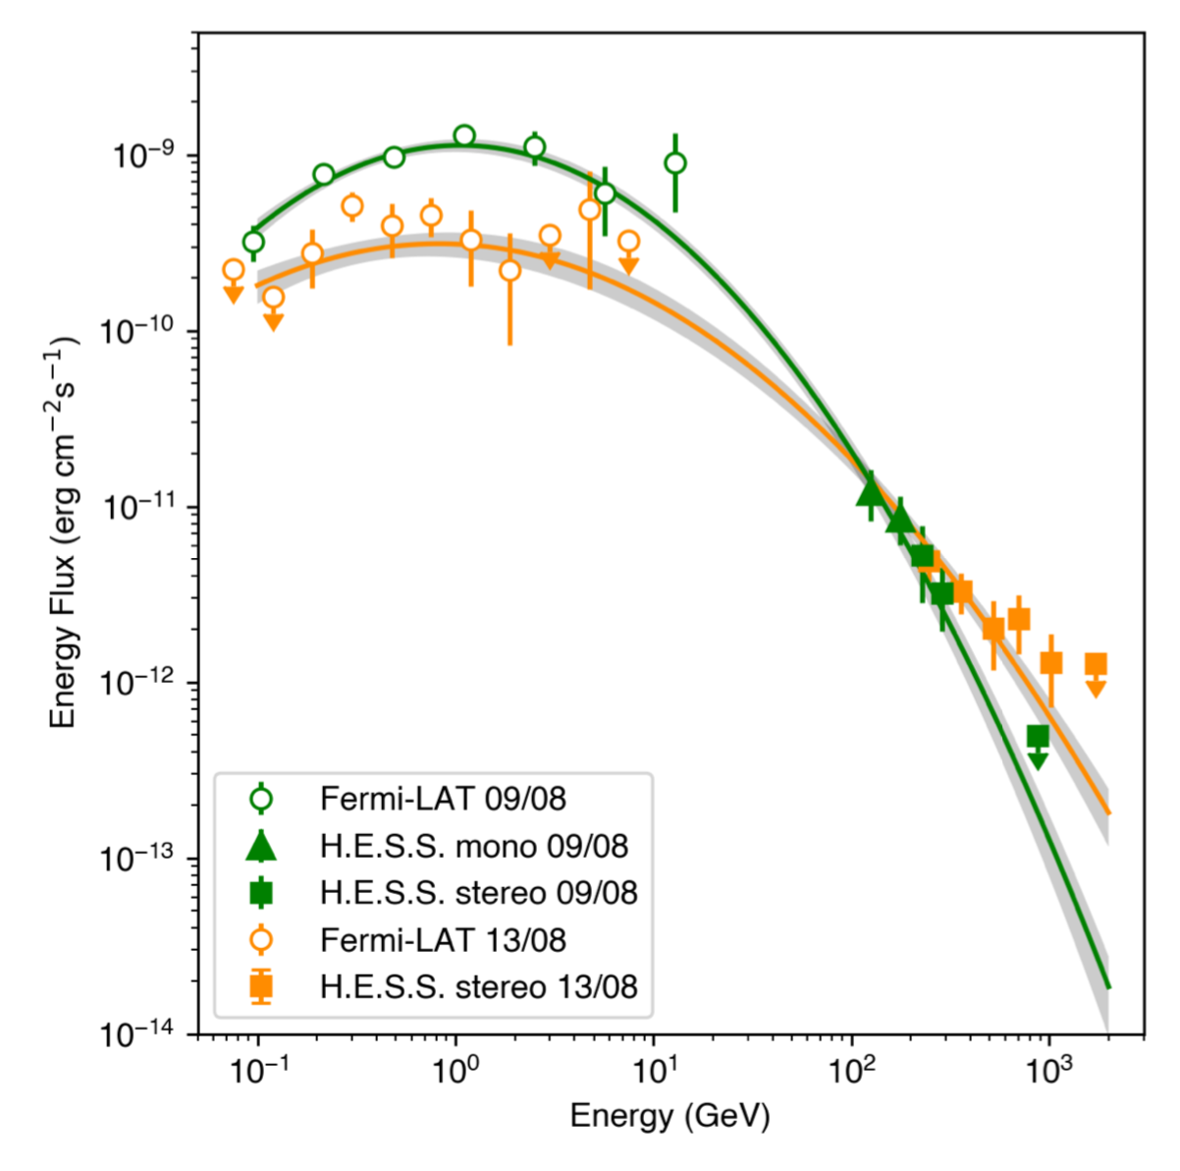
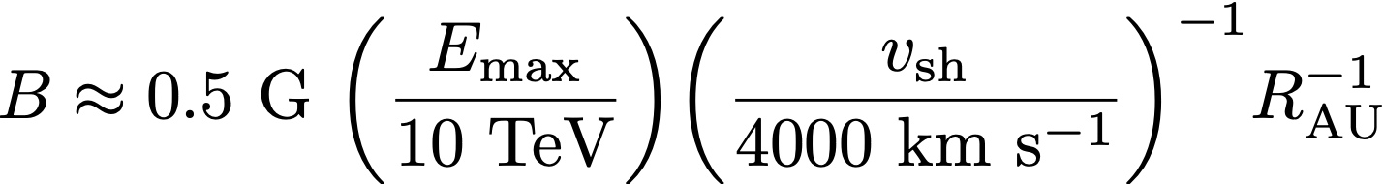
Magnetic field amplification in RS Ophiuchi
RS Oph’s 2021 outburst produced TeV ɣ-rays, corresponding to ~10 TeV protons.
HESS22
1 TeV

Slide 8
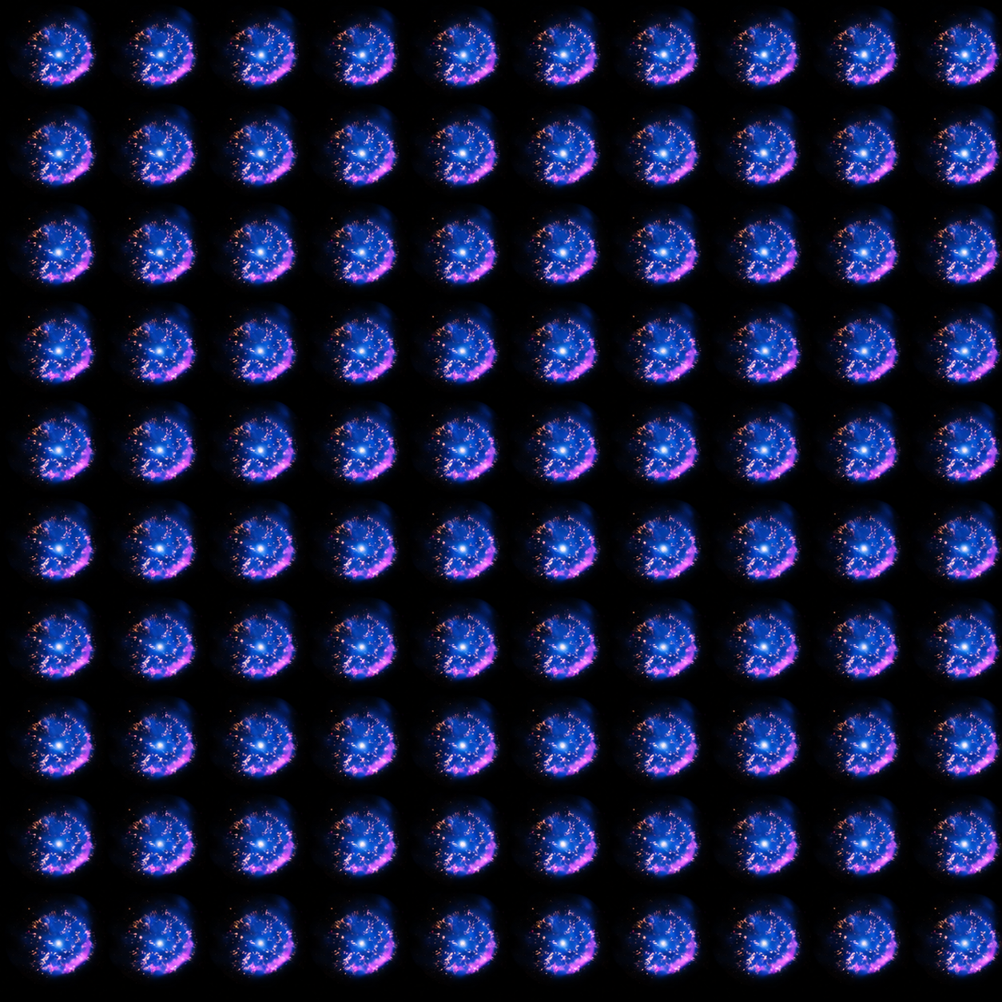
Why novae?
Novae are common.
~ 1/yr
(Fermi-detectable)
~ 1/century

Slide 9
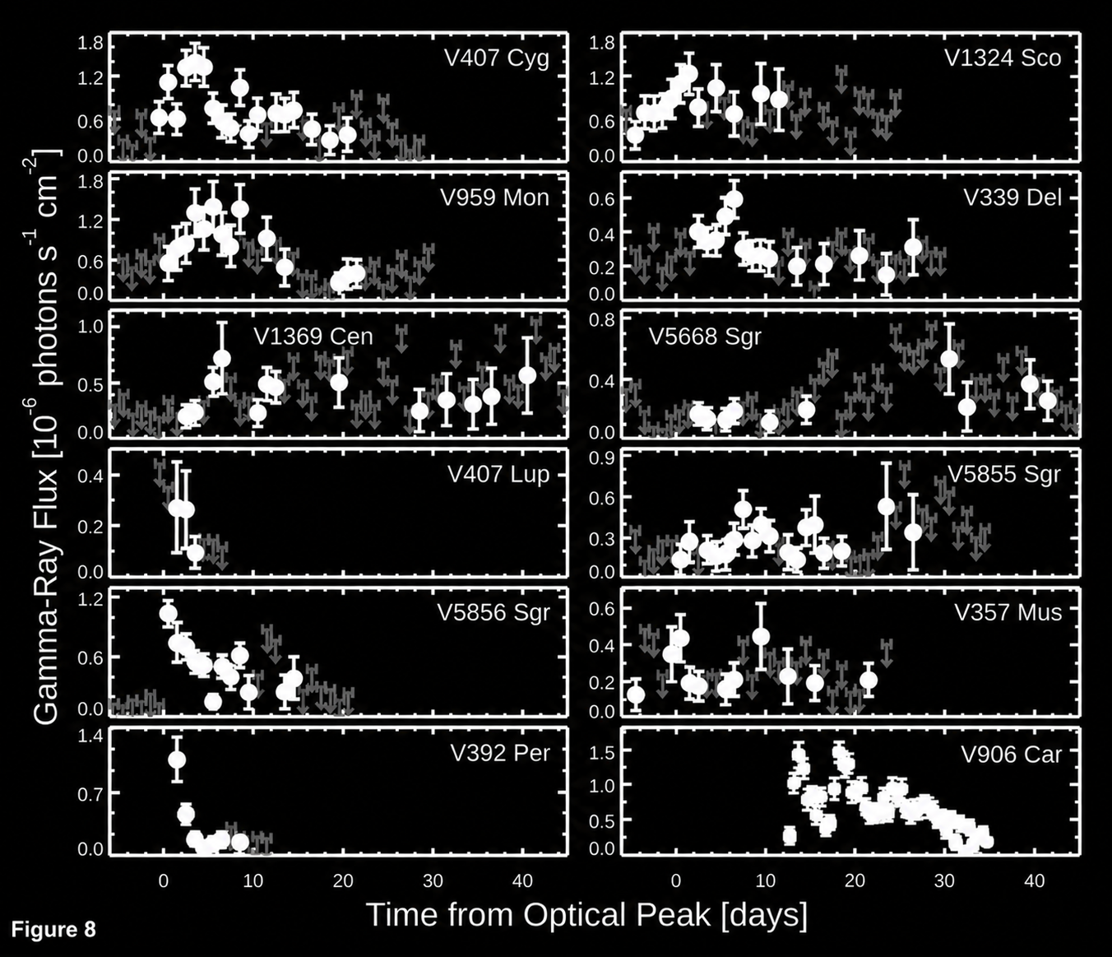
Why novae?
Novae are fast.
Chomiuk+21
t ~ 10⁵ years
t ~ 1 month

Slide 10
Why novae?
The size of the acceleration region can be constrained observationally.

Slide 11
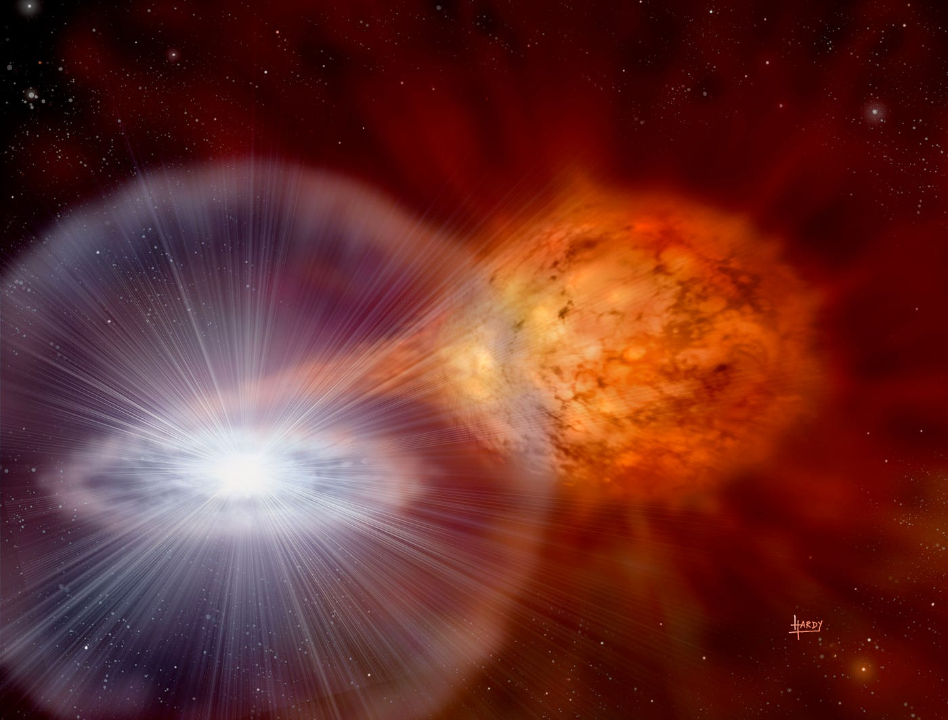
Novae
Accretion from a stellar companion triggers runaway nuclear fusion on the surface of a white dwarf, leading to an outburst.

Slide 12
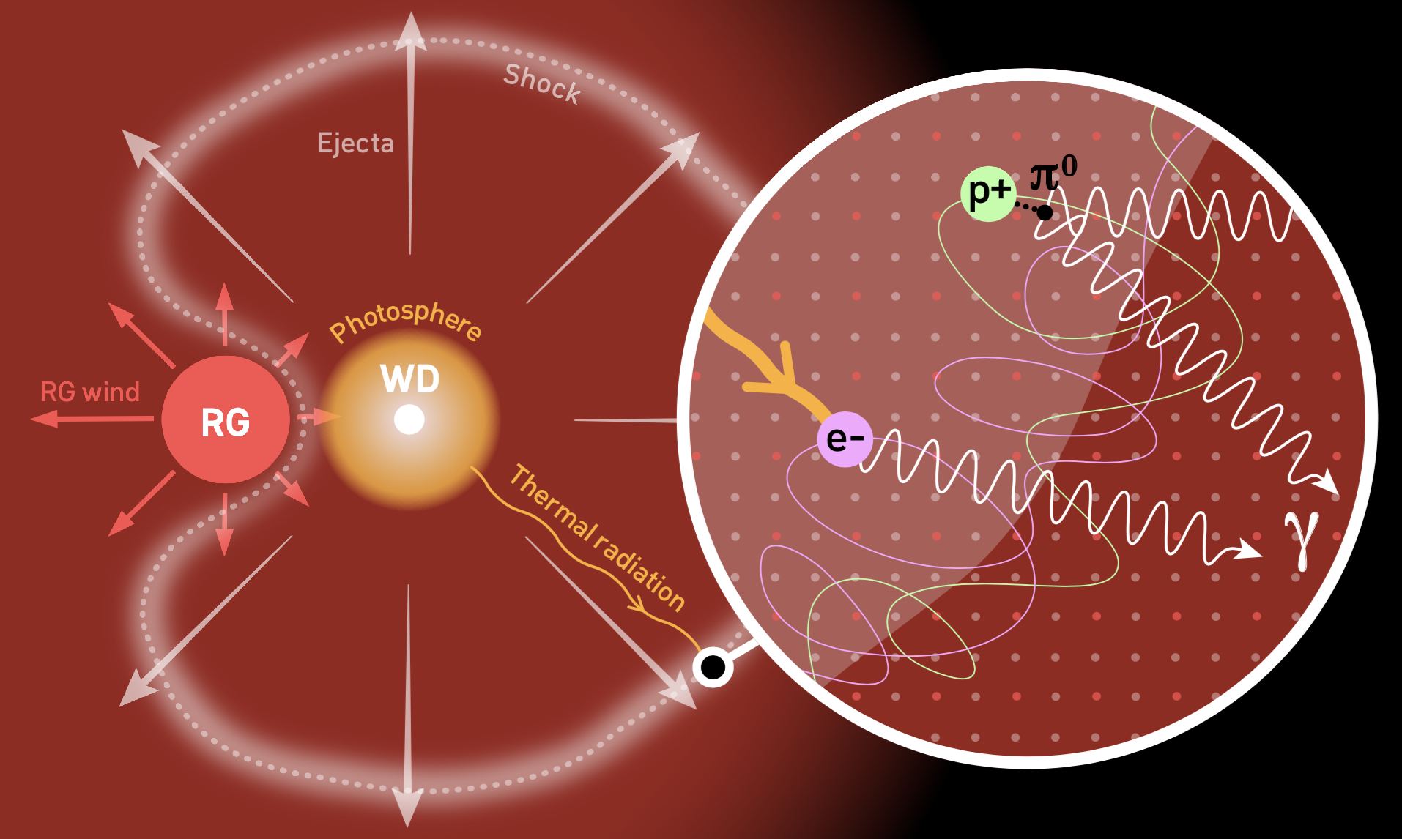
ɣ-ray production in symbiotic novae

Slide 13
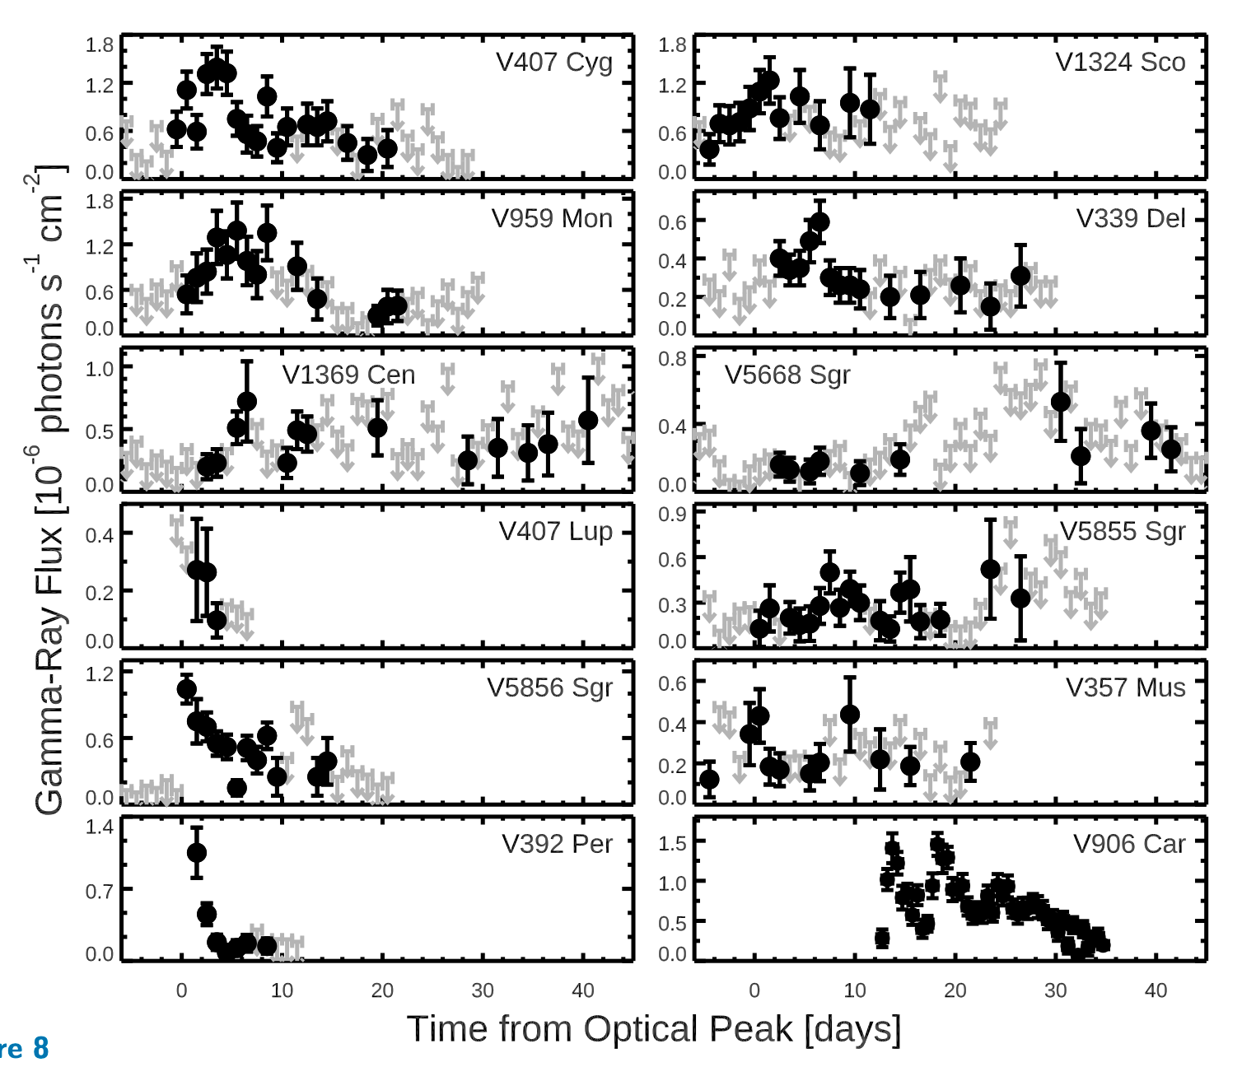
ɣ-ray production in classical novae
Main Sequence
Chomiuk+21
Classical novae have main sequence companions, with little to no stellar wind.
But, they still produce GeV γ-rays!
The shocks responsible are “internal” (fast material colliding with previously-ejected slow material).*
*Friedjung+87, Metzger+14, Martin+18, Hachisu+22

Slide 14
The hydrodynamic picture
This scenario is consistent with optical/infrared/radio imaging*, as well as the evolution of optical spectral lines**.
*Schaefer+14, Aydi+25, Chomiuk+14
**Ribeiro+13, Shore+13, Aydi+20

Slide 15
The hydrodynamic picture
This scenario is consistent with optical/infrared/radio imaging*, as well as the evolution of optical spectral lines**.
*Schaefer+14, Aydi+25, Chomiuk+14
**Ribeiro+13, Shore+13, Aydi+20

Slide 16
The hydrodynamic picture
This scenario is consistent with optical/infrared/radio imaging*, as well as the evolution of optical spectral lines**.
*Schaefer+14, Aydi+25, Chomiuk+14
**Ribeiro+13, Shore+13, Aydi+20

Slide 17
The hydrodynamic picture
This scenario is consistent with optical/infrared/radio imaging*, as well as the evolution of optical spectral lines**.
*Schaefer+14, Aydi+25, Chomiuk+14
**Ribeiro+13, Shore+13, Aydi+20
Ansatz: v_{w} rises to some final v_{f} on a timescale τ ~ t₂

Slide 18
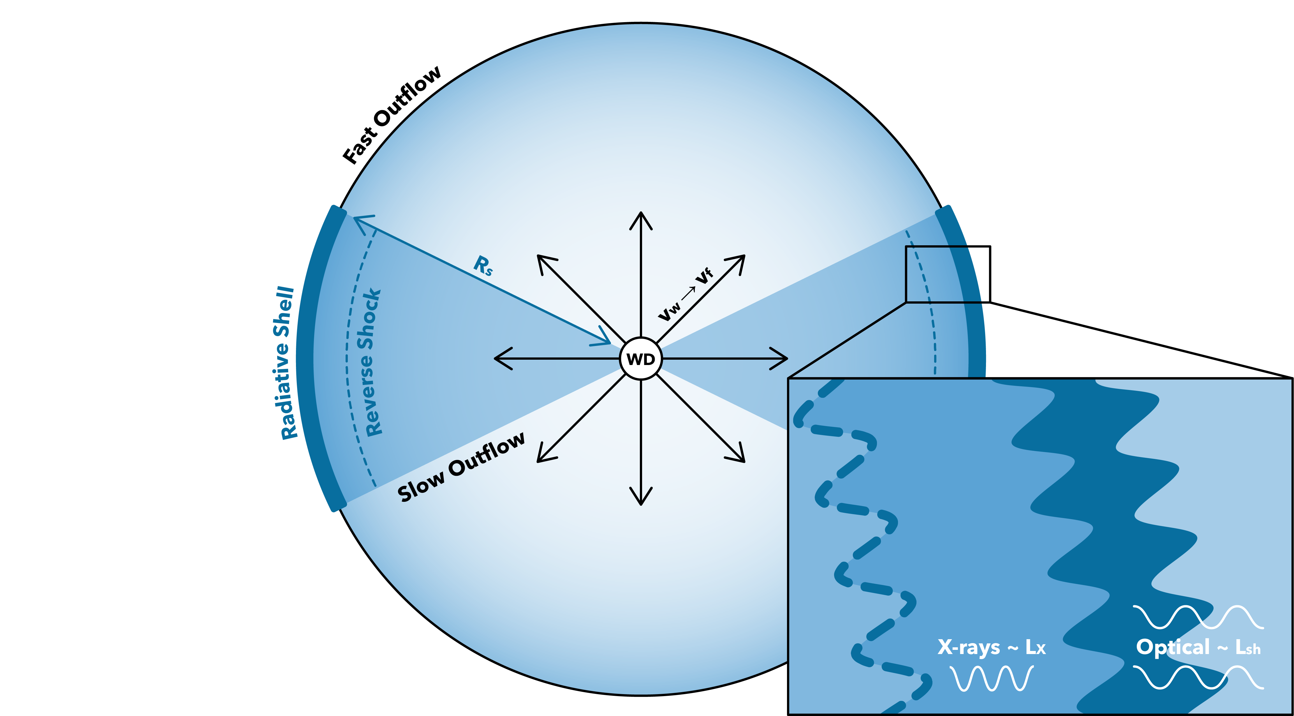
Particle acceleration
Internal shocks provide a very narrow (but observationally constrained) region in which to accelerate particles.
γ-rays

Slide 19
Particle acceleration
The acceleration region grows with time; so too does the maximum energy.

Slide 20
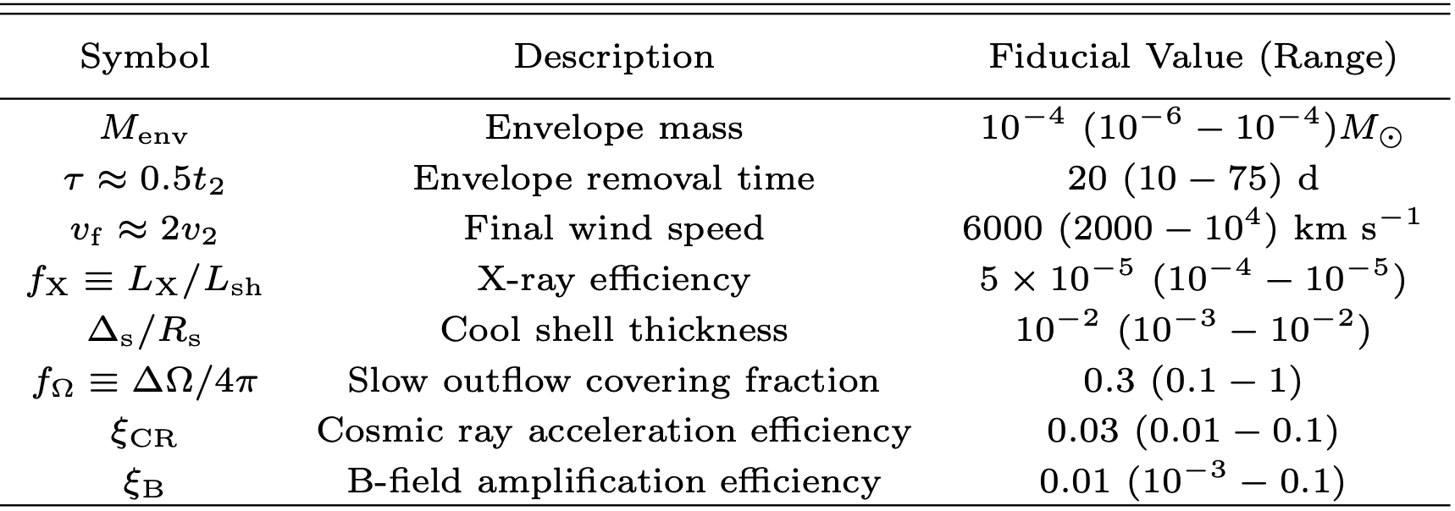
Putting it all together

Slide 21
Putting it all together
Constrained with radio observations
Constrained with optical observations
Constrained with X-ray observations
Constrained with ɣ-ray observations

Slide 22
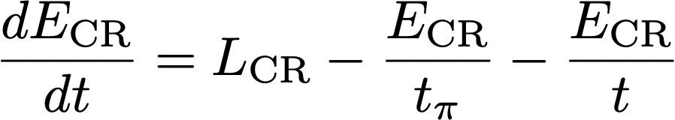
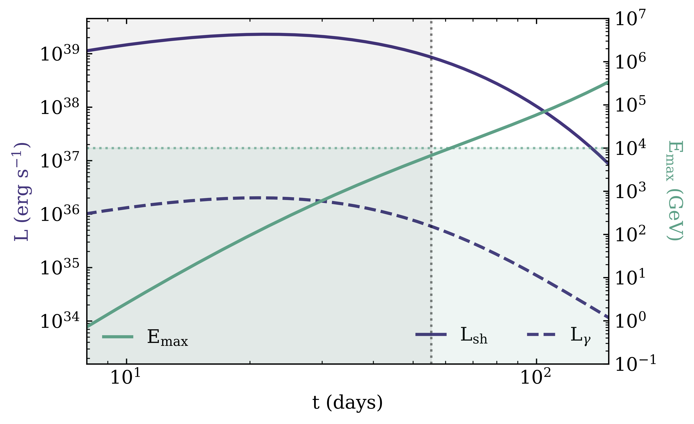
Typical ɣ-ray light curve
v_{f}
At early times (t ≲ τ), t_{π} < t; classical novae are cosmic ray calorimeters.
At late times, classical novae can produce TeV ɣ-rays!
Threshold for TeV ɣ-rays
τ
τ_{ɣɣ} = 1

Slide 23
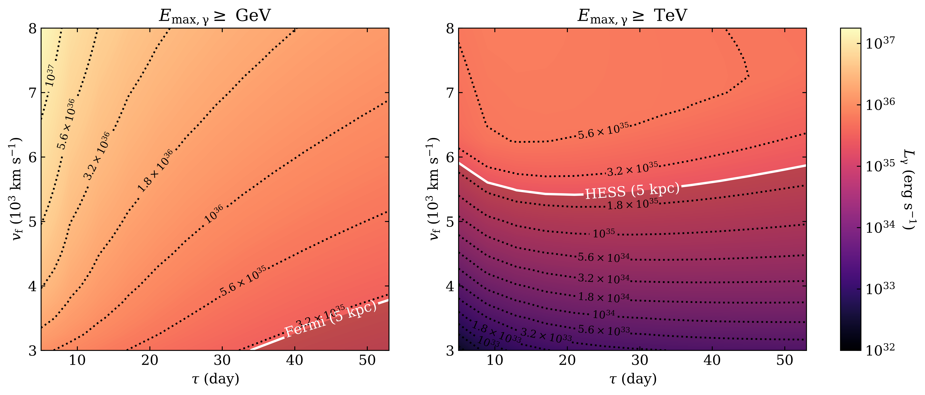
For some parameters, TeV emission may be detectable…

Slide 24
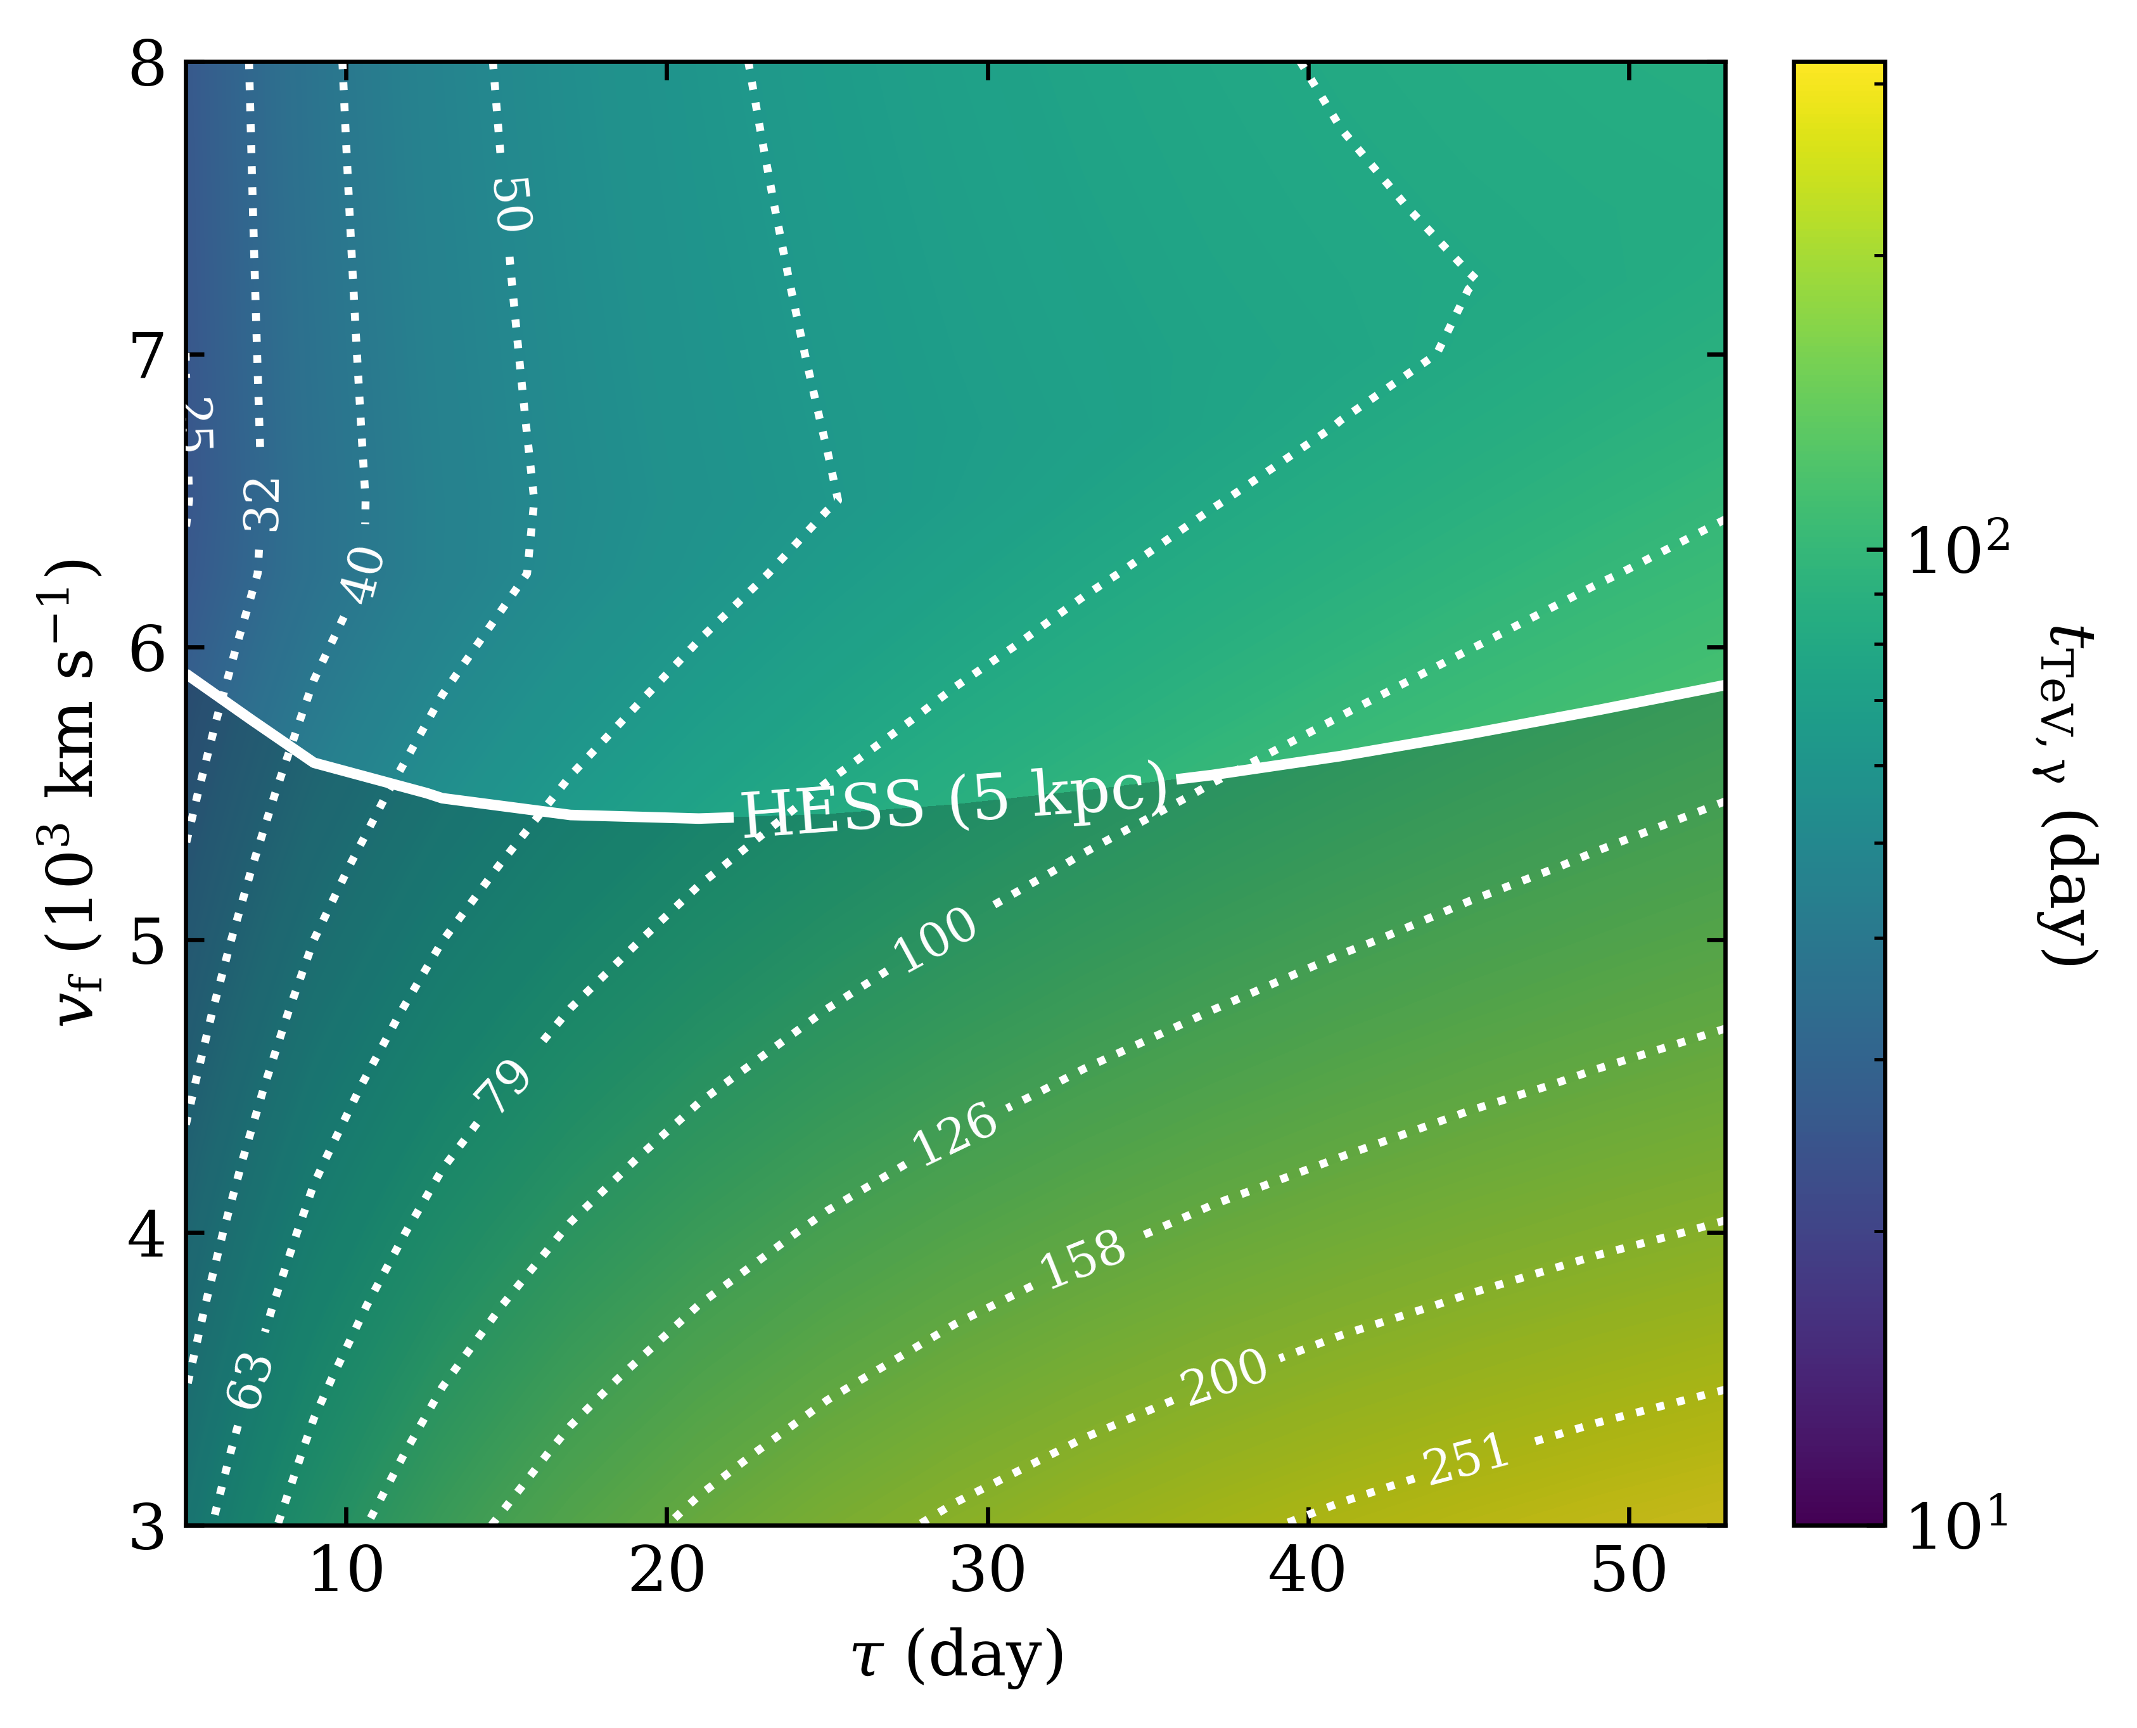
…but only at late times
The best candidates have large characteristic timescales and outflow velocities.

Slide 25
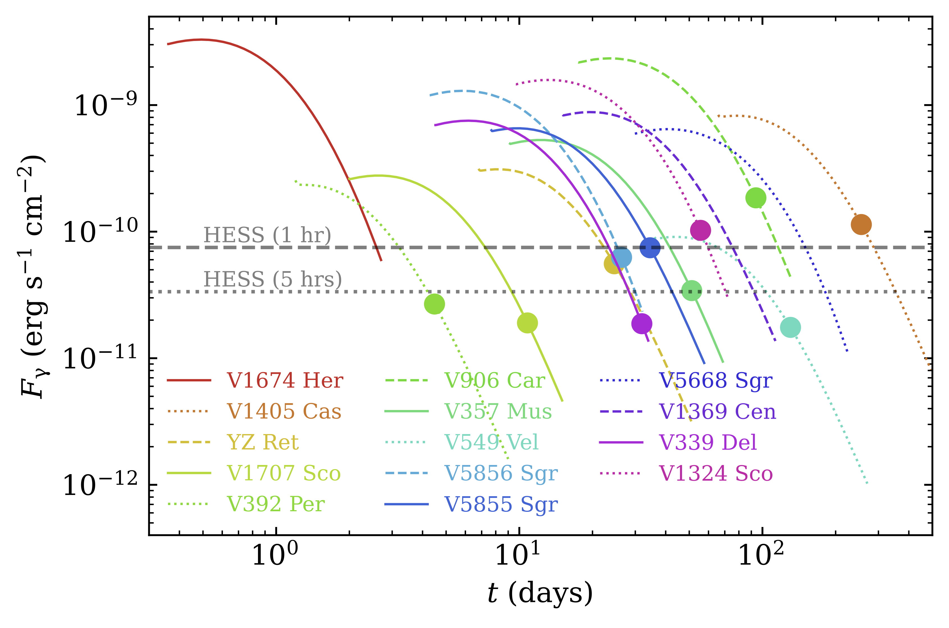
Applying this model to real novae
A handful of Fermi-detected classical novae may have been (briefly) detectable at TeV energies.

Slide 26

Summary
Novae are excellent laboratories for shock physics and particle acceleration.
To leverage this capability, we developed a parameterized (“toy”) model for classical nova evolution.
The parameters in this model can be constrained observationally, but require multi-wavelength coordination.
Classical novae may produce detectable TeV emission at late times.
For more information,
see Diesing+26

