Slide 1
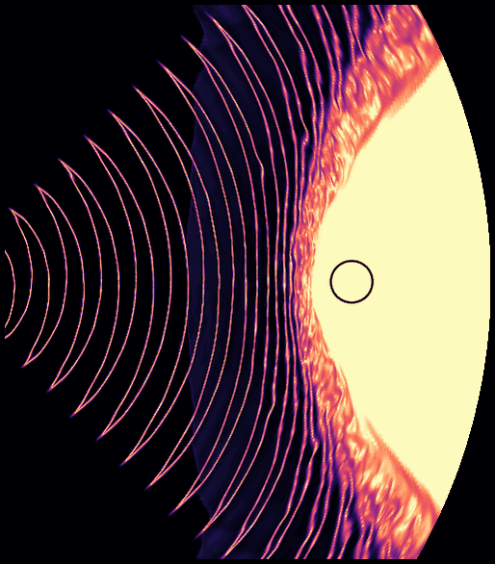



Intrabinary Shocks in Spider Pulsars
Sebastiaan Selvi
TeV Particle Astrophysics
2026
Tendo, Japan
August 31, 2026
Collaborators: Koushik Chatterjee, Lorenzo Sironi, Alexander Philippov

Slide 2
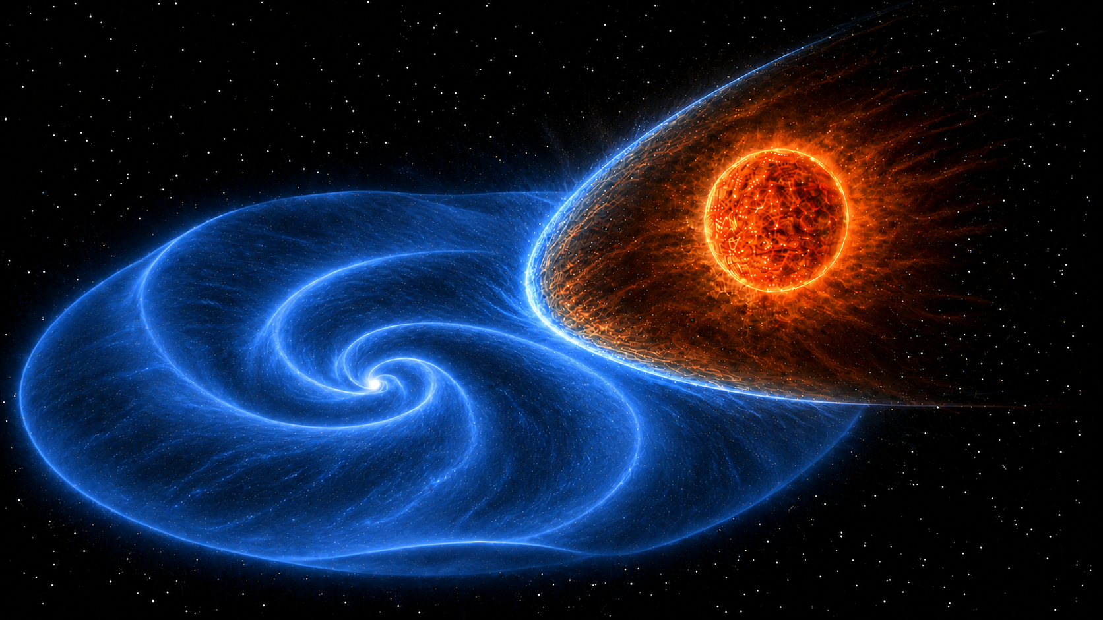
What are Spider Pulsars ?
ms-Pulsar & low-mass companion
Orbital period ≲1 day
Relativistic Pulsar striped wind, corrugated geometry, Parker spiral
Pulsar wind irradiates companion inducing a companion outflow
Colliding winds form intrabinary shock region (IBS)
Orbitally modulated nonthermal X-rays
AI generated

Slide 3
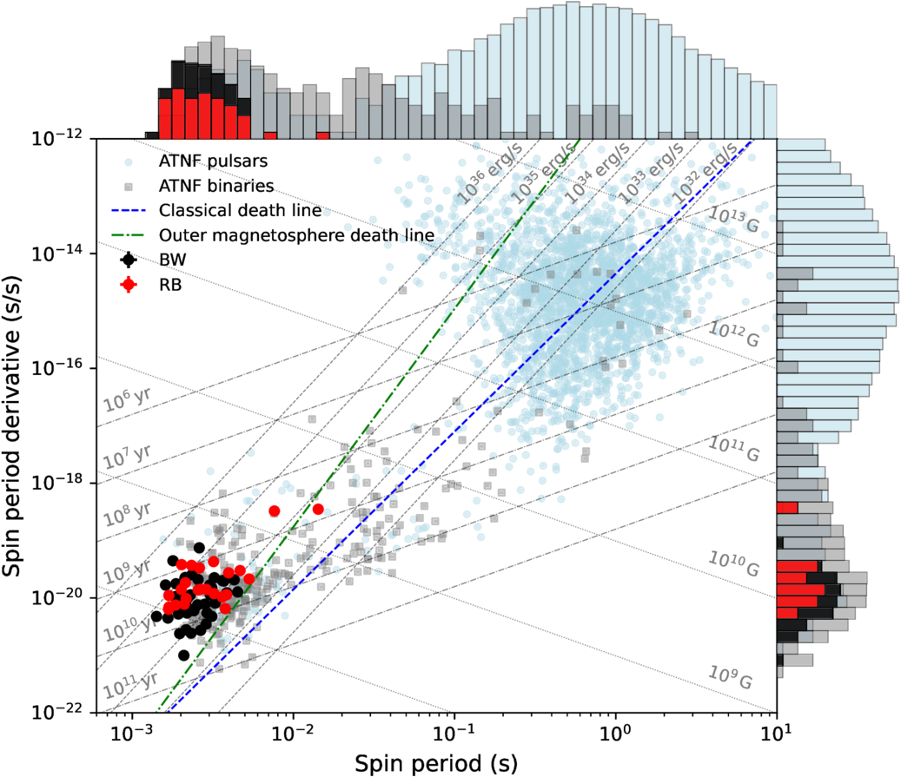
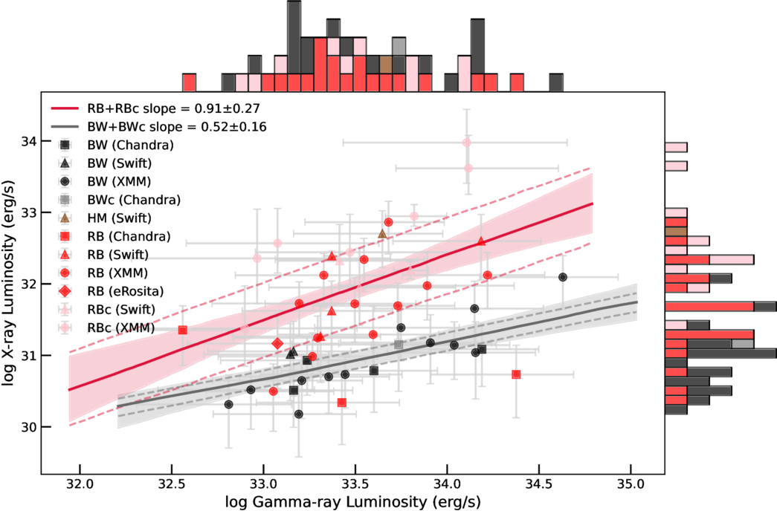
What do we observe from Spider Pulsars ?
Multiwavelength (gamma-ray, optical, IR, X-ray)
~ 100 observed spider systems
Correlation of spin down power to X-ray luminosity
Koljonen K. I. I. & Linares M. 2025 ApJ 994 8
Fastest MSPs

Slide 4
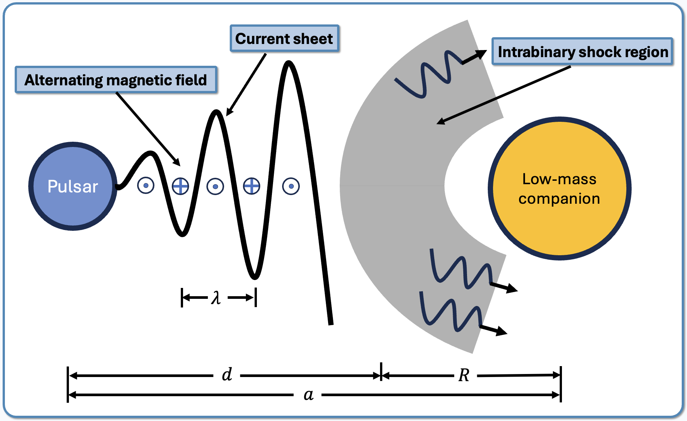

Why are Spider Pulsars special? Lengthscales !
$λ \sim {10}^{8}cm$
$a \sim {10}^{3}λ$
$R \sim {10}^{2}λ$
$d \sim {10}^{3}λ$
$$a ≥d≥R≫λ$$
${10}^{6}$x closer than in the Crab Nebula !
$d_{diss} \sim {10}^{3}λ \sim d$
→ still magnetized !
(e.g., Cerutti+2020)

Slide 5
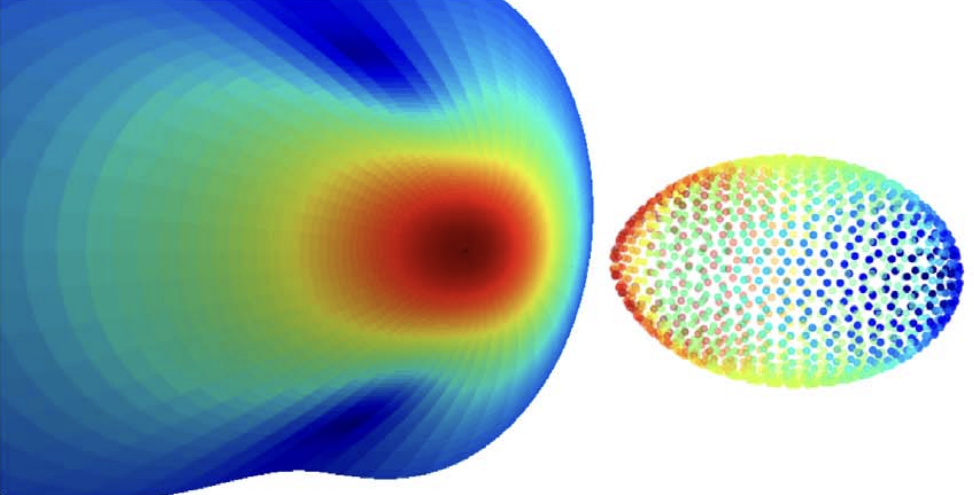
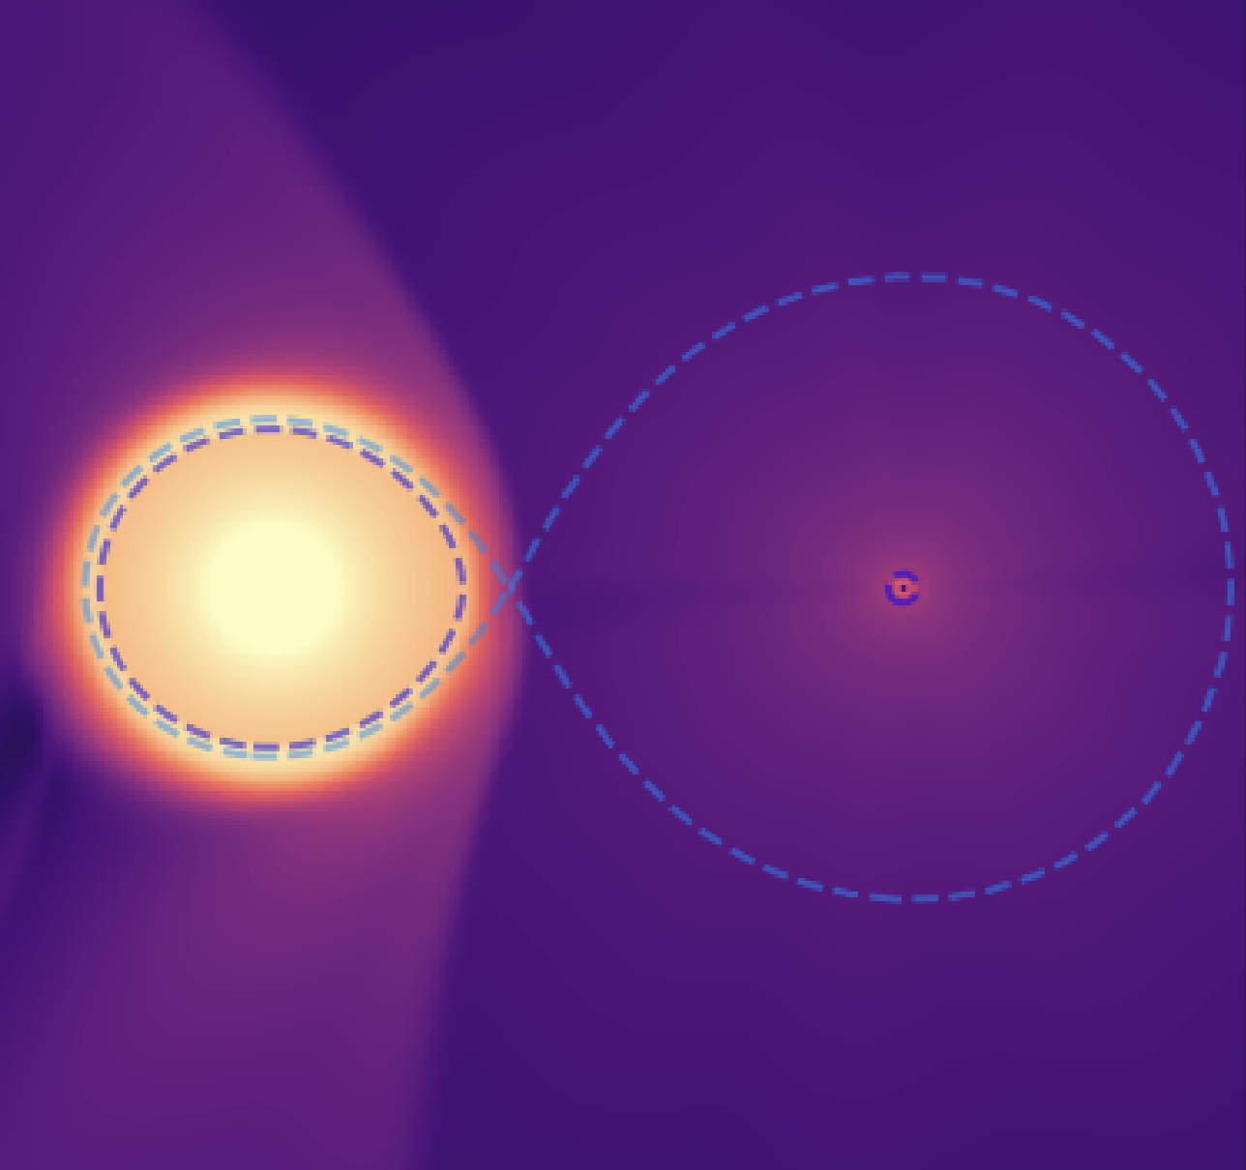
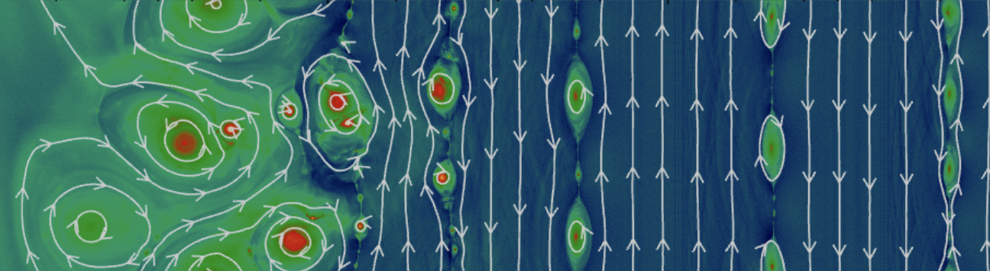
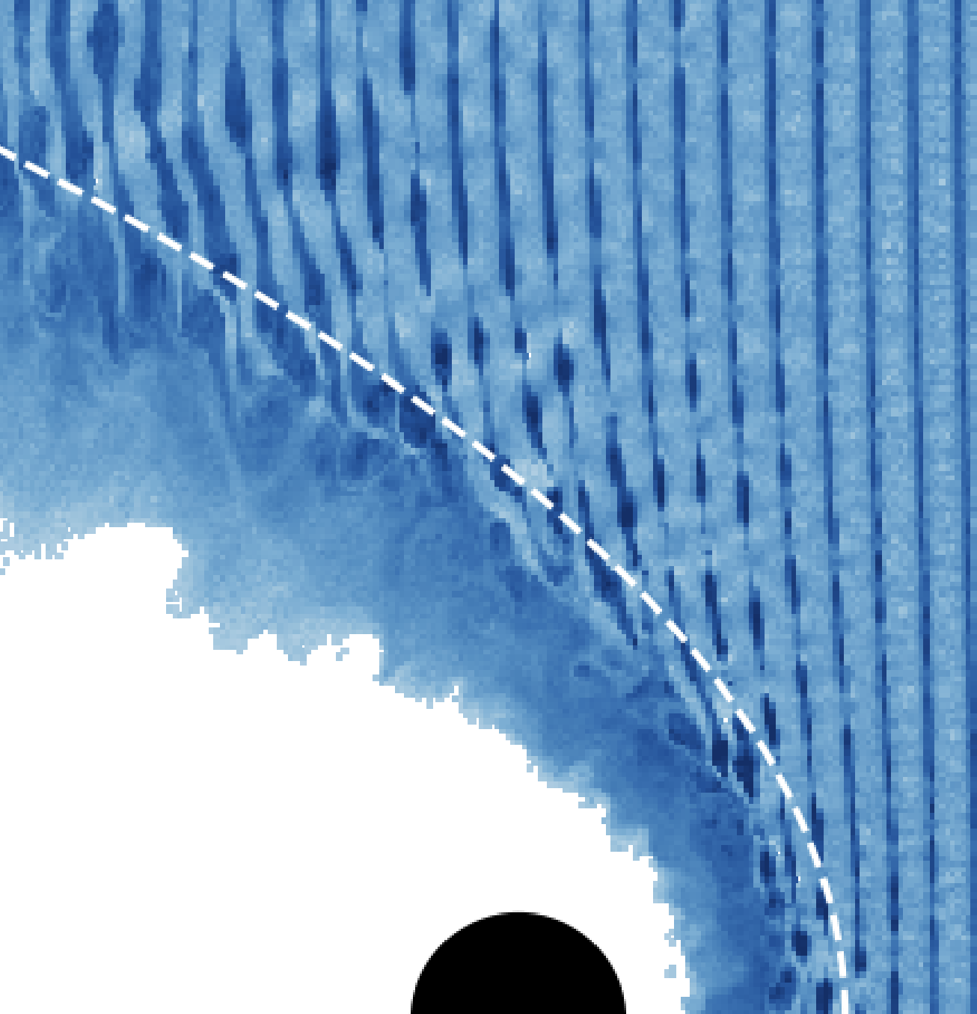
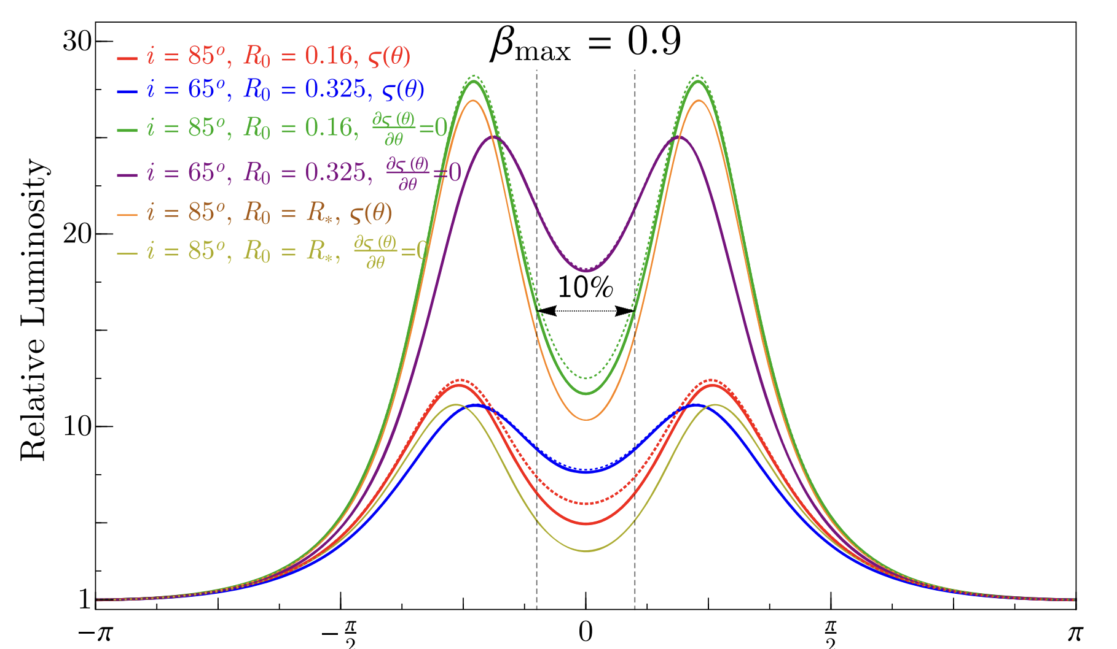
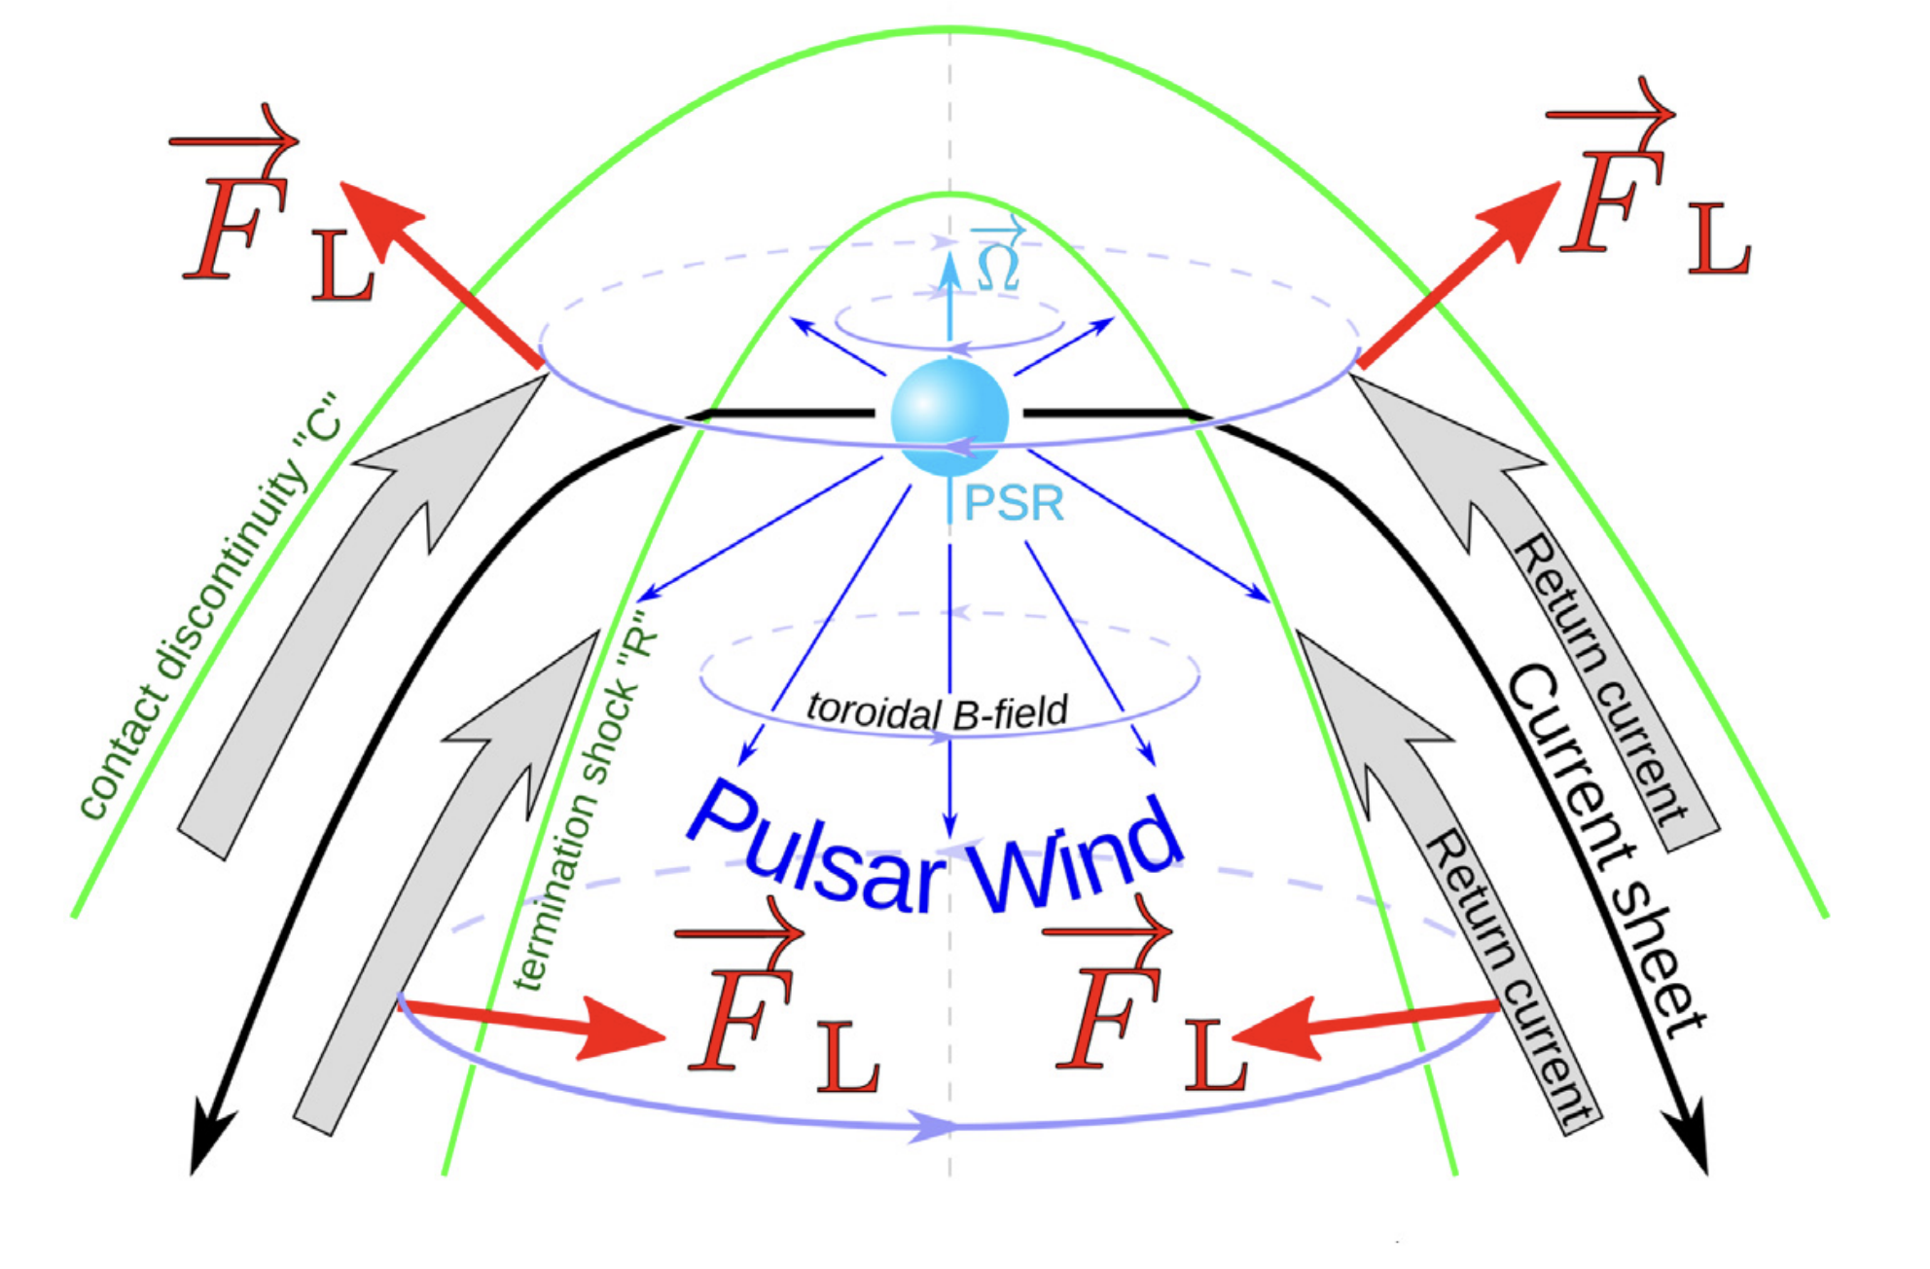
Existing approaches capture parts of the problem
Geometric / emission
Pulsar wind dissipation
Wind-wind interaction
Sironi+2012
Kandel+2019
Guerra+2024
Wadiasingh+2017
Sullivan+2025
Bogovalov+2019
✅ dissipation + nonthermal acceleration
❌ local box + plane parallel waves + no global geometry
✅ Global structures
❌ Axisymetric + Hydro + no stripes + not spider regime
✅ shock shape ↔ observations
❌ imposed shock shape

Slide 6
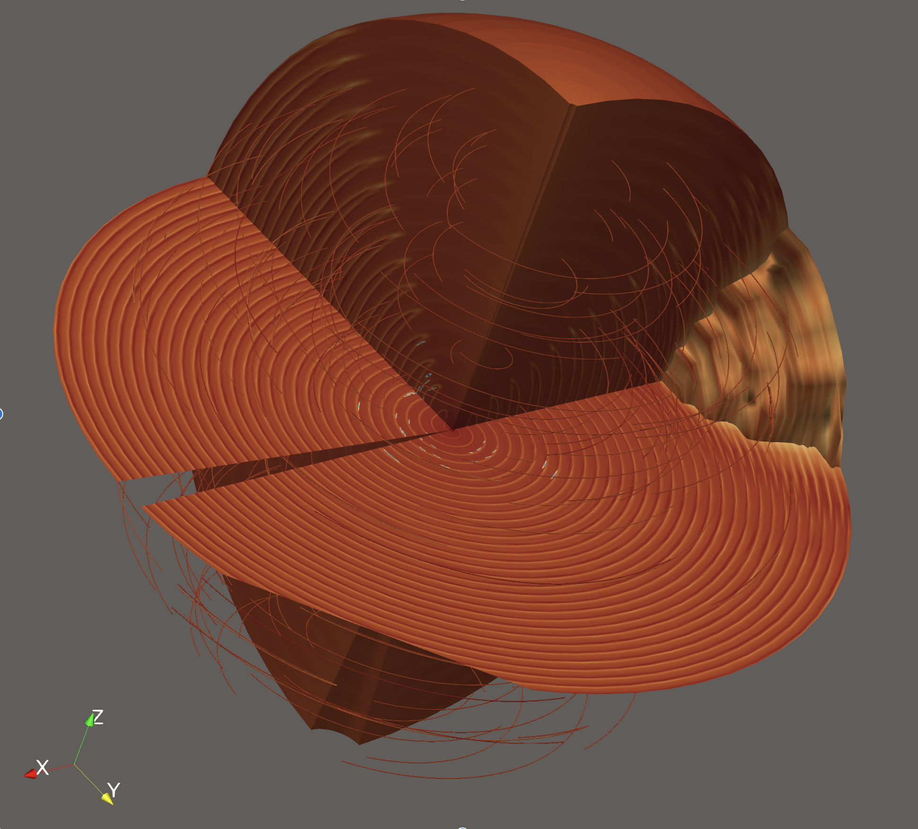
Our work: 3D General relativistic magnetohydrodynamics simulations
Oblique spinning magnetic dipole
Relativistic magnetized striped wind
Latitude dependent wind momentum flux
Magnetic polarity imbalance
Radial incidence angles
IBS formation through interaction with companion outflow
✅
IBS geometry
Pulsar wind energy conversion
Properties of outflows
Synthetic emission
✅
✅
✅

Slide 7
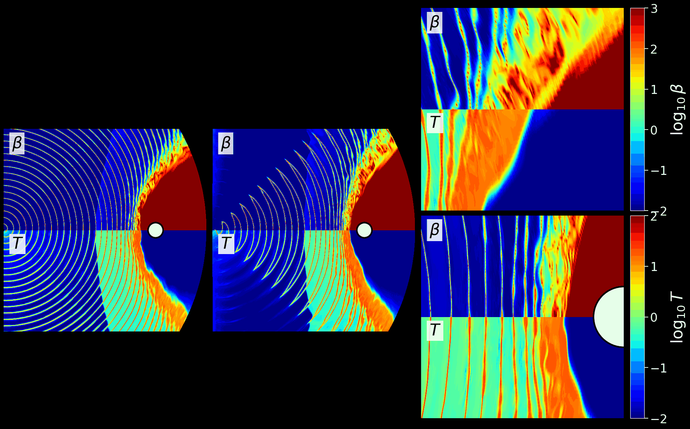
3D pulsar wind forming IBS with companion
Equatorial
Meridional

Slide 8
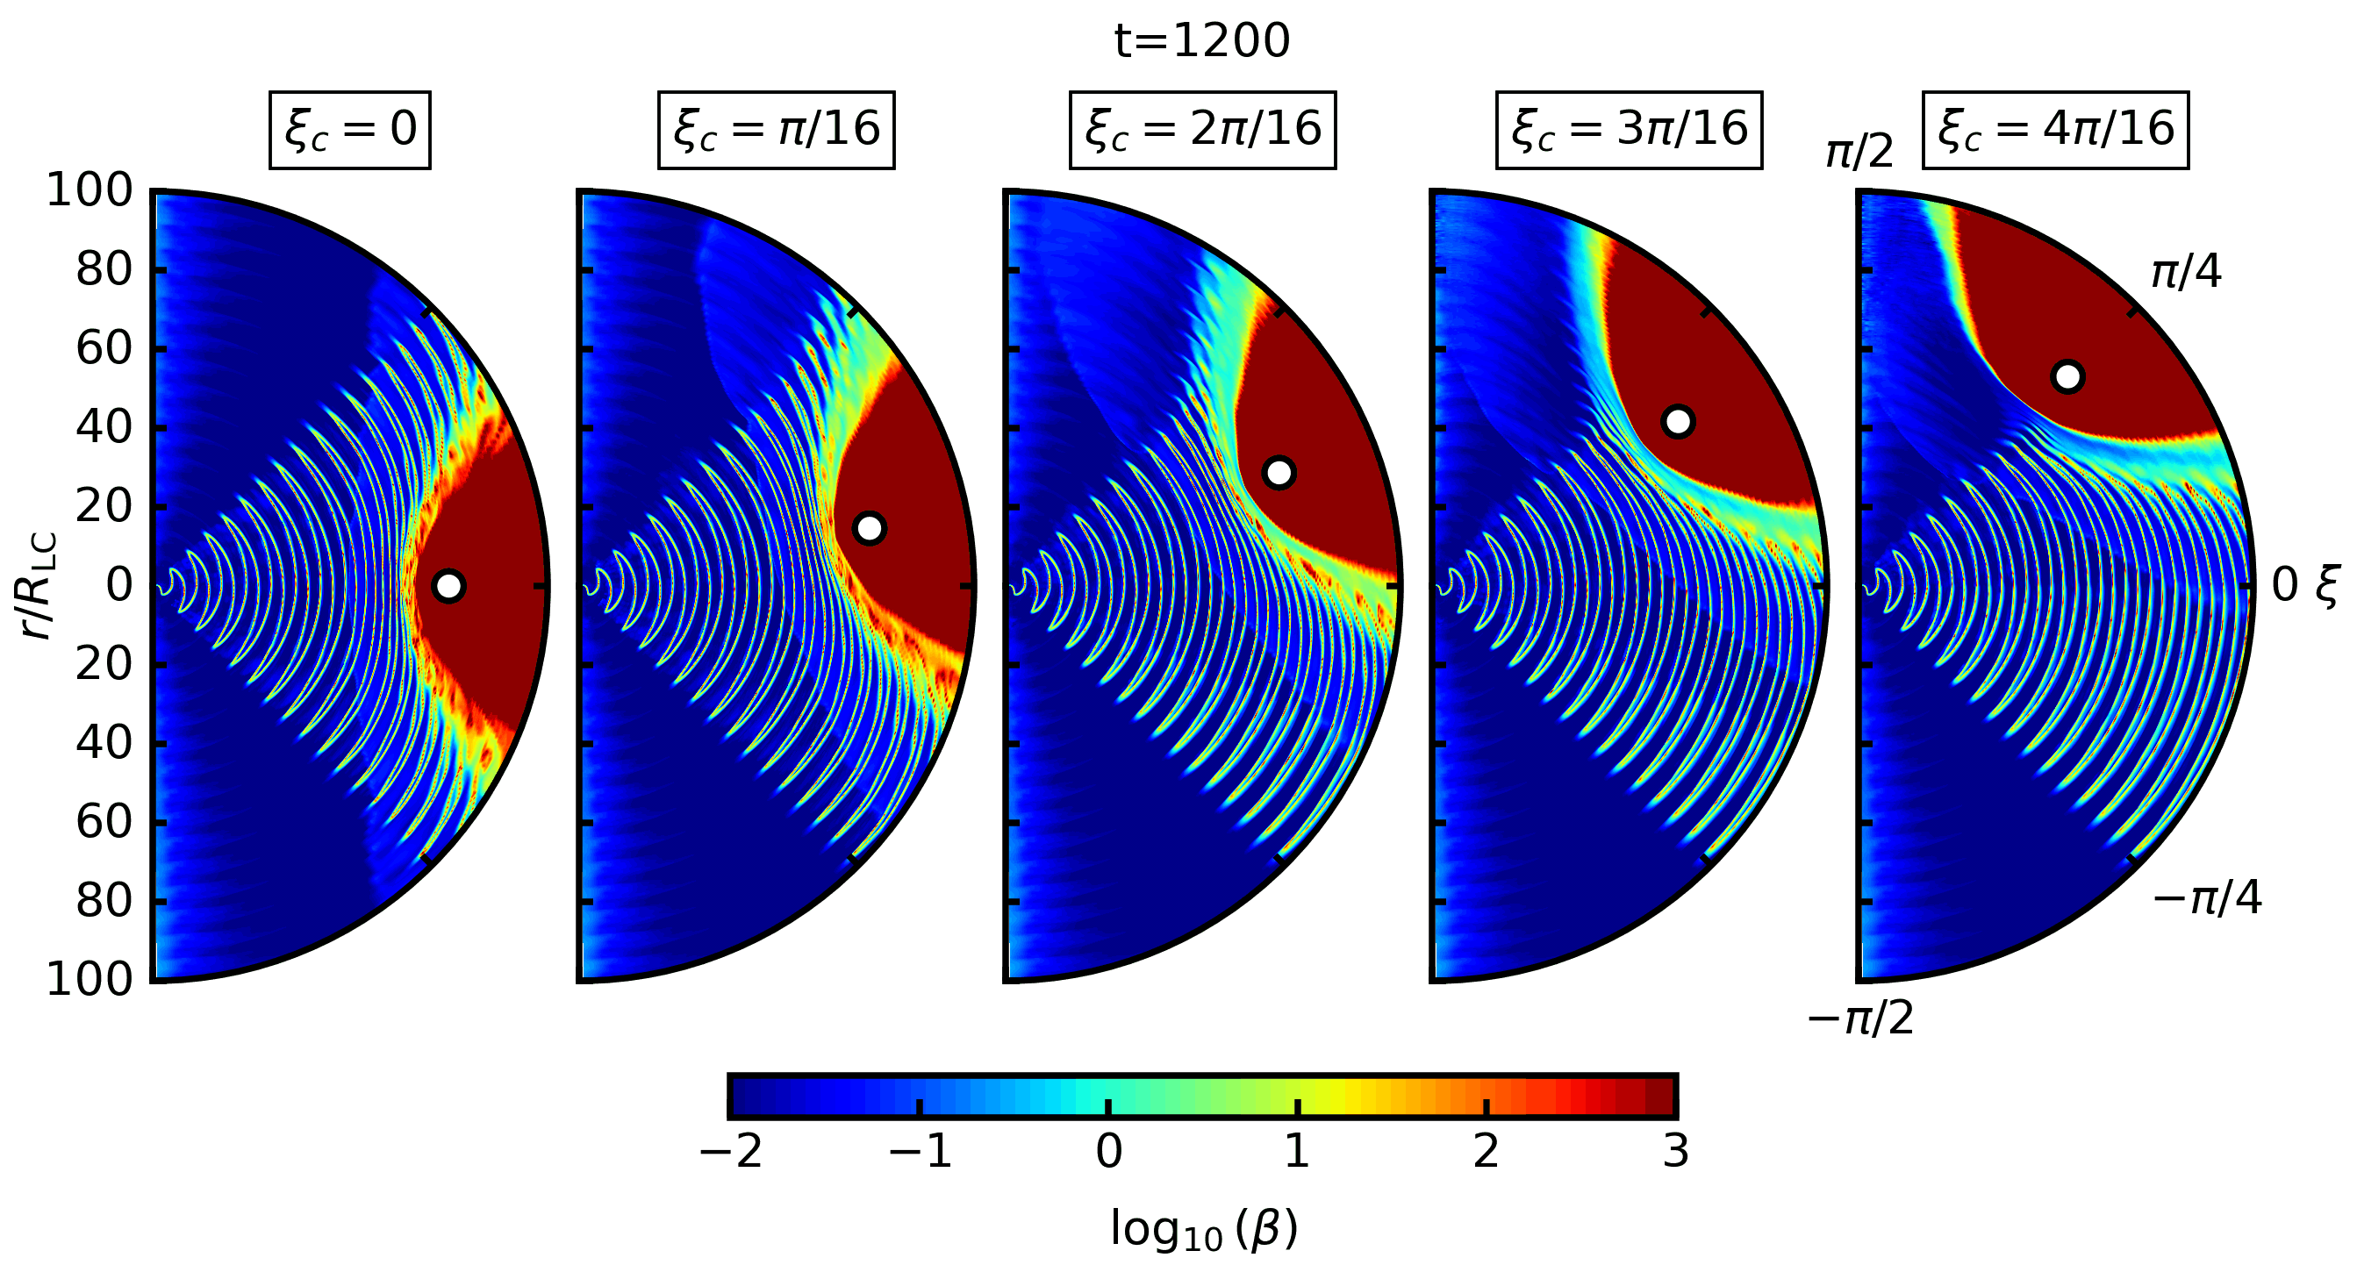
Varying companion latitudes

Slide 9
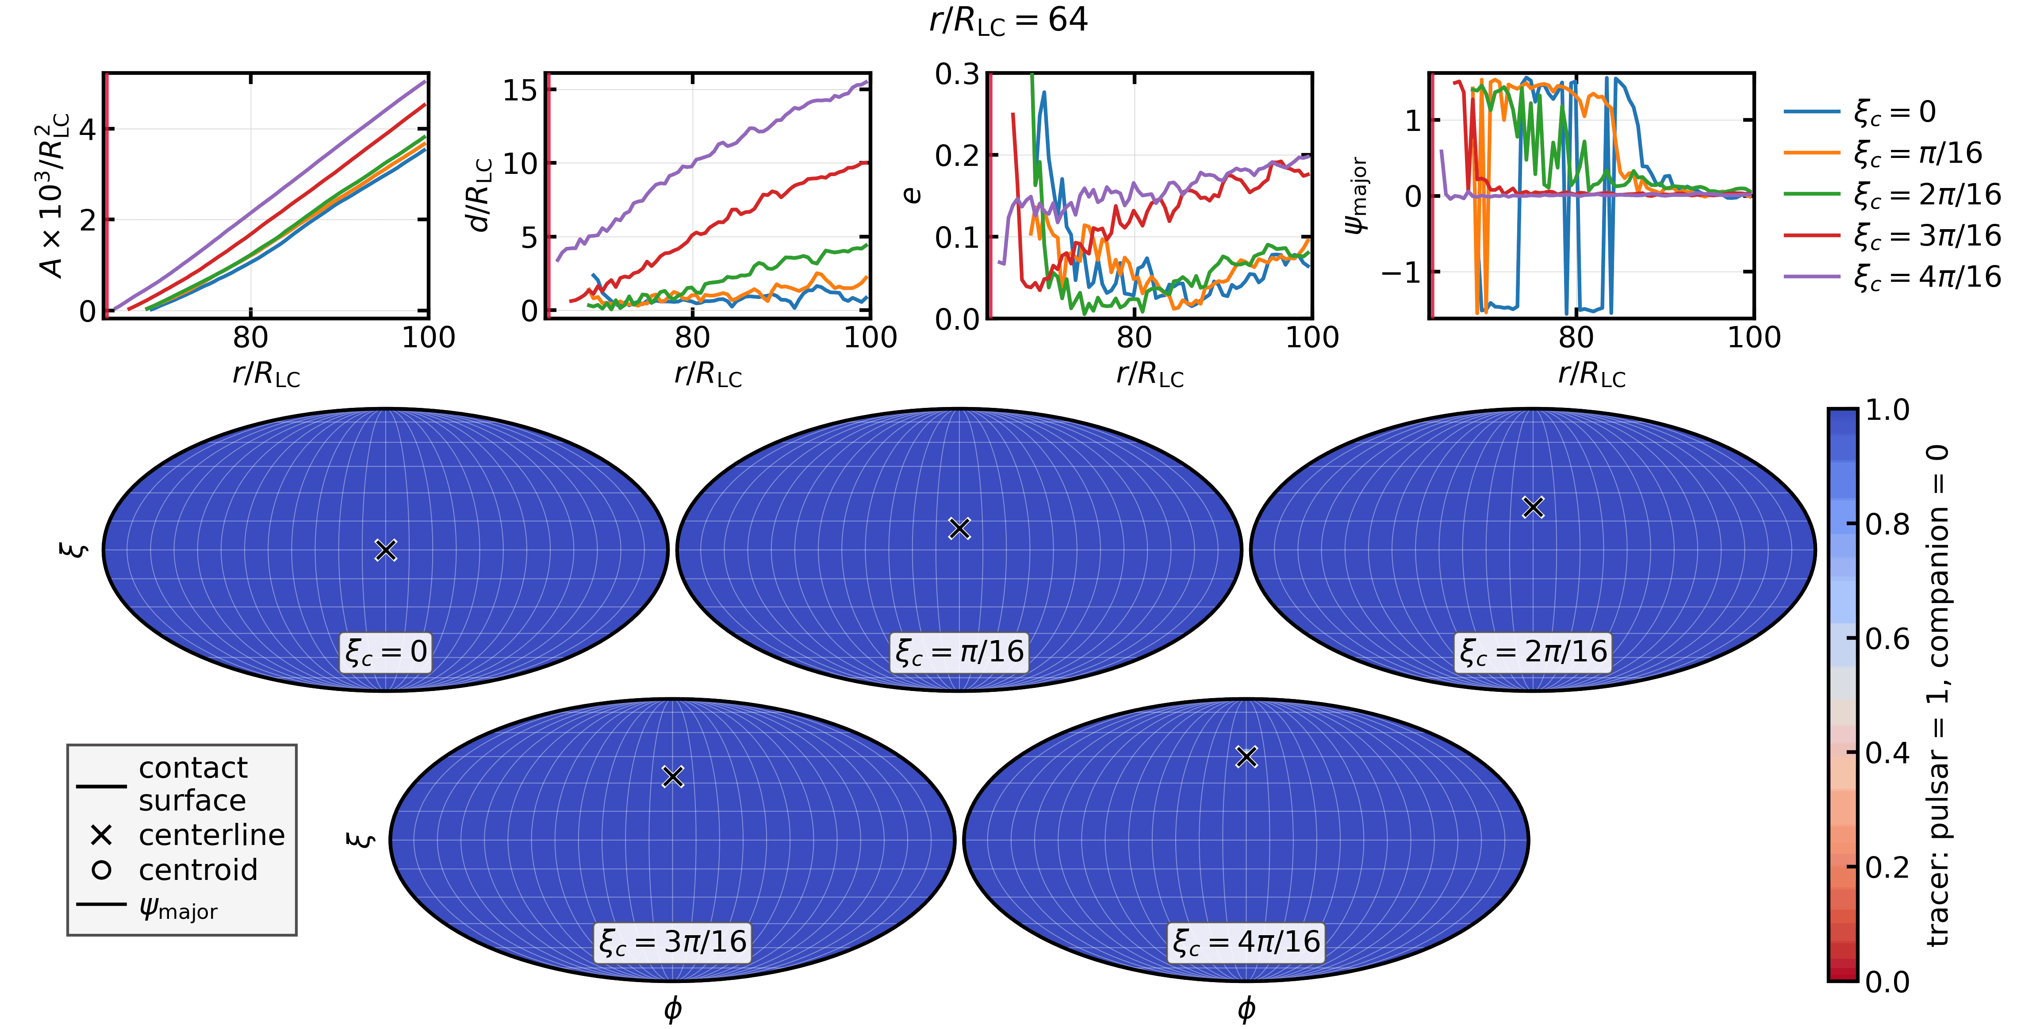
Contact surface geometry through spherical shells

Slide 10
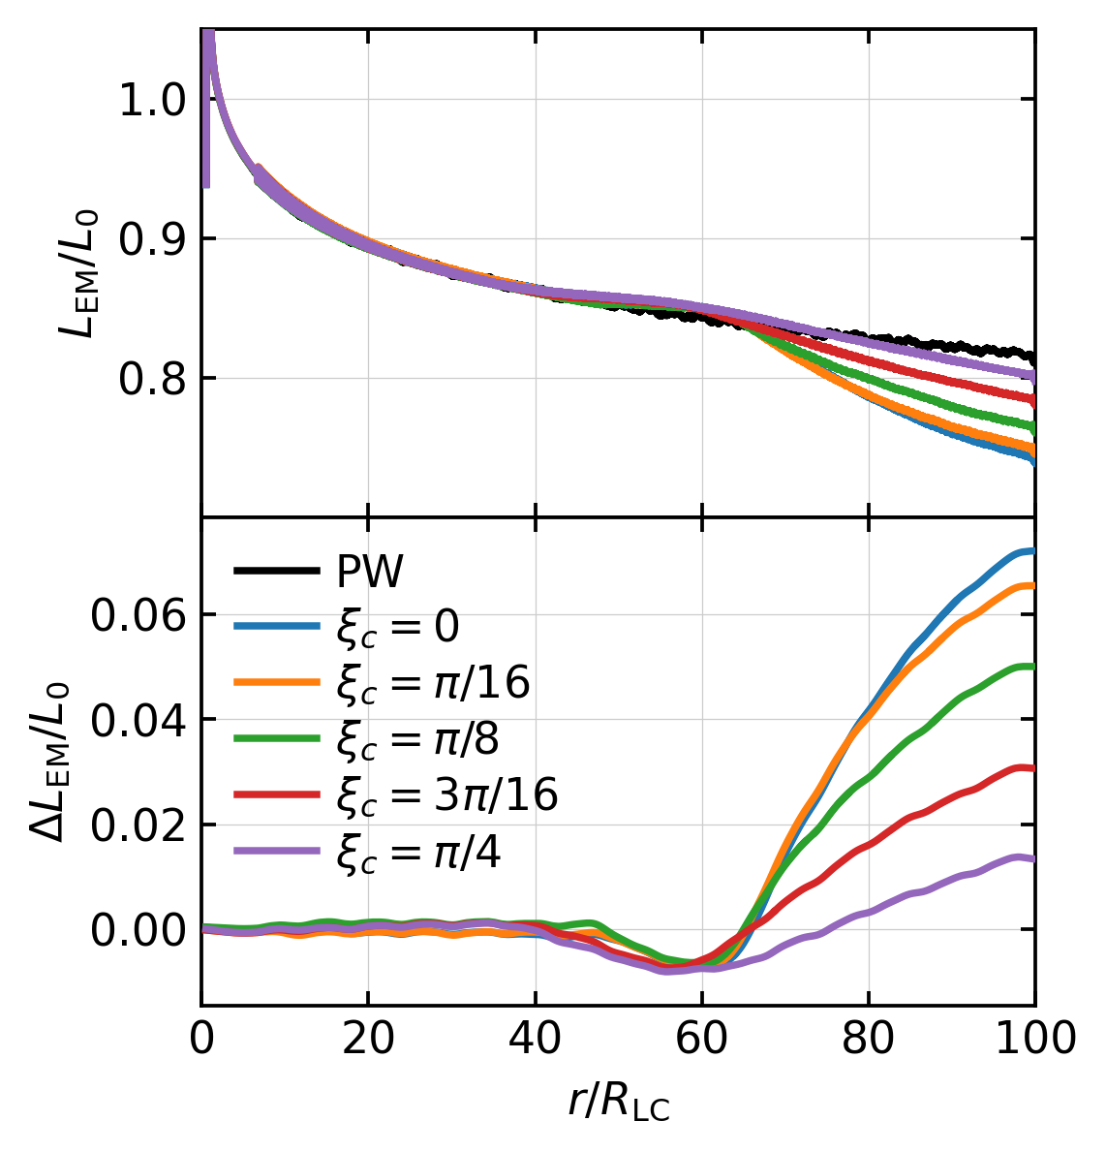
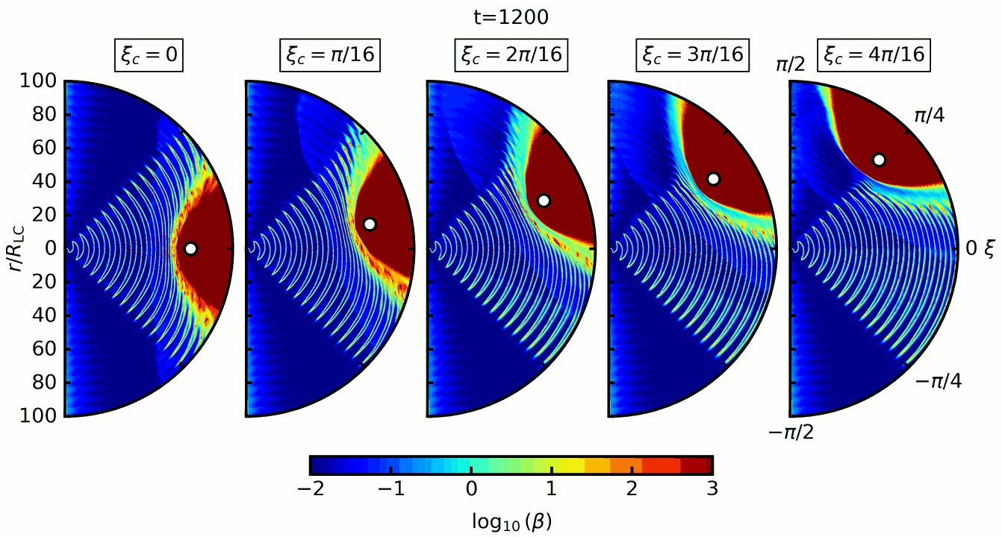
Pulsar wind dissipation
L_{EM} : EM luminosity though pulsar-centered spherical shells
ΔL_{EM}=L^{PW}-L_{EM} : EM luminosity deficit relative to isolated pulsar wind (PW)
~ 0 – 40R_{LC} : Unshocked PW
~ 40 – 60R_{LC} : Post MHD shock pre-apex compression
~ 60 – 100 R_{LC} : Post apex bowshock interaction
Strongest conversion rate near apex
Local balance of stagnation and advection of incident annihilable flux governs local reconnection efficiency

Slide 11
Pulsar wind dissipation
L_{EM} : EM luminosity though pulsar-centered spherical shells
ΔL_{EM}=L^{PW}-L_{EM} : EM luminosity deficit relative to isolated pulsar wind (PW)
~ 0 – 40R_{LC} : Unshocked PW
~ 40 – 60R_{LC} : Post MHD shock pre-apex compression
~ 60 – 100 R_{LC} : Post apex bowshock interaction
Strongest conversion rate near apex
Local balance of stagnation and advection of incident annihilable flux governs local reconnection efficiency

Slide 12
Pulsar wind dissipation
L_{EM} : EM luminosity though pulsar-centered spherical shells
ΔL_{EM}=L^{PW}-L_{EM} : EM luminosity deficit relative to isolated pulsar wind (PW)
~ 0 – 40R_{LC} : Unshocked PW
~ 40 – 60R_{LC} : Post MHD shock pre-apex compression
~ 60 – 100 R_{LC} : Post apex bowshock interaction
Strongest conversion rate near apex
Local balance of stagnation and advection of incident annihilable flux governs local reconnection efficiency

Slide 13
Pulsar wind dissipation
L_{EM} : EM luminosity though pulsar-centered spherical shells
ΔL_{EM}=L^{PW}-L_{EM} : EM luminosity deficit relative to isolated pulsar wind (PW)
~ 0 – 40R_{LC} : Unshocked PW
~ 40 – 60R_{LC} : Post MHD shock pre-apex compression
~ 60 – 100 R_{LC} : Post apex bowshock interaction
Strongest conversion rate near apex
Local balance of stagnation and advection of incident annihilable flux governs local reconnection efficiency

Slide 14
Pulsar wind dissipation
L_{EM} : EM luminosity though pulsar-centered spherical shells
ΔL_{EM}=L^{PW}-L_{EM} : EM luminosity deficit relative to isolated pulsar wind (PW)
~ 0 – 40R_{LC} : Unshocked PW
~ 40 – 60R_{LC} : Post MHD shock pre-apex compression
~ 60 – 100 R_{LC} : Post apex bowshock interaction
Strongest conversion rate near apex
Local balance of stagnation and advection of incident annihilable flux governs local reconnection efficiency

Slide 15
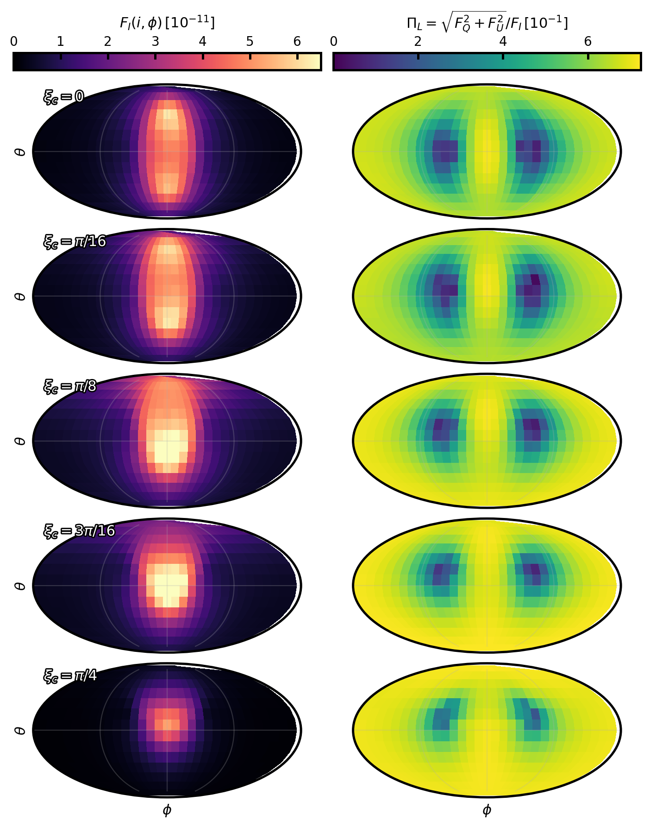
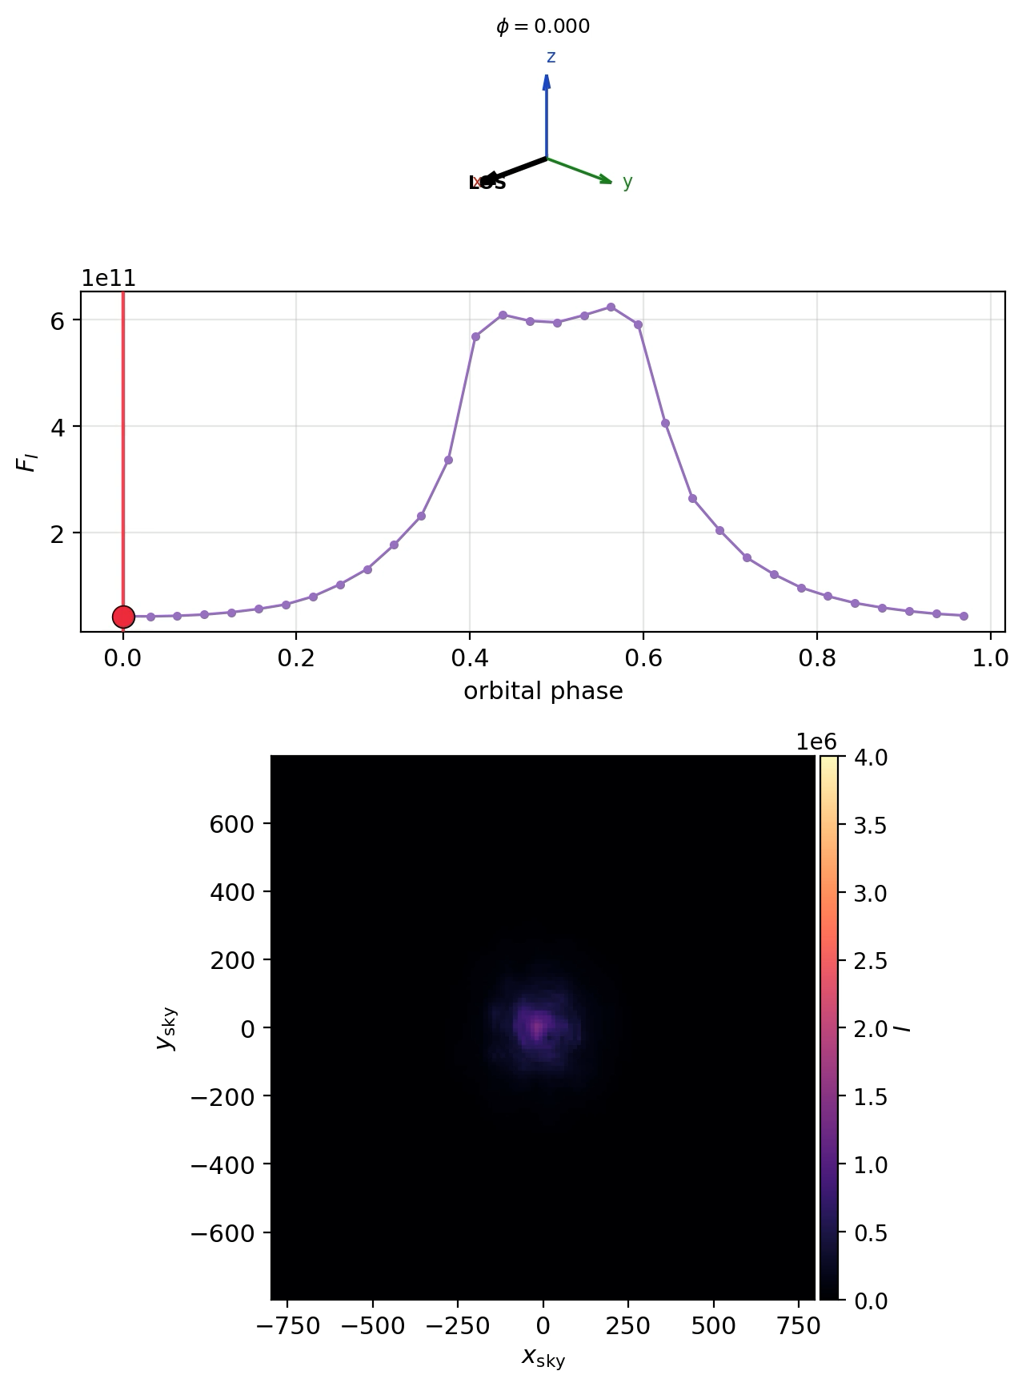
Synthetic emission (preliminary)

Slide 17
Intrabinary Shocks in Spider Pulsars
Sebastiaan Selvi
TeV Particle Astrophysics
2026
Tendo, Japan
August 31, 2026
Collaborators: Koushik Chatterjee, Lorenzo Sironi, Alexander Philippov

