Slide 1

Void Radial Velocity Statistics as a Probe of Dark-Sector Interactions
Kin Ho Luo, Ming-chung Chu, Kwan Chuen Chan, Wangzheng Zhang
The Chinese University of Hong Kong

Slide 2
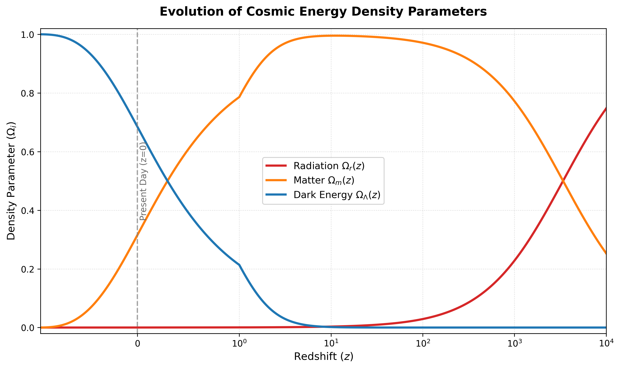

Introduction
In $ΛCDM$, dark energy (DE) and dark matter (DM) evolves independently, yet their energy densities at $z=0$ are of the same order, this is called the cosmic coincidence

Slide 3
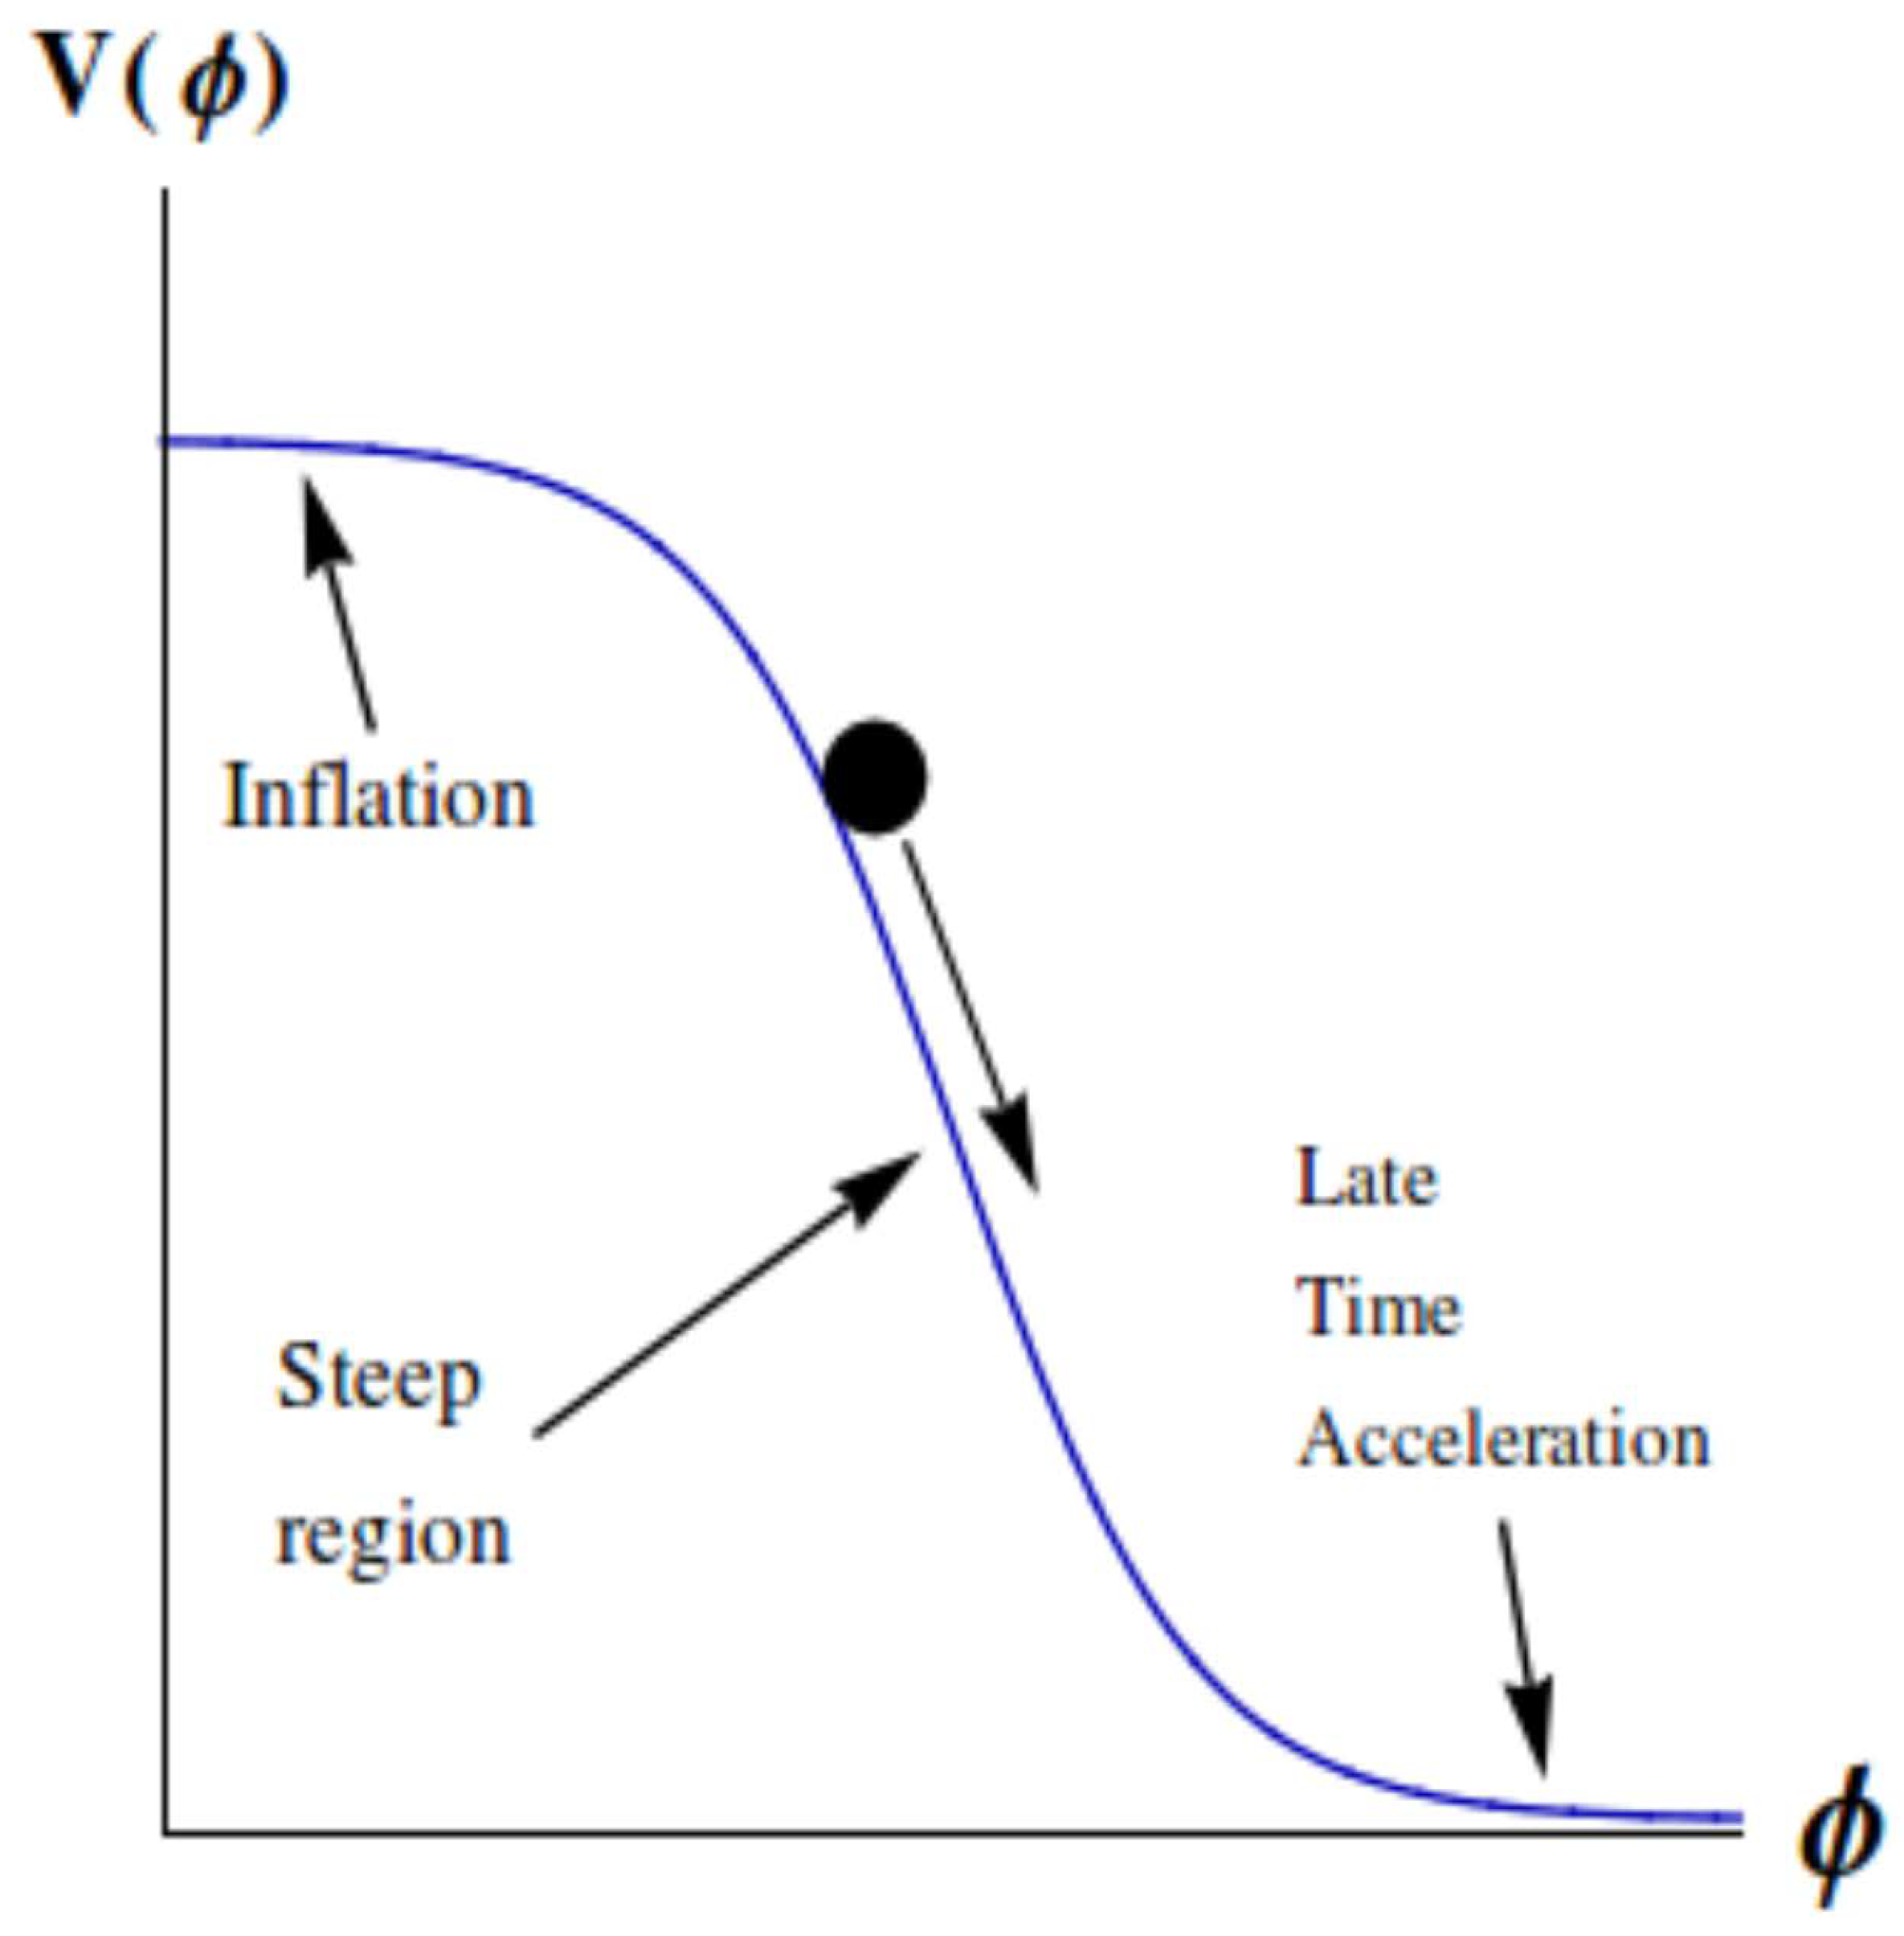


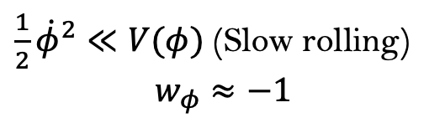
Introduction: Alternatives to $ΛCDM$
Instead of describing DE using a cosmological constant $Λ$, let’s recast it as a varying scalar field $φ$
$$ρ_{φ}=\frac{1}{2}{\dot{φ}}^{2}+V\left(φ\right), P_{φ}=\frac{1}{2}{\dot{φ}}^{2}−V\left(φ\right), w_{φ}=\frac{P_{φ}}{ρ_{φ}}$$
$$\frac{1}{2}{\dot{φ}}^{2}≫V(φ)$$
Kinetic term
Potential term
$\frac{1}{2}{\dot{φ}}^{2}≪V(φ)$ (Slow rolling)
$$w_{φ}≈−1$$
Mimics the DE EoS of the $ΛCDM$ ($ω_{DE}=−1)$
Post-inflation
early Universe
Late Universe
Notes:
Slide 7-9 should be fixed, specifically the beta term should be specified to capture the dark sector interaction, also the background equation should serve as a motivation for employing class to constrain the parameter for the type 3 model. Also include picture of scalar field model
This allows the scalar field to track dominant fluids during different eras while remaining sub-dominant
Overtime it slowly rolls down the slope such that $\frac{1}{2}{\dot{φ}}^{2}≪V(φ)$ to mimic the late-time acceleration expansion ($w_{φ}≈−1$), thus giving DE a natural evolutionary history

Slide 4
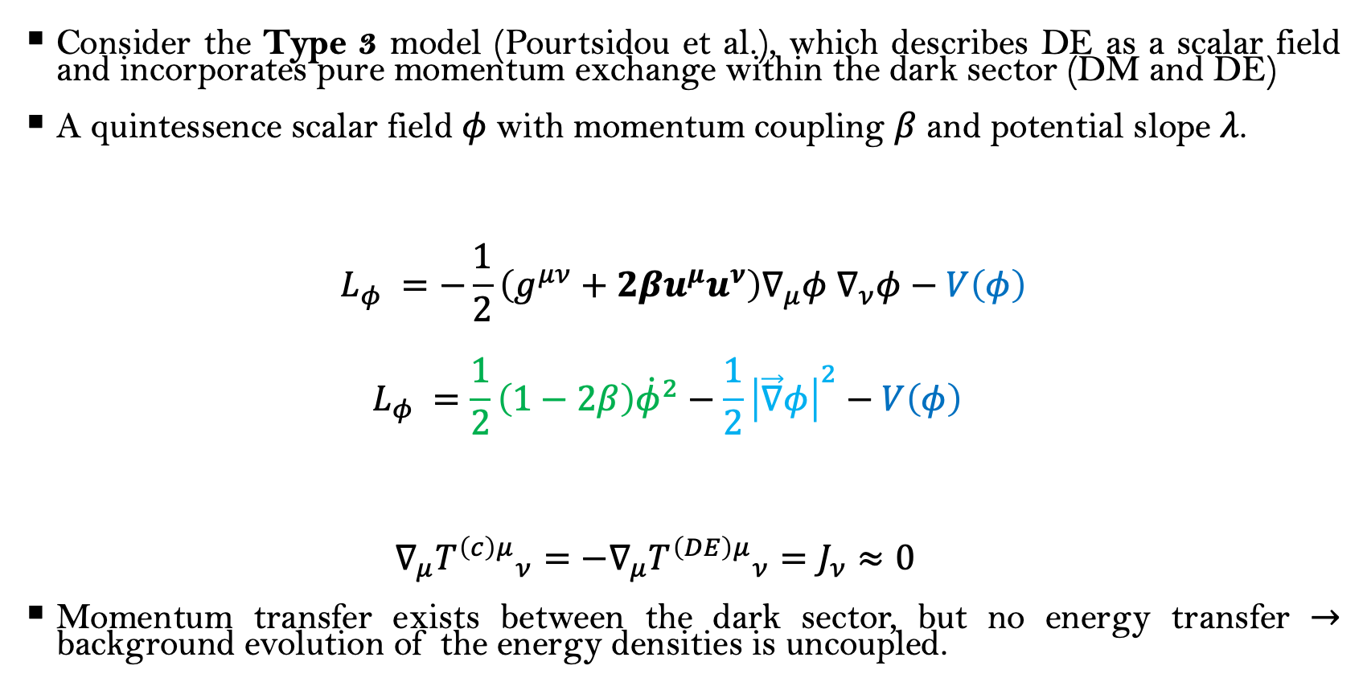

Type 3 model
Consider the Type 3 model (Pourtsidou et al.), which describes DE as a scalar field and incorporates pure momentum exchange within the dark sector (DM and DE)
A quintessence scalar field $φ$with momentum coupling $β$ and potential slope $λ$.
$$L_{φ} =−\frac{1}{2}\left(g^{μν}+2βu^{μ}u^{ν}\right)∇_{μ}φ{ ∇}_{ν}φ−V\left(φ\right)$$
$$L_{φ} =\frac{1}{2}\left(1−2β\right){\dot{φ}}^{2}−\frac{1}{2}{\left|\vec{∇}φ\right|}^{2}−V\left(φ\right)$$
$$∇_{μ}{T^{\left(c\right)μ}}_{ν}=−∇_{μ}{T^{\left(DE\right)μ}}_{ν}=J_{ν}≈0$$
Momentum transfer exists between the dark sector, but no energy transfer $→$ background evolution of the energy densities is uncoupled.
Interaction term
$$u^{μ}=\left(1,0,0,0\right) (DM four velocity)$$
Kinetic term Spatial term $(=0)$ Potential term = $V₀e^{−\frac{λφ}{m_{P}}}$
Notes:
#suggesting non-gravitational interaction within the dark sector
#with dark energy modelled as a dynamical scalar field
#to study the effects of dark sector interaction on the structure formation
with $V(φ) = V₀e^{−\frac{λφ}{m_{P}}}$. $β$ and $λ$modify the friction force felt by matter to affect the structure formation.
Need to explain how beta explain dark sector interaction
Link the nbody simulation better to the procedure
Aim is to investigate the sensitivity of the matter pairwise velocity statistics to the parameters in the Type 3 model

Slide 5



Type 3 model
$L_{φ} =\frac{1}{2}\left(1−2β\right){\dot{φ}}^{2}−\frac{1}{2}{\left|\vec{∇}φ\right|}^{2}−V\left(φ\right)$
Effects of $β$ and $λ$:
  $β<0:$ In term $−β{\dot{φ}}^{2}$, when $β$ approaches $0$, the kinetic term decreases
  $λ:$ In term $\frac{1}{2}\left(1−2β\right){\dot{φ}}^{2}$, increase in $λ$ speeds up the scalar field evolution $\dot{φ}$ to increase the kinetic term
Kinetic term Spatial term $(=0)$ Potential term = $V₀e^{−\frac{λφ}{m_{P}}}$
Flow of momentum
Dark matter (DM)
Scalar field
$$↑β (<0)$$
$$↑λ$$
Notes:
Momentum is transferred from dark matter to the scalar field, but there is no energy transfer, because it is the scalar field’s internal dynamics that’s changed, not necessarily at the expense of the DM energy. In another word’s the internal dynamics of scalar field changes, and that it alters the evolution of its evolution history, but it doesn’t mean there is a net energy transfer.

Slide 6
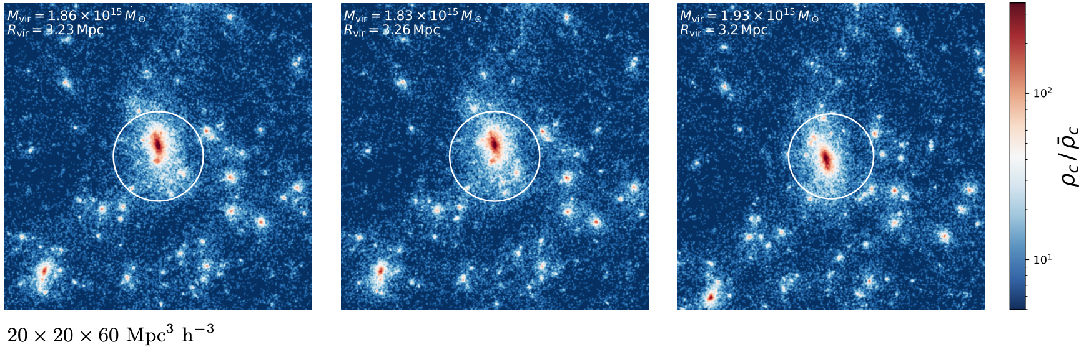



Type 3 model: effects on dark matter halos
Dark sector interaction affects structure formation of halos and momentum transfer, suggesting that it also affects halos motion
$$β=−1.4, λ=0.6$$
$$β=−0.5, λ=0.6$$
$$β=−0.5, λ=1.4$$
Notes:
Density evolution plot -> Halo catalogs -> Motion of Halos
Non-linear effects within the halos

Slide 7
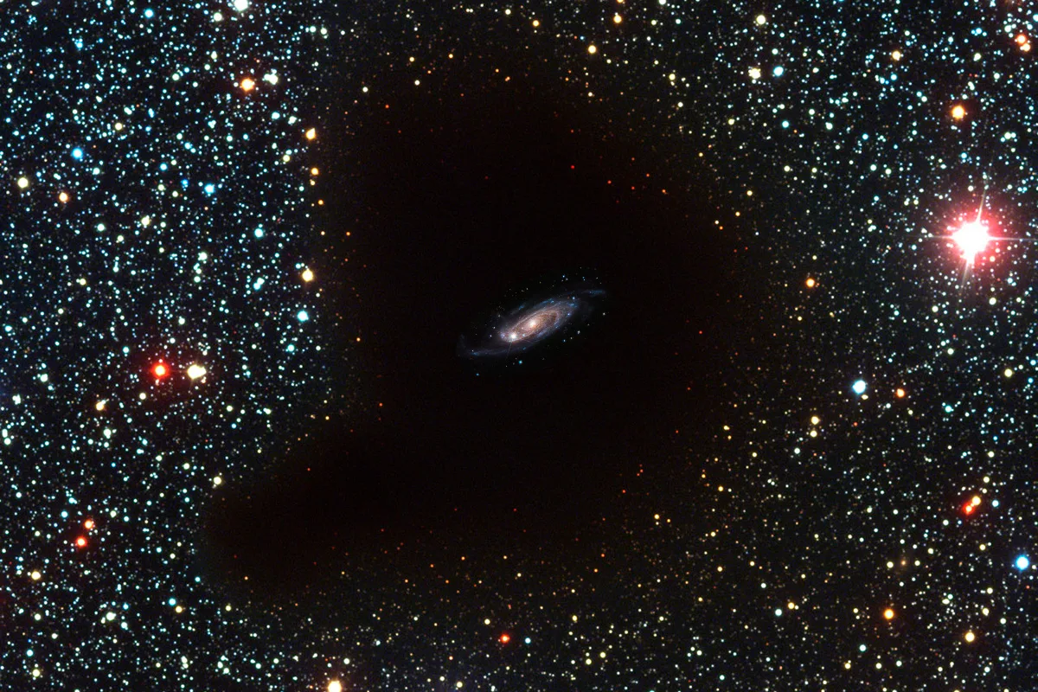
Cosmic voids as cosmological laboratories
Cosmic Voids
  Under-dense regions minimally affected by baryonic processes
  Continuously expanding (similar to a mini-universe) and occupy huge volume
  Ideal for testing gravity and dark energy models, and studying tracer’s kinematics around voids can probe dark sector interactions
Credit: ESO/NASA

Slide 8
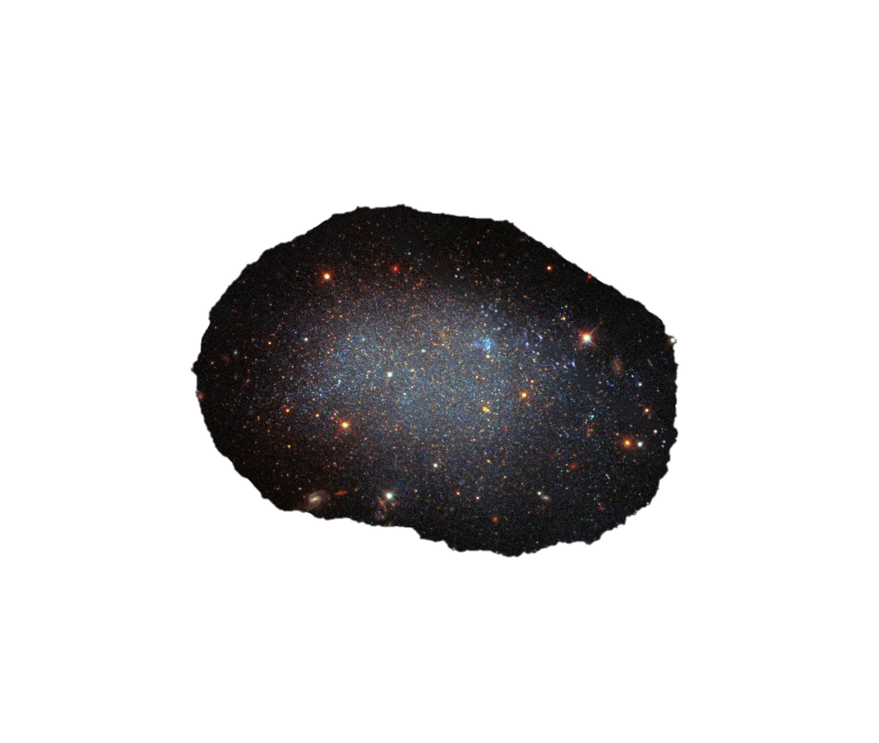
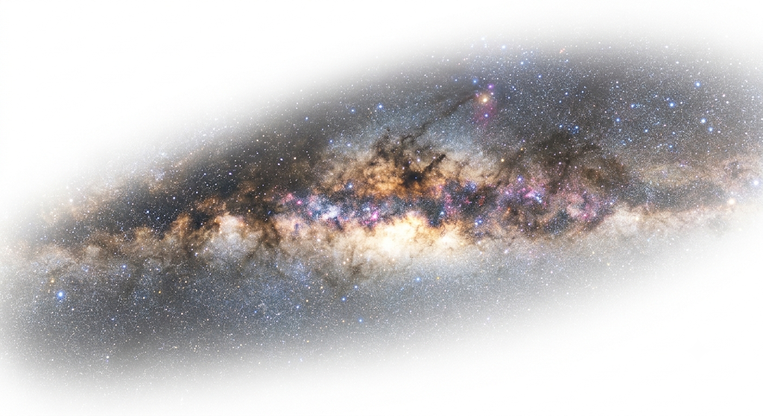



Void radial velocity statistics
Radial Velocity Profile $v_{v}$: Radial velocity profile measures mean peculiar velocity of tracers from void centre
Velocity Dispersion Profile $σ_{v}$: Velocity dispersion profile quantifies spread of tracer velocities around voids
$$\hat{r}$$
$$v_{tracer}$$

Slide 9
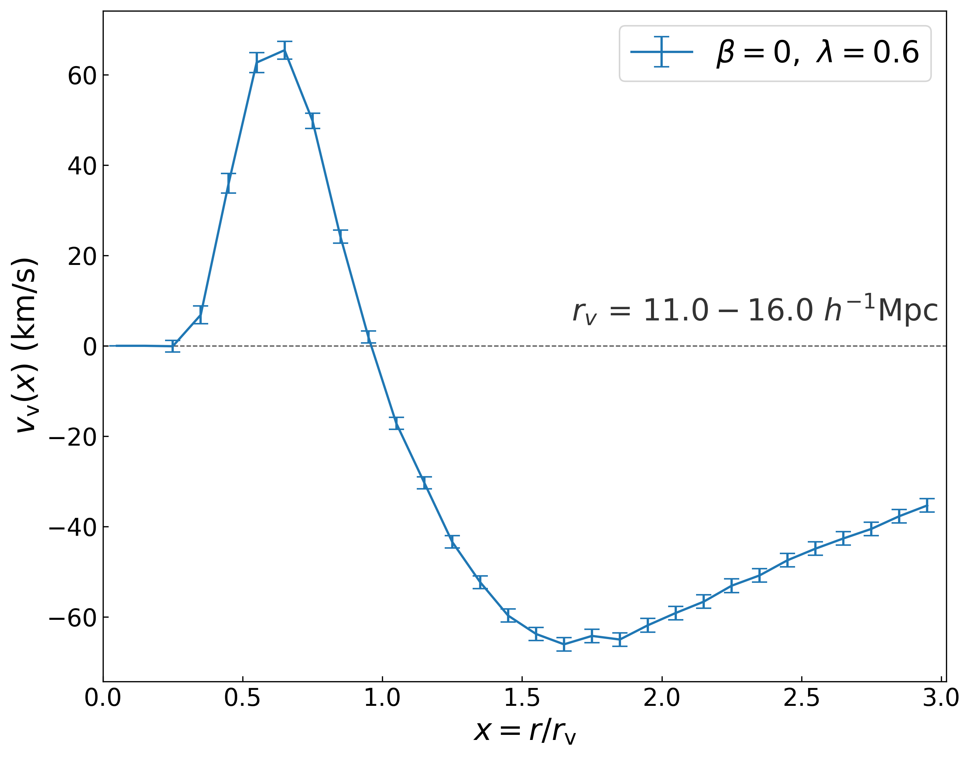
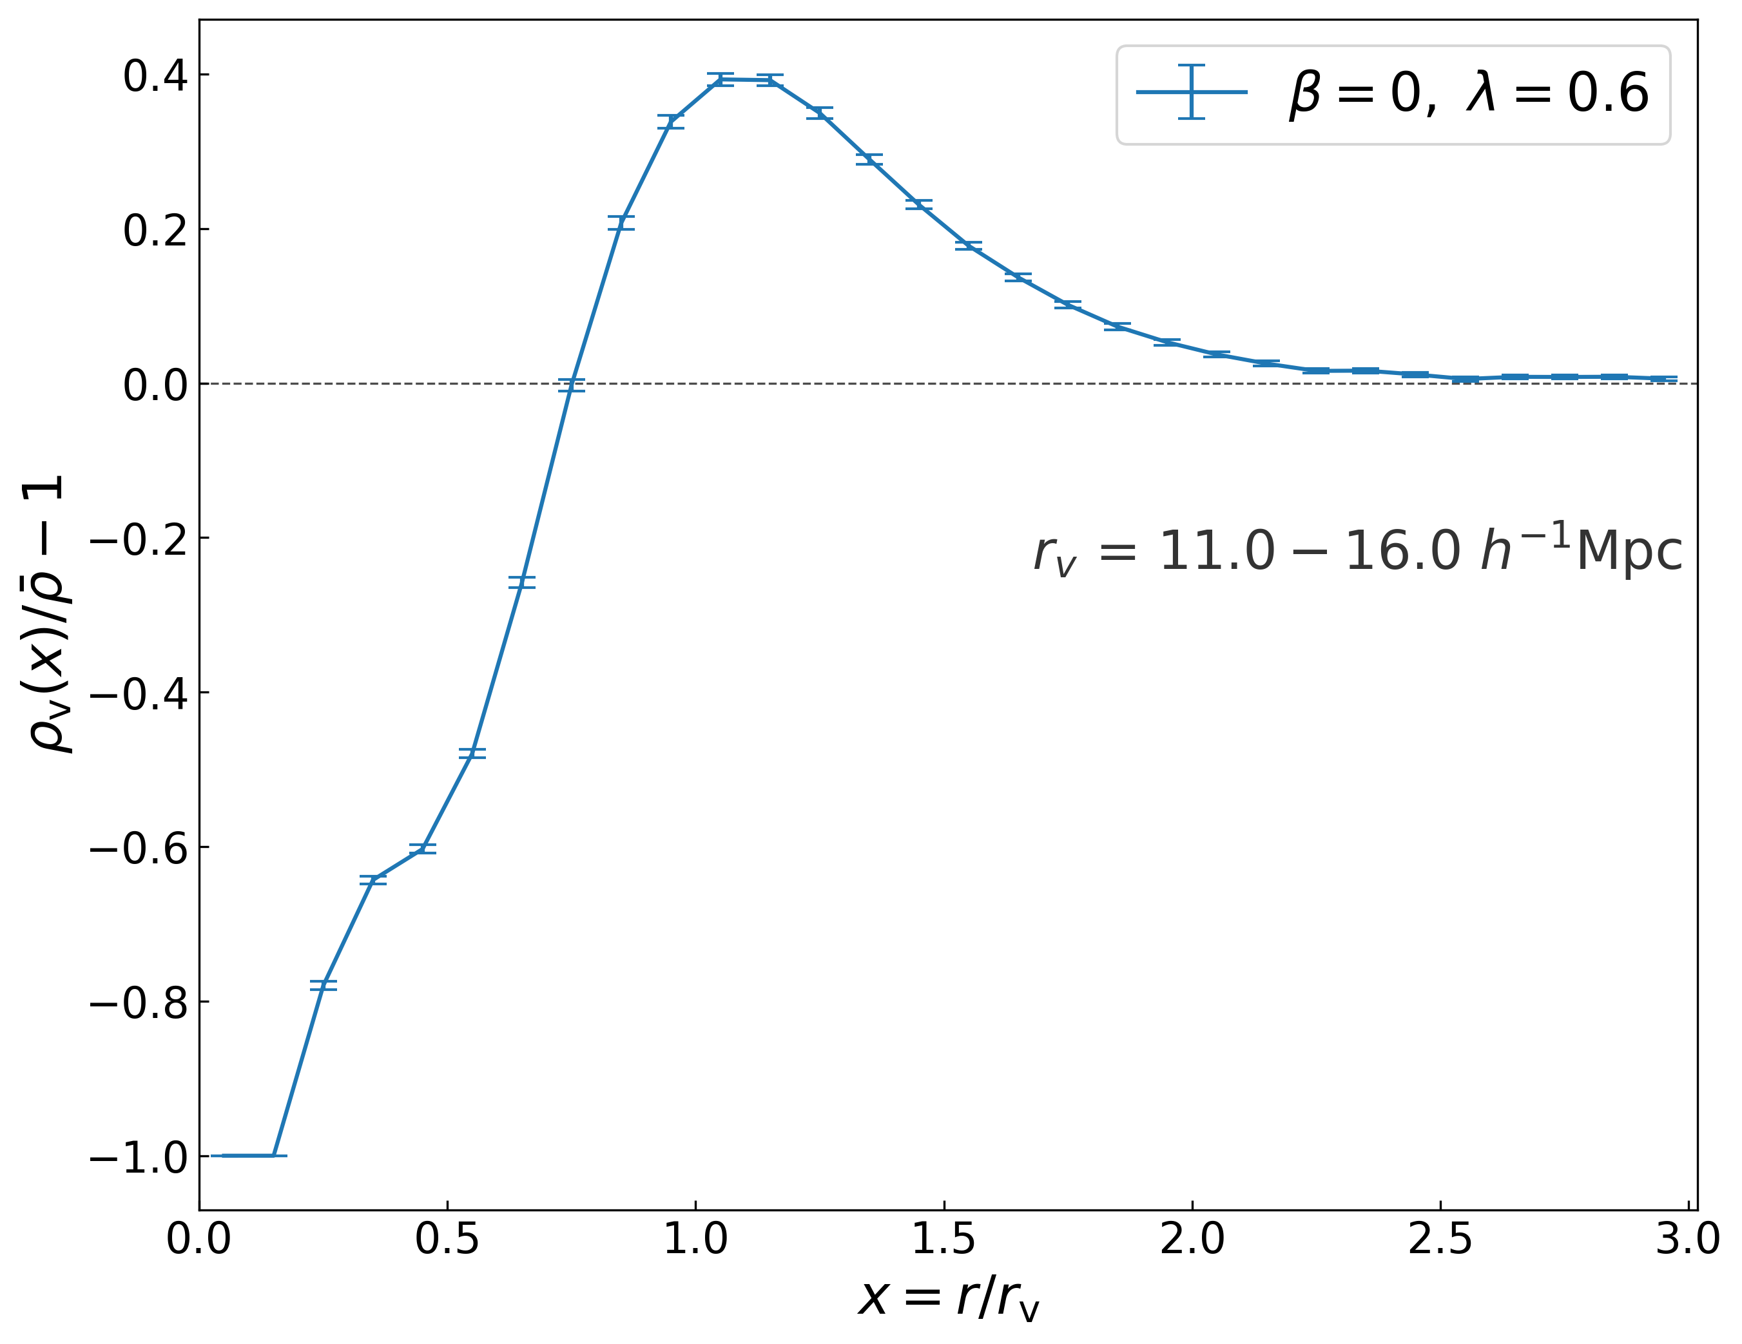


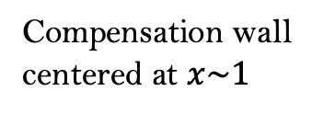
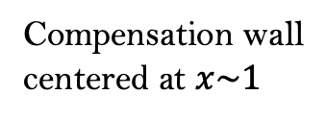
Void radial velocity statistics
Void radial velocity profile $v_{v}$
Void density profile $δ_{v}$
Compensation wall
centered at $x\sim 1$
Compensation wall
centered at $x\sim 1$
Outflow
Inflow

Slide 10
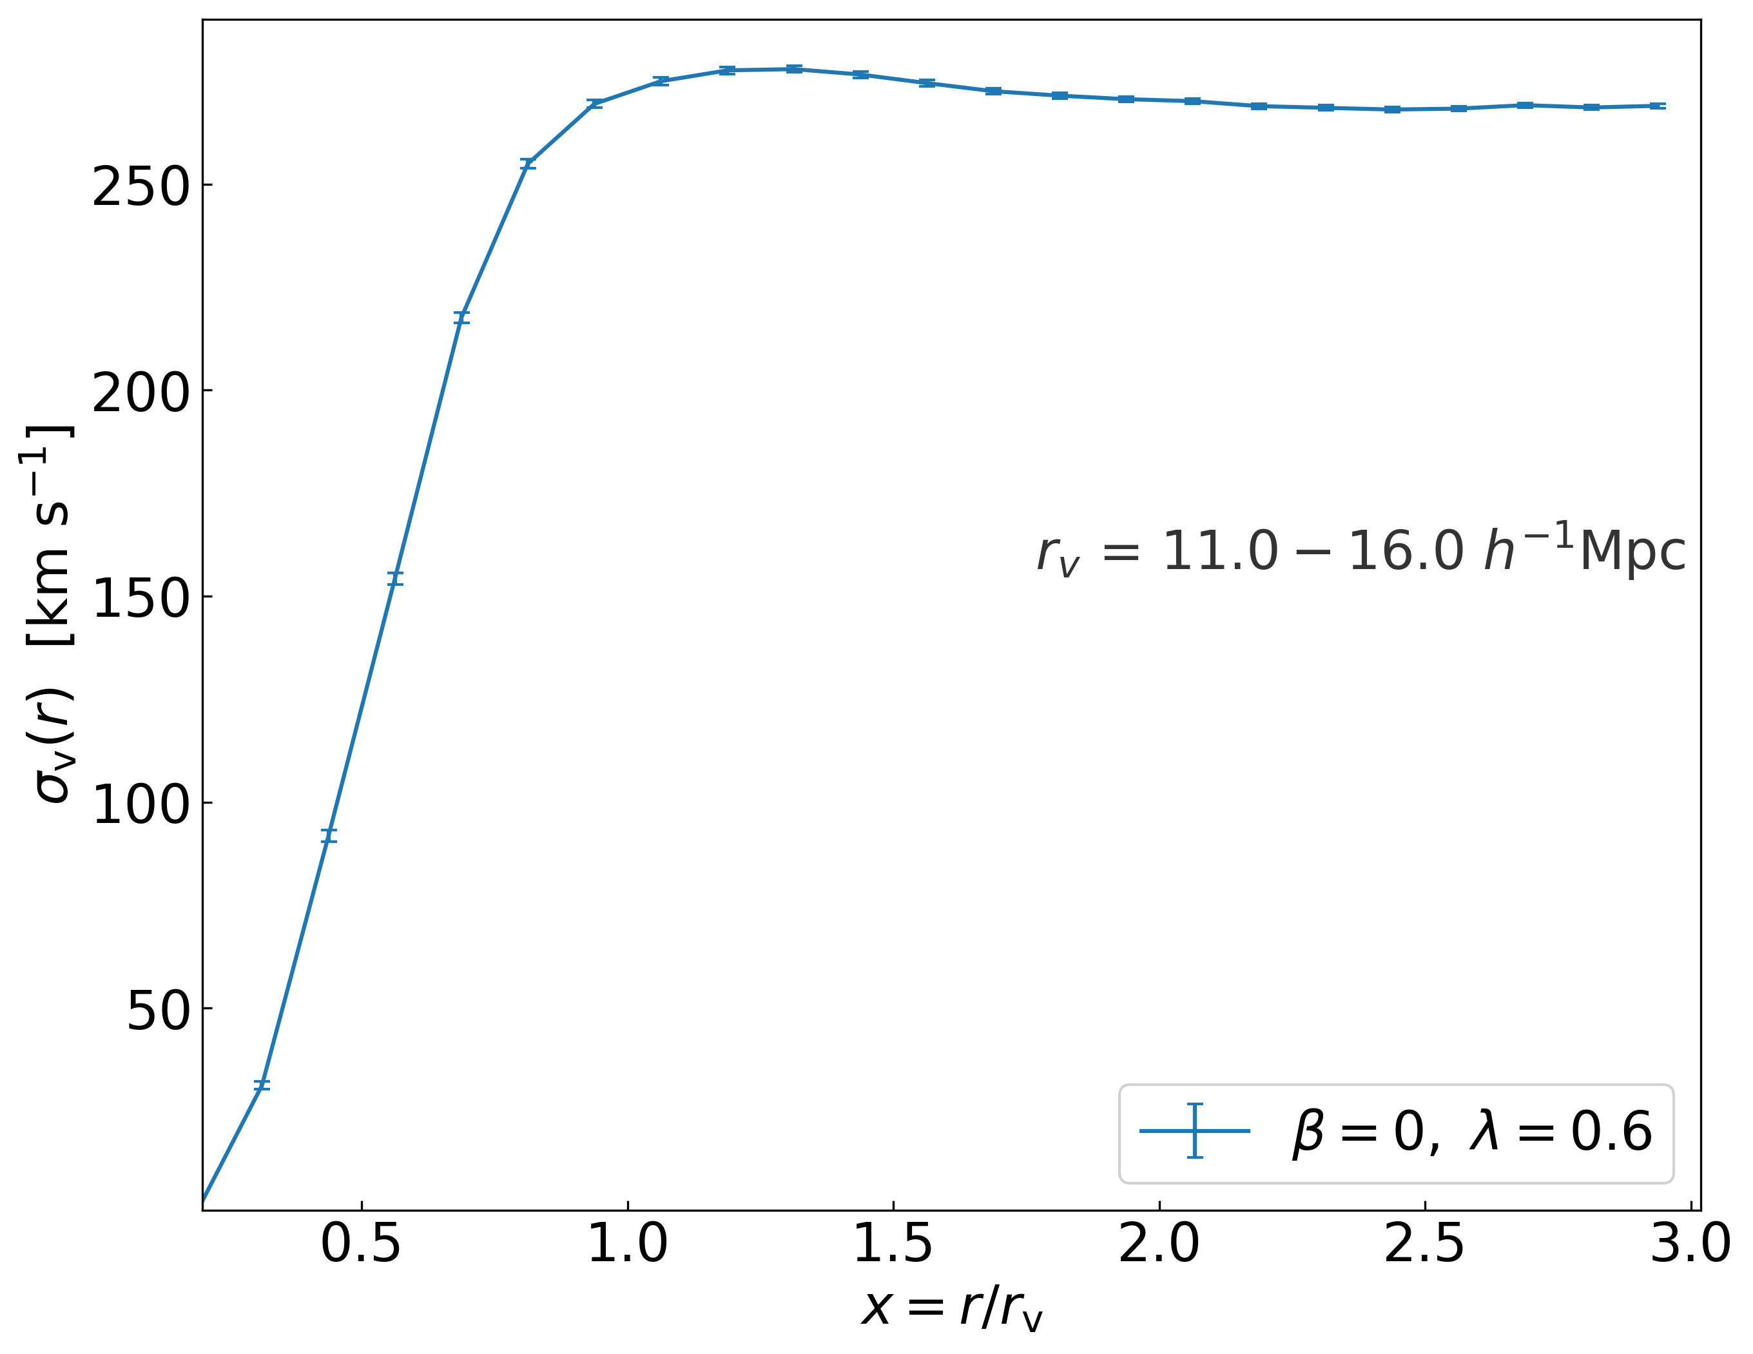
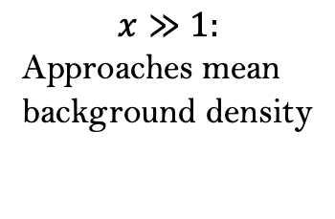

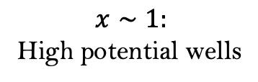
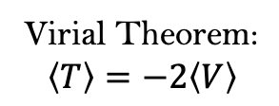
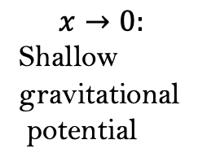




Void radial velocity statistics
Virial Theorem:
$$\left\langle T\right\rangle =−2\left\langle V\right\rangle$$
Void radial velocity dispersion profile $σ_{v}$
Void density profile $δ_{v}$
$$x∼1:$$
Strong gravity
causes non-uniform
, chaotic motions
$$x≫1:$$
Gravity of background
LSS drives
random motions
$$x∼1:$$
High potential wells
$$x≫1:$$
Approaches mean
background density
$$x→0:$$
Coherent outward flow
$$x→0:$$
Shallow gravitational
potential

Slide 11
Methodology
1.
CLASS (Linear perturbation solver modified for the Type 3 model)
Accurately describes the Type 3 model at linear scales because it has no energy transfer (evolution of energy densities is uncoupled )
2.
Cobaya (Monte Carlo code for cosmological parameter extraction)
Pick 3 values of $β$ and $λ$ ($3×3=9$ cases), and fiducial case $(β=0, λ=0.6)$
For all cases, re-fit the cosmological parameters to observational datasets (Planck CMB, DESI DR2, DES-Y5) and do
3.
2LPTic (Initial condition generator, $z=49$)
4.
ME-Gadget-2 ($N$-body simulation code, ${1024}^{3}$ DM particles)
Figure 3: Work flow of the project
Notes:
Computes the linear matter power spectrum

Slide 12
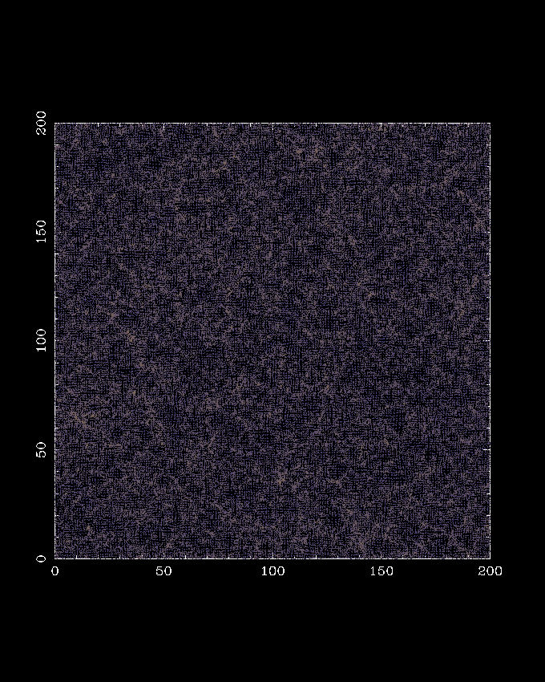
Methodology (N-body simulations)
ME-Gadget-2 ($N$-body simulation code, ${1024}^{3}$ DM particles)
4.

Slide 13
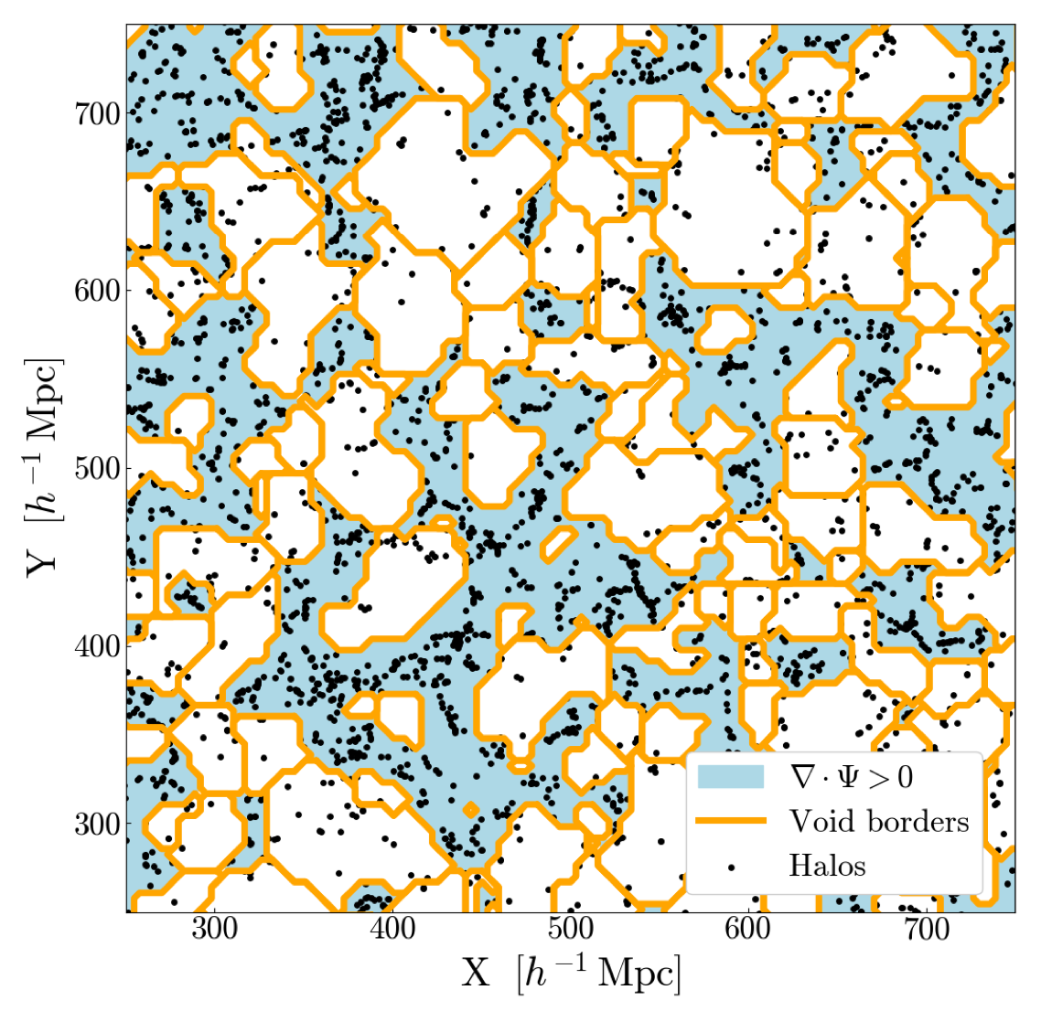
Methodology
5.
ROCKSTAR (Dark matter halo finder) + VIDE (Void finder) at $z=0$
Credit: Simone Sartori
6.
Self developed codes (Void radial velocity statistics calculator)
Sampled voids in different sizes ($r_{v}=11−16 h^{−1}Mpc,{ r}_{v}=16−21 h^{−1}Mpc$)
Figure 3: Work flow of the project
Notes:
To account for overlapping void volumes, uncertainty in measurements are calculated using Jackknife approach

Slide 14
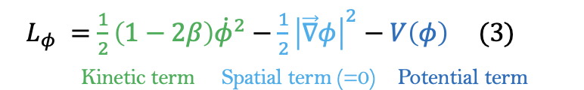



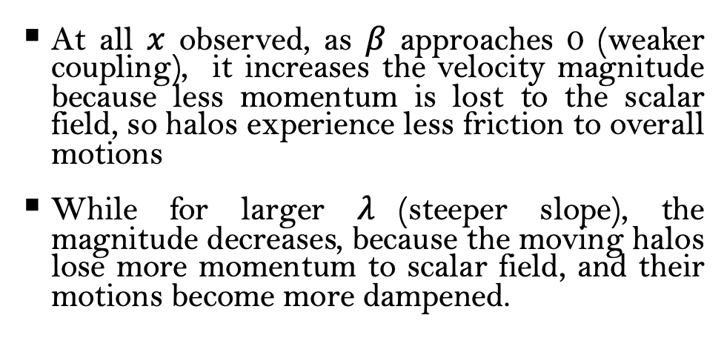



Results (Halo): Void radial velocity profile $v_{v}$
$v_{v}$:
$$β\left(<0\right)$$
At all $x$ observed, as $β$ approaches 0 (weaker coupling), it increases the velocity magnitude because less momentum is lost to the scalar field, so halos experience less friction to overall motions
While for larger $λ$(steeper slope), the magnitude decreases, because the moving halos lose more momentum to scalar field, and their motions become more dampened.
$$↑β$$
$$↑λ$$
$$↑λ$$
$$↑β$$
Notes:
Weaker coupling (increase in $β$) decreases the frictional damping on tracers $→$ increases the outflow/inflow $\left|v_{v}\right|$
Steeper potential’s slope (increase in $λ$) increases the frictional damping on tracers $→$ decreases $\left|v_{v}\right|$

Slide 15


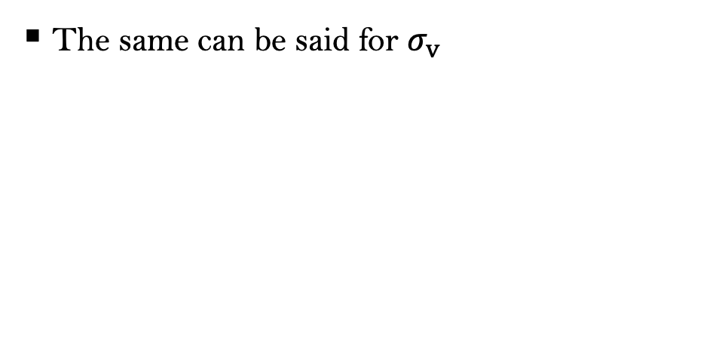


Results (Halo): Void radial dispersion velocity $σ_{v}$
$σ_{v}$:
$$β\left(<0\right)$$
The same can be said for $σ_{v}$
$$↑β$$
$$↑λ$$
$$↑β$$
$$↑λ$$
Notes:
Weaker coupling (increase in $β$) decreases the frictional damping on tracers $→$ increases the fluctuations $σ_{v}$
Steeper potential’s slope (increase in $λ$) increases the frictional damping on tracers $→$ decreases the fluctuations $σ_{v}$

Slide 16
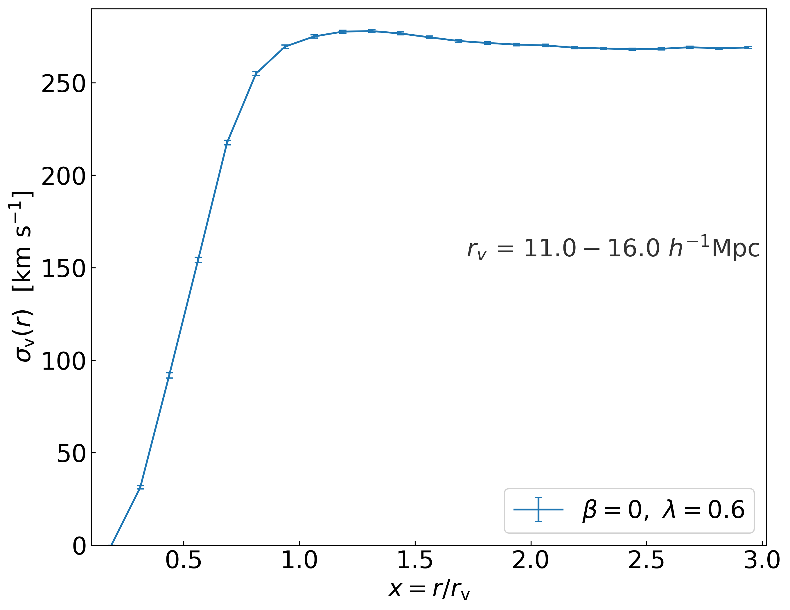


Velocity spans and 4-variable regression
$${\overline{σ}}_{span}$$
${\overline{v}}_{span}$
Notes:
Calculate the average velocity span (3 maximum and minimum) ${\overline{v}}_{span}$ and ${\overline{σ}}_{span}$ for all the cases

Slide 17
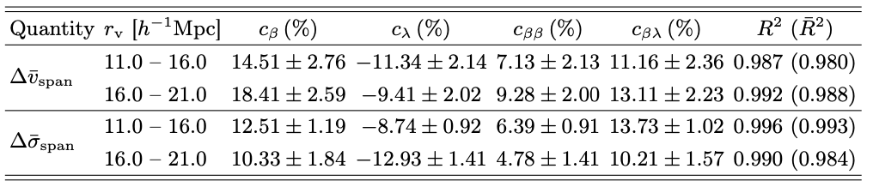
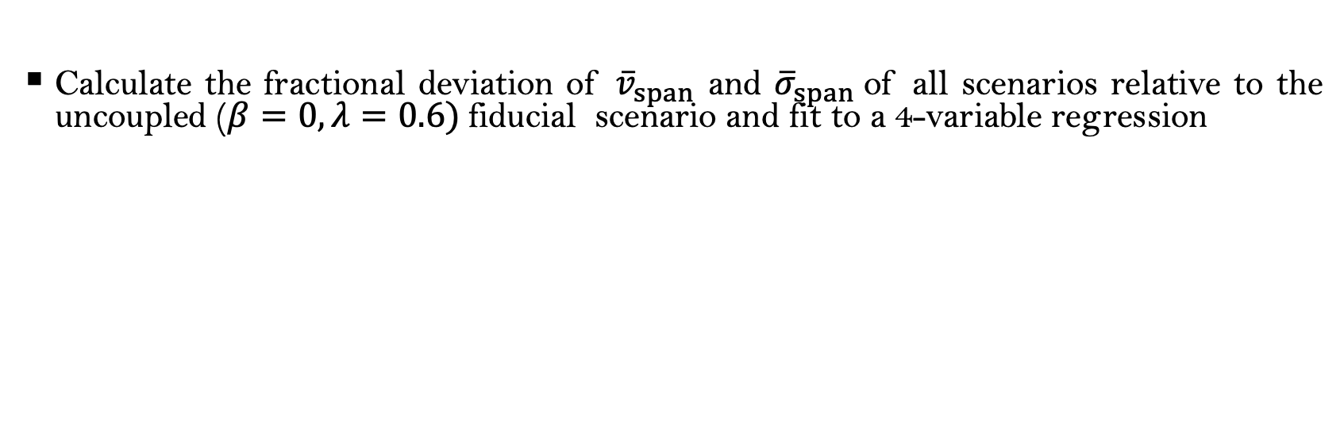
Velocity spans and 4-variable regression
Calculate the fractional deviation of ${\overline{v}}_{span}$ and ${\overline{σ}}_{span}$of all scenarios relative to the uncoupled ($β=0, λ=0.6)$fiducial scenario and fit to a 4-variable regression
$$Δ\left[{\overline{v}}_{span} | { \overline{ σ}}_{span}\right]=c_{β}Δβ+c_{λ}Δλ+c_{ββ}Δβ^{2}+c_{βλ}ΔβΔλ, with Δβ=β+1.4, Δλ=λ−0.6$$
The significant cross-term $c_{βλ}$ is explained by the dark sector interaction, encoded in the term $−β{\dot{φ}}^{2}$
Recall

Slide 18
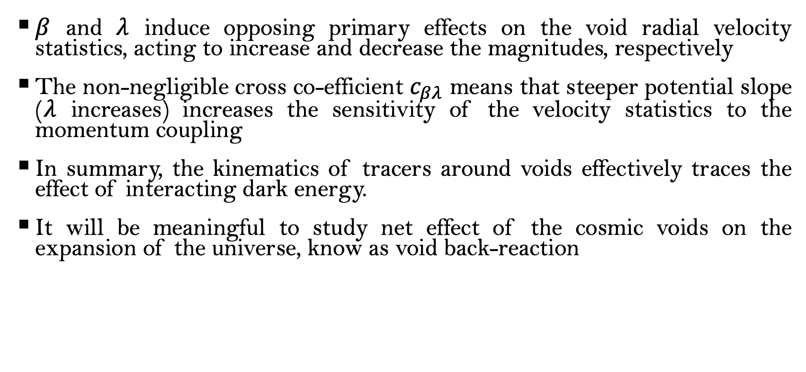
Conclusion and Outlook
$β$ and $λ$ induce opposing primary effects on the void radial velocity statistics, acting to increase and decrease the magnitudes, respectively
The non-negligible cross co-efficient $c_{βλ}$ means that steeper potential slope ($λ$ increases) increases the sensitivity of the velocity statistics to the momentum coupling
In summary, the kinematics of tracers around voids effectively traces the effect of interacting dark energy.
It will be meaningful to study net effect of the cosmic voids on the expansion of the universe, know as void back-reaction

Slide 19
The end

Slide 20
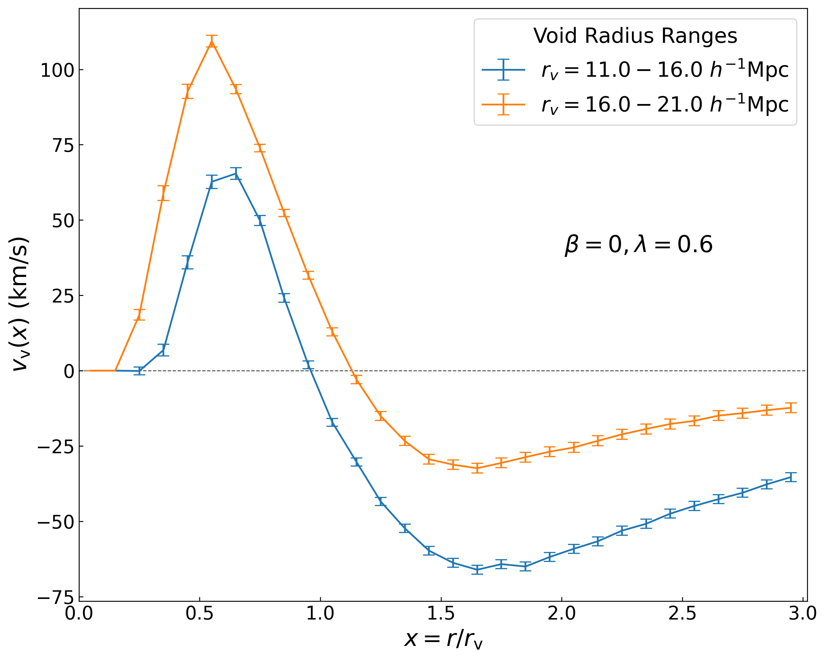
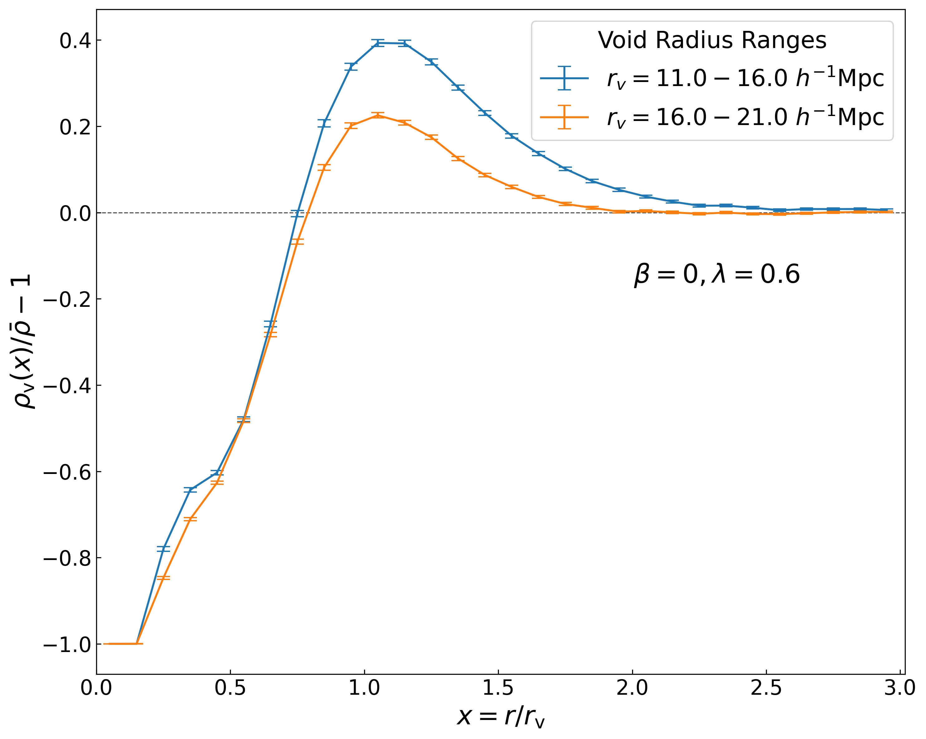
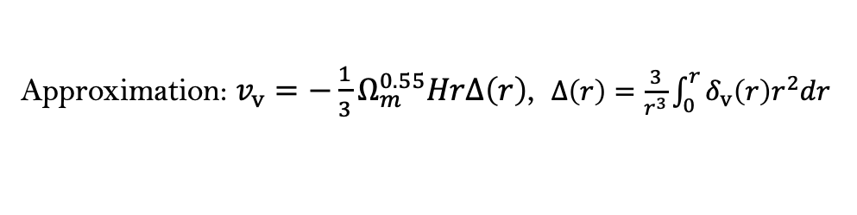
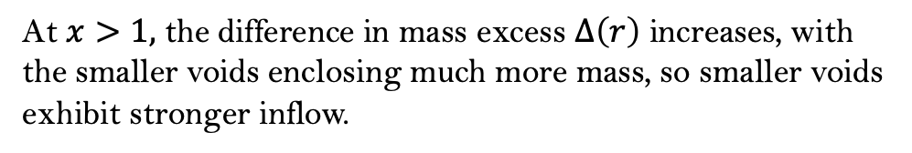
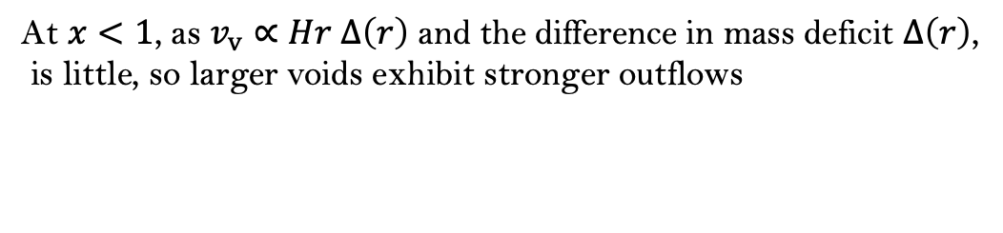


Appendix: Void radial velocity statistics
Void Radial Velocity Profile $v_{v}$
Void Density Profile $δ_{v}$
Approximation: $v_{v}=−\frac{1}{3}Ω_{m}^{0.55}HrΔ\left(r\right)$, $Δ\left(r\right)=\frac{3}{r^{3}}\int_{0}^{r}{δ_{v}\left(r\right)r^{2}dr }$
Larger voids experience stronger
outflows (weaker inflow).
At $x<1$, as $v_{v}∝Hr$ $Δ\left(r\right)$ and the difference in mass deficit $Δ\left(r\right)$,
is little, so larger voids exhibit stronger outflows
At $x>1,$ the difference in mass excess $Δ\left(r\right)$ increases, with the smaller voids enclosing much more mass, so smaller voids exhibit stronger inflow.

Slide 21
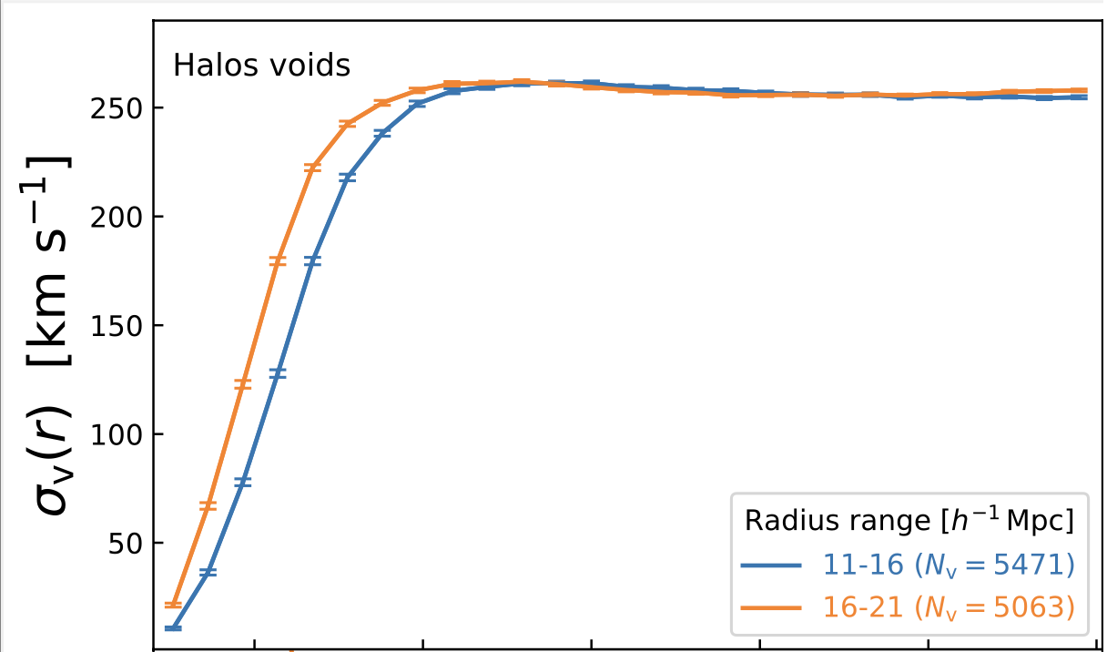
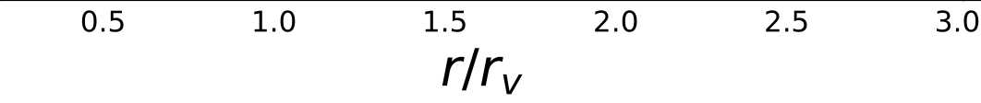


Appendix: Void radial velocity statistics
Void Radial Velocity Dispersion Profile $σ_{v}$
Void Density Profile $δ_{v}$
Larger voids experience stronger
outflows (weaker inflow) because their compensation walls are more massive, producing stronger gravitational pull.

Slide 22
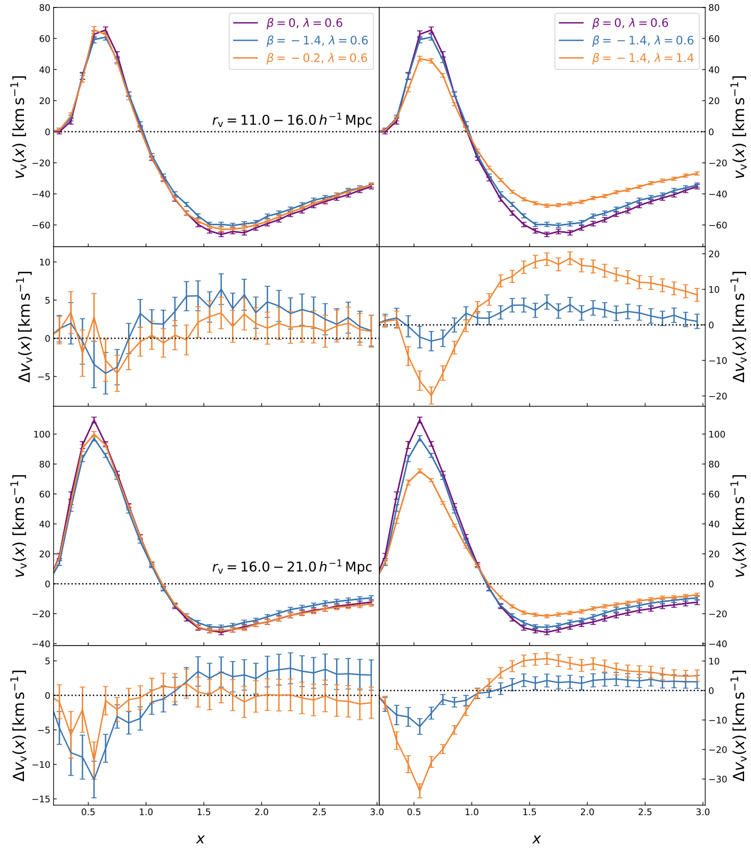




Appendix: Void radial velocity (CDM voids)
Weaker coupling (increase in $β$) decreases the frictional damping on tracers $→$ increases the outflow/inflow $\left|v_{v}\right|$
Steeper potential’s slope (increase in $λ$) increases the frictional damping on tracers $→$ decreases $\left|v_{v}\right|$
$$↑β$$
$$↑λ$$
$$↑β$$
$$↑λ$$

Slide 23
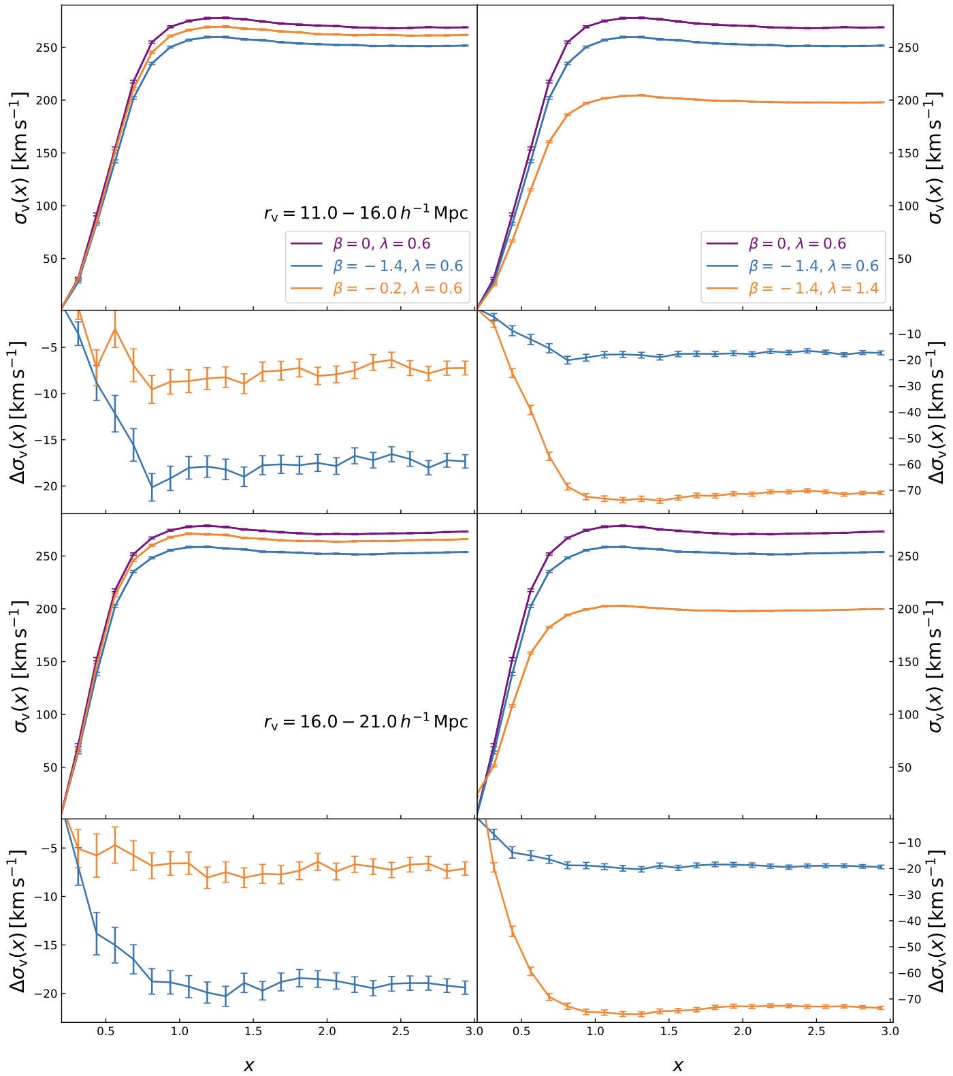
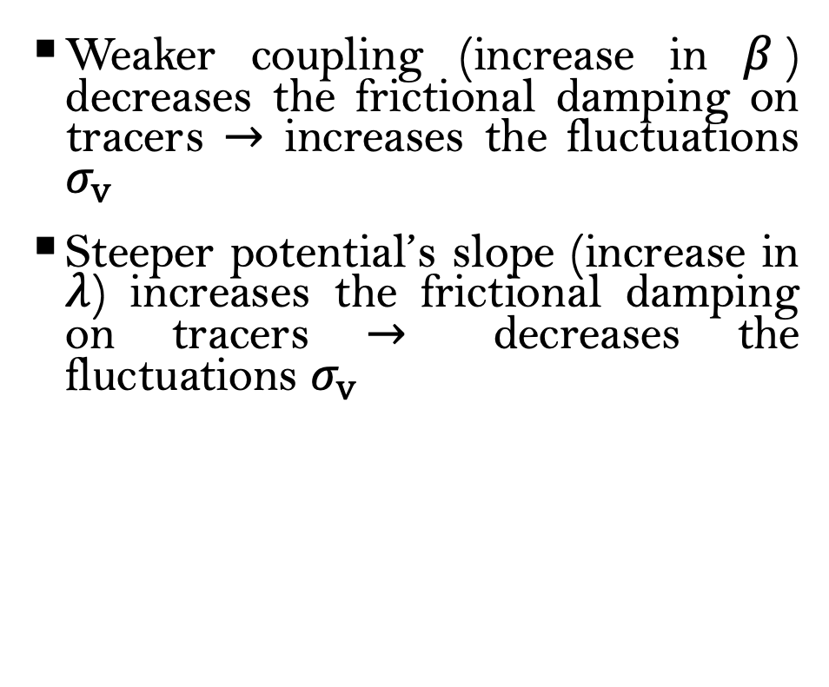

Appendix: Void radial velocity dispersion (CDM voids)
Weaker coupling (increase in $β$) decreases the frictional damping on tracers $→$ increases the fluctuations $σ_{v}$
Steeper potential’s slope (increase in $λ$) increases the frictional damping on tracers $→$ decreases the fluctuations $σ_{v}$
$$↑β$$
$$↑λ$$
$$↑β$$
$$↑λ$$

Slide 24
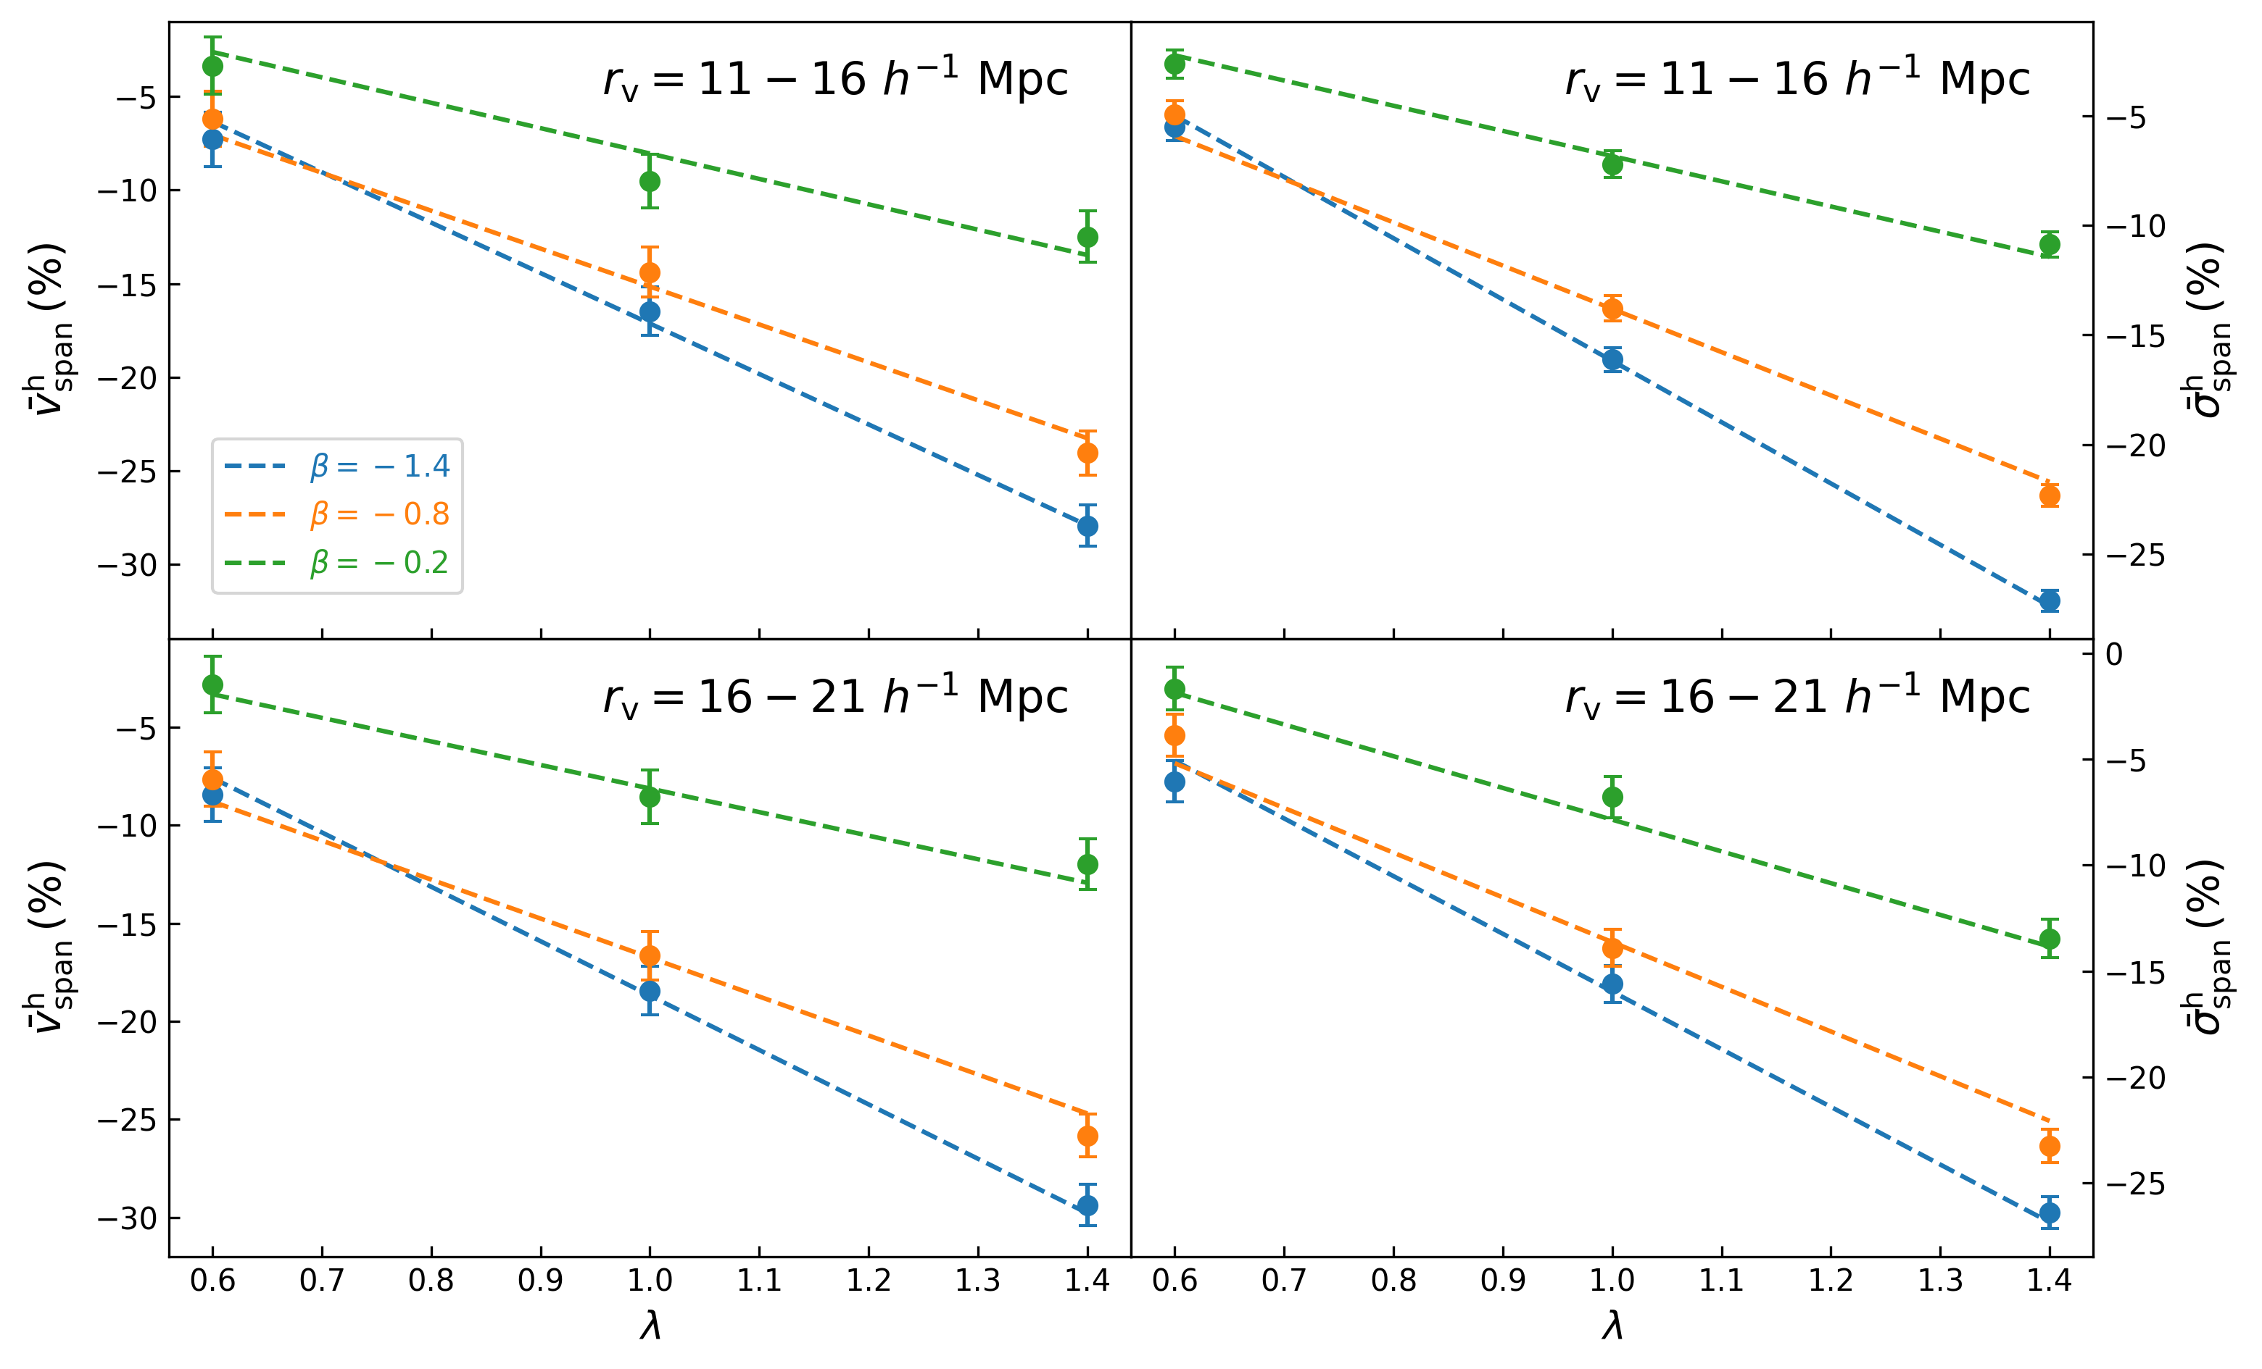

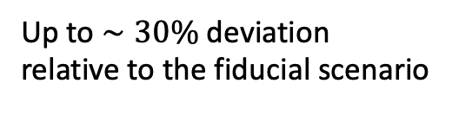
Appendix: 4-variable regression (Halo voids)
$$↑β$$
Up to $∼30\%$deviation
relative to the fiducial scenario
$$↑λ$$

Slide 25
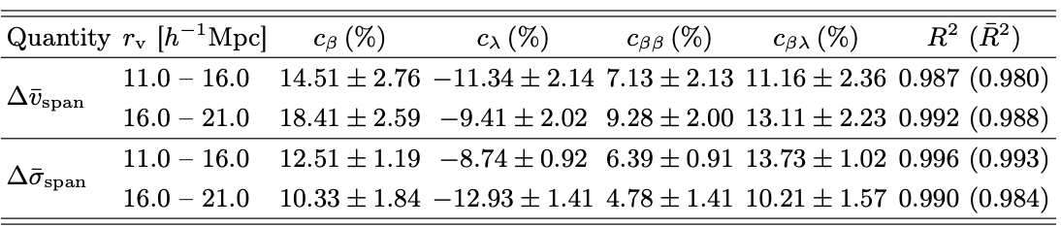
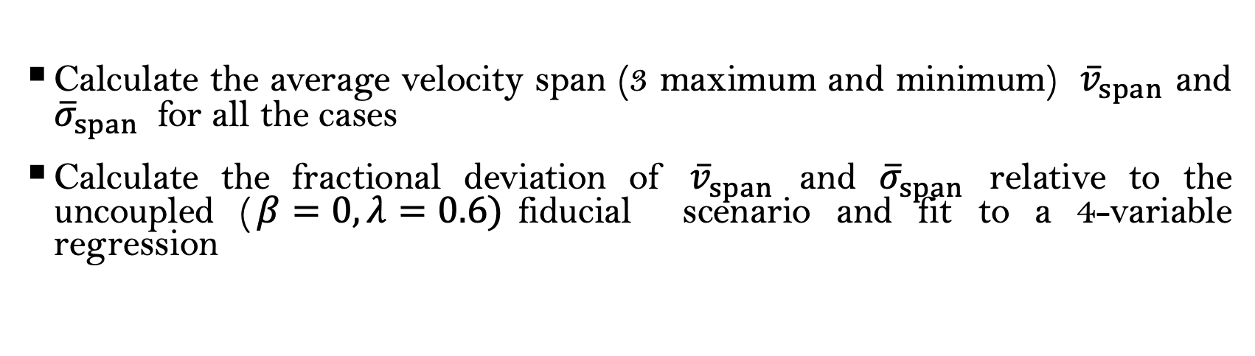
Appendix: 4-variable regression (CDM voids)
Calculate the average velocity span (3 maximum and minimum) ${\overline{v}}_{span}$ and ${\overline{σ}}_{span}$ for all the cases
Calculate the fractional deviation of ${\overline{v}}_{span}$ and ${\overline{σ}}_{span}$ relative to the uncoupled ($β=0, λ=0.6)$fiducial scenario and fit to a 4-variable regression
$$Δ\left[{\overline{v}}_{span} | { \overline{ σ}}_{span}\right]=c_{β}Δβ+c_{λ}Δλ+c_{ββ}Δβ^{2}+c_{βλ}ΔβΔλ. \left(6\right), with Δβ=β+1.4, Δλ=λ−0.6$$

Slide 26
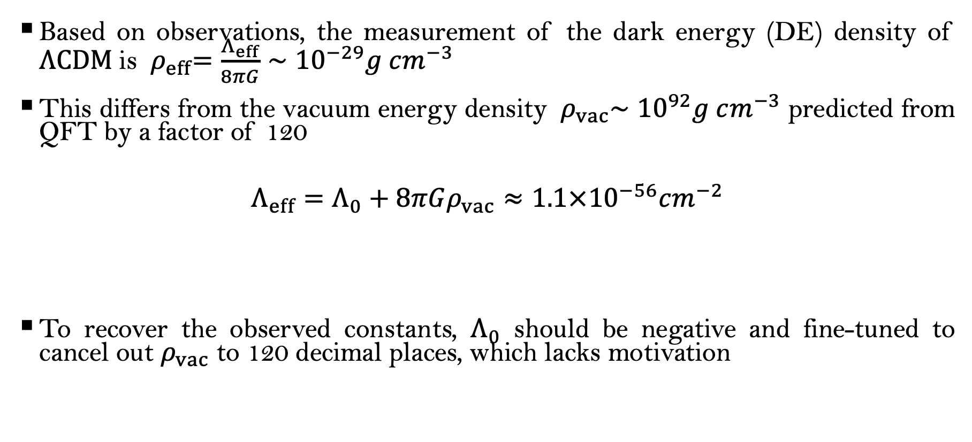

Appendix: Cosmological constant problem
Based on observations, the measurement of the dark energy (DE) density of $ΛCDM$is ${ ρ}_{eff}=\frac{Λ_{eff}}{8πG}∼{10}^{−29}g cm^{−3}$
This differs from the vacuum energy density ${ ρ}_{vac}∼{10}^{92}g cm^{−3}$ predicted from QFT by a factor of 120
$$Λ_{eff}=Λ_{0}+8πGρ_{vac}≈1.1×{10}^{−56}cm^{−2}$$
To recover the observed constants, $Λ_{0}$ should be negative and fine-tuned to cancel out $ρ_{vac}$ to 120 decimal places, which lacks motivation
Bare Geometric constant
$$≈{1.87×10}^{65}cm^{−2}$$

Slide 27


Appendix: DESI findings
Recently, Dark Energy Spectroscopic Instrument (DESI) suggests a dynamical equation of state (EoS) $w_{DE}=w_{0}+w_{a}(1−a)$ for DE (for $ΛCDM$, $w_{DE}=−1)$
In particular, it suggests that DE is weaker than that of the $ΛCDM$ and weakens over time
Credit: DESI DR2 results

