Slide 1
Search for molecular clouds in the dark ultra-high-energy gamma-ray source 1LHAASO J0007+5659u with the Nobeyama 45-m radio telescope
Ryohei Kanazashi, Shinta Kasuya, Shunya Takekawa (Kanagawa University)
Naomi Tsuji (Institute for Cosmic Ray Research, The University of Tokyo)
TeV Particle Astrophysics 2026 (TeVPA 2026), August 31-September 4, 2026
Takinoyu Hotel, Tendo, Yamagata, Japan
Notes:
Good afternoon, everyone.
My name is Ryohei Kanazashi. I am a second-year master’s student at Kanagawa University.
I am very happy to have this opportunity to give a presentation at TeVPA 2026.
Today, I will talk about our search for molecular clouds around the dark gamma-ray source, 1LHAASO J0007+5659u, using the Nobeyama 45-meter radio telescope.
This work was carried out in collaboration with Shinta Kasuya, Shunya Takekawa, and Naomi Tsuji.
So, let’s get started.

Slide 2
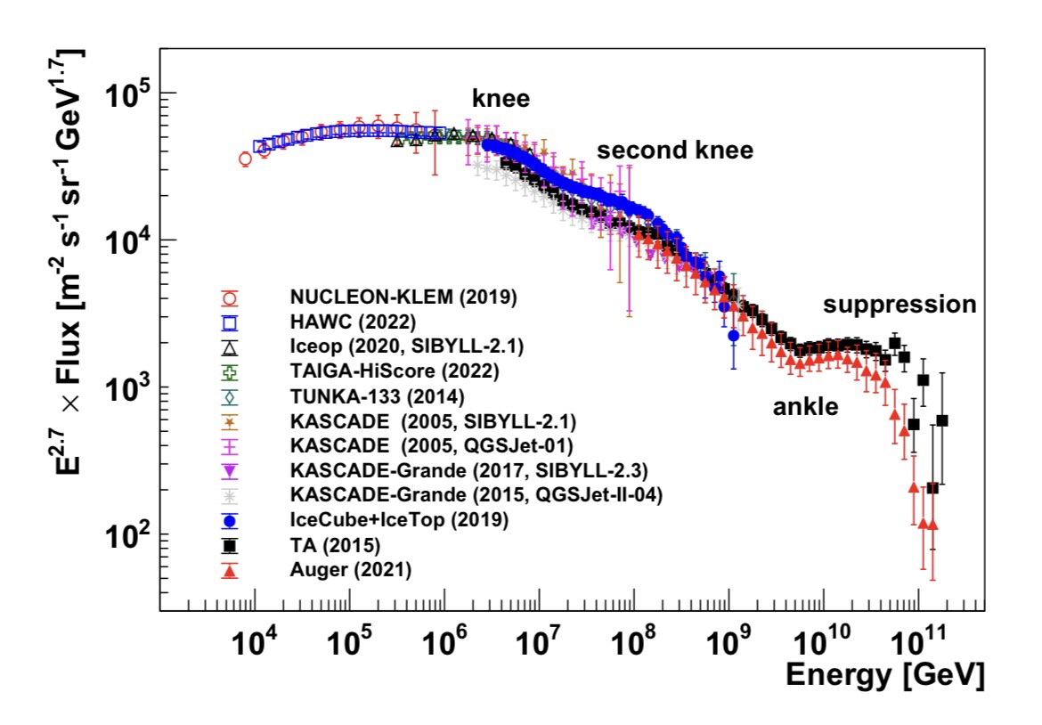
Cosmic Ray
・Cosmic-ray spectrum shows a knee at ~ 3 PeV.
・Sources that accelerate particles to PeV energies are referred to as PeVatrons.
unknown
< knee
knee – ankle
> ankle
Galactic SNRs?
Unknown
Extragalactic?
SNRs?
Ultra-high-energy (E > 100 TeV) gamma-ray
sources are PeVatron candidates.
Galactic cosmic-ray energy spectrum (Fahim et al. 2025).
Notes:
First, I will briefly explain Galactic cosmic rays.
Cosmic rays are high-energy particles coming from space.
They are mainly composed of protons.
The figure on the left shows the energy spectrum of cosmic rays.
We can see a break in the spectrum at around 3 PeV, called the knee.
Sources that can accelerate cosmic rays up to PeV energies are called PeVatrons.
Cosmic rays below the knee are thought to be accelerated by sources in our Galaxy.
Supernova remnants have traditionally been considered the main candidates.
However, other objects, such as microquasars, pulsar wind nebulae, and stellar clusters, are also considered possible candidates.
Ultra-high-energy gamma rays provide an important clue to finding PeVatrons.

Slide 3
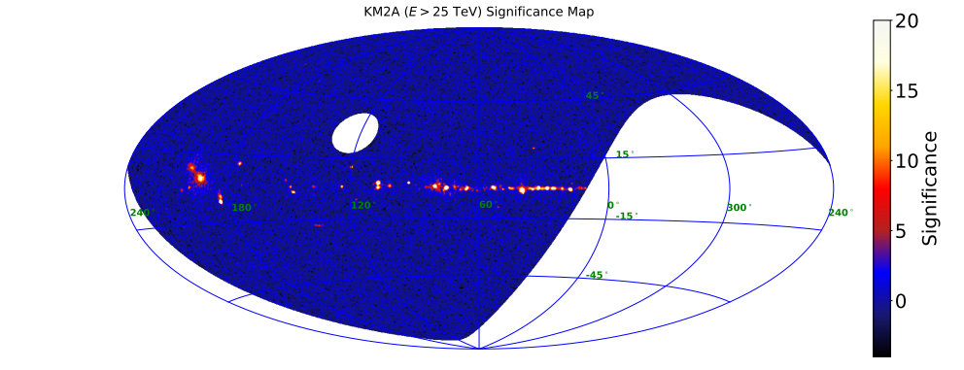
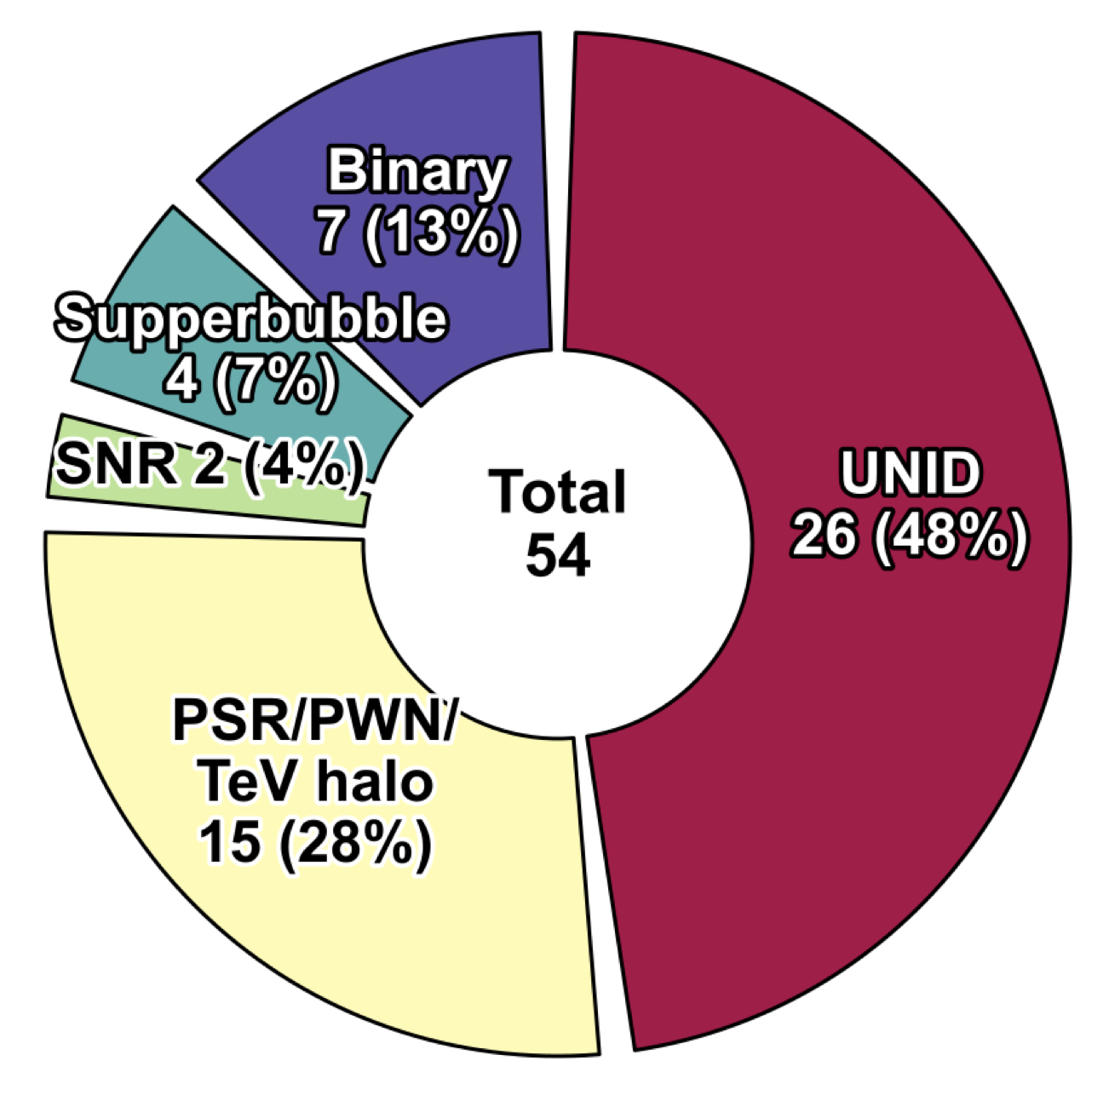
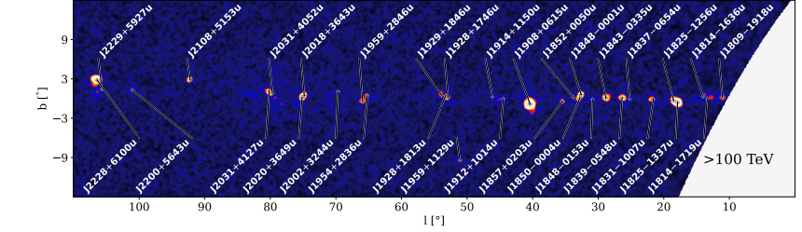
Gamma rays to find PeVatrons
LHAASO (Large High Altitude Air Shower Observatory)
・Observes gamma rays from TeV to PeV energies.
(Cao+ 2023)
・90 gamma-ray sources have been detected.
・About 50 sources are detected above 100 TeV.
Breakdown of 50 UHE LHAASO sources
Courtesy of N. Tsuji
Notes:
Next, I will introduce LHAASO, an important gamma-ray observatory for finding PeVatrons.
LHAASO is a ground-based gamma-ray observatory in China.
It has been operating since 2019.
LHAASO mainly observes high-energy gamma rays from TeV to PeV energies.
So far, LHAASO has detected 90 gamma-ray sources.
Among them, about 50 sources are detected above 100 TeV.
The pie chart on the lower left shows the breakdown of these approximately 50 ultra-high-energy gamma-ray sources.
About half of these sources are still unidentified.
Therefore, it is important to understand the origin of these unidentified gamma-ray sources.

Slide 4







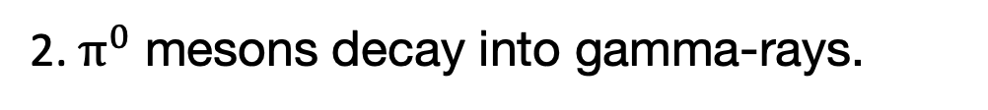

Hadronic scenario (proton origin)
Molecular cloud observations are key!
Proton
$$p$$
1. High-energy protons interact with the MCs.
$$p$$
Molecular clouds (MCs)
$$p$$
$$p$$
SNR
$$p$$
$$p$$
$$p$$
$$p$$
gamma rays
$$p$$
$$p$$
2. $π^{0}$ mesons decay into gamma-rays.
$p + p$
→
$p + p$ + $π^{0}+π^{+}+π^{−}$
SNR shocks
$$p$$
$π^{0}$ → $γ+γ$
Notes:
In this study, we focus on the hadronic scenario for gamma-ray emission.
For example, in the case of a supernova remnant, protons are accelerated to high energies by shocks.
The accelerated protons interact with protons in molecular clouds through proton-proton interactions.
This interaction produces neutral pions.
Then, the neutral pions decay into gamma rays.
Therefore, molecular cloud observations are very important for testing the hadronic scenario.

Slide 5
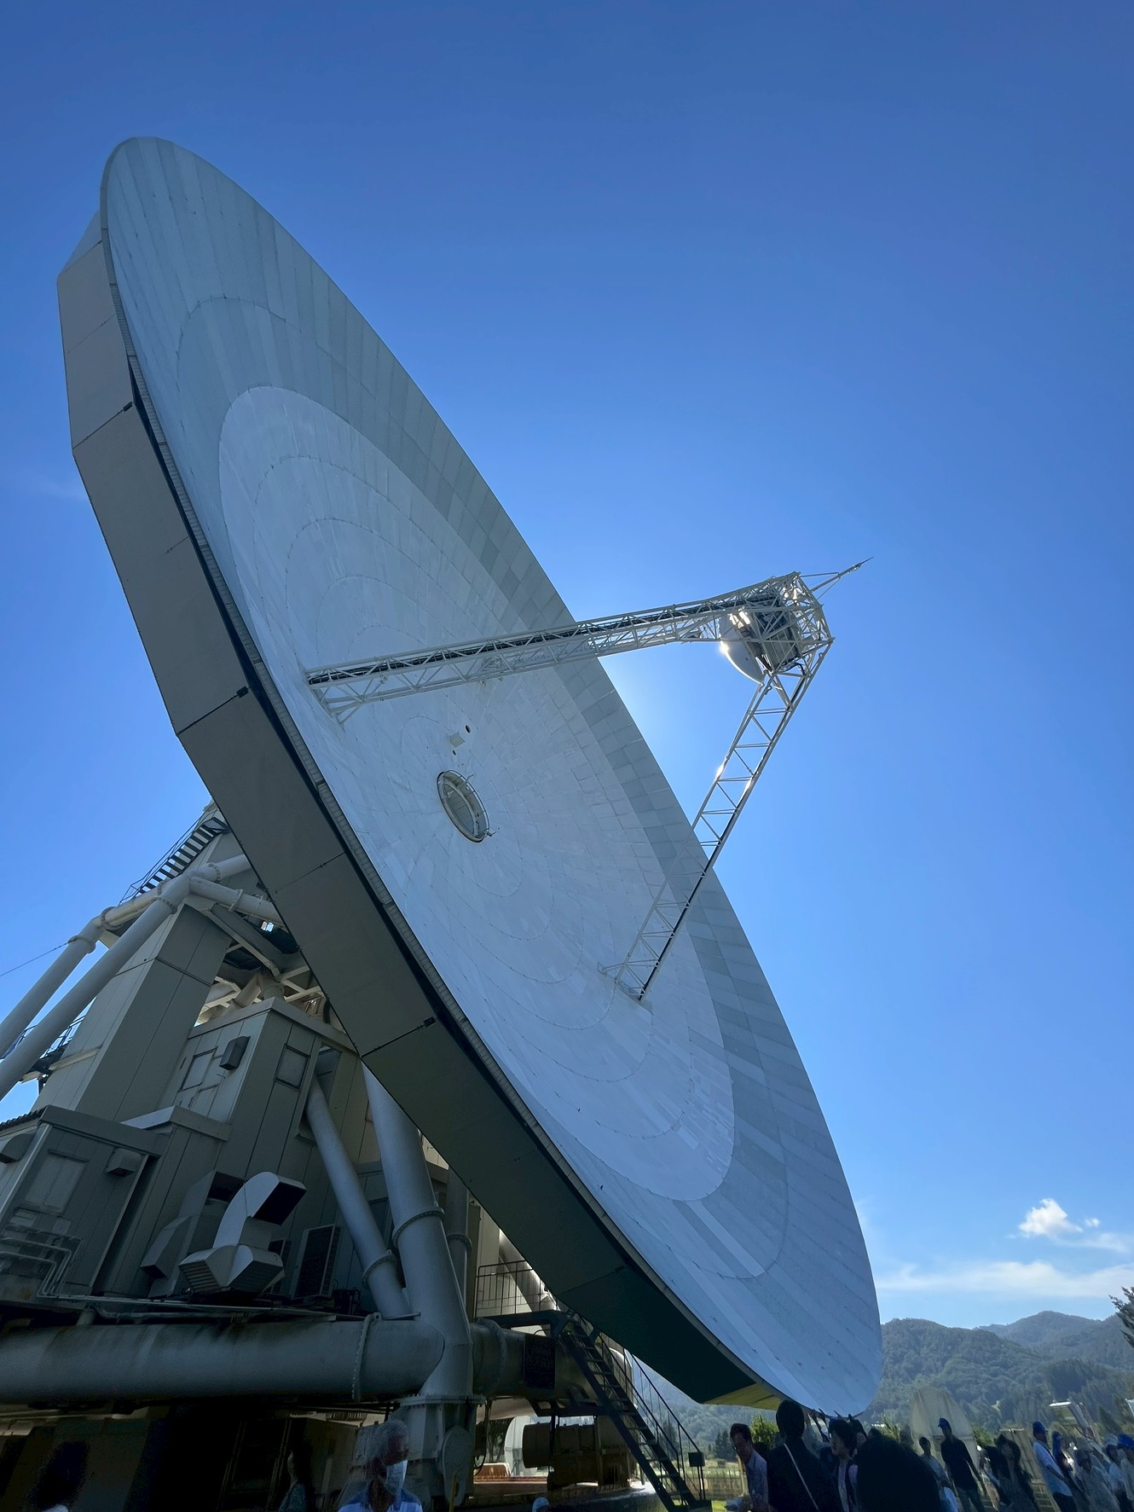
Molecular clouds ＆ CO observations
Molecular clouds
・H₂ is difficult to observe directly.
・CO emission is commonly used as a tracer of H₂.
Nobeyama 45-m radio telescope
・Observed lines: ¹²CO, ¹³CO and C¹⁸O (J=1-0)
・Angular resolution: ~ 20”
Research purpose
Nobeyama 45-m radio telescope
Search for molecular clouds associated with gamma rays.
Notes:
Next, I will briefly explain how we observe molecular clouds.
Molecular hydrogen, H2, is difficult to observe directly.
Therefore, CO emission is commonly used as a tracer of molecular hydrogen.
In this study, we observed the 12CO, 13CO, and C18O J equals one to zero lines using the Nobeyama 45-meter radio telescope.
The angular resolution of the telescope is about 20 arcseconds.

Slide 6
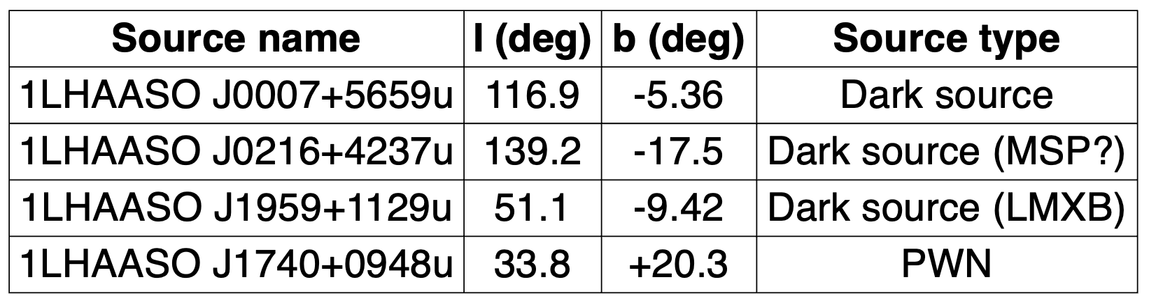
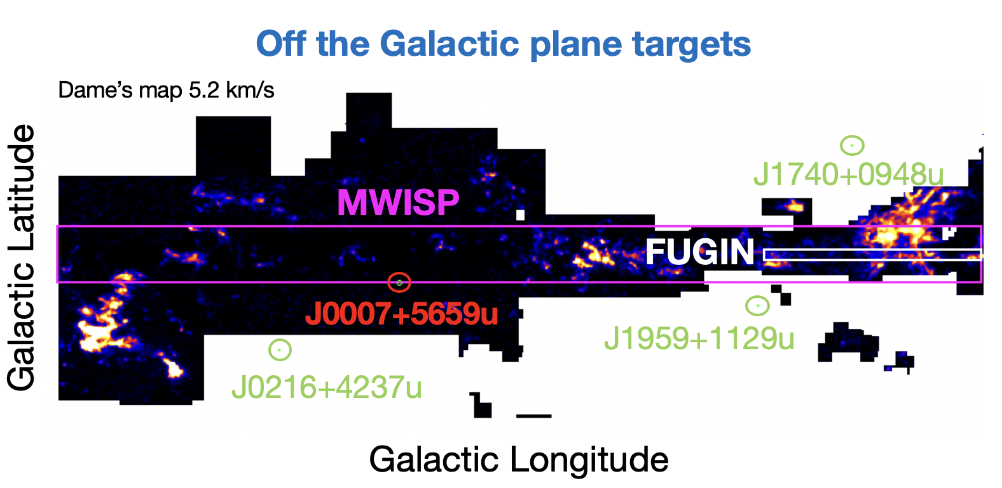
Our targets observed with the Nobeyama 45-m radio telescope
Dame et al. (2001).
Notes:
Next, I will introduce our observed targets.
The table shows the four LHAASO sources observed with the Nobeyama 45-meter radio telescope in 2025. The figure below shows the all-sky CO distribution from the Dame et al. It also shows the coverage of the FUGIN and MWISP CO surveys.
The all-sky CO survey has relatively low angular resolution, while high-resolution CO surveys do not sufficiently cover high-Galactic-latitude regions.
Therefore, we targeted unidentified LHAASO sources at high Galactic latitudes.
Today, I will mainly focus on 1LHAASO J0007+5659u, where we detected molecular clouds.

Slide 7

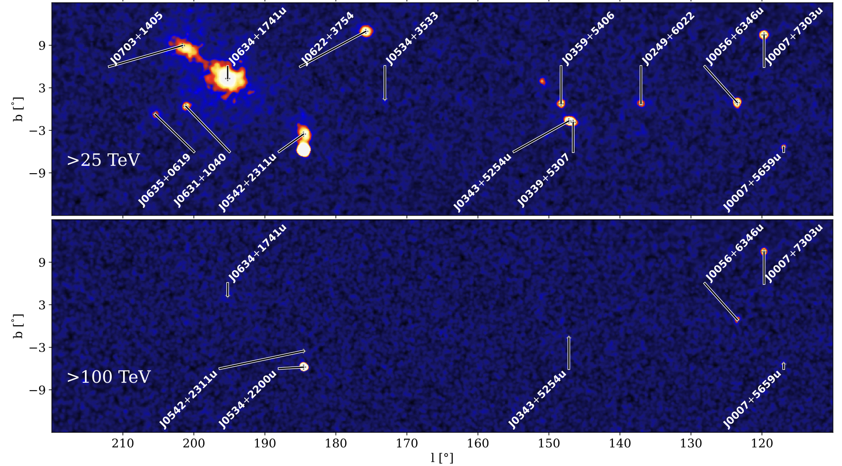
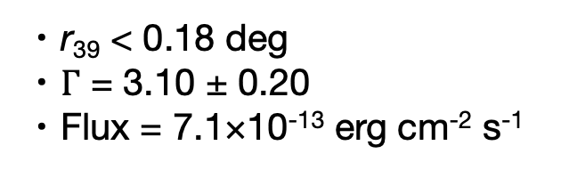
1LHAASO J0007+5659u
1LHAASO J0007+5659u
・Point-like gamma-ray source detected above 100 TeV.
・r₃₉ < 0.18 deg
・$Γ$ = 3.10 ± 0.20
・Flux = 7.1×10⁻¹³ erg cm⁻² s⁻¹
・No firmly identified counterpart
・Dark source
(Cao+ 2023)
Notes:
Next, I will introduce 1LHAASO J0007+5659u.
This source is a point-like gamma-ray source detected by LHAASO.
The significance maps on the lower left show gamma-ray emission above 25 TeV in the upper panel and above 100 TeV in the lower panel.
As you can see, ultra-high-energy gamma rays above 100 TeV have been detected.
On the other hand, no corresponding gamma-ray emission has been detected at lower energies.
Therefore, this source is classified as a dark gamma-ray source.
Also, no clear counterpart has been identified around this source, so the origin of the gamma-ray emission is still unknown.
The figure on the right also shows a nearby Fermi-LAT source, but its relation to J0007+5659u is unclear.

Slide 8
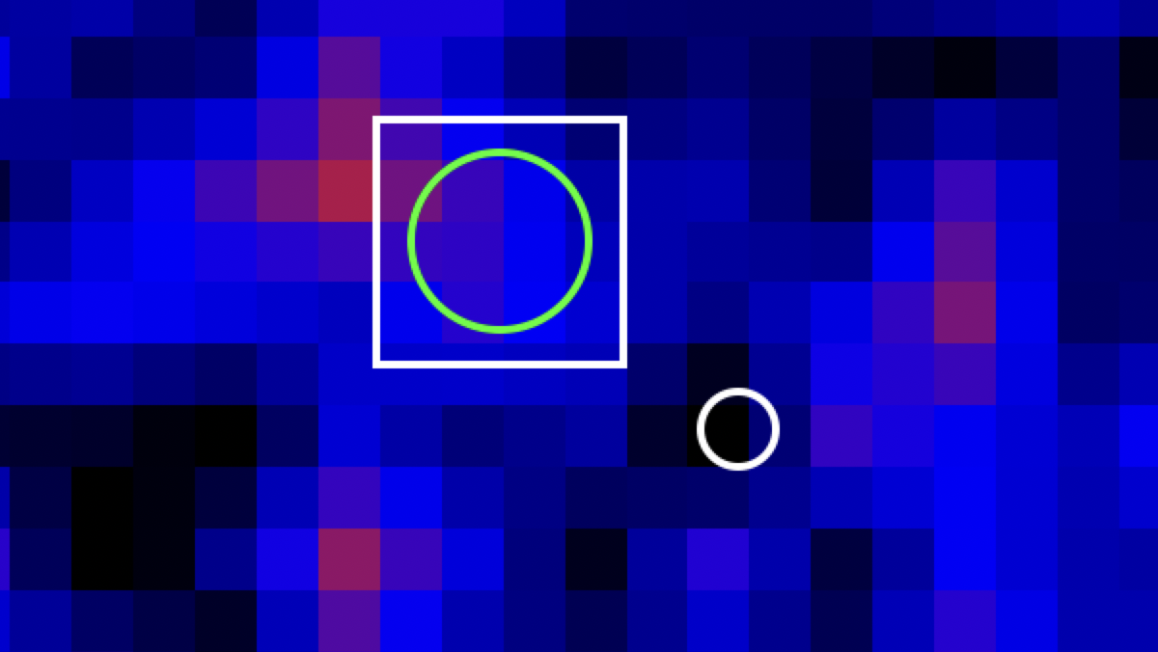
NRO (Nobeyama Radio Observatory) observation overview
● Observations of the ¹²CO, ¹³CO, and C¹⁸O lines (J=1-0), using the
NRO 45-m telescope
● Overview
・ Mapped area: 0.5 × 0.5 deg²
・ Velocity range: -150 to 150 km/s
・ Velocity resolution: 0.2 km/s
・ Observation dates (21 hours in total)
- (Day1) 2025-12-08
- (Day2) 2025-12-12
- (Day3) 2025-12-14
- (Day4) 2025-12-15
- (Day5) 2026-04-01
Observation region
(0.5 deg × 0.5 deg)
・ Configuration: four-beam receiver FOREST and
autocorrelation spectrometer SAM45
off1
Gamma rays by LHAASO
・ Pointing source: Y-cas (20-40 K)
・ Calibration source: J0007 cloud 1
・ Off position: off1
Galactic CO distribution from Dame et al. (2001).
(v=20 km/s)
Notes:
We observed a 0.5 by 0.5 degrees region including the LHAASO gamma-ray source with the Nobeyama 45-meter radio telescope.
I will skip the details of the observations in this presentation.

Slide 9
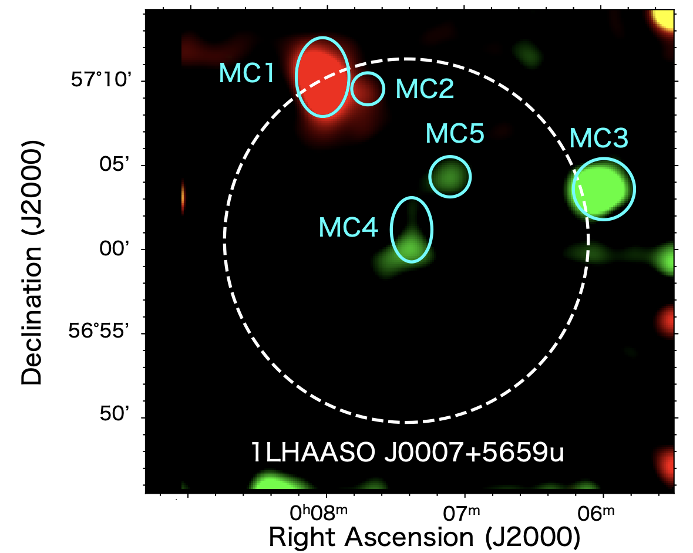
Detection of molecular clouds
Red: -37.1 to -34.9 km/s, Green: -4.1 to -2.1 km/s
Five molecular clouds (MC1-MC5) were detected around 1LHAASO J0007+5659u.
Notes:
First, I will show the observational results.
We detected five molecular clouds, MC1 to MC5, around 1LHAASO J0007+5659u.
In particular, MC4 is located near the center of the LHAASO gamma-ray source.
This figure shows the integrated intensity map of the CO emission.
The red emission is integrated from minus 37.1 to minus 34.9 kilometers per second, and the green emission is integrated from minus 4.1 to minus 2.1 kilometers per second.
Among these molecular clouds, MC1 shows the strongest CO emission.
So, next, I will explain our analysis method using MC1 as an example.

Slide 10
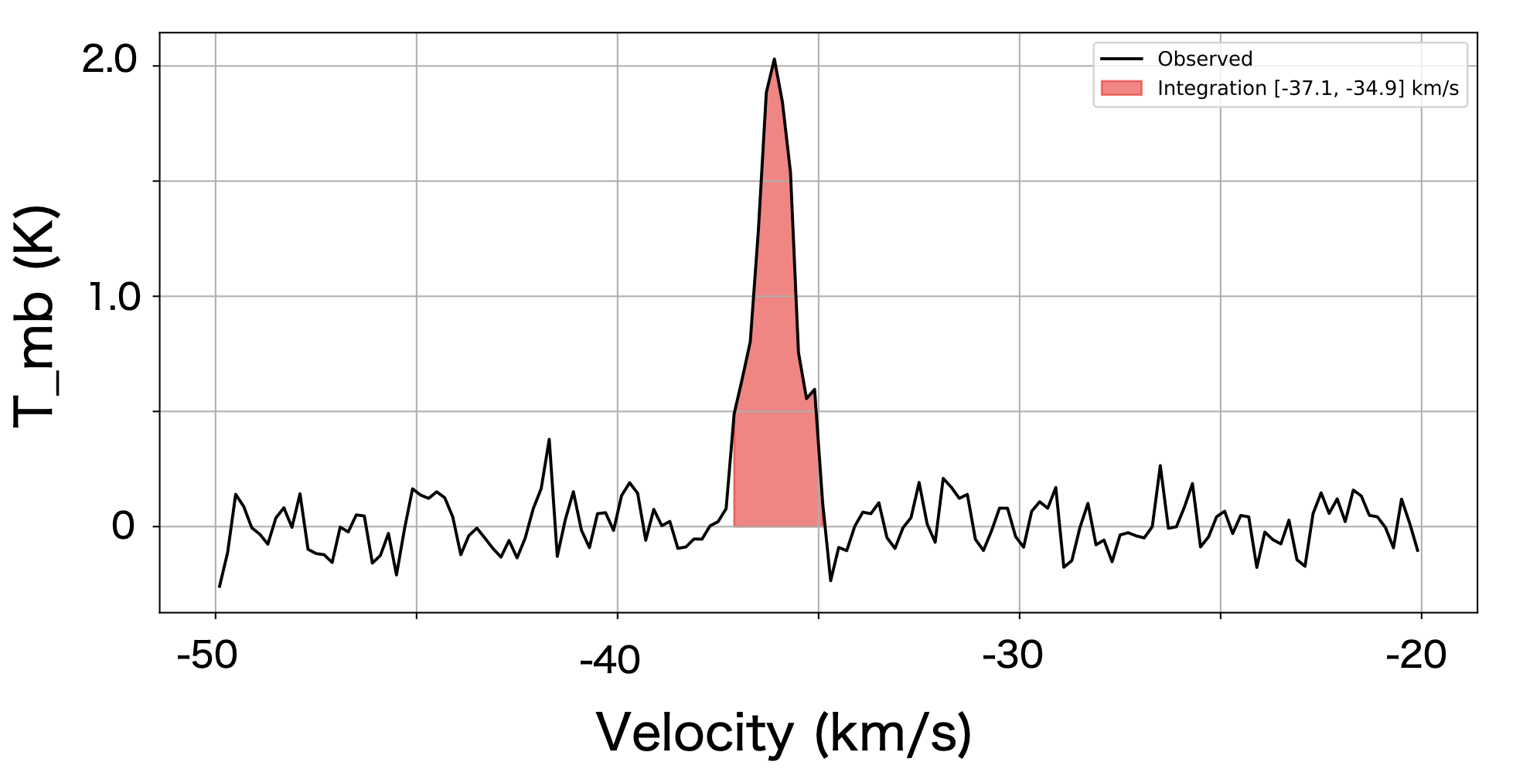

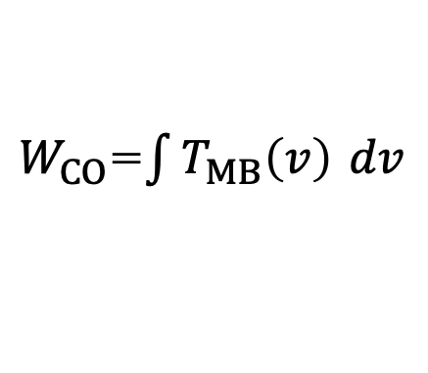

Physical parameters of MCs derived from CO observations
¹²CO integrated intensity map
(-37.1 to -34.9 km/s)
$W_{CO}$=$\int{T_{MB}\left(v\right)} dv$
$T_{MB}$ (K)
MC1
Velocity (km/s)
Gamma-ray emission region
Mean velocity spectrum of MC1
Main-beam temperature $T_{MB}$[K]: CO line intensity
Molecular hydrogen column density
$$N\left(H_{2}\right)=X_{CO}⋅W_{CO}$$
$X_{CO}$: CO-to-H₂ conversion factor 2.0×10²⁰ cm⁻² ( K・km/s )⁻¹
(Bolatto et al. 2013)
Notes:
Next, I will briefly explain our analysis method.
This is the 12CO integrated intensity map, and this is the mean CO spectrum of the molecular cloud.
We calculated W_{\rm CO} by integrating the spectrum over the velocity range of the cloud.
Then, we derived the molecular hydrogen column density using the CO-to-H₂ conversion factor, X_{\rm CO}.

Slide 11
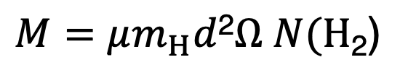
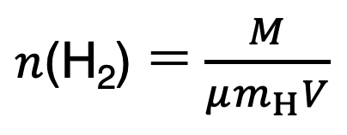
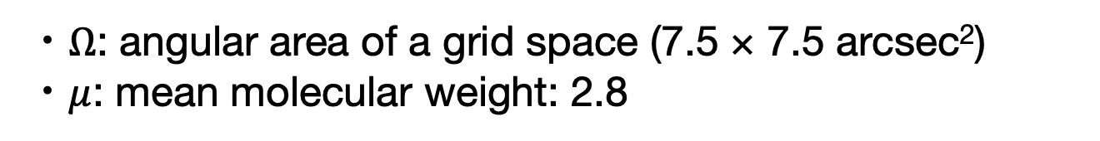
Physical parameters of MCs derived from CO observations
Distance
・Traditional kinematic distance using the Galactic rotation curves
(e.g., Brand & Blitz 1993; Reid et al 2014; Wenger et al. 2018)
¹²CO integrated intensity map
(-37.1 to -34.9 km/s)
Mass
$M=μm_{H}d$²$Ω$ $N(H\text{2}\text{) }$
・$Ω$: angular area of a grid space (7.5 × 7.5 arcsec²)
・$μ$: mean molecular weight: 2.8
MC1
Number Density
$n\text{(}\text{H}\text{2}\text{) }$= $\frac{M}{μm_{H}V}$
Gamma-ray emission region
・$V$: Volume of the MC
・The cloud geometry approximated by a sphere or an ellipsoid
Notes:
Next, we estimated the distance to each molecular cloud using the Galactic rotation curve.
Using the equations shown here, we then derived the cloud mass and the molecular hydrogen number density.

Slide 12
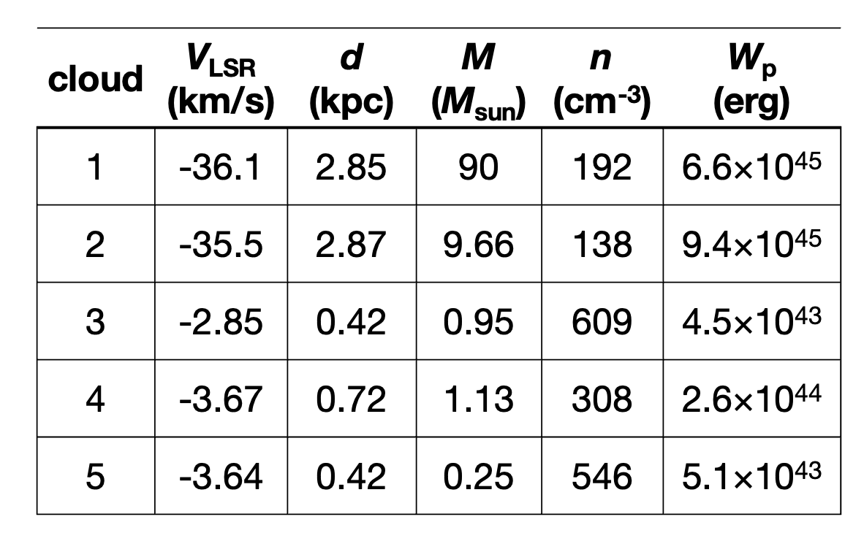
Parameters of clouds
Red: -37.1 to -34.9 km/s
Green: -4.1 to -2.1 km/s
Notes:
Next, I will summarize our results.
The table on the left summarizes the physical parameters of the five molecular clouds, including their velocities, distances, masses, and number densities.
Here, W_p is the total proton energy required to explain the gamma-ray energy flux observed by LHAASO through hadronic interactions.
The lower panels show the mean CO spectra of the five molecular clouds.

Slide 13
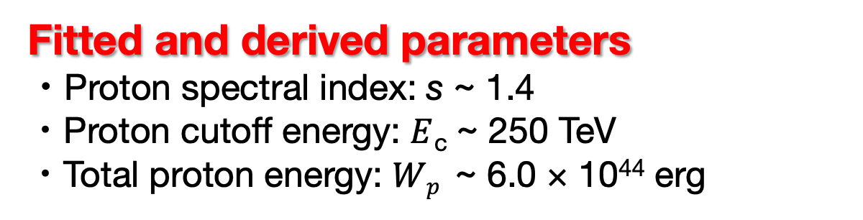
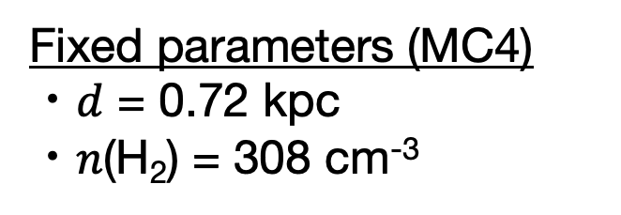
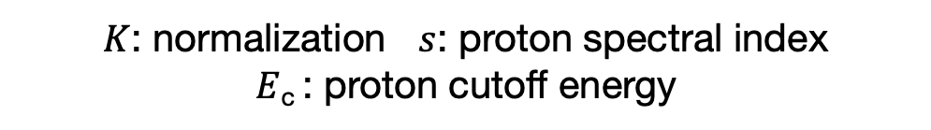
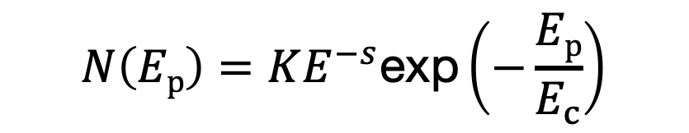
Hadronic modeling using the physical properties of MC4
Assumed proton distribution
Fixed parameters (MC4)
・$d$ = 0.72 kpc
・$n$(H₂) = 308 cm⁻³
$$N\left(Ep\right)=KE^{−s}\text{exp}\left(−\frac{Ep}{E_{c}}\right)$$
$K$: normalization $s$: proton spectral index
$E$_{c} : proton cutoff energy
The Fermi-LAT 95% C.L. upper limits and LHAASO-WCDA upper limits from Xie et al. (2025) were used as constraints.
Fitted and derived parameters
・Proton spectral index: s ~ 1.4
・Proton cutoff energy: $E$_{c} ~ 250 TeV
・Total proton energy: $Wp$ ~ 6.0 × 10⁴⁴ erg
Notes:
Next, we performed hadronic spectral fitting using the physical properties of MC4.
We fixed the distance of MC4 at 0.72 kiloparsecs and the molecular hydrogen number density at 308 per cubic centimeter.
We assumed a power-law proton energy distribution with an exponential cutoff.
Here, K is the normalization, s is the proton spectral index, and E_c is the cutoff energy.
From this proton distribution, we calculated the gamma-ray spectrum produced by proton-proton interactions and neutral pion decay, and fitted it to the LHAASO gamma-ray spectrum.
In the figure on the right, the blue line shows the LHAASO-KM2A gamma-ray spectrum, and the orange line shows the gamma-ray spectrum from the hadronic model.
We also used the Fermi-LAT and LHAASO-WCDA upper limits as constraints.
As a result, the proton spectral index is about 1.4, the cutoff energy is about 250 TeV, and the total proton energy is about 10^{45} ergs.

Slide 14
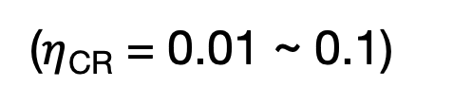
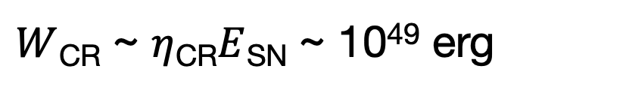
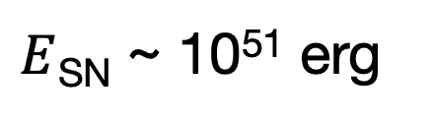
Discussion
Required proton energy: $Wp$ (> 1 TeV) : 10⁴³ – 10⁴⁵ erg
Typical SNR cosmic-ray budget
$E$_{SN} ~ 10⁵¹ erg
$W$_{CR} ~ $η$_{CR}$E$_{SN} ~ 10⁴⁹ erg
($η$_{CR} = 0.01 ~ 0.1)
The origin of the high-energy protons remains unclear
Possible particle accelerators
・Escaped cosmic rays from an undiscovered SNR
・Proton acceleration by an isolated black hole
Kimura et al. (2025)
Notes:
Next, I will discuss the gamma-ray emission from J0007.
From our CO observations, the total proton energy required to explain the LHAASO gamma-ray emission is about 10^{43} to 10^{45} ergs.
On the other hand, the typical energy of a supernova explosion is about 10^{51} ergs.
If about one to ten percent of this energy is converted into cosmic rays, the cosmic-ray energy is about 10^{49} ergs.
Therefore, the required proton energy can be explained in terms of the energy budget.
However, no clear particle accelerator has been identified around J0007.
Therefore, the origin of these high-energy protons is still unclear.
Possible accelerators include escaped cosmic rays from an undiscovered supernova remnant and an isolated black hole.

Slide 15
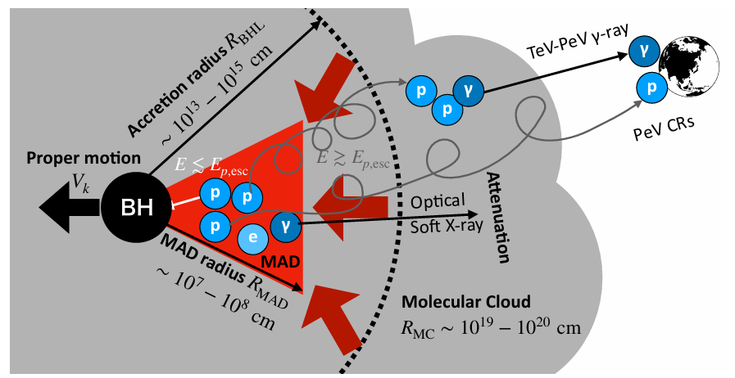
Isolated Black Hole Scenario for 1LHAASO J0007+5659u
An isolated black hole accretes gas in
a molecular cloud and forms
a magnetically arrested disk (MAD).
Kimura’s talk in this session
Protons are accelerated around
the black hole.
Isolated Black Hole PeVatron Scenario
Escaping PeV protons interact with molecular gas (pp → π⁰ → γγ).
From Kimura et al. (2025)
This scenario will be tested with XMM-Newton and NuSTAR observations in 2026-2027 (approved in NuSTAR AO-12).
X-rays are emitted near the black hole.
Notes:
Next, I will introduce the isolated black hole scenario as one possible explanation for dark gamma-ray sources like J0007.
Dr. Kimura will talk about this scenario in more detail later in this session.
In this scenario, an isolated black hole accretes gas from a molecular cloud and forms a magnetically arrested disk, or MAD.
Protons are accelerated to high energies around the black hole.
These high-energy protons escape from the black hole and interact with molecular gas, producing gamma rays.
X-rays are also expected to be emitted near the black hole.
To test this scenario, X-ray observations with XMM-Newton and NuSTAR are planned for 2026 and 2027.

Slide 16
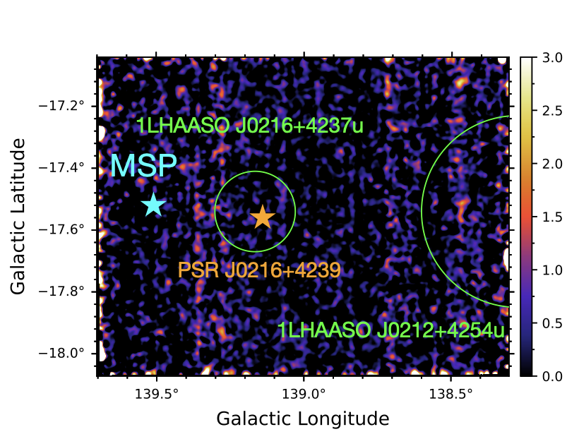
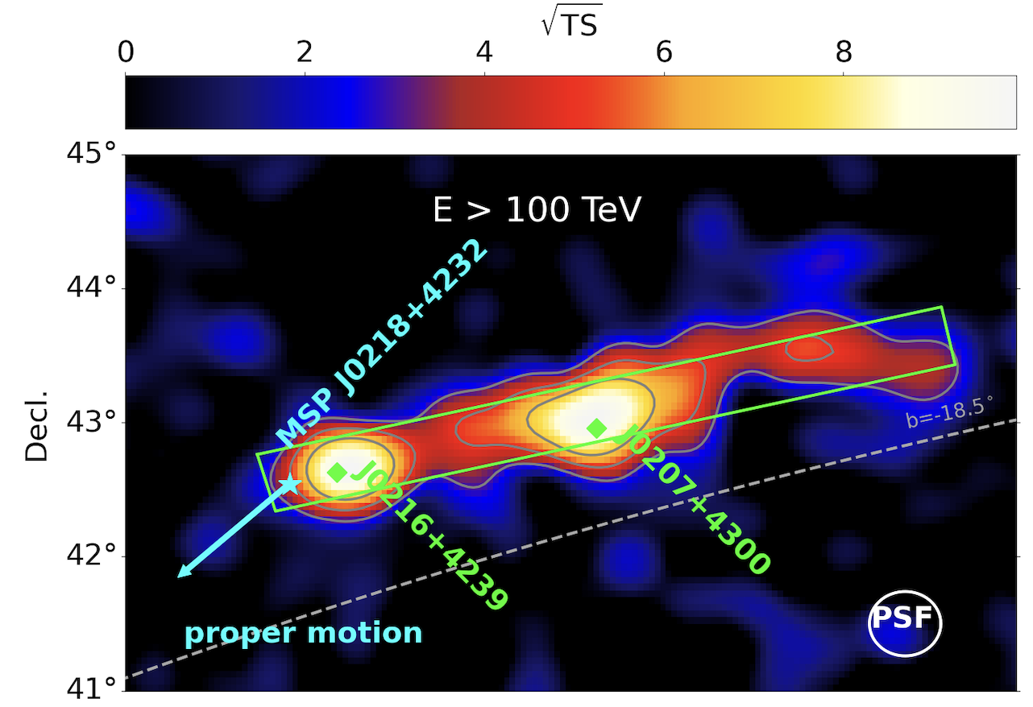
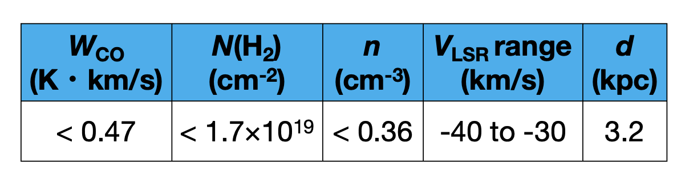

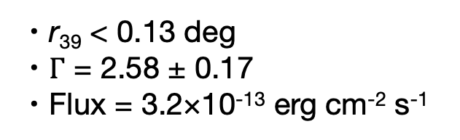
1LHAASO J0216+4237u
LHAASO Collab.
¹²CO Map$(v$ = -40 to -30 km/s)
● 1LHAASO J0216+4237u
・r₃₉ < 0.13 deg
・$Γ$ = 2.58 ± 0.17
・Flux = 3.2×10⁻¹³ erg cm⁻² s⁻¹
● Nobeyama observations
・1.4 × 0.9 deg²
・21 hours in total
● No clear CO emission
Peanut region
● Possible associated
source: MSP PSR J0218+4232
Velocity spectrum from the green circle (r=0.13°)
・E_dot = 2.4×10³⁵ erg/s
・d = 3.2 kpc
Notes:
taNext, I will briefly present the gamma-ray sources where no significant CO emission was detected.
First, I will show 1LHAASO J0216+4237u.
In this region, three gamma-ray sources form an extended structure called the Peanuts region because of its shape.
The whole region extends over about one by four degrees.
In this study, we did not observe the entire region.
We observed the region around the millisecond pulsar PSR J0218+4232, which is a possible counterpart.
The upper-right figure shows the CO integrated intensity map for the velocity range corresponding to the pulsar distance of about 3.2 kiloparsecs.
The lower-right figure shows the mean CO spectrum within the LHAASO region.
No significant CO emission was detected in the corresponding velocity range.
Therefore, we derived three-sigma upper limits on the physical parameters from the RMS noise.
We used the same method for the following sources.

Slide 17
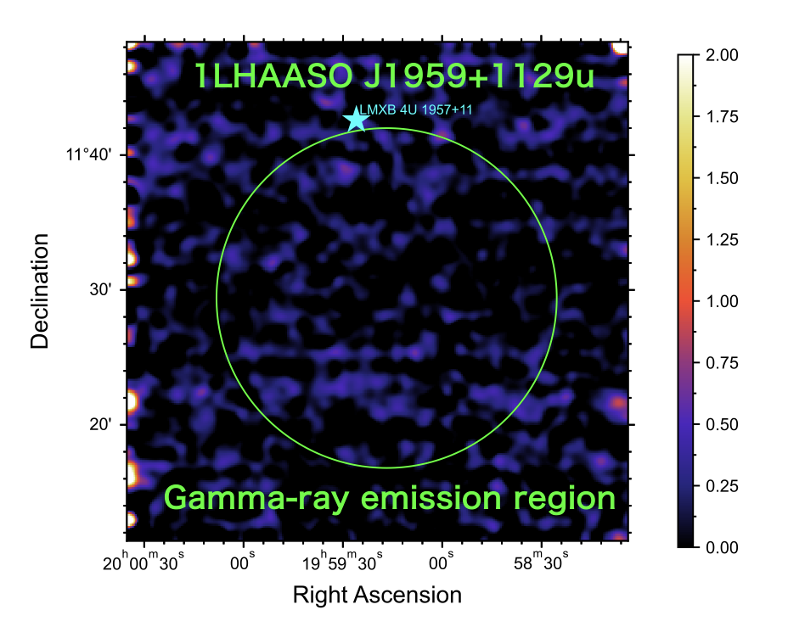
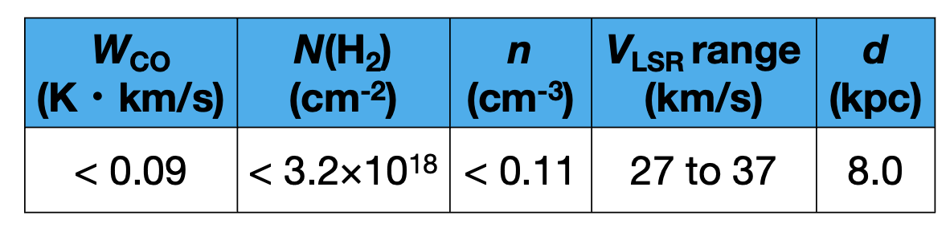

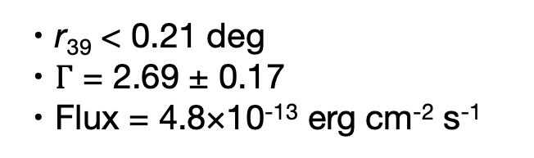
1LHAASO J1959+1129u
¹²CO Map$(v$ = 27 to 37 km/s)
● 1LHAASO J1959+1129u
・r₃₉ < 0.21 deg
・$Γ$ = 2.69 ± 0.17
・Flux = 4.8×10⁻¹³ erg cm⁻² s⁻¹
● Nobeyama observation
・0.6 × 0.6 deg²
・7 hours in total
● No clear CO emission
● Possible associated
source: LMXB 4U 1957+11
Velocity spectrum from the green circle (r=0.21°)
・Low-mass X-ray binary
・d = 6 - 10 kpc
Notes:
Next is 1LHAASO J1959+1129u.
A low-mass X-ray binary, 4U 1957+11, which contains a black hole candidate, is located near the LHAASO source.
However, it is outside the LHAASO gamma-ray region, so their relation is unclear.
No significant CO emission was detected in the corresponding velocity range.

Slide 18
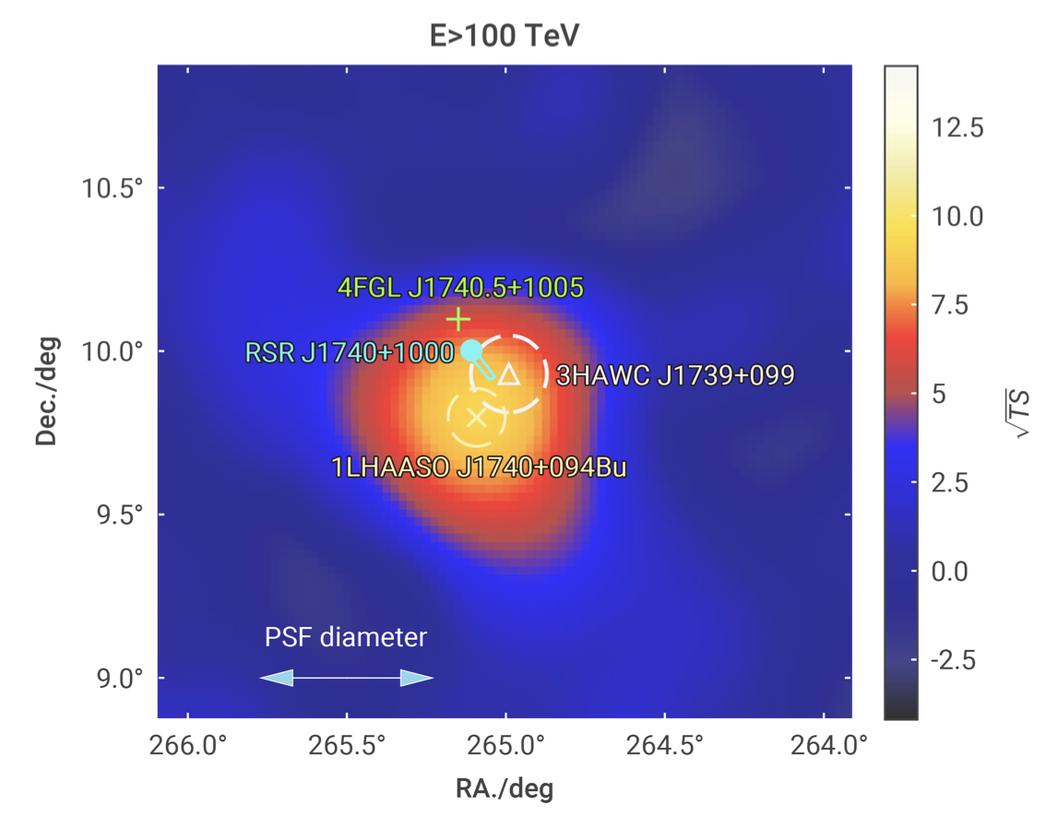
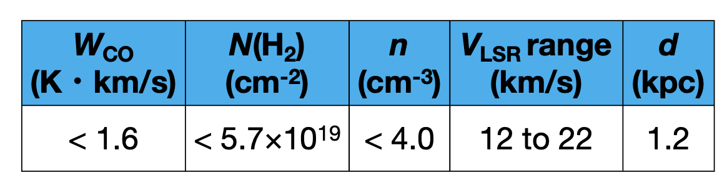

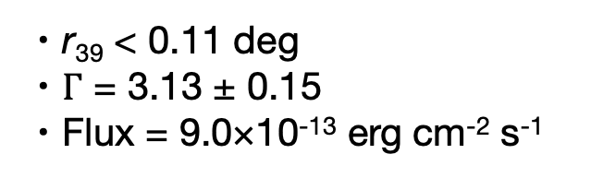
1LHAASO J1740+0948u
LHAASO Collab.
¹²CO Map$(v$ = 12 to 22 km/s)
● 1LHAASO J1740+0948u
・r₃₉ < 0.11 deg
・$Γ$ = 3.13 ± 0.15
・Flux = 9.0×10⁻¹³ erg cm⁻² s⁻¹
PSR J1740+1000
● Nobeyama observation
・1 × 0.8 deg²
・14 hours in total
1LHAASO J1740+0948u
● No clear CO emission
● Possible associated
source: PSR J1740+1000
Velocity spectrum from the green circle (r=0.11°)
・E_dot = 2.3×10³⁵ erg/s
・d = 1.2 kpc
Notes:
Next is 1LHAASO J1740+0948u.
This source has a possible PWN counterpart, but it is located at high Galactic latitude, where high-resolution CO data are not available. Therefore, we observed this source with the Nobeyama 45-meter radio telescope.
A possible counterpart is the pulsar PSR J1740+1000, located at a distance of about 1.2 kiloparsecs.
This pulsar has a bow-shock pulsar wind nebula and an extended X-ray tail behind it.
The LHAASO gamma-ray source is offset from the pulsar and is located in the direction of the X-ray tail.
Therefore, high-energy particles in the tail may produce the gamma-ray emission.
However, no significant CO emission was detected in the velocity range corresponding to the pulsar distance.

Slide 19
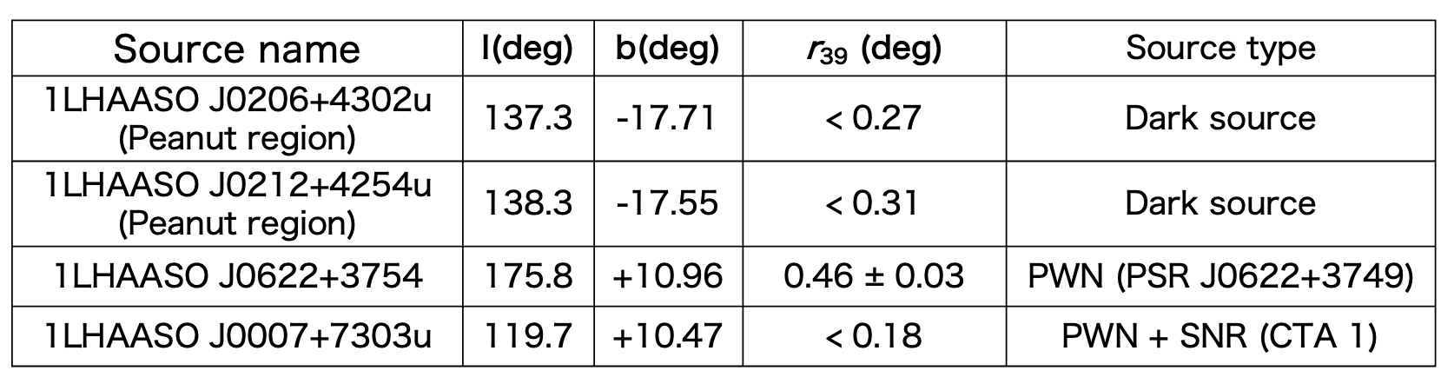
Future Work
We will continue CO observations of high-Galactic-latitude LHAASO sources that have not been sufficiently covered by previous CO surveys.
Target list for observations in 2026
Notes:
As future work, we will continue observations with the Nobeyama 45-meter radio telescope, focusing on LHAASO sources at high Galactic latitudes where CO observations are still limited.
The table below shows the targets planned for observations in 2026.
Thank you for your attention.

Slide 20
Summary
Research objective
To investigate the hadronic origin of LHAASO UHE gamma-ray sources through molecular cloud observations.
1.
1LHAASO J0007+5659u
・Molecular clouds were detected in two velocity ranges.
・A hadronic origin is possible if a suitable proton accelerator is present.
2.
Other observed LHAASO sources
・No clear CO emission was detected around 1LHAASO J0216+4237u,
1LHAASO J1740+0948u and 1LHAASO J1959+1129u.
・Hadronic scenarios involving dense molecular clouds are unlikely
for these sources.
Notes:
Finally, I will summarize our results.
For 1LHAASO J0007+5659u, we detected molecular clouds in two different velocity ranges and estimated their physical properties from the CO data.
The required proton energy can be supplied by Galactic particle accelerators.
Therefore, if a suitable proton accelerator exists, the gamma-ray emission could have a hadronic origin.
On the other hand, for 1LHAASO J0216+4237u, J1740+0948u, and J1959+1129u, no significant molecular clouds were detected.
Therefore, for these sources, a hadronic scenario involving dense molecular clouds as target material is less likely.

Slide 21
Thank you for your attention.

Slide 22

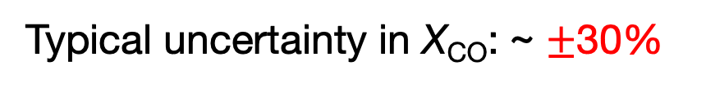
Uncertainty in the CO-to-H₂ conversion factor
$$N\left(H_{2}\right)=X_{CO}⋅W_{CO}$$
Typical uncertainty in X_{CO}: ~ $±$30%
(for the Milky Way disk; Bolatto et al. 2013)
Why does X_{CO} vary?
X_{CO} depends on the physical and chemical conditions of molecular gas.
● Metallicity: CO abundance
● UV radiation / shielding: CO-dark H₂
● Gas temperature and density: CO excitation
Therefore, the same amount of H₂ does not always produce the same CO intensity.
Notes:
Next, I will explain the uncertainty in the CO-to-H₂ conversion factor, X_{\rm CO}.
We derive the molecular hydrogen column density by multiplying the CO integrated intensity by X_{\rm CO}.
In the Milky Way disk, X_{\rm CO} typically has an uncertainty of about 30 percent.
This is because X_{\rm CO} depends on the physical and chemical conditions of the molecular gas.
For example, metallicity affects the CO abundance.
UV radiation and shielding can produce CO-dark H₂ gas.
Also, gas temperature and density affect the excitation of CO.
Therefore, the same amount of H₂ does not always produce the same CO intensity, resulting in uncertainty in X_{\rm CO}.

Slide 23
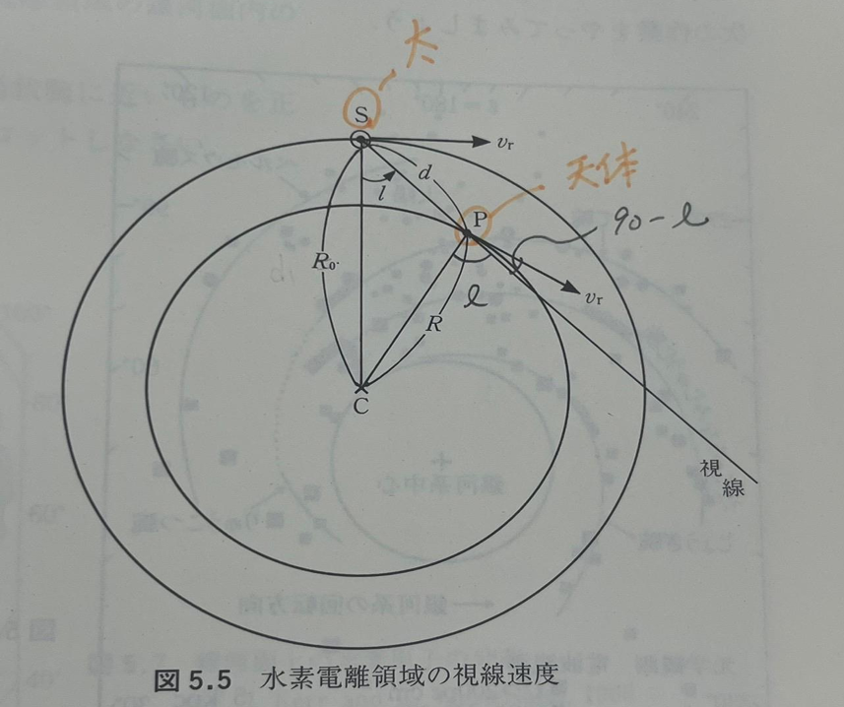



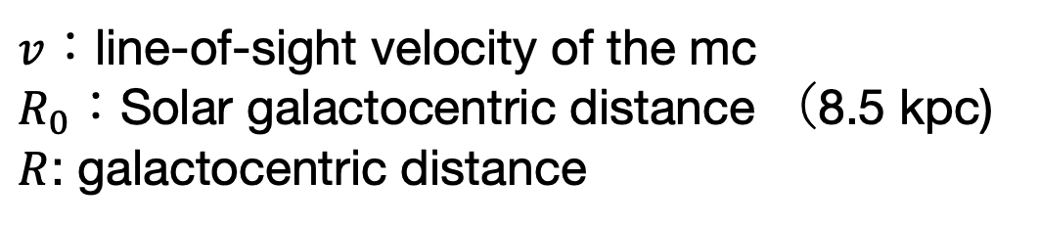
Kinematic distance and near-far ambiguity
$$v=R_{0} v_{r}\left(\frac{1}{R}−\frac{1}{R_{0}}\right)\sin{l}$$
$v$：line-of-sight velocity of the mc
$R_{0}$：Solar galactocentric distance （8.5 kpc)
$R$: galactocentric distance
Adapted from Seminar on Astrophysics
(T.Ebisuzaki)
$$R^{2}=d^{2}−2R_{0}d\cos{l}+R_{0}^{2}$$
Distance
・ Coordinate and velocity
・ Traditional kinematic distance using the
Galactic rotation curves
(e.g., Brand & Blitz 1993; Reid et al. 2014; Wenger et al. 2018)
Inner Galaxy $\left(\left|l\right|<{90}^{∘}\right)$:
near and far solutions exist
Notes:
Next, I will explain how we estimate the distance to the molecular clouds.
We estimate the distance using the traditional kinematic distance method based on Galactic rotation.
First, using the observed line-of-sight velocity and Galactic longitude, we estimate the Galactocentric distance, R, from the Galactic rotation curve.
Then, using the geometrical relation between the Galactic center, the Sun, and the molecular cloud, we estimate the distance, d, from the Sun to the molecular cloud.
In the inner Galaxy, the same line-of-sight velocity can correspond to two different distances. This is known as the near-far ambiguity.
In this work, we estimated the distances to the molecular clouds using the Galactic rotation curves.

Slide 24
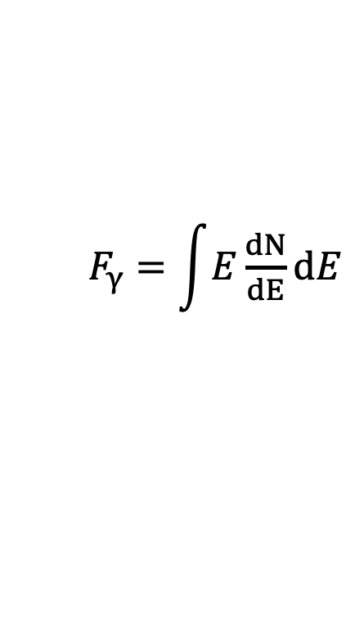


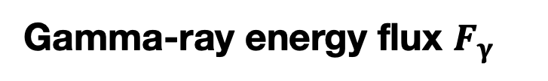
Gas physical parameters from CO observations
Gamma-ray energy flux $F_{γ}$
$F_{γ}=\int{E\frac{ⅆN}{ⅆE}ⅆE}$
(Cao+ (2023))
The gamma-ray energy flux was calculated using the spectral parameters reported in the LHAASO catalog
Total energy of cosmic-ray protons $W_{p}$
Spectral Modeling
$W_{p}$=$\frac{4πd^{2}F_{γ}}{n_{H}{κσ}_{PP}c}$
・Proton spectrum assumed (power-law with cutoff)
・Target density from CO observation
(Gabici et al. (2006))
・Gamma-ray emission via pp interaction
This gives the minimum proton energy required to explain the observed gamma-ray emission
・We model the gamma-ray spectrum using Naima
Need spectral modeling
Notes:
Next, we estimate the required proton energy.
First, we estimate the proton density from the cloud mass.
Then, we use the gamma-ray flux.
From these, we estimate the required energy of cosmic-ray protons.
This allows us to test whether the observed gamma rays can be explained.
However , This estimate is approximation.
So, we performed spectral modeling assuming a more realistic proton spectrum.

Slide 25
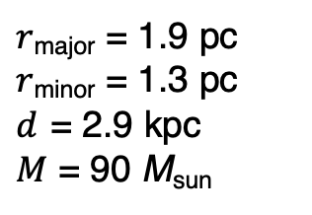
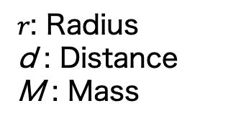
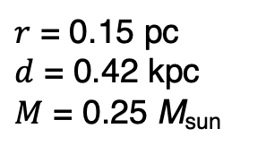
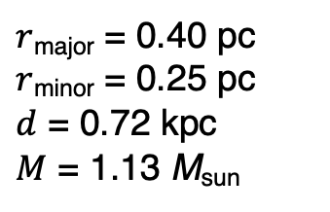
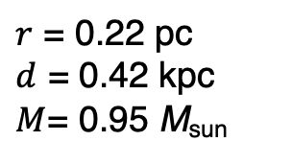
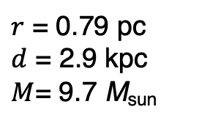
1LHAASO J0007+5659u ¹²CO Map
$r$: Radius
d : Distance
M : Mass
(-37.1 to -34.9 km/s)
(-35.9 to -34.3 km/s)
MC1
MC2
$r$_{major} = 1.9 pc
$r$_{minor} = 1.3 pc
$d$ = 2.9 kpc
$M$ = 90 M_{sun}
$r$ = 0.79 pc
$d$ = 2.9 kpc
$M$= 9.7 M_{sun}
Gamma rays by LHAASO
(-3.7 to -2.1 km/s)
(-3.7 to -2.9 km/s)
MC4
$r$_{major} = 0.40 pc
$r$_{minor} = 0.25 pc
$d$ = 0.72 kpc
$M$ = 1.13 M_{sun}
MC5
MC3
$r$ = 0.22 pc
$d$ = 0.42 kpc
$M$= 0.95 M_{sun}
MC4
MC5
$r$ = 0.15 pc
$d$ = 0.42 kpc
$M$ = 0.25 M_{sun}
Notes:
以上の手法を用いて、1LHAASO J0007+5659u周辺のCOデータを解析した結果、5つの分子雲候補を検出しました。それぞれの図は、各分子雲が存在する速度範囲で作成したCO積分強度図です。右側には、各分子雲について推定した半径、距離、質量を示しています。Cloud 1およびCloud 2は約2.9 kpc、一方でCloud 3からCloud 5は約0.3〜0.4 kpcと推定され、異なる距離に存在する分子雲であることが分かりました。つまり、J0007の視線方向には複数の分子雲が重なって存在していることが分かりました。次に、これらの分子雲から求めた物理量について説明します。

Slide 26
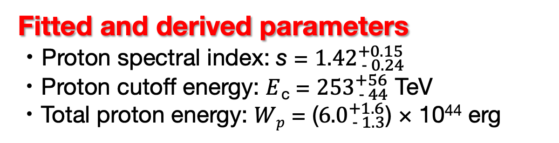
Hadronic modeling using the physical properties of MC4
Assumed proton distribution
Fixed parameters (MC4)
・$d$ = 0.72 kpc
・$n$(H₂) = 308 cm⁻³
$$N\left(Ep\right)=KE^{−s}\text{exp}\left(−\frac{Ep}{E_{c}}\right)$$
$K$: normalization $s$: proton spectral index
$E$_{c} : proton cutoff energy
The Fermi-LAT 95% C.L. upper limits and LHAASO-WCDA upper limits from Xie et al. (2025) were used as constraints.
Fitted and derived parameters
・Proton spectral index: s = ${1.42}_{ − 0.24}^{+0.15}$
・Proton cutoff energy: $E$_{c} = ${253}_{ − 44}^{+56}$ TeV
・Total proton energy: $Wp$ = (${6.0}_{ − 1.3}^{+1.6}$) × 10⁴⁴ erg
Notes:
Next, we performed hadronic spectral fitting using the physical properties of MC4.
We fixed the distance of MC4 at 0.72 kiloparsecs and the molecular hydrogen number density at 308 per cubic centimeter.
We assumed a power-law proton energy distribution with an exponential cutoff.
Here, K is the normalization, s is the proton spectral index, and E_c is the cutoff energy.
From this proton distribution, we calculated the gamma-ray spectrum produced by proton-proton interactions and neutral pion decay, and fitted it to the LHAASO gamma-ray spectrum.
In the figure on the right, the blue line shows the LHAASO-KM2A gamma-ray spectrum, and the orange line shows the gamma-ray spectrum from the hadronic model.
We also used the Fermi-LAT and LHAASO-WCDA upper limits as constraints.
As a result, the proton spectral index is about 1.4, the cutoff energy is about 250 TeV, and the total proton energy is about 10^{45} ergs.

Slide 27



Leptonic modeling using the physical properties of MC4
Fixed parameters (MC4)
・$d$ = 0.72 kpc
Courtesy of N. Tsuji
Fitted and derived parameters
・Electron spectral index: s = ${1.87}_{ − 0.26}^{+0.13}$
・Electron cutoff energy: $E$_{c} = ${102}_{ − 17}^{+24}$ TeV
・Total electron energy: $We$ = (${1.3}_{ − 0.51}^{+0.41}$) × 10⁴⁴ erg

Slide 28






Estimation of upper limits for non-detected CO emission
RMS noise
・Mean RMS noise within the LHAASO r₃₉ region.
・$∆T_{MB}$: RMS noise
・$∆V = 0.2 km/s$
3$σ$ upper limit on CO integrated intensity
H₂ column density
Assuming a CO line width of 10 km/s
$${N(H2)}^{3σ} = X_{CO}W_{CO}^{3σ}$$
$$W_{CO}^{3σ} = 3∆V\sqrt{N}∆T_{MB}$$
X_{CO} = 3.5 × 10¹⁹ cm⁻² (K・km/s)⁻¹
Number density
L: assumed line-of-sight size of the gamma-ray emission region.
${n(H2)}^{3σ}$ = $\frac{{N(H2)}^{3σ}}{L}$
The X_{CO} value for high Galactic latitudes was adopted from Acharyya et al. (2025).
Notes:
Next, I will explain how we estimated the upper limits for sources with no significant CO emission.
First, we calculated the mean RMS noise, \Delta T_{\rm MB}, within the LHAASO r_{39} region.
The velocity resolution of our observations is 0.2 kilometers per second.
Then, assuming a CO line width of 10 kilometers per second, we estimated the three-sigma upper limit on the CO integrated intensity, W_{\rm CO}, from the RMS noise.
Next, we converted the upper limit on W_{\rm CO} into an upper limit on the molecular hydrogen column density, N({\rm H_2}), using the X_{\rm CO} factor.
We adopted the X_{\rm CO} value for high Galactic latitudes from Acharyya et al. 2025.
Finally, we divided the column density by the assumed line-of-sight size of the gamma-ray emission region to estimate the upper limit on the molecular hydrogen number density.

