Slide 1







Earth Tomography with Atmospheric Neutrino Absorption at TRIDENT
$${\text{Jingtao Huang}}^{1}$$
, ${\text{Jun−Nan Lu}}^{2}$, ${\text{Boyu Yang}}^{2}$
Tsung-Dao Lee Institute, Shanghai Jiao Tong University, China
Department of Modern Physics, University of Science and Technology of China, China
2026.08.31 @ TeVPA 2026

Slide 2
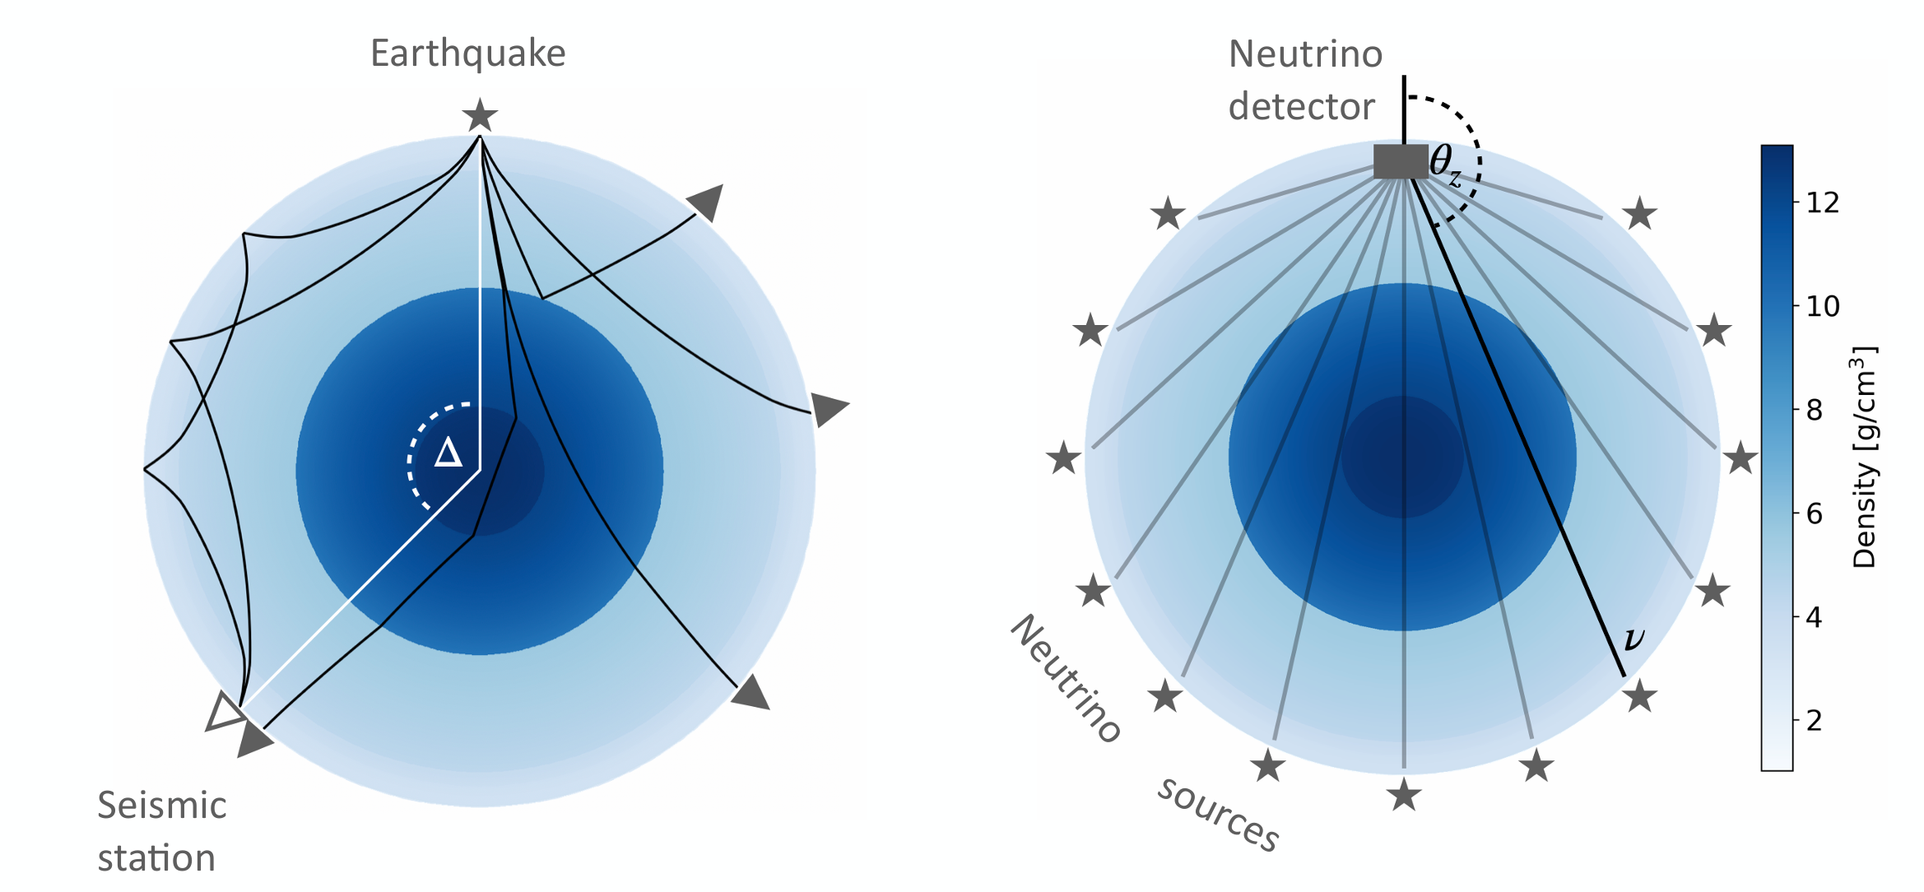
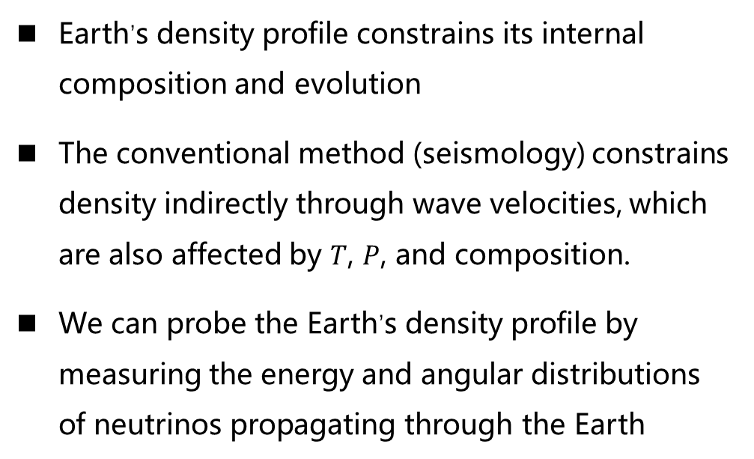
Introduction: Earth tomography
Earth tomography: Using through-going neutrinos to probe the Earth’s interior
Why?
Earth’s density profile constrains its internal composition and evolution
The conventional method (seismology) constrains density indirectly through wave velocities, which are also affected by $T$, $P$, and composition.
We can probe the Earth’s density profile by measuring the energy and angular distributions of neutrinos propagating through the Earth
seismic tomography
neutrino tomography
Image Credit: Isabel Goos @ Neutrino Geoscience 2025
Jingtao Huang | TeVPA 2026

Slide 3
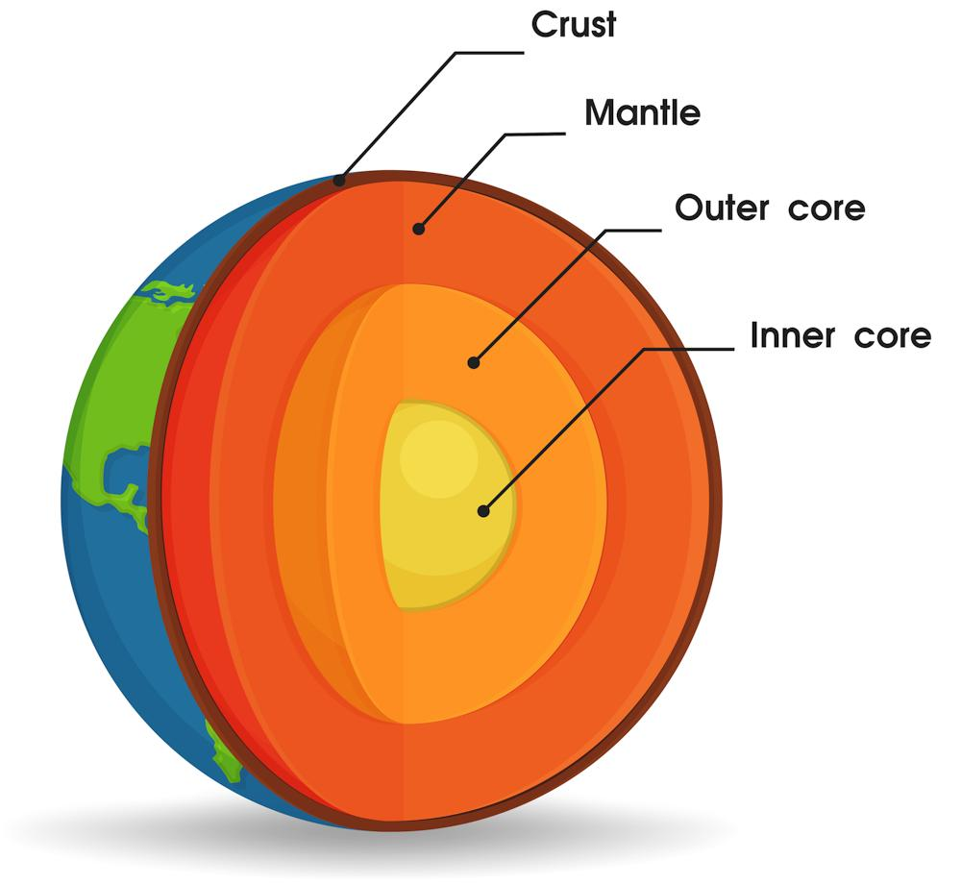
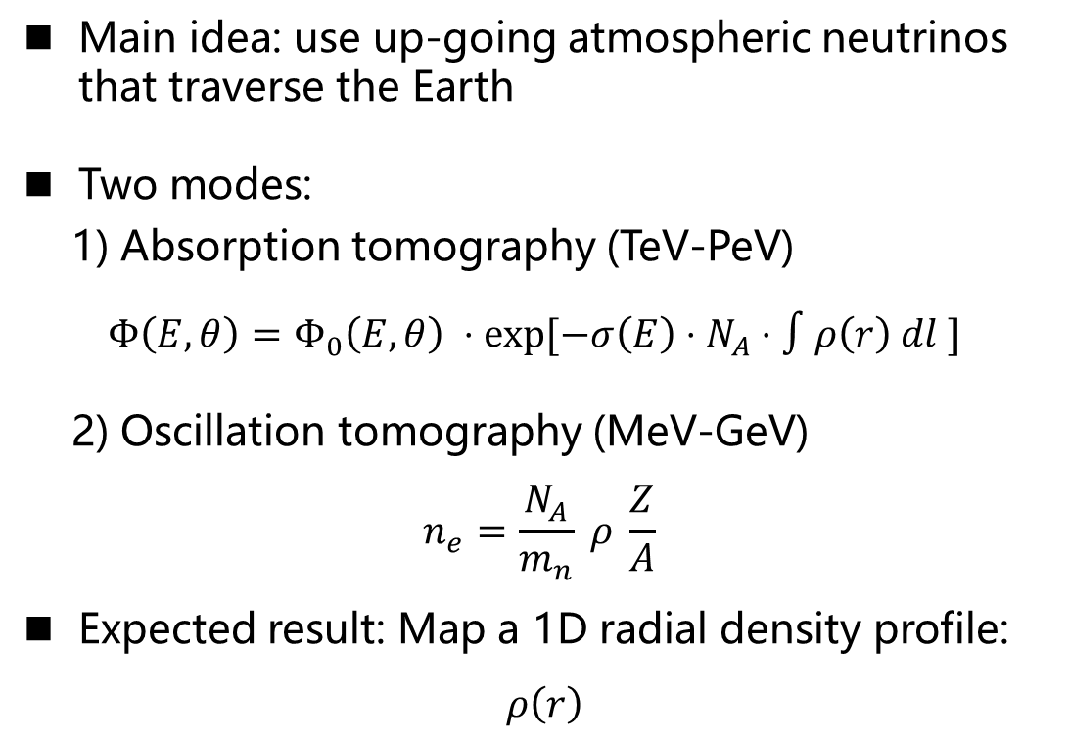
Introduction: Earth tomography
Main idea: use up-going atmospheric neutrinos that traverse the Earth
Two modes:
1) Absorption tomography (TeV-PeV)
$$Φ\left(E,θ\right)=Φ_{0}\left(E,θ\right) ⋅\exp{[−σ\left(E\right)⋅N_{A}}⋅∫ρ\left(r\right) dl ]$$
2) Oscillation tomography (MeV-GeV)
$$n_{e}=\frac{N_{A}}{m_{n}} ρ \frac{Z}{A}$$
Expected result: Map a 1D radial density profile:
$ρ\left(r\right)$
Image credit: VRVector / Shutterstock, via Carleton University
Jingtao Huang | TeVPA 2026

Slide 4
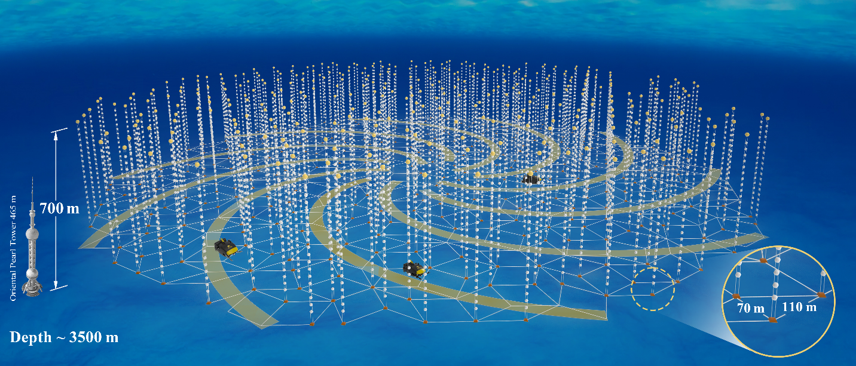
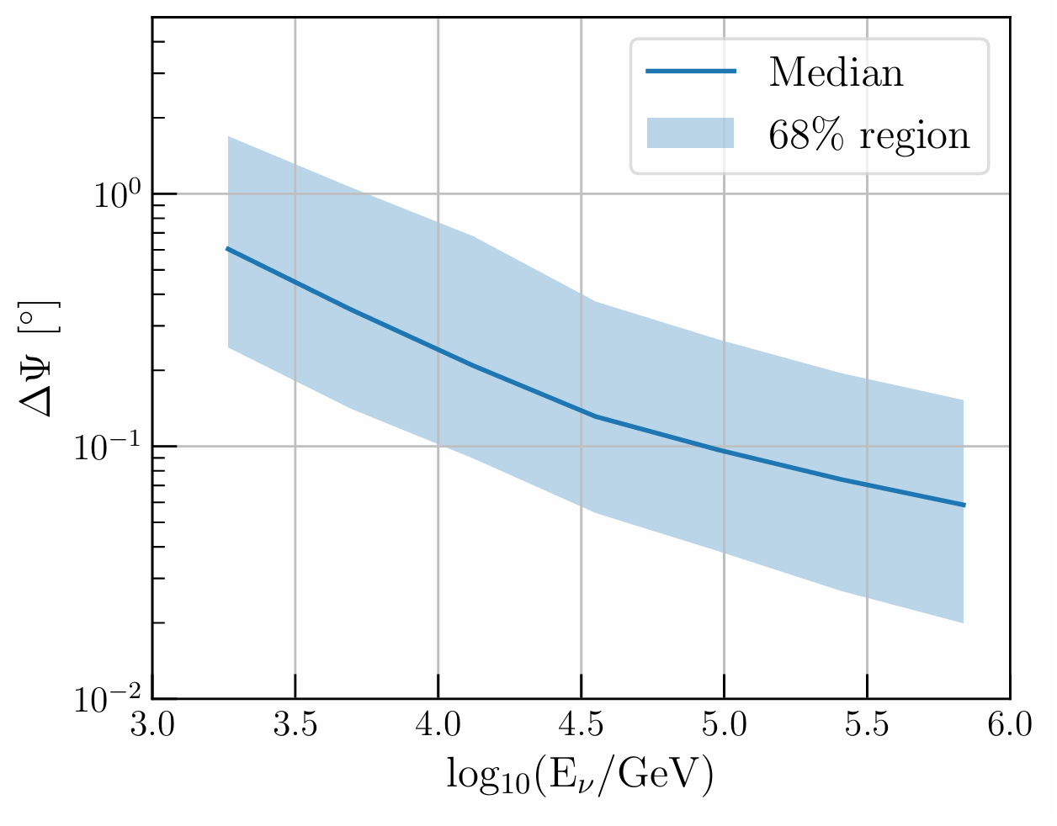

Introduction: TRIDENT
Angular resolution for $ν_{μ}$ track events
Ye Z.P et al.. Nat Astro 7, 1497–1505 (2023).
I. Morton-Blake et al.. Phys. Rev. D 113, 043030 (2026)
An up-coming next-gen neutrino telescope
Including ~1000 strings with 20 hDOMs (hybrid digital optical modules) per string
Size: ~8 km³
Broad neutrino sensitivity from sub-TeV to EeV energies
Jingtao Huang | TeVPA 2026

Slide 5
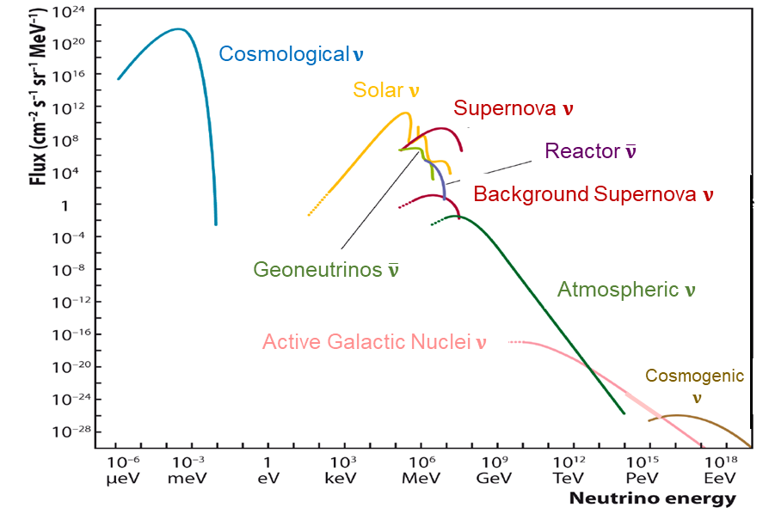
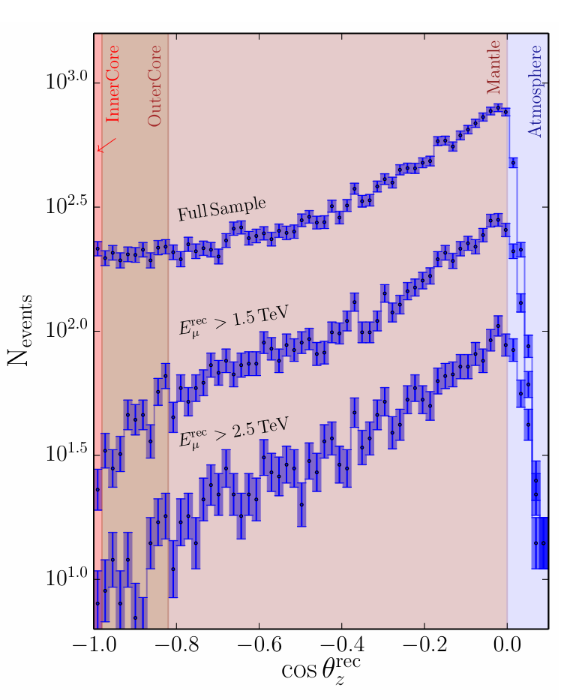
Introduction: TRIDENT
IceCube 1yr events
Earth attenuation becomes significant at high energies
Snowmass 2023
Sensitive region of TRIDENT
Donini, A. Nature Phys 15, 37–40 (2019).
Jingtao Huang | TeVPA 2026

Slide 6

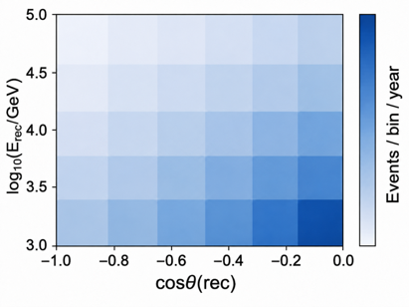
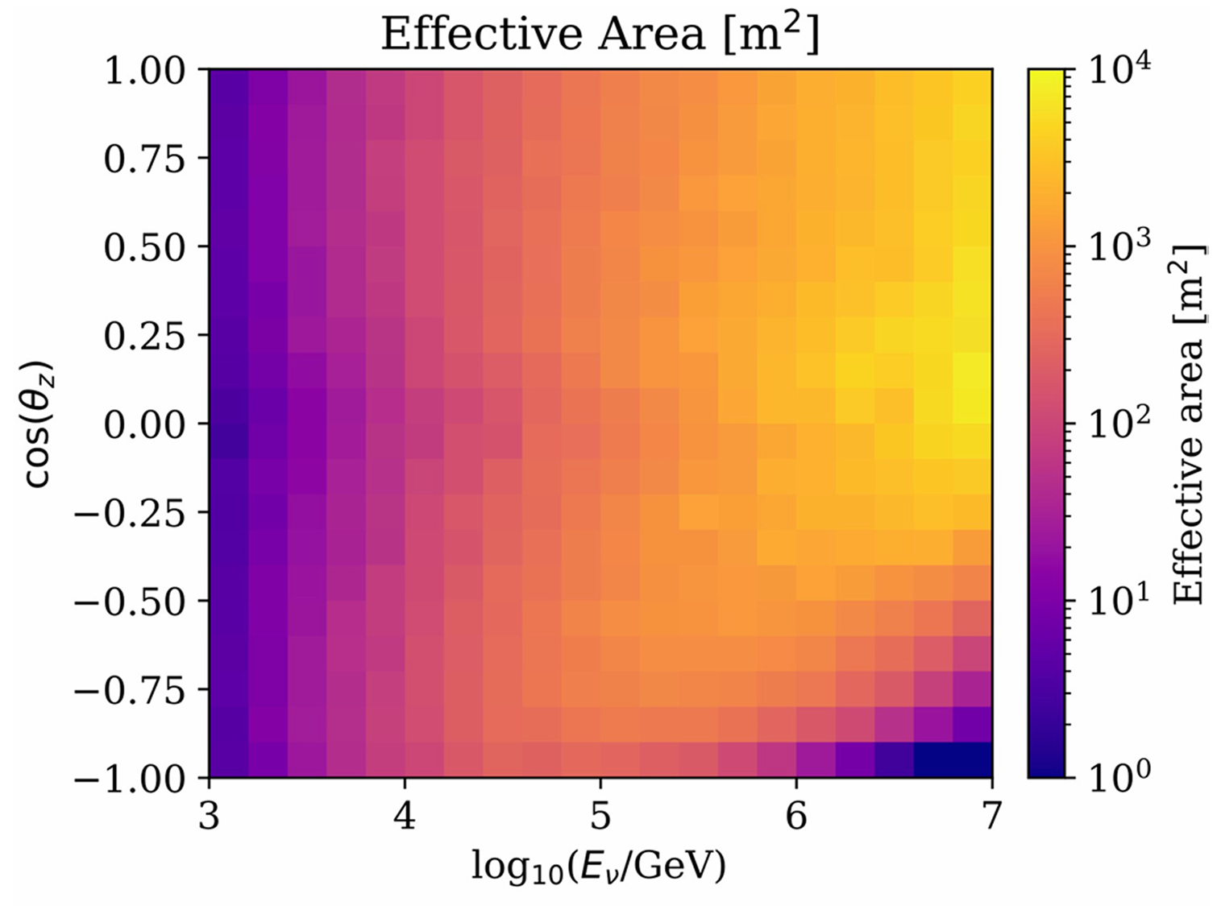
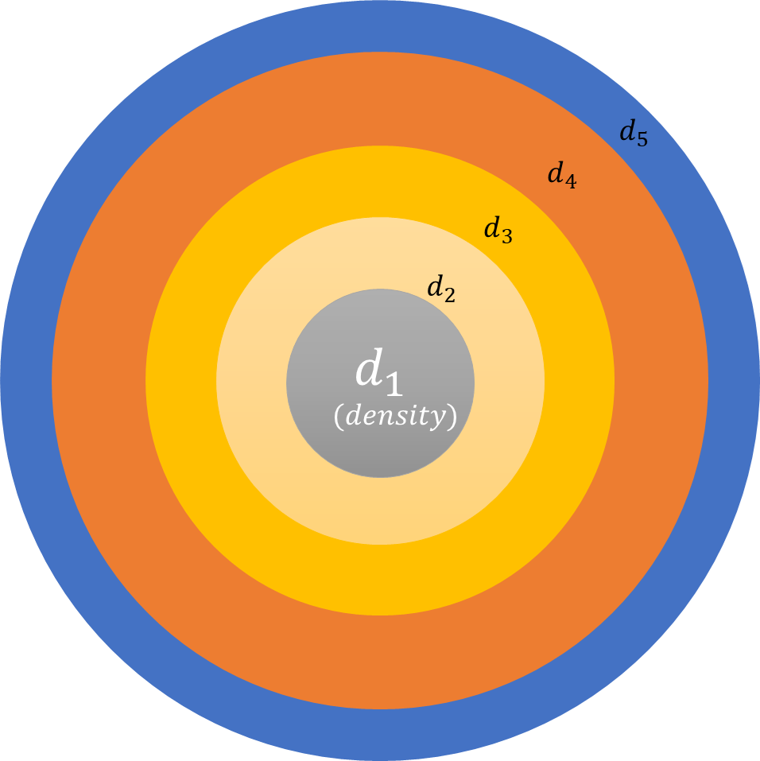
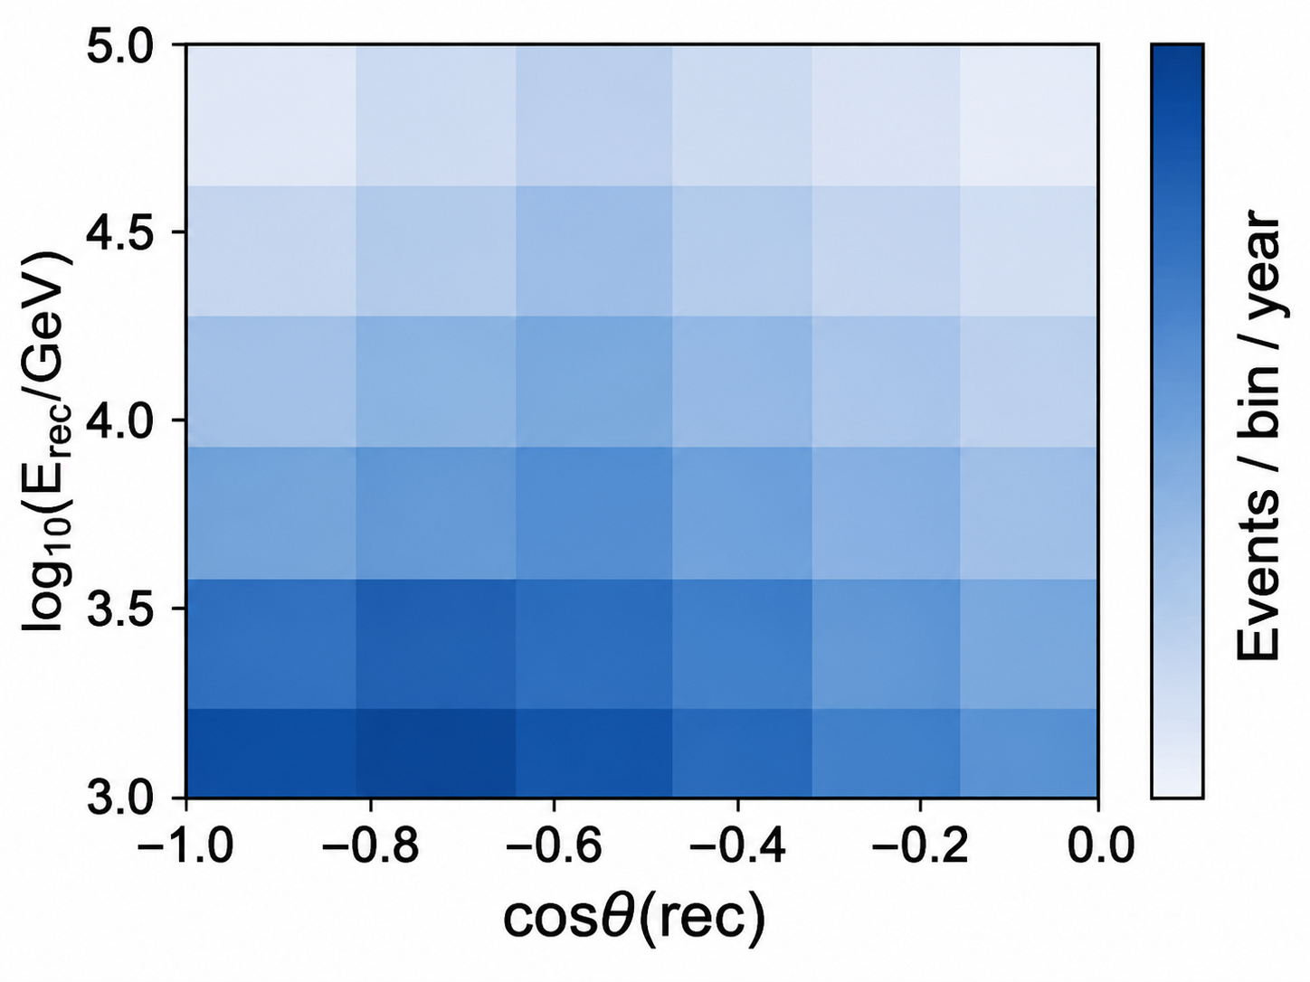





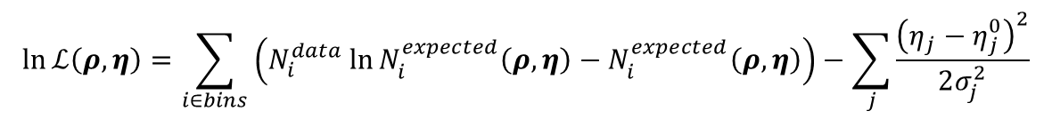


Methodology
$$Φ_{0}$$
$$Φ$$
$$N^{data}$$
Earth
Daemonflux[1]
$$Φ_{0}^{′}$$
$$Φ^{′}$$
$$N^{expected}$$
Propagate by nuSQuIDS[2]
Assumed density profile
$×A_{eff}$ [3]
$$\ln{ℒ\left(ρ, η\right)=\sum_{i∈bins}{\left(N_{i}^{data}\ln{N_{i}^{expected}\left(ρ, η\right)}−N_{i}^{expected}\left(ρ, η\right)\right)}}−\sum_{j}{\frac{{\left(η_{j}−η_{j}^{0}\right)}^{2}}{2σ_{j}^{2}}}$$
[1] Juan Pablo Yañez, Anatoli Fedynitch. Phys. Rev. D 107, 123037, 2023
[2] Carlos A. Argüelles, et al.. Comput. Phys. Commun. 277, 108346, 2022.
[3] Z. P. Ye et al., Nat. Astron. 7, 1497–1505, 2023.
Jingtao Huang | TeVPA 2026

Slide 7


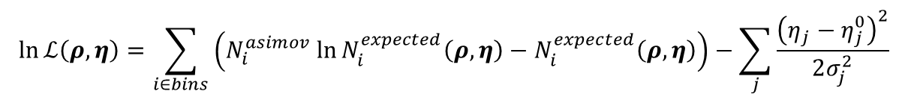
Methodology
PREM
(Preliminary
Reference Earth Model)
$$Φ$$
$×A_{eff}$ [3]
$$N^{asimov}$$
Daemonflux[1]
$$Φ_{0}^{′}$$
$$Φ^{′}$$
$$N^{expected}$$
Propagate by nuSQuIDS[2]
Assumed density profile
$×A_{eff}$ [3]
$$\ln{ℒ\left(ρ, η\right)=\sum_{i∈bins}{\left(N_{i}^{asimov}\ln{N_{i}^{expected}\left(ρ, η\right)}−N_{i}^{expected}\left(ρ, η\right)\right)}}−\sum_{j}{\frac{{\left(η_{j}−η_{j}^{0}\right)}^{2}}{2σ_{j}^{2}}}$$
[1] Juan Pablo Yañez, Anatoli Fedynitch. Phys. Rev. D 107, 123037, 2023
[2] Carlos A. Argüelles, et al.. Comput. Phys. Commun. 277, 108346, 2022.
[3] Z. P. Ye et al., Nat. Astron. 7, 1497–1505, 2023.
Jingtao Huang | TeVPA 2026

Slide 8
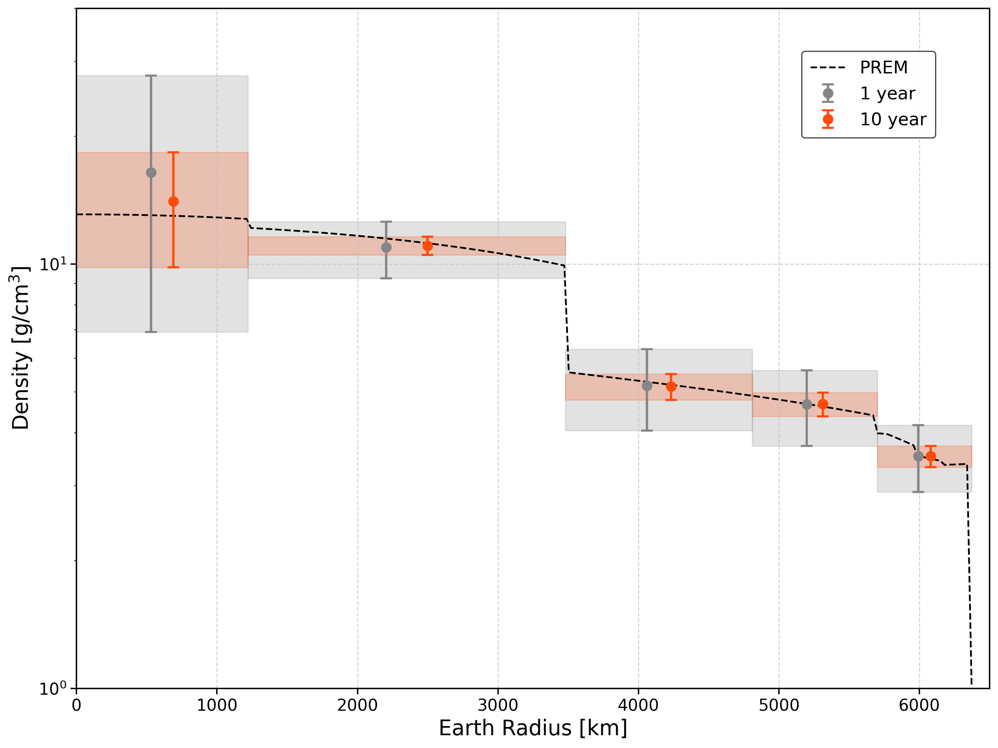
Results
TRIDENT simulation, work in progress
With enough statistics TRIDENT expects to reconstruct a multi-layer Earth density profile.
Most Earth layers can be well constrained, while the innermost region remains the most challenging.
Neutrino absorption enables layer-by-layer constraints on the Earth’s internal density.
Jingtao Huang | TeVPA 2026

Slide 9
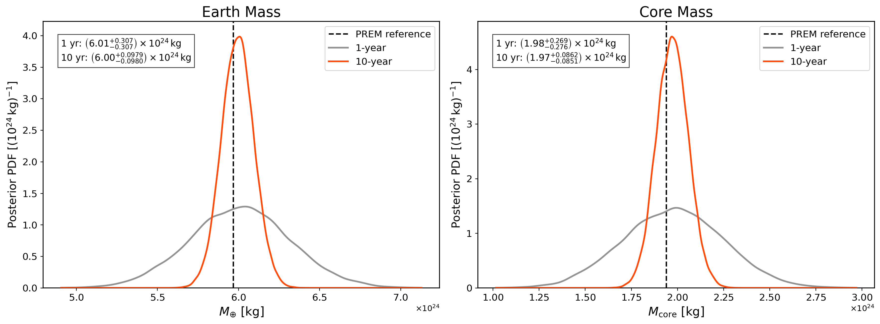
Results
Neutrino tomography also provides an independent measurement of the Earth and core masses
TRIDENT simulation, work in progress
TRIDENT simulation, work in progress
Jingtao Huang | TeVPA 2026

Slide 10
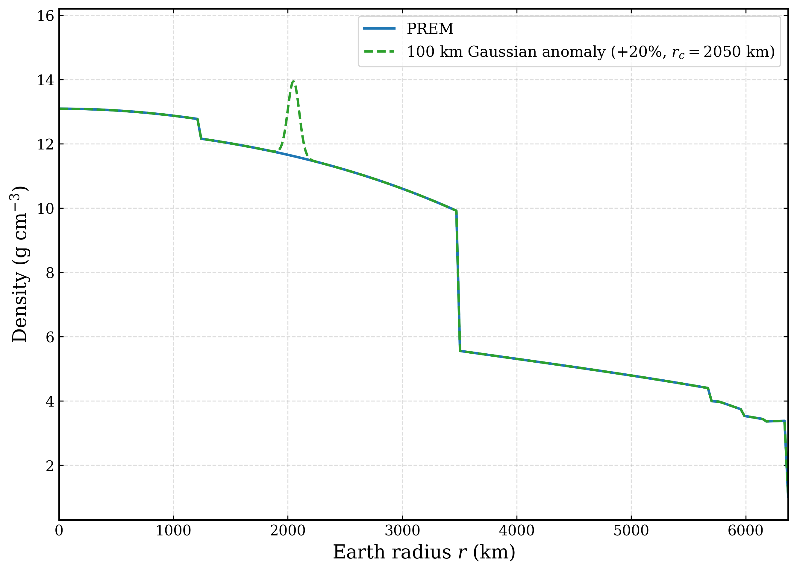
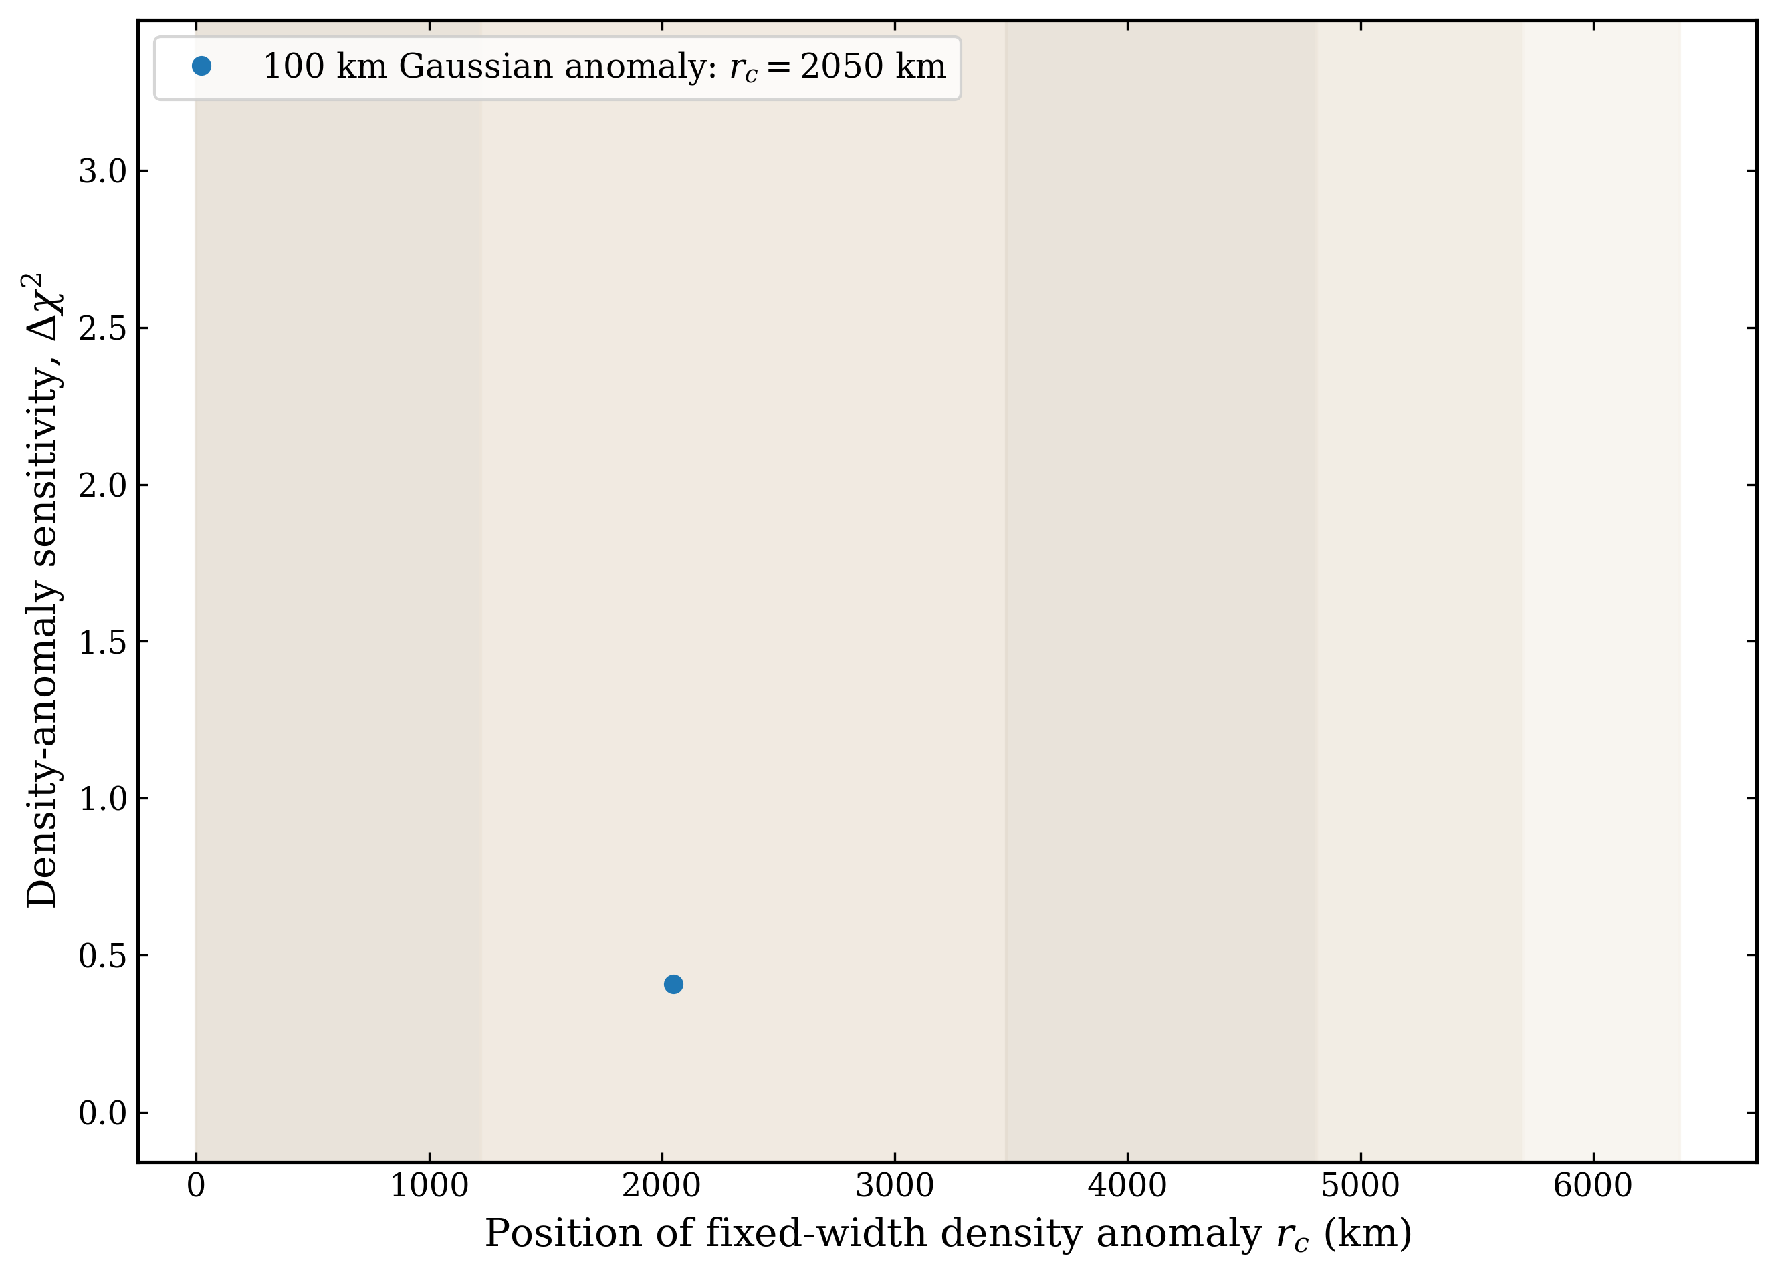
Sensitivity to Density Anomalies
What if the Earth contains a localized density anomaly?
Sensitivity for TRIDENT-10y to localized density anomalies
TRIDENT simulation, work in progress
Jingtao Huang | TeVPA 2026

Slide 11
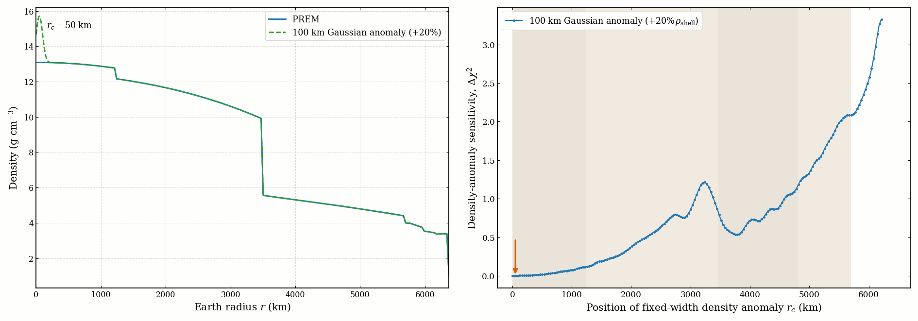
Sensitivity to Density Anomalies
What if the Earth contains a localized density anomaly?
Sensitivity for TRIDENT-10y to localized density anomalies
TRIDENT simulation, work in progress
Higher potential to detect anomalies in the outer mantle
Jingtao Huang | TeVPA 2026

Slide 12
Summary
Neutrino attenuation directly probes matter density through the weak interaction, independently of conventional geophysical observables.
TRIDENT can constrain multiple radial density layers, with precision improving continuously as exposure accumulates.
The same framework can independently constrain global Earth properties and probe localized density anomalies.
Thank you!
Jingtao Huang | TeVPA 2026

Slide 13
Backup

Slide 14
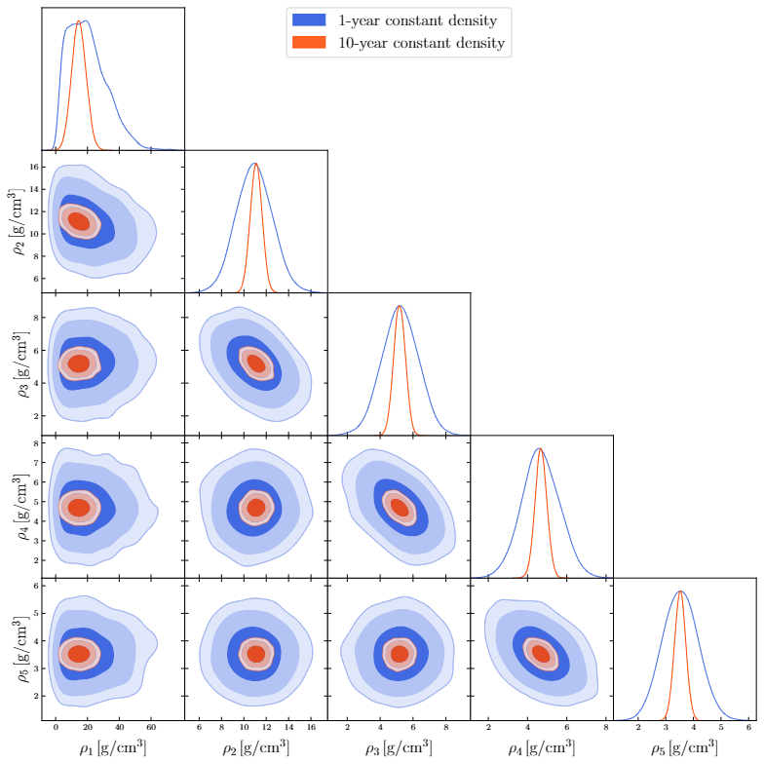
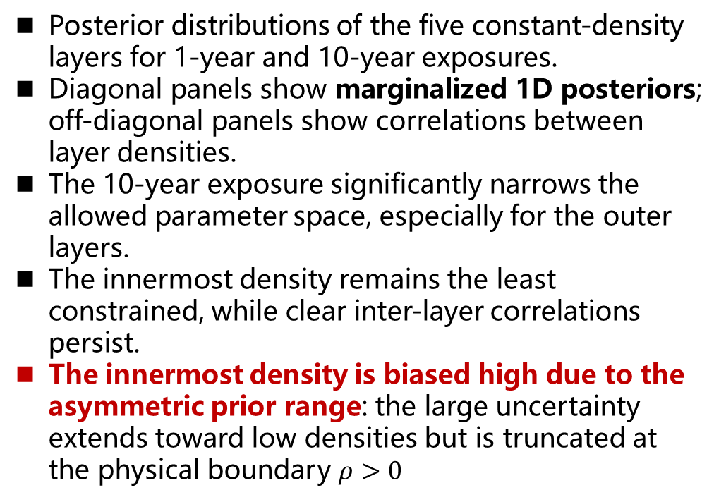
Results from Multinest
Posterior distributions of the five constant-density layers for 1-year and 10-year exposures.
Diagonal panels show marginalized 1D posteriors; off-diagonal panels show correlations between layer densities.
The 10-year exposure significantly narrows the allowed parameter space, especially for the outer layers.
The innermost density remains the least constrained, while clear inter-layer correlations persist.
The innermost density is biased high due to the asymmetric prior range: the large uncertainty extends toward low densities but is truncated at the physical boundary $ρ>0$
Jingtao Huang | TeVPA 2026

Slide 15
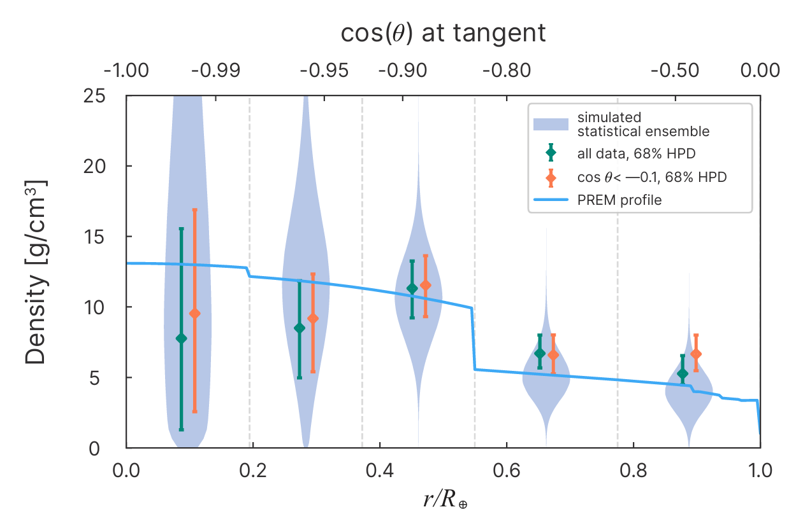
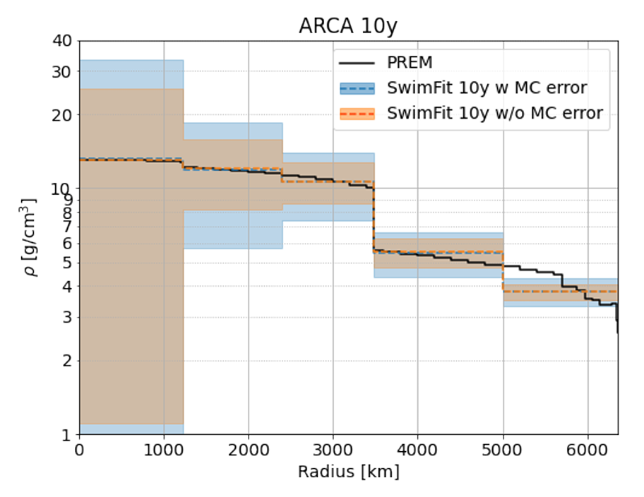
Results Comparing
TRIDENT simulation
IceCube results
IceCube Coll. arXiv:2607.02644
KM3NeT results
L. Maderer, Ph. D thesis
Jingtao Huang | TeVPA 2026

