Slide 1




Status of Solar ⁸B CE𝜈NS and Light Dark Matter Search in PandaX
Speaker：Qing Lin (qinglin@ustc.edu.cn)
(On behalf of PandaX collaboration)
University of Science and Technology of China
TeVPA2026 @ Tendo, 2026.08.31

Slide 2

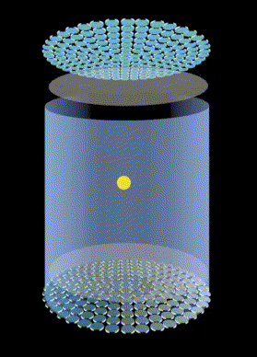
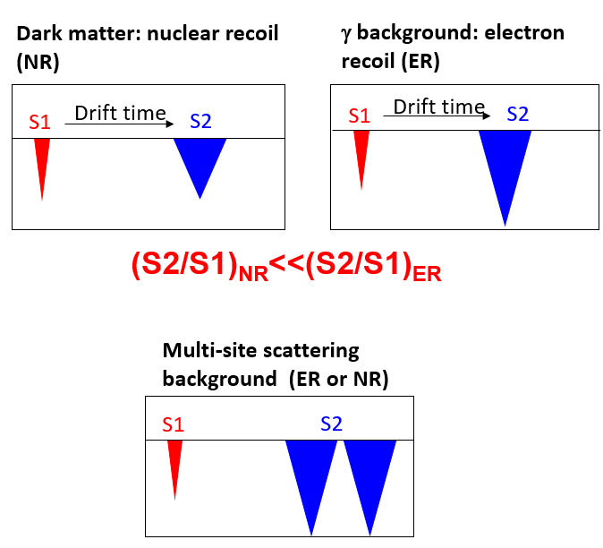
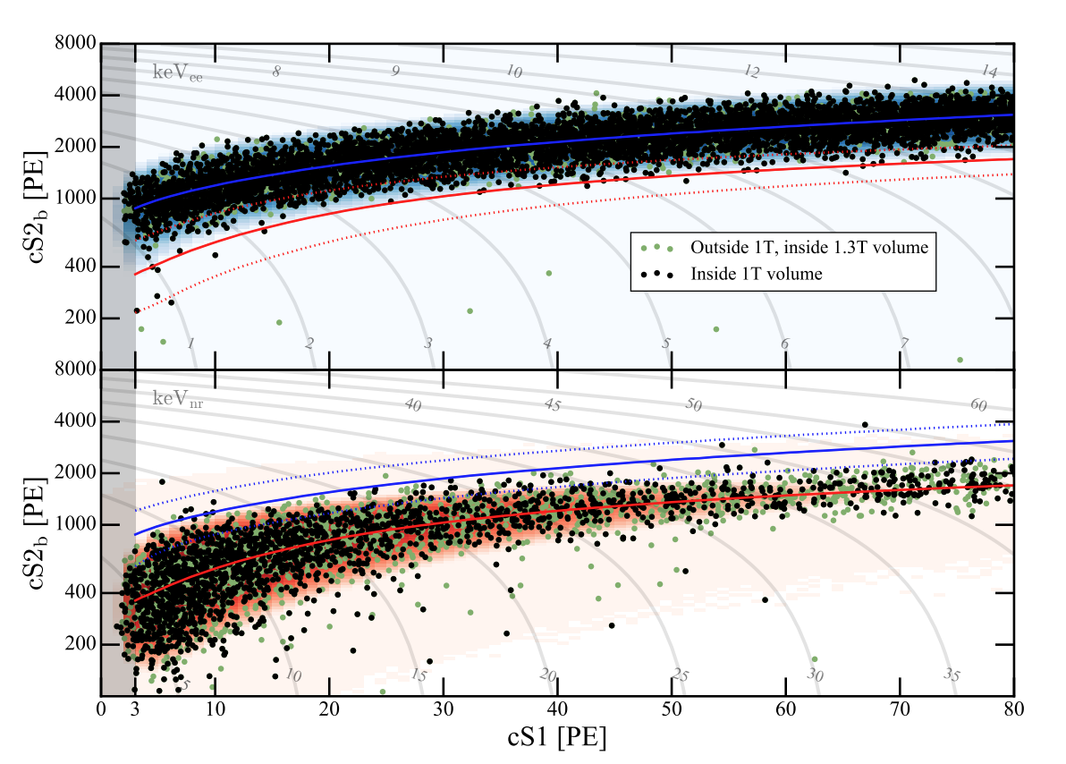
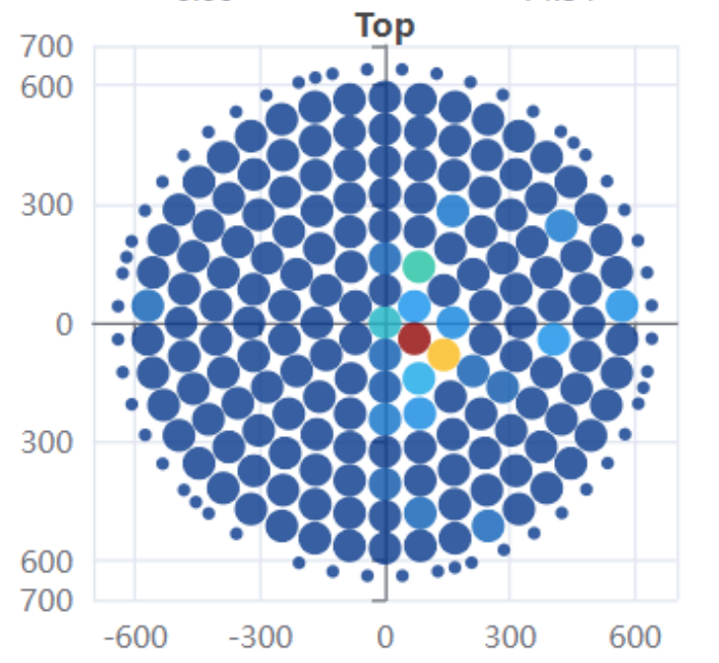
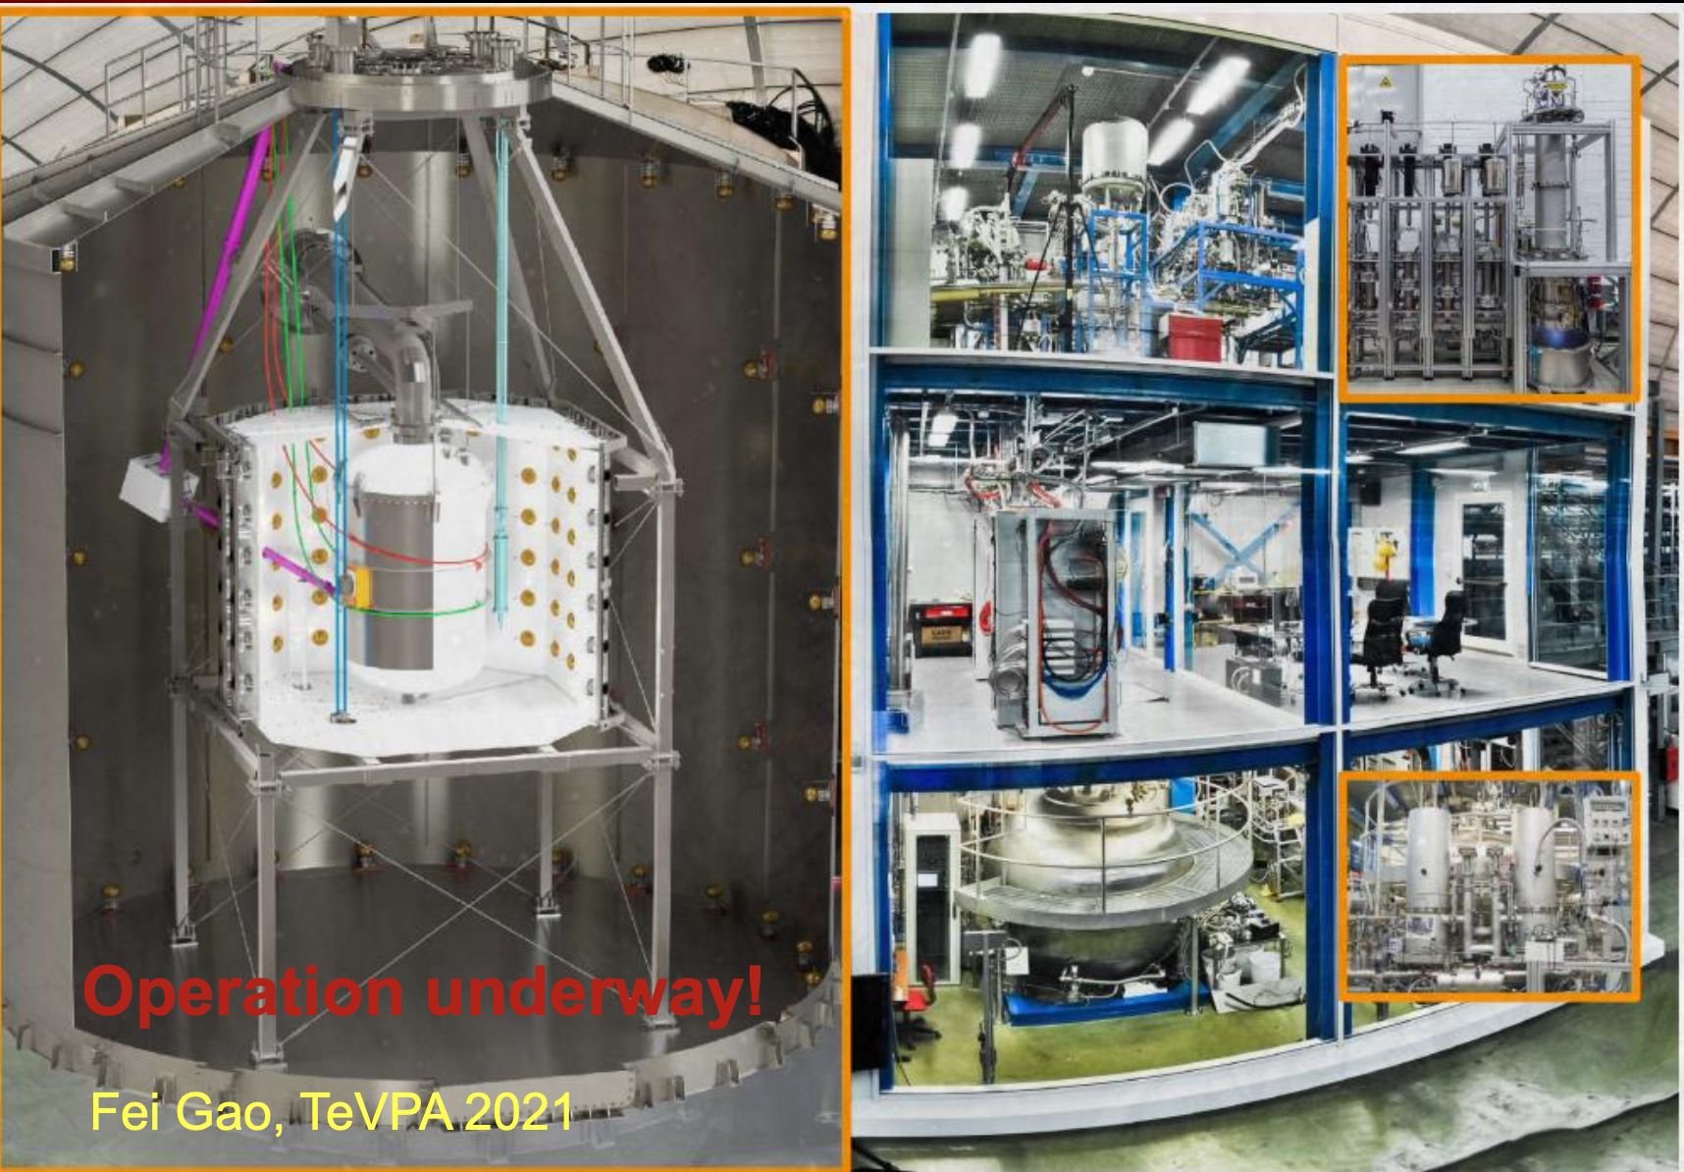
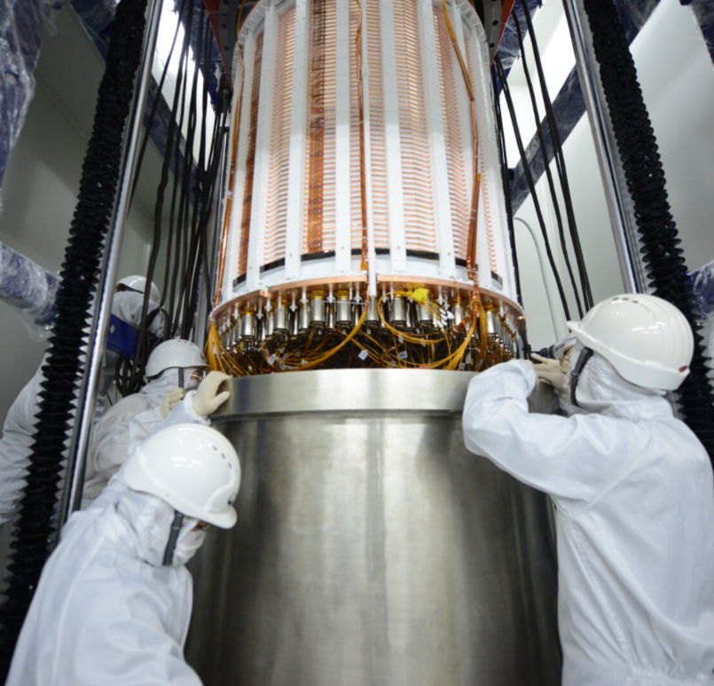
Dual phase xenon TPC
Global efforts for dark matter direct searches
LZ
XENONnT
PandaX-4T
See plenary and next talk
See talks on Thursday
See last talk by Yong
PRL131, 041002 (2023)
PRL131, 041003 (2023)
1

Slide 3
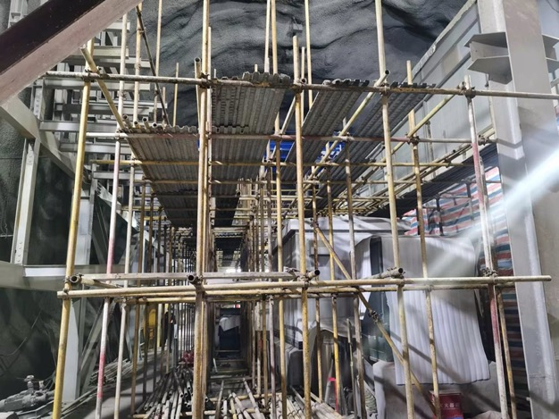
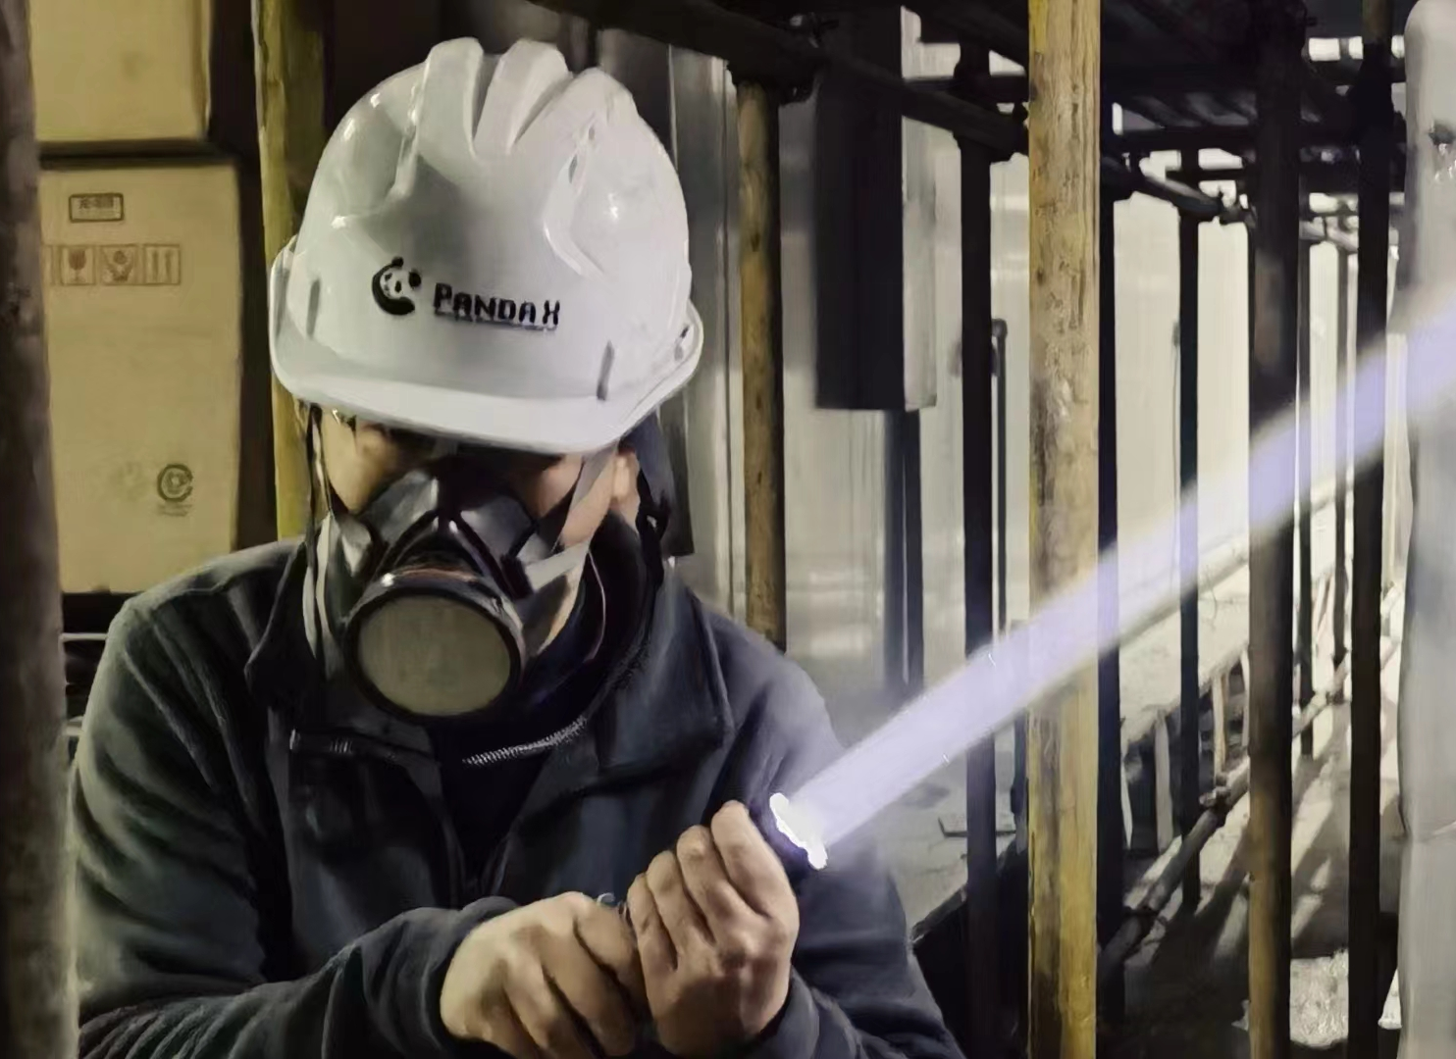
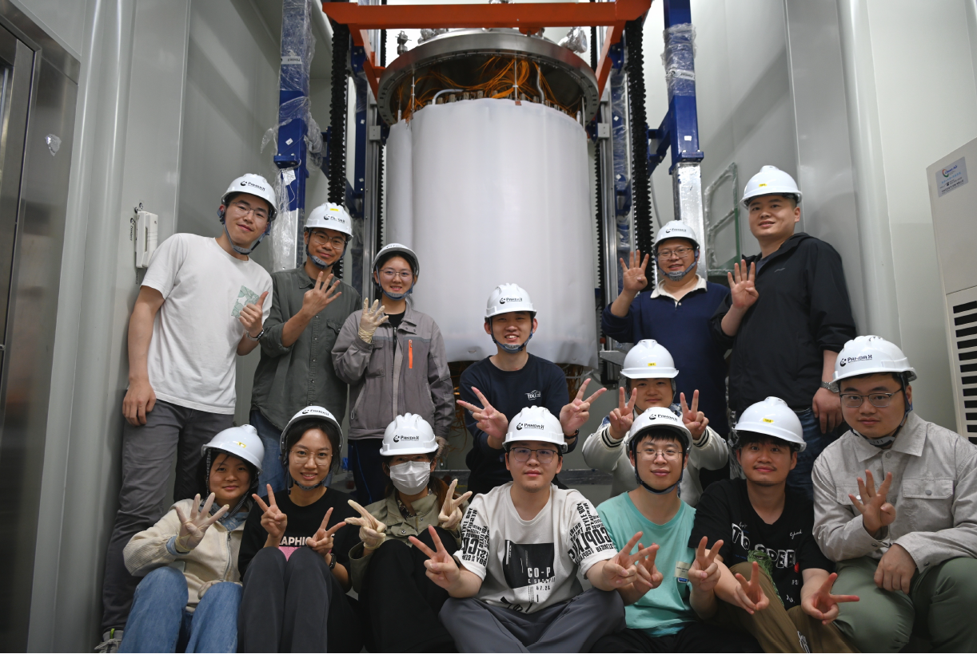
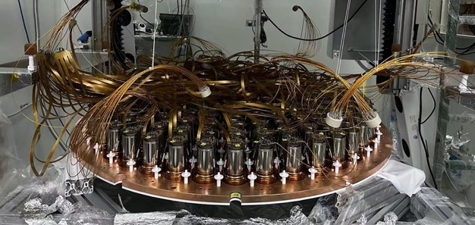
Timeline of PandaX-4T Experiment
2020/11 – 2021/04 | Commissioning (Run0) 95 days
2021/07 – 2021/10 | Tritium removal xenon distillation, gas flushing, etc
2021/11 – 2022/05 | Physics run (Run1) 164 days
2022/09 – 2023/12 | CJPL B2 hall construction xenon recuperation, detector upgrade
2024/01- 2026/04 | Physics run (Run2)
2026/04/15 | PandaX-4T decommission
2
7

Slide 4
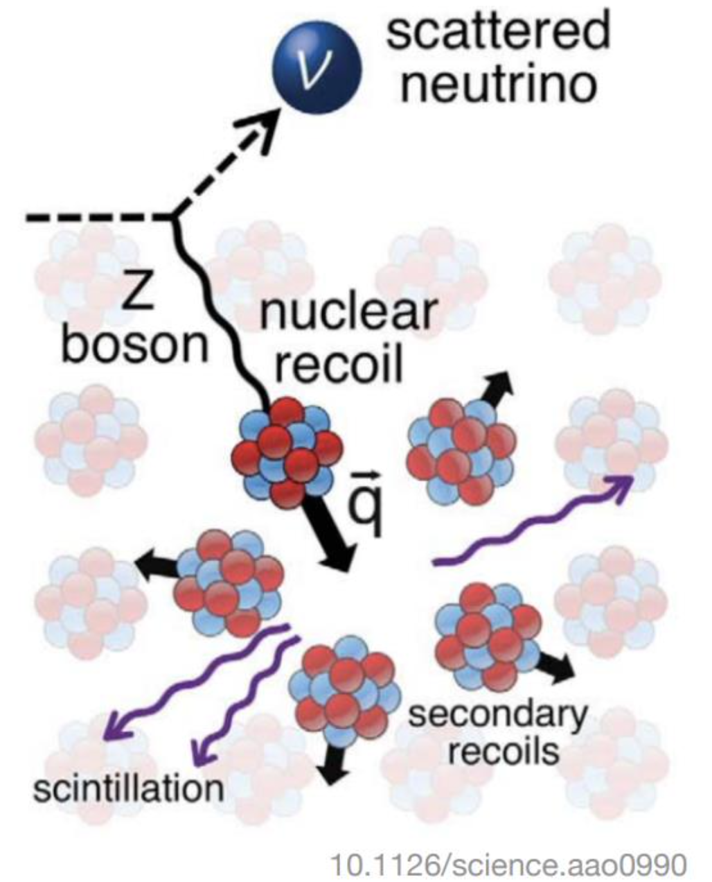
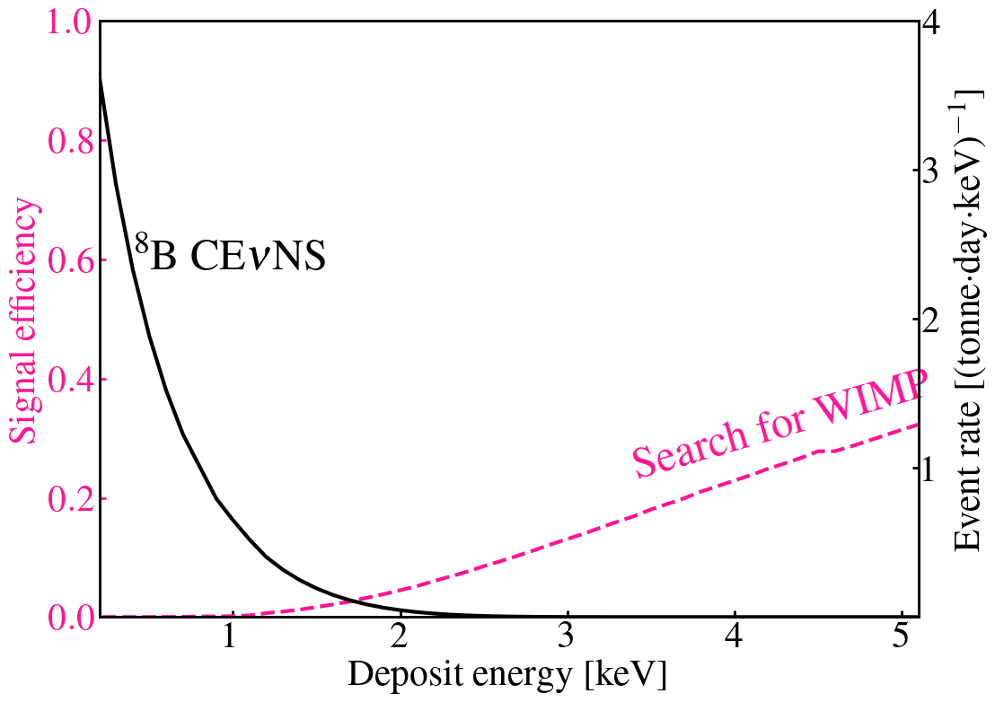
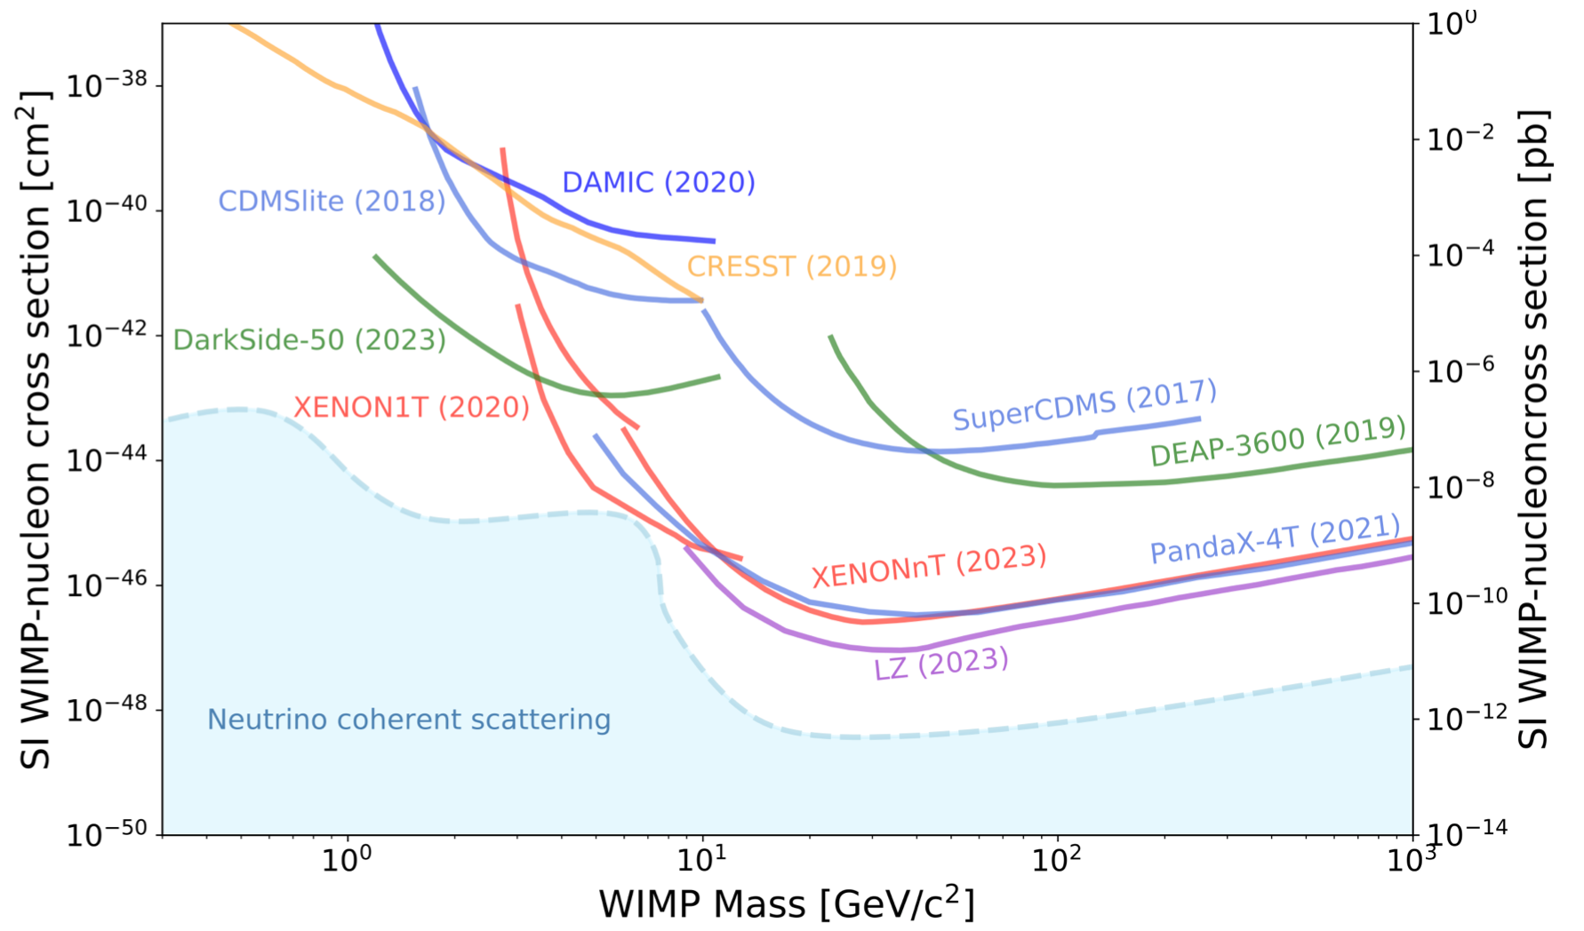
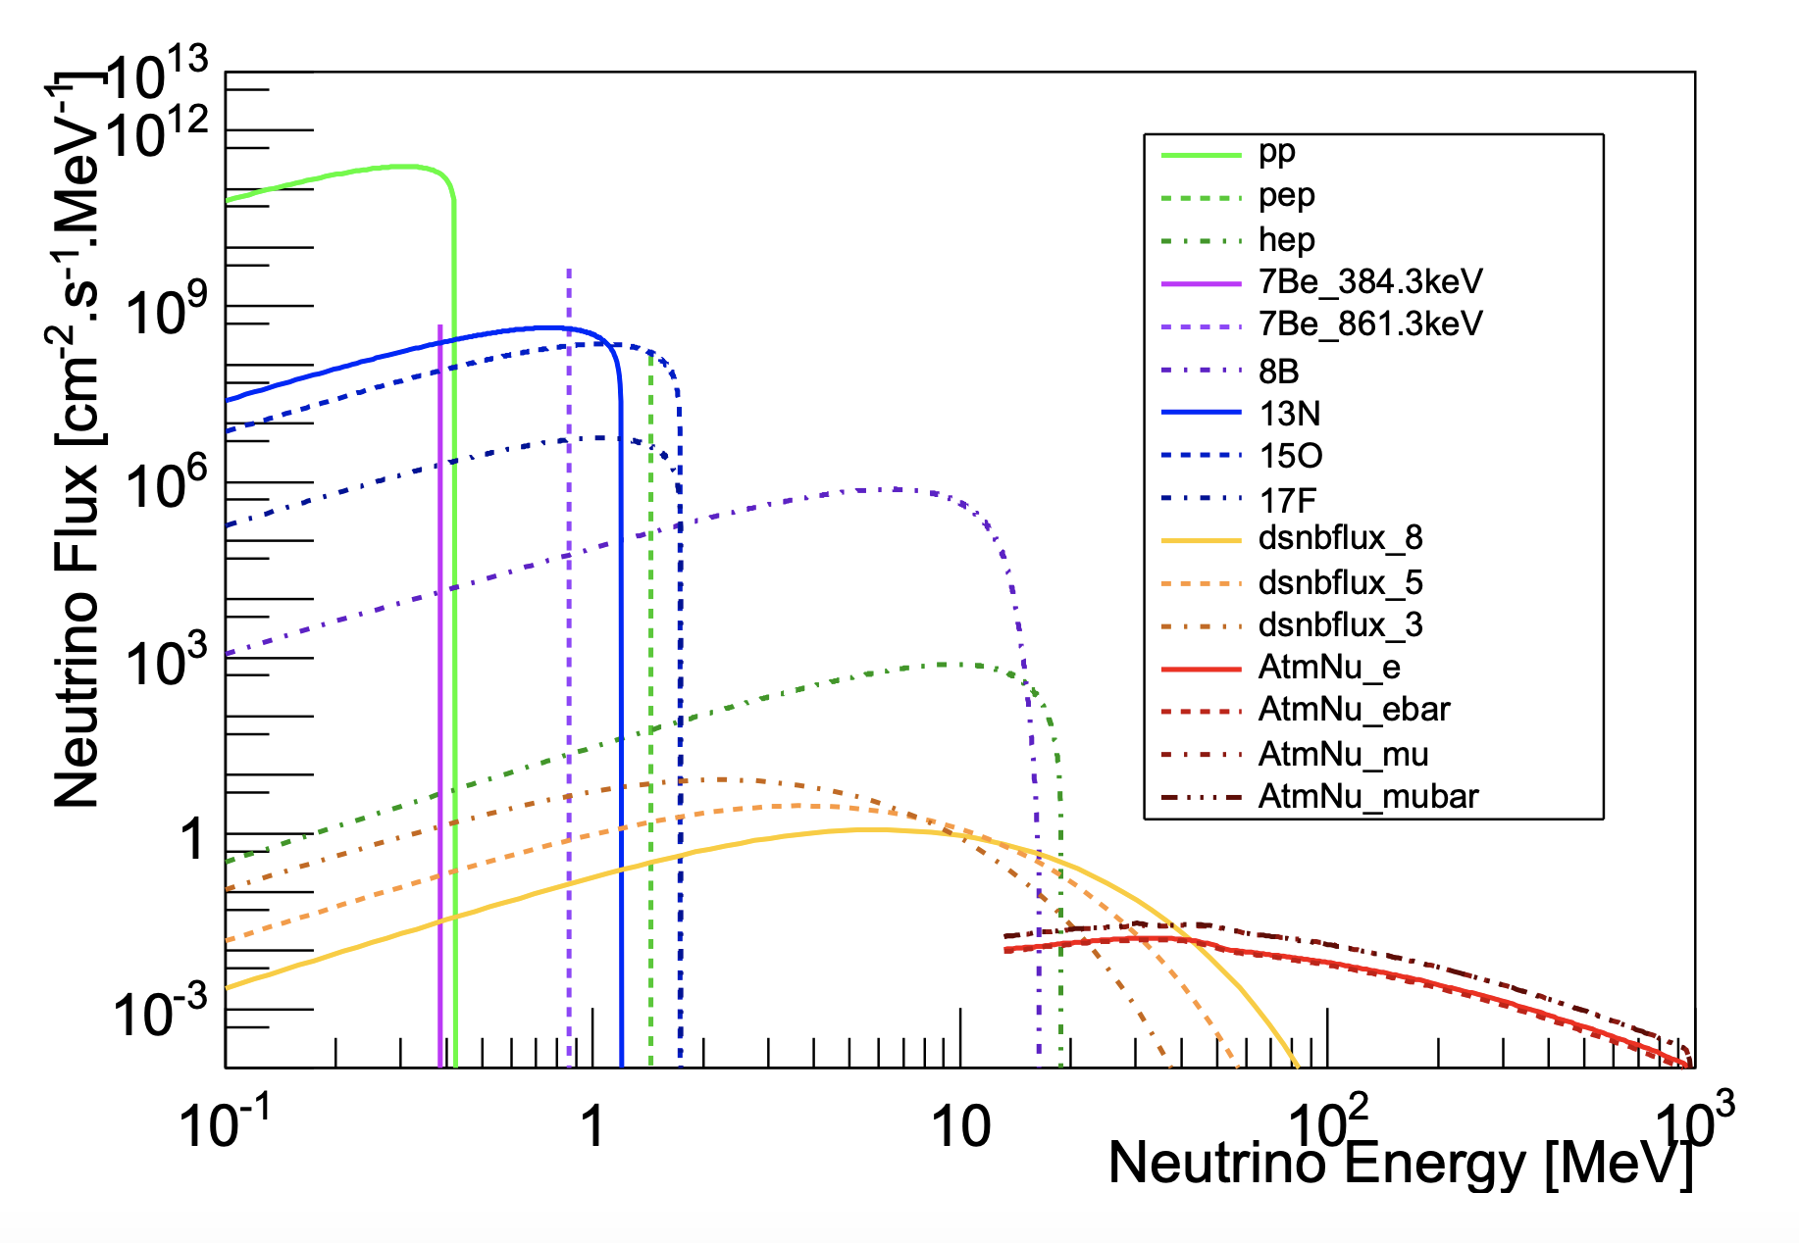
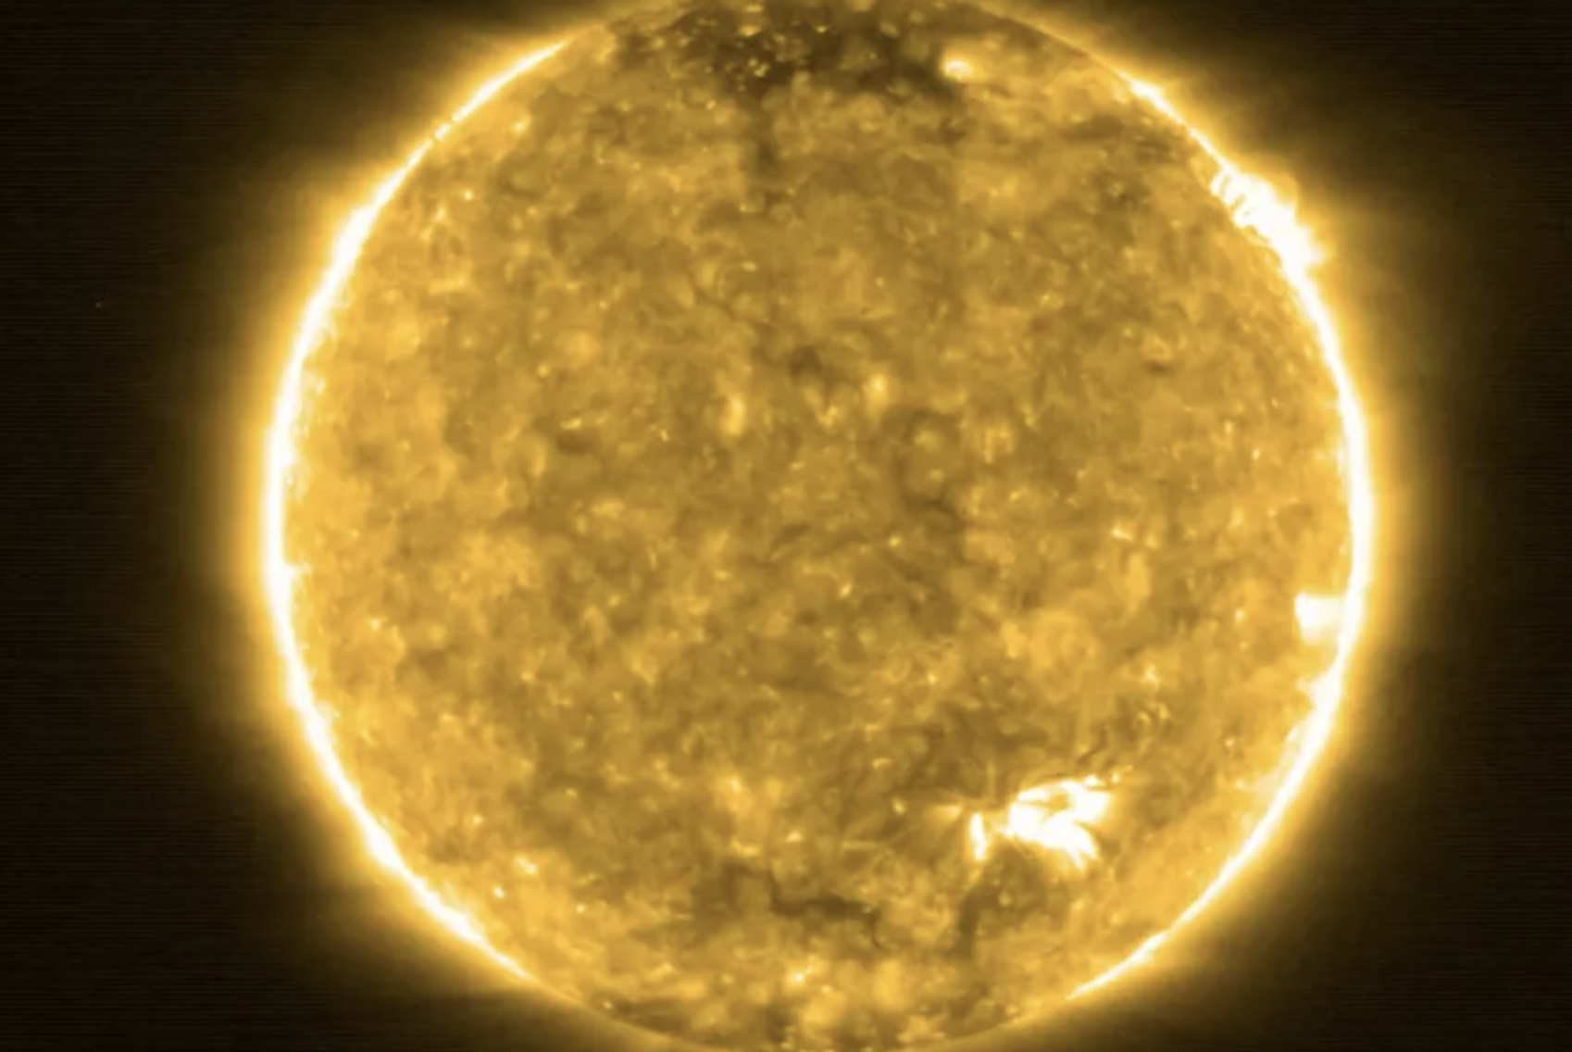
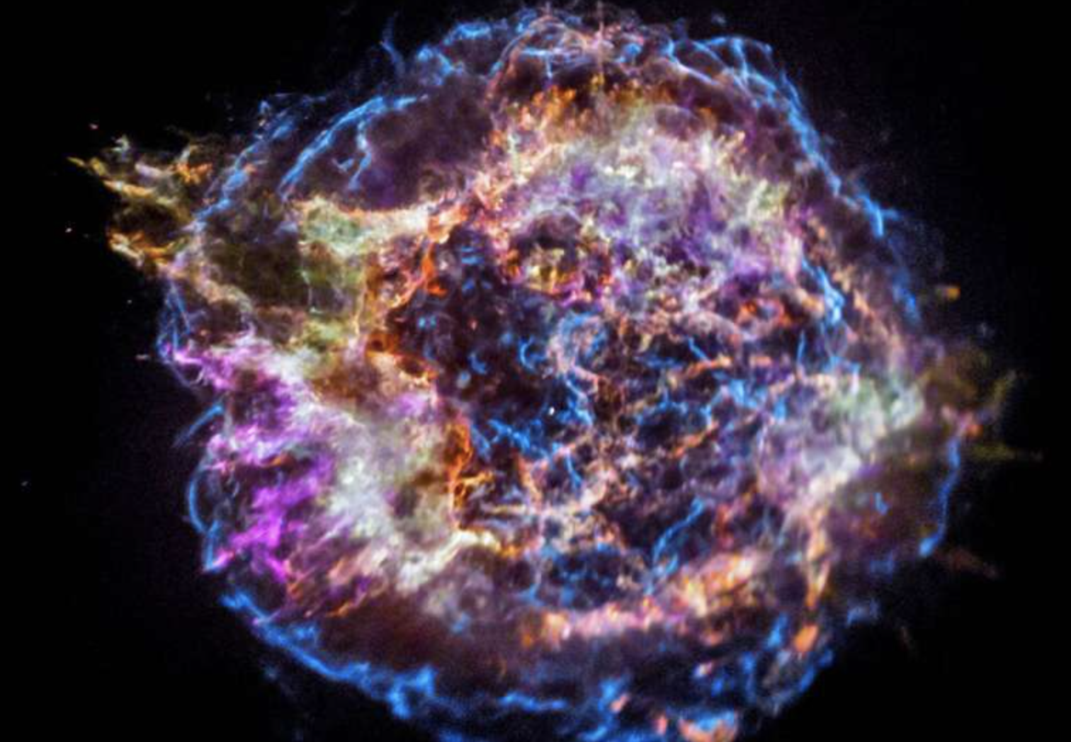
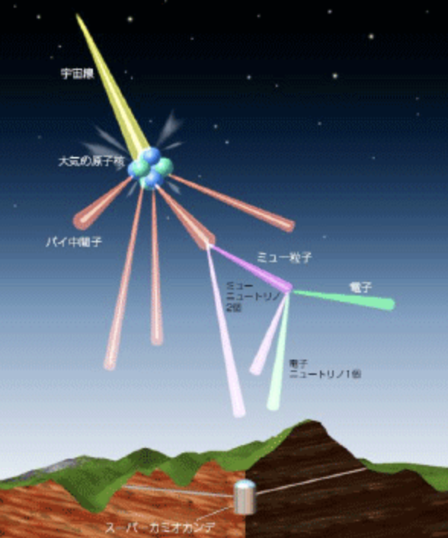
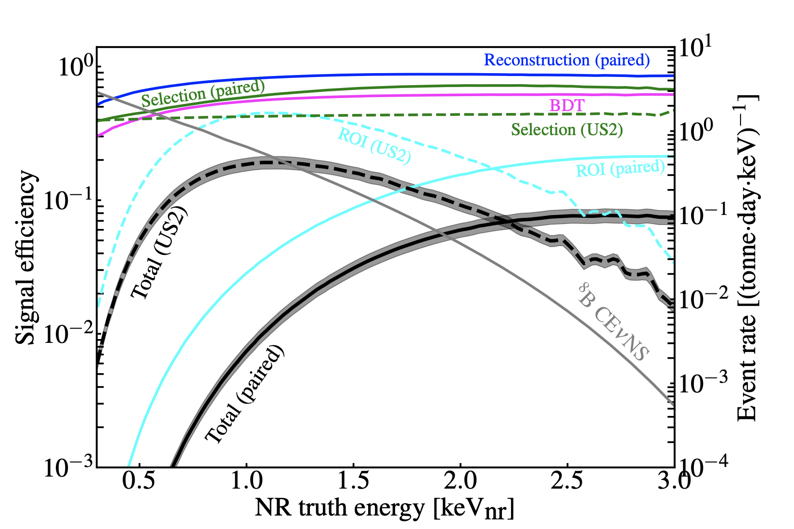
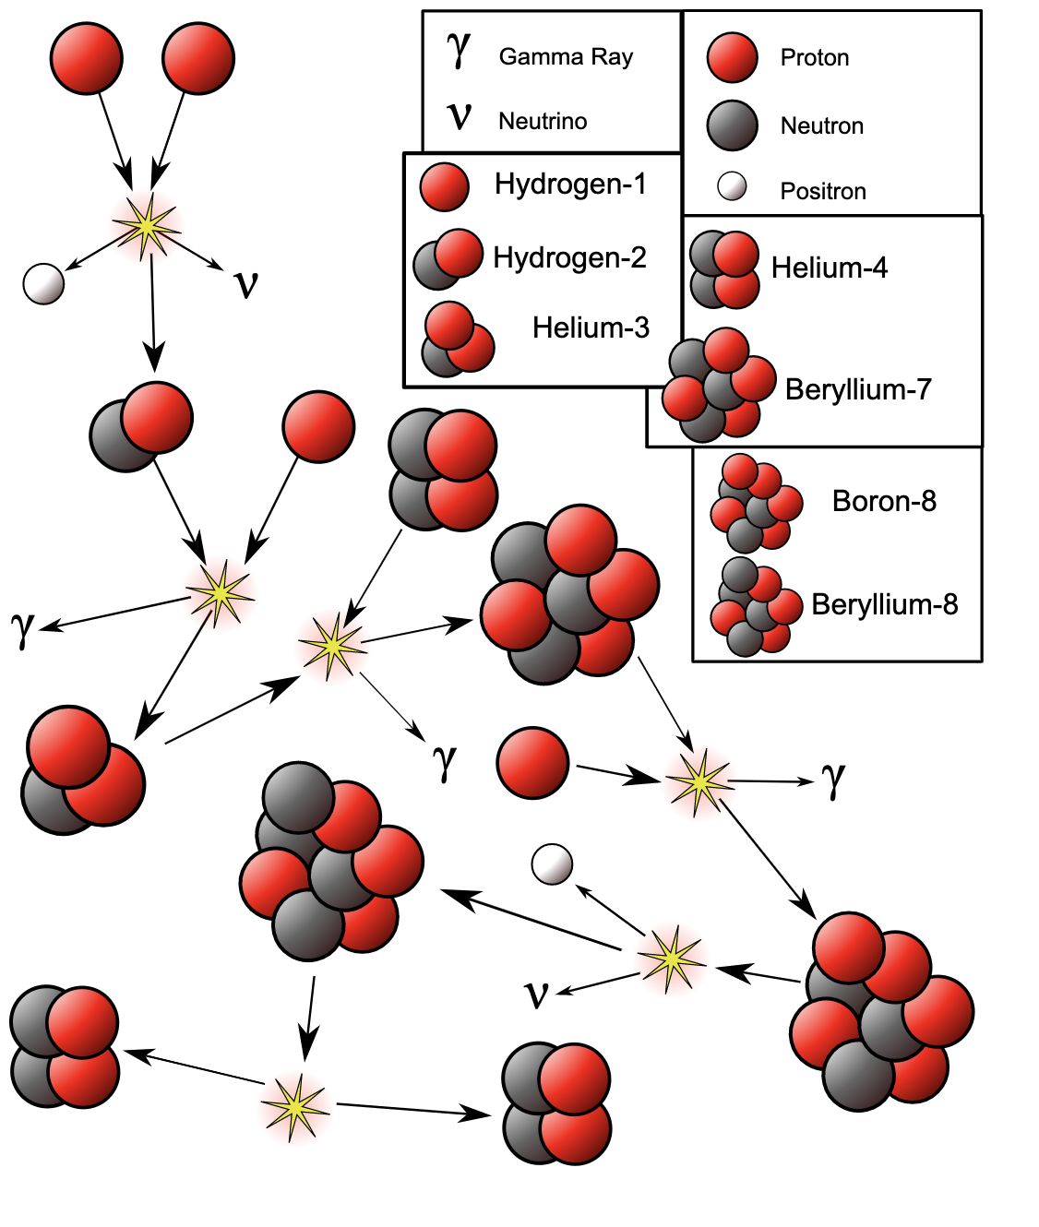
Search for solar neutrinos
Paired
S2-only
Baudis & Profumo, PDG2023
Solar
S1
S2
(~10% eff)
(~90% eff)
SN
Atomspheric
PandaX-4T searches for solar B8 CEvNS with lowered threshold;
Large amount of background emerged with lowered threshold;
Two data regions used: Paired and S2-only;
3

Slide 5
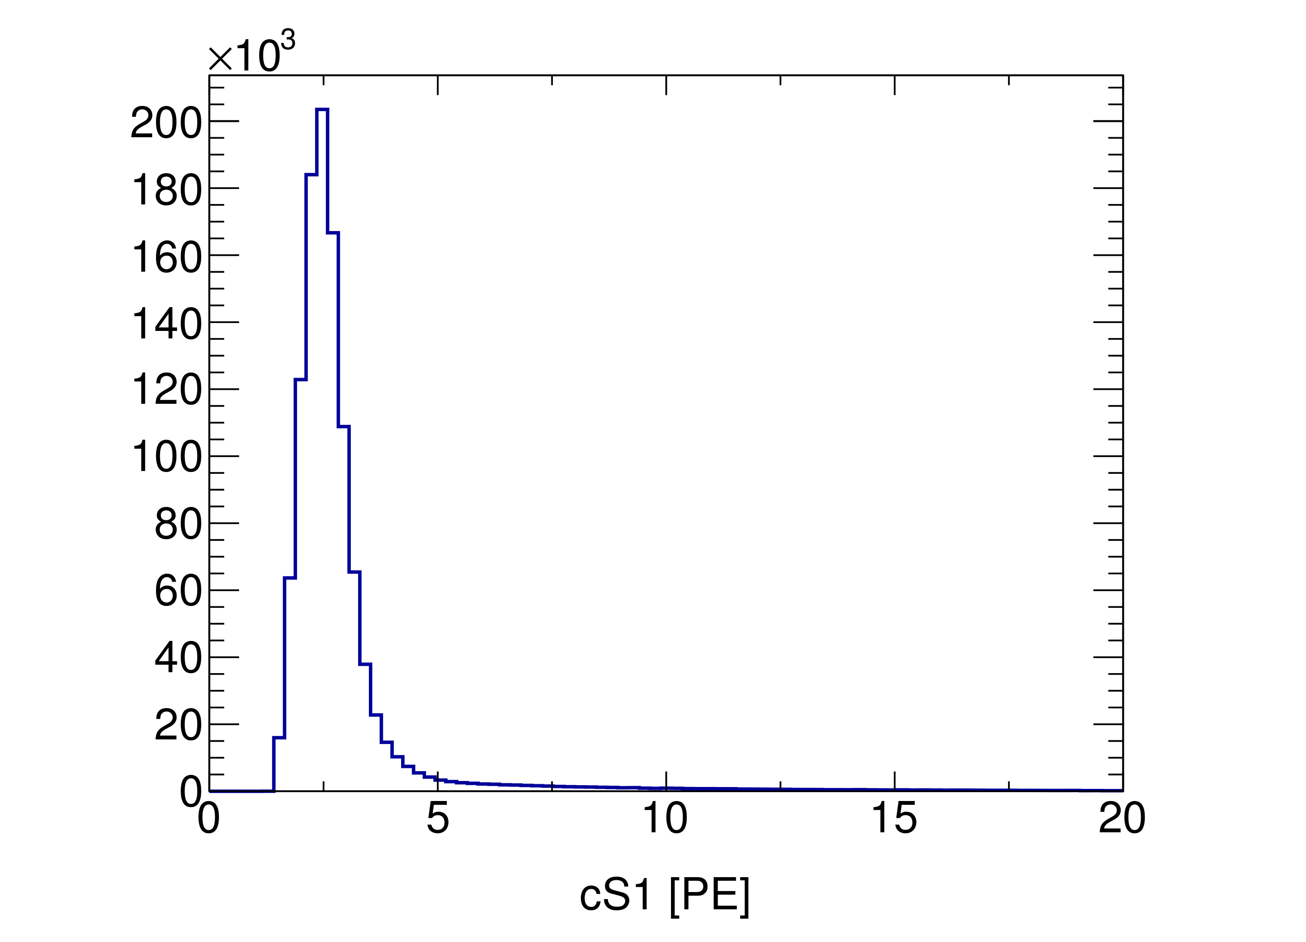
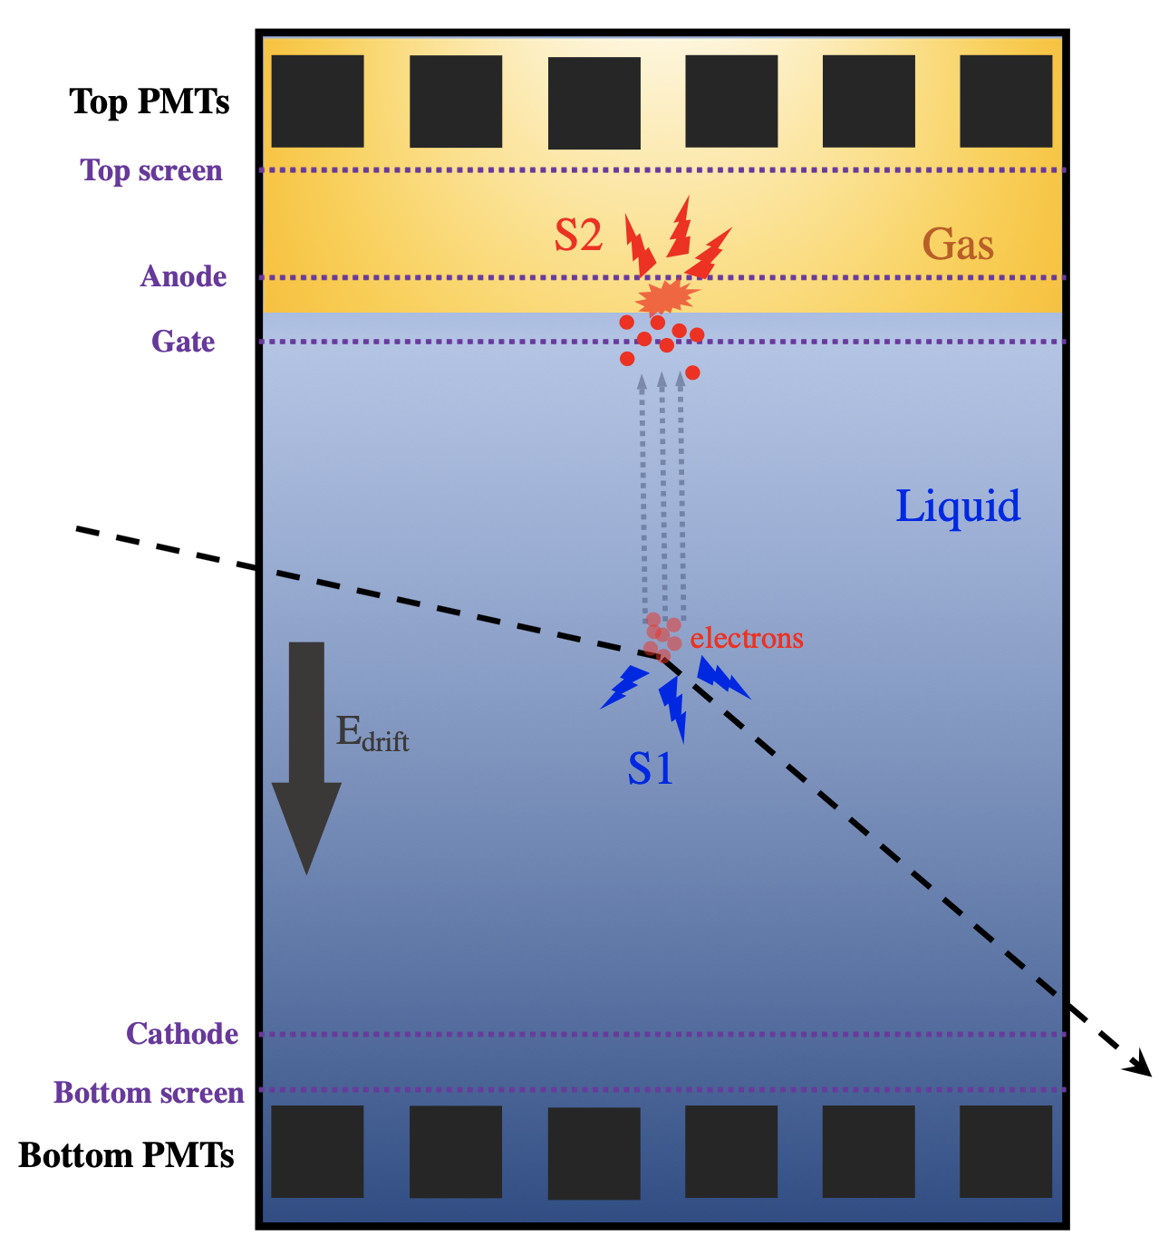
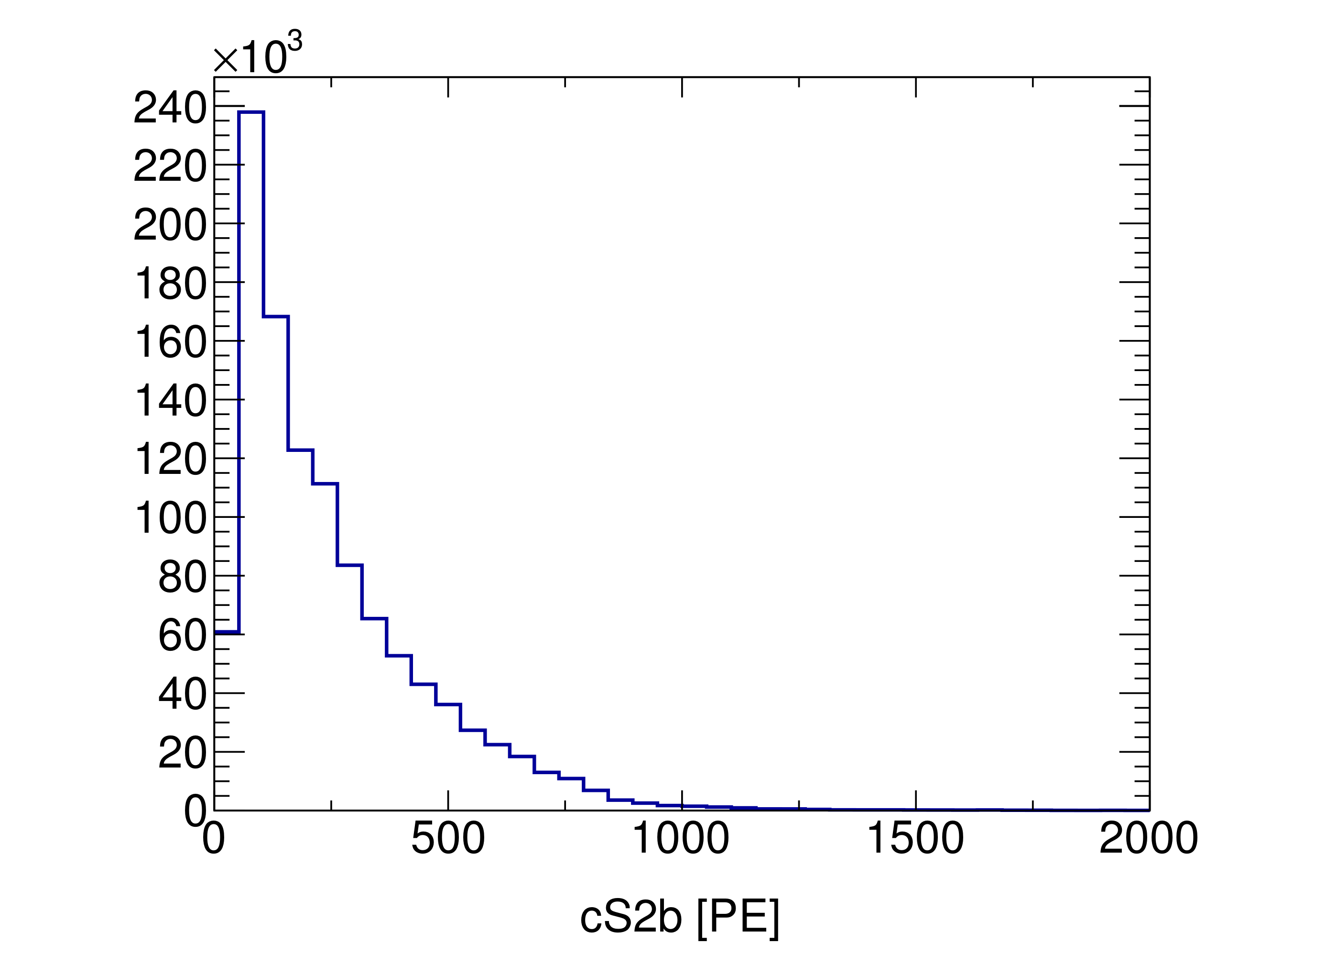
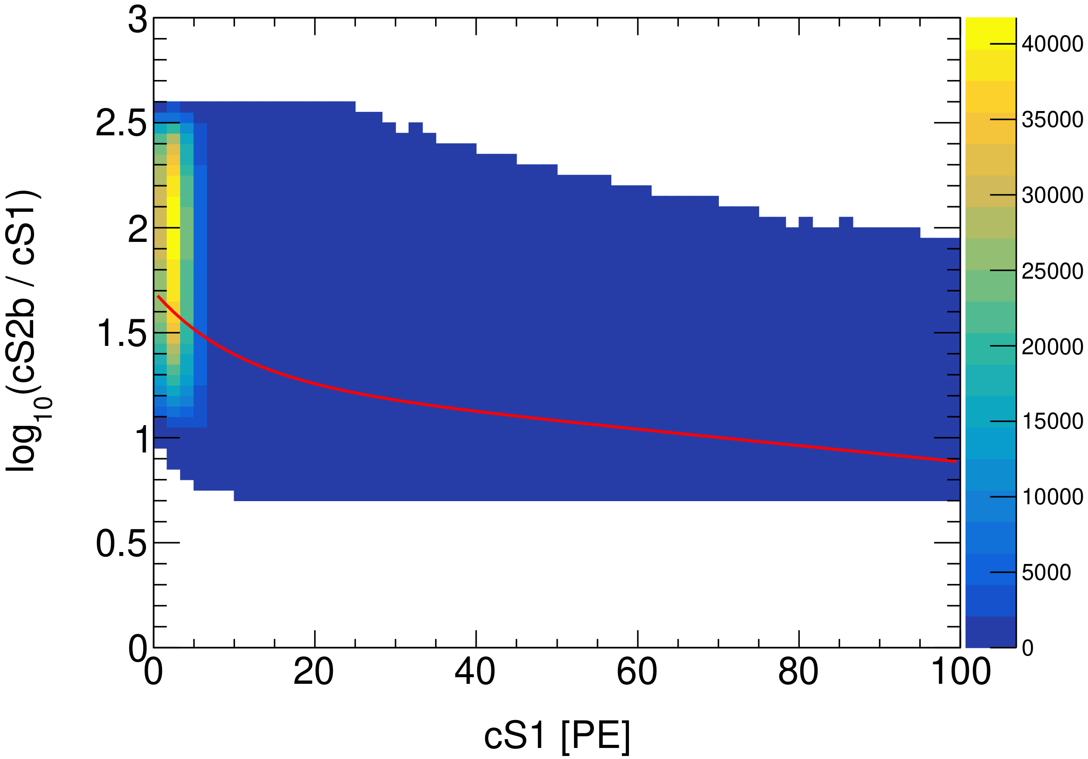
Major AC background for paired data
Isolated S1
e⁻
𝛄 or β
anode
E
Gas
e⁻
gate
Liquid
Isolated S2
Impurity
e⁻
e⁻
E
e⁻
AC
Isolated S1
Isolated S2
4

Slide 6
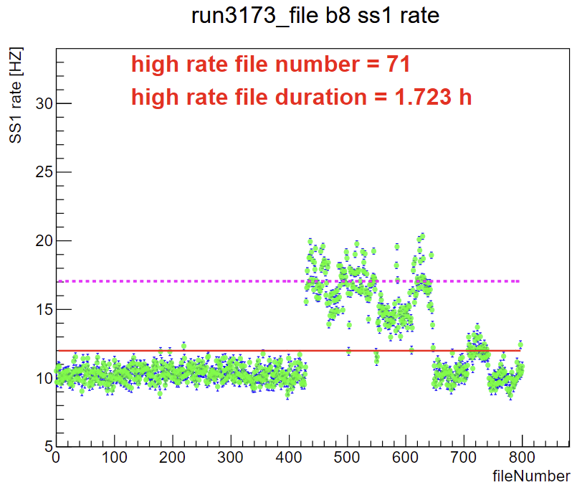
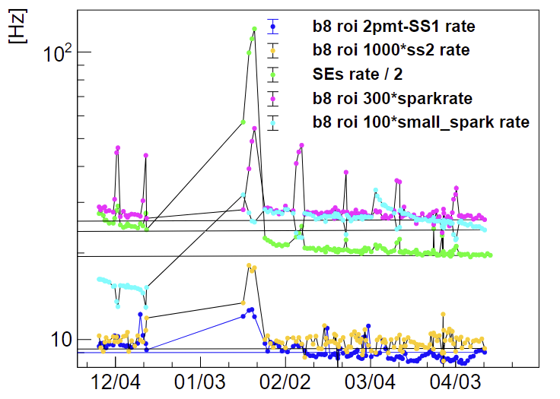
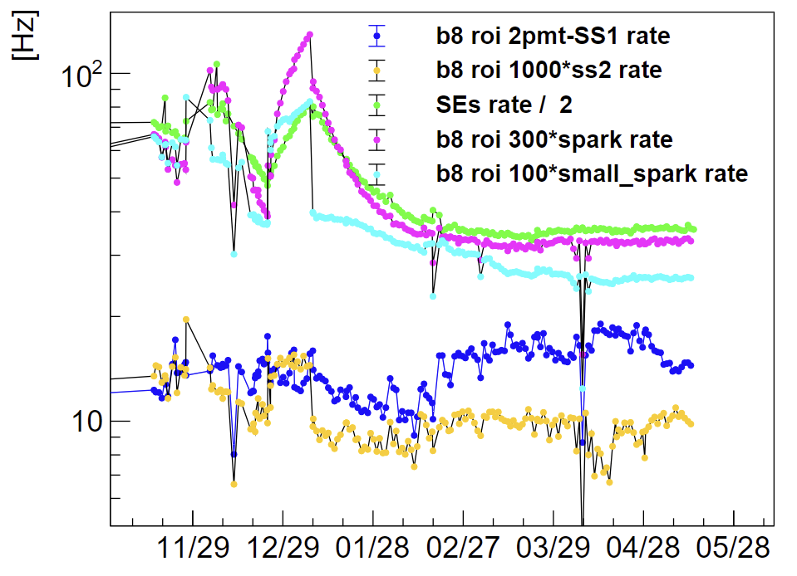
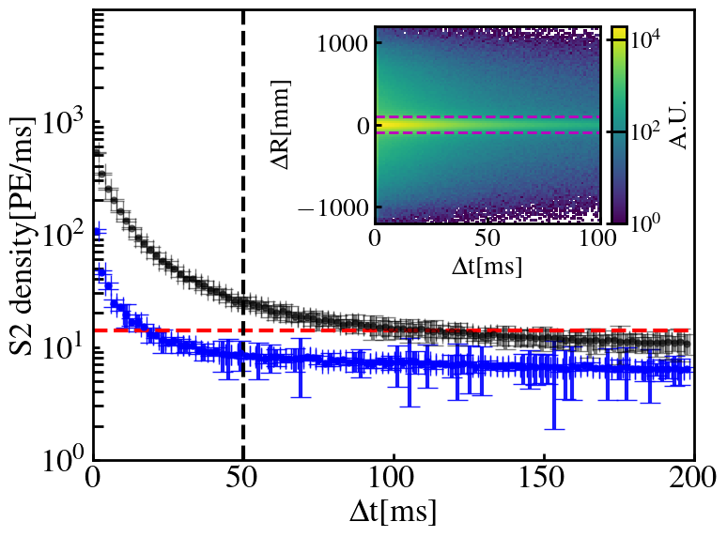
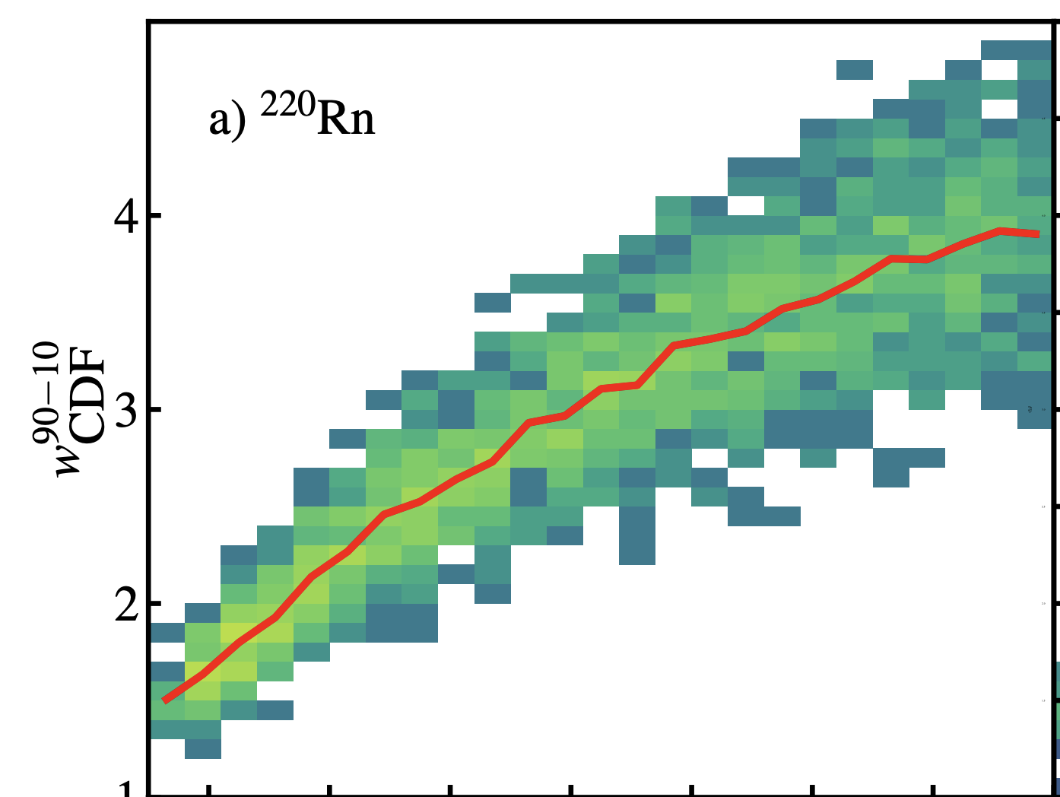
Data Selection in paired data
Raw data
Remove bad file
Remove deadtime
Golden data
 | Paired | US2
Exposure [tonne.year] | 1.20 | 1.04
Drift time
Tag abnormal data as bad file through detector parameters
Remove the period after the large signal and the volume near the large S2
5

Slide 7
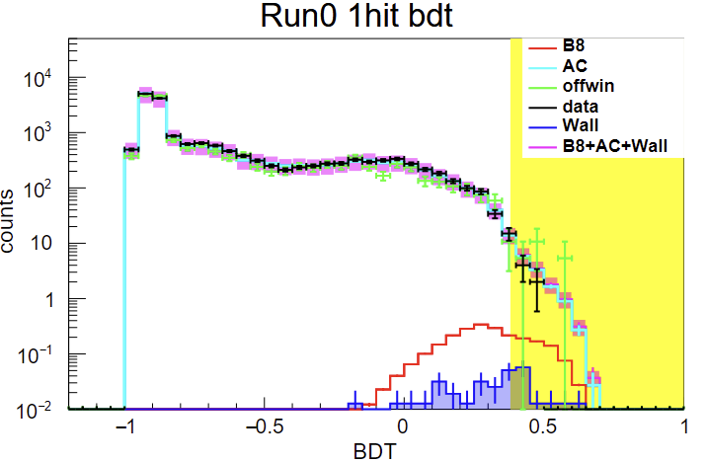
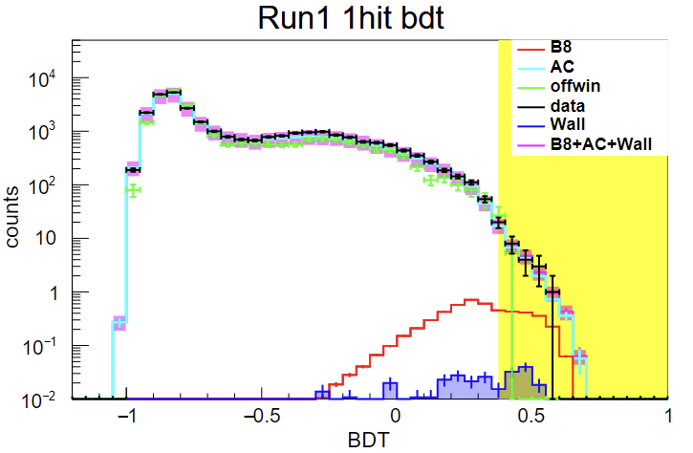
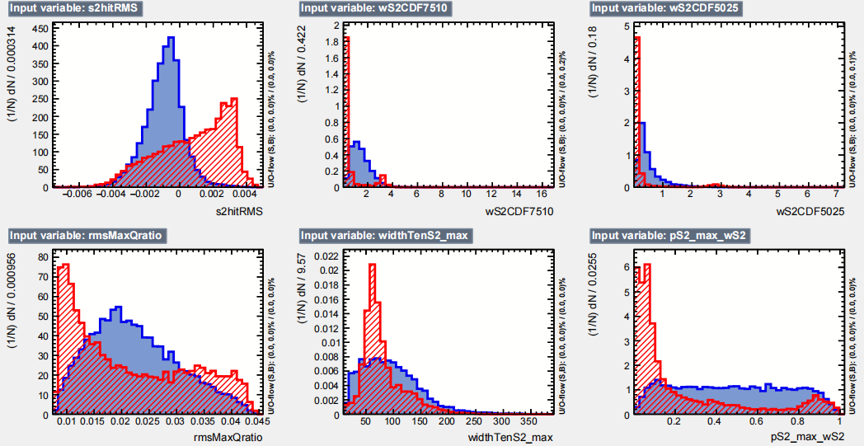

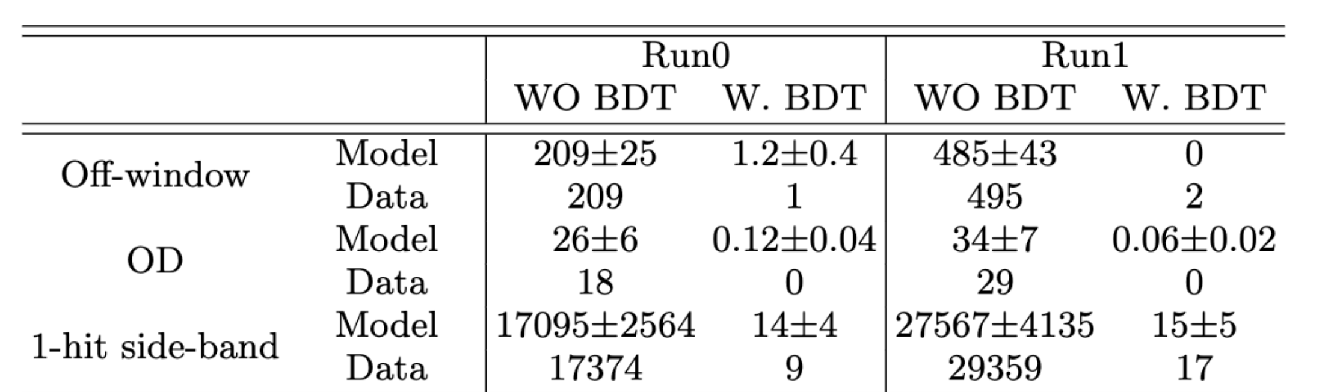
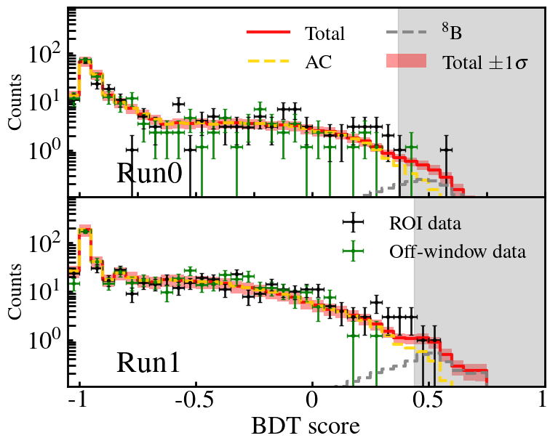
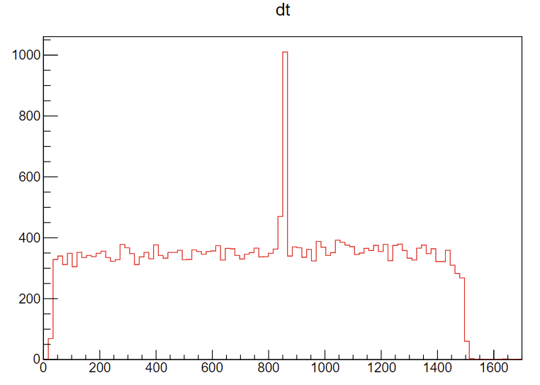
BDT suppression of paired AC
1-hit sideband
23 BDT variables
Variables developed for the shape and pattern features of S1 and S2;
Some BDT variables
ROI & Off-window
ROI
off-window
6

Slide 8
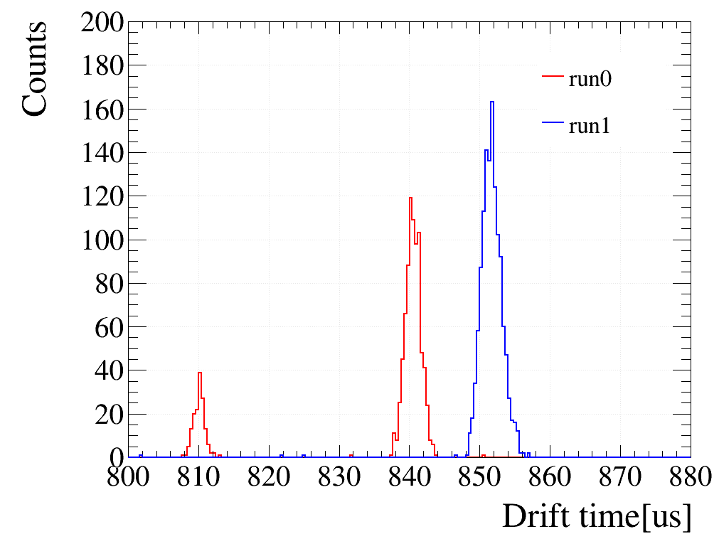
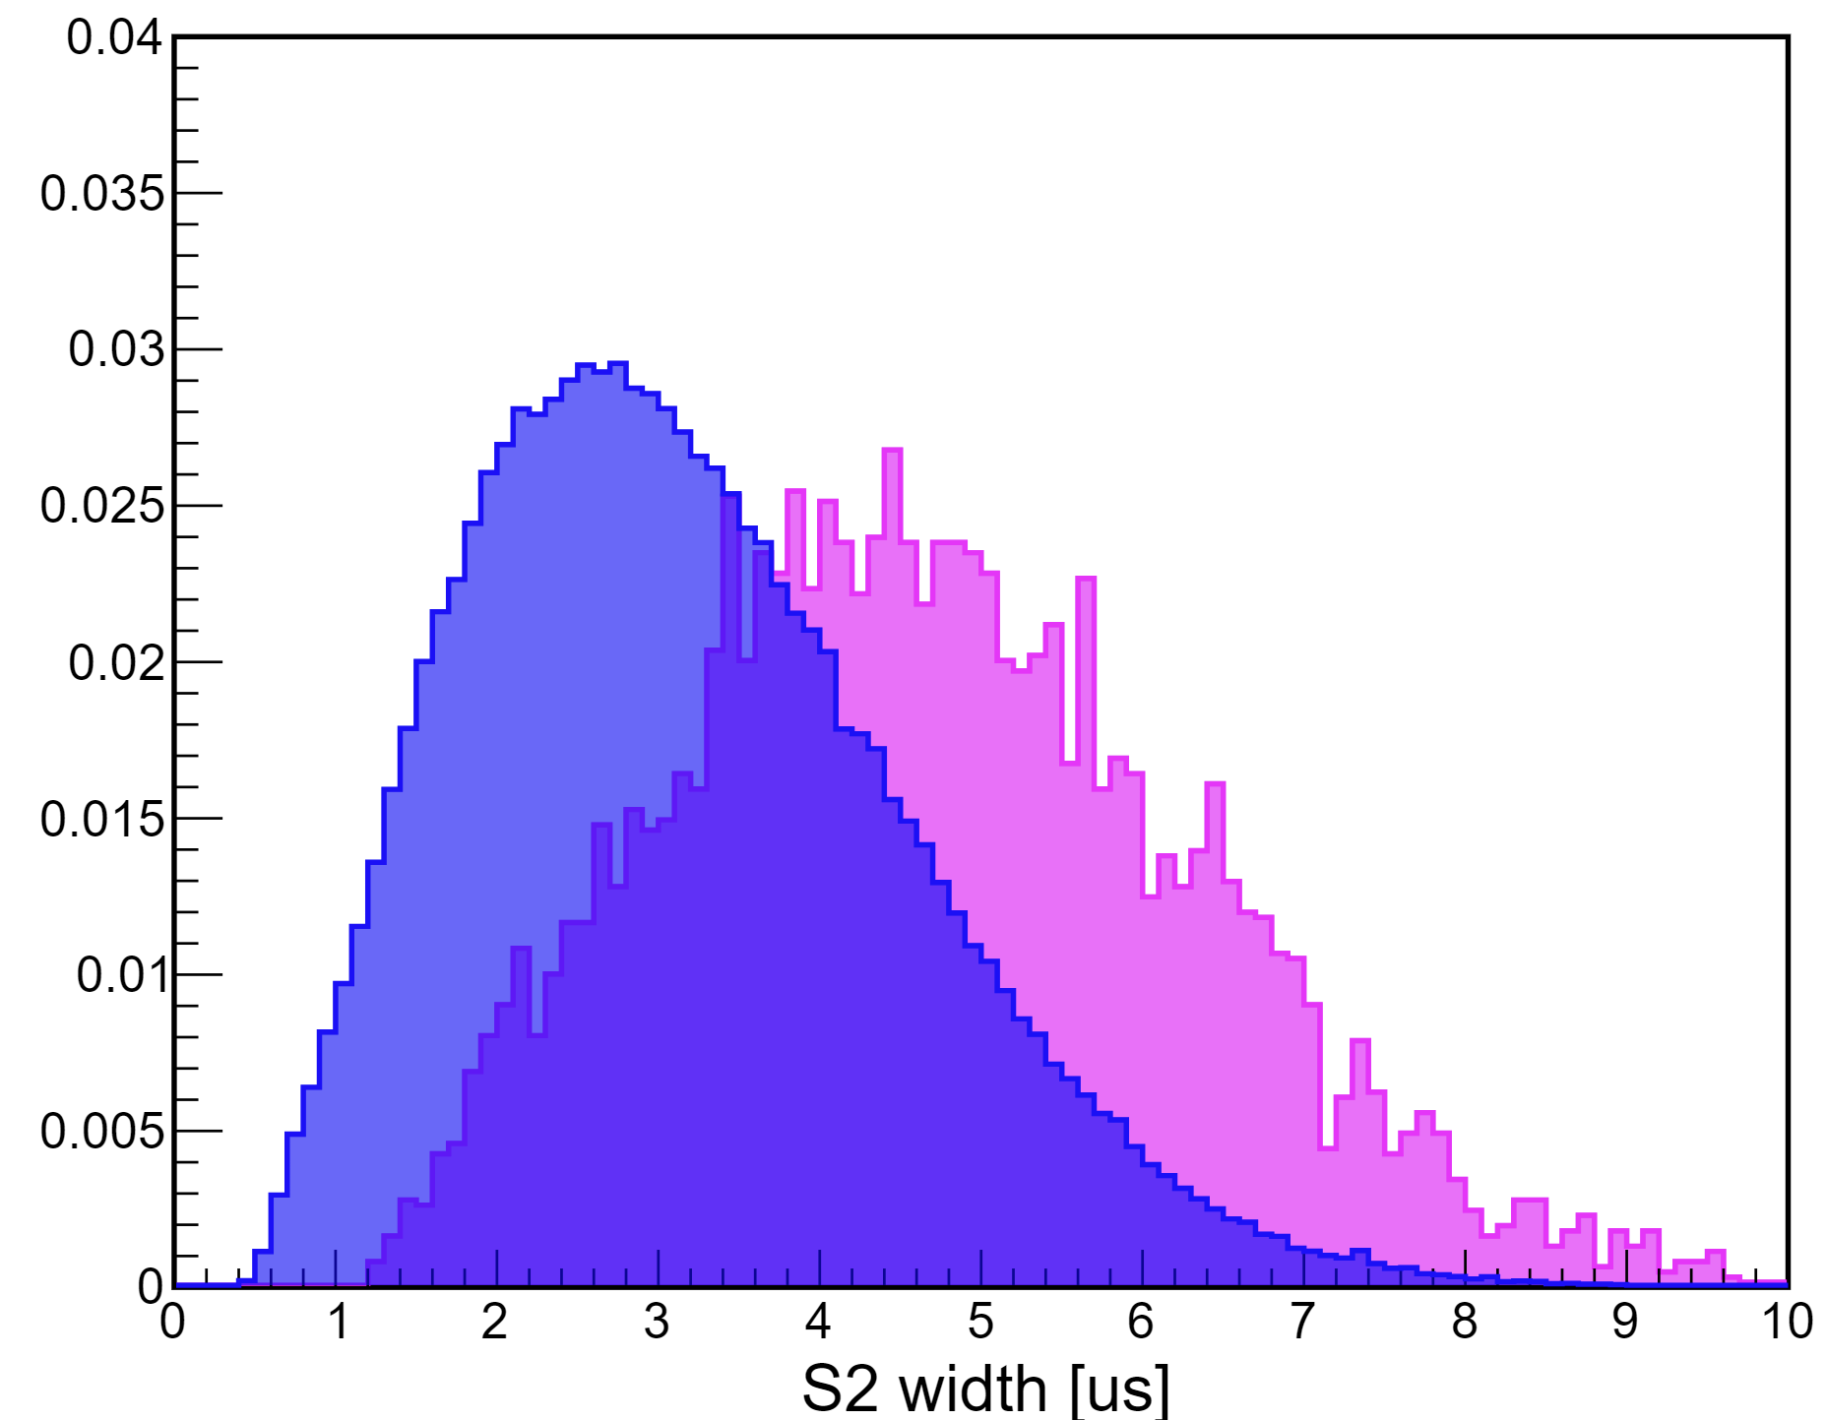
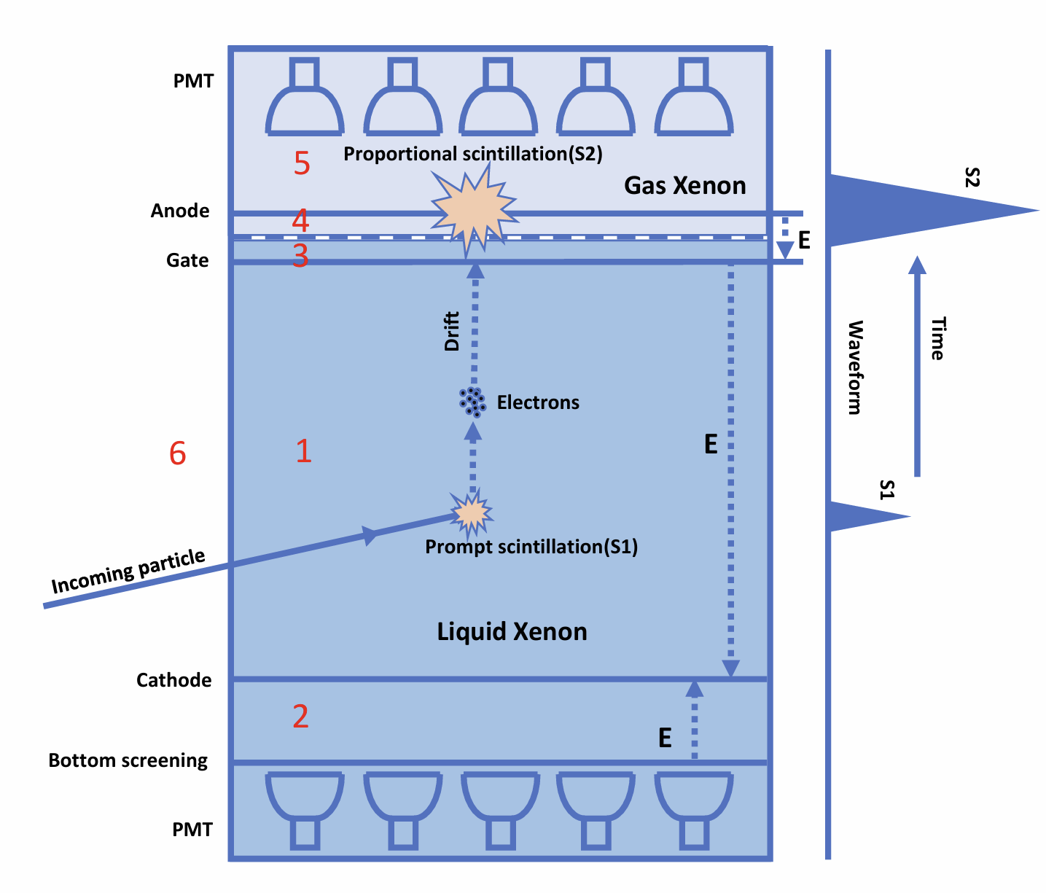
Cathode Background in S2-only data
Gate events can easily be removed by width cut
Cathode drift time distribution
B8
Cathode event
run0 set2
Cathode control samples are selected with characteristic drift time;
Cathode background has larger width due to its larger mean drift length.
7

Slide 9
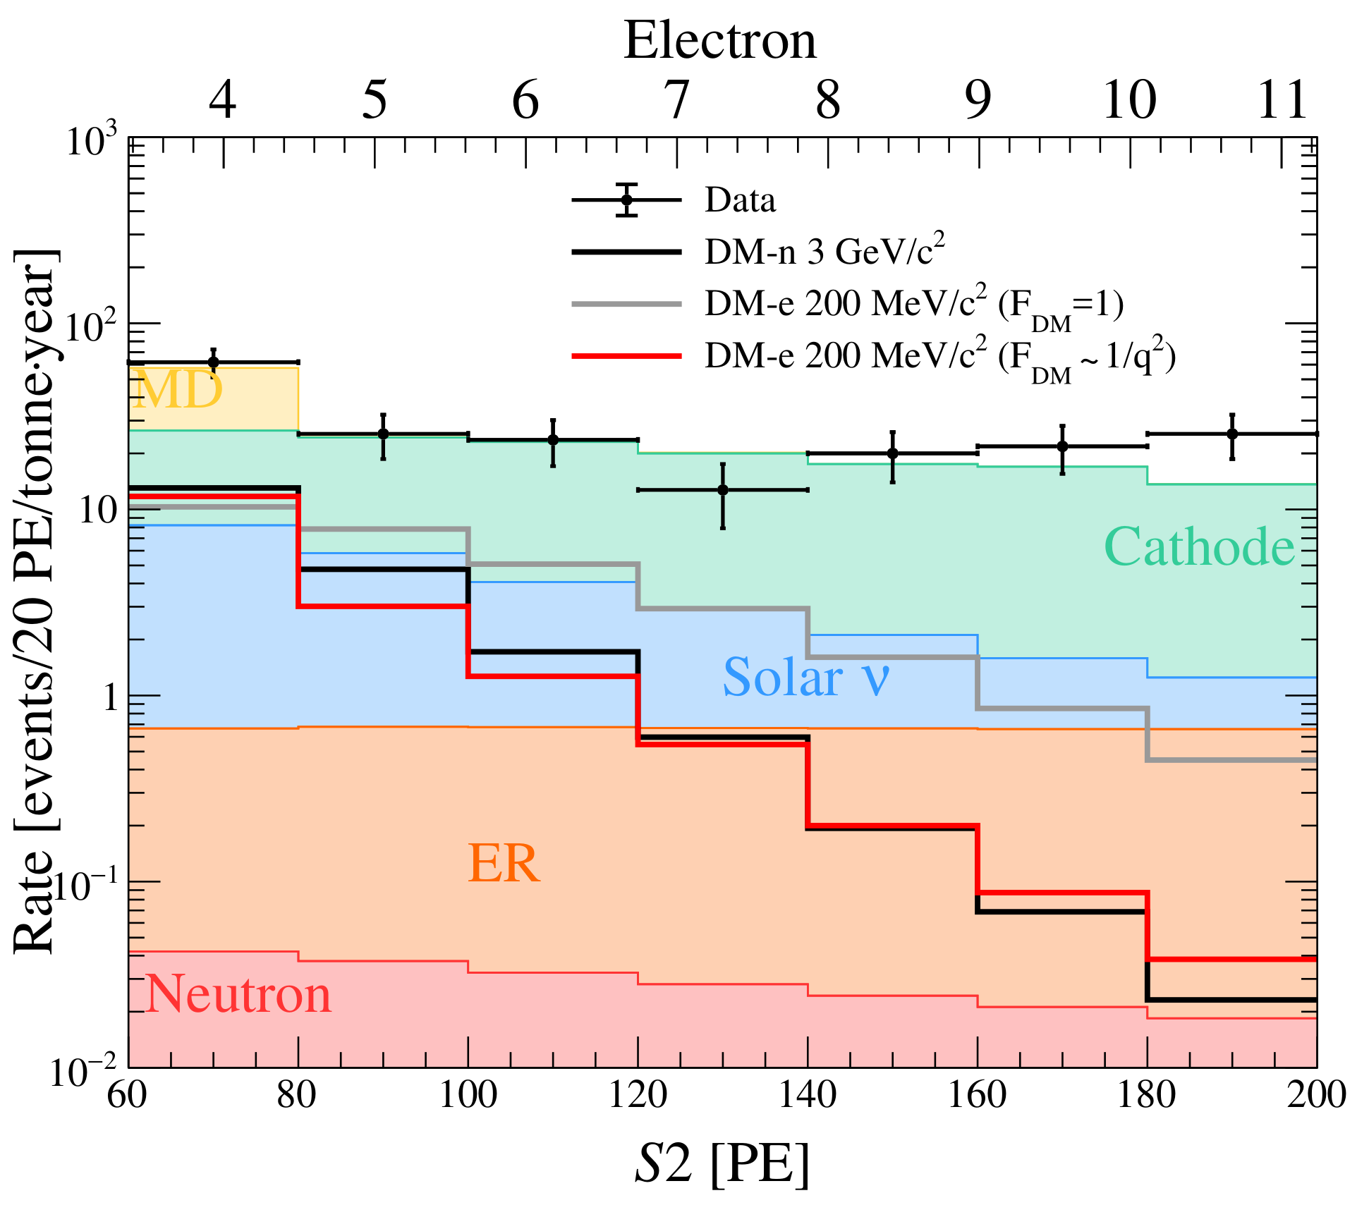
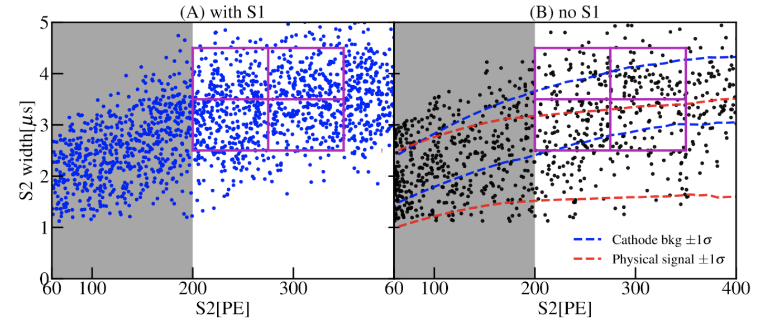
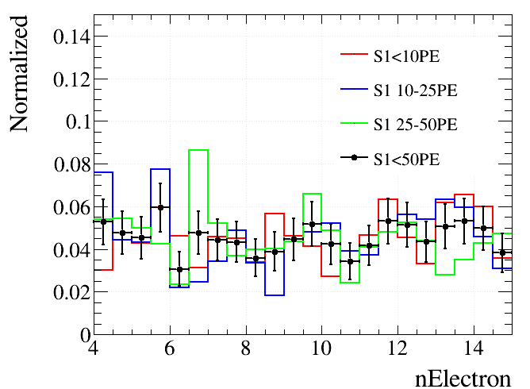
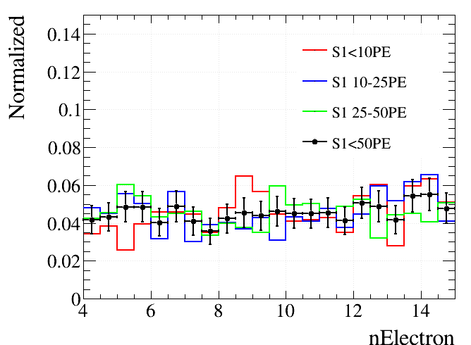
Cathode Background in S2-only data
Run0 as example (PRL 130, 261001)
Paired control sample
S2-only
Cathode bkg spectral shape in ROI is using cathode control samples;
The rate normalization is done using high-S2 sideband;
No S1 dependence is observed for the cathode background spectral shape.
Run0
Run1
8

Slide 10
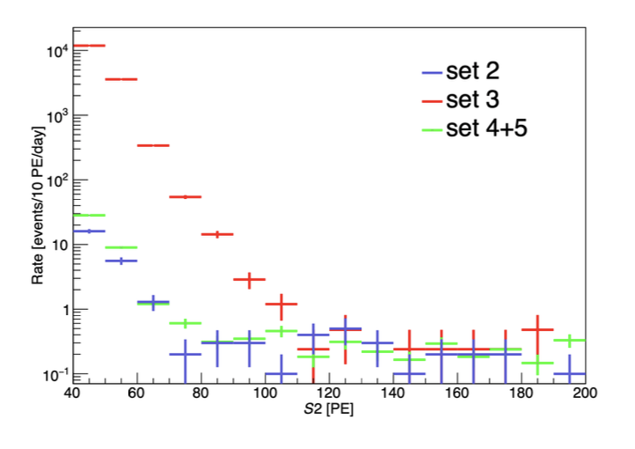
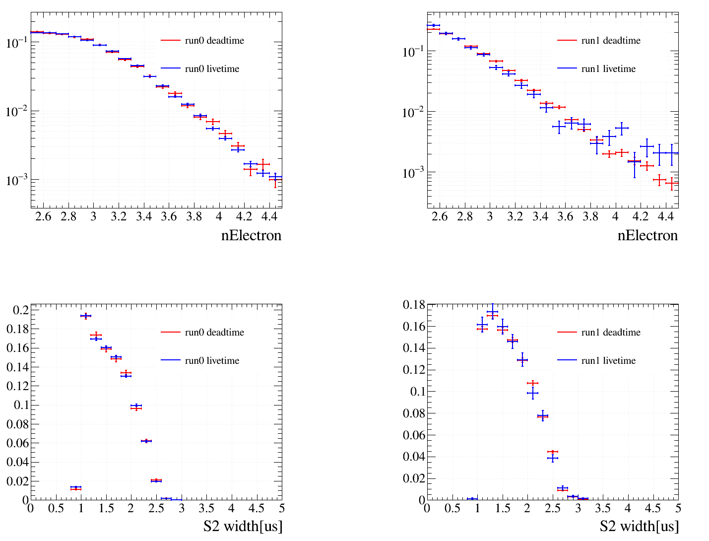
Delay electron (DE) background in S2-only data
Run0 as example (PRL 130, 261001)
Deadtime (Control)
Sideband normalization
Livetime (ROI)
2-3 e
Charge Spectrum
spectral
Width distribution
9

Slide 11
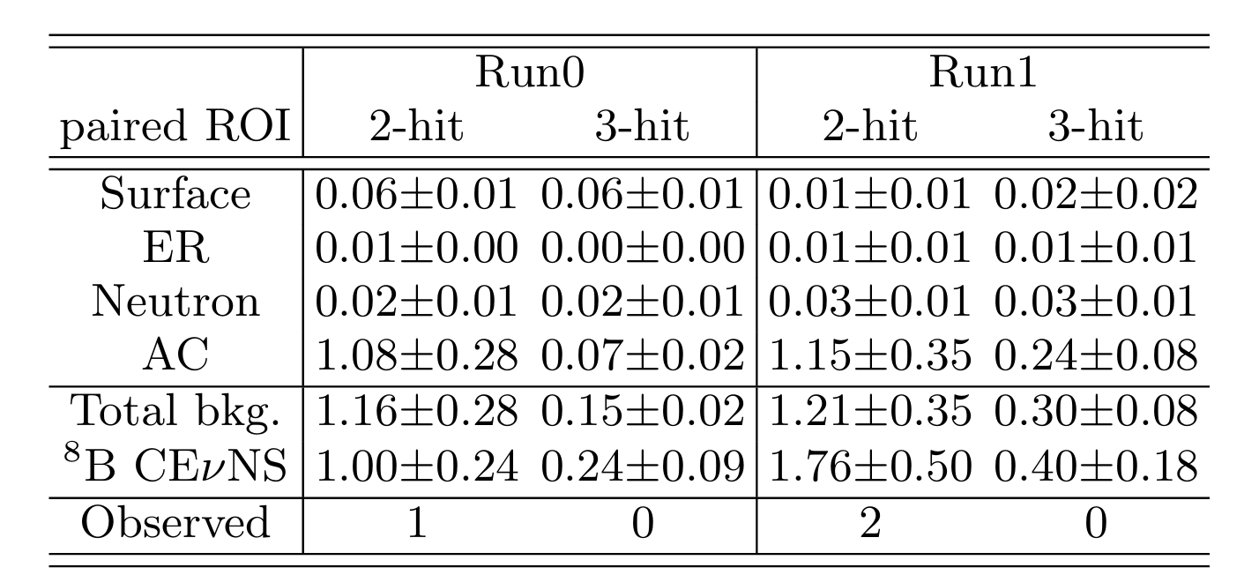
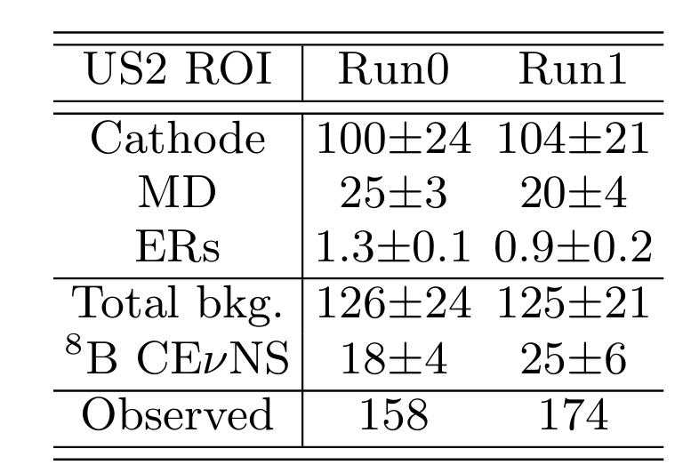
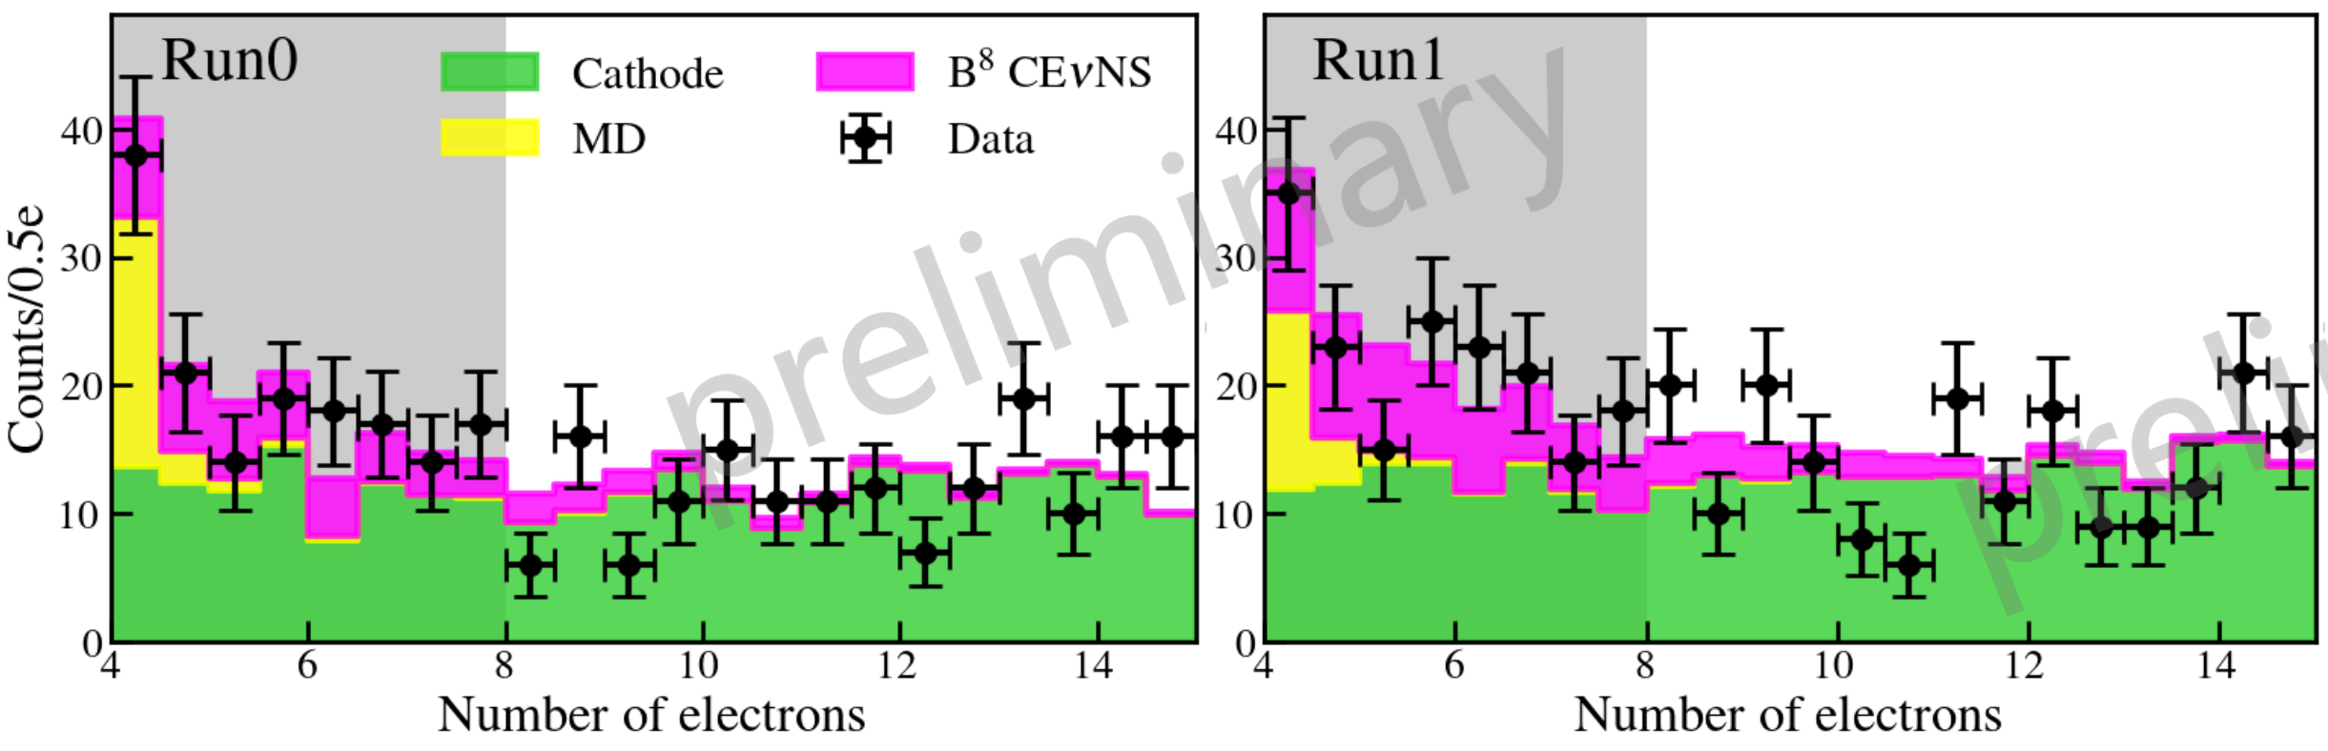
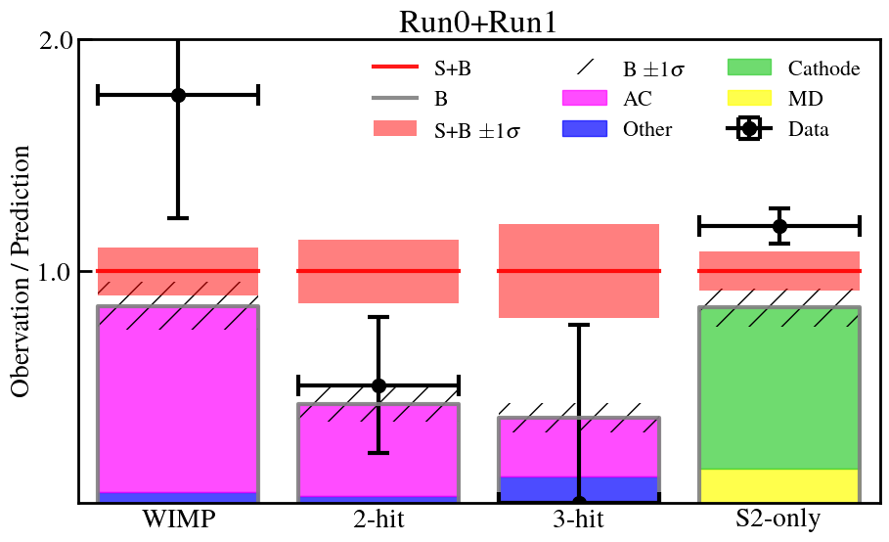
Data Unblinded
Paired data
S2-only data
Run0+Run1 seem to see an excess in US2 data
Paired data has a downward fluctuation
DE
DE
DE
10

Slide 12
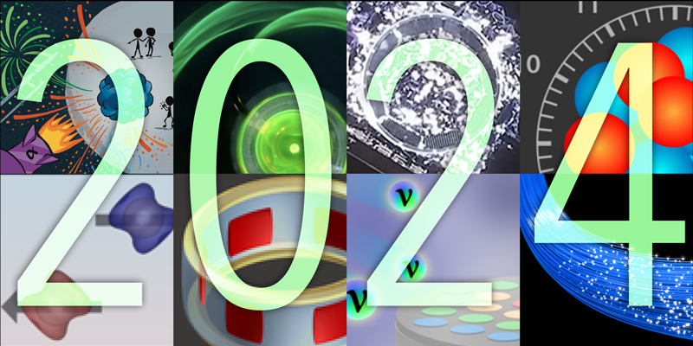
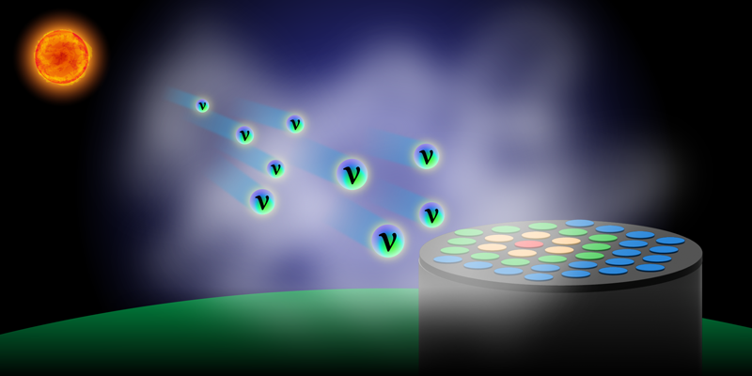
Indication of B8 CE𝝼NS
First indication of solar B8 CE𝛎NS signal
  Significance: 2.64𝜎
  Fitted flux (8.4 ± 3.1) x 10⁶ cm⁻² s⁻¹
PRL editor suggestion
Best-fit ⁸B yield
Paired: 3.5 ± 1.3 evts
S2only: 75 ± 28 evts
PRL 133, 191001 (2024)
11

Slide 13
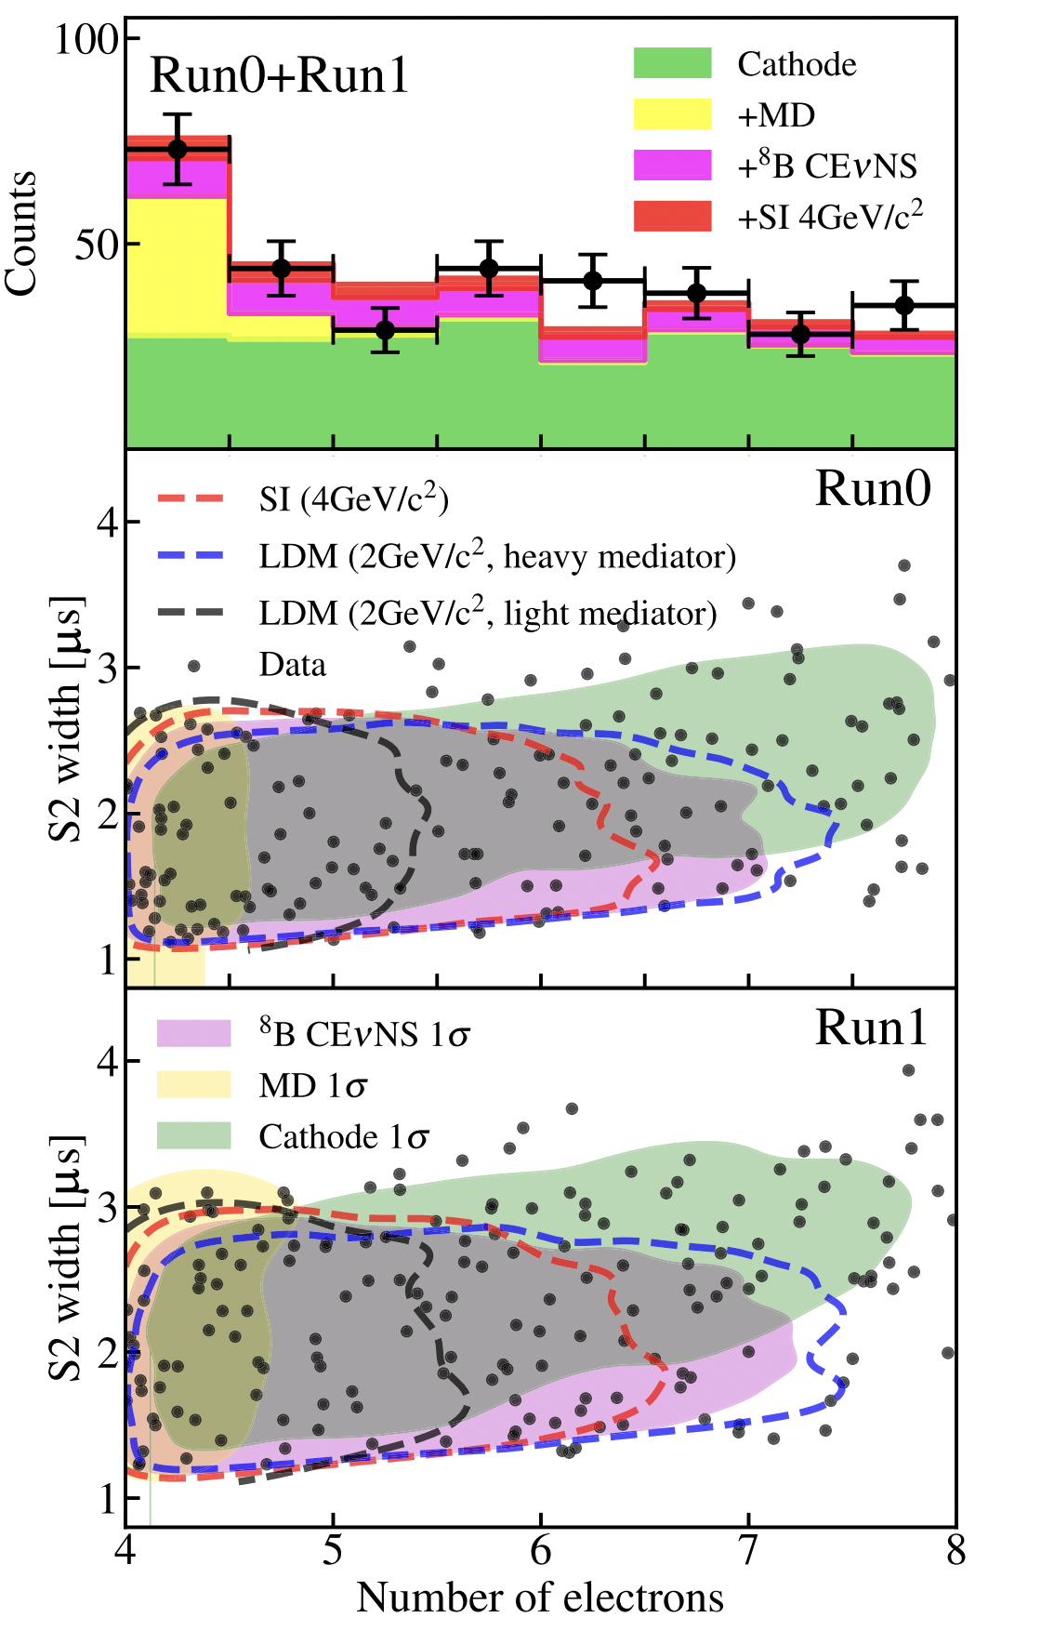

Extend to Light Dark Matter Search
Greatly lower the threshold for Noble Liquid TPCs;
Combine with large exposures, can reach good sensitivities for ~100 MeV LDM (LDM-e scattering);
PandaX-4T, PRL 135, 211001 (2025)
12

Slide 14

Run2 data
Total 438 calendar days in Run2!
Preliminary
Preliminary
DD
Rn
Kr
AmBe
13

Slide 15


Run2 data quality
DE differential probability
Isolated S1 rate
Preliminary
Preliminary
Isolated S2 rate
SS1 and SS2 rates are compatible with Run0 and Run1 before quality cuts applied;
The delay electron occurring probability after large S2 is getter smaller in Run2;
14

Slide 16


DE and cathode background in Run2
Compare with 10% open data
Preliminary
Preliminary
DE model = control region (spatially and temporally close to large S2) scaled based on sideband (2-3e); Not much different from Run01;
Cathode model = pre-cut spec * efficiency, which is obtained by control region, 20 times larger than Run01;
Match well with 10% open data.
15

Slide 17





Cathode increase in Run2
Run1
5.6 MeV
6.1 MeV
7.8 MeV
5.4 MeV
Run2
Po210
Po214
Po218
Run2 saw a significant increase of 210Po alphas (~20 times increase in rate), indicating 210Pb could be the reason of increased cathode events (betas);
This is likely due to the contamination during installation;
16

Slide 18


Future experiment: PandaX-xT
Next generation of PandaX detector:
47 tonne with 40 tonne as sensitive volume;
TPC 2.5m in diameter and 3m in height;
Cold LS veto right outside Cu cryostat;
2-inch Hamamatsu PMTs to be used;
First stage: PandaX-20T
(TPC with 2m in diameter and 2.6m in height)√
Sci. China Phys. Mech. Astron. 68, 221011 (2025)
17

Slide 19

Summary
B8 CEvNS search using Run0 and Run1 data sees indication of B8 signal with a significance of 2.6𝛔;
We saw an increase of cathode background in Run2 likely due to Pb210 attachment during installation;
Mitigation method using DNN and transformer is under-development!
Next stage of PandaX (PandaX-20T) is expected to be online in 2027, further improving the CEvNS search sensitivity!
Thanks for listening!
18

Slide 20
Backup

Slide 21




Transformer-based Discriminator
t2
t3
t1
Hit
startTimeHit=t2-t1
peakTimeHit=t3-t2
S2
Transformer to extract waveform information;
MLP to extract higher signal-level features;
Simulated B8 neutrino waveforms as “signal”;
Data-driven cathode S2s as “background”;
Preliminary

