Slide 1




Robust 3+1D simulations of BDNK causal relativistic viscous hydrodynamics
Toward dissipative relativistic astrophysics
Teerthal Patel
Postdoctoral Researcher, Department of Mathematics, Vanderbilt
VandyGRAF (Vanderbilt initiative for gravity, waves, and fluids)
arXiv:26??.xxxx Ongoing work with (Hirvonen H., Disconzi M., Bemfica F.S., Paquet JF, Noronha J.)
arXiv:2510.1660 (with Clarisse, N., Pinho, E. O., Patel, T., Bemfica, F. S., Hippert, M., & Noronha, J.)
TEVPA 2026, 28th August 2026

Slide 2

Navier-Stokes
Relativistic Hydrodynamics
Effective theory for long-wavelength fluid dynamics
Fluid variables: Velocity, Density and Pressure
Ideal (Inviscid)
Fluids
Non-dissipative
Non-Relativistic
Relativistic
4 DOFS
Energy-Momentum Tensor
Foundation of GRHD/GRMHD simulations in relativistic astrophysics
Ideal Relativistic Hydrodynamics + Einstein equations + Maxwell equations
Viscous
Fluids
Dissipative
IDEAL
Viscous Terms

Slide 3

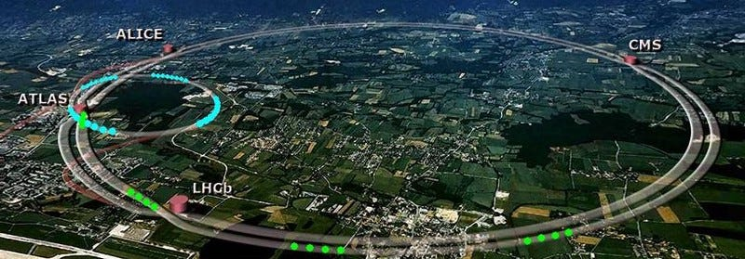
Relativistic Viscous Formulations
Recent interest in astrophysics
Most et al. ’21
Chabanov & Rezzolla ’23
Espino et al. ’23
Shibata et al. ‘25
BNS mergers
Accretion
How do we formulate relativistic viscosity?
Relativistic Generalization of Navier-Stokes
Gradient Expansion: Eckart (1940) and Landau-Lifshitz (1950s).
Acausal and Unstable.
IDEAL
Viscous Terms
Heavy-ion collisions / Quark Gluon Plasma
Established application of relativistic
viscous hydrodynamics
Second-Order: Müller & Israel-Stewart (MIS) in the 60s.
Viscous terms are variables with relaxation-type EOMs
Causality not rigorously established.
(Bemifica et al., 2026 : Causality conditions for a class of MIS-type theories)
Causality + Stability + Hyperbolicity
Essential for relativity and numerical simulations
First-Order theories are always acausal and unstable?

Slide 4
BDNK (Bemfica, Disconzi, Noronha, Kovtun)
Most general viscous energy-momentum tensor with first order gradient terms.
BDNK: Causal First-order Viscous Hydrodynamics
Causal and Stable First-Order Gradient Expansion Theory
IDEAL
Bemfica, Disconzi and Noronha, 2018
Kovtun, 2019
Example: Gradient correction to the energy density
Explicit constraints on transport coefficients
CAUSAL | STABLE | HYPERBOLIC
Causality & Stability conditions: Can be checked when initializing
Can we turn it into a useful general numerical tool?

Slide 5

Simulating BDNK
2+1D Flat Spacetimes
2+1D QGP: Heavy Ion Collisions
1+1D Neutron Stars
Pandya et al. ’21, ‘22
Bantilan et al. 2022, Bea et al. 2023, Bhambure et al. 2025, Fantini et al. 2025
Keeble et al. 2025, Shumet et al. 2025.
Our Work : General 3+1 Dimensional Relativistic Simulations
2nd Order PDE System 1st Order flux conservative form (Finite volume methods)
Mathematical Formulation (2 Mathematically Equivalent Formulisms):
  Full First order formulism (Strictly Flux Conservative with Curl-Cleaning)
  Hybrid formulism (Computationally cheaper – Similar to HIC sims)
  Numerical Implementation :
Arbitrary Spacetimes (Thousands of terms)
General Equation of State (Analytical and Tabulated)
C++ Portable code (Scalable on CPUs and GPU clusters)
Testing is crucial!
Convergence tests
Shock tests
Low
viscosity
Ideal
Hydro

Slide 6
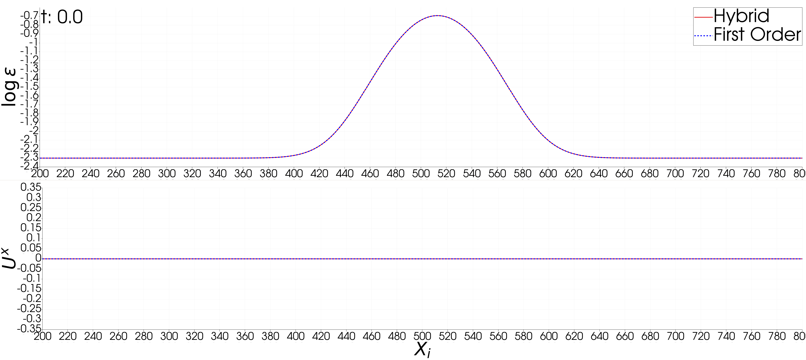
Validation I (2 Formulisms): 1+1 Gaussian
Comparing the results from the two independent formalisms

Slide 7
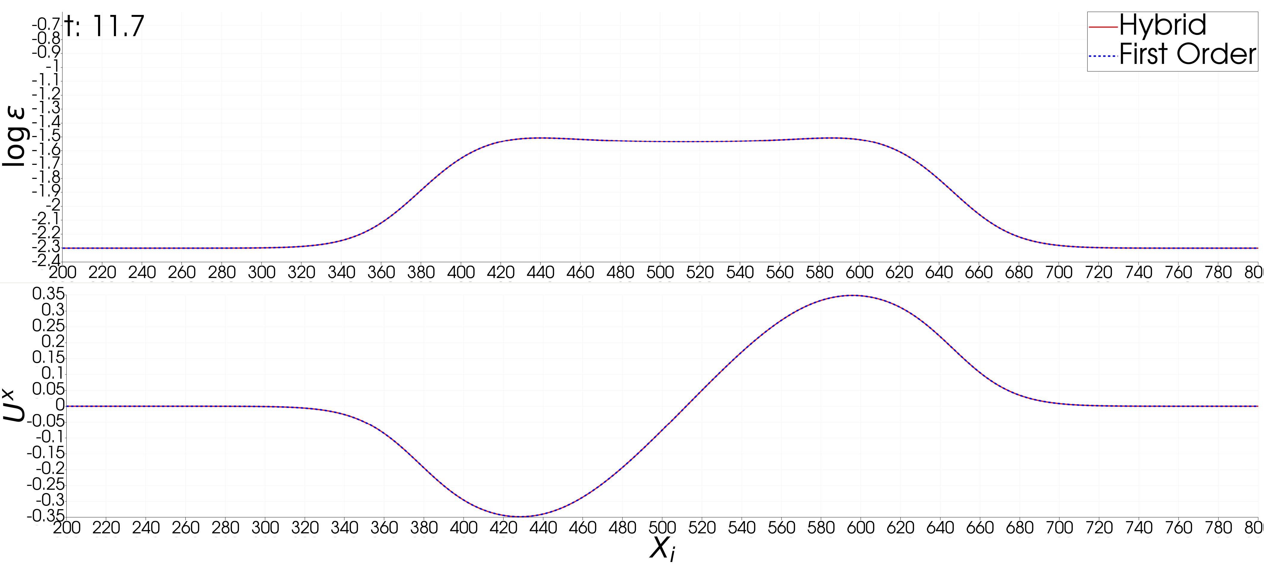
Validation I (2 Formulisms): 1+1 Gaussian
Comparing the results from the two independent formalisms

Slide 8
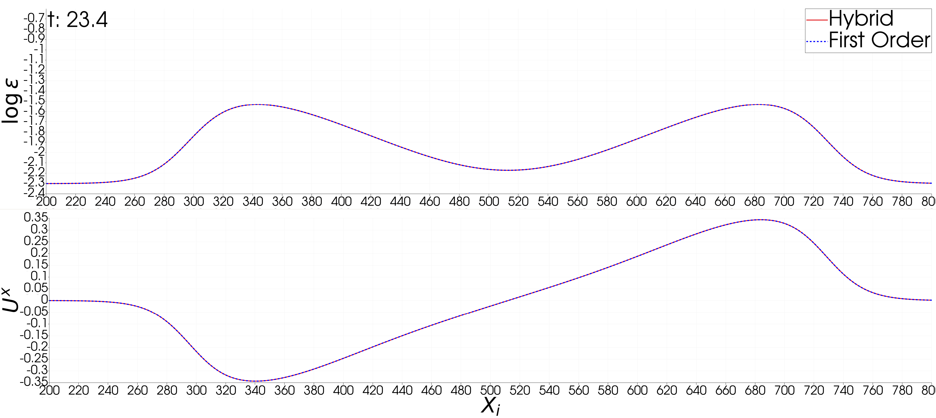
Validation I (2 Formulisms): 1+1 Gaussian
Comparing the results from the two independent formalisms

Slide 9
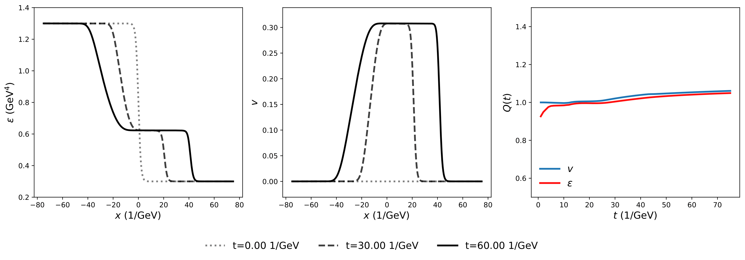
Validation II:
Shock Tube tests
Shock tests conducted to check numerical stability : With an independent code
Clarisse, N., Pinho, E. O., Patel, T., Bemfica, F. S., Hippert, M., & Noronha, J. (2025). arXiv:2510.16603.

Slide 10
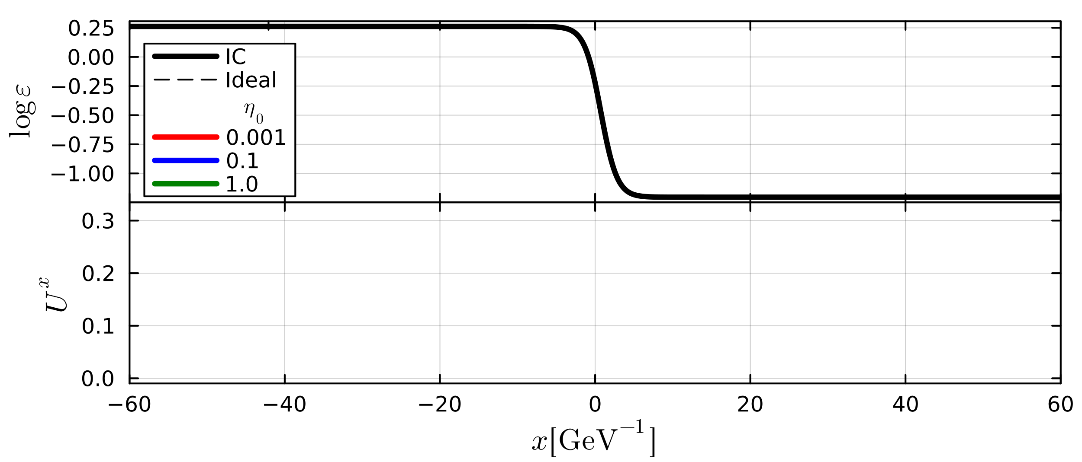

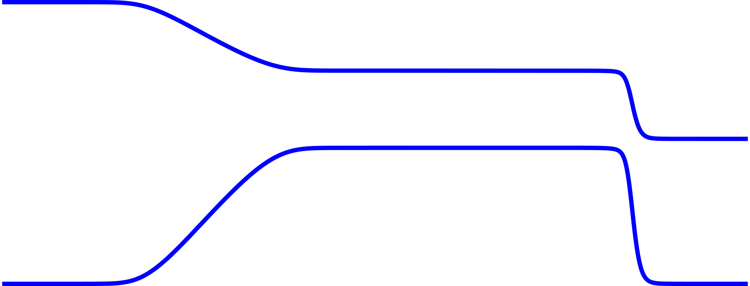

Validation II:
Shock Tube tests
Validated against code of Clarisse et al (2025)
Agreement with Ideal at low viscosity

Slide 11

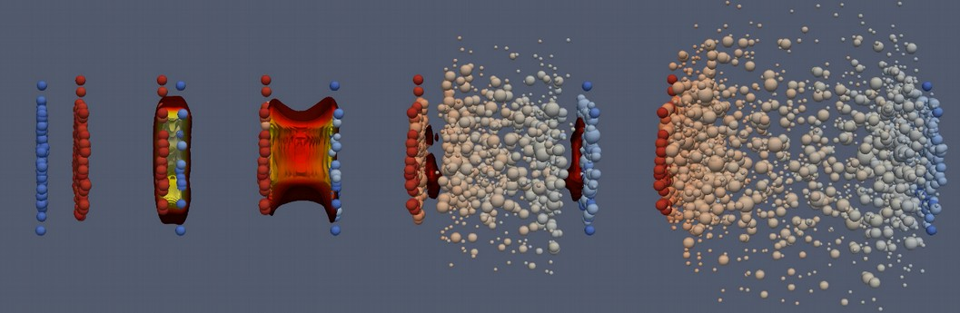
Validation III: Gubser Flow
Illustration of a Heavy Ion Collision [Ref: MADAI collaboration, Hannah Petersen and Jonah Bernhard]
Hyperbolic coordinates used in heavy ion collisions
Minkowski metric with curvilinear coordinates
Gubser Flow
Cylindrically symmetric flow with semi-analytical solution
Toy model for QGP expansion
Semi-analytical solution : Bemfica et al. 2018

Slide 12

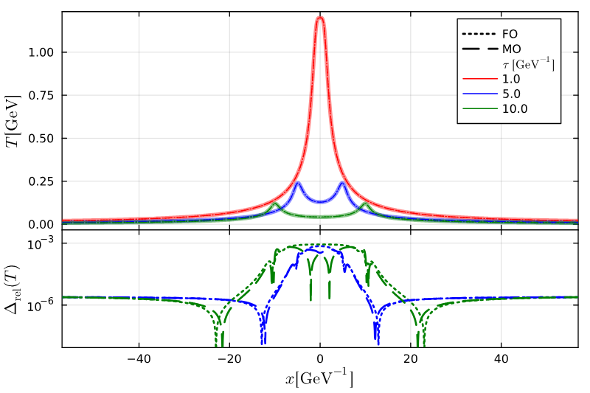
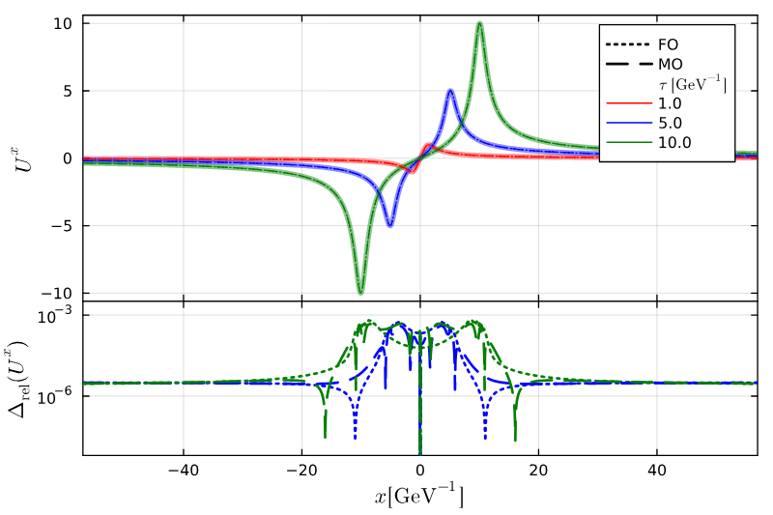
Validation III: Gubser
Conformal fluid set up in 2+1D (xy-transverse plane).
Initialized with semi-analytical solution for temperature and velocity.
Agreement with semi-analytical solution.
Two formulisms are consistent.

Slide 13
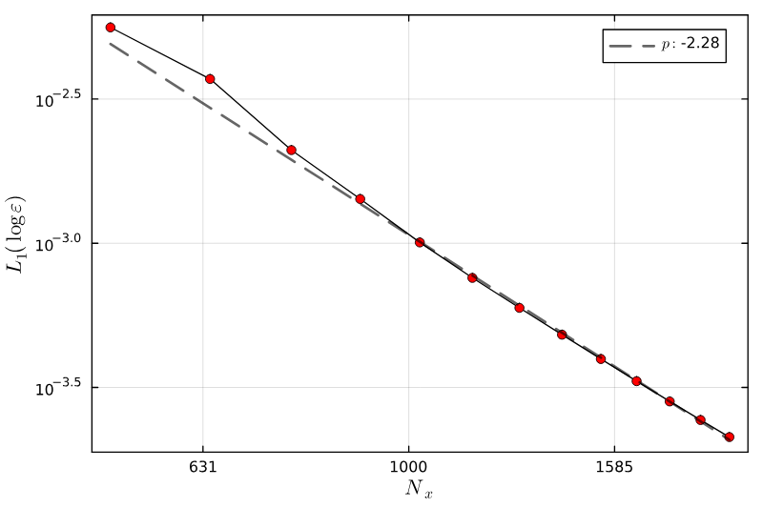
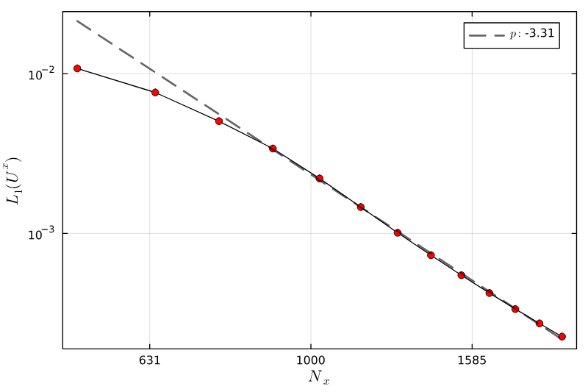

Validation I : Gubser flow
Validation III: Gubser
Convergence Test : Simulation should converge to the continuum solution with resolution
at a certain rate
Error scaling for 2nd Order Finite Volume methods
Error computed relative to the true semi-analytical solutions

Slide 14
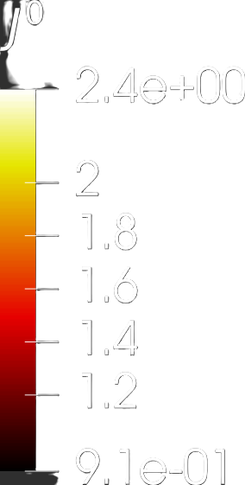
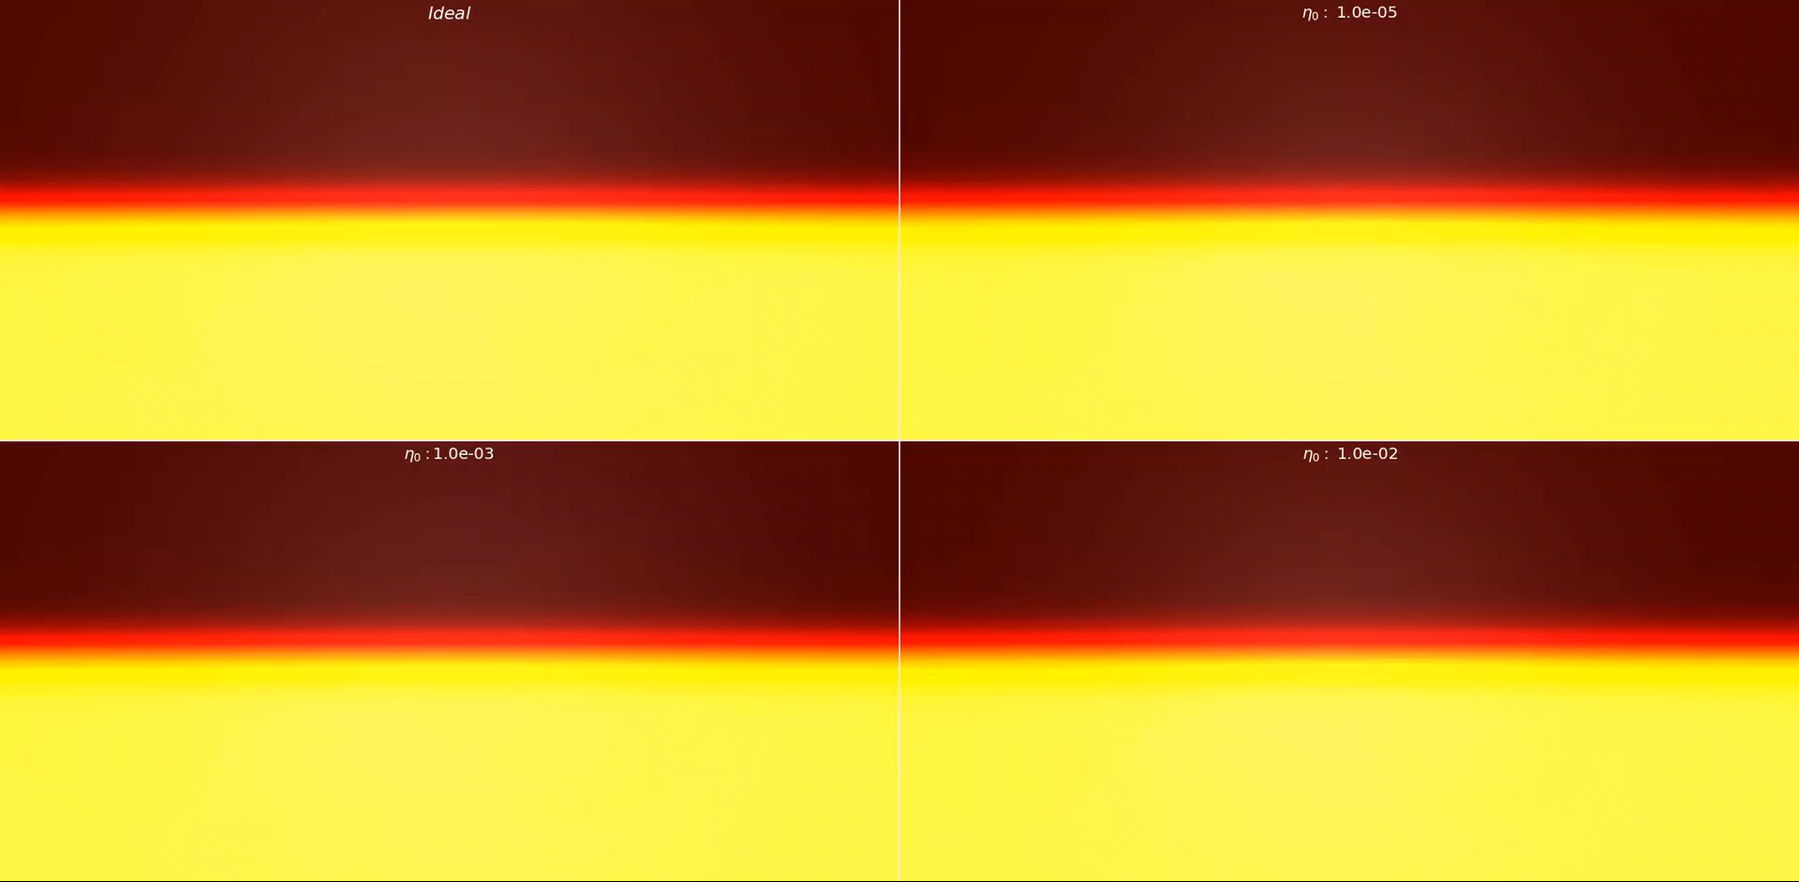
Validation IV (Ideal Recovery): Kelvin Helmholtz
Low viscosity BDNK matches Ideal Hydro solution
Inviscid
Smallest viscosity
Largest viscosity
Intermediate viscosity

Slide 15
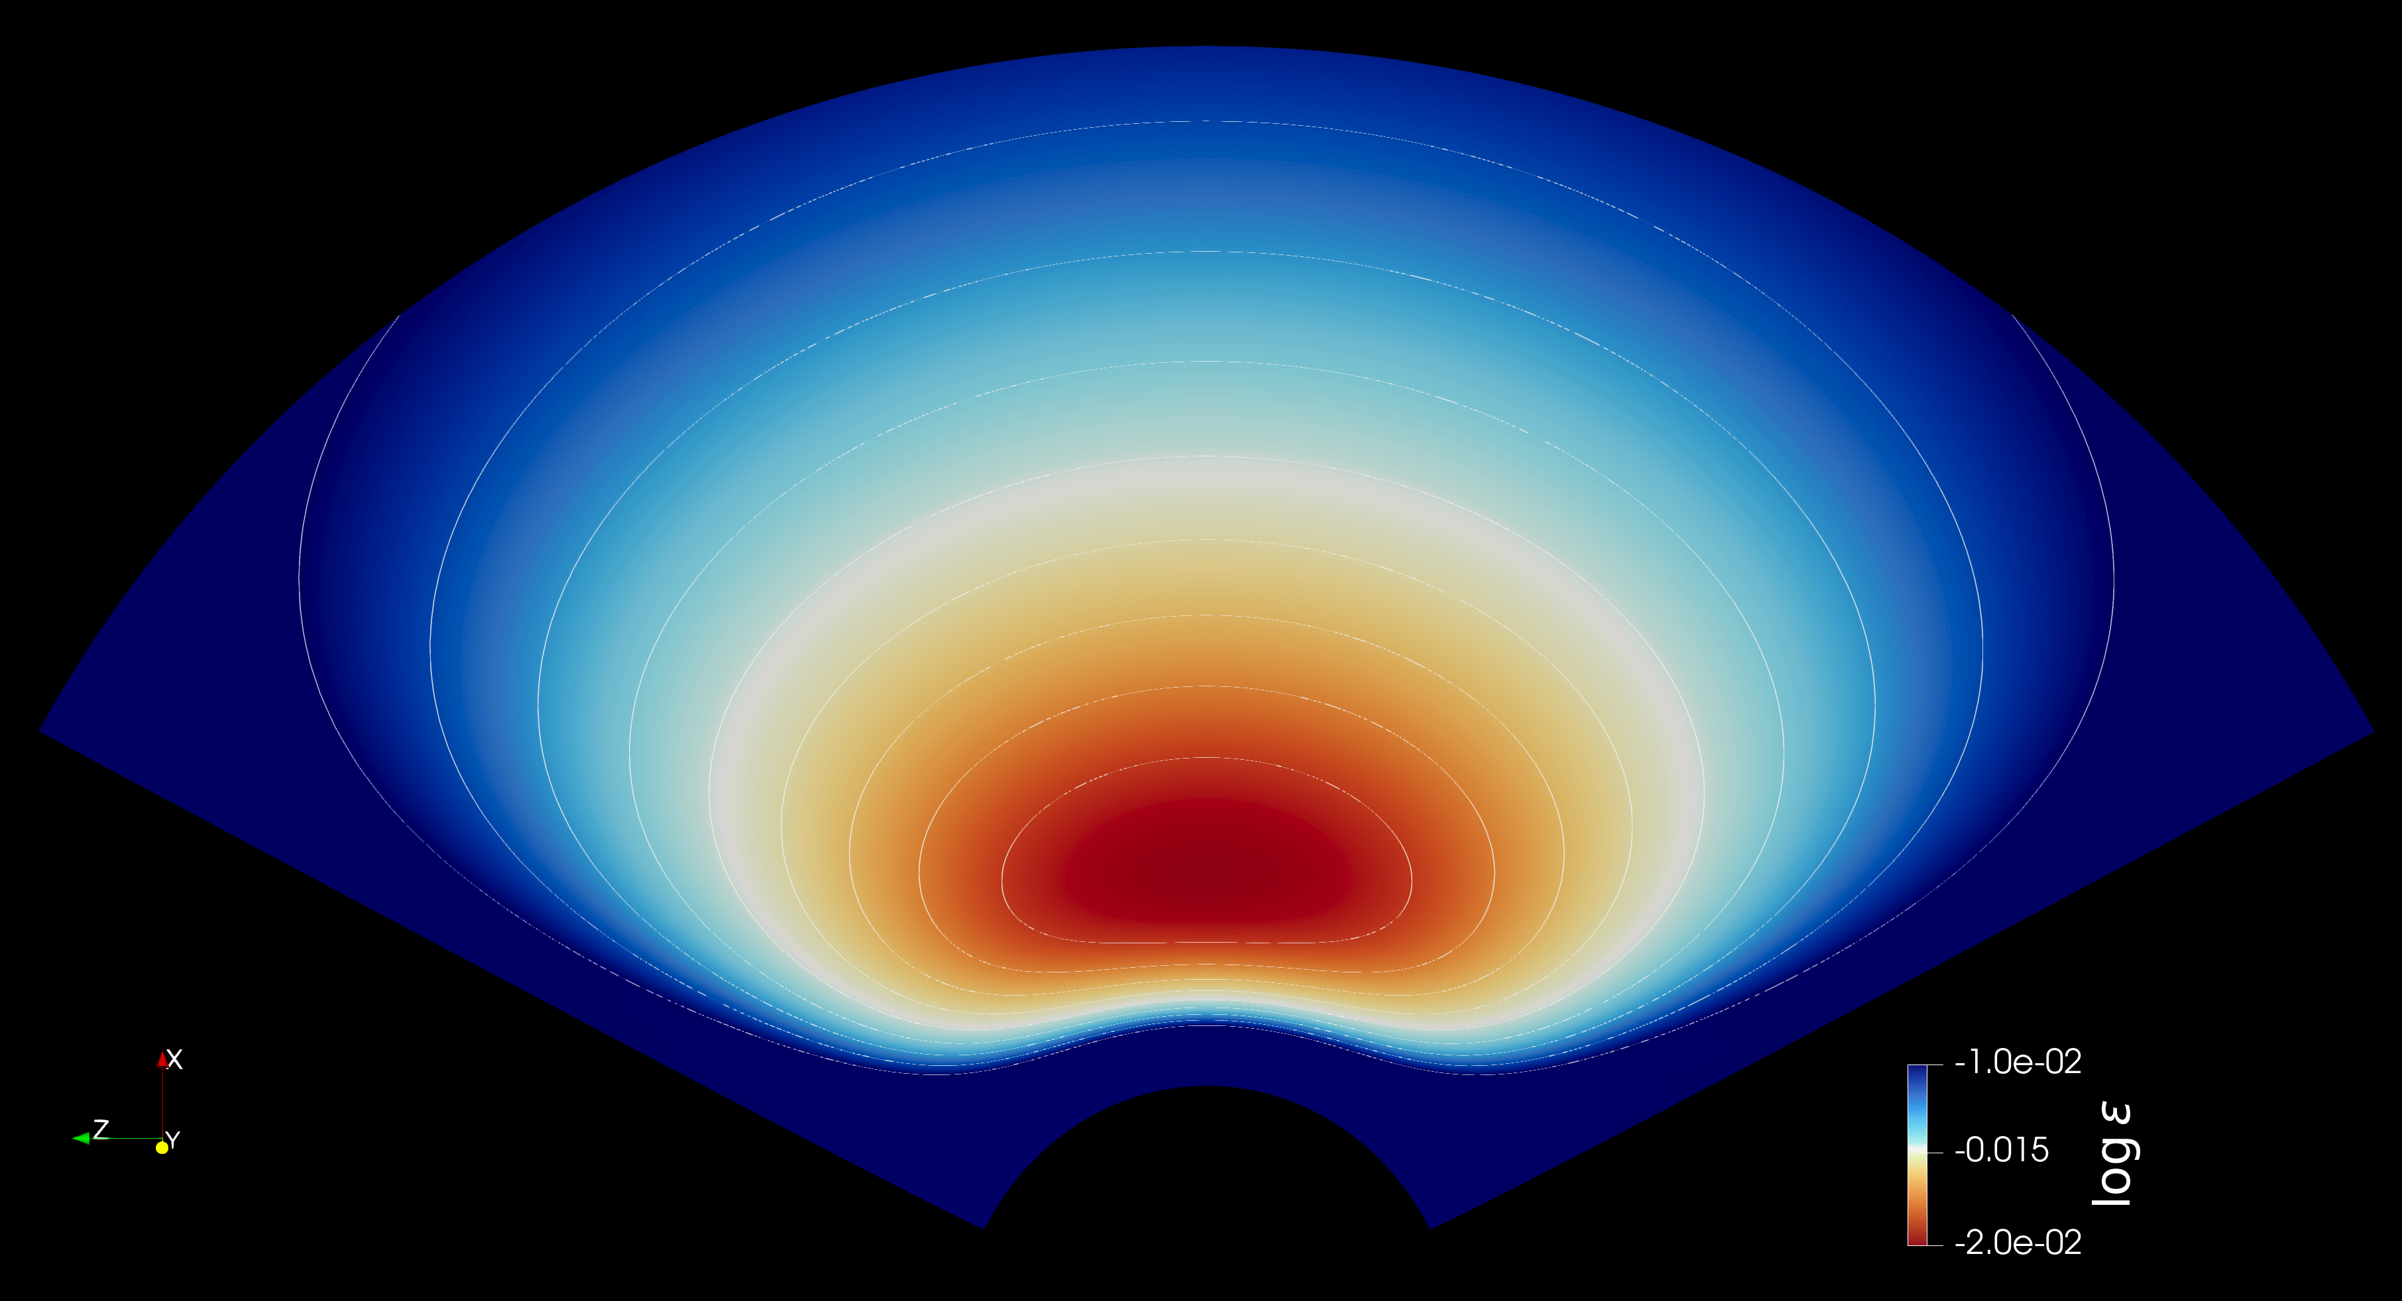
Validation V : Curved Spacetime
Kerr Fat Disks
Fishborne-Moncrief stationary disk:
  Known Ideal Hydro stationary solution for purely azimuthal flow in Kerr.
Used in testing ideal relativistic hydrodynamics codes
Our BDNK implementation
  Initialized with the Ideal solution
  Near-Extremal a/M=0.99
  Challenges: Boundary effects, sharp discontinuities, atmosphere
  Critically, the ideal solution is not a stationary solution in BDNK!

Slide 16
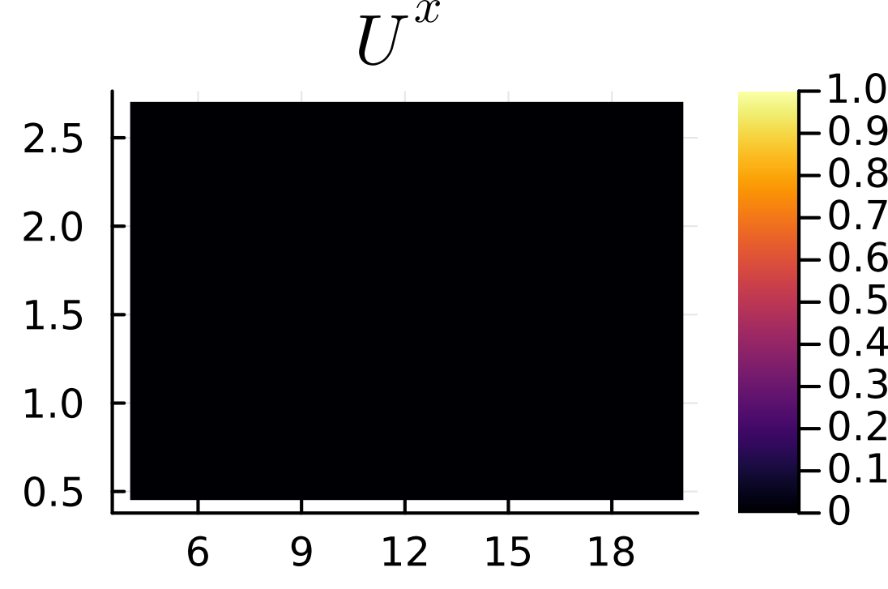
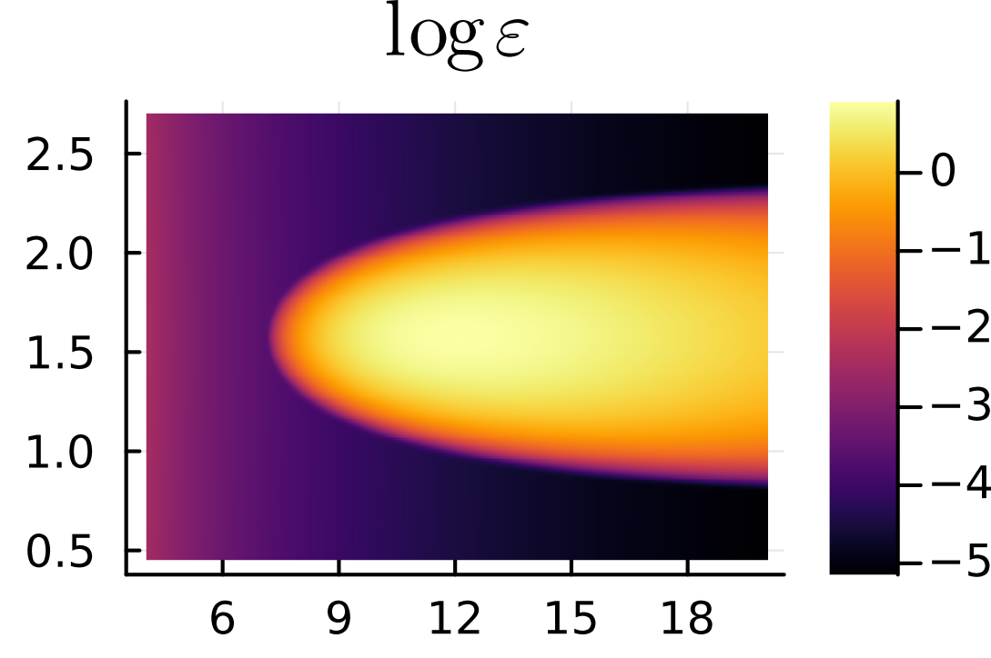
Validation V : Curved Spacetime – Kerr Disks
t=0.0 M
Initial conditions: Ideal stationary Fishborne-Moncrief disk
In BDNK, small but finite viscosity leads to infall

Slide 17
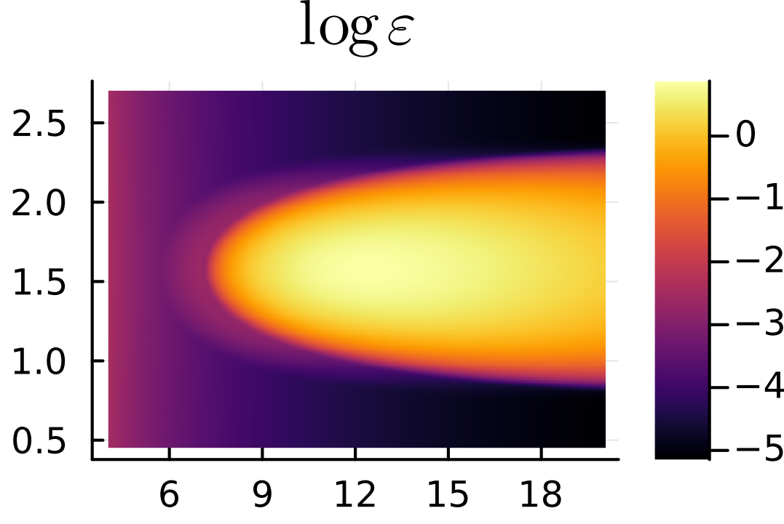
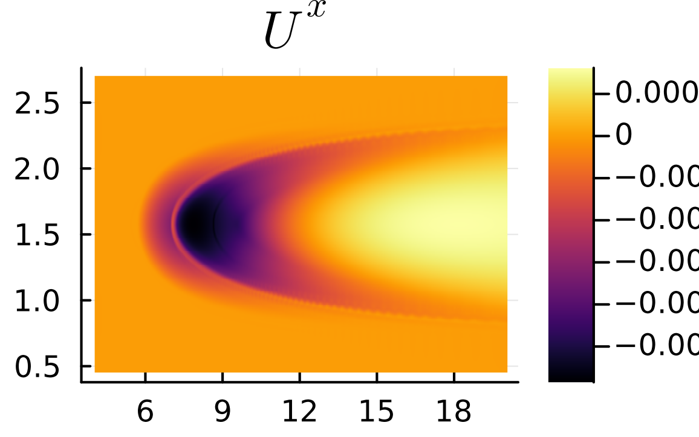
Validation V : Curved Spacetime – Kerr Disks
t=2.5 M

Slide 18
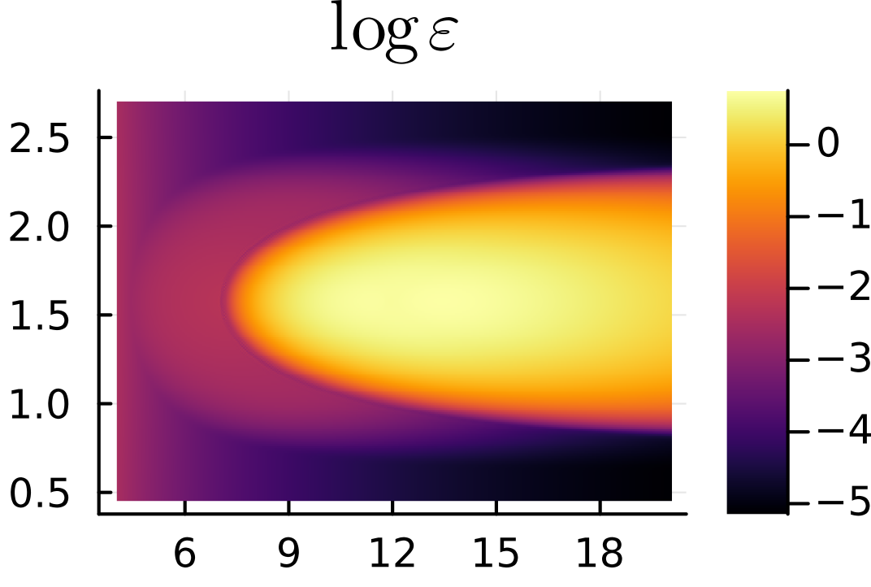
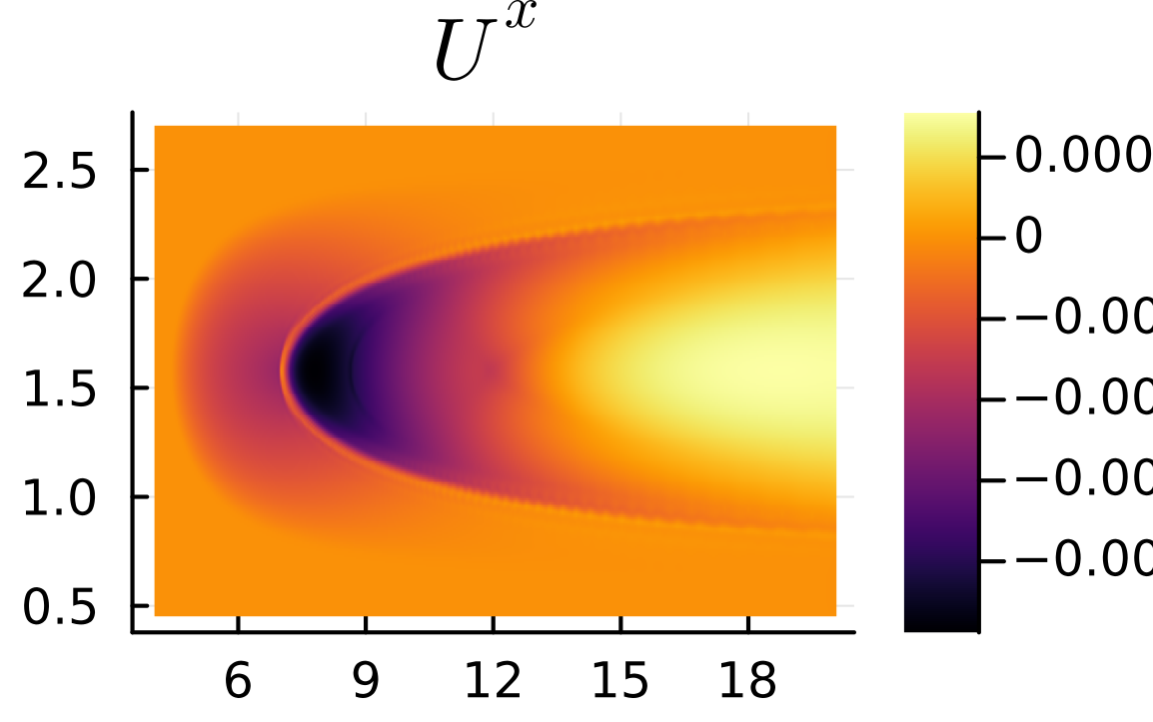
Validation V : Curved Spacetime – Kerr Disks
t=5.0 M

Slide 19
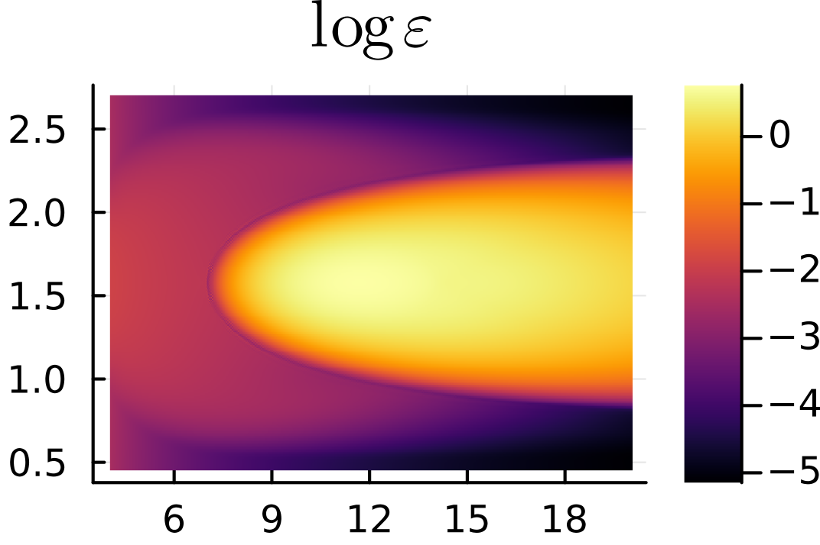
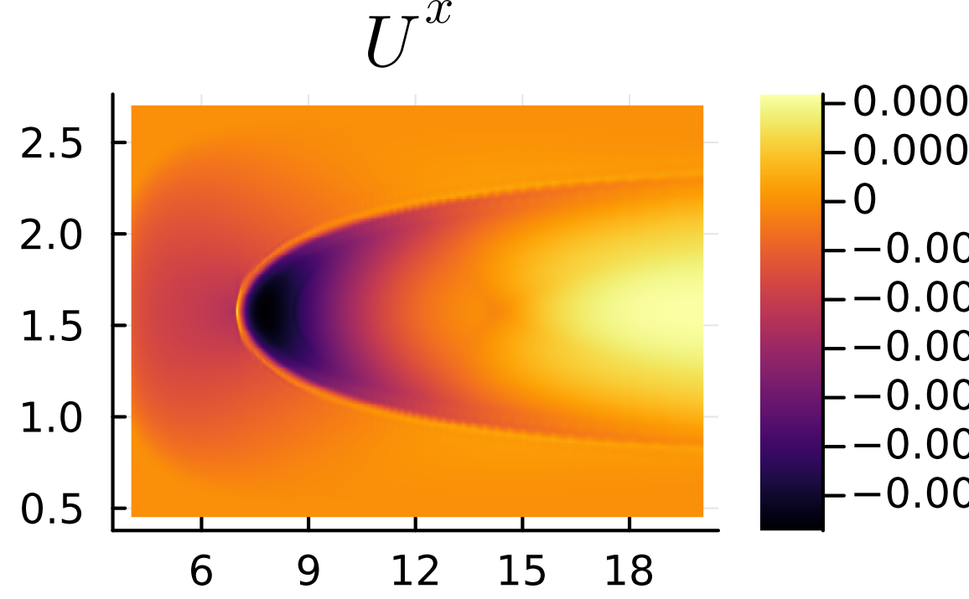
Validation V : Curved Spacetime – Kerr Disks
t=7.5 M

Slide 20
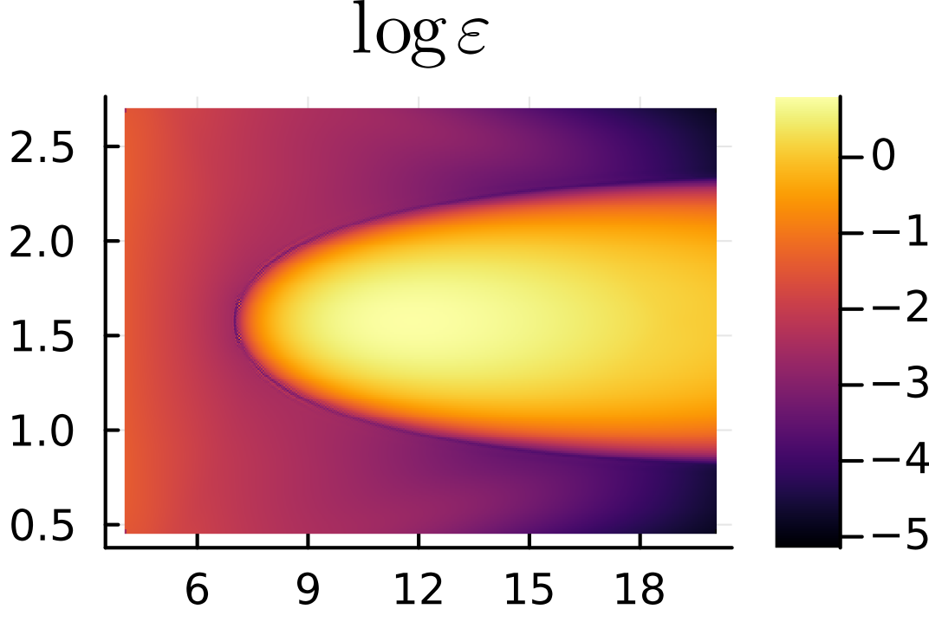
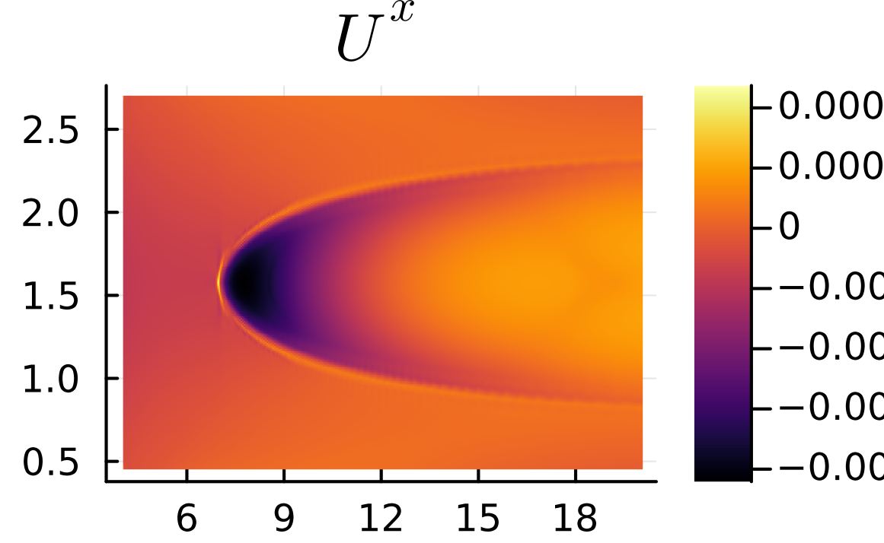
Validation V : Curved Spacetime – Kerr Disks
t=10.0 M

Slide 21

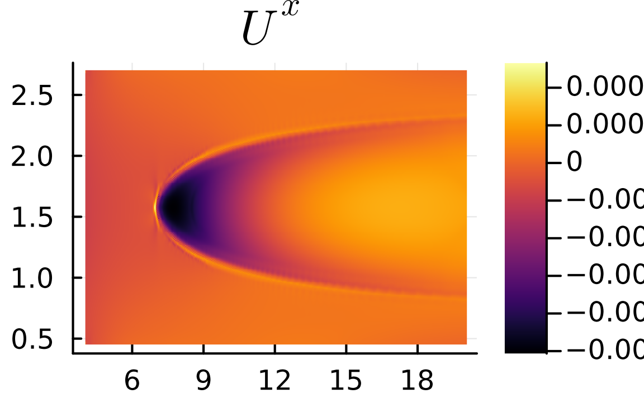
Validation V : Curved Spacetime – Kerr Disks
t=12.5 M

Slide 22
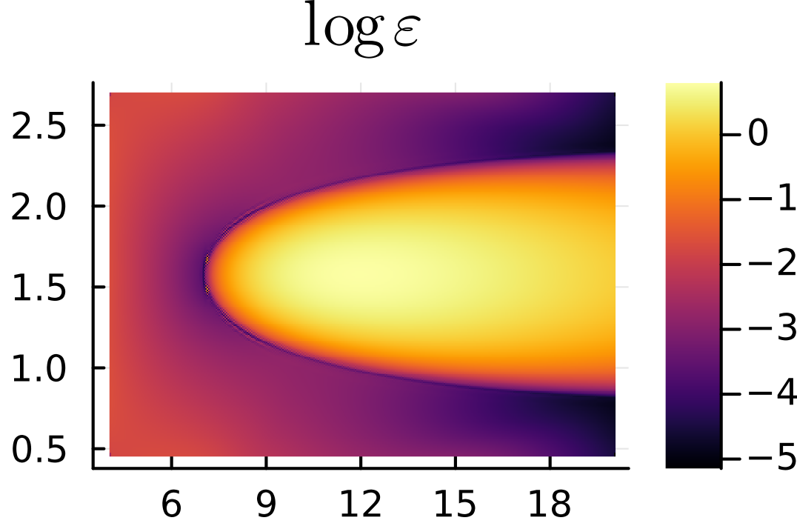
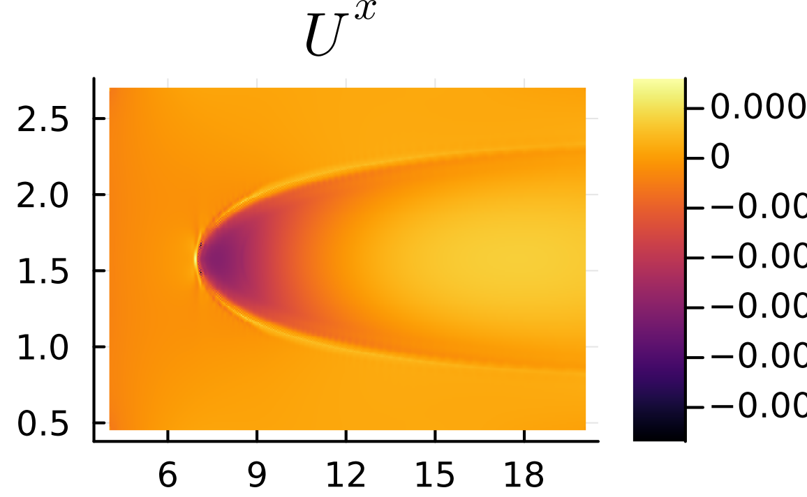
Validation V : Curved Spacetime – Kerr Disks
t=15.0 M

Slide 23

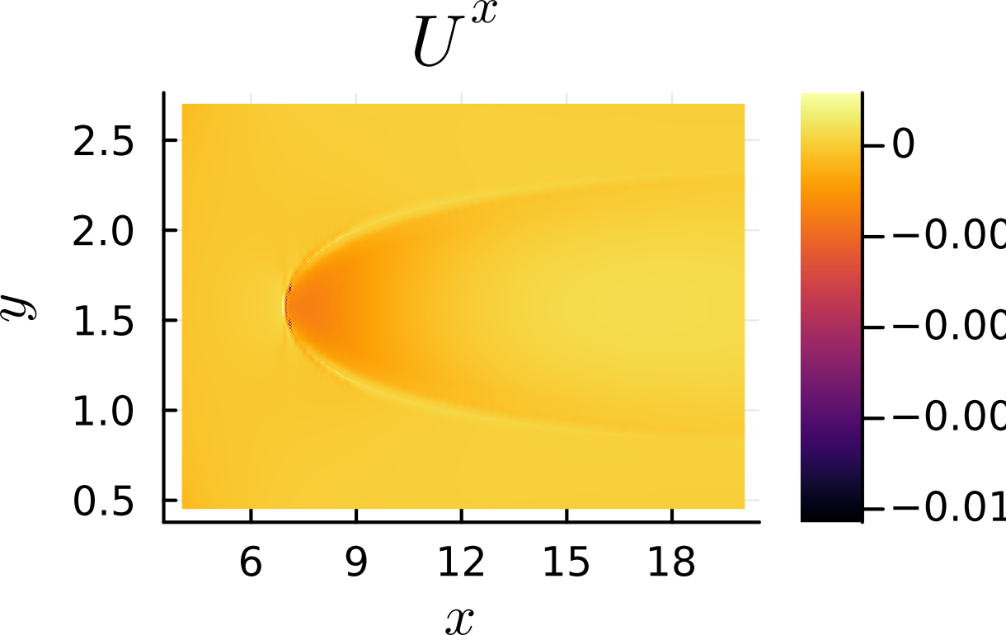
Validation V : Curved Spacetime – Kerr Disks
t=20.0 M

Slide 24

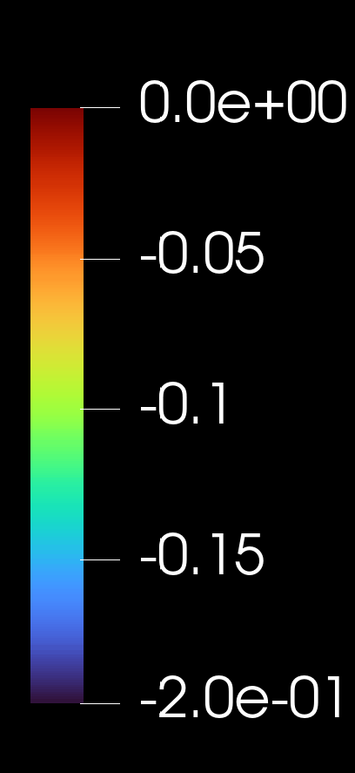
Validation V : Curved Spacetime – Kerr Disks
Comparing viscous effects
t=20.0 M
Less Viscous
More Viscous

Slide 25
Summary
BDNK : Causal and Stable Relativistic Viscous Hydrodynamics
3+1D, general spacetimes, arbitrary EOS
Validation
  Reproduced known semi-analytical solutions
  Low-Viscosity agreement with Ideal-Hydro solutions
  Comparisons with Israel-Stewart theory for QCD EOS
  Shock Tube tests
arXiv:26??.xxxx
Outlook
Open Source Code (HIC and Astrophysics community)
Applications to Heavy Ion Collision data
AMR for Large Scale GR-Hydro Simulations
Visco-resistive MHD formulism
2+1D, 3+1D Shock Analysis
Lots of ‘exciting’ technical challenges remain on the mathematical formulation as well practical implementation and applications!

Slide 26




Summarizing the viscous landscape
IDEAL
Relativistic Navier Stokes
CAUSAL
STABLE
HYPERBOLIC
CODES
Landau/Eckart: Bad Frame Choice
OR
BDNK: General choice
THIS
WORK
Explicit algebraic constraints on transport coefficients
Israel-Stewart theories
10 New degrees of freedom
Causality conditions only partially known
Exceedingly complicated GR implementation

Slide 27
Backups

Slide 28
Simulating BDNK
Previous Works
Pandya et al. ’21, ’22’
Bea et al. 2023
Keeble et al. 2025, Shumet et al. 2025.
2+1D : Flat Spacetime
1+1D,2+1D : QGP
1+1D : Neutron star
Our Work : General 3+1 Dimensional Relativistic Simulations
8 DOFS
Finite Volume Method (FVM)
  Extensively used in relativistic and non-relativistic simulations.
  Equations cast in a first-order flux-conservative form.
  Complicated in BDNK : Second order PDE system.
  Our FVM: KT scheme used in MUSIC
Variable
Flux
Sources
FIRST ORDER
HYBRID / MIXED
Spatial gradients are treated as independent variables
New variables lead to new constraint equations
Need additional auxiliary variables and extra EOMs
Spatial derivatives are numerically evaluated
Not exactly flux-conservative : Sources have derivatives
Fewer variables : Computationally cheaper
44
Variables
9
Variables

Slide 29
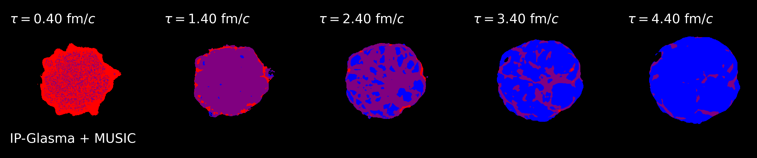
Plumber et al, 2021
Causality violations in realistic simulations of heavy-ion collisions

Slide 30
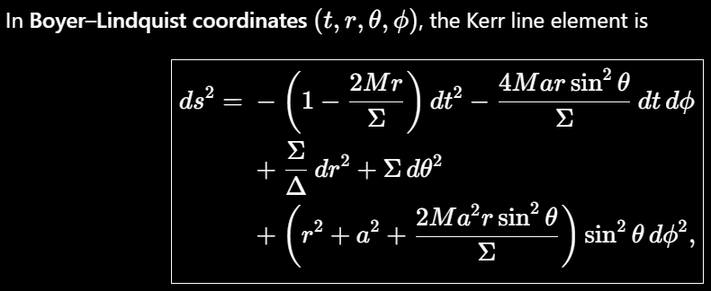

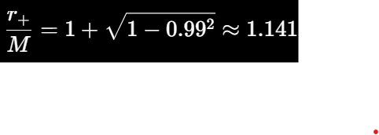
Validation V : Curved Spacetime – Kerr Disks
Ideal Fishborne-Moncrief stationary disk
Near-Extremal a/M=0.99
Used in testing ideal relativistic hydrodynamics codes
BDNK implementation challenges: Boundary effects, sharp discontinuities, astmosphere

Slide 31
Definition of out-of-equilibrium variables: Hydrodynamic Frame
Fictitious
Ambiguity in parameterizing fluid stress-energy tensor, provided one recovers the unambiguous equilibrium ideal fluid tensor in equilibrium.
Different choices correspond to different effective descriptions.
Minimal IS theory : MUSIC
BDNK

Slide 32
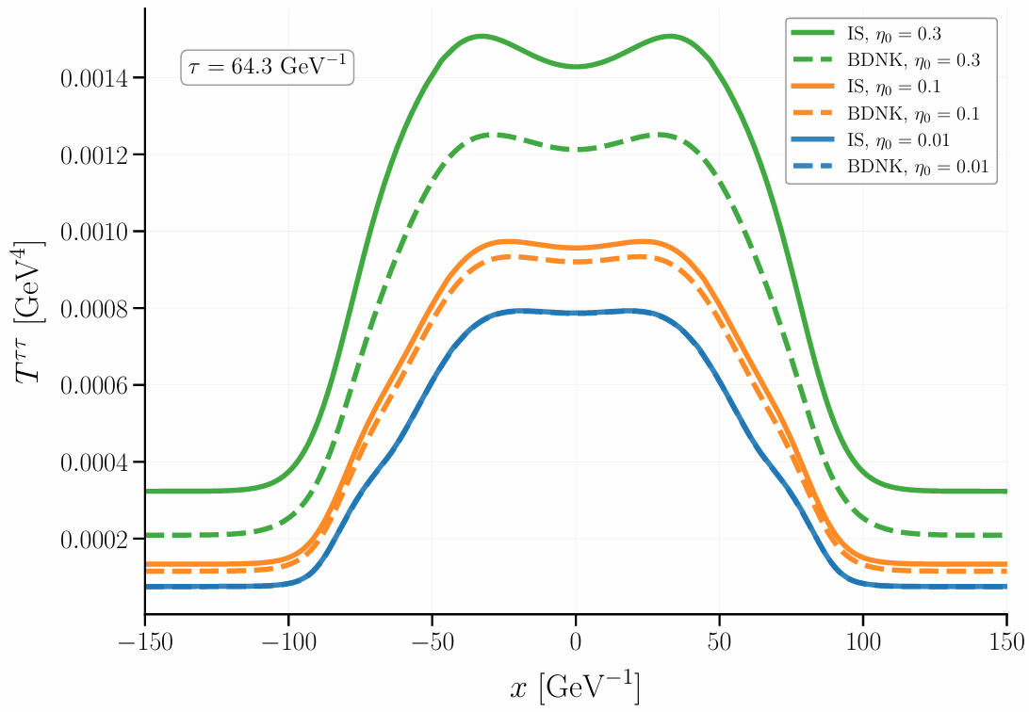
Comparison with IS
Gaussians: BDNK vs IS (Hot QCD EOS)
Advantages of BDNK vs IS (Implementation)
  Simpler GR versions of the equations
  Simpler non-linear causality and stability conditions
Equal initial conditions (Recovery)
  Straightforward in IS
  Tricky in BDNK
  Approach here:
Minimal IS theory : MUSIC

Slide 33
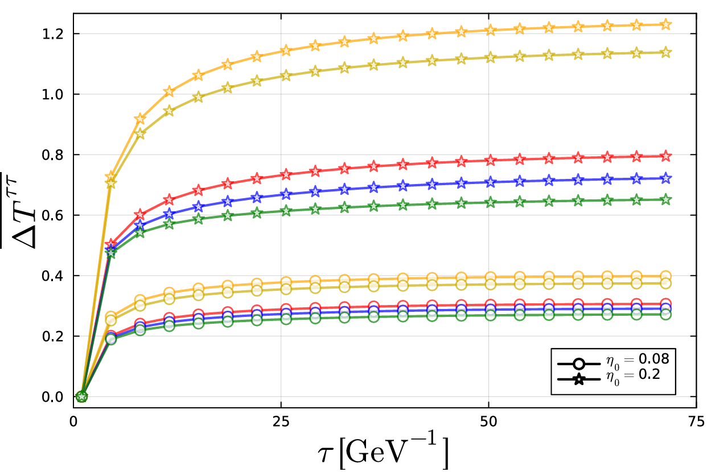
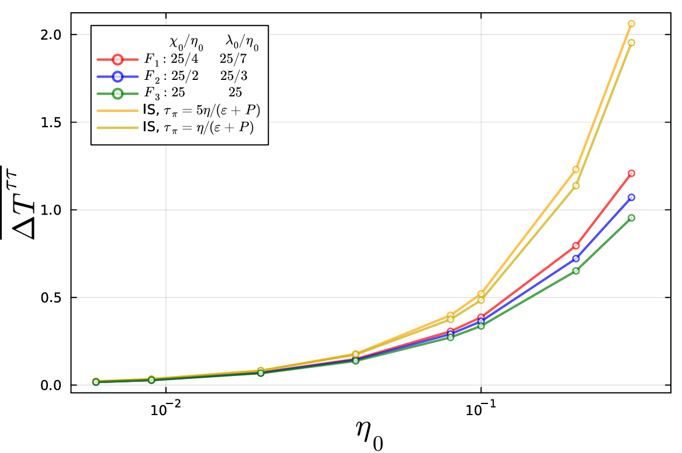
Comparison with IS
Largest differences coming from initial expansion
BDNK approaches equilibrium faster
  Because of finite time relaxation in IS
Normalized absolute difference w.r.t ideal averaged over the domain

Slide 34
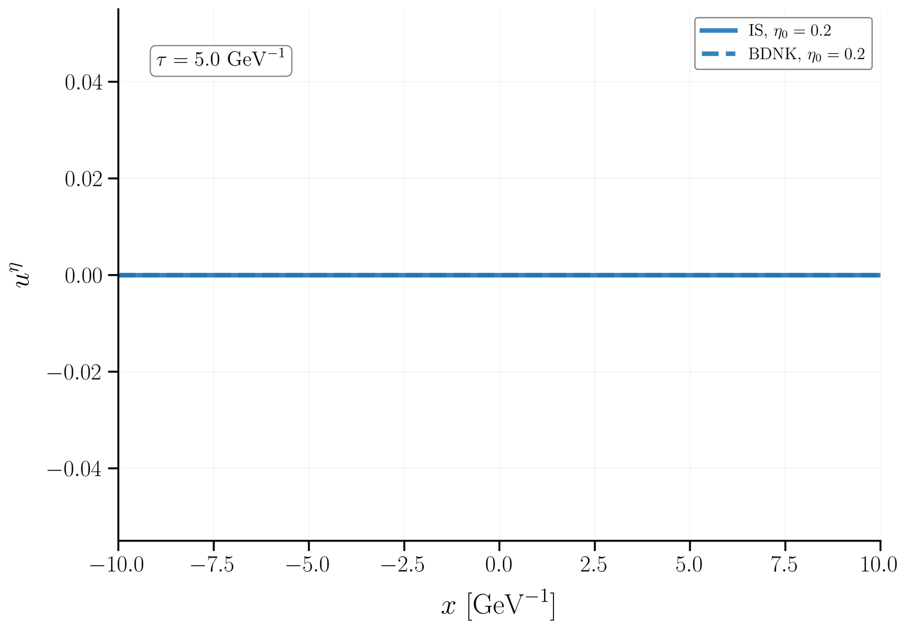
Comparison with IS
Comparison in the longitudinal direction: Velocity
MUSIC: Artifacts in near the edges

Slide 35

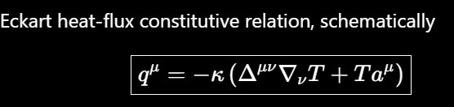







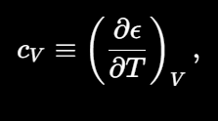
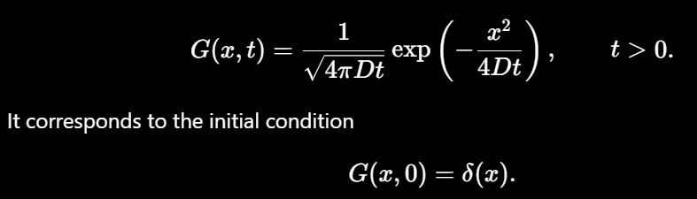
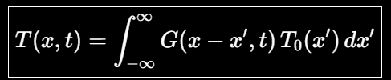

Causality & Stability Illustration
IDEAL
Viscous Terms
LRF
Heat Diffusion Equation
(Parabolic)
Instantaneous response everywhere!

Slide 36

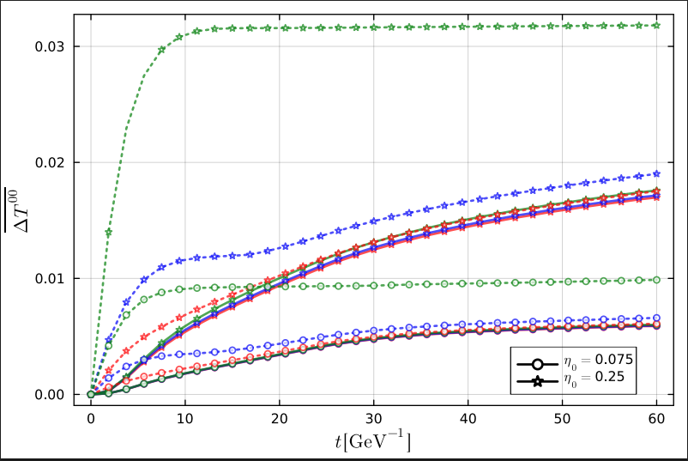
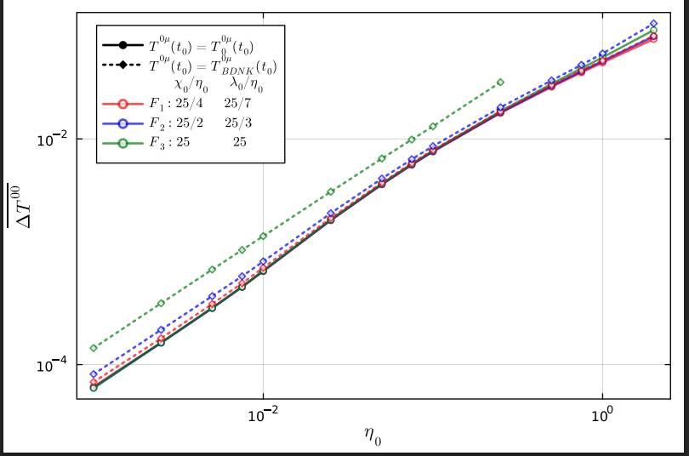





Validation III:
Shock Tube tests
Quantifying departure from Ideal Hydrodynamics
Relative absolute difference averaged over the grid
Viscous Transport Coefficients
Independence of frame parameters : Frame Robust
BDNK Frame
(Causality and Stability)
Ideal/Inviscid

Slide 37

Kelvin Helmholtz Setup
Adopted from Lecoanet et. al. 2015

Slide 38


BDNK EOMs – Constitutive Relations

Slide 39
Transport coefficients – Simplifying choices

Slide 40



BDNK EOMs – H Tensor

Slide 41





Divergence Cleaning
Dedner et al. (2002) : GLM methods to resolve numerical errors causing instability in MHD simulations
Full first-order formulation introduces curl constraints
Introduce an auxiliary curl-cleaning (CC) field to propagate and damp constraint violations
Cleaning/damping controlled by adjustable coefficients

Slide 42






First Order Formulism – Curl Cleaning
New variables which are gradients requires methods to ensure curl is zero
Ensure Curl does not grow

Slide 43


First Order Formulism – Curl Cleaning
New Variables for flux conservative form
BDNK Tensor
Auxiliary Definitions
EOMs

Slide 44
First Order Formulism – Curl Cleaning
New Variables for flux conservative form
BDNK Tensor
Auxiliary Definitions
EOMs

Slide 45


Flux Conservative Form
44 Variables

Slide 46
Symbolic Expressions
BDNK Tensor
New Variables
EOMs
Auxiliary Definitions

Slide 47


Symbolic Expressions for Code
BDNK Tensor
Large number of terms via contractions.
xAct symbolic simplifications reduces this significantly

Slide 48
Simulating BDNK
BDNK EOMs are second order
Finite Volume Method
  Equations cast in a First Order Flux Conservative Form.
  Volume is divided into cells.
  Discretized variables are cell-averaged and derivatives have to be computed on interfaces.
Variable
Flux
Sources
There is a plethora of numerical techniques to compute the derivatives on cell interfaces

Slide 49
Simulating BDNK
Variable
Flux
Sources
First Order
Hybrid
New variables lead to new constraint equations
Numerically, they are violated
Need additional auxiliary variables and extra EOMs
Derivatives are numerically evaluated
Not exactly flux-conservative
Fewer variables : Computationally cheaper

Slide 50




Relativistic Hydrodynamics
Euler Equations
Conservation of energy-momentum
Ideal Fluid Energy-Momentum Tensor
In relativity,
we have 4-velocity
4-Current
Conservation of mass becomes conservation of 4-current
Normalization
Rest Frame
Metric Tensor
Einstein’s equations : Energy-Momentum ↔ Spacetime Geometry

Slide 51
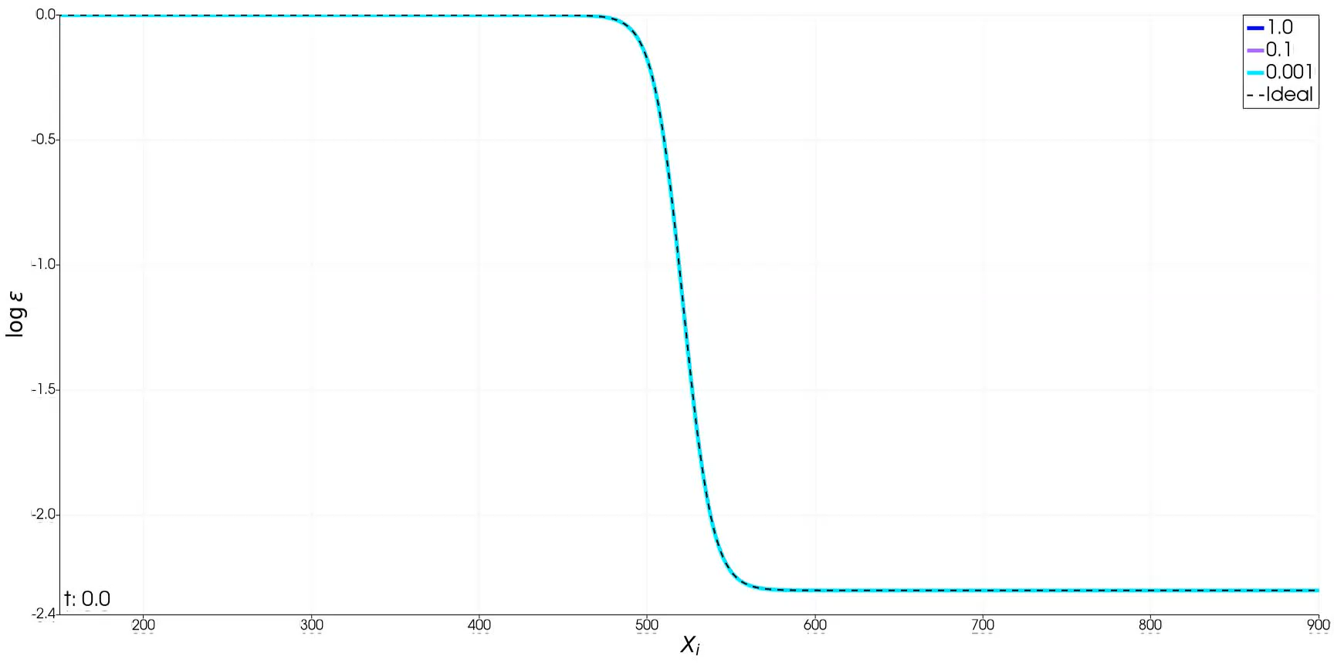
Shock smoothing

