Slide 1



Development of a real-time in-situ calibration system for deep-sea neutrino telescopes
Tailin Zhu
on behalf of the TRIDENT Collaboration
Tsung-Dao Lee Institute, Shanghai Jiao Tong University
TeVPA 2026
2026/09/01
(t.zhu@sjtu.edu.cn)

Slide 2

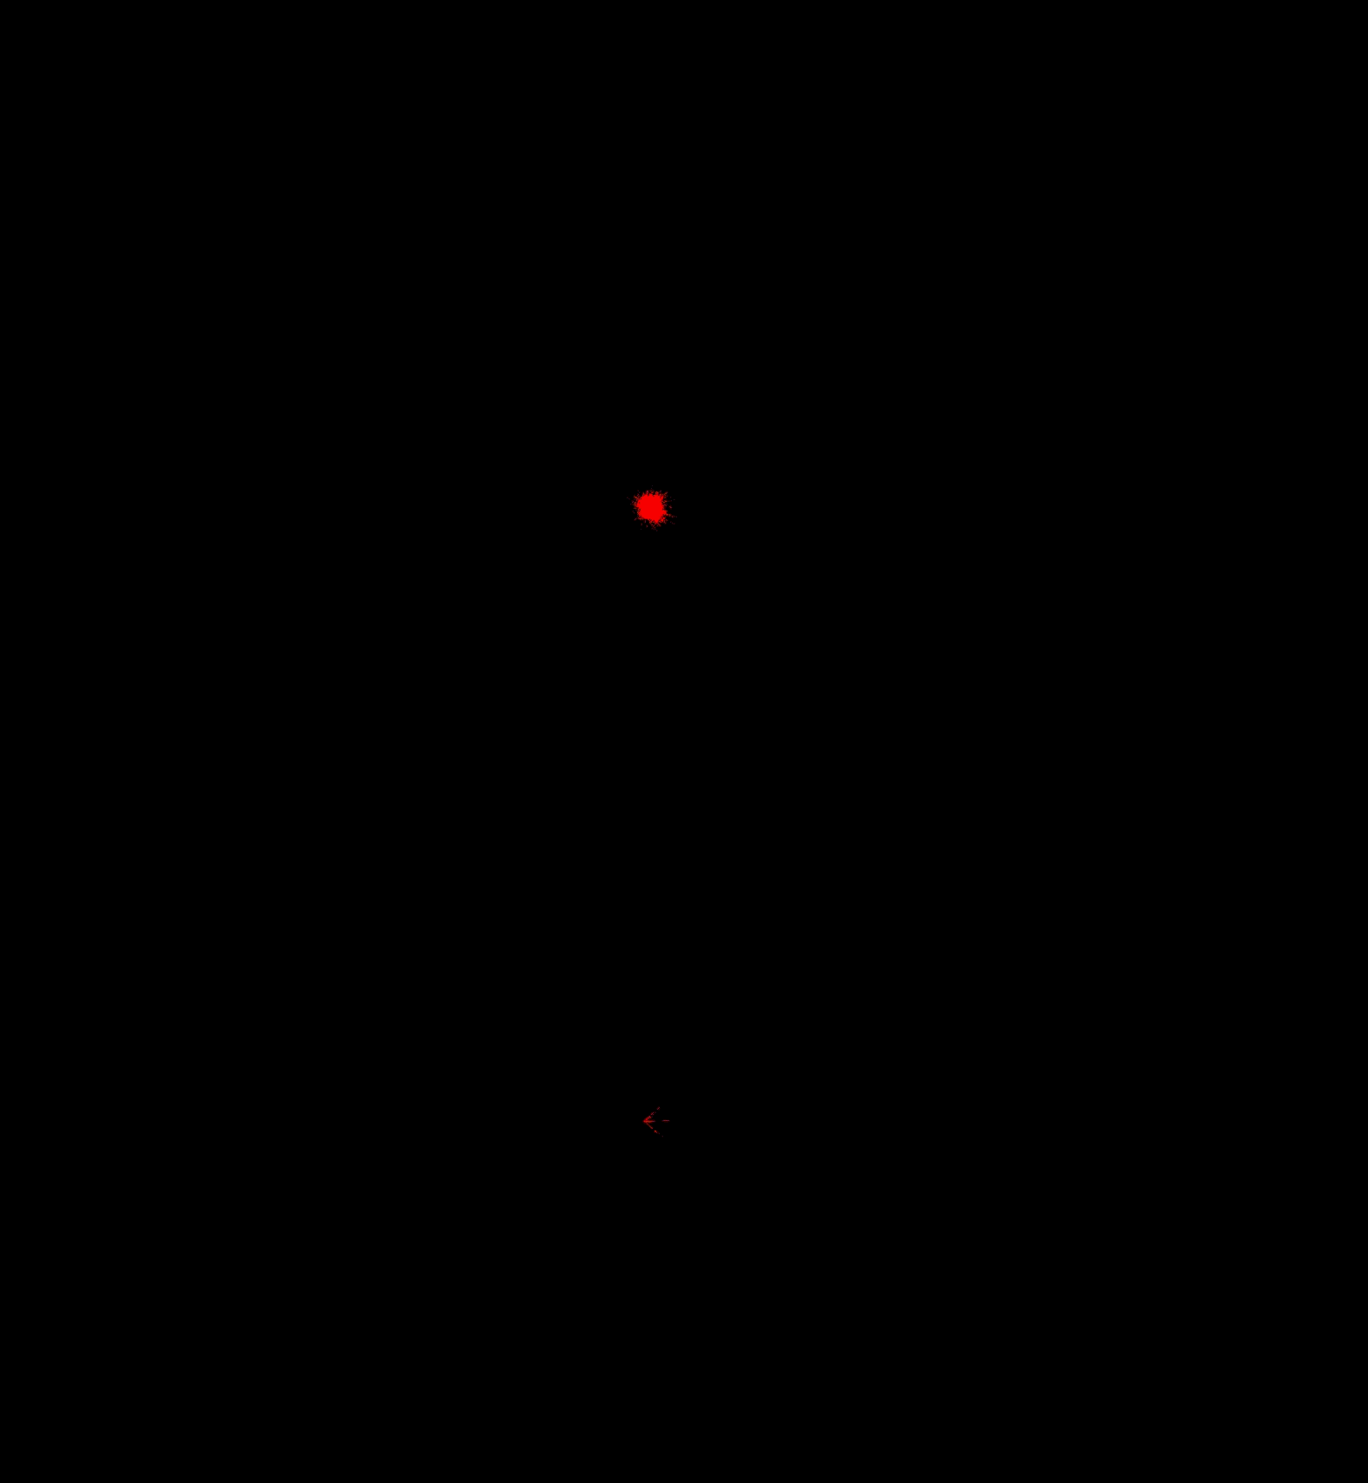


Calibration Purposes
Event reconstruction uses the timing, charge and spatial distribution of detected photons.
Some calibration inputs enter detector-response model used in event reconstruction.
$ν_{μ}$ Track
Calibration Input
Medium: scattering and absorption; Optical background
Geometry: DOM position and orientation; String motion
Sensor response: PMT/SiPM efficiency, timing, waveform
$ν_{e}$ Cascade
TRIDENT Simulation
Detector Response
Reconstruction
Physics output
Direction
Energy
Flavour
Photon hit time / number
Photon spatial distribution
Photon waveform
Hypothesis
Likelihood calculation
In the deep sea, these conditions evolve with time → calibration must be in situ and time-dependent.
1
Tailin Zhu (TDLI) | In-situ Calibration System for Deep-sea Neutrino Telescope | TeVPA 2026

Slide 3
Calibration Purposes
Event reconstruction uses the timing, charge and spatial distribution of detected photons.
Some calibration inputs enter detector-response model used in event reconstruction.
$ν_{μ}$ Track
Calibration Input
Medium: scattering and absorption; Optical background
Geometry: DOM position and orientation; String motion
Sensor response: PMT/SiPM efficiency, timing, waveform
$ν_{e}$ Cascade
TRIDENT Simulation
Detector Response
Reconstruction
Physics output
Direction
Energy
Flavour
Photon hit time / number
Photon spatial distribution
Photon waveform
Hypothesis
Likelihood calculation
In the deep sea, these conditions evolve with time → calibration must be in situ and time-dependent.
1
Tailin Zhu (TDLI) | In-situ Calibration System for Deep-sea Neutrino Telescope | TeVPA 2026

Slide 4
Calibration Purposes
Event reconstruction uses the timing, charge and spatial distribution of detected photons.
Some calibration inputs enter detector-response model used in event reconstruction.
$ν_{μ}$ Track
Calibration Input
Medium: scattering and absorption; Optical background
Geometry: DOM position and orientation; String motion
Sensor response: PMT/SiPM efficiency, timing, waveform
$ν_{e}$ Cascade
TRIDENT Simulation
Detector Response
Reconstruction
Physics output
Direction
Energy
Flavour
Photon hit time / number
Photon spatial distribution
Photon waveform
Hypothesis
Likelihood calculation
In the deep sea, these conditions evolve with time → calibration must be in situ and time-dependent.
1
Tailin Zhu (TDLI) | In-situ Calibration System for Deep-sea Neutrino Telescope | TeVPA 2026

Slide 5
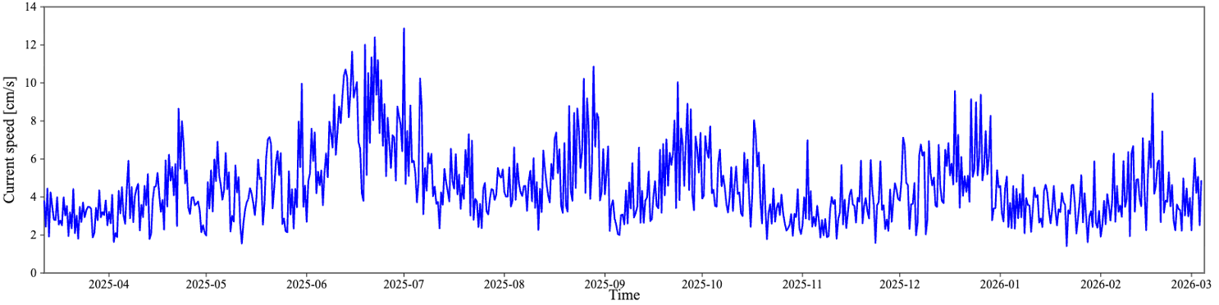
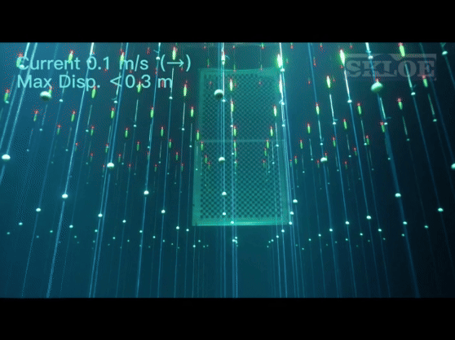
The Need for Real-Time Deep-Sea Calibration
TRIDENT site, stable current speeds typically below 10cm/s over 1-year
TRIDENT Preliminary
Detector Geometry
Sea currents may move the strings
DOM positions measured with acoustic sensors
1
Tailin Zhu (TDLI) | In-situ Calibration System for Deep-sea Neutrino Telescope | TeVPA 2026

Slide 6
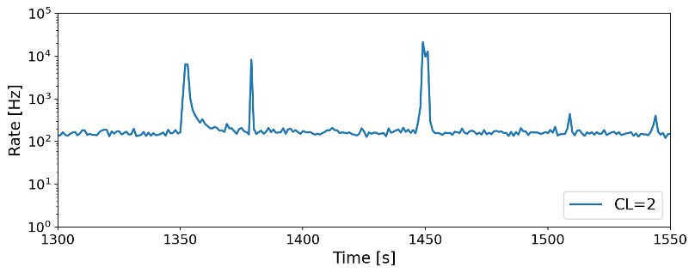
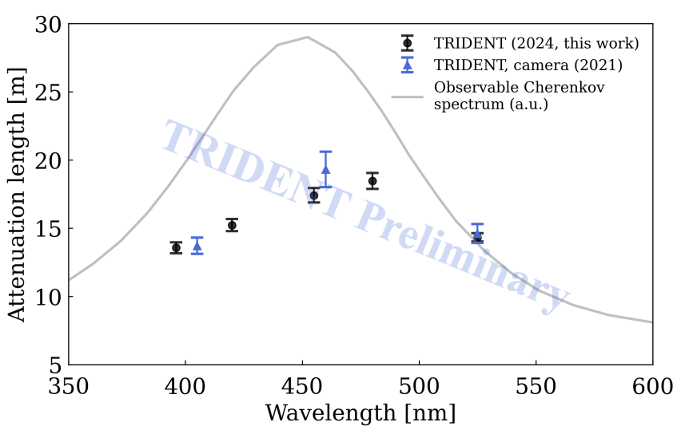
The Need for Real-Time Deep-Sea Calibration
TRIDENT Preliminary
F. Zhang (TAUP 2025)
Y. Wang, et. al., PoS (ICRC 2025) 1209
Optical Background
⁴⁰K and bioluminescence affect the observed hit rate and constitute a background
Water Optical Properties
Absorption and scattering affect photon survival and arrival times
1
Tailin Zhu (TDLI) | In-situ Calibration System for Deep-sea Neutrino Telescope | TeVPA 2026

Slide 7
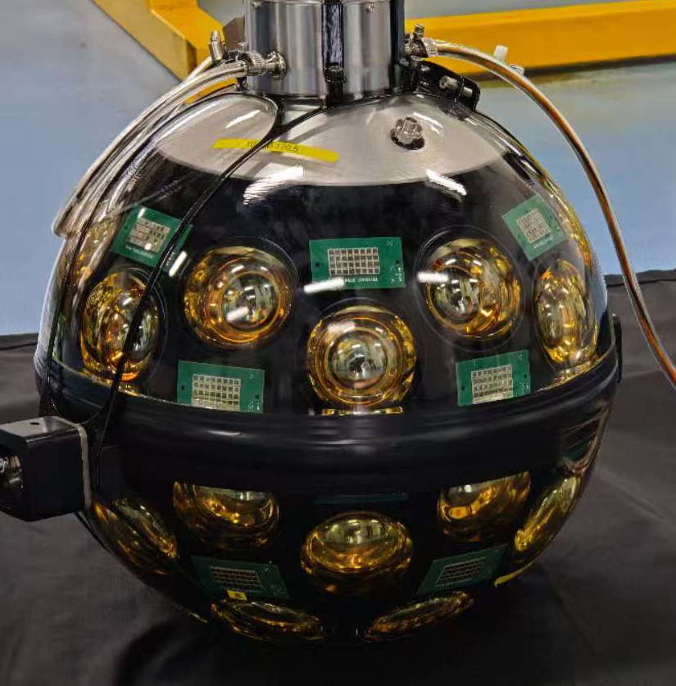
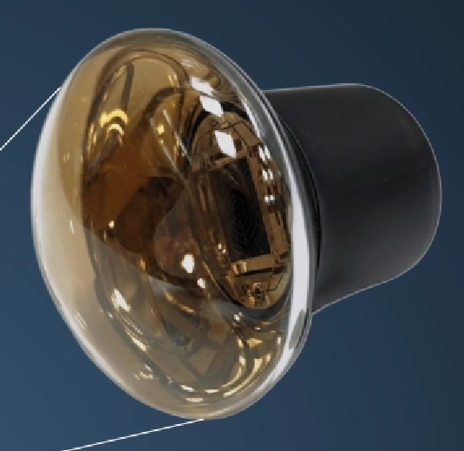
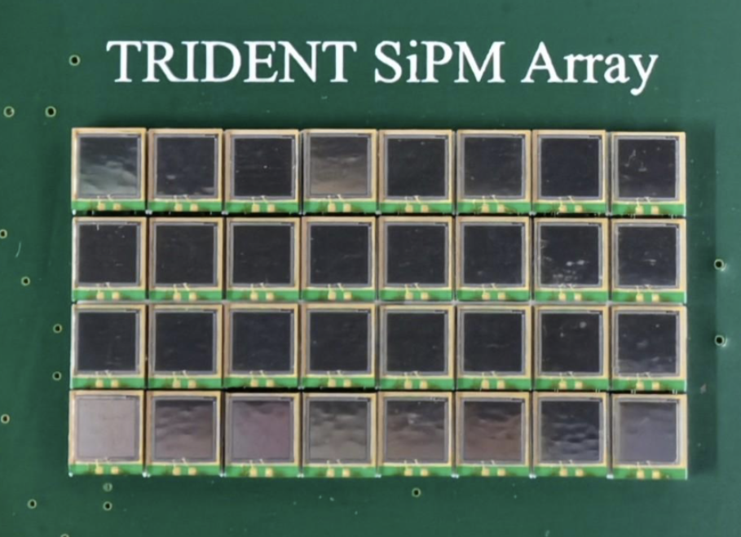
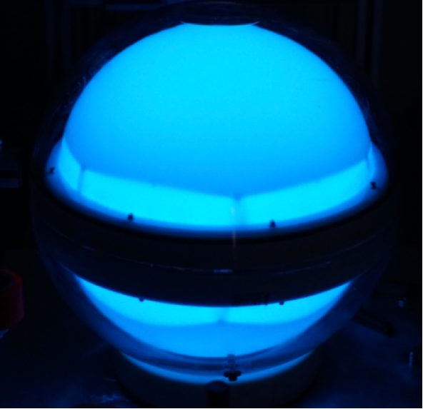
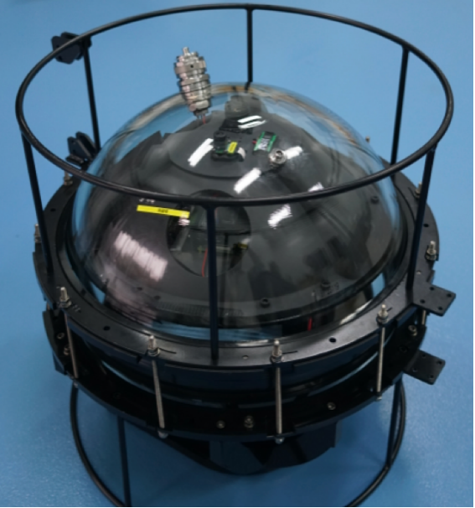
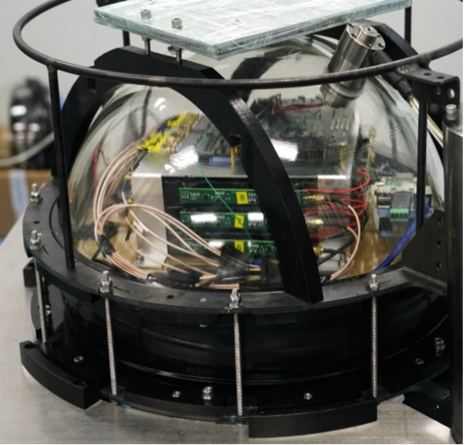
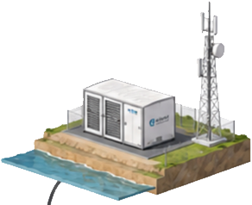
TRIDENT Phase-1
10 optical strings;
200 hybrid-DOMs
A dedicated calibration string
Real-time data transmitting and power supply
Sub-ns time sync between calibration string and hDOMs
PMTs:
< 2ns TTS
~30% QE
700 m
hDOM
Acoustic emitter/receiver
Junction boxes
Electro-optical cable
Float
Calib. optical receivers
Light system
Isotropic light
Hydrographic sensor
42 cm
SiPMs:
< 0.3 ns jitter
Z. Wei, et. al., PoS (ICRC 2023) 1213
~ 60 m
70-110 m
Fibre
W. Li, et. al., NIM-A, 1056 168588 (2023)
W. Tian, et. al., NIM-A, 1076 170489 (2025)
J. Wu, et. al., JINST 20 P07035 (2025)
375 V Power
Y. Wang, et. al., PoS (ICRC 2025) 1209
1
Tailin Zhu (TDLI) | In-situ Calibration System for Deep-sea Neutrino Telescope | TeVPA 2026

Slide 8
TRIDENT Phase-1
10 optical strings;
200 hybrid-DOMs
A dedicated calibration string
Real-time data transmitting and power supply
Sub-ns time sync between calibration string and hDOMs
PMTs:
< 2ns TTS
~30% QE
700 m
hDOM
Acoustic emitter/receiver
Junction boxes
Electro-optical cable
Float
Calib. optical receivers
Light system
Isotropic light
Hydrographic sensor
42 cm
SiPMs:
< 0.3 ns jitter
Z. Wei, et. al., PoS (ICRC 2023) 1213
~ 60 m
70-110 m
Fibre
W. Li, et. al., NIM-A, 1056 168588 (2023)
W. Tian, et. al., NIM-A, 1076 170489 (2025)
J. Wu, et. al., JINST 20 P07035 (2025)
375 V Power
Y. Wang, et. al., PoS (ICRC 2025) 1209
1
Tailin Zhu (TDLI) | In-situ Calibration System for Deep-sea Neutrino Telescope | TeVPA 2026

Slide 9
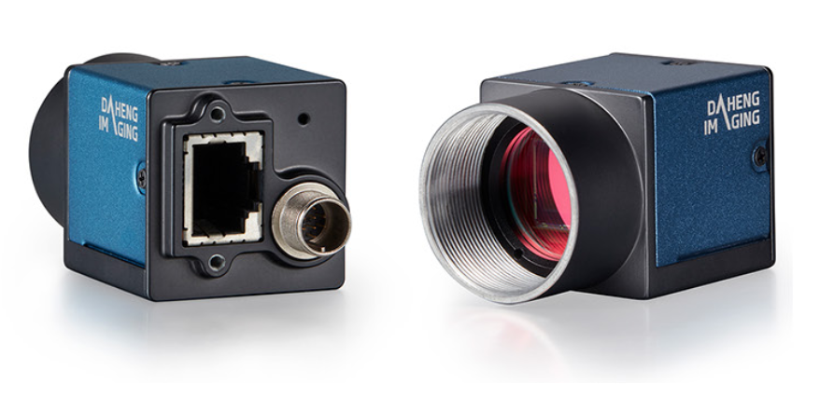
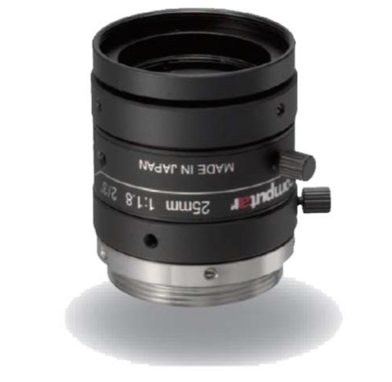
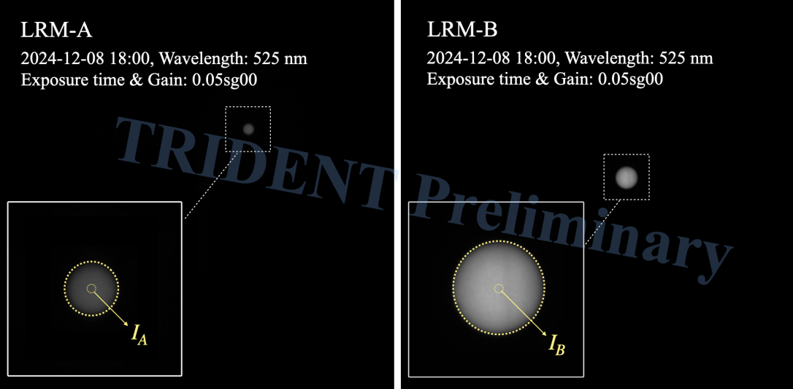
Water Optical Calibration
Goal: monitor water optical properties on timescales of seconds at multiple wavelengths.
Light Receiving Module: Camera + PMT
GigE Camera: 5M pixels, 12 bit
25 mm lens: 16° viewing angle
Light Emitting Module: Continuous + pulsed modes
Two receiver distances → attenuation from relative intensity
Camera image halo → sensitivity to scattering
PMT SPE arrival-time distributions → absorption + scattering
Validated at previous site expeditions in 2021 and 2024
Y. Wang, et. al., PoS (ICRC 2025) 1209
W. Tian, et. al., NIM-A, 1076 170489 (2025)
1
Tailin Zhu (TDLI) | In-situ Calibration System for Deep-sea Neutrino Telescope | TeVPA 2026

Slide 10
Water Optical Calibration
Goal: monitor water optical properties on timescales of seconds at multiple wavelengths.
Light Receiving Module: Camera + PMT
GigE Camera: 5M pixels, 12 bit
25 mm lens: 16° viewing angle
Light Emitting Module: Continuous + pulsed modes
Two receiver distances → attenuation from relative intensity
Camera image halo → sensitivity to scattering
PMT SPE arrival-time distributions → absorption + scattering
Validated at previous site expeditions in 2021 and 2024
Y. Wang, et. al., PoS (ICRC 2025) 1209
W. Tian, et. al., NIM-A, 1076 170489 (2025)
1
Tailin Zhu (TDLI) | In-situ Calibration System for Deep-sea Neutrino Telescope | TeVPA 2026

Slide 11
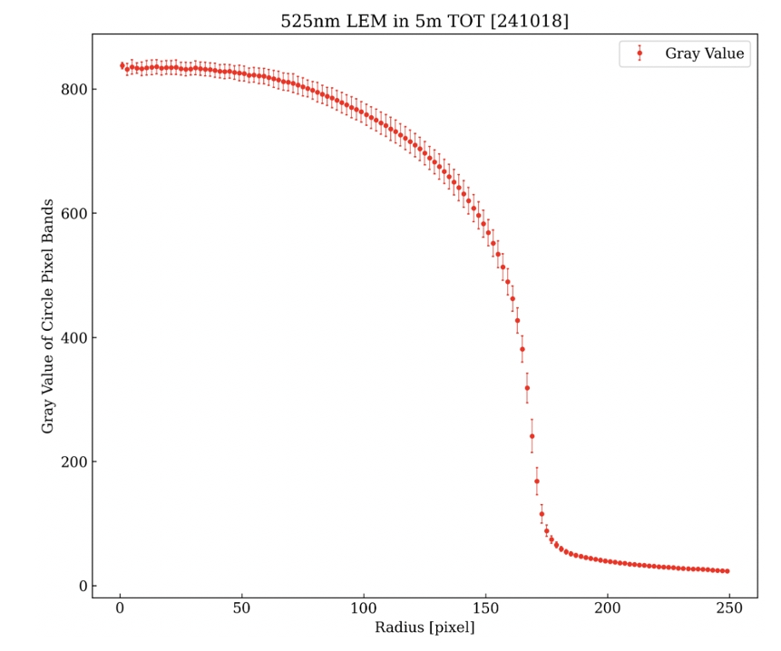
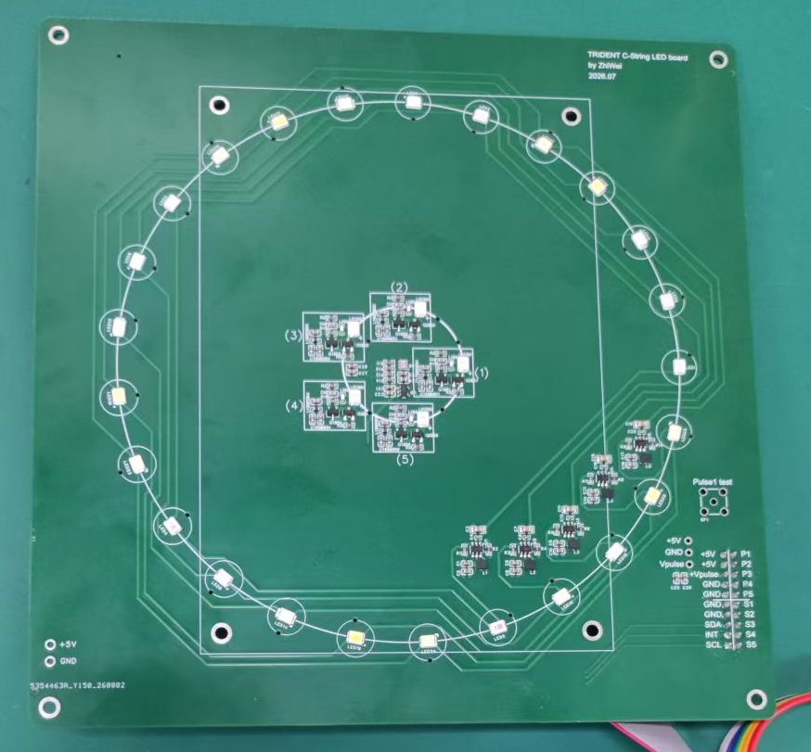
The Light System
One light system, two calibration functions:
water optics + timing response
Continuous emitting mode supports camera-based water monitoring
396 nm
420 nm
455 nm
480 nm
525 nm
The light source non-uniformity
Pulsed LEDs with < 5 ns pulse width; 1-10kHz;
Same pulsed light source for PMT response and inter-DOM timing offsets.
1
Tailin Zhu (TDLI) | In-situ Calibration System for Deep-sea Neutrino Telescope | TeVPA 2026

Slide 12
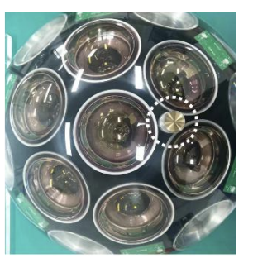
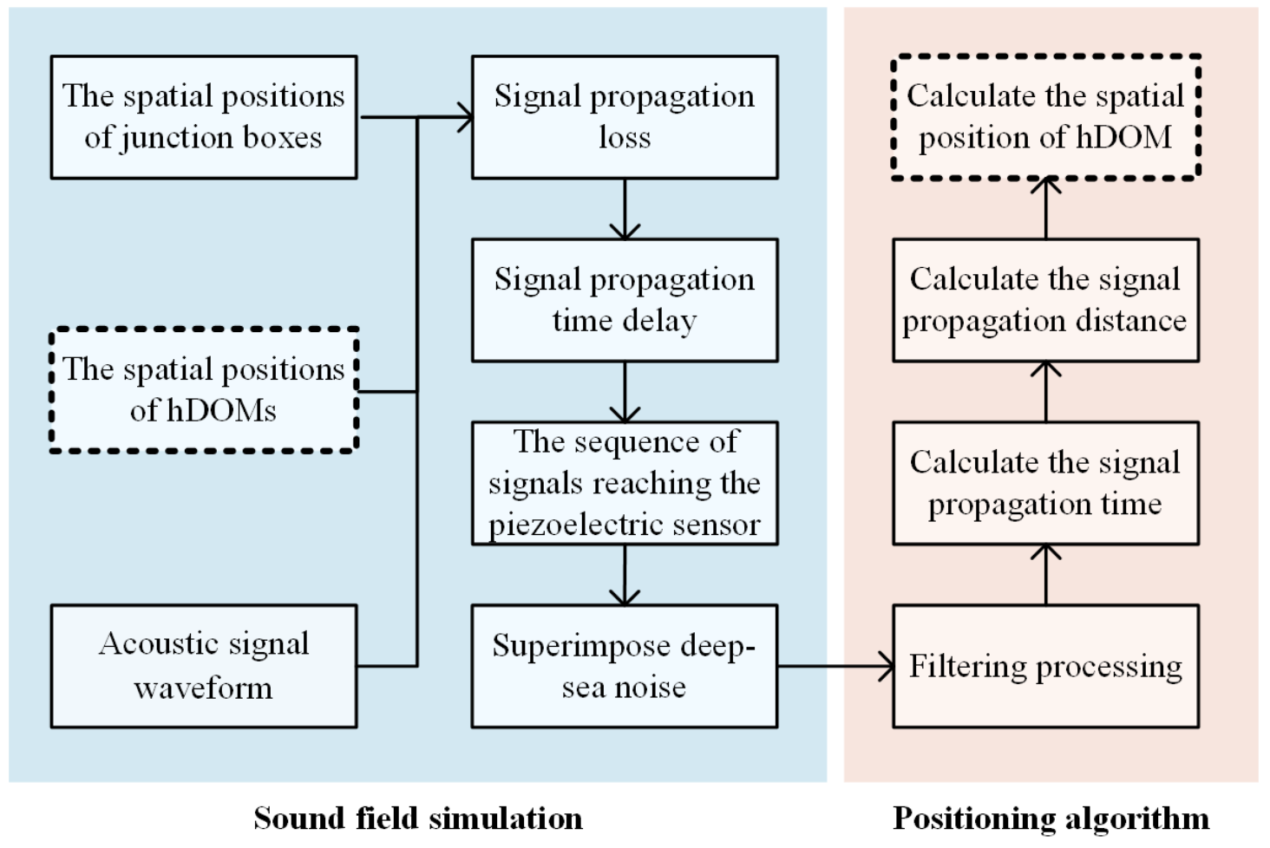
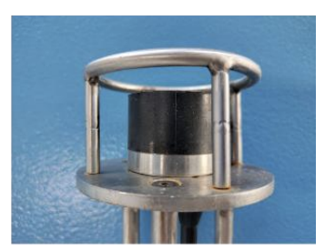
Geometry: Acoustic Positioning
< 20 cm hDOM positioning precision is targeted to support sub-ns photon timing and ~0.1° track angular resolution at ~100 TeV.
Acoustic receivers integrated in hDOMs
Piezo-acoustic sensors:
sensitive to 10k-70k Hz, -160 dB
Transmitters are deployed at string junction boxes
J. Liu, et. al., Ocean Engineering, 347 124038 (2026)
1
Tailin Zhu (TDLI) | In-situ Calibration System for Deep-sea Neutrino Telescope | TeVPA 2026

Slide 13
Geometry: Acoustic Positioning
< 20 cm hDOM positioning precision is targeted to support sub-ns photon timing and ~0.1° track angular resolution at ~100 TeV.
Acoustic receivers integrated in hDOMs
Piezo-acoustic sensors:
sensitive to 10k-70k Hz, -160 dB
Transmitters are deployed at string junction boxes
J. Liu, et. al., Ocean Engineering, 347 124038 (2026)
1
Tailin Zhu (TDLI) | In-situ Calibration System for Deep-sea Neutrino Telescope | TeVPA 2026

Slide 14
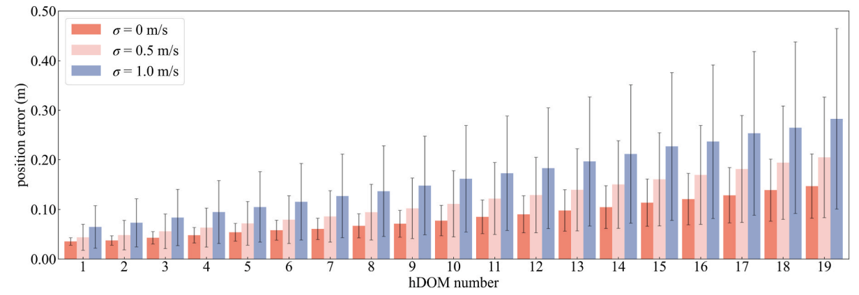
Geometry: Acoustic Positioning
Hydrographic measurements provide environmental inputs to the acoustic positioning model.
  Sound velocity + sea current profile
Real-time environmental inputs for acoustic positioning
J. Liu, et. al., Ocean Engineering, 347 124038 (2026)
1
Tailin Zhu (TDLI) | In-situ Calibration System for Deep-sea Neutrino Telescope | TeVPA 2026

Slide 15
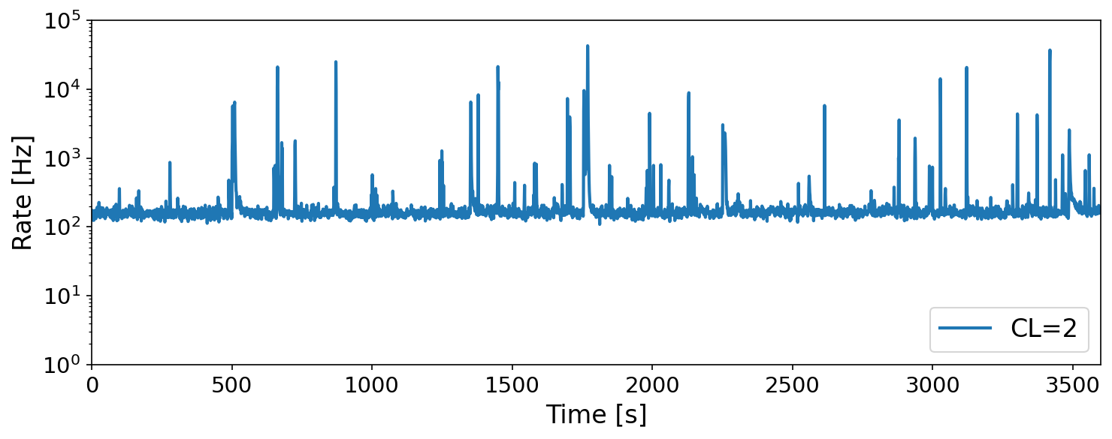
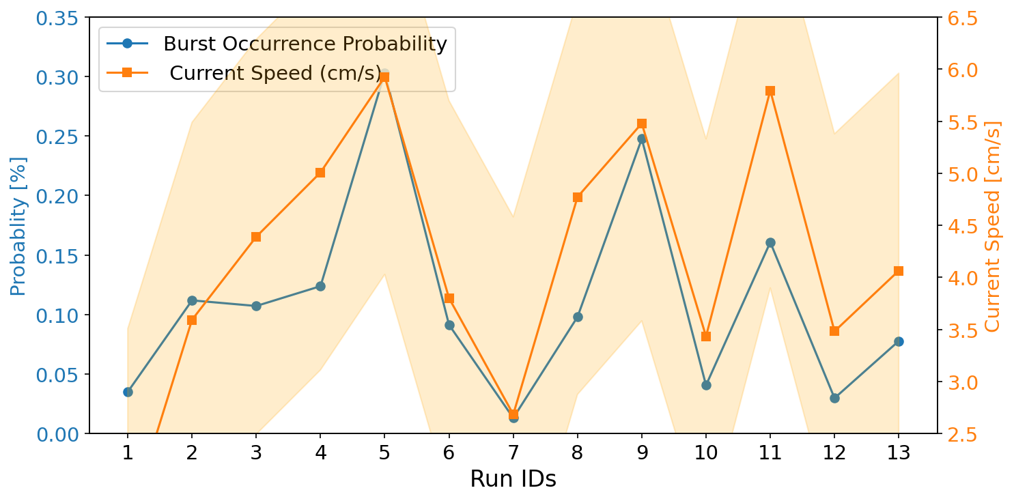
Optical Background: Bioluminescence
Aim: monitor background rate, variability, and environmental correlations
10³ -10⁵ trigger-rate bursts observed on seconds timescales
Camera + PMT: intensity, spatial and spectral information
TRIDENT Preliminary
F. Zhang (TAUP 2025)
TRIDENT Preliminary
Correlation between bioluminescence and sea currents observed.
Hydrographic data → environmental inputs for background modelling
F. Zhang (TAUP 2025)
1
Tailin Zhu (TDLI) | In-situ Calibration System for Deep-sea Neutrino Telescope | TeVPA 2026

Slide 16
Optical Background: Bioluminescence
Aim: monitor background rate, variability, and environmental correlations
10³ -10⁵ trigger-rate bursts observed on seconds timescales
Camera + PMT: intensity, spatial and spectral information
TRIDENT Preliminary
F. Zhang (TAUP 2025)
TRIDENT Preliminary
Correlation between bioluminescence and sea currents observed.
Hydrographic data → environmental inputs for background modelling
F. Zhang (TAUP 2025)
1
Tailin Zhu (TDLI) | In-situ Calibration System for Deep-sea Neutrino Telescope | TeVPA 2026

Slide 17
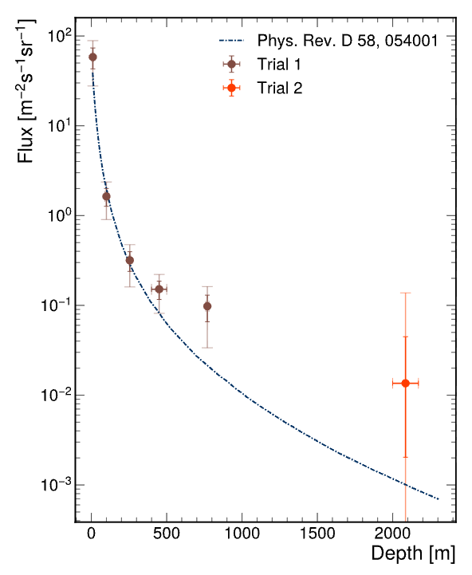

Independent Muon Tagging
Plastic sinctillator + SiPM
4 x 20 cm x 20 cm x 2 cm slabs
SiPM readout: millimeter-level spatial resolution
MuonSLab has demonstrated stable muon counting in deep-sea measurements.
For TRIDENT, a scintillator-based tag provides an independent particle reference for detector studies and muon-calibration development.
$$μ$$
J. Wu, et. al., JINST 20 P07035 (2025)
1
Tailin Zhu (TDLI) | In-situ Calibration System for Deep-sea Neutrino Telescope | TeVPA 2026

Slide 18

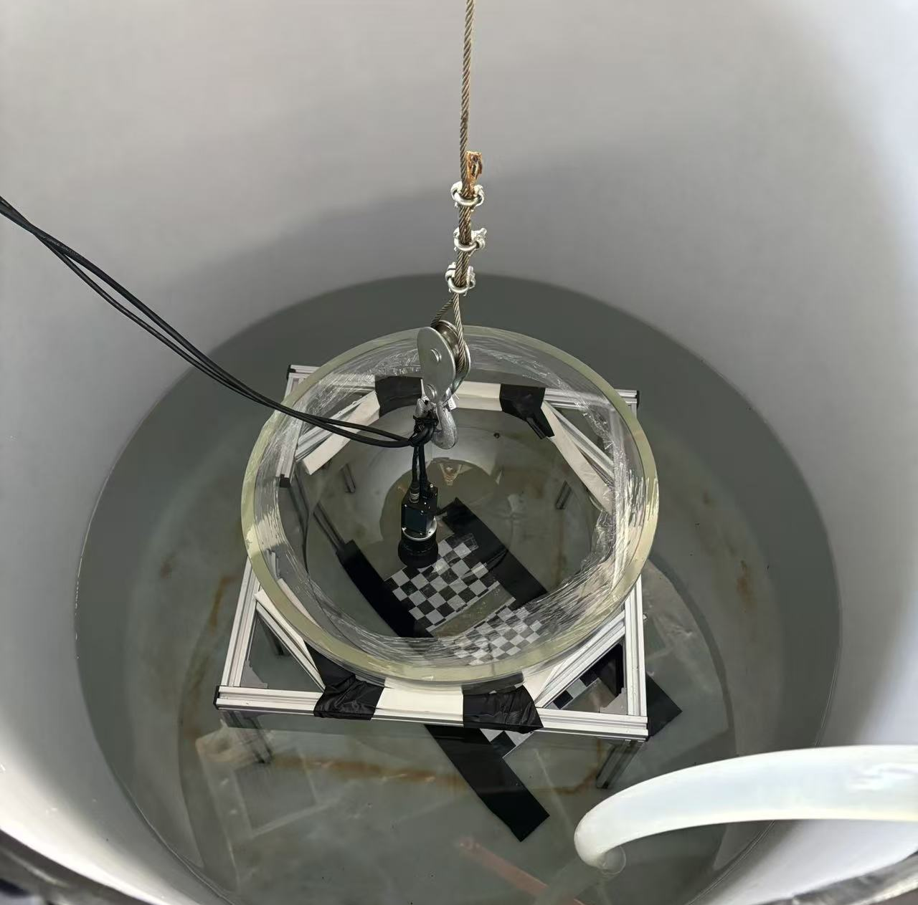
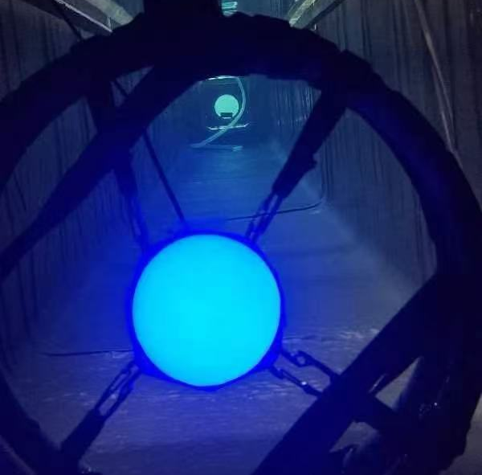
Status
Validated in sea trials
Optical calibration strategy
Muon tagging
Deepsea conditions characterised
Bioluminescence and environmental correlations
See Fuyudi Zhang’s talk on 2026/09/01
The First Long-Term In-situ Performance of a Prototype Demonstrator for TRIDENT Neutrino Telescope
1
Tailin Zhu (TDLI) | In-situ Calibration System for Deep-sea Neutrino Telescope | TeVPA 2026

Slide 19
Conclusion
A compact multi-purpose calibration system is under development
Attenuation-length measurements using cameras and PMTs in 2021 and 2024 sea trials show consistency
Optical background: camera + PMT + hydrographic information characterise background intensity and variability.
Timing: pulsed LED + White Rabbit provide precise inter-DOM timing calibration.
Geometry: precise acoustic positioning required underwater.
Independent muon tagging: dedicated scintillator-based modules prepared.
Target Phase-1 operation: 2027
1
Tailin Zhu (TDLI) | In-situ Calibration System for Deep-sea Neutrino Telescope | TeVPA 2026

Slide 20

Running in the Dark, Calibrating the Way ...
(Pic credit: Yingwei Wang)
Thank you!
1
Tailin Zhu (TDLI) | In-situ Calibration System for Deep-sea Neutrino Telescope | TeVPA 2026

Slide 21
Backup
1
Tailin Zhu | In-situ Calibration System for Deep-sea Neutrino Telescope | TeVPA 2026

Slide 22
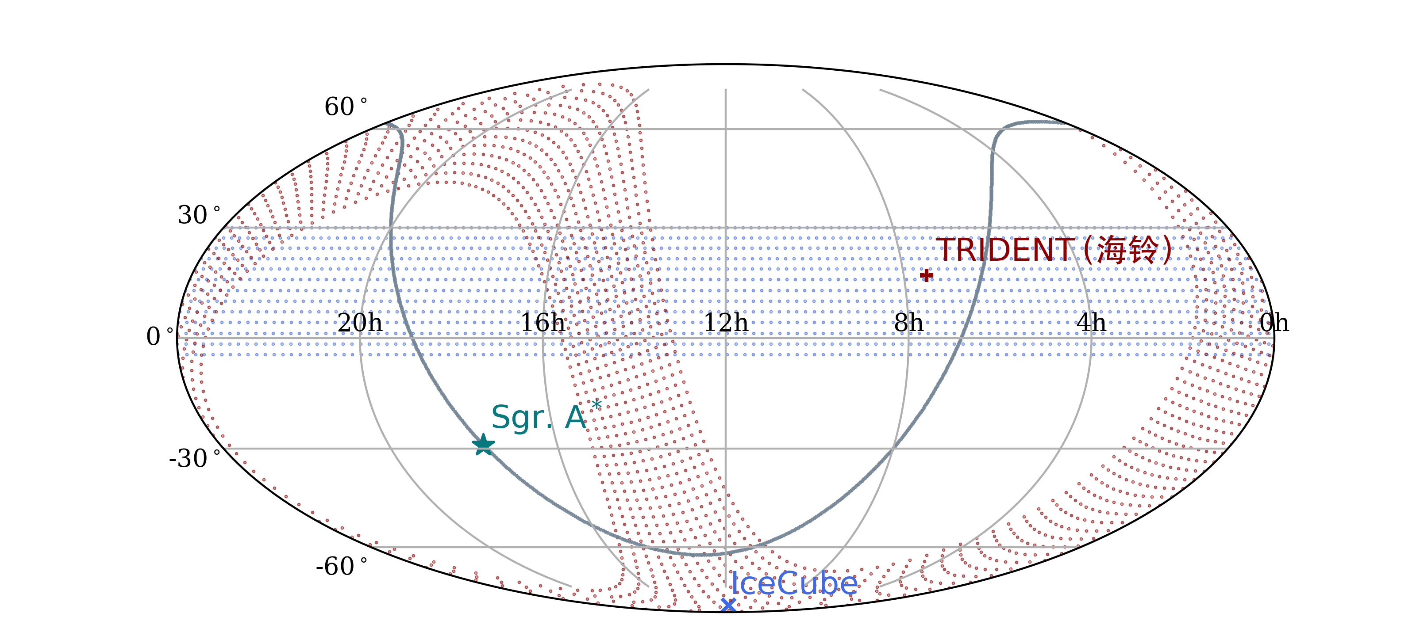
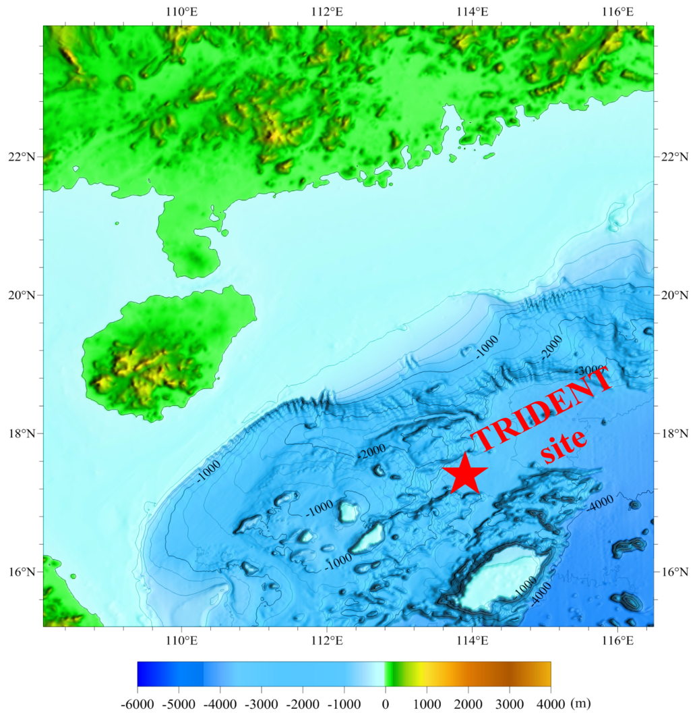
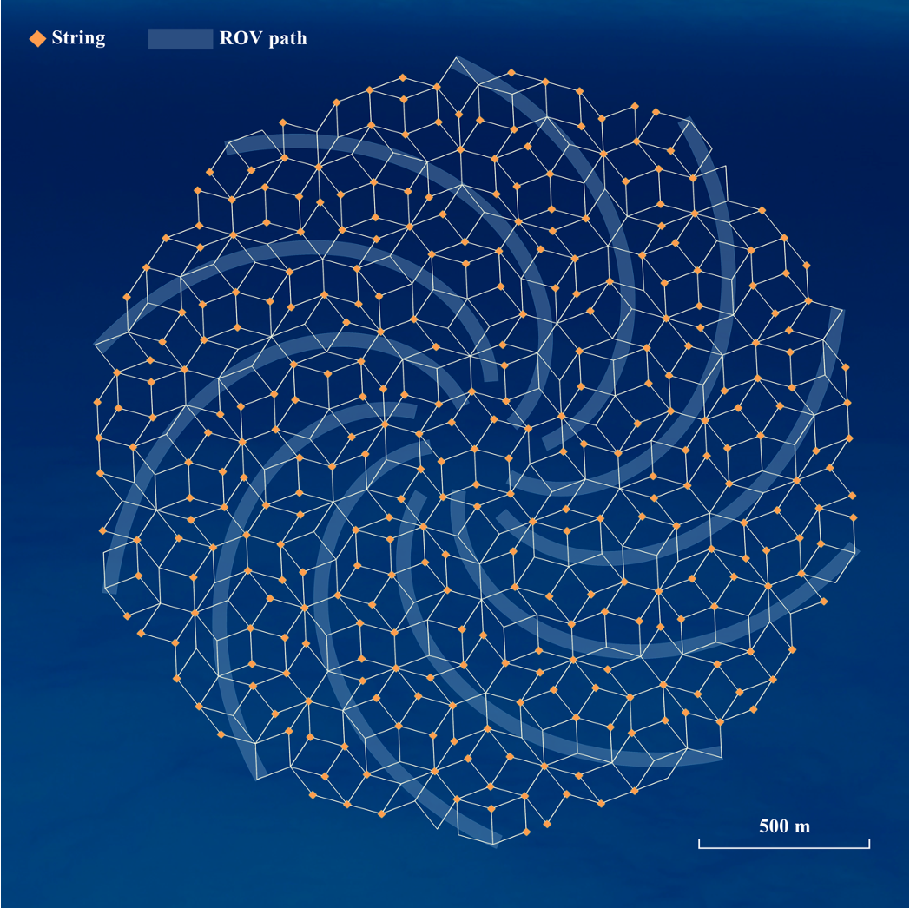
TRIDENT
Planned for 8km³ in South China Sea
3.5 km deep, flat plane site chosen
Close to equator for full-sky coverage
Hong Kong
480 km
Sanya
Scientific goals:
Point source searches
All-flavour detection @ 100 GeV – EeV
Detector design:
Penrose tiling – Irregular 70-110 m string spacing.
Curved wider pathways for inner string access, to reduce muon corridor events
1
Tailin Zhu | In-situ Calibration System for Deep-sea Neutrino Telescope | TeVPA 2026

Slide 23
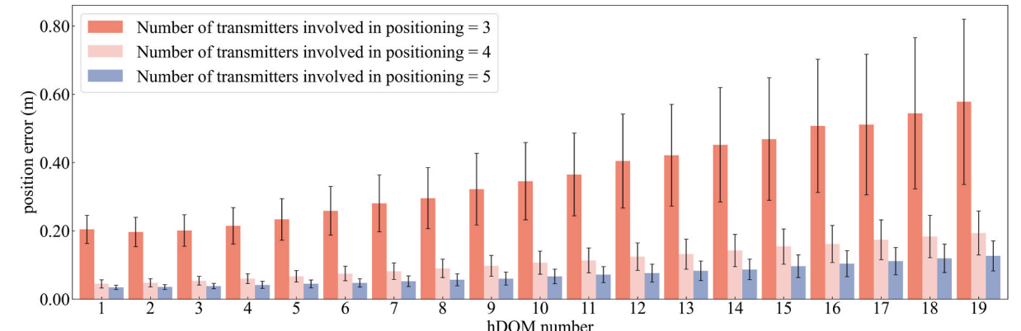
Acoustic Positioning system
In total 11 transmitters, at least 5 will be used for positioning
J. Liu, et. al., Ocean Engineering, 347 124038 (2026)
1
Tailin Zhu | In-situ Calibration System for Deep-sea Neutrino Telescope | TeVPA 2026

