Slide 1
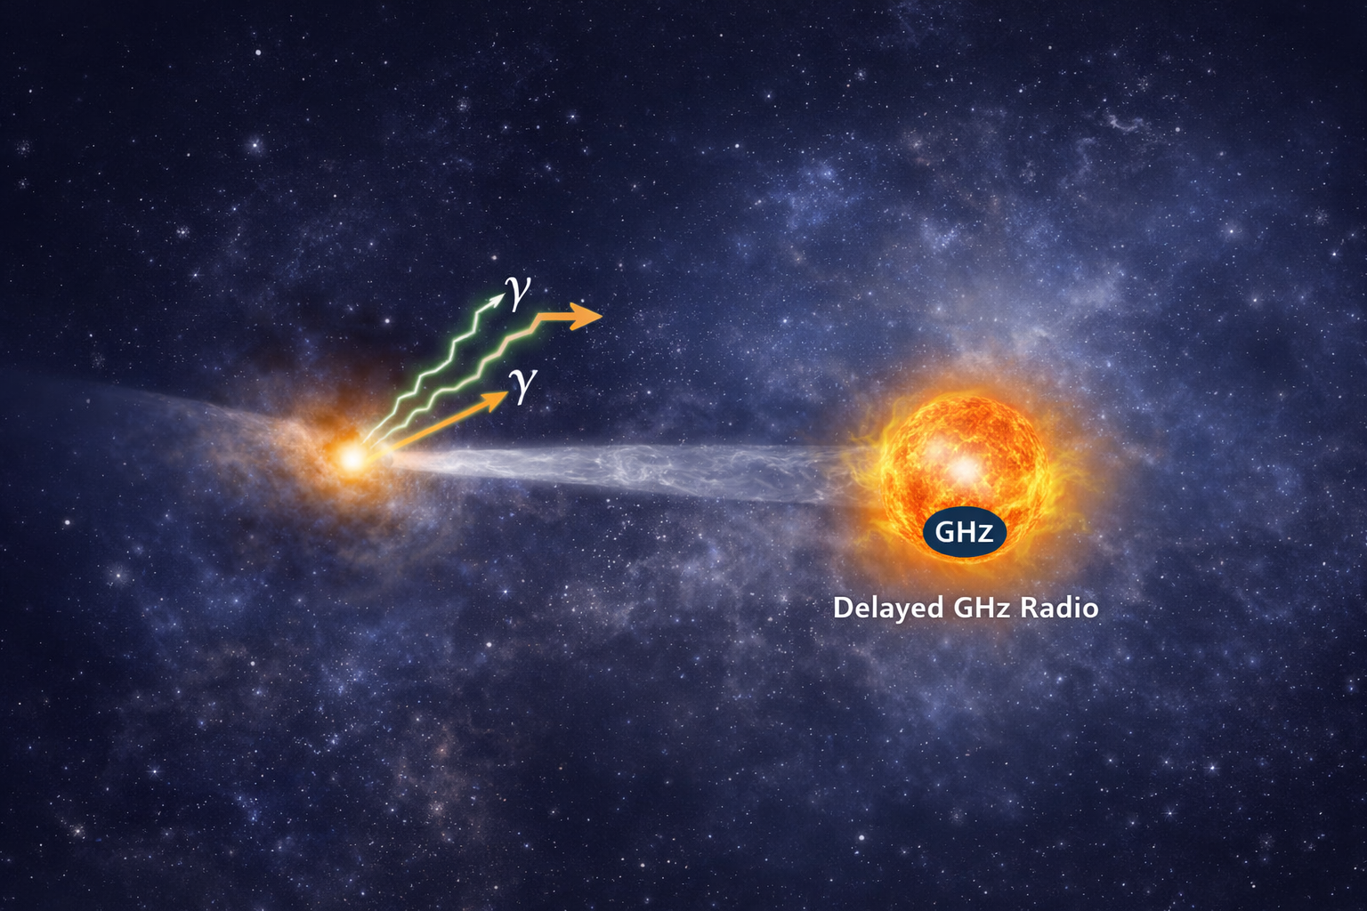


On the origin of delayed radio flares in neutrino-associated blazars:
The case of TXS 0506+056
Stamatios Ilias Stathopoulos
In collaboration with C. Yuan, D. Karavola, F. Testagrossa, G. Vasilopoulos, M. Petropoulou, and W. Winter
Stathopoulos et al., ApJL 1006, L4 (2026)
DOI: 10.3847/2041-8213/ae80bb
TeVPA 2026 — Tendo, Japan.
03/09/26

Slide 2
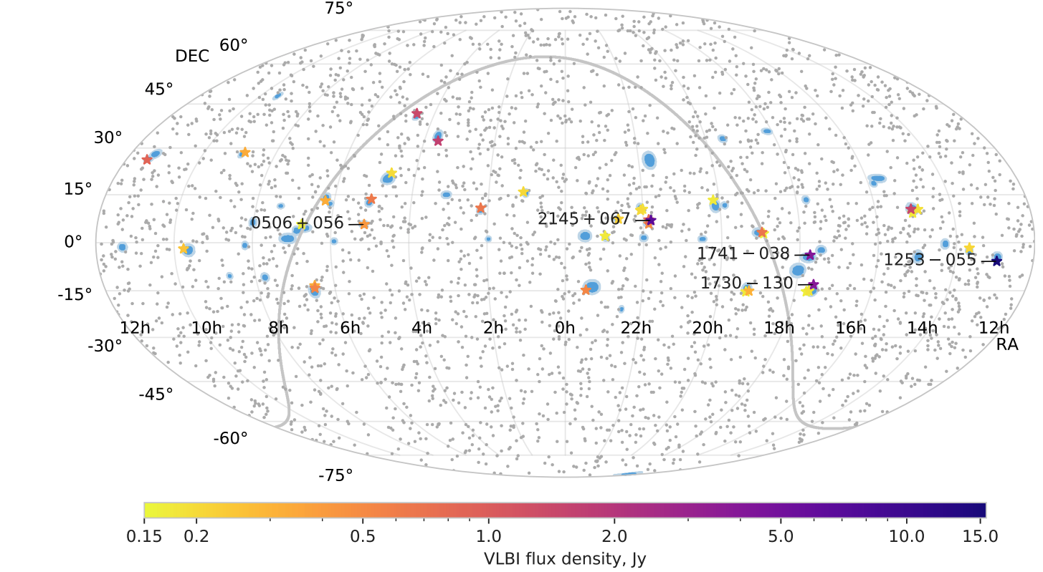
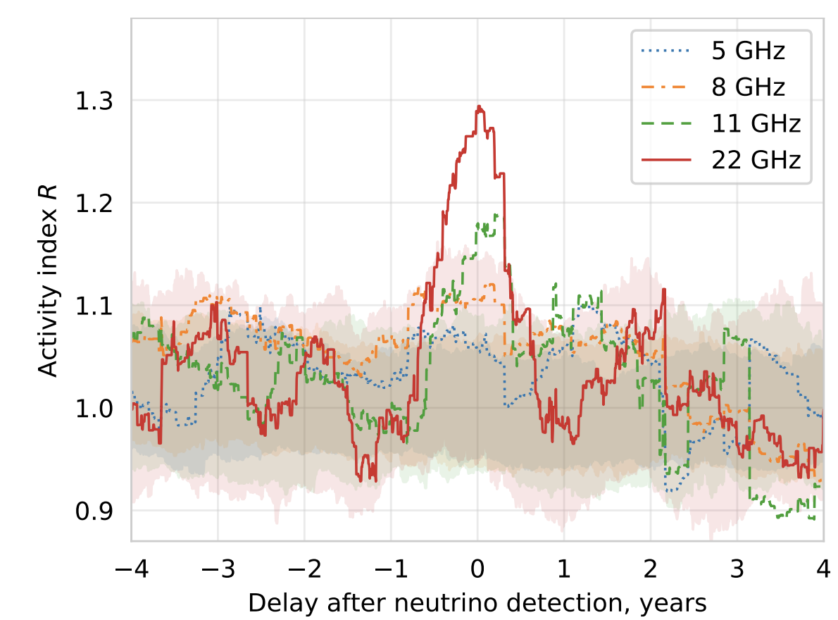
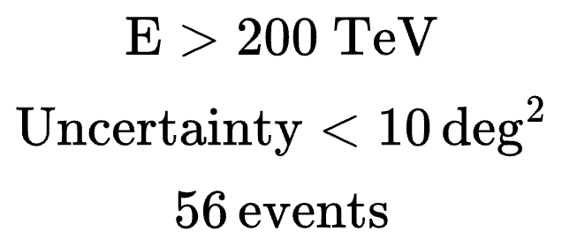
HE astrophysical neutrinos and compact radio cores: population-level hints
Plavin et al 2020
Temporal association does not imply: same zone? same particles?
Plavin et al 2020
HE neutrinos coincide spatially with radio bright VLBI cores.
Some candidate associations occur during major radio activity.
Correlation = co-spatial emission.
Plavin et al 2020
Hovatta et al 2021

Slide 3
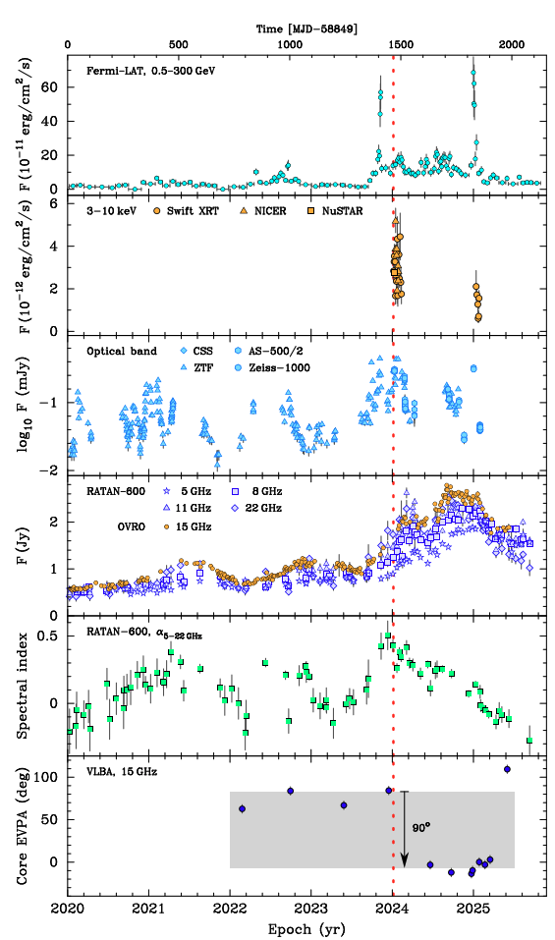
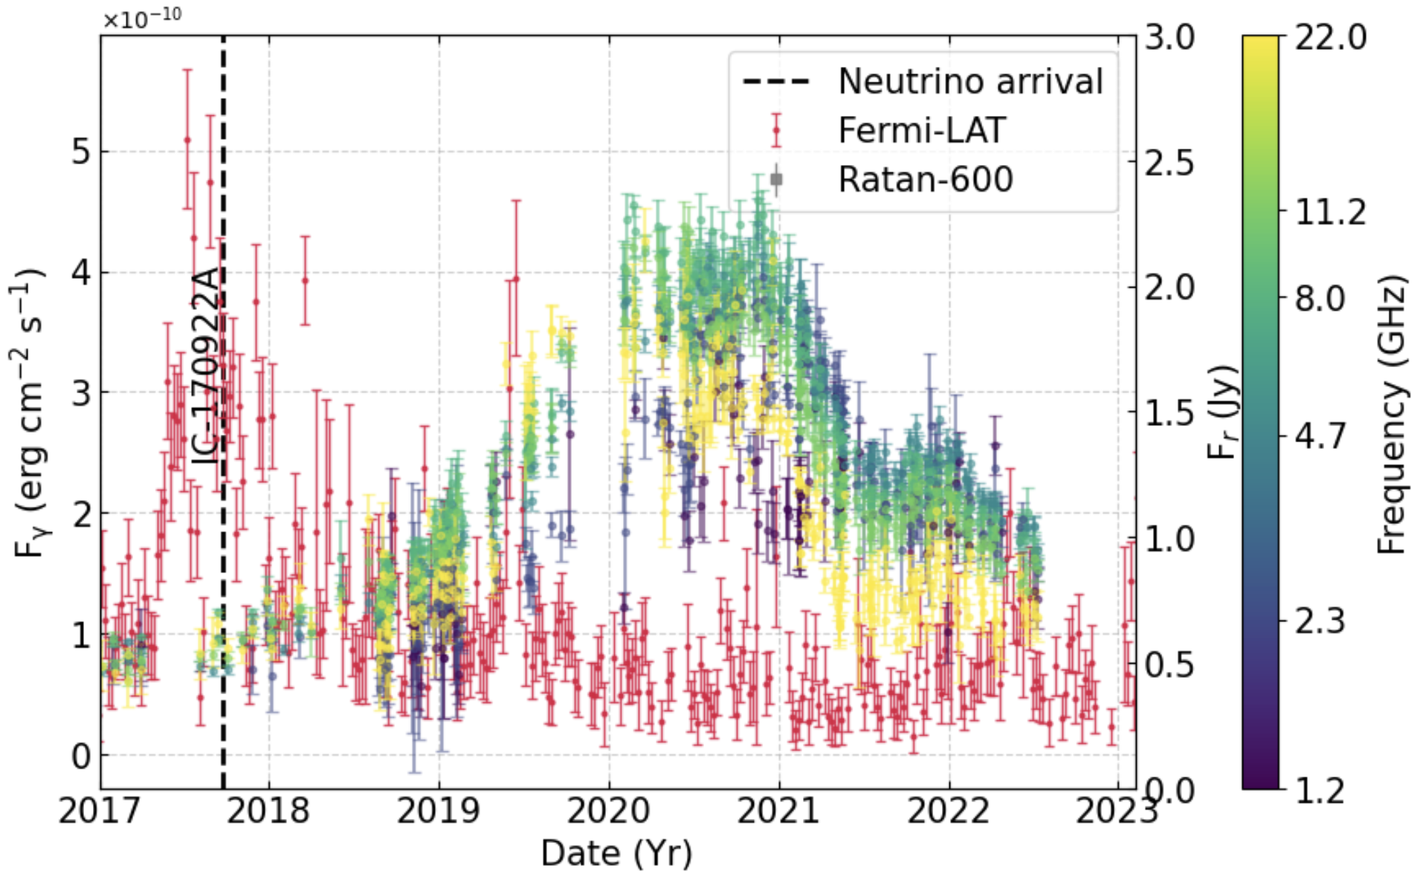
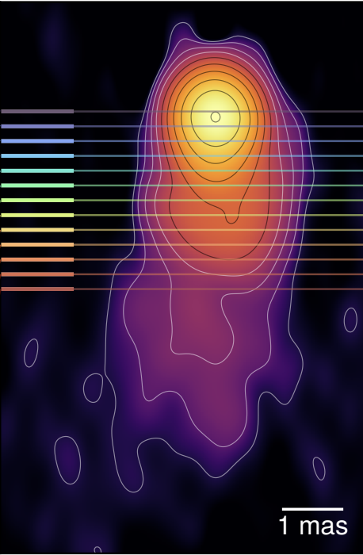
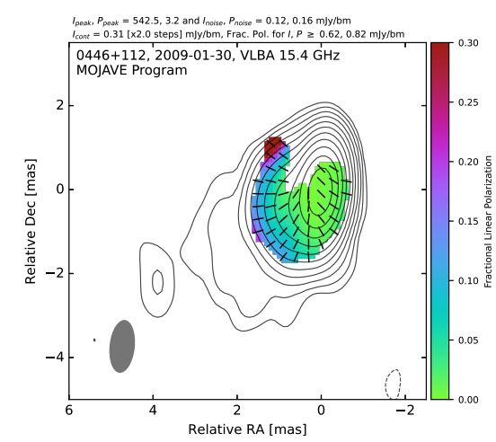
γ–radio delays in neutrino-associated blazars
Stathopoulos et al 2026
Kovalev et al 2025
Kovalev et al 2026
Blazars -> multiwavelength flare during neutrino arrival
TXS~GHz maximum occurs
Δt ≈ 2–3 yr later (peaking ~2020)
PKS~GHz maximum occurs
Δt ≈ 1 yr later (peaking ~2025)

Slide 4
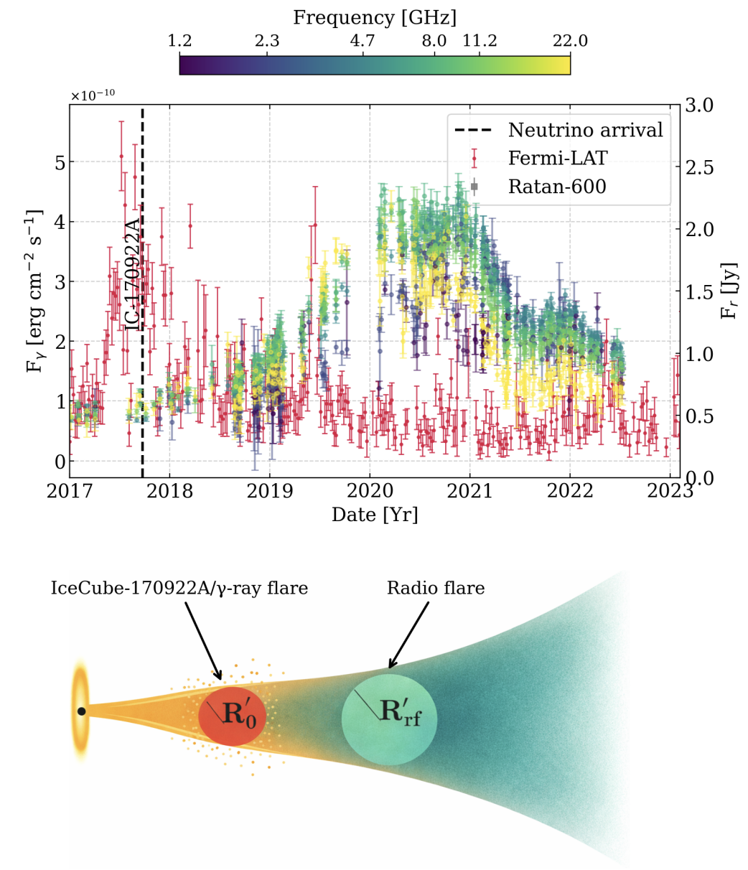
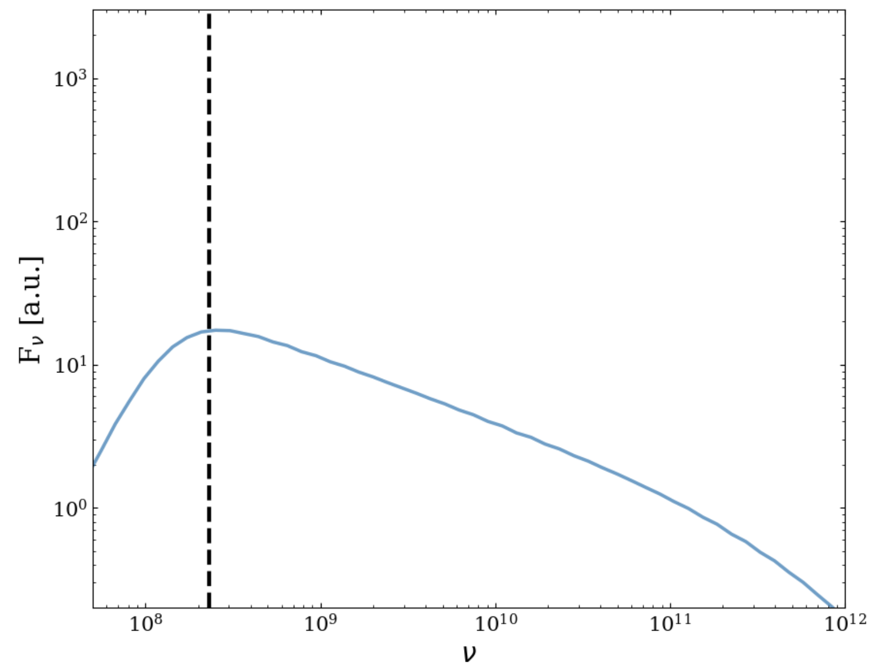


Hypothesis to Test: SSA Unveiling of the Neutrino/γ-ray zone
turnover
Stathopoulos et al 2026
optically thick
emission
optically thin emission
Initially high SSA turnover.
2017 neutrino/γ flare emitting region travels out: Each band brightens when its τ~1
Frequency-ordered peaks + decay consistent with light-crossing/adiabatic times.
S. Boula et al. 2022
A. Tramacere et al. 2022

Slide 5
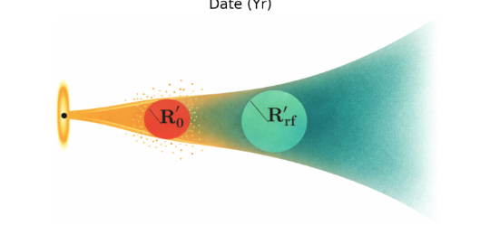
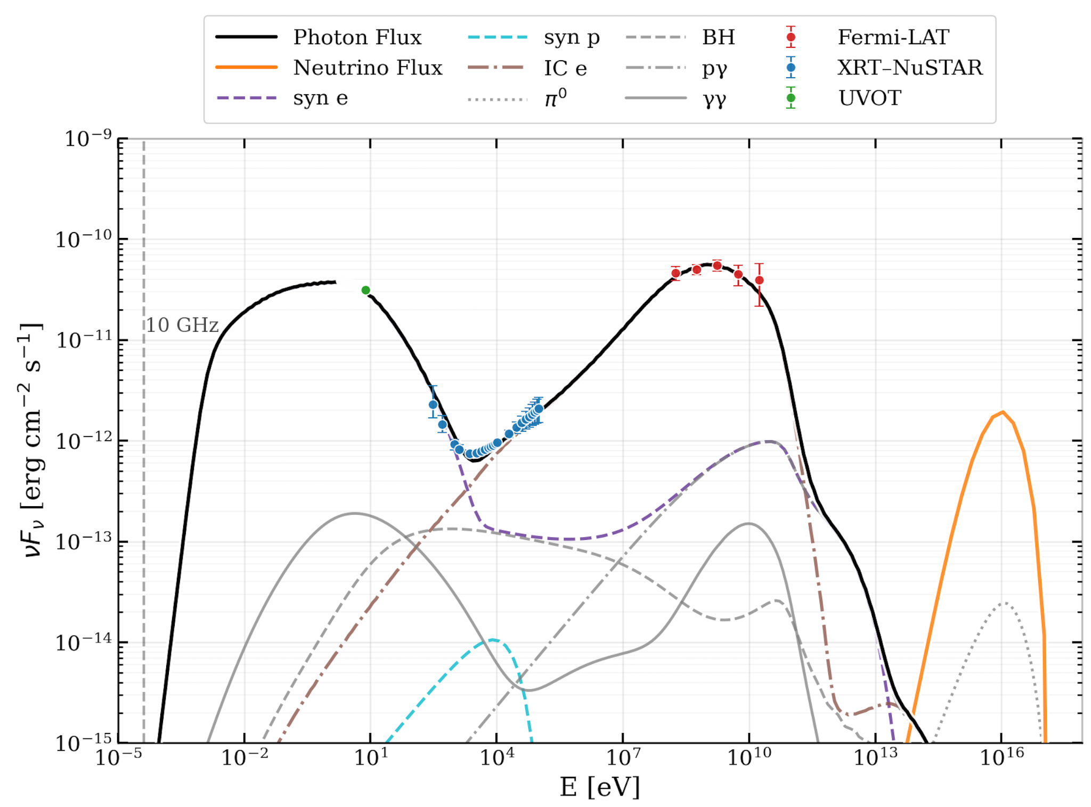
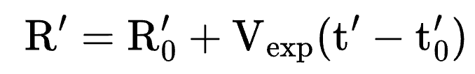
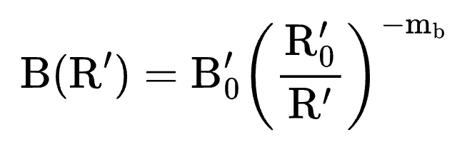

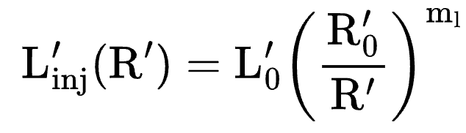
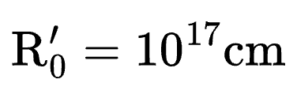



We evolve the 2017 multimessenger zone into the radio phase
2017 flare state
Time-dependent evolution
Post flare dynamics
2
3
1
3
1
2
Stathopoulos et al 2026
LeHaMoC
Stathopoulos et al 2024a
Output: six RATAN light curves 1.2-22 GHz
Homogenous expanding one zone. Evolve e± , p, γ, ν self consistently
What we vary later:
LMBB2b solution from Keivani+2018 (max neutrino output)
Post flare radio evolution follows the primary pairs
GHz initially opaque
https://github.com/Stamatis-Ilias/LeHaMoC-V2/tree/new-version
2017 conditions fixed test whether post-flare evolution alone explains the radio data

Slide 6

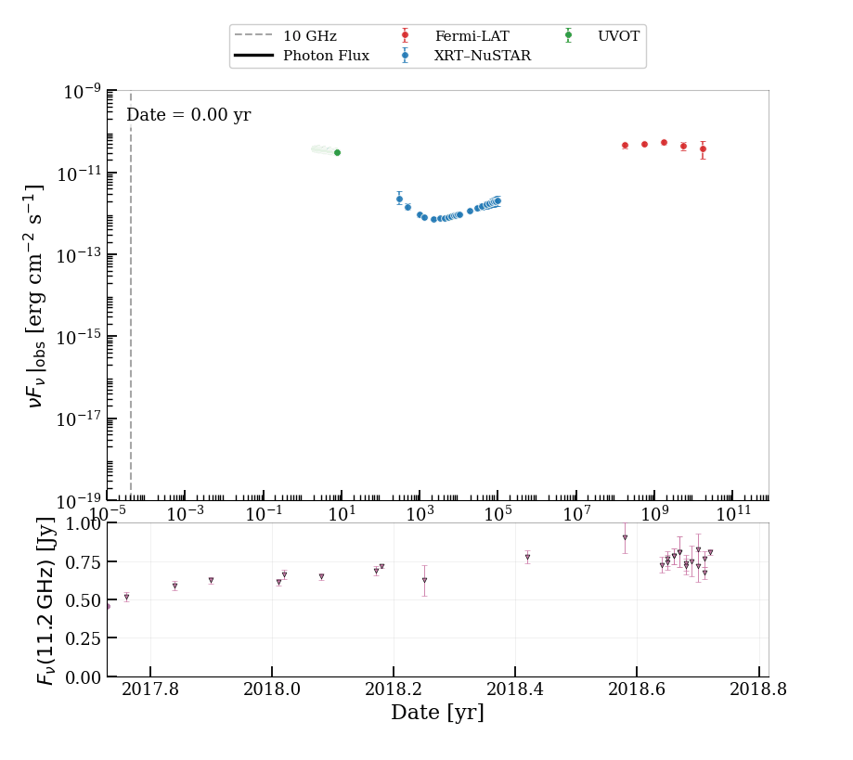
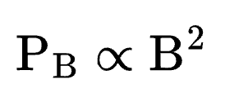
Scenario A– Expanding Fossil Pairs (no new injection and escape)
Evolve the pairs from the 2017 γ/neutrino flare
Free parameters: mb and Vexp
,
Physical Intuition
Slow B decay strong cooling → GHz peaks too early (pairs move to lower energies faster)
Fast B → Weak emissivity → flux too low
No (Vexp, mb) region reproduce ~2.5 yr delay+Jy peaks+morphology

Slide 7
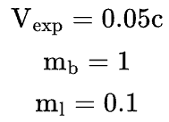
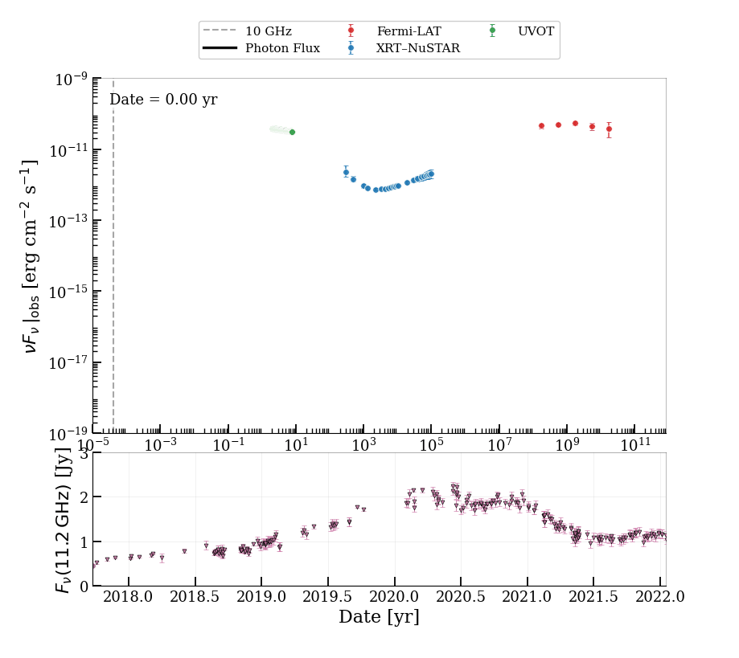


Scenario B– Continuous Injection + Escape during expansion
Evolve the pairs from the 2017 γ/neutrino flare+injection & escape of pre-accelerated pairs (escape timescale )
Free parameters: mb, ml and Vexp

Slide 8
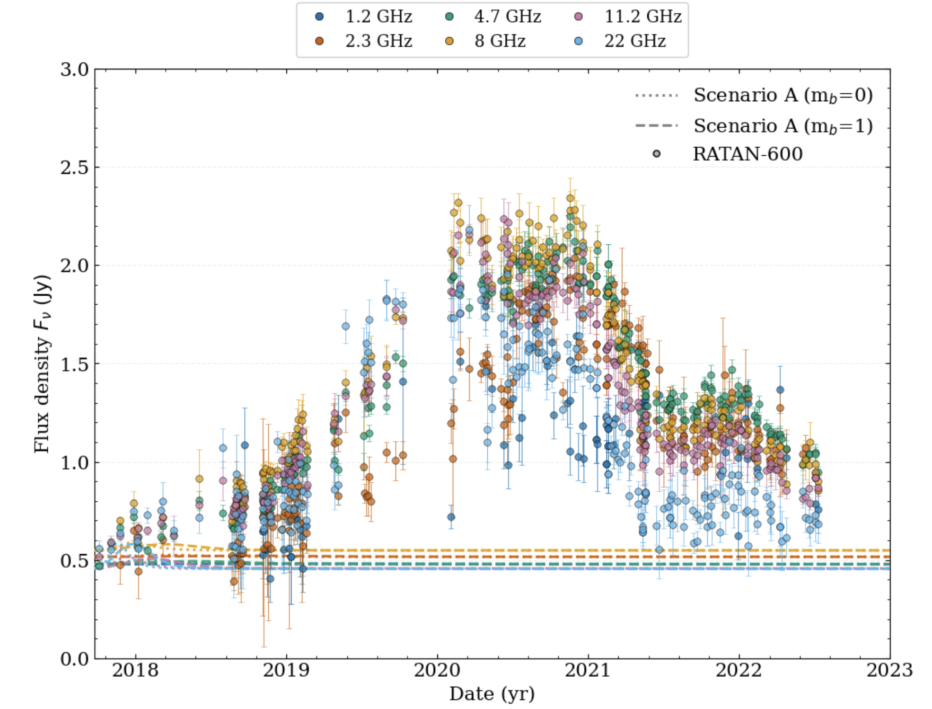
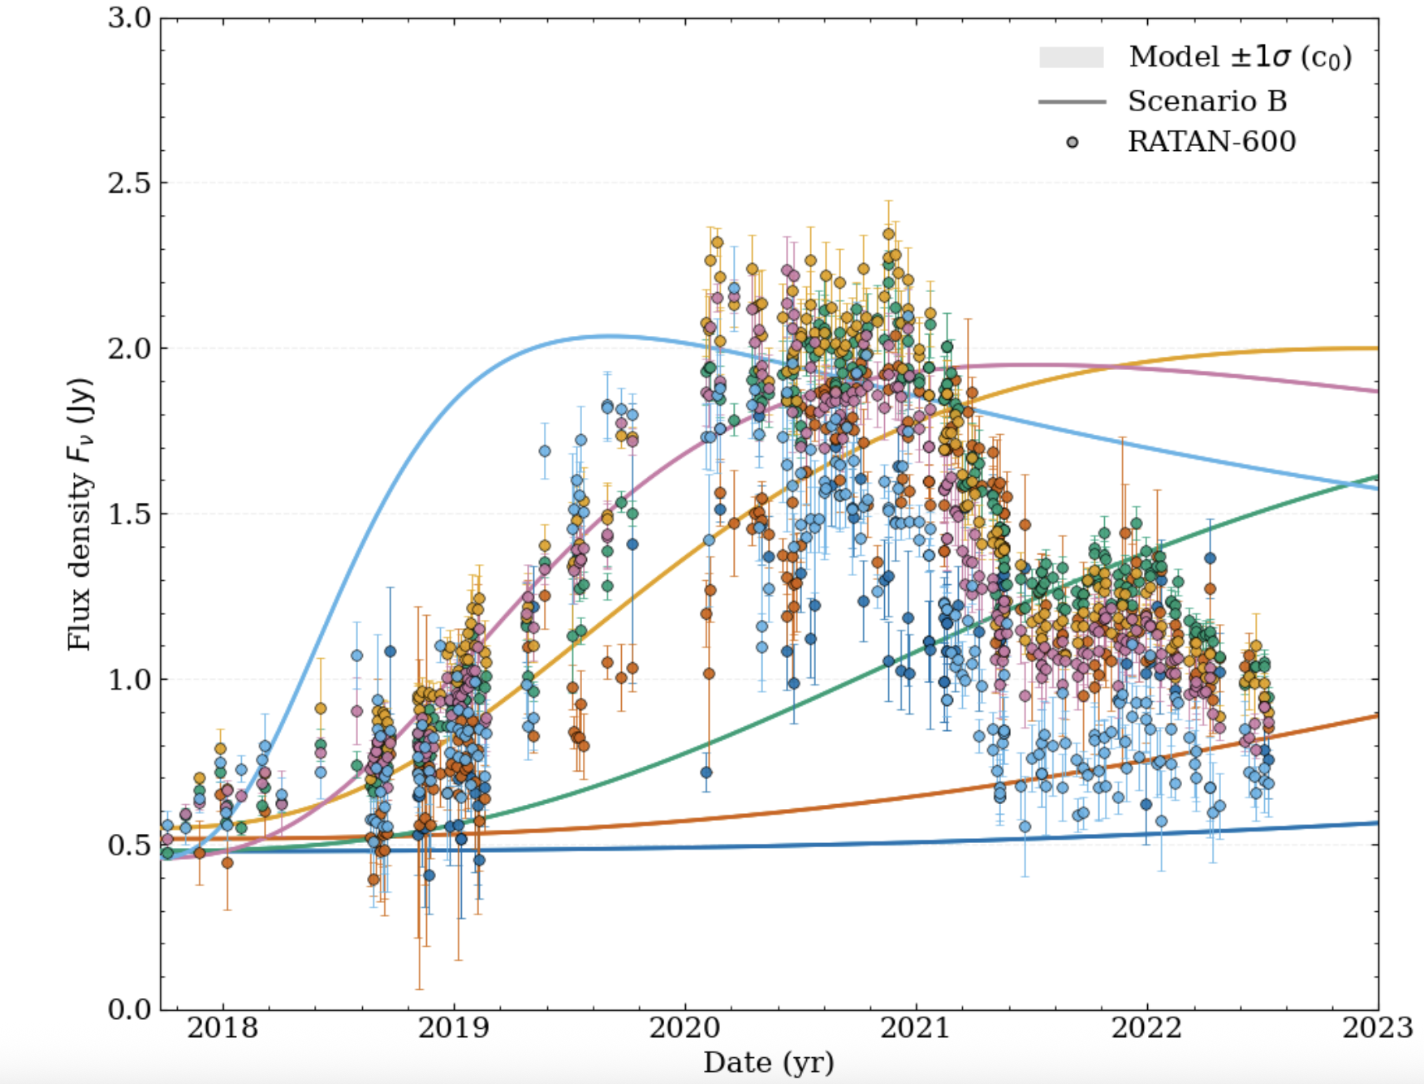
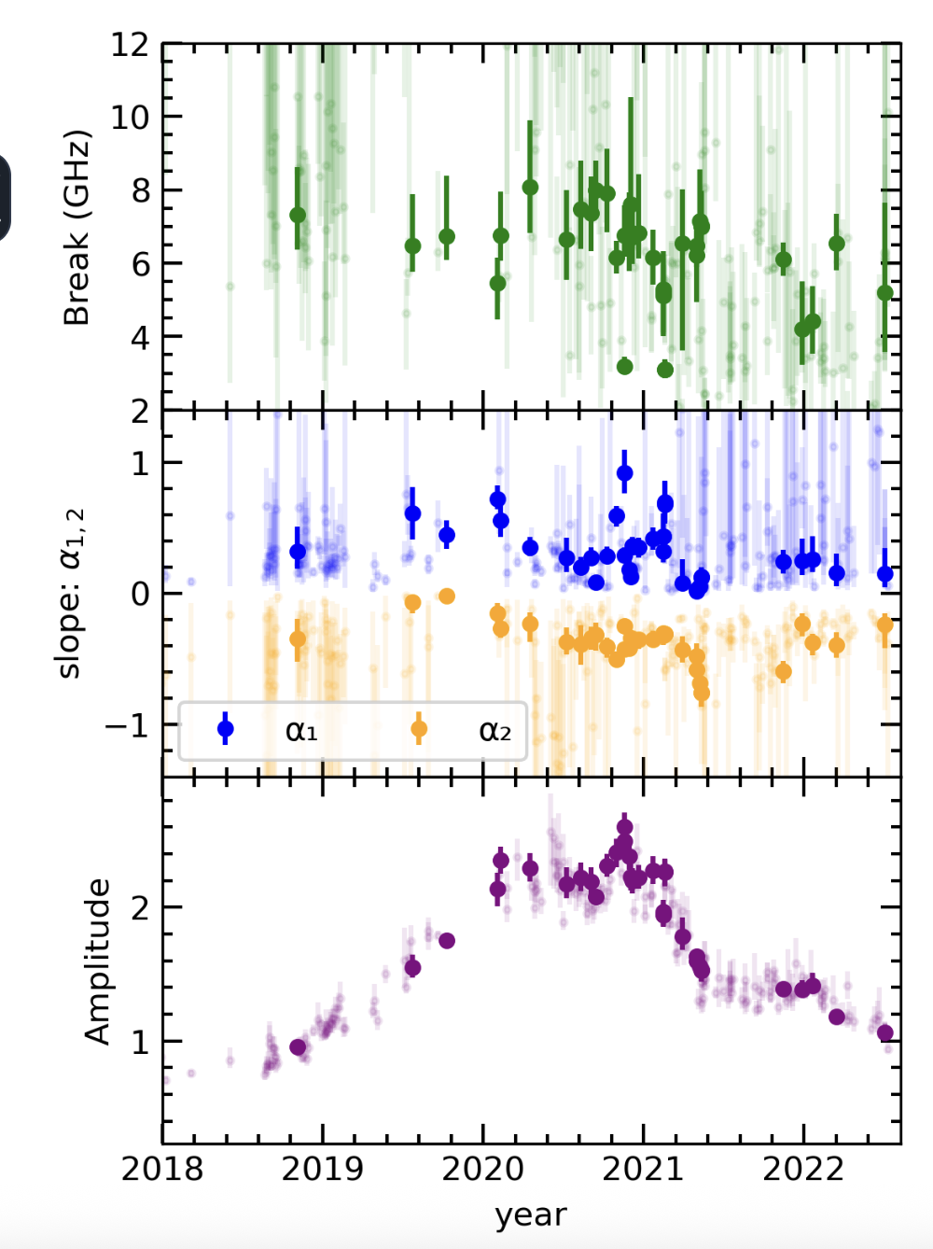
Scenario B– Continuous Injection + Escape during expansion
Free parameters: mb, ml and Vexp
, ,
Model reproduce individual radio bands (rising part+Jy level flux)
SSA-driven flare predicts frequency-ordered peaks as νssa sweeps to lower frequencies
Light-curve decay is too slow
Outcome: Reproduce the rise of the flare in individual bands, but fails on simultaneity and decay

Slide 9
Scenario C– Optically Thin Re-Dissipation at Parsec scales
Scenario C– Renewed downstream energization
Two separate events
schematic - not to scale
already GHz-thin
νSSA,obs < 1.2 GHz
Become transparent Produce radio flare
2020 optically thin radio flare
disturbance propagates + expands
central engine
A common energization episode produces clustered 1.2-22 GHz peaks
ν+γ
Renewed e± energization
GHz opaque
νSSA,obs > 22 GHz
R′ ↑ B′ ↓ νSSA ↓
transparency occurs first
2026 VLBI fast spine wave+ slower / quasi-stationary structures -> supports a structured downstream response picture.
Possible downstream interaction site
standing/reconfinement feature or structured spine-sheath interaction
Kovalev et al. 2026, Eppel et al. 2026
1) Transparency occurs first 2) Renewed dissipation sets the radio-peak time

Slide 10
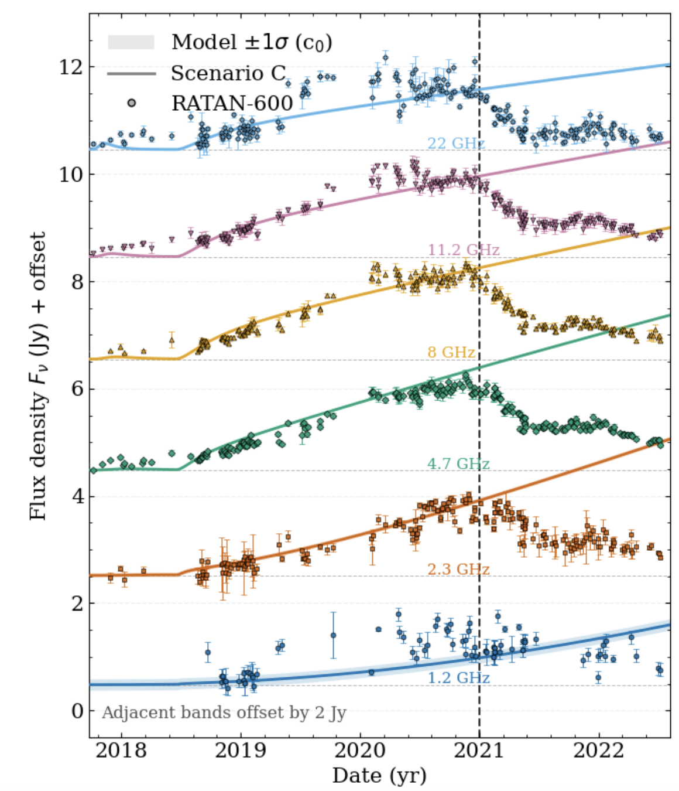
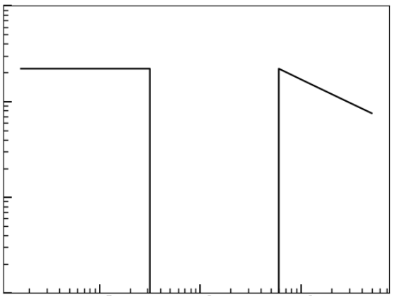

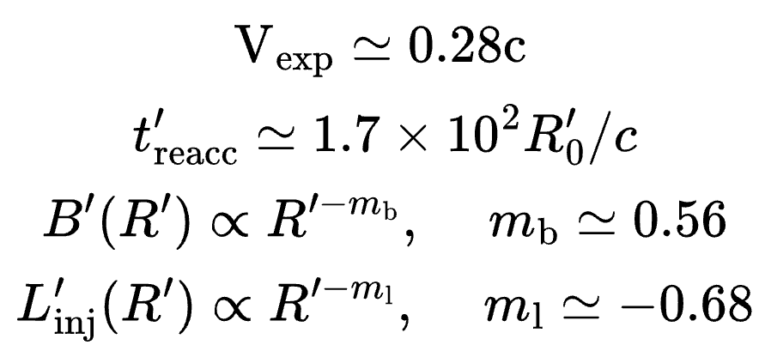

Best-Fit Light Curves: Fit summary from 2017->2021 (constant δ)
Estimate the best fit parameters through MCMC
re-dissipation
2017 flare
expansion
Same injection episode drives the rise in RATAN bands and reproduces their relatively clustered GHz max.
Constant Doppler factor-> the model remains too bright after the peak.
Observed post-peak drop is faster than cooling / light-crossing ⇒ requires δ(R′) change (deceleration / stratification).
Fresh e± injection

Slide 11
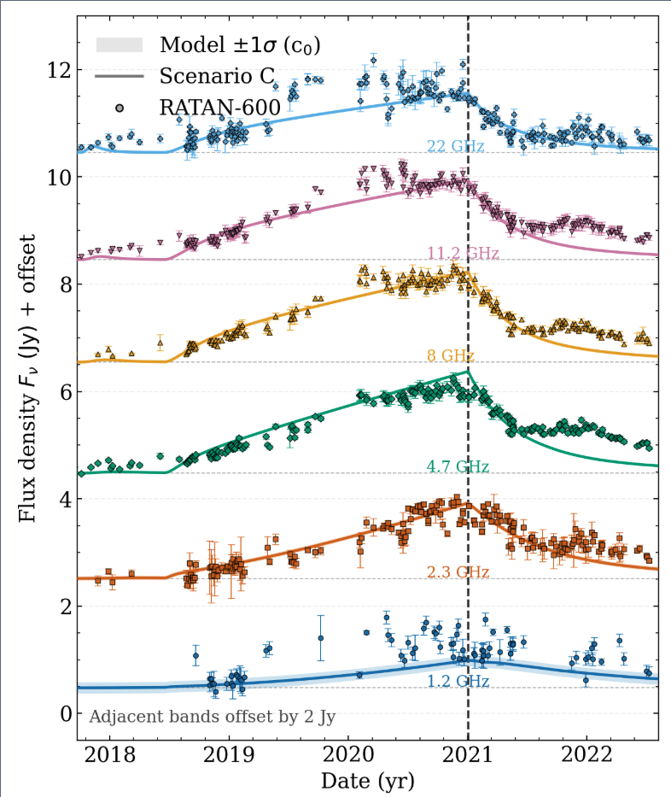
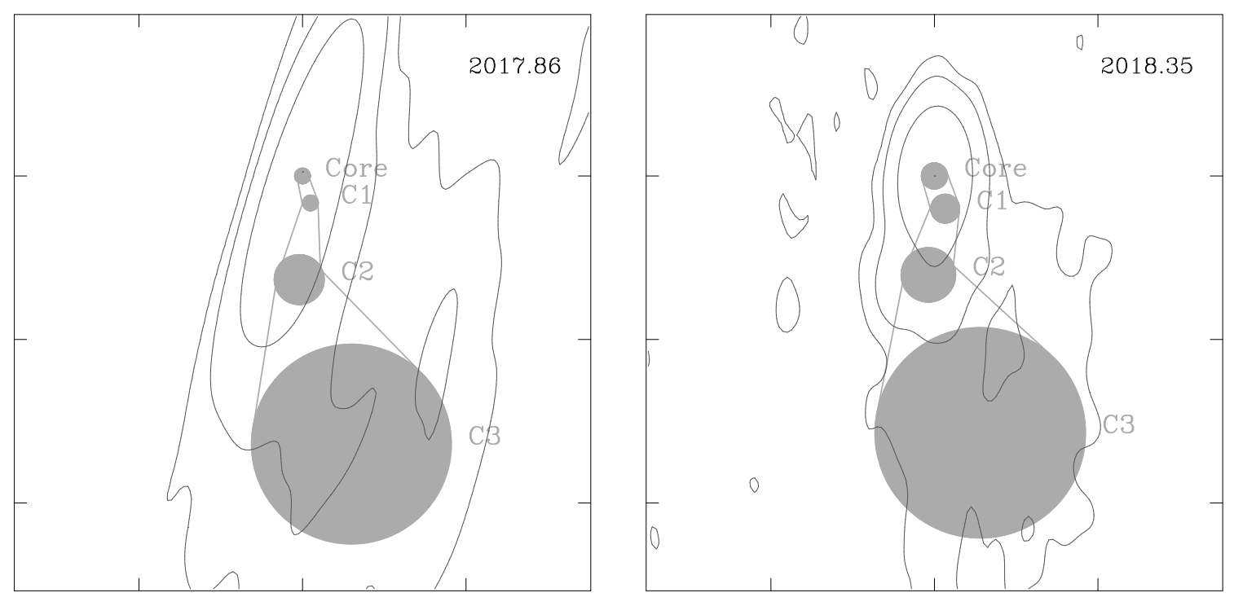
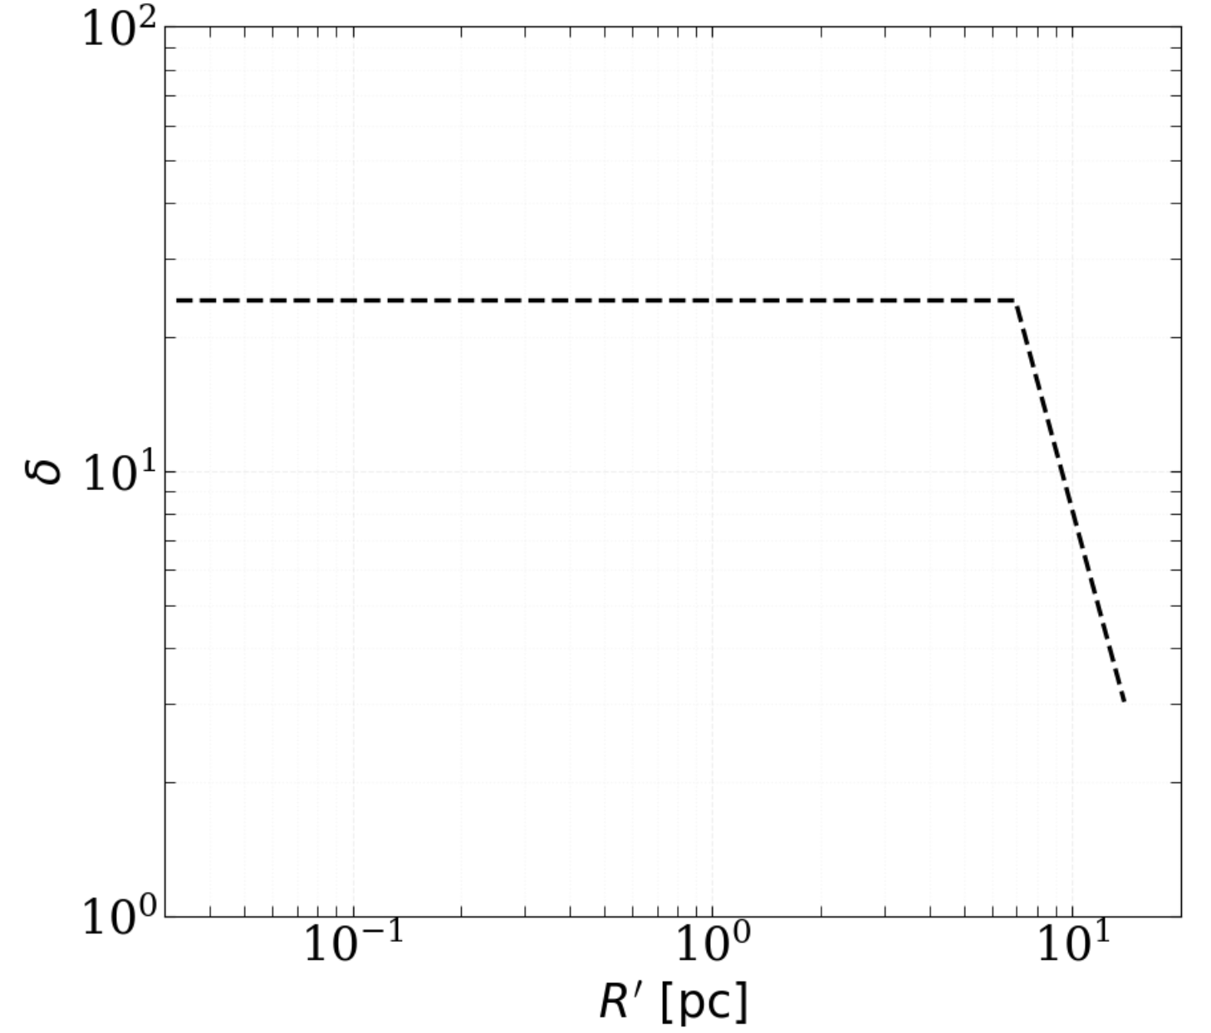

Scenario C–Fast decay ⇒ Doppler-factor evolution (deceleration)
Ros et al. 2019
43 GHz
VLBI evidence for Doppler-factor evolution(jet broadens downstream): Signs of deceleration and/or a spine-sheath structure within the inner 1 mas (70–140pc deprojected) , from the millimeter-VLBI core.
Model ingredient: rapid post-peak decay requires δ(R’)↓
Propagation scale: Δtobs≃2.5 yr⇒Δz≃0.57 (δ0Γ0)pc∼few×100 pc
Stathopoulos et al 2026

Slide 12

Discussion
Picture
2017 flare launches a disturbance that travels outward with little GHz signature (opaque + compact).
At pc scales, it interacts with a quasi-stationary structure → re-accelerates pairs → optically thin radio flare.
Post-peak: beaming decreases (δ down) → rapid dimming.
Protons
GHz emission is leptonic synchrotron from e±. Hadrons radiate inefficiently at radio.
Radio flare is insensitive to the proton population producing neutrinos.
Implication: delayed radio flares are not guaranteed neutrino tracers-> diagnose jet dissipation geometry.
Decay of the radio flare
Optically thin in GHz
t’reacc
re-dissipation
δ decrease
Spheres shown in the jet
co-moving frame.
2017
flare
δ0
z1
z2
z3
12

Slide 13
Conclusions
SSA-unveiling of the neutrino zone alone does *not* reproduce TXS 0506+056 2020 radio flare.
A downstream re-dissipation episode in the optically thin regime explains clustered GHz peaks.
The fast decay likely requires δ evolution.
“The neutrino may mark the launch of a disturbance but the delayed radio flare maps how the jet processes it downstream.”
Thank you!

Slide 14
Scenario C– Optically Thin Re-Dissipation at Parsec scales
Neutrino-VLBI comparison
VLBI flux limited sample: > 150mJy of total VLBI flux density (integrated flux over VLBI map flux) at 8GHz.
HE neutrino sample: Icecube events with E>200 TeV, uncertainty < 10deg^2 accounting systematic errors.

Slide 15
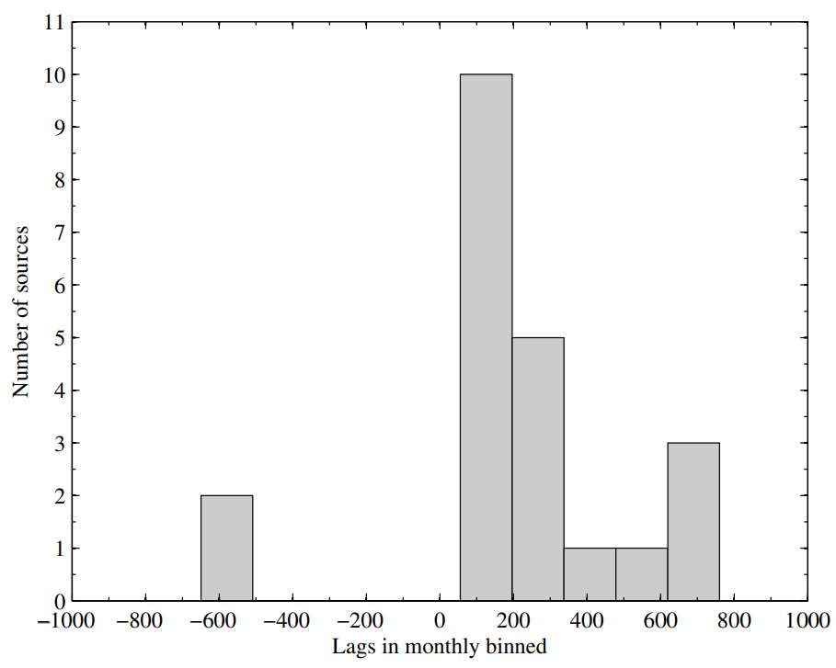
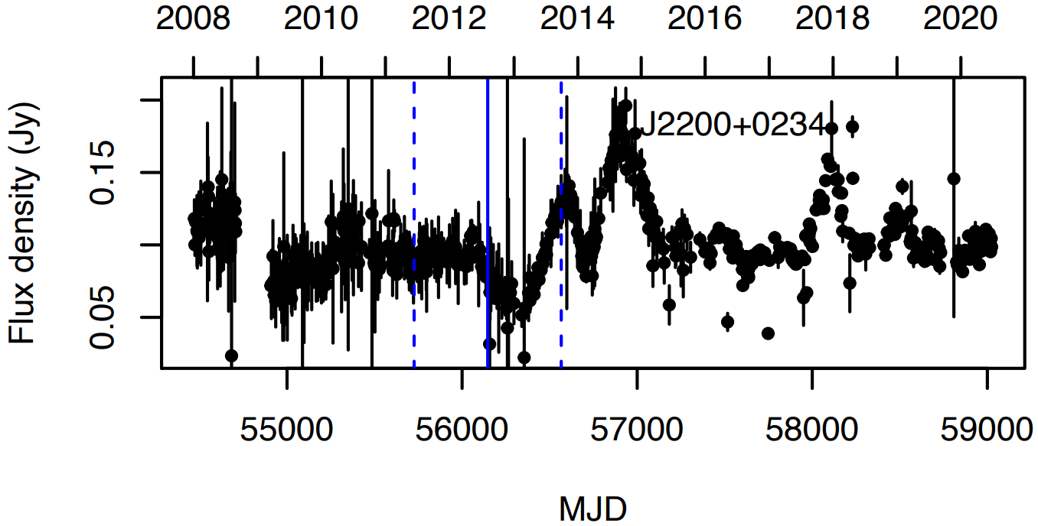
γ-radio delays
Neutrino arrival
V. Ramakrishnan et al. 2018
55 sources
T. Hovatta et al. 2021
High-Energy Outbursts (often in γ-ray or even neutrino) precede a radio flare with a measurable delay.
This delay timescale can range from months or even years in some sources.

Slide 16
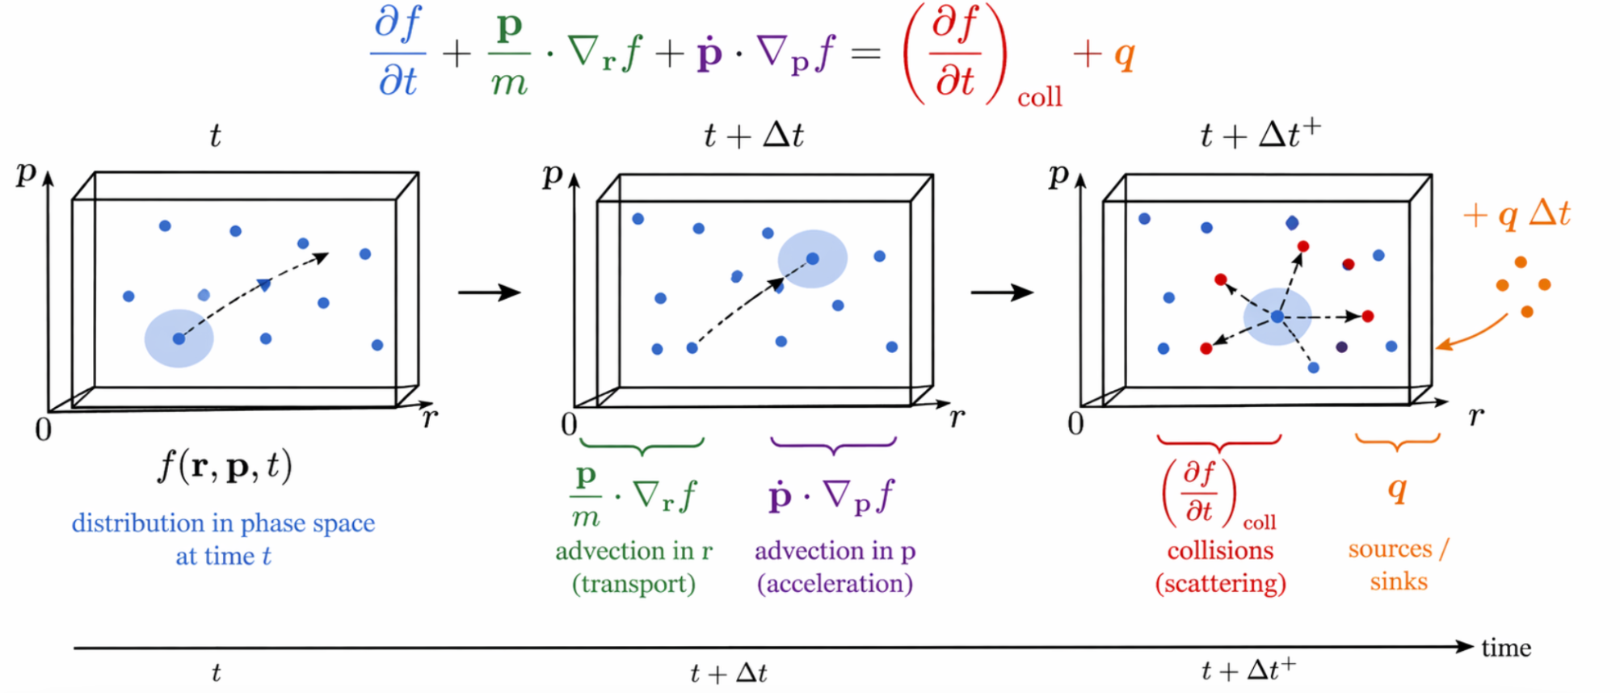
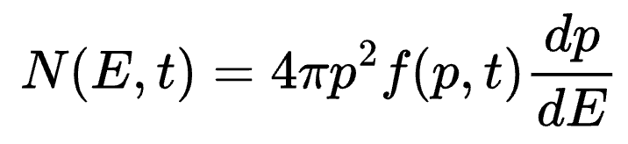
From Boltzmann to one-zone energy space kinetic equation
The Boltzmann equation:
unresolved AGN emission
one-zone, isotropic, angle-integrated, continuous-loss approximation
The continuity equation in energy:

Slide 17
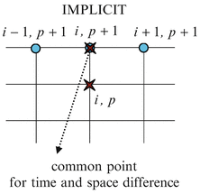


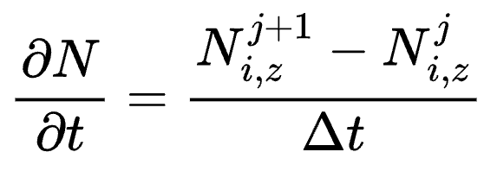
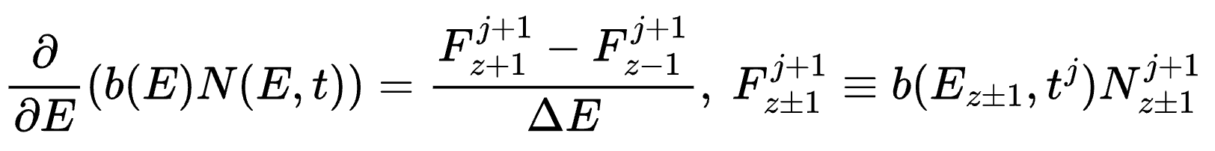
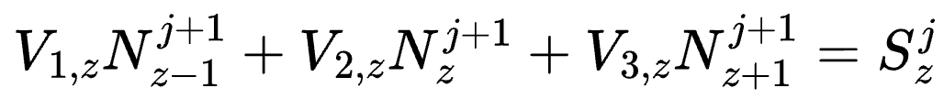

Numerical Solution of the Kinetic Equation with LeHaMoC
z-1, j+1 z, j+1 z+1,j+1
t
Faster computational time
(No constraint on dt)
+
Unconditional stable
z, j
+
Implicit Method
Common point
for time and energy difference
Points involved in time difference
Points involved in energy difference
Discretization
t = (t₁,t₂,..,t_{n}), jЄ(1,n)
x = (x₁,x₂,..,x_{m}), zЄ(1,m)
(Euler’s Method)
Fluxes are computed at cell interfaces z±1​ and all terms are evaluated at the new time step
https://github.com/Stamatis-Ilias/LeHaMoC-V2/tree/new-version/LeHaMoC%20V2
Stathopoulos et al. 2024a ,A&A

Slide 18
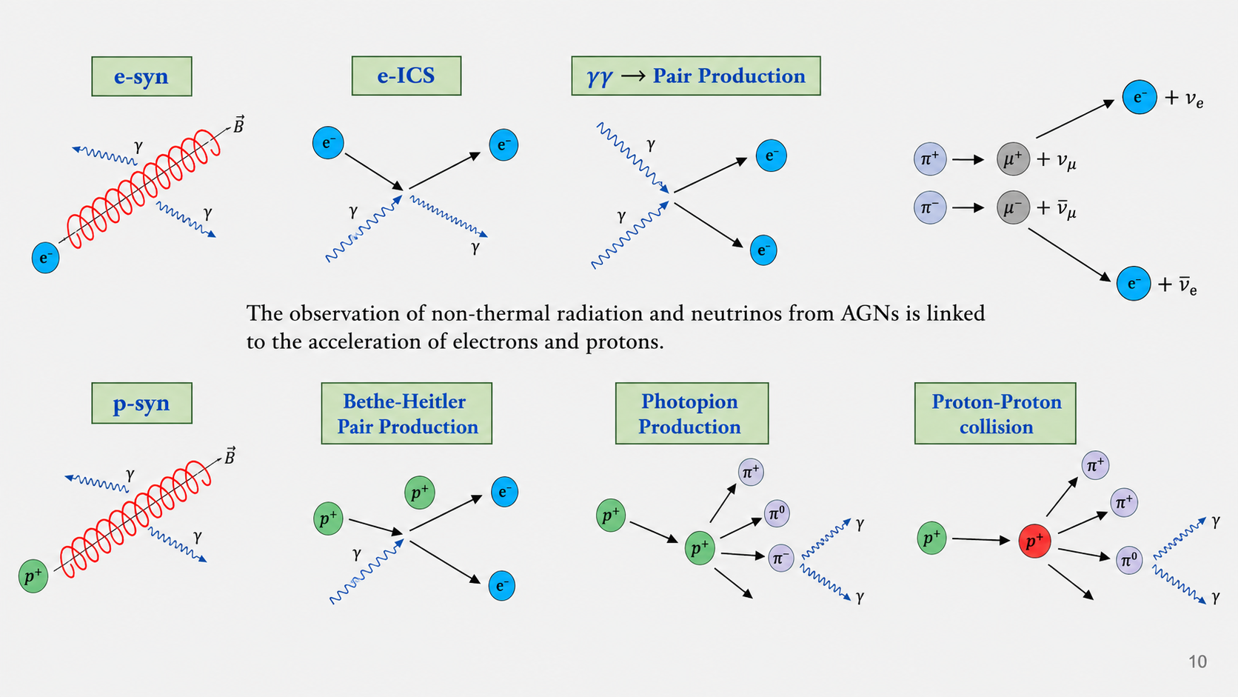
Physical processes

Slide 19
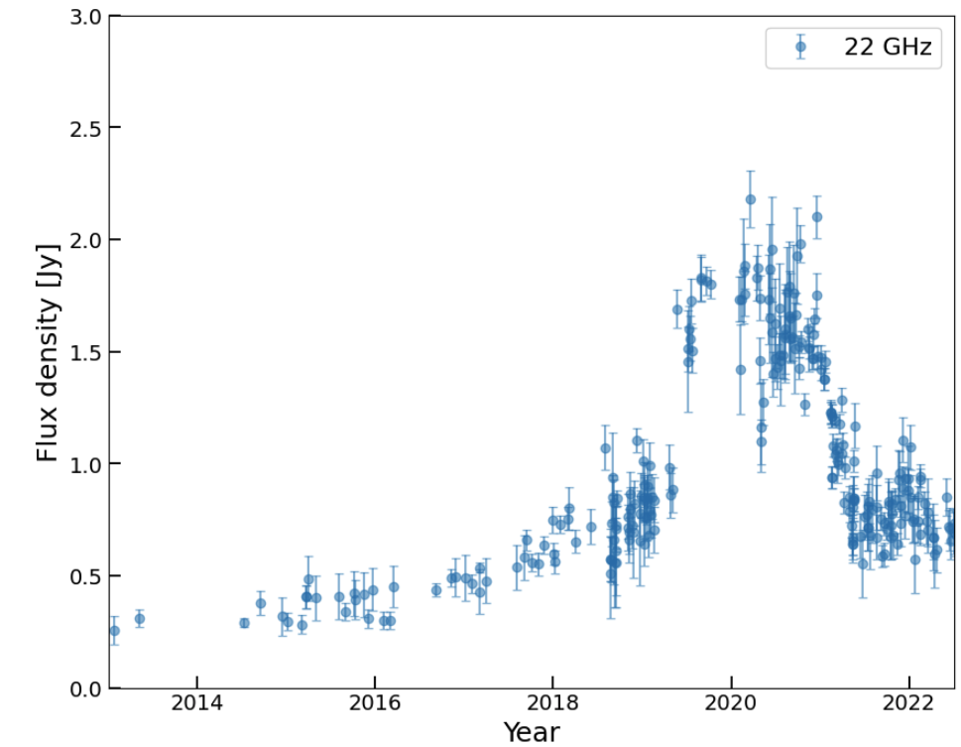
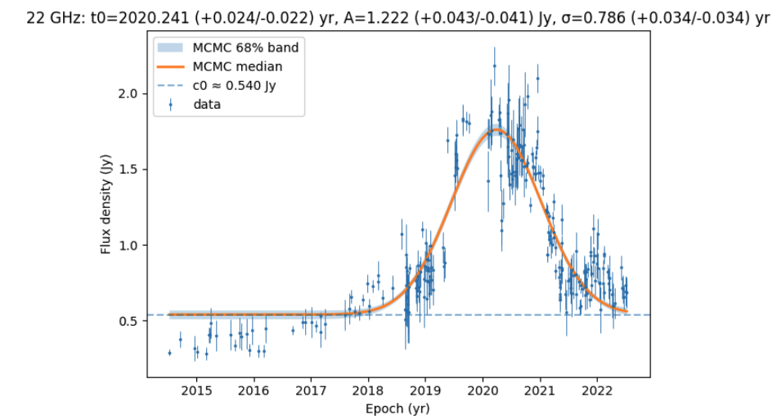
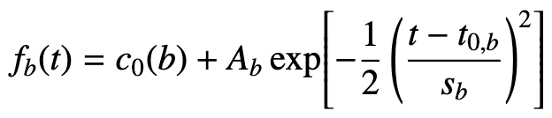
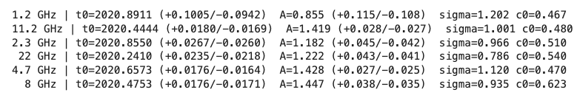
Radio lcs background estimation
Gaussian+constant

Slide 20
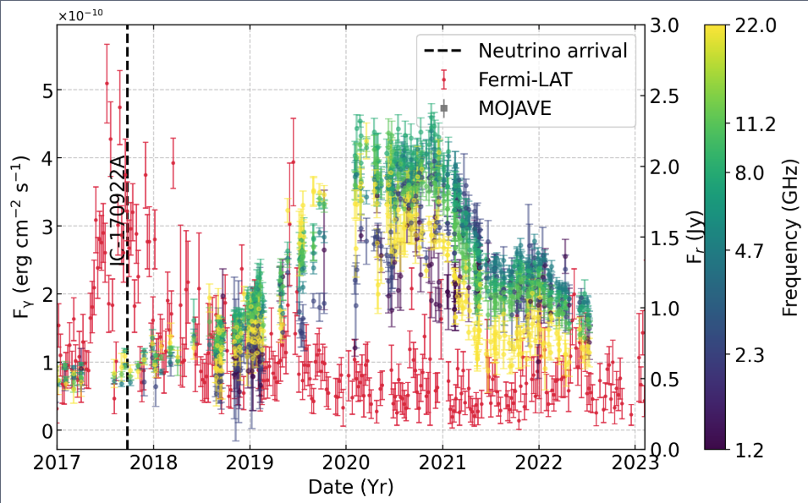
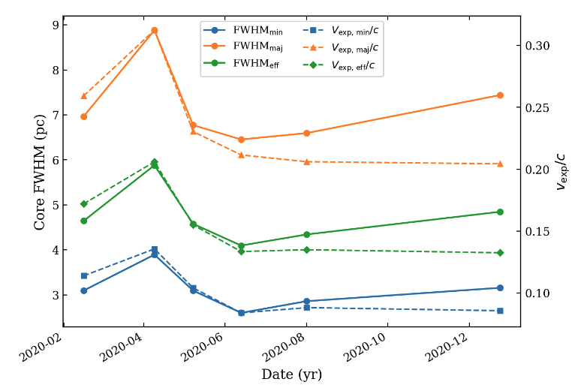
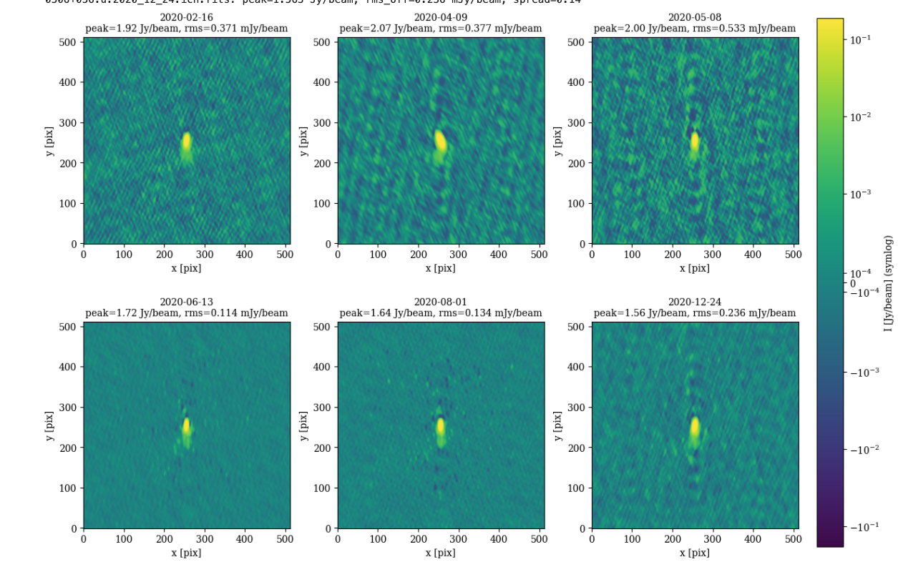
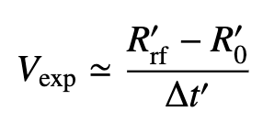
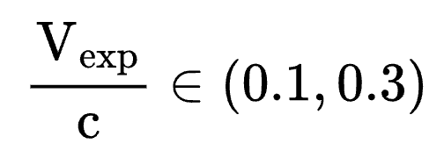
External Constraint– Core-Size Evolution→Expansion-Speed Prior
Stathopoulos et al 2026 in prep.
2020 MOJAVE 15 GHz epochs → measure core growth during flare.
Elliptical Gaussian fits → FWHM_maj/min/eff
→

Slide 21
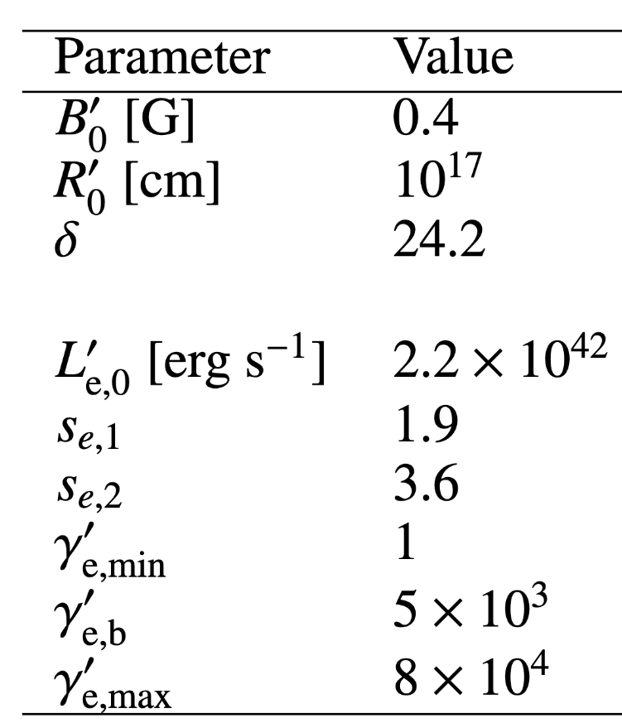
2017 Flare Initial Conditions
Adopt LMBB2b leptohadronic solution from Keivani+2018 (max neutrino output among viable models + parameters consistent with independent one-zone fits) Gao et al. 2019; Cerruti et al. 2019; ++
Take initial conditions: R′0, B′0, δ0 ​ +injected lepton spectrum
Evolve system until steady state-> initial distribution at the start of the post-flare evolution.
Primary leptons dominate radio–GeV emission (synchrotron + IC), secondaries subdominant
Post-flare evolution: evolve only the primary pairs
Stathopoulos et al 2026

Slide 22
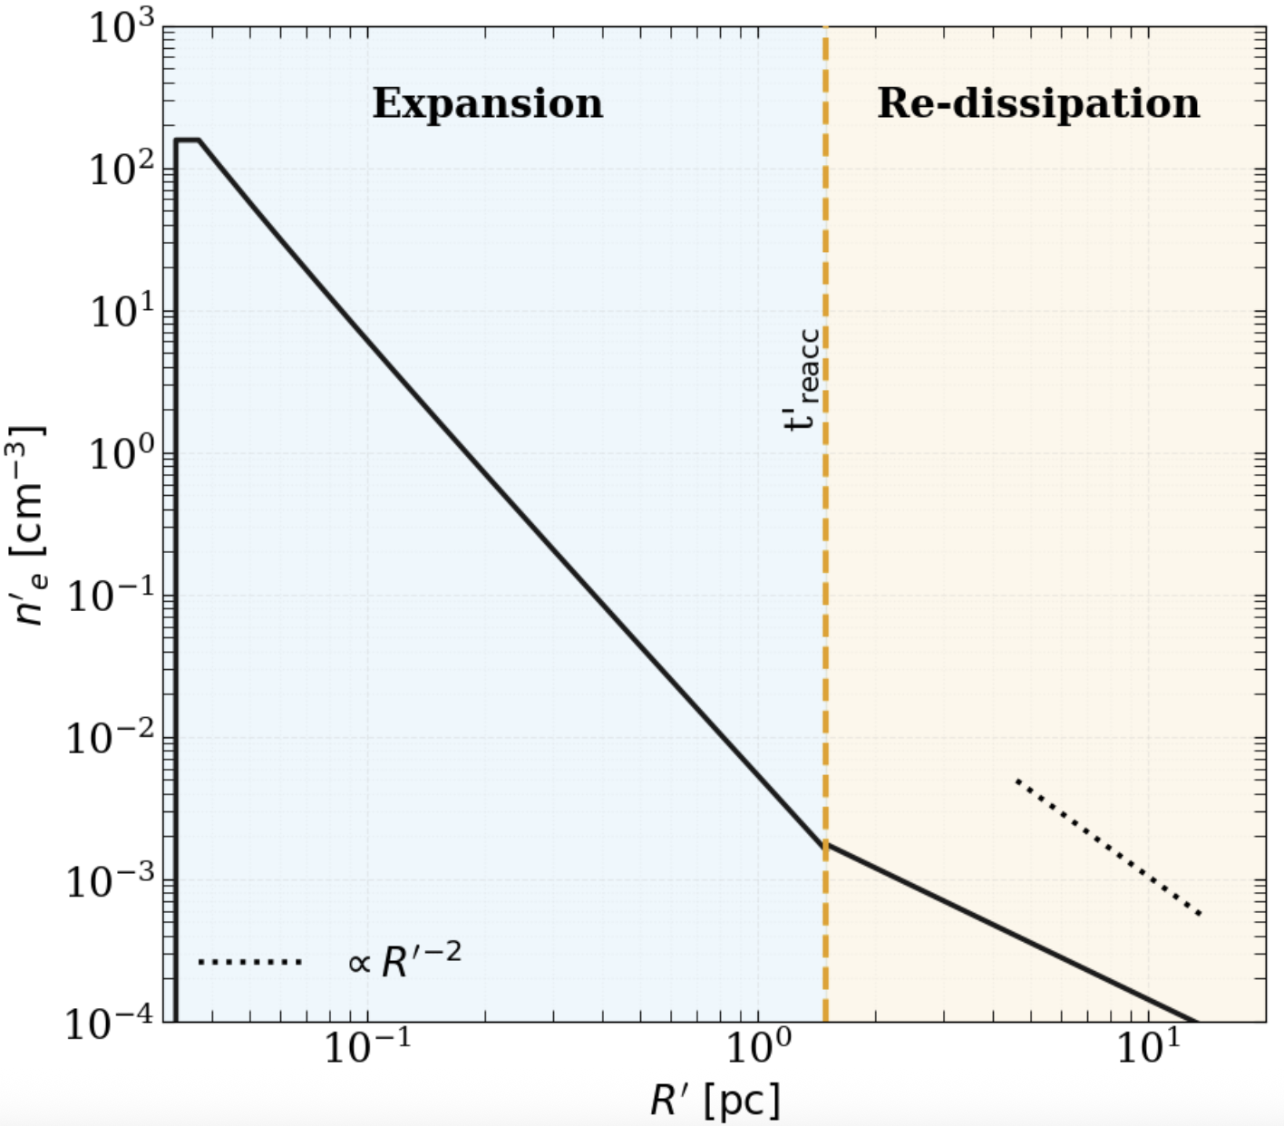
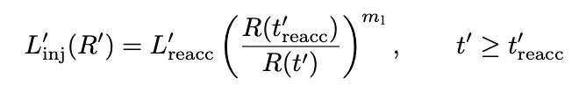
Best-Fit Light Curves: Matching the 2021 Multi-Frequency Flare
Fit summary (constant δ)
Downstream re-dissipation explains how the flare begins and peaks but not why it decays so rapidly.
Observed post-peak drop is faster than cooling / light-crossing ⇒ requires δ(R′) change (deceleration / stratification).
Fresh e± injection

Slide 23


Scenario C– Optically Thin Re-Dissipation at Parsec scales
Scenario C– Optically Thin Re-Dissipation at Parsec scales
Model concept
Sketch not in scale
SSA driven flare can not explain the simultaneity.
2017 disturbance propagates and expands. SSA drops below GHz.
At t′reacc: renewed particle energization (standing shock / reconfinement).
MCMC sampler ->explore parameters -> reproduce the light curves (Vexp prior from VLBI).
t’reacc
re-dissipation
Optically thin in GHz
z2
standing shock
propagation
expansion
+
δ0
2017
flare
z1
re-dissipation
2017 flare
expansion
Spheres shown in the jet co-moving frame.

Slide 24


Effects of Vexp on the lightcurve
Key Results
Higher expansion velocities lead to:
Smaller time-lags between γ-ray and radio flares.
More luminous radio flares
S. Boula et al. 2019
A. Tramacere et al. 2021
24

Slide 25





SSA-driven flare
Kinetic equation:
Injection term:
turnover
SSA turnover (frequency):
optically thick
emission
optically thin emission
Optically thin spectrum:

Slide 26

Doppler-factor evolution (deceleration)
Ros et al. 2019
43 GHz
The apparent opening angle increases with distance, and the core expands rapidly over time.
These observations can be explained by two main scenarios:
  Jet deceleration (Georganopoulos & Kazanas 2003)
  Spine–sheath jet structure (Ghisellini et al. 2005)
The inner jet region (between the core and C1) appears highly collimated, suggesting a fast relativistic flow.
Beyond C1, the jet may decelerate and change direction:
  bends east toward C2
  then bends back south toward C3
This bending + deceleration pattern matches the Georganopoulos & Kazanas (2003) model.
Alternatively, C2 and C3 could be local brightness enhancements within a much wider, diffuse jet.
This alternative interpretation aligns with the Ghisellini et al. (2005) spine–sheath scenario.
expansion
MOJAVE XII

