Slide 1



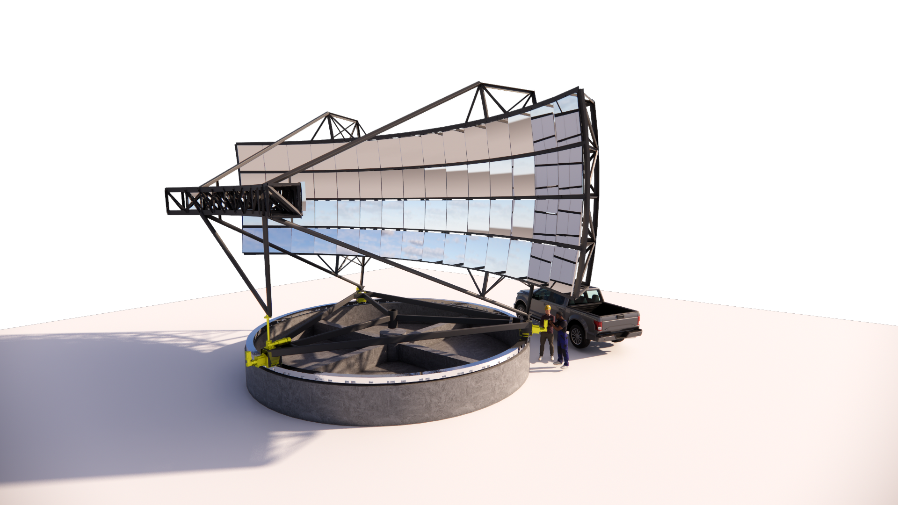








The Trinity Neutrino Observatory: Probing the PeV-EeV Neutrino Sky
David A. Raudales
on behalf of the Trinity Collaboration
School of Physics and Center for Relativistic Astrophysics, Georgia Institute of Technology
trinity-observatory.org

Slide 2
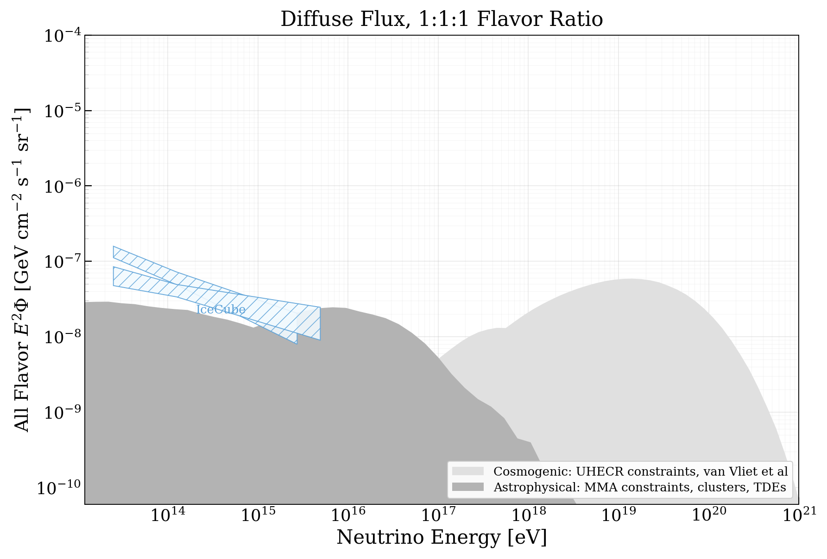
Neutrino Astronomy has made great progress over the last decade…

Slide 3
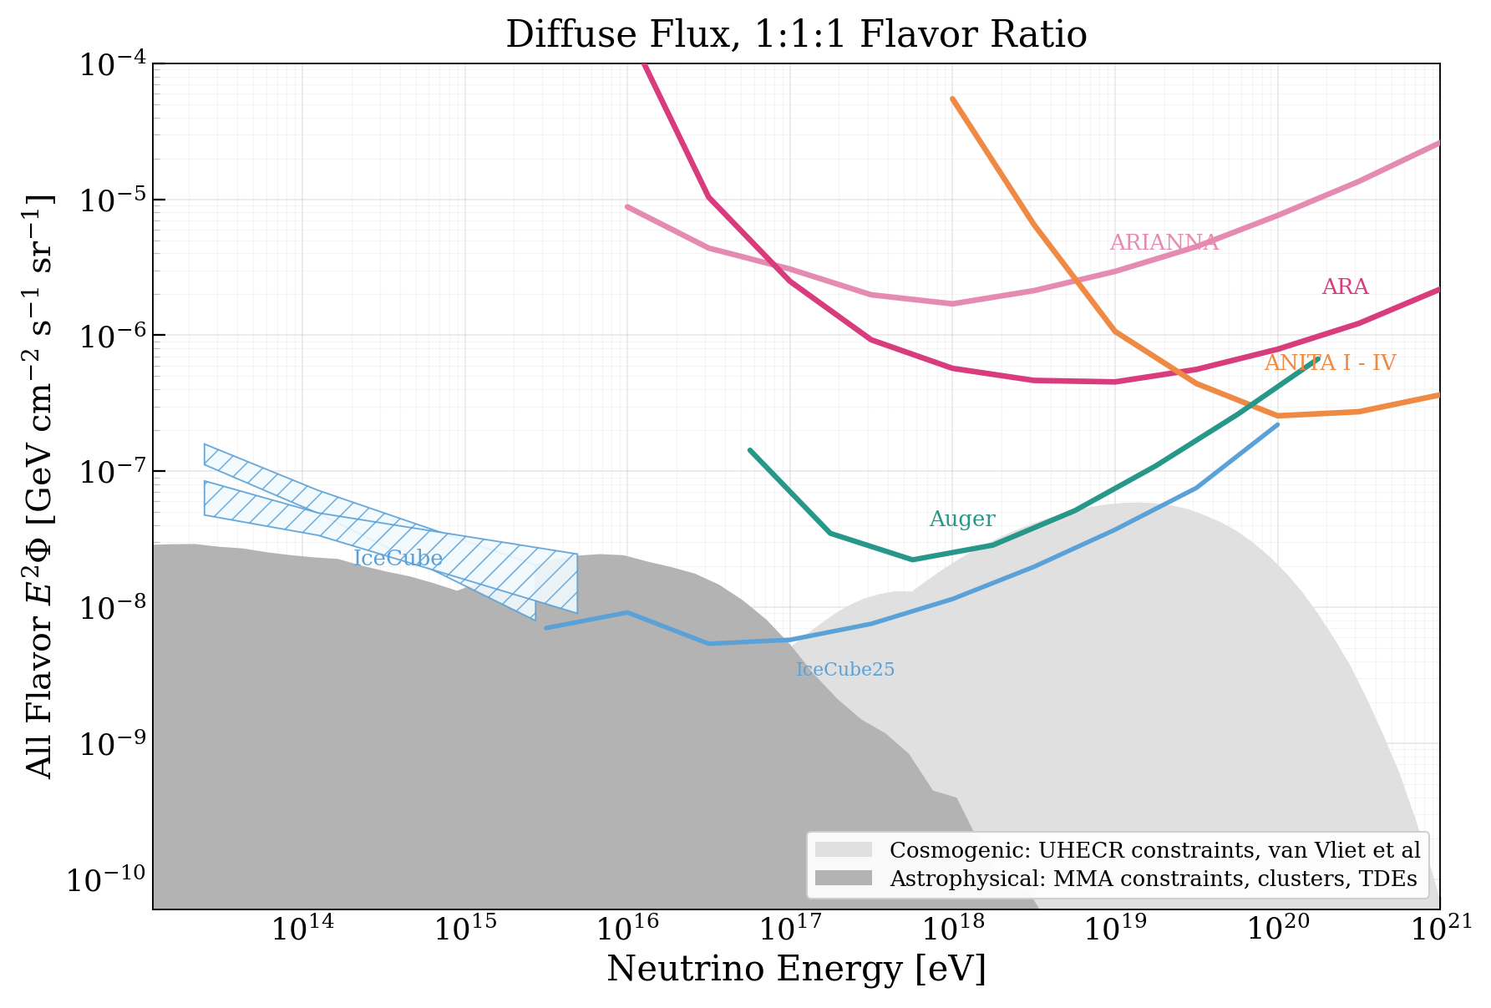
Neutrino Astronomy has made great progress over the last decade…

Slide 4
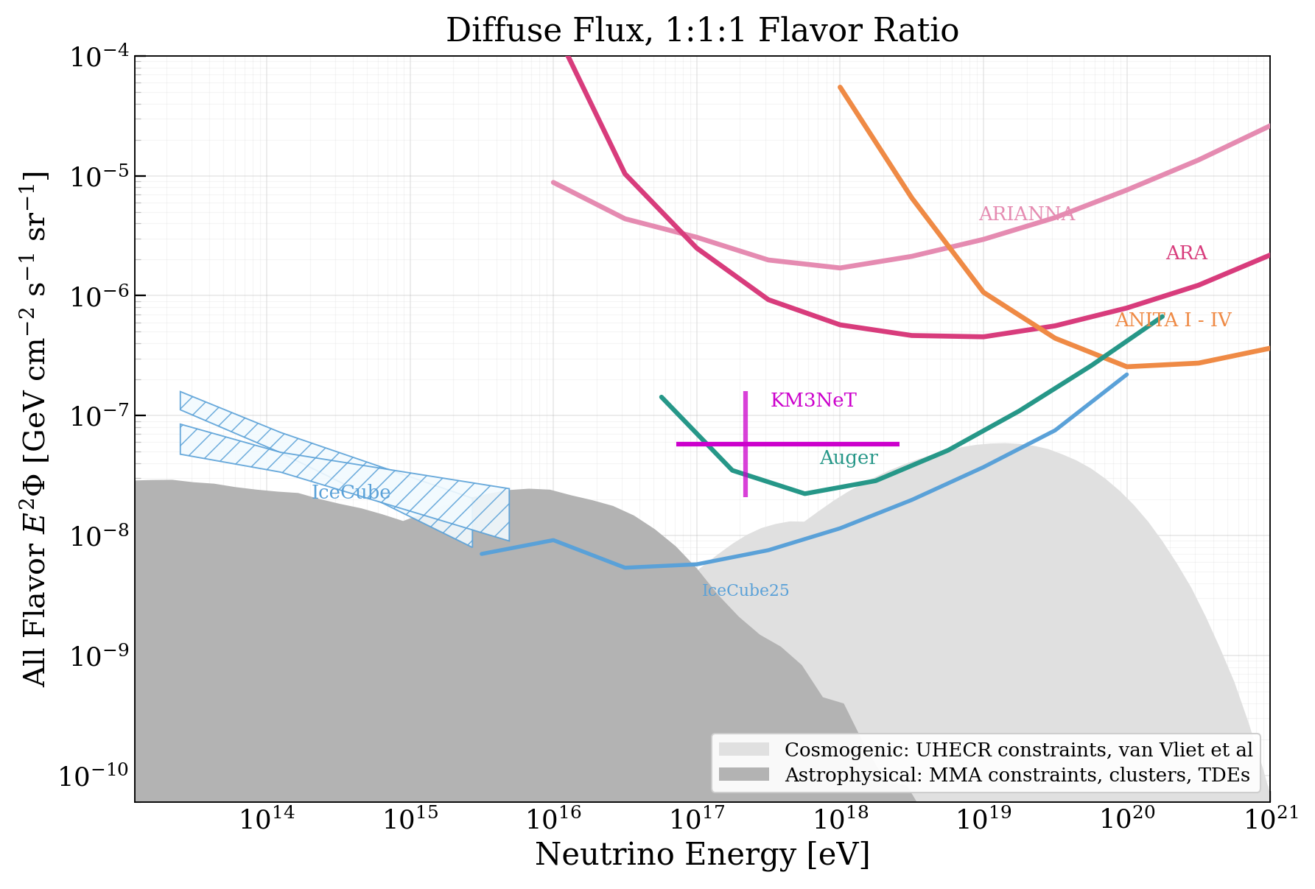
Neutrino Astronomy has made great progress over the last decade…

Slide 5
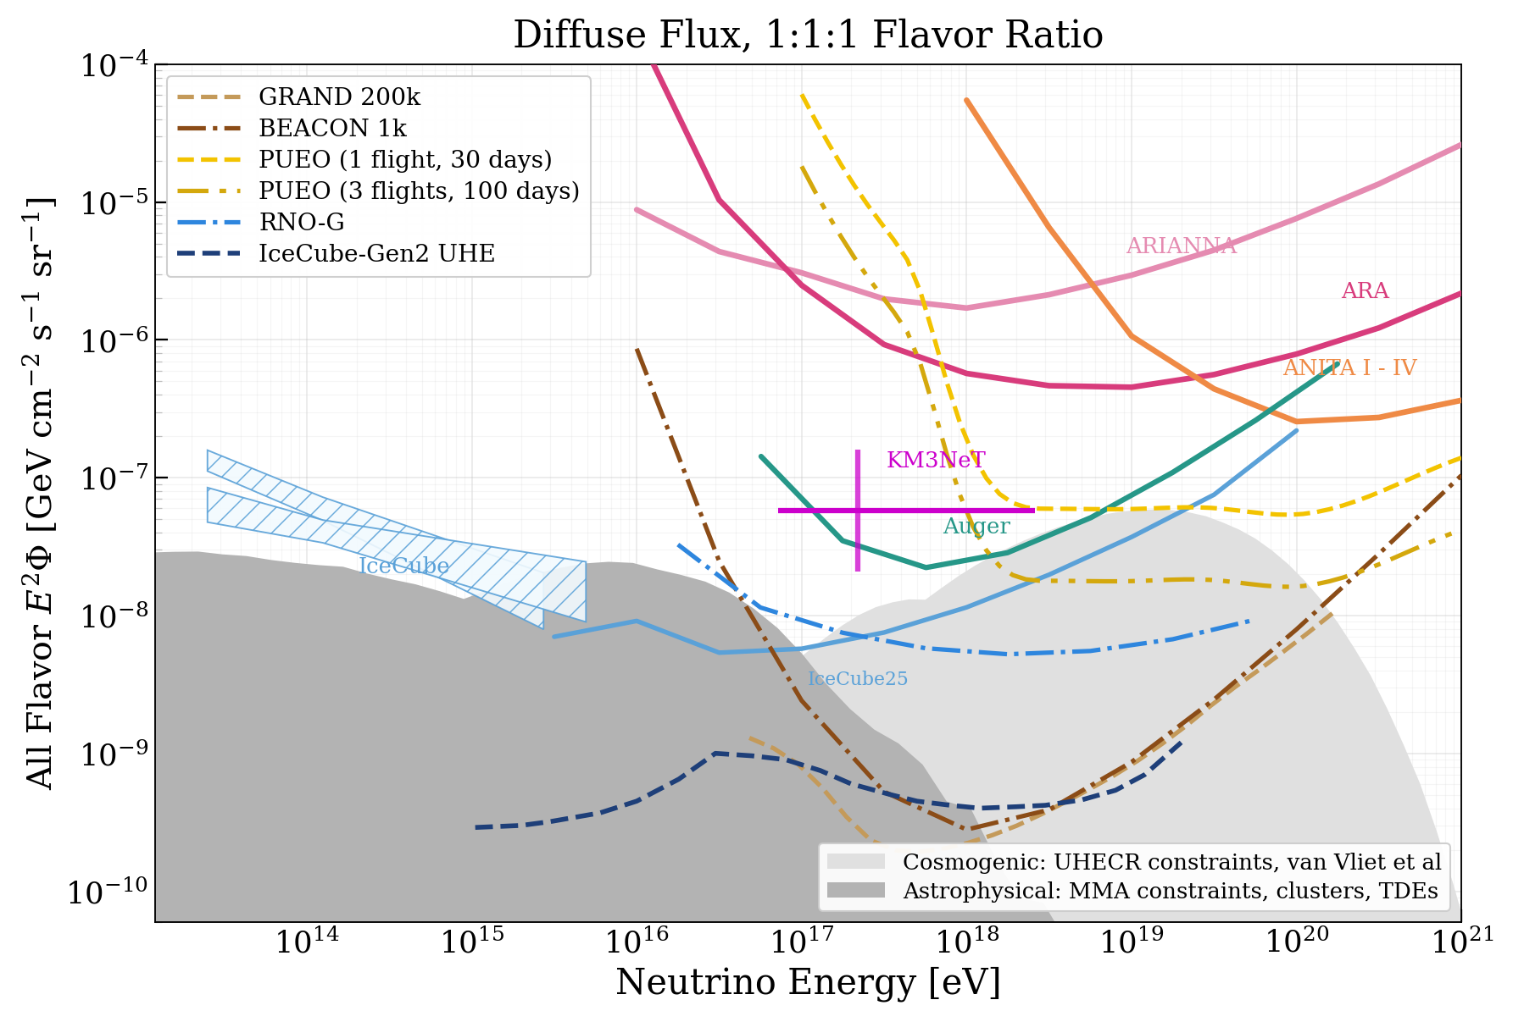
Neutrino Astronomy has made great progress over the last decade…

Slide 6
… but there are still gaps to be filled

Slide 7
… but there are still gaps to be filled
RADIO
ICE/WATER

Slide 8
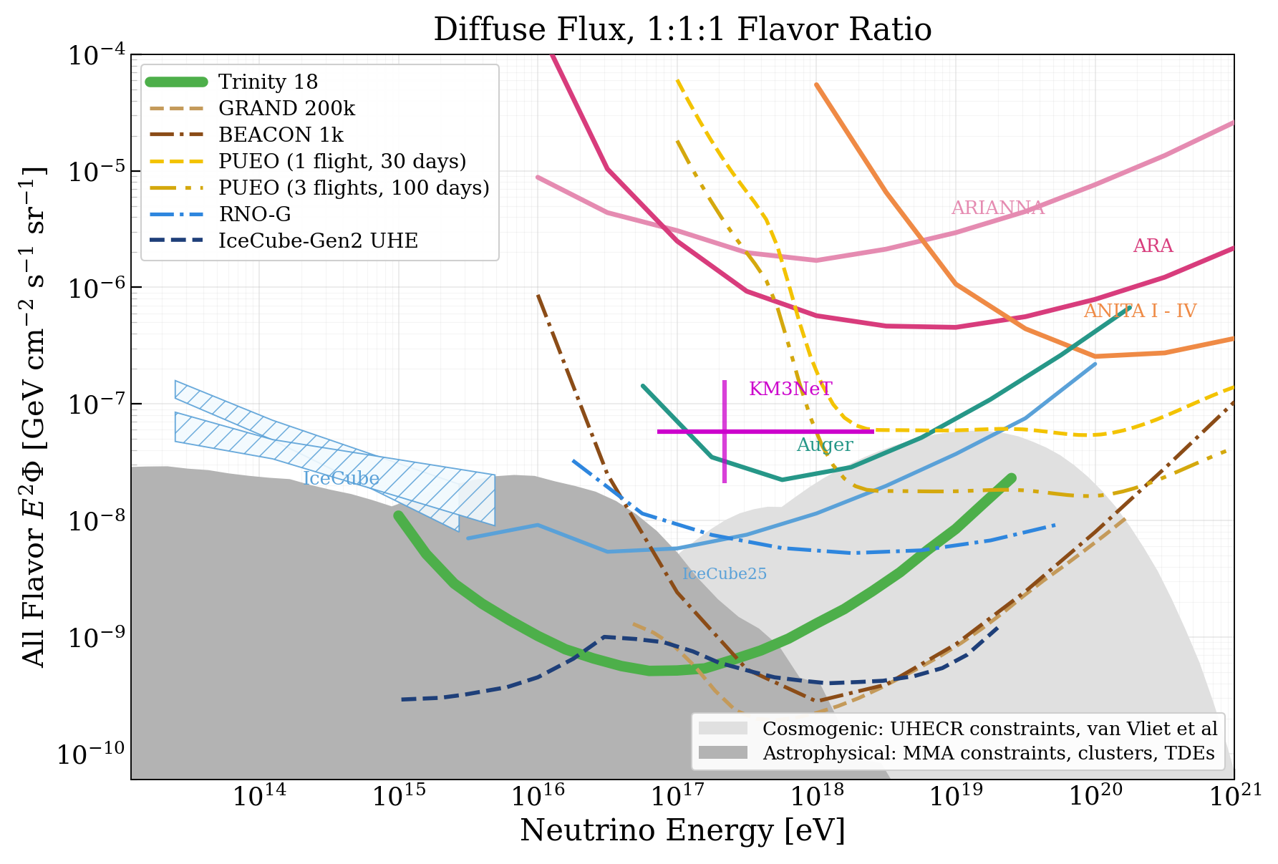
… but there are still gaps to be filled

Slide 9
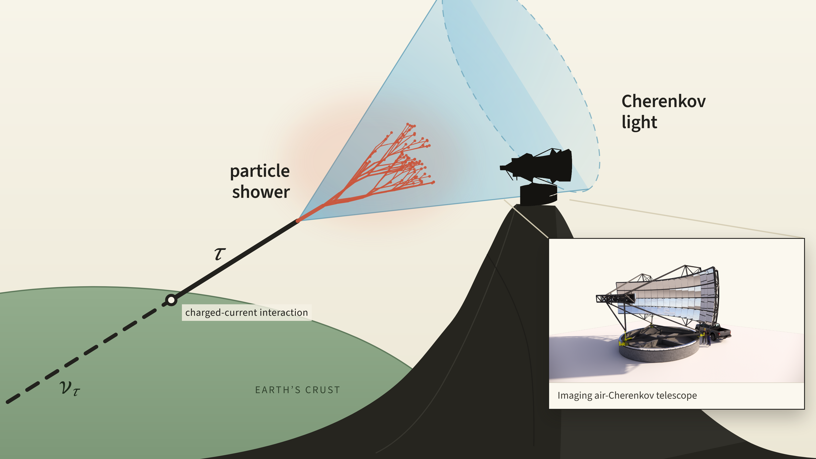
Trinity looks for Earth-Skimming Tau Neutrinos

Slide 10

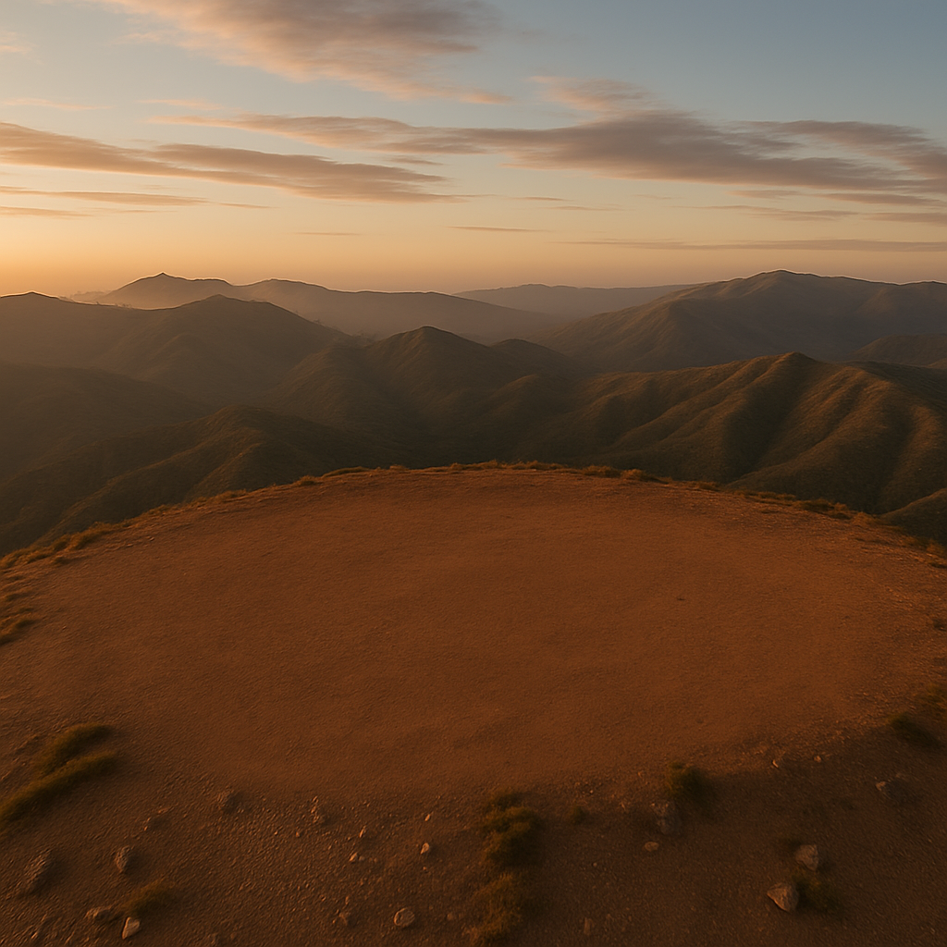
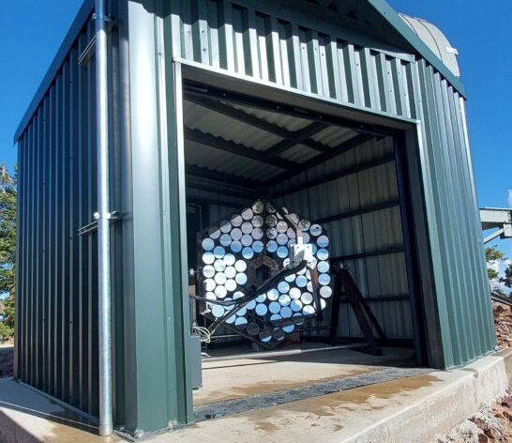

The path towards the Trinity Observatory is ready
Area -> 1 sq meter
Field of View -> 3.87°x3.87°
Resolution -> 0.24 °
Commissioning Started October 2023
Demonstrator

Slide 11
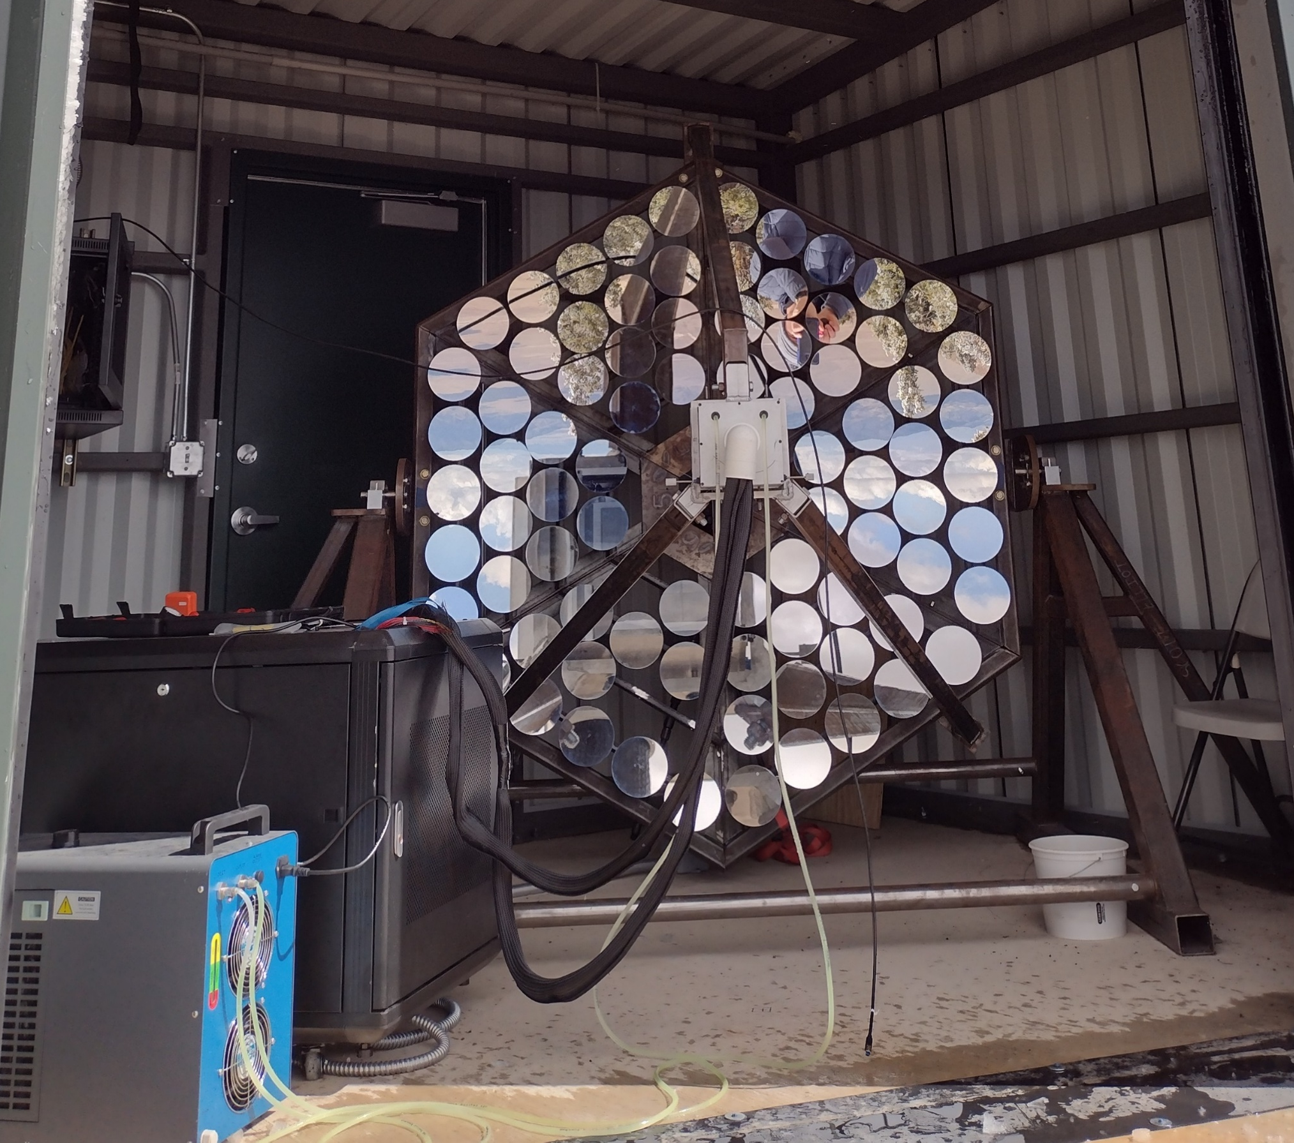
The Demonstrator is a Success!!
  Purpose:
  Validate detection concept
  Characterize background
Data Taking Period | October 2024-Dec 2025
Hours Analyzed | 554 Hours Door Open 238 Hours Door Closed
Triggered Events | 1.2 Million Door Open 0.6 Million Door Closed
Deployed on Friso Peak, Utah
In October 2023
Camera paper: [arXiv:2406.08274]
Commissioning paper: [arXiv:2503.11864]

Slide 12
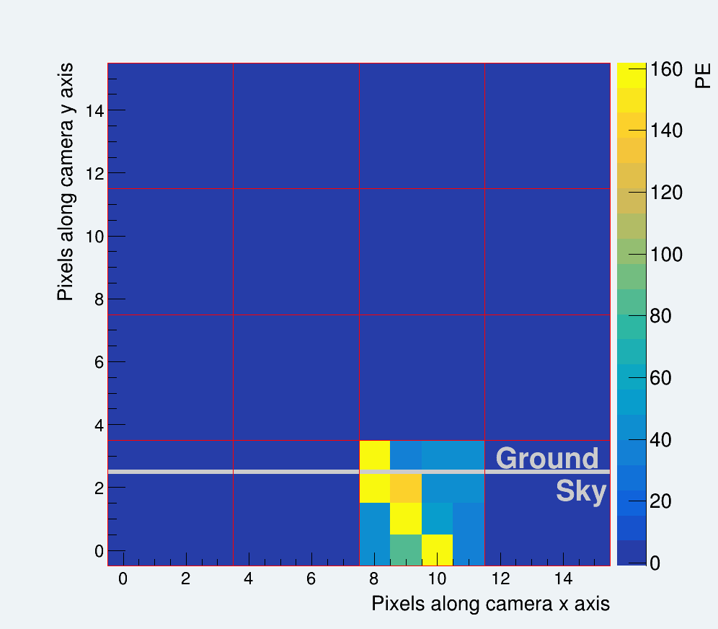
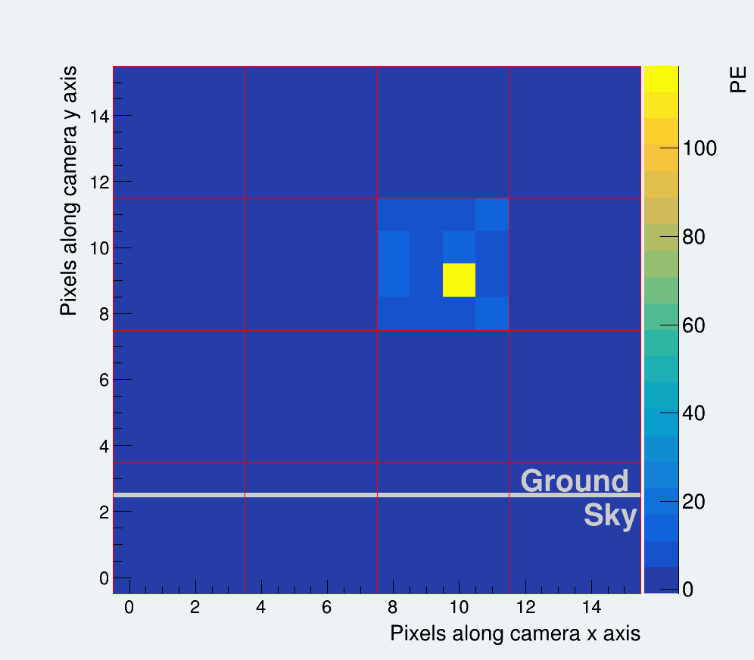
Event Processing Significantly Reduces Noise
1.2 Million Events

Slide 13
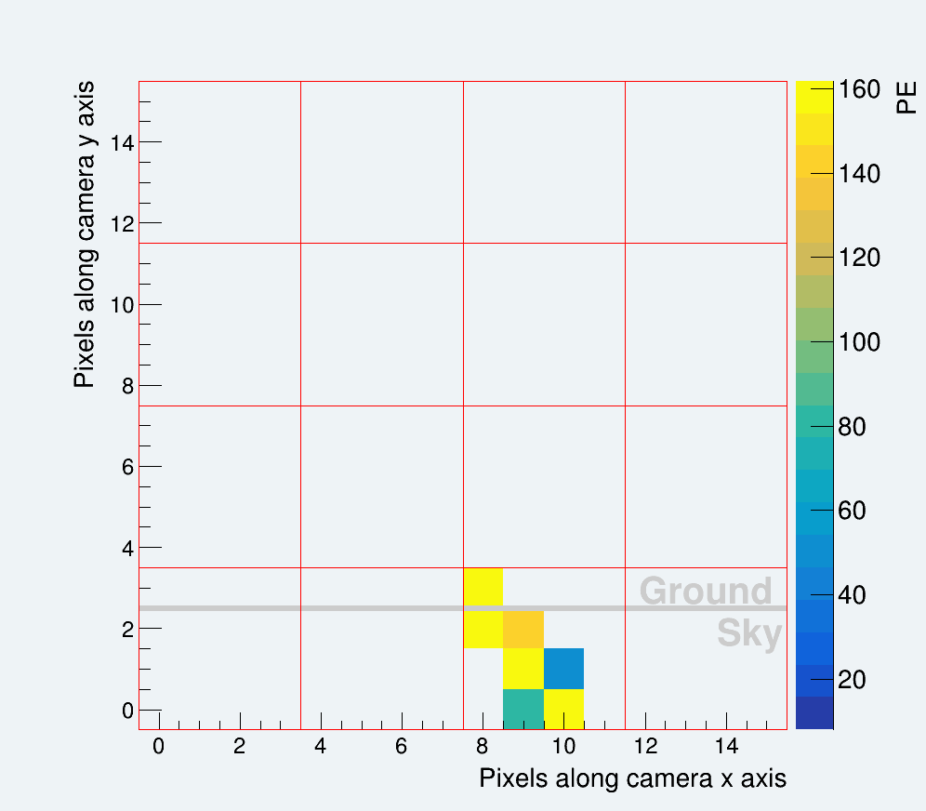
Event Processing Significantly Reduces Noise
3 Surviving pixels
2 Core pixels
Same time bin
1.2 Million Events
2193 Events

Slide 14
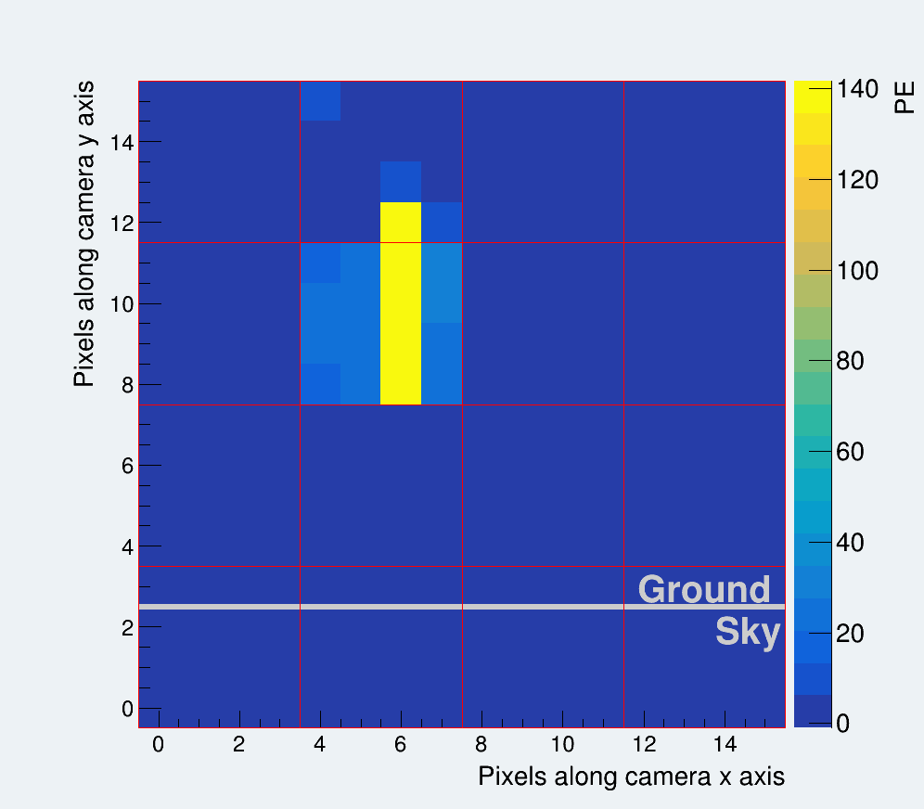
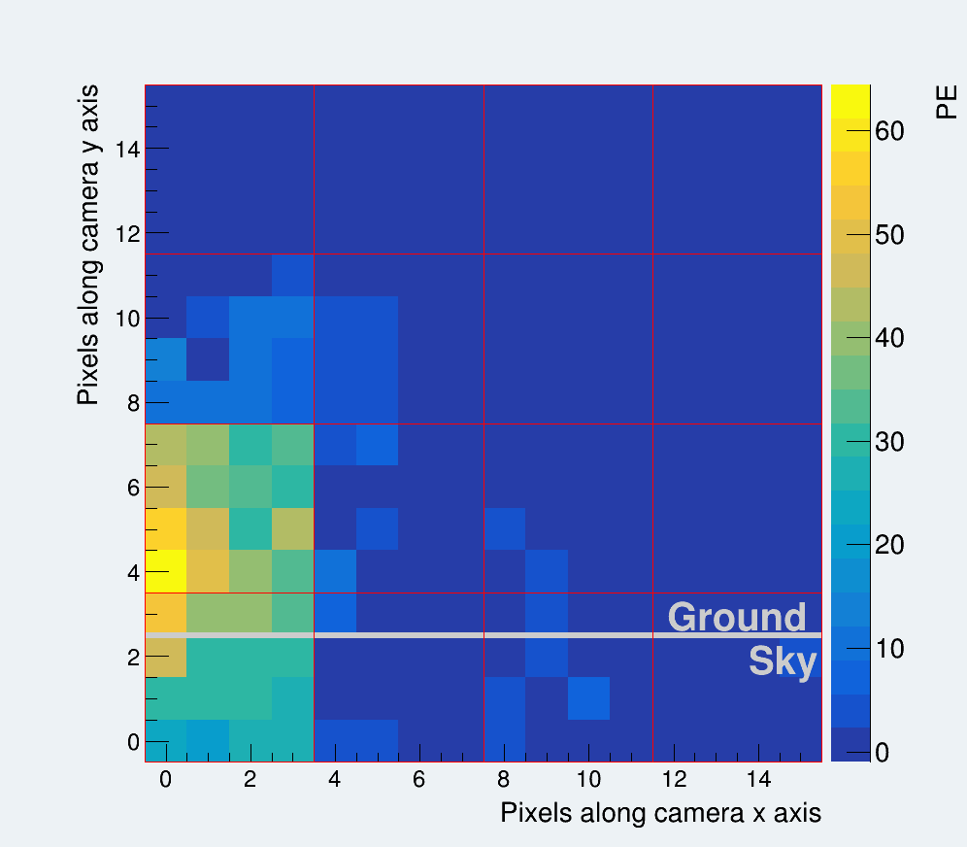
All Surviving Events are Muon Events
Muon Track
Isolated Muon Cherenkov Candidate
Event

Slide 15
Muon Tracks Arise when Muons Cross the Camera
4×4 SiPM Array
Muon Track
Isolated Muon Cherenkov Candidate
Event

Slide 16
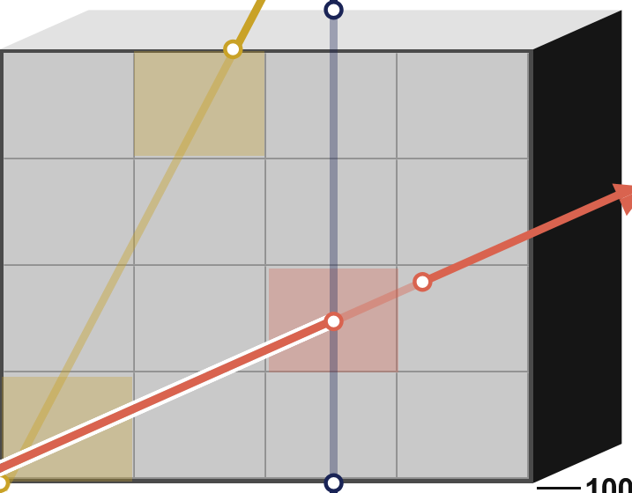

Muon Tracks Arise when Muons Cross the Camera
4×4 SiPM Array
μ
Muon Track
Isolated Muon Cherenkov Candidate
Event
6.4 mm
100 µm
6.4 mm

Slide 17
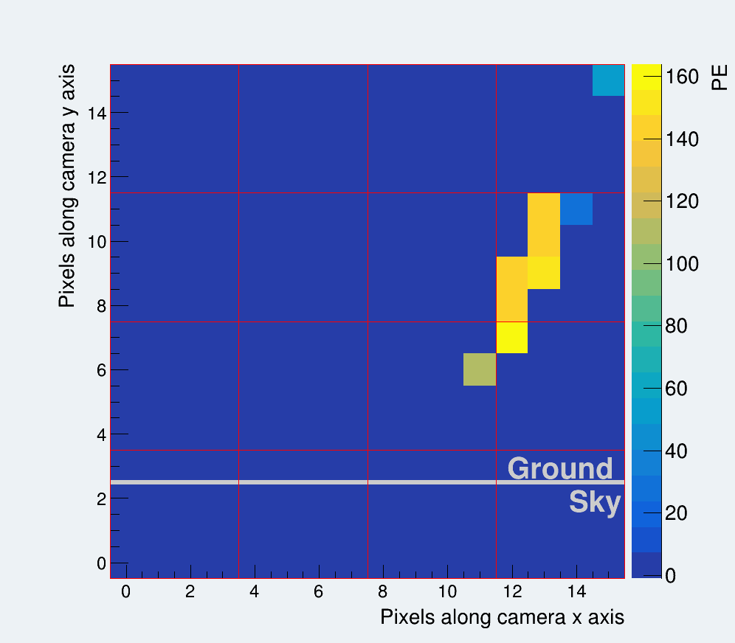

Muon Tracks Arise when Muons Cross the Camera
4×4 SiPM Array
μ
μ
Muon Track
Isolated Muon Cherenkov Candidate
Event
6.4 mm
100 µm
6.4 mm

Slide 18
Muon Tracks Arise when Muons Cross the Camera
4×4 SiPM Array
μ
μ
Muon Track
Isolated Muon Cherenkov Candidate
Event
6.4 mm
100 µm
2177 Muon Tracks Events
3.9 ± 0.1 event per hour
6.4 mm

Slide 19
Cherenkov Light from Muons Also Survives
~50 m
1.48 m

Slide 20
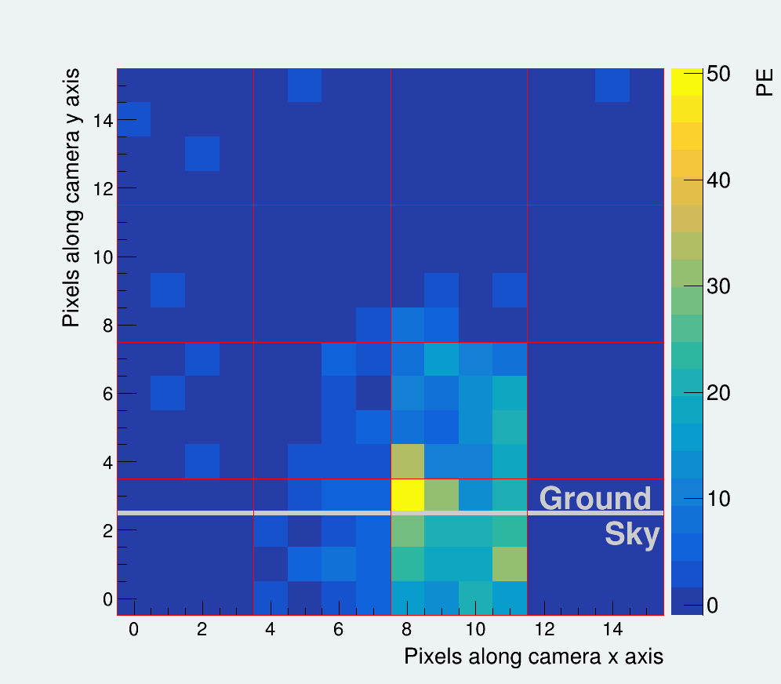
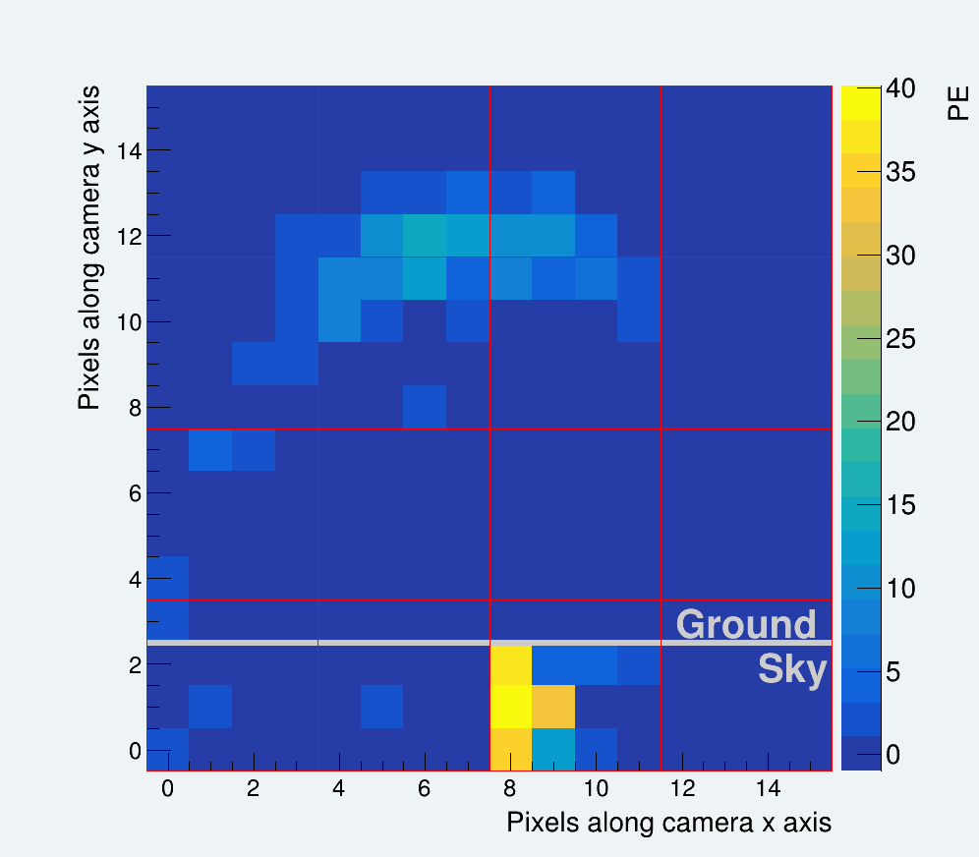
Cherenkov Light from Muons Also Survives

Slide 21
Cherenkov Light from Muons Also Survives
16 Isolated Muon Cherenkov Candidate Events
1.0 ± 0.1 event per 34 hours

Slide 22
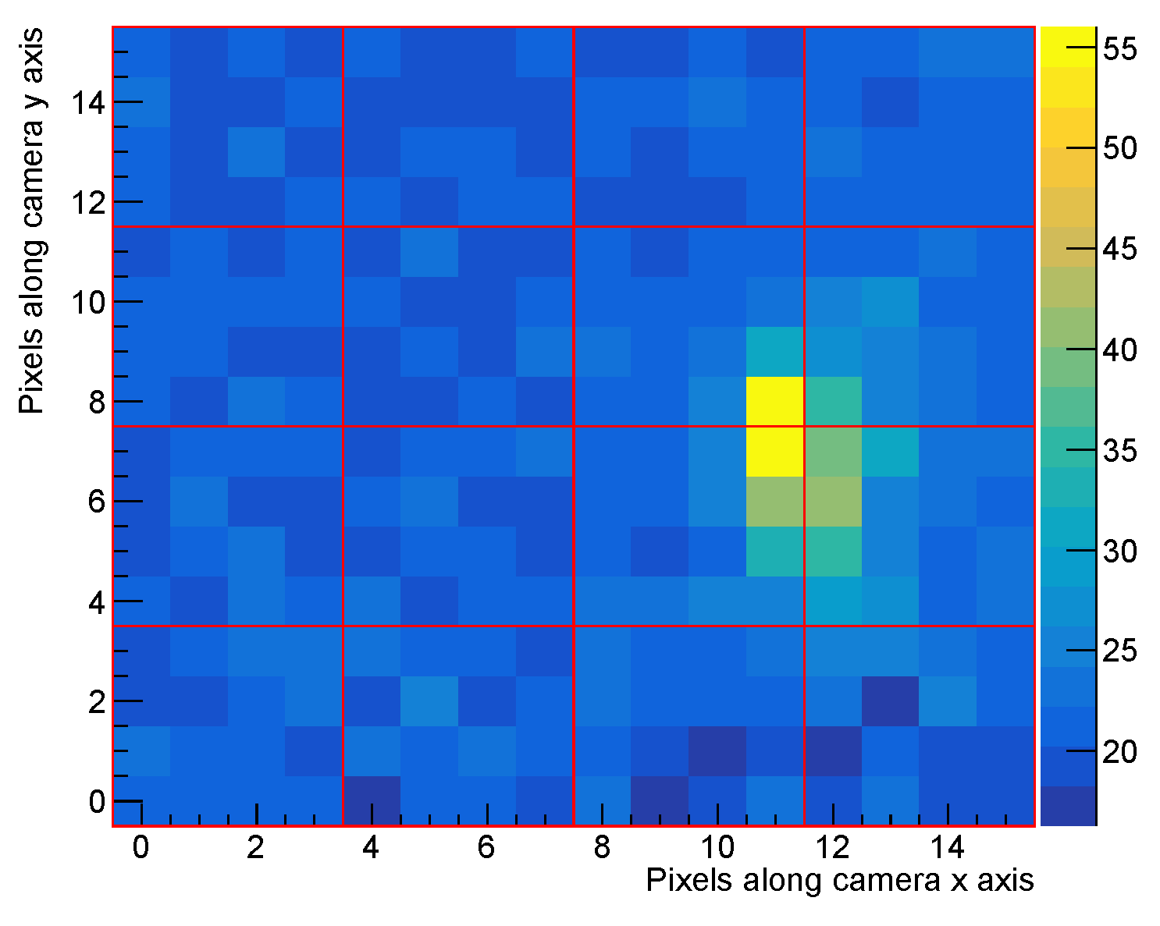
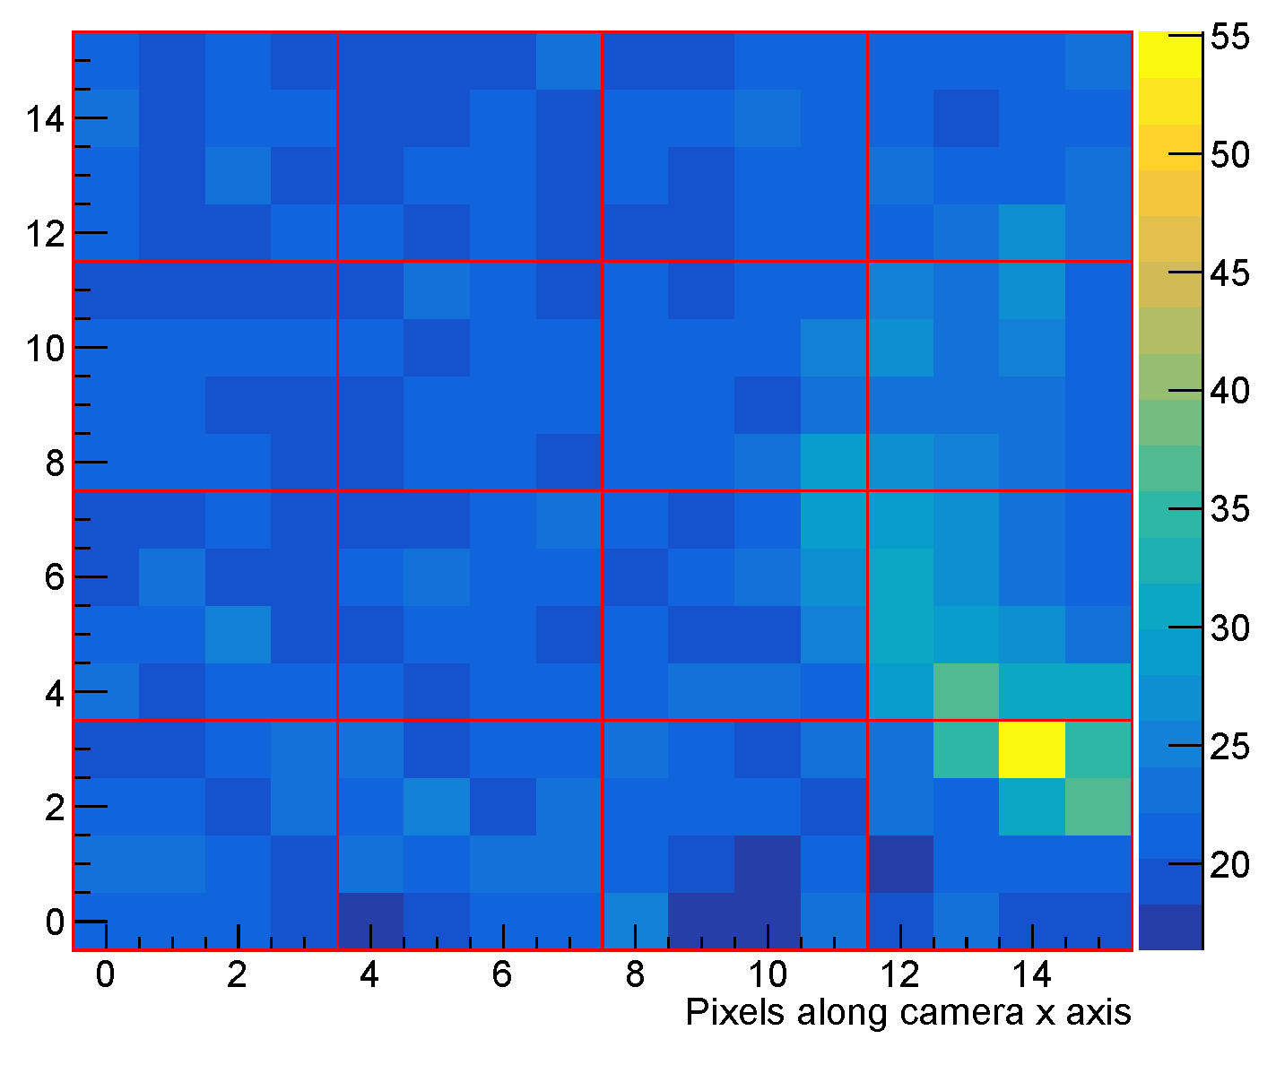
Muon Cherenkov Events are Consistent with Simulations

Slide 23
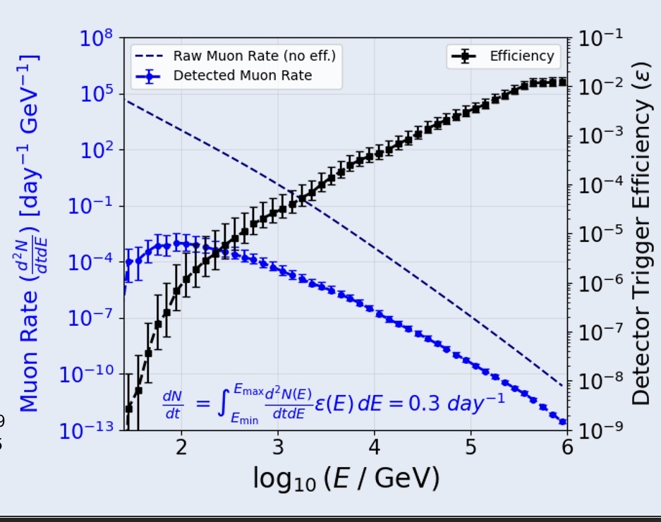
Muon Cherenkov Events are Consistent with Simulations
Simulated observed muon rate is 0.01_{-0.003}^{+0.02} event/hour

Slide 24
Tau Neutrino Simulation Chain

Slide 25
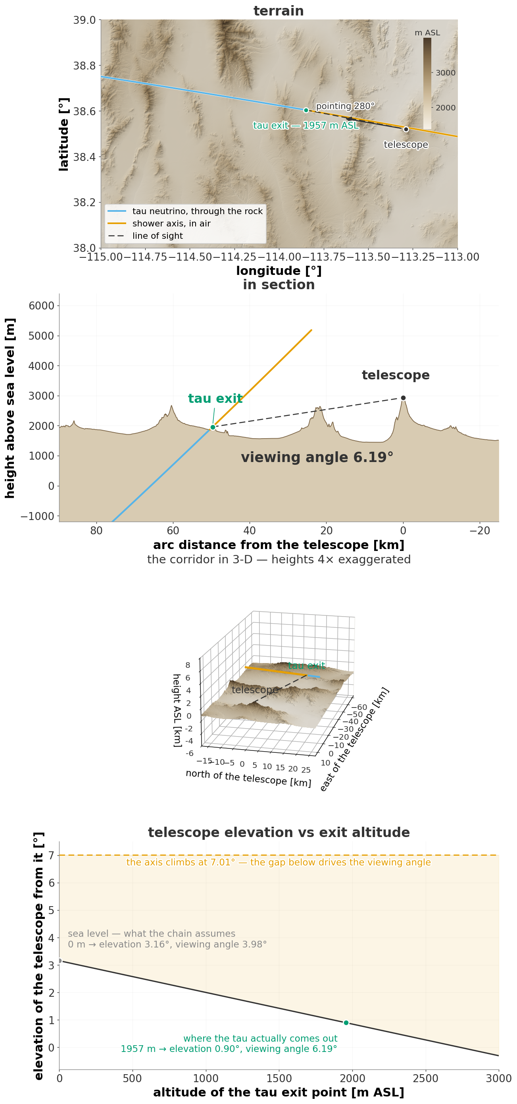
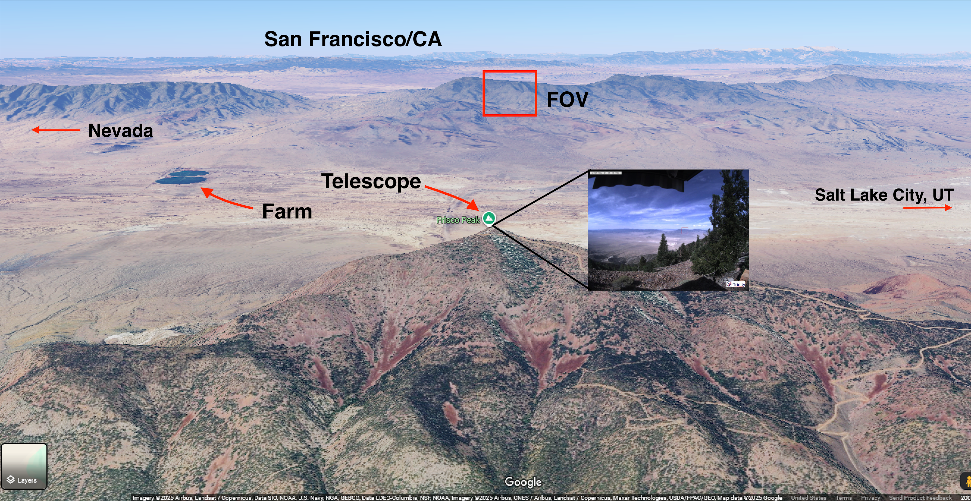
Tau Neutrino Simulation Chain: ISOG

Slide 26
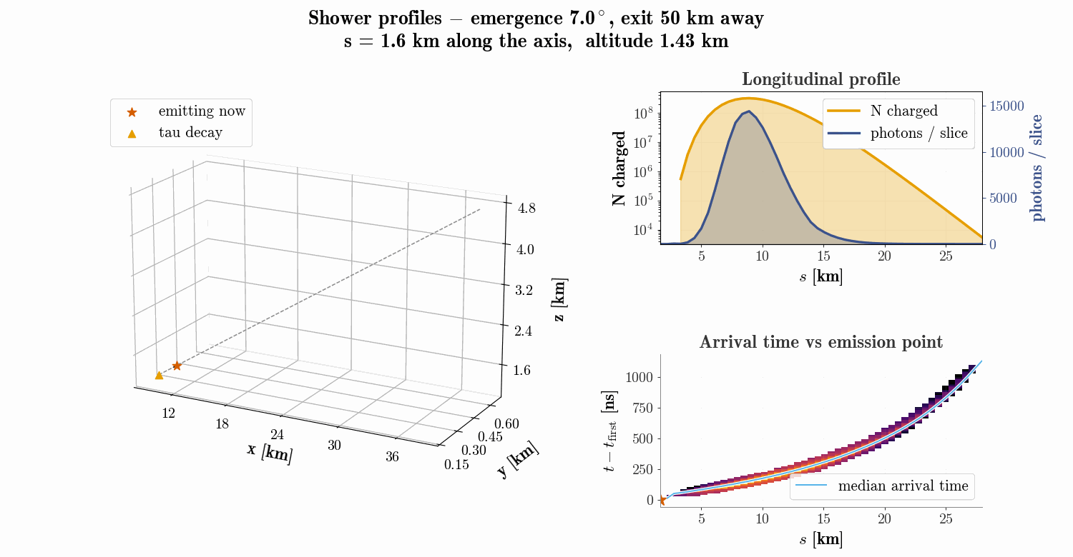
Tau Neutrino Simulation Chain: CHASM
Energy: 1 EeV
Distance: 50 km
Viewing angle: 6 degrees

Slide 27
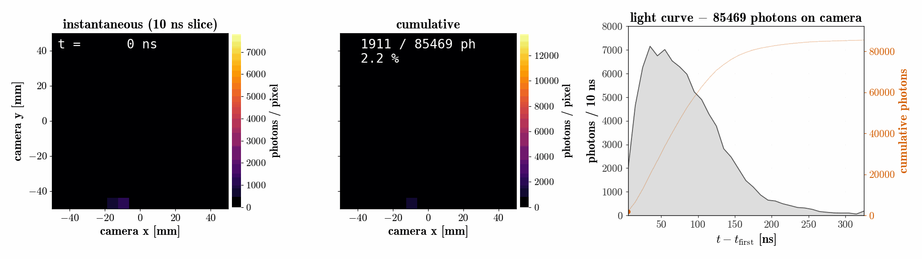
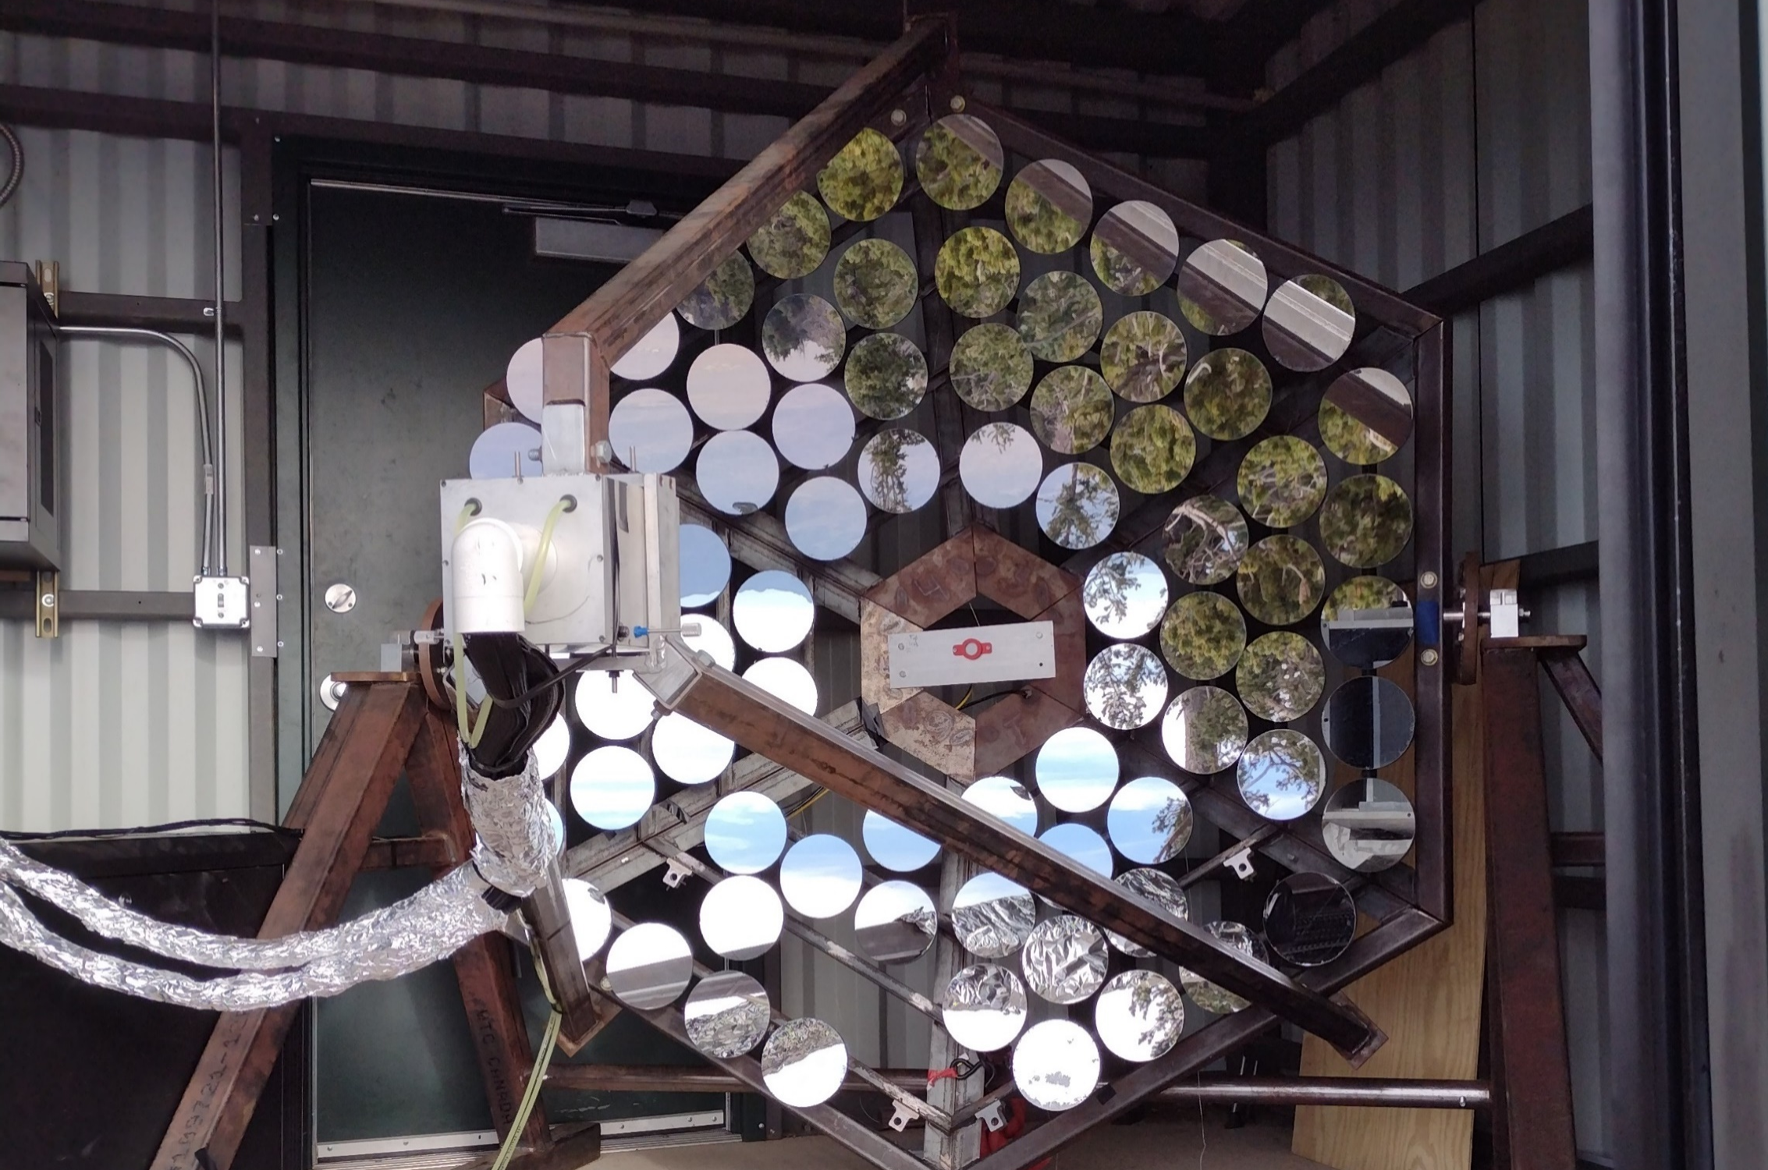
Tau Neutrino Simulation Chain: GrOptics
Energy: 1 EeV
Distance: 50 km
Viewing angle: 6 degrees

Slide 28
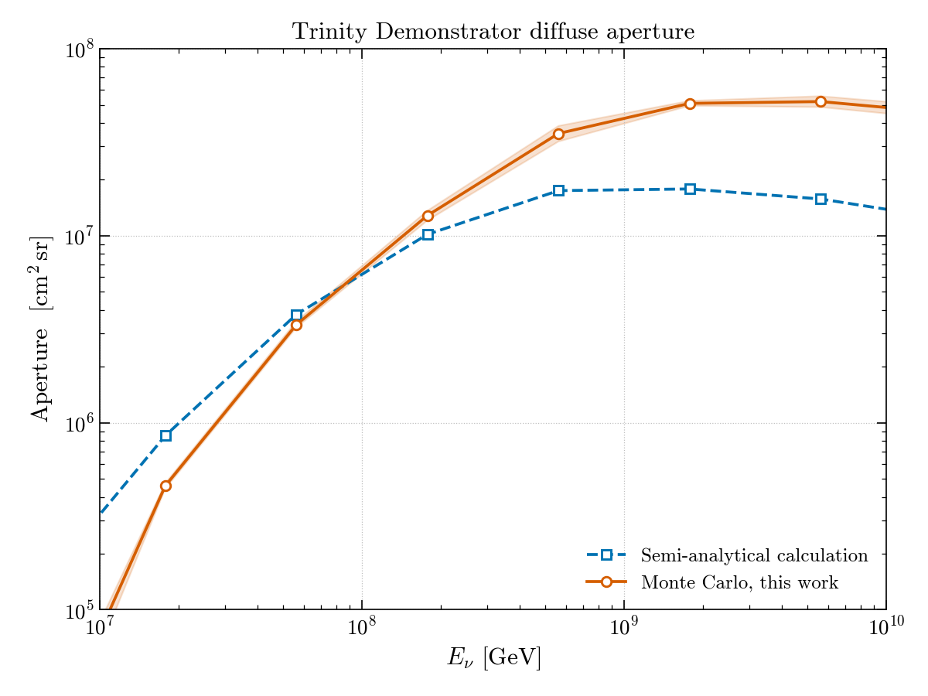
Effective Area
Preliminary
Pointing:
90 degree zenith
Maximum Distance:
~150 km (horizon)

Slide 29
The path towards the Trinity Observatory is ready
Area -> 1 sq meter
Field of View -> 3.87°x3.87°
Resolution -> 0.24 °
Taking data since October 2023
Area -> 60 sq meter
Field of View -> 60°x5°
Resolution -> 0.3 °
Construction starting next year. (?)
Demonstrator
Trinity One

Slide 30
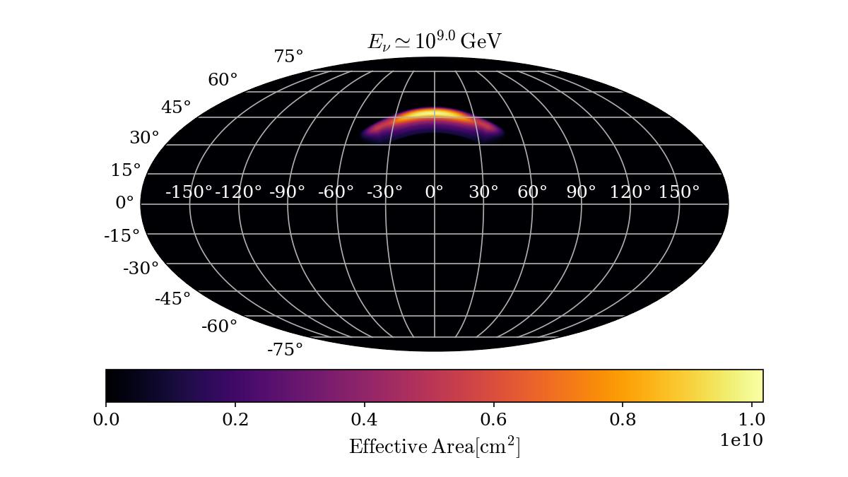
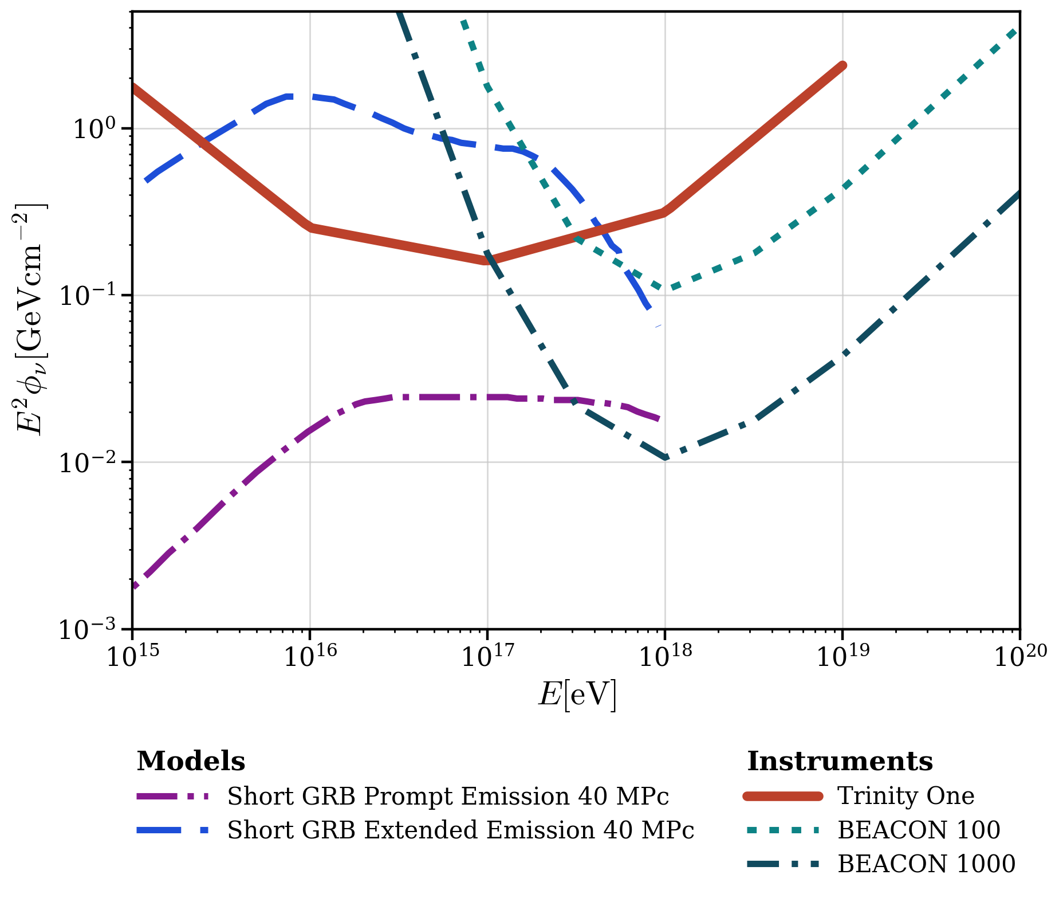
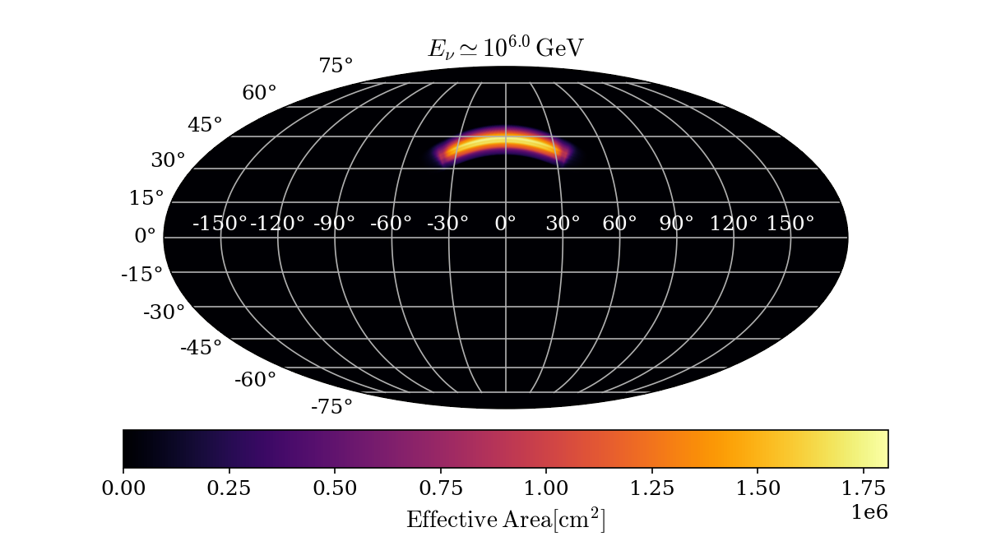
Trinity-One will have very deep point source sensitivity

Slide 31
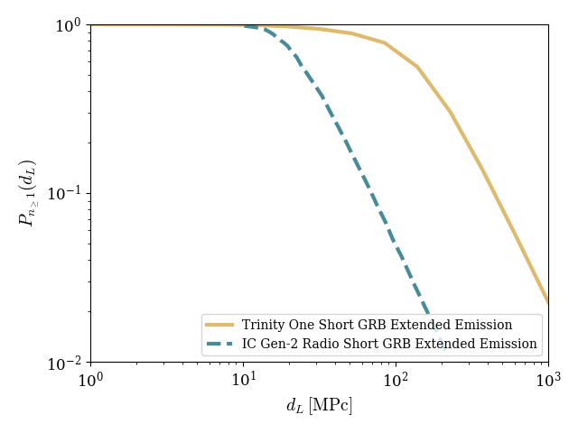
Trinity-One will have very deep point source sensitivity

Slide 32
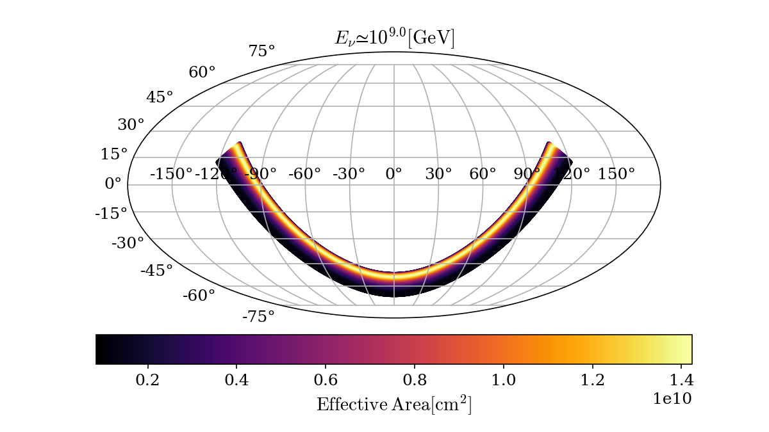
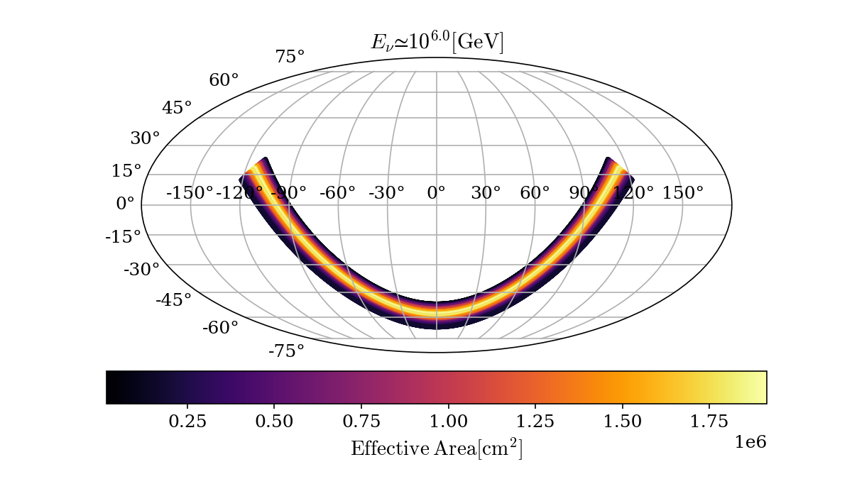
Azimuth rotation will enable source follow-ups
Accessible sky with repointing

Slide 33
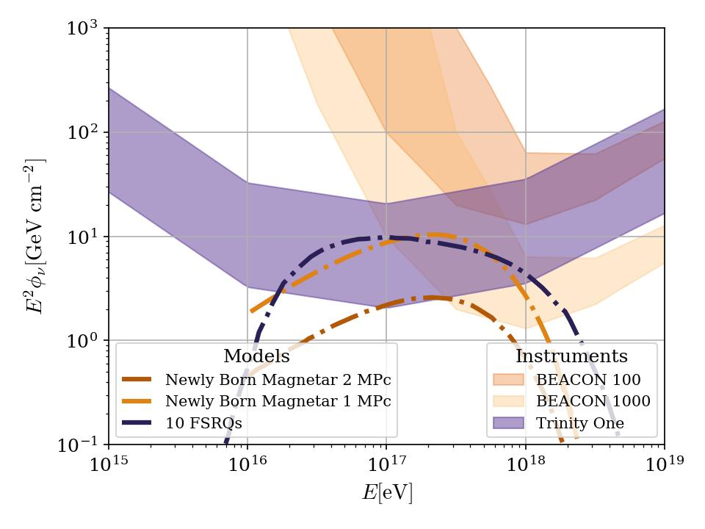
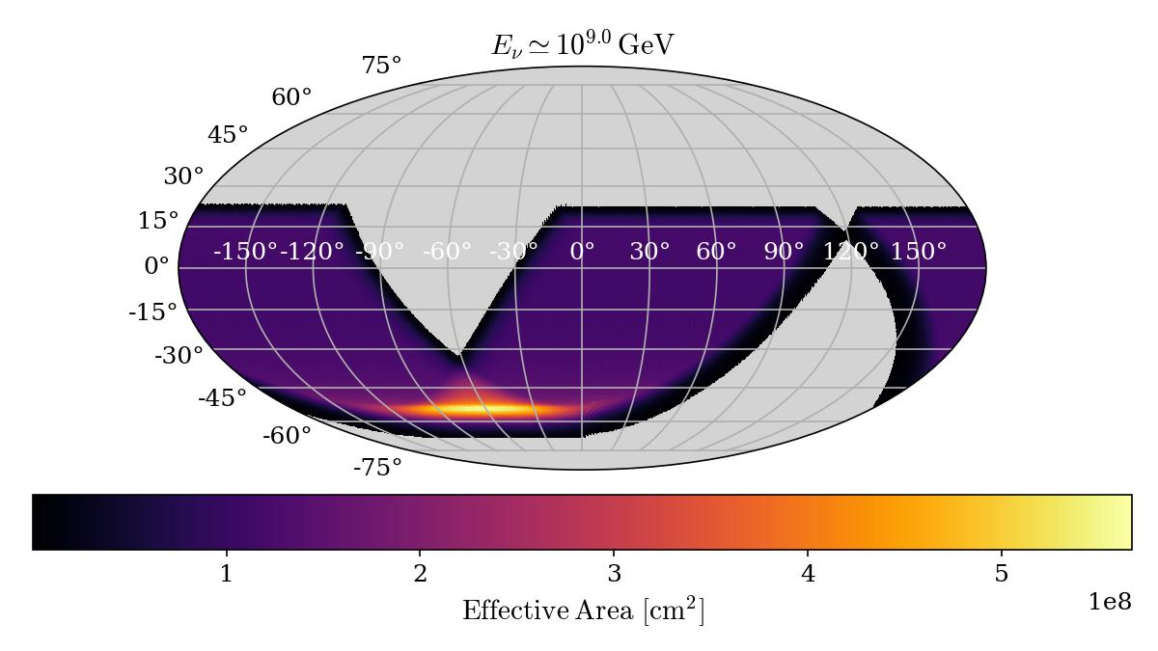
Azimuth rotation also enhances long duration burst sensitivity
One day

Slide 34
The path towards the Trinity Observatory is ready
Area -> 1 sq meter
Field of View -> 3.87°x3.87°
Resolution -> 0.24 °
Taking data since October 2023
Area -> 60 sq meter
Field of View -> 60°x5°
Resolution -> 0.3 °
Construction starting next year. (?)
3 sites
6 telescopes per site
Linear increase in diffuse flux sensitivity with number of telescopes
Demonstrator
Trinity One
Trinity Observatory

Slide 35
Summary and Outlook
Current Data Analysis Run Points to a Background Free Experiment.
Event discrimination and selection based on end-to-end Monte Carlo on the way!
Pretty good transient source sensitivity and follow up potential with repointing.
Limit on diffuse neutrino flux and some point sources soon!

Slide 36
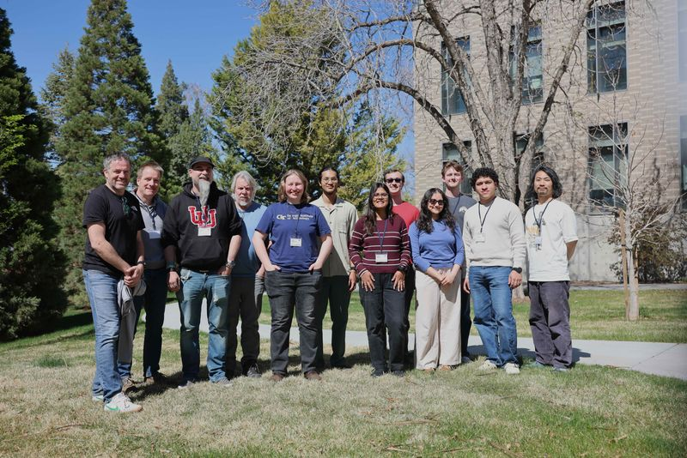
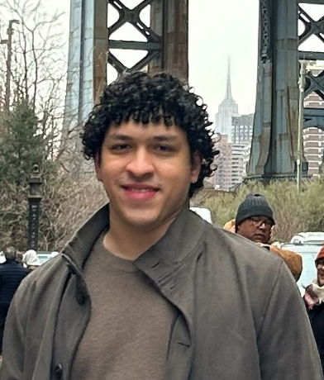
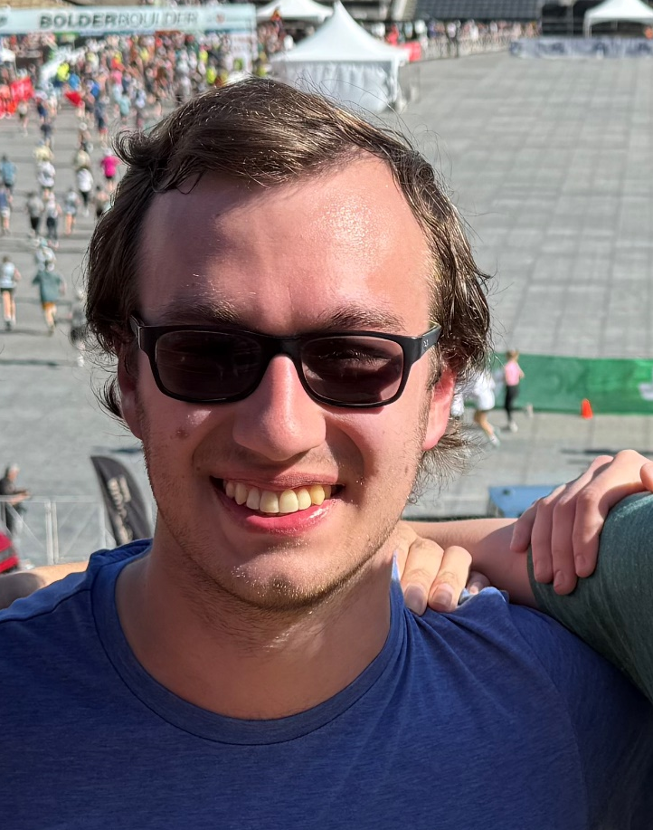
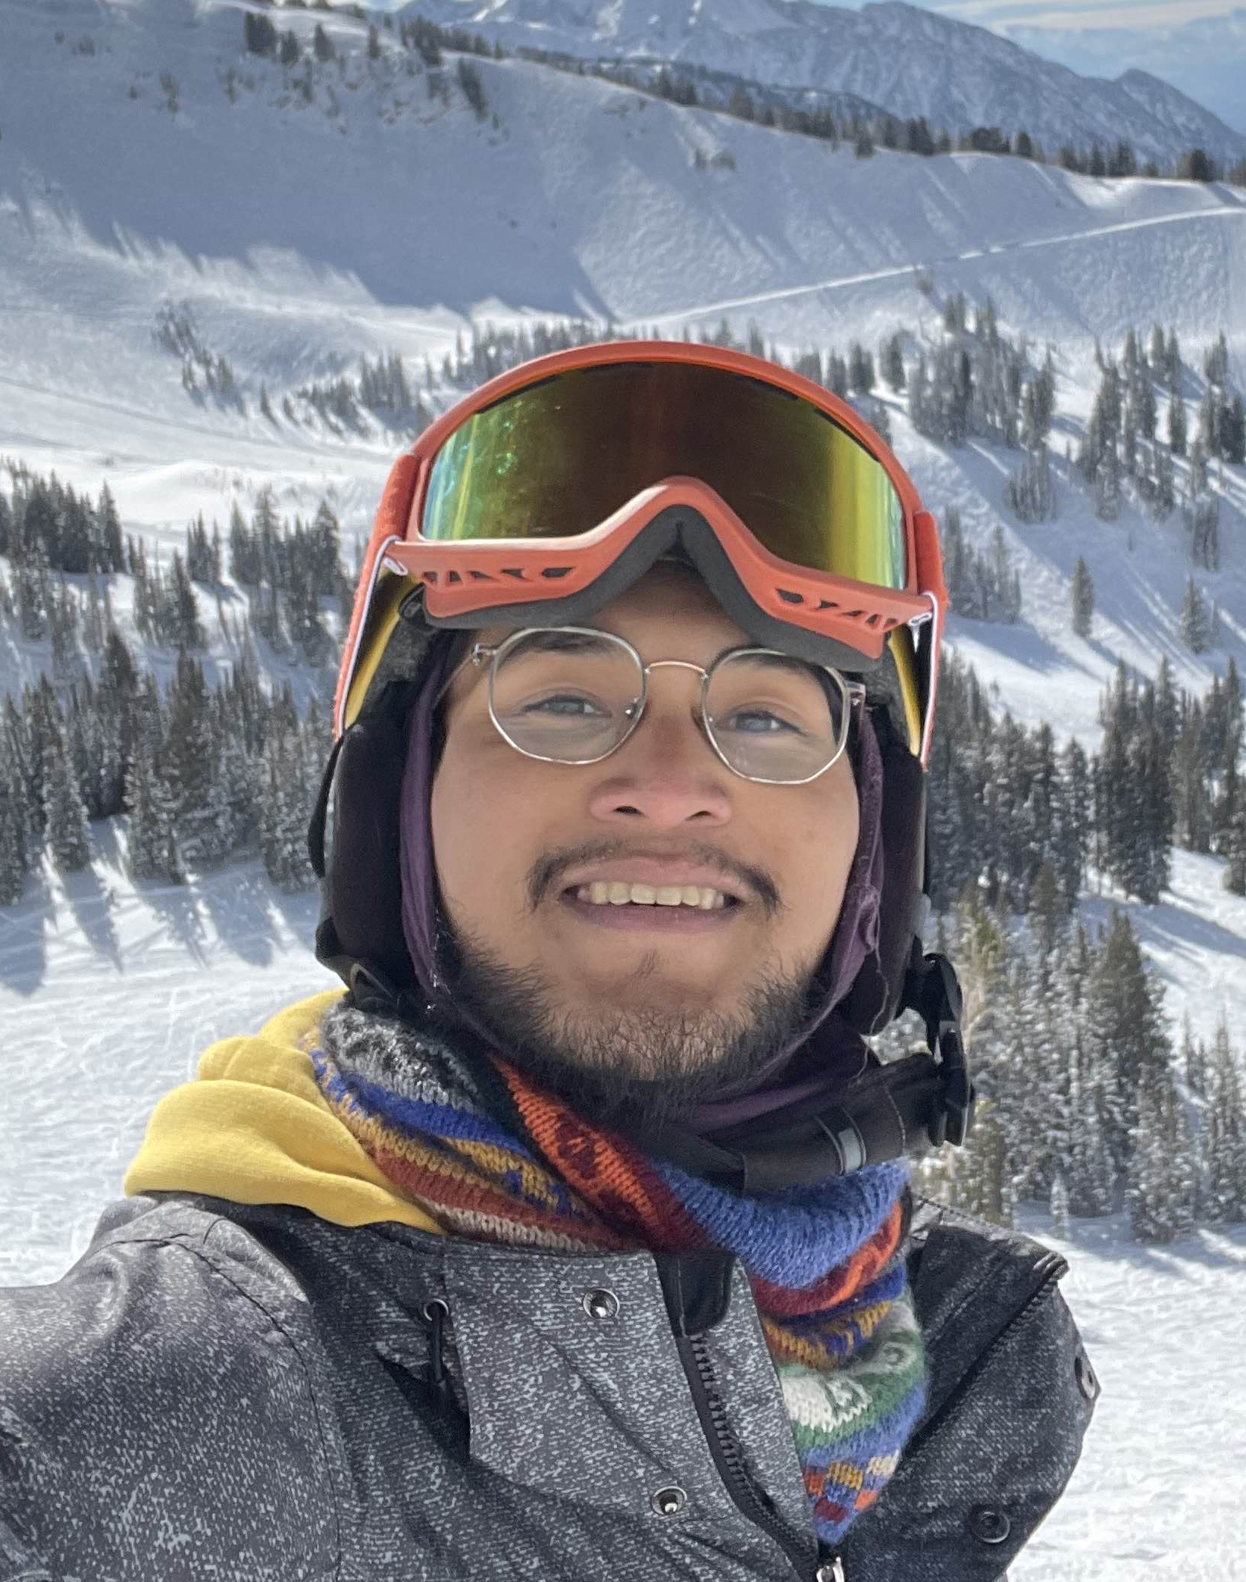
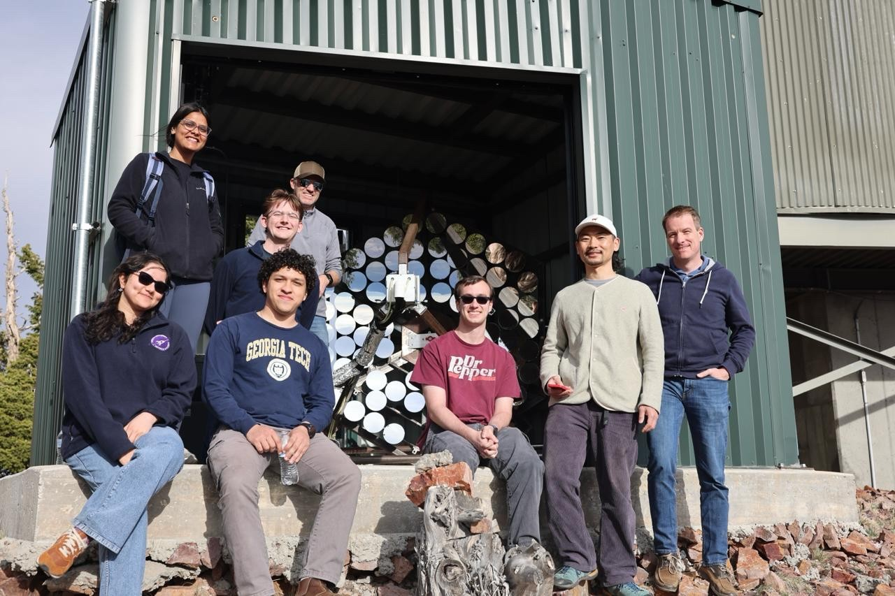
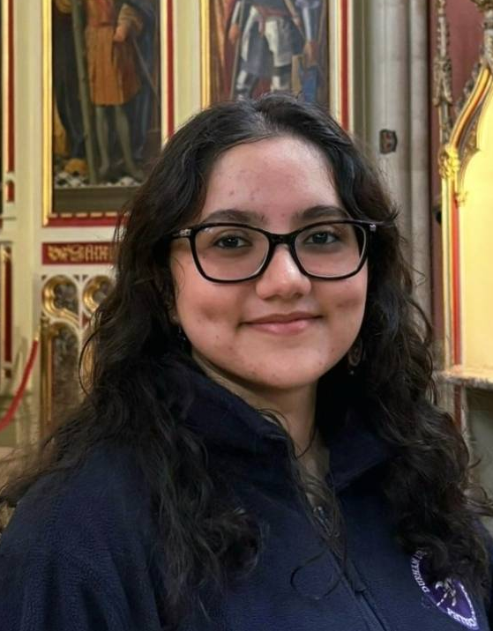
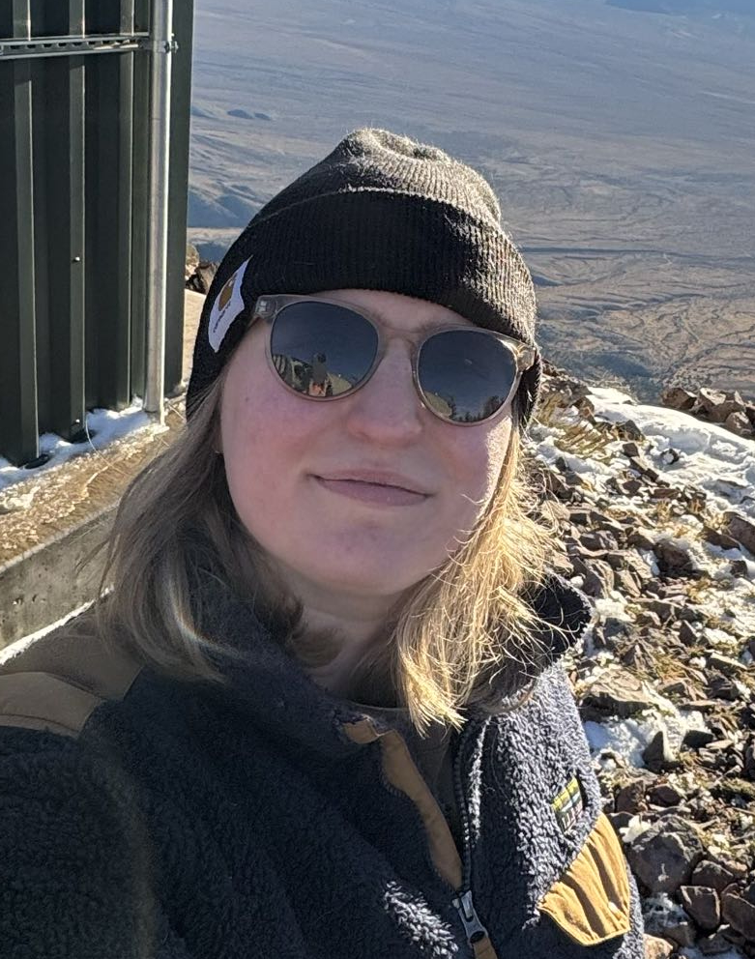
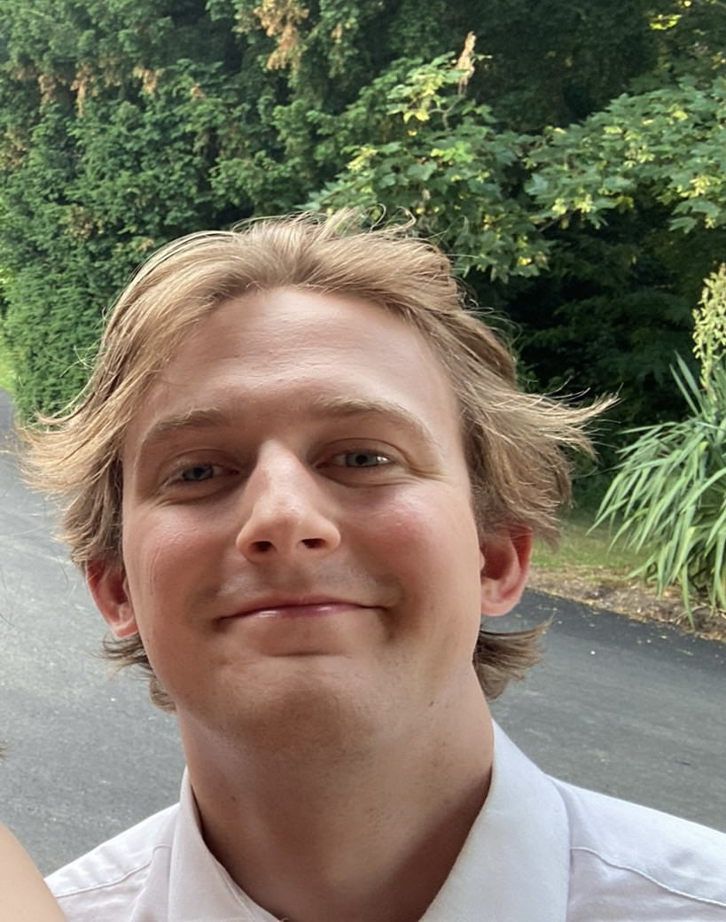
Thank you!!
Graduate Students
Muon Simulations
Tau Simulations and Performance
David
Raudales (me)
Nathan
Rauch
Kiet Tran
Phenomenology
and Science
Analysis and Operations
Atmospheric
Calibration
Sameeksha
Saini
Sofia
Stepanoff
Jake
McMillan

Slide 37
Backups

Slide 38
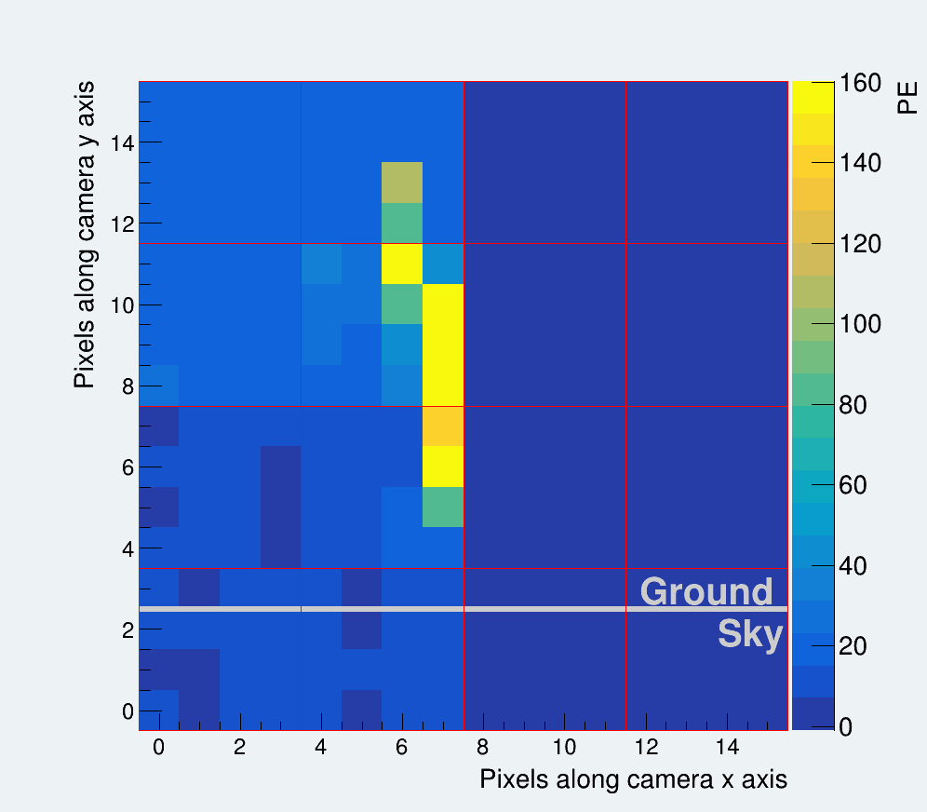
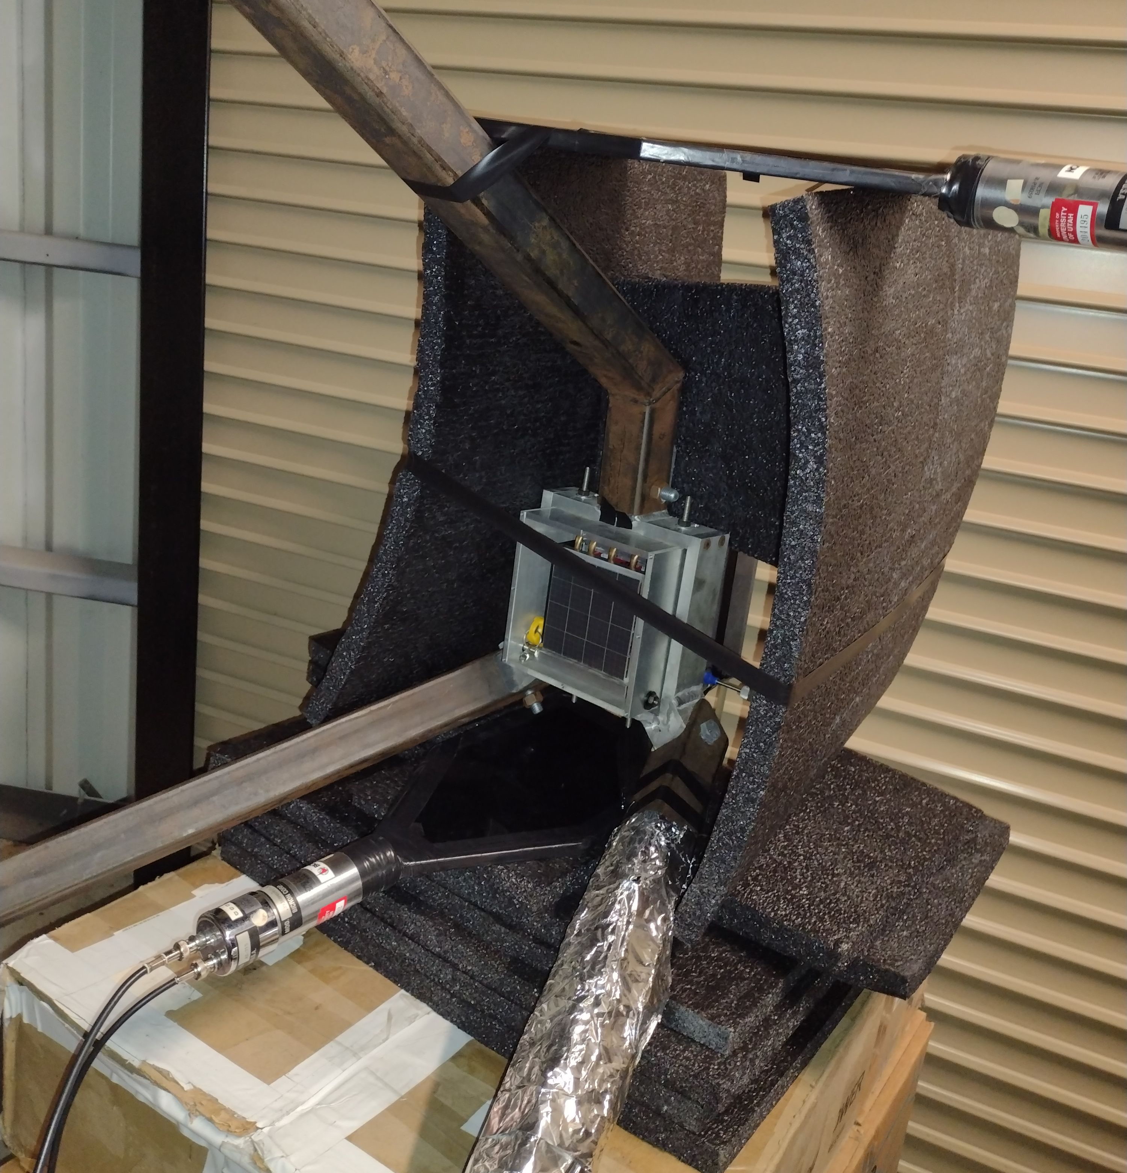
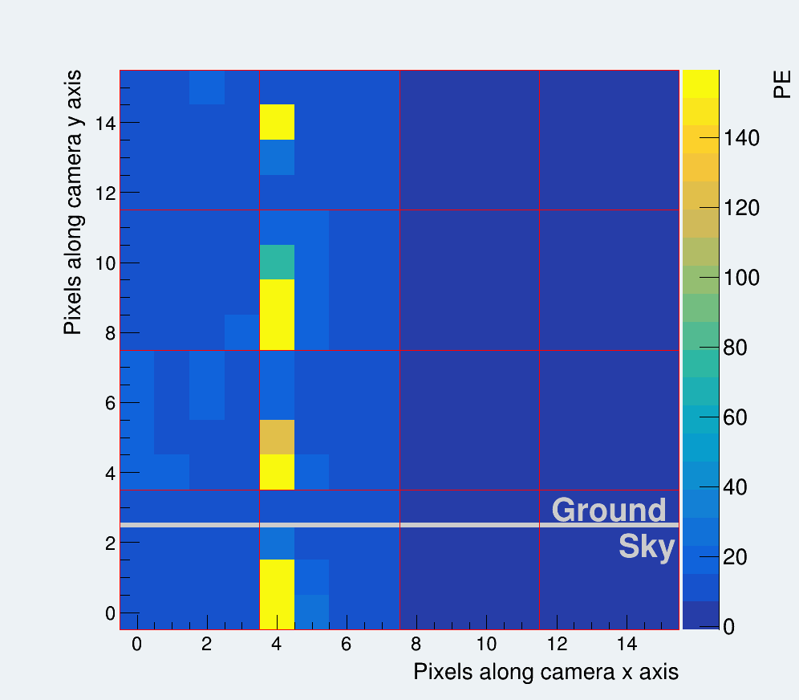
Images consistent with scintillator trigger
Muon Track
Isolated Muon Cherenkov Candidate
Event
Door Closed
Plastic Scintillator Detectors

Slide 39
Muon Tracks Arise when Muons Cross the Camera
4×4 SiPM Array
μ
μ
Muon Track
Isolated Muon Cherenkov Candidate
Event
6.4 mm
100 µm
238 Door Closed Hours
4.4 ± 0.1 event per hour
6.4 mm

Slide 40
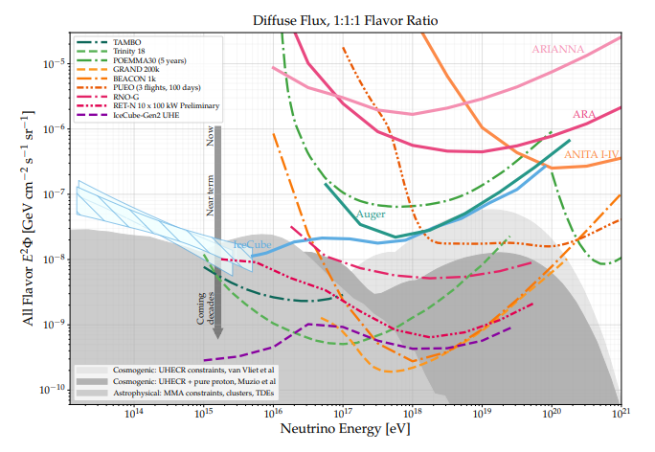
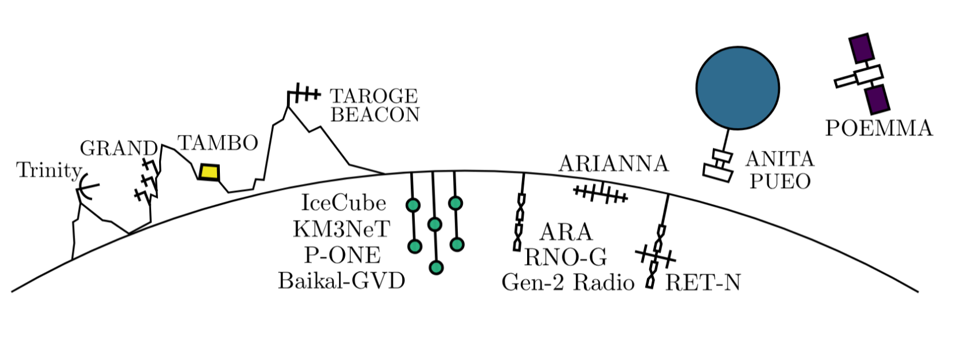
Neutrino Telescopes Landscape
RADIO
Esteban, Prohira, Beacom, Phys. Rev. D 106, 023021
ICE/WATER
Ackermann, M. et al., Snowmass, JHEAp 36 (2022) 55–110

Slide 41
Neutrino Telescopes Landscape
Closes the gap between ice/water Cherenkov telescopes and radio detectors
Astrophysical Neutrinos
Cosmogenic Neutrinos
Ackermann, M. et al., Snowmass, JHEAp 36 (2022) 55–110

Slide 42

Neutrino Telescopes Landscape
Closes the gap between ice/water Cherenkov telescopes and radio detectors
Overlap with IceCube ensures neutrino detection
Ackermann, M. et al., Snowmass, JHEAp 36 (2022) 55–110

Slide 43
What is the past, present and future of Trinity?
Demonstrator

Slide 44
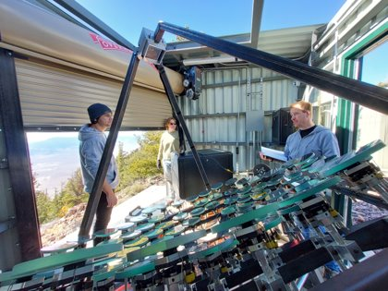
Commissioning
Aligning optics
Signal calibration
Trigger calibration
Remote operation
Commissioning paper:
Bagheri et al., Nucl. Instrum. Meth. A 1080, 170769 (2025)
Demonstrator

Slide 45


Event Cleaning
Simulated Gold-Plated Event
Energy: 414 PeV, Distance: 170 km, Emergence Angle: 1.75̊
Expected Camera Response
Demonstrator

Slide 46

Event Cleaning
Core Pixel Selection
Demonstrator

Slide 47
Event Cleaning
Boundary Pixel Selection
Demonstrator

Slide 48

Event Cleaning
Cleaned Event
Demonstrator

Slide 49

Distribution of Cleaned Events
Image Pixels:
Pixels in the cleaned image
Size:
Sum signal of all pixels in the cleaned image
Size = 2520 PE
Image Pixel = 18
Demonstrator

Slide 50

Distribution of Cleaned Events
Image Pixels:
Pixels in the cleaned image
Size:
Sum signal of all pixels in the cleaned image
497 events
1 event per 1.4 hours
Size = 2520 PE
Image Pixel = 18
Demonstrator

Slide 51


Event Taxonomy
19 events in one glitching camera module
Demonstrator

Slide 52


Trinity Is Effectively Background Free!
Background events are caused by muons hitting the camera.
1 event per hour
1 event per 173 hours
Spill Over
Gold Plated Simulation Event
1 event per 23 hours
Demonstrator

Slide 53

Daily Effective Area
Instantaneous
One day

Slide 54

Acceptance
One year
20% duty cycle

Slide 55




What Can We Expect from Transient Sources?
BOAT-like GRB IS Model 10 GPc

Slide 56

What Can We Expect from Transient Sources?
sGRB Extended Emission 40 MPc

