Slide 1

Daisuke YONETOKU (Kanazawa University)
・ Competitive M-class mission (Epsilon mission) in JAXA
・ Launch target is ~FY2034 …
HiZ-GUNDAM pre-project candidate team
2026/08/30 – 09/04 TeVPA @ Tendo, Yamagata, Japan

Slide 2
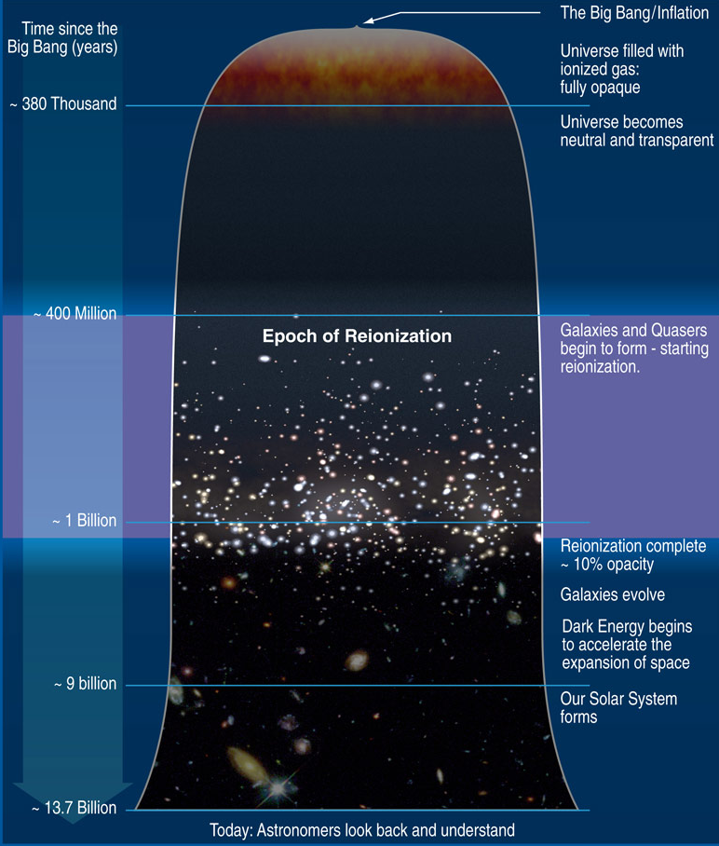
HiZ-GUNDAM： Promotion of Time Domain Astronomy
Key Science 1: Multi-Messenger Astronomy
z=1000
Identification/localization of
E-M counterparts associated with
GW and neutrino
Transition from gravitational energy to
heavy element (kilonova) and particles
Diversities of multi messenger sources
from X-ray to optical/NIR observation
z=12
Key Science 2: Exploration of early universe with GRB
z=7
(1) GRB rate at z > 6
(2) Reionization history
(3) First heavy metals
(4) Survey of Pop-III GRBs
z=6
z=0.5
Planck HP
z=0
These observations require both “wide field monitor” and “near-infrared follow-up”

Slide 3
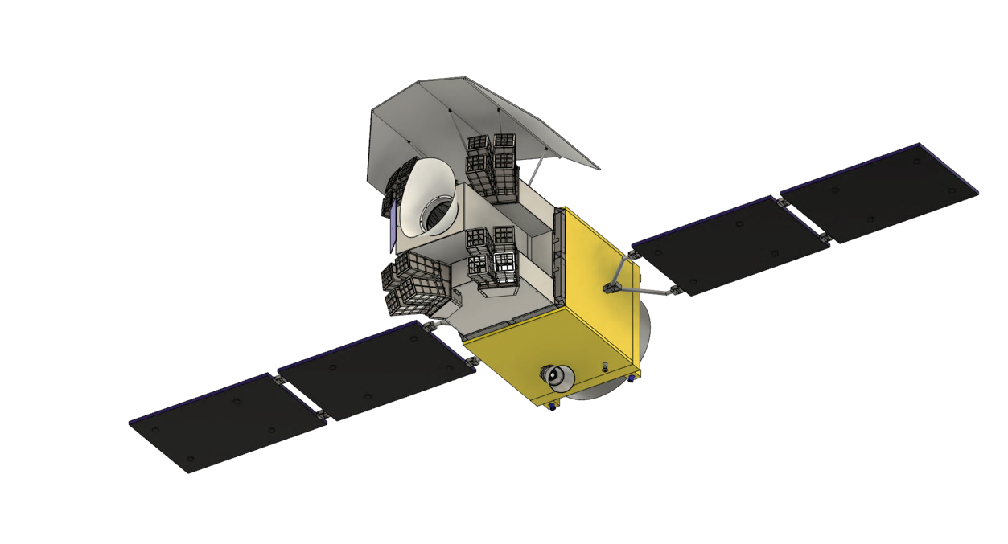
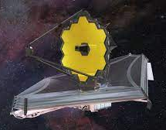
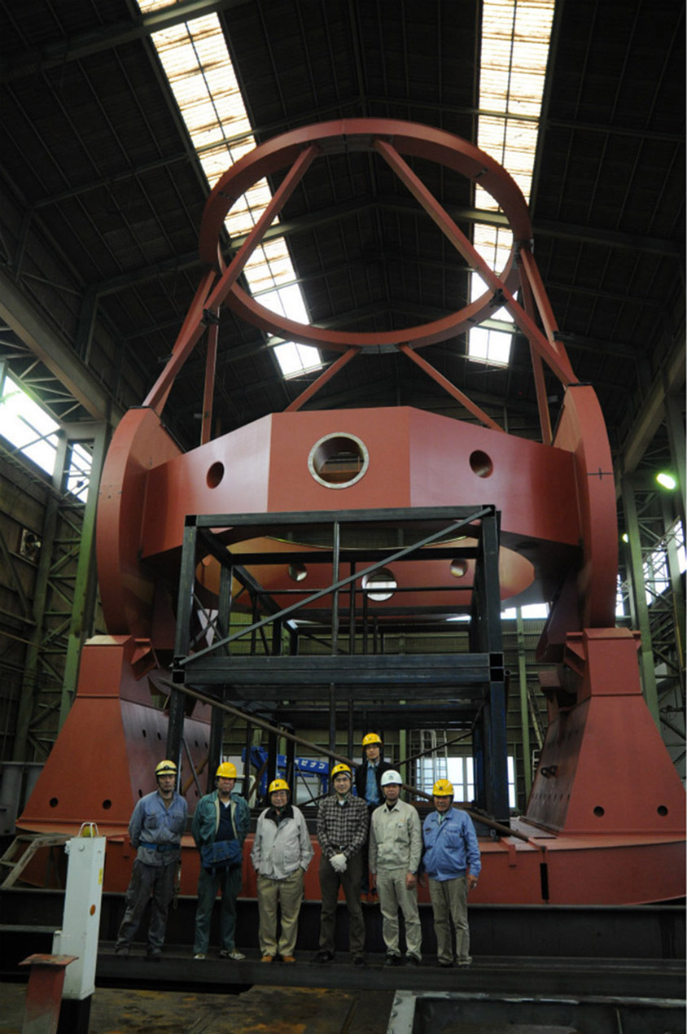
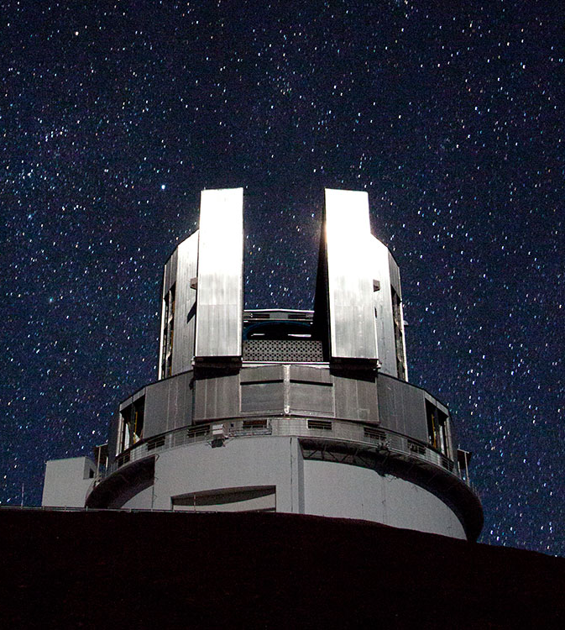
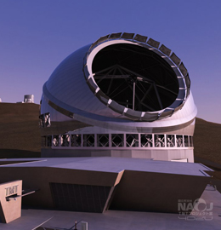
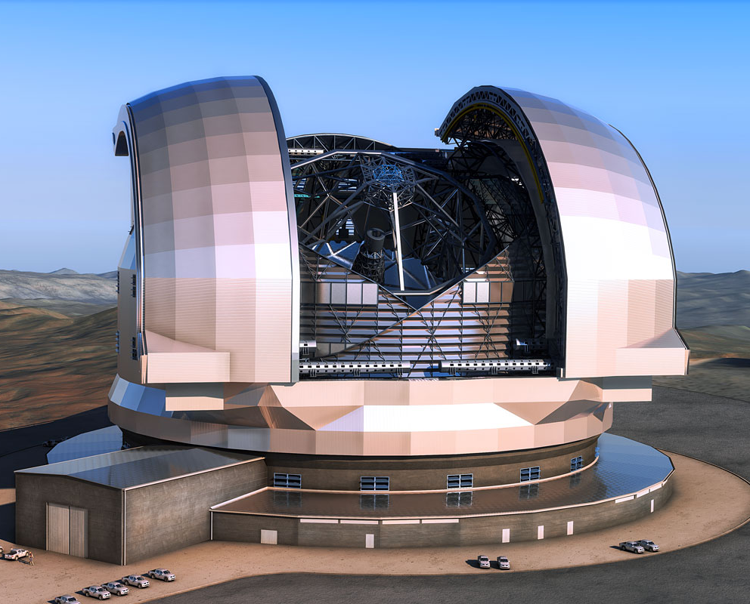
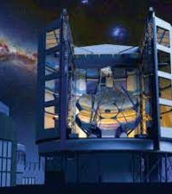
HiZ-GUNDAM (High-z Gamma-ray bursts for Unraveling the Dark Ages Mission)
EAGLE: Exploration of Ancient GRBs with Lobster Eye
Mission： Time Domain Astronomy
“Multi-messenger astronomy” and “Exploration of the early universe”
・ Lobster Eye Optics
・ pnCCD imaging detector
Observation strategy
(1) Discovery of GRBs/transients with the wide field X-ray monitor (t < 0 sec)
(2) Automatic repointing (t < 300 sec)
(3) Identification of counterpart with the near infrared telescope (t ~ 1000 sec)
(4) Alert message (t ~ 0 sec for X-ray, ~ 1800 sec for Opt/NIR)
(5) Spectroscopic observation with large area telescopes (t ~ 1.5 hour)
We will discover treasured targets from a large amount of
transient sources, and provide important observation targets
to large area telescopes.
We will promote "early space exploration” and ”MM astronomy"
with all the power of astronomy.
MONSTER:
Multiband Optical and Near-infrared
Simultaneous Telescope for Efficient Response
・ Simultaneous 5-band photometry
・ 0.5 – 2.5 um
JWST
TAO
Subaru
TMT
E-ELT
GMT
Space telescope
8m-class
Future 30m-class

Slide 4
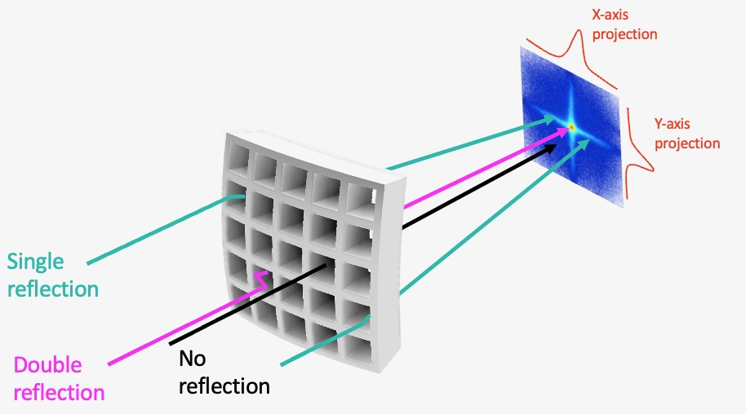
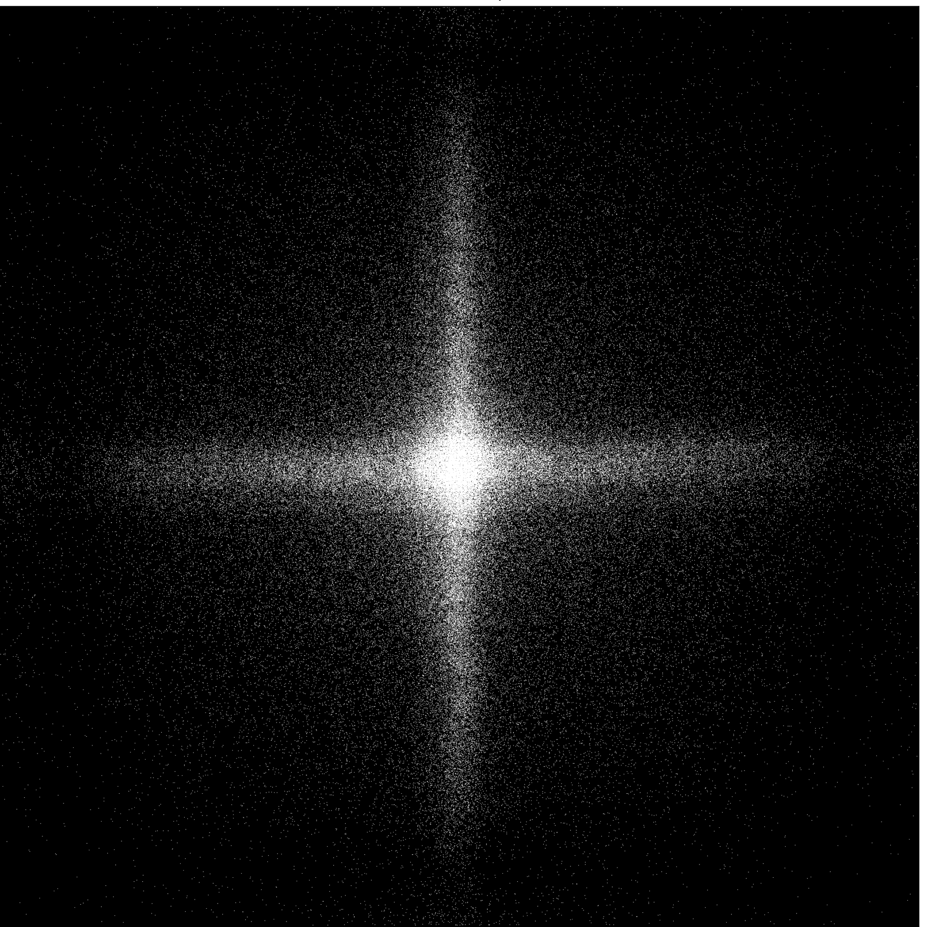
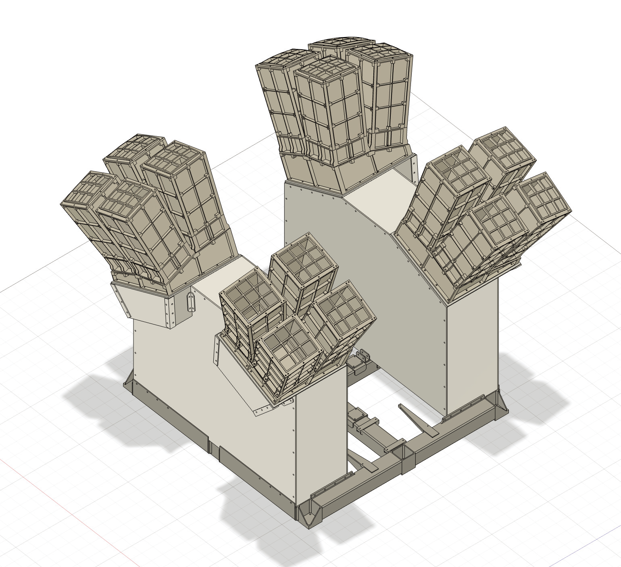
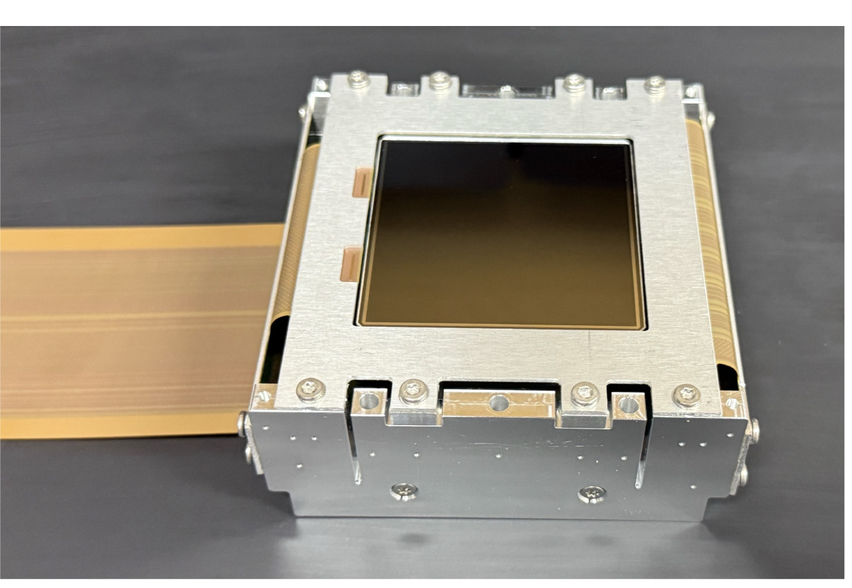
EAGLE (Wide Field X-ray Monitor)
Micro Pore (Lobster Eye) Optics
Focal Image
5μm
20μm
pnCCD (Focal Imaging Detector)
Items | Parameters
Energy band (keV) | 0.4 – 4 keV
Telescope type: | Lobster Eye Optics
Number of Modules | 16
Field of View | 0.53 str (16 modules)
Focal length | 300 mm
Focal plane detectors | pnCCD array
Time resolution | < 100 msec
Sensitivity | ~ 1e-10 (erg/cm2/s) For 100 sec
Position accuracy | 3 arcmin
Requirements for the focal plane detector
Sensitive Area | > 55 × 55 mm²
Pixel Size | 108 μm
Depletion Layer | 450 μm
Quantum efficiency | > 90% @ 0.4 – 4 keV
Frame rate | ≥ 10 fps
55 mm

Slide 5
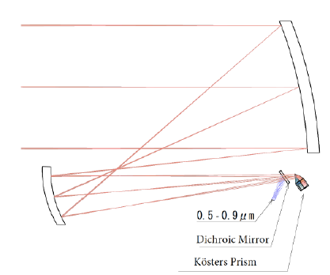
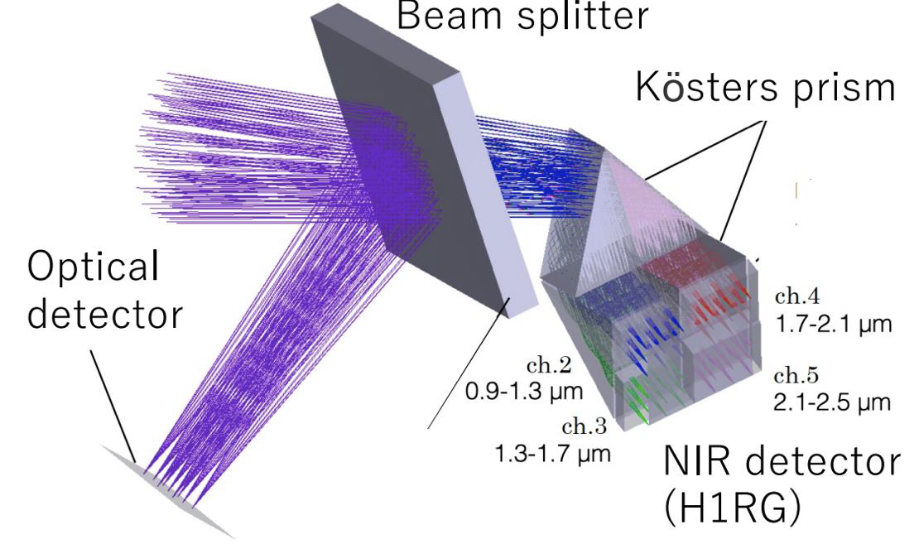
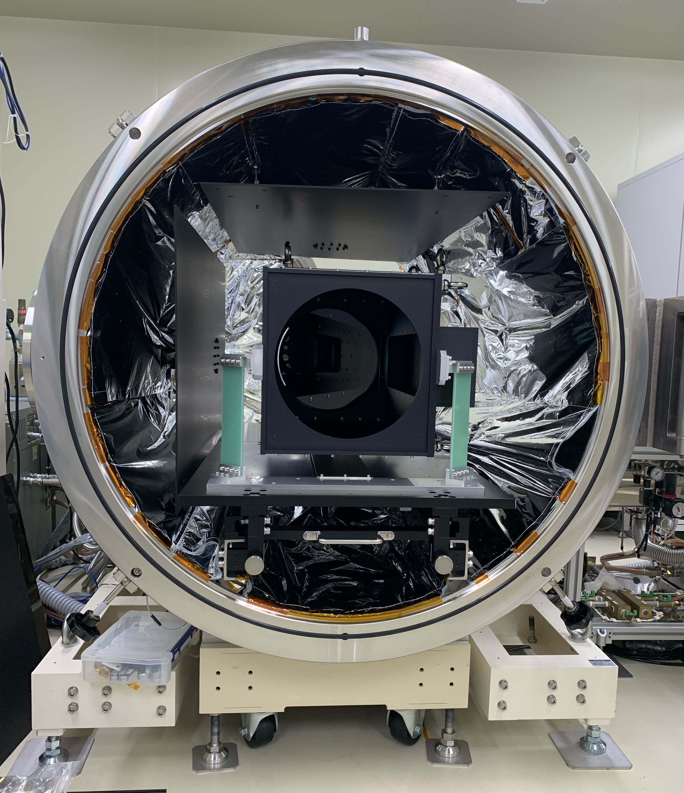
MONSTER (Near Infrared Telescope)
Kohji TSUMURA’s Talk
Primary Mirror
φ300 mm
Thermal Vacuum Optical Test (2026.8 – )
Telescope
T < 200 K
NIR imaging
Detector T < 120 K
5-band simultaneous photometry
Items | Parameters
Telescope type | Offset Optics
Aperture size | 30 cm
Focal length | 183.5 cm
F number | F6.1
Field of view | 15 arcmin × 15 arcmin
FoV per pixel | 2 acsec × 2 arcsec
Image size | 3 pixel × 3 pixel
Integration time | 10 minutes (2 minutes x 5 frames)
Observation Band (μm) | 0.5−0.9 | 0.9−1.3 | 1.3−1.7 | 1.7−2.1 | 2.1-2.5
Limiting Magnitude mag (AB) 10min, 10σ | 21.3 | 20.9 | 20.6 | 20.5 | 20.4
Focal detector | HyViSi | HgCdTe (H1RG)

Slide 6
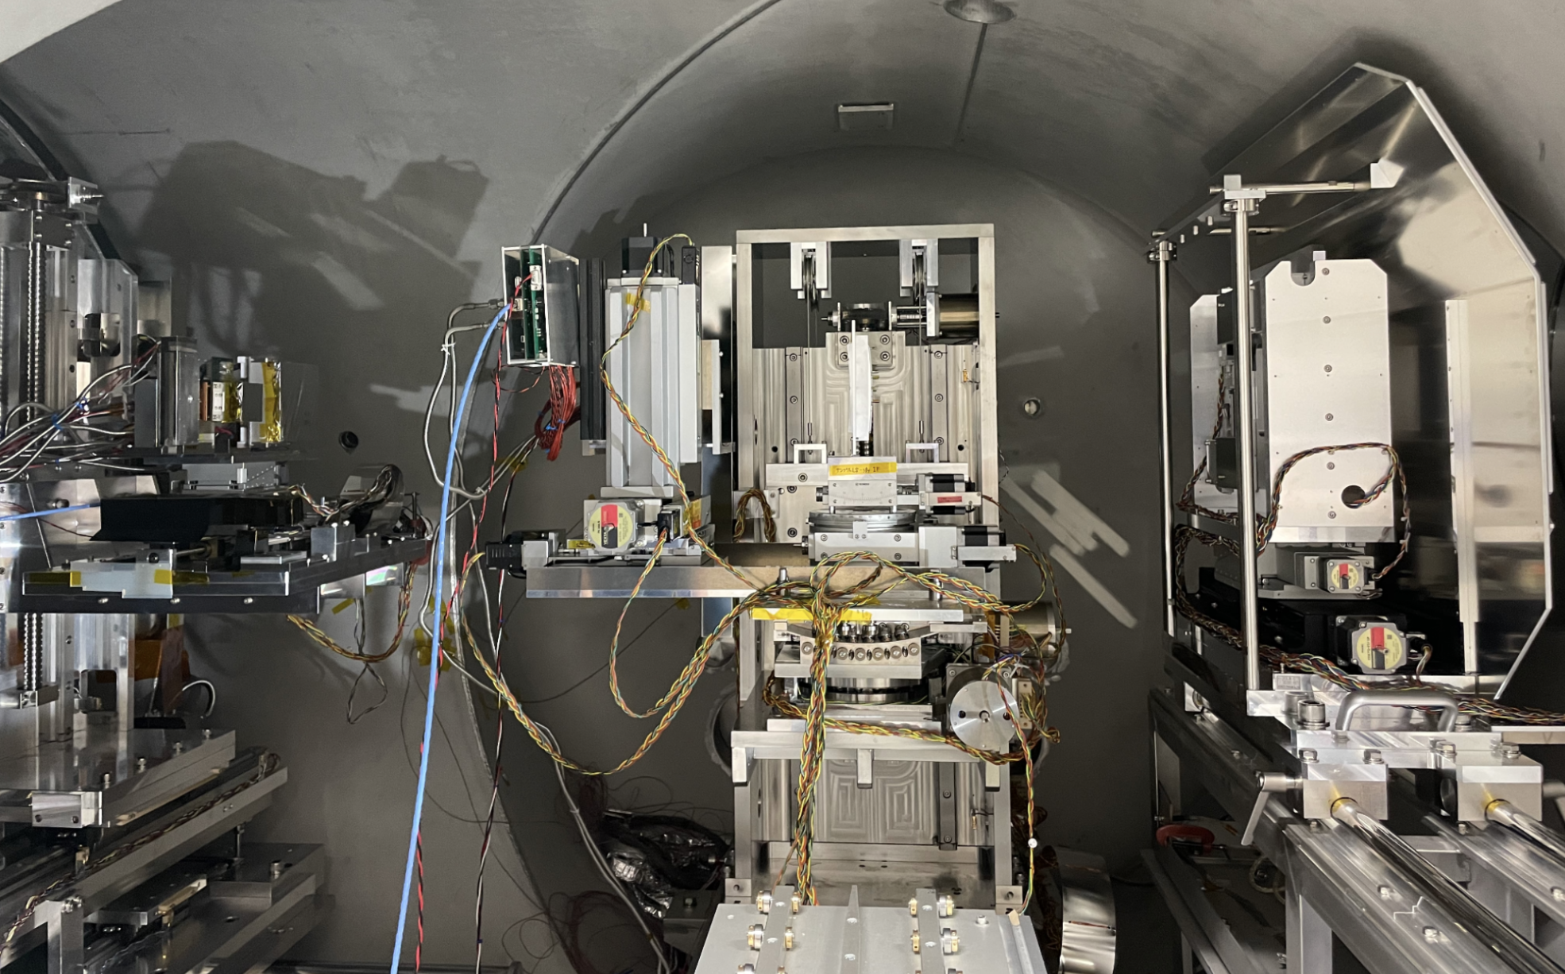
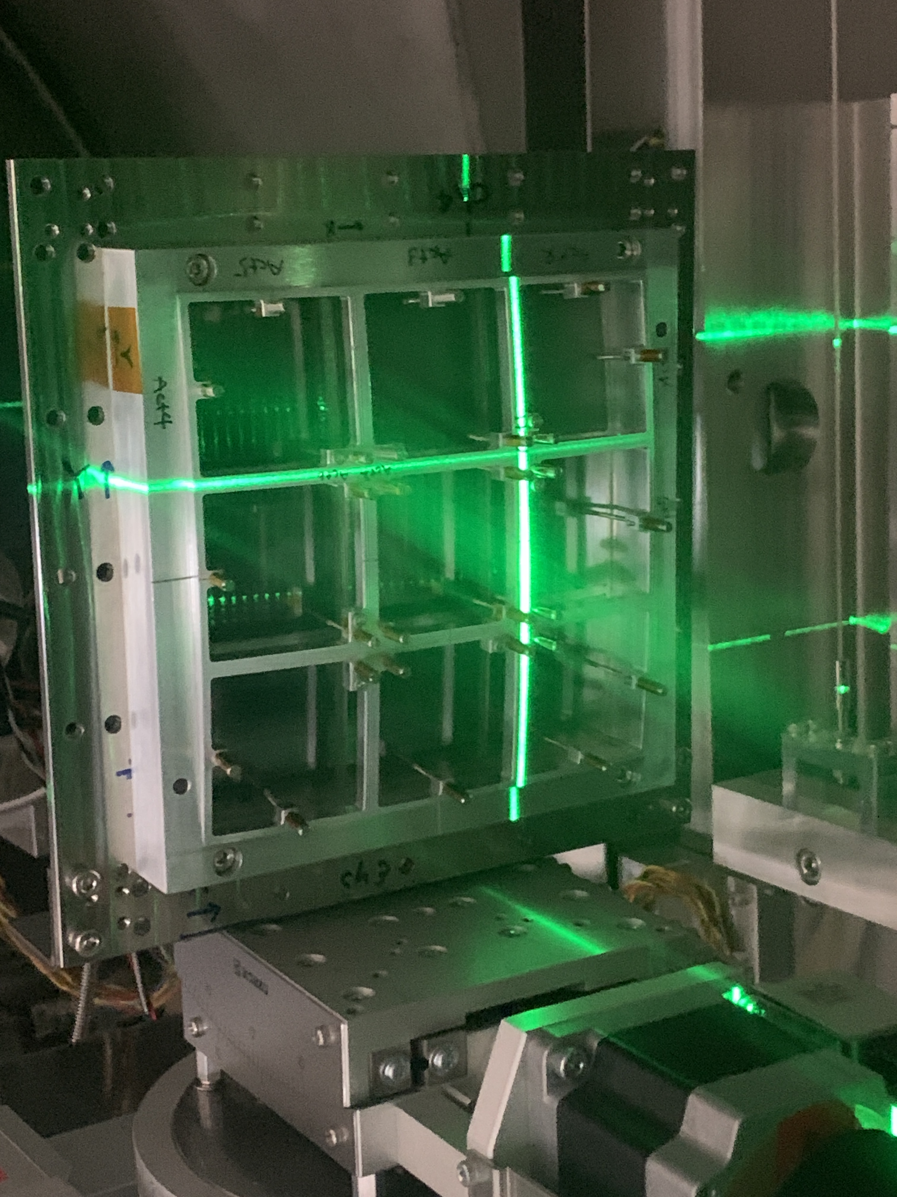
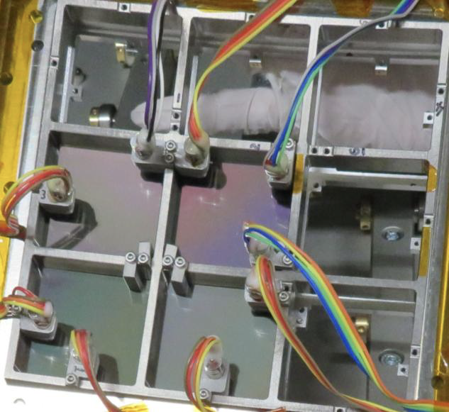
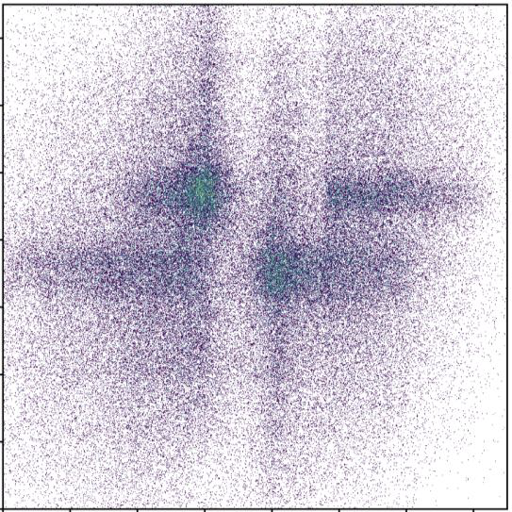
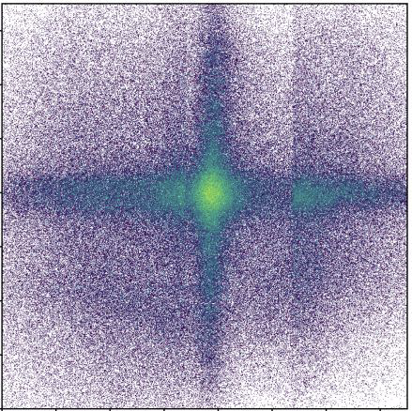
EAGLE (Wide Field X-ray Monitor)
Micro Pore (Lobster Eye) Optics
Bread Board Model
CMOS
LEO
X-ray collimator
Alignment Adjustment
Items | Parameters
Energy band (keV) | 0.4 – 4 keV
Telescope type: | Lobster Eye Optics
Number of Modules | 16
Field of View | 0.53 str (16 modules)
Focal length | 300 mm
Focal plane detectors | pnCCD array
Time resolution | < 100 msec
Sensitivity | ~ 1e-10 (erg/cm2/s) For 100 sec
Position accuracy | 3 arcmin
Before
After
~ 1 arcmin accuracy
Micro Actuators

Slide 7
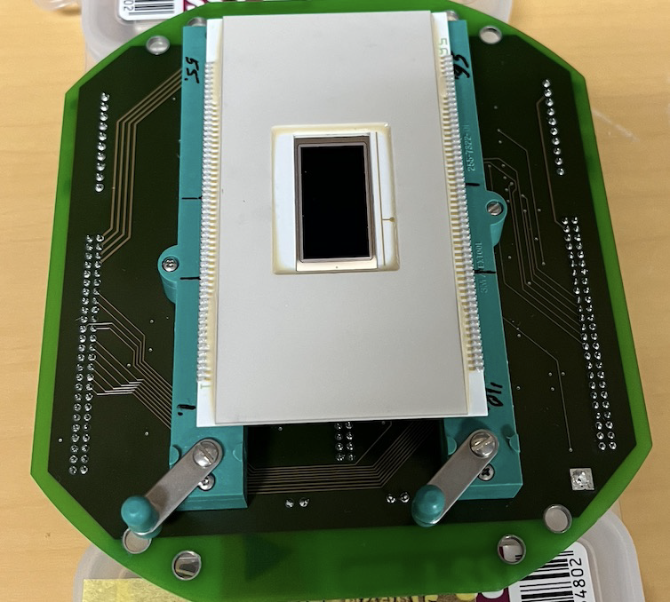
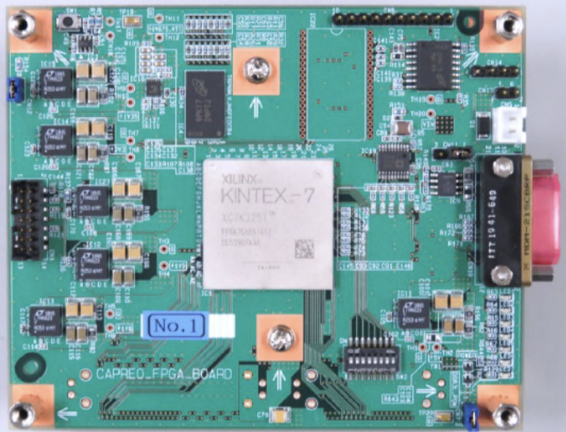
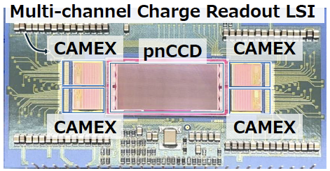
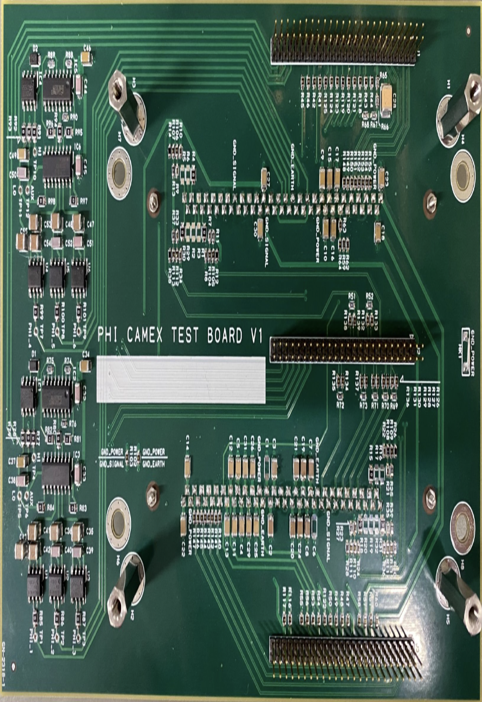
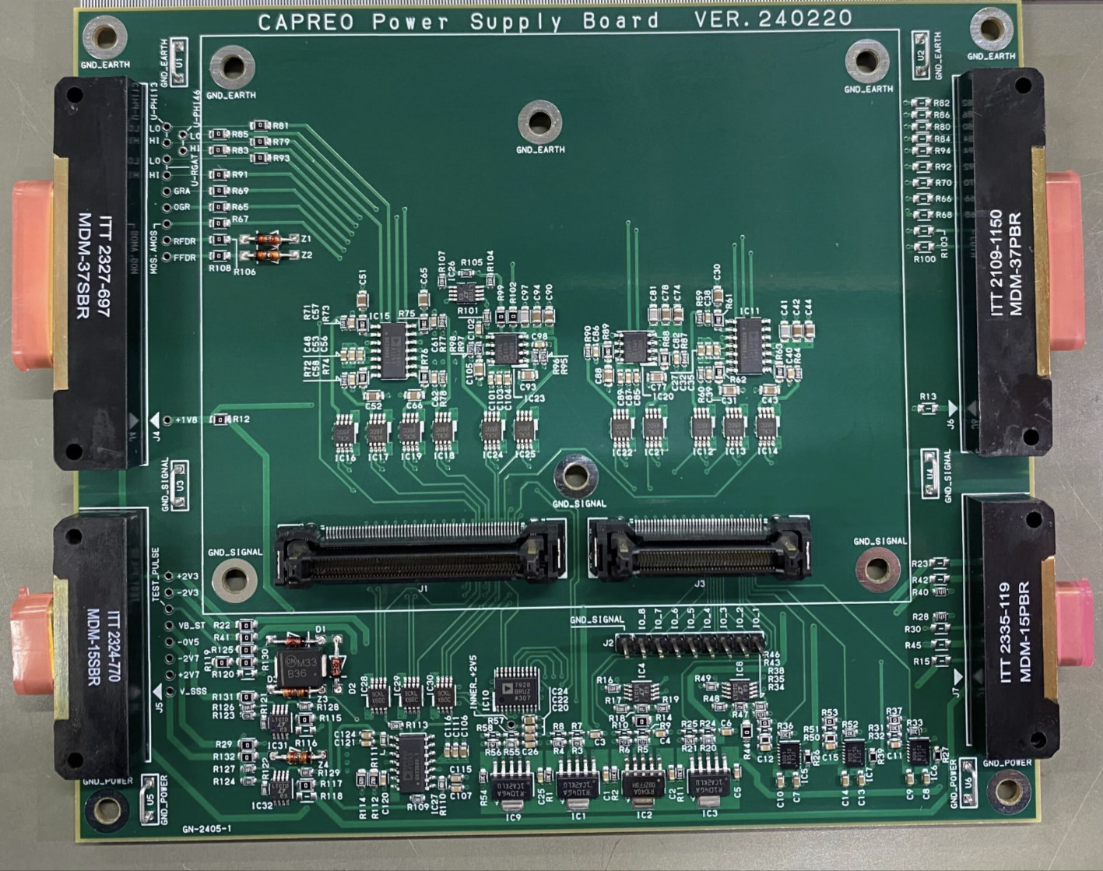
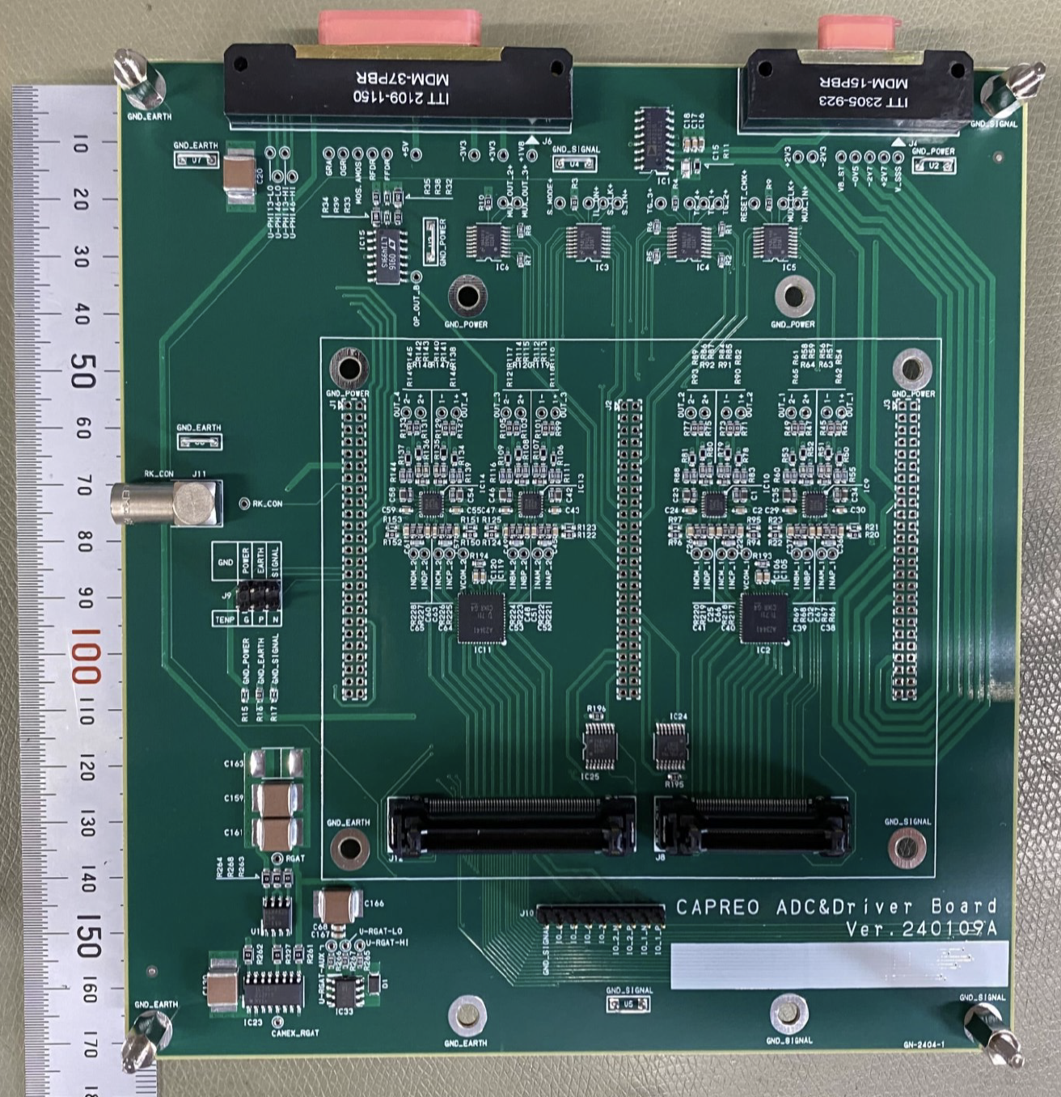
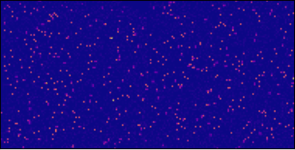
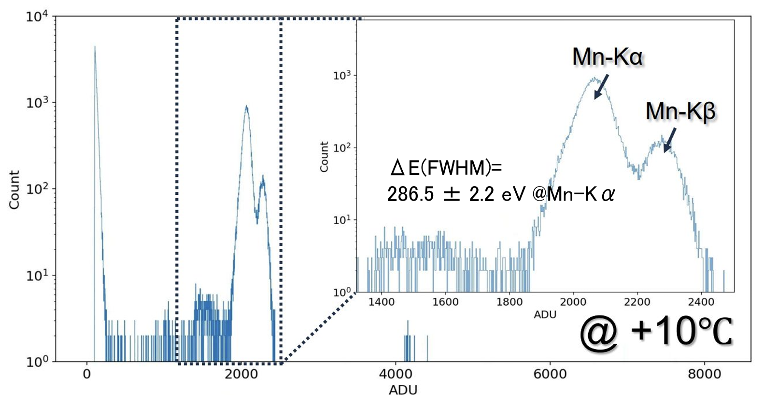
EAGLE (Wide Field X-ray Monitor)
pnCCD (Focal Imaging Detector)
In-house Electronics
Small pnCCD and Readout LSIs
pnCCD
Readout FPGA
PHI Driver
Power Supply
ADC
X-ray imaging movie
X-ray spectrum of Mn-Kα/β
Items | Parameters
Energy band (keV) | 0.4 – 4 keV
Telescope type: | Lobster Eye Optics
Number of Modules | 16
Field of View | 0.53 str (16 modules)
Focal length | 300 mm
Focal plane detectors | pnCCD array
Time resolution | < 100 msec
Sensitivity | ~ 1e-10 (erg/cm2/s) For 100 sec
Position accuracy | 3 arcmin
We have obtained pnCCD driving technology using in-house electronics.
@+3 degC、150 ms exposure

Slide 8
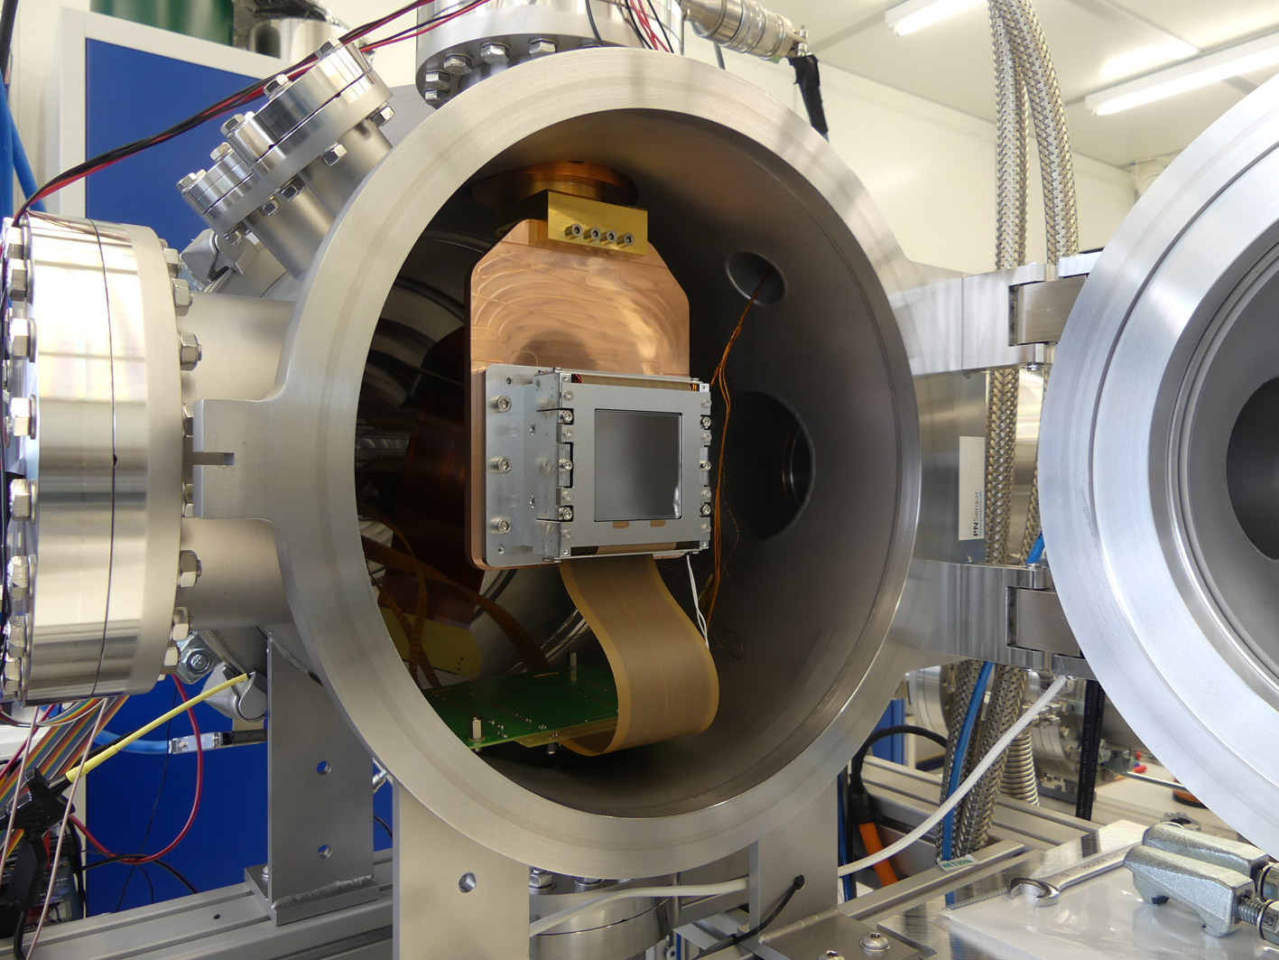
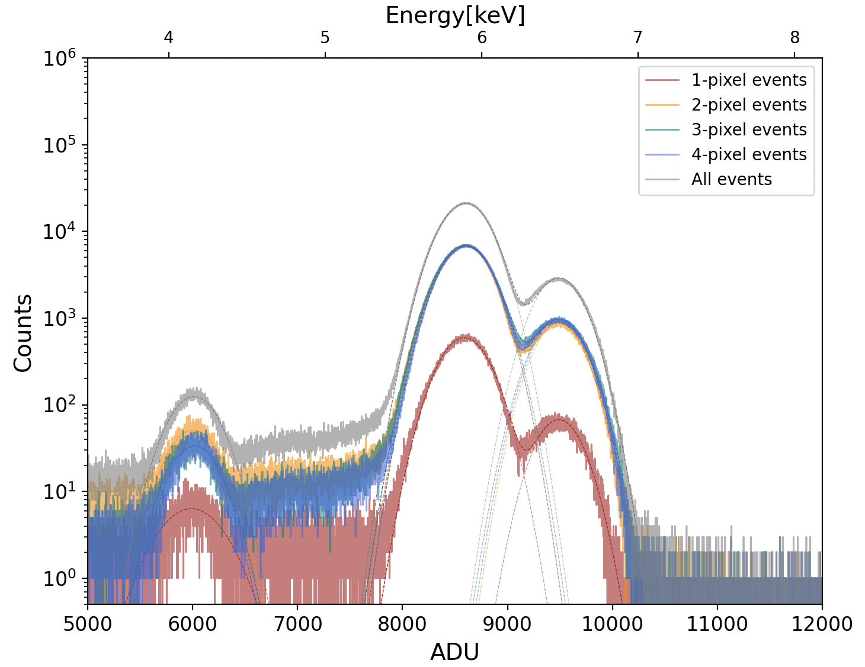
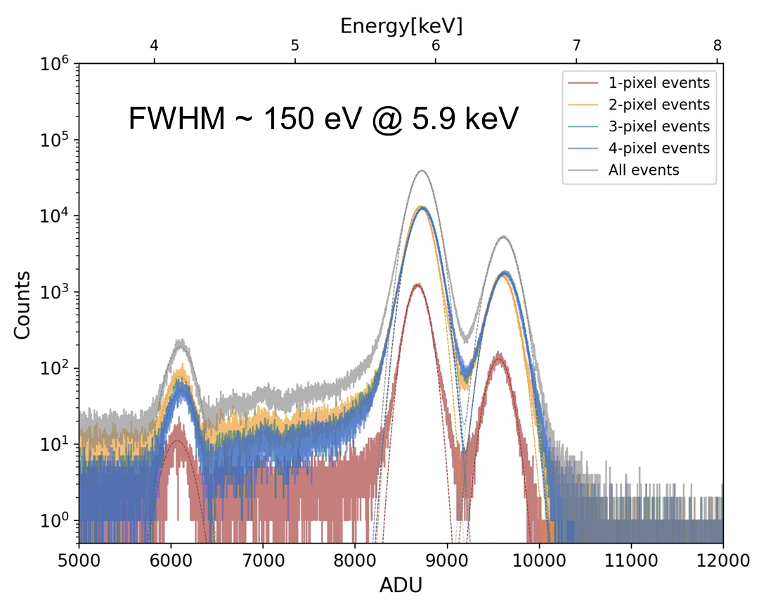
EAGLE (Wide Field X-ray Monitor)
Large-format pnCCD (Focal Imaging Detector)
We started the development of large-format pnCCDs.
We evaluated requirements are satisfied
・ Lower detection limit (LD) < 0.3 keV
・ Energy resolution ~ 150 eV @ 5.9 keV
@ PNSensor (Germany)
Items | Parameters
Energy band (keV) | 0.4 – 4 keV
Telescope type: | Lobster Eye Optics
Number of Modules | 16
Field of View | 0.53 str (16 modules)
Focal length | 300 mm
Focal plane detectors | pnCCD array
Time resolution | < 100 msec
Sensitivity | ~ 1e-10 (erg/cm2/s) For 100 sec
Position accuracy | 3 arcmin
@ -60 degC, 10 Hz
Gain Correction
CTI Correction

Slide 9
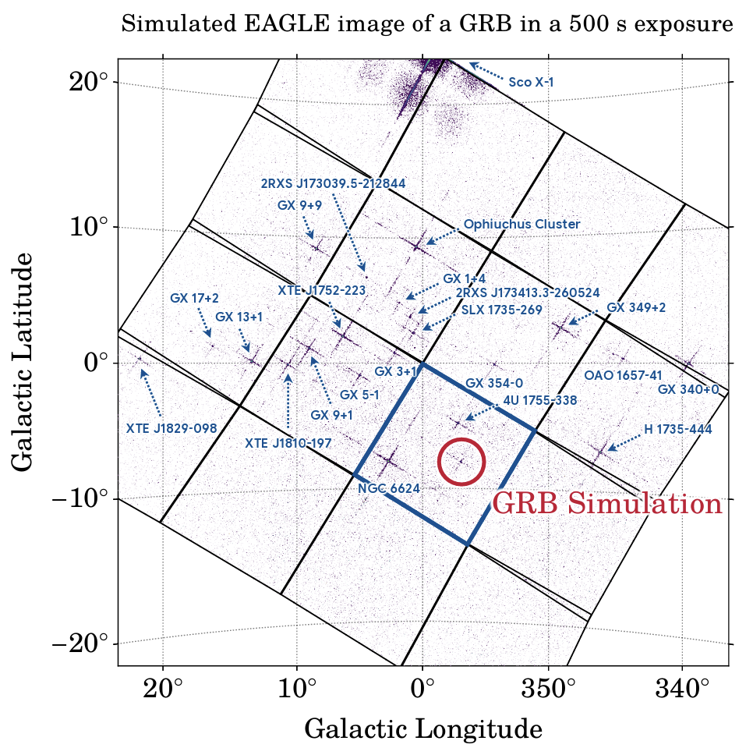
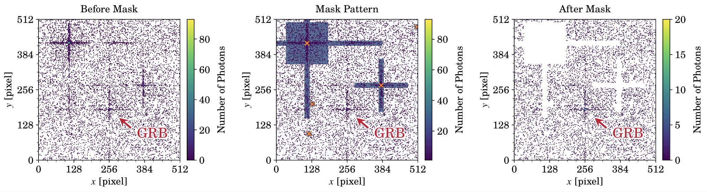
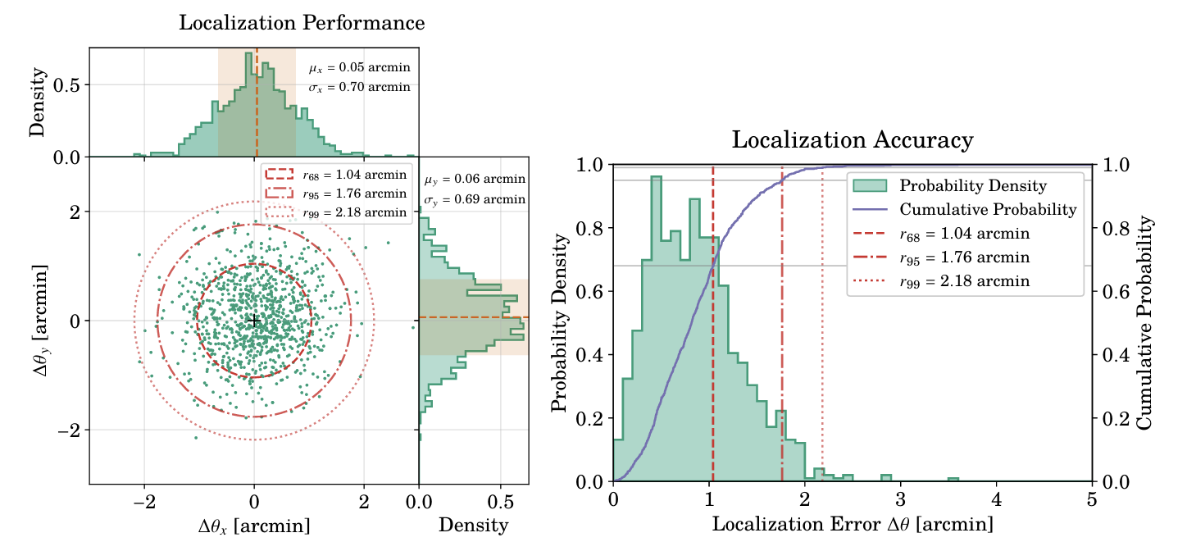
Simulation Studies for Trigger Algorithms
・ Masking the known bright X-ray sources
・ Search for NEW X-ray sources using a fixed-size window
that is shifted across the X-ray image.
Localization Accuracy
- 80 photons, 1,000 simulations

Slide 10
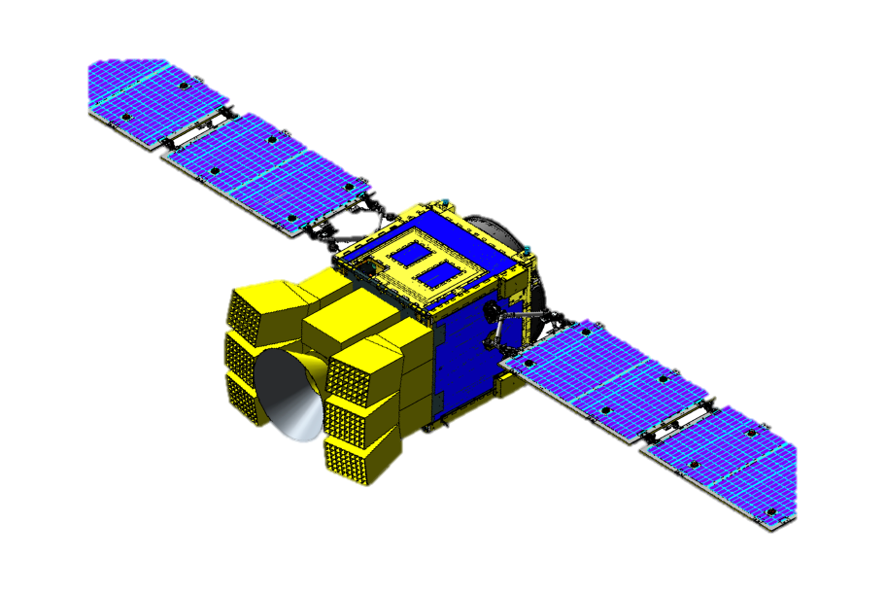
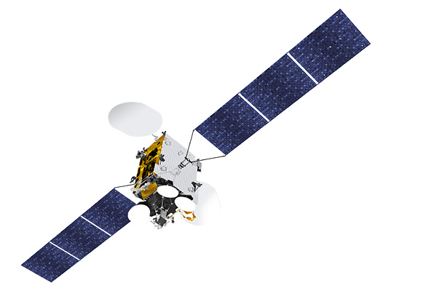
Nominal Operation
Coverage : > 90 %
Latency : ~ 0 sec
max delay : 5 min
KSAT
Pointing
560 sec
Inmarsat
Satellite orbit:
Sun-synchronous polar dawn-dusk orbit
Maneuver
150 sec
(1) A solar separation angle of 120 degrees and
Tilted by 50 degrees toward the forward direction.
(2) Keeping the inertial pointing during 560 sec
HiZ-GUNDAM monitors X-ray transients
(3) The satellite slews to the next nominal pointing
Alert message
geostationary orbit
We observe roughly eight different fields of view in every orbit.
This sequence is optimized for follow-up observations with the NIR telescope,
we make sure of more than 10 minutes for 97% GRBs discovered by itself.
Inmarsat
Ground Station
HiZ-GUNDAM
Project Server
KSAT
⦿
GCN, Atel
Solar

Slide 11
Future Schedule
Fiscal Year | Plans and Milestones
Current | Development of BBM (front loading)
FY2027 | Down Selection Review for 3 candidates (HiZ-GUNDAM / LAPYUTA / Silvia) Establishment of Pre-Project Team
FY2028 | Mission Definition Review
FY2029 | System Definition Review Establishment of Project Team
FY2029 – 30 | EM phase, System Definition Review
FY2030 – 32 | FM phase
FY2034 | Launch

Slide 12
High-z Gamma-ray bursts for Unraveling the Dark Ages Mission
Mission Aim: Strong Promotion of
“Time Domain” & “Multi-Messenger Astronomy”.
EAGLE: Exploration of Ancient GRBs with Lobster Eye
・ Lobster Eye Optics
・ pnCCD imaging detector
Key Science1: Progress of Multi messenger Astronomy
・ Localization of X-ray transients from MM sources
・ Energy transition from gravity to particles/elements
Key Science2: Probing the Early Universe
・ Detection of high-redshift GRBs (6 < z < 13 … 20)
・ Probing the reionization history and first metal elements
Observation Strategy
(1) Discovery of high-energy transient with EAGLE
(2) Automatic/Comprehensive follow-up with MONSTER
(3) Sending Quasi-Realtime Alert Messages
(4) Spectroscopy with Large Area Telescopes for selected events
MONSTER:
Multiband Optical and Near-infrared
Simultaneous Telescope for Efficient Response
・ Simultaneous 5-band photometry
・ 0.5 – 2.5 um
Wide Field X-ray Monitor
Near Infrared Telescope
Items | Parameters
Energy band (keV) | 0.4 – 4 keV
Field of View | 0.53 str (16 modules)
Sensitivity | ~1 e-10 (erg/cm2/s) For 100 sec exposure
Position accuracy | 3 arcmin
Time resolution | < 100 msec
Items | Parameters
Aperture size | 30 cm
Field of view | 15 arcmin × 15 arcmin
Integration time | 10 minutes (2 minutes x 5 frames)
Observation Band (μm) | 0.5−0.9 | 0.9−1.3 | 1.3−1.7 | 1.7−2.1 | 2.1-2.5
Limiting mag (AB) | 21.3 | 20.9 | 20.6 | 20.5 | 20.4

Slide 13
Backup Slides

Slide 14
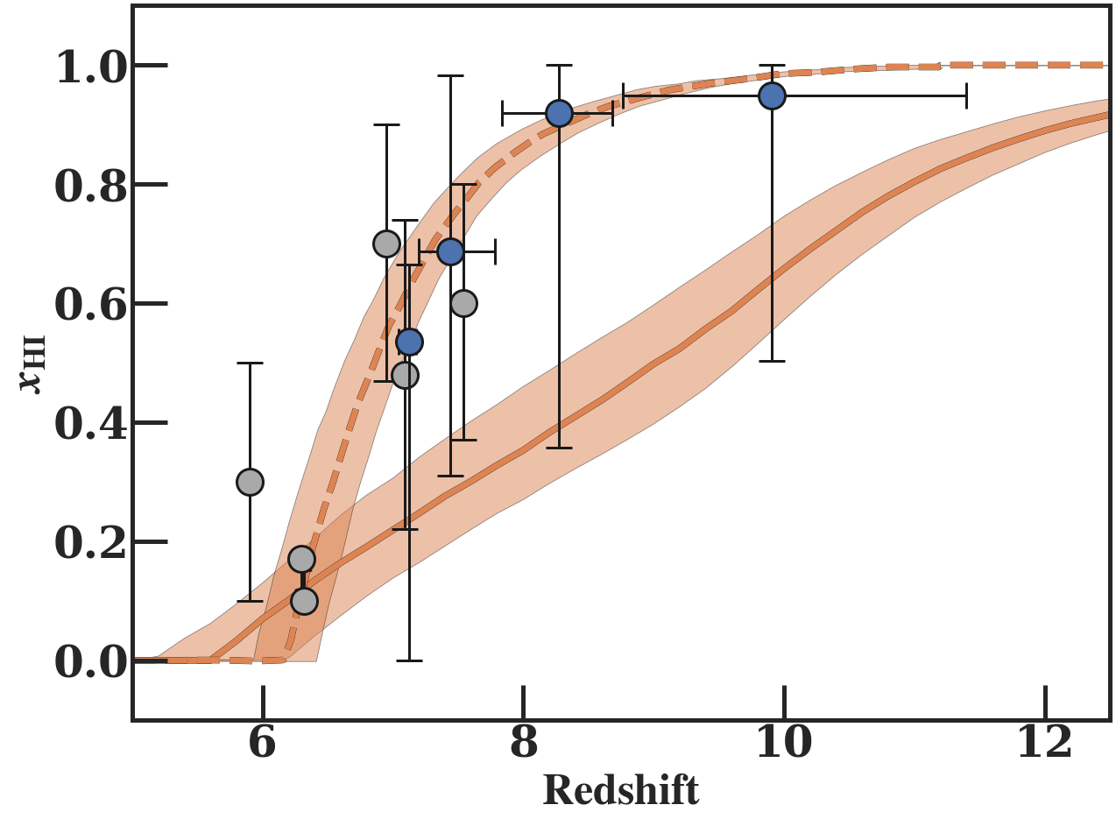
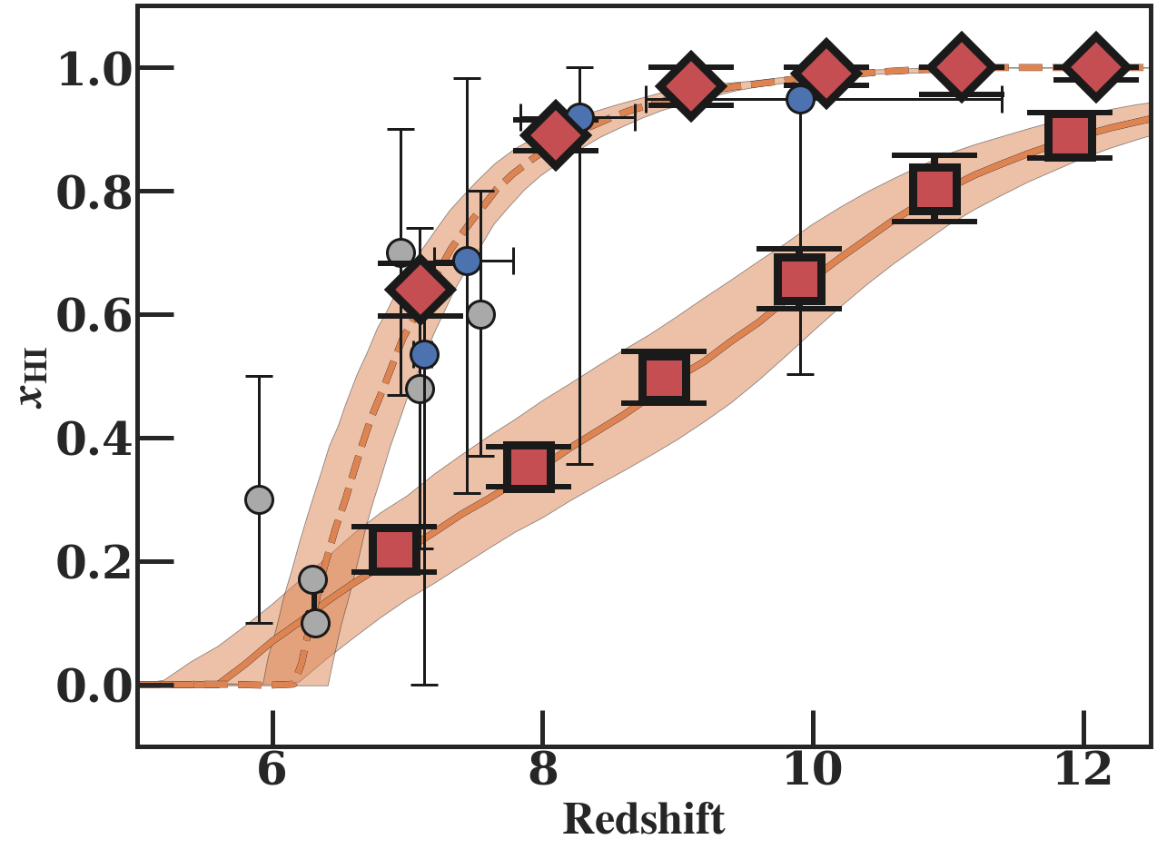
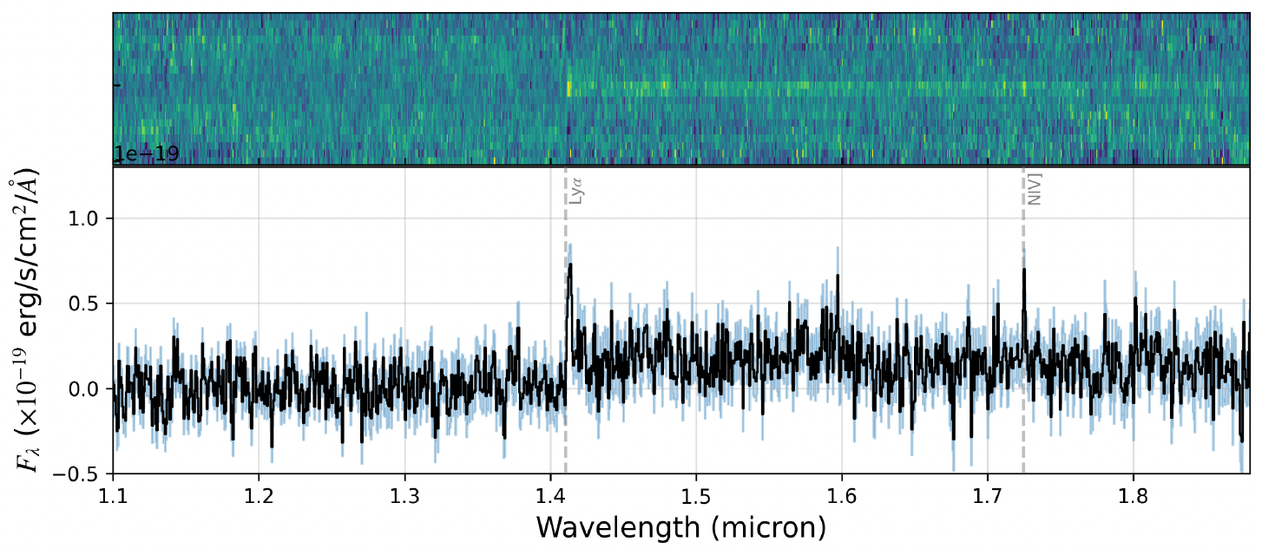
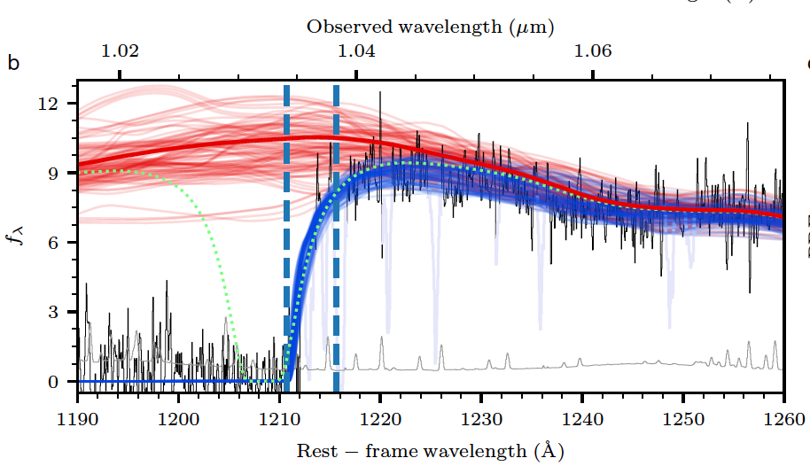
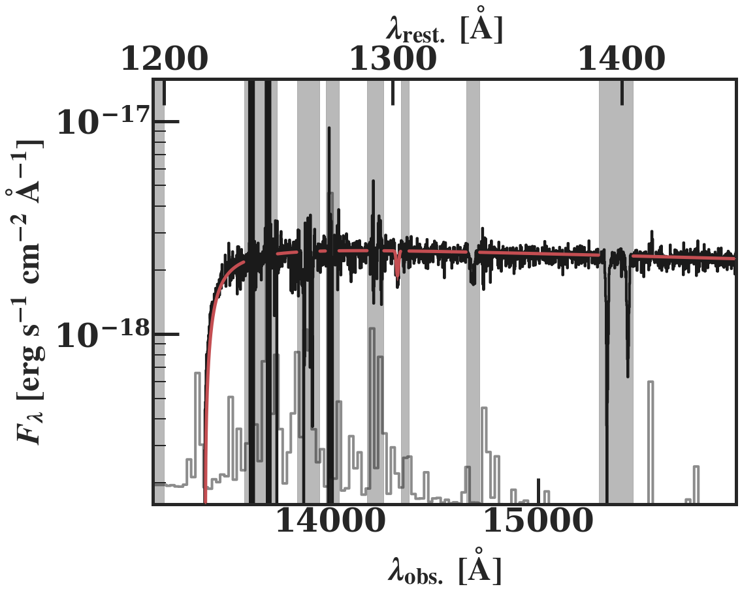
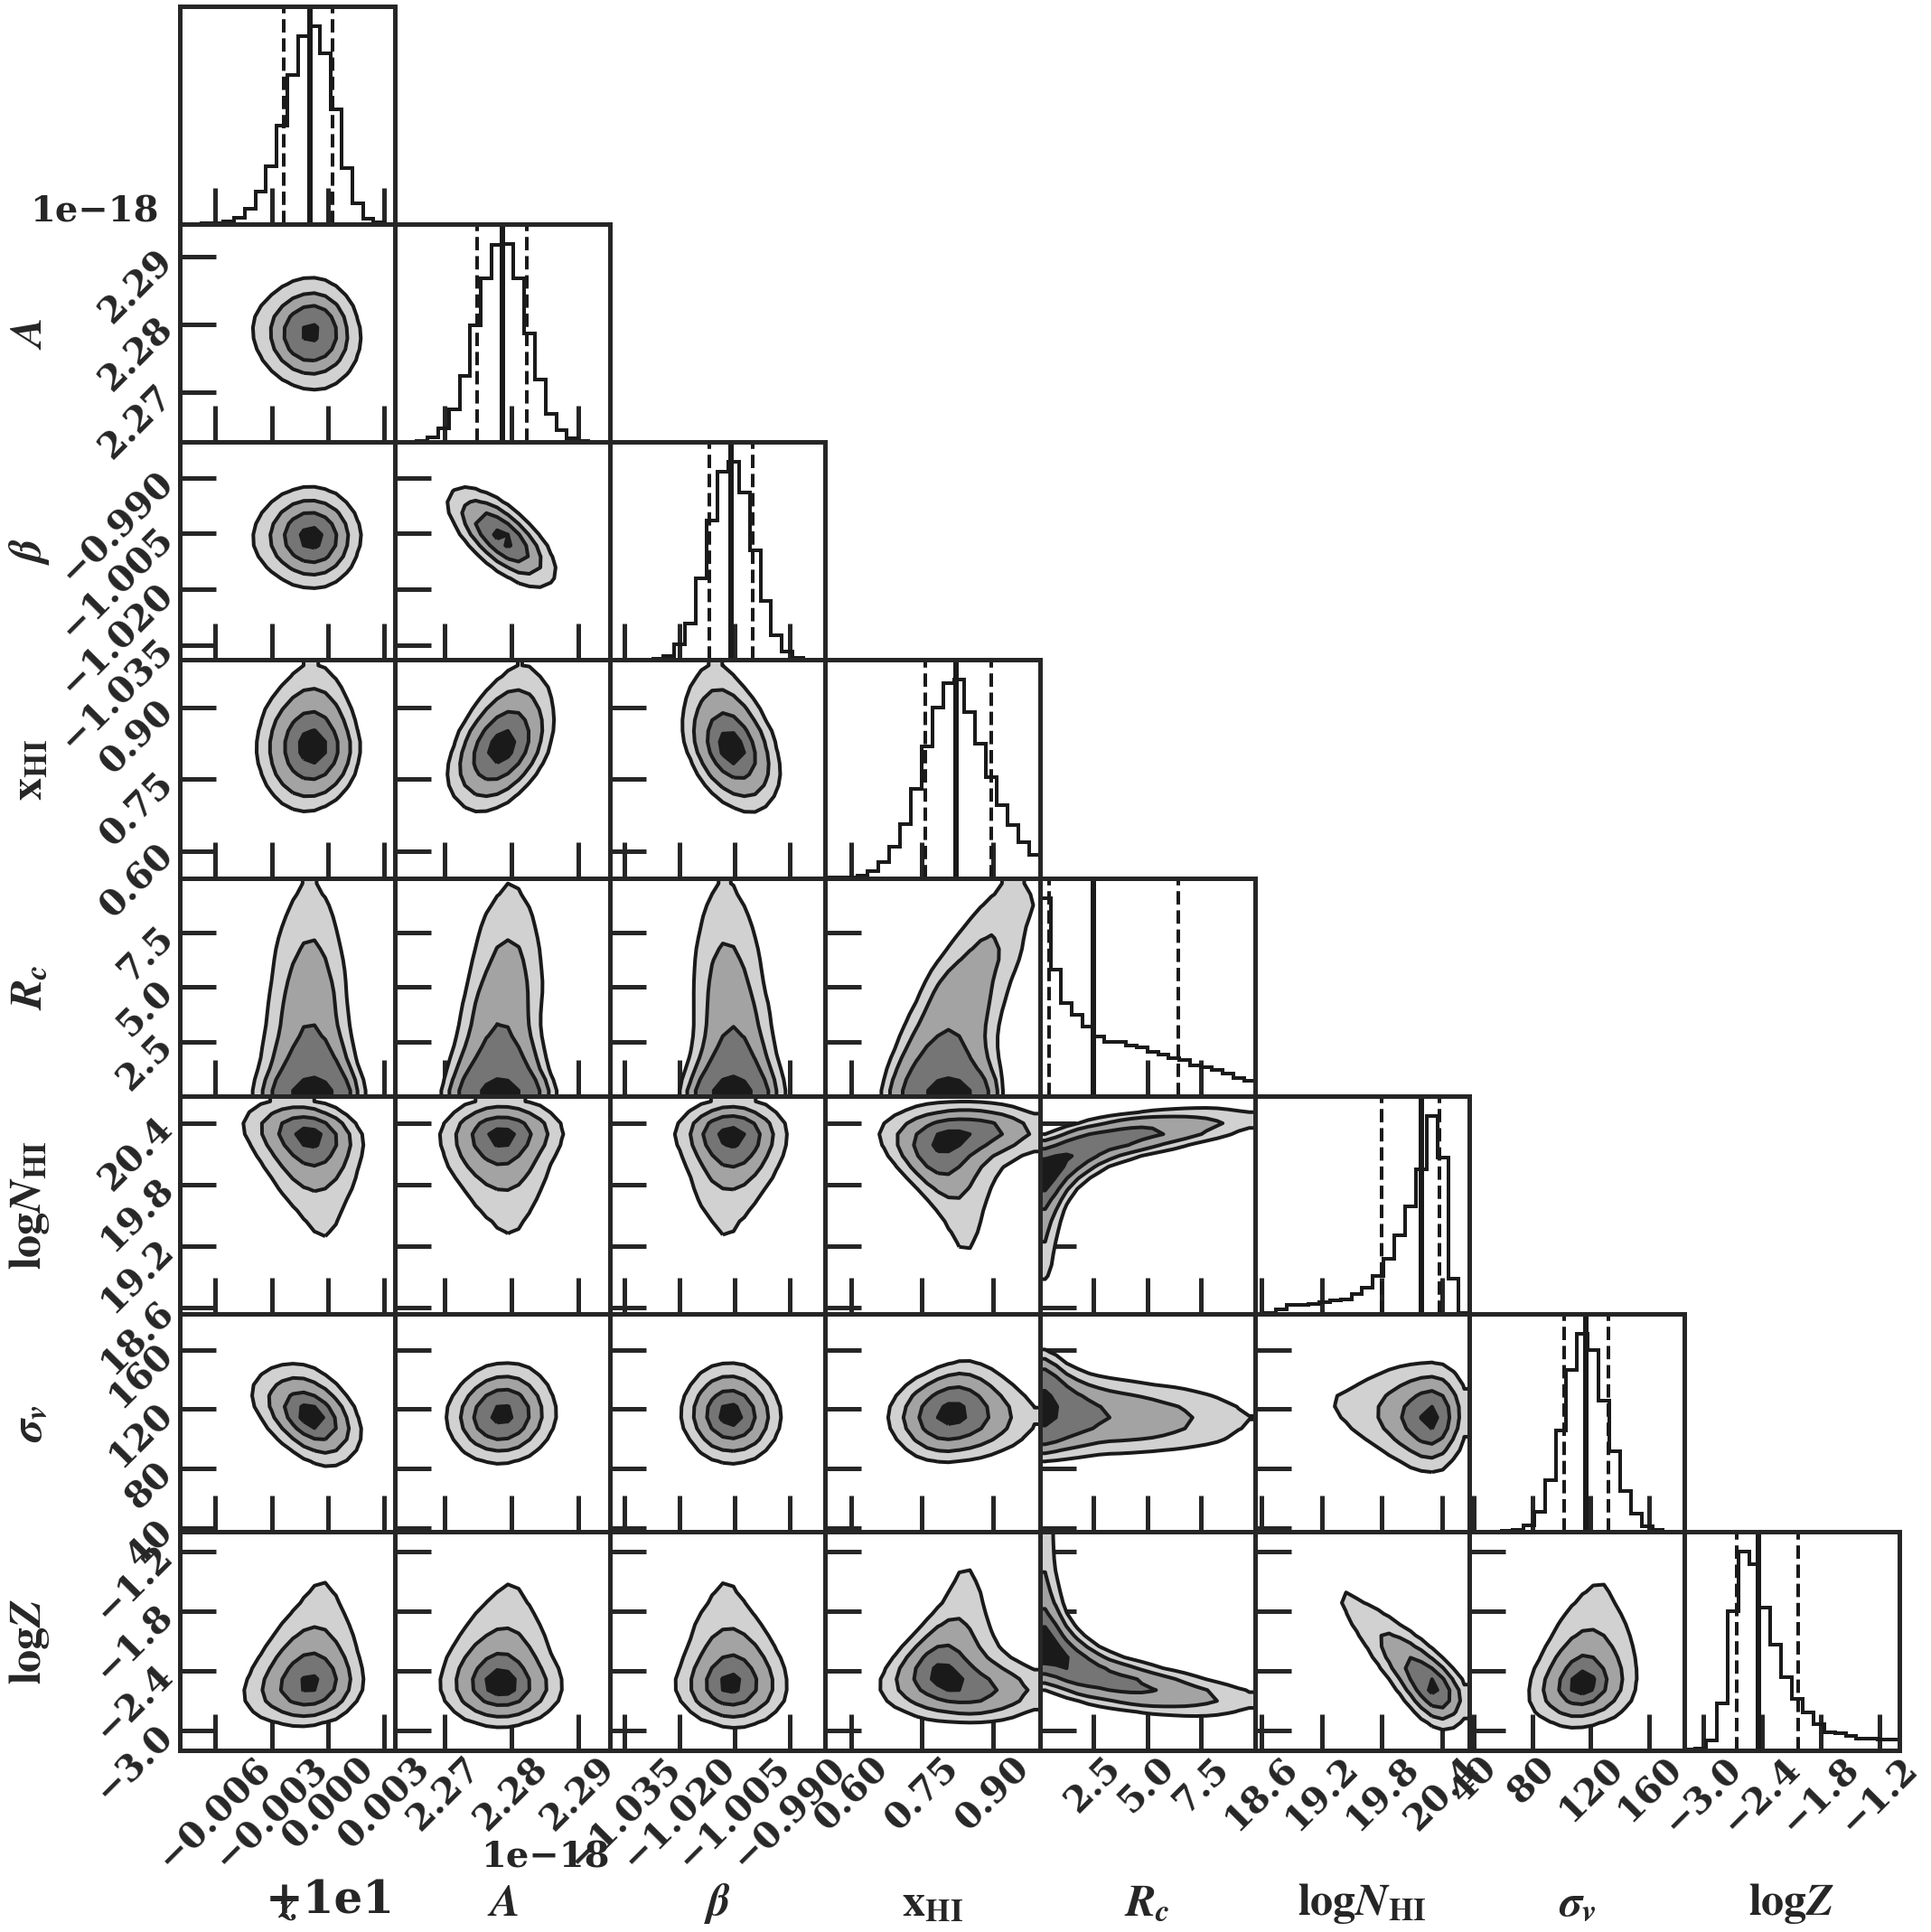
Cosmic Reionization
Brightest galaxy GN-z11, z=10.60
6 hours exposure (JWST)
Late Epoch Reionization
Galaxy
(JWST)
Bunker+23
GRB+
Quasar
？
Neutral Fraction of H
Quasar z=7.5 (8 hours exposure)
Early Epoch Reionization
Banados+17
Simulation (Umeda & Harikane)
2 hours exposure (Subaru)
High-redshift GRBs are
- Enough bright
- Simple spectrum
redshift, x_{HI}, galactic neutral gas,
metallicity, ionization bubble size, etc.
z = 10

Slide 15
Detection Sensitivity
Sensitivity of NIR Telescope
GW170817 @ 200 Mpc
Swift/BAT
Too late
Observation start
検出感度 (erg/cm²/s)
2% of all sky
Discovery
Space
Limiting Magnitude (AB magnitude)
HiZ-GUNDAM
12% of all sky
15
Time Since Transient Discovery (sec)
観測時間スケール (秒)
Time Scale of X-ray Transient (sec)

