Slide 1
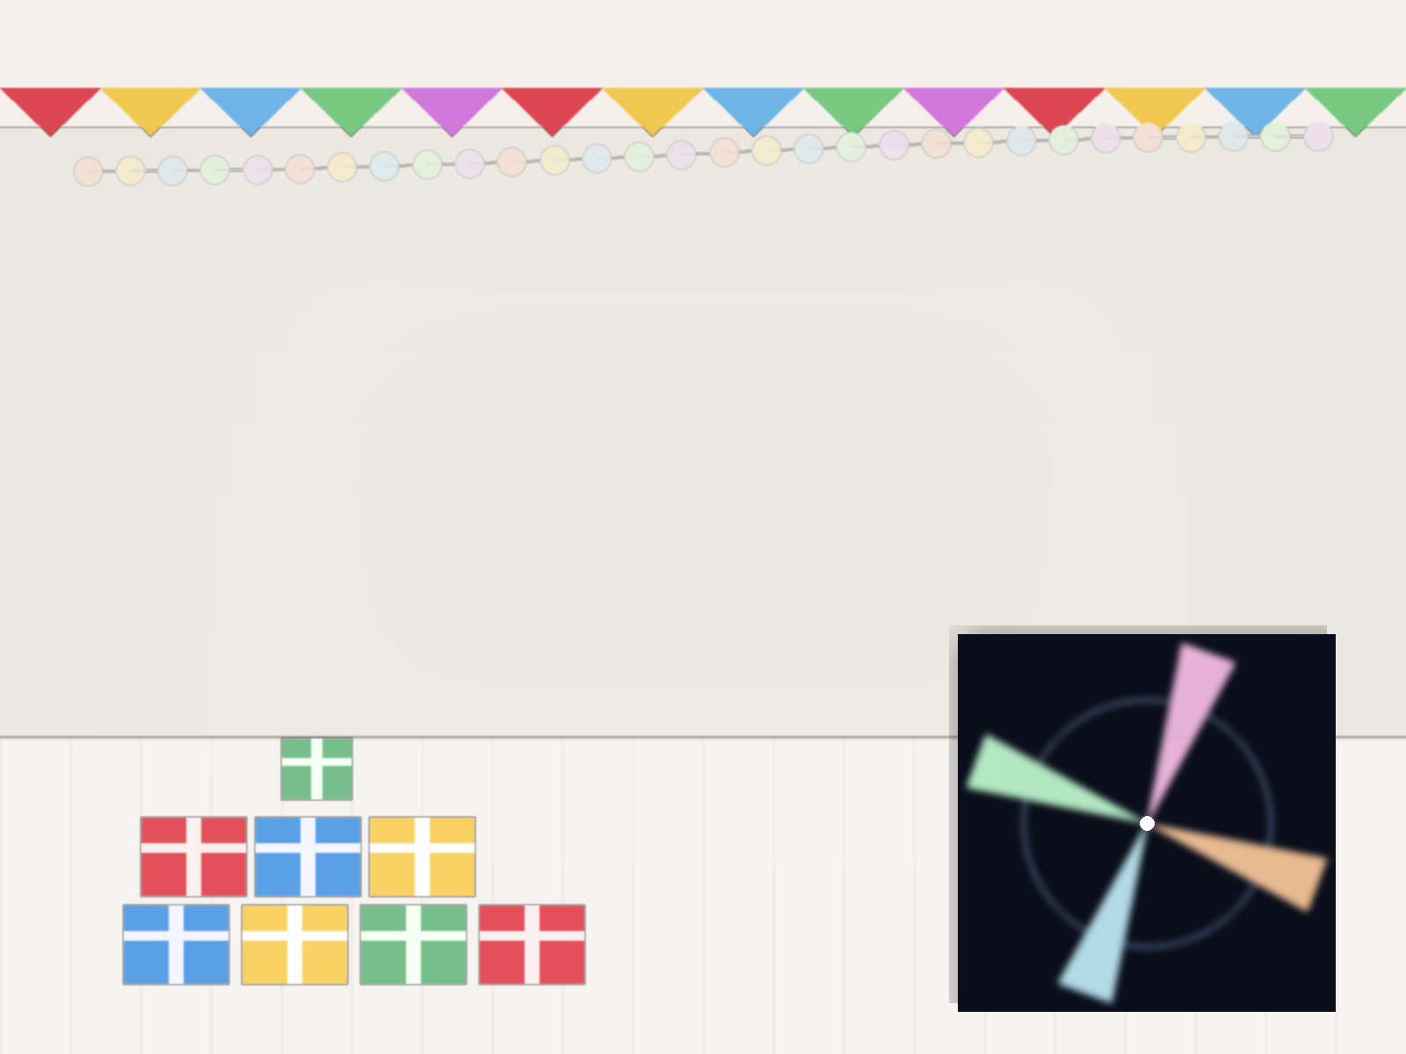
A common four-beam geometry reveals altitude-stratified GeV pulses in canonical young pulsars
Paul K. H. Yeung & Takayuki Saito (ICRR, UTokyo)
Discussed with Dmitry Khangulyan & Ievgen Vovk
Relevant publications:
Yeung+2025,
MNRAS, 541, 2053;
Yeung+2026,
ApJ, 1007, 119

Slide 2
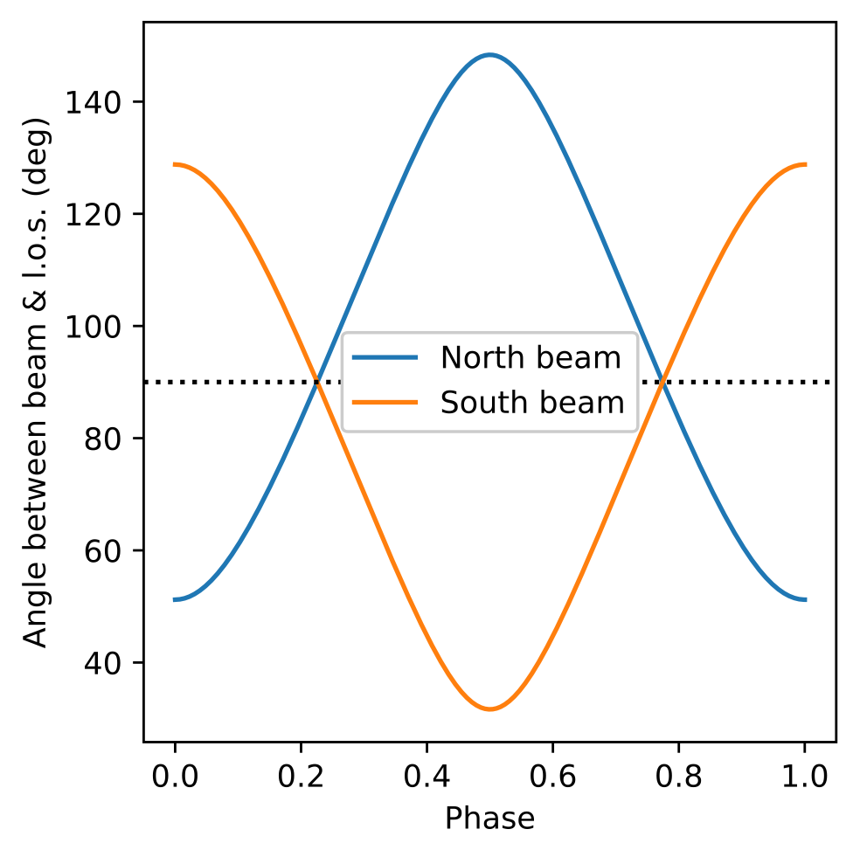

Why is pulsar emission periodic? Observer’s perspective
Pulsar is rotating rapidly
    Equivalently, our line of sight (l.o.s.) is revolving around pulsar
Trajectory of l.o.s. cuts through the beam periodically
The moments of peak detections
A beam’s “real” peak is never observable
Cross section of a pulsar’s beam

Slide 3
Concepts of “motions” for pulsars
Aristotle (Physics):
“Motion is one kind of change – a change in place, quantity, or quality of something that already exists.”
Albert Einstein (Special Relativity):
“Motion is the change of spatial coordinates with time as measured in a given inertial frame.”
In context of pulsars:
  Kinematic Bulk Flow —> Doppler shift
  Pattern-level “Virtual” Corotation —> Pulsation
    Photon-emitting particles are continuously replaced
    in a wave-like manner

Slide 4

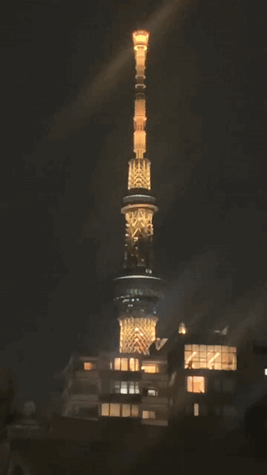
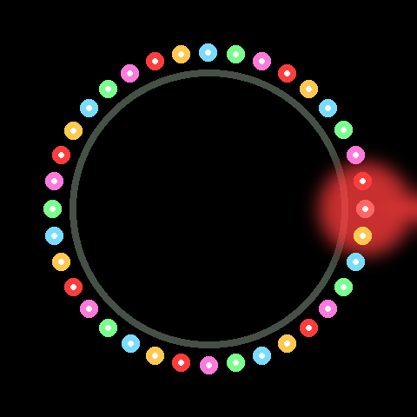
“Virtually Corotating” Emission Site
What appears observationally “corotating”?
✘ Kinematic Bulk flow ❌
✓ Virtual motion of emissivity pattern ✔
✓ Christmas Light Belt ✔
Tokyo SkyTree Tower
✘ A single glowing bulb rotating around a center ❌

Slide 5
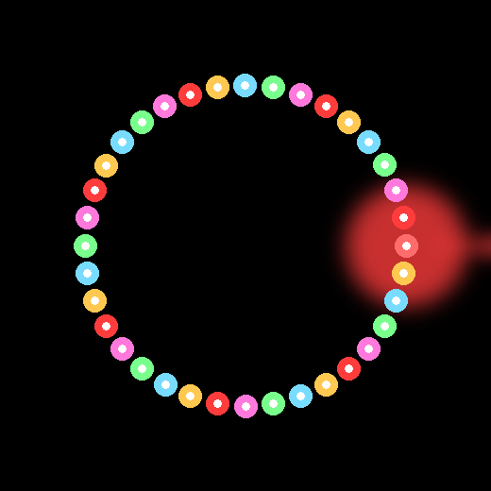
“Kinematic Christmas Light” Analogy of Pulsar Emission Site
The ON bulb is both replacing and kinematically moving.
Only the pattern corotates; the light bulbs (plasma particles) themselves do Not.
Real pulsar emission is more complex:
  Particles also have vertical and radial drifts;
  Each emitting particle radiates once and cools.
✓ Kinematically Rotating Christmas Light Belt ✔

Slide 6
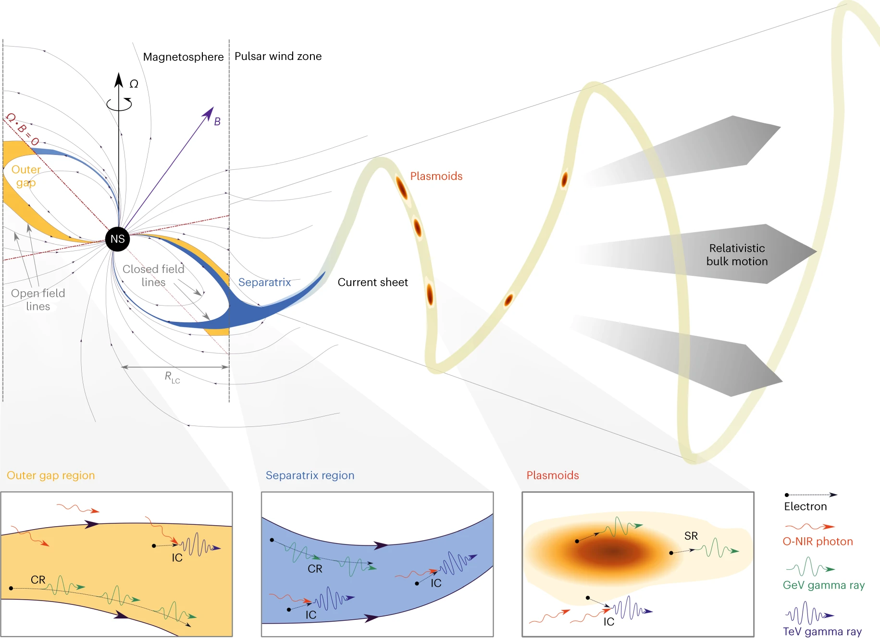
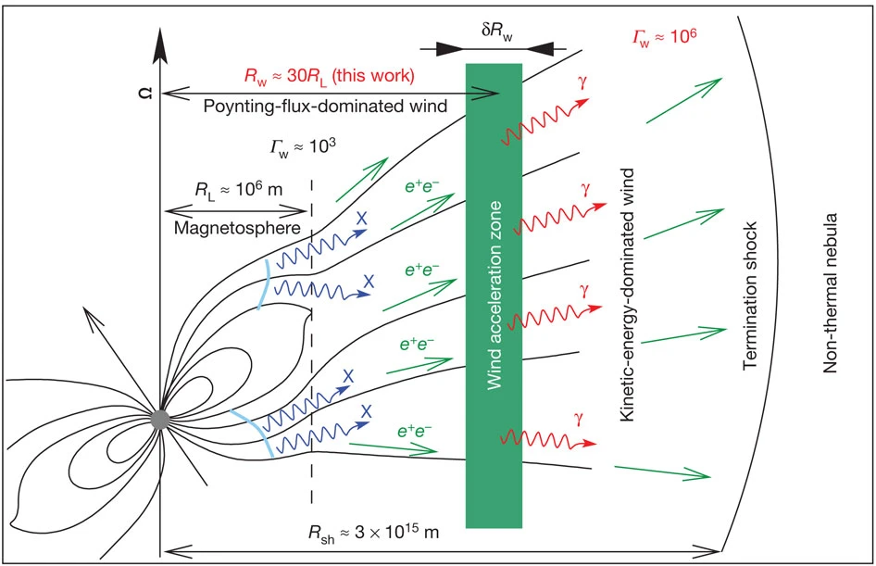
Emission site beyond light cylinder
‘Cold’ Ultrarelativistic Wind Wind Current Sheet
Aharonian et al. (2012, Nature)
H.E.S.S. Collaboration (2023, Nature Astronomy)
No known substance can travel faster than light, but
some ‘virtual’ concepts can ‘virtually’ exceed the speed of light. ✅
pattern speed ≠ bulk speed

Slide 7
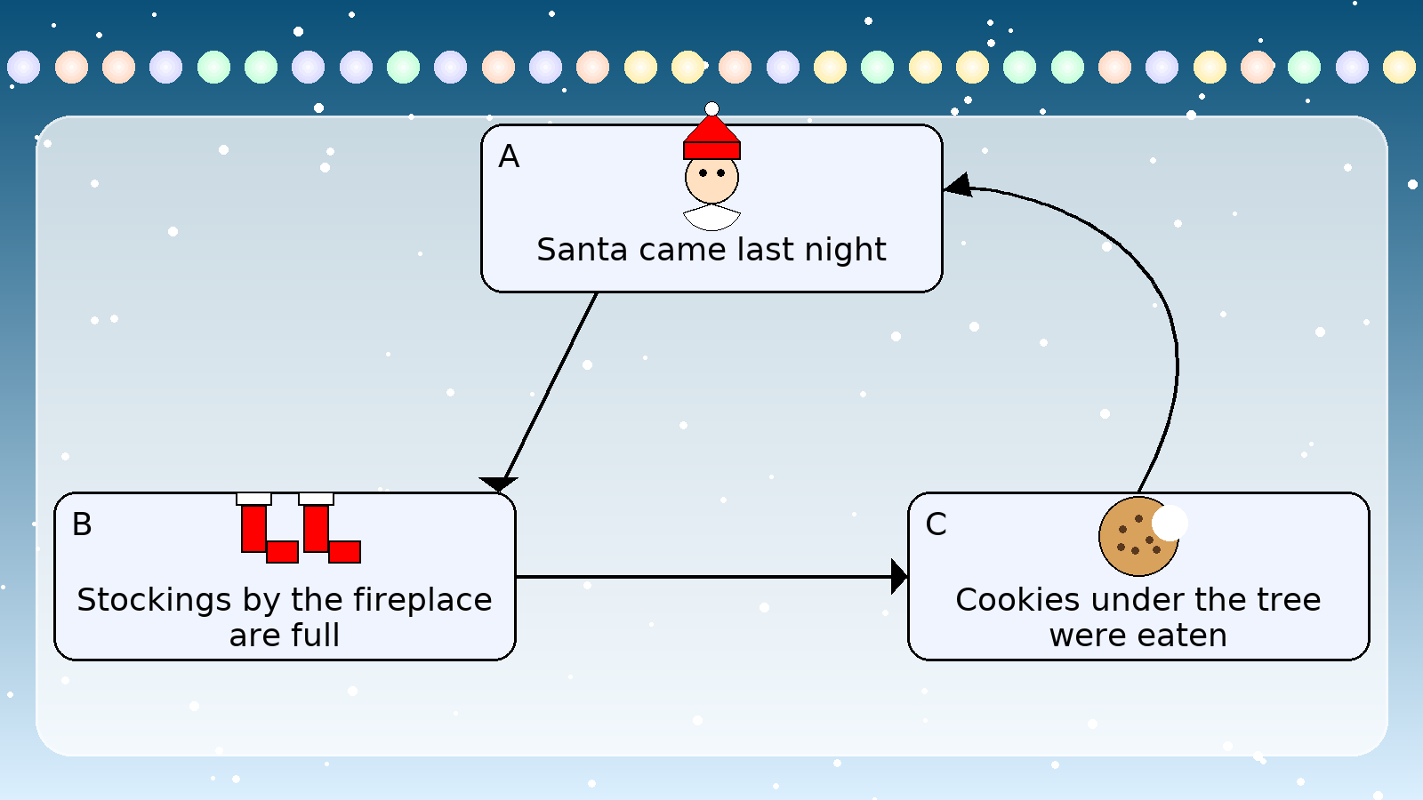
Purpose of mechanism-independent paradigm
✓ Geometry-first + mechanism-later ✔
Complementary strategy to mechanism-specific modelling
An attempt to avoid Circular Reasoning
A → B → C → A
(no independent evidence,
just a circle)

Slide 8
Four elements of our modelling paradigm
Emission Geometry
Light-Travel-Time Delay
Phase-Dependent Doppler Shift
Energy-Dependent Beam Shape
“Four Seasons in One Day”
Reference Frames
Detector frame
Corotating frame — governing viewing angle & light-travel-time delay
Ever-replacing plasma frame (bulk frame) — governing Doppler shift

Slide 9
Advancements of mechanism-independent modelling
v1.0 (YKS2025, MNRAS) | v2.0 (Yeung+2026, ApJ)
Single site, single beam per hemisphere | Double site, double beam per hemisphere | Model complexity↑
(Co-)rotating plasma | Escaping plasma
Vertical(+Radial) extension | Point-like | Model complexity↓ / Data constraints↑
Energy-dependent geometry | Uniform geometry across energies
Structured count-rate function | Economical beam-shape prescription
Simultaneously fit 3 phaseograms | Simultaneously fit 4 phaseograms

Slide 10
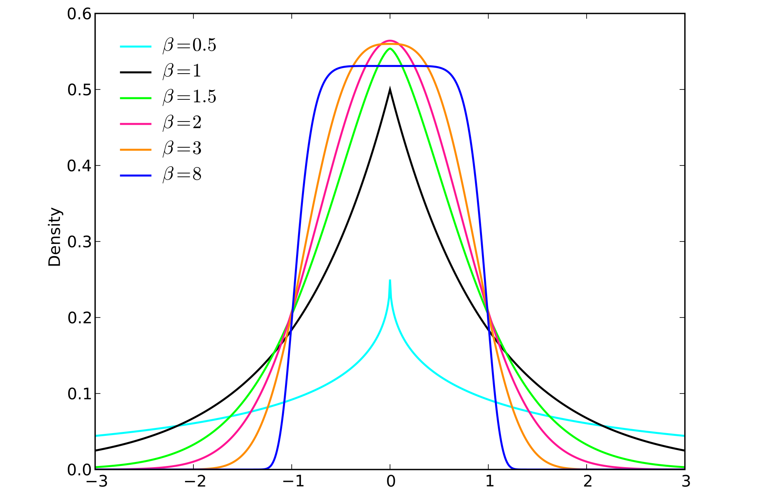
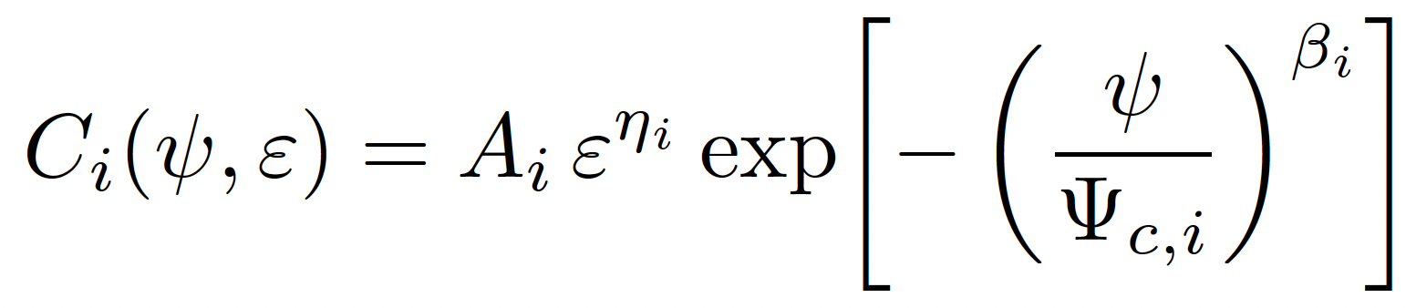
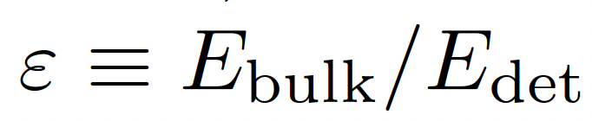
Mechanism-Independent Model v2.0
Assume double site and double beams per hemisphere
(i.e. Beam1&3 from north; Beam2&4 from south)
Parametrise the direction of particles’ drift motion as well, allowing escaping plasma.
For each beam shape, assume a simpler function of Generalised Normal Distribution (GND). Assign amplitude a power-law energy-dependence, while assuming width & sharpness to be “locally uniform”.
 | Emission site location |  |  | Particles’ drift motion |  |  | Beam axis
Beam1&2 | d | θB | t0 | γLor1 | θM | θN | θC | θQ
Beam3&4 | D | φB | T0 | γLor3 | φM | φN | φC | φQ
 | Energy-dependent beam shape
Beam1&2 | A1 | η1 | Ψc,1 | β1
Beam3&4 | A3 | η3 | Ψc,3 | β3
GND
(From Wikipedia)
Amplitude PL index (E-dep) width sharpness

Slide 11
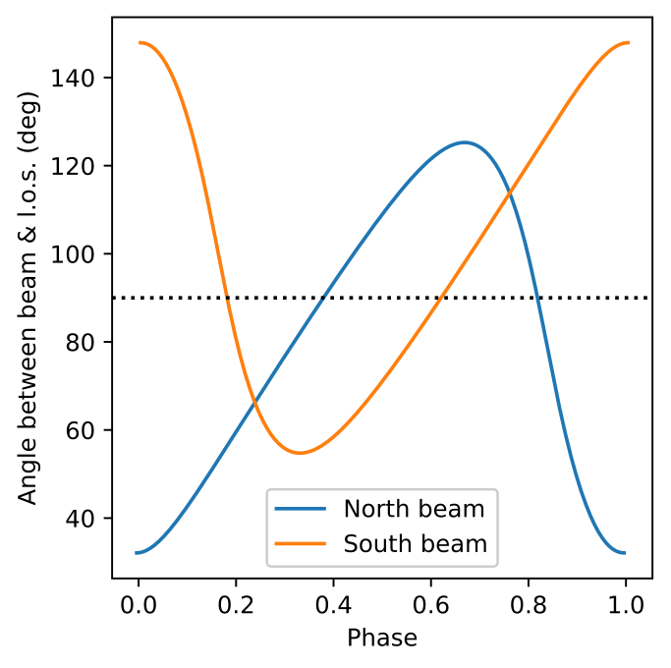
Light-Travel-Time Delay
Emission site is at a separation (d) from pulsar center
Times taken for North & South beams to reach
us are different
Photons’ travel times vary from phase to phase
Time in detector frame (tdet) changes
non-linearly with time in pulsar frame (tpsr)
Time Delay partially accounts for:
    P2−P1 phase intervals < 0.5 ;
    Leading Wing—Trailing Wing
    (LW—TW) Asymmetry
Absolute relation:
P2 phase − P1 phase =
0.5 − d*cos(θB)*cos(ΘA)/RLC

Slide 12

Phase-Dependent Doppler Shift
Emission site moves towards us and away from us periodically
Observed beam is redshifted & blueshifted alternately
The level of redshift/blueshift varies from phase to phase
Photons with the same detected energy (Edet) at different phases correspond to different pre-shift energies (Epsr)
Doppler Shift further modulates P2−P1 phase intervals & LW—TW Asymmetry
“Four Seasons in One Day”

Slide 13
Data Samples & Scope
3 young pulsars: Crab, Vela & Dragonfly (<20 kyr)
    Age trends:
    Very young Crab vs. Adolescent Vela & Dragonfly
Below 3 GeV —> Suppress inverse-Compton
Divide 60 MeV—3 GeV into 4 segments:
60—150 MeV, 0.15—0.36 GeV, 0.36-0.9 GeV & 0.9—3 GeV
Magnetosphere vs. Outflow
Systematic errors

Slide 14
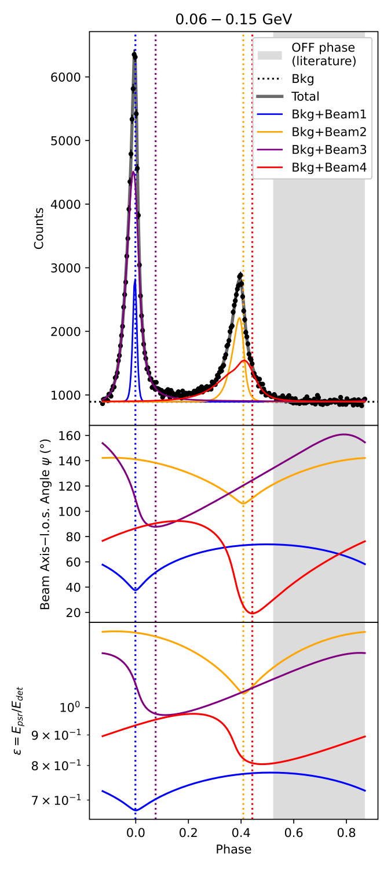
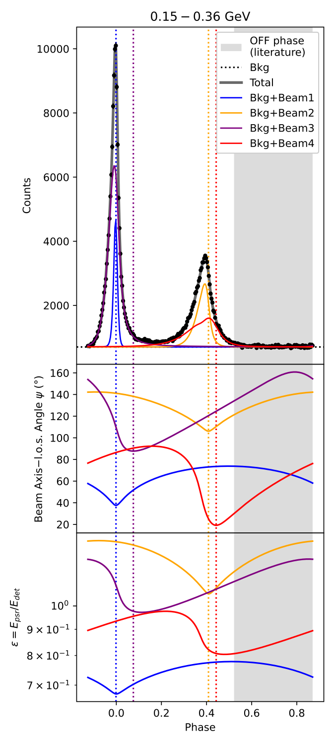
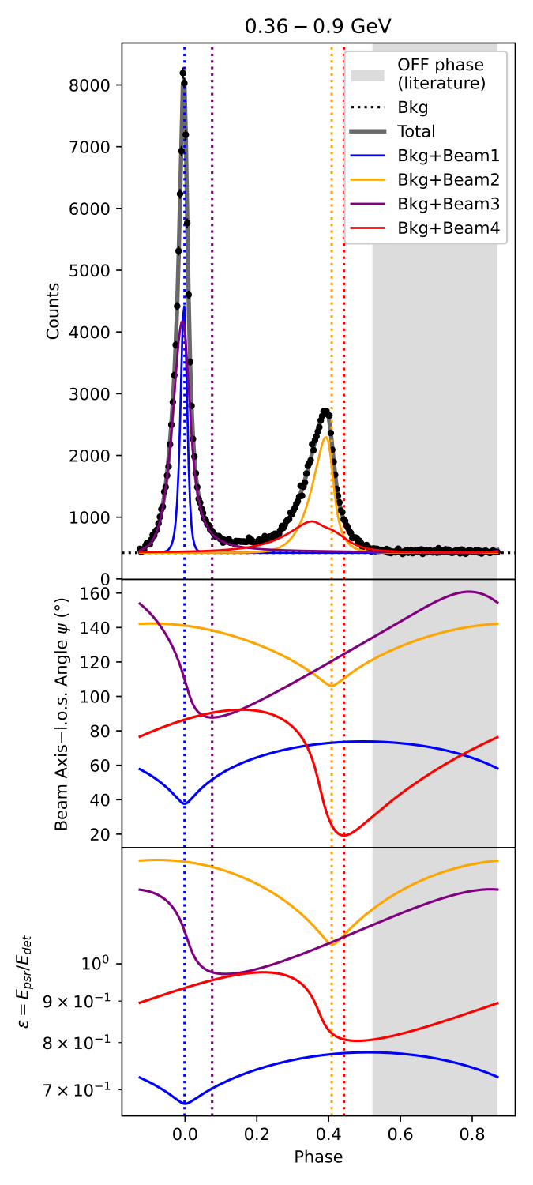
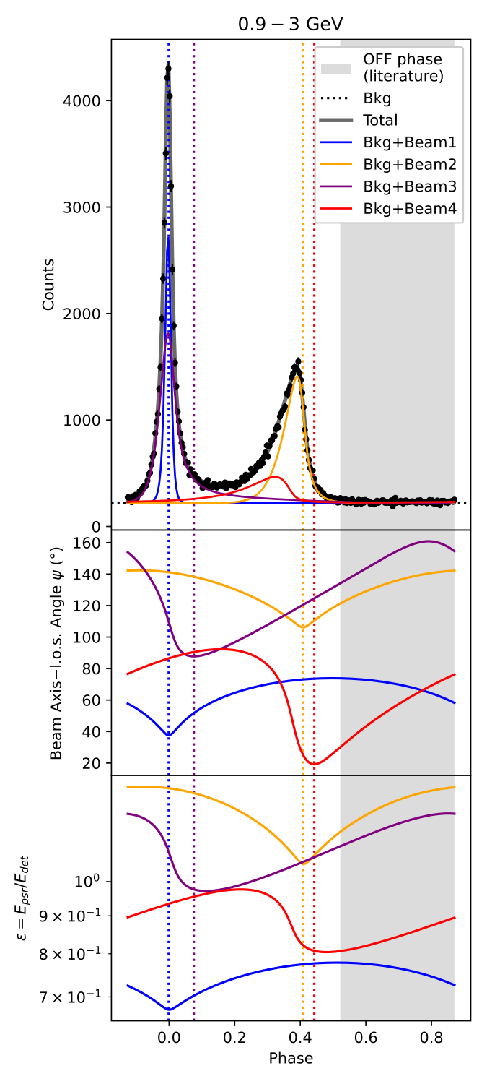
Crab
Spin axis—l.o.s. angle (ΘA) = 55.7°
PWN Torus: 61°–63° (Ng & Romani 2004)
Beam3 & Beam4 are “modulation” components,
accounting for bridges, overlapping with sharp primary peaks.
Credits to Jodrell Bank for monthly ephemerides

Slide 15
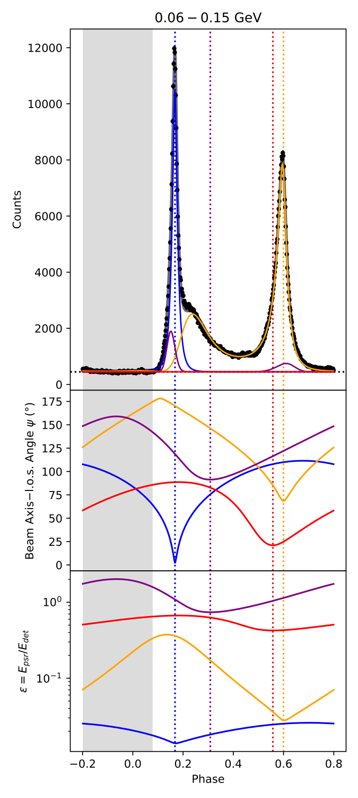
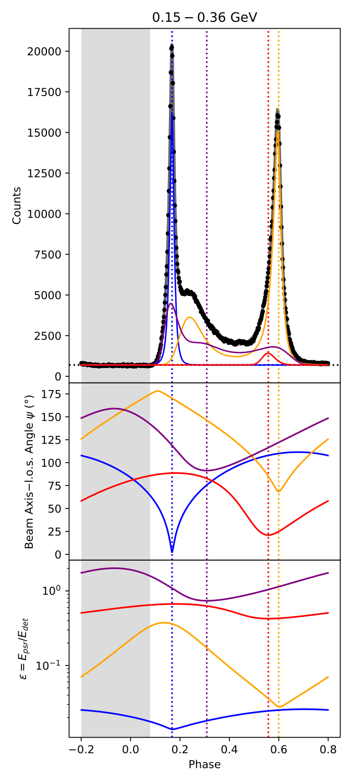
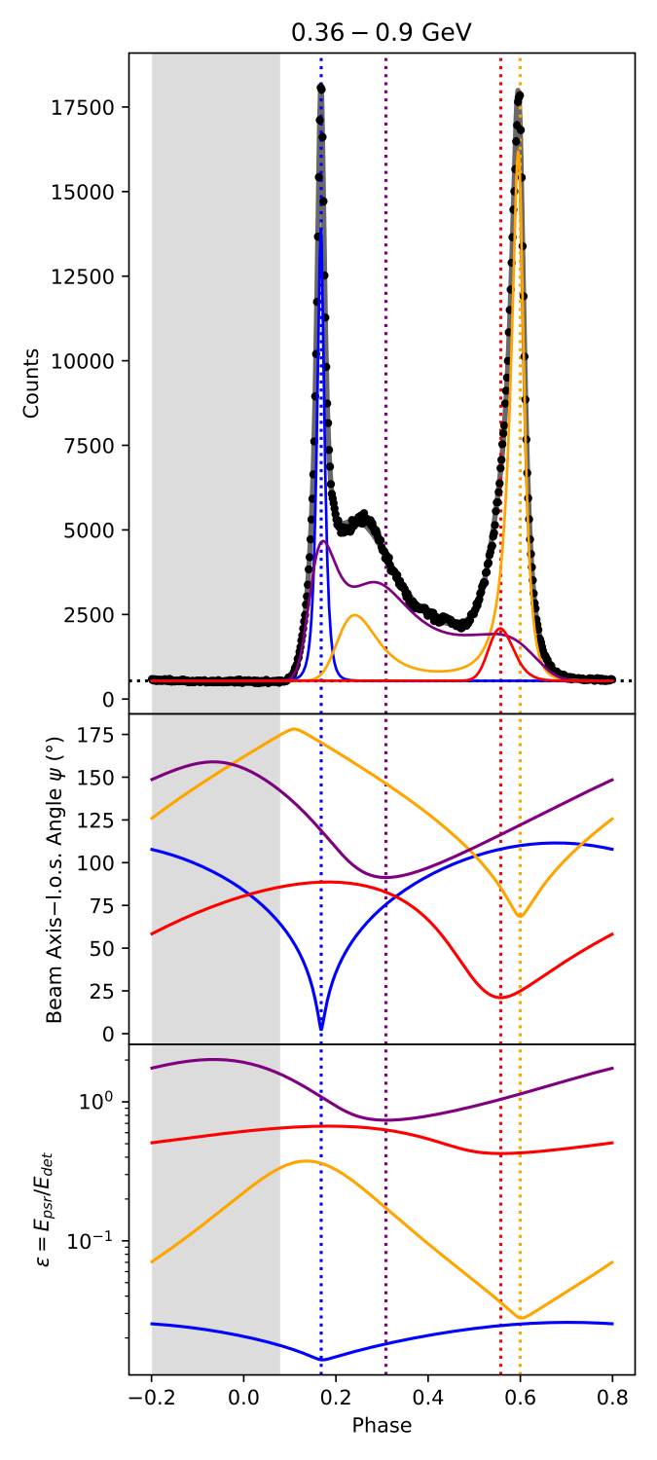
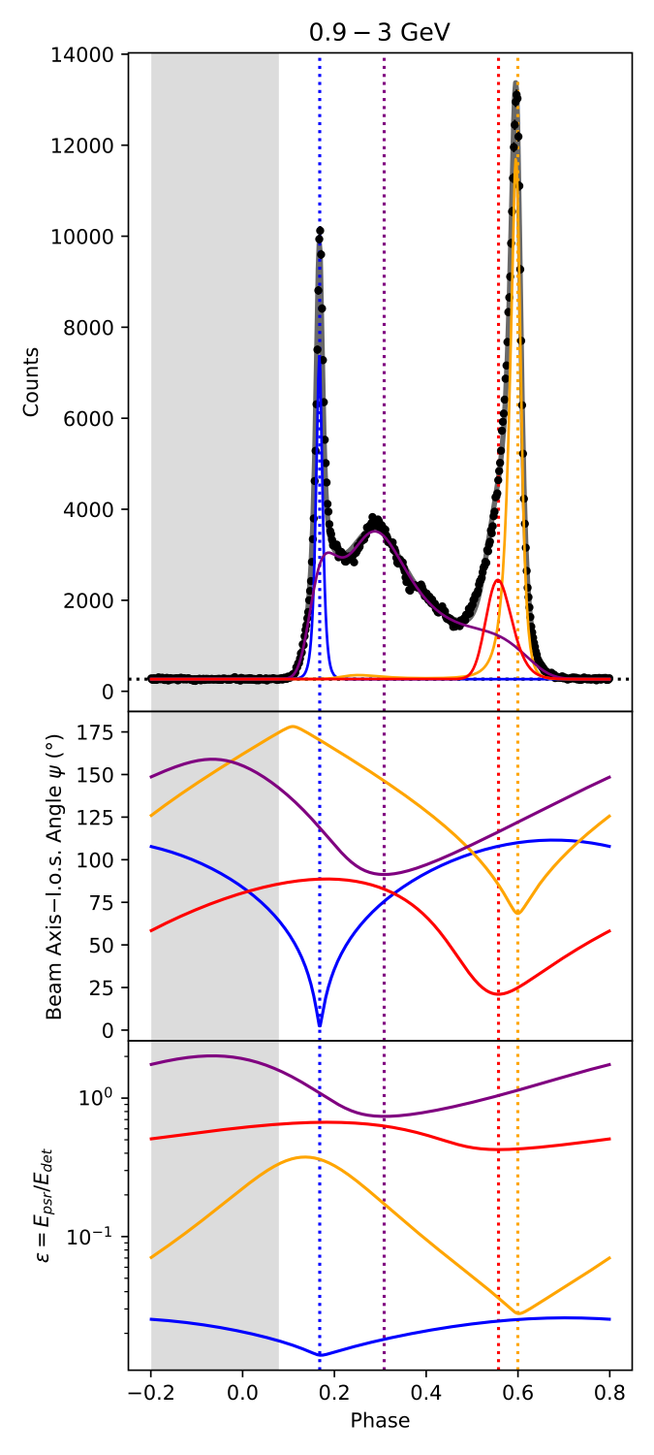
Vela
Spin axis—l.o.s. angle (ΘA) = 54.9°
PWN Torus: 63°–64° (Ng & Romani 2004)
Beam3 & Beam4 are “ripple” components,
accounting for bridges, overlapping with sharp primary peaks.
Credits to Matthew Kerr for an optimised ephemeris

Slide 16
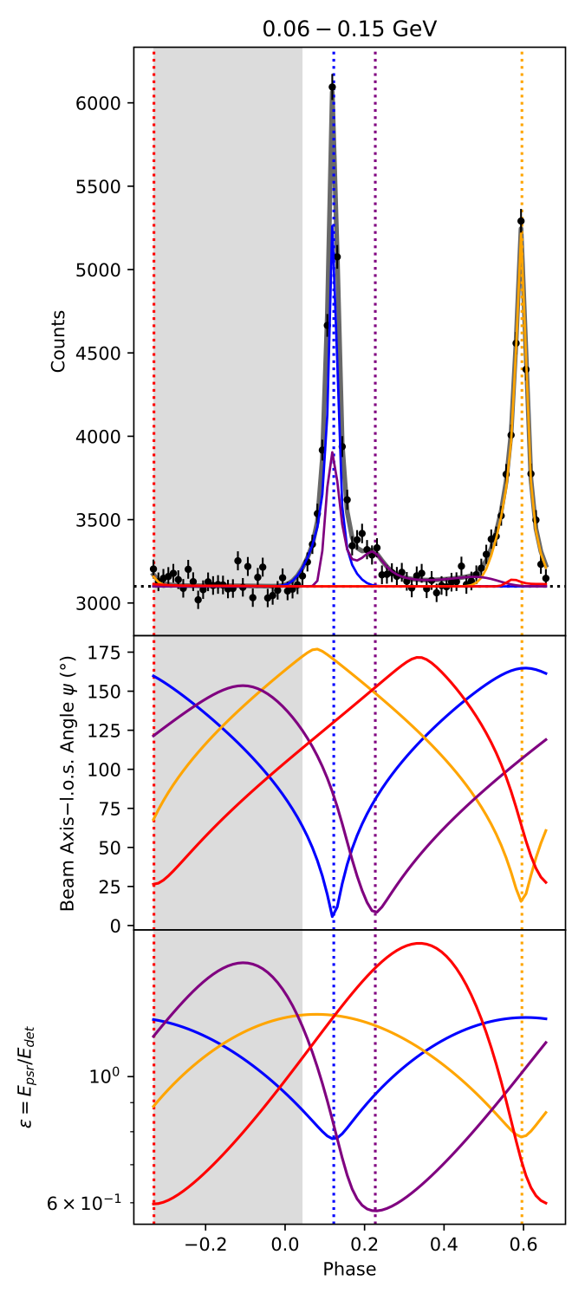
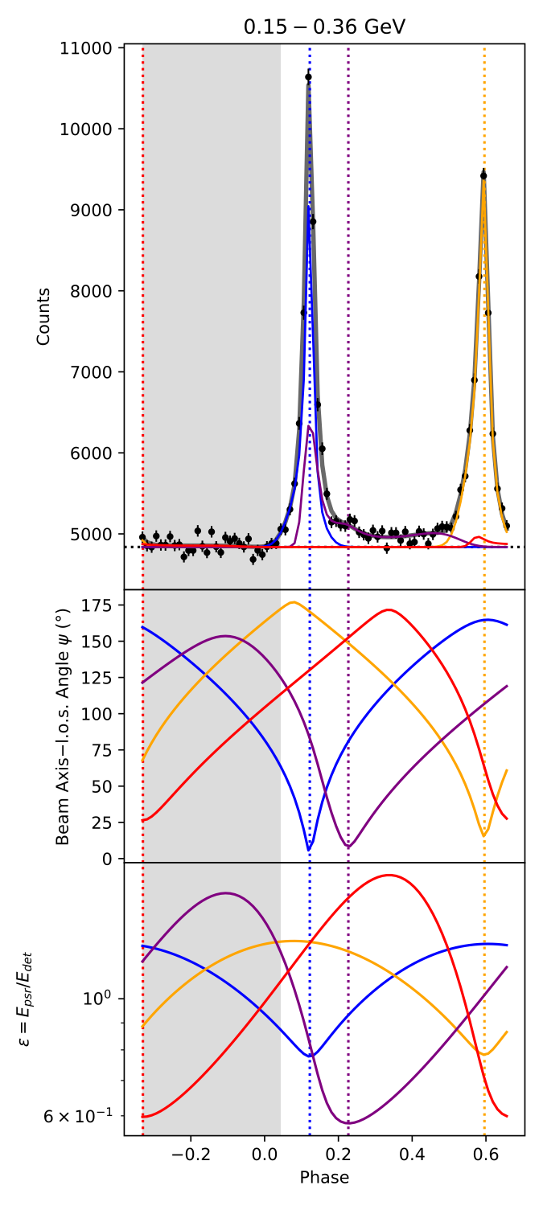
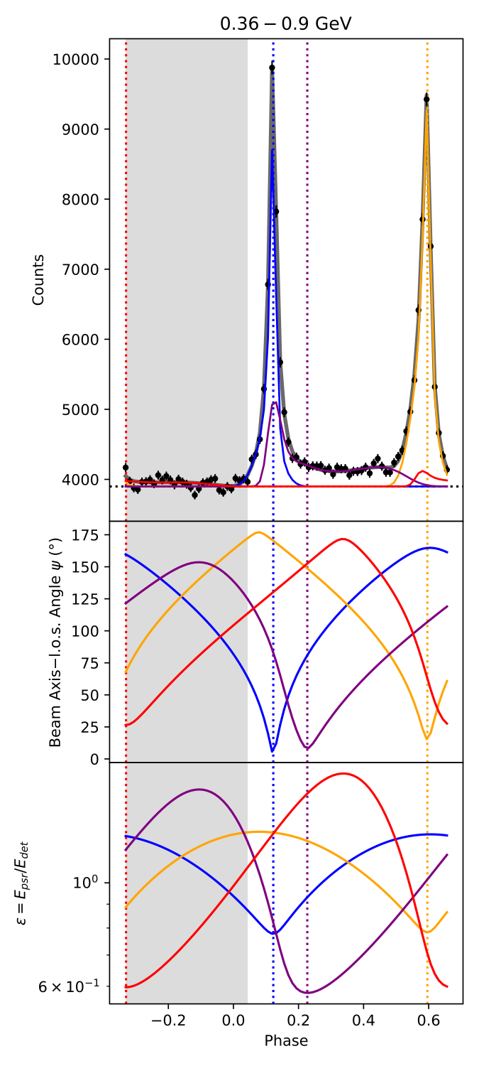

Dragonfly
Spin axis—l.o.s. angle (ΘA) = 80.9°
PWN Torus: 85°—88° (Van Etten et al. 2008; Jin et al. 2023)
Beam3 & Beam4 are “ripple” components,
accounting for bridges, overlapping with sharp primary peaks.
Credits to Fermi 3PC for an event list

Slide 17
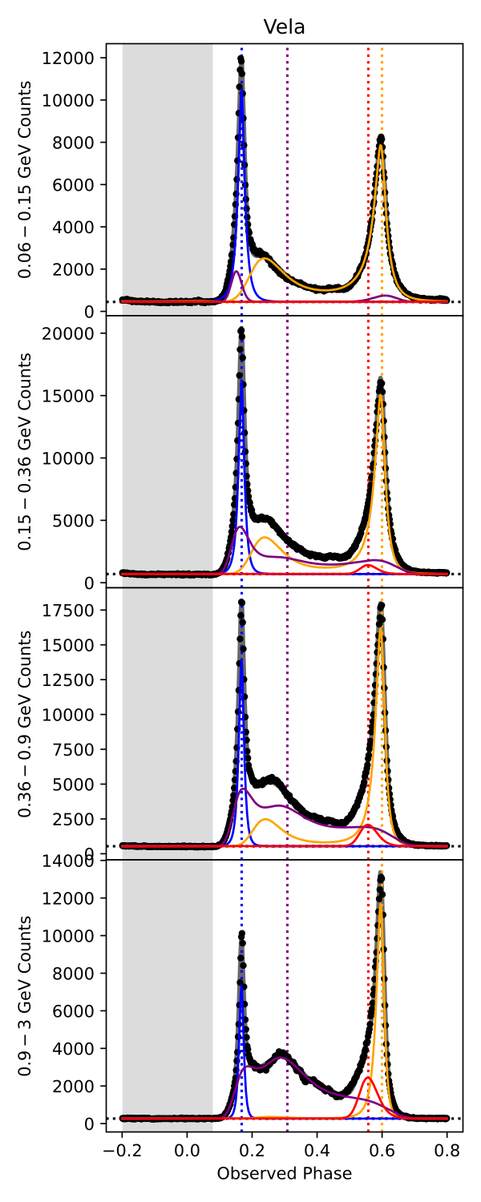
Magic of Doppler Boost
Away from the beam axis, the count rate generally drops.
This angle-dependent decrement could be countered/overcome by energy-dependent increment.
The interplay between energy-dependent beam shape & Doppler Boost could lead to an extensive tail or even sub-spikes of a pulse component.
This effect is more conspicuous for Beams3—4.

Slide 18
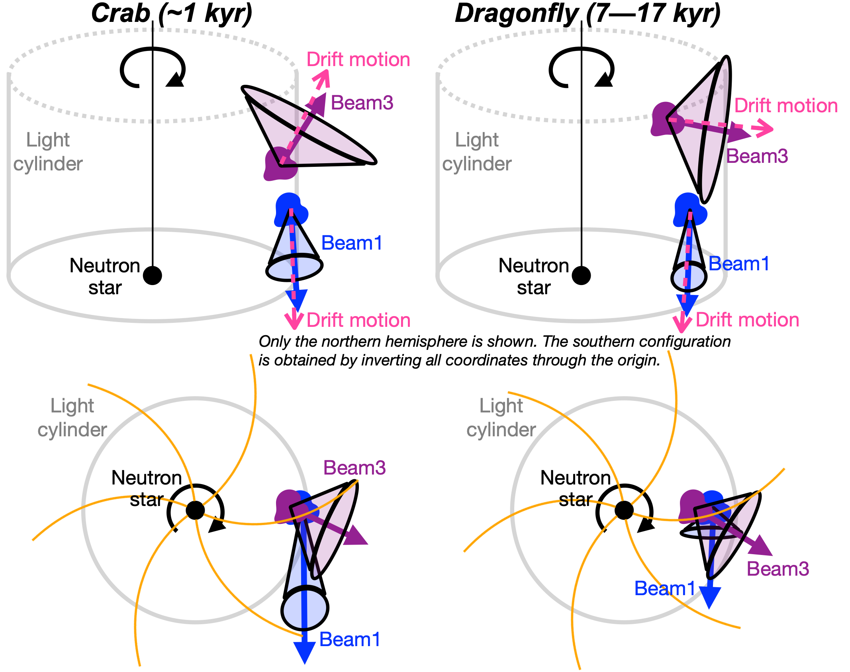
Schematic Diagrams

Slide 19
Definitions of Parameters
Spin axis—l.o.s. |  | ΘA | The angle between our l.o.s. and the pulsar’s rotational axis.
Beam1 & Beam2 | Emission site location | d*sin(θB) | The average radial separation of the emission site from the pulsar centre.
 |  | d*cos(θB) | The average vertical separation of the emission site from the pulsar centre.
 |  | t0 | The phase (in the detector frame) corresponding to the moment when the Beam1’s emission site is at its closest approach to our l.o.s.
 | Bulk motion (related to Doppler Shift) | γLor1 | The average Lorentz factor of the collective motion of the emission site.
 |  | θM | The bulk velocity vector’s zenith angle measured from the rotational axis.
 |  | θN | The azimuthal angle by which the bulk velocity vector is ahead of the emission site.
 | Beam axis | θC | The beam axis’s zenith angle measured from the rotational axis.
 |  | θQ | The azimuthal angle by which the beam axis is ahead of the emission site.
Beam3 & Beam4 | Emission site location | D*sin(φB) | The average radial separation of the emission site from the pulsar centre.
 |  | D*cos(φB) | The average vertical separation of the emission site from the pulsar centre.
 |  | T0 | The phase (in the detector frame) corresponding to the moment when the Beam3’s emission site is at its closest approach to our l.o.s.
 | Bulk motion (related to Doppler Shift) | γLor3 | The average Lorentz factor of the collective motion of the emission site.
 |  | φM | The bulk velocity vector’s zenith angle measured from the rotational axis.
 |  | φN | The azimuthal angle by which the bulk velocity vector is ahead of the emission site.
 | Beam axis | φC | The beam axis’s zenith angle measured from the rotational axis.
 |  | φQ | The azimuthal angle by which the beam axis is ahead of the emission site.
Clarifications: Magnetic poles are Not parametrised. Rotational axis = Zenith.

Slide 20
Magnetosphere (Beams 1–2) & Age Trends
Beams 1–2 originate radially close to the light-cylinder wall, suggesting emission from the outermost magnetospheric zones.
θN ≃ 80°−100° ==> Bulk motions remain nearly tangential and strongly tied to quasi-rigidly co-rotating field-line bundles near the last closed field lines.
θM declines with age ==> Flows roughly follow field lines whose tangents in older systems progressively align with the equatorial plane.

Slide 21
Outflow (Beams 3–4) & Age Trends
Beams 3–4 arise at smaller cylindrical radii but higher vertical altitudes, implying a rotation-decoupled outflow.
The vertical migration of Beams 3–4 traces the weakening magnetic confinement with age:
  Very young Crab’s high magnetization and strong field-tension keep the outflow zones still entangled with the outer magnetosphere;
  Adolescent Vela and Dragonfly (with reduced magnetisation & reduced field-tension) allow vertical inflation of the emission zone and and clearer outflow-dominated geometry.
Two sites at one hemisphere are nearly co-longitudinal: |Δφsite| ≲ 12°.

Slide 22
Toroidal Magnetic Field
Hoop stress of the toroidal magnetic field naturally narrows high-latitude outflows toward the spin axis, giving smaller radial separations at higher altitudes.
Two beam axes at one hemisphere are azimuthally (i.e. longitudinally) separated by Δφbeam ≃ 40°–65°.
  Outflow-transition layer is swept back by plasma inertia and a growing toroidal field component.

Slide 23
Mildly Relativistic & Highly Relativistic Bulk Flow
Fitted γLor should be regarded as an effective Lorentz factor along the beam direction.
In general, the pulse-emitting plasma is mildly relativistic
(1.03 ≲ γLor ≲ 1.5) for all three pulsars.
  ==> Pulsed emissions are likely associated with magnetosphere & outflow-transition layer.
  Relatively large bulk Lorentz factor (γLor > 10) is inferred for
  primary pair in Vela
  ==> Consistent with particularly fast flows in the outer magnetosphere
  Coincidently, primary site of Vela is around the edge of the light cylinder (d*sinθB ≃ 1.0 RLC)
  True flow in the transition layer may well contain ultra-relativistic components, but turbulence, pitch-angle spreads and the extended current-sheet geometry can dilute the net beaming towards the observer

Slide 24
Beam–Motion Alignment
Angular separation between a beam axis and a bulk flow direction are computed using the scalar product formula.
Observed γ-ray beams trace bulk flows, rather than being strongly smeared by large pitch angles or long propagation distances.
Along beam axis: Intrinsically brightest emission pattern.
Along bulk-flow direction: Maximal Doppler boosting.
 | Crab | Vela | Dragonfly
Δθ (°) | 3.9 | 23.9 | 1.0
Δϕ (°) | 10.3 | 2.6 | 2.1

Slide 25
Speculations on magnetic-field configuration and radiation mechanisms
Beams 1–2 are rooted near the last closed field lines and following extended trajectories that graze the light-cylinder boundary
==> Compatible with curvature radiation
(e.g. outer gap/slot gap)
Beams 3–4 emerge at larger |z| in regions where the magnetic field is predominantly toroidal and the flow has entered the wind zone
==> Suited to synchrotron radiation
(e.g. wind current sheet)
Inverse-Compton is very minor below 3 GeV

Slide 26
Clarifications on assumptions
North–south symmetry: local, not global (r ≲ RLC)
    PWN/SNR asymmetries occur on >> RLC scales
    → Not contradicting our near-source symmetry
    Circular beam “kernel” in the bulk frame (minimal assumption)
      Enables stable component decomposition;
      Misaligned beam axes + Time delay + Doppler shift
      → effective hemispheric asymmetry in the observer frame

Slide 27
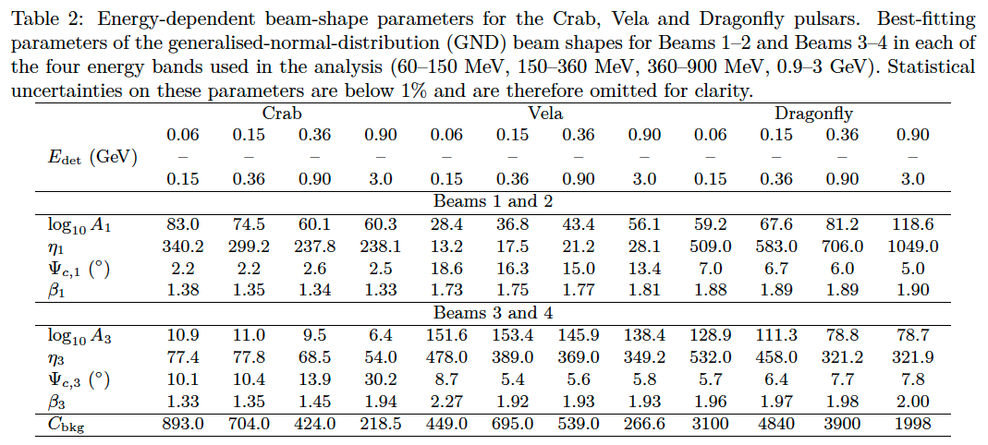
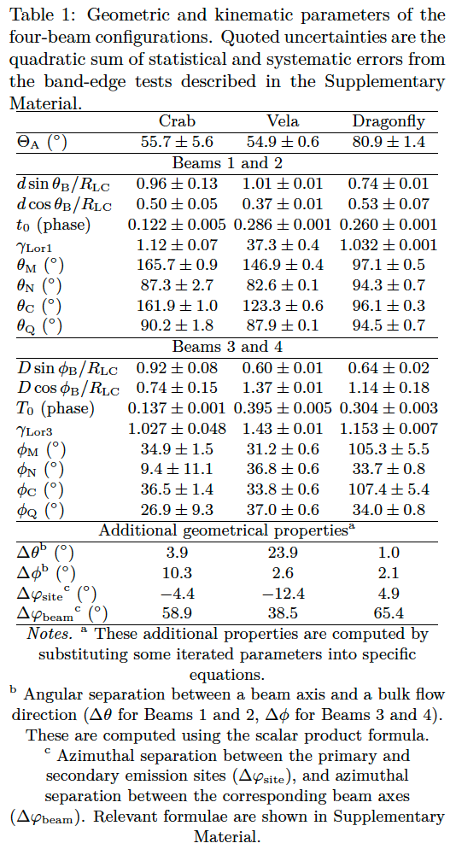
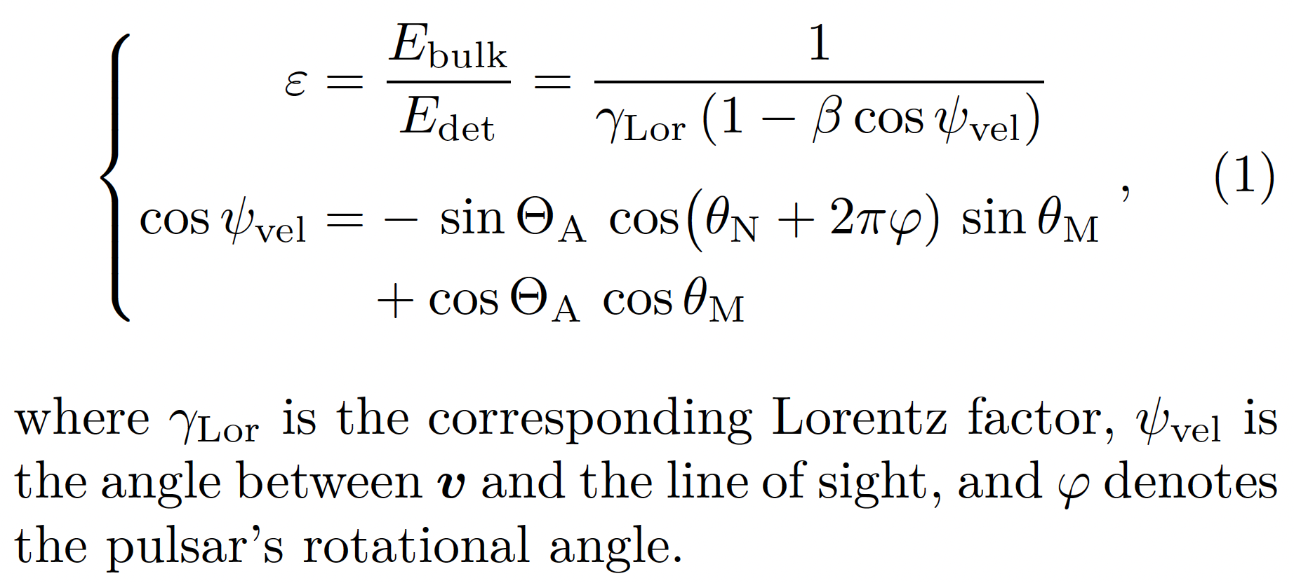
Additional Information (Yeung+2026, ApJ)
Doppler formula

Slide 28

Summary & Outlook
Our geometry-first paradigm:
  organises Crab, Vela and Dragonfly within a common four-beam framework;
  makes testable predictions for other young pulsars / future MeV–PeV observations;
  remains mechanism-independent:
  different models can be confronted within
  the same geometric + Doppler framework.
  Outlook:
  Four-beam geometry is judged not by how elegant it looks, but by how well it predicts and organises γ-ray data.
Mechanism B
Mechanism C
Mechanism A

Slide 29

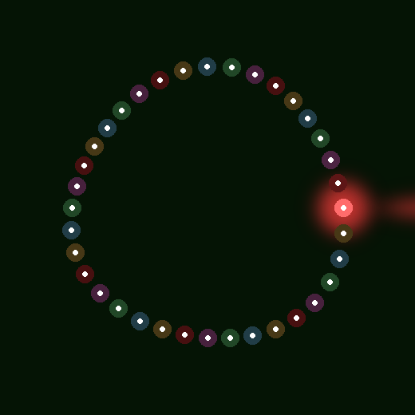
Don’t forget about pulsars during Christmas

