Slide 1
HiZ-GUNDAM: The Ultimate On-Board Mission for Multimessenger Astronomy
Hatsune Goto | RIKEN / HiZ-GUNDAM Working Group
TeVPA 2026 Pre-conference Workshop
2028/08/30

Slide 2
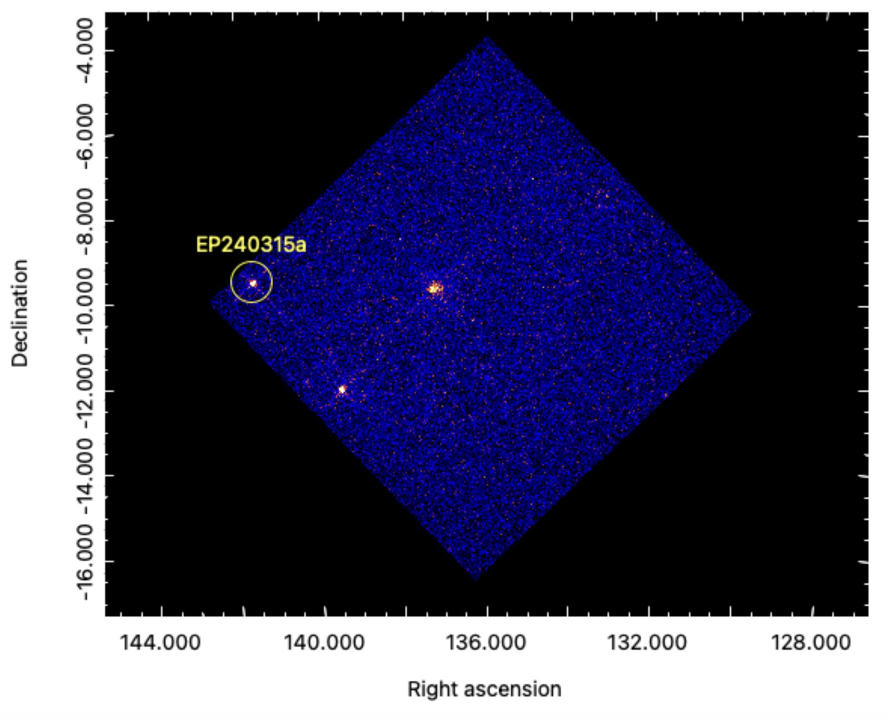
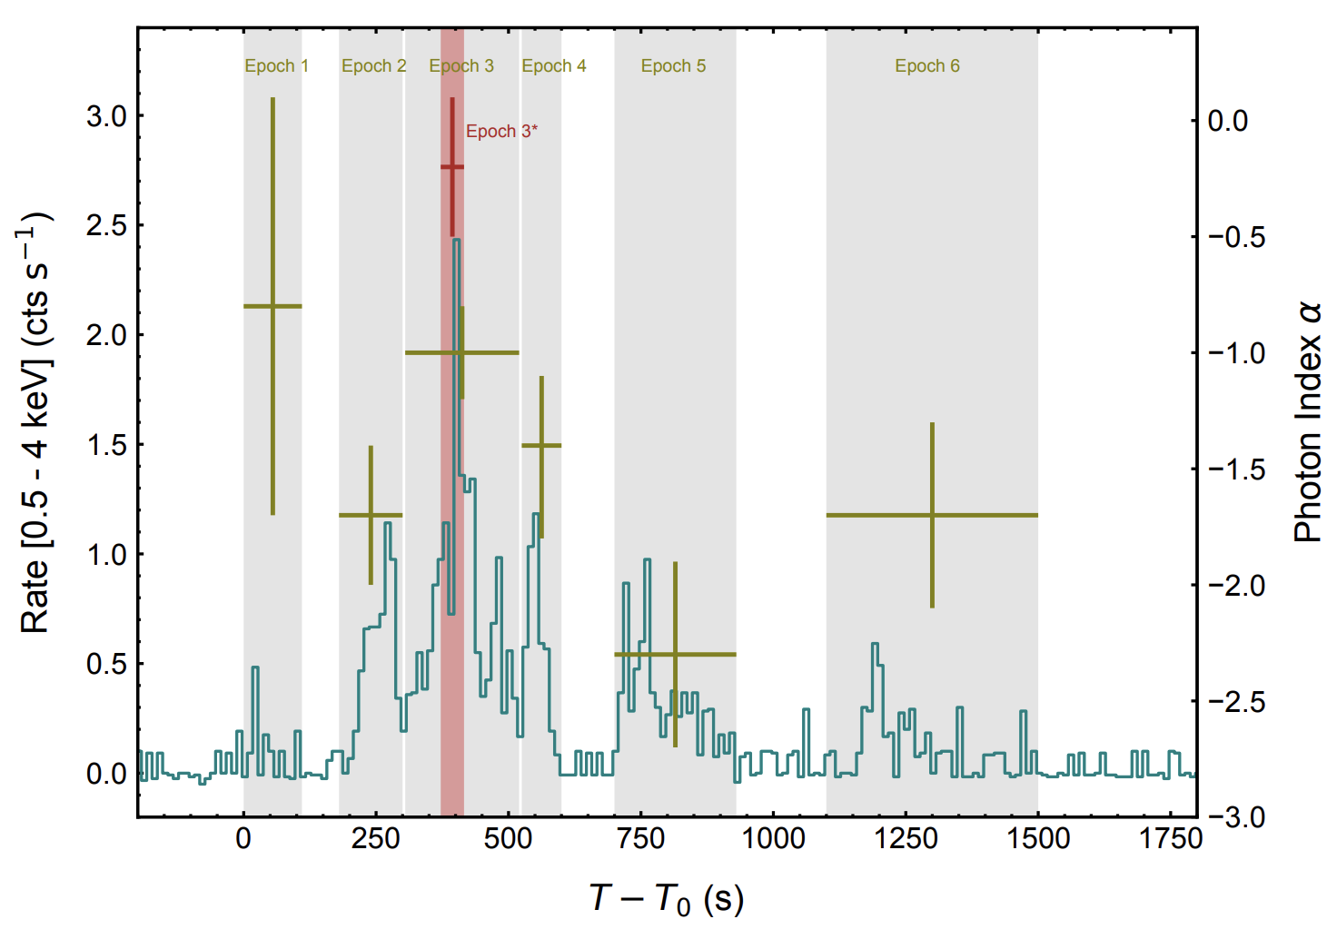
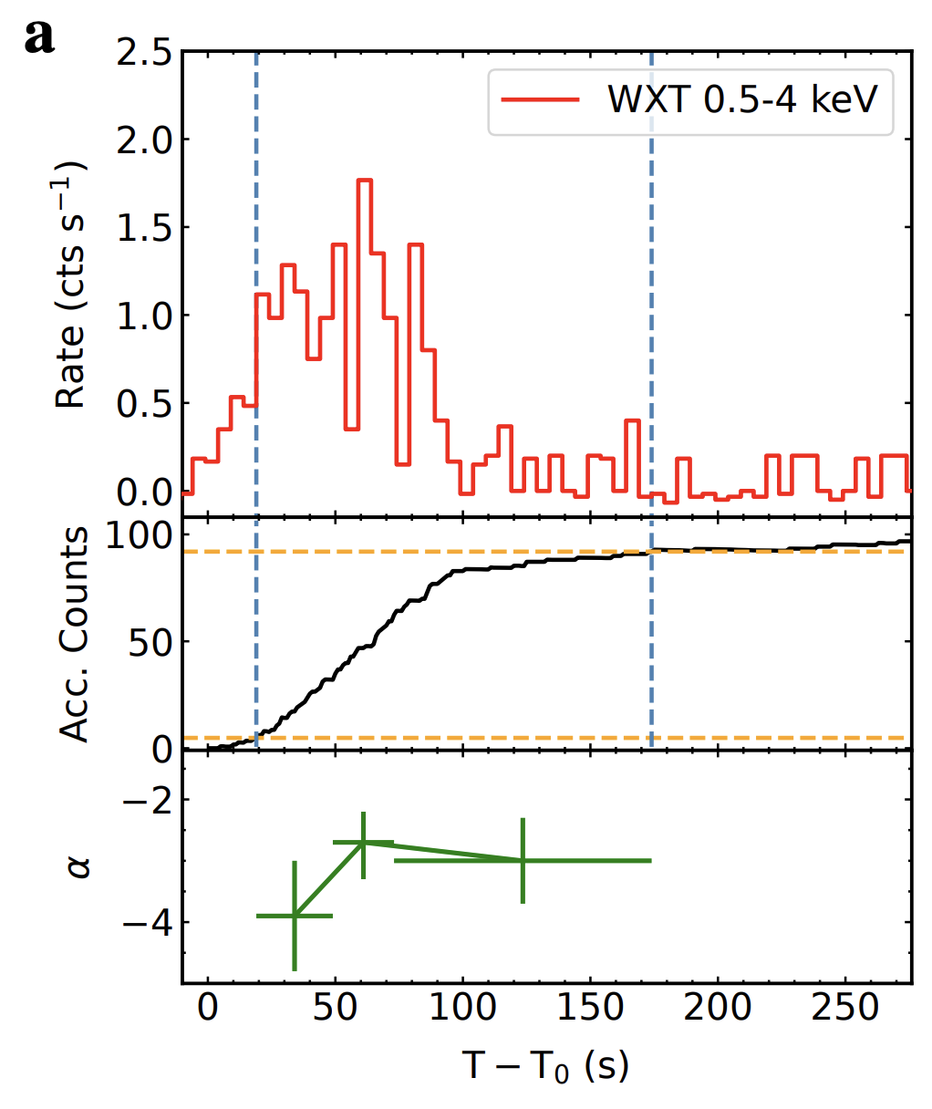
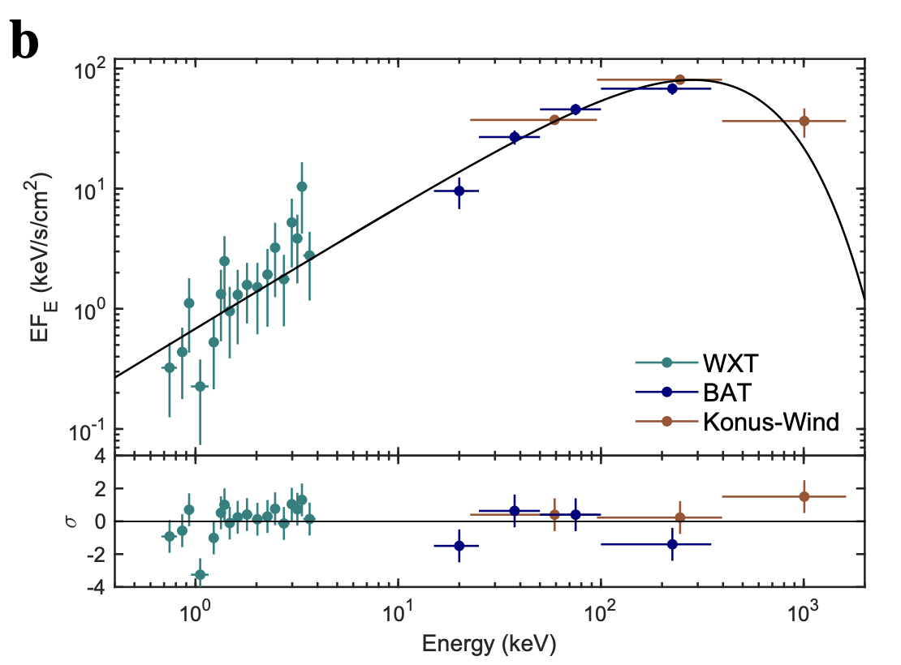
The soft X-ray transient sky
EP240315a
Liu et al. 2024
7 minutes early precursor of GRB 240315C
Wide-field soft-X-ray focusing
EP/WXT
Expands the selection to softer & fainter transients
/ reveals earlier or extended emission phases
EP/WXT
EP240414a
Dalen et al. 2025
EP/WXT
Swift/BAT
Konus-Wind
Failed jet before SN 2024gsa
Notes:
The soft X-ray transient sky is opening.
Wide-field soft X-ray monitoring changes both what we discover and what we see in known transient populations.
EP240315a was also detected by Swift-BAT and Konus-Wind in offline analyses, so it was not exclusively a soft X-ray event. However, the soft X-ray emission began 372 seconds before the gamma-ray emission and lasted much longer, revealing earlier engine activation and extended activity that were not apparent in gamma rays.
Einstein Probe has also discovered faint soft X-ray transients associated with weak relativistic jets and supernovae, including EP240414a.
Soft X-ray monitoring therefore provides both a different transient selection and a more complete view of rapidly evolving high-energy phenomena.
It is becoming an essential discovery and diagnostic channel for multimessenger astronomy.
[Sources]
- https://www.esa.int/Science_Exploration/Space_Science/Einstein_Probe_detects_puzzling_cosmic_explosion
- https://www.nature.com/articles/s41550-025-02571-1

Slide 3
The soft X-ray transient sky
EP240315a
Liu et al. 2024
7 minutes early precursor of GRB 240315C
Wide-field soft-X-ray focusing
EP/WXT
Expands the selection to softer & fainter transients
/ reveals earlier or extended emission phases
EP/WXT
EP240414a
Dalen et al. 2025
EP/WXT
Swift/BAT
Konus-Wind
Failed jet before SN 2024gsa
Wide-field soft X-ray monitoring is becoming an essential discovery channel for multimessenger astronomy.
Notes:
The soft X-ray transient sky is opening.
Wide-field soft X-ray monitoring changes both what we discover and what we see in known transient populations.
EP240315a was also detected by Swift-BAT and Konus-Wind in offline analyses, so it was not exclusively a soft X-ray event. However, the soft X-ray emission began 372 seconds before the gamma-ray emission and lasted much longer, revealing earlier engine activation and extended activity that were not apparent in gamma rays.
Einstein Probe has also discovered faint soft X-ray transients associated with weak relativistic jets and supernovae, including EP240414a.
Soft X-ray monitoring therefore provides both a different transient selection and a more complete view of rapidly evolving high-energy phenomena.
It is becoming an essential discovery and diagnostic channel for multimessenger astronomy.
[Sources]
- https://www.esa.int/Science_Exploration/Space_Science/Einstein_Probe_detects_puzzling_cosmic_explosion
- https://www.nature.com/articles/s41550-025-02571-1

Slide 4
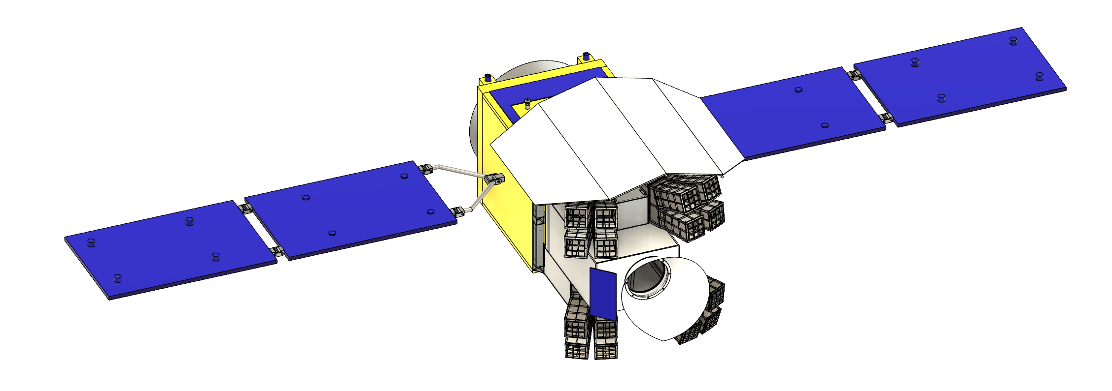
HiZ-GUNDAM
(2034~, 3 year)
Optical and Near Infrared Telescope MONSTER
Wide Field soft X-ray Monitor
EAGLE
2. Identify and measure the redshift of counterpart
1. Detect & locate GRBs/X-ray transients
3. Alert message (T << 1 hour)
4. Spectroscopic observation with large area telescopes
i.e. JWST, Subaru (T ∼ 1.5 hr)
Science Goals
1. Exploration of the early Universe with GRB
2. Timely contribution to Multi-messenger astronomy
Notes:
HiZ-GUNDAM is designed to close this discovery-to-identification loop within a single mission.
It is a proposed JAXA-led mission for the 2030s, combining two complementary instruments.
EAGLE is a wide-field soft X-ray monitor operating from 0.4 to 4 keV. Using lobster-eye focusing optics, it monitors 0.53 steradians of the sky and discovers faint and soft transients with arcminute-class localization.
Following a trigger, the spacecraft rapidly slews to the source, and MONSTER—a 30-centimeter optical and near-infrared telescope—performs simultaneous five-band observations from 0.5 to 2.5 microns.
These observations provide a more accurate counterpart position, broadband colors, constraints on the source redshift, and the information needed to prioritize further observations.
HiZ-GUNDAM therefore connects wide-field discovery, rapid localization, optical and near-infrared characterization, and community follow-up in a continuous observation flow.
The goal is to provide the community with not only an X-ray trigger, but an already characterized and prioritized transient target.

Slide 5
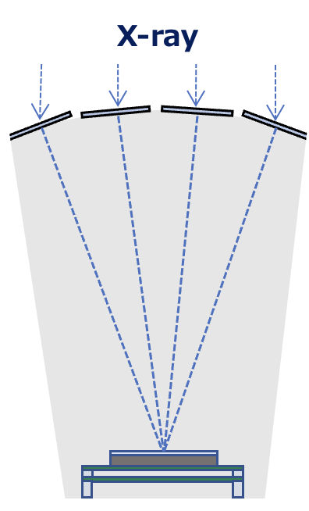
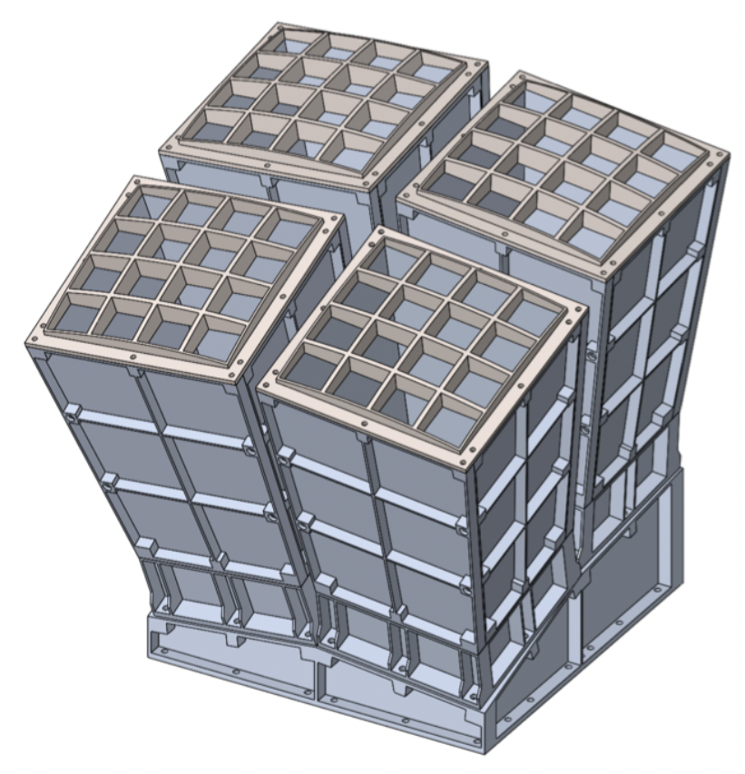
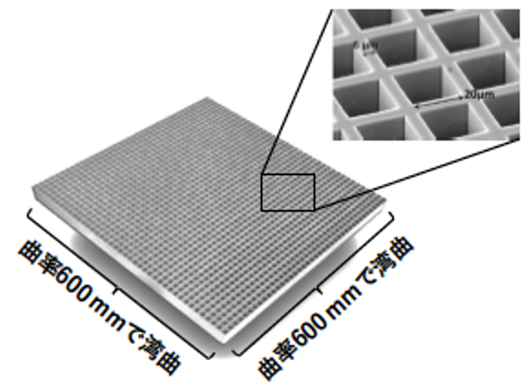
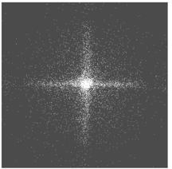
EAGLE finds faint and soft transients
X-ray from transient source
Lobster Eye Optics (MPO)
Focusing X-ray from transients
1 module
d
pnCCD image sensor
Performance
Observation energy band | 0.4-4 keV
Field of View | ~0.53 str
Detection sensitivity | 7×10⁻¹⁰ erg/cm²/s (100s exposure)
Positioning accuracy | 3 arcmin with 1 σ ( for follow up observation)
Focused X-ray image
Notes:
望遠鏡視野 34 arcmin
コンタミ天体の中でHiZ天体を見つけるため

Slide 6
EAGLE finds faint and soft transients
X-ray from transient source
Lobster Eye Optics (LEO)
Focusing X-ray from transients
1 module
d
pnCCD image sensor
Performance
Observation energy band | 0.4-4 keV
Field of View | ~0.53 str
Detection sensitivity | 7×10⁻¹⁰ erg/cm²/s (100s exposure)
Positioning accuracy | 3 arcmin ( for follow up observation)
Focused X-ray image
EAGLE detects transient and provide arcmin localization in ~100 seconds
Notes:
望遠鏡視野 34 arcmin
コンタミ天体の中でHiZ天体を見つけるため

Slide 7
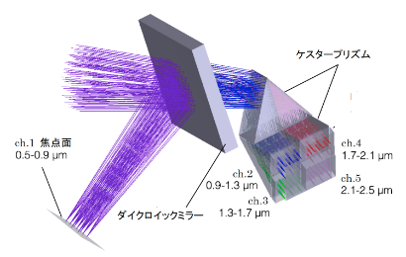
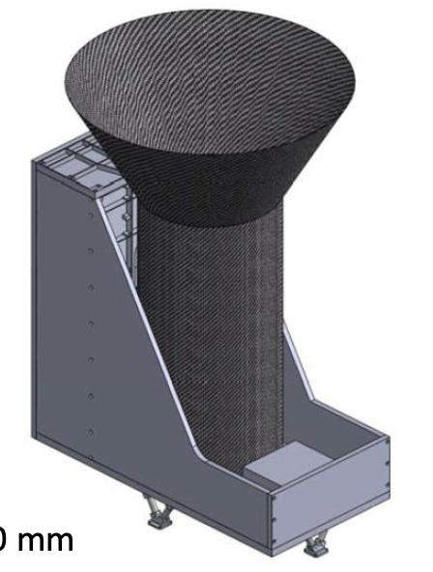
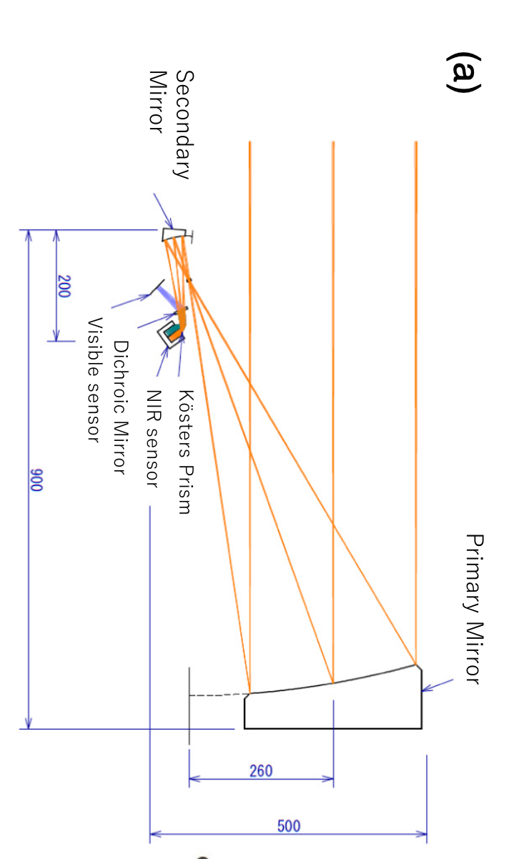
MONSTER enables rapid optical/NIR identification
Köster prism
Items | Parameters
Telescope type | Offset Optics
Aperture size | 30 cm
Focal length | 83.5 cm
F number | 6.1
Field of view | 15 arcmin × 15 arcmin
FoV per pixel | 2 acsec × 2 arcsec
Integration time | 10 minutes (2 minutes x 5 frames)
Observation Band (μm) | 0.5−0.9 | 0.9−1.3 | 1.3−1.7 | 1.7−2.1 | 2.1-2.5
Limiting AB mag (@10 min) | 21.3 | 20.9 | 20.6 | 20.5 | 20.4
Focal detector | HyViSi | HgCdTe (H1RG)
φ300 mm aperture
telescope
Notes:
MONSTER provides the optical and near-infrared component of the HiZ-GUNDAM observation flow.
It is a 30-centimeter telescope covering wavelengths from 0.5 to 2.5 microns. After the spacecraft slews to an EAGLE trigger, MONSTER performs simultaneous imaging in five photometric bands.
The simultaneous observations provide optical and near-infrared colors without being affected by rapid temporal evolution between different filters. They also enable a more accurate counterpart position, identification of a possible host galaxy, and constraints on the source redshift.
For high-redshift GRBs, the five-band photometry is designed to identify Lyman-break candidates onboard. For other transient populations, it provides early color information and counterpart identification while the source is still bright.
MONSTER therefore adds the information needed to connect an EAGLE detection with rapid ground-based follow-up.

Slide 8
MONSTER enables rapid optical/NIR identification
Items | Parameters
Telescope type | Offset Optics
Aperture size | 30 cm
Focal length | 83.5 cm
F number | 6.1
Field of view | 15 arcmin × 15 arcmin
FoV per pixel | 2 acsec × 2 arcsec
Integration time | 10 minutes (2 minutes x 5 frames)
Observation Band (μm) | 0.5−0.9 | 0.9−1.3 | 1.3−1.7 | 1.7−2.1 | 2.1-2.5
Limiting AB mag (@10 min) | 21.3 | 20.9 | 20.6 | 20.5 | 20.4
Focal detector | HyViSi | HgCdTe (H1RG)
φ300 mm aperture
telescope
MONSTER obtains an arcsecond localization, and photometric redshift within 10 minutes.
Notes:
MONSTER provides the optical and near-infrared component of the HiZ-GUNDAM observation flow.
It is a 30-centimeter telescope covering wavelengths from 0.5 to 2.5 microns. After the spacecraft slews to an EAGLE trigger, MONSTER performs simultaneous imaging in five photometric bands.
The simultaneous observations provide optical and near-infrared colors without being affected by rapid temporal evolution between different filters. They also enable a more accurate counterpart position, identification of a possible host galaxy, and constraints on the source redshift.
For high-redshift GRBs, the five-band photometry is designed to identify Lyman-break candidates onboard. For other transient populations, it provides early color information and counterpart identification while the source is still bright.
MONSTER therefore adds the information needed to connect an EAGLE detection with rapid ground-based follow-up.

Slide 9
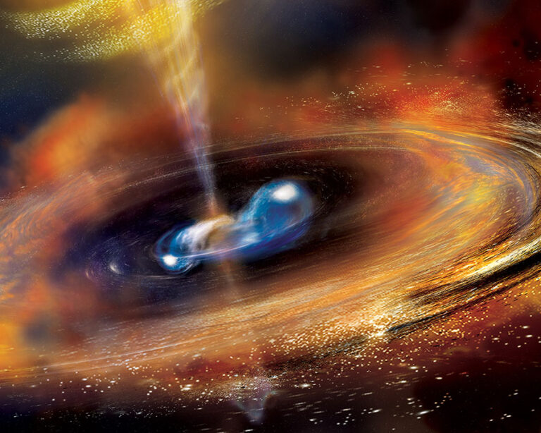
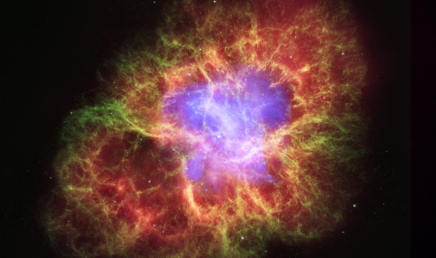
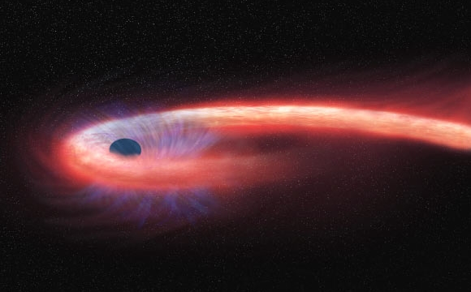
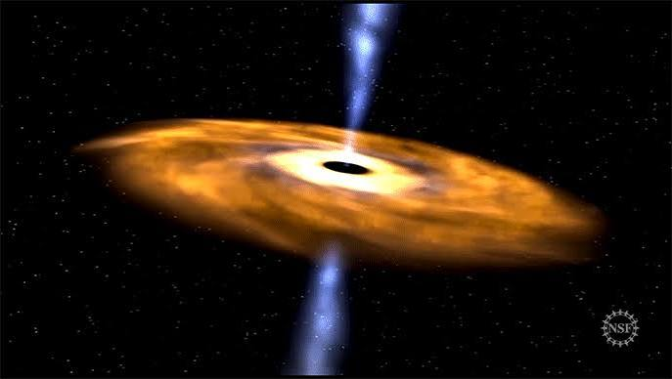
MM source detectable in soft X-ray
Compact object
merger
Source class | Messenger | Possible EAGLE signal | Characteristic timescale of the EAGLE signal
Compact-object merger | GW | Short-GRB prompt or extended soft X-ray emission | ~0.01–10² s
Core-collapse SN | MeV neutrinos + GW | X-ray shock breakout or associated GRB | seconds–hours
TDE | HE neutrinos | Bright jetted TDE or X-ray rebrightening | hours–months
Blazar | HE neutrinos | Exceptionally bright X-ray jet flare | days–months
Core-collapse SN
TDE
Blazar

Slide 10
MM source detectable in soft X-ray
Compact object
merger
Source class | Messenger | Possible EAGLE signal | Characteristic timescale of the EAGLE signal
Compact-object merger | GW | Short-GRB prompt or extended soft X-ray emission | ~0.01–10² s
Core-collapse SN | MeV neutrinos + GW | X-ray shock breakout or associated GRB | seconds–hours
TDE | HE neutrinos | Bright jetted TDE or X-ray rebrightening | hours–months
Blazar | HE neutrinos | Exceptionally bright X-ray jet flare | days–months
Core-collapse SN
Joint soft X-ray and messenger detections would provide unique laboratories
-stellar explosions, relativistic jets, extreme accretion, and high-energy particle acceleration.
TDE
Blazar

Slide 11
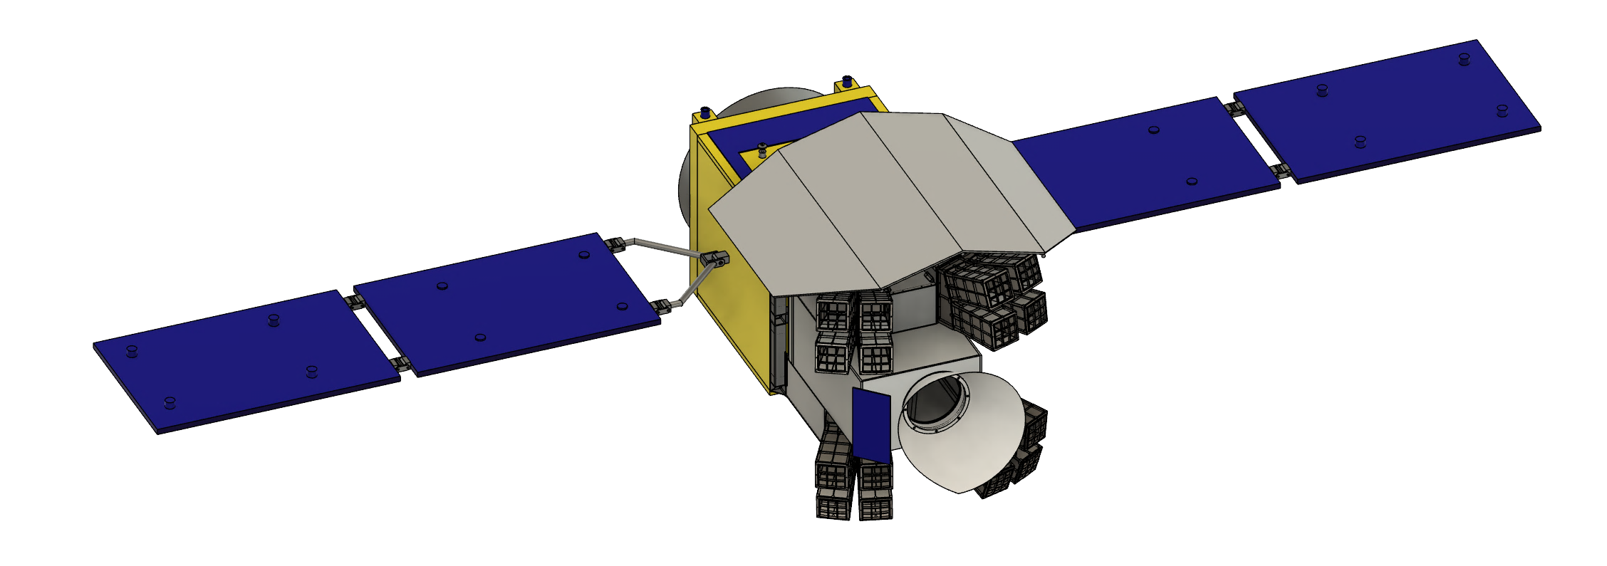
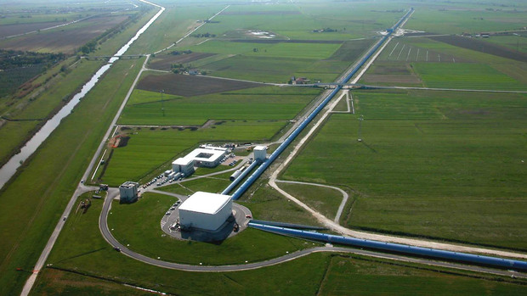
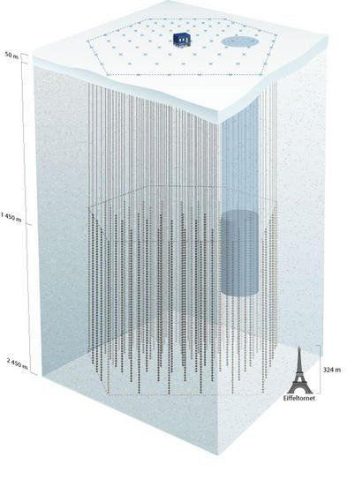
Paths to multimessenger discovery
HiZ-GUNDAM can independently detect, localize, and characterize in “onset phase” of multimessenger events
Detection in soft X-ray
~10 min
~hour
~hours
~days
GW
neutrino
a few -10 deg localization
10-1000² deg localization
LIGO
IceCube
Notes:
[Sources]
- https://pmc.ncbi.nlm.nih.gov/articles/PMC6914724/
- https://ep.bao.ac.cn/ep/cms/article/view?id=63

Slide 12
Paths to multimessenger discovery
HiZ-GUNDAM can independently detect, localize, and characterize in “onset phase” of multimessenger events
arcmin-arcsec localization, redshift
MM event coincidence confirmed in GCN
Detection in soft X-ray
~10 min
~hour
~hours
~days
GW
neutrino
a few -10 deg localization
10-1000² deg localization
LIGO
IceCube
Notes:
[Sources]
- https://pmc.ncbi.nlm.nih.gov/articles/PMC6914724/
- https://ep.bao.ac.cn/ep/cms/article/view?id=63

Slide 13
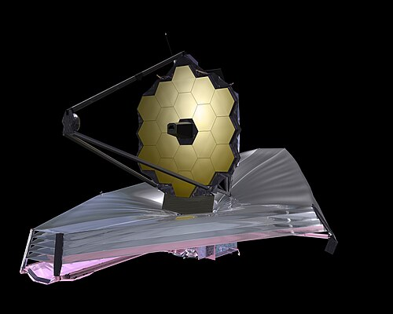
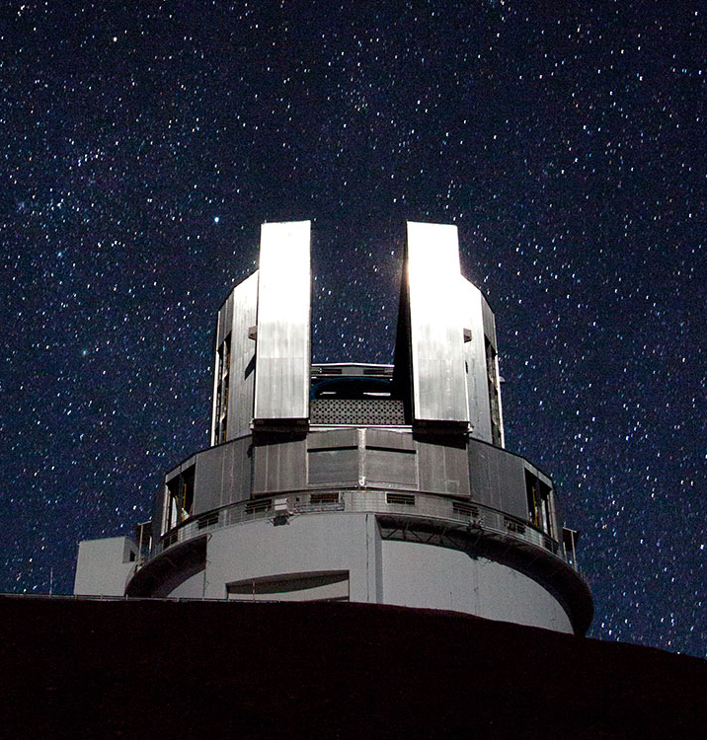
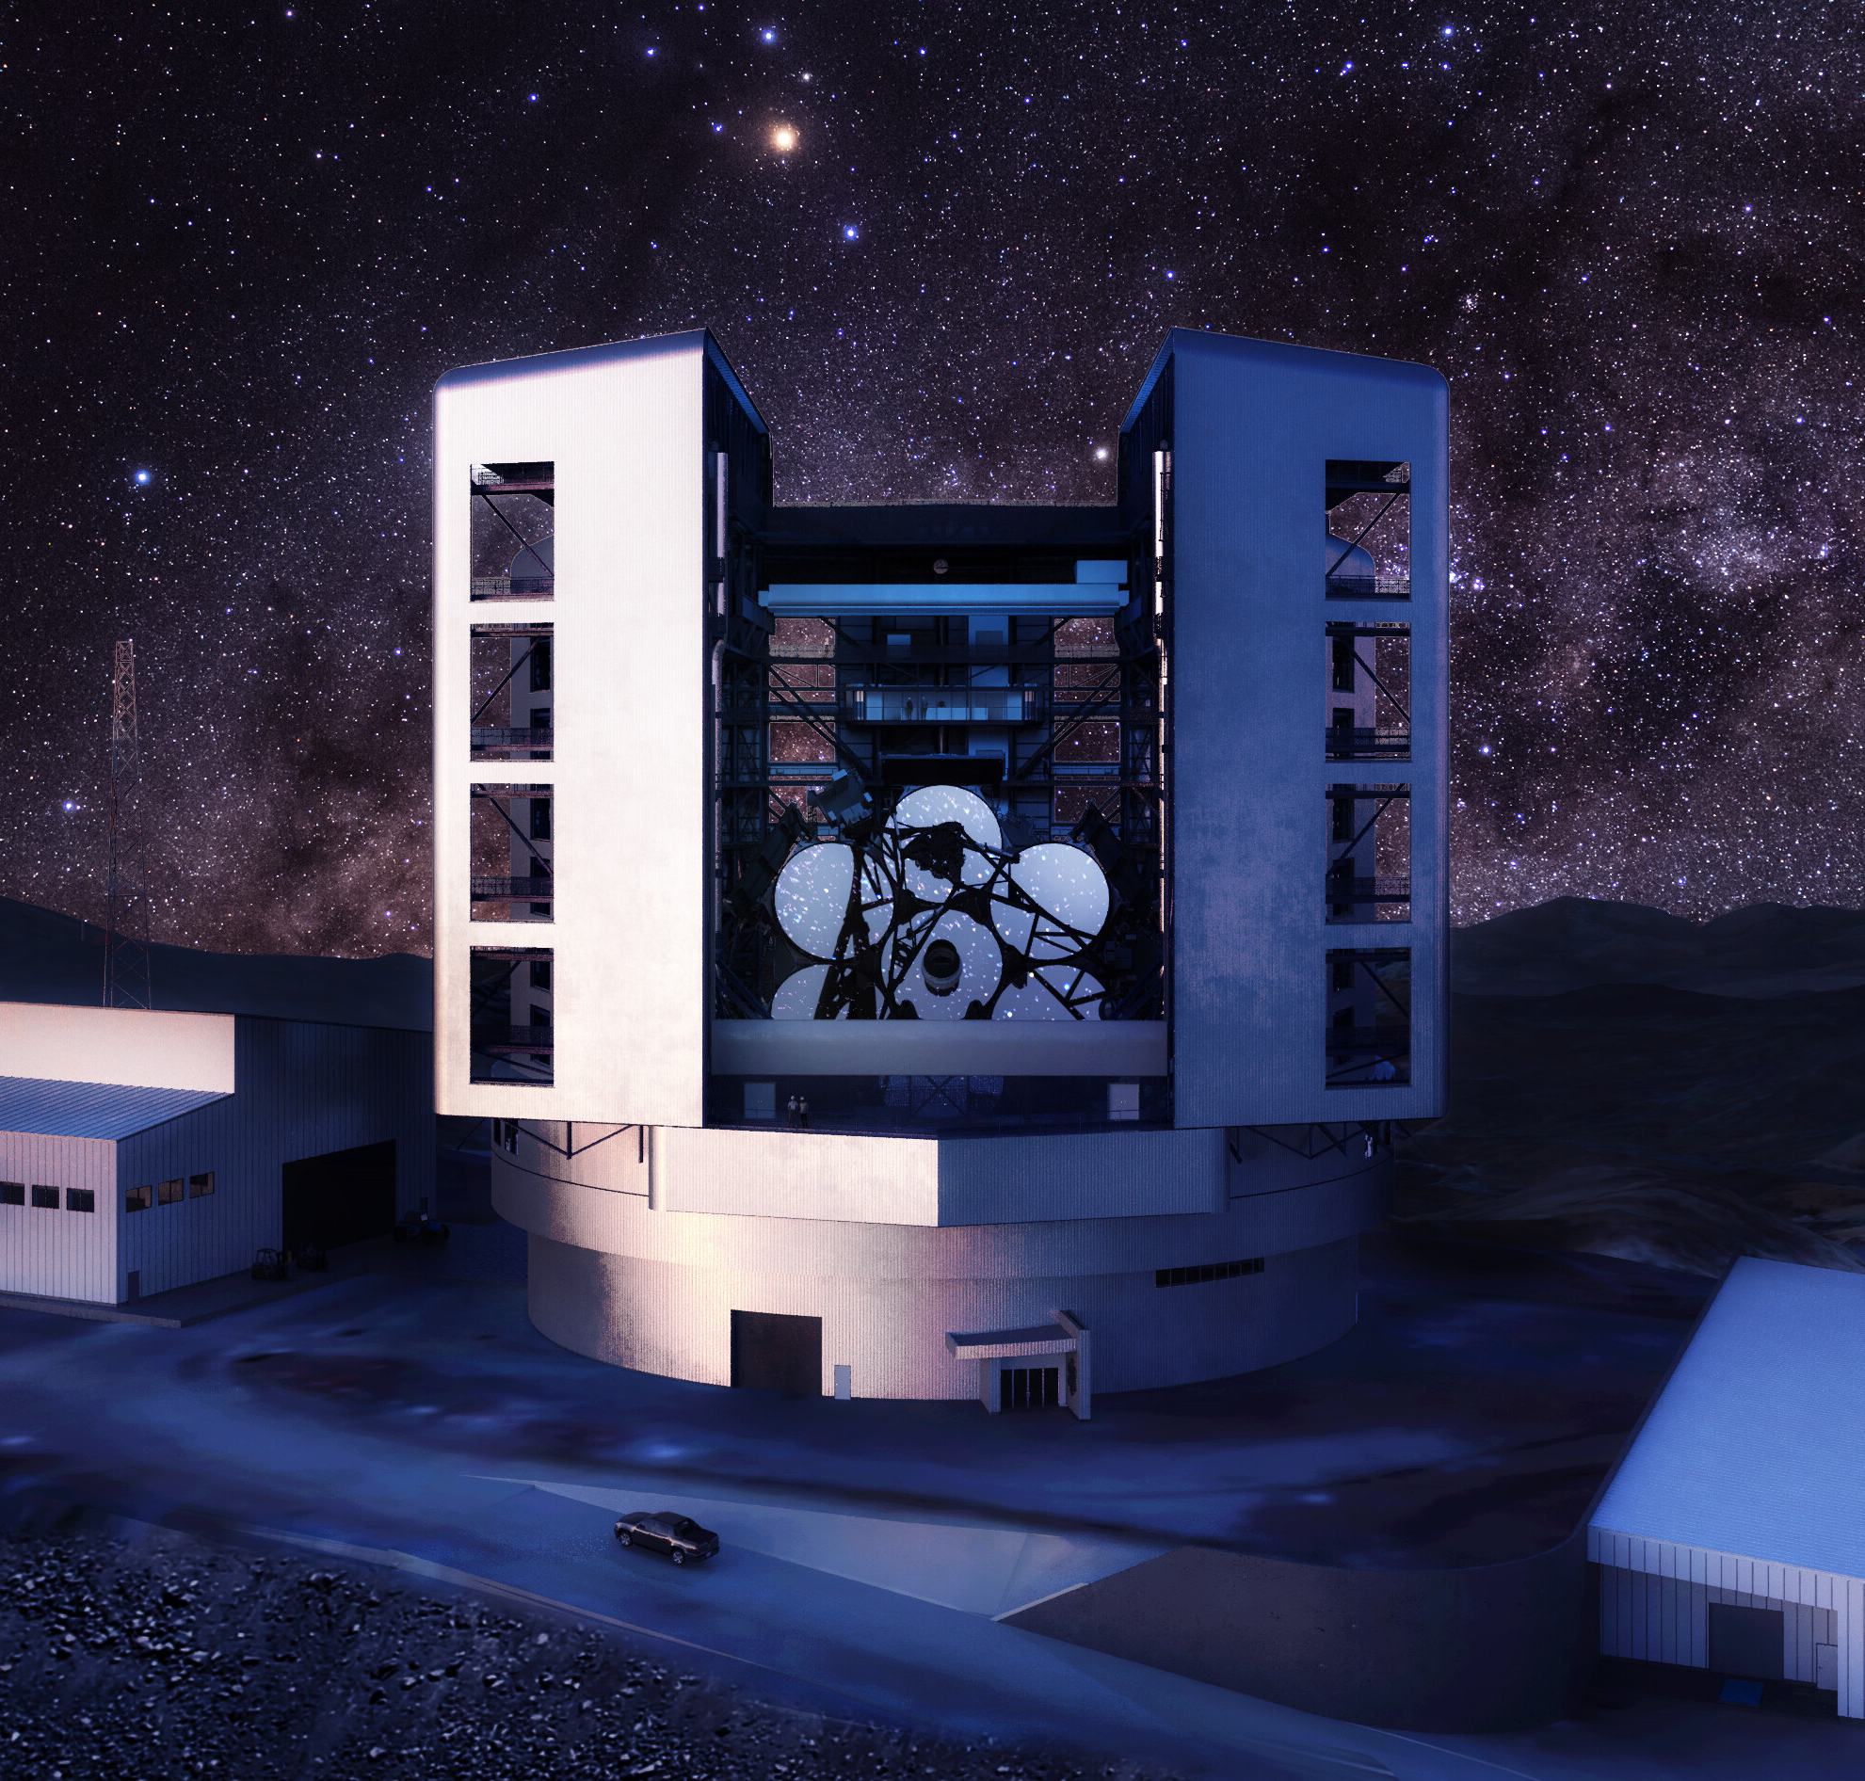
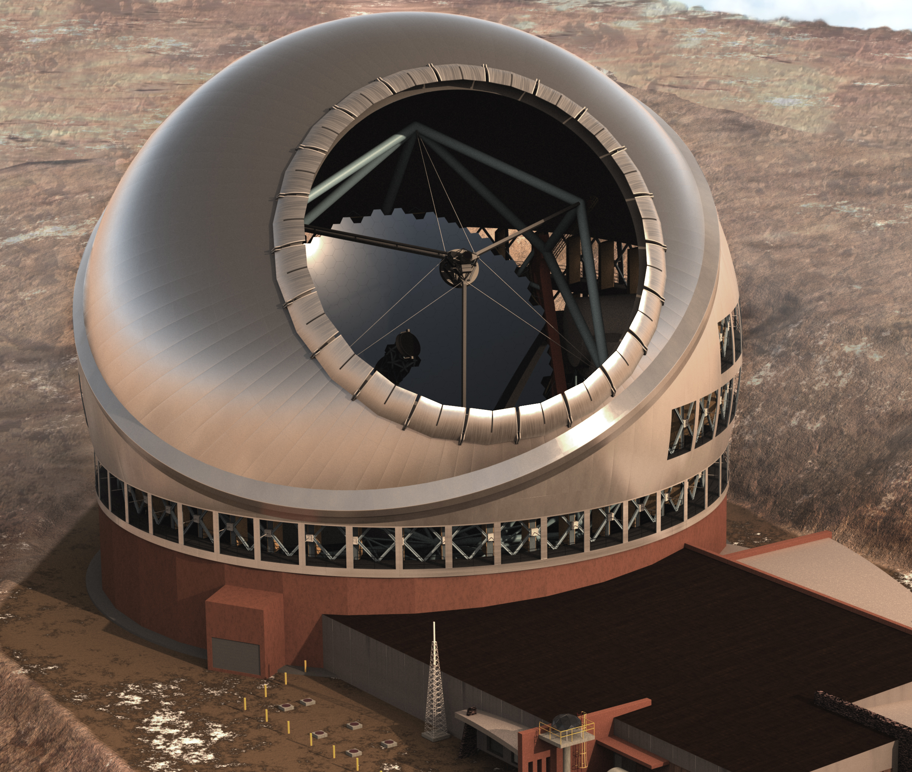
Paths to multimessenger discovery
HiZ-GUNDAM can independently detect, localize, and characterize in “onset phase” of multimessenger events
JWST
arcmin-arcsec localization, redshift
MM event coincidence confirmed in GCN
Detection in soft X-ray
~10 min
~hour
~hours
~days
Large Area Telescope
GW
neutrino
a few -10 deg localization
Subaru
GMT
TMT
< 1000² deg localization
8m
future 30m class
LIGO
IceCube
Notes:
[Sources]
- https://pmc.ncbi.nlm.nih.gov/articles/PMC6914724/
- https://ep.bao.ac.cn/ep/cms/article/view?id=63

Slide 14
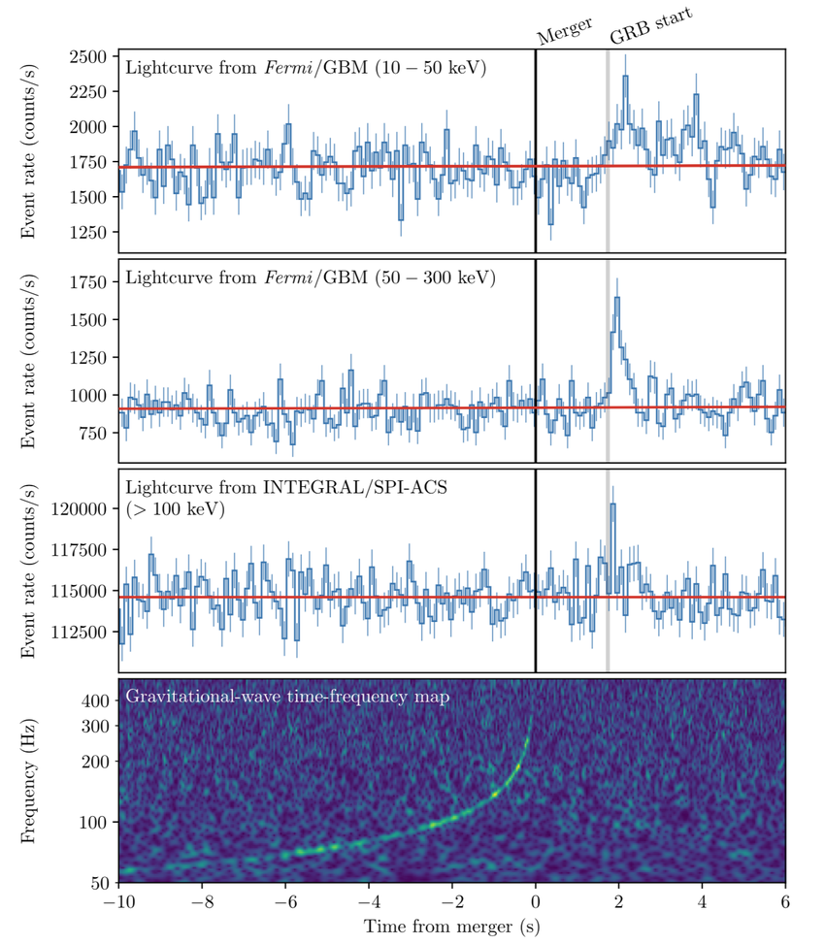
Compact-object merger (BNS / NS–BH)
GW170817 / AT 2017gfo
T0
BNS / NS–BH coalescence
Gravitational waves
Notes:
[Sources]
- Abbott et al. 2017, ApJL 848, L12, https://doi.org/10.3847/2041-8213/aa91c9 (timeline data).
- Cowperthwaite et al. 2017, ApJL 848, L17, https://doi.org/10.3847/2041-8213/aa8fc7.
- Villar et al. 2017, ApJL 851, L21, https://doi.org/10.3847/2041-8213/aa9c84.
Not every BNS or NS–BH merger produces an observable jet or kilonova; the timeline shows the principal expected electromagnetic components.

Slide 15
Compact-object merger (BNS / NS–BH)
GW170817 / AT 2017gfo
T0
BNS / NS–BH coalescence
Gravitational waves
T0 + 0–10 seconds
Short GRB + soft X-ray emission
Gamma / X-ray
Notes:
[Sources]
- Abbott et al. 2017, ApJL 848, L12, https://doi.org/10.3847/2041-8213/aa91c9 (timeline data).
- Cowperthwaite et al. 2017, ApJL 848, L17, https://doi.org/10.3847/2041-8213/aa8fc7.
- Villar et al. 2017, ApJL 851, L21, https://doi.org/10.3847/2041-8213/aa9c84.
Not every BNS or NS–BH merger produces an observable jet or kilonova; the timeline shows the principal expected electromagnetic components.

Slide 16
Compact-object merger (BNS / NS–BH)
GW170817 / AT 2017gfo
T0
BNS / NS–BH coalescence
Gravitational waves
T0 + 0–10 seconds
Short GRB + soft X-ray emission
Gamma / X-ray
T0 + minutes to hours
Blue kilonova:
lanthanide-poor r-process ejecta
Optical
Notes:
[Sources]
- Abbott et al. 2017, ApJL 848, L12, https://doi.org/10.3847/2041-8213/aa91c9 (timeline data).
- Cowperthwaite et al. 2017, ApJL 848, L17, https://doi.org/10.3847/2041-8213/aa8fc7.
- Villar et al. 2017, ApJL 851, L21, https://doi.org/10.3847/2041-8213/aa9c84.
Not every BNS or NS–BH merger produces an observable jet or kilonova; the timeline shows the principal expected electromagnetic components.

Slide 17
Compact-object merger (BNS / NS–BH)
GW170817 / AT 2017gfo
T0
BNS / NS–BH coalescence
Gravitational waves
T0 + 0–10 seconds
Short GRB + soft X-ray emission
Gamma / X-ray
T0 + minutes to hours
Blue kilonova:
lanthanide-poor r-process ejecta
Optical(blue)
T0 + hours to days
Red kilonova:
lanthanide-rich r-process ejecta
Optical / NIR
Notes:
[Sources]
- Abbott et al. 2017, ApJL 848, L12, https://doi.org/10.3847/2041-8213/aa91c9 (timeline data).
- Cowperthwaite et al. 2017, ApJL 848, L17, https://doi.org/10.3847/2041-8213/aa8fc7.
- Villar et al. 2017, ApJL 851, L21, https://doi.org/10.3847/2041-8213/aa9c84.
Not every BNS or NS–BH merger produces an observable jet or kilonova; the timeline shows the principal expected electromagnetic components.

Slide 18
Compact-object merger (BNS / NS–BH)
GW170817 / AT 2017gfo
T0
Detection by GW facility
Gravitational waves
≤ minutes
T0 + 0–10 seconds
EAGLE
short / soft X-ray uncatalogued transient
arcminute position
MONSTER
new optical/NIR source
arcsecond position + host
Gamma / X-ray
T0 + minutes to hours
Optical(blue)
counterpart
candidate
1st GCN minutes
2nd GCN ~1hour
T0 + hours to days
Targeted follow-up
Optical / NIR
Optical / NIR
Notes:
[Sources]
- Abbott et al. 2017, ApJL 848, L12, https://doi.org/10.3847/2041-8213/aa91c9 (timeline data).
- Cowperthwaite et al. 2017, ApJL 848, L17, https://doi.org/10.3847/2041-8213/aa8fc7.
- Villar et al. 2017, ApJL 851, L21, https://doi.org/10.3847/2041-8213/aa9c84.
Not every BNS or NS–BH merger produces an observable jet or kilonova; the timeline shows the principal expected electromagnetic components.

Slide 19
Compact-object merger (BNS / NS–BH)
GW170817 / AT 2017gfo
T0
Detection by GW facility
Gravitational waves
≤ minutes
T0 + 0–10 seconds
EAGLE
short / soft X-ray uncatalogued transient
arcminute position
MONSTER
new optical/NIR source
arcsecond position + host
Gamma / X-ray
T0 + minutes to hours
EAGLE and MONSTER can provide localization before Optical/NIR brightening,
also have chance for blue kilonova follow-up
Optical(blue)
counterpart
candidate
1st GCN minutes
2nd GCN ~1hour
T0 + hours to days
Targeted follow-up
Optical / NIR
Optical / NIR
Notes:
[Sources]
- Abbott et al. 2017, ApJL 848, L12, https://doi.org/10.3847/2041-8213/aa91c9 (timeline data).
- Cowperthwaite et al. 2017, ApJL 848, L17, https://doi.org/10.3847/2041-8213/aa8fc7.
- Villar et al. 2017, ApJL 851, L21, https://doi.org/10.3847/2041-8213/aa9c84.
Not every BNS or NS–BH merger produces an observable jet or kilonova; the timeline shows the principal expected electromagnetic components.

Slide 20
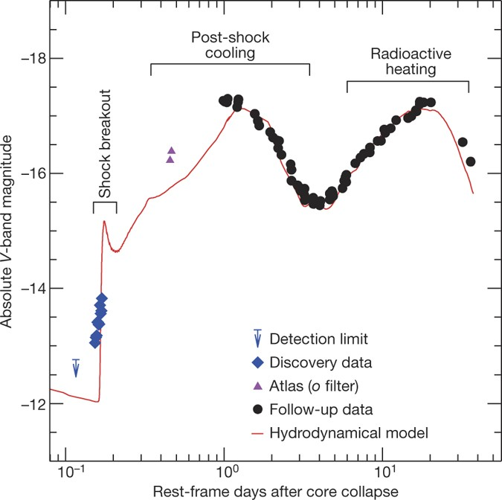
Collapsar SN and shock breakout
SN 2016gkg
T0
Core collapse and compact-object formation
MeV neutrinos + GW
Bersten et al. 2025

Slide 21
Collapsar SN and shock breakout
SN 2016gkg
T0
Core collapse and compact-object formation
MeV neutrinos + GW
T0+seconds to hours
Shock breakout ~100-1000 seconds
soft X-ray, EUV
Bersten et al. 2025

Slide 22
Collapsar SN and shock breakout
SN 2016gkg
T0
Core collapse and compact-object formation
MeV neutrinos + GW
T0+seconds to hours
Shock breakout ~100-1000 seconds
soft X-ray, EUV
T0+ hours to days
Expansion and cooling of shock heated ejecta
Optical, UV
Bersten et al. 2025

Slide 23

Collapsar SN and shock breakout
SN 2016gkg
T0
Core collapse and compact-object formation
MeV neutrinos + GW
T0+seconds to hours
Shock breakout ~100-1000 seconds
soft X-ray, EUV
T0+ hours to days
Expansion and cooling of shock heated ejecta
Optical, UV
Bersten et al. 2025
T0+10 to 30 days
Radioactive heating
${Ni}^{56}$and ${Co}^{56}$
Optical/NIR

Slide 24
Collapsar SN and shock breakout
SN 2016gkg
T0
Detection by neutrino & GW facility
MeV neutrinos + GW
seconds-hours
T0+seconds to hours
EAGLE
single soft-long flare
from uncatalogued source
MONSTER
a rapidly cooling and evolving optical/NIR SED
soft X-ray, EUV
T0+ hours to days
Optical, UV
shock breakout candidate
Bersten et al. 2025
GCN ~hours
T0+10 to 30 days
${Ni}^{56}$and ${Co}^{56}$
Follow-up by UV/Optical/NIR telescope
Optical/NIR

Slide 25
Collapsar SN and shock breakout
SN 2016gkg
T0
Detection by neutrino & GW facility
MeV neutrinos + GW
seconds-hours
T0+seconds to hours
EAGLE
single soft-long flare
from uncatalogued source
MONSTER
a rapidly cooling and evolving optical/NIR SED
soft X-ray, EUV
T0+ hours to days
EAGLE and MONSTER can provide localization and characterization of
SN shock breakout, before it has UV/Optical peak
Optical, UV
shock breakout candidate
Bersten et al. 2025
GCN ~hours
T0+10 to 30 days
${Ni}^{56}$and ${Co}^{56}$
Follow-up by UV/Optical/NIR telescope
Optical/NIR

Slide 26
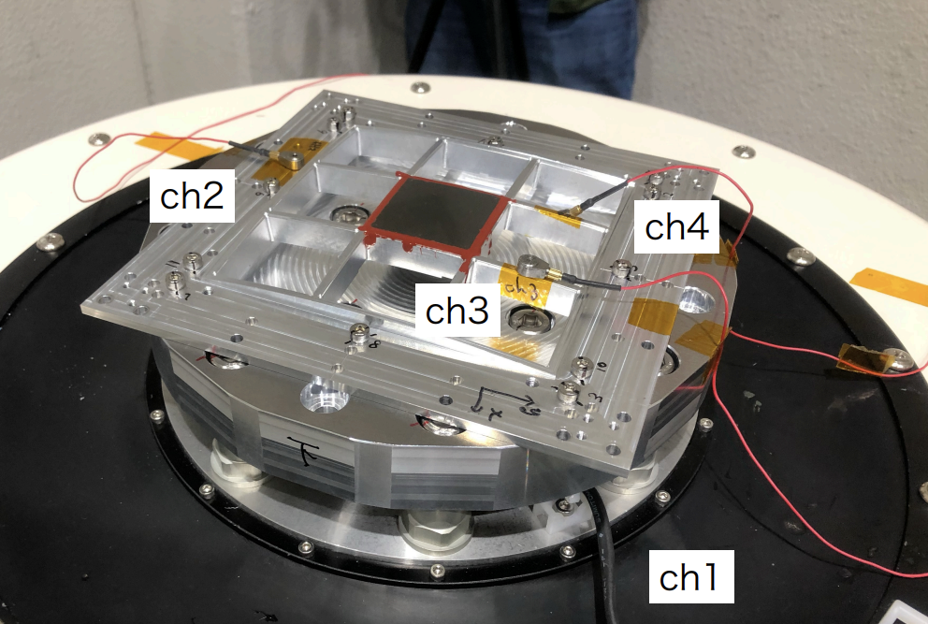
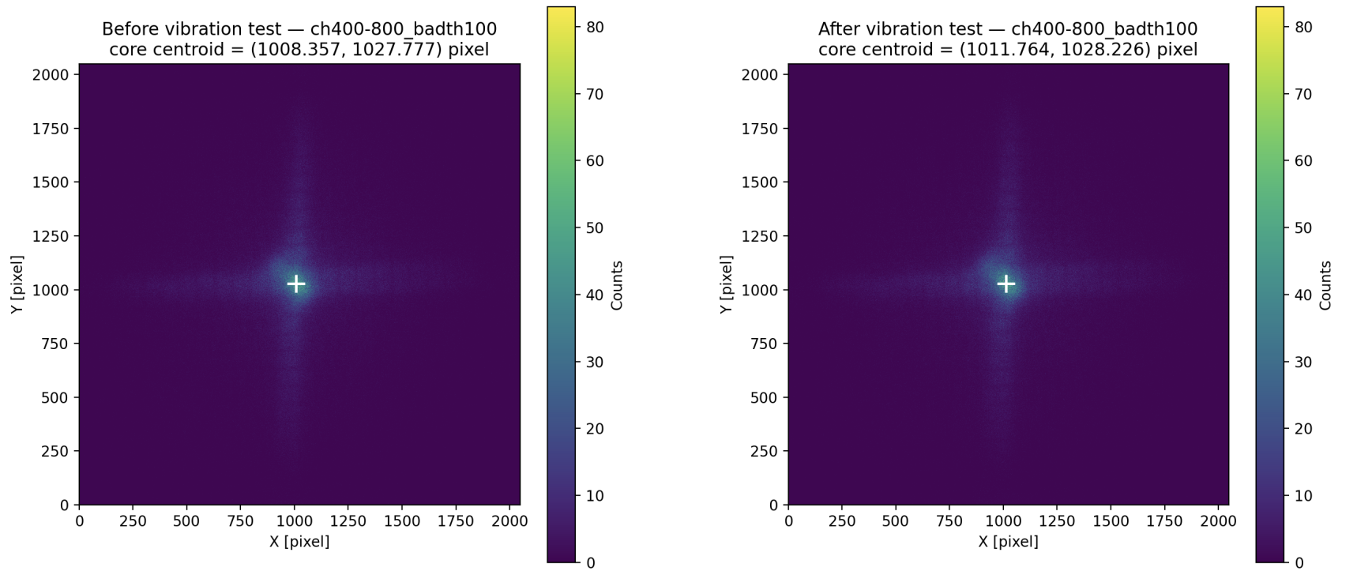
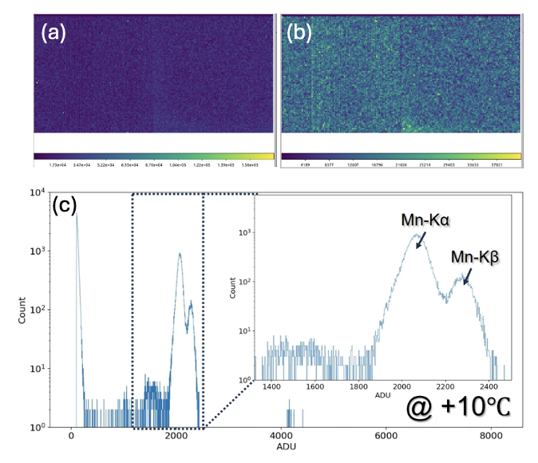
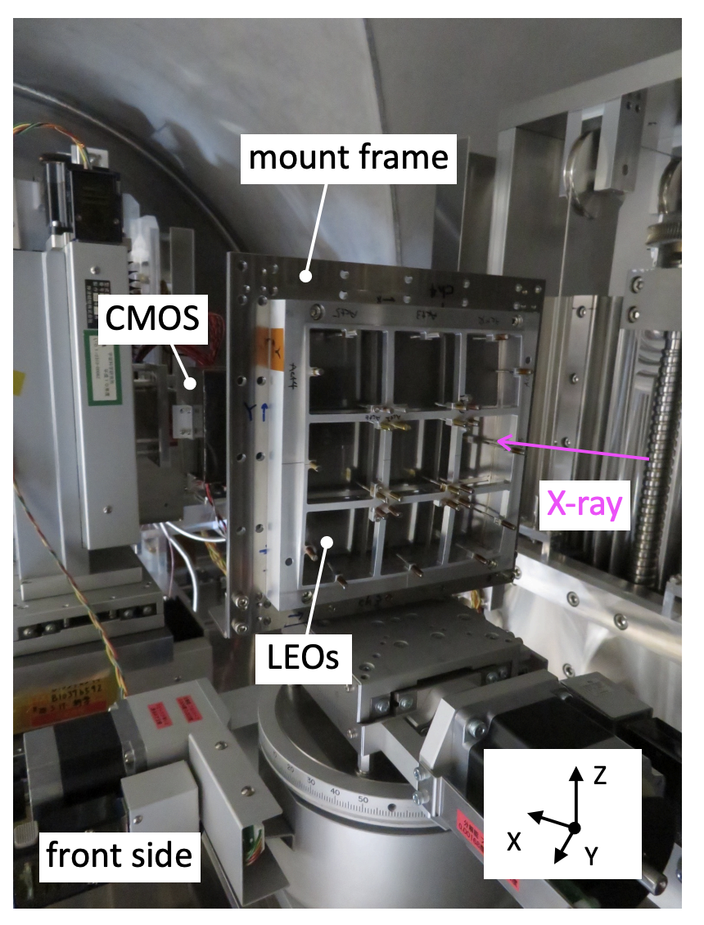
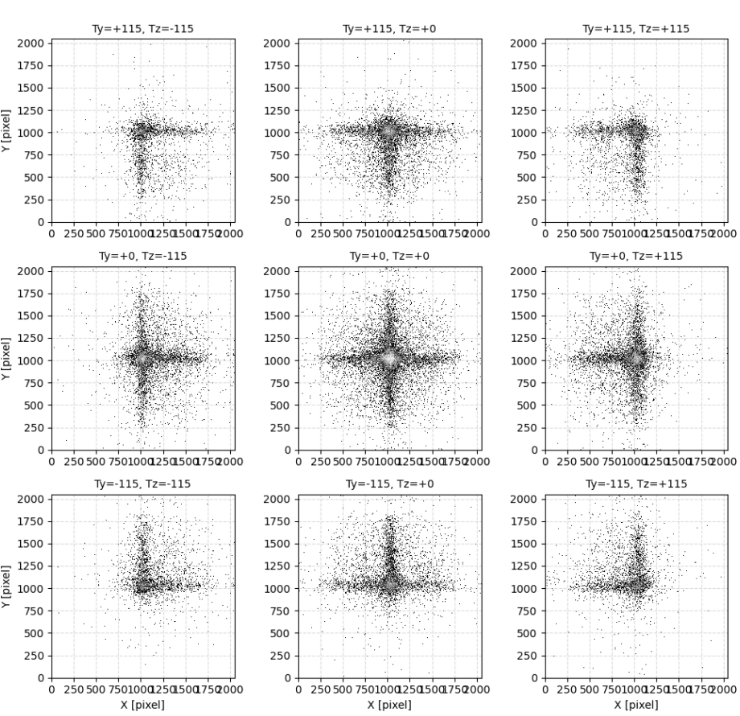
key technology: EAGLE Prototype
Optics System
pnCCD detector
AT level vibration test @ISAS/JAXA, 2026.08
Functional demonstration of the drive and readout system
X-ray tests with a Fe-55 source confirmed the detection of Mn-Kα and Mn-Kβ line
before
after
single pixel event
multi pixel event
Validation of optics selection criteria
e.g. measurement of angular response
Spectra obtained from Fe-55 source
@ISAS/JAXA, 2026.06
Notes:
Breadboard Model（BBM）として、Lobster Eye Opticsを固定したフレームのロケット打上げ環境を模擬した振動試験を実施し、試験前後で結像性能の劣化や有意な光学系の位置ずれがないことを確認した。 MPO素子の選別・性能改良に向け、ISASビームラインで1 mm角ラスタースキャンなどの詳細評価を実施した。

Slide 27
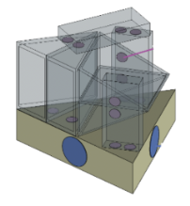
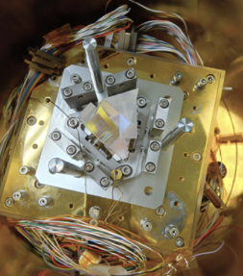
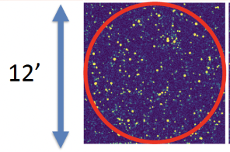
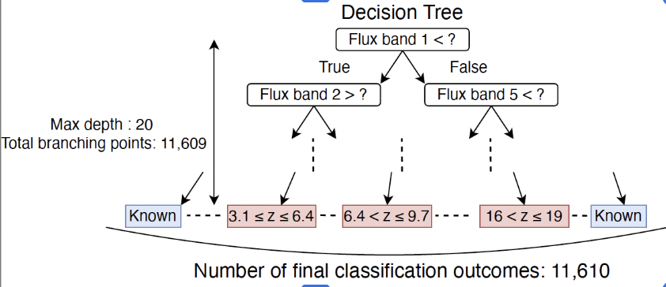
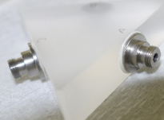
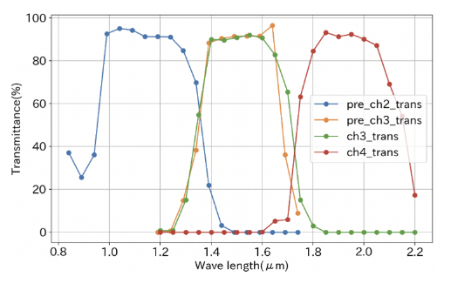
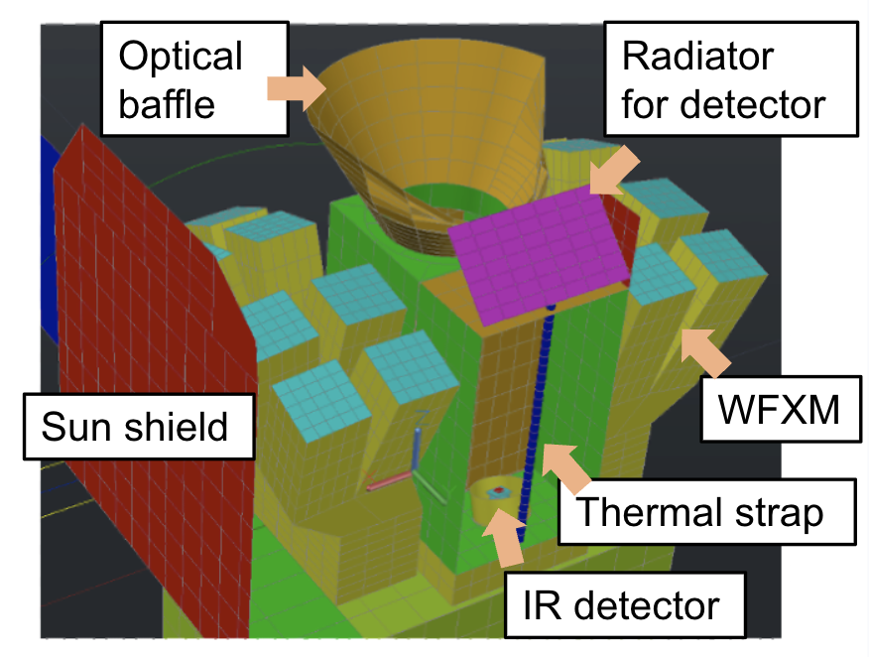
key technology: MONSTER
Köster prism
Data processing
A machine-learning-trained decision tree
reduces ~1,000 sources in the MONSTER field to
< 100 GRB candidates.
Design and testing of holders, selection of adhesives
Niinuma et al. (2026)
Measurement of spectral transmittance
Thermal model
Build an inhouse-model of EAGLE and MONSTER:
with improved thermal design, thermal feasibility has been confirmed.
Hori et al. (2026)
Kageyama et al. (2026)

Slide 28
key technology: MONSTER
Köster prism
Data processing
A machine-learning-trained decision tree
reduces ~1,000 sources in the MONSTER field to
< 100 GRB candidates.
Design and testing of holders, selection of adhesives
Niinuma et al. (2026)
Measurement of spectral transmittance
Thermal model
Build an inhouse-model of EAGLE and MONSTER:
with improved thermal design, thermal feasibility has been confirmed.
We have steady progress in establishing the core technologies, providing solid foundation for the next stage, design for flight model and complete observational work flow.
Hori et al. (2026)
Kageyama et al. (2026)

Slide 29
HiZ-GUNDAM turns soft X-ray triggers into actionable targets
Wide-field focusing in soft X-rays expands discovery to fainter and softer transients and reveals early or extended emission phases.
EAGLE detects and localizes X-ray transients, while MONSTER immediately searches for optical/NIR counterparts and provides early multiband information.
Compact-object mergers and core-collapse supernovae demonstrate the workflow of rapid identification, and follow-up.
Those workflows are applicable to a broader range of multimessenger transients.
Key technologies for EAGLE and MONSTER are now being developed and validated through prototype model testing.

Slide 30
HiZ-GUNDAM turns soft X-ray triggers into actionable targets
Wide-field focusing in soft X-rays expands discovery to fainter and softer transients and reveals early or extended emission phases.
EAGLE detects and localizes X-ray transients, while MONSTER immediately searches for optical/NIR counterparts and provides early multiband information.
Compact-object mergers and core-collapse supernovae demonstrate the feasibility of rapid identification, alert distribution, and follow-up.
Those workflows are applicable to a broader range of multimessenger transients.
Key technologies for EAGLE and MONSTER are now being developed and validated through prototype model testing.
HiZ-GUNDAM is now open to MM community, to make unique science discoveries together.
We are waiting for specialists from a wide range of transients, to develop new science cases and follow-up strategies with us!!

Slide 32
Discussion: From X-ray Trigger to Multimessenger Action
A growing diversity of transient alerts
Future wide-field monitors will detect many different classes of transient sources.
GRB-focused experts and automated systems may have difficulty to recognize unfamiliar events and rapidly connect them with the appropriate communities.
Alerts may be delivered fast enough technically, while delays in classification and decision-making still create gaps in follow-up coverage.
How can we move rapidly from an X-ray transient trigger to classification and coordinated multimessenger follow-up?

Slide 33
Appendix

Slide 34
Expected detection possibility for various transients
Detection sensitivity of X-ray transient
Detection sensitivity of follow-up
Swift/BAT
Too late
Observation start
Flux Sensitivity (erg/cm²/s)
2% of all sky
HiZ-GUNDAM
1日
12% of all sky
F_lim = 1e-10 erg/cm/s
FoV = 0.53 str (16 module)
X-ray | event/yr
GRB (6<z<12) best | 17
GW/SGRB prompt | ~5
GW/SGRB E.E. | ~5
GRB/SGRB | ~464
Low-Luminosity GRB | > 3
X-Ray Flash | 33
X-ray | event/yr
Tidal Disruption | 40
SN Shock Breakout | > 3
Stellar Flare | many
Direct collapse BH | a few
Accretion induced collapse | ~7
Near Infrared | event/yr
afterglow (6<z<12) best | 9
macronova | ~5 + α
Supernovae | 27
afterglow of GRB/SGRB/XRF | many
Variable stars | many

Slide 35
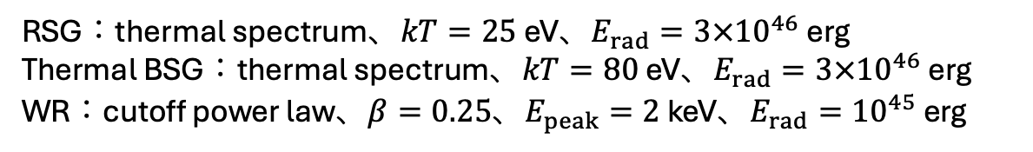
EAGLE spectral response to SN Shock breakout
SN shock breakout from RSG (red supergiant), BSG (blue supergiant),
and WR (Wolf–Rayet star)
models: Nakar & Sari (2010)
RSG：thermal spectrum、$kT=25$ eV、$E_{rad}=3×{10}^{46}$ erg
Thermal BSG：thermal spectrum、$kT=80$ eV、$E_{rad}=3×{10}^{46}$ erg
WR：cutoff power law、$β=0.25$、$E_{peak}=2$ keV、$E_{rad}={10}^{45}$ erg

Slide 36
EAGLE detectability SN Shock breakout
WR, BSG have enough counts in EAGLE energy band, above EAGLE detection fluence limit.
EAGLE fluence limit
RSG is very faint in EAGLE band

Slide 37
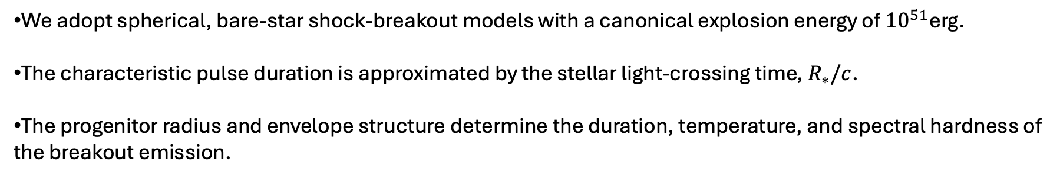
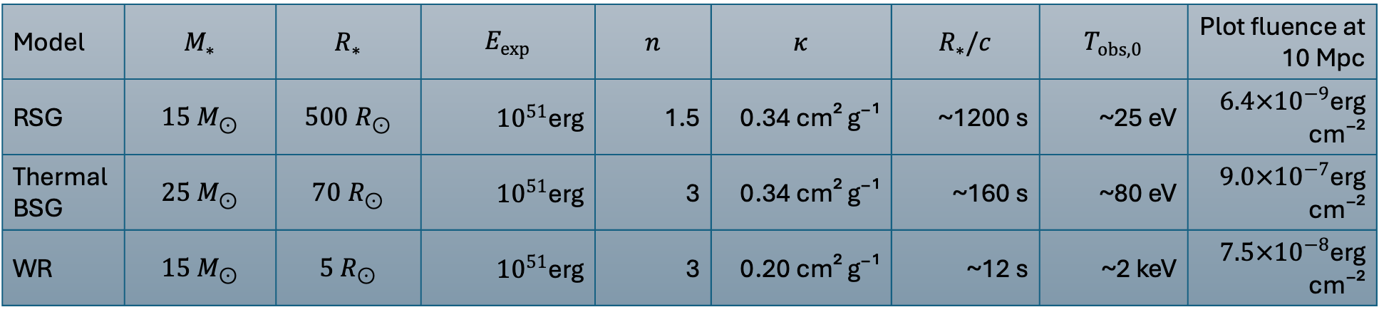
Details of spectral model of SN shock breakout
model details adopted from: Nakar & Sari (2010)
Model | $$M_{∗}$$ | $$R_{∗}$$ | $$E_{exp}$$ | $$n$$ | $$κ$$ | $$R_{∗}/c$$ | $$T_{obs,0}$$ | Plot fluence at 10 Mpc
RSG | $$15 M_{⊙}$$ | $$500 R_{⊙}$$ | ${10}^{51}$erg | 1.5 | 0.34 cm² g⁻¹ | ~1200 s | ~25 eV | $6.4×{10}^{−9}$erg cm⁻²
Thermal BSG | $$25 M_{⊙}$$ | $$70 R_{⊙}$$ | ${10}^{51}$erg | 3 | 0.34 cm² g⁻¹ | ~160 s | ~80 eV | $9.0×{10}^{−7}$erg cm⁻²
WR | $$15 M_{⊙}$$ | $$5 R_{⊙}$$ | ${10}^{51}$erg | 3 | 0.20 cm² g⁻¹ | ~12 s | ~2 keV | $7.5×{10}^{−8}$erg cm⁻²
We adopt spherical, bare-star shock-breakout models with a canonical explosion energy of ${10}^{51}$erg.
The characteristic pulse duration is approximated by the stellar light-crossing time, $R_{∗}/c$.
The progenitor radius and envelope structure determine the duration, temperature, and spectral hardness of the breakout emission.

Slide 38
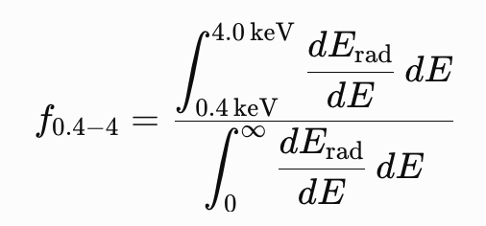
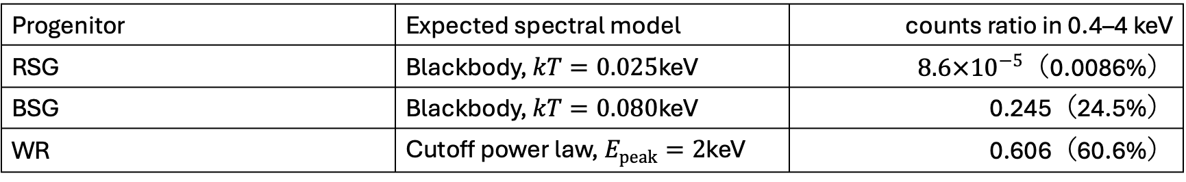
Simplest comparison without EAGLE spectral responce
Assumptions for the detectability plot
Distance: 10 Mpc
Unabsorbed 0.4–4.0 keV fluence
Simple spectral band-fraction estimates
No detector-response folding
EAGLE fluence limit
Progenitor | Expected spectral model | counts ratio in 0.4–4 keV
RSG | Blackbody, $kT=0.025$keV | $8.6×{10}^{−5}$（0.0086%）
BSG | Blackbody, $kT=0.080$keV | 0.245（24.5%）
WR | Cutoff power law, $E_{peak}=2$keV | 0.606（60.6%）

Slide 39
Expected detection possibility for various transients
Detection sensitivity of X-ray transient
Detection sensitivity of follow-up
Swift/BAT
Too late
Observation start
検出感度 (erg/cm²/s)
近赤外線帯の検出限界 (magnitude)
2% of all sky
HiZ-GUNDAM
1日
12% of all sky
F_lim = 1e-10 erg/cm/s
FoV = 0.8 str (24 module)
X-ray | event/yr
GRB (6<z<12) best | 26
GW/SGRB prompt | ~8
GW/SGRB E.E. | ~8
GRB/SGRB | ~700
Low-Luminosity GRB | > 5
X-Ray Flash | 50
X-ray | event/yr
Tidal Disruption | 60
SN Shock Breakout | > 5
Stellar Flare | many
Direct collapse BH | a few
Accretion induced collapse | ~10
Near Infrared | event/yr
afterglow (6<z<12) best | 13
macronova | ~8 + α
Supernovae | 40
afterglow of GRB/SGRB/XRF | many
Variable stars | many

