Slide 1

The Data-Driven Approach to Modeling Backgrounds in Optical Transient Searches
Seiji TOSHIKAGE in collaboration with
Masaomi Tanaka, Shigeo S. Kimura (Tohoku U.),
Nobuhiro Shimizu, Wataru B. Iwakiri, Shigeru Yoshida (Chiba U.),
Tomoki Morokuma (Chiba Tech), and IceCube follow-up team

Slide 2
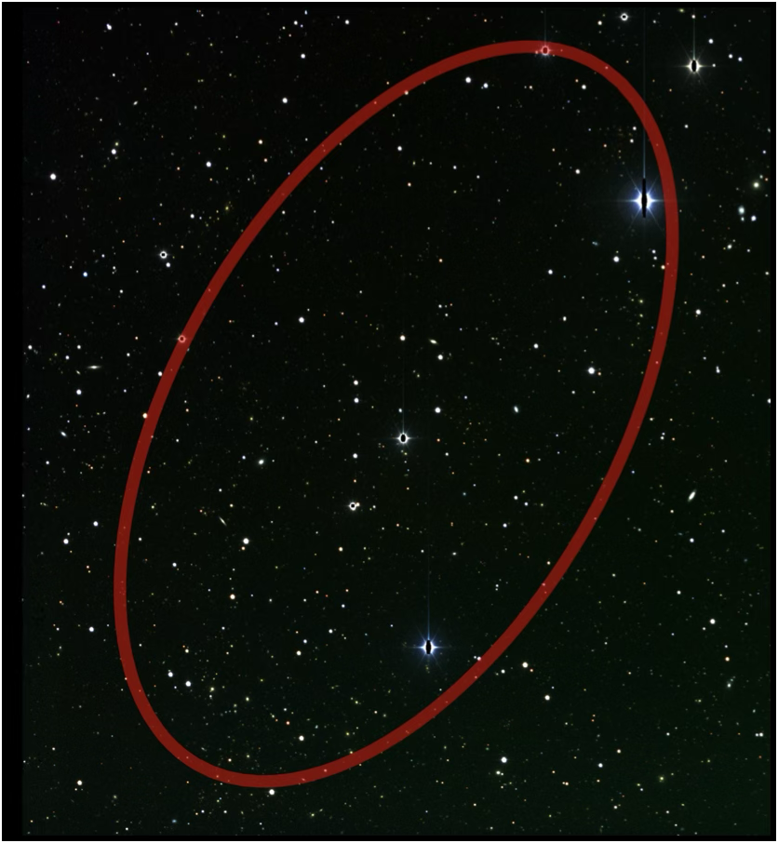

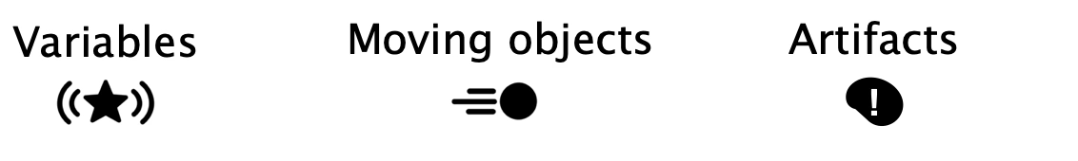
Optical counterpart search
Background characterization is essential before arrival-direction analysis
1. Astrophysical transient
    → Simulation-driven estimate
2. Non-transient objects & artifacts
    → Data-driven measurement
Explosive transient (SNe, TDEs)

Slide 3
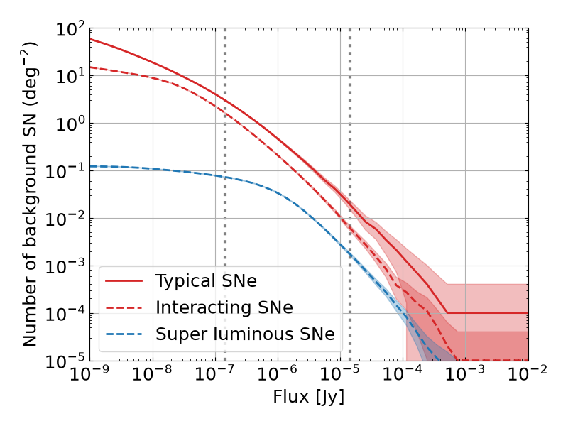
Astrophysical transient background
Subaru/Rubin
ZTF
Low astrophysical transient background for multiplet

Slide 4
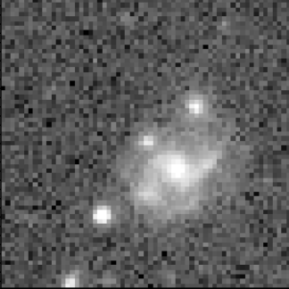
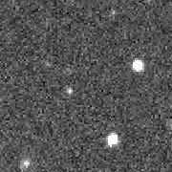
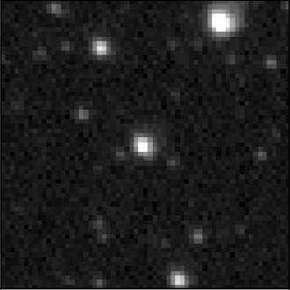
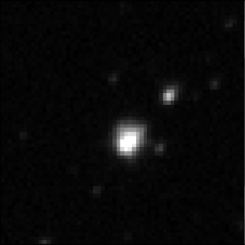
In real data …
Background in optical transient counterpart search
Astrophysical transient
Astrophysical
poorly-modeled background
Non-astrophysical
background
SNe, TDEs
moving objects
variable stars
artifacts
Difficult to simulate (poorly modeled/depend on data quality, instrument,…)
→ Data driven approach !

Slide 5
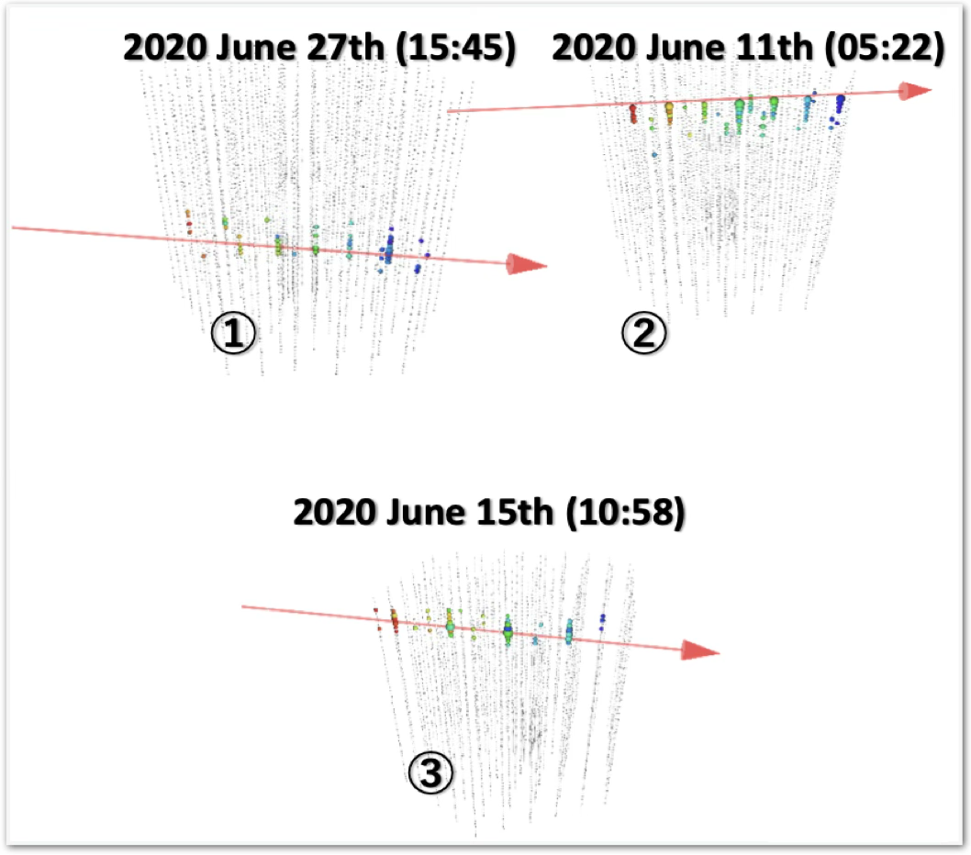
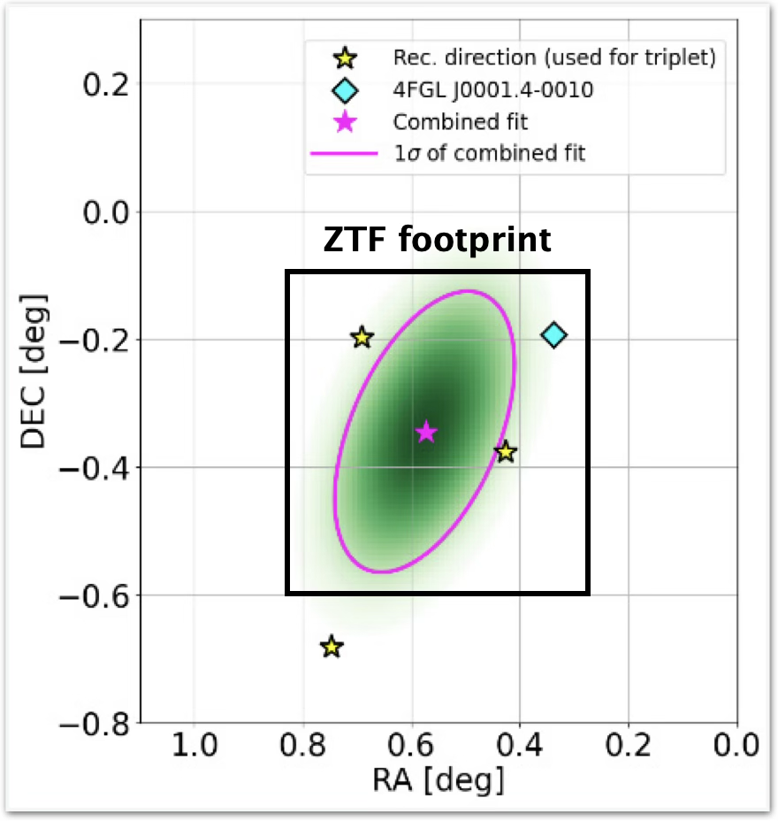
A neutrino triplet event in June 2020
IceCube collaboration 2025
Month-timescale neutrino triplet!
Serendipitous ZTF observations!
From Nobu Shimizu’s slide
The first opportunity to search for an optical counterpart to a neutrino multiplet

Slide 6
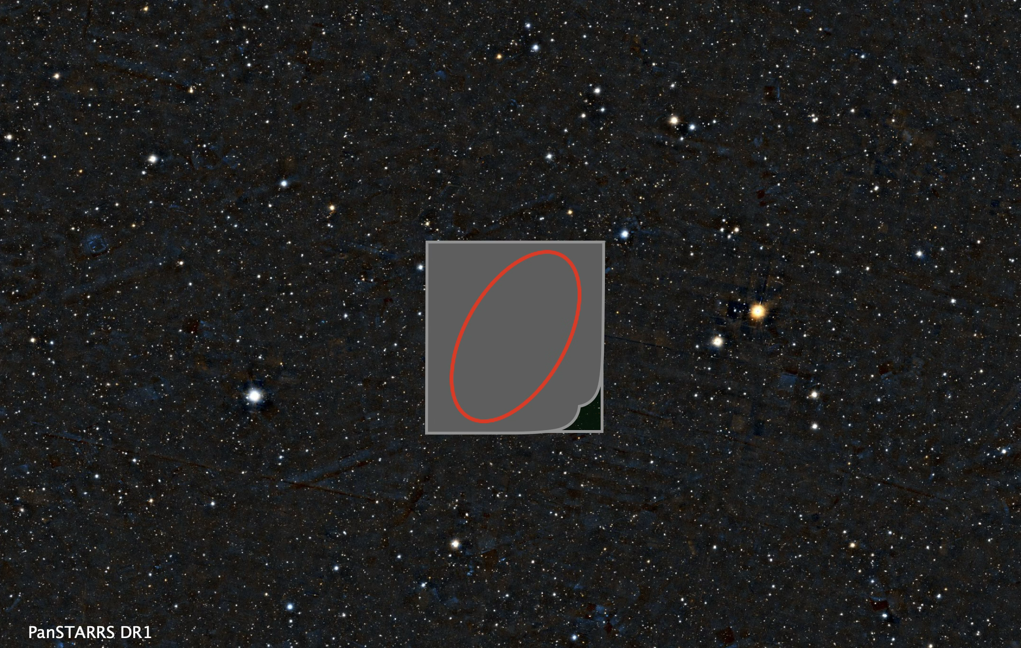
Data driven approach through blind analysis

Slide 7





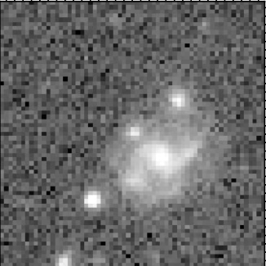
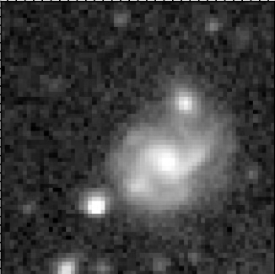
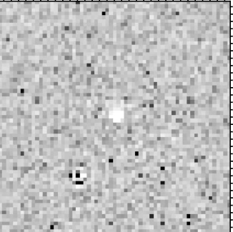
Data analysis: ZTF general filtering procedure
Image quality
Multiple detections
No galactic star
All detections
Transient
New
Diff
-
Old
=
Artifacts
Moving objects
Variables

Slide 8
Data analysis: ZTF general filtering procedure
Image quality
Multiple detections
No galactic star
All detections
Recovery rate
has not been measured
Room to
reduce background
~ 0.1
per sq. deg
Artifacts
Moving objects
Variables
Optimize for month-timescale optical counterpart search

Slide 9
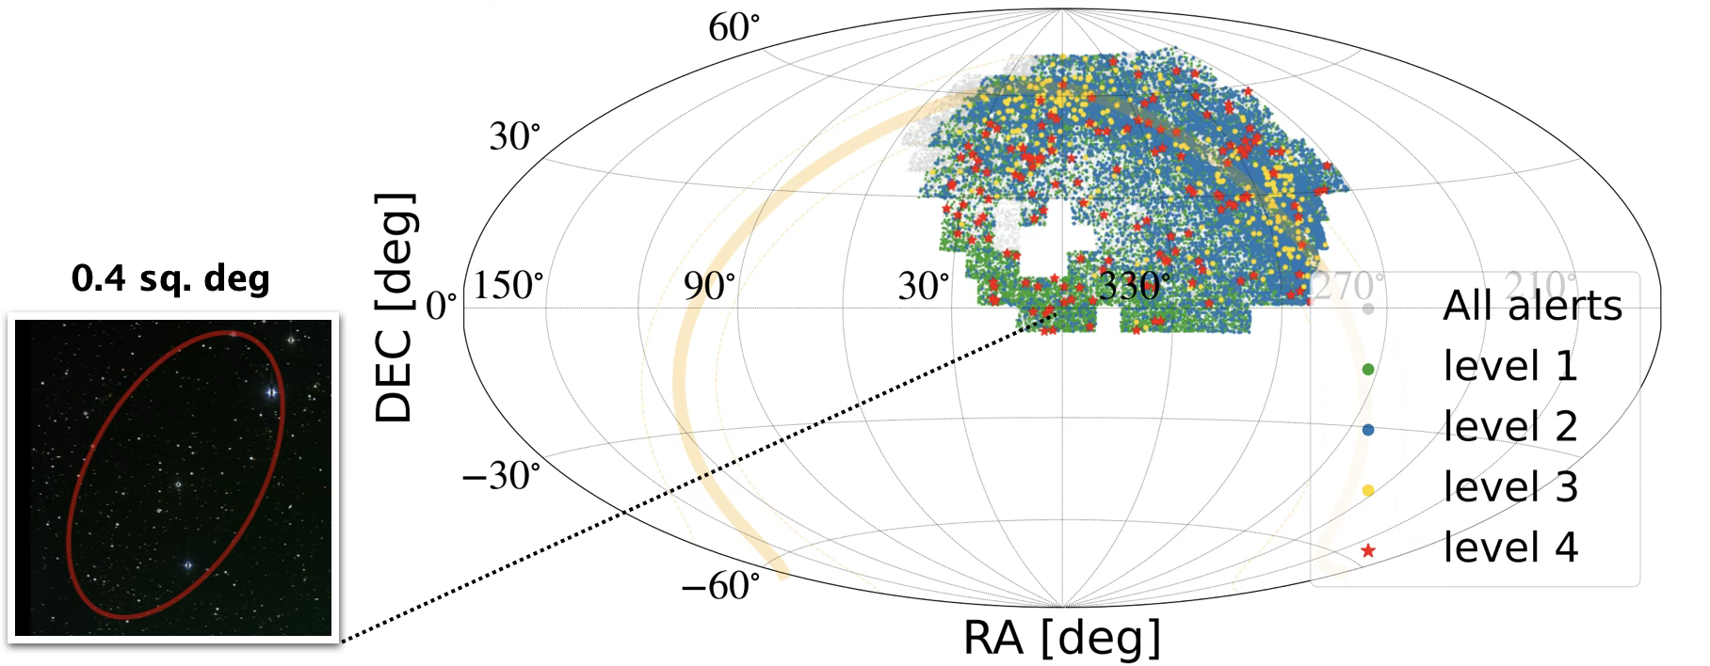
Background estimation
Using background area ~ 16,000 times larger than target area

Slide 10

Data analysis: optimized for counterpart
No galactic star
No galactic star criterion
Transient-like
Variable-like
Classification score
Pass
Cut
ZTF
New
Low background rate!
BUT, low recovery rate …
High recovery rate!
BUT, high background rate …

Slide 11

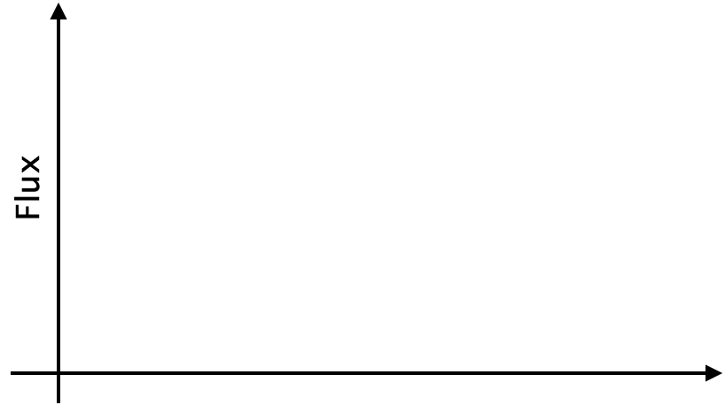
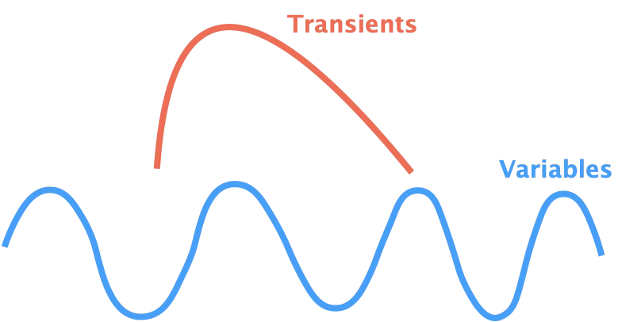
Data analysis: optimized for counterpart
No galactic star
No persistent source
No persistent source
High recovery rate!
AND, low background rate !
High recovery rate!
BUT, high background rate …

Slide 12
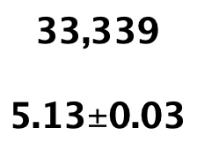
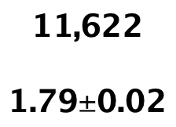
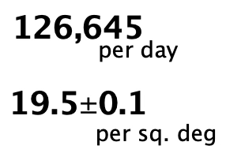
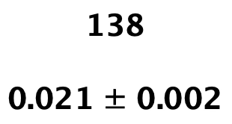

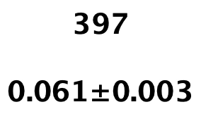
Data analysis:
Image quality
Multiple detections
No galactic star
No persistent source
All detections
Predefined criteria optimized through data-driven measurements

Slide 13
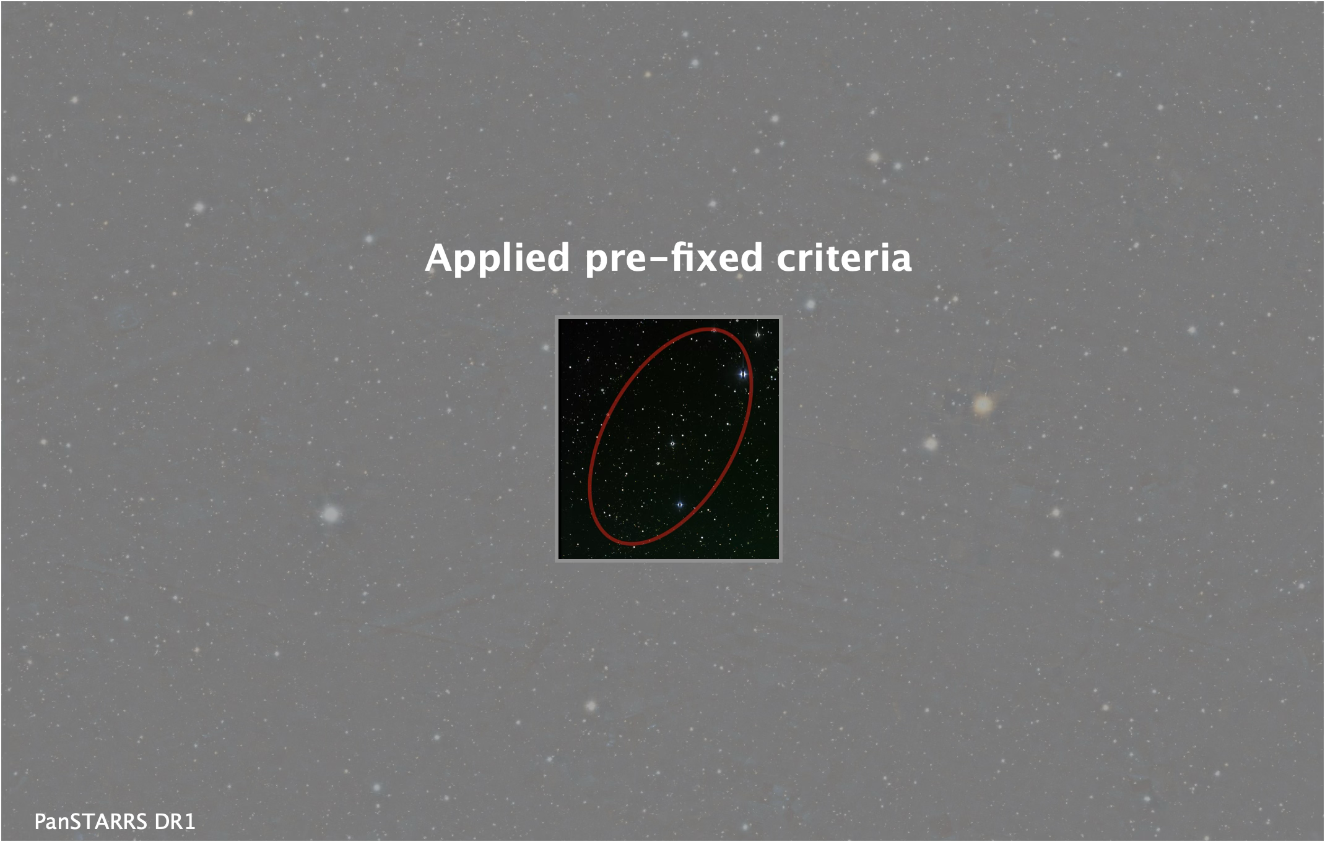
Finally, unblind the data!
No candidate was found in the multiplet direction

Slide 14
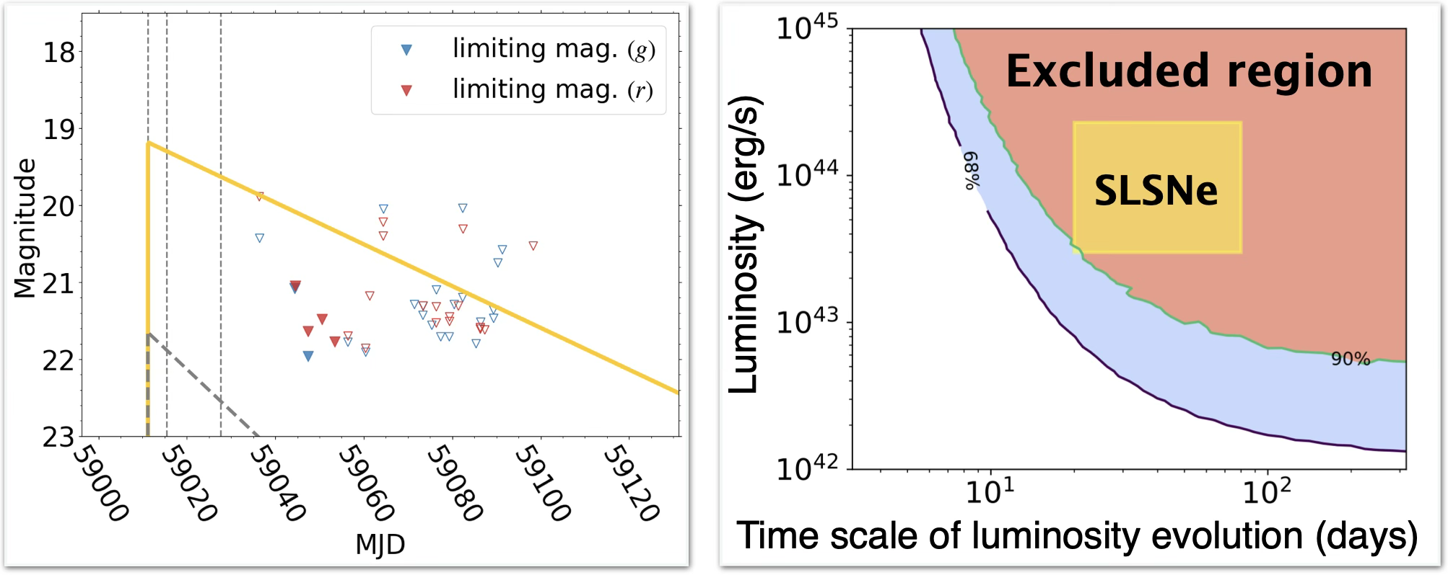
Results: Constraints from non-detection
Confirmation of low-background&high-recovery rate a priori
One multiplet search can put meaningful constraints on source properties

Slide 15
Summary
Background characterization in optical counterpart search
  Poorly modeled background (e.g., artifacts, moving objects)
  → data-driven approach is needed
We did a pilot work for IceCube triplet event in 2020
  Prefixed criteria through data-driven approach
    High recovery rate ~ 0.983 for typical source
    Low background rate ~ 0.02 per sq. deg per epoch
  Demonstrated that non-detection gives stringent constraints on source properties

Slide 16
Appendix

Slide 17
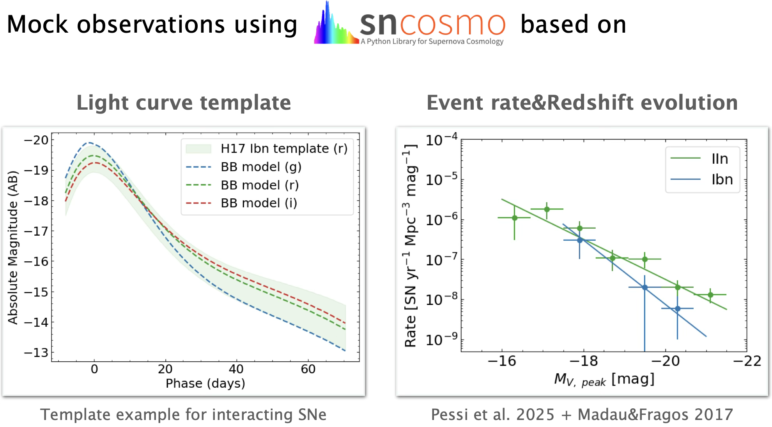
Simulation-driven estimate 1

Slide 18
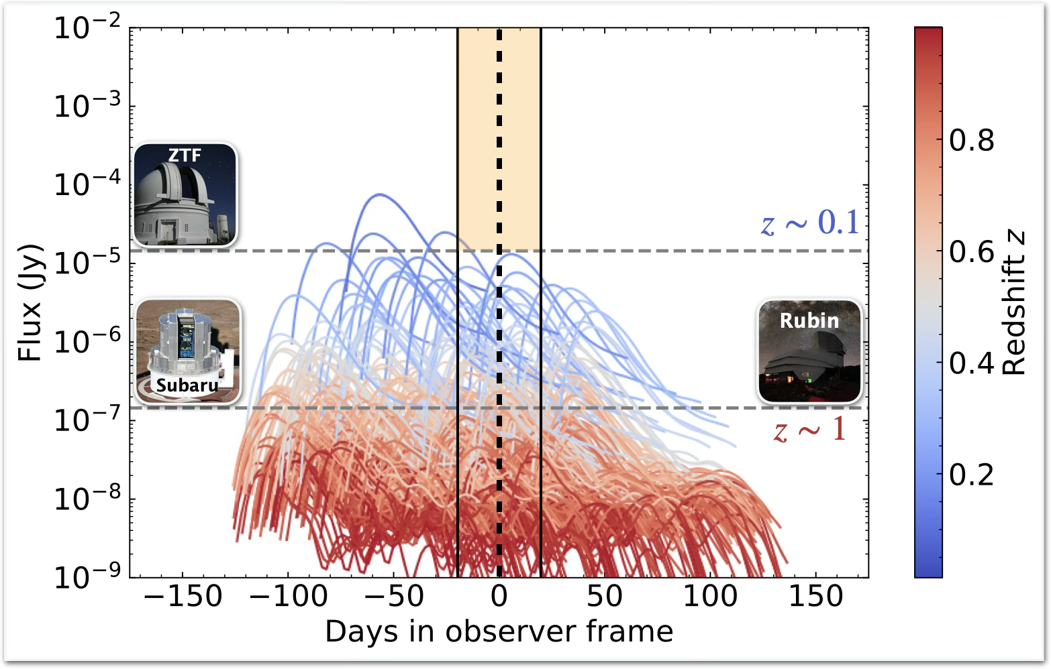
Simulation-driven estimate 2

Slide 19
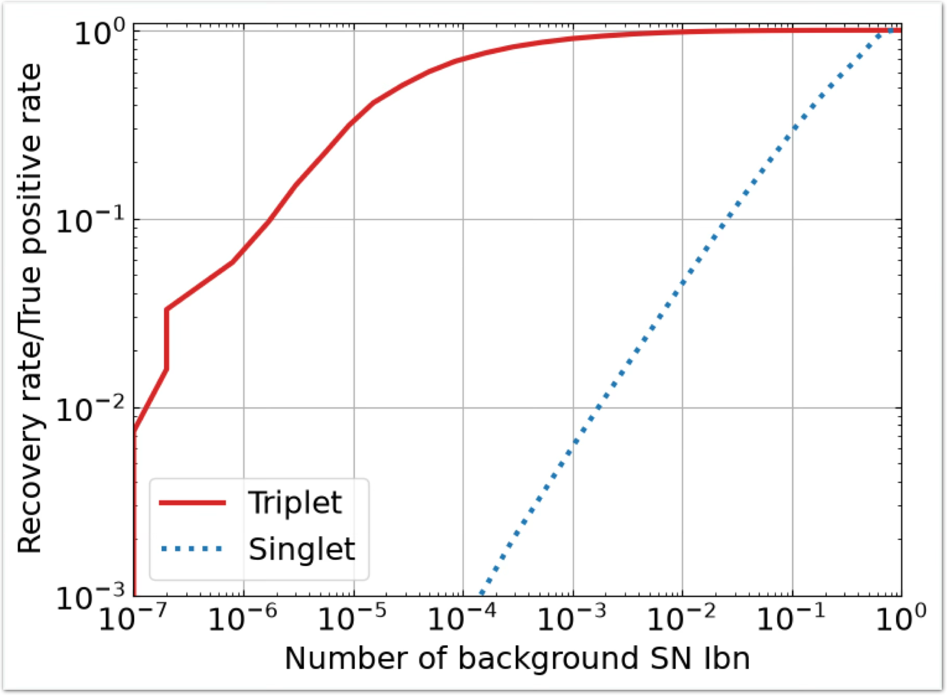
Recovery rate vs Background rate

Slide 20
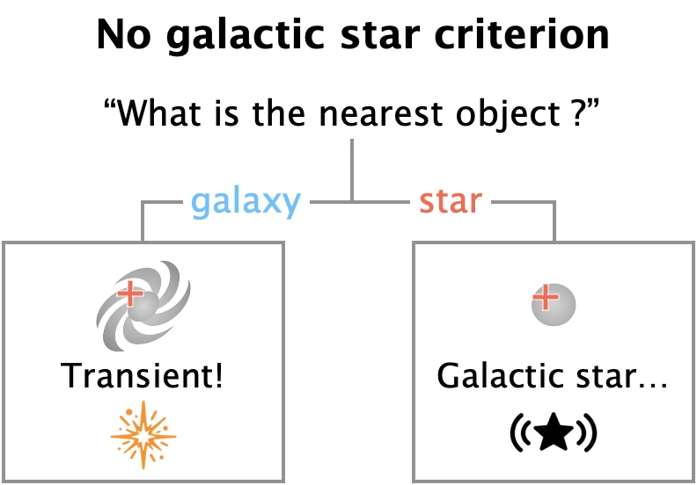
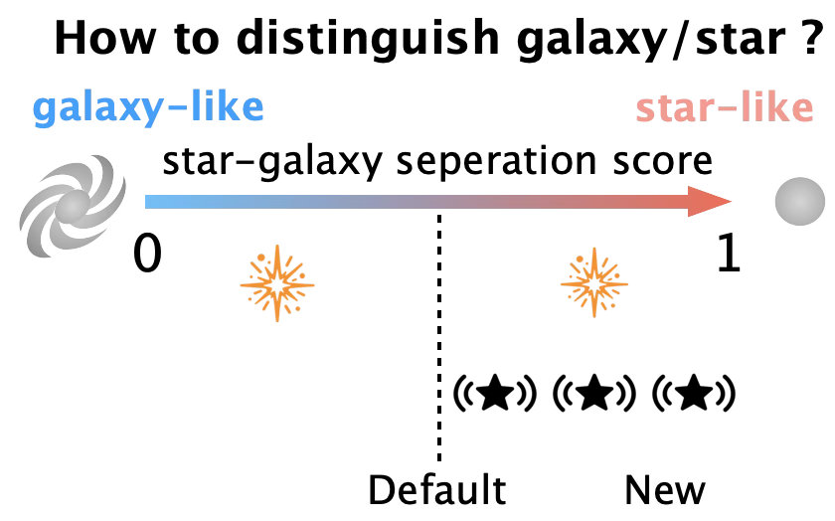
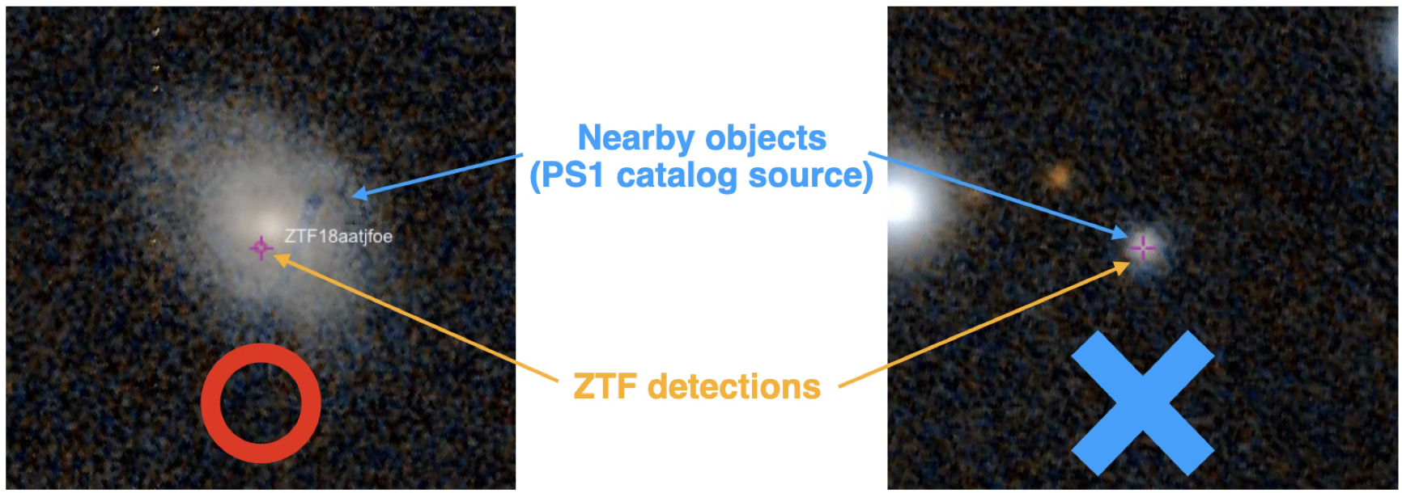
No galactic star criterion

Slide 21
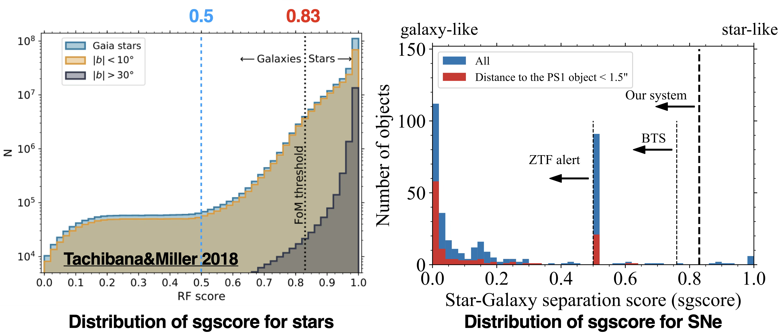
Star-galaxy separation score

Slide 22
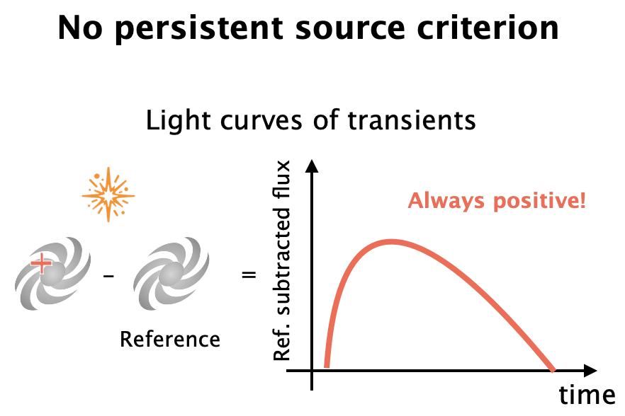
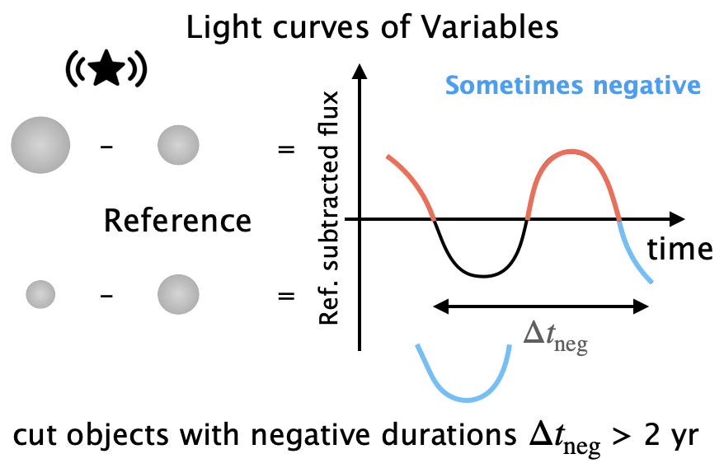
Light curve cut

Slide 23
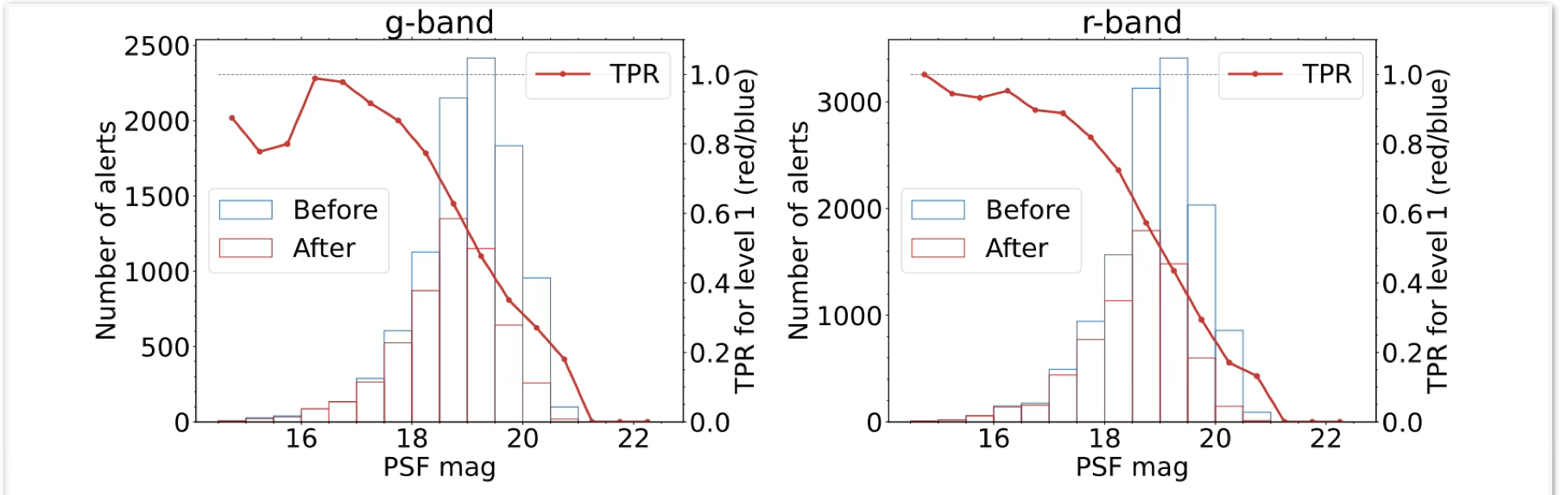
Flux dependence of recovery rate

Slide 24
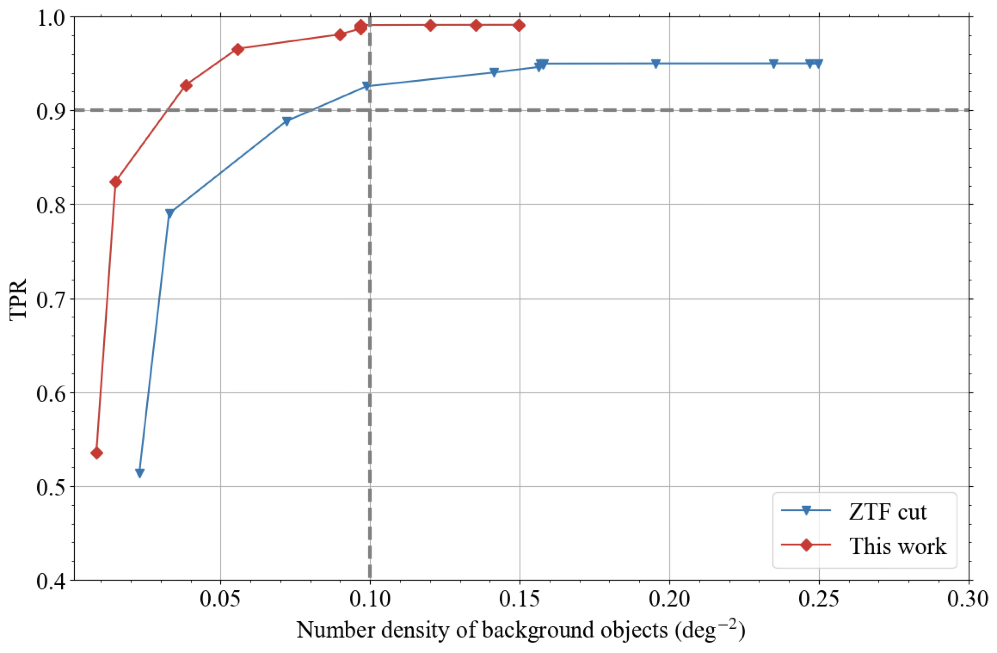
Recovery rate vs Background rate

Slide 25
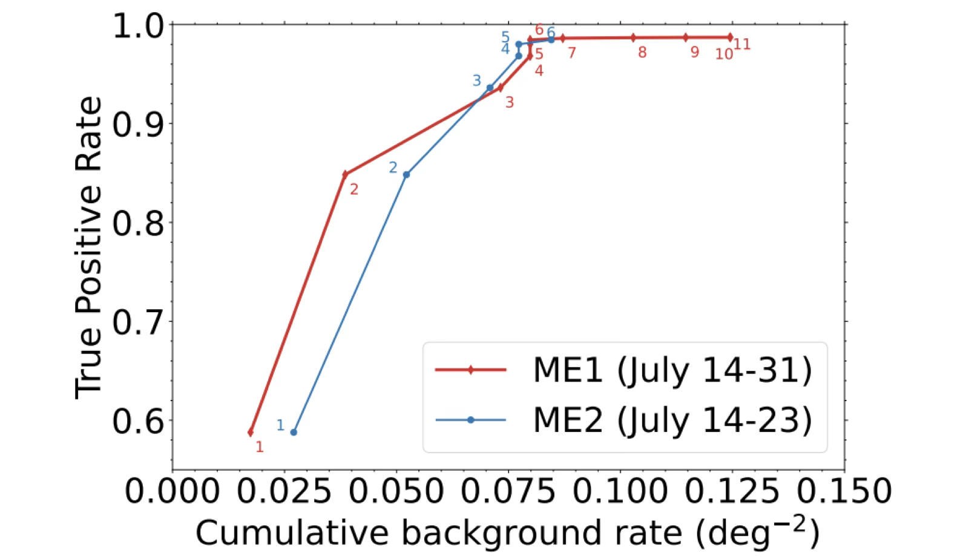
Recovery rate vs background rate

