Slide 1
CAMELOT and IXPE: All-Sky Monitoring and Polarimetry for Multimessenger Astrophysics (3)
T. Mizuno (Hiroshima Univ.)
on behalf of the CAMELOT and IXPE team
2025 Nov. 19, Annual Conference on Multi Messenger Astrophysics @ Miyagi
Notes:
Hello everyone
Introduce CAMELOT and IXPE with updates; unique and important missions for MM (and MW) astrophysics

Slide 2
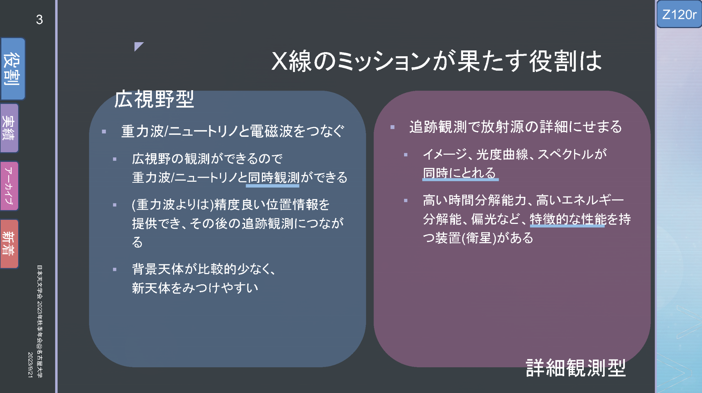
Introduction: Role of X-ray Missions in MM Astrophys.
(Adopted from M. Serino’s slides at ASJ meeting, 2023.09)
(Wide FOV)
CAMELOT
and
IXPE
Imaging, photometry (light curve), spectroscopy, and polarimetry
Simultaneous obs. with GW/neutrino events
(Follow-up)
Notes:
Let me introduce the roles of X-ray mission in MM (in general)
Slides taken from Motoko’s talk (in 2023)
We can classify them into two types: Firstly, wide FOV. Secondly, in-depth follow-up obs.
We can achieve two roles by CAMELOT and IXPE, respectively

Slide 3
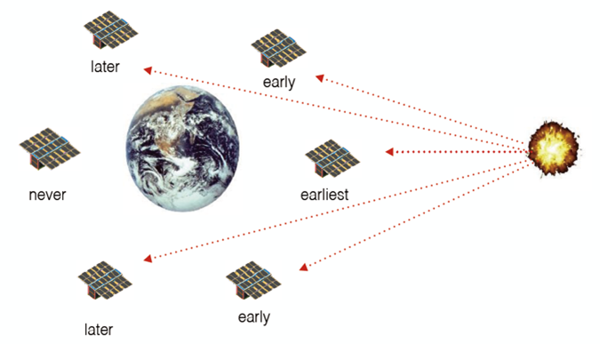
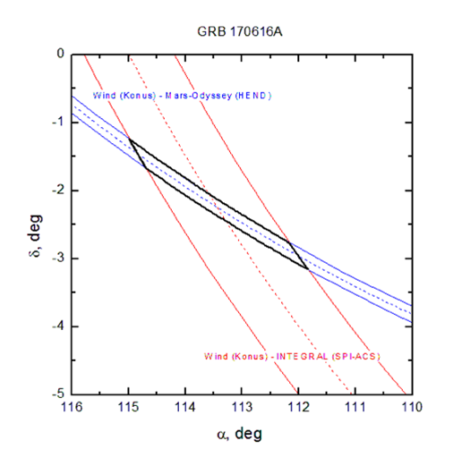
Wide FOV Obs. with a Fleet of Nano Sat.
Simultaneous observation using GW/neutrino and EM wave is essential for MM Astrophys (e.g., GW170817, IC-170922A)
We need to monitor all sky (~4π sr) with good angular resolution (<=1deg)
~10 nano satellites allow all-sky monitoring in hard X-ray and gamma rays
Timing-based localization; triangulation principle with different arrival time (<=0.1 ms) enables sub-degree localization
Notes:
Let’s me first discuss wide FOV observations
Simultaneous obs. is essential
We need to monitor all-sky with good angular resolution; both are important
Our solution: all-sky monitoring with a fleet of nano satellites
(left) ~10 satellites to monitor all sky
(right) also timing-based localization for sub-deg resolution

Slide 4
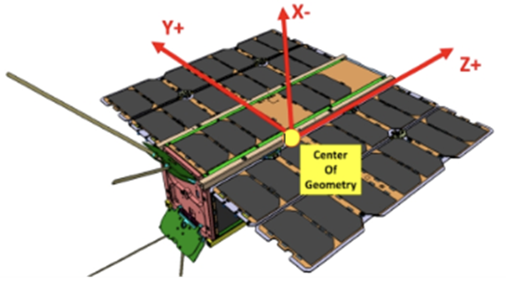
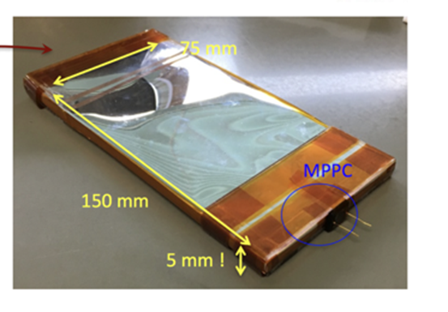
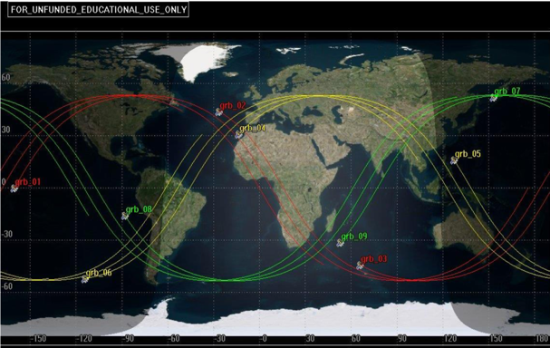
CAMELOT Mission
Hungarian-Japanese-Czech-Slovak project using standardized nanosatellites
Werner+18
Ohno+20
Satellite platform | 3-U cubesat platform
Target orbit | >=9 satellites constellation in LEO with various orbital configuration
Payload | 150x75x5 mm³ CsI readout by multi-channel MPPCs
Goal | Degree-scale timing-based localisation with a similar sensitivity to the Fermi-GBM
Notes:
The project (we put forward) is called CAMELOT
being developed through collaboration among H, J, C, S
(table) 3-U cubesat (left), 9>=satellites constellation (btm), CsI scintillator+MPPC (right), all-sky degree-scale localization

Slide 5
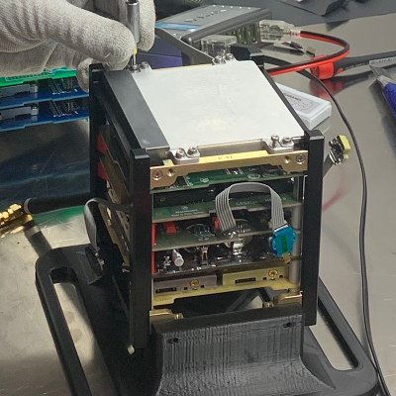
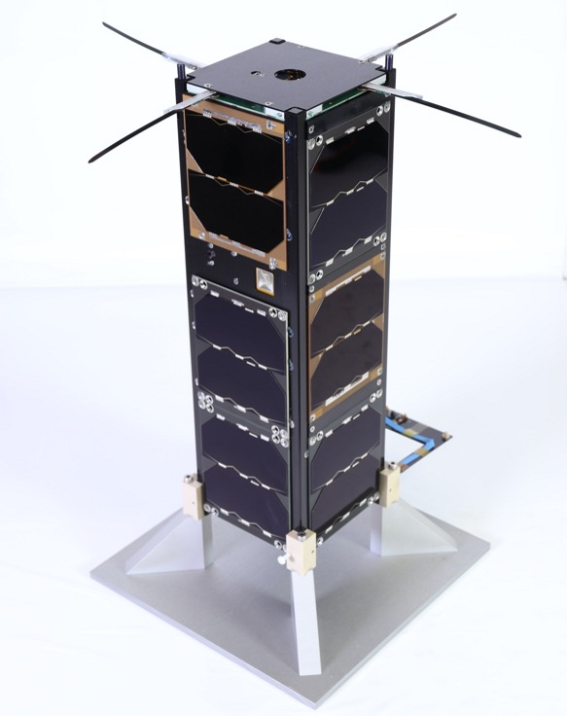
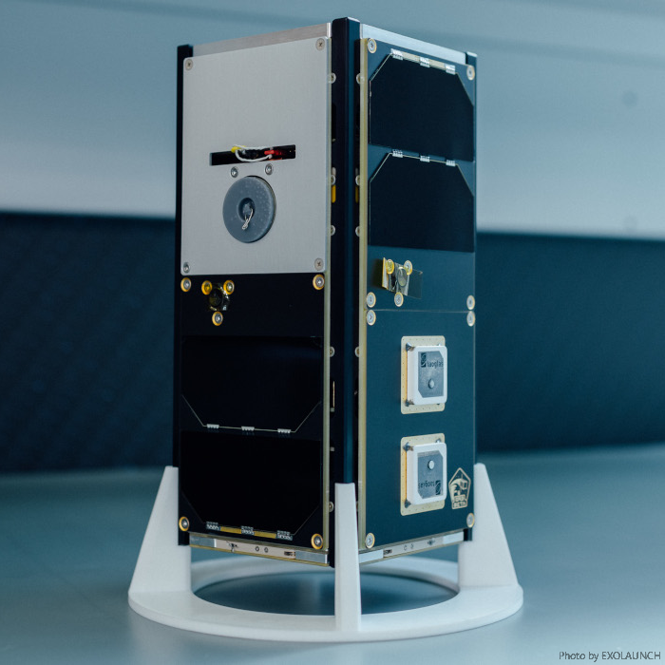
Mission Status
Pal+23; Ripa+22; Münz+24
3 demonstration satellites in/completed operation
GRBbeta; 2U-sized next technological precursor, planned in 2024
GRBalpha (2021.03-2024.06); 1U-sized prototype satellite (https://grbalpha.konkoly.hu/)
・has smaller detector, but the same basic concept
VZLUSAT-2 (2022.01-); 2 prototype detectors as 2ndary payloads (https://www.vzlusat2.cz/en/)
・allows simultaneous GRB detection using nanosatellites
GRBbeta (2024.07-); 2U-sized technological precursor (https://grbbeta.tuke.sk/index.php/en/)
・tests several technologies such as attitude control and UV camera
Notes:
Here I show the mission status
3 demonstration satellites in/complated operation
GRB alpha, VZLUSAT-2, and GRB beta
GRBalpha; demonstrate GRB obs. by nanosat.
VZLUSAT-2; (with 2 cameras for Earth obs., etc.) GRB detectors as 2ndary payloads
GRBbeta; technological precursor

Slide 6
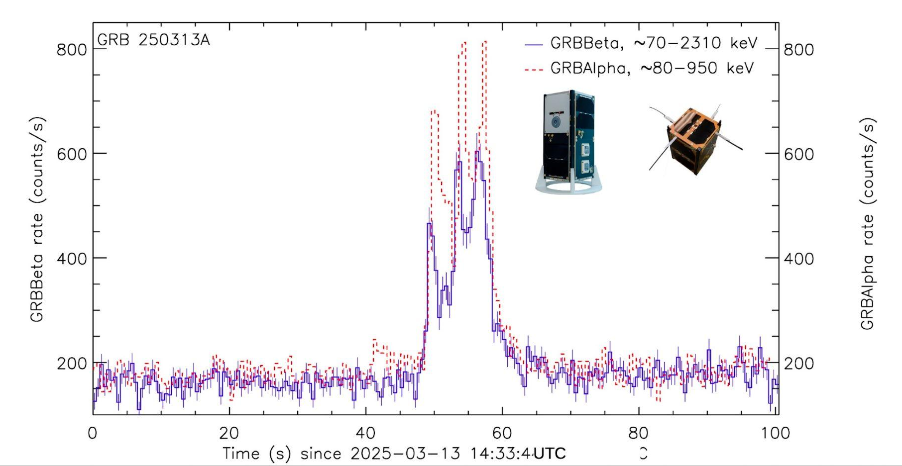
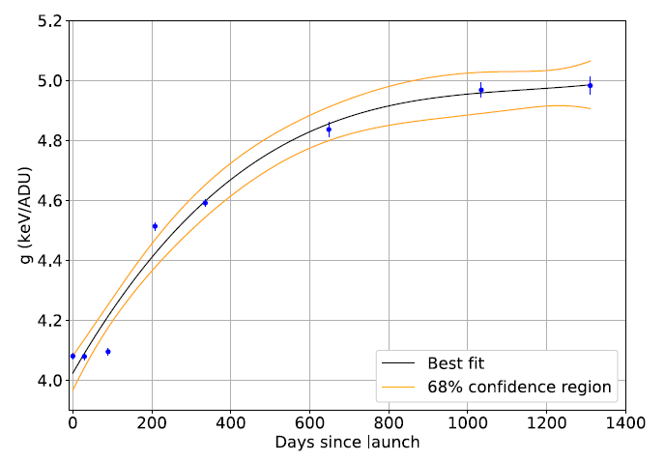
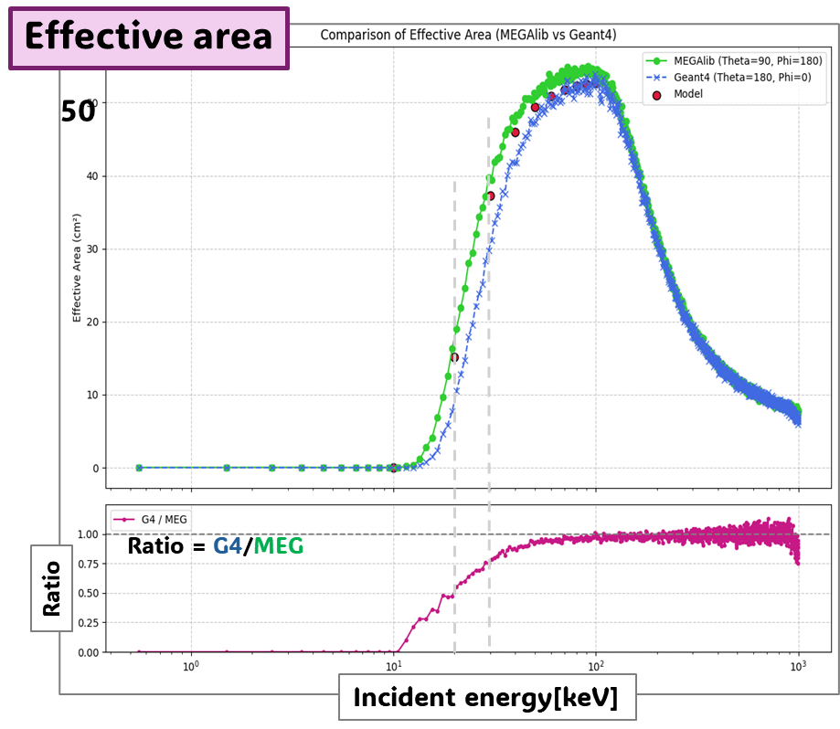
In-orbit Performance
Pal+23; Ripa+22&25; Münz+24
GRBalpha completed >4 yrs operation successfully
>200 transients detection
Characterization of MPPC degradation in LEO (Ripa+25)
Mass model and detector response of GRBalpha&VZLUSAT-2 being developed (Yokota)
GRBalpha & GRBbeta joint detection
new mass model
old mass model
● expectation
gain shift in orbit
Statistics of significant detection
validation of mass model (GRBalpha geometry)
(as of 2025.11.13) | GRBalpha | VZLUSAT-2
GRB (short) | 127(23) | 70(10)
Solar flare | 101 | 74
SGR | 2 | 3
GRB beta: commissioning completed
testing UV camera (precursor for future UV obs.) and attitude control
also confirming transient detection (12(L)+1(S) GRBs since 2025.03)
Light curves of detected events are in public (one transient per ~5 day)
Notes:
Here I show the in-orbit Performance (and relevant activities)
GRBalpha completed operation successfully
(left) Characterization of MPPC degradation in LEO # with minimum sheelding
We develop mass model and detector response in a common scheme
(middle) validation of mass model
GRB beta; started operation
Testing of UV camera (kilonova) and attitude control # moon picture in backup
confirming transient detection; joint detection of GRB (right) # 0.5s but now 0.125s
Statistics of detection; light curve data are in public (data in text format)

Slide 7
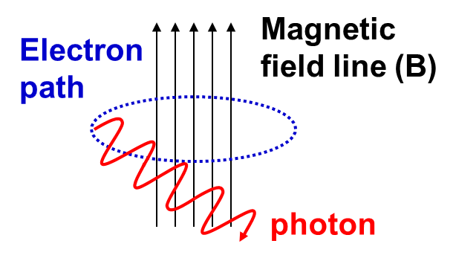
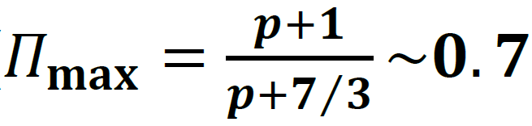
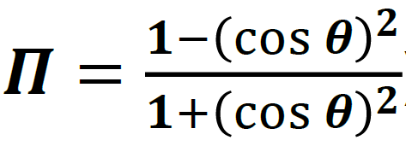
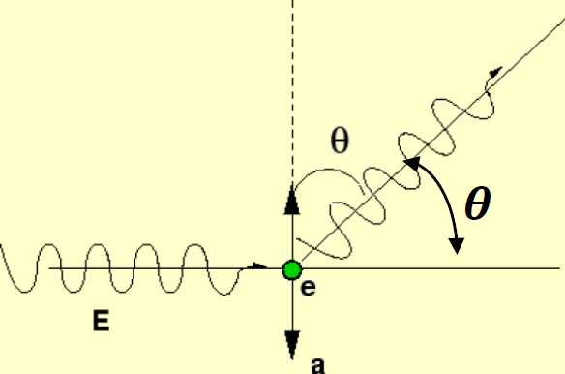
X-ray Polarimetry for Proving Mag. Field and Disk/Conona Geometry
HE e- + B-field produce synchrotron radiation polarized ( ) on electron’s orbital plane
Unique probe for B-configuration (and accelerated electrons)
Scattered photos are polarized ( along the plane of scattering
Unique probe for geometry of disk/corona around compact objects
We can investigate B-field & disk/corona using X-ray polarimetry by IXPE
Polarization vector
⊥ B direction
)
Notes:
Now let me move to the follow-up observation w/ X-ray polarization
(title) Polarization is a unique probe for B (synchrotron) and disk/corona (IC)
HE e- produce sync. that is highly polarized; probe magnetic field configuration and HE-e of PSR, PWN, AGN jet, etc.
Scattered photons are polarized; probe for geometry of disk and corona (around SmBH and SMBH)
We can investigate geometry by IXPE

Slide 8
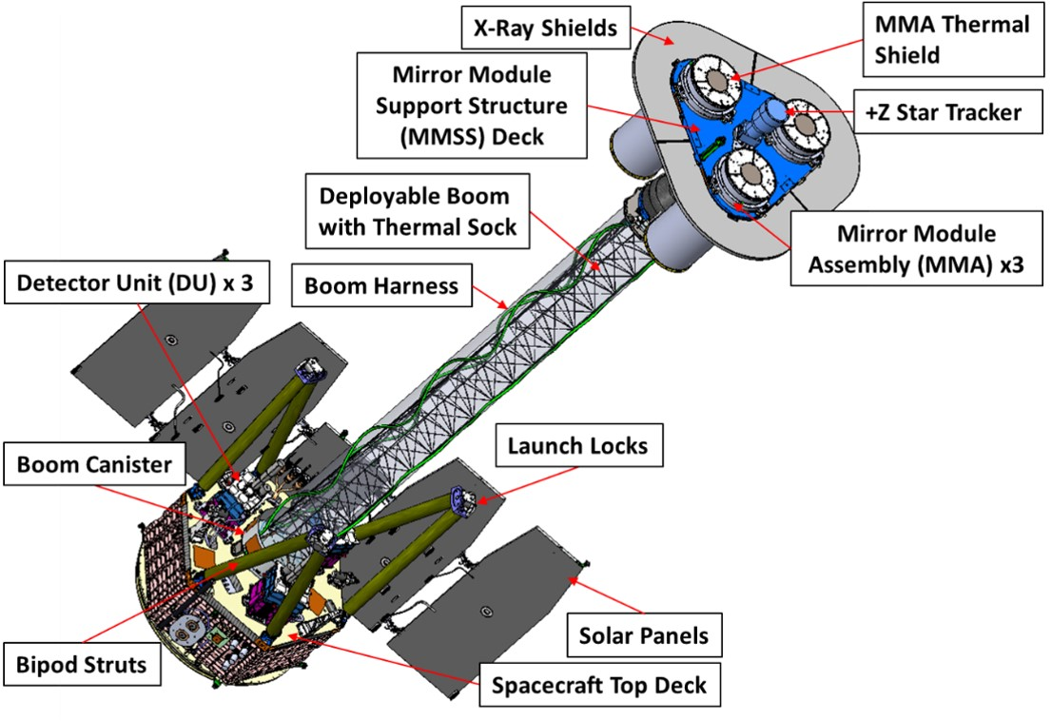
IXPE Mission
The first mission devoted to spatially-resolved X-ray polarimetry
NASA SMEX mission, launched in 2021 Dec
Bilateral collaboration btw. NASA/MSFC & Italian Space Agency (w/ Japanese group providing key devices)
2 year mission (baseline) + Guest Observer Program (2024 Feb.-)
Imaging-polarimetry in 2-8 keV for the first time
Data are archived by NASA’s HEASARC, released 1 week after the completion of the observation
Unticipated ToO can be requested via IXPE website; latest example is that for Crab PSR after glitches (see also Goya’s poster for PWN analysis)
DU1+2+3 PA map
3 x (Mirror + Gas Pixel Detector)
FOV=12.9’ x 12.9’, HPD=25”, μ₁₀₀>0.5 achieved
(see Weisskopf 18)
Notes:
Let me show IXPE overview
First mission devoted to “X-ray imaging & polarization”
US, Italy, Japan
2y baseline（GO started in 2024.02）
(fig) 3x(X-ray mirror and gas polarimeter)
Imaging polarimetry in 2-8 keV
Data archived and made public soon after the observation
Unticipated ToO possible (Crab glitch in 2025.Jul.&Aug; obs. in 2025.Sep)
=====
＃Cycle1は2024/02/Bから2025/01/Eまで
＃Cycle2は2025/02/Bから2026/01/Eまで
＃Cycle3は2026/02/Bから2027/01/Eまで
諸源補足：Equatorial orbit (600-km altitude), 100 times more efficient (less exposure required) than OSO-8 (Weisskopf+78)

Slide 9
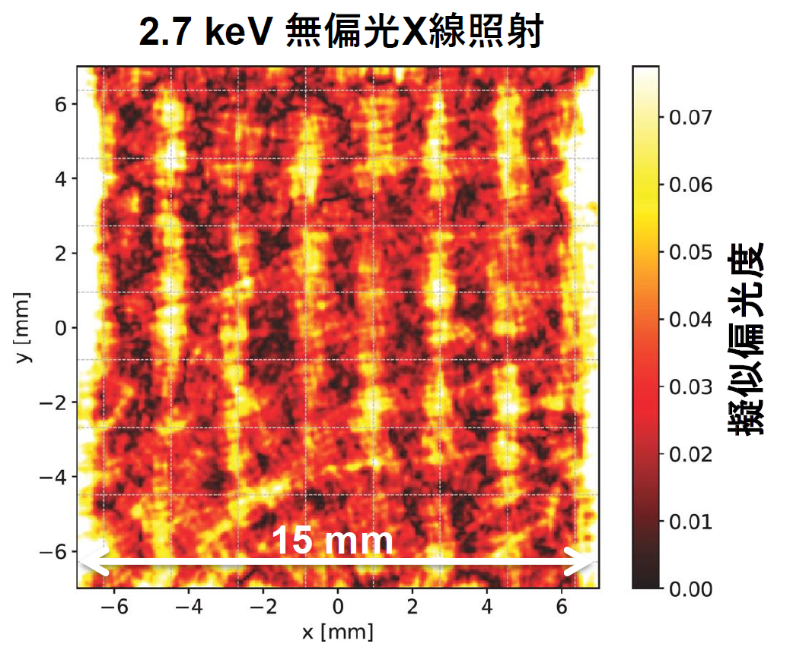
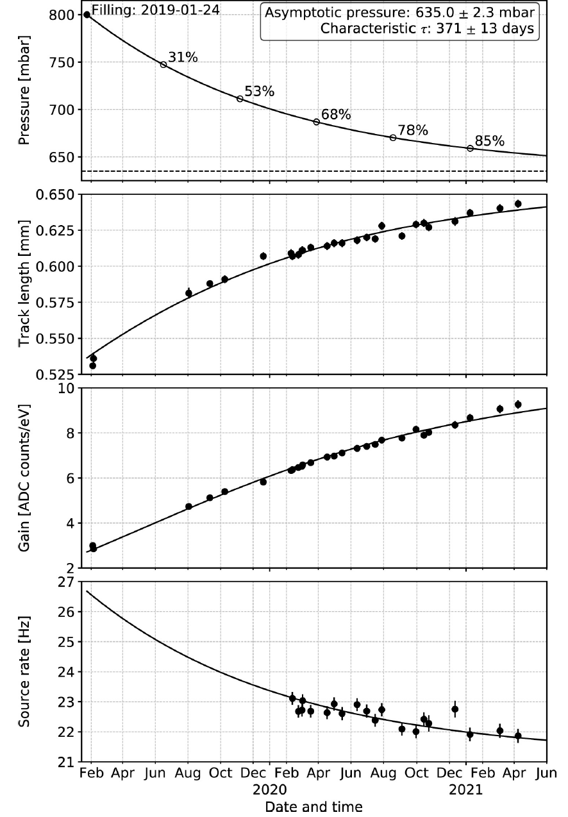
Notes on Detector Performance in Orbit
GPD pressure decrease gradually (known issue before the launch)
will affect efficiency, track length, and gain (and instrumental response)
We continuously monitor the efficiency and update responses
DU2 anomaly since 2025.04
Part of readout ASIC not work
We continuously take data, but need to re-calibrate the spurious modulation correction
DU2 date (after 2025.05) removed temporary. Stay tuned
Notes:
Let me report detector performance in orbit
Gas pressure decreases gradually (know feature; top shows pre-launch history of p)
Affect detector performance
Continuously monitor efficiency and update response twice a year
(No problem if you chose adequate response)
[#click] DU2 anomaly
Part of readout ASIC not work (2025.04-)
Need to re-calibrate spurious modulation (due to non-uniformity of amplification foil, GEM)
Temporary remove from data; stay tuned

Slide 10
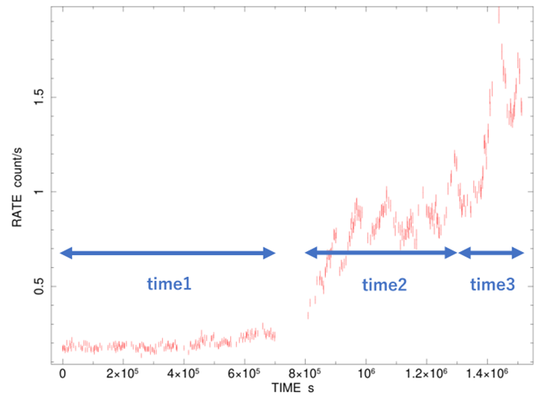
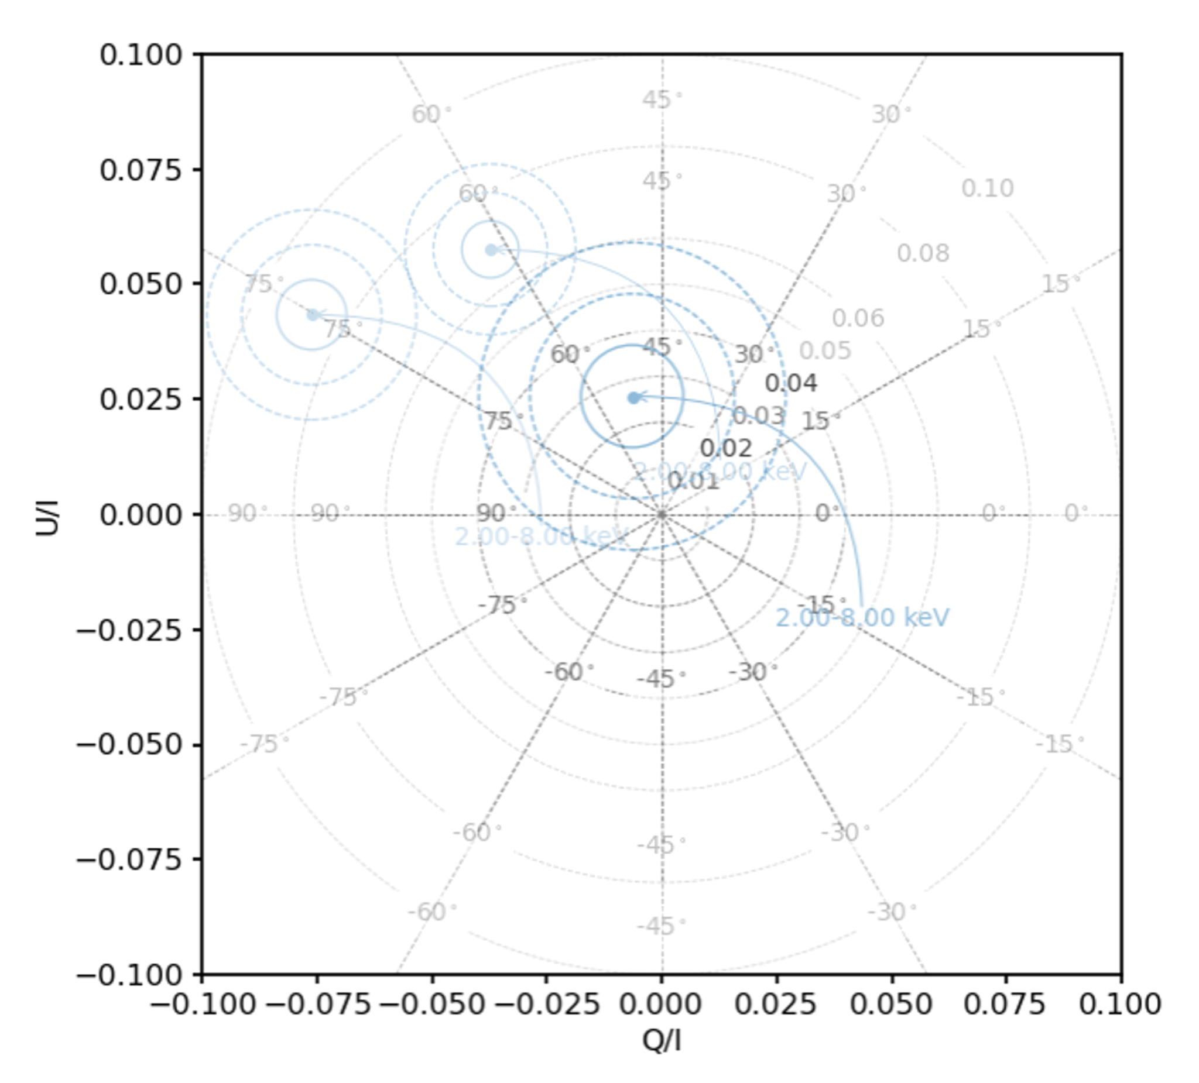
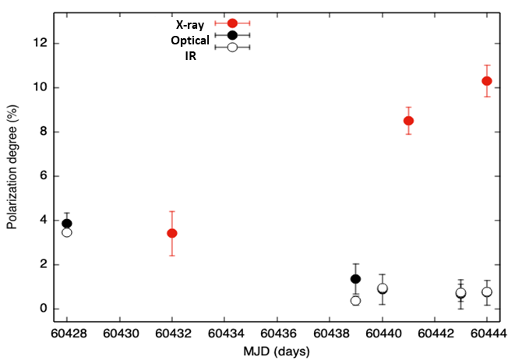
Science w/ IXPE : Multi-λ Polarimetry of Mrk 421
High-synchrotron-peaked blazar (at z=0.031)
Flux increased by x10 in 2024; Coordinated polarimetry in X-ray (IXPE) and IR&opt. (Kanata)
2024/04/28 5/14
(Tochihara+25 @ASJ meeting)
T1 T2 T3
Significant change of PD_{X} by Q/U analysis
During the flare, only PD_{X} increased
(PD_{IR} & PD_{opt} stayed low and stable)
HE particles are localized and unrelated to those producing IR/opt.
PD_{X} of T1 is lowest among past observation; likely depends on the flux
T3 T2
PD=10%
T1
X-ray
IR/Opt.
Notes:
Finally let me introduce science casen with IXPE; multi-λ Mrk 421
Famous HBL (extragal TeV source), has been observed to study jet
Flux increased by x10 in 2024 (upper right); simultaneous observation by IXPE (X-ray) and Kanata (IR/opt) polarization
(left) PA (B-direction) almost constant, increase of PD (statistically significant in Q/U plane)
(lower right) Only PDx changed; HE particles are localized and unrelated to LE ones
Also, PDx of T1 lowest among past obs (2022,2023,2024); likely PD depends on the flux
Discussion in progress. Stay tuned
=====
# 2D gaussianだと1sigmaで39%, 2sigmaで87%, 3sigmaで99%

Slide 11
Summary and Future Prospect
All-sky monitoring and X-ray polarimetry are crucial in multimessenger (and multiwavelength) astrophysics
CAMELOT mission enables all-sky monitoring in hard X-ray with good spatial resolution using fleet of nanosatellites
Demonstration satellites; GRBalpha, VZLUSAT-2 and GRBbeta
GRBalpha completed operation successfully
One transient per ~5 day and light curves are publicly available (GRBalpha and VZLUSAT-2)
GRBbeta was launched last year; testing technologies and detecting transients
IXPE is the first mission devoted to spatially-resolved polarimetry in soft X-rays
Data are made public after completion of observation, ToO also possible upon request
GPD pressure change and DU2 anomaly (no need to worry once you understand them)
It reveals B-configuration of AGN, PWN, etc. (also reveals disk/corona geometry)
Thank you for your attention
Notes:
OK, here is the summary
（May skip if time is short）
All-sky monitoring and X-ray polarimetry crucial
CAMELOT mission enables all-sky monitoring; 3 demonstration missions in/complated operation
Testing technologies; joint GRB detection
IXPE enables imaging polarimetry for the first time
data is open and ToO possible upon request; reveals B-field (and disk/corona)

Slide 12
References & Useful Links
GRBalpha transient light curves (https://monoceros.physics.muni.cz/hea/GRBAlpha/) and website (https://grbalpha.konkoly.hu/)
VZLUSAT-2 transient light curves (https://monoceros.physics.muni.cz/hea/VZLUSAT-2/) and website (https://www.vzlusat2.cz/en/)
GRBbeta website (https://grbbeta.tuke.sk/index.php/en/home/)
Werner et al. 2018, Proc. SPIE 10669, 2;Ohno et al. 2020, Proc. SPIE 11454, 114541Z
Pal et al. 2023, A&A 677, 40; Ripa et al. 2022, Proc. SPIE 12181, 121811K; Münz et al. 2024, Proc. SPIE 13093 130936J; Ripa et al. 2025, NIMA 1076, 170513
IXPE Archive (https://heasarc.gsfc.nasa.gov/docs/ixpe/archive/)
IXPE technical information (https://ixpe.msfc.nasa.gov/for_scientists/index.html)
Kislat et al. 2015, Astropart. Phys. 68, 45; Vink & Zhoug 2018, Galaxies 6, 46 (Stokes Param. analysis)
Di Gesu et al. 2022, ApJL 938, 7; Di Gesu et al. 2023, Nature Astronomy 7, 1245; Kim et al. 2024, Maksym et al. 2025, ApJ 986, 230 (Mrk 421 results)
Weisskopf 2018, Galaxies 6,33; Soffitta et al. 2021, AJ 162, 208; Baldini et al. 2021, Astropart. Phys. 133, 102628 (Mission & Instruments)

Slide 13
Backup Slide

Slide 14
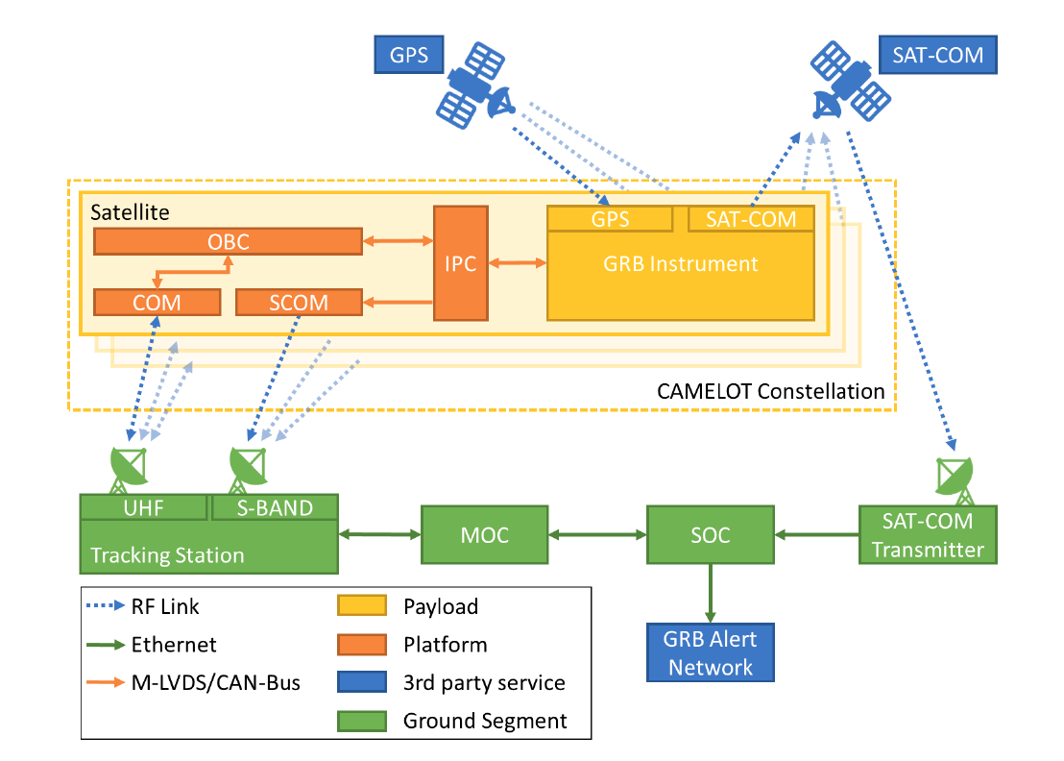
Mission Concept
Data flow for CAMELOT constellation
Following on-board trigger, satellite payload will downlink data using global satellite communication module
After the localization of GRB, the SOC will send GRB alert

Slide 15
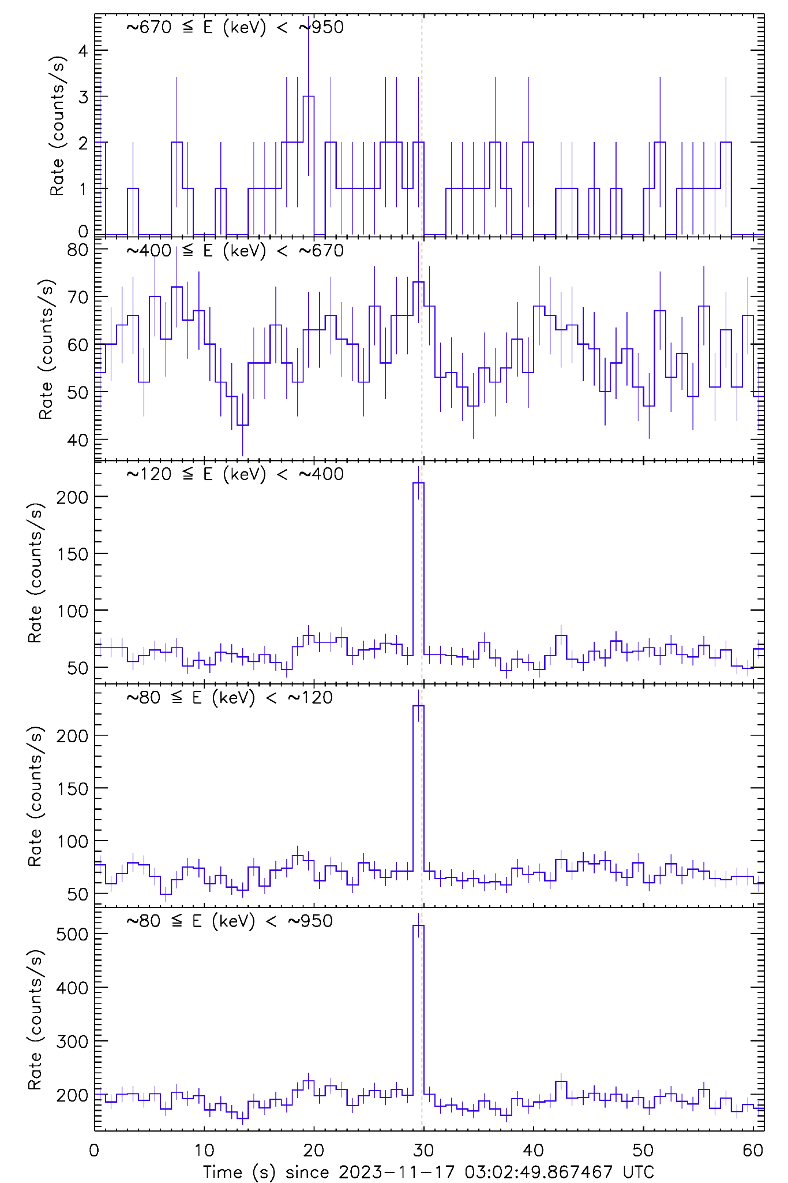
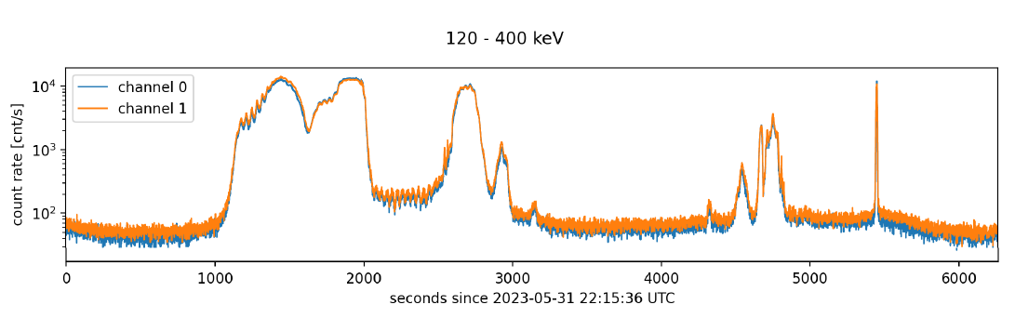
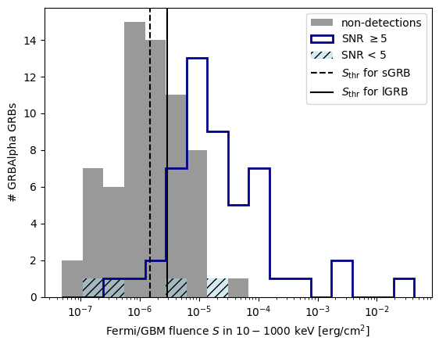
In-orbit Performance
GRBalpha light curve
(one orbit)
Pal+23; Ripa+22; Münz+24
Light curves of detected events are in public;
one transient per ~5 day
~2/3 of orbit is suitable for GRB detection
~70% Fermi-GBM GRBs (with fluence of >=3x10⁻⁶ erg/cm2) will be detected if in FOV and low background region
Statistics of significant detection
(as of 2024.11.11) | GRBalpha | VZLUSAT-2
GRB (short) | 102(19) | 57(10)
Solar flare | 92 | 58
SGR | 2 | 3
M. Dafčíková (Ph.D. thesis)
Also in progress: commissioning of GRB beta, characterizing BG
In future: implement a rate trigger algorithm for autonomous detection
Notes:
Here I show the in-orbit Performance
2/3 orbit for GRB detection
Light curve data are in public (data in text format); one transient per ~5 days, >=100 GRBs detected
Sensitivity; 70% Fermi GBM can be detected if FOV
Also studying radiation environment, aim to implement self-trigger

Slide 16
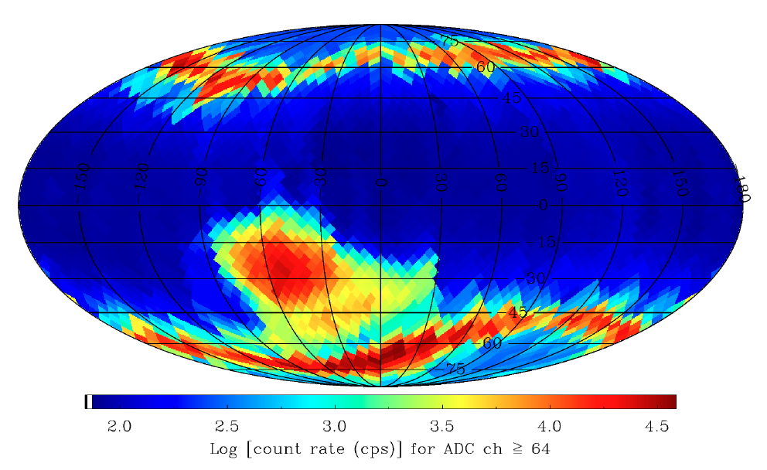
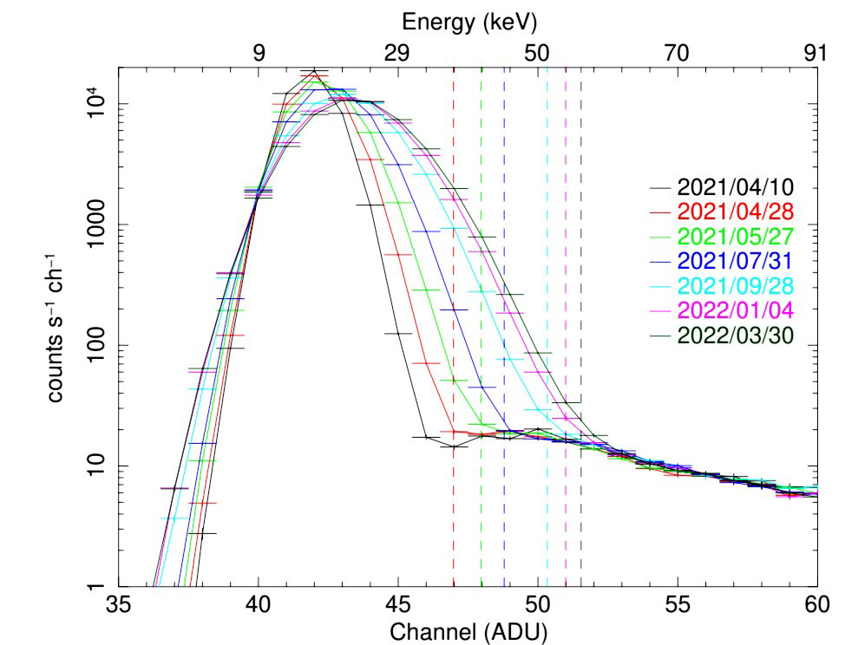
Radiation Environment
GRBalpha also provides useful information about radiation environment and MPPC performance
Count rate map by GRBalpha (particle background, CXB, albedo X-ray) => rate trigger algorithm
Noise spectrum as measured by GRB in one year operation (degradation of MPPC in LEO)

Slide 17
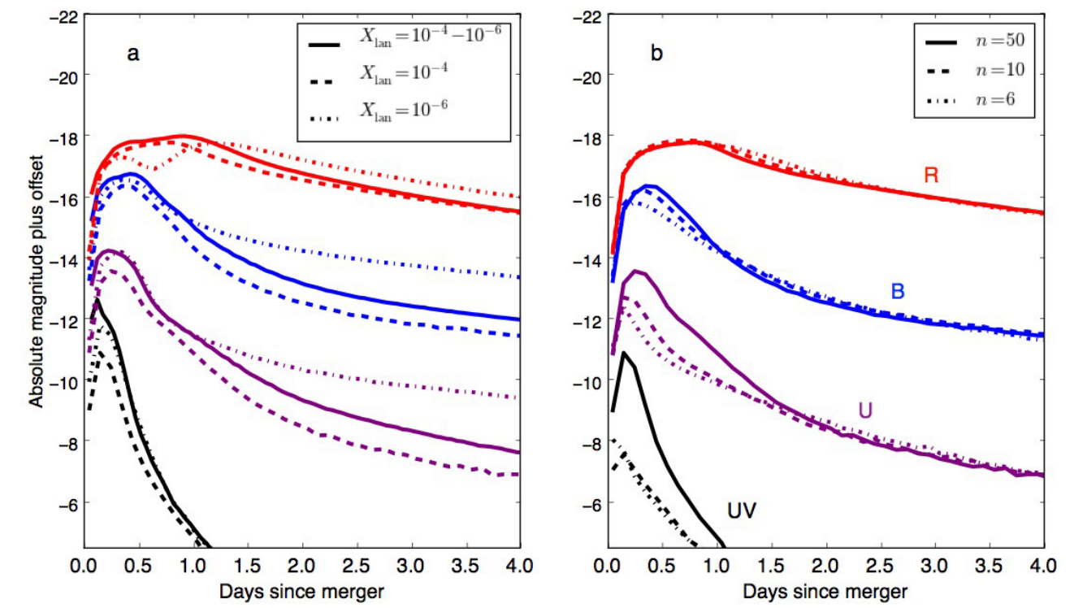

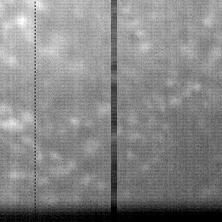

GRBbeta (2024.07-)
2U Cubesat proof-of-concept mission for a technology demonstration
smaller effective area design to prove CAMELOT mission concept (all-sky monitoring and timing-based localization of GRB)
experimental UV camera called LUVCam (precursor for future UV observations of kilonova),
various platform-side features including attitude determination and control subsystem
UV image of earth rim, clouds and moon
Kasen+15 (kilonova model lightcurve)

Slide 18
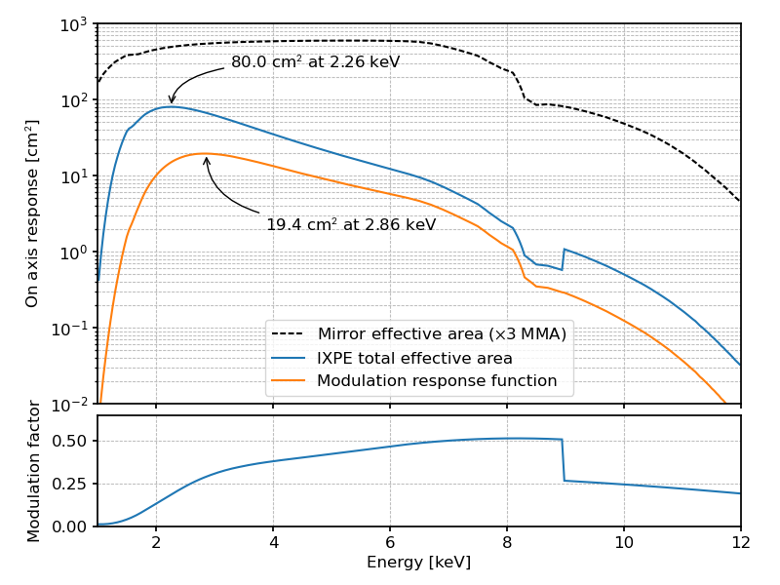
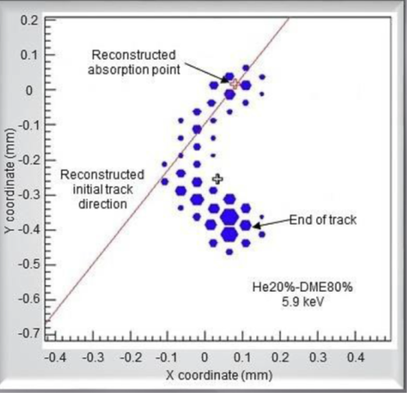
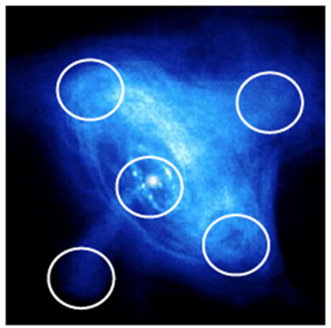
IXPE Instruments
(see Soffitta+21 and Baldini+21 for latest information)
2-8 keV, 3 Mirror Module Assemblies (MMAs) and Detector Unites (DUs)
MMAs: each contains 24 nested shells and has >200 cm² (3-6 keV)
DUs: Gas pixel detector, measure photoelectron track (polarization) direction
FOV=12.9’ x 12.9’, HPD=25”, m₁₀₀>0.5 achieved
Event-by-event Stokes parameter to use imaging-polarimetry capability (Kislat+15, Vink & Zhou 18)
Electron track
image
HPD=25”
Notes:
IXPE：搭載装置の紹介
X線望遠鏡（同じ形状のシェルでcost effective）：集光＆撮像（中）
ガス偏光計：撮像＆偏光分光観測（左）
「かに星雲」などのPWNやSNRを空間分解（右）

Slide 19
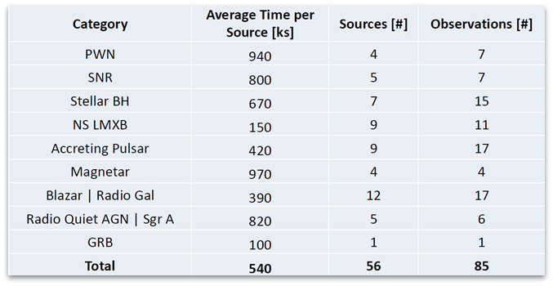
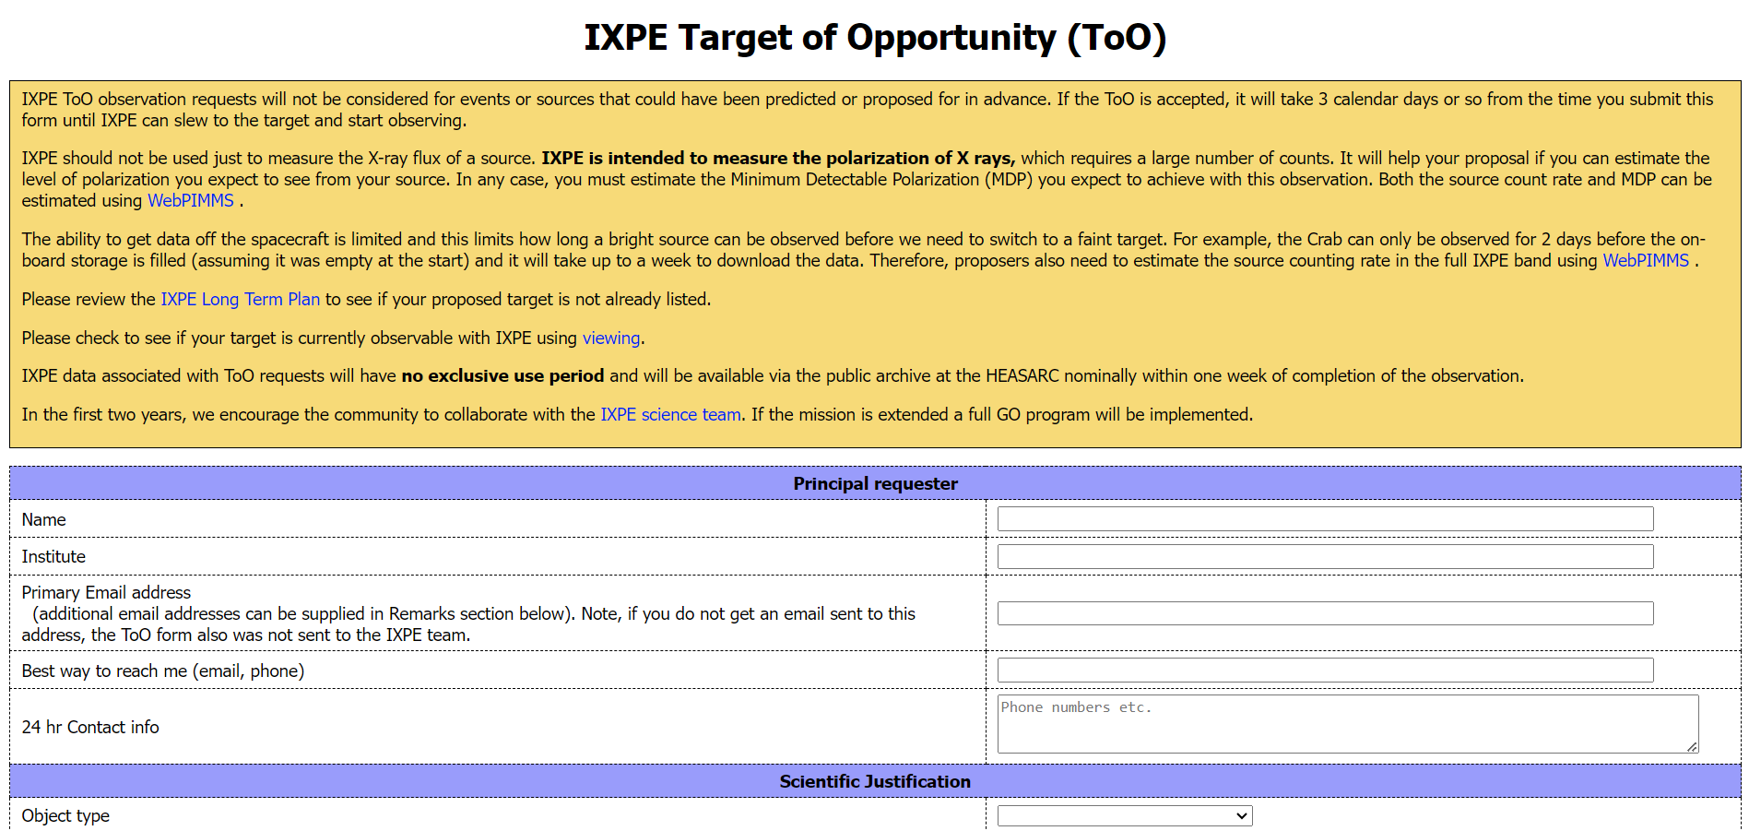
Mission Status
Baseline mission completed successfully
Almost all classes of sources observed; >70 discovery papers (3 in Nature, 2 in Science)
Data are released 1 week after completion of obs.
GO phase started in 2024/Feb, cycle2 will be 2025/Feb-Aug
Call for proposals (incl. ToOs) just closed and being selected
Unanticipated ToOs can be requested via the IXPE ToO website
(as of 2023.09)
Chandra
Count
Notes:
ミッション（運用）の概要
ベースラインは2024.02に 無事終了
X線天体のカテゴリを一通りサーベイ。多数の論文。
まとめのテーブル：典型的な観測時間（観測天体数）が分かる (total=obs*av)
GO phase が開始(2024.02)。今はCycle 2提案締め切り（2025.02から）
予期せぬToO は受け付けている

Slide 20
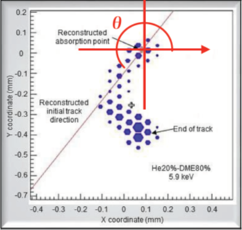
Stokes Parameter Based Analysis
Event-by-event Stokes parameters:
i_{k}=1, q_{k}=2cos2θ_{k}, u_{k}=2sin2θ_{k}
Stokes parameters of the entire data:
I=Σi_{k}, Q=Σq_{k}, U=Σu_{k}
Normalized Stokes parameters, PD & PA:
Q_{N}=Q/I, U_{N}=U/I, PD=(1/m₁₀₀)sqrt(Q_{N}²+U_{N}²), PA=(1/2) arctan2(U, Q)
Erros:
V(Q)=Σq_{k}², V(U)=Σu_{k}²
Aeff, m₁₀₀ , and reconstruction quality of each event can also be taken into account
(unlike PD/PA, Stokes params. are additive and allow flexible binning in space and time)

Slide 21
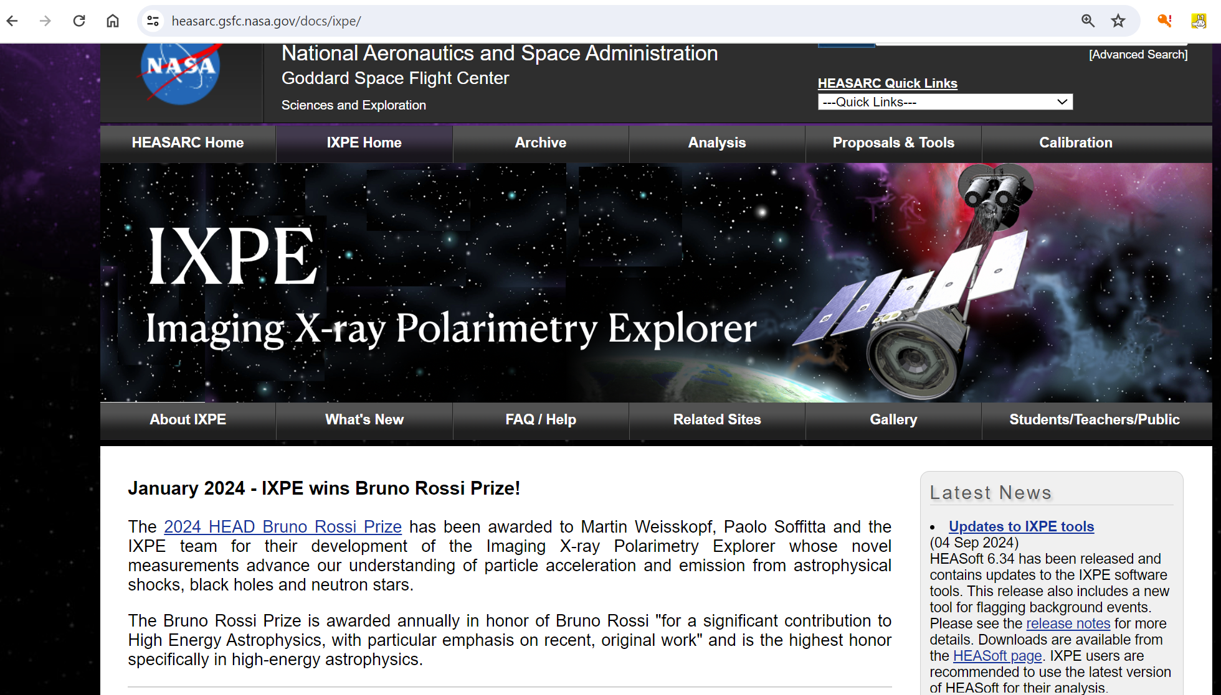
For “Do It Yourself” Persons
IXPE Data archived by NASA’s HEASARC
Data format and HEASOFT analysis tool well documented
Alternative package (ixpeobssim) also available (link under GOF “Contributed IXPE Software” page
Much of analysis can be done in Xspec
Notes:
自分で解析したい人のために
データは全て公開（占有期間なし）
解析ツールはheasoftまたはixpeobssim（NASA GSFCから取得）
点源ならxpec解析すればよい

Slide 22
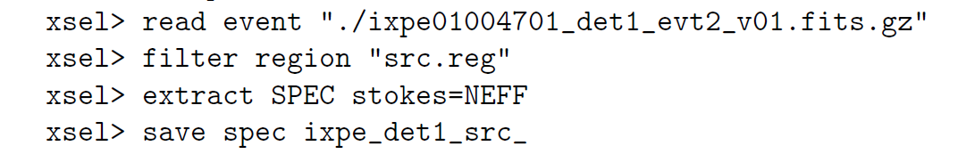
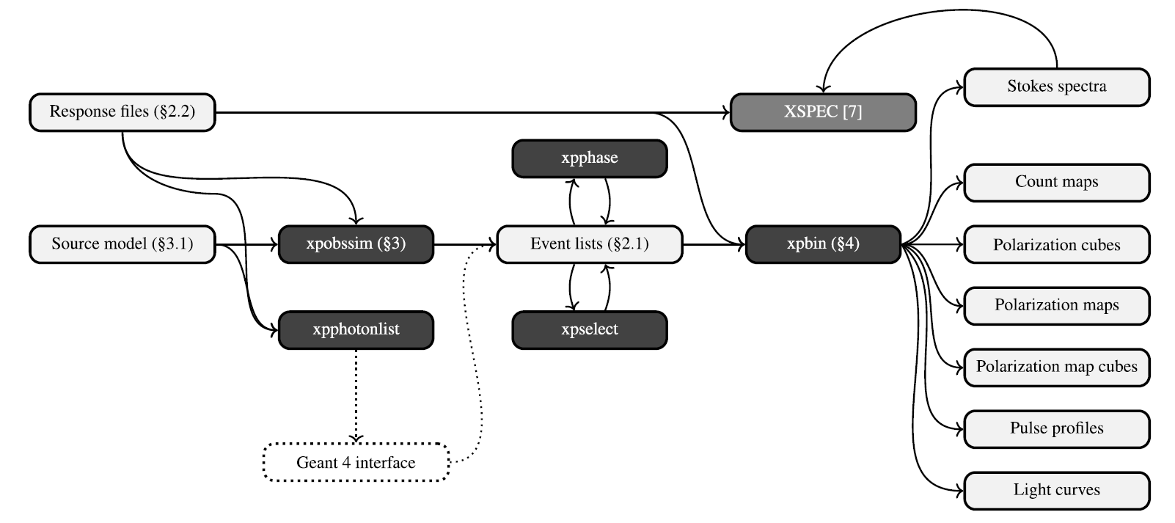
For “Do It Yourself” Persons (Cont’d)
You may use xselect to read/filter events and extract spectrum
Or, use ixpeobssim to read/select events and bin spectrum
You will have 3 outputs: Stokes-I/Q/U spectra
xpselect --regfile src.reg --sufix sel ixpe01004701_det1_evt2_v01.fits
xpbin --algorithm PHA1Q --irfname ixpe:obssim:alpha075_v012 --weights True ixpe01004701_det1_evt2_v01_sel.fits
(Baldini+22)
Notes:
自分で解析したい人のために（２）
xselectで普通に処理できる
read event, filter region, extract spectrum
Ixpeobssim（チームが開発してきたツール）でも良い
全体構成：左半分は無視してよい。真ん中がイベントファイル
xpselect, xpbin（コマンド例。テストしてないが雰囲気を伝えるため掲載）
Stokes-Iに加え，Stokes-Q, Stokes-Uを作ることができる

Slide 23
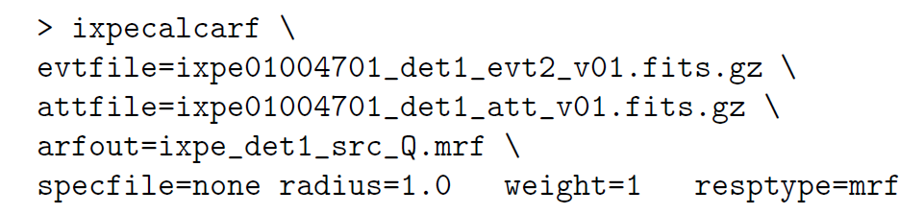
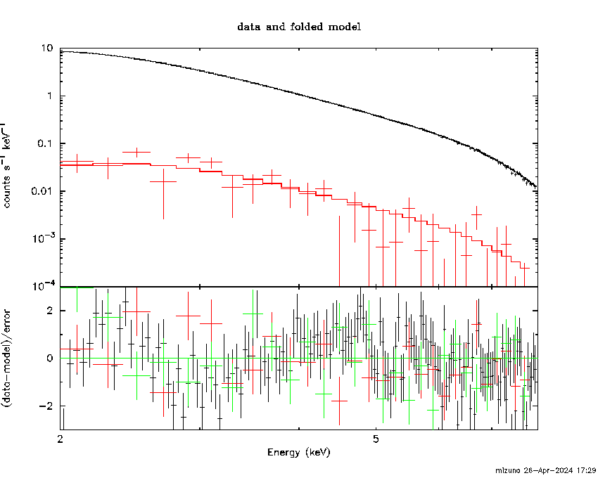
For “Do It Yourself” Persons (Cont’d)
3 responses (not 2) required for each detector: rmf, arf, and mrf
mrf = arf*μ₁₀₀
use ixpecalcarf to generate arf/mrf
mrf shall be read instead of arf for Stokes-Q or U spectra. Then you may fit 3 spectra simultaneously with, e.g., TBabs*polconst*powerlaw
Stokes-I (black)
Stokes-Q (red)
Stokes-U (green; negative and not shown in upper panel)
(Ixpeobssim may be more user-friendly for imaging-polarimetry analysis [like Vela PWN])
Notes:
自分で解析したい人のために（３）
応答関数が３つ必用（mrf）
mrfはarf*u100。arf/mrfはその都度作る
「同時フィット」すればよい。偏光評価のモデル（の一つ）がpolsonst。（図も説明）
Vela PWNみたいなイメージ偏光解析はixpeobssimの方が楽だろう(PCUBEオプション)

Slide 24
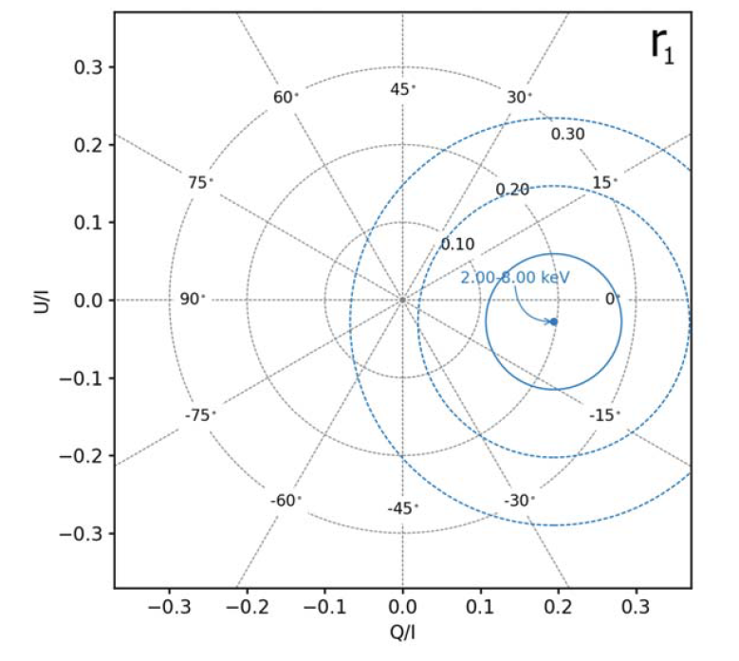
Note On Statistics
Since PD shall be >=0, PD-PA contour will be skewed when the significance is not so high (σ<=3)
If so, examine Stokes-Q/U plane instead of PD/PA（w/ ixpeobssim）; error contours are circular and you can adequately evaluate significance and errors
PD=sqrt(Q_{N}²+U_{N}²), PA=(1/2) arctan2(U, Q)
Use ixpeobssim and Stokes-Q/U for imaging-polarimetry analysis
See Kislat+15 and Vink&Zhou18 for the formalism (Mizuno+23 may also be useful)
(Negro+23)
Notes:
統計について注意
偏光度は0以上なのでPD/PA contourがゆがむ
PD=5+/-2だとして2.5sigmaとは言えない
Q/U平面でやればよい。error coutourが円になる
論文から拝借した例。PD/PAへの変換式
イメージ・偏光解析はixpeobssmでできる。Vela PWNがその例。Kislat+15とVink&Zhouがリファレンス

